Slide 1
MTH374: Optimization
For
Master of Mathematics
By
Dr. M. Fazeel Anwar
Assistant Professor
Department of Mathematics, CIIT Islamabad

Slide 2
Lecture 11

Slide 3
Recap
More examples of Lagrange multiplier
Other versions of Lagrange multiplier

Slide 4
Today’s Topics
More examples and versions of Lagrange multiplier

Slide 5
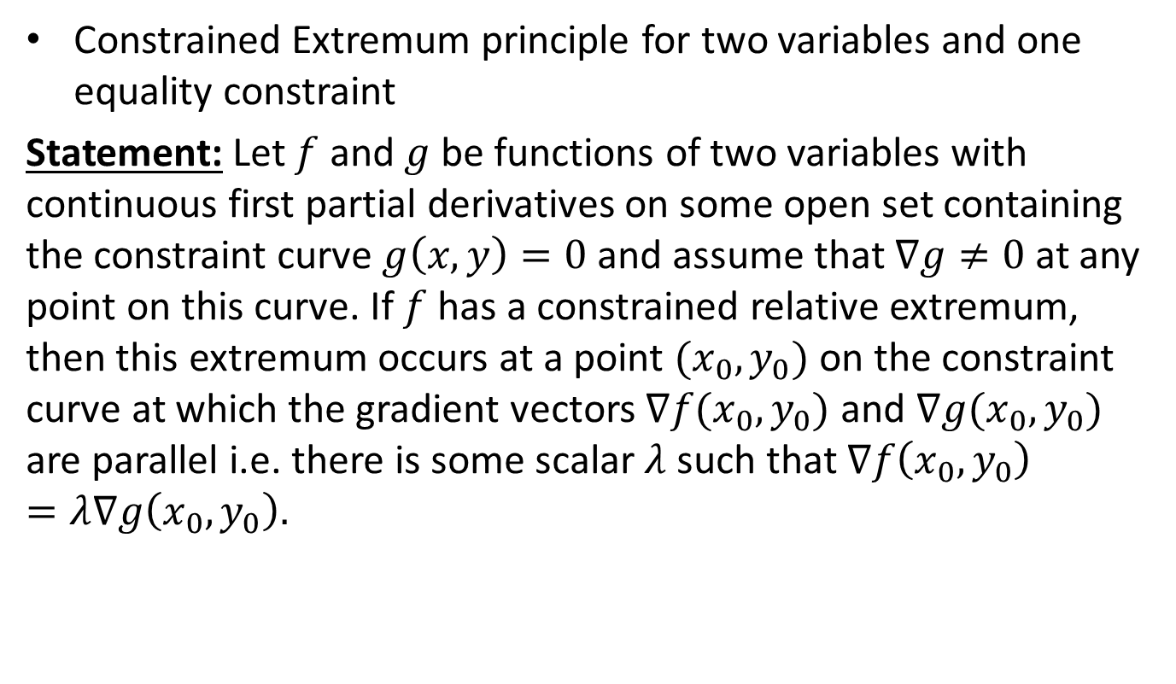
Lagrange Multipliers-I
Constrained Extremum principle for two variables and one equality constraint
Statement:Let $f$and $g$be functions of two variables with continuous first partial derivatives on some open set containing the constraint curve $g\left(x,y\right)=0$and assume that $∇g≠0$at any point on this curve. If $f$has a constrained relative extremum, then this extremum occurs at a point $(x_{0},y_{0})$ on the constraint curve at which the gradient vectors $∇f(x_{0},y_{0})$ and $∇g(x_{0},y_{0})$ are parallel i.e. there is some scalar $λ$ such that $∇f\left(x_{0},y_{0}\right)=λ∇g\left(x_{0},y_{0}\right).$

Slide 6
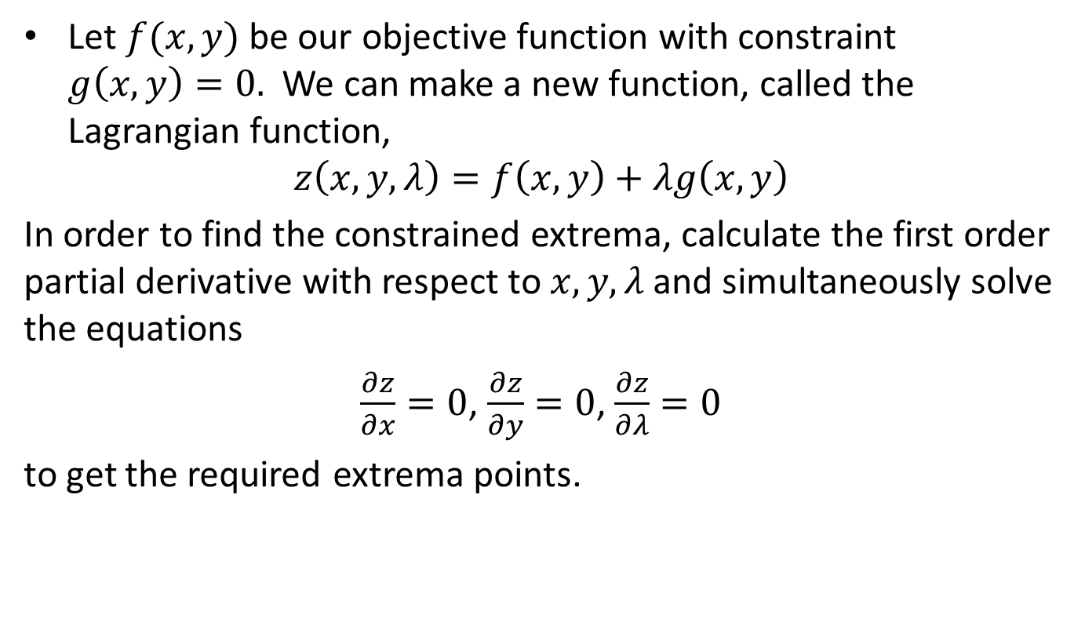
Lagrange Multipliers-I
Alternate Approach
Let $f(x,y)$ be our objective function with constraint $g\left(x,y\right)=0.$ We can make a new function, called the Lagrangian function,
$$z\left(x,y,λ\right)=f\left(x,y\right)+λg\left(x,y\right)$$
In order to find the constrained extrema, calculate the first order partial derivative with respect to $x,y,λ$ and simultaneously solve the equations
$\frac{∂z}{∂x}=0$, $\frac{∂z}{∂y}=0$, $\frac{∂z}{∂λ}=0$
to get the required extrema points.

Slide 7
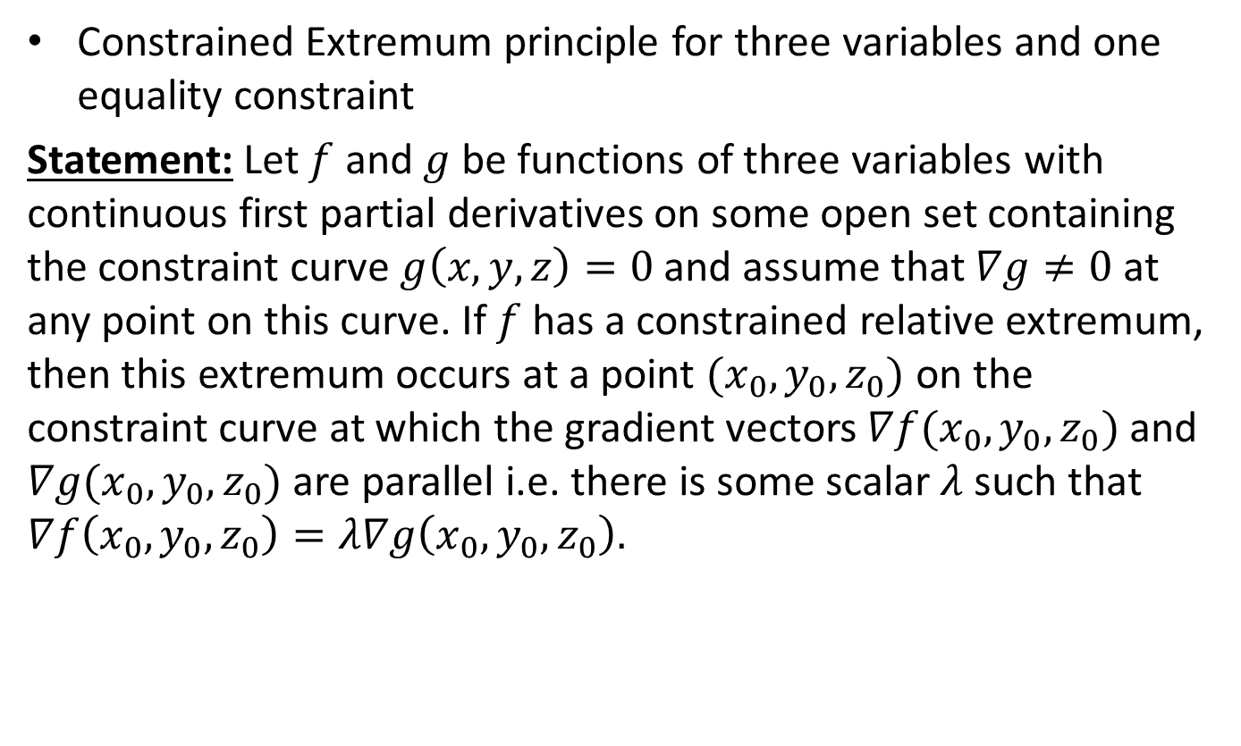
Lagrange Multipliers-II
Constrained Extremum principle for three variables and one equality constraint
Statement:Let $f$and $g$be functions of three variables with continuous first partial derivatives on some open set containing the constraint curve $g\left(x,y,z\right)=0$and assume that $∇g≠0$at any point on this curve. If $f$has a constrained relative extremum, then this extremum occurs at a point $(x_{0},y_{0},z_{0})$ on the constraint curve at which the gradient vectors $∇f(x_{0},y_{0},z_{0})$ and $∇g(x_{0},y_{0},z_{0})$ are parallel i.e. there is some scalar $λ$ such that $∇f\left(x_{0},y_{0},z_{0}\right)=λ∇g\left(x_{0},y_{0},z_{0}\right).$

Slide 8
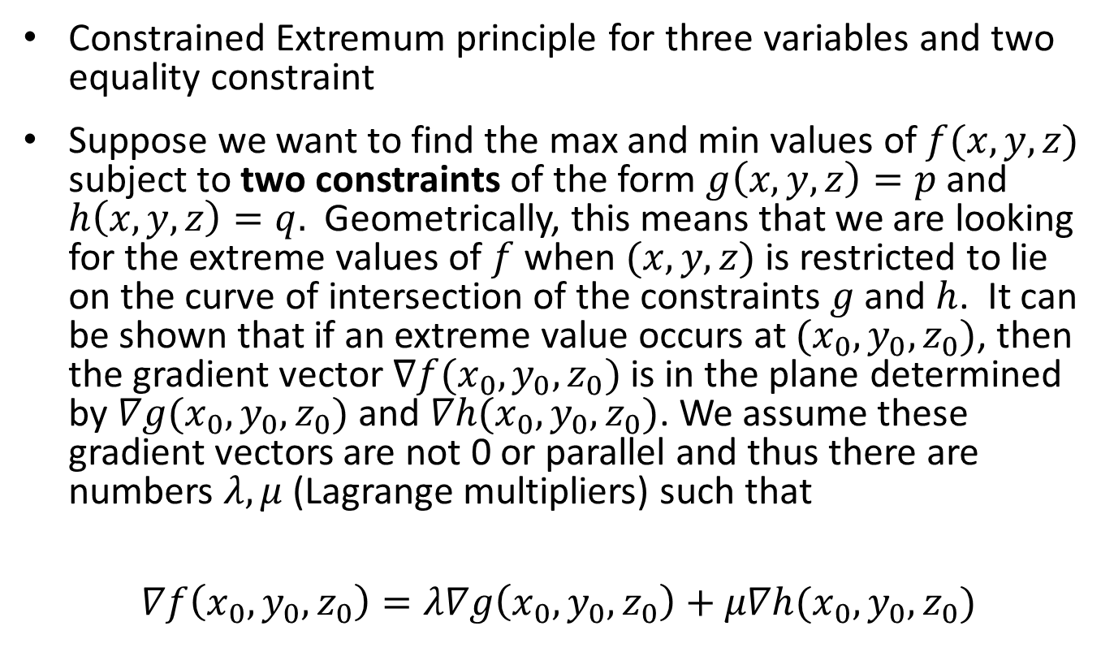
Lagrange Multipliers-III
Constrained Extremum principle for three variables and two equality constraint
Suppose we want to find the max and min values of $f(x,y,z)$subject to two constraints of the form $g\left(x,y,z\right)=p$and $h\left(x,y,z\right)=q.$Geometrically, this means that we are looking for the extreme values of $f$when $(x,y,z)$is restricted to lie on the curve of intersection of the constraints $g$and $h$. It can be shown that if an extreme value occurs at $(x_{0},y_{0},z_{0})$, then the gradient vector $∇f(x_{0},y_{0},z_{0})$is in the plane determined by $∇g(x_{0},y_{0},z_{0})$and $∇h(x_{0},y_{0},z_{0})$.We assume these gradient vectors are not 0 or parallel and thus there are numbers $λ,μ$(Lagrange multipliers) such that
$$∇f\left(x_{0},y_{0},z_{0}\right)=λ∇g\left(x_{0},y_{0},z_{0}\right)+μ∇h(x_{0},y_{0},z_{0})$$

Slide 9
Example-VII

Slide 12
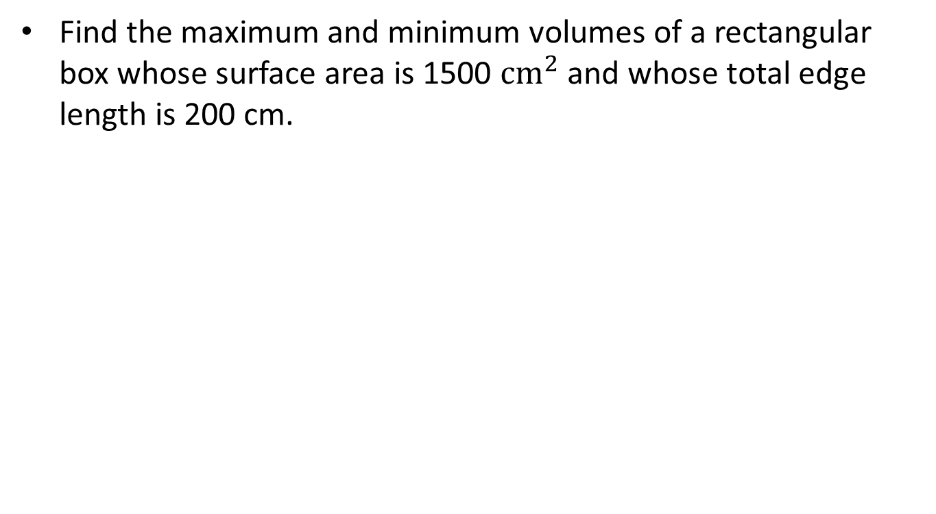
Example-VIII
Find the maximum and minimum volumes of a rectangular box whose surface area is 1500 $cm^{2}$and whose total edge length is 200 cm.

Slide 16
Summary

Slide 17
Thank You

