Slide 1
MTH374: Optimization
For
Master of Mathematics
By
Dr. M. Fazeel Anwar
Assistant Professor
Department of Mathematics, CIIT Islamabad

Slide 2
Lecture 10

Slide 3
Recap
Constrained optimization
Lagrange Multiplier

Slide 4
Today’s Topics
More examples of Lagrange multiplier
Other versions of Lagrange multiplier

Slide 5
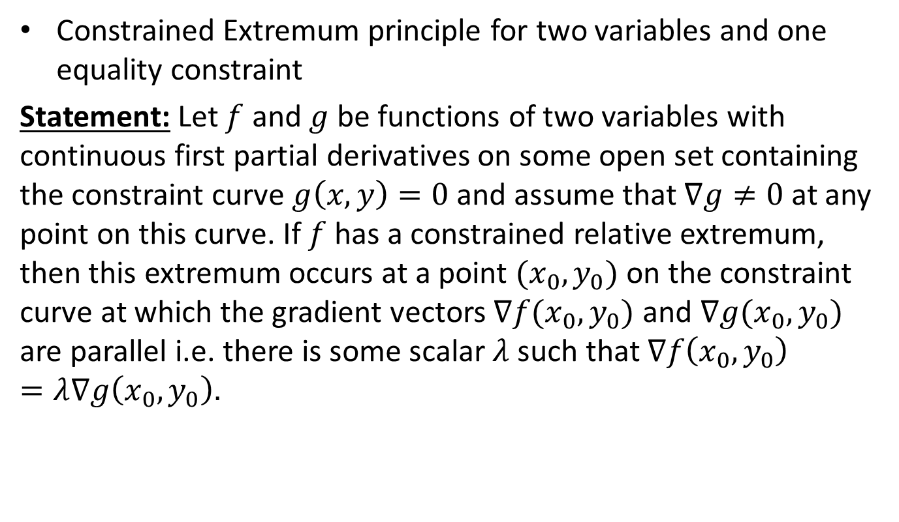
Lagrange Multipliers-I
Constrained Extremum principle for two variables and one equality constraint
Statement:Let $f$and $g$be functions of two variables with continuous first partial derivatives on some open set containing the constraint curve $g\left(x,y\right)=0$and assume that $∇g≠0$at any point on this curve. If $f$has a constrained relative extremum, then this extremum occurs at a point $(x_{0},y_{0})$ on the constraint curve at which the gradient vectors $∇f(x_{0},y_{0})$ and $∇g(x_{0},y_{0})$ are parallel i.e. there is some scalar $λ$ such that $∇f\left(x_{0},y_{0}\right)=λ∇g\left(x_{0},y_{0}\right).$

Slide 6
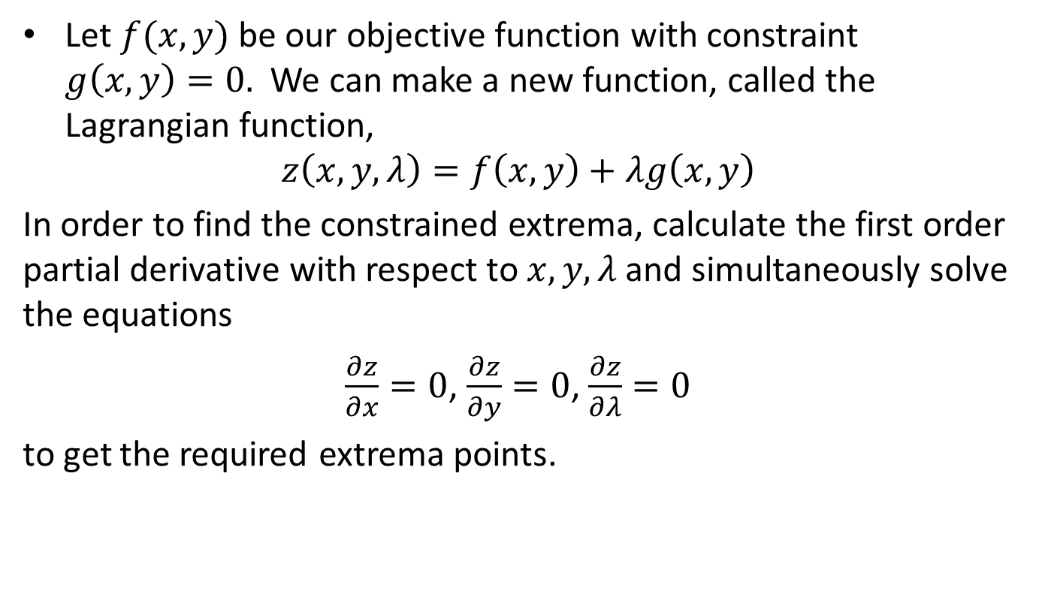
Lagrange Multipliers-I
Alternate Approach
Let $f(x,y)$ be our objective function with constraint $g\left(x,y\right)=0.$ We can make a new function, called the Lagrangian function,
$$z\left(x,y,λ\right)=f\left(x,y\right)+λg\left(x,y\right)$$
In order to find the constrained extrema, calculate the first order partial derivative with respect to $x,y,λ$ and simultaneously solve the equations
$\frac{∂z}{∂x}=0$, $\frac{∂z}{∂y}=0$, $\frac{∂z}{∂λ}=0$
to get the required extrema points.

Slide 7
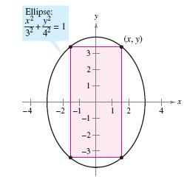
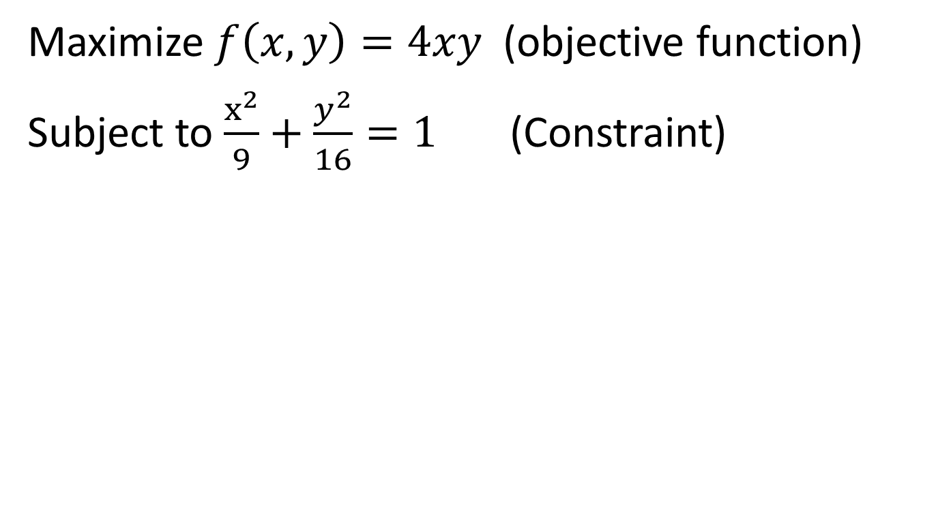
Example-V
Maximize $f\left(x,y\right)=4xy$ (objective function)
Subject to $\frac{x^{2}}{9}+\frac{y^{2}}{16}=1$ (Constraint)

Slide 12
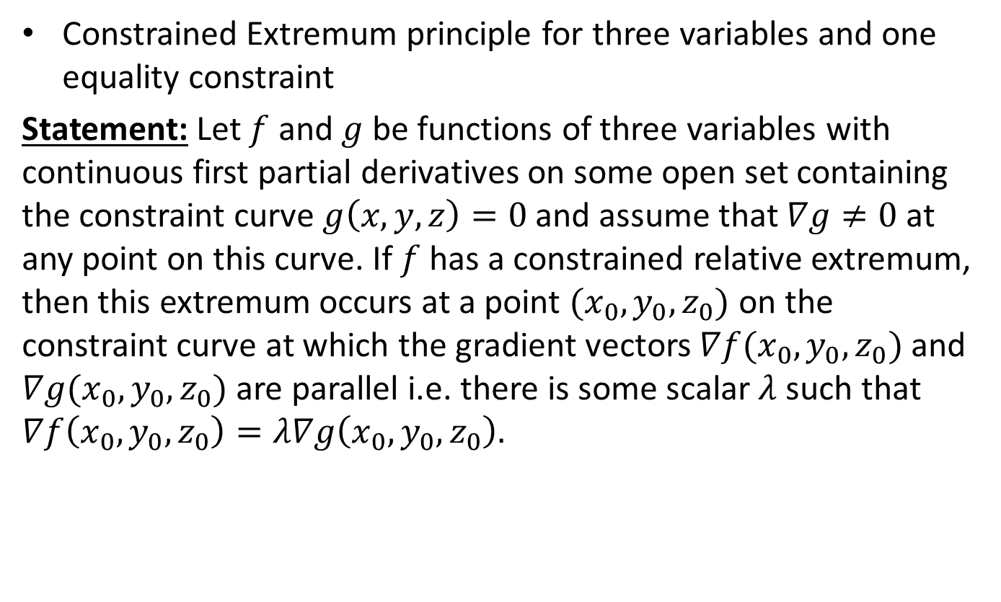
Lagrange Multipliers-II
Constrained Extremum principle for three variables and one equality constraint
Statement:Let $f$and $g$be functions of three variables with continuous first partial derivatives on some open set containing the constraint curve $g\left(x,y,z\right)=0$and assume that $∇g≠0$at any point on this curve. If $f$has a constrained relative extremum, then this extremum occurs at a point $(x_{0},y_{0},z_{0})$ on the constraint curve at which the gradient vectors $∇f(x_{0},y_{0},z_{0})$ and $∇g(x_{0},y_{0},z_{0})$ are parallel i.e. there is some scalar $λ$ such that $∇f\left(x_{0},y_{0},z_{0}\right)=λ∇g\left(x_{0},y_{0},z_{0}\right).$

Slide 13
Example-VI
Find the dimensions of the box with largest volume if the total surface area is 64 cm².
z
y
x

Slide 19
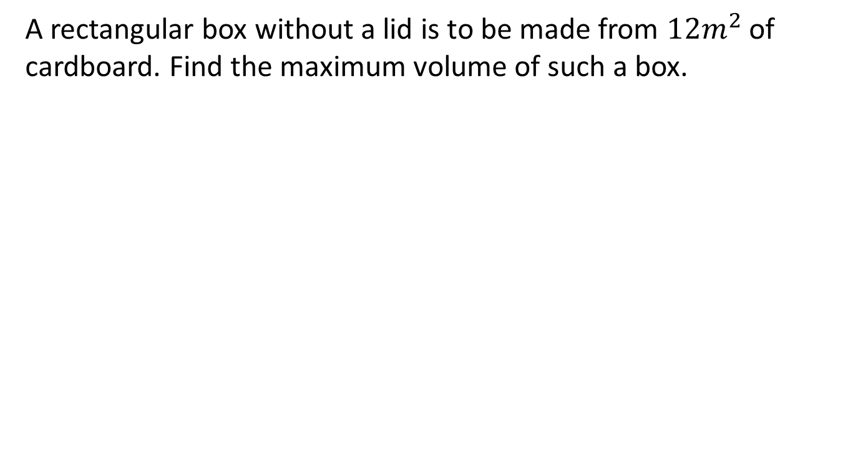
Example-III
A rectangular box without a lid is to be made from $12m^{2}$of cardboard. Find the maximum volume of such a box.

Slide 20
Summary

Slide 21
Thank You

