Slide 1
MTH-374
Optimization
Lecture 1

Slide 2
Instructor: Dr. Muhammad Fazeel Anwar
Assistant Professor
Department of Mathematics
COMSATS Institute of Information
Technology Islamabad
Ph.D. Mathematics
University of York, UK

Slide 3
Books
Text Book:
Introduction to Optimization Theory;
by Byron S. Gottfried and Joel Weisman
Additional Reading:
Optimization: Theory and Practice
by Mohan C. Joshi and Kannan M. Moudgalya

Slide 4
Grading
Credit hours (3,0)
Total marks = 100
Sessional 1 = 10 points
Sessional 2 = 15 points
At least 3 quizzes
At least 3 assignments
Final Exam = 50 points

Slide 5
Course Outline
Introduction to optimization
Mathematical Models
Variables and Objective Functions
Multifactor Objectives
Stationary Values and Extrema
Relative and Absolute Extrema
Convex, Concave and Unimodel Functions

Slide 6
Course Outline Cont’d
Constraints
Mathematical Programming Problems
One dimensional and multidimensional functions
Lagrange Multipliers
Unconstrained Optimization
Linear Programing

Slide 7
Chapter 1
Introduction

Slide 8
Today’s Topics
Introduction
Why do we need optimization?
Some important optimization problems
Mathematical models
Variables and objective functions
Multifactor objectives

Slide 9
Introduction
Optimization is the art of obtaining best policies to satisfy certain objectives while at the same time satisfying fixed requirements.
Effective decision making both in personal and professional capacity
Choosing the best possible option

Slide 10
Introduction (Cont…)
In this course we will learn how to transform certain practical problems into mathematics.
We will also study some mathematical techniques that will help us solve these problems
This course will show us how the concepts of calculus, linear algebra and other branches of mathematics can be applied in real life
In short we are trying to make the art of effective decision making into a science.

Slide 11
Problem 1: Transportation
A certain company makes canned food
food are prepared in 2 cities
  Karachi, Peshawar
Shipped to 4 distributing warehouses
  Lahore, Quetta, Islamabad, Multan
How much should we ship from each plant to each warehouse?
  Transportation costs are different between each pair of locations
  There is a limit on capacity at each plant

Slide 12
Problem 2: Engineering Design Problem
Consider lighting a large area with a number of lamps:
Each lamp has a total power limit
Several points in the room have a ‘desired illumination level’
How much power should be applied to each lamp to get the room as close as possible to desired level?

Slide 13
Problem 2 continued
Now add two more constraints:
No more than half the total power goes to any five lamps
No more than 15 lamps are turned on
What effect do (1) and (2) have on the original problem?

Slide 14
Problem 3: Medical Team Distribution
World Health Council wants to send medical teams to provide health care in underdeveloped countries:
Need to allocate five teams to three different countries
Each team added gains more person-years of life saved in the country
You cannot assign partial teams or partial people

Slide 15
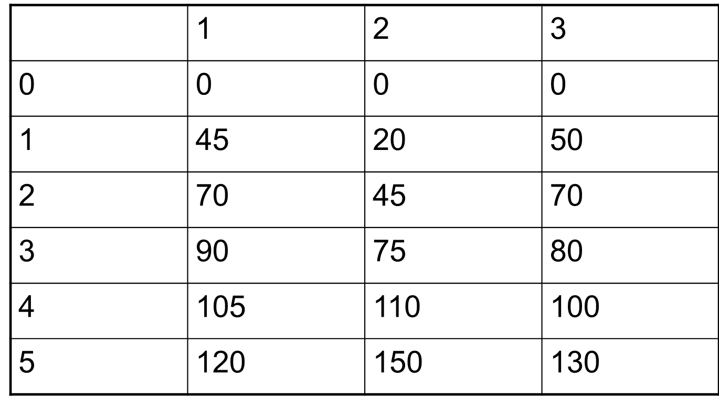
Thousand person-years gained
country
No. of teams

Slide 16
Problem 4: Inventory Levels
A wholesale Bicycle Distributor:
  Purchases bikes from manufacturer and supplies to many shops
  Demand to each shop is uncertain
  How many bikes should the distributor order from the manufacturer?
Costs:
  Ordering cost to manufacturer
  Holding cost in factory
  Shortage cost due to lack of sales

Slide 17
More Optimization problems
Finding the shortest route
Finding the quickest route
Finding the best route under desired conditions
Making an investment decision
Maximizing profit
Minimizing risk
Maximizing stock
Designing an airplane with minimum weight and desired capacity.

Slide 18
More Optimization problems (cont...)
Best possible utilization of resources
Optimize production within the constraints
Minimize labor while obtaining desired results
Deployment of army to minimize damage by an army attack

Slide 19
Summary

Slide 20
Thank You

