Slide 1
Business Mathematics
MTH-367
Lecture 32

Slide 2
Chapter 20
Optimization:
Functions of Several Variables
continued

Slide 3
Last Lecture Summary
We covered section 20.2: Partial Derivatives
Started Sec. 20.3: Optimization of Bivariate Functions
Partial Derivatives of Bivariate Functions
Interpreting Partial Derivatives
Second-Order Partrial Derivatives

Slide 4
Today’s Topics
We will continue with Sec. 20.3:
Optimization of Bivariate Functions
Review of Relative Extrema
Distinguishing Critical Points
Test for critical points
Applications of Bivariate Optimization

Slide 5
Optimization of Bivariate Functions
We start with the revision of the optimization of bivariate functions, which was introduced in last lecture.

Slide 6
Revision
A function z = f (x, y) is said to have a relative maximum at x = a and y = b if for all points (x, y) “sufficiently close” to (a, b)
f (a, b) ≥ f (x, y)
A function z = f (x, y) is said to have a relative minimum at x = a and y = b if for all points (x, y) “sufficiently close” (a, b)
f (a, b) ≤ f (x, y)

Slide 7
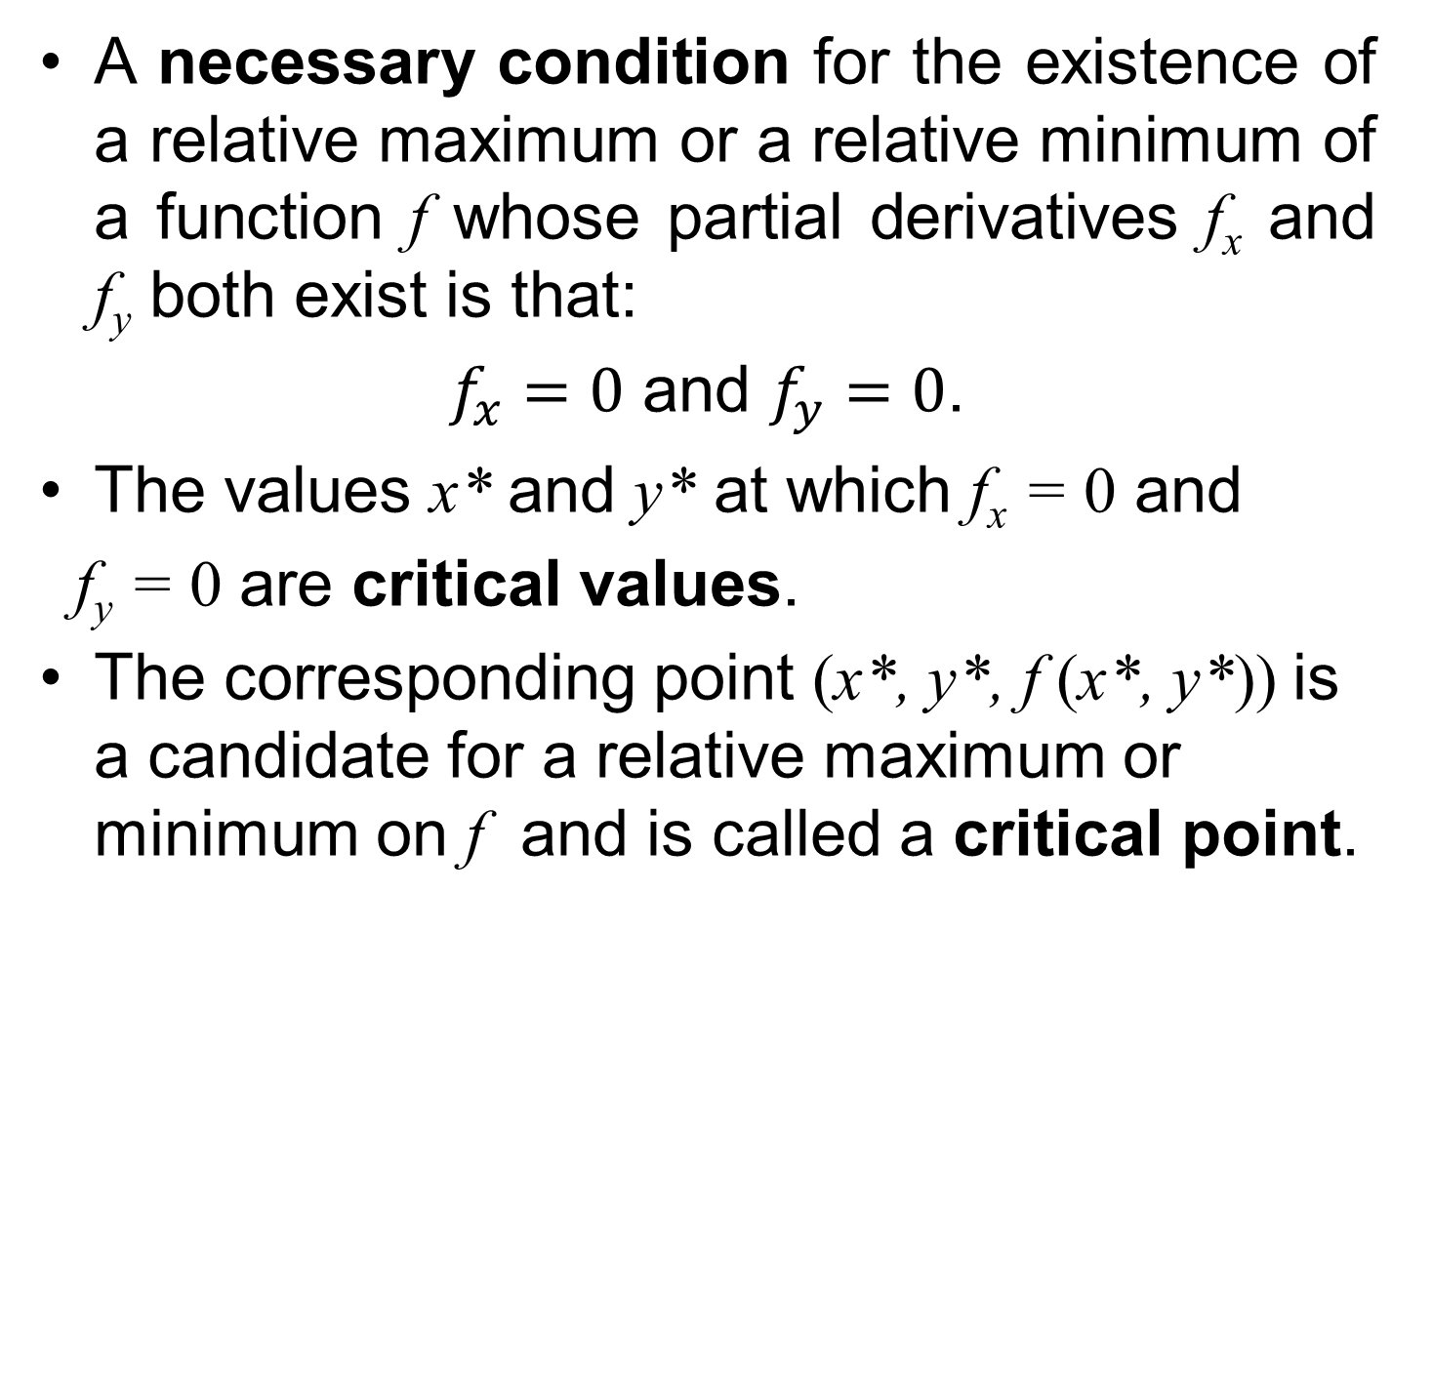
Revision cont’d
A necessary condition for the existence of a relative maximum or a relative minimum of a function f whose partial derivatives f_{x} and f_{y} both exist is that:
$f_{x}=0$ and $f_{y}=0$.
The values x* and y* at which f_{x} = 0 and
f_{y} = 0 are critical values.
The corresponding point (x*, y*, f (x*, y*)) is a candidate for a relative maximum or minimum on f and is called a critical point.

Slide 8
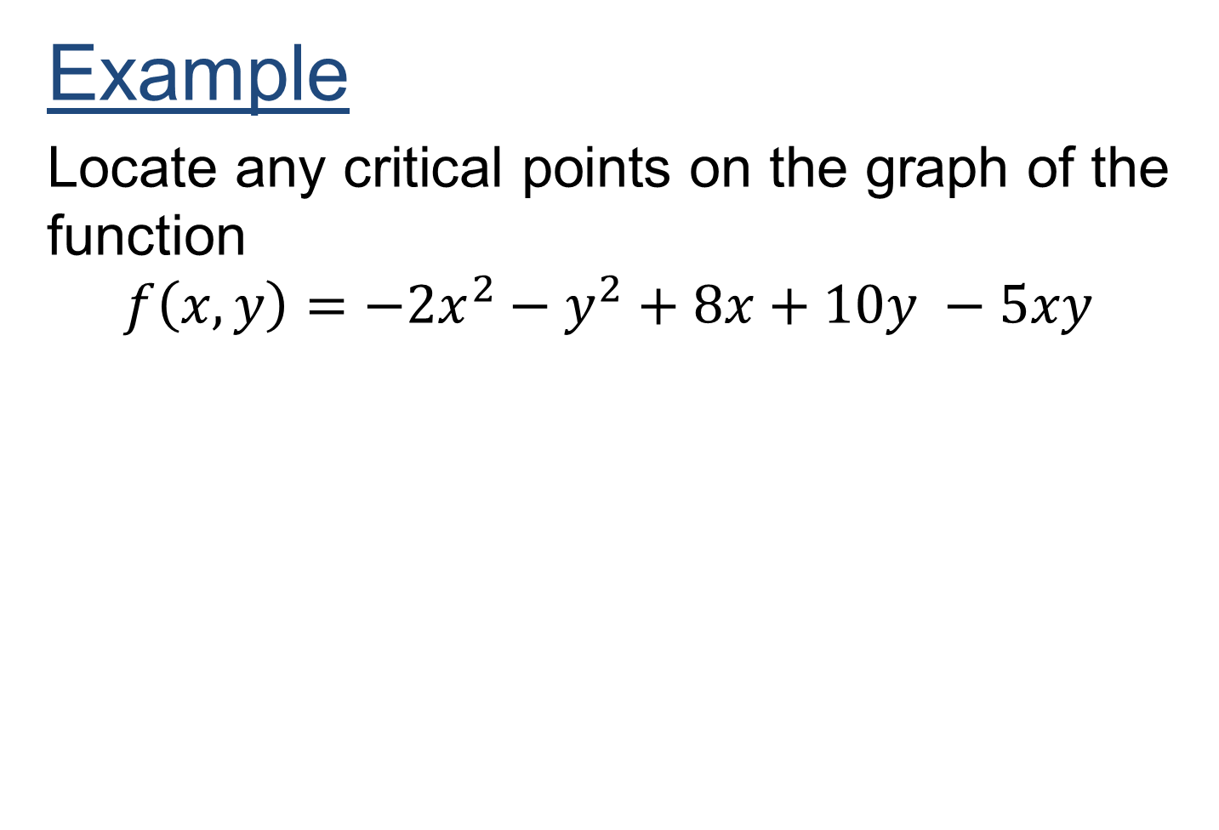
Example
Locate any critical points on the graph of the function
$$f\left(x,y\right)=−2x^{2}−y^{2}+8x+10y −5xy$$

Slide 10
Distinguishing Nature of Critical Points
Once a critical point has been identified, it is necessary to determine its nature.
Aside from relative maximum and minimum points, there is one other situation in which f_{x} and f_{y} both equal 0.
Which is referred to as a saddle point.
A saddle point P is a portion of a surface which has the shape of a saddle.
At point P – “where you sit on the horse” – the value of f_{x} and f_{y} both equal 0.
However, the function does not reach either a relative maximum or a relative minimum at P.

Slide 11
Test of Critical Point
Given that a critical point of f is located at (x*, y*, z) where all second partial derivatives are continuous, determine the value of D (x*, y*), where

Slide 12
If D(x*, y*)>0, the critical point is
  A relative maximum if both f_{xx}(x*, y*) and f_{yy}(x*,y*) are negative.
  A relative minimum if both f_{xx}(x*, y*) and f_{yy}(x*, y*) are positive.
If D(x*,y*)<0, the critical point is a saddle point.
If D(x*, y*)=0, no conclusion.

Slide 13
Example
Given the function
determine the location and nature of all critical points.

Slide 17
Applications of Bivariate Optimization
This section presents some applications of the optimization of bivariate functions.

Slide 18
Example:
Advertising Expenditures
A manufacturer’s estimated annual sales (in units) is a function of the expenditures made for radio and TV advertising.
The function specifying this relationship was stated as
where z equals the number of units sold each year, x equals the amount spent for TV advertising and y equals the amount spent for radio advertising (x and y both in $1,000s).

Slide 19
Determine how much money should be spent on TV and radio advertising in order to sell maximum number of units.

Slide 22
Example:
Pricing Model
A manufacturer sells two related products, the demands for which are estimated by the following two demand functions:
where p_{j} equals the price (in dollars) of product j and q_{j} equals the demand (in thousands of units) for product j.

Slide 23
Examination of these demand functions indicates that the two products are related.
The demand for one product depends not only on the price charged for the product itself but also on the price charged for the other product.
The firm wants to determine the price it should charge for each product in order to maximize total revenue from the sale of the two products.

Slide 24
Solution:
This revenue-maximizing problem is exactly like the single-product problems discussed in Chap. 17.
The only difference is that there are two products and two pricing decisions to be made.
Total revenue from selling the two products is determined by the function

Slide 25
This function is stated in terms of four independent variables.
As with the single-product problems, we can substitute the right side of equations

Slide 26
We can now proceed to examine the revenue for relative maximum points.
The first partial derivatives are

Slide 29
Example:
Satellite Clinic Location
A large health maintenance organization (HMO) is planning to locate a satellite clinic in a location which is convenient to three suburban townships.
The relative locations of which are indicated in the Figure.
The HMO wants to select a preliminary site by using the following criterion:
Determine the location (x, y) which minimize the sum of the squares of the distances from each township to the satellite clinic.

Slide 30
Figure

Slide 31
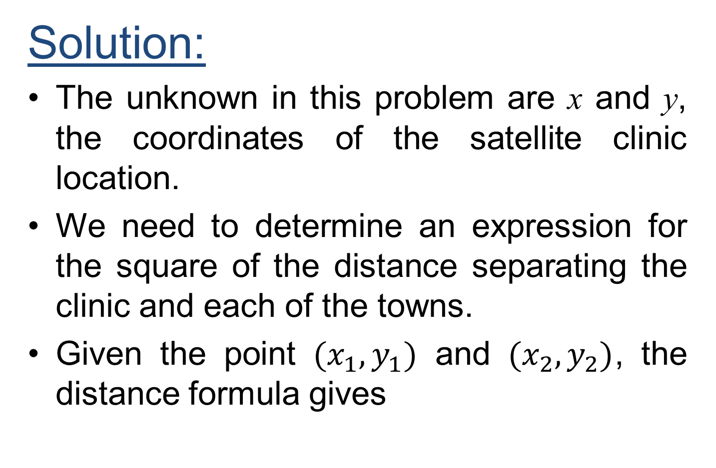
Solution:
The unknown in this problem are x and y, the coordinates of the satellite clinic location.
We need to determine an expression for the square of the distance separating the clinic and each of the towns.
Given the point $(x_{1},y_{1})$ and $(x_{2},y_{2})$, the distance formula gives

Slide 32
The square of the distance separating the clinic with location (x, y) and township A located at (40, 20) is
Similarly we can the formulae for townships B and C.

Slide 33
Finding similar expressions for the square of the distance separating township B and the clinic and summing for the three township, we get

Slide 36
Review
We covered section 20.3 and section 20.4: :
Optimization of Bivariate Functions
Critical Points and their types
Relative Maximum and Minimum
Test for critical points
Applications of Bivariate Optimization
Finished the material for the course of Business Mathematics MTH-367.

