Slide 1
Business Mathematics
MTH-367
Lecture 30

Slide 2
Chapter 19
Integral Calculus:
Applications
continued

Slide 3
Today’s Topics
We will go over Sec.19.4
Applications of Integral calculus, by solving variety of problems in business, economics and finance.

Slide 4
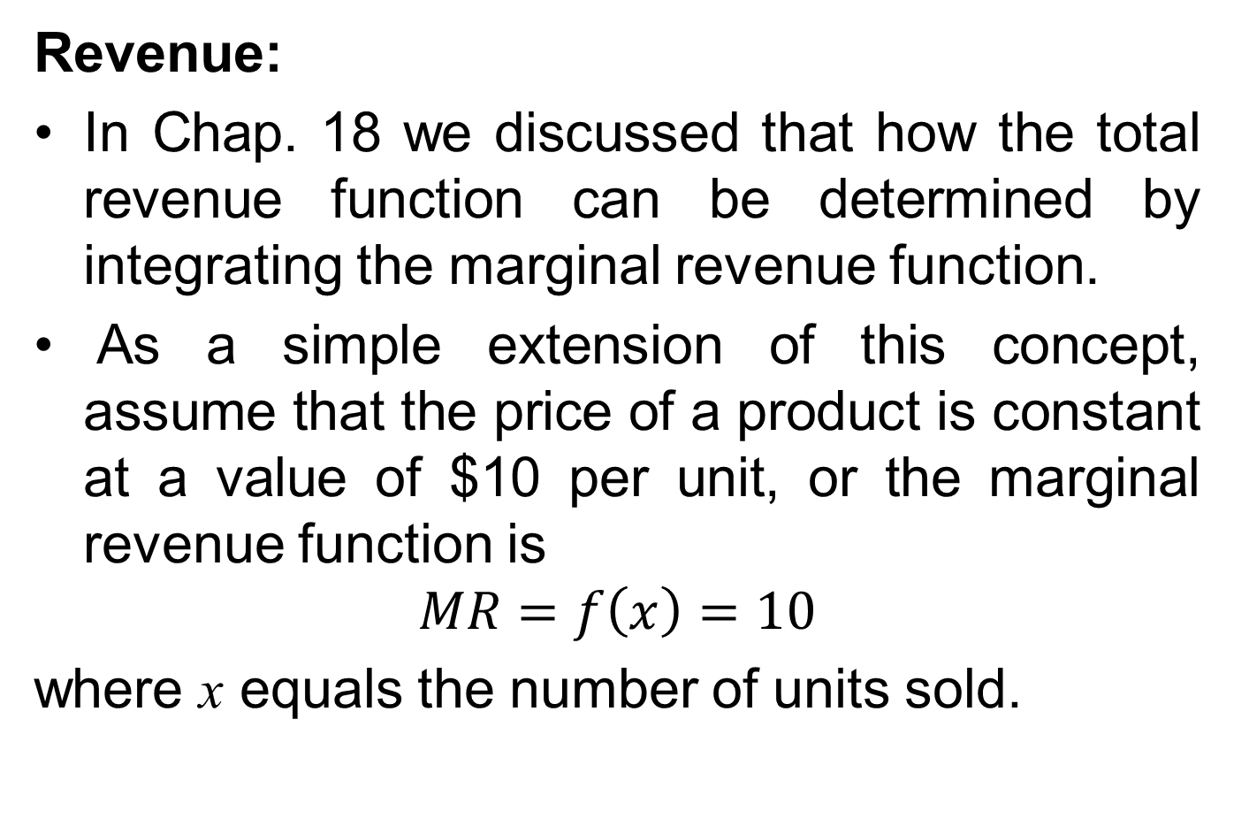
Applications of Integral Calculus
Revenue:
In Chap. 18 we discussed that how the total revenue function can be determined by integrating the marginal revenue function.
As a simple extension of this concept, assume that the price of a product is constant at a value of $10 per unit, or the marginal revenue function is
$$MR=f\left(x\right)=10$$
where x equals the number of units sold.

Slide 5
Total revenue from selling x units can be determined by integrating the marginal revenue function between 0 and x.
For example, the total revenue from selling 1,500 units can be computed as

Slide 6
This is a rather elaborate procedure for calculating total revenue since we simply could have multiplied price by quantity sold to determine the same result.
However, it does illustrate how the area beneath the marginal revenue function (see figure) can be interpreted as total revenue or incremental revenue.
The additional revenue associated with increasing sales from 1,500 to 1,800 units can be computed as

Slide 8
Example:
Maintenance Expenditures
An automobile manufacturer estimates that the annual rate of expenditure r(t) for maintenance on one of its models is represented by the function
where t is the age of the automobile stated in years and r(t) is measured in dollars per year.

Slide 9
This function suggests that when the car is 1 year old, maintenance expenses are being incurred at a rate of.

Slide 10
As would be anticipated, the older the automobile, the more maintenance is required. The following figure illustrates the sketch of the rate of expenditure function.

Slide 11
The area under this curve between any two values of t is a measure of the expected maintenance cost during that time interval.
The expected maintenance cost during the automobile’s first 5 years are computed as

Slide 13
Example
Fund-Raising
A state civic organization is conducting its annual fund-raising campaign for its summer camp program for the disadvantaged.
Campaign expenditures will be incurred at a rate of $10,000 per day.
From past experience it is known that contributions will be high during the early stages of the campaign and will tend to fall off as the campaign continues.

Slide 14
The function describing the rate at which contributions are received is
where t represents the day of the campaign, and c(t) equals the rate of which contribution are received, measured in dollars per day.
The organization wishes to maximize the net proceeds from the campaign.

Slide 15
Determine how long the campaign should be conducted in order to maximize the net profit.
What are total campaign expenditures expected to equal?
What are total contributions expected to equal?
What are the net proceeds (total contributions less total expenditures) expected to equal?

Slide 16
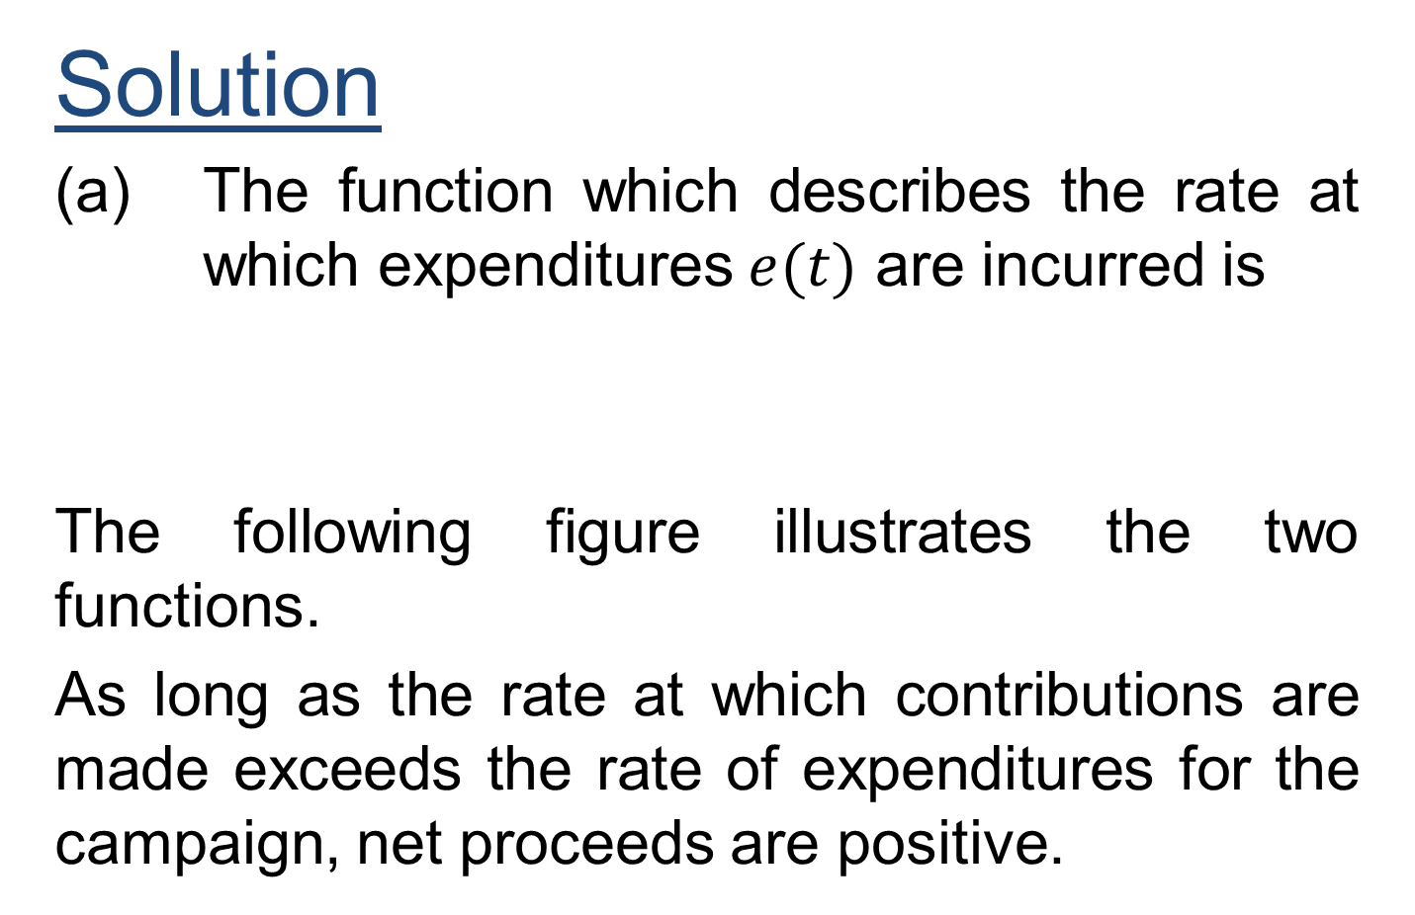
Solution
(a) The function which describes the rate at which expenditures $e(t)$ are incurred is
The following figure illustrates the two functions.
As long as the rate at which contributions are made exceeds the rate of expenditures for the campaign, net proceeds are positive.

Slide 17
Figure

Slide 18
Net proceeds will be positive up until the time when the graphs of the two functions intersect.
Beyond this point, the rate of expenditure exceeds the rate of contribution.
That is, contributions would be coming in at a rate of less that $10,000 per day.
The graphs of the two functions intersect when

Slide 20
Total campaign expenditures are represented by the area under e(t) between t = 0 and t = 10.
This could be found by integrating e(t) between these limits or more simply by multiplying

Slide 21
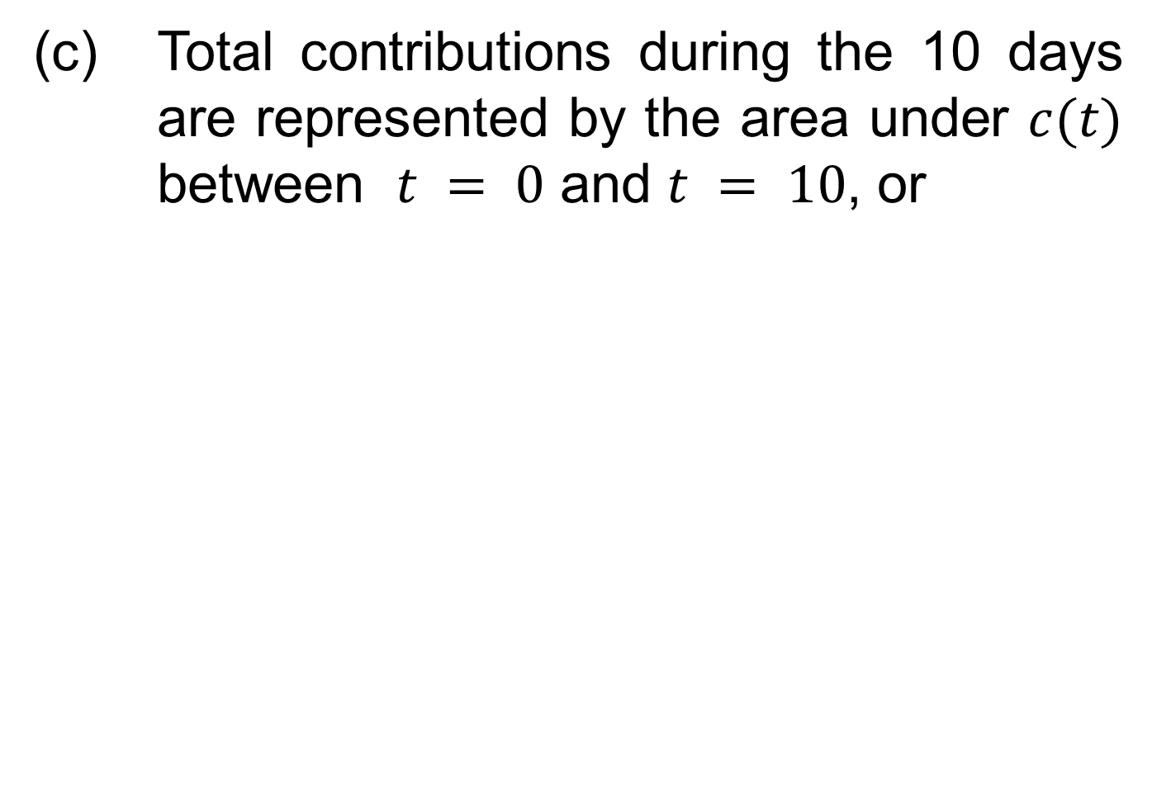
(c) Total contributions during the 10 days are represented by the area under $c(t)$ between $t = 0$ and $t = 10$, or

Slide 22
(d)

Slide 23
Example:
Blood Bank Management;
A hospital blood bank is conducting a blood drive to replenish its inventory of blood.
The hospital estimates that blood will be donated at a rate of d(t) pints per day, where and t equals the length of the blood drive in days. If the goal of the blood drive is 1,000 pints, when will the hospital reach its goal?

Slide 24
Solution:
In this problem the area between the graph of d and the t axis represents total donations of blood in pints.
Unlike previous applications, the desired area is known; the unknown is the upper limit of integration, as shown in the following figure.

Slide 25
Figure

Slide 26
The hospital will reach its goal when

Slide 28
Example
Consumer’s Surplus
Consumer surplus is the difference between the maximum price a consumer is willing to pay and the actual price they do pay.
If a consumer would be willing to pay more than the current asking price, then they are getting more benefit from the purchased product than they spent to buy it.
One way of measuring the value or utility that a product holds for a consumer is the price that he or she is willing to pay for it.
Economists contend that consumers actually receive bonus or surplus value from the products they purchase according to the way in which the marketplace operates.

Slide 29
Figure

Slide 30
The above figure portrays the supply and demand functions for a product.
Equilibrium occurs when a price of $10 is charged and demand equals 100 units.
If dollars are used to represent the value of this product to consumers, accounting practices would suggest that the total revenue ($10 . 100units = $1,000) is a measure of the economic value of this product.
The area of rectangle ABCE represents this measure of value.

Slide 31
However, if you consider the nature of the demand function, there would have been a demand for the product at prices higher than $10.
That is, there would have been consumers willing to pay almost $20 for the product.
Additional consumers would have been drawn into the market at prices between $10 and $20.
If we assume that the price these people would be willing to pay is a measure of the utility the product holds for them, they actually receive a bonus when the market price is $10. Refer again to the above figure.

Slide 32
Economists would claim that a measure of the actual utility of the product is the area ABCDE.
When the market is in equilibrium, the extra utility received by consumers, referred to as the consumer’s surplus, is represented by the shaded area CDE. This area can be found as

Slide 33
Our accounting methods would value the utility of the product at $1,000.
Economists would contend that the actual utility is $1,333.34, or that the consumer’s surplus equals $333.34.
This measure of added, or bonus, utility applies particularly to those consumers who would have been willing to pay more than $10.

Slide 34
Review
We studied Sec. 19.4: Applications of Integral calculus, by solving variety of different problems in business, economic and finance.

Slide 35
Next Lecture
We will start Chapter 20

