Slide 1
Business Mathematics
MTH-367
Lecture 29

Slide 2
Chapter 19
Integral Calculus:
Applications

Slide 3
Last Lecture’s Summary
Anti-derivatives
Rules of Integration
Additional Rules of Integration
Differential Equations

Slide 4
Today’s Topics
Definite Integrals
Properties of Definite Integrals
Finding Area Using Definite Integrals
Finding Area Between Curves

Slide 5
Definite Integrals
In this section we will introduce the definite integral, which forms the basis for many applications of integral calculus.

Slide 6
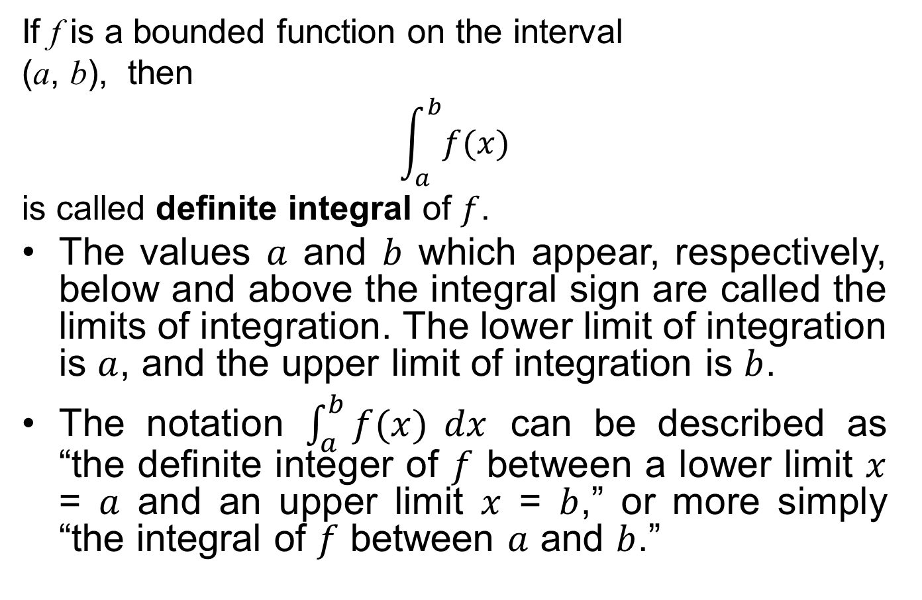
The Definite Integral
If f is a bounded function on the interval
(a, b), then
$$\int_{a}^{b}{f(x)}$$
is called definite integral of $f$.
The values $a$ and $b$ which appear, respectively, below and above the integral sign are called the limits of integration. The lower limit of integration is $a$, and the upper limit of integration is $b$.
The notation $\int_{a}^{b}{f(x)} dx$ can be described as “the definite integer of $f$ between a lower limit $x$ = $a$ and an upper limit $x$ = $b$,” or more simply “the integral of $f$ between $a$ and $b$.”

Slide 7
Evaluating Definite Integrals
The evaluation of definite integrals is facilitated by the following important theorem.

Slide 8
Fundamental Theorem of Integral Calculus
If a function f is continuous over an interval and F is any anti-derivative of f, then for any points x = a and x = b on the interval, where a ≤ b,

Slide 9
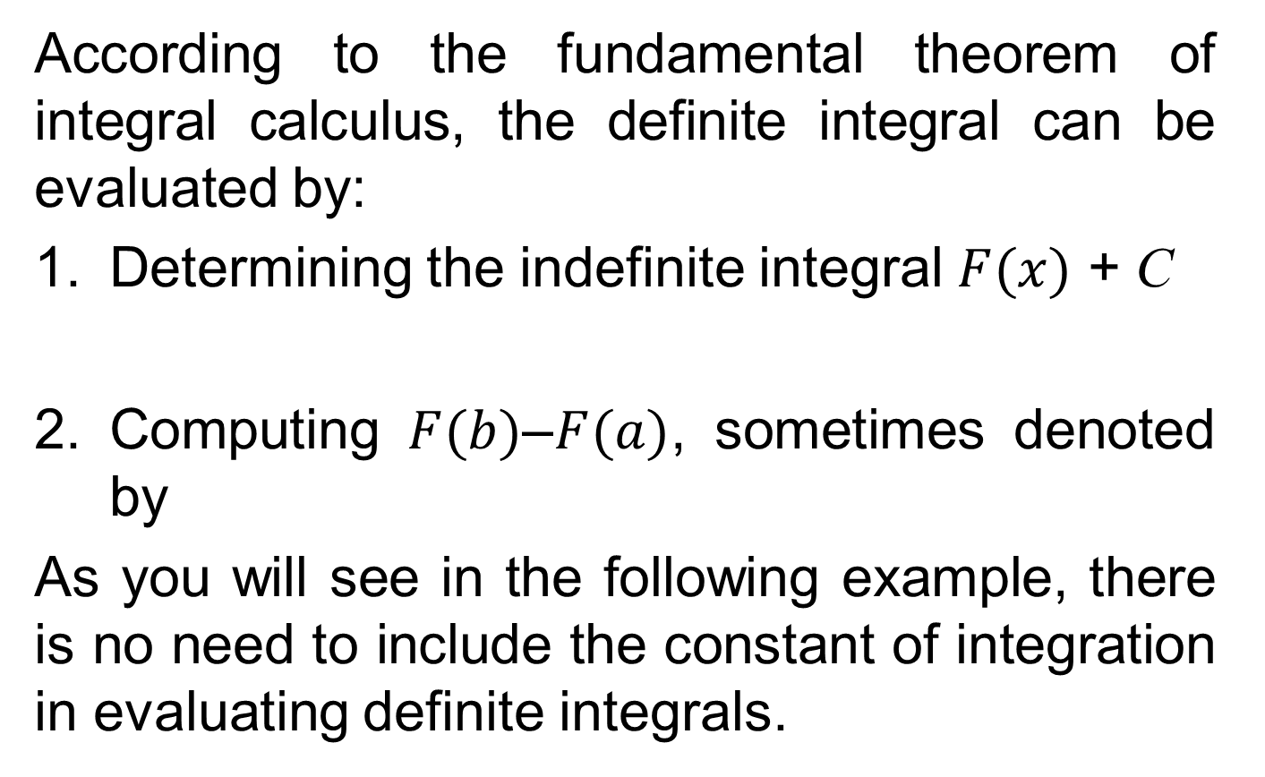
According to the fundamental theorem of integral calculus, the definite integral can be evaluated by:
Determining the indefinite integral $F(x)$ + C
Computing $F(b)$–$F(a)$, sometimes denoted by
As you will see in the following example, there is no need to include the constant of integration in evaluating definite integrals.

Slide 10
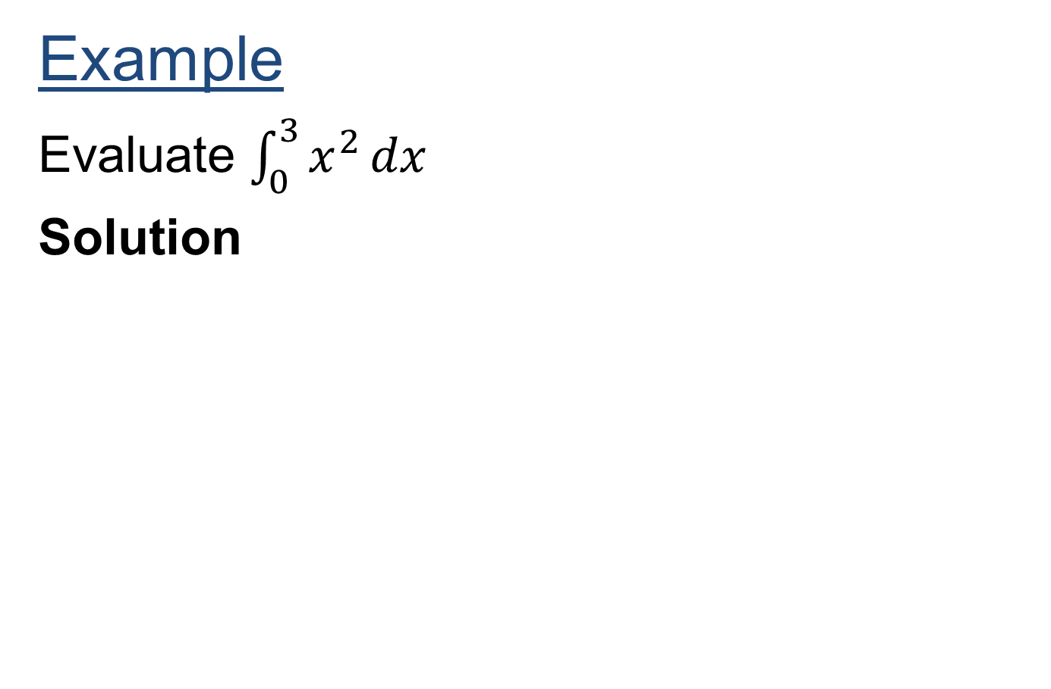
Example
Evaluate $\int_{0}^{3}{x^{2}}dx$
Solution

Slide 12
Properties of Definite Integrals
Property-1
If f is defined and continuous on the interval (a, b),

Slide 14
Property-2

Slide 15
Property-3
If f is continuous on the interval (a, c) and a<b<c,

Slide 17
Property-4
where c is constant.

Slide 19
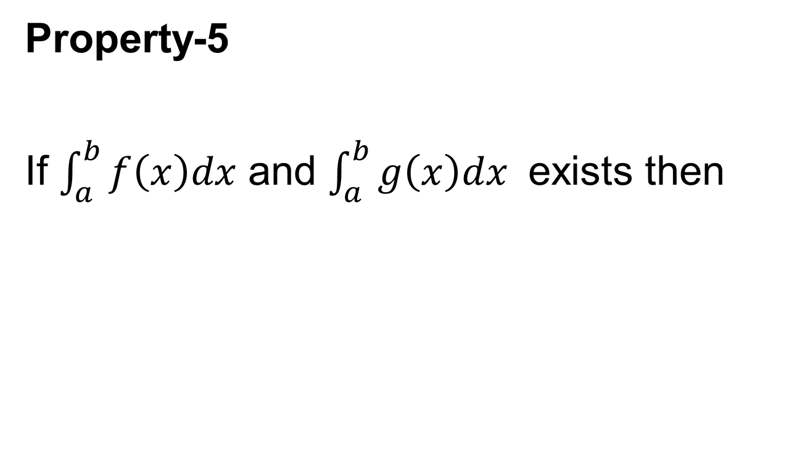
Property-5
If $\int_{a}^{b}{f\left(x\right)dx}$ and $\int_{a}^{b}{g\left(x\right)dx}$ exists then

Slide 21
Definite Integrals and Areas
One of the practical applications of integral calculus is that definite integrals can be used to compute areas.
These may represent areas which are bounded by curves representing functions and/or the coordinate axes.

Slide 22
Areas between a Function and x-axis
Definite integrals can be used to compute the area between the curve representing a function and the x axis. Several different situations may occur. The treatment of each varies and is now discussed.

Slide 23
Case 1: (f(x) > 0)
When the value of a continuous function f is positive over the interval a ≤ x ≤ b – that is, the graph of f lies above the x axis – the area which is bounded by f, the x axis, x = a, and x = b is determined by

Slide 24
Figure

Slide 25
Example:
Determine the area beneath f(x) = x² and above the x axis between x = 1 and x = 3

Slide 26
Case 2: (f(x) < 0)
When the value of a continuous function f is negative over the interval a ≤ x ≤ b, that is, the graph of f lies below the x axis – the area which is bounded by f, the x axis, x = a, and x = b is determined by

Slide 27
However, the definite integral evaluates the area as negative when it lies below the x axis, Because area is absolute (or positive), the area will be computed as

Slide 29
Case 3: (f(x) < 0 and f(x) > 0)
When the value of a continuous function f is positive over part of the interval a ≤ x ≤ b and negative over the remainder of the interval,
part of the area between f and the x axis is above the x axis and part is below the x axis than calculates the net area.
That is, area above the x axis are evaluated as positive, and those below are evaluated as negative. The two are combined algebraically to yield the net value.

Slide 32
Finding Areas between Curves
The following examples illustrate procedures for determining areas between curves.
EXAMPLE:
Determine the shaded area between f and g indicated in the following figure.

Slide 34
Solution

Slide 37
Area Between Two Curves
If the function y = f (x) lies above the function y = g (x) over the interval a ≤ x ≤ b, the area between the two functions over the interval is

Slide 38
Figure:

Slide 39
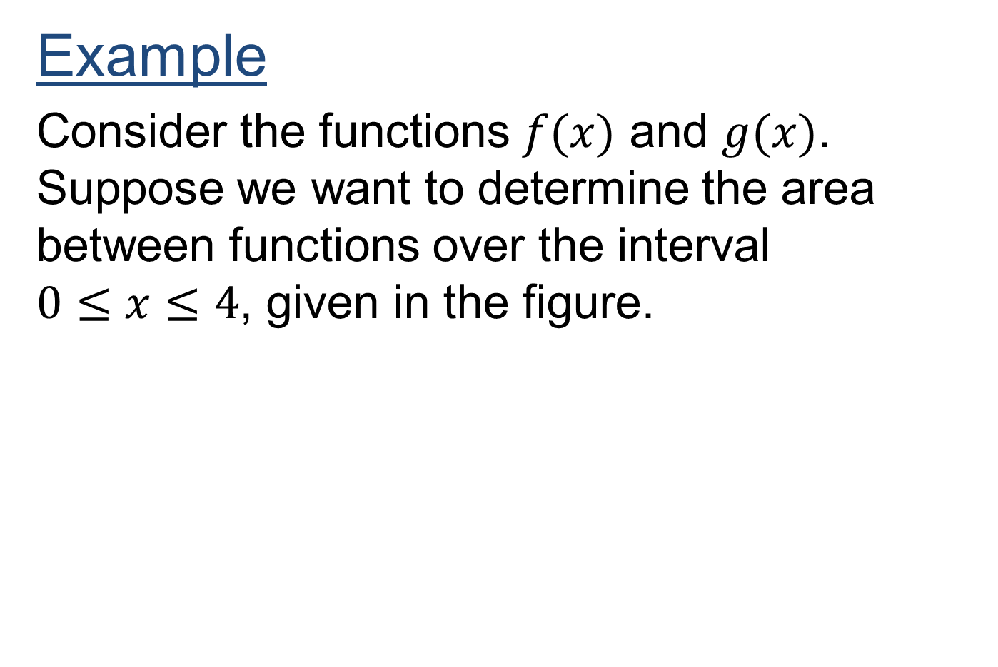
Example
Consider the functions $f(x)$ and $g(x)$. Suppose we want to determine the area between functions over the interval $0≤x≤4$, given in the figure.

Slide 40
Solution

Slide 41
Review
Definite Integrals
Properties of Definite Integrals
Finding Area Using Definite Integrals
Finding Area Between Curves

Slide 42
Next Lecture

