Slide 1
Business Mathematics
MTH-367
Lecture 28

Slide 2
Last Lecture’s Summary
Covered Sec 17.2:
Optimization: Additional Applications
Finished Chapter 17

Slide 3
Chapter 18
Integral Calculus:
An Introduction

Slide 4
Chapter Objectives
Introduce the nature and methods of integral calculus.
Present selected rules of integration and illustrate their use.
Illustrate other methods of integration which may be appropriate when basic rules are not.

Slide 5
Today’s Topics
Anti-derivatives
Rules of Integration
Additional Rules of Integration
Differential Equations

Slide 6
In this chapter we will introduce a second major area of study within the calculus – integral calculus.
An important concern of integral calculus is the determination of areas which occur between curves and other defined boundaries.
Also, if the derivative of an unknown function is known, integral calculus may provide a way of determining the original function.

Slide 7
Antiderivatives
The Antiderivative Concept
Given a function f, we are acquainted with how to find the derivative f’.
There may be occasions in which we are given the derivative f’ and wish to determine the original function f.
Since the process of finding the original function is the reverse of differentiation, f is said to be an anti-derivative of f’

Slide 8
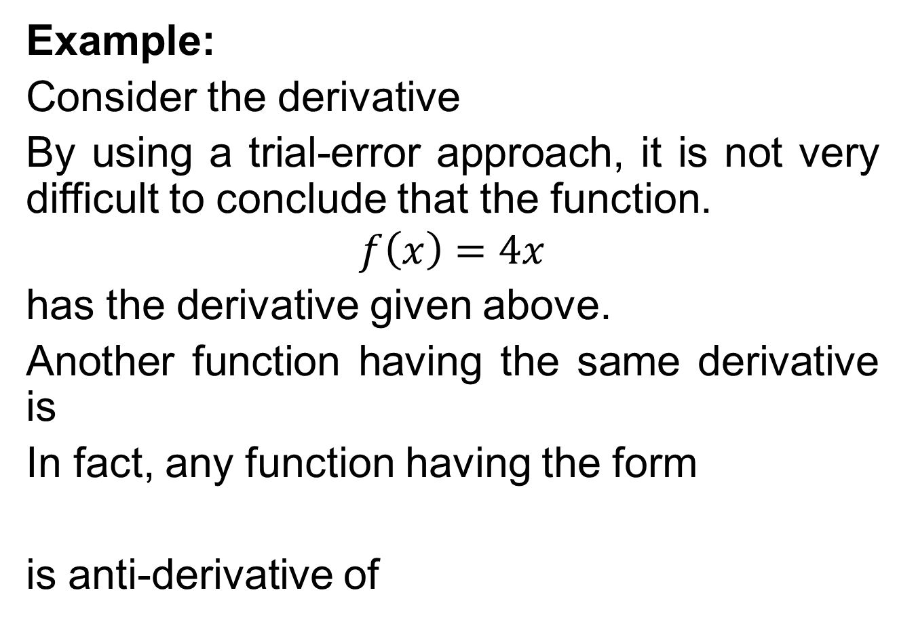
Example:
Consider the derivative
By using a trial-error approach, it is not very difficult to conclude that the function.
$$f\left(x\right)=4x$$
has the derivative given above.
Another function having the same derivative is
In fact, any function having the form
is anti-derivative of

Slide 10
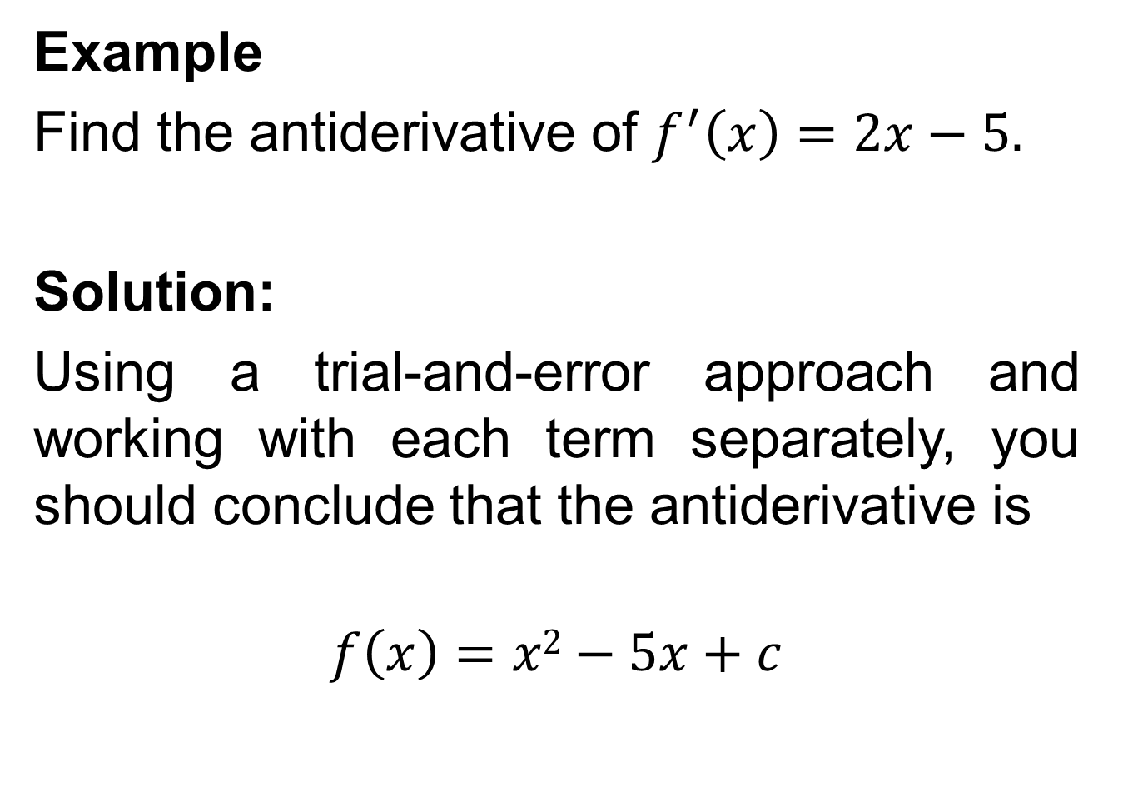
Example
Find the antiderivative of $f^{′}\left(x\right)=2x−5.$
Solution:
Using a trial-and-error approach and working with each term separately, you should conclude that the antiderivative is
$$f\left(x\right)=x2−5x+c$$

Slide 11
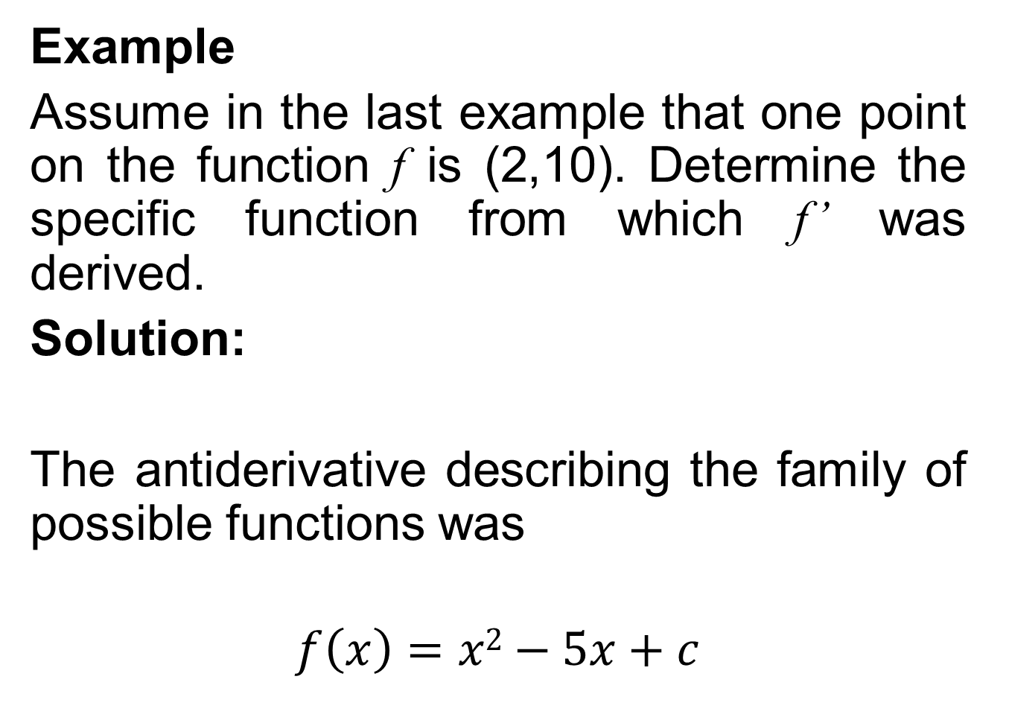
Example
Assume in the last example that one point on the function f is (2,10). Determine the specific function from which f’ was derived.
Solution:
The antiderivative describing the family of possible functions was
$$f\left(x\right)=x2−5x+c$$

Slide 13
Revenue and Cost Functions
If we have an expression for either marginal revenue or marginal cost, the respective antiderivatives will be the total revenue and total cost functions.

Slide 14
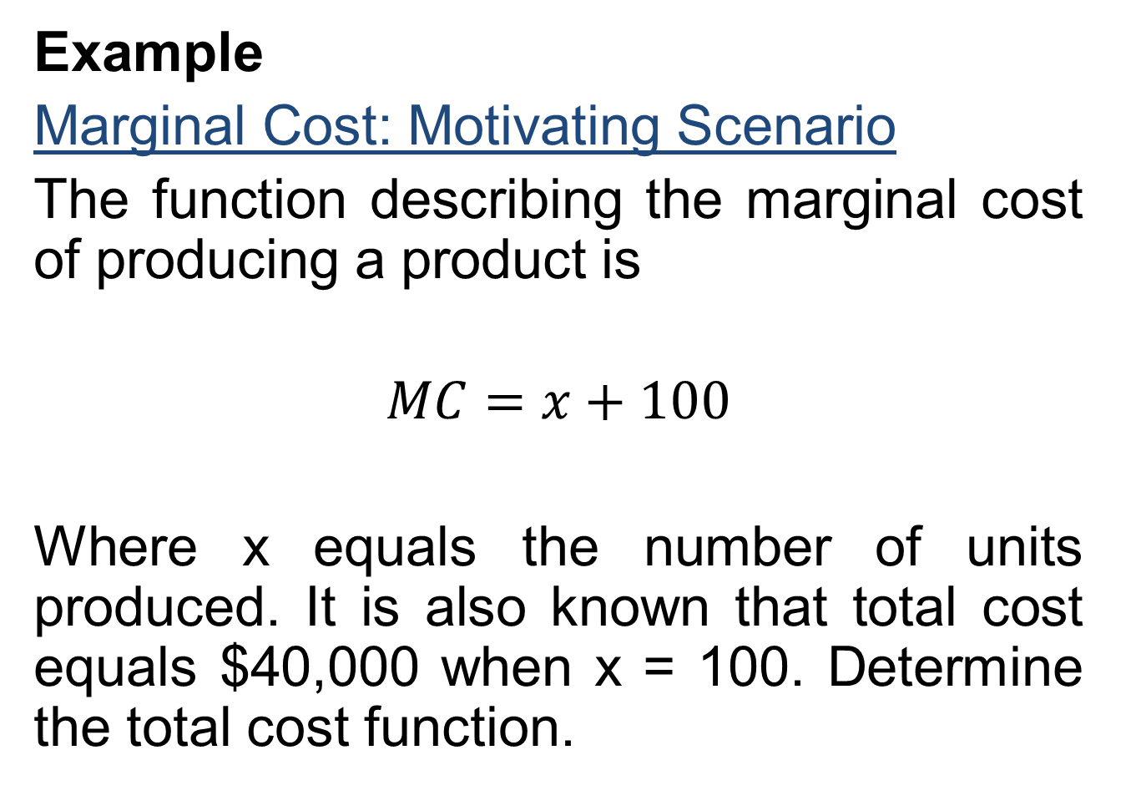
Example
Marginal Cost: Motivating Scenario
The function describing the marginal cost of producing a product is
$$MC=x+100$$
Where x equals the number of units produced. It is also known that total cost equals $40,000 when x = 100. Determine the total cost function.

Slide 15
Solution:
To determine the total cost function, we must first find the antiderivative of the marginal cost function,
Given that C(100) = 40,000, we can solve for the value of C, which happens to represent the fixed cost.

Slide 16
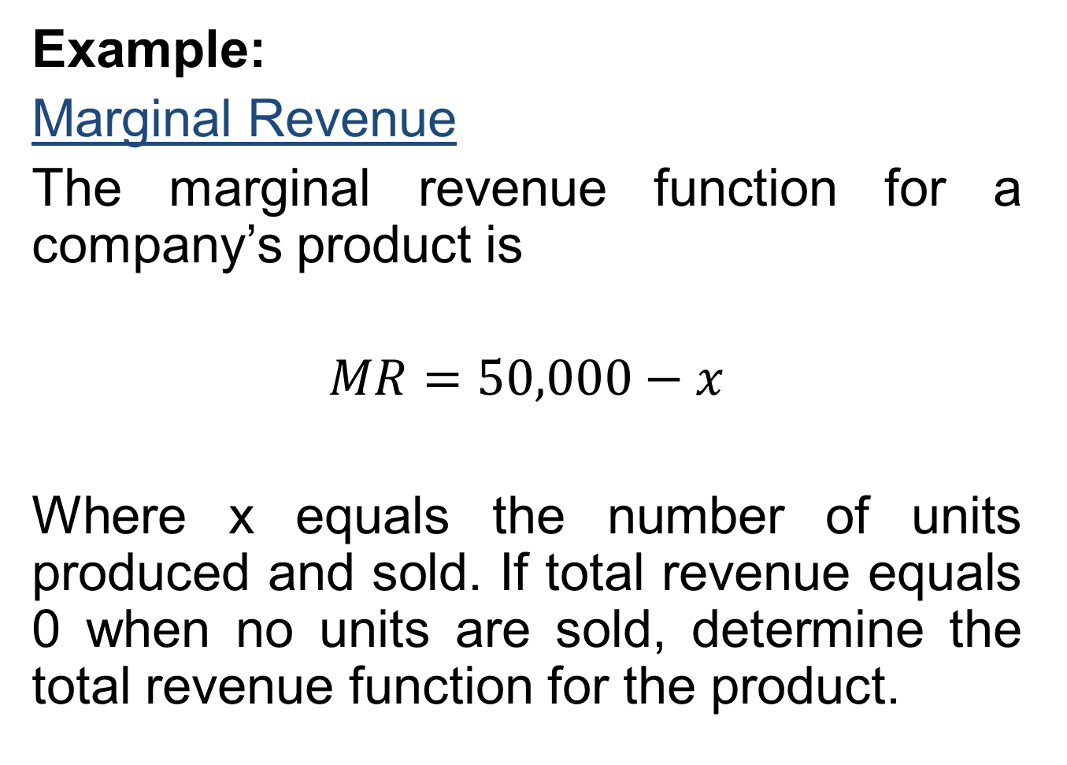
Example:
Marginal Revenue
The marginal revenue function for a company’s product is
$$MR=50,000−x$$
Where x equals the number of units produced and sold. If total revenue equals 0 when no units are sold, determine the total revenue function for the product.

Slide 18
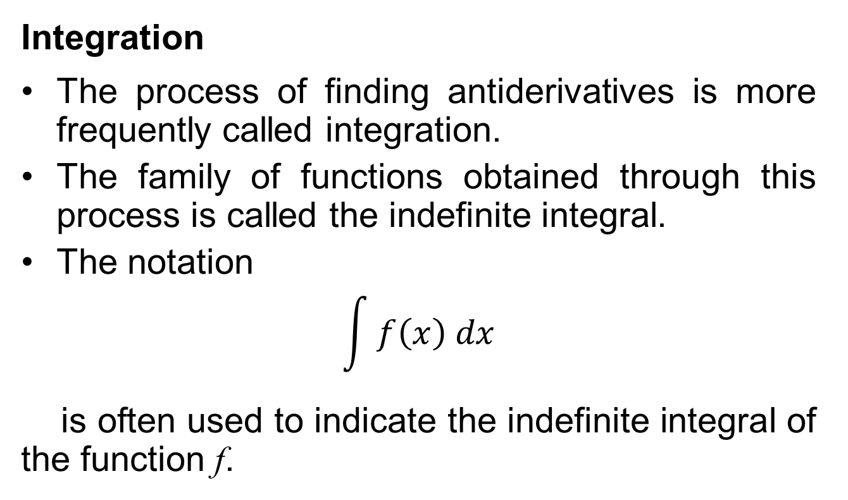
Rules Of Integration
Integration
The process of finding antiderivatives is more frequently called integration.
The family of functions obtained through this process is called the indefinite integral.
The notation
$$\int{f\left(x\right) dx}$$
is often used to indicate the indefinite integral of the function f.

Slide 19
The symbol ∫ is the integral sign; f is the integrand, and dx, as we will deal with it, indicates the variable with respect to which the integration process is performed.
Two verbal descriptions of the process are: “integrate the function f with respect to the variable x” or “find the indefinite integral of f with respect to x”.

Slide 20
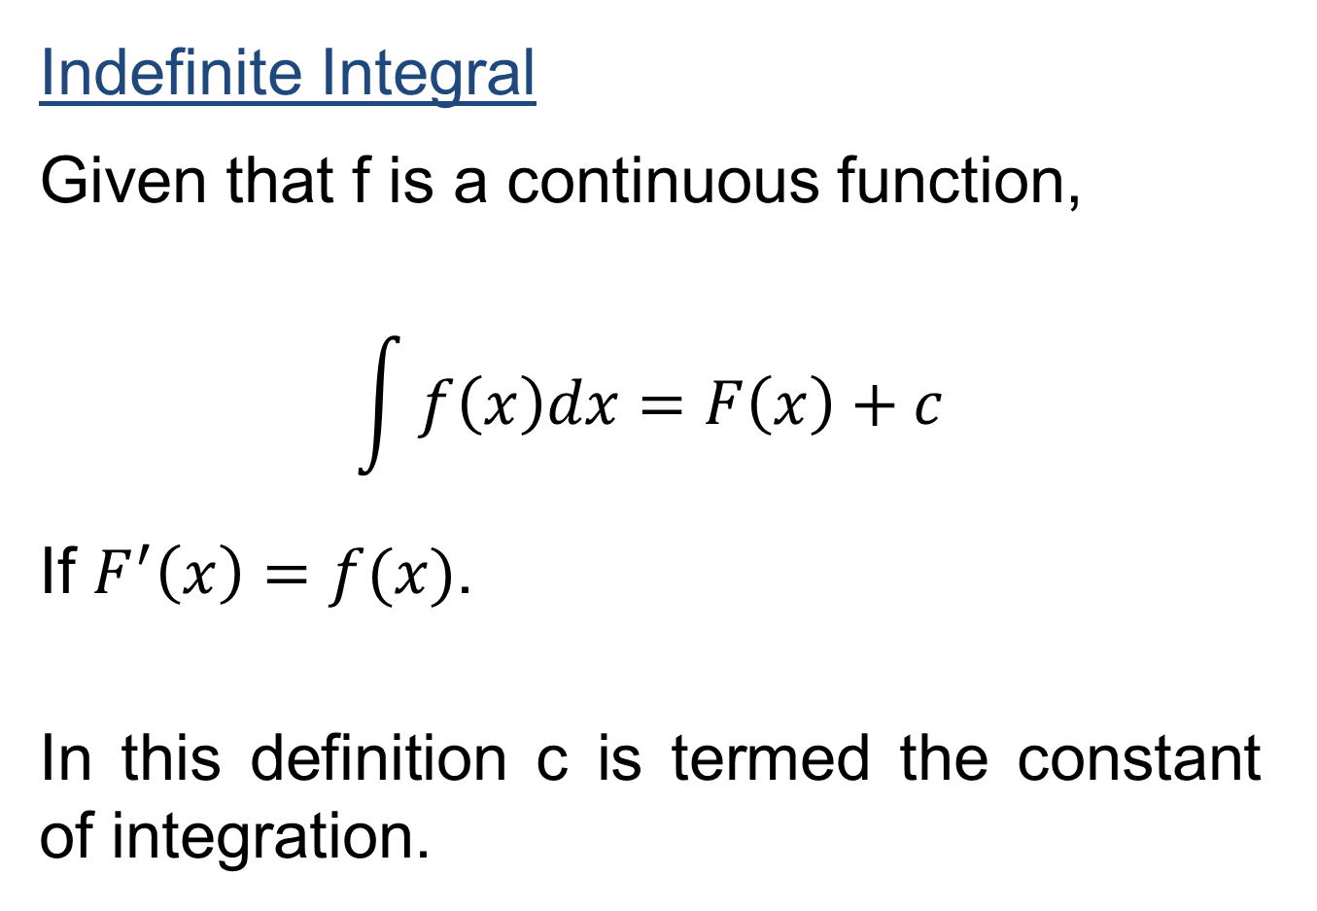
Indefinite Integral
Given that f is a continuous function,
$$\int{f\left(x\right)dx=F\left(x\right)+c}$$
If $F^{′}\left(x\right)=f(x)$.
In this definition c is termed the constant of integration.

Slide 21
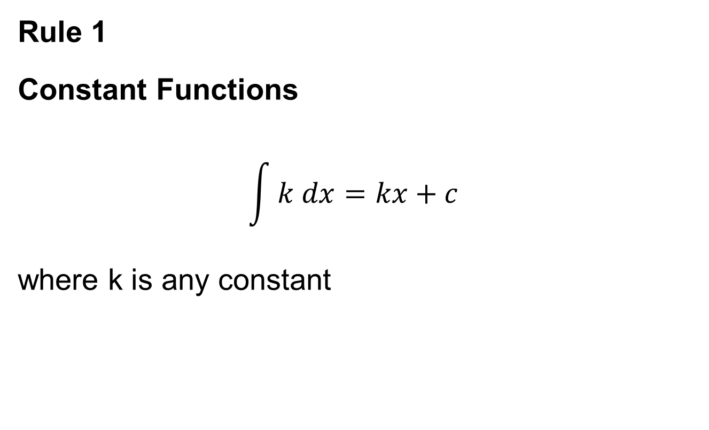
Rules of Integration
Rule 1
Constant Functions
$$\int{k dx=kx+c}$$
where k is any constant

Slide 22
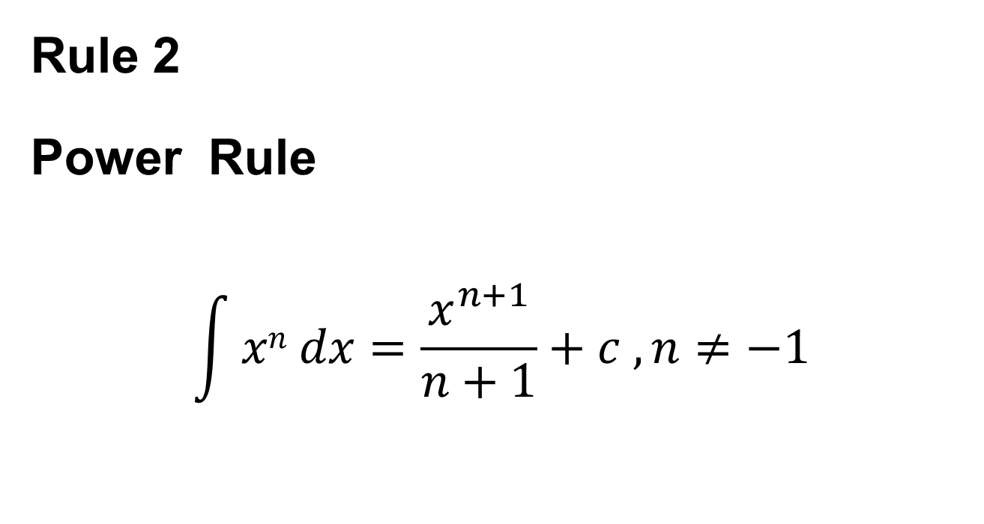
Rule 2
Power Rule
$$\int{xn dx=\frac{x^{n+1}}{n+1}+c ,n≠−1}$$

Slide 23
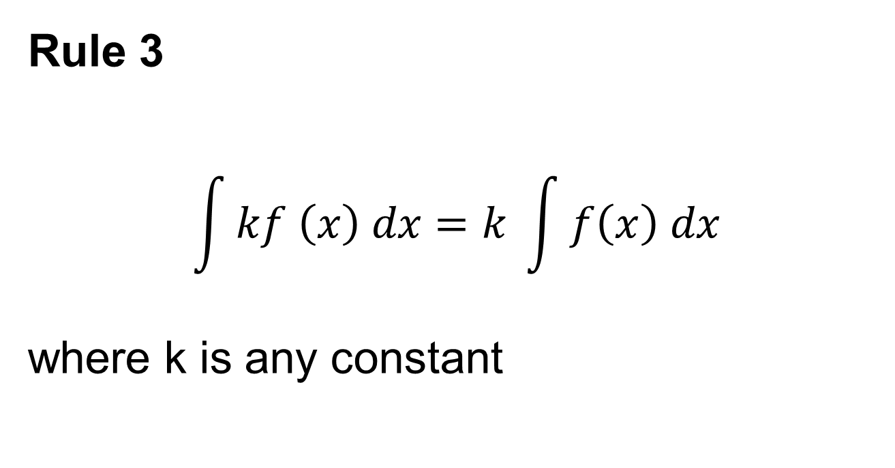
Rule 3
$$\int{kf \left(x\right) dx=k }\int{f\left(x\right) dx}$$
where k is any constant

Slide 24
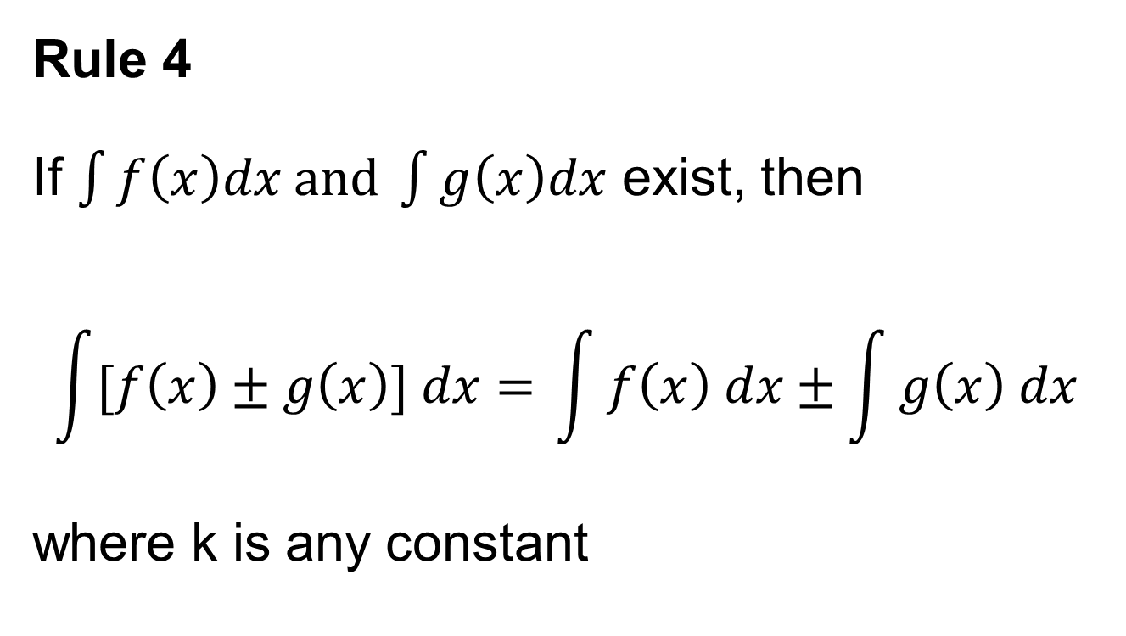
Rule 4
If $\int{f\left(x\right)dx and \int{g\left(x\right)dx}}$ exist, then
$$\int{[f\left(x\right)±g\left(x\right)] dx= }\int{f\left(x\right) dx±\int{g\left(x\right) dx}}$$
where k is any constant

Slide 25
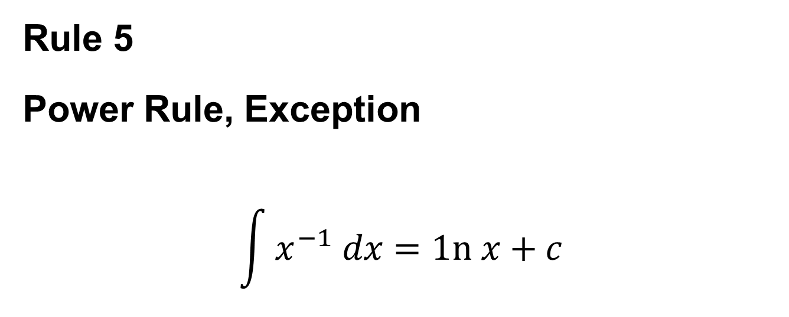
Additional Rules of Integration
Rule 5
Power Rule, Exception
$$\int{x^{−1} dx=1n x+c}$$

Slide 26
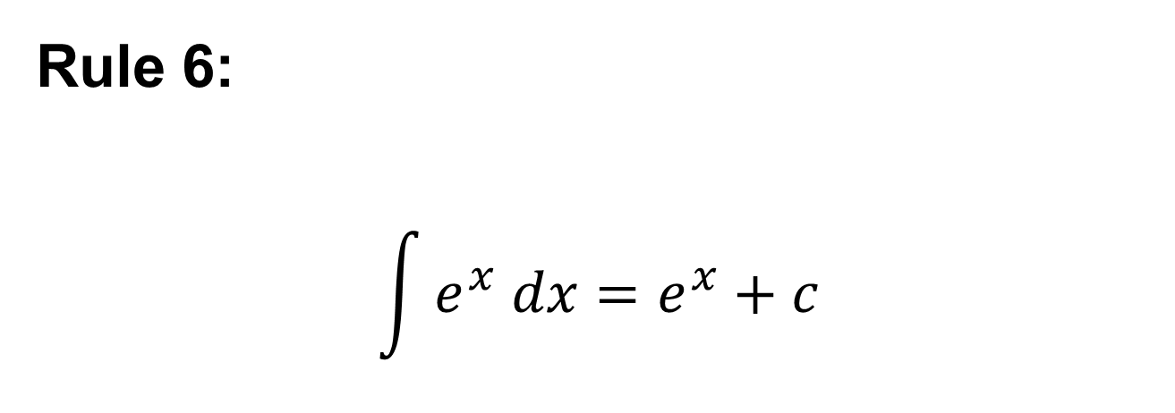
Rule 6:
$$\int{e^{x} dx=e^{x}+c}$$

Slide 27
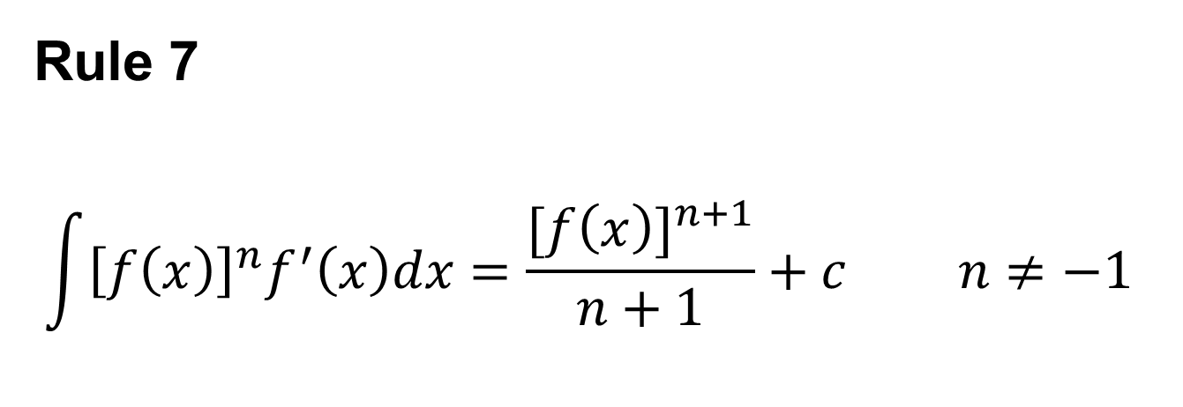
Rule 7
$$\int{{\left[f\left(x\right)\right]}^{n}f^{′}\left(x\right)dx=\frac{{[f\left(x\right)]}^{n+1}}{n+1}}+c n≠−1$$

Slide 31
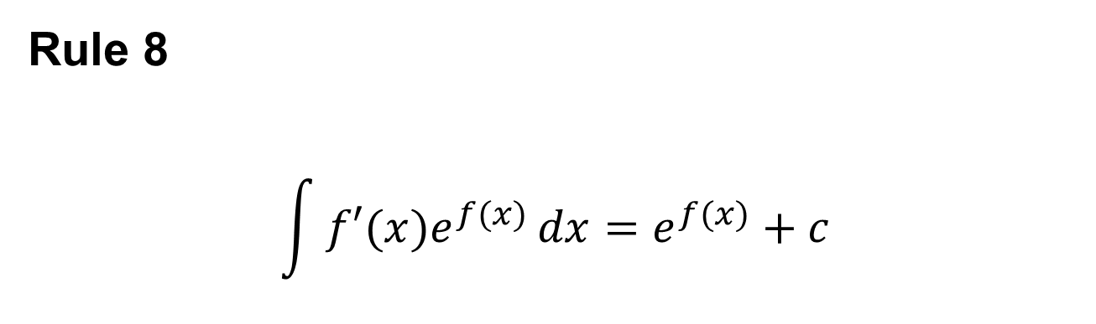
Rule 8
$$\int{f′(x)e^{f(x)}}dx=e^{f(x)}+c$$

Slide 33
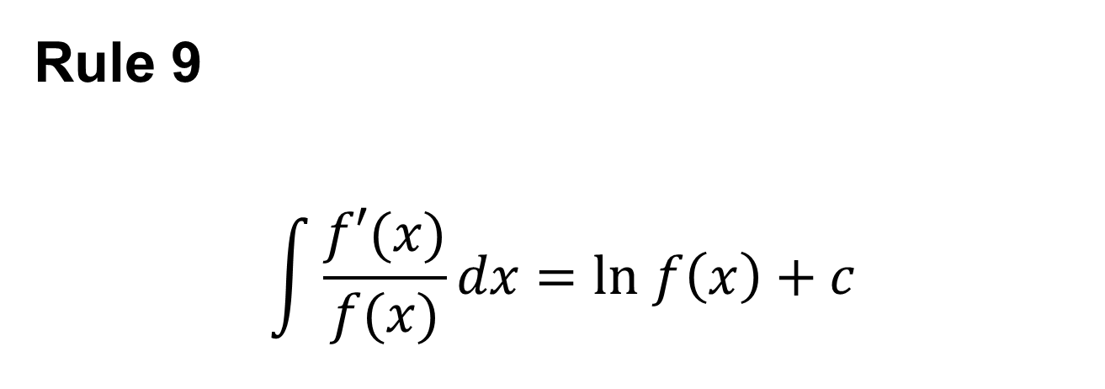
Rule 9
$$\int{\frac{f′(x)}{f(x)}}dx=ln f\left(x\right)+c$$

Slide 36
Differential Equations
A differential equation is an equation which involves derivatives and/or differentials.

Slide 37
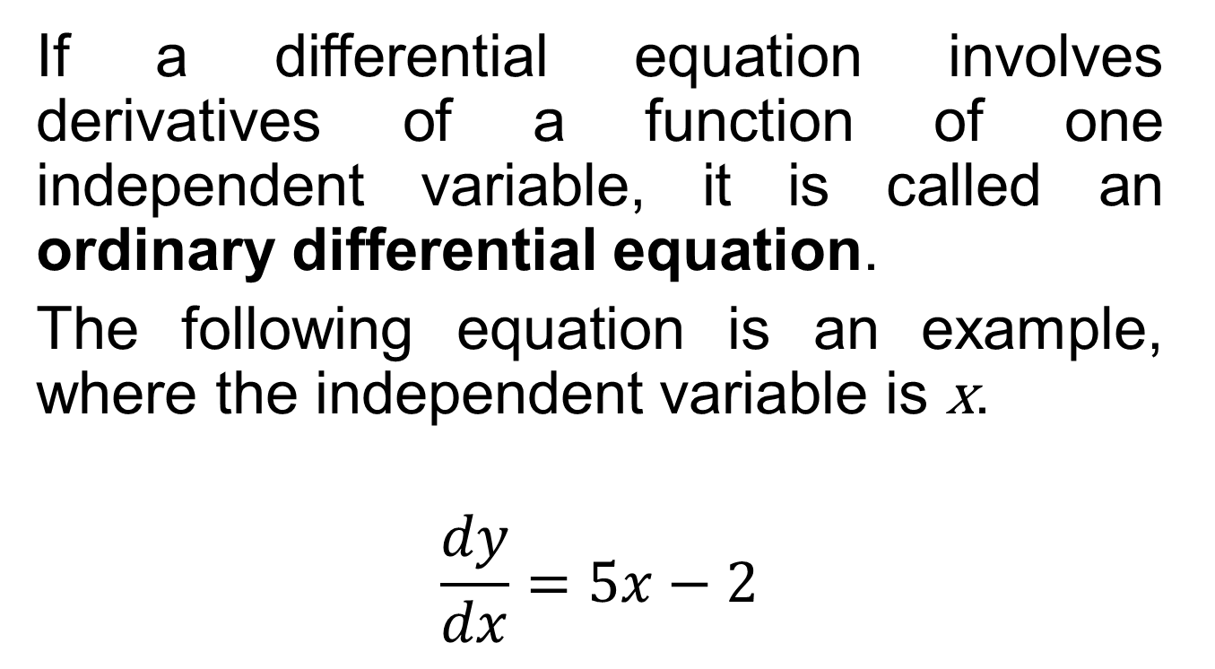
Ordinary Differential Equations
If a differential equation involves derivatives of a function of one independent variable, it is called an ordinary differential equation.
The following equation is an example, where the independent variable is x.
$$\frac{dy}{dx}=5x−2$$

Slide 38
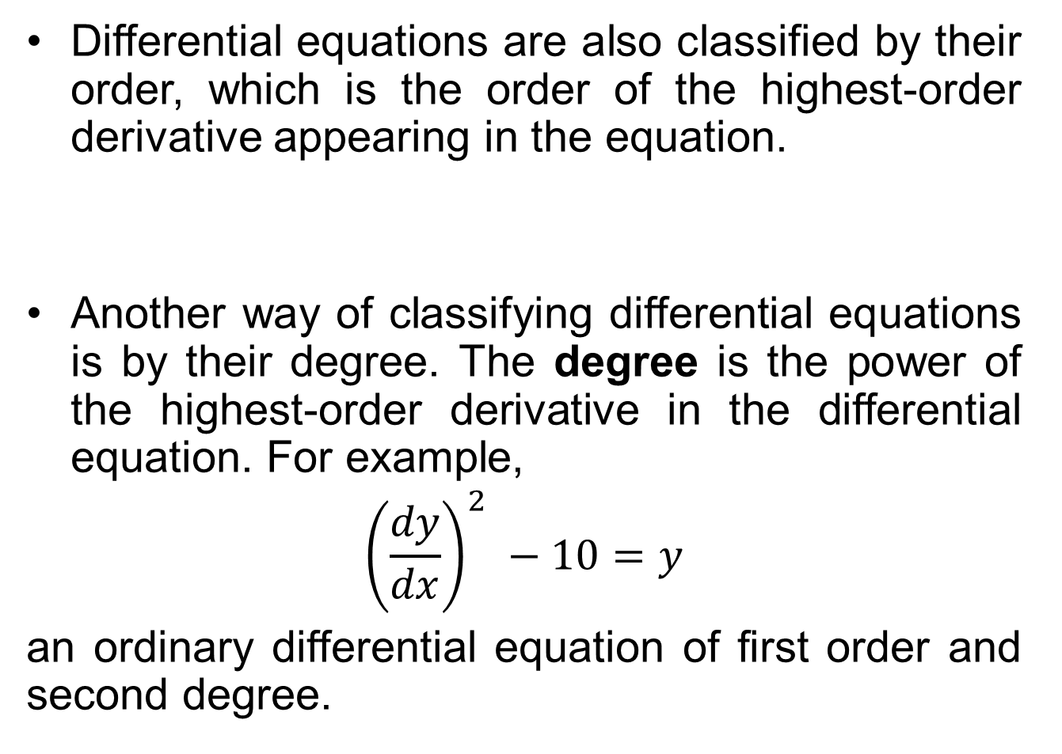
Differential equations are also classified by their order, which is the order of the highest-order derivative appearing in the equation.
Another way of classifying differential equations is by their degree. The degree is the power of the highest-order derivative in the differential equation. For example,
$${\left(\frac{dy}{dx}\right)}^{2} −10=y$$
an ordinary differential equation of first order and second degree.

Slide 39
Solutions of Ordinary Differential Equations
Solution to differential equations can be classified into general solutions and particular solutions.
A general solution is one which contains arbitrary constants of integration.
A particular solution is one which is obtained from the general solution.
  For particular solutions, specific values are assigned to the constants of integration based on initial conditions or boundary conditions.

Slide 40
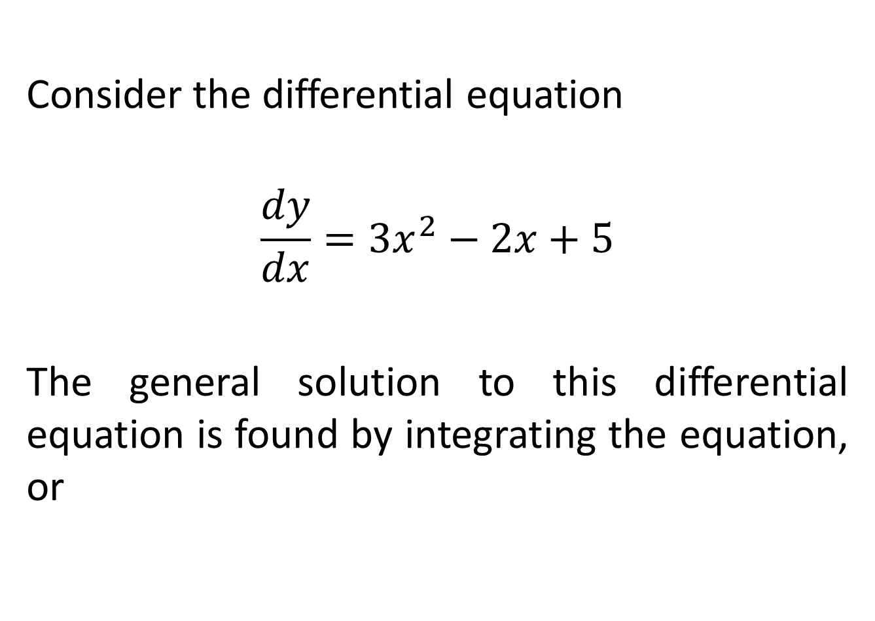
Consider the differential equation
$$\frac{dy}{dx}={3x}^{2}−2x+5$$
The general solution to this differential equation is found by integrating the equation, or

Slide 41
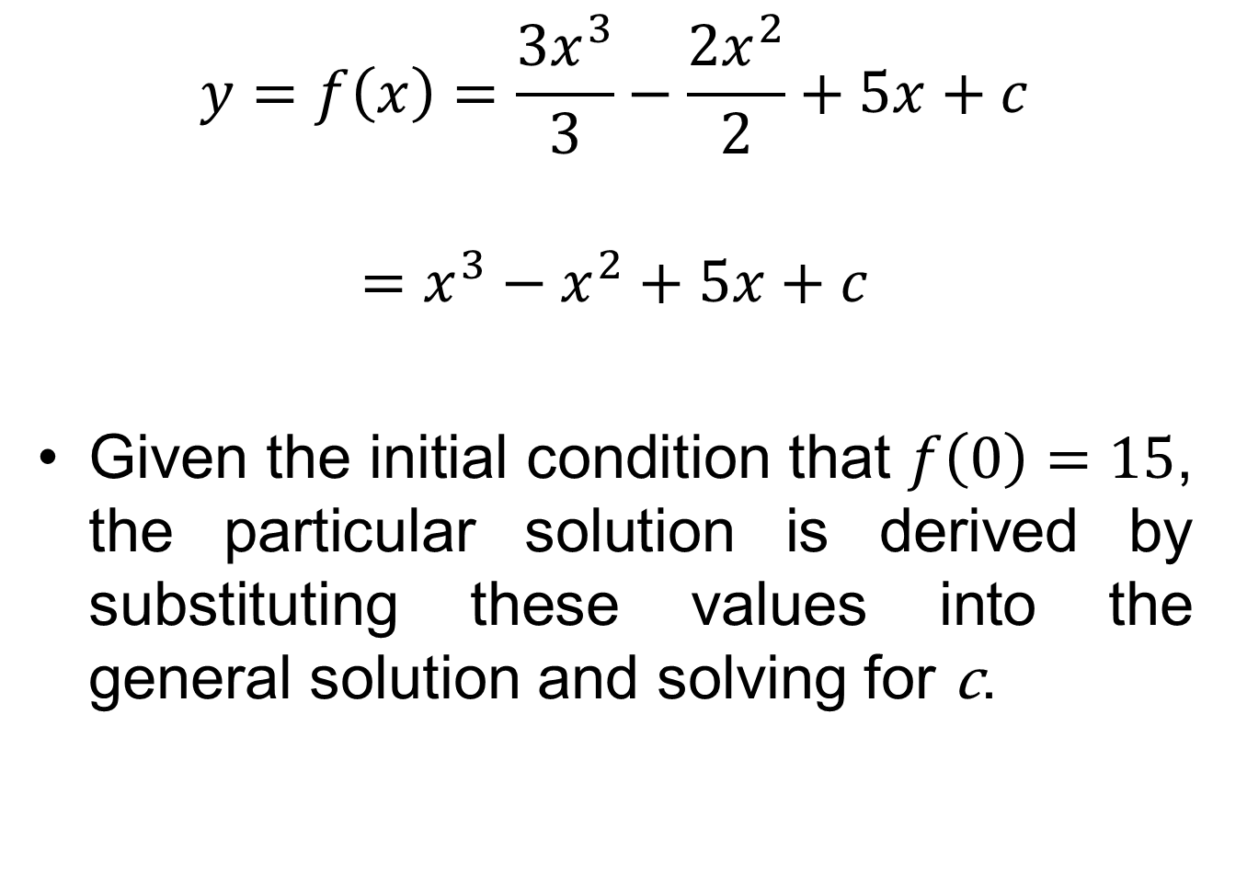
$$y=f\left(x\right)=\frac{{3x}^{3}}{3}−\frac{{2x}^{2}}{2}+5x+c$$
$$=x^{3}−x^{2}+5x+c$$
Given the initial condition that $f\left(0\right)=15$, the particular solution is derived by substituting these values into the general solution and solving for c.

Slide 42
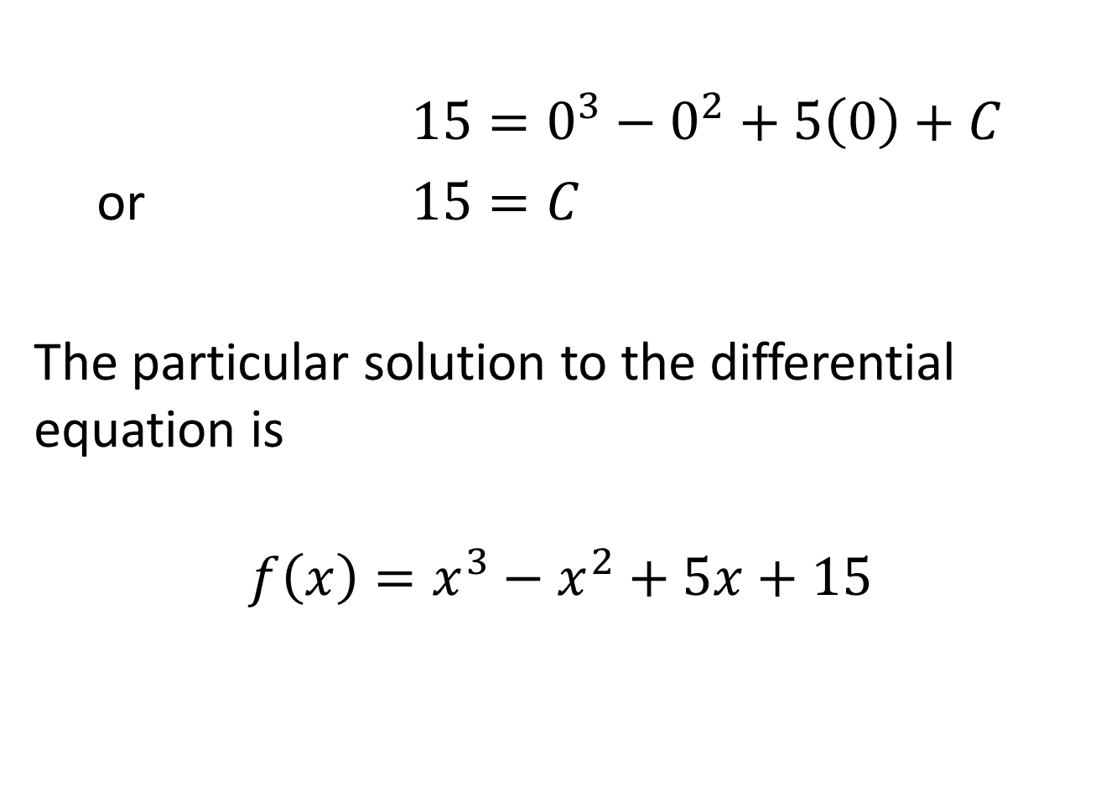
$15=0^{3}−0^{2}+5\left(0\right)+C$
or $15=C$
The particular solution to the differential equation is
$$f\left(x\right)=x^{3}−x^{2}+5x+15$$

Slide 43
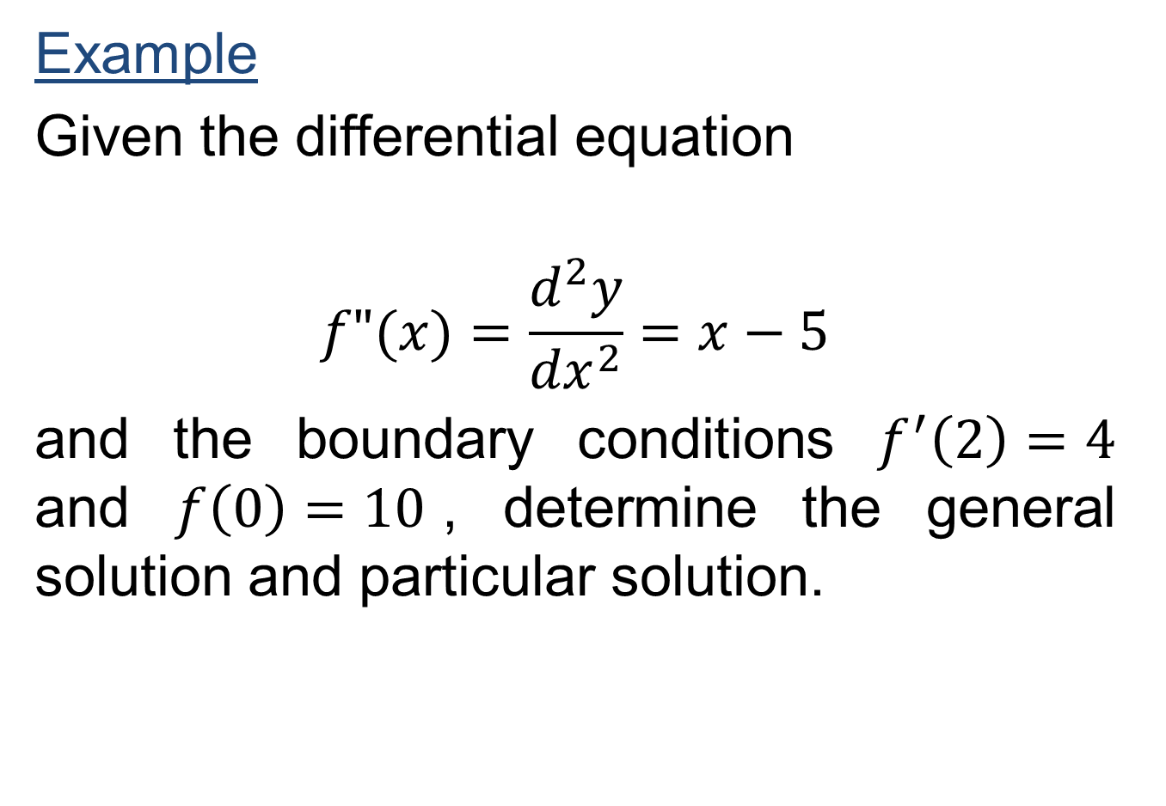
Example
Given the differential equation
$$f"(x)=\frac{d^{2}y}{{dx}^{2}}=x−5$$
and the boundary conditions $f^{′}\left(2\right)=4$ and $f\left(0\right)=10$, determine the general solution and particular solution.

Slide 47
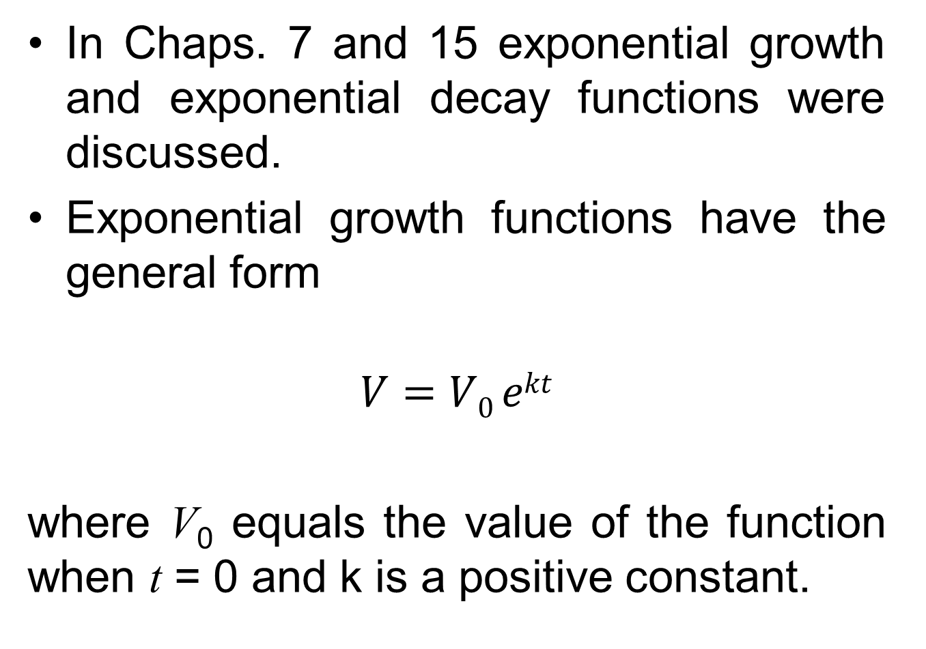
In Chaps. 7 and 15 exponential growth and exponential decay functions were discussed.
Exponential growth functions have the general form
$$V=V0 ekt$$
where V₀ equals the value of the function when t = 0 and k is a positive constant.

Slide 48
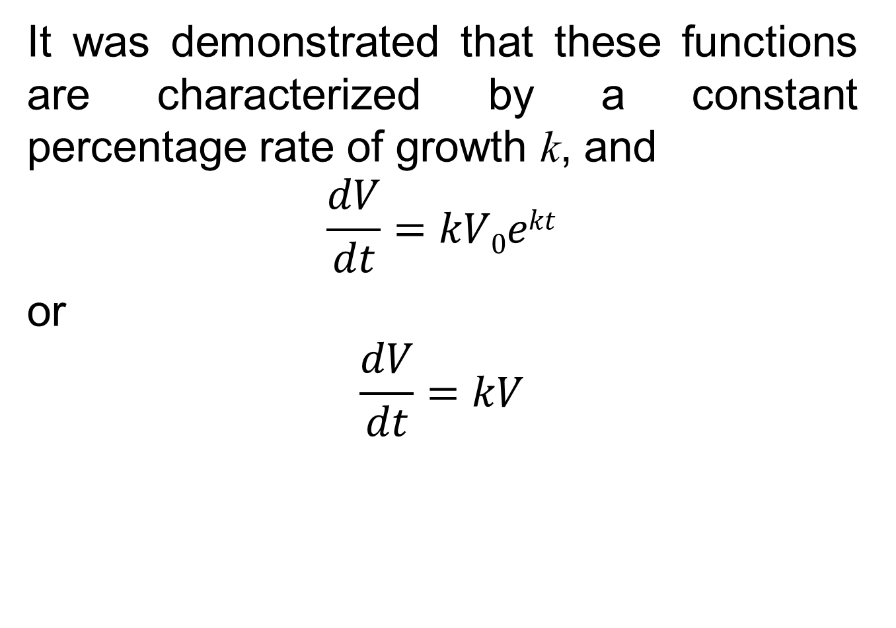
It was demonstrated that these functions are characterized by a constant percentage rate of growth k, and
$$\frac{dV}{dt}=kV0ekt$$
or
$$\frac{dV}{dt}=kV$$

Slide 49
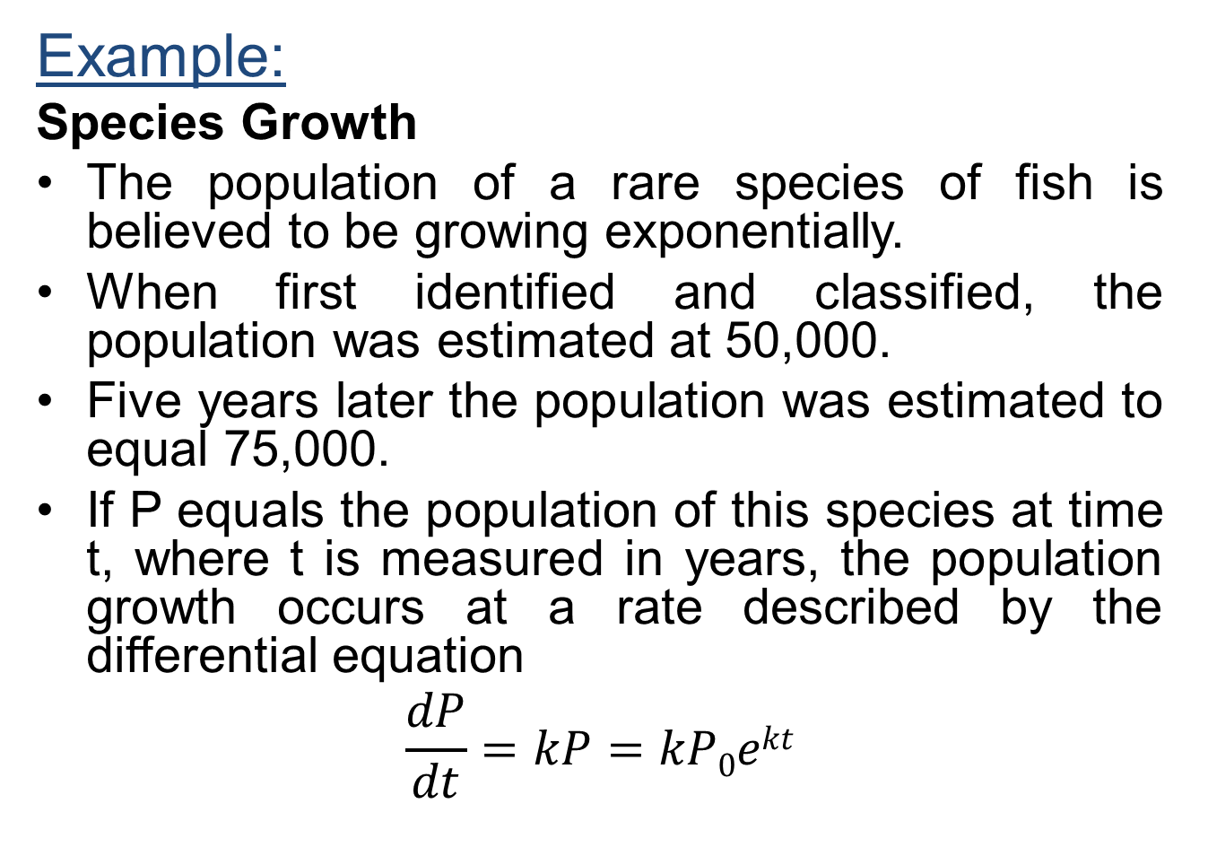
Example:
Species Growth
The population of a rare species of fish is believed to be growing exponentially.
When first identified and classified, the population was estimated at 50,000.
Five years later the population was estimated to equal 75,000.
If P equals the population of this species at time t, where t is measured in years, the population growth occurs at a rate described by the differential equation
$$\frac{dP}{dt}=kP=kP0ekt$$

Slide 50
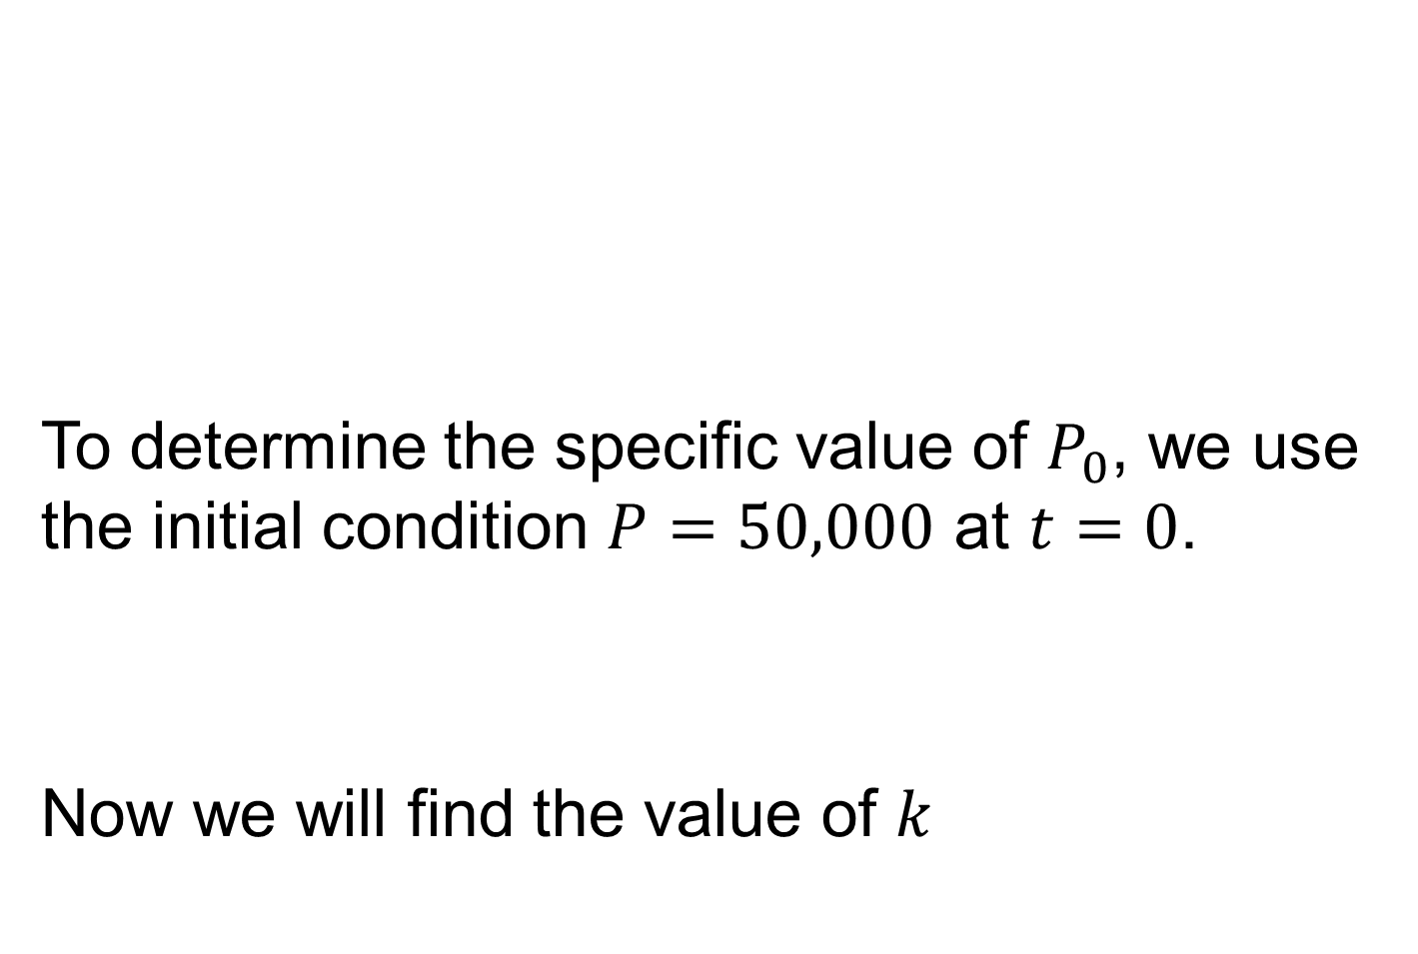
To determine the specific value of $P_{0}$, we use the initial condition $P=50,000$ at $t=0$.
Now we will find the value of $k$

Slide 51
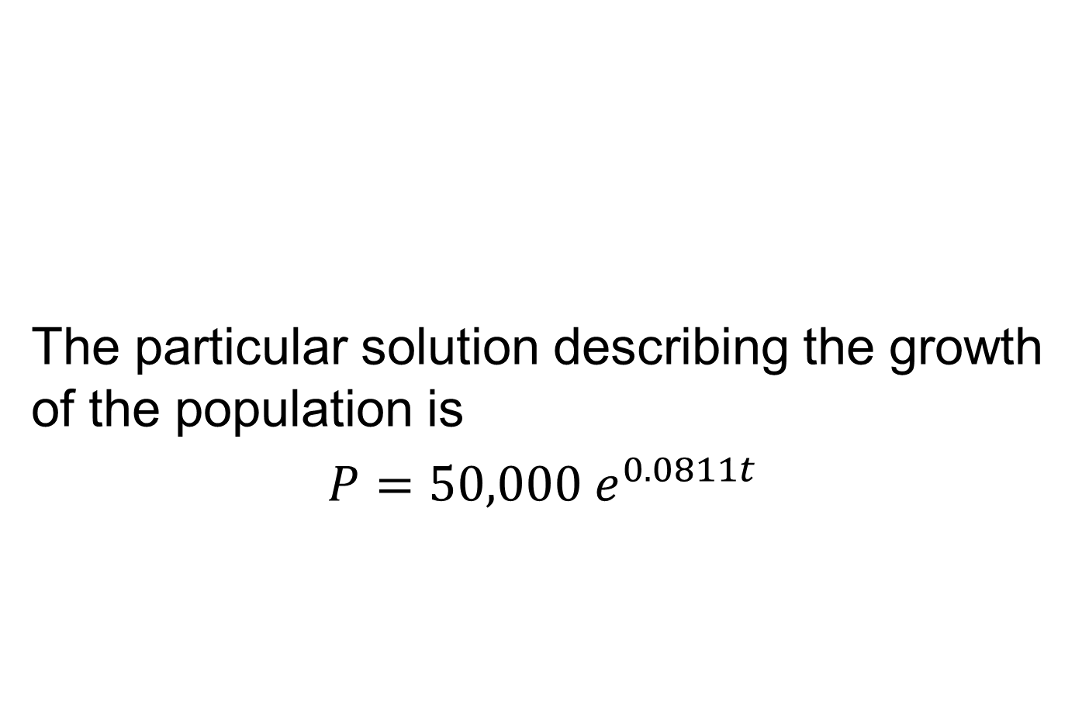
The particular solution describing the growth of the population is
$P=50,000 e^{0.0811t}$

Slide 52
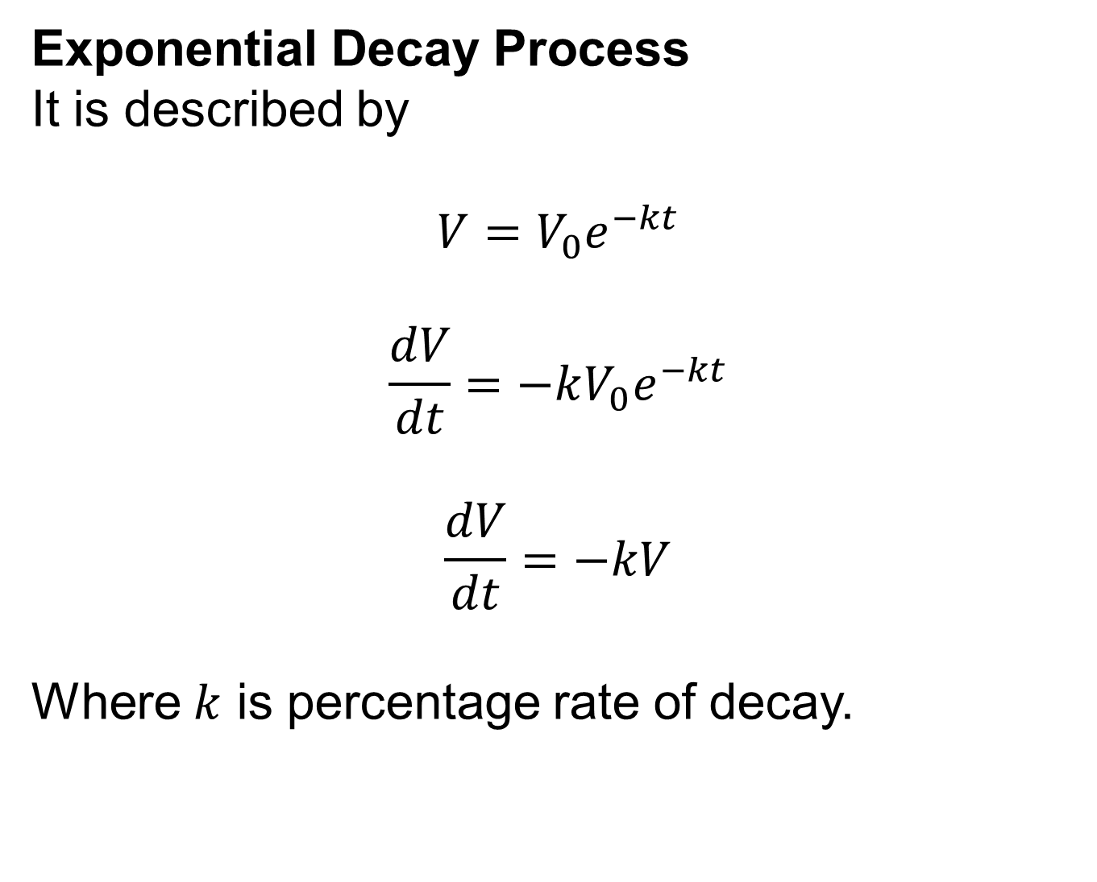
Exponential Decay Process
It is described by
$$V=V_{0}e^{−kt}$$
$$\frac{dV}{dt}=−kV_{0}e^{−kt}$$
$$\frac{dV}{dt}=−kV$$
Where $k$ is percentage rate of decay.

Slide 53
Review
Anti-derivatives
Rules of Integration
Additional Rules of Integration
Differential Equations
Next time, Applications of Integral Calculus

Slide 54
Next Lecture
Applications of Integral Calculus
Definite Integrals
Properties of Definite Integrals
Finding Area Using Definite Integrals
Finding Area Between Curves

