Slide 1
Business Mathematics
MTH-367
Lecture 25

Slide 2
Chapter 16
Optimization Methodology
continued

Slide 3
Last Lecture’s Summary
We covered Sec 16.2:
Identification of Maxima and Minima
Relative Extrema (maxima and minima)
Absolute Maxima and Minima
First derivative test
Second derivative test

Slide 4
Today’s Topics
We will cover sections 16.3 and 16.4:
Curve Sketching
Restricted Domain Considerations
Procedure for Identifying Absolute Maxima and Minima

Slide 5
Curve Sketching
Sketching functions is facilitated with the information we have acquired in this chapter.
One can get a feeling for the general shape of the graph of a function without determining and plotting a large number of ordered pairs.

Slide 6
Key Date Points
In determining the general shapes of the graph of a function, the following attributes are the most significant.
Relative maxima and minima.
Inflection points.
x and y intercepts.
Ultimate direction

Slide 7
Example
Consider the function,

Slide 8
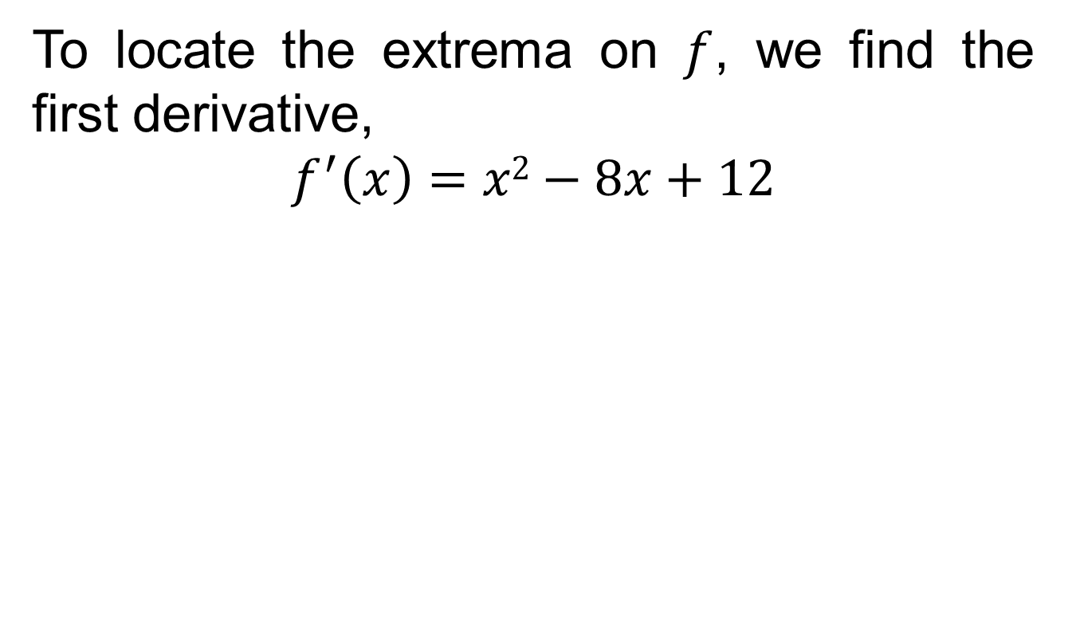
1- Relative Maxima and Minima
To locate the extrema on $f$, we find the first derivative,
$$f^{′}\left(x\right)=x2−8x+12$$

Slide 11
2- Inflection Points

Slide 12
Note: There must exist an inflection point between relative maximum at (2, 47/3) and the relative minimum at (6,5), for a continuous function, the concavity of the function must change between adjacent critical points.

Slide 13
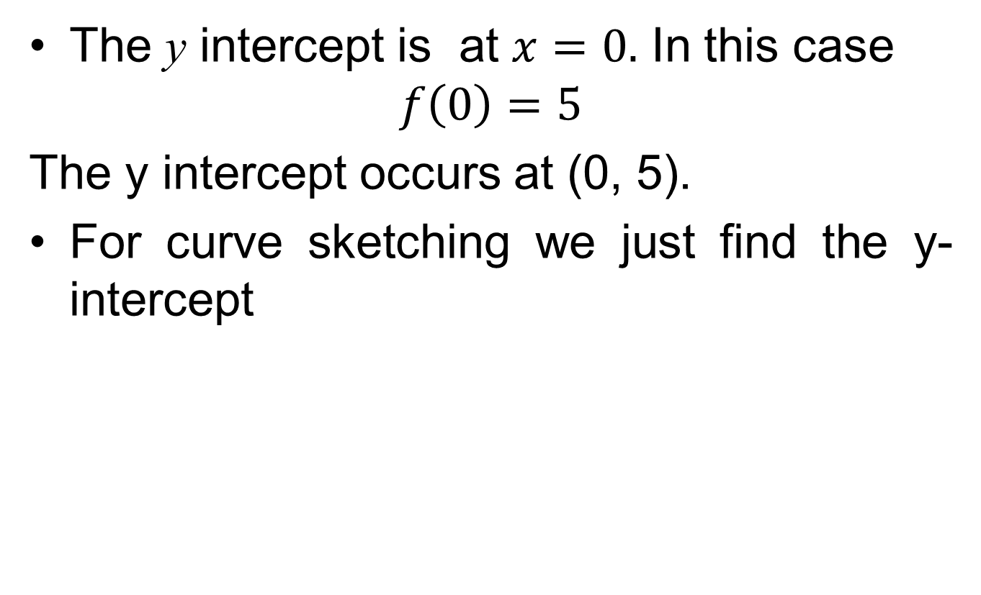
3- Intercepts
The y intercept is at $x=0.$ In this case
$$f\left(0\right)=5$$
The y intercept occurs at (0, 5).
For curve sketching we just find the y-intercept

Slide 14
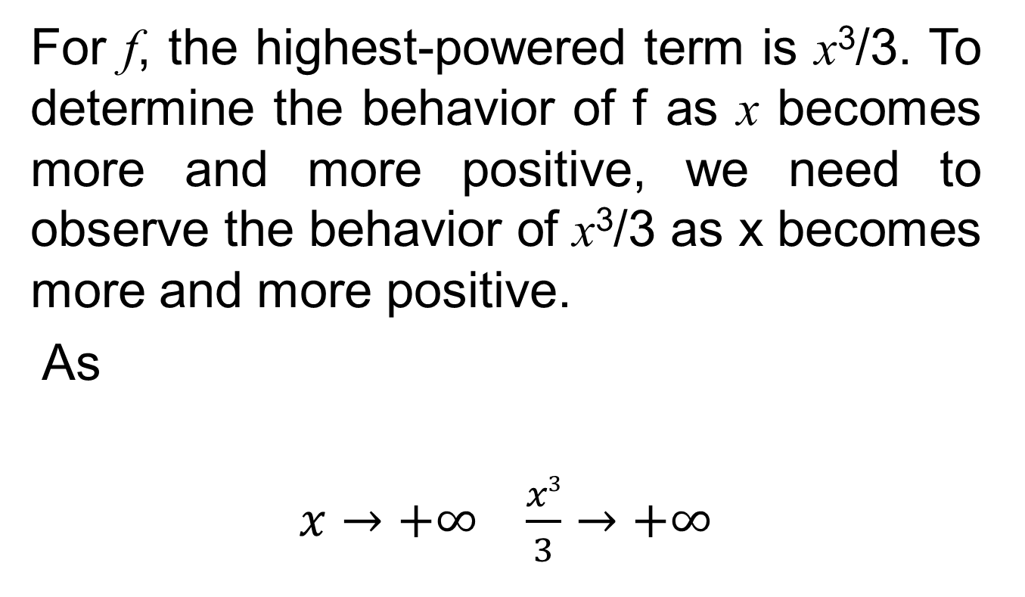
4- Ultimate Direction
For f, the highest-powered term is x³/3. To determine the behavior of f as x becomes more and more positive, we need to observe the behavior of x³/3 as x becomes more and more positive.
As
$x→+∞$ $\frac{x3}{3}→+∞$

Slide 18
Note: If x is an inflection point for f then the second derivative, f″(x), is equal to zero if it exists, but this condition does not provide a sufficient definition of a point of inflection. One also needs the lowest-order (above the second) non-zero derivative to be of odd order (third, fifth, etc.).

Slide 19
Restricted-domain Considerations
In this section we will examine procedures for identifying absolute maxima and minima when the domain of a function is restricted.

Slide 20
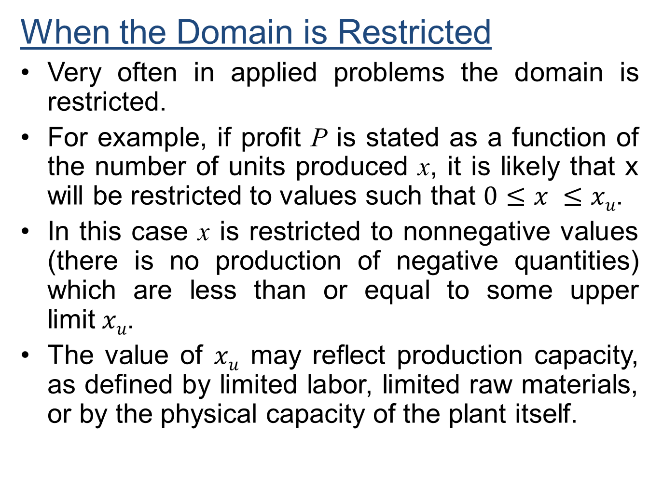
When the Domain is Restricted
Very often in applied problems the domain is restricted.
For example, if profit P is stated as a function of the number of units produced x, it is likely that x will be restricted to values such that $0≤x ≤xu$.
In this case x is restricted to nonnegative values (there is no production of negative quantities) which are less than or equal to some upper limit$xu$.
The value of $xu$ may reflect production capacity, as defined by limited labor, limited raw materials, or by the physical capacity of the plant itself.

Slide 21
In searching for the absolute maximum or absolute minimum of a function, consideration must be given not only to the relative maxima and minima of the function but also to the endpoints of the domain of the function.

Slide 22
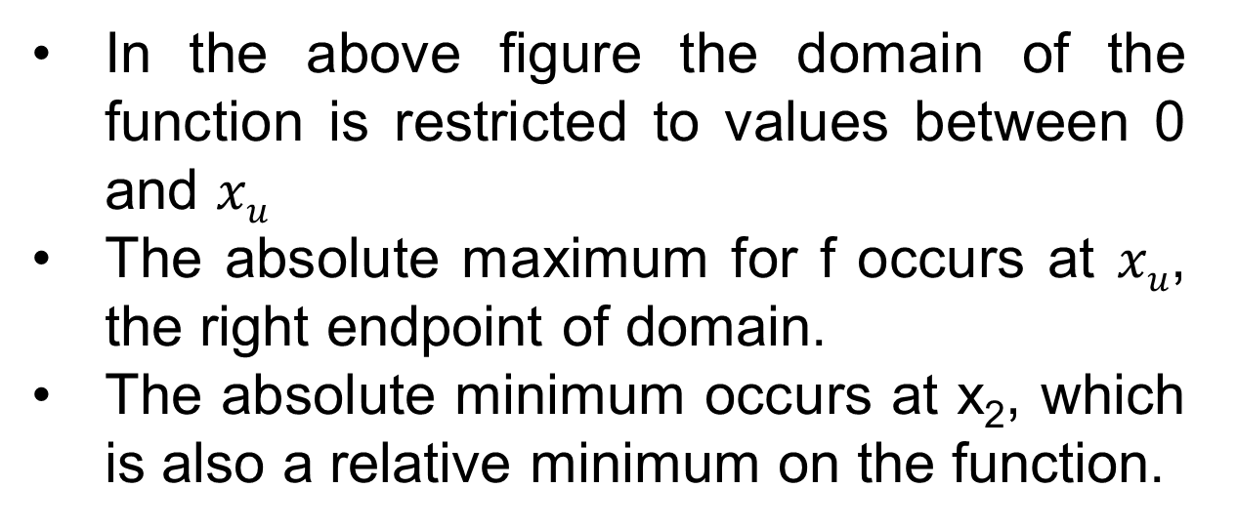
In the above figure the domain of the function is restricted to values between 0 and $xu$
The absolute maximum for f occurs at $xu$, the right endpoint of domain.
The absolute minimum occurs at x₂, which is also a relative minimum on the function.

Slide 23
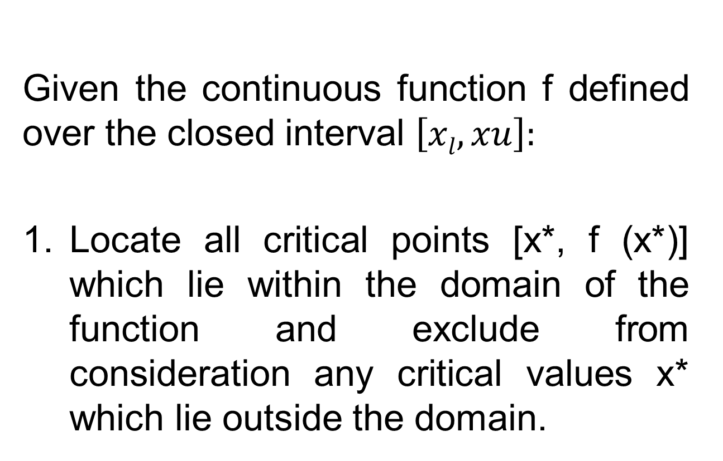
Procedure for Identifying Absolute Maximum and Minimum Points
Given the continuous function f defined over the closed interval $\left[xl, xu\right]:$
Locate all critical points [x*, f (x*)] which lie within the domain of the function and exclude from consideration any critical values x* which lie outside the domain.

Slide 24
Compute the values of f(x) at the two endpoints of the domain [f(x₁) and f(x_{u}).
Compare the values of f(x*) for all relevant critical points with (x₁) and (x_{u}). The absolute maximum in the largest of these values. The absolute minimum is the smallest of these values.

Slide 25
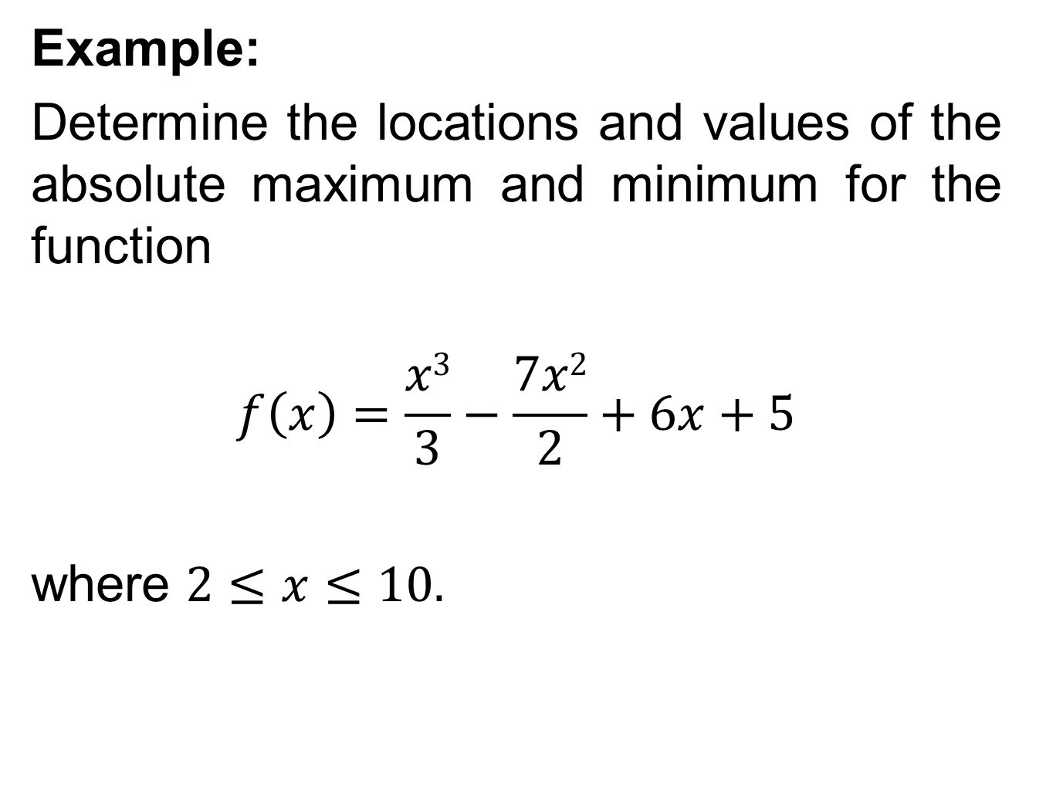
Example:
Determine the locations and values of the absolute maximum and minimum for the function
$$f\left(x\right)=\frac{x3}{3}−\frac{7x2}{2}+6x+5$$
where $2≤x≤10.$

Slide 26
Solution:
Step 1:

Slide 27
Step 2 The values of f (x) at the endpoints of the domain are

Slide 28
Step3 Comparing f (2), f (6), and f (10), we find the absolute minimum of -13 occurs when x = 6 and the absolute maximum of 48¹/₃ occurs when x = 10..

Slide 29
Review
Covered sections 16.3 and 16.4:
Curve Sketching
Restricted Domain Considerations
Procedure for Identifying Absolute Maxima and Minima

Slide 30
Next Lecture
We will start chapter 17 and go over Sec 17.1:
Optimization: Applications
Revenue Applications
Cost Applications
Profit Applications
Marginal Approach to Profit Maximization

