Slide 1
Business Mathematics
MTH-367
Lecture 24

Slide 2
Chapter 16
Optimization Methodology
continued

Slide 3
Last Lecture’s Summary
We covered Sec 16.1:
Derivatives: Additional Interpretations
Increasing Functions
Decreasing Functions
Concavity
Inflection Points

Slide 4
Today’s Topics
We will go over Sec 16.2:
Identification of Maxima and Minima
Relative Extrema (maxima and minima)
Absolute Maxima and Minima
First derivative test
Second derivative test

Slide 5
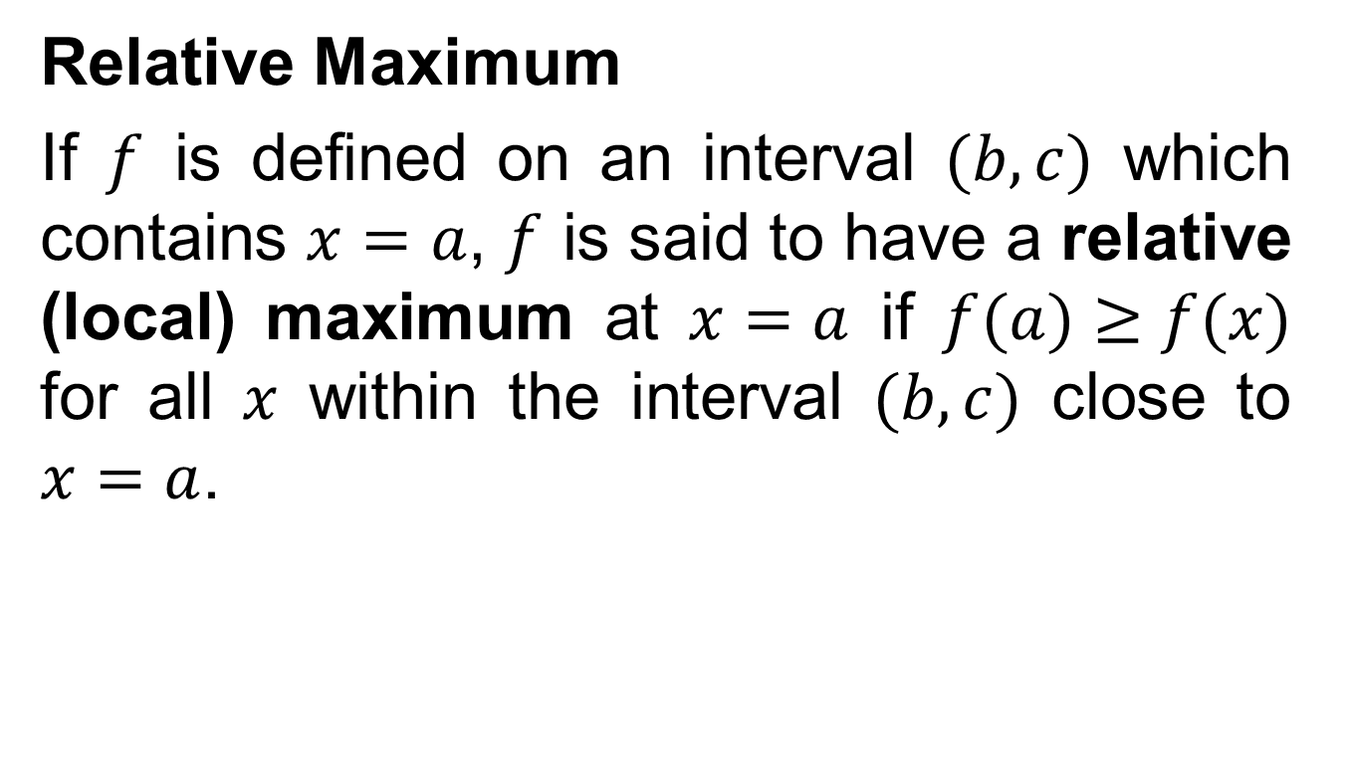
Relative Extrema
Relative Maximum
If $f$ is defined on an interval $(b,c)$ which contains $x=a$, $f$ is said to have a relative (local) maximum at $x=a$ if $f(a)≥f(x)$ for all $x$ within the interval $(b,c)$ close to $x=a$.

Slide 6
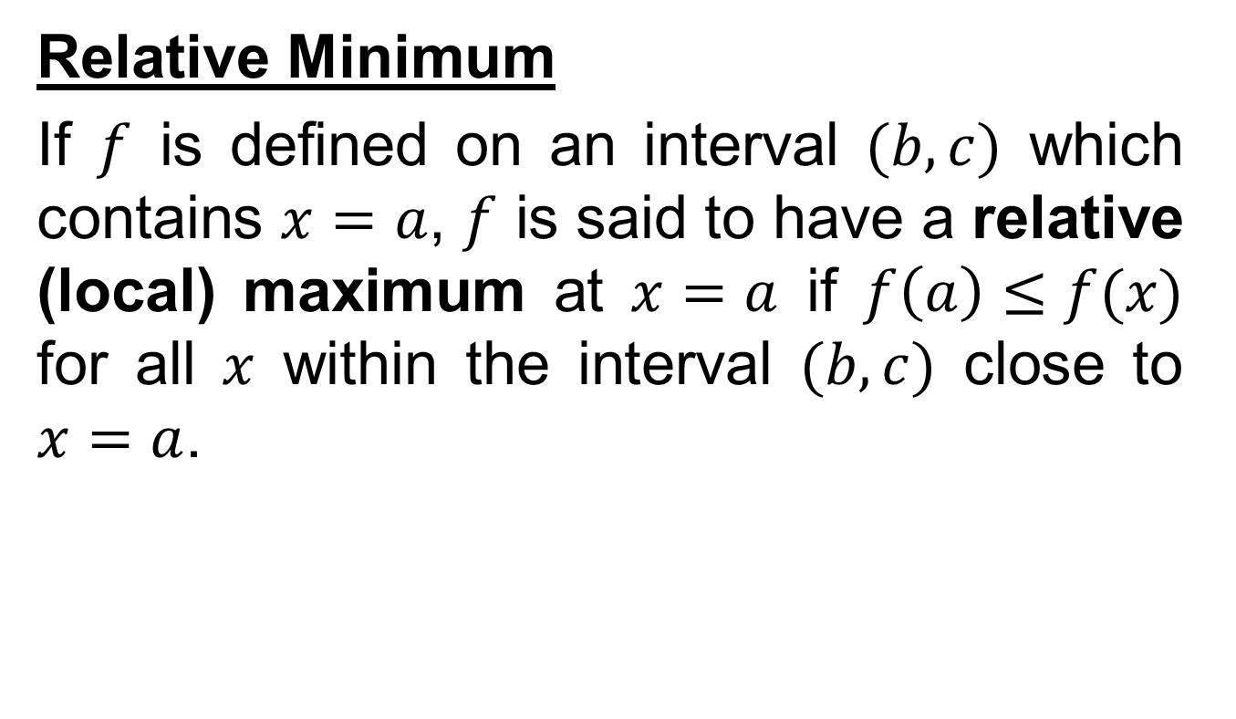
Relative Extrema cont’d
Relative Minimum
If $f$ is defined on an interval $(b,c)$ which contains $x=a$, $f$ is said to have a relative (local) maximum at $x=a$ if $f\left(a\right)≤f(x)$ for all $x$ within the interval $(b,c)$ close to $x=a$.

Slide 8
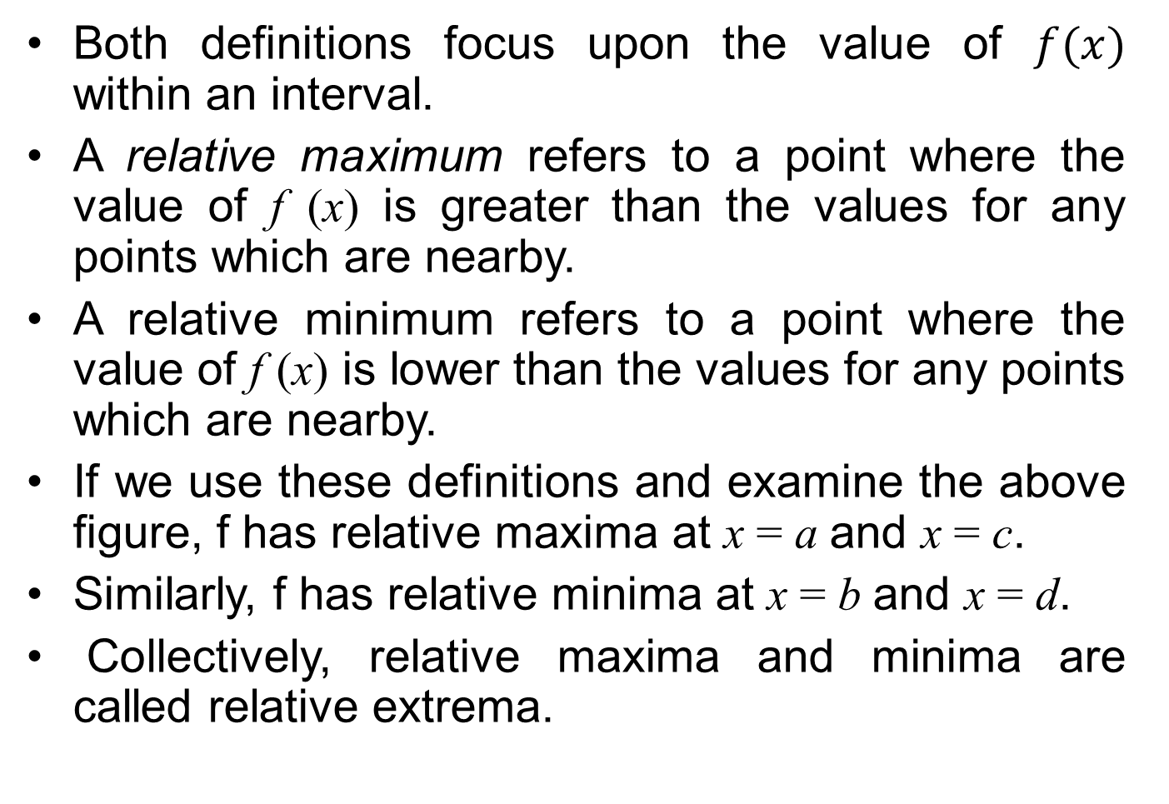
Both definitions focus upon the value of $f(x)$ within an interval.
A relative maximum refers to a point where the value of f (x) is greater than the values for any points which are nearby.
A relative minimum refers to a point where the value of f (x) is lower than the values for any points which are nearby.
If we use these definitions and examine the above figure, f has relative maxima at x = aand x = c.
Similarly, f has relative minima at x = band x = d.
Collectively, relative maxima and minima are called relative extrema.

Slide 9
Absolute Maximum
A function f is said to reach an absolute maximum at x = a if f (a) > f (x) for any other x in the domain of f.

Slide 10
Absolute Minimum
A function f is said to reach an absolute minimum at x = a if f (a) < f (x) for any other x in the domain of f.

Slide 11
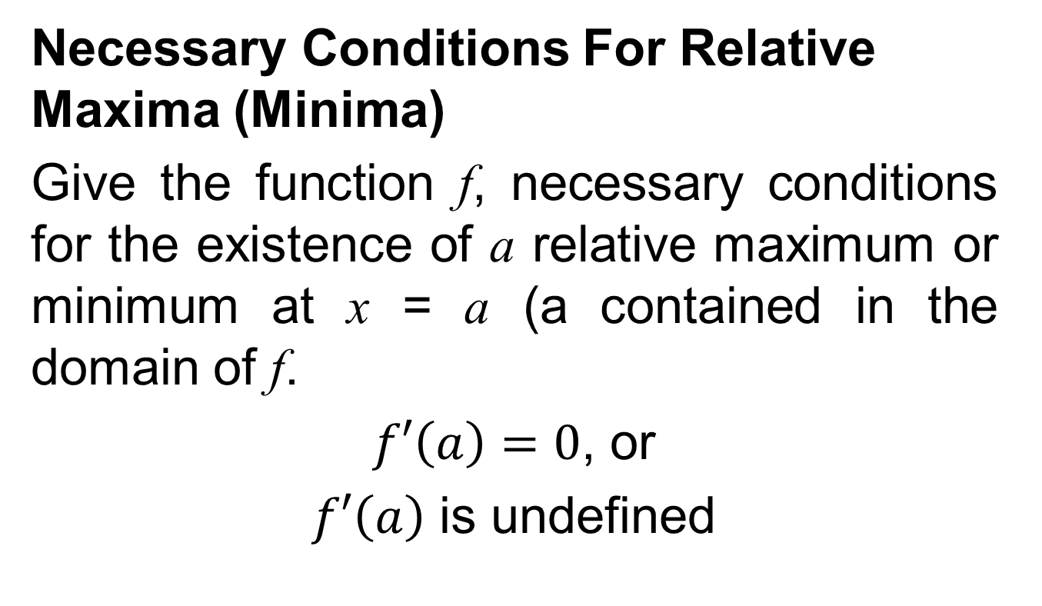
Critical Points
Necessary Conditions For Relative Maxima (Minima)
Give the function f, necessary conditions for the existence of a relative maximum or minimum at x = a (a contained in the domain of f.
$f′\left(a\right)=0$, or
$f′\left(a\right)$ is undefined

Slide 12
Points which satisfy either of the conditions in this definition are candidates for relative maxima (minima).
Such points are often referred to as critical points.
Any critical point where f’(x) =0 will be a relative maximum, a relative minimum, or an inflection point.

Slide 13
Example

Slide 14
The First Derivative Test
After the locations of critical points are identified, the first-derivative test requires an examination of slope conditions to the left and right of the critical point.

Slide 15
The First-Derivative Test
Locate all critical values x*.
For any critical value x*, determine the value of f’ (x) to the left (x_{l}) and right (x_{r}) of x*.
(a) If f’ (x_{l}) > 0 and f’ (x_{r}) < 0, there is a for f at [x*,f(x*)].
(b) If f’(x_{l}) < 0 and f’ (x_{r}) > 0, there is a
for f at [x*,f(x*)].
(c) If f’(x) has the same sign of both x_{l} and x_{r}, an inflection point exists at [x*,f (x*)].

Slide 16
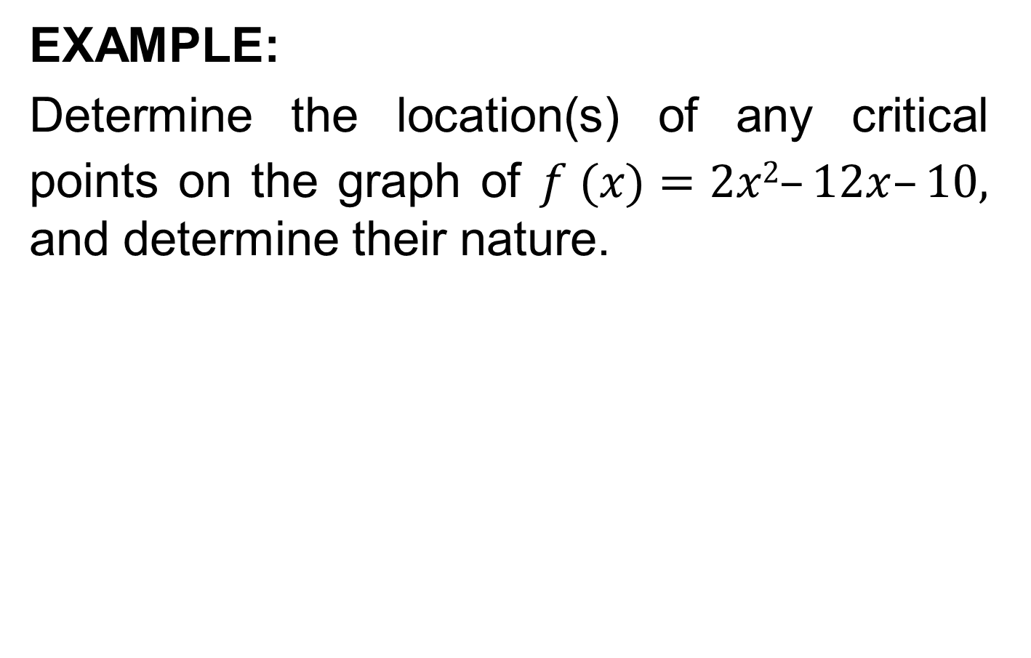
EXAMPLE:
Determine the location(s) of any critical points on the graph of $f (x)=2x2–12x–10,$ and determine their nature.

Slide 19
The Second Derivative Test
For critical points, where f’(x)=0, the most expedient test is the second-derivative test.

Slide 20
The Second-Derivative Test
Find all critical values x*, such that f’(x) = 0.
For any critical value x*, determine the value of f”(x*).
(a) If f”(x*) > 0, the function is concave up at x* and there is a relative minimum for f at [x*, f(x*)]
(b) If f”(x*) < 0, the function is concave down at x* and there is a relative maximum for f at [x*, f(x*)].
(c) If f”(x*) = 0, no conclusions can be drawn about the concavity at x* nor the nature of the critical point. Another test such as the first-derivative test is necessary.

Slide 21
EXAMPLE:
Examine the following function for any critical points and determine their nature.

Slide 24
When the Second-Derivative Test Fails
If f”(x*)=0, the second derivative does not allow for any conclusion about the behavior of f at x*. Consider the following example.
Example:
Examine the following function for any critical points and determine their nature.

Slide 27
Review
We covered Sec 16.2:
Identification of Maxima and Minima
Relative Extrema (maxima and minima)
Absolute Maxima and Minima
First derivative test
Second derivative test

Slide 28
Next Lecture
We will cover sections 16.3 and 16.4:
Curve Sketching
Restricted Domain Considerations
Procedure for Identifying Absolute Maxima and Minima

