Slide 1
Business Mathematics
MTH-367
Lecture 23

Slide 2
Chapter 16
Optimization Methodology

Slide 3
Last Lecture’s Summary
We covered sections 15.5, 15.6, 15.7 and 15.8:
Differentiation
Rules of Differentiation
Instantaneous rate of change interpretation
Higher order derivatives

Slide 4
Today’s Topics
We will start Chapter 16
Derivatives: Additional Interpretations
Increasing functions
Decreasing functions
Concavity
Inflection points

Slide 5
Chapters Objectives
Enhance understanding of the meaning of first and second derivatives.
Reinforce understanding of the nature of concavity.
Provide a methodology for determining optimization conditions for mathematical functions.
Illustrate a wide variety of applications of optimization procedures.

Slide 6
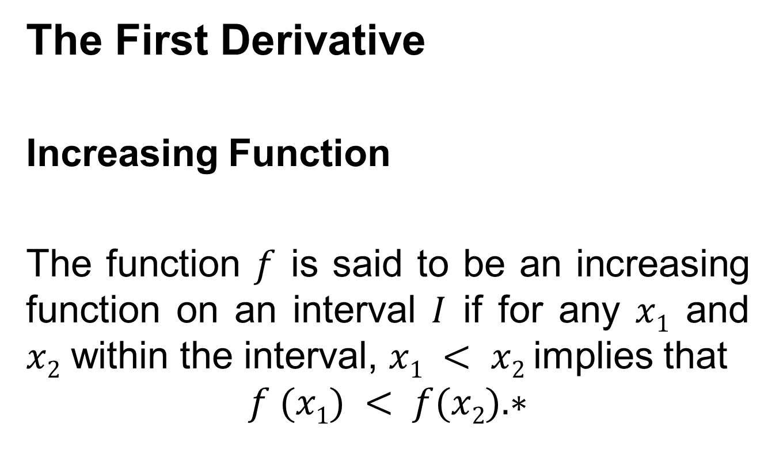
Derivatives: Additional Interpretations

Slide 7
Increasing functions can be identified by slope conditions.
If the first derivative of f is positive throughout an interval, then the slope is positive and f is an increasing function on the interval.
Which mean that at any point within the interval, a slight increase in the value of x will be accompanied by an increase in the value of f(x).

Slide 8
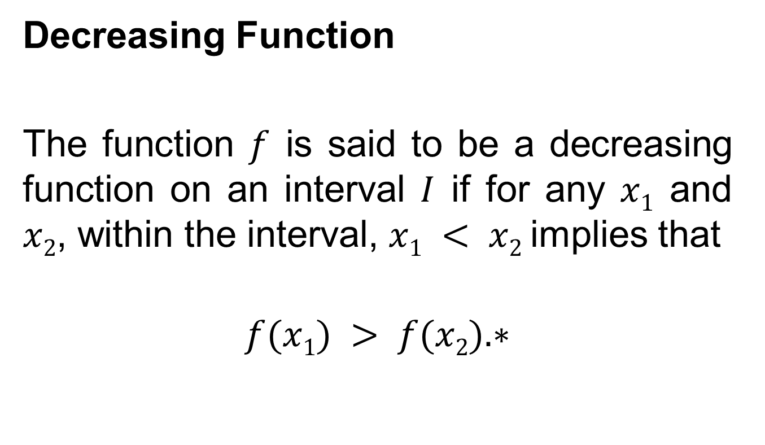
Decreasing Function
The function $f$ is said to be a decreasing function on an interval $I$ if for any $x1$ and $x2$, within the interval, $x1 < x2$implies that
$$f(x1) > f(x2).∗$$

Slide 9
As with increasing functions, decreasing functions can be identified by tangent slope conditions.
If the first derivative of f is negative throughout an interval, then the slope is negative and f is a decreasing function on the interval.
Which means that, at any point within the interval a slight increase in the value of x will be accompanied by a decrease in the value of f(x).

Slide 14
Note
If a function is increasing (decreasing) on an interval, the function is increasing (decreasing) at every point within the interval.

Slide 15
The Second Derivative
If f”(x) is negative on an interval I of f, the first derivative is decreasing on I.
Graphically, the slope is decreasing in value, on the interval.
If f”(x) is positive on an interval I of f, the first derivative is increasing on I.
Graphically, the slope is increasing in value, on the interval.

Slide 17
Concavity and Inflection Points
Concavity:
The graph of a function f is concave up (down) on an interval if f’ increases (decreases) on the entire interval.
Inflection Point:
A point at which the concavity changes is called an inflection point.

Slide 18
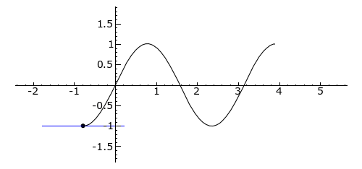
Graphics of Inflection Points
The graph of $f\left(x\right)=\sin{2x}$

Slide 19
Relationships Between The Second Derivative And Concavity
I- If f”(x) < 0 on an interval a ≤ x ≤ b, the graph of f is concave down over that interval. For any point x = c within the interval, f is said to be concave down at [c, f(c)].
II- If f”(x) > 0 on any interval a ≤ x ≤ b, the graph of f is concave up over that interval. For any point x = c within the interval, f is said to be concave up at [c, f(c)].

Slide 20
III- If f”(x) = 0 at any point x = c in the domain of f, no conclusion can be drawn about the concavity at [c, f(c)]

Slide 21
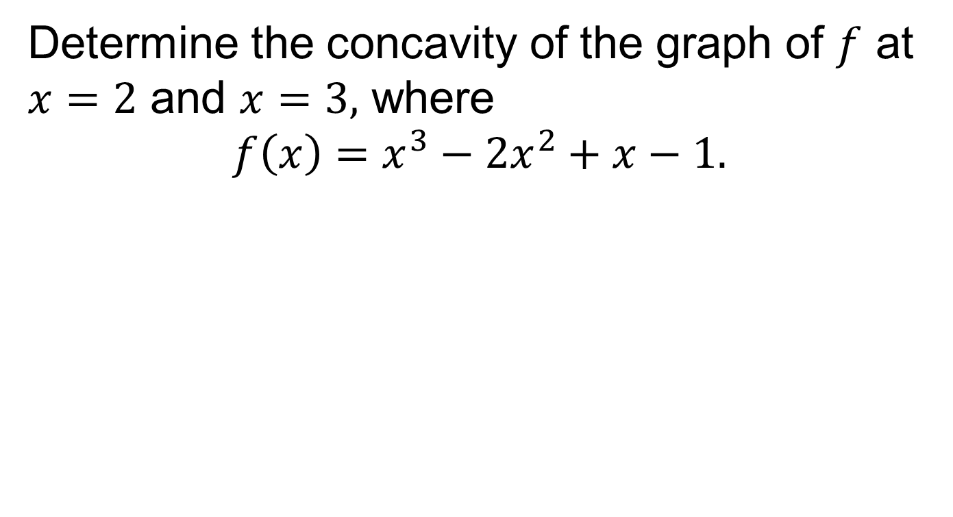
Example
Determine the concavity of the graph of $f$ at $x=2$ and $x=3,$ where
$$f\left(x\right)=x^{3}−2x^{2}+x−1.$$

Slide 23
Locating Inflection Points
I- Find all points a where f”(a) = 0.
II- If f”(x) change sign when passing through x = a, there is an inflection point at x = a.

Slide 26
Review
We started chapter 16.
Derivatives: Additional Interpretations
Increasing functions
Decreasing functions
Concavity
Inflection points

Slide 27
Next Lecture
Critical points: Maxima and Minima
The first derivative test
The second derivative test

