Slide 1
Business Mathematics
MTH-367
Lecture 22

Slide 2
Chapter 15
Differentiation

Slide 3
Last Lecture’s Summary
Covered Sec 15.1, 15.2, 15.3 and 15.4
Limits
Properties of Limits
Continuity
Average rate of change
The difference quotient
The derivative
Using and interpreting the derivative

Slide 4
Today’s Topics
We will cover the following topics starting from sections 15.5:
Differentiation
Rules of Differentiation
Instantaneous rate of change interpretation
Higher order derivatives

Slide 5
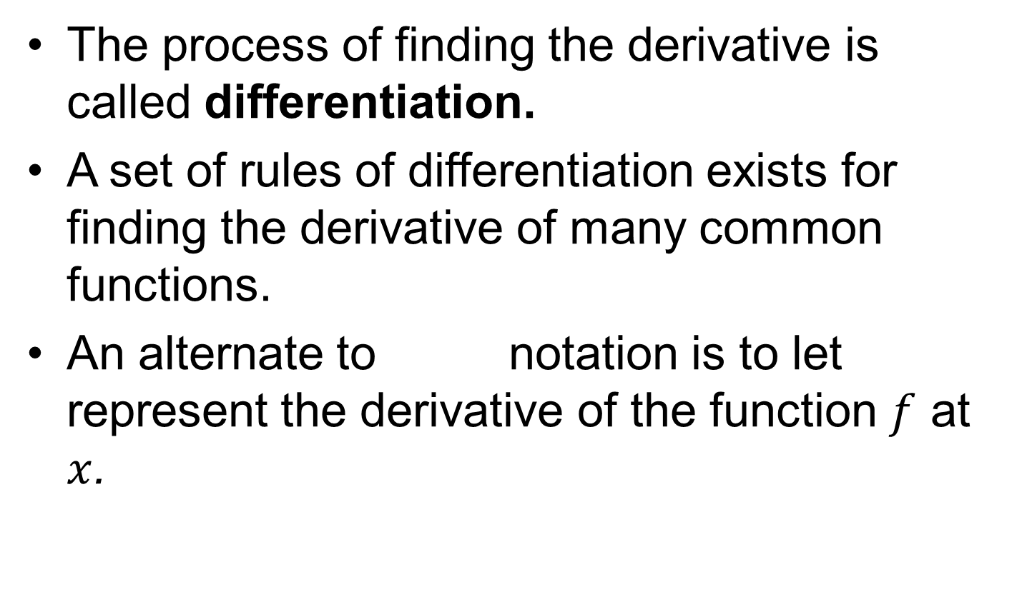
Differentiation
The process of finding the derivative is called differentiation.
A set of rules of differentiation exists for finding the derivative of many common functions.
An alternate to notation is to let represent the derivative of the function $f$at $x$.

Slide 6
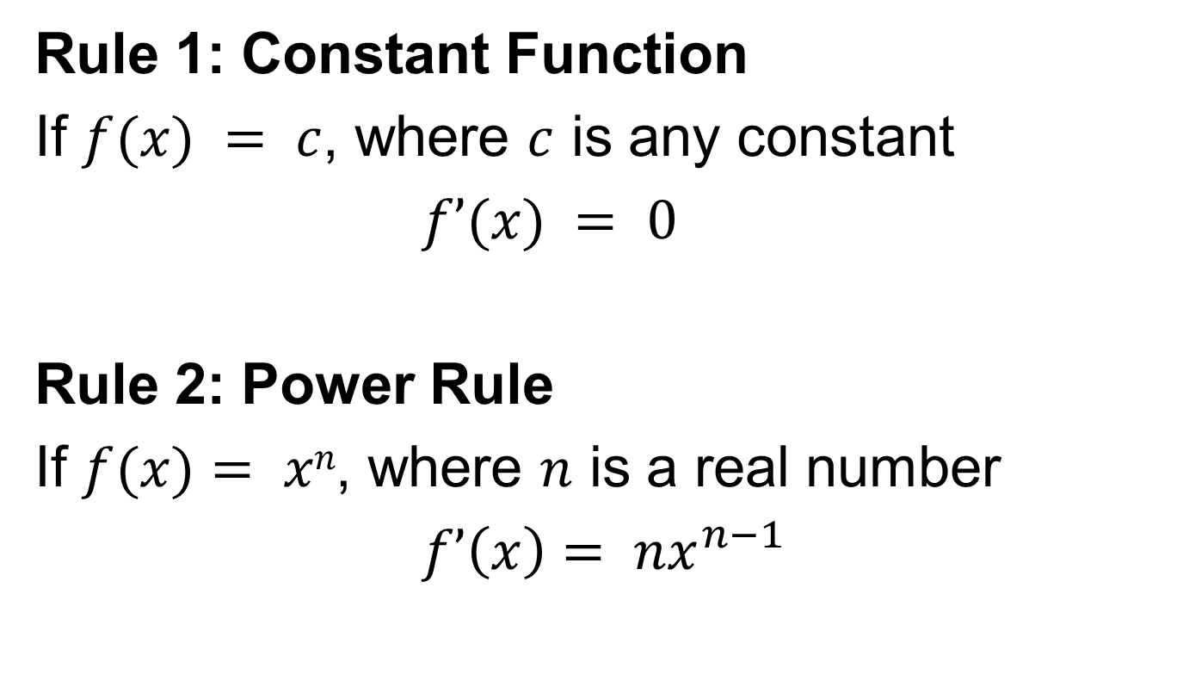
Rules of Differentiation
Rule 1: Constant Function
If $f(x) = c$, where $c$ is any constant
$f’(x) = 0$
Rule 2: Power Rule
If $f(x)= xn$, where $n$ is a real number
$f’\left(x\right)= nx^{n−1}$

Slide 7
Algebra Flashback

Slide 8
Algebra Flashback

Slide 9
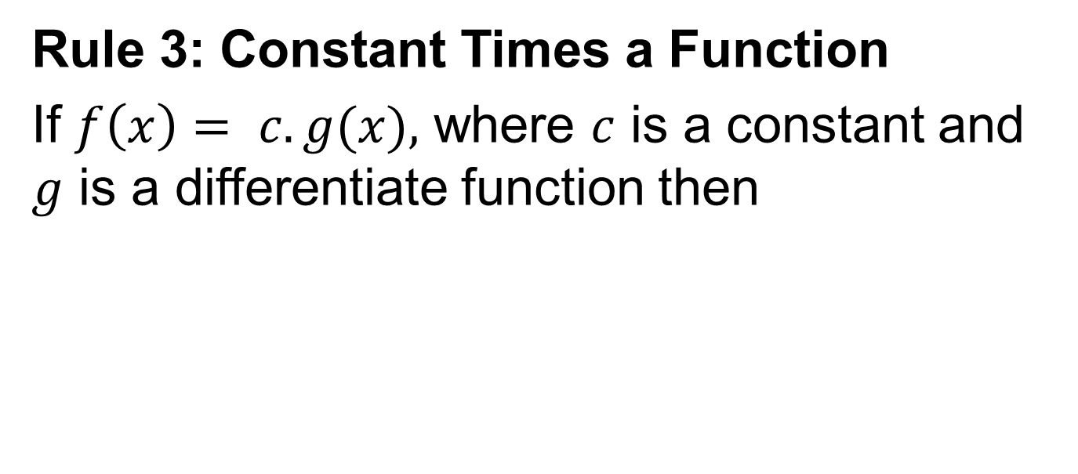
Rule 3: Constant Times a Function
If $f\left(x\right)= c. g(x),$ where $c$ is a constant and $g$ is a differentiate function then

Slide 10
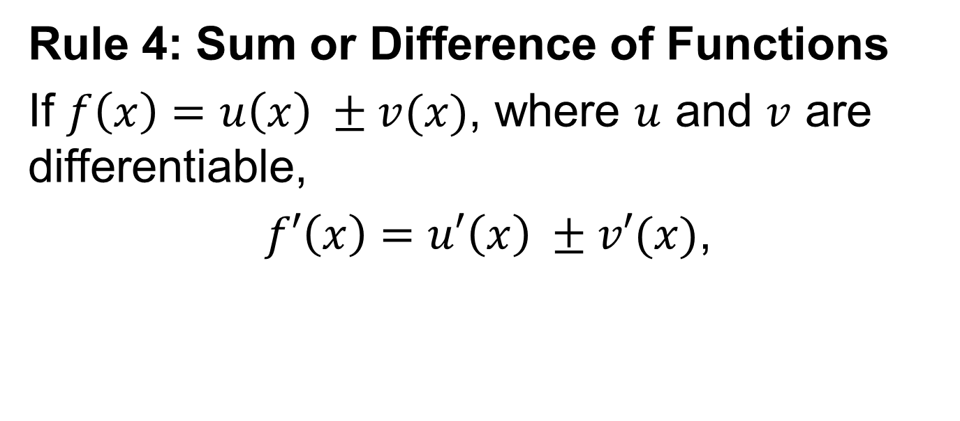
Rule 4: Sum or Difference of Functions
If $f\left(x\right)=u\left(x\right) ±v(x)$, where $u$ and $v$ are differentiable,
$f′\left(x\right)=u′\left(x\right) ±v′(x)$,

Slide 11
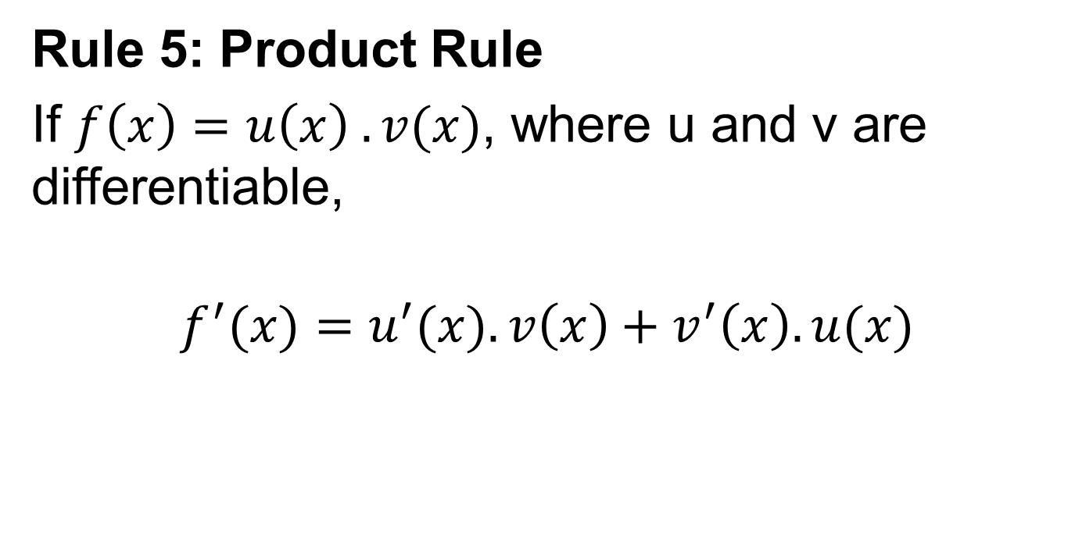
Rule 5: Product Rule
If $f\left(x\right)=u\left(x\right) .v(x)$, where u and v are differentiable,
$$f^{′}(x)=u^{′}(x).v\left(x\right)+v^{′}\left(x\right).u(x)$$

Slide 12
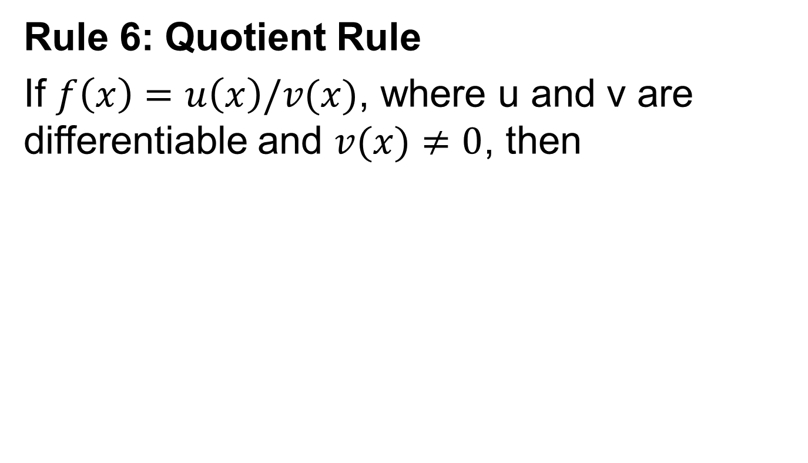
Rule 6: Quotient Rule
If $f\left(x\right)=u\left(x\right)/v(x)$, where u and v are differentiable and $v(x)≠0$, then

Slide 13
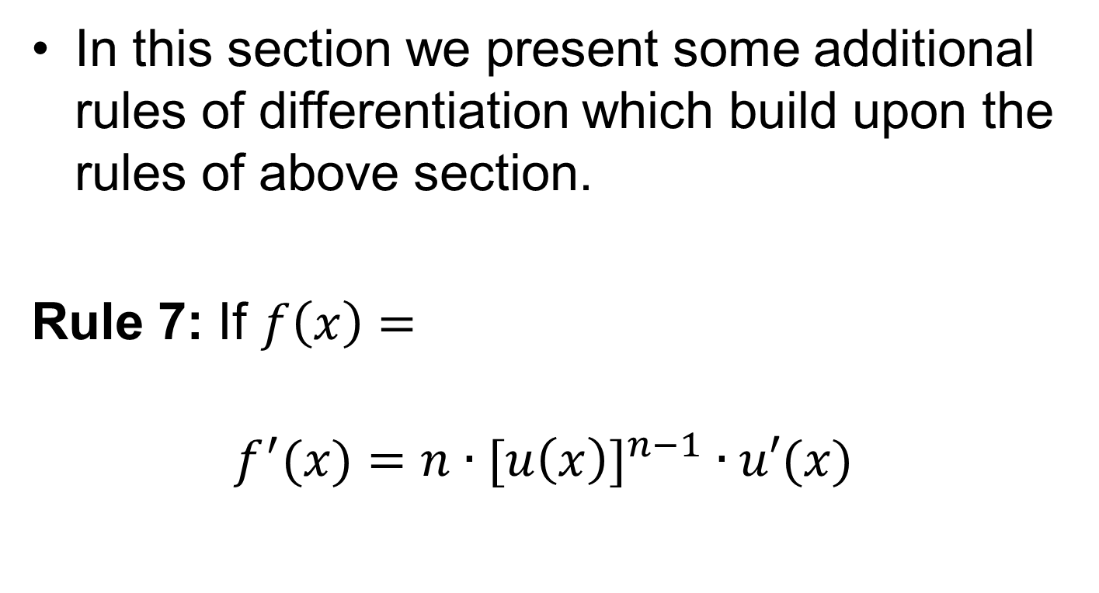
Additional Rules Of Differentiation
In this section we present some additional rules of differentiation which build upon the rules of above section.
Rule 7: If $f\left(x\right)=$
$$f^{′}(x)=n∙{[u\left(x\right)]}^{n−1} ∙u′(x)$$

Slide 15
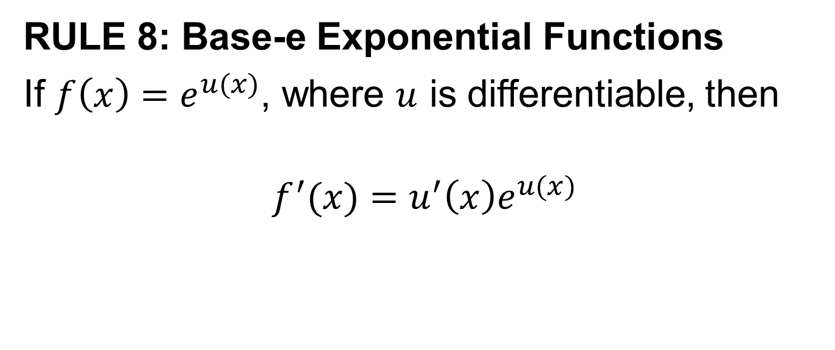
RULE 8: Base-e Exponential Functions
If $f\left(x\right)=e^{u(x)}$, where $u$ is differentiable, then
$$f^{′}(x)=u^{′}\left(x\right)e^{u(x)}$$

Slide 16
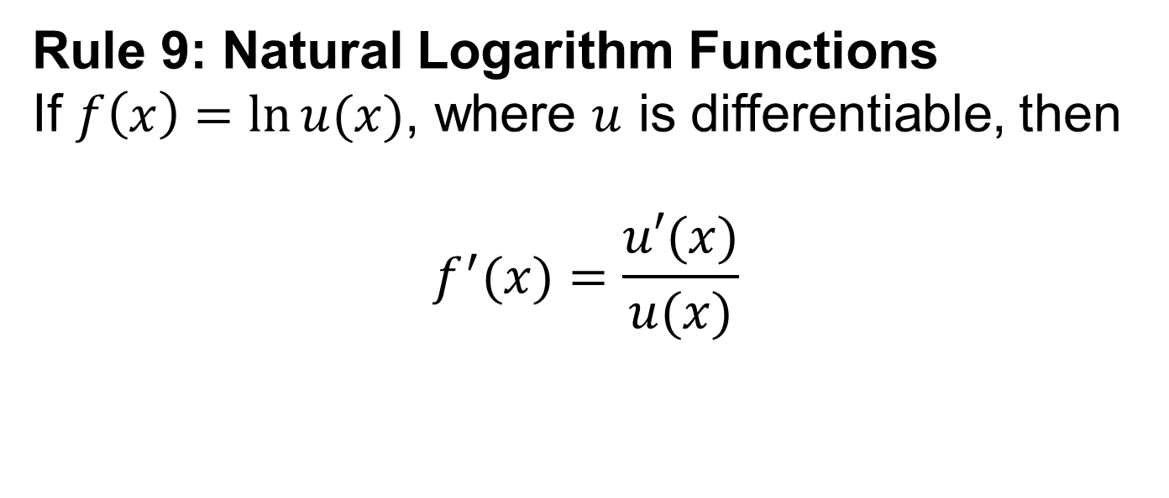
Rule 9: Natural Logarithm Functions
If $f\left(x\right)=\ln{u(x)}$, where $u$ is differentiable, then
$$f^{′}(x)=\frac{u′(x)}{u(x)}$$

Slide 17
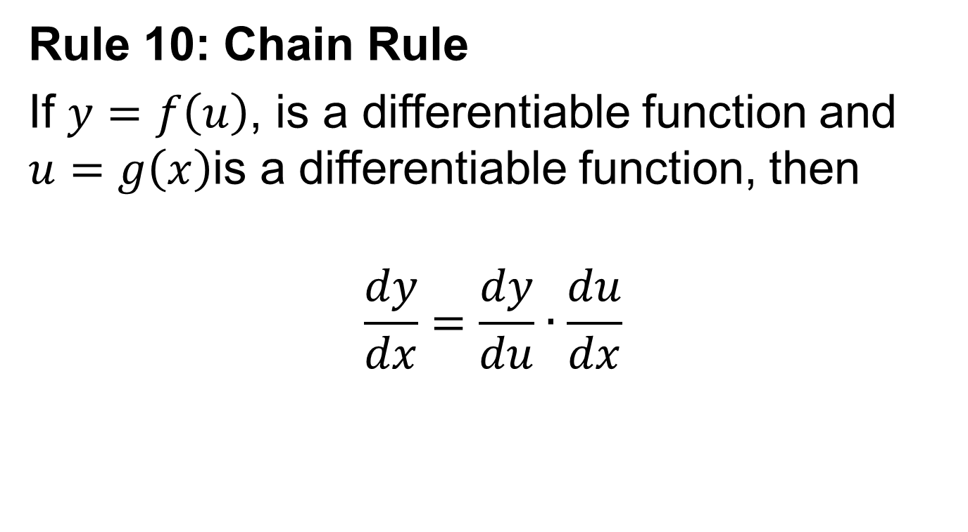
Rule 10: Chain Rule
If $y=f\left(u\right)$, is a differentiable function and $u=g\left(x\right)$is a differentiable function, then
$$\frac{dy}{dx}=\frac{dy}{du}∙\frac{du}{dx}$$

Slide 19
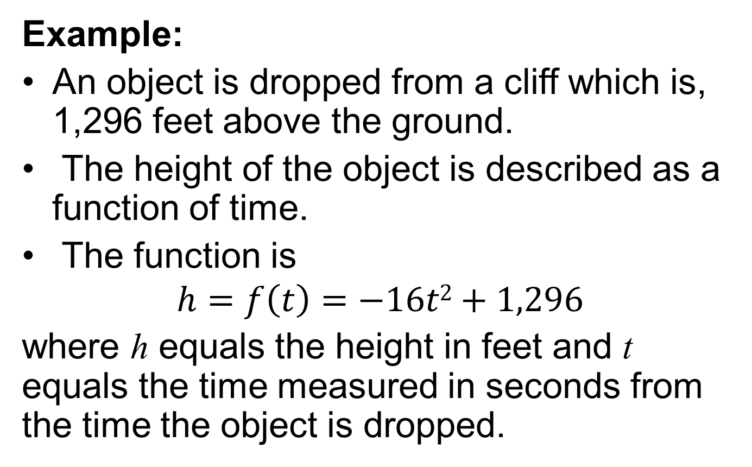
Instantaneous Rate of Change, Interpretation
Example:
An object is dropped from a cliff which is, 1,296 feet above the ground.
The height of the object is described as a function of time.
The function is
$$h=f\left(t\right)=−16t2+1,296$$
where hequals the height in feet and tequals the time measured in seconds from the time the object is dropped.

Slide 20
How far will the object drop in 2 seconds?
What is the instantaneous velocity of the object at t = 2?
What is the velocity of the object at the instant it hits the ground?

Slide 21
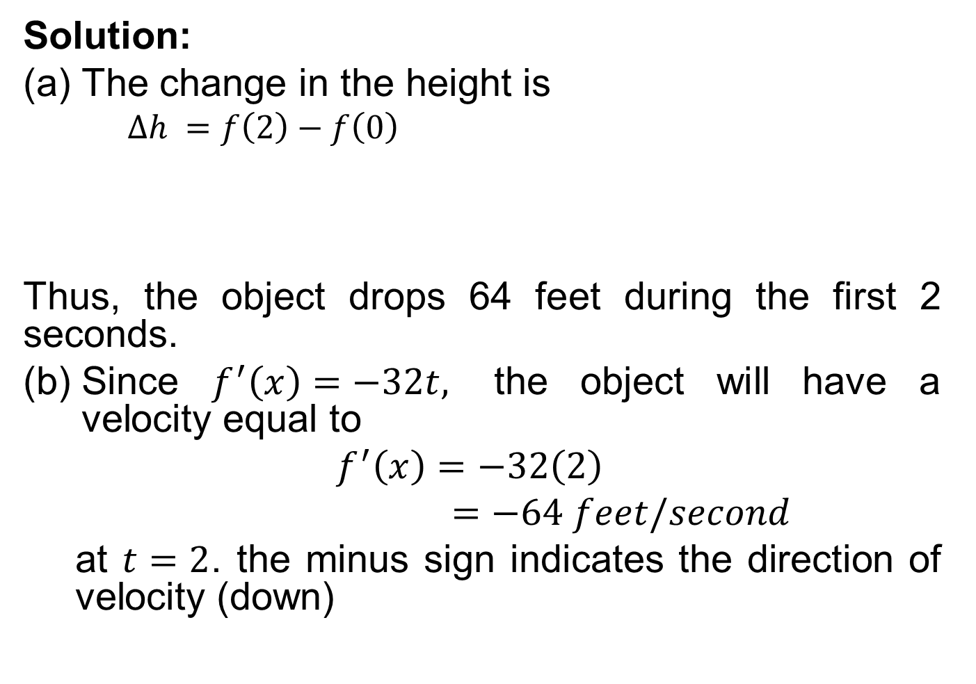
Solution:
The change in the height is
$∆h =f\left(2\right)−f\left(0\right)$
Thus, the object drops 64 feet during the first 2 seconds.
Since $f^{′}\left(x\right)=−32t,$ the object will have a velocity equal to
$f^{′}\left(x\right)=−32\left(2\right)$
$=−64 feet/second$
at $t=2$. the minus sign indicates the direction of velocity (down)

Slide 22
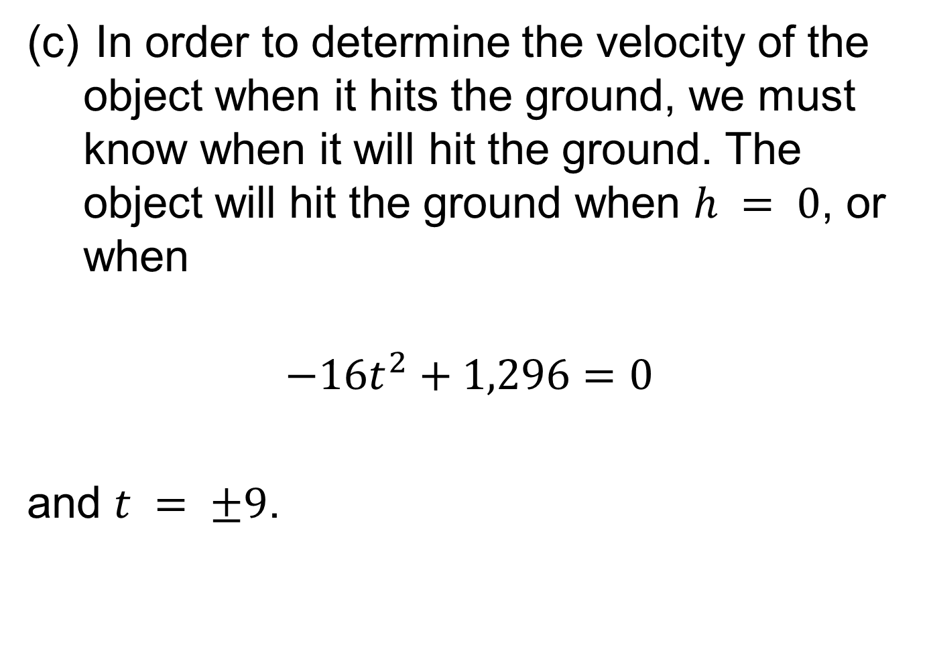
In order to determine the velocity of the object when it hits the ground, we must know when it will hit the ground. The object will hit the ground when $h = 0$, or when
$$−16t^{2}+1,296=0$$
and $t = ±9$.

Slide 23
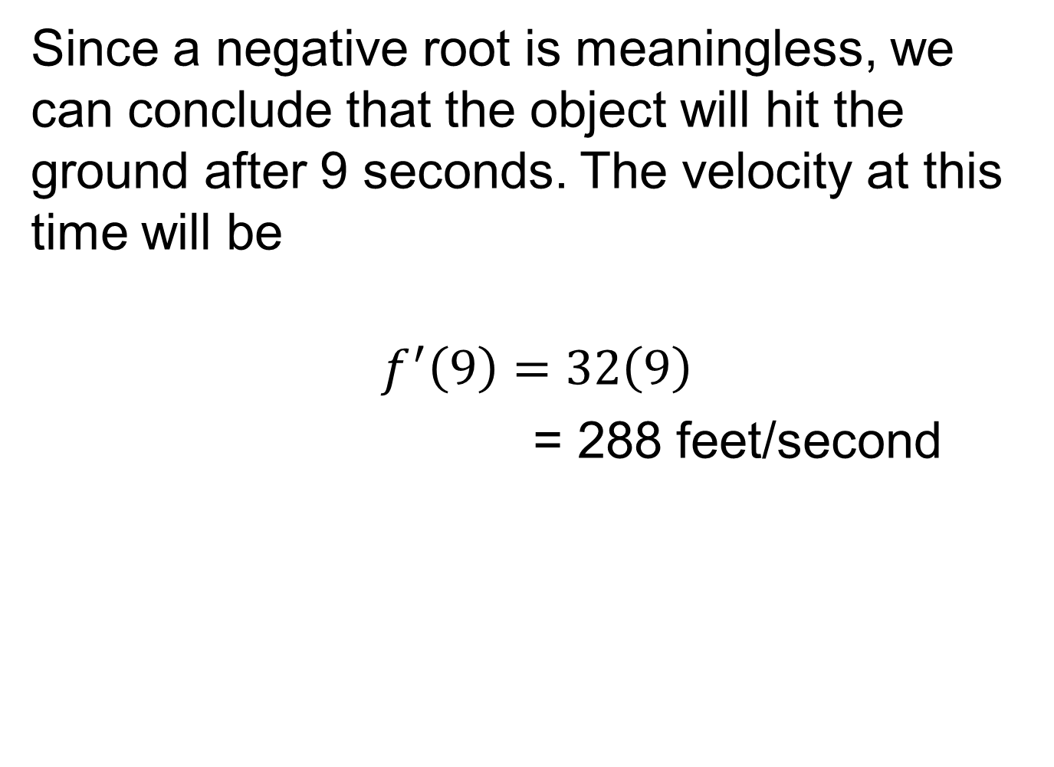
Since a negative root is meaningless, we can conclude that the object will hit the ground after 9 seconds. The velocity at this time will be
$$f^{′}\left(9\right)=32\left(9\right)$$
= 288 feet/second

Slide 24
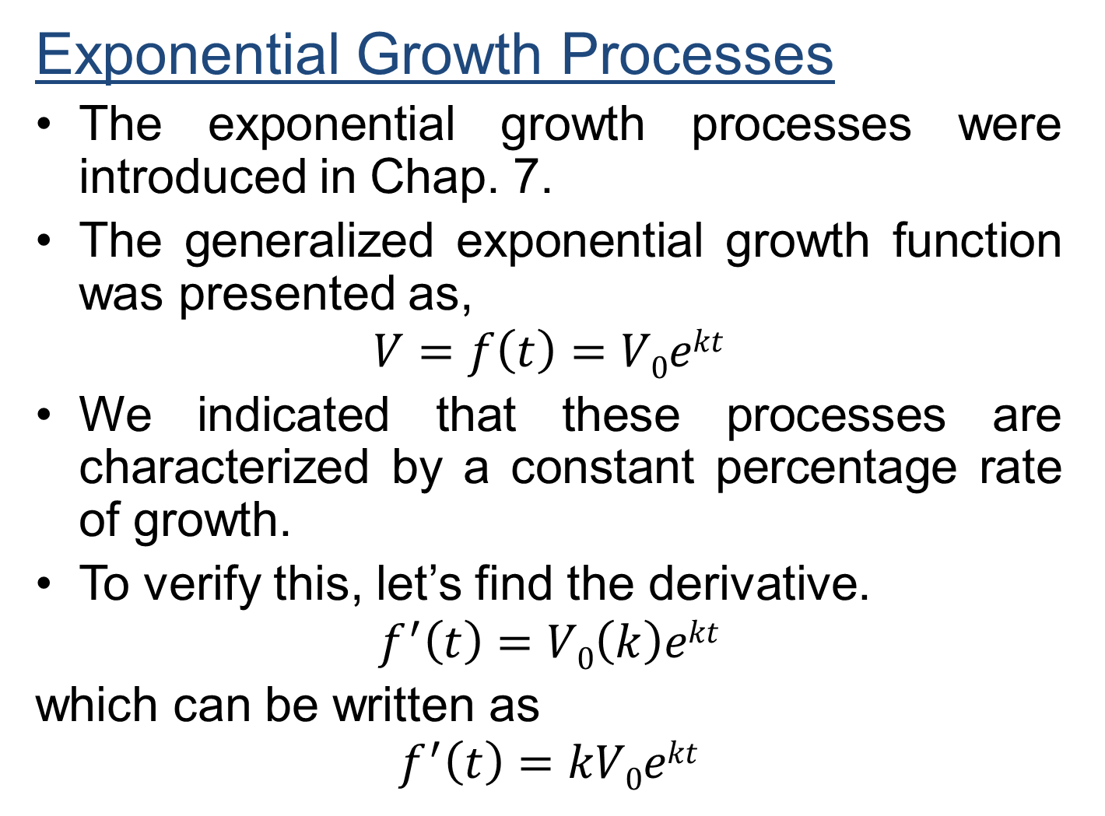
Exponential Growth Processes
The exponential growth processes were introduced in Chap. 7.
The generalized exponential growth function was presented as,
$$V=f\left(t\right)=V0ekt$$
We indicated that these processes are characterized by a constant percentage rate of growth.
To verify this, let’s find the derivative.
$$f^{′}\left(t\right)=V0\left(k\right)ekt$$
which can be written as
$$f^{′}\left(t\right)=kV0ekt$$

Slide 25
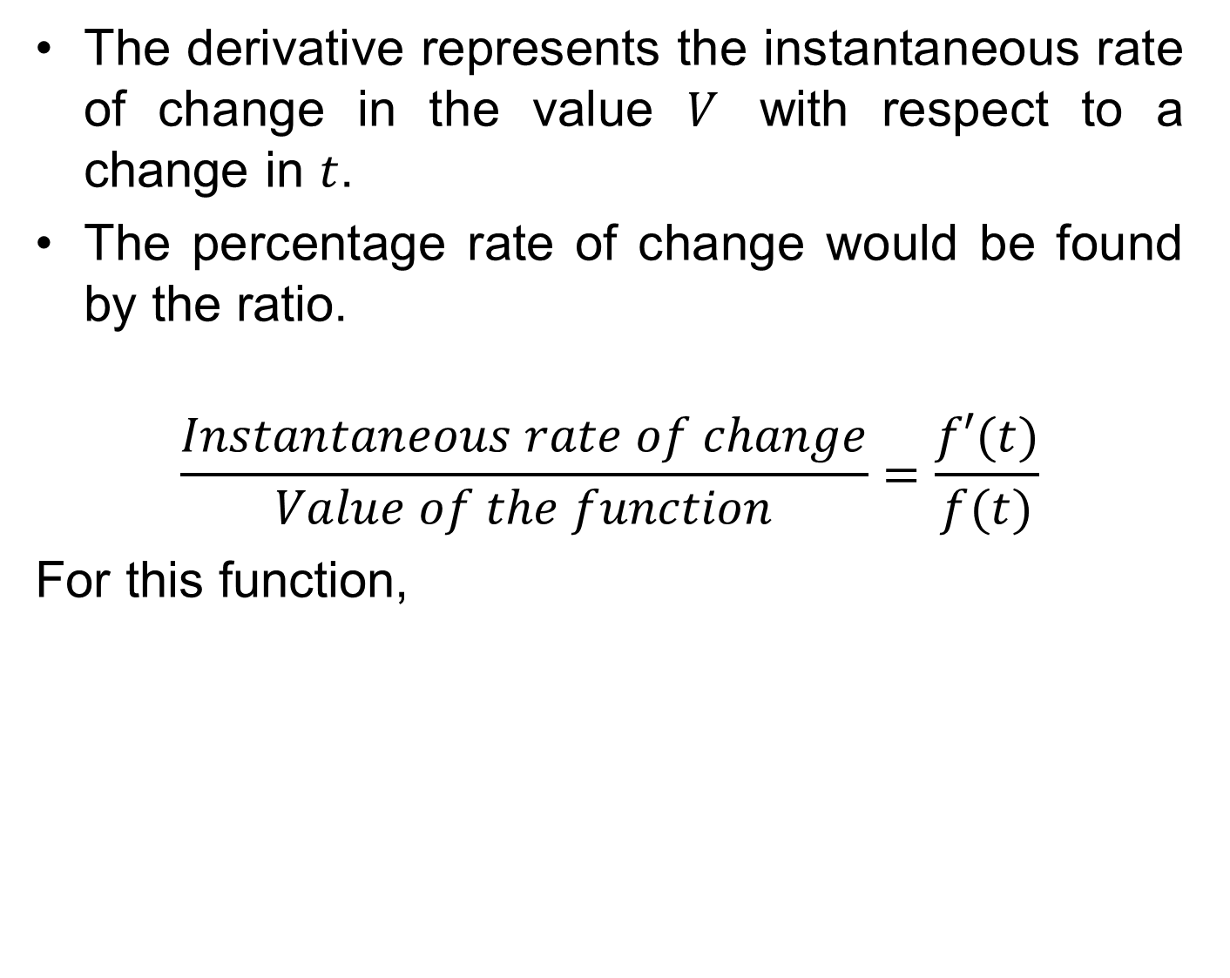
The derivative represents the instantaneous rate of change in the value $V$ with respect to a change in $t$.
The percentage rate of change would be found by the ratio.
$$\frac{Instantaneous rate of change}{Value of the function}=\frac{f′(t)}{f(t)}$$
For this function,

Slide 26
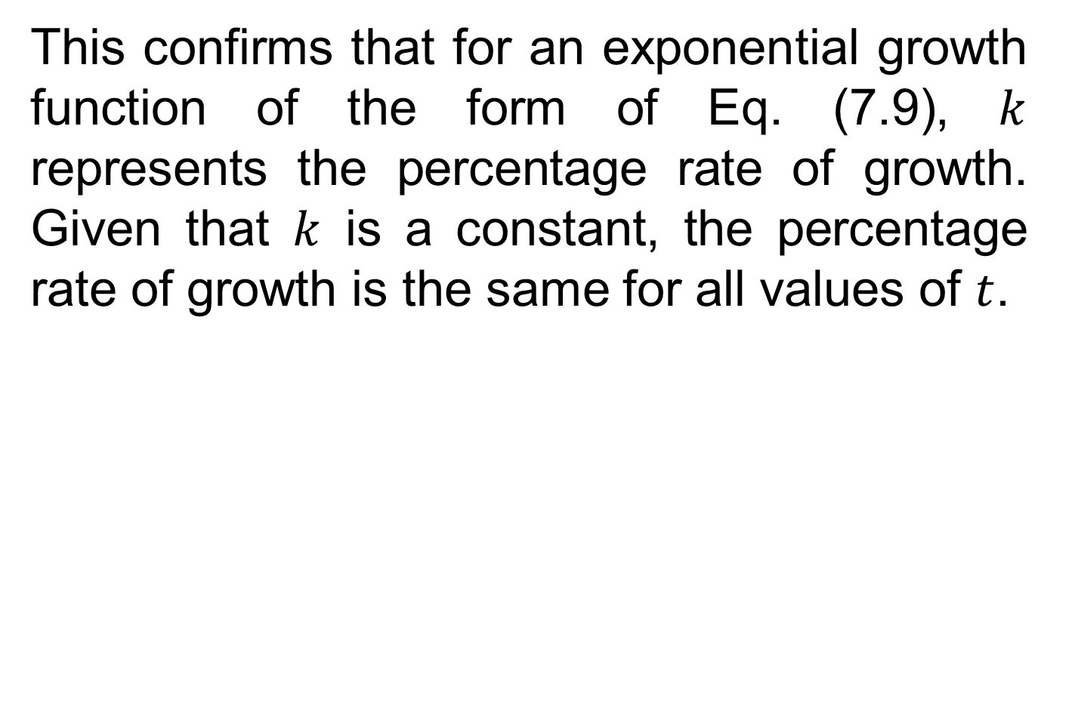
This confirms that for an exponential growth function of the form of Eq. (7.9), $k$ represents the percentage rate of growth. Given that $k$ is a constant, the percentage rate of growth is the same for all values of $t$.

Slide 27
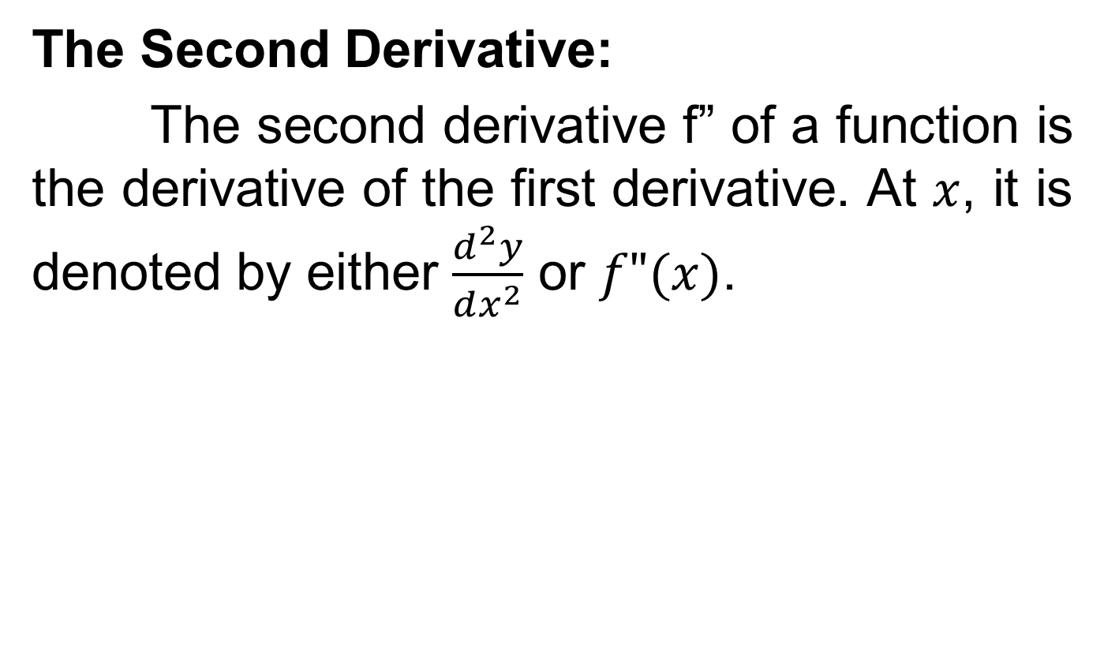
Higher-order Derivatives
The Second Derivative:
The second derivative f” of a function is the derivative of the first derivative. At $x$, it is denoted by either $\frac{d^{2}y}{dx^{2}}$ or $f"(x)$.

Slide 28
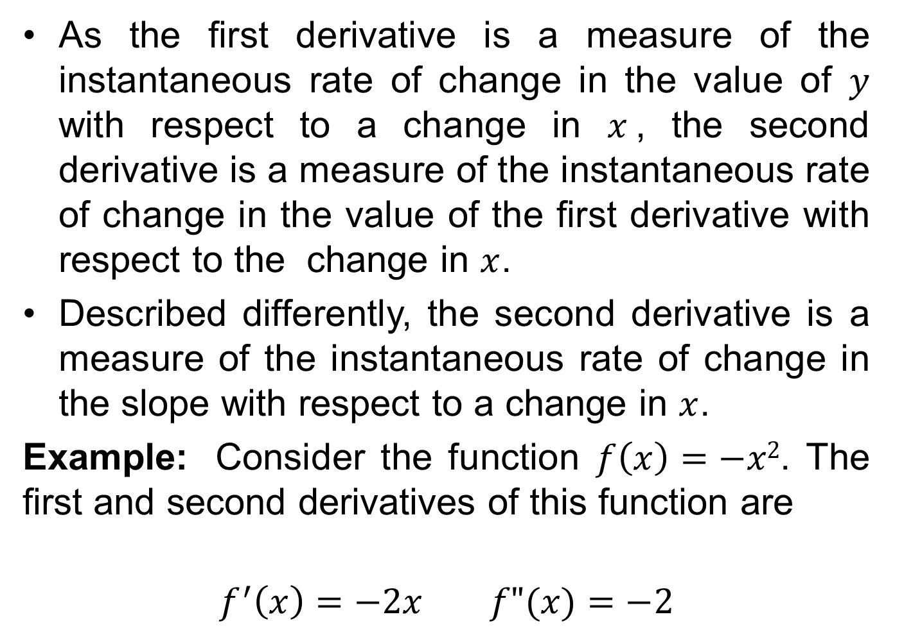
As the first derivative is a measure of the instantaneous rate of change in the value of $y$ with respect to a change in $x$, the second derivative is a measure of the instantaneous rate of change in the value of the first derivative with respect to the change in $x$.
Described differently, the second derivative is a measure of the instantaneous rate of change in the slope with respect to a change in $x$.
Example:Consider the function $f\left(x\right)=−x2$. The first and second derivatives of this function are
$$f^{′}\left(x\right)=−2x f"(x)=−2$$

Slide 29
The following figure illustrates the graphs of f, f’ and f”.

Slide 30
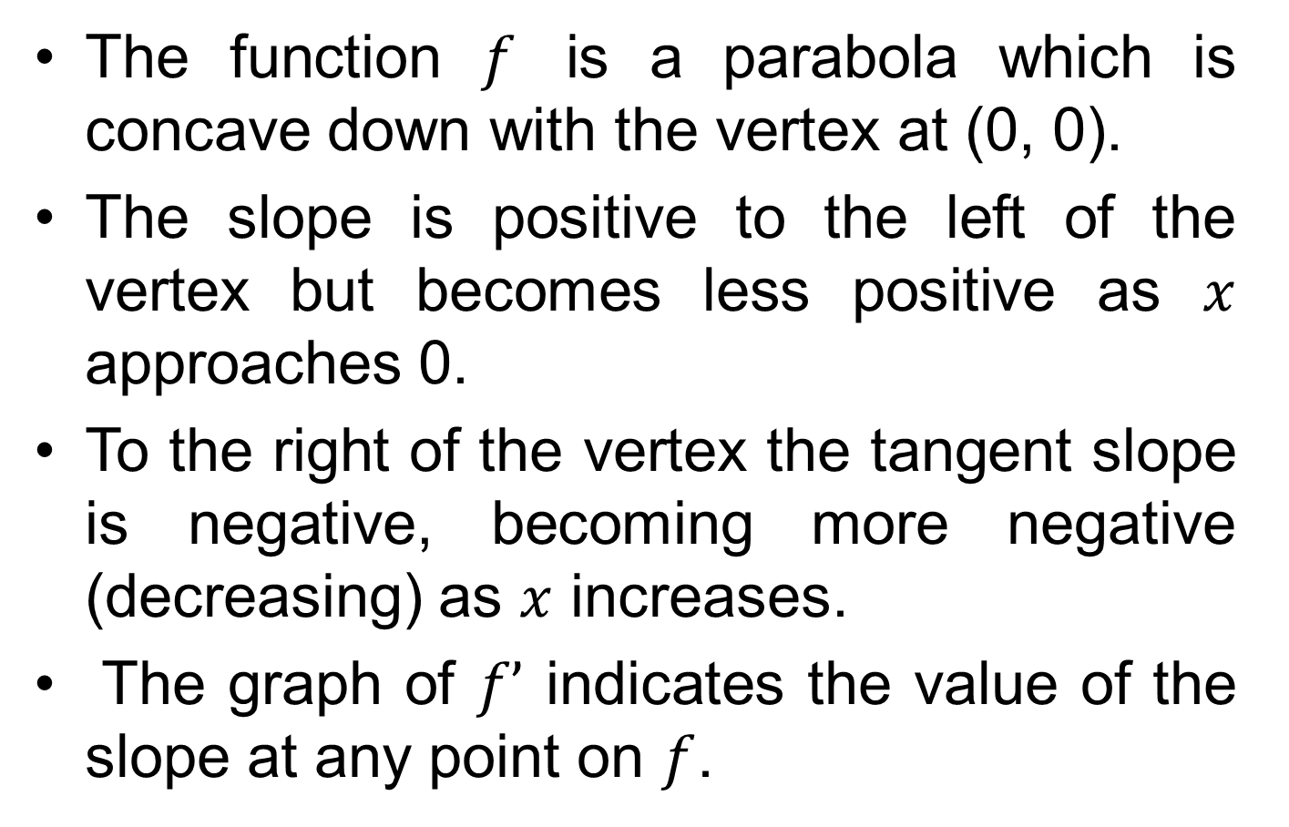
The function $f$ is a parabola which is concave down with the vertex at (0, 0).
The slope is positive to the left of the vertex but becomes less positive as $x$ approaches 0.
To the right of the vertex the tangent slope is negative, becoming more negative (decreasing) as $x$ increases.
The graph of $f’$ indicates the value of the slope at any point on $f$.

Slide 31
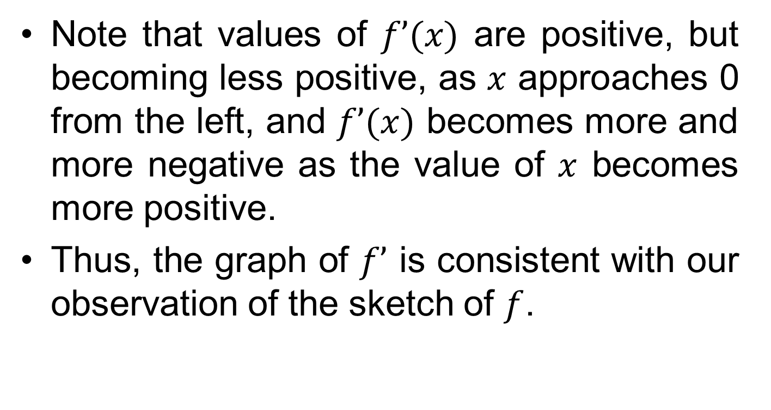
Note that values of $f’(x)$ are positive, but becoming less positive, as $x$ approaches 0 from the left, and $f’(x)$ becomes more and more negative as the value of $x$ becomes more positive.
Thus, the graph of $f’$ is consistent with our observation of the sketch of $f$.

Slide 32
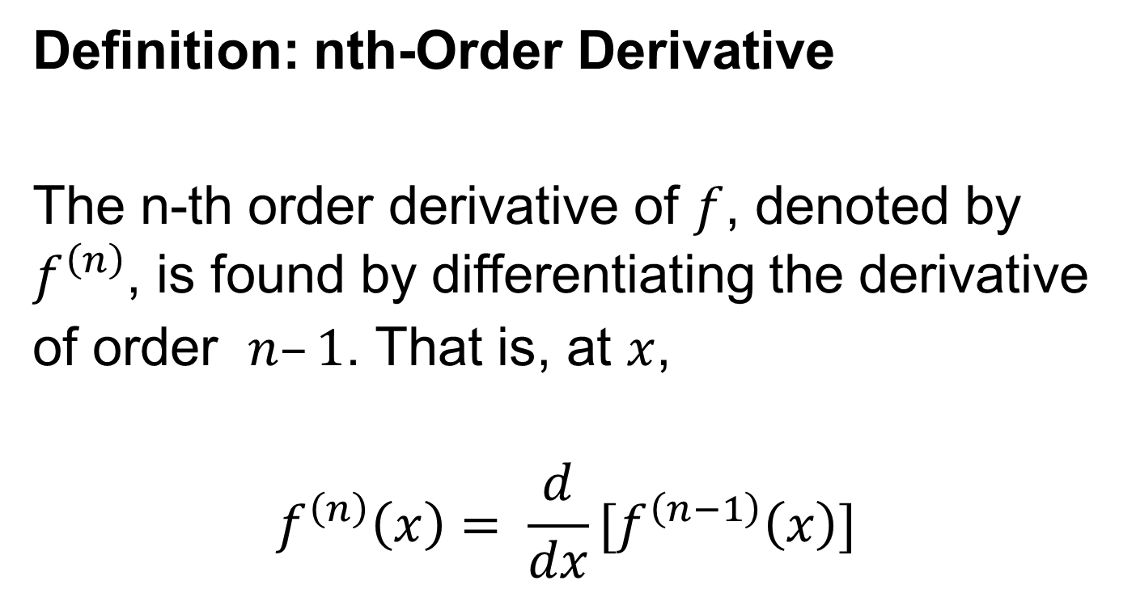
Definition: nth-Order Derivative
The n-thorder derivative of $f$, denoted by $f^{\left(n\right)}$, is found by differentiating the derivative of order $n–1$. That is, at $x$,
$$f^{\left(n\right)}\left(x\right)= \frac{d}{dx}[f^{\left(n−1\right)}\left(x\right)]$$

Slide 33
Review
We covered sections 15.5, 15.6, 15.7 and 15.8:
Differentiation
Rules of Differentiation
Instantaneous rate of change interpretation
Higher order derivatives

Slide 34
Next Lecture
We will start Chapter 16
Increasing and decreasing functions
Concavity and inflection points
Critical points: Maxima and minima
The first derivative test
The second derivative test

