Slide 1
Business Mathematics
MTH-367
Lecture 21

Slide 2
Chapter 15
Differentiation

Slide 3
Last Lecture’s Summary
Covered Sec 12.3: Finishes Chapter 12.
General Form and Assumptions of Assignment Model
Methods of Solutions to Assignment Model

Slide 4
Today’s Topics
We will start Chapter 15: Differentiation
Cover Sec 15.1, 15.2, 15.3 and 15.4
Limits
Properties of Limits
Continuity
Average rate of change
The difference quotient
The derivative
Using and interpreting the derivative

Slide 5
Chapter Objective
Introduce the concepts of limits and continuity.
Provide an understanding of average rate of change.
Provide an understanding of the derivative, including its computation and interpretation.
Present selected rules of differentiation and illustrate their use.
Introduce the nature of higher-order derivatives and their interpretation.

Slide 6
This is the first of six chapters which examine the calculus and its application to business, economics, and other areas of problem solving. Two major areas of study within the calculus are differential calculus and integral calculus. Differential calculus focuses on rates of change in analyzing a situation. Graphically, differential calculus solves of following problem: Given a function whose graph is a smooth curve and given a point in the domain of the function, what is the slope of the line tangent to the curve at this point?

Slide 7
Limits
Two concepts which are important in the theory of differential and integral calculus are the limit of a function and continuity.

Slide 8
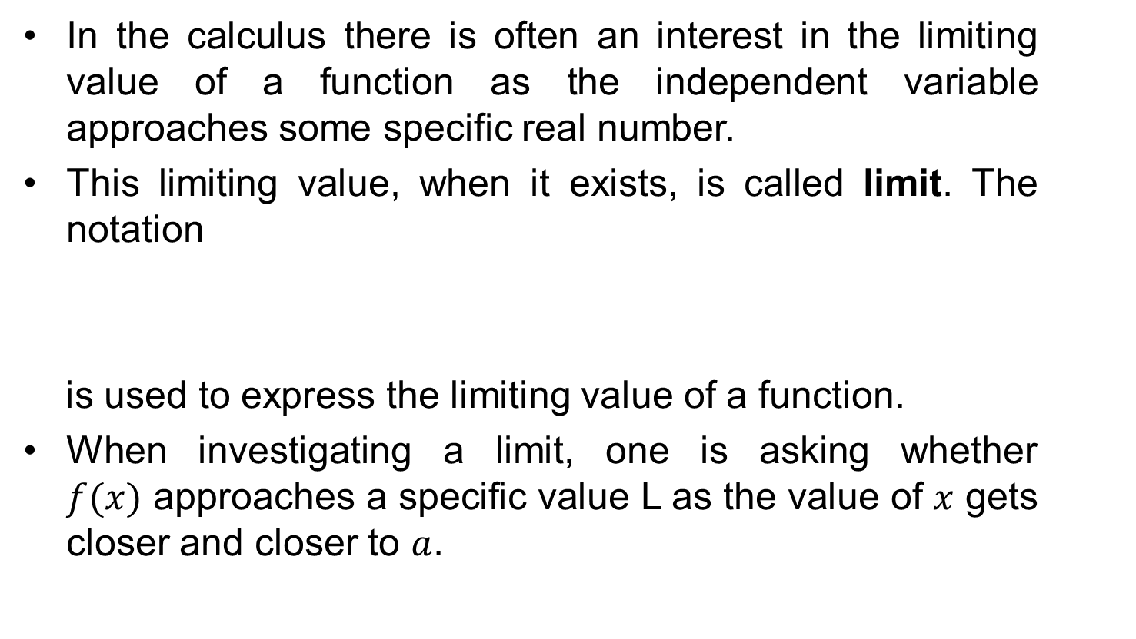
Limits of Functions
In the calculus there is often an interest in the limiting value of a function as the independent variable approaches some specific real number.
This limiting value, when it exists, is called limit. The notation
is used to express the limiting value of a function.
When investigating a limit, one is asking whether $f(x)$ approaches a specific value L as the value of $x$gets closer and closer to $a$.

Slide 9
Notation of Limits
The notation represents the limit of f(x) as x approaches ‘a’ from the left (left-hand limit).
The notation represents the limit of f(x) as x approaches ‘a’ from the right (right-hand limit).
If the value of the function approaches the same number L as x approaches ‘a’ from either direction, then the limit is equal to L.

Slide 10
Test For Existence Of Limit
If lim f(x) = L and lim f(x) = L, then
lim f(x) = L
If the limiting values of f(x) are different when x approaches a from each direction, then the function does not approach a limit as x approaches a.
^{x → a-}
^{x → a+}
^{x → a}

Slide 11
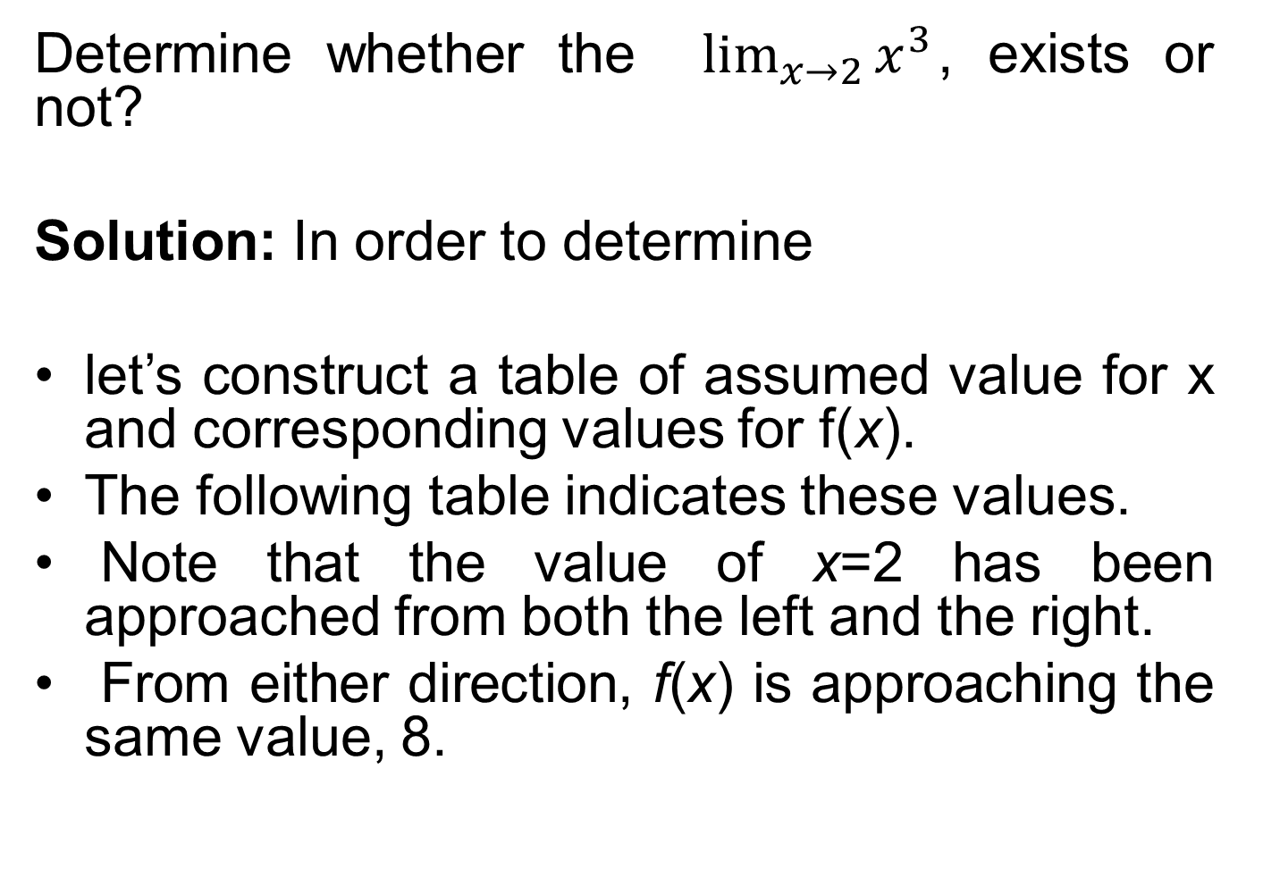
Example
Determine whether the $\lim_{x→2}{x^{3}}$, exists or not?
Solution: In order to determine
let’s construct a table of assumed value for x and corresponding values for f(x).
The following table indicates these values.
Note that the value of x=2 has been approached from both the left and the right.
From either direction, f(x) is approaching the same value, 8.

Slide 12
Approaching x = 2 from the left
x | 1 | 1.5 | 1.9 | 1.95 | 1.99 | 1.995 | 1.999
f(x) = x³ | 1 | 3.375 | 6.858 | 7.415 | 7.881 | 7.94 | 7.988
Approaching x = 2 from the Right
x | 3 | 2.5 | 2.1 | 2.05 | 2.01 | 2.005 | 2.001
f(x) = x³ | 27 | 15.625 | 9.261 | 8.615 | 8.121 | 8.060 | 8.012

Slide 13
Example: Given the function
2x when x ≤ 4
2x + 3 when x > 4
f (x) =
Approaching x = 4 from the left
x | 3 | 3.5 | 3.8 | 3.9 | 3.95 | 3.99
f(x) = 2x | 6.0 | 7.0 | 7.6 | 7.8 | 7.9 | 7.98
Approaching x = 4 from the Right
x | 5 | 4.5 | 4.3 | 4.1 | 4.05 | 4.01
f(x)=2x+3 | 13.0 | 12.0 | 11.6 | 11.2 | 11.1 | 11.02

Slide 14
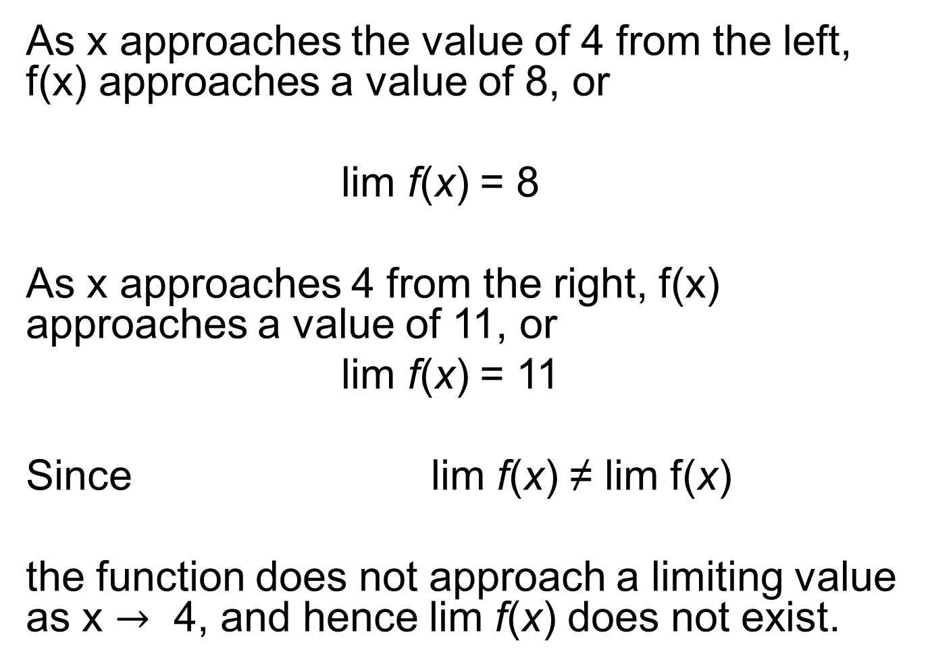
As x approaches the value of 4 from the left, f(x) approaches a value of 8, or
lim f(x) = 8
As x approaches 4 from the right, f(x) approaches a value of 11, or
lim f(x) = 11
Since lim f(x) ≠ lim f(x)
the function does not approach a limiting value as x $→$4, and hence limf(x) does not exist.
x → 4–
x → 4⁺

Slide 15
Example: Let’s determine whether lim f(x) exists if
Solution: Since the denominator equals 0 when x = 3, we can conclude that the function is undefined at this point.
It would be tempting to conclude that no limit exists when x = 3.

Slide 16
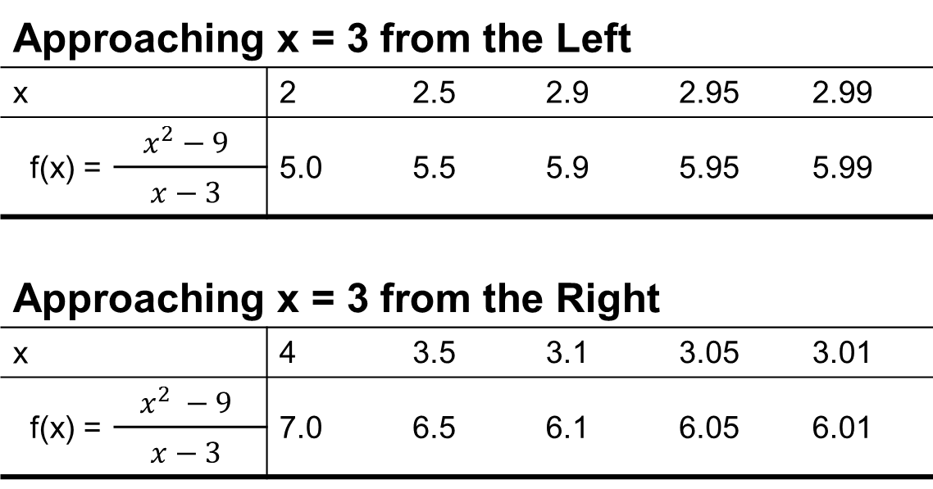
Approaching x = 3 from the Left
x |  | 2 | 2.5 | 2.9 | 2.95 | 2.99
f(x) = | $$x^{2}−9$$ | 5.0 | 5.5 | 5.9 | 5.95 | 5.99
 | $$x−3$$
Approaching x = 3 from the Right
x |  | 4 | 3.5 | 3.1 | 3.05 | 3.01
f(x) = | $$x^{2} −9$$ | 7.0 | 6.5 | 6.1 | 6.05 | 6.01
 | $$x−3$$

Slide 17
The above table contains values of f(x) as x approaches 3 from both the left and the right.
Since
lim f(x) = 6 and lim f(x) = 6
Then
Even though the function is undefined when x=3, the function approaches a value of 6 as the value of x comes closer to 3.

Slide 18
Properties Of Limits And Continuity
Some Properties of Limits
Property 1 If f(x) = c, where c is real,
lim (c) = c
Property 2 If f(x) = x^{n}, where n is a
positive integer, then
lim x^{n} = a^{n}
x → a
x → a

Slide 19
Property 3 If f(x) has a limit as x → a and c is any real number, then
lim c . f(x) = c . lim f(x)
Property 4 If lim f(x) and lim g(x) exist, then
lim [f(x) ± g(x)] = lim f(x) ± lim g(x)

Slide 20
Property 5 If lim f(x), lim g(x) exist, then
lim [f(x) . g(x)]= lim f(x) . lim g(x)
Property 6 If lim f(x) and lim g(x) exist, then
x → a

Slide 21
Examples:

Slide 22
The properties make the process of evaluating limits considerably easier for certain classes of functions.
Limits of these types of functions may be evaluated by substitution to determine f(a). For these classes of functions.
lim f(x) = f(a)
Polynomial functions are a commonly used class of functions for which the above is valid.

Slide 23
Limits and Infinity
Examine the two functions sketched in the following Figures.

Slide 24
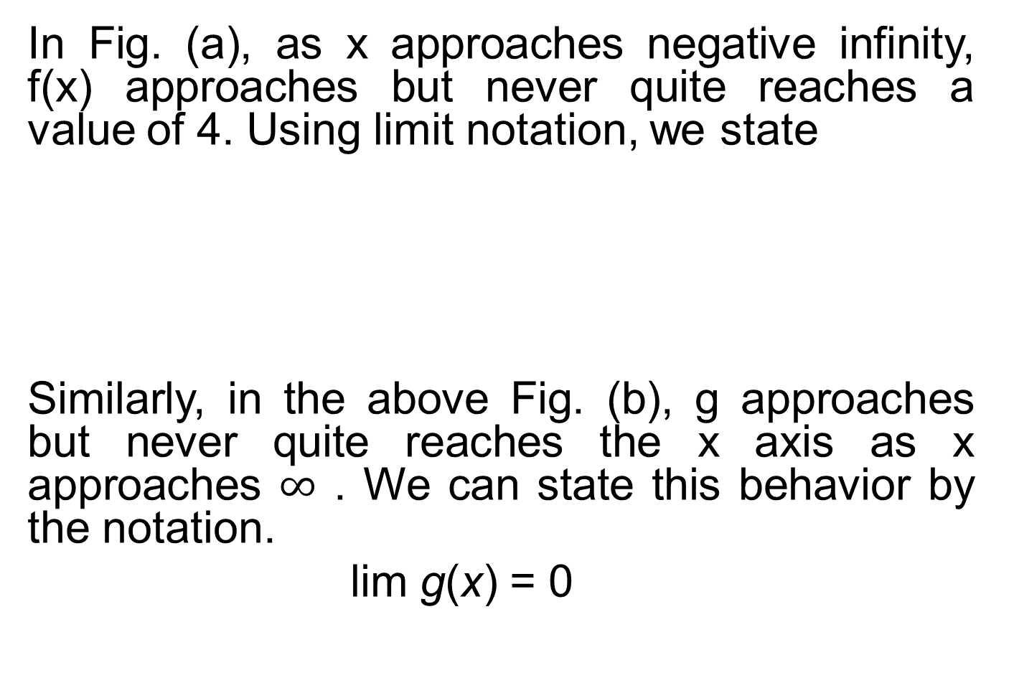
In Fig. (a), as x approaches negative infinity, f(x) approaches but never quite reaches a value of 4. Using limit notation, we state
Similarly, in the above Fig. (b), g approaches but never quite reaches the x axis as x approaches $∞$. We can state this behavior by the notation.
limg(x) = 0
lim f(x) = 4

Slide 25
Definition: (Horizontal Asymptote)
The line y = a is a horizontal asymptote of the graph of f if and only if
In the above graph, the line y = 4 is horizontal asymptote.

Slide 26
Example: Evaluate the limit
Solution: One technique for evaluating this limit is to factor the monomial term of the highest degree from both the numerator and the denominator. Factoring 3x² in the numerator and 4x² in the denominator results in.

Slide 27
Vertical Asymptote
The line x = a is a vertical asymptote of the graph of f if and only if

Slide 28
Example: Evaluate the limit,
Solution: We must take left and right-hand limits as x approaches 0.
The following table presents selected values.
Approaching x = 0 from the Left
x |  | –1 | –0.5 | –0.1 | –0.01 | –0.001
f(x) = | 1 | 1 | 4 | 100 | 10,000 | 1,000,000
 | X²
Approaching x = 0 from the Right
X |  | 1 | 0.5 | 0.1 | 0.01 | 0.001
f(x) = | 1 | 1 | 4 | 100 | 10,000 | 1,000,000
 | X²

Slide 29
We should conclude that lim (1/x²) = ∞. Graphically,
f appears as in the following Fig. Note that f(x)=1/x² has a vertical asymptote of x = 0 and horizontal asymptotes of y = 0

Slide 30
NOTE: A conclusion that
acknowledges that a limit does not exist: that is, there is not a real-number limiting value for f(x).

Slide 31
Continuity:
In a informal sense, a function is described as continuous if it can be sketched without lifting your pen or pencil from the paper (i.e., it has no gaps, no jumps, and no breaks).
A function that is not continuous is termed as discontinuous.

Slide 32
Continuity at a Point
A function f is said to be continuous at x = a if
1- the function is defined at x = a, and
2- lim f(x) = f(a)

Slide 33
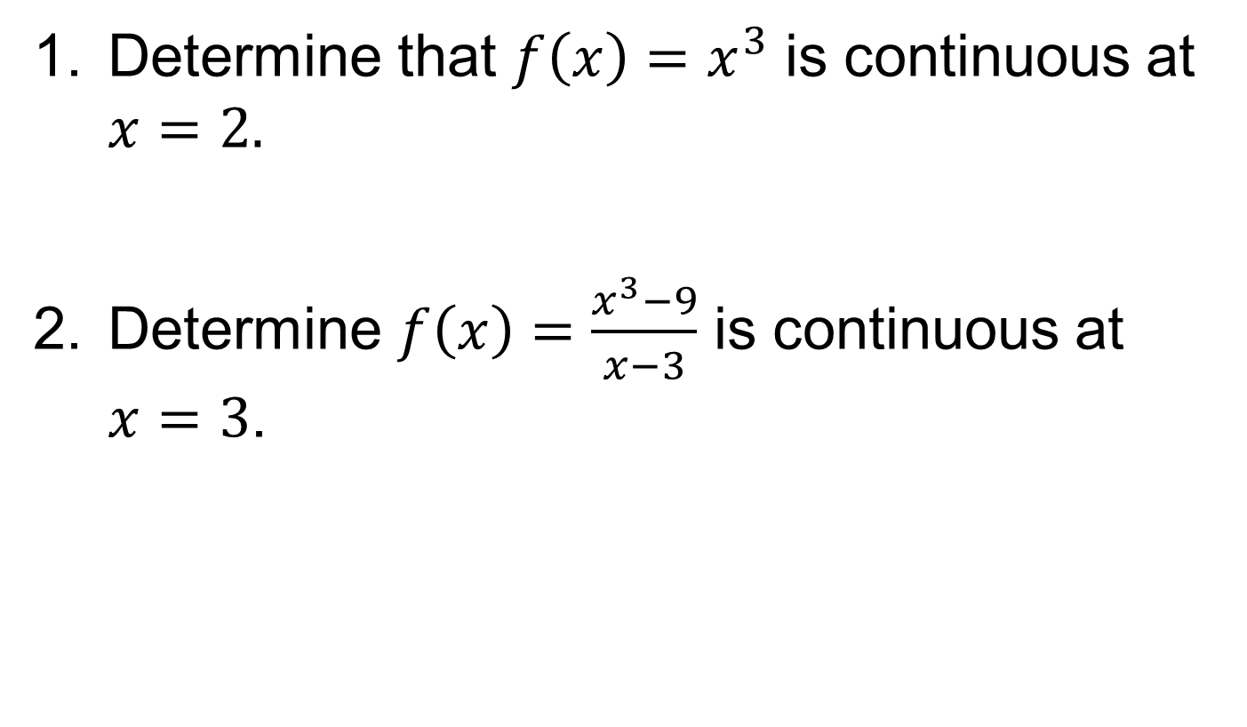
Examples
Determine that $f\left(x\right)=x^{3}$ is continuous at $x=2.$
Determine $f\left(x\right)=\frac{x^{3}−9}{x−3}$ is continuous at $x=3$.

Slide 34
Average Rate of Change and the Slope
The slope of a straight line can be determined by the two-point formula

Slide 35
The following figure illustrates the graph of a linear function. With linear functions the slope is constant over the domain if the function. The slope provides an exact measure of the rate of change in the value of y with respect to a change in the value of x.
B
A

Slide 36
If the function in the above figure represents a cost function and x equals the number of units produced, the slope indicates the rate at which total cost increases with respect to changes in the level of output.
With nonlinear functions the rate of change in the value of y with respect to a change in x is not constant.
One way of describing nonlinear functions is by the average rate of change over some interval.

Slide 37
Consider the following figure.

Slide 38
In moving from point A to point B, the change in the value of x is (x + Δx) – x, or Δx. The associated change in the value of y is
Δy = f(x + Δx) – f(x)
The ratio of these changes is.
Δy f(x + Δx) – f(x)
Δx Δx
The above equation is sometimes referred to as the difference quotient.
----- = ---------------------

Slide 39
What Does The Difference Quotient Represent
Given any two points on a function f having coordinates [x, f(x)] and [(x + Δx), f(x + Δx)], the difference quotient represents.
I- the average rate of change in the value of y with respect to the change in x while moving from
[x, f(x)] to [(x + Δx), f(x + Δx)]
II- The slope of the secant line connecting the two points.

Slide 40
Examples:
Find the general expression for the difference quotient of the function y = f(x) = x².
Find the slope of the line connecting (-2, 4) and (3, 9) using the two-point formula.
Find the slope in part (b) using the expression for the difference quotient found in part (a).

Slide 41
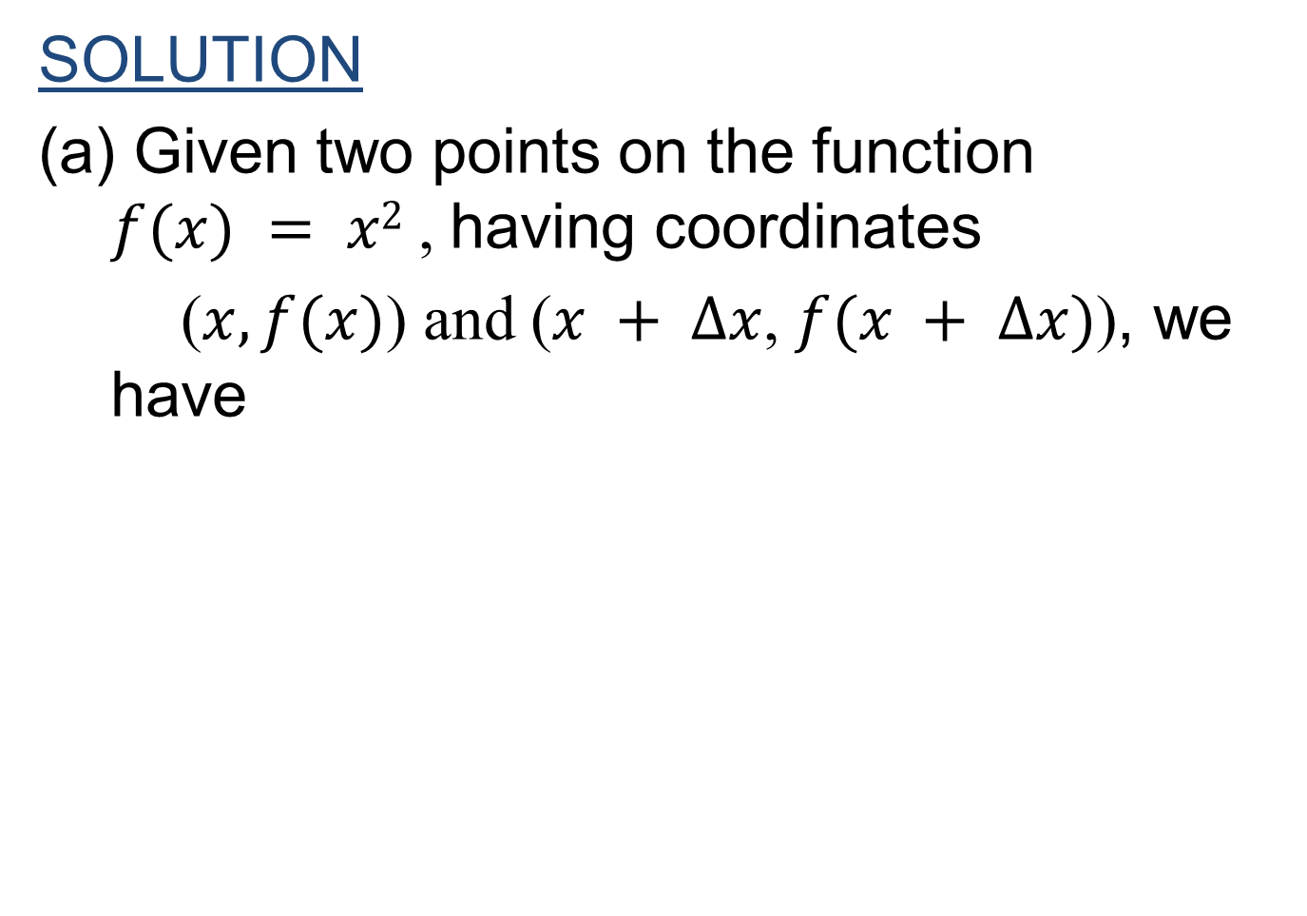
SOLUTION
(a) Given two points on the function $f(x) = x2$, having coordinates
($x,f(x)$) and ($x + Δx$, $f(x + Δx)$), we have

Slide 43
The Derivative
DEFINITION:
Given a function of the form y = f(x), the derivative of the function is defined as
If this limit exists.

Slide 44
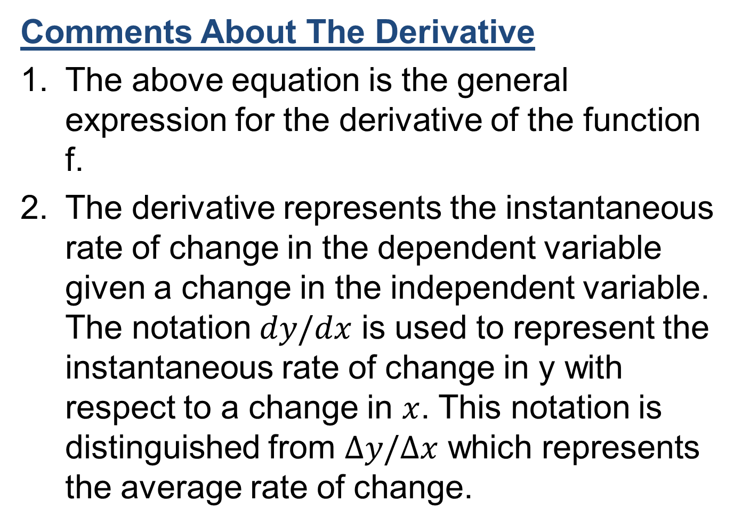
Comments About The Derivative
The above equation is the general expression for the derivative of the function f.
The derivative represents the instantaneous rate of change in the dependent variable given a change in the independent variable. The notation $dy/dx$ is used to represent the instantaneous rate of change in y with respect to a change in $x$. This notation is distinguished from $Δy/Δx$ which represents the average rate of change.

Slide 45
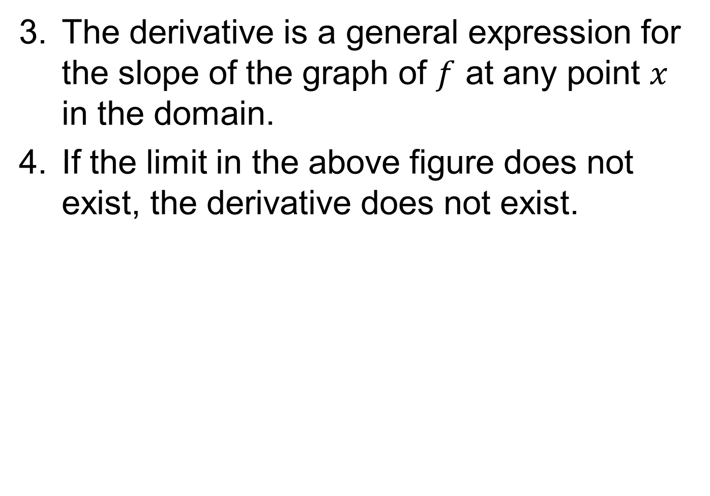
The derivative is a general expression for the slope of the graph of $f$ at any point $x$ in the domain.
If the limit in the above figure does not exist, the derivative does not exist.

Slide 46
Finding The Derivative (Limit Approach)
Step 1 Determine the difference quotient for the given function.
Step 2 Find the limit of the difference quotient as Δx → 0.

Slide 47
Example
Find the derivative .

Slide 48
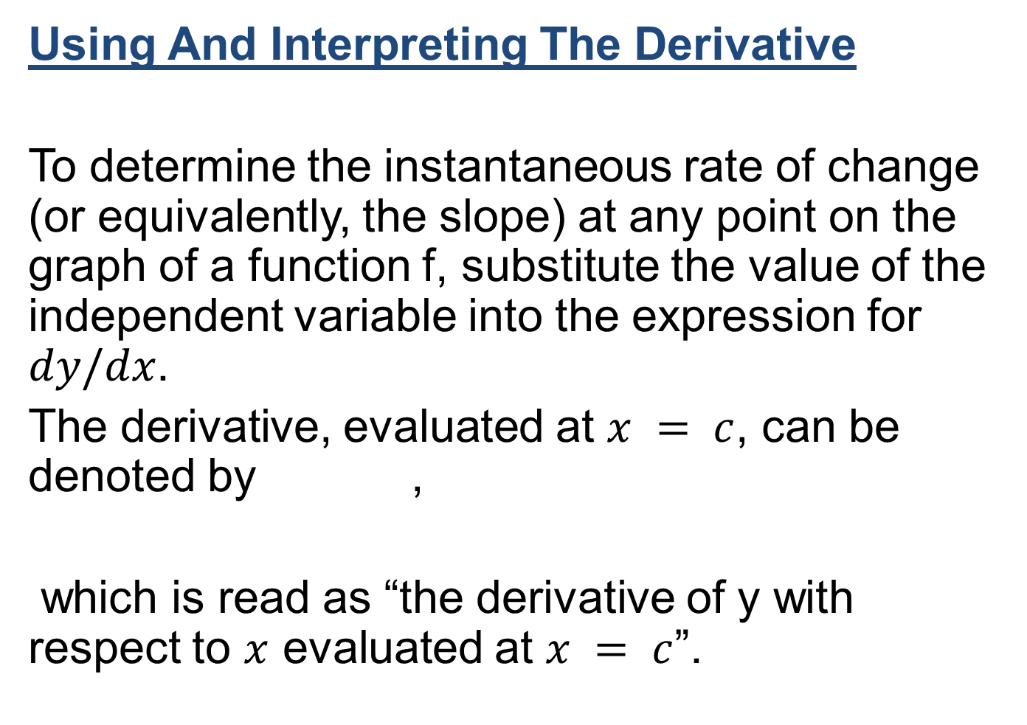
Using And Interpreting The Derivative
To determine the instantaneous rate of change (or equivalently, the slope) at any point on the graph of a function f, substitute the value of the independent variable into the expression for $dy/dx$.
The derivative, evaluated at $x = c$, can be denoted by ,
which is read as “the derivative of y with respect to $x$ evaluated at $x = c$”.

Slide 49
Review
Covered Sec 15.1, 15.2, 15.3 and 15.4
Limits
Properties of Limits
Continuity
Average rate of change
The difference quotient
The derivative
Using and interpreting the derivative

Slide 50
Next Lecture
We will cover the following topics, starting from section Sec 15.5:
Differentiation
Rules of Differentiation
Instantaneous rate of change interpretation
Higher order derivatives

