Slide 1
Business Mathematics
MTH-367
Lecture 15

Slide 2
Chapter 11
The Simplex and Computer Solutions Methods
continued

Slide 3
Last Lecture’s Summary
Covered Sec. 11.1: Simplex Preliminaries
Requirements of Simplex Method
Requirements for different types of constraints
Feasible Solution, Basic Solution, and
Basic Feasible Solution
Incorporating objective function

Slide 4
Today’s topics
The Simplex Method for Maximization problem with all ≤ constraints
Maximization problem with mixed constraints

Slide 5
Incorporating the Objective Function (Recall)
Given the LP problem
Maximize z = 5x₁ + 6x₂
subject to 3x₁ + 2x₂ ≤ 120 (1)
4x₁ + 6x₂ ≤ 260 (2)
x₁ , x₂ ≥ 0
The required form by simplex method is given as follows.

Slide 6
Incorporating the Objective Function (recall)
z – 5x₁ – 6x₂ – 0S₁ – 0S₂ = 0 (0)
3x₁ + 2x₂ + S₁ = 120 (1)
4x₁ + 6x₂ + S₂ = 260 (2)
Since we are particularly concerned about the value of z and will want to know its value for any solution, z will always be a basic variable.
The standard practice, however, is not to refer to z as a basic variable. The terms basic variable and non-basic variable are usually reserved for other variables in the problem.

Slide 7
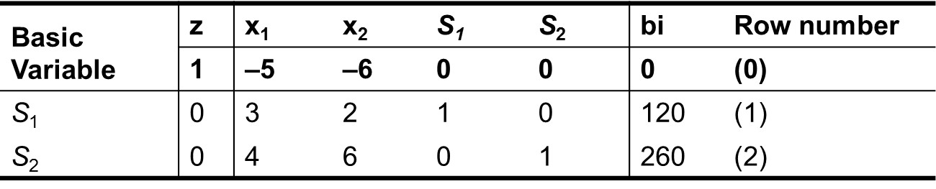
The simplex operations are performed in a tabular format.
The initial table, or tableau, for our problem is shown in the table below.
Note that there is one row for each equation and the table contains the coefficients of each variable in the equations and bi column contains right hand sides of the equation.

Slide 8
RULE: 1 OPTIMALITY CHECK IN MAXIMIZATION PROBLEM
In a maximization problem, the optimal solution has been found if all row (0) coefficients for the variables are greater than or equal to 0. If any row (0) coefficients are negative for non-basic variable, a better solution can be found by assigning a positive quantity to these variables.

Slide 9
RULE: 2 NEW BASIC VARIABLE IN MAXIMIZATION PROBLEM
In a maximization problem the non-basic variable which will replace a basic variable is the one having the most negative row (0) coefficient. “Ties” may be broken arbitrarily.

Slide 10
RULE: 3 DEPARTING BASIC VARIABLE
The basic variable to be replaced is found by determining the row i associated with
min ---- i = 1, . . . . m
Where a_{ik} > 0. In addition to identifying the departing basic variable, the minimum b_{i}/a_{ik} value is the maximum number of units which can be introduced of the incoming basic variable.
b_{i}
a_{ik}

Slide 11
Summary of simplex prodedure
We summaries the simplex procedure for maximization problems having all (≤) constraints.
First, add slack variables to each constraint and the objective function and place the variable coefficients and right-hand-side constants in a simplex tableau:

Slide 12
Summary of Simplex procedure cont’d
1- Identify the initial solution by declaring each of the slack variables as basic variables. All other variables are non-basic in the initial solution.
2- Determine whether the current solution is optimal by applying rule 1 [Are all row (0) coefficients ≥ 0?]. If it is not optimal, proceed to step 3.

Slide 13
Summary of Simplex procedure cont’d
3- Determine the non-basic variable which should become a basic variable in the next solution by applying rule 2 [most negative row (0) coefficient].
4- Determine the basic variable which should be replaced in the next solution by applying rule 3 (min b_{i}/a_{ik} ratio where a_{ik} > 0)
5- Applying the Gaussian elimination operations to generate the new solution (or new tableau). Go to step 2.

Slide 14
Example
Solve the following linear programming problem using the simplex method.
Maximize z = 5x₁ + 6x₂
subject to 3x₁ + 2x₂ ≤ 120
4x₁ + 6x₂ ≤ 260
x₁ , x₂ ≥ 0

Slide 15
Rewriting the problem in standard form with slack variables added in, we have the following:
Maximize z = 5x₁ + 6x₂
subject to
x₁ , x₂ , S₁ , S₂ ≥ 0
The objective function should be restated by moving all variables to the left side of the equation.
The initial simplex tableau is shown in the following table.

Slide 16
Basic Variables |  | Key Column |  |  |  |  |  | Ratio
 | z | x₁ | x₂ | s₁ | s₂ | b_{i}
 | 1 | –5 | –6 | 0 | 0 | 0
S₁ | 0 | 3 | 2 | 1 | 0 | 120
S₂ | 0 | 4 | 6 | 0 | 1 | 260
Step 1 in the initial solution x₁ and x₂ are non-basic variable having values equal to 0. The basic variables are the slack variables with S₁ = 120, S₂ = 260, and z = 0.
Step 2 Now in table 1, we look for row(0) and observe that the current solution is optimal or not. Since all row (0) coefficients are not greater than or equal to 0, the initial solution is not optimal.

Slide 17
Step 3 The most negative coefficient in row (0) is –6, and it is associated with x₂. So x₂ column is the key column. Thus, x₂ will become a basic variable in the next solution and its column of coefficients becomes the key column.
Step 4 In order to find the basic variable, which should be replaced in the next solution, we will look for the least ration in the last column.
In order to find the least ratio, we will divide the values of R.H.S by the corresponding values of the key column.
This ratio should be a real positive number, so ignore the 0, negative and undefined values. As the least ration is 43.33 which correspond to s₂ we will replace it by x₂ in the next table.

Slide 18
Step 5 The new solution is found by transforming the coefficients in the x₂ column

Slide 20
Basic Variables |  | Key Column |  |  |  |  | Ratio
 | z | x₁ | x₂ | s₁ | s₂ | b_{i}
 | 1 | -1 | 0 | 0 | 1 | 260
s₁ | 0 | -5 | 0 | -3 | 1 | -100
x₂ | 0 | 4/6 | 1 | 0 | 1/6 | 260/6
Since all row(0) coefficients are not non-negative, i.e the solution is not optimal, so we start again from step 3.
The most negative value is -1 in row(0), so the column below x₁ is key column.
The least ratio is 20 which corresponds to s₁. So s₁ is replace by x₁ in the next table.

Slide 21
By applying Gaussian elimination method, we want to convert

Slide 23
Basic Variables |  | Key Column |  |  |  |  | Ratio
 | z | x₁ | x₂ | S₁ | S₂ | b_{i}
 | 1 | 0 | 0 | ³/₅ | 4/₅ | 280
x₁ | 0 | 1 | 0 | ³/₅ | –¹/₅ | 20
x₂ | 0 | 0 | 30 | ₋₁₂ | ₁₇ | 900

Slide 24
Maximization Problems with Mixed Constraints
For a maximization problem having a mix of (≤, ≥, and =) constraints the simplex method itself does not change.
The only change is in transforming constraints to the standard equation form with appropriate supplemental variables.
Recall that for each (≥) constraint, a surplus variable is subtracted and an artificial variable is added to the left side of the constraint. For each (=) constraint, an artificial variable is added to the left side.

Slide 25
Maximization Problems with Mixed Constraints cont’d
An additional column is added to the simplex tableau for each supplemental variable.
Also, surplus and artificial variables must be assigned appropriate objective function coefficients (c, values)
Surplus variables usually re-assigned an objective function coefficient of 0.

Slide 26
Maximization Problems with Mixed Constraints cont’d
Artificial variables are assigned objective function coefficient of –M, where |M| is a very large number. This is to make the artificial variables unattractive in the problem.
In any linear programming problem, the initial set of basic variables will consist of all the slack variables and all the artificial variables which appear in the problem.

Slide 27
Example
Maximize z = 8x₁ + 6x₂
subject to 2x₁ + x₂ ≥ 10
3x₁ + 8x₂ ≤ 96
x₁, x₂ ≥ 0
We have a maximization problem which has a mix of a (≤) constraint and a (≥) constraint.

Slide 28
Example cont’d
Rewriting the problem with constraints expressed as equations,
Maximize z = 8x₁ + 6x₂ + 0E₁ – MA₁ + 0S₂
subject to 2x₁ + x₂ – E₁ + A₁ = 10
3x₁ + 8x₂ +S₂ = 96
x₁ , x₂ E₁, A₁, S₂ ≥ 0

Slide 29
Example cont’d
The initial tableau for this problem appears as in the following table:
Basic Variables | z | x₁ | x₂ | E₁ | A₁ | S₂ | b_{i} Row Number
 | 1 | –8 | –6 | 0 | M | 0 | 0 | (0)
A₁ | 0 | 2 | 1 | –1 | 1 | 0 | 10 | (1)
S₂ | 0 | 3 | 8 | 0 | 0 | 1 | 96 | (2)

Slide 30
Example cont’d
Note that the artificial variable is one of the basic variables in the initial solution.
For any problem containing artificial variables, the row (0) coefficients for the artificial variable will not equal zero in the initial tableau.
We need to make M equal to zero by
we get

Slide 31
Example cont’d
Basic Variables | z | Key Column |  |  |  |  | Transformed to zero Row b_{i} Number b_{i}/a_{ik}
 |  | x₁ | x₂ | E₁ | A₁ | S₂
 | 1 | –8–2M | –6–M | M | 0 | 0 | –10M | (0)
A₁ | 0 | 2 | 1 | –1 | 1 | 0 | 10 | (1) 10/2 = 5*
S₂ | 0 | 3 | 8 | 0 | 0 | 1 | 96 | (2) 96/3 = 32
We want to transform

Slide 32
Example cont’d
Basic Variables | z | Key Column |  |  |  |  | Transformed to zero Row b_{i} Number Ratio
 |  | x₁ | x₂ | E₁ | A₁ | S₂
 | 1 | 0 | –4 | –8 | 8+2M | 0 | 80 | (0)
x₁ | 0 | 1 | ½ | –½ | ½ | 0 | 5 | (1)
S₂ | 0 | 0 | 13 | ₃ | ₋₃ | 2 | 162 | (2)

Slide 33
Example cont’d
By Gaussian elimination method, we want to transform
Basic Variables | z | x₁ | x₂ | E₁ | A₁ | S₂ | b_{i} Row Number
 | 1 | 0 | 92 | 0 | 6M | 16 | 1536 | (0)
x₁ | 0 | 6 | 16 | 0 | 0 | 2 | 192 | (1)
E₂ | 0 | 0 | 13 | 3 | –3 | 2 | 162 | (2)

Slide 34
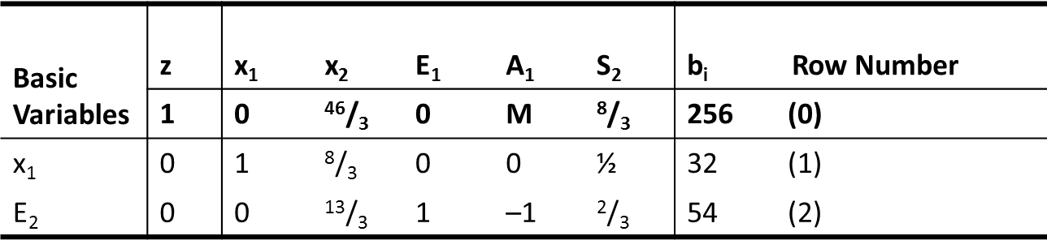
Example cont’d
In short form we can write.
The objective function is maximized at

Slide 35
Review
The Simplex Method for Maximization problem with all ≤ constraints
Maximization problem with mixed constraints

Slide 36
Next Lecture
Minimization problems
Special phenomena
Alternative Optimal Solutions
No Feasible Solution
Unbounded Solutions
Examples

