Slide 1
Business Mathematics
MTH-367
Lecture 12

Slide 2
Chapter 10
Linear Programming
An Introduction

Slide 3
Objectives
Provide an understanding of the structure and assumptions underlying linear programming models
Illustrate the graphical representation of linear inequalities
Provide an understanding of graphical solution procedures for linear programming models
Applications in business, finance

Slide 4
Main Topics
Basic concepts of Linear Programming
Graphical Solutions
Applications of Linear Programming
Applications in Business Industry

Slide 5
Today’s topics
Basic concepts of Linear Programming
Graphical Solutions
System of linear inequalities
Region of feasible solution
Corner point method

Slide 6
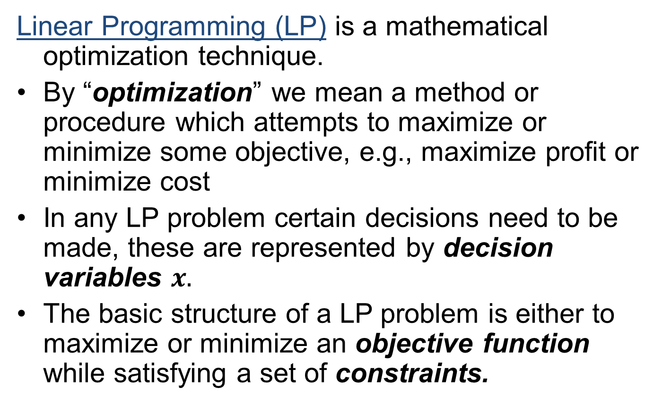
Basic concepts
Linear Programming (LP) is a mathematical optimization technique.
By “optimization” we mean a method or procedure which attempts to maximize or minimize some objective, e.g., maximize profit or minimize cost
In any LP problem certain decisions need to be made, these are represented by decision variables $x.$
The basic structure of a LP problem is either to maximize or minimize an objective function while satisfying a set of constraints.

Slide 7
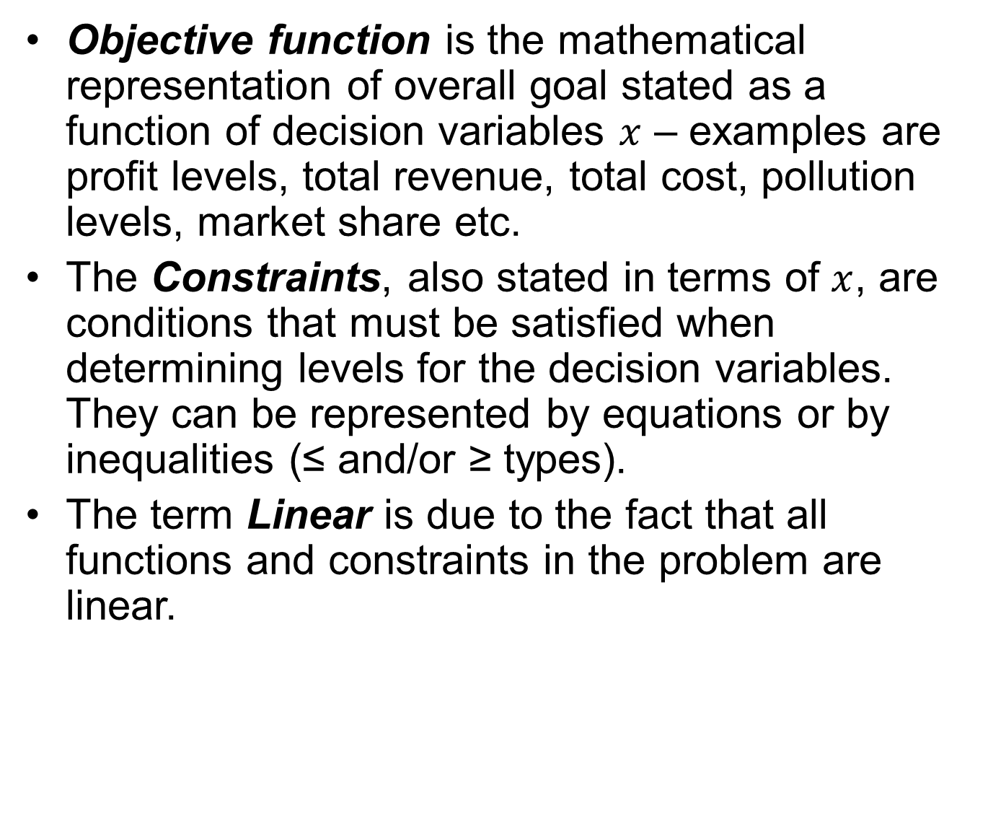
Basic concepts cont’d
Objective function is the mathematical representation of overall goal stated as a function of decision variables $x$ – examples are profit levels, total revenue, total cost, pollution levels, market share etc.
The Constraints, also stated in terms of $x$, are conditions that must be satisfied when determining levels for the decision variables. They can be represented by equations or by inequalities (≤ and/or ≥ types).
The term Linear is due to the fact that all functions and constraints in the problem are linear.

Slide 8
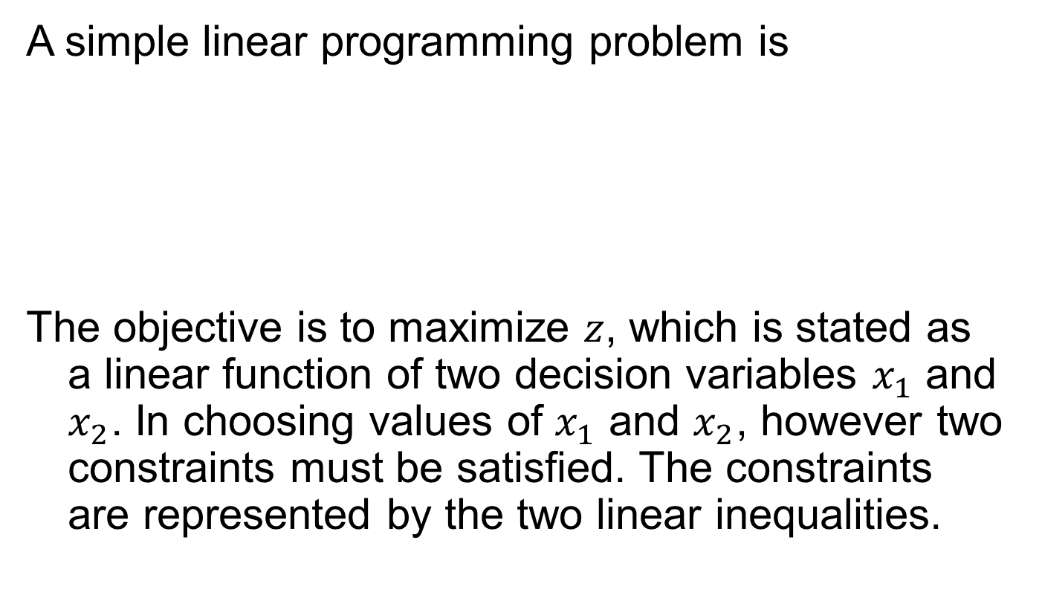
Example
A simple linear programming problem is
The objective is to maximize $z$, which is stated as a linear function of two decision variables $x_{1}$ and $x_{2}$. In choosing values of $x_{1}$ and $x_{2}$, however two constraints must be satisfied. The constraints are represented by the two linear inequalities.

Slide 9
A Scenario (a LP example) A firm manufactures two products, each of which must be processed through two departments 1 and 2.
 | Product A | Product B | Weekly Labor Capacity
Department 1 | 3 h per unit | 2 h per unit | 120 h
Department 2 | 4 h per unit | 6 h per unit | 260 h
Profit Margins | $5 per unit | $6 per unit

Slide 10
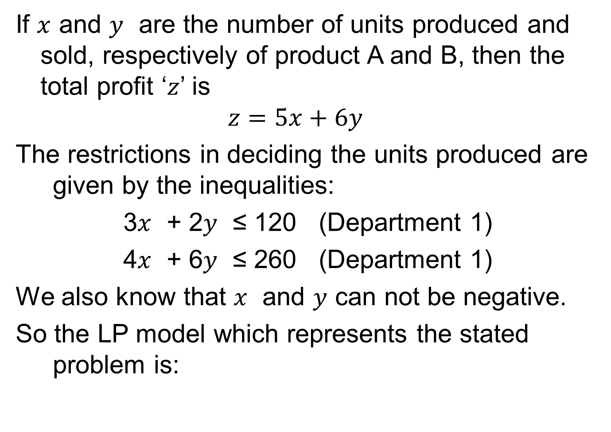
If $x$ and $y$ are the number of units produced and sold, respectively of product A and B, then the total profit ‘$z$’ is
$$z=5x+6y$$
The restrictions in deciding the units produced are given by the inequalities:
3$x$ + 2$y$ ≤ 120 (Department 1)
4$x$ + 6$y$ ≤ 260 (Department 1)
We also know that $x$ and $y$ can not be negative.
So the LP model which represents the stated problem is:

Slide 11
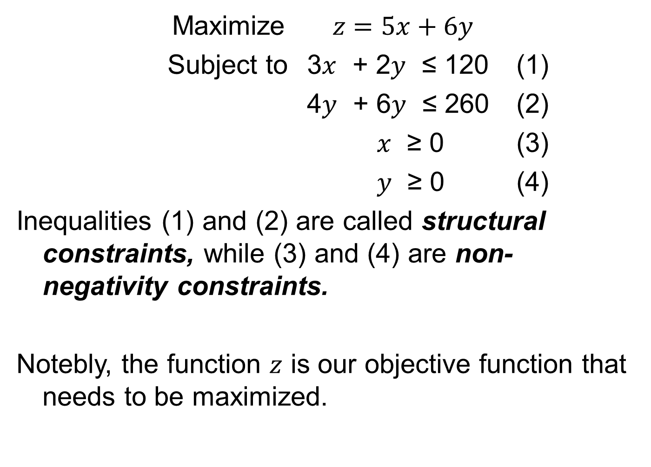
Maximize$z=5x+6y$
Subject to 3$x$ + 2$y$ ≤ 120 (1)
4$y$ + 6$y$ ≤ 260 (2)
$x$ ≥ 0 (3)
$y$ ≥ 0 (4)
Inequalities (1) and (2) are called structural constraints, while (3) and (4) are non-negativity constraints.
Notebly, the function $z$ is our objective function that needs to be maximized.

Slide 12
Graphical Solutions
When a LP model is stated in terms of 2 decision variables, it can be solved by graphical methods.
Before discussing the graphical solution method, we will discuss the graphics of linear inequalities.

Slide 13
Graphics of Linear Inequalities
Linear inequalities which involve two variables can be represented graphically in two dimensions by a closed half space of a certain type of the certain plane.
The half space consists of the boundary line representing the equality part of the inequality and all points on one side of the boundary line (representing the strict inequality).
Graph the boundary which represents the equation.
Determine the side that satisfy the strict inequality.

Slide 14
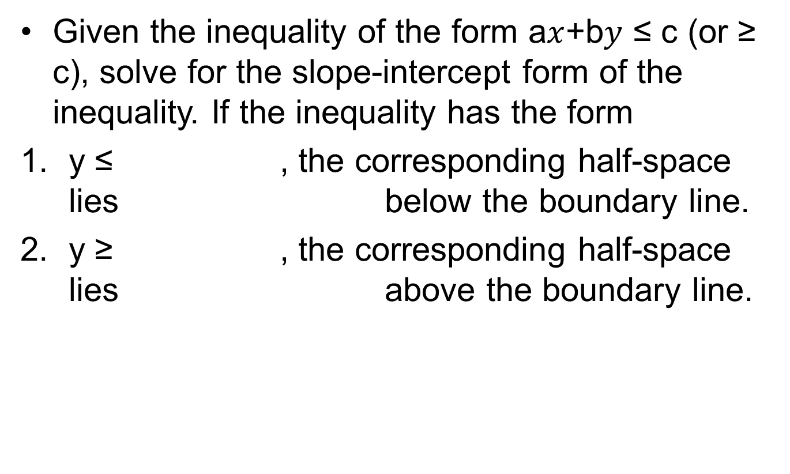
Or you can do this...
Given the inequality of the form a$x$+b$y$ ≤ c (or ≥ c), solve for the slope-intercept form of the inequality. If the inequality has the form
y ≤ , the corresponding half-space lies below the boundary line.
y ≥ , the corresponding half-space lies above the boundary line.

Slide 15
Example
A firm manufactures two products.
Product A requires 4 hours per unit, and the product B requires 2 hours per unit.
Total production time is 120 hours
A restriction is that total hours used in providing the two products can not exceed 60.
Find the graphical solution?.

Slide 16
Example cont’d
.

Slide 17
System of Linear Inequalities
In LP problems we will be dealing with system of linear inequalities
We will be interested to determine the solution set which satisfies all the inequalities in the system constraints
Example: Given two inequalities

Slide 18
Cont’d...

Slide 19
Region of feasible solution
The first step in graphical procedure is to identify the solution set for the system constraints.
This solution set is called region of feasible solution.
It includes all combinations of decision variables which satisfy the structural and non-negativity constraints.

Slide 20
Corner point solution
Given a linear objective function in a linear programming problem, the optimal solution will always include a corner point on the region of feasible solution.
This will hold, irrespective of the slope of objective function and for either maximization or minimization problems.
We can use a method, called corner point method, to solve the linear programming problems.

Slide 21
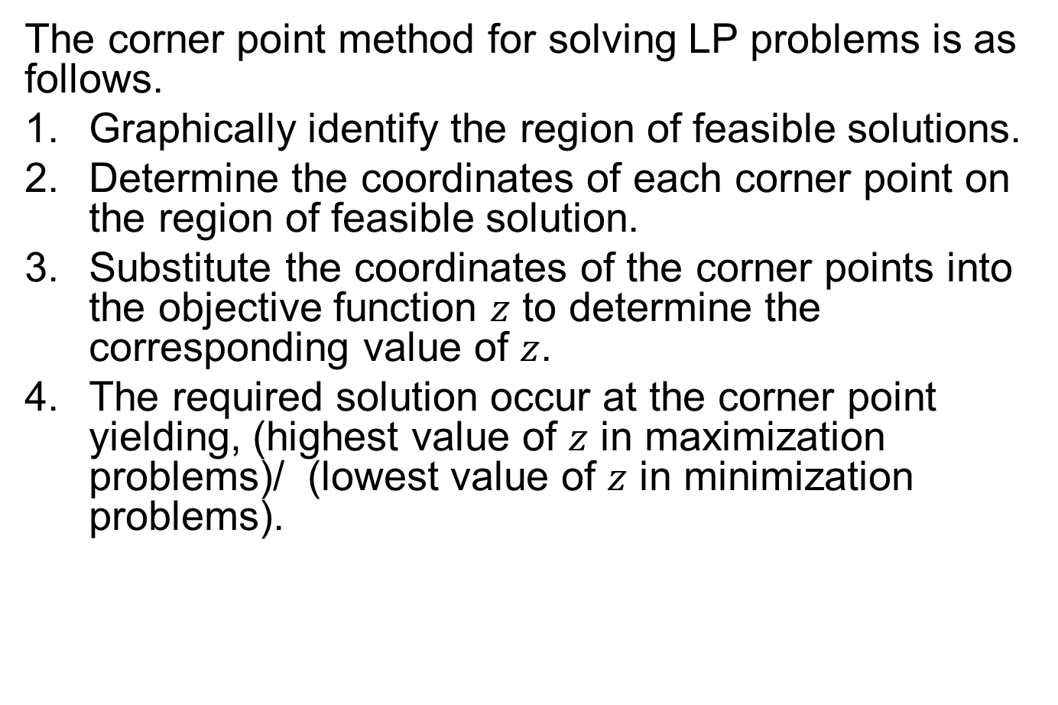
Corner point method
The corner point method for solving LP problems is as follows.
Graphically identify the region of feasible solutions.
Determine the coordinates of each corner point on the region of feasible solution.
Substitute the coordinates of the corner points into the objective function $z$ to determine the corresponding value of $z$.
The required solution occur at the corner point yielding, (highest value of $z$ in maximization problems)/ (lowest value of $z$ in minimization problems).

Slide 22
Example
Given the following LP problem, graph the region of feasible solution (if one exist) and solve by corner point method.

Slide 23
Example cont’d

Slide 25
Review
Basic concepts of Linear Programming
Graphical Solutions
System of linear inequalities
Region of feasible solution
Corner point method
Covered Sec. 10.1 and most of Sec. 10.2

Slide 26
Next Lecture
Alternative Optimal Solutions
No Feasible Solution and Unbounded Solution Scenarios
Applications of Linear Programming:
  Diet Mix Model
  Highway Maintenance (Transportation Model)

