Slide 1
Business Mathematics
MTH-367
Lecture 11

Slide 2
Chapter 8
Mathematics of Finance
continued

Slide 3
Review
Compound amount formula (Example)
Computing present value
Further applications of compound amount formula
Effective interest rates
Annuities and their future values by a mathematical formula

Slide 4
Today’s Topics
Annuities and their future values by a mathematical formula (Revision)
Determining the size of annuity
Annuities and their present value

Slide 5
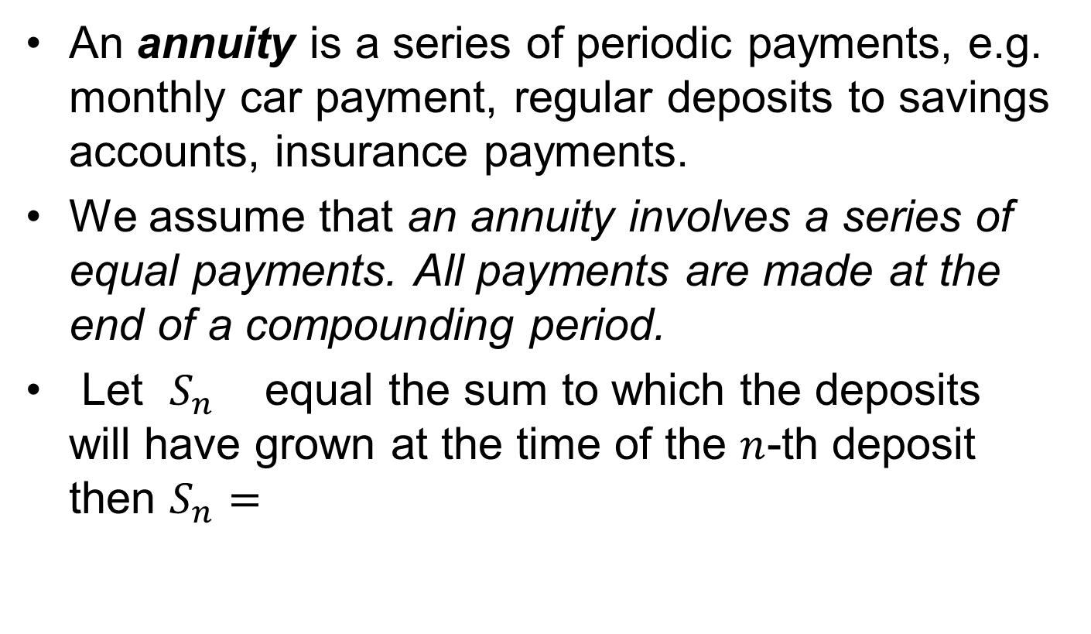
Annuities and their Future value(Revision)
An annuity is a series of periodic payments, e.g. monthly car payment, regular deposits to savings accounts, insurance payments.
We assume that an annuity involves a series of equal payments. All payments are made at the end of a compounding period.
Let $S_{n}$ equal the sum to which the deposits will have grown at the time of the $n$-th deposit then $S_{n}=$

Slide 6
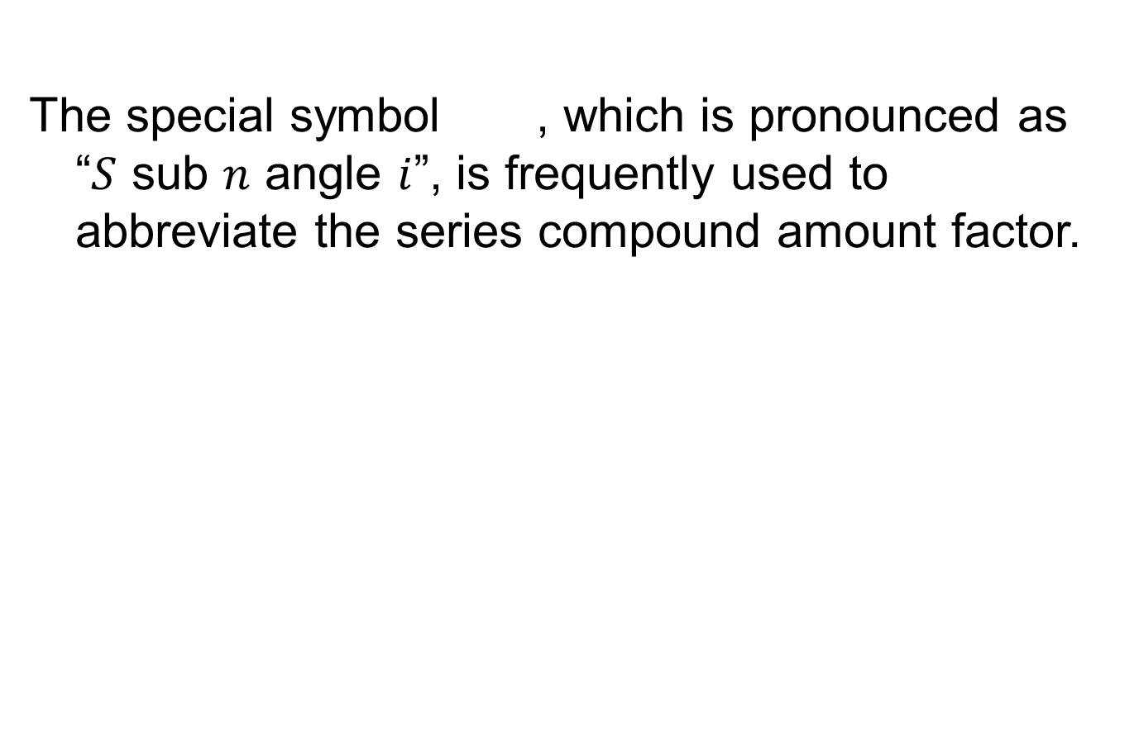
The special symbol , which is pronounced as “$S$ sub $n$ angle $i$”, is frequently used to abbreviate the series compound amount factor.

Slide 7
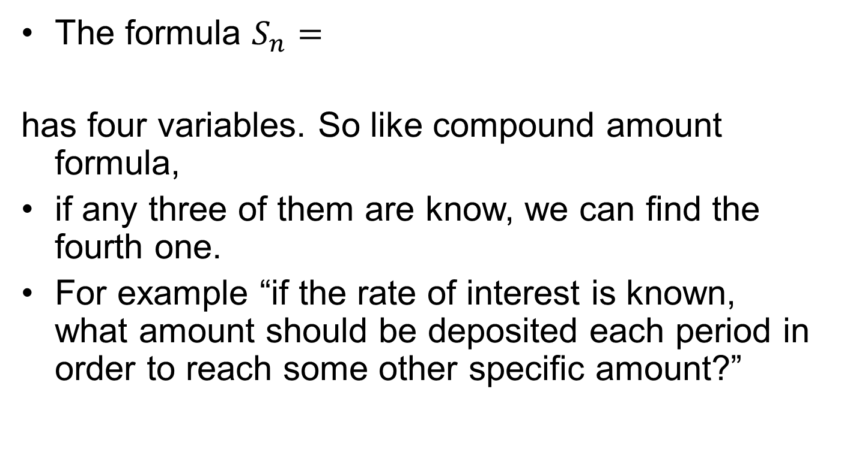
Determining the size of an annuity
The formula $S_{n}=$
has four variables. So like compound amount formula,
if any three of them are know, we can find the fourth one.
For example “if the rate of interest is known, what amount should be deposited each period in order to reach some other specific amount?”

Slide 8
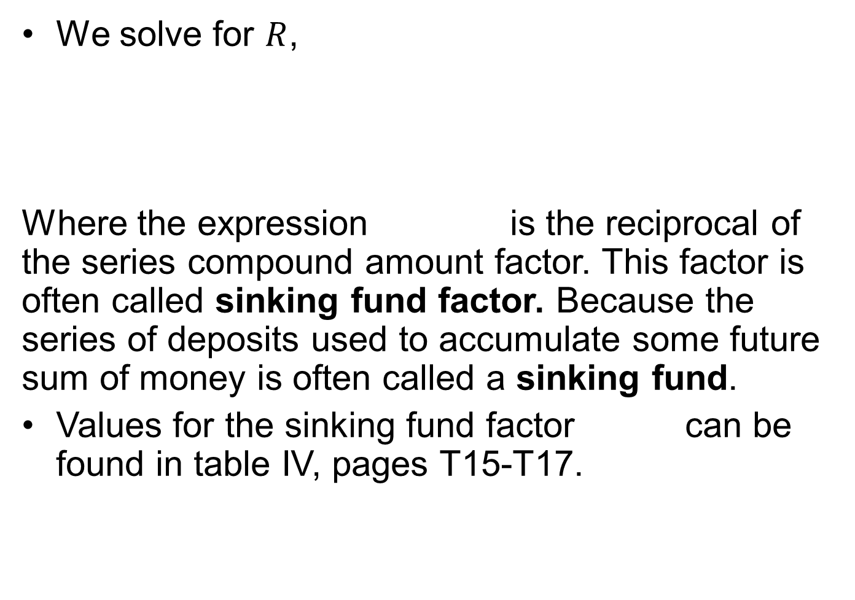
Determining the size of an annuity cont’d
We solve for $R$,
Where the expression is the reciprocal of the series compound amount factor. This factor is often called sinking fund factor. Because the series of deposits used to accumulate some future sum of money is often called a sinking fund.
Values for the sinking fund factor can be found in table IV, pages T15-T17.

Slide 9
Example
A corporation wants to establish a sinking fund beginning at the end of this year.
Annual deposits will be made at the end of this year and for the following 9 years.
If deposits earn interest at the rate of 8 % per year compounded annually, how much money must be deposited each year in order to have $ 12 million at the time of the 10th deposit.?
How much interest will be earned?

Slide 10
Example cont’d
10 deposits of 828360 will be made during this period, total deposits will equal 8283600.
Interest earned = 12 million – 8283600 = 3716400

Slide 11
Example
Assume in the last example that the corporation is going to make quarterly deposits and that the interest is earned at the rate of 8 % per year compounded quarterly.
How much money should be deposited each quarter?
How much less will the company have to deposit over the 10 year period as compared with annual deposits and annual compounding?

Slide 12
Example cont’d
Since there will be 40 deposits of $198720, total deposits over the 10 year period will equal $7948800.
Comparing with annual deposits and annual compounding in the last example,

Slide 14
Annuities and their Present value
There are applications which relate an annuity to its present value equivalent. e.g. we may be interested in knowing the size of a deposit which will generate a series of payments (an annuity) for college, retirement years, … or given that a loan has been made, we may be interested in knowing the series of payments (annuity) necessary to repay the loan with interest.

Slide 15
Annuities and their Present value
The present value of an annuity is an amount of money today which is equivalent to a series of equal payments in the future.
An assumption is that: the final withdrawal would deplete the investment completely.
Example:
A person recently won a state lottery. The terms of the lottery are that the winner will receive annual payments of $ 20,000 at the end of this year and each of the following 3 years.
If the winner could invest money today at the rate of 8 % per year compounded annually, what is the present value of the four payments?

Slide 16
Annuities and their Present value
Solution:
If A defines the present value of the annuity, we might determine the value of A by computing the present value of each 20000 payment.

Slide 18
Formula
As with the future value of an annuity, we can find the general formula for the present value of an annuity. In case of large number of payments the method of example is not practical, so if

Slide 19
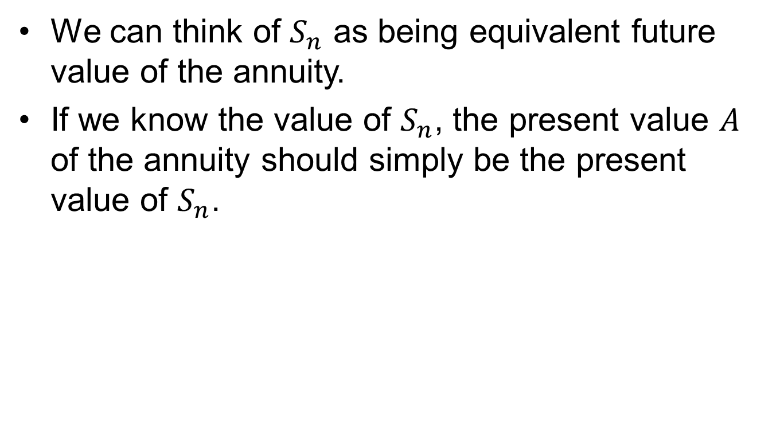
Formula cont’d
We can think of $S_{n}$ as being equivalent future value of the annuity.
If we know the value of $S_{n}$, the present value $A$ of the annuity should simply be the present value of $S_{n}$.

Slide 20
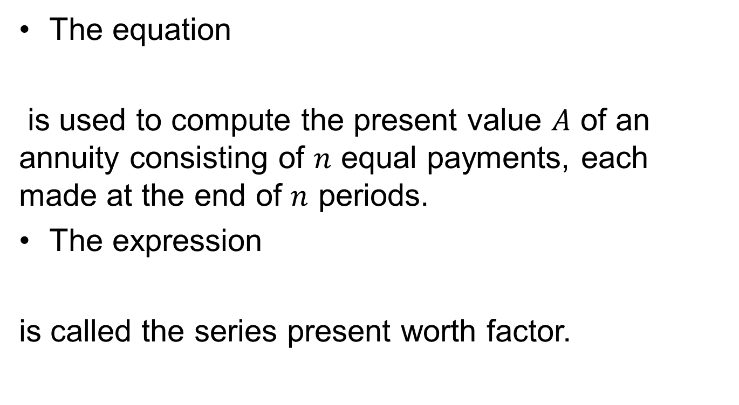
Formula
The equation
is used to compute the present value $A$ of an annuity consisting of $n$ equal payments, each made at the end of $n$ periods.
The expression
is called the series present worth factor.

Slide 21
Examples
2) Parents of a teenager girl want to deposit a sum of money which will earn interest at the rate of 9 % per year compounded semi-annually.
The deposit will be used to generate a series of 8 semi annual payments of $2500 beginning 6 months after the deposit.
These payments will be used to help finance their daughter’s college education.
What amount must be deposited to achieve their goal? How much interest will be earned?

Slide 22
Examples cont’d

Slide 23
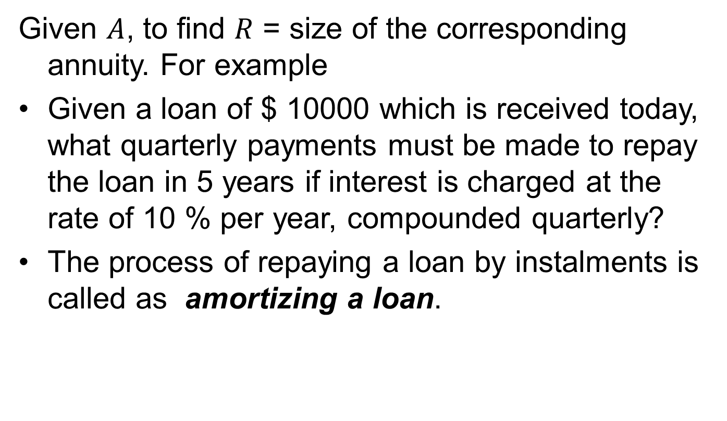
Determining the size of an annuity
Given $A$, to find $R$ = size of the corresponding annuity. For example
Given a loan of $ 10000 which is received today, what quarterly payments must be made to repay the loan in 5 years if interest is charged at the rate of 10 % per year, compounded quarterly?
The process of repaying a loan by instalments is called as amortizing a loan.

Slide 24
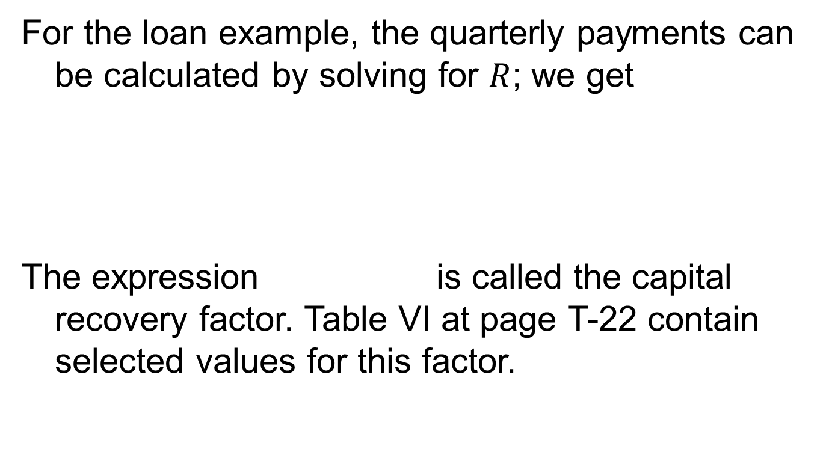
Example
For the loan example, the quarterly payments can be calculated by solving for $R$; we get
The expression is called the capital recovery factor. Table VI at page T-22 contain selected values for this factor.

Slide 25
Example
Determine the quarterly payments necessary to repay the previously mentioned $10,000 loan. How much interest will be paid on the loan?

Slide 26
Summary
Annuity
Formula for the future value of annuity
Determining the size of an annuity
Formula for present value of annuity
Determining the size of an annuity

Slide 27
Next Lecture
Linear Programming

