Slide 1
Business Mathematics
MTH-367
Lecture 10

Slide 2
Chapter 8
Mathematics of Finance
continued

Slide 3
Objectives
Provide an understanding of the time value of money
Provide an understanding of the mathematics of interest computations for singly payment and annuity cash flow structures

Slide 4
Review
Interest
Simple interest
Compound interest
Graphical comparison
Single payment and its computations

Slide 5
Today’s Topics
Compound amount formula (Examples)
Computing present value
Further applications of compound amount formula
Effective interest rates
Annuities and their future values

Slide 6
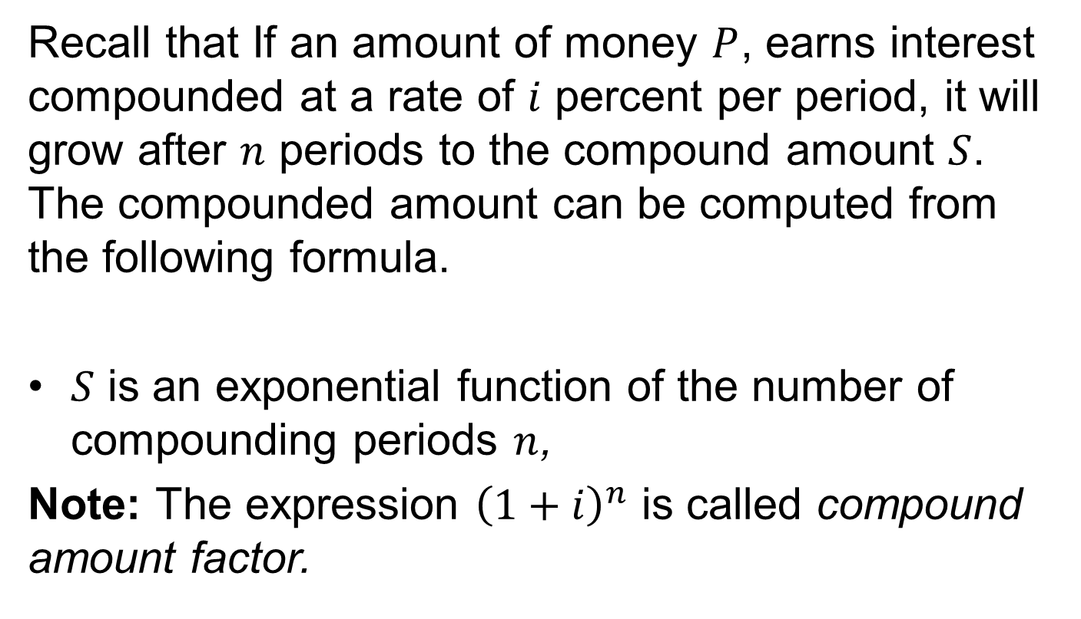
Compound amount formula
Recall that If an amount of money $P$, earns interest compounded at a rate of $i$percent per period, it will grow after $n$ periods to the compound amount $S$. The compounded amount can be computed from the following formula.
$S$ is an exponential function of the number of compounding periods $n$,
Note: The expression ${\left(1+i\right)}^{n}$is called compound amount factor.

Slide 7
Examples
Suppose that $ 1000 is invested in a saving bank which earns interest at the rate of 8 % per year compounded annually. If all interest is left in the account, what will be the account balance after 10 years?

Slide 8
Examples cont’d
A long term investment of $ 250000 has been made by a small company. The interest rate is 12 % per year, and interest is compounded quarterly. If all interest is reinvested at the same rate, what will the value of the investment be after 8 years?
Solution:
Note:

Slide 9
Examples
Here, the interest rate per quarter equals,
The number of compounding periods over 8-years period is

Slide 10
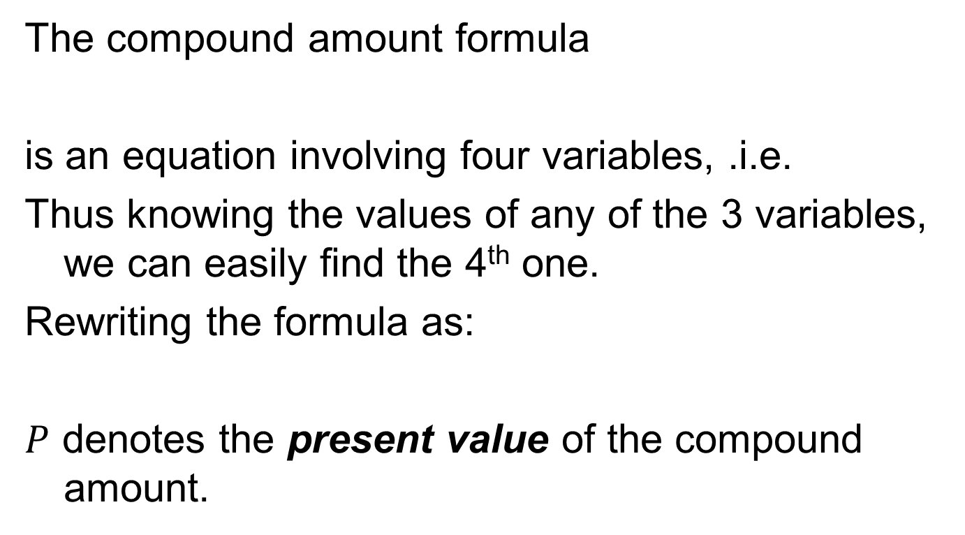
Present value computation
The compound amount formula
is an equation involving four variables, .i.e.
Thus knowing the values of any of the 3 variables, we can easily find the 4th one.
Rewriting the formula as:
$P$denotes the present value of the compound amount.

Slide 11
Example
A person can invest money in saving account at the rate of 10 % per year compounded quarterly.
The person wishes to deposit a lump sum at the beginning of the year and have that sum grow to $ 20,000 over the next 10 years.
How much money should be deposited?

Slide 12
Example cont’d
How much amount of money should be invested at the rate of 10 % per year compounded quarterly, if the compound amount is $ 20000 after 10 years?

Slide 13
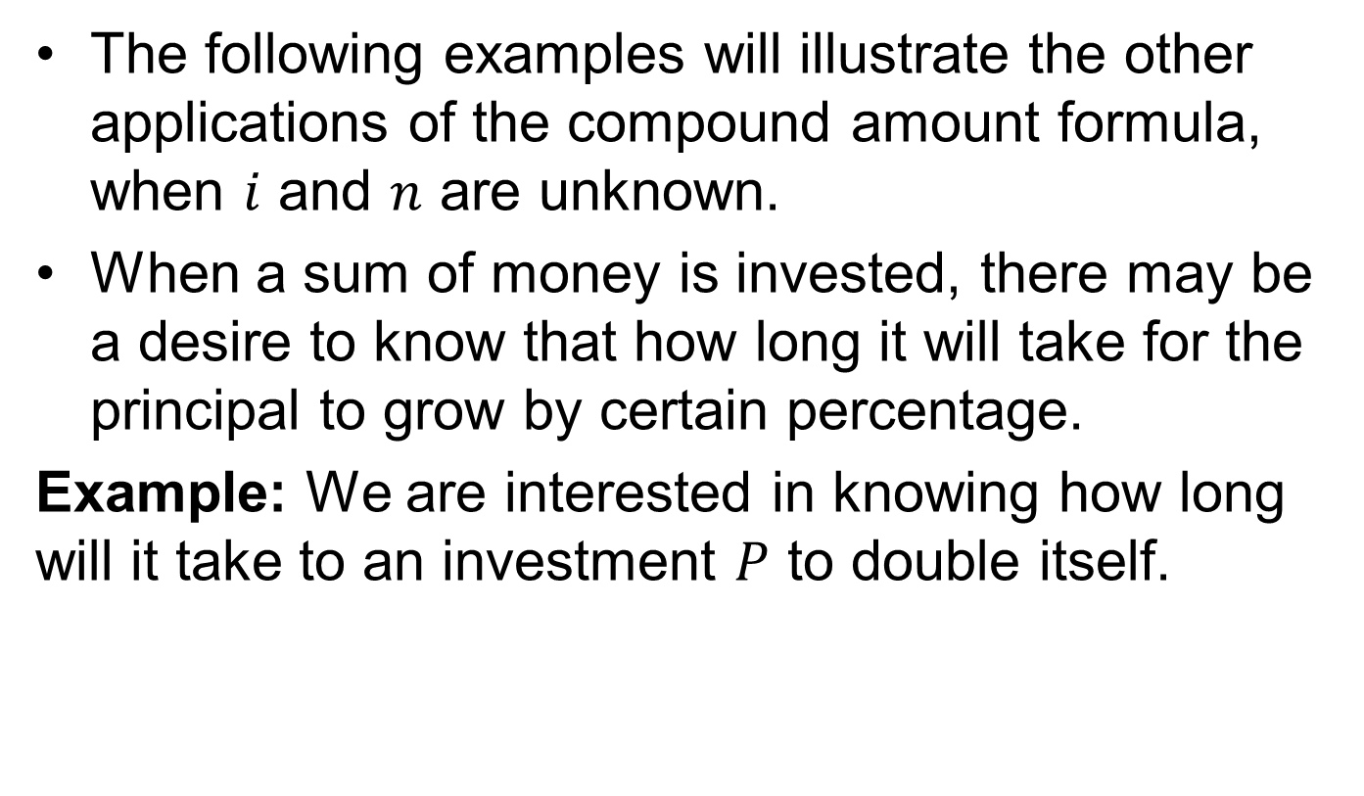
Other applications of compound amount formula
The following examples will illustrate the other applications of the compound amount formula, when $i$ and $n$ are unknown.
When a sum of money is invested, there may be a desire to know that how long it will take for the principal to grow by certain percentage.
Example: We are interested in knowing how long will it take to an investment $P$ to double itself.

Slide 14
Other applications of compound amount formula cont’d
Example: A person wishes to invest $ 10000 and wants the investment to grow to $ 20000 over the next 10 years. At what annual interest rate the required amount is obtained assuming annual compounding?

Slide 16
Effective Interest Rates
The stated annual interest rate is usually called nominal rate.
We know that when interest is compounded more frequently then interest earned is greater than earned when compounded annually.
When compounding is done more frequently than annually, then effective annual interest rates can be determined.
Two rates would be considered equivalent if both results in the same compound amount.

Slide 17
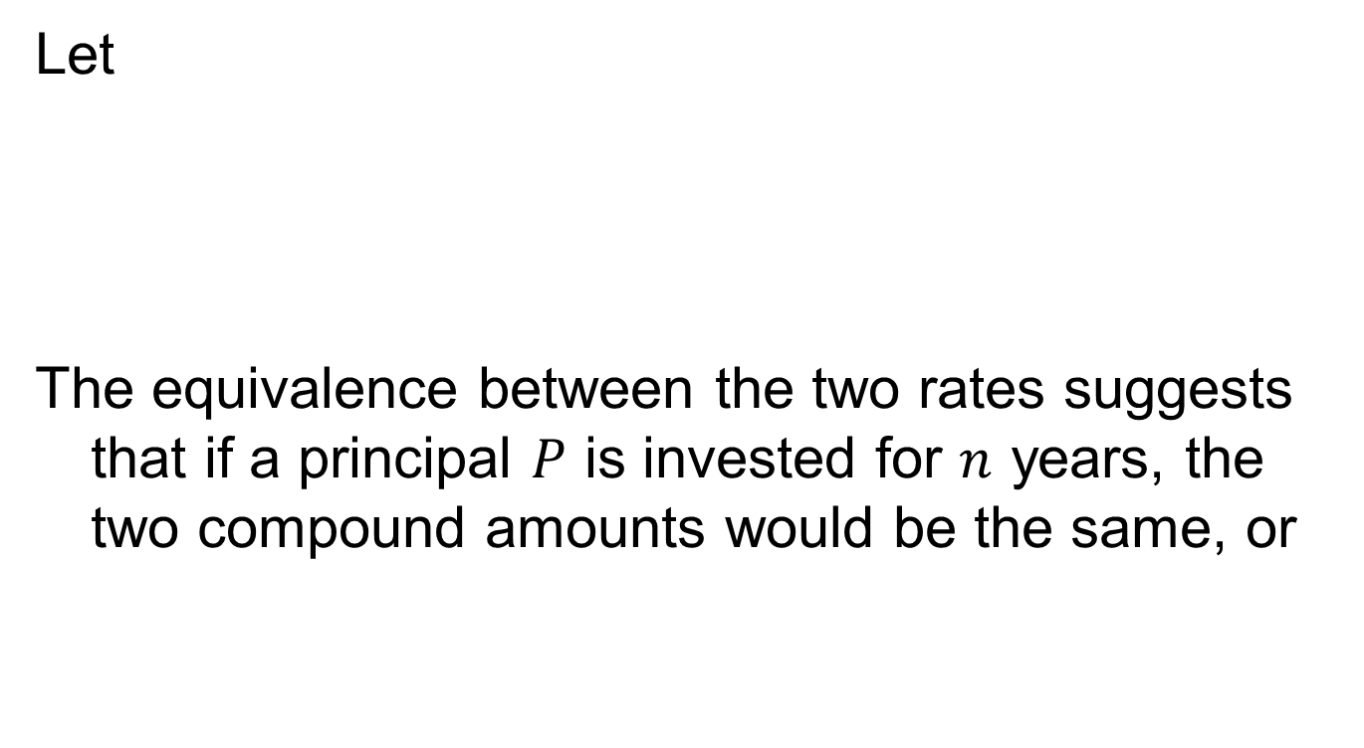
Effective Interest Rates
Let
The equivalence between the two rates suggests that if a principal $P$is invested for $n$years, the two compound amounts would be the same, or

Slide 19
Example
Nominal interest rate = 12 % / year, quarterly

Slide 20
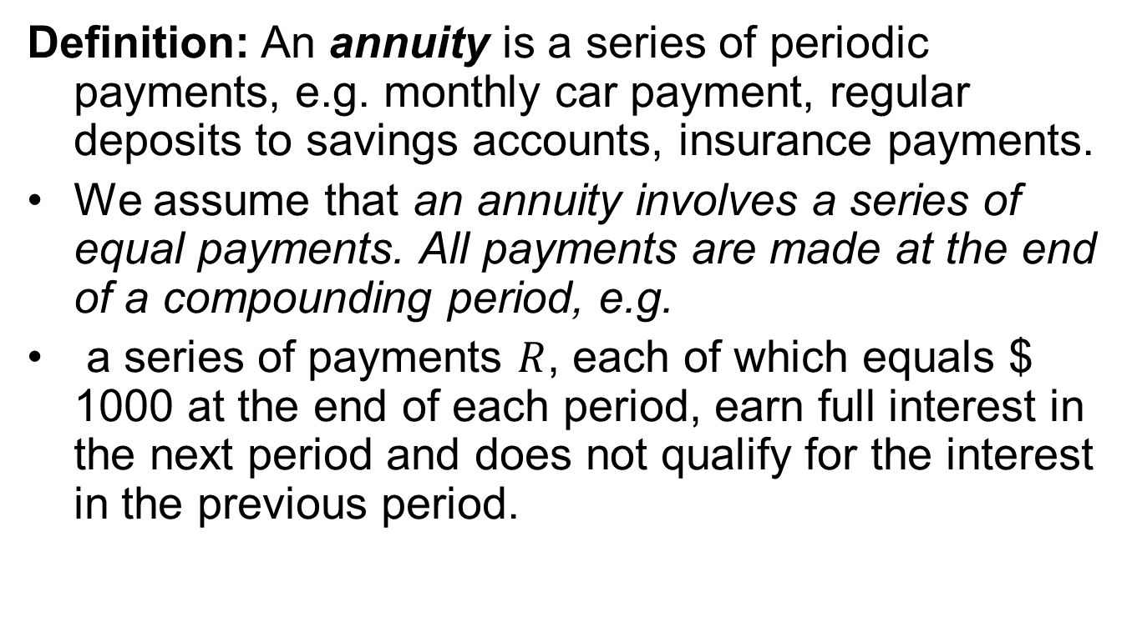
Annuities and their Future value
Definition: An annuity is a series of periodic payments, e.g. monthly car payment, regular deposits to savings accounts, insurance payments.
We assume that an annuity involves a series of equal payments.All payments are made at the end of a compounding period, e.g.
a series of payments $R$, each of which equals $ 1000 at the end of each period, earn full interest in the next period and does not qualify for the interest in the previous period.

Slide 21
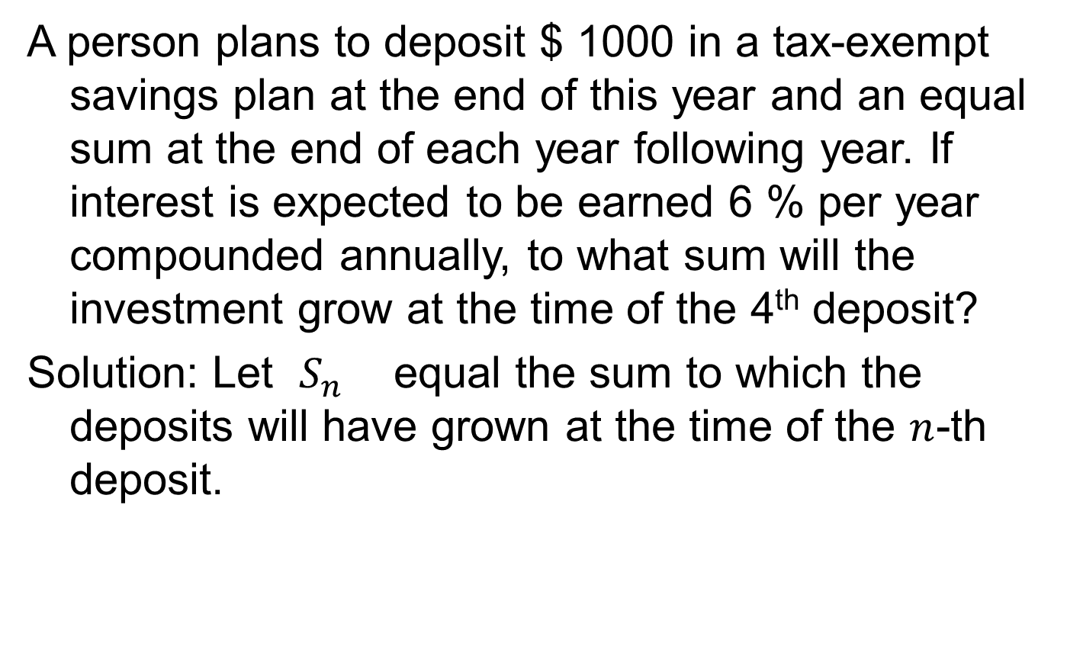
Example
A person plans to deposit $ 1000 in a tax-exempt savings plan at the end of this year and an equal sum at the end of each year following year. If interest is expected to be earned 6 % per year compounded annually, to what sum will the investment grow at the time of the 4th deposit?
Solution: Let $S_{n}$ equal the sum to which the deposits will have grown at the time of the $n$-th deposit.

Slide 22
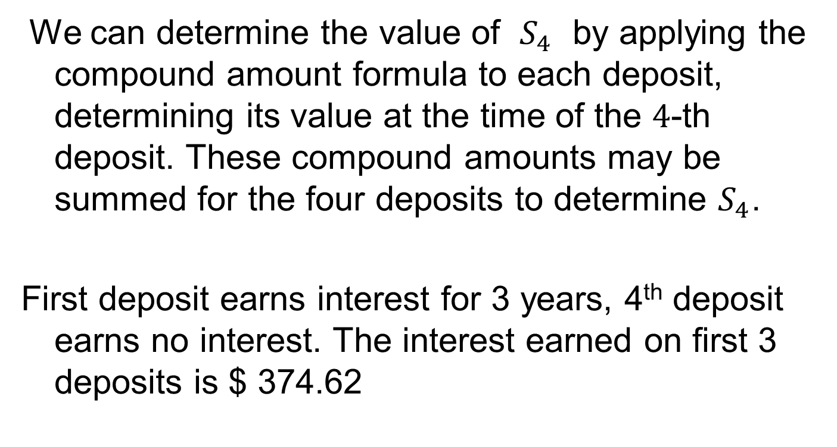
Example cont’d
We can determine the value of $S_{4}$ by applying the compound amount formula to each deposit, determining its value at the time of the $4$-th deposit. These compound amounts may be summed for the four deposits to determine $S_{4}$.
First deposit earns interest for 3 years, 4th deposit earns no interest. The interest earned on first 3 deposits is $ 374.62

Slide 23
Formula
The procedure used in the above example is not practical when dealing with large number of payments.

Slide 24
Formula cont’d

Slide 25
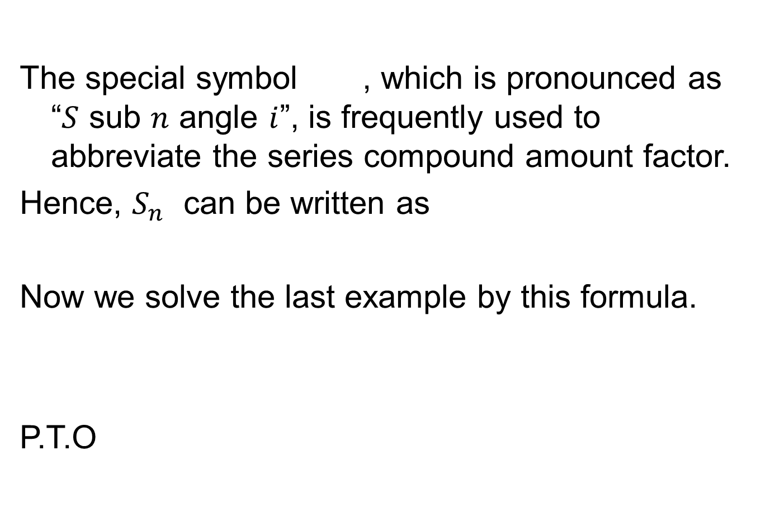
The special symbol , which is pronounced as “$S$ sub $n$ angle $i$”, is frequently used to abbreviate the series compound amount factor.
Hence, $S_{n}$ can be written as
Now we solve the last example by this formula.
P.T.O

Slide 26
Examples
A boy plans to deposit $ 50 in a savings account for the next 6 years. Interest is earned at the rate of 8% per year compounded quarterly. What should her account balance be 6 years from now? How much interest will he earn?

Slide 28
Summary
Compound amount formula (Examples)
Computing present value
Further applications of compound amount formula
Effective interest rates
Annuities and their future values by a mathematical formula

Slide 29
Next Lecture
Determining the size of annuity
Annuities and their present value

