Slide 1
Business Mathematics
MTH-367
Lecture 9

Slide 2
Chapter 8
Mathematics of Finance

Slide 3
Objectives
To discuss interest rates and their effect on the value of money
Provide an understanding of the time value of money
Provide an understanding of the mathematics of interest computations for singly payment and annuity cash flow structures

Slide 4
Main Topics
Interest and its computations
Single payment computations
Annuities and their future value
Annuities and their present value

Slide 5
Today’s Topics
Interest
Simple interest
Compound interest
Graphical comparison
Single payment and its computations

Slide 6
Introduction
In this chapter, we shall model selected topics in finance that deal with the time value of money, such as investments, loans, e.t.c.
Mainly, we will study the interest rates and their effects on the value of money.
Interests are not only related to money e.g. population growth can be characterized by ‘rate of growth’.

Slide 7
Interest
Definition: The Interest is a fee which is paid for having the use of money.
We pay interest on loans for having the use of bank’s money.
Similarly, the bank pay us interest on money invested in savings accounts because the bank has temporary access to our money.
Definition: The amount of money that is lent or invested is called the principal.

Slide 8
Interest cont’d
Interest is usually paid in proportion to the principal amount and the period of time over which the money is used.
The interest rate specifies the rate at which the interest accumulates.
It is typically stated as a percentage of the principal amount per period of time, e.g. 18 % per year, 12 % quarterly or 13.5 % per month.

Slide 9
Simple Interest
Definition: Interest that is paid solely on the amount of the principal is called simple interest.
Simple interest is usually associated with loans or investments which are short-term in nature, computed as:
Simple interest =

Slide 10
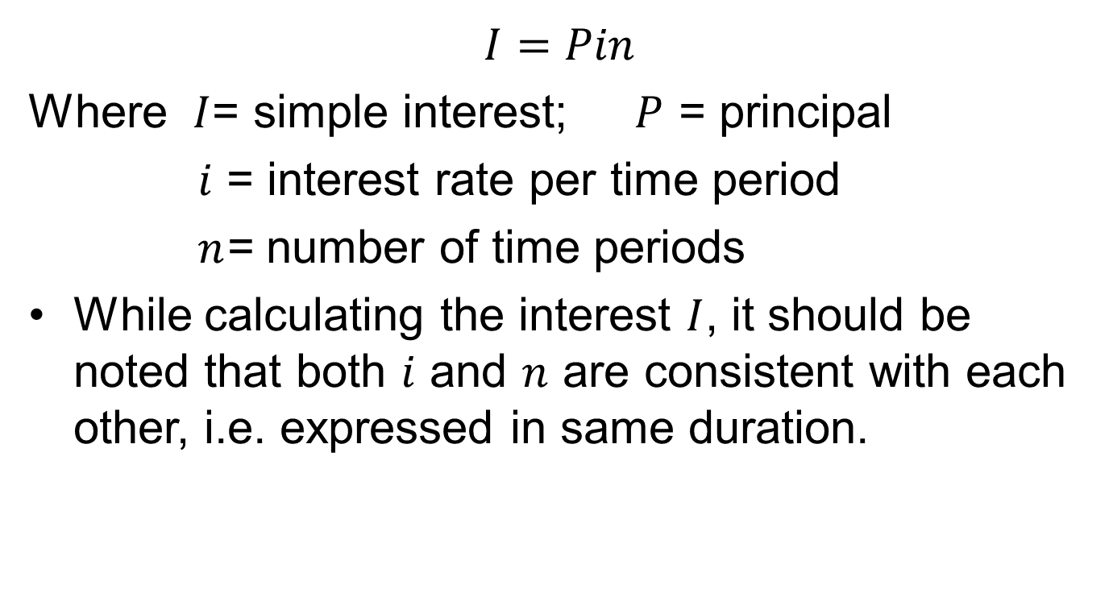
Simple Interest cont’d
$$I=Pin$$
Where $I$= simple interest; $P$ = principal
$i$ = interest rate per time period
$n$= number of time periods
While calculating the interest $I$, it should be noted that both $i$ and $n$ are consistent with each other, i.e. expressed in same duration.

Slide 11
Example
A credit union has issued a 3 year loan of $ 5000. Simple interest is charged at the rate of 10% per year. The principal plus interest is to be repaid at the end of the third year. Compute the interest for the 3 year period. What amount will be repaid at the end of the third year?

Slide 12
Compound Interest
In compound interest, the interest earned each period is reinvested, i.e. added to the principal for purposes of computing interest for the next period.
The amount of interest computed using this procedure is called the compound interest.

Slide 13
Compound Interest
Example: Assume that we have deposited $ 8000 in a credit union which pays interest of 8% per year compounded quarterly.
The amount of interest at the end of 1 quarter would be:

Slide 14
Compound Interest cont’d
The simple interest after 1 year would be:
The difference between simple and compound interest is:

Slide 15
Continuous compounding
After simple and compound interest, we will compute the continuous compounding.
Recall that, the continuous compounding can be thought of as occurring infinite number of times.
It can be computed by the following formula.

Slide 16
Continuous compounding
Example: Compute the growth in a $ 10,000 investment which earns interest at 10 per cent per year over the period of 10 years.

Slide 17
Calculation of annual compounding for same example.

Slide 19
Graphical comparison
Compound interest is greater than simple interest.
The value of an investment increases with increased frequency of compounding.

Slide 20
Graphical comparison

Slide 21
Single-Payment computations
Suppose we have invested a sum of money and we wish to know that: “what will be the value of money at sometime in the future?”
In knowing this, we assume that any interest is computed on compounding basis.
Recall that the amount of money invested is called the principal and the interest earned is called (after some period of time) the compound amount.

Slide 22
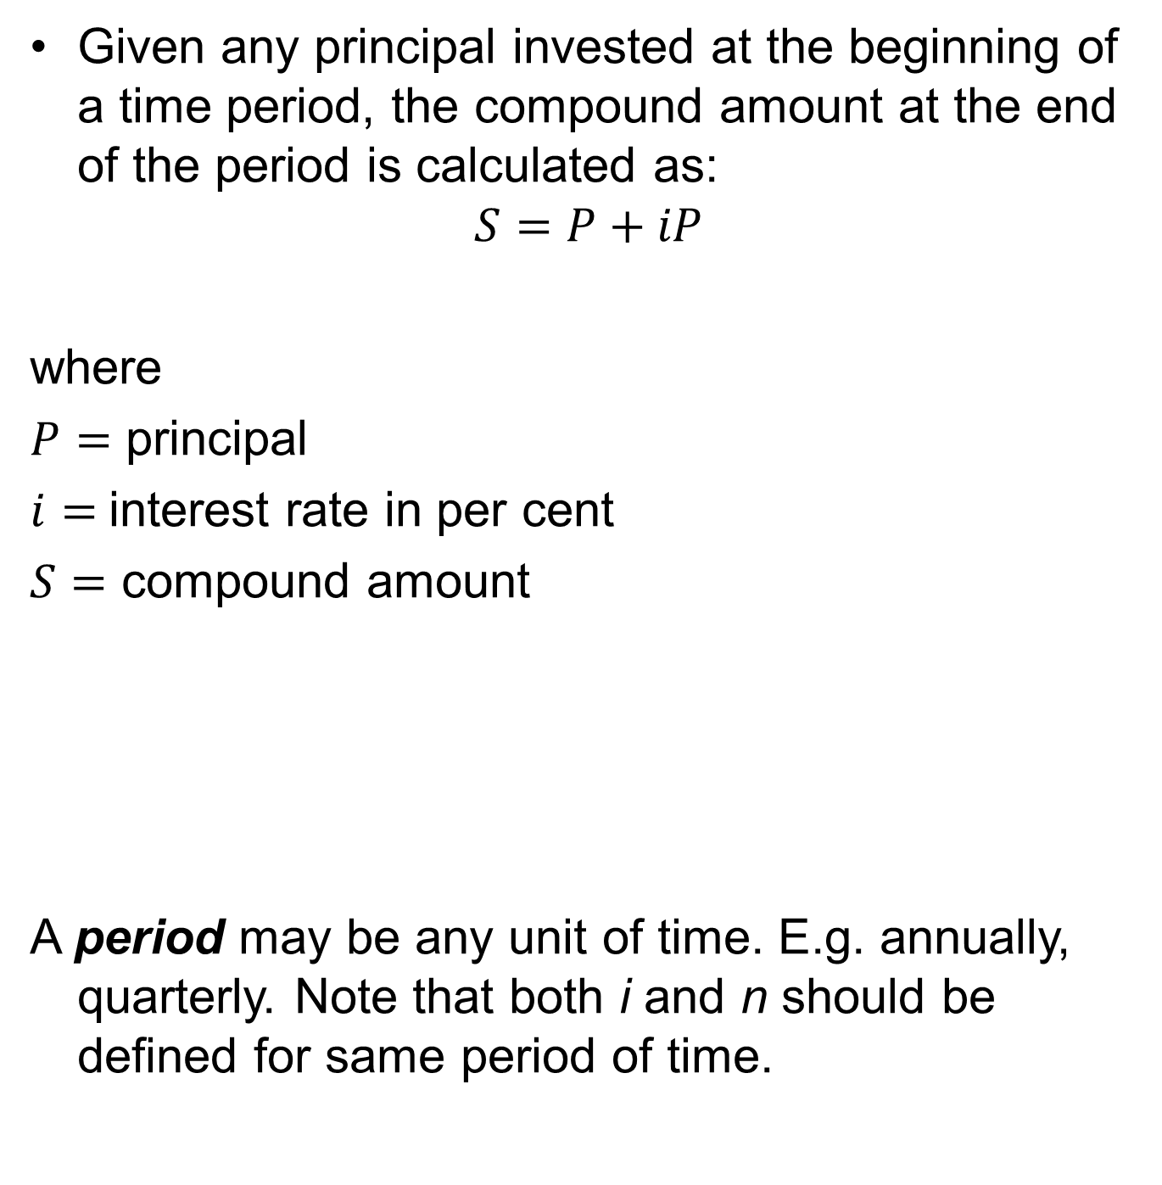
Given any principal invested at the beginning of a time period, the compound amount at the end of the period is calculated as:
$$S=P+iP$$
where
$P=$ principal
$i=$interest rate in per cent
$S=$ compound amount
A period may be any unit of time. E.g. annually, quarterly. Note that both i and n should be defined for same period of time.

Slide 23
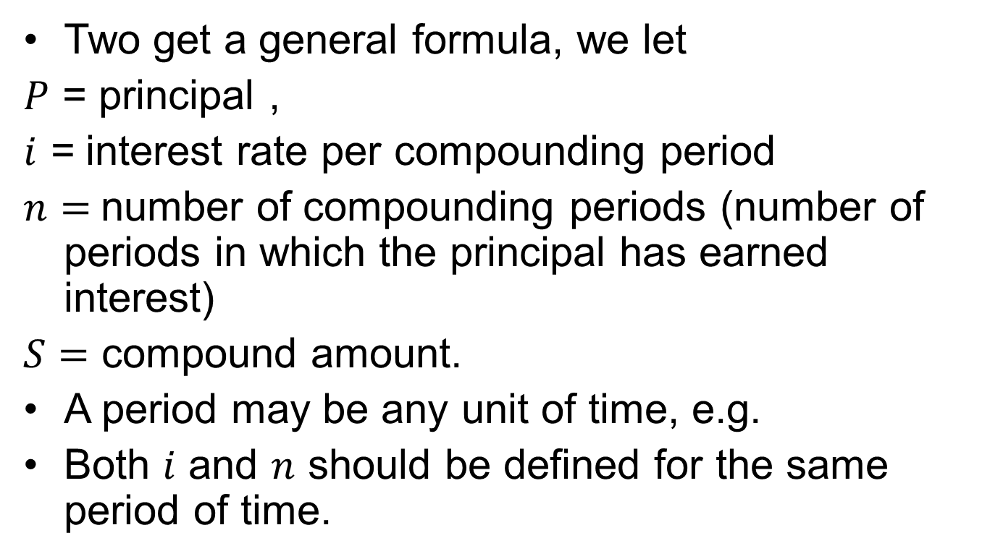
Compound amount formula
Two get a general formula, we let
$P$ = principal ,
$i$ = interest rate per compounding period
$n=$number of compounding periods (number of periods in which the principal has earned interest)
$S=$ compound amount.
A period may be any unit of time, e.g.
Both $i$ and $n$ should be defined for the same period of time.

Slide 24
Compound amount formula cont’d
We know that compound amount after 1 period:
Compound amount after 2 periods:
Compound amount after + interest earned during the
1 period second period

Slide 25
Compound amount formula cont’d
Compound amount after 3 periods:
Continuing in this way, after n periods the compound amount will be:

Slide 26
Summary
Interest
Simple interest
Compound interest
Graphical comparison
Single payment and its computations

Slide 27
Next Lecture
Compound amount formula (Examples)
Computing present value
Further applications of compound amount formula
Effective interest rates
Annuities and their future values

