Slide 1
Business Mathematics
MTH-367
Lecture 8

Slide 2
Chapter 7
Exponential and Logarithmic Functions

Slide 3
Main topics
Properties of exponents and radicals
Exponential functions
Characteristics of Exponential Functions
Exponential functions with base e
Applications of exponential functions

Slide 4
Objectives
Discuss the nature of exponential functions: their structural characteristics and graphical behaviour
Present a variety of applications of exponential functions

Slide 5
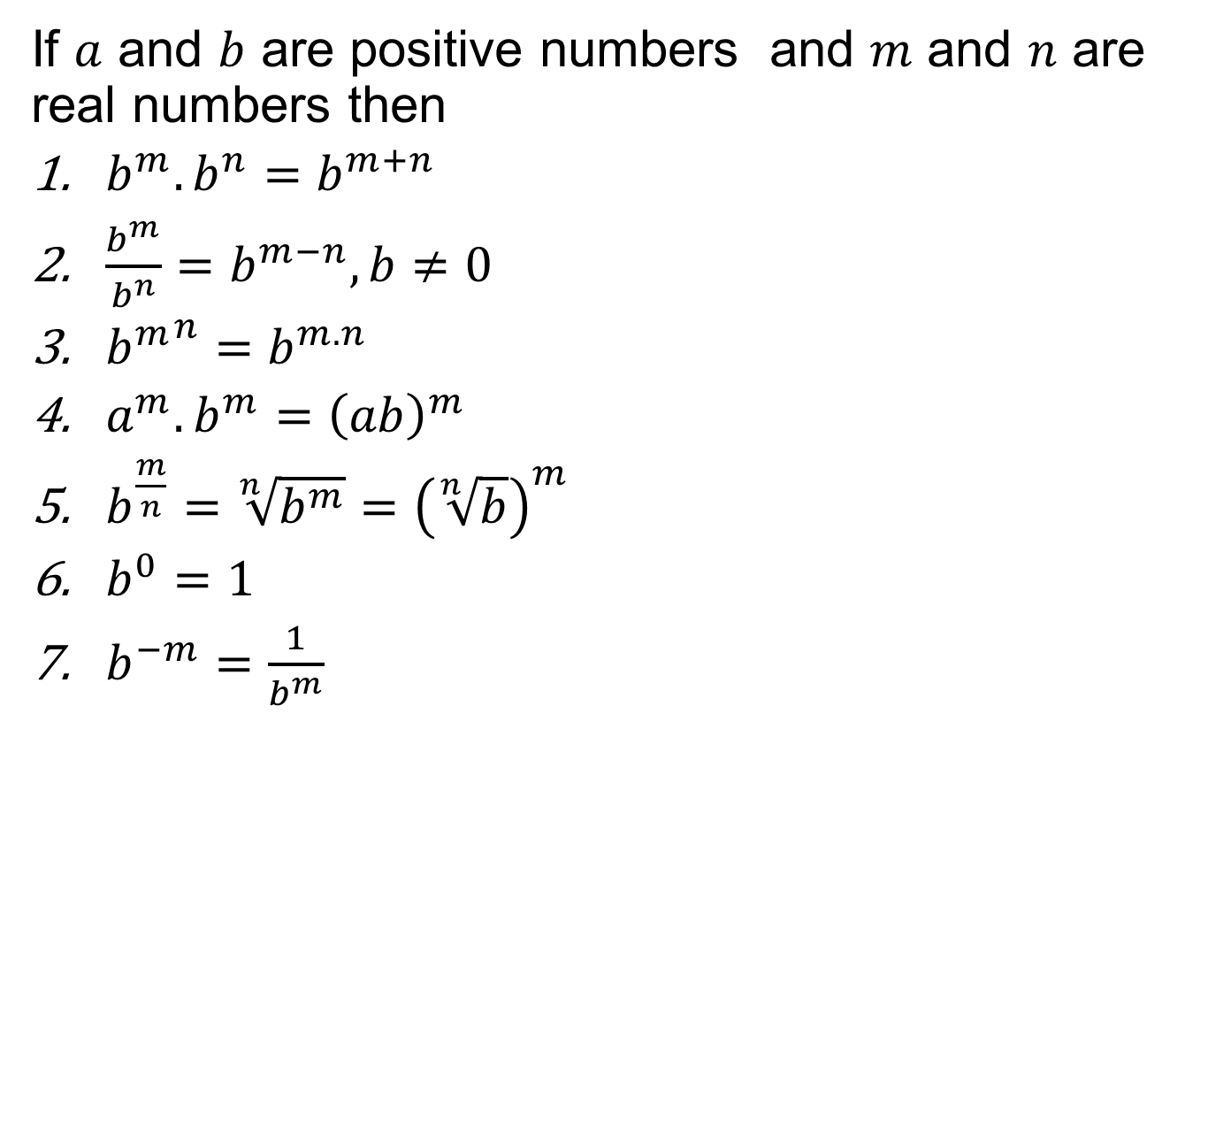
Properties of exponents and radicals
If $a$ and $b$ are positive numbers and $m$ and $n$ are real numbers then
$b^{m}.b^{n}=b^{m+n}$
$\frac{b^{m}}{b^{n}}=b^{m−n}, b≠0$
${b^{m}}^{n}=b^{m.n}$
$a^{m}.b^{m}={\left(ab\right)}^{m}$
$b^{\frac{m}{n}}=\sqrt[n]{b^{m}}={\left(\sqrt[n]{b}\right)}^{m}$
$b^{0}=1$
$b^{−m}=\frac{1}{b^{m}}$

Slide 6
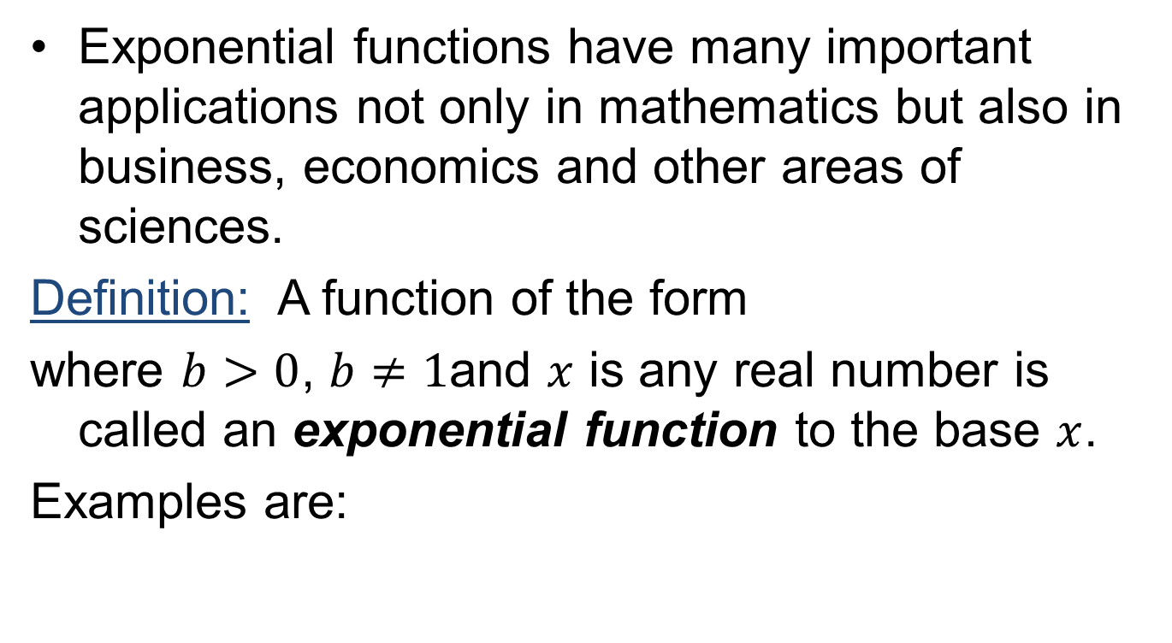
Exponential Function
Exponential functions have many important applications not only in mathematics but also in business, economics and other areas of sciences.
Definition: A function of the form
where $b>0$, $b≠1$and $x$ is any real number is called an exponential function to the base $x$.
Examples are:

Slide 7
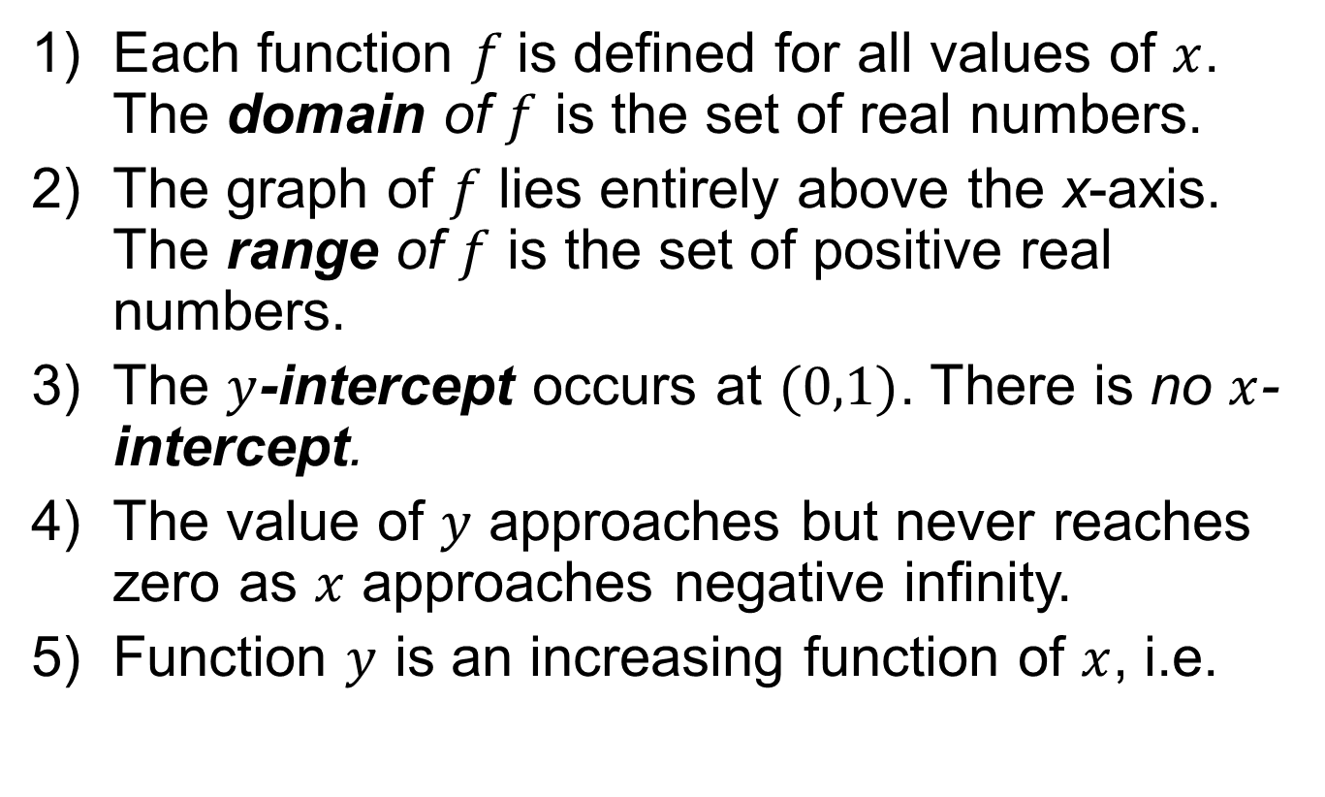
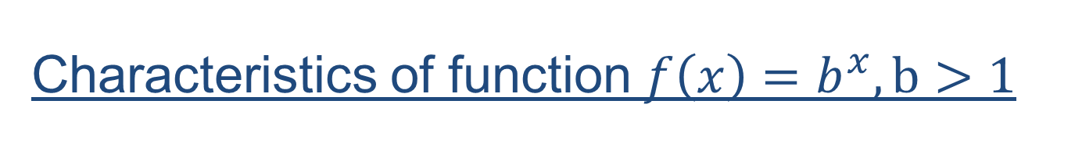
Characteristics of function $f\left(x\right)=b^{x},b>1$
Each function $f$is defined for all values of $x$. The domain of $f$ is the set of real numbers.
The graph of $f$ lies entirely above the x-axis. The range of $f$ is the set of positive real numbers.
The $y$-intercept occurs at $(0,1)$. There is no $x$-intercept.
The value of $y$ approaches but never reaches zero as $x$ approaches negative infinity.
Function $y$ is an increasing function of $x$, i.e.

Slide 8
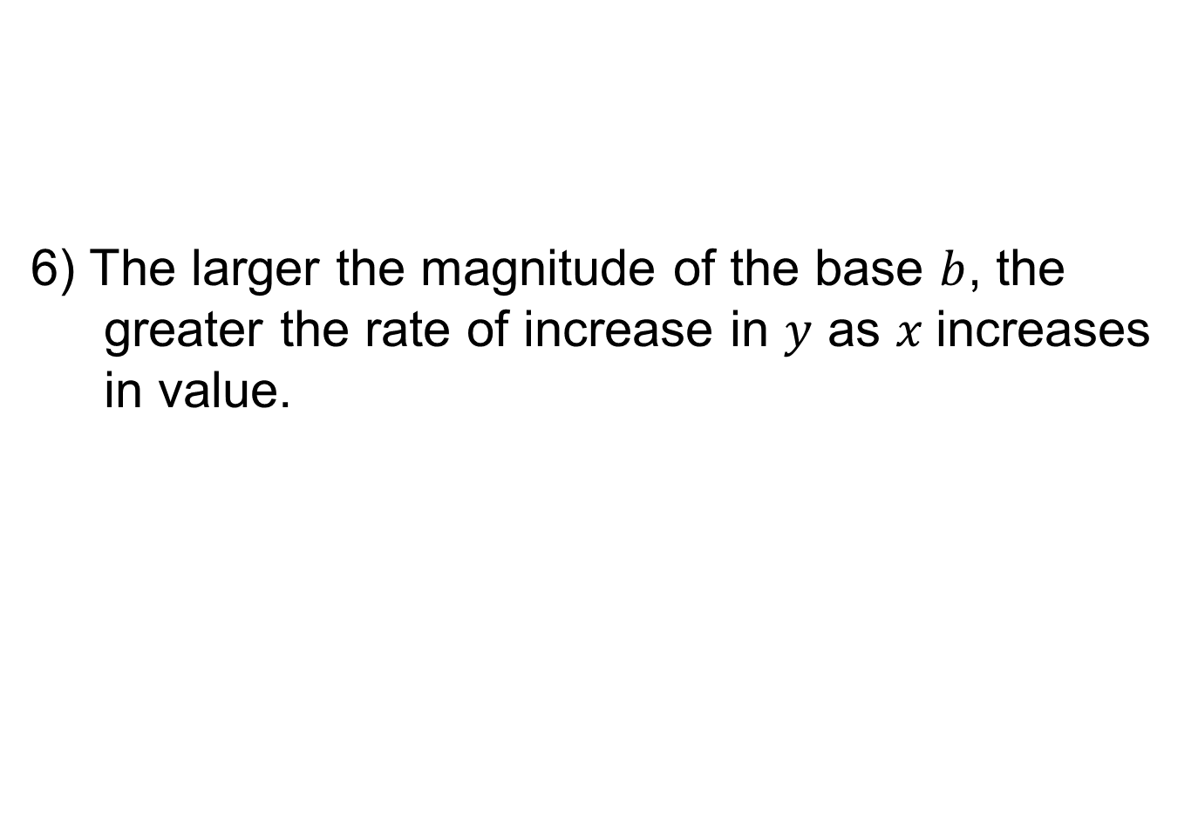
6) The larger the magnitude of the base $b$, the greater the rate of increase in $y$ as $x$increases in value.

Slide 9
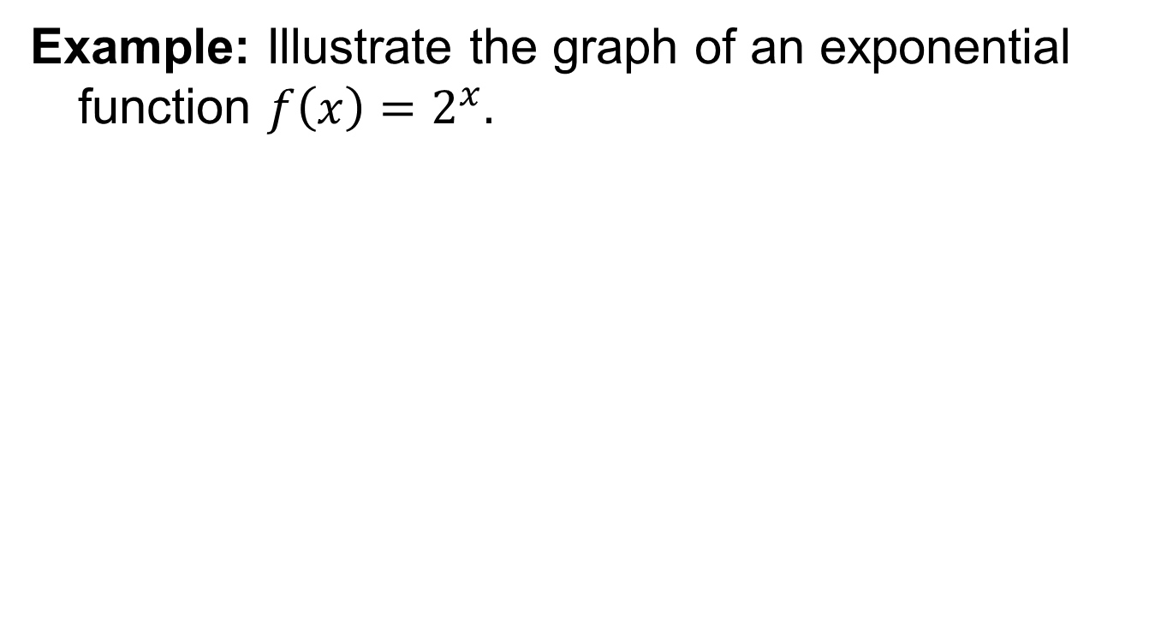
Graphs of exponential functions
Example: Illustrate the graph of an exponential function $f\left(x\right)=2^{x}.$

Slide 10
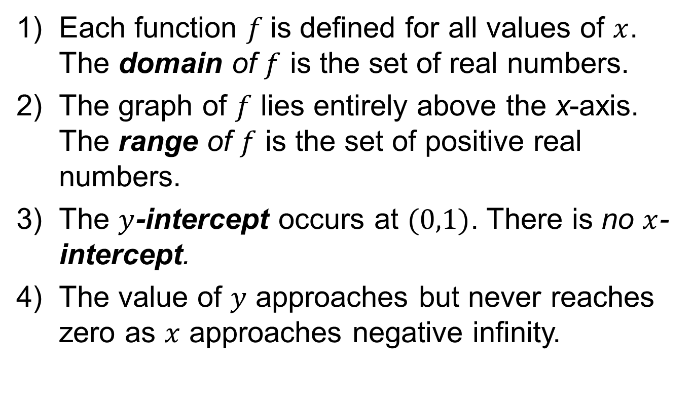
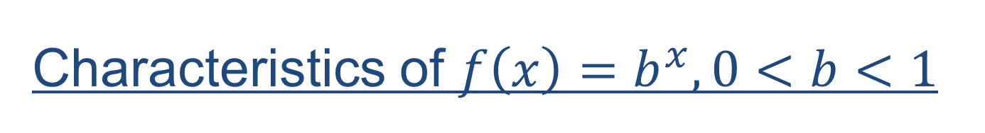
Characteristics of $f\left(x\right)=b^{x},0<b<1$
Each function $f$is defined for all values of $x$. The domain of $f$ is the set of real numbers.
The graph of $f$ lies entirely above the x-axis. The range of $f$ is the set of positive real numbers.
The $y$-intercept occurs at $(0,1)$. There is no $x$-intercept.
The value of $y$ approaches but never reaches zero as $x$ approaches negative infinity.

Slide 11
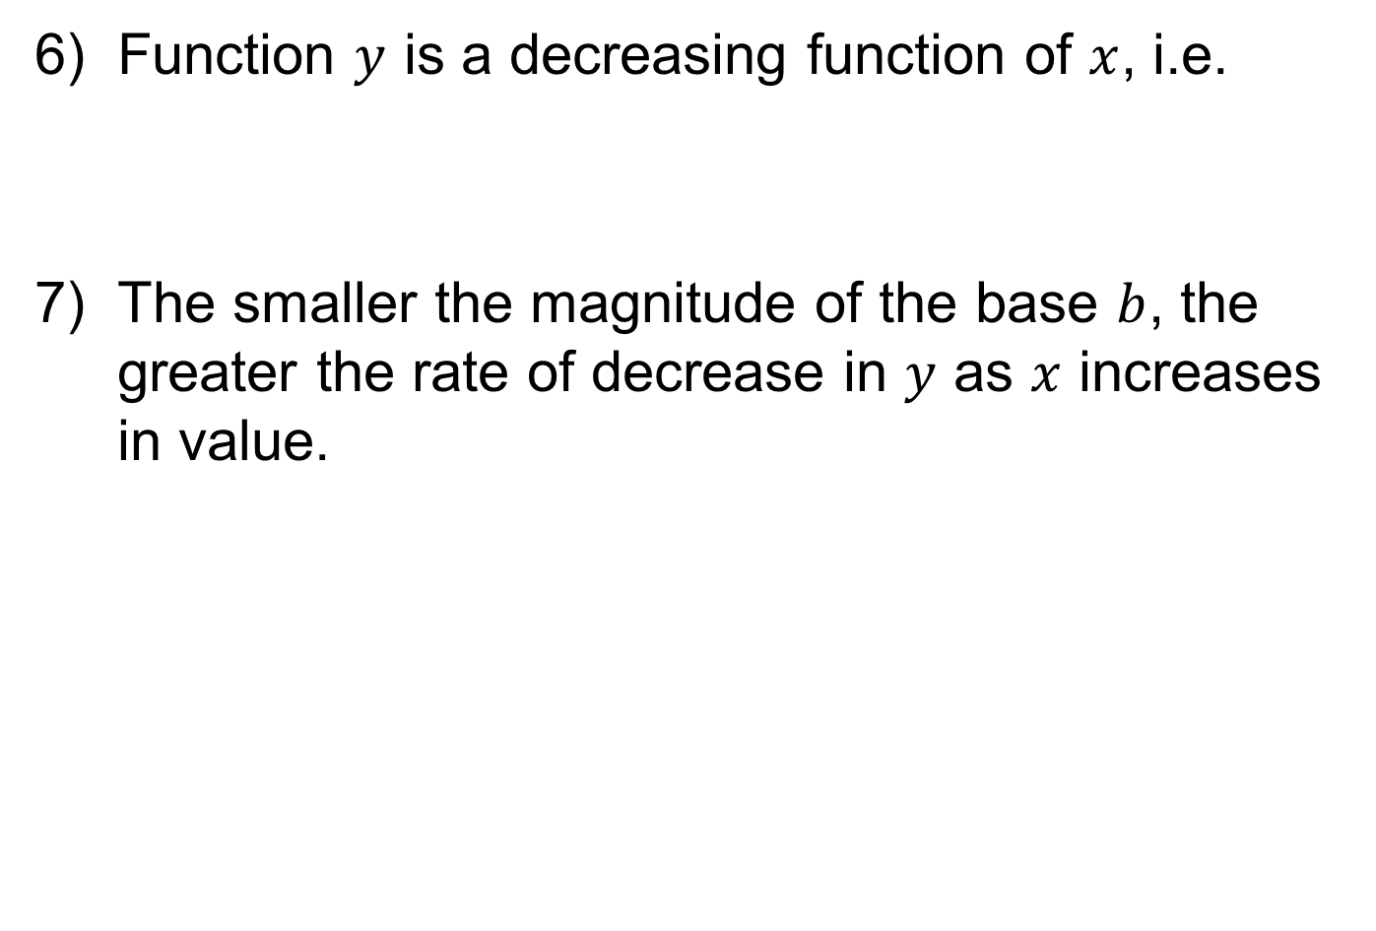

Slide 12
Base e exponential functions
A special class of exponential functions is of the form
Base e exponential functions also called as natural exponential functions and are particularly appropriate in modelling continuous growth and decay process, continuous compounding of interest.
Base e exponential functions are more widely applied than any other class of functions.

Slide 13
Two special exponential functions are

Slide 14
Conversion to base e
There are instances where base e exponential functions are preferred to those having another base. Exponential functions having a base other than e can be transformed into equivalent base e functions.
This can be done because any positive number can be expressed equivalently as some power of the base e, or we can find an exponent n such that

Slide 15
Example:

Slide 16
Applications of exponential functions
Exponential Growth process: When a growth process is characterized by a constant per cent increase in value, it is referred as an exponential growth process.
Exponential Decay process: When a decay process is characterized by a constant per cent decrease in value, it is referred as an exponential decay process.

Slide 17
Applications of exponential functions
Exponential functions have particular application to growth processes and decay processes.
Growth processes: population growth, appreciation in the value of assets, inflation, growth in the rate at which some resources(like energy) are used.
Decay processes: declining value of certain assets such as machinery, decline in the efficiency of machine, decline in the rate of incidence of certain diseases with the improvement of medical research and technology. … exponential decay process.
Both process are usually stated in terms of time.

Slide 18
Example (Compound interest)
Compound Interest: The interest earned by an invested amount of money is reinvested so that it also earns interest, i.e. the interest is converted into principal and hence there is “interest on interest”.

Slide 19
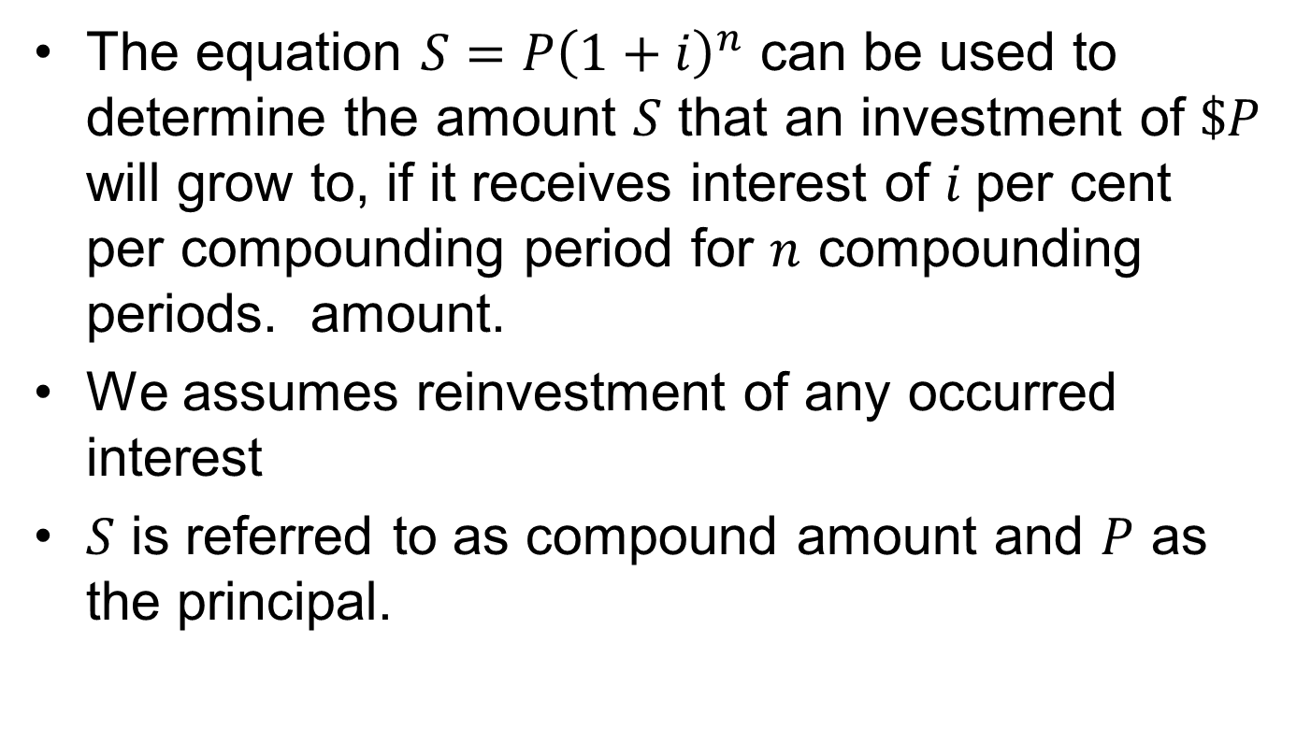
Compound interest cont’d

Slide 20
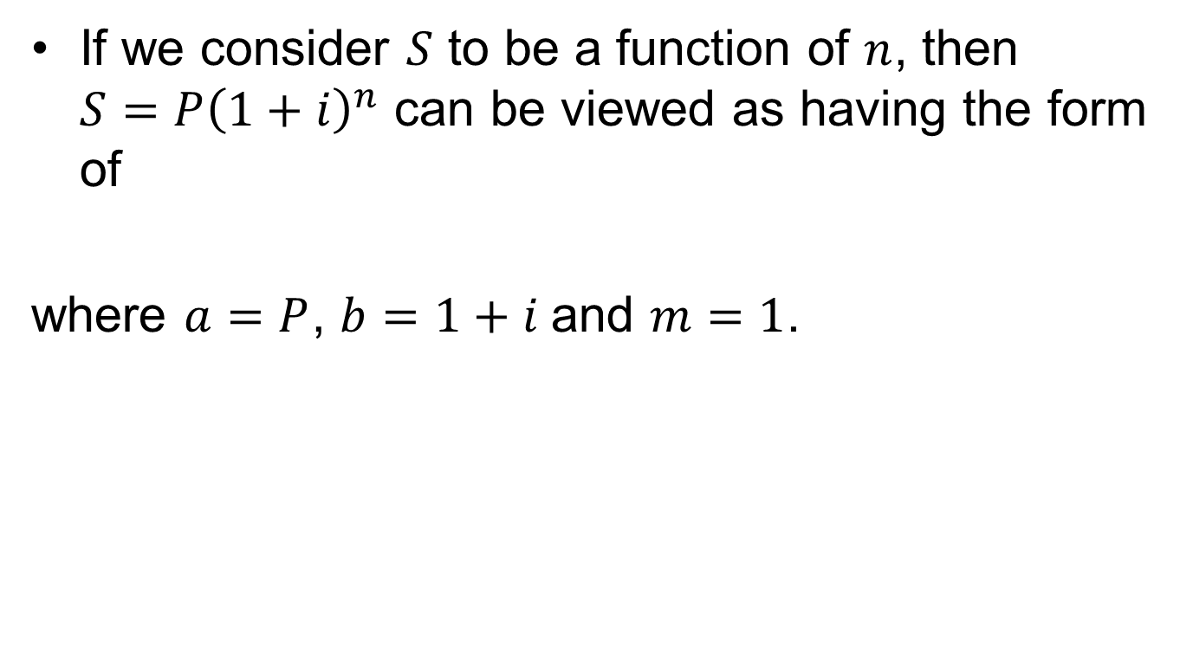
Compound interest cont’d
If we consider $S$ to be a function of $n$, then $S=P{\left(1+i\right)}^{n}$ can be viewed as having the form of
where $a=P$, $b=1+i$and $m=1$.

Slide 21
Compound interest cont’d

Slide 22
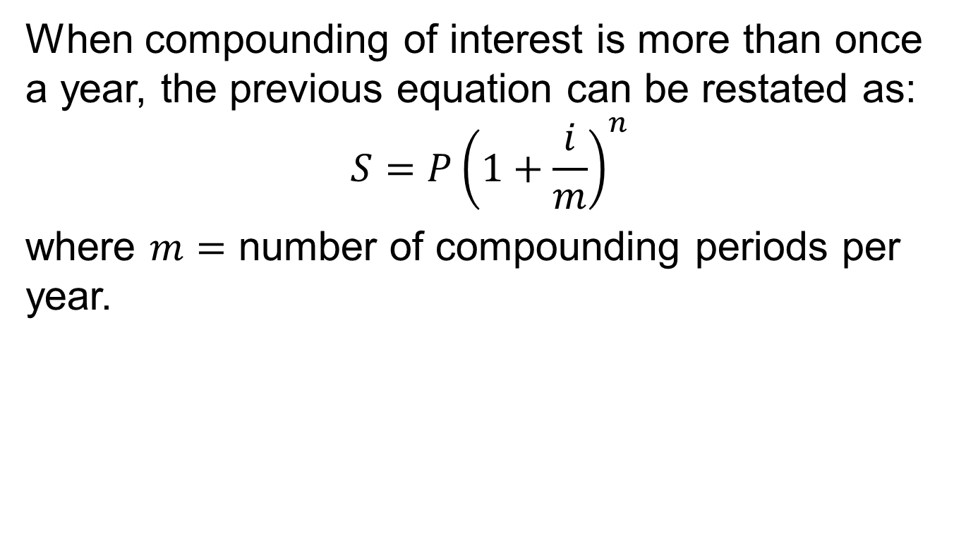
Compound interest cont’d
When compounding of interest is more than once a year, the previous equation can be restated as:
$$S=P{\left(1+\frac{i}{m}\right)}^{n}$$
where $m=$ number of compounding periods per year.

Slide 23
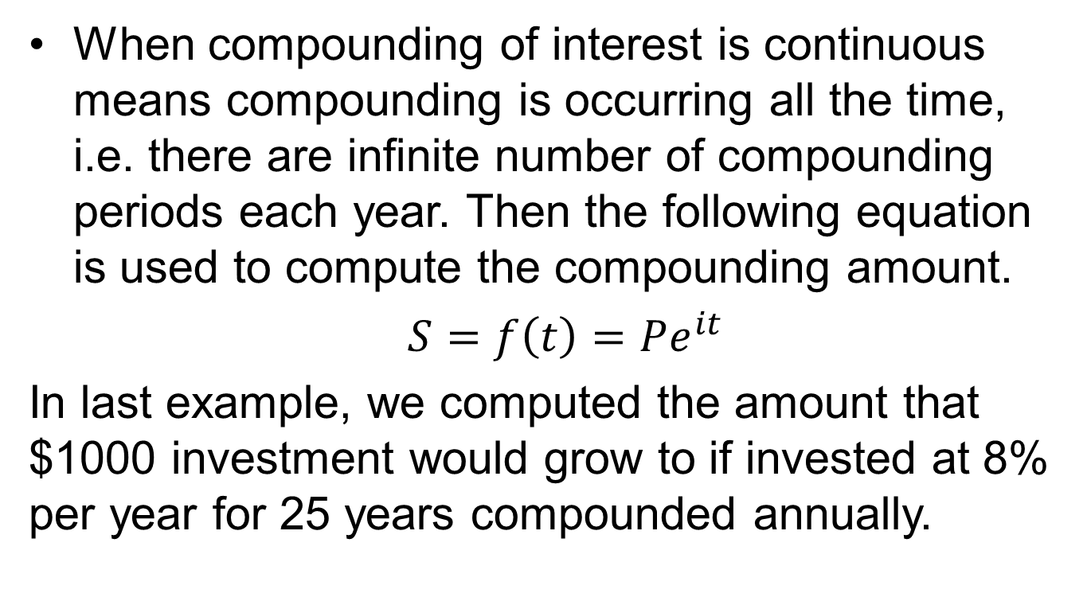
Continuous compounding
When compounding of interest is continuous means compounding is occurring all the time, i.e. there are infinite number of compounding periods each year. Then the following equation is used to compute the compounding amount.
$S=f\left(t\right)=Pe^{it}$
In last example, we computed the amount that $1000 investment would grow to if invested at 8% per year for 25 years compounded annually.

Slide 24
(Continuous compounding) cont’d:
If the $1,000 earns 8% per year compounded continuously, it will grow to a sum

Slide 25
(Continuous compounding) cont’d:

Slide 26
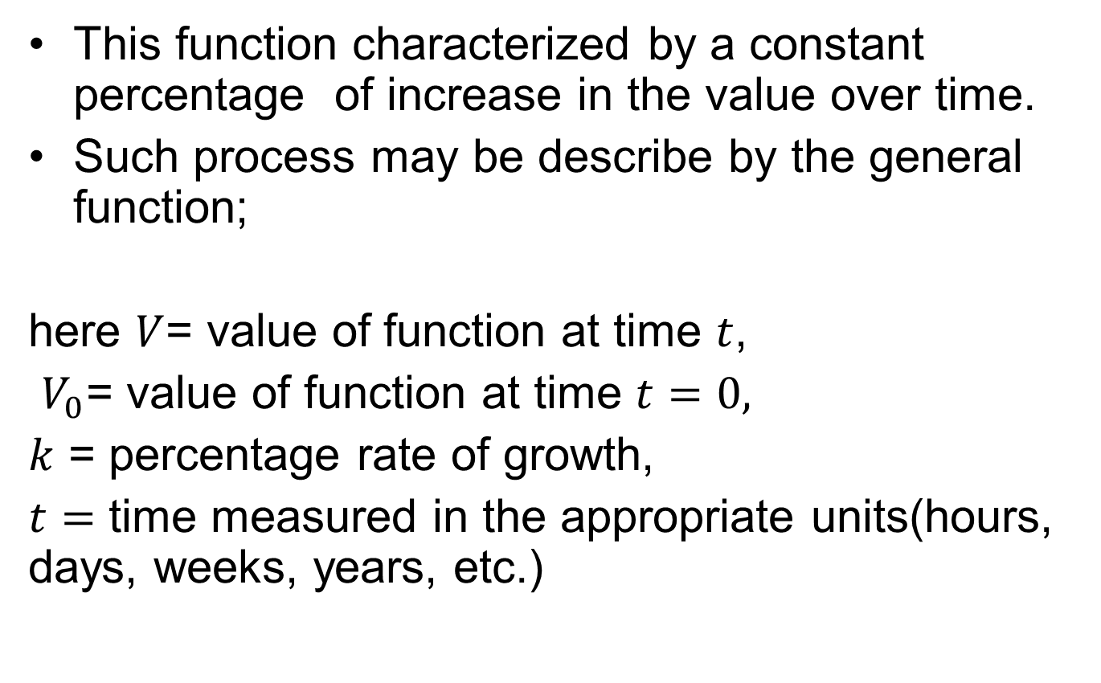
Example(population growth process)
This function characterized by a constant percentage of increase in the value over time.
Such process may be describe by the general function;
here $V$= value of function at time $t$,
$V_{0}$= value of function at time $t=0,$
$k$ = percentage rate of growth,
$t=$ time measured in the appropriate units(hours, days, weeks, years, etc.)

Slide 27
Example Cont’d
The population of a country was 100 million in 1990 and is growing at the constant rate of 4 per cent per year.

Slide 28
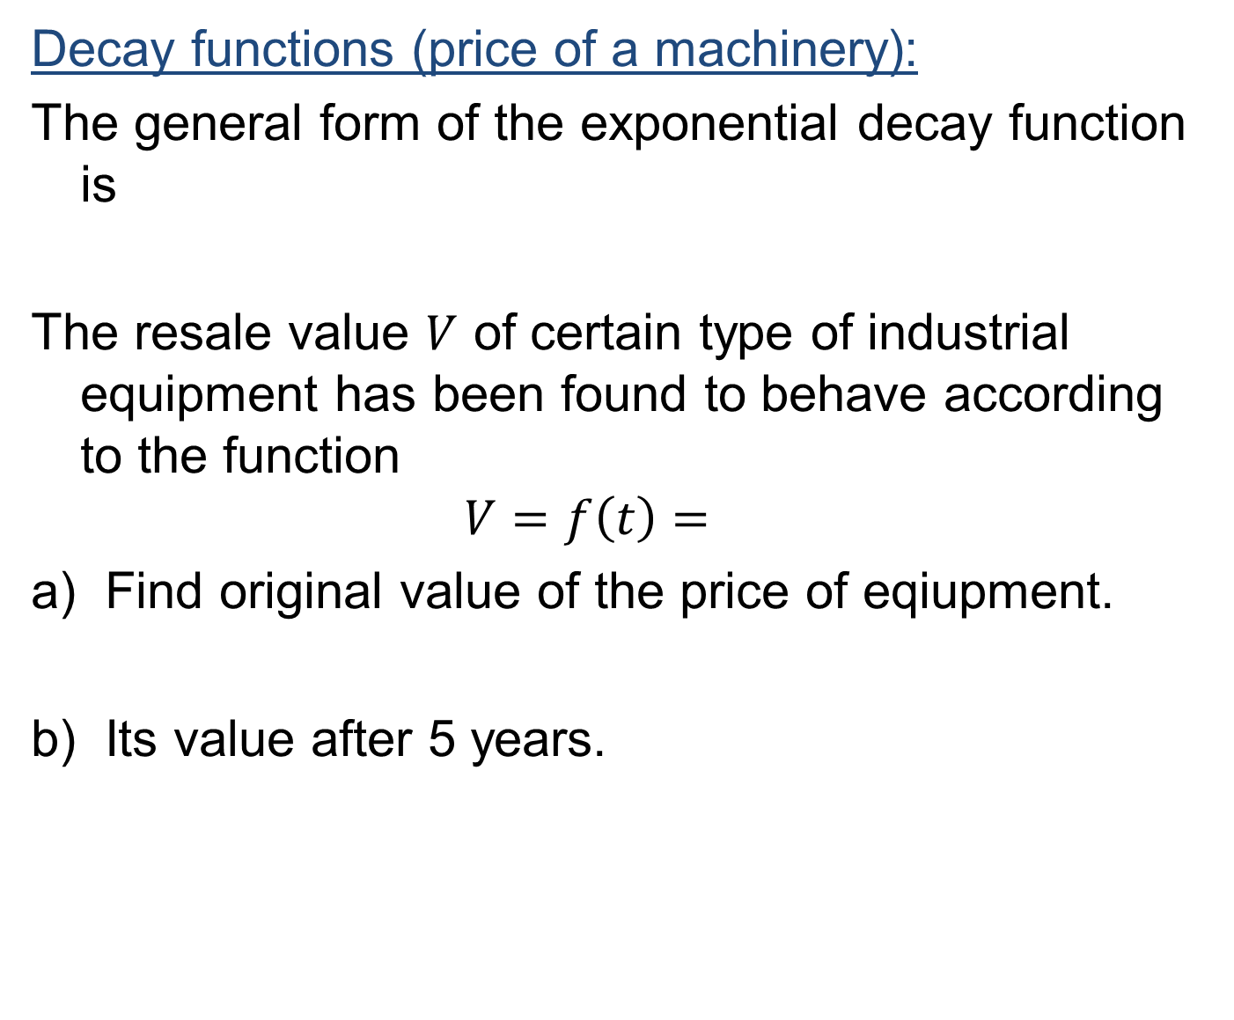
Decay functions (price of a machinery):
The general form of the exponential decay function is
The resale value $V$ of certain type of industrial equipment has been found to behave according to the function
$$V=f\left(t\right)=$$
Find original value of the price of eqiupment.
Its value after 5 years.

Slide 29
Summary
Properties of exponents and radicals
Exponential functions
Exponential functions with base e
Applications of exponential functions

Slide 30
Next Lecture
Interest
Simple interest
Compound interest
Graphical comparison
Single payment and its computations

