Slide 1
Business Mathematics
MTH-367
Lecture 7

Slide 2
Chapter 6
Quadratic and Polynomial Functions

Slide 3
Objectives
Generally, introduce the reader to nonlinear functions
More specifically, provide an understanding of the algebraic and graphical characteristics of quadratic and polynomial functions
Illustrate a variety of applications of these types of functions

Slide 4
Review
Linear Depreciation
Linear demand functions
Linear supply functions
Market equilibrium
Break-even models

Slide 5
Today’s Topics
Quadratic functions and their characteristics
Graphical representation
Applications of quadratic functions as revenue function, demand function, supply functions.
Polynomial function
Application of rational functions

Slide 6
Why Quadratic Functions?
We focused on linear and non linear mathematics and linear mathematics is very useful and convenient.
There are many phenomena which do not behave in a linear manner and can not be approximated by using linear functions.
We need to introduce nonlinear functions.
One of the more common nonlinear function is the quadratic function.

Slide 7
Quadratic Functions
Definition A quadratic function involving one independent variable x and the dependent variable y has the general form
Observe that the coefficient of can not be equal zero.
Clearly, if then our equation reduces to

Slide 8
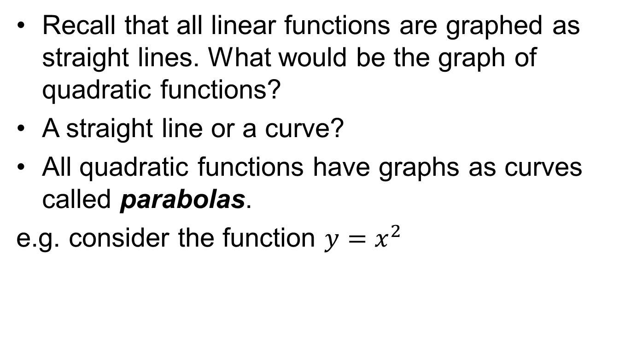
Graphical Representation
Recall that all linear functions are graphed as straight lines. What would be the graph of quadratic functions?
A straight line or a curve?
All quadratic functions have graphs as curves called parabolas.
e.g. consider the function $y=x^{2}$

Slide 9
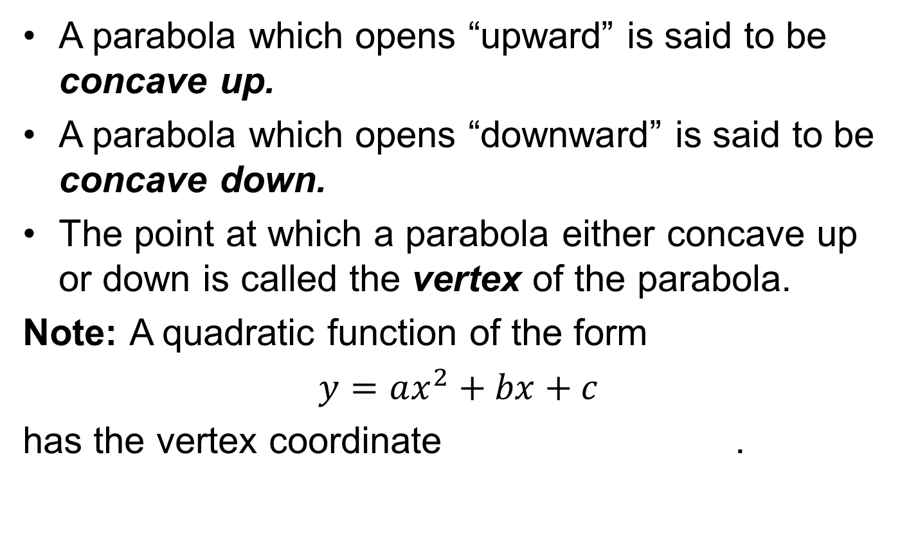
Properties of Parabolas
A parabola which opens “upward” is said to be concave up.
A parabola which opens “downward” is said to be concave down.
The point at which a parabola either concave up or down is called the vertex of the parabola.
Note: A quadratic function of the form
$y=ax^{2}+bx+c$
has the vertex coordinate .

Slide 10
As we have discussed earlier, here are the results about concavity.
If ; the function will graph as parabola which is concave up.
If ; the function will graph as parabola which is concave down.

Slide 11
Properties of Parabolas
A parabola is a curve having a particular symmetry.
The line which passes through the vertex is called the axis of symmetry.
This line separates the parabola into two equal halves.

Slide 12
Sketching of Parabola
Parabolas can be sketched by using the method of chapter 4. But, there are certain things which can make the sketching relative easy.
These include:
Concavity of the parabola
Y-intercept, where graph meets y-axis.
X-intercept, where graph meets x-axis
Vertex

Slide 13
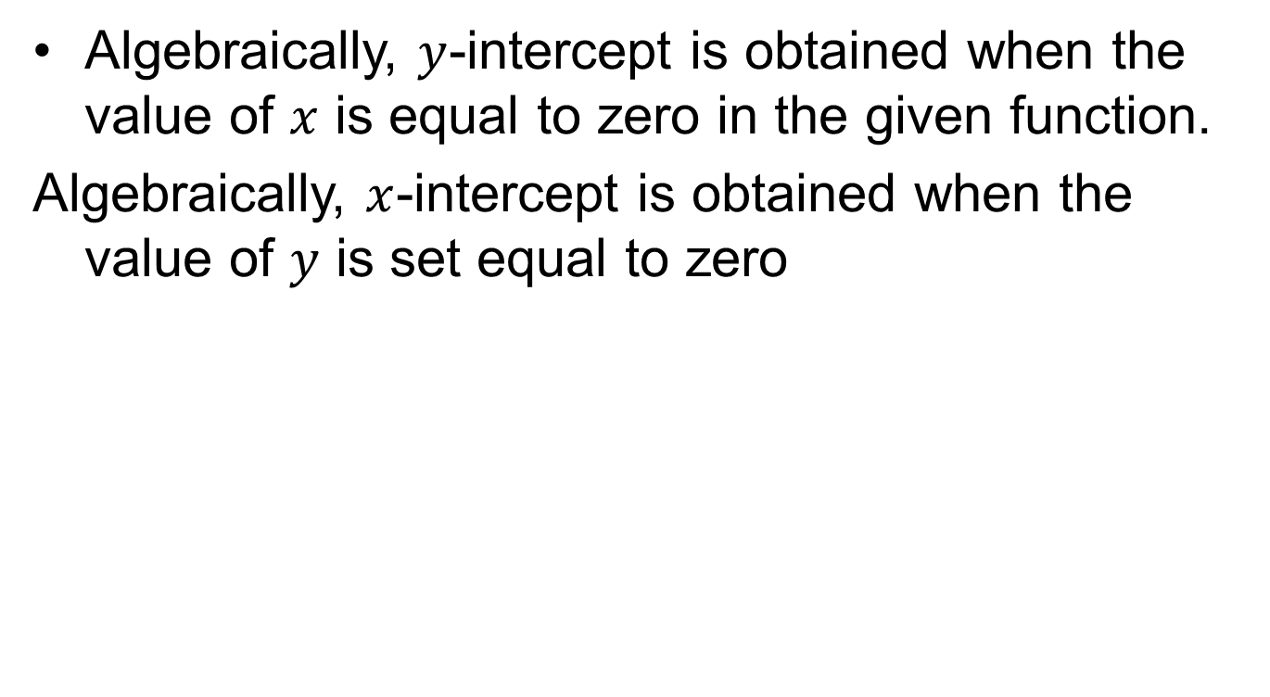
How to find intercepts
Algebraically, $y$-intercept is obtained when the value of $x$ is equal to zero in the given function.
Algebraically, $x$-intercept is obtained when the value of $y$ is set equal to zero

Slide 14
Methods to find the x-intercept
The x-intercept of a quadratic equation is determined by finding the roots of an equation.
Finding roots by factorisation:
If a quadratic can be factored, it is an easy way to find the roots, e.g.

Slide 15
Finding roots by using the quadratic formula
The quadratic formula will always identify the real roots of an equation if any exist.
The quadratic formula of an equation which has the general form
will be

Slide 16
Example

Slide 17
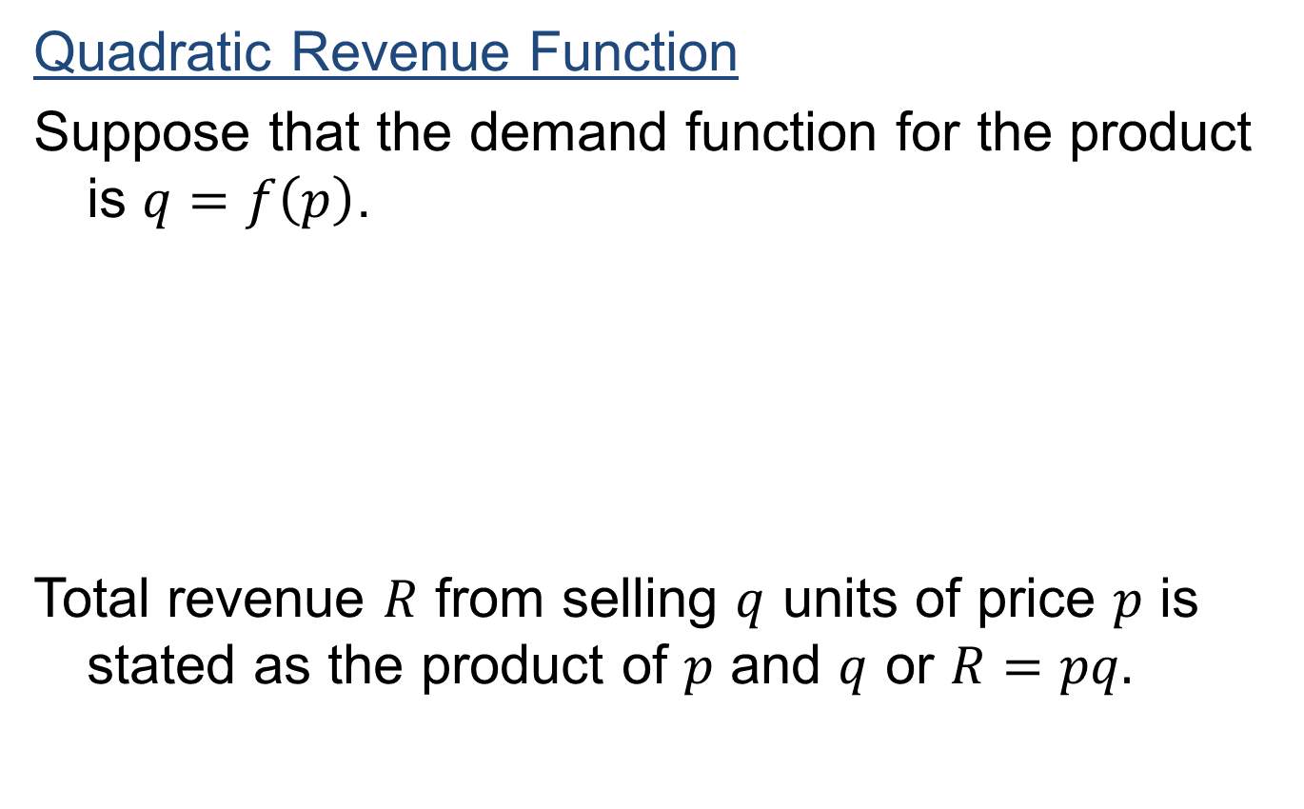
Quadratic functions; Applications
Quadratic Revenue Function
Suppose that the demand function for the product is $q=f\left(p\right)$.
Total revenue $R$ from selling $q$ units of price $p$ is stated as the product of $p$ and $q$ or $R=pq.$

Slide 18
Since the demand function q is stated in terms of price p, total revenue as a function of price is

Slide 19
Quadratic supply function
Market surveys of suppliers of a particular product have resulted in the conclusion that the supply function is approximately quadratic in form.
Suppliers were asked what quantities they would be willing to supply at different market prices.
Results of the survey indicated that at market prices of $25, $30 and $ 40, the quantities which suppliers would be willing to offer to the market were 112.5, 250 and 600 (thousands) units, respectively.

Slide 20
Quadratic supply function cont’d
We determine the equation of the quadratic supply function by substituting the tree price-quantity combination into the general equation.

Slide 22
Quadratic demand function
A consumer survey was conducted to determine the demand function for the same product as in the previous example discussed for supply function.
Researchers asked consumers if they would purchase the product at various prices and from their responses constructed estimates of market demand at various market prices.
After sample data points were plotted, it was concluded that the demand relationship was estimated best by a quadratic function. Researchers concluded that the quadratic representation was valid for prices between $5 and $45.

Slide 23
Three data points chosen for fitting the curve were (5, 2025), (10, 1600) and (20, 900).
Substituting these data points into the general equation for a quadratic function and solving the resulting system simultaneously gives the demand function:

Slide 24
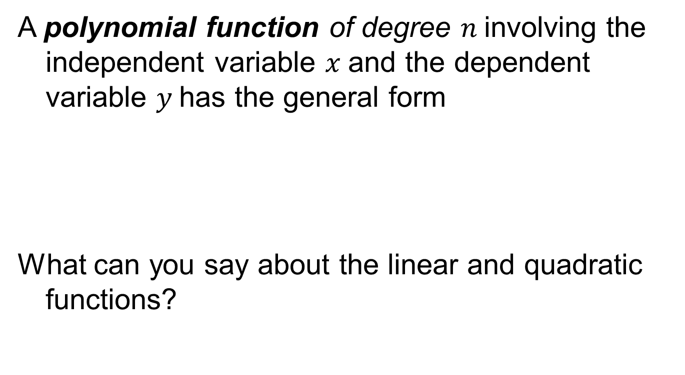
Polynomial functions
A polynomial function of degree $n$involving the independent variable $x$and the dependent variable $y$has the general form
What can you say about the linear and quadratic functions?

Slide 25
The degree of a polynomial is the exponent of the highest powered term in the expression.
A linear function is a first-degree polynomial function.
A quadratic function is a second-degree polynomial function.

Slide 26
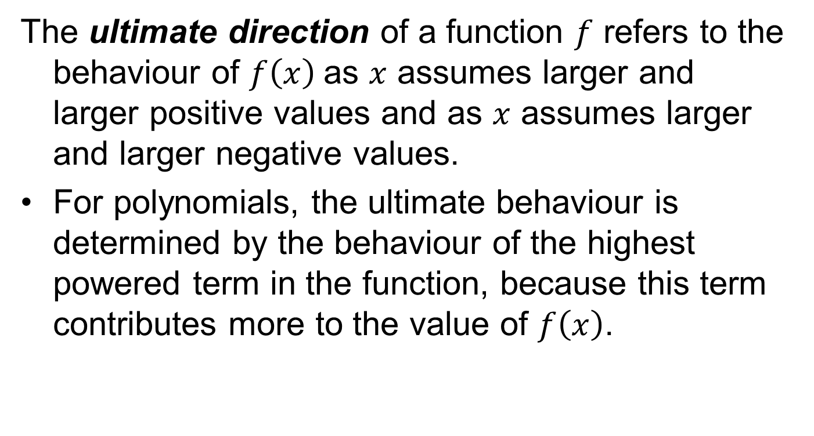
Ultimate Direction Attribute
The ultimate direction of a function $f$ refers to the behaviour of $f\left(x\right)$as $x$ assumes larger and larger positive values and as $x$ assumes larger and larger negative values.
For polynomials, the ultimate behaviour is determined by the behaviour of the highest powered term in the function, because this term contributes more to the value of $f\left(x\right)$.

Slide 27
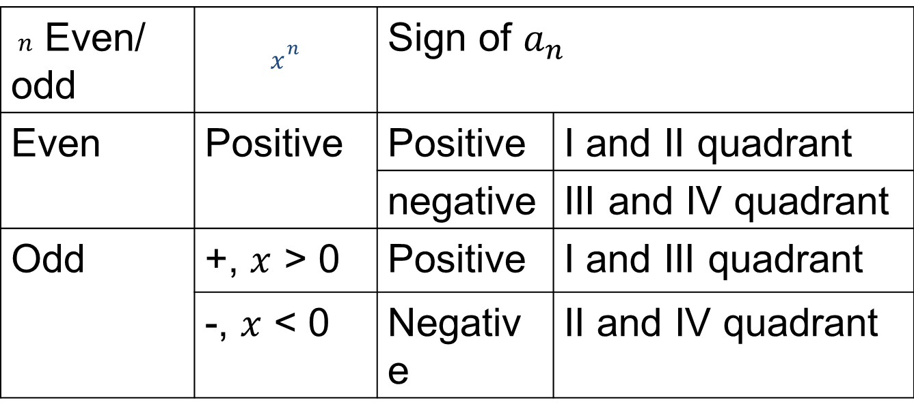
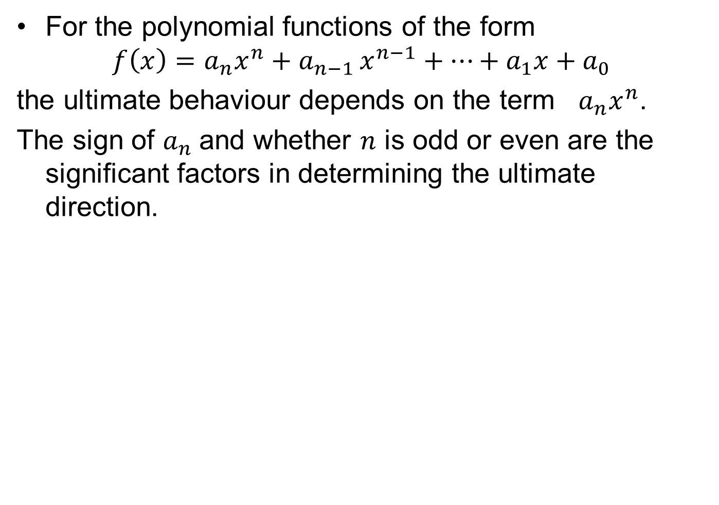
For the polynomial functions of the form
$$f\left(x\right)={a_{n}x}^{n}+a_{n−1 }x^{n−1}+⋯+a_{1}x+a_{0}$$
the ultimate behaviour depends on the term $a_{n}x^{n}$.
The sign of $a_{n}$and whether $n$ is odd or even are the significant factors in determining the ultimate direction.
$n$ Even/ odd | $$x^{n}$$ | Sign of $a_{n}$
Even | Positive | Positive | I and II quadrant
 |  | negative | III and IV quadrant
Odd | +, $x$ > 0 | Positive | I and III quadrant
 | -, $x$ < 0 | Negative | II and IV quadrant

Slide 29
Rational Functions
Rational functions are the ratios of two polynomial functions with the general form as:

Slide 30
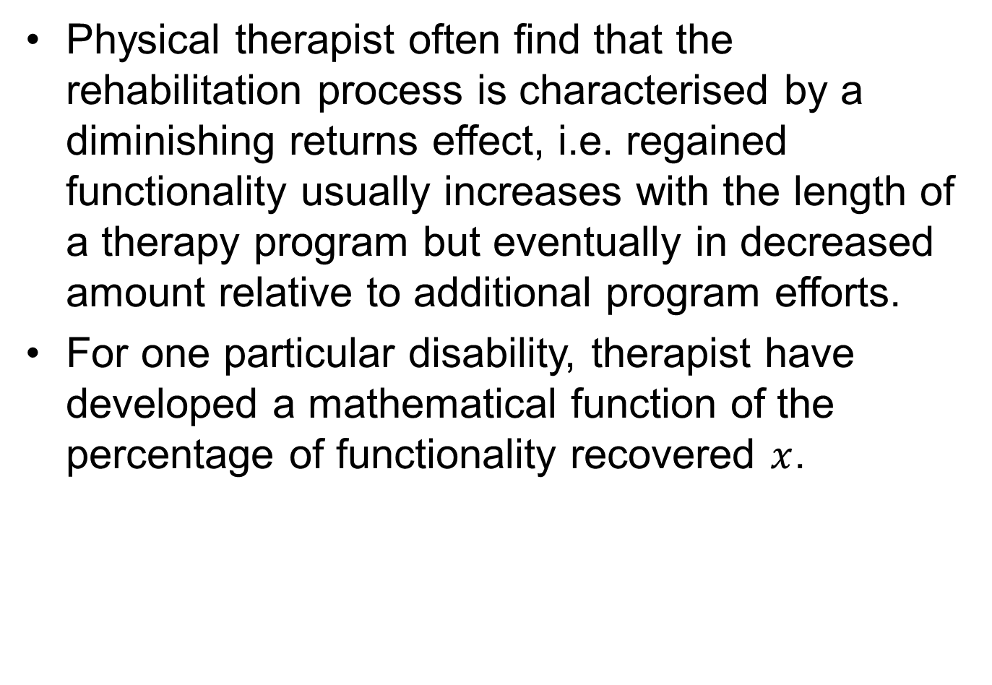
Disability Rehabilitation
Physical therapist often find that the rehabilitation process is characterised by a diminishing returns effect, i.e. regained functionality usually increases with the length of a therapy program but eventually in decreased amount relative to additional program efforts.
For one particular disability, therapist have developed a mathematical function of the percentage of functionality recovered $x$.

Slide 31
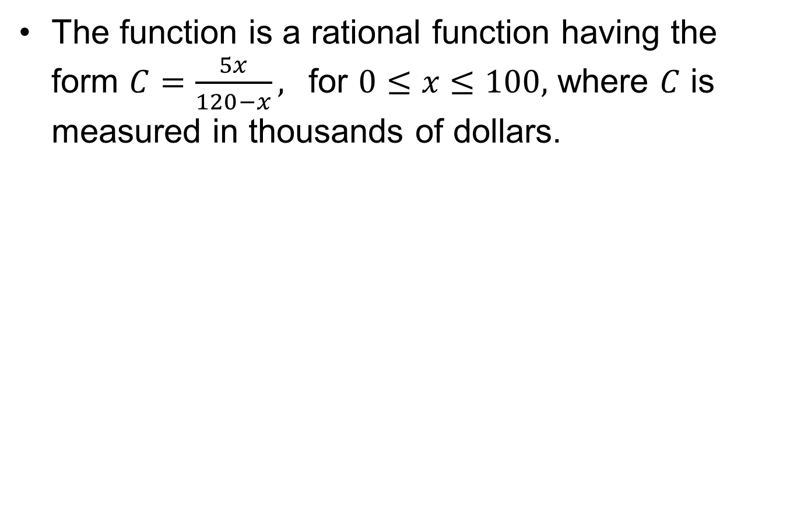
The function is a rational function having the form $C=\frac{5x}{120−x},$ for $0≤x≤100,$ where $C$ is measured in thousands of dollars.

Slide 33
Summary
Quadratic functions and their Characteristics
Graphical representation
Applications of quadratic functions as revenue function, demand function, supply functions.
Polynomial function
Application of rational functions

Slide 34
Next Lecture
Exponential functions
Characteristics of exponential functions
Applications of exponential functions

