Slide 1
Business Mathematics
MTH-367
Lecture 6

Slide 2
Chapter 5
Linear Functions: Applications

Slide 3
Review
Graphical representation of functions
Vertical line test
Characteristics of linear function
Applications of linear functions as a Cost, Revenue and Profit function

Slide 4
Today’s Topics
Linear Depreciation
Linear demand functions
Linear supply functions
Market equilibrium
Break-even models

Slide 5
When organizations purchase an item, usually cost is allocated for the item over the period the item is used.
Example: If a company purchases a vehicle costing $20,000 having a useful life of 5 years, then accountants might allocate $4,000 per year as a cost of owning the vehicle.
Definition: The cost allocated to any given period is called depreciation.
The value of the truck at the limp of purchase is $20,000 and after one year,

Slide 6
Each major item purchased is recorded according to its current or book value.
e.g. value of truck may appear on accounting statements as $ 20,000 at the time of purchase, but, after 1 year the price will be
$20000- $4000 = $ 16000
and so forth.
In this case, depreciation can also be thought of as an amount by which the book value of an asset has decreased.

Slide 7
Straight line depreciation
Straight line depreciation is one of the simplest method. Under this method, the rate of depreciation is constant.
Thus, the book value declines as a linear function over time. If V equals the book value of an asset and t equals time (in years) measured from the purchase date for the previously mentioned truck, then

Slide 9
Linear demand functions
A demand function is a mathematical relationship expressing the way in which the quantity demanded of an item varies with the price charged for it.
The relationship between these two variables---quantity demanded and price per unit ---is usually inverse, i.e. a decrease in price results in increase in demand.

Slide 10
Most demand functions are nonlinear, but there are situations in which the demand relationship either is, or can be approximated by a linear function.
Quantity demanded = f(price per unit)
q=f(p)=45000-75000p

Slide 11
Linear Supply Function
A supply function relates market price to the quantities that suppliers are willing to produce or sell. The supply function implicates:
What is brought to the market depends upon the price people are willing to pay.
In contrast to the demand function, the quantity which suppliers are willing to supply usually varies directly with the market price.
The higher the market price, the more a supplier would like to produce and sell.

Slide 12
The lower the price people willing to pay, the less incentive to produce and sell.
Quantity supplied = f(market price)
Assume that you own a fish boat. All others factors considered equal, how much incentive is there to sell the fishes if wholesale price is $ 100 per kg. How much incentive is there if wholesale price is $ 350 per kg.

Slide 13
The following figure Illustrate a sample supply function.

Slide 14
Market Equilibrium
Given supply and demand functions of a product, market equilibrium exits if there is a price at which the quantity demanded equals the quantity supplied.
Example
Suppose demand and supply functions have been estimated for two competing products

Slide 16
The demand and supply functions are linear.
Quantity demanded of a given product depends not only on the price of the product but also on the price of competing product.
The quantity supplied of a product depends only upon the price of that product.
Market equilibrium would exist in this two-product market place if prices existed such that

Slide 17
Supply and demand are equal for product 1, when
Supply and demand are equal for product 2 when

Slide 18
If the products are priced accordingly, the quantities demanded and supplied will be equal for each product.

Slide 19
Break-Even Models
Break-even models is a set of planning tools which can be useful in managing organizations. One significant indication of the performance of a company is reflected by how much profit is earned.
Break-even analysis focuses upon the profitability of a firm.
Break-even analysis identifies the level of operation or level of output that would result in a zero profit.
The level of operations or output is called the break-even point.

Slide 20
Break-even point represents the level of operation at which total revenue equals total cost.
Any changes from the level of operations will result in either a profit or a loss.
Break-even analysis is mostly used when:
Firms are offering new products or services.
Evaluating the pros and cons of starting a new business.

Slide 21
Assumptions
Total cost function and total revenue function are linear.
Total cost function:
Linear total cost function implies that variable costs per unit either are constant or can be assumed to be constant.
Total variable costs depend upon the level of operation or output.
Fixed cost portion is constant over the level of operation or output being considered.

Slide 22
Assumptions
Total revenue function:
Linear total revenue function assumes that the selling price per unit is constant.
In case of non-constant selling price, average price is chosen for purposes of conducting the analysis.

Slide 23
Break-even Analysis
In break-even analysis the main goal is to determine the break-even point.
The break-even point may be expressed in terms of
Volume of output (or level of activity)
total dollars sales or
Percentage of production capacity
e.g. a firm will break-even at 1000 units of output, when total sales equal 2 million dollars or when the firm is operating 60% of its plant capacity.

Slide 24
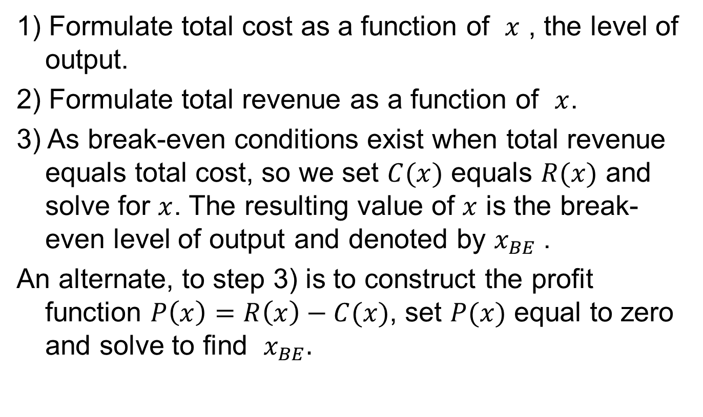
Method:
1) Formulate total cost as a function of $x$ , the level of output.
2) Formulate total revenue as a function of $x$.
3) As break-even conditions exist when total revenue equals total cost, so we set $C(x)$ equals $R(x)$ and solve for $x$. The resulting value of $x$ is the break-even level of output and denoted by $x_{BE}$.
An alternate, to step 3) is to construct the profit function $P\left(x\right)=R\left(x\right)−C(x)$, set $P(x)$ equal to zero and solve to find $x_{BE}.$

Slide 25
Example
Group of engineers is interested in forming a company to produce smoke detectors.
They have developed a design and estimated that variable costs per unit, including materials, labor, and marketing costs are $22.50.
Fixed costs associated with the formation, operation, management of the company and purchase of the machinery costs $250,000.
They estimated that the selling price will be 30 dollars per detector.

Slide 26
Example Cont’d
Determine the number of smoke detectors which must be sold in order for the firm to break-even on the venture.

Slide 27
Example Cont’d

Slide 28
Example Cont’d
b) Preliminary marketing data indicate that the firm can expect to sell approximately 30,000 smoke detectors over the life of the project, if the detectors are sold at $30 per unit. Determine expected profits at this level of output.

Slide 29
Graphical Analysis

Slide 30
Summary
Linear Depreciation
Linear demand functions
Linear supply functions
Market equilibrium
Break-even models

Slide 31
Next Lecture
Quadratic functions and their characteristics
Graphical representation
Applications of quadratic functions as revenue function, demand function, supply functions.
Polynomial function
Application of rational functions

