Slide 1
Business Mathematics
MTH-367
Lecture 5

Slide 2
Chapter 4
Mathematical functions
Cont’d

Slide 3
Review
Functions
Domain and Range of a function
Multivariate functions
Types of functions

Slide 4
Today’s topics
Graphical representation of functions
Vertical line test
Characteristics of linear function
Applications of linear functions as a Cost, Revenue and Profit function

Slide 5
Graphical Representation of Functions
The function of one or two variables (independent) can be represented graphically.
The functions of one independent variable are graphed in two dimensions, 2-space.
The functions in two independent variables are graphed in three dimension, 3-space.
For the case of more than two independent variables, graphical representation is lost.

Slide 6
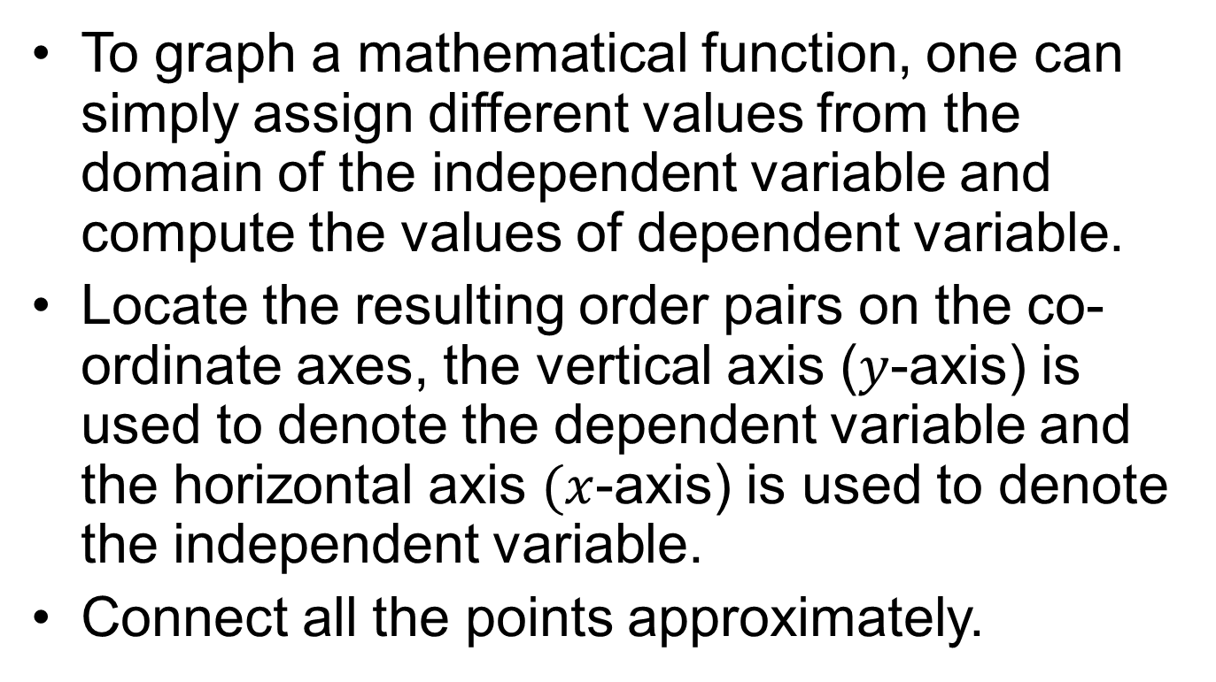
Method of graphing
To graph a mathematical function, one can simply assign different values from the domain of the independent variable and compute the values of dependent variable.
Locate the resulting order pairs on the co-ordinate axes, the vertical axis ($y$-axis) is used to denote the dependent variable and the horizontal axis $(x$-axis) is used to denote the independent variable.
Connect all the points approximately.

Slide 7
Examples
Linear functions

Slide 8
Examples
Quadratic functions

Slide 9
Examples
Cubic functions

Slide 10
Vertical Line Test
By definition of a function, to each element in the domain there should correspond only one element in the range. This allows a simple graphical check to determine whether a graph represents a function or not.
If a vertical line is drawn through any value in the domain, it will intersect the graph of the function at one point only.
If the vertical line intersects at more than one point then, the graph depicts a relation and not a function.

Slide 11
Examples
Determine whether the given graph represents a function or not?

Slide 12
Example Cont’d

Slide 13
Chapter 5
Linear functions, Applications

Slide 14
Objectives
Present a discussion of the characteristics of linear functions
Present a wide variety of applications of linear functions

Slide 15
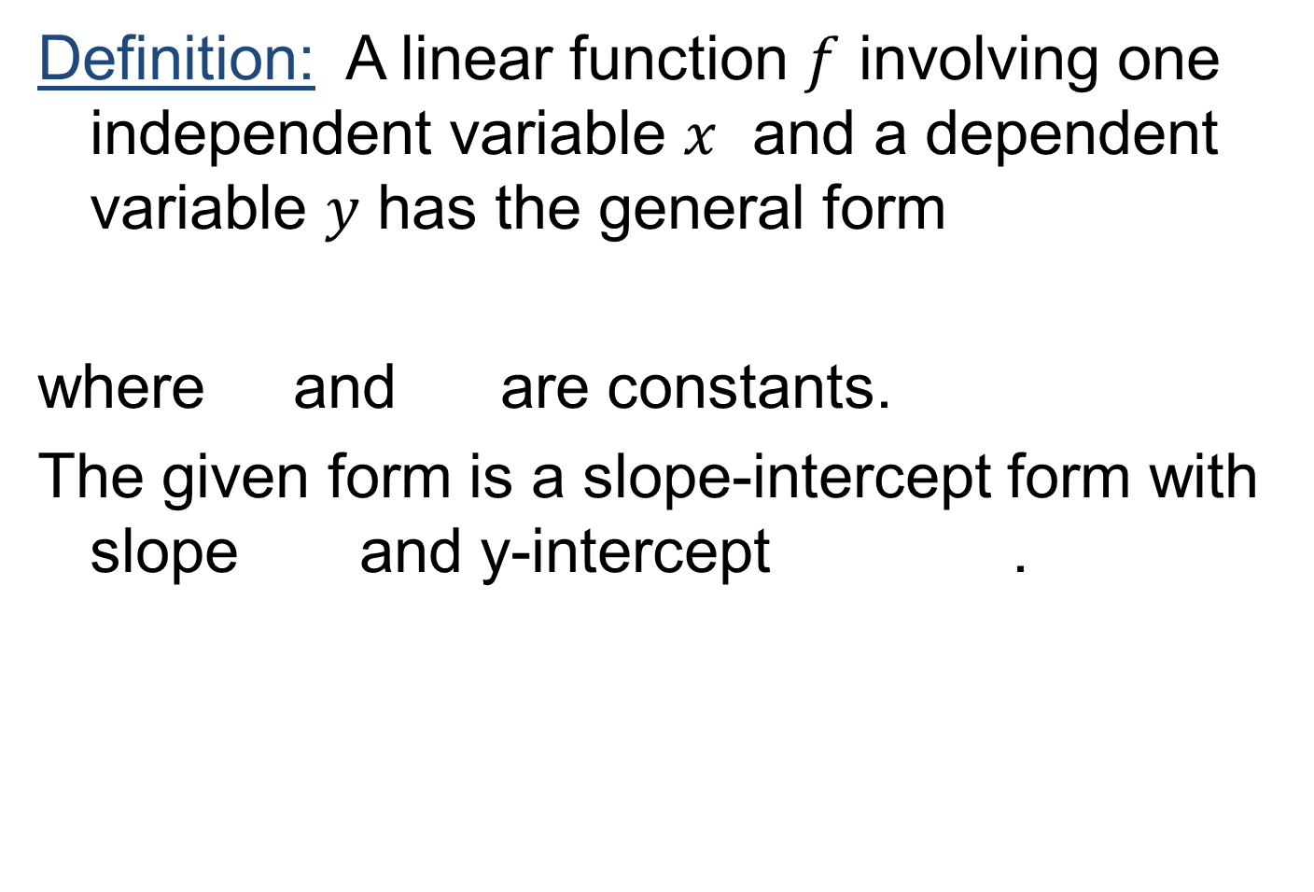
Linear function
Definition: A linear function $f$ involving one independent variable $x$ and a dependent variable $y$ has the general form
where and are constants.
The given form is a slope-intercept form with slope and y-intercept .

Slide 16
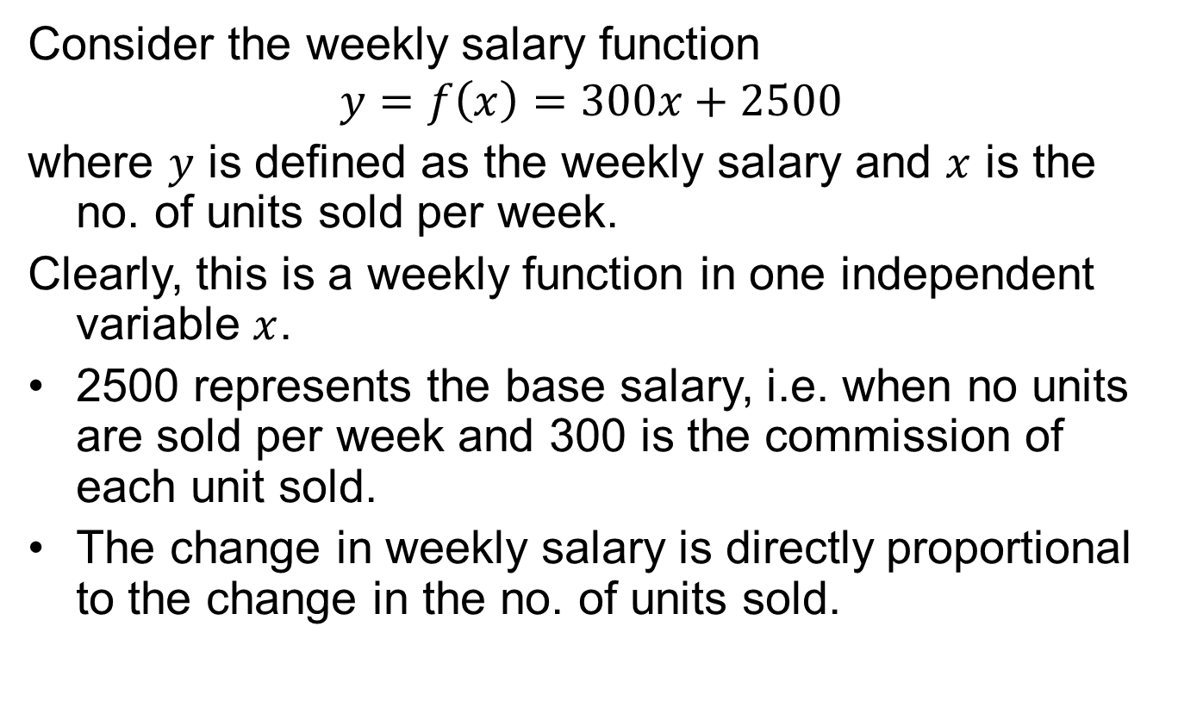
Example
Consider the weekly salary function
$$y=f\left(x\right)=300x+2500$$
where $y$ is defined as the weekly salary and $x$ is the no. of units sold per week.
Clearly, this is a weekly function in one independent variable $x$.
2500 represents the base salary, i.e. when no units are sold per week and 300 is the commission of each unit sold.
The change in weekly salary is directly proportional to the change in the no. of units sold.

Slide 17
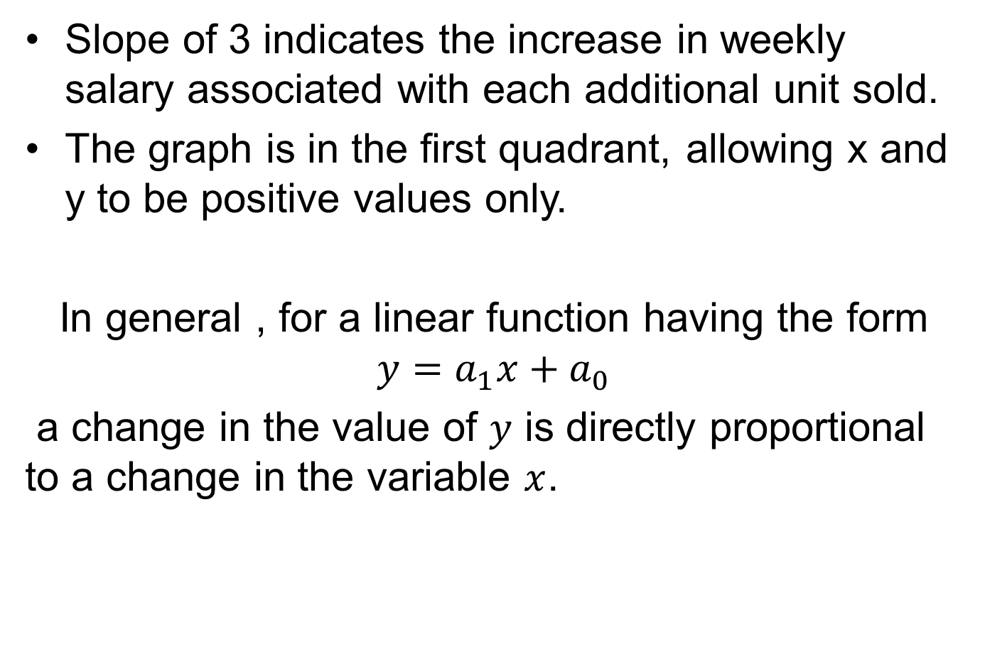
Slope of 3 indicates the increase in weekly salary associated with each additional unit sold.
The graph is in the first quadrant, allowing x and y to be positive values only.
In general , for a linear function having the form $y=a_{1}x+a_{0}$
a change in the value of $y$ is directly proportional to a change in the variable $x$.

Slide 18
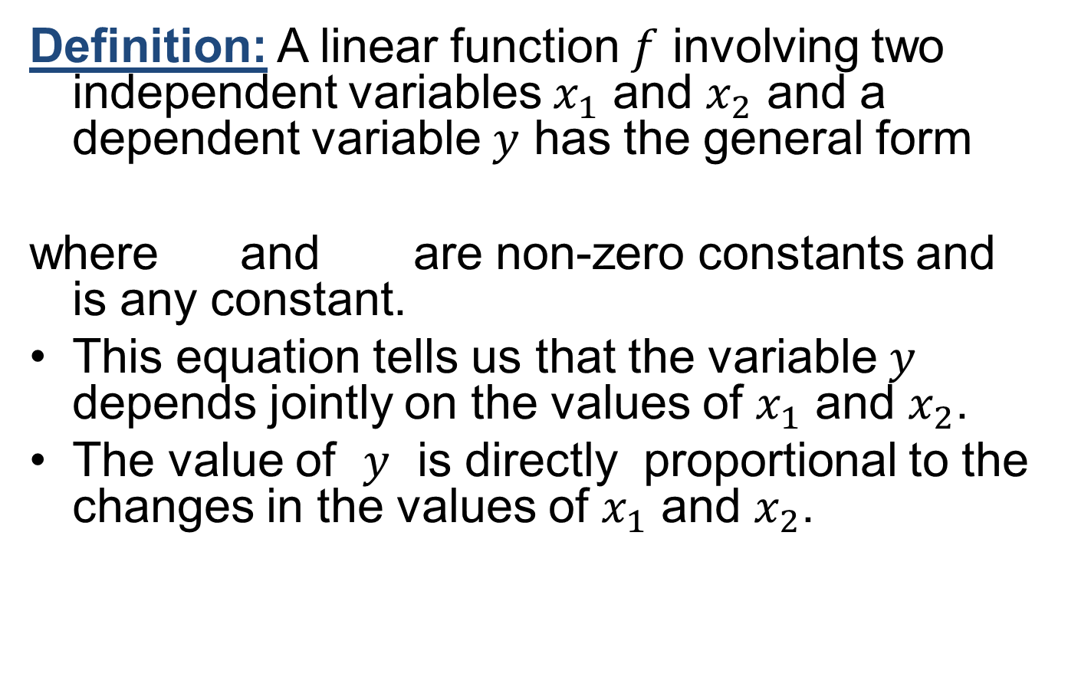
Linear function in two independent variables
Definition: A linear function $f$involving two independent variables $x_{1}$and $x_{2}$and a dependent variable $y$has the general form
where and are non-zero constants and is any constant.
This equation tells us that the variable $y$depends jointly on the values of $x_{1}$ and $x_{2}$.
The value of $y$ is directly proportional to the changes in the values of $x_{1}$ and $x_{2}$.

Slide 19
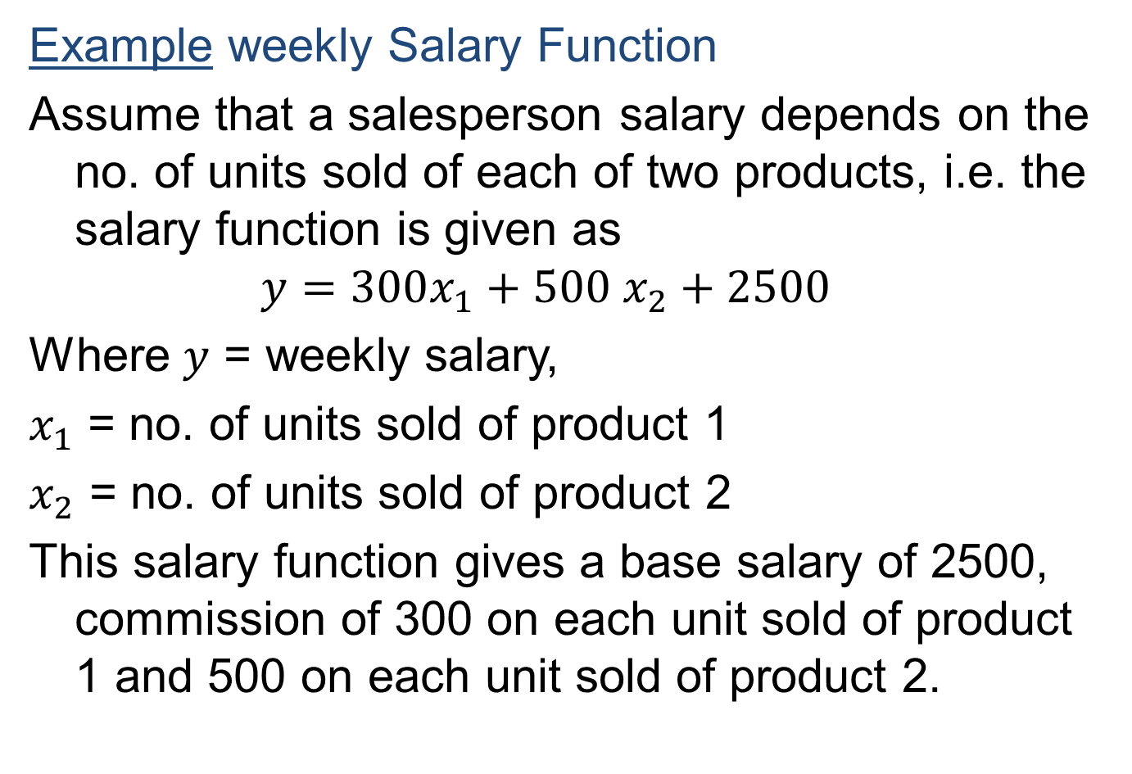
Exampleweekly Salary Function
Assume that a salesperson salary depends on the no. of units sold of each of two products, i.e. the salary function is given as
$$y=300x_{1}+500 x_{2}+2500$$
Where $y$ = weekly salary,
$x_{1}$ = no. of units sold of product 1
$x_{2}$ = no. of units sold of product 2
This salary function gives a base salary of 2500, commission of 300 on each unit sold of product 1 and 500 on each unit sold of product 2.

Slide 20
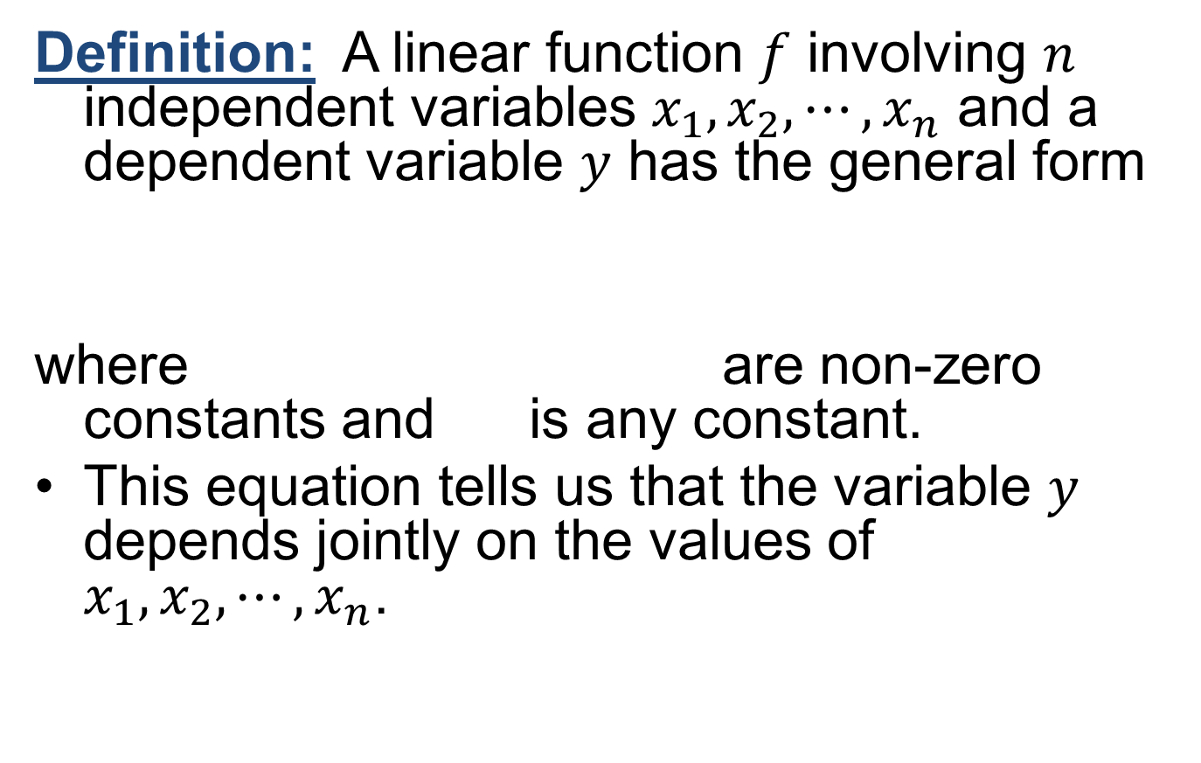
Linear function in n-independent variables
Definition: A linear function $f$ involving $n$ independent variables $x_{1},x_{2},⋯, x_{n}$ and a dependent variable $y$ has the general form
where are non-zero constants and is any constant.
This equation tells us that the variable $y$depends jointly on the values of $x_{1},x_{2},⋯, x_{n}$.

Slide 21
Linear cost function
Cost: The organizations are concerned with the costs as they reflect the money flowing out of the organisation. The total cost usually consists on two components: total variable cost and total fixed cost. These two components determines the total cost of the organisation.

Slide 22
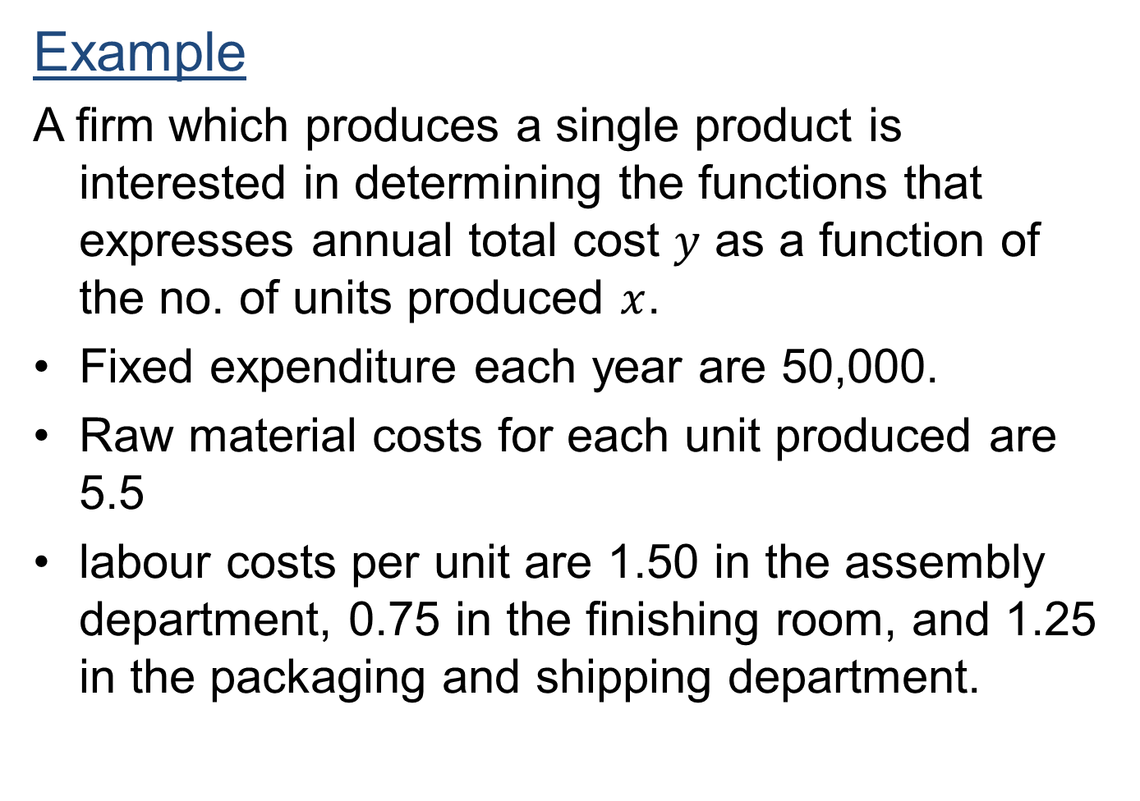

Slide 23
Solution:
The total cost function will be in the form:
=total variable cost + total fixed cost
Total fixed cost = 50,000
Total variable cost = total raw material cost +
total labour cost

Slide 24
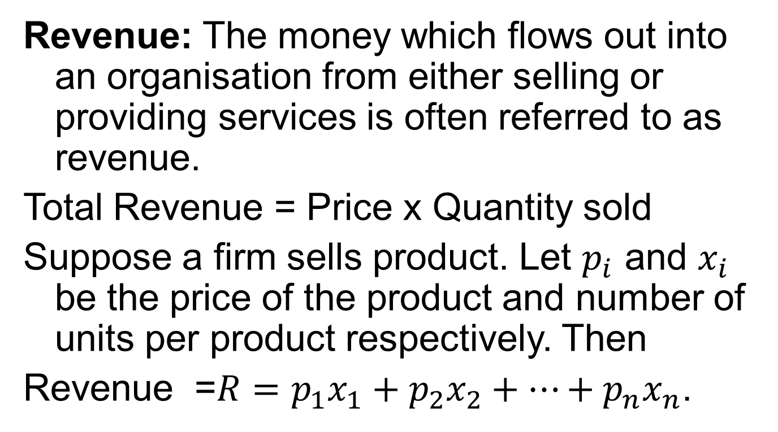
Linear Revenue function
Revenue: The money which flows out into an organisation from either selling or providing services is often referred to as revenue.
Total Revenue = Price x Quantity sold
Suppose a firm sells product. Let $p_{i}$ and $x_{i}$ be the price of the product and number of units per product respectively. Then
Revenue =$R=p_{1}x_{1}+p_{2}x_{2}+⋯+p_{n}x_{n}$.

Slide 25
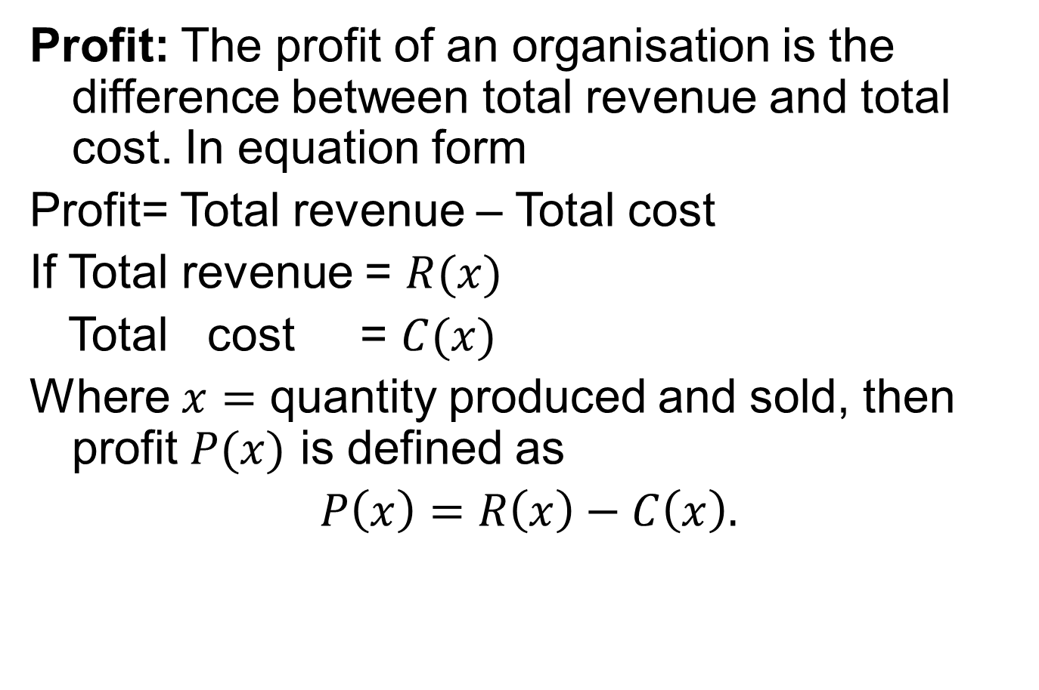
Linear Profit function
Profit: The profit of an organisation is the difference between total revenue and total cost. In equation form
Profit= Total revenue – Total cost
If Total revenue = $R(x)$
Total cost = $C(x)$
Where $x=$ quantity produced and sold, then profit $P(x)$ is defined as
$P\left(x\right)=R\left(x\right)−C\left(x\right).$

Slide 26
Linear Profit function
If total revenue exceeds total cost the profit is positive
In such case, profit is referred as net gain or net profit
On the other hand the negative profit is referred to as a net loss or net deficit.

Slide 27
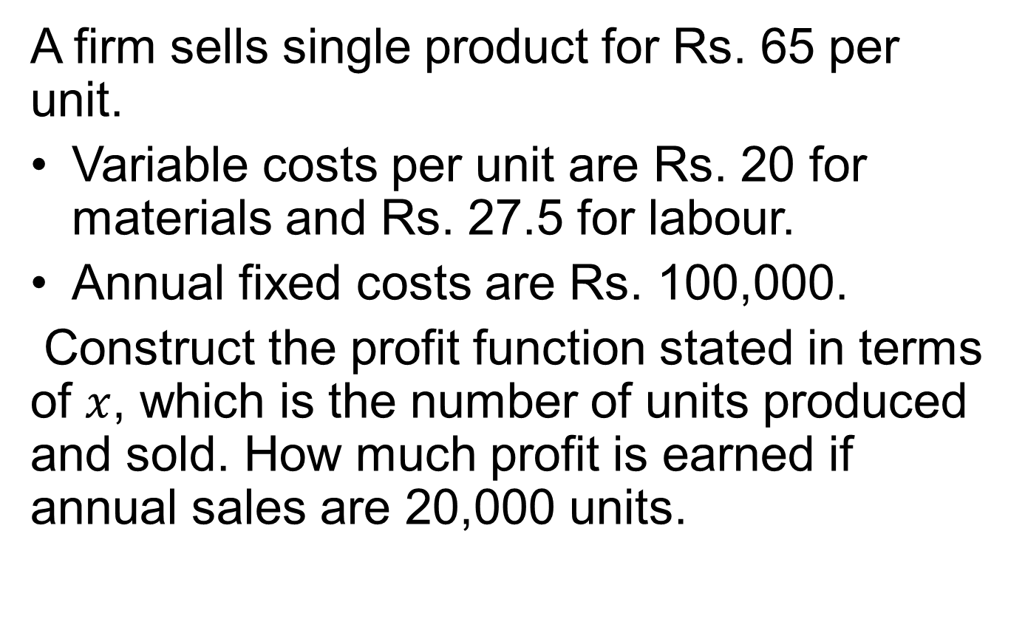
Example
A firm sells single product for Rs. 65 per unit.
Variable costs per unit are Rs. 20 for materials and Rs. 27.5 for labour.
Annual fixed costs are Rs. 100,000.
Construct the profit function stated in terms of $x$, which is the number of units produced and sold. How much profit is earned if annual sales are 20,000 units.

Slide 28
Example Cont’d

Slide 29
Review
Graphical representation of functions
Vertical line test
Characteristics of linear function
Applications of linear functions as a Cost, Revenue and Profit function

Slide 30
Next Lecture
Linear Depreciation
Linear demand functions
Linear supply functions
Market equilibrium
Break-even models
Graphical analysis

