Slide 1
Business Mathematics
MTH-367
Lecture 4

Slide 2
Chapter 4
Mathematical Functions

Slide 3
Objectives
Enable the reader to understand the nature and notation of mathematical functions
Provide illustrations of the application of mathematical functions
Provide a brief overview of important types of functions and their characteristics
Discuss the graphical representation of functions

Slide 4
Review
Solution of system of linear equations with n> 2.
Application to product mix problem

Slide 5
Today’s Topics
Functions
Domain and Range of a function
Multivariate functions
Types of functions

Slide 6
Why functions?
Identification of the relevant mathematical representation of the real world phenomenon is done by mathematical modelling.
If a model is a good approximation, it can be very useful in studying the reality and decision making in real world problems.
In mathematical models, the significant relationships are typically represented by mathematical functions.

Slide 7
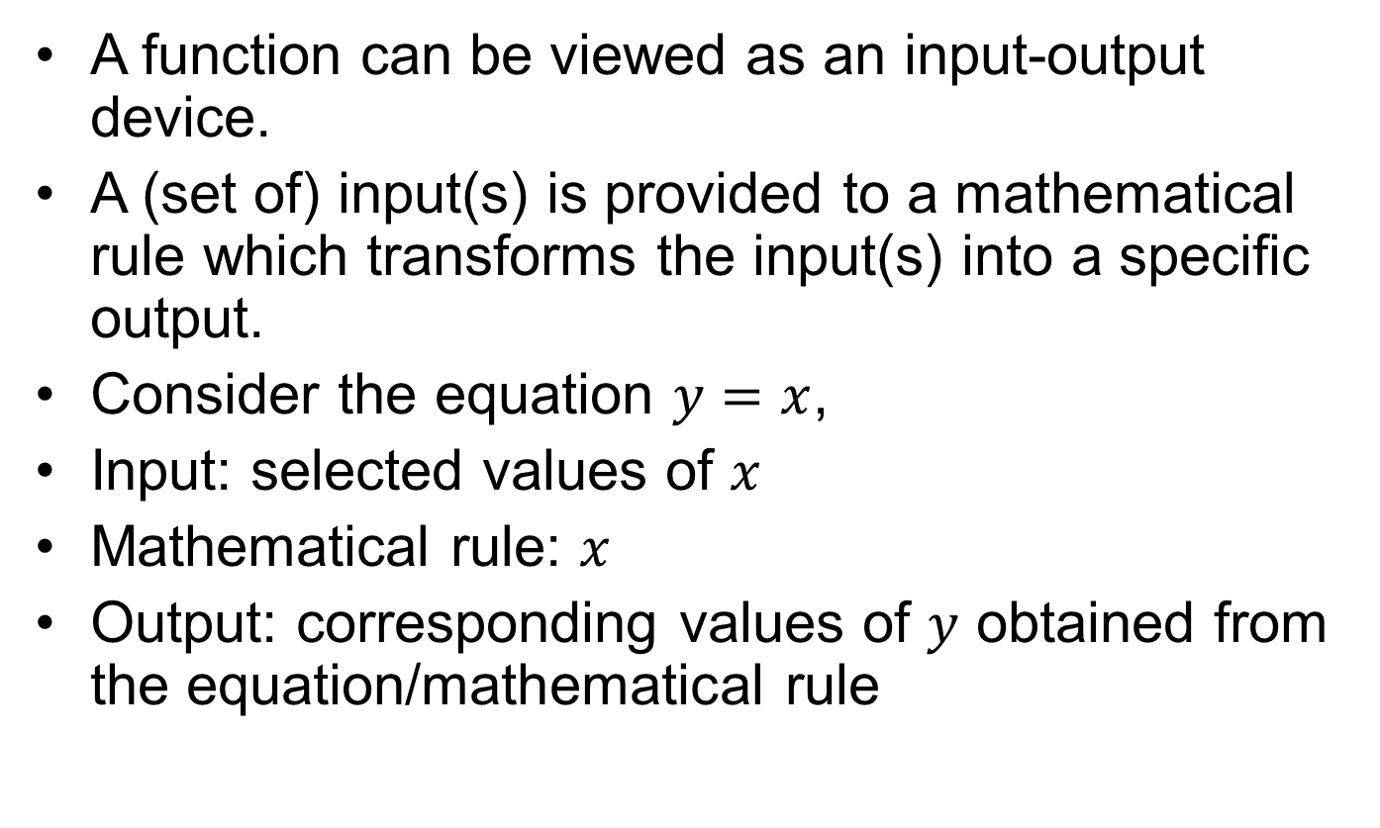
Intuition of function
A function can be viewed as an input-output device.
A (set of) input(s) is provided to a mathematical rule which transforms the input(s) into a specific output.
Consider the equation $y=x$,
Input: selected values of $x$
Mathematical rule: $x$
Output: corresponding values of $y$ obtained from the equation/mathematical rule

Slide 8
Function
Definition: A function is a mathematical rule that assigns to each input value one and only one output value.
Definition: The domain of a function is the set consisting of all possible input values.
Definition: The range of a function is the set of all possible output values.

Slide 9
Some examples
The fare of taxi depend upon the distance and the day of the week.
The fee structure depend upon the program and the type of education (on campus/off campus) you are admitting in.
The house prices depends on the location of the house.

Slide 10
Notation
The assigning of output values to corresponding input values is often called as mapping. The notation
represents the mapping of the set of input values of x into the set of output values y, using the mapping rule.

Slide 11
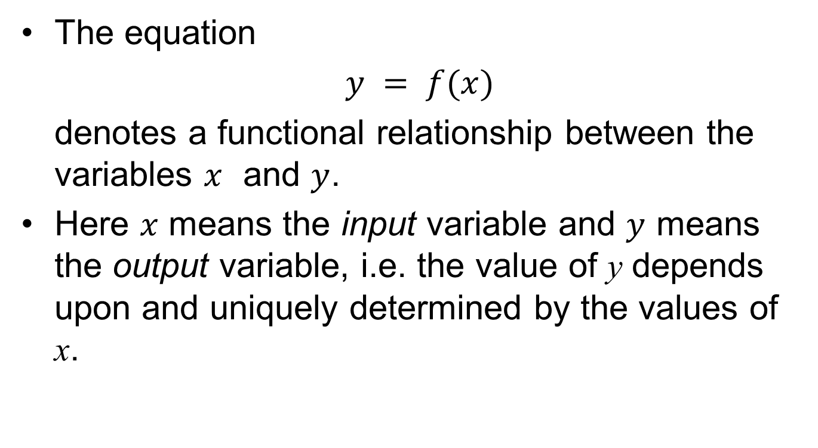
Notation (contd.)
The equation
$y = f(x)$
denotes a functional relationship between the variables $x$ and $y$.
Here $x$ means the input variable and $y$ means the output variable, i.e. the value of y depends upon and uniquely determined by the values of x.

Slide 12
The input variable is called the independent variable and the output variable is called the dependent variable.
Note that x is not always the independent variable, y is not always the dependent variable and f is not always the rule relating x and y.
Once the notation of function is clear then, from the given notation, we can easily identify the input variable, output variable and the rule relating them, e.g. u=g(v)
v = input variable, u= output variable
g= rule relating u and v

Slide 13
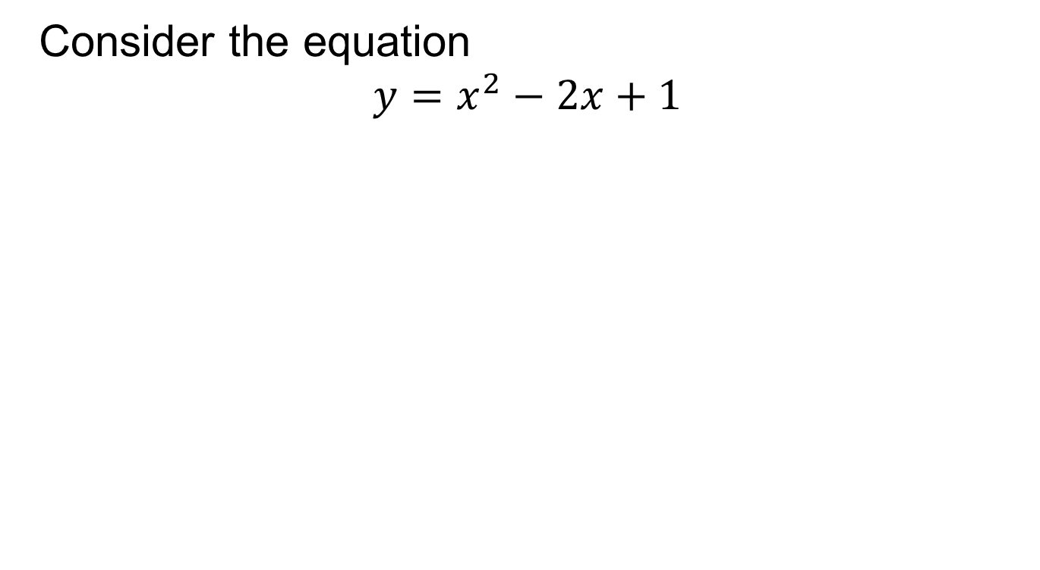
Example
Consider the equation
$$y=x^{2}−2x+1$$

Slide 14
Example-Weekly Salary Function
A person gets a job as a salesperson.
His salary depends upon the number of units he sells each week.
Then, dependency of weekly salary on the units sold per week can be represented as:
where f is the name of the salary function.

Slide 15
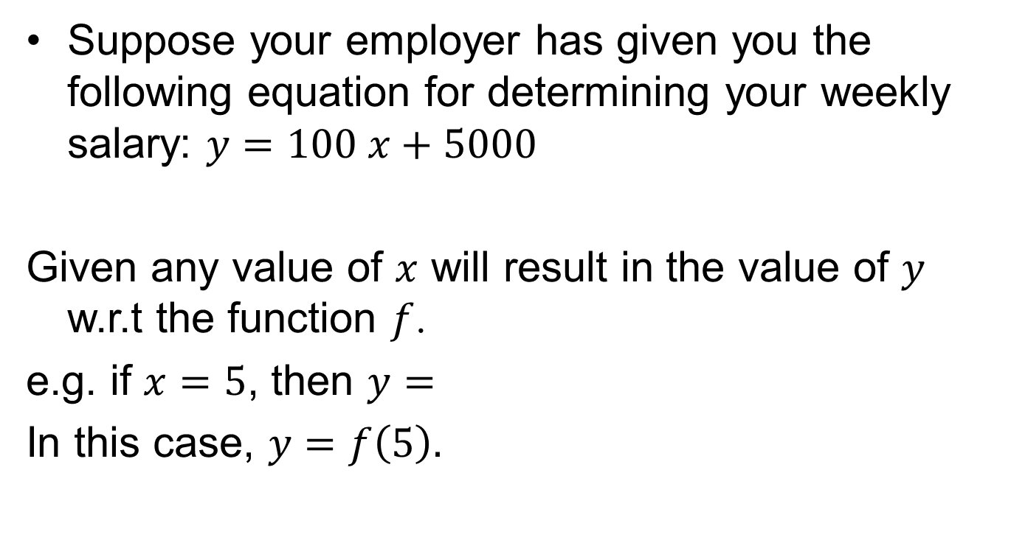
Example (contd.)
Suppose your employer has given you the following equation for determining your weekly salary: $y=100 x+5000$
Given any value of $x$ will result in the value of $y$ w.r.t the function $f$.
e.g. if $x=5$, then $y=$
In this case, $y=f\left(5\right).$

Slide 16
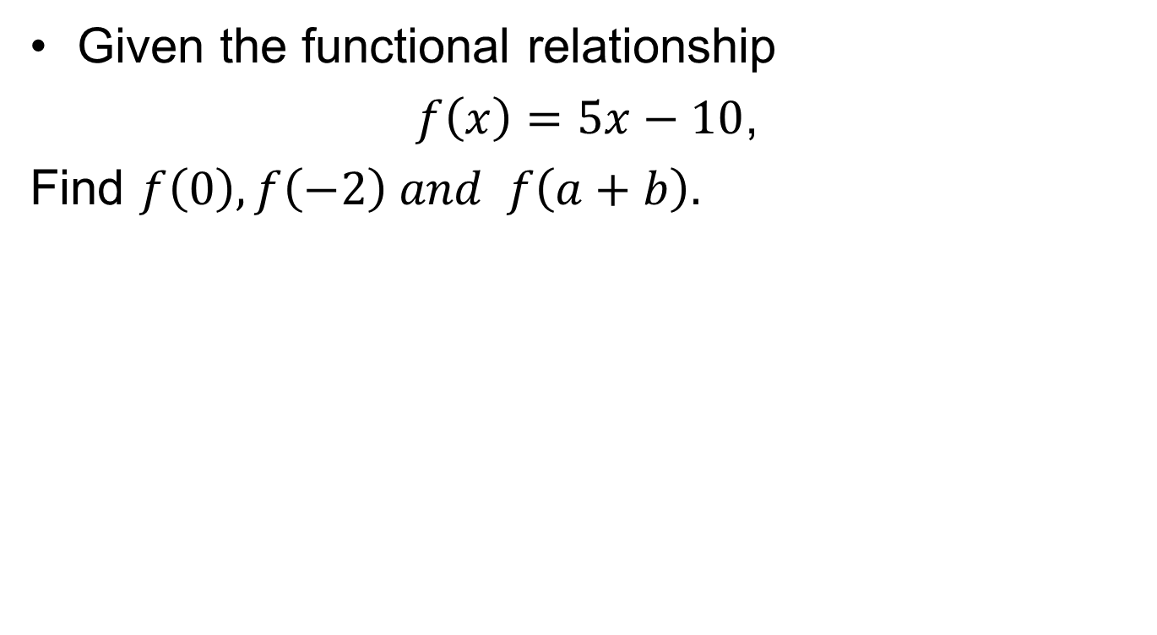
Example
Given the functional relationship
$f\left(x\right)=5x−10$,
Find $f\left(0\right),f\left(−2\right) and f\left(a+b\right).$

Slide 17
Ways to define a function
In words:
The output function is square of the input function
The output function is square of the input function plus 1
This method is not easy and practical when functions involve more variables or more terms.

Slide 18
Domain and Range
Recall that the set of all possible input values is called the domain of a function. Domain consists of all real values of the independent variable for which the dependent variable is defined and real.
To find the domain of a function, we look at few examples.

Slide 19
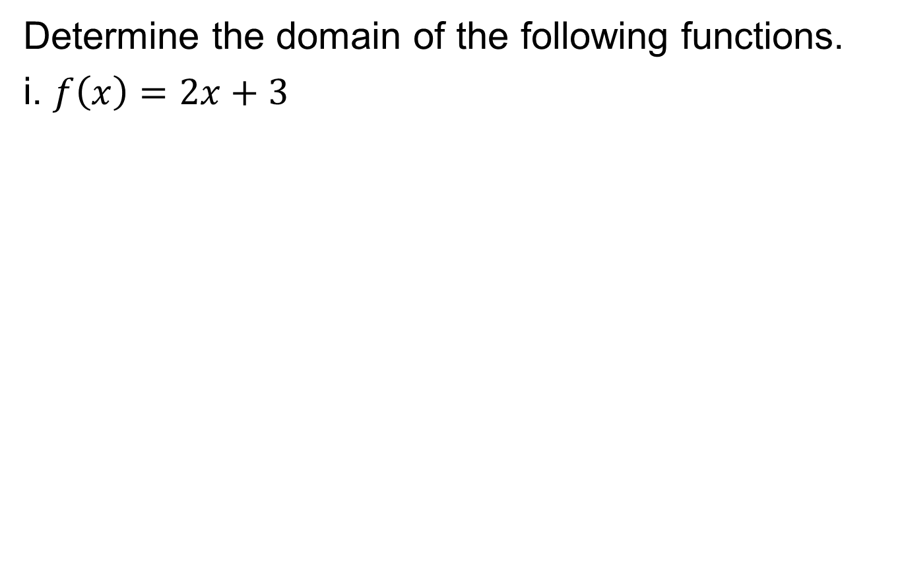
Examples
Determine the domain of the following functions.
i. $f\left(x\right)=2x+3$

Slide 20
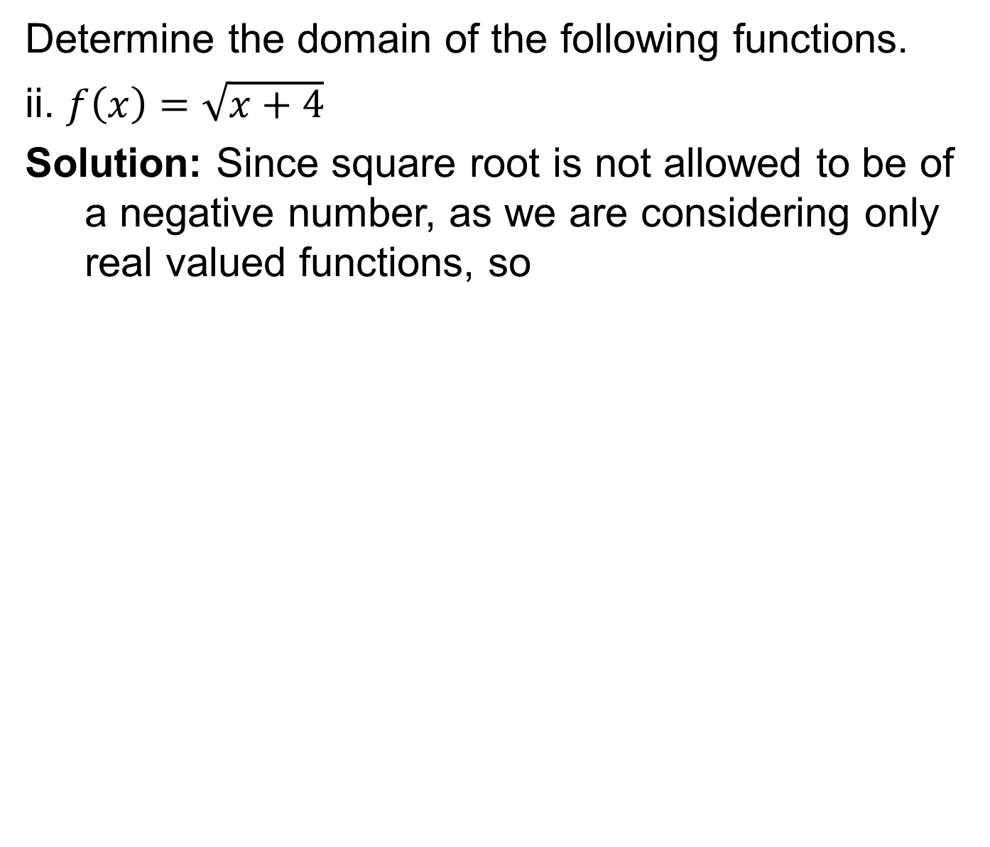
Examples
Determine the domain of the following functions.
ii. $f\left(x\right)=\sqrt{x+4}$
Solution: Since square root is not allowed to be of a negative number, as we are considering only real valued functions, so

Slide 21
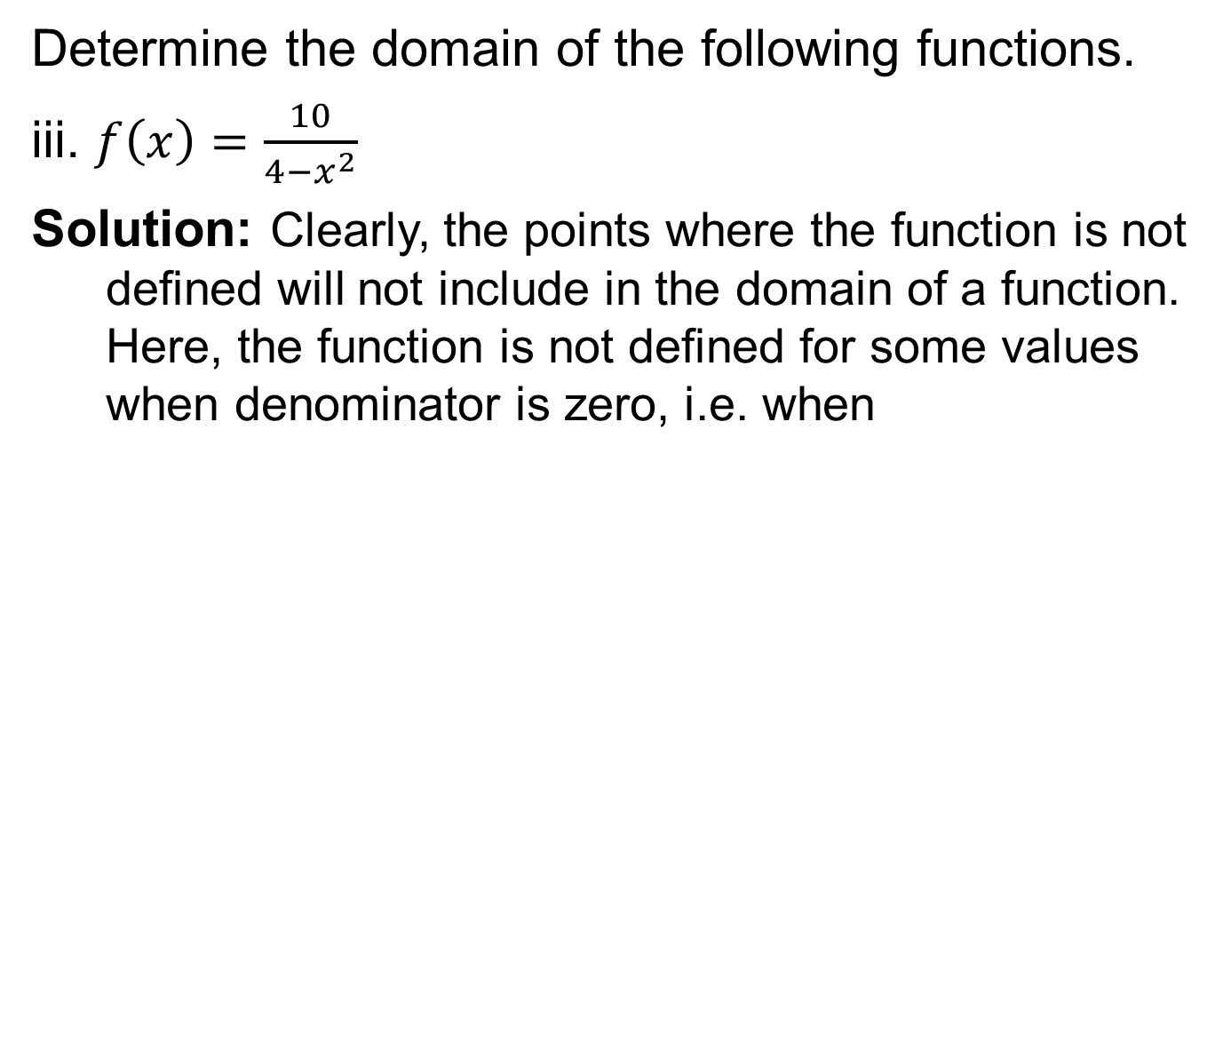
Examples
Determine the domain of the following functions.
iii. $f\left(x\right)=\frac{10}{4−x^{2}}$
Solution: Clearly, the points where the function is not defined will not include in the domain of a function. Here, the function is not defined for some values when denominator is zero, i.e. when

Slide 22
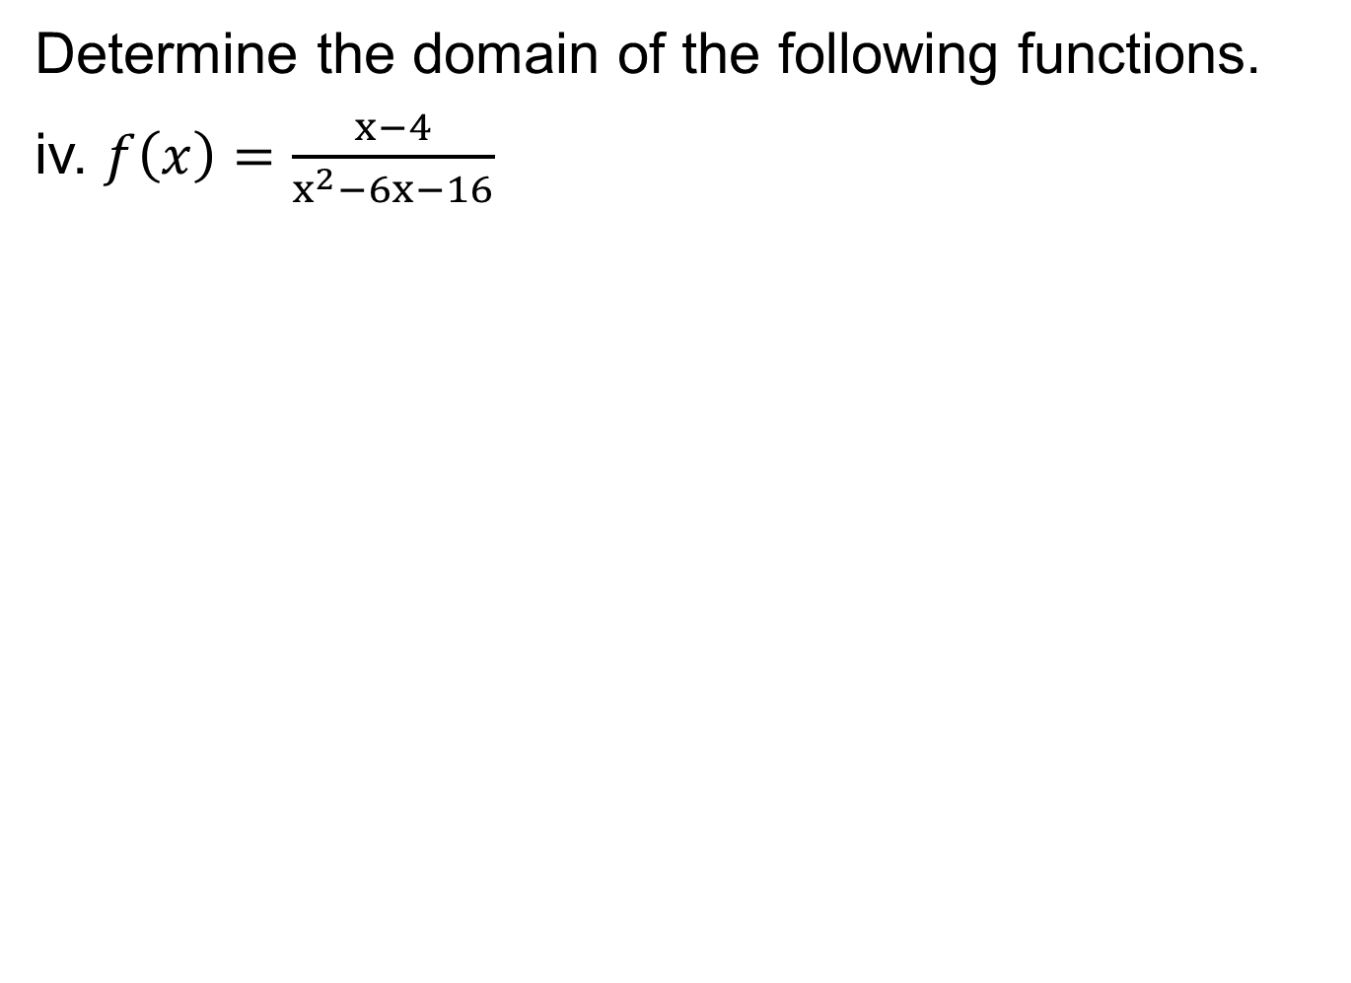
Examples
Determine the domain of the following functions.
iv. $f\left(x\right)=\frac{x−4}{x^{2}−6x−16}$

Slide 23
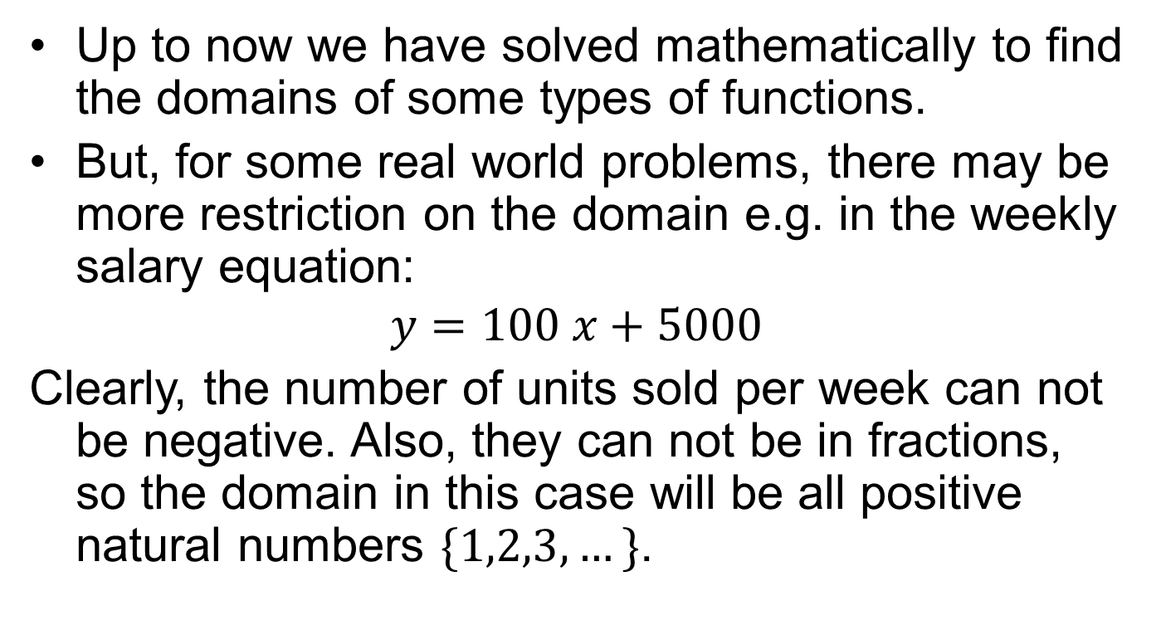
Restricted domain and range
Up to now we have solved mathematically to find the domains of some types of functions.
But, for some real world problems, there may be more restriction on the domain e.g. in the weekly salary equation:
$$y=100 x+5000$$
Clearly, the number of units sold per week can not be negative. Also, they can not be in fractions, so the domain in this case will be all positive natural numbers $\{1,2,3,…\}$.

Slide 24
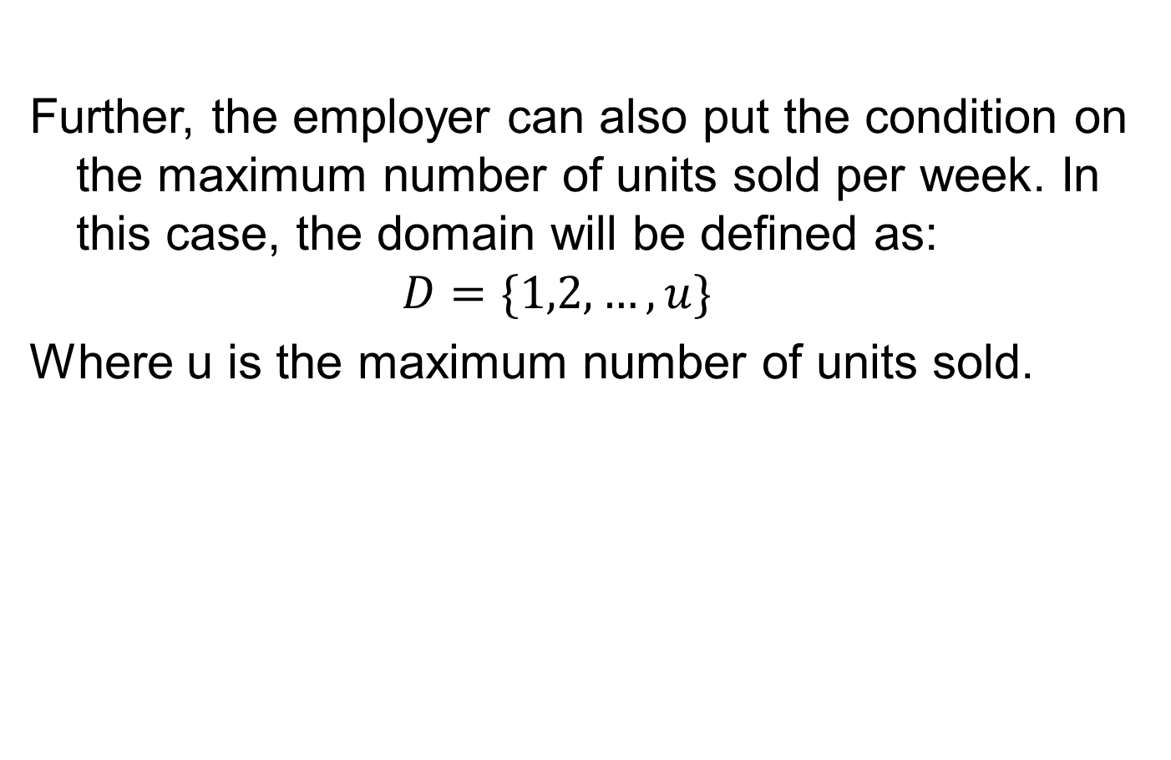
Further, the employer can also put the condition on the maximum number of units sold per week. In this case, the domain will be defined as:
$$D=\{1,2,…,u\}$$
Where u is the maximum number of units sold.

Slide 25
Multivariate Functions
For many mathematical functions, the value of the dependent variable depends upon more than one independent variable.
Functions which contain more than one independent variables are called multivariate functions.
A function having two independent variables is called bivariate function.

Slide 26
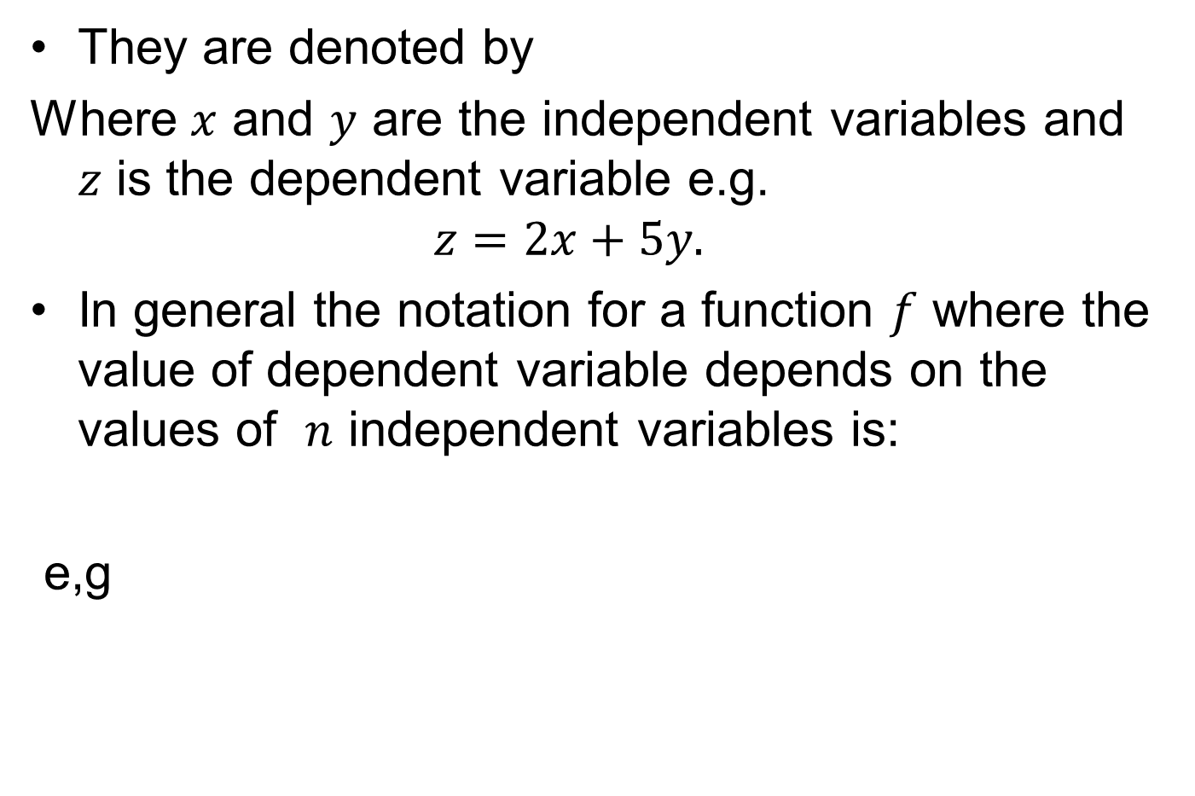
They are denoted by
Where $x$ and $y$ are the independent variables and $z$ is the dependent variable e.g.
$$z=2x+5y.$$
In general the notation for a function $f$ where the value of dependent variable depends on the values of $n$ independent variables is:
e,g

Slide 27
Types of Functions
Constant function
Linear function
Quadratic function
Cubic function
Polynomial function
Rational function
Combination of functions
Composite function
Demand function

Slide 28
Constant Functions
Definition:
A constant function has the general form
Here, domain is the set of all real numbers, i.e.
And range is the single value

Slide 29
Marginal Revenue: This revenue is the additional revenue derived from selling one more unit of a product on service.
If each unit of a product sells at the same price, the marginal revenue is always equal to the price.
e.g. if a product is sold for 80 rupee per unit, the marginal revenue function can be stated as the constant function.
MR=f(x)=80

Slide 30
Linear Functions
Definition: A linear function has the general (slope-intercept) form
where
e,g
This function is represented by a straight line with slope and y-intercept
The weekly salary function is also an example of linear function.

Slide 31
Quadratic Functions
Definition A quadratic function has the general form
provided that
e,g

Slide 32
Cubic Functions
Definition A cubic function has the general form
provided that
e,g

Slide 33
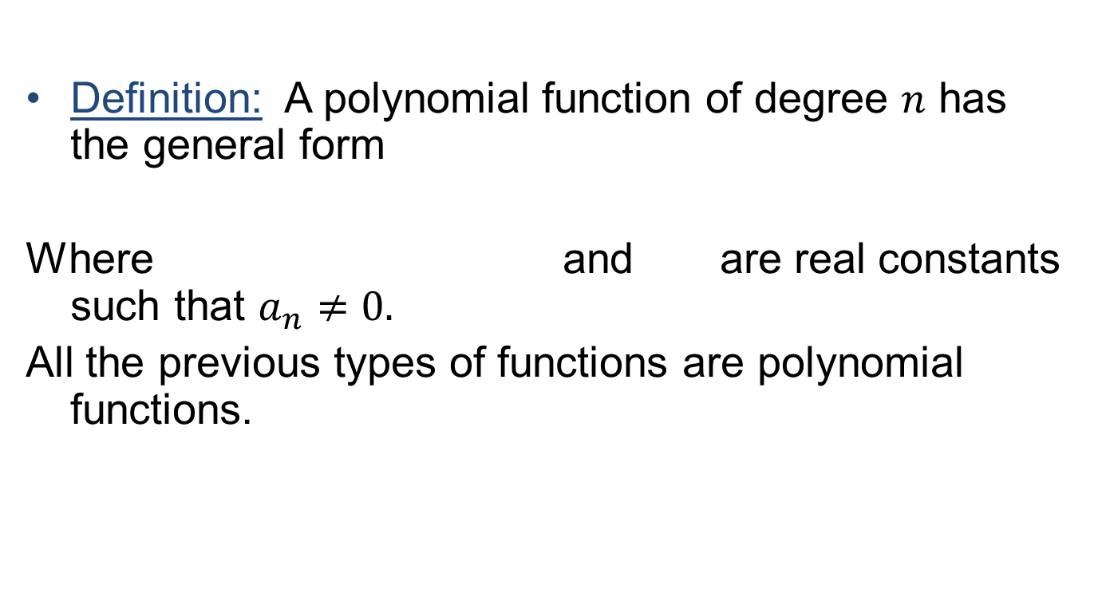
Polynomial Functions
Definition: A polynomial function of degree $n$ has the general form
Where and are real constants such that $a_{n}≠0.$
All the previous types of functions are polynomial functions.

Slide 34
Rational Functions
Definition: A rational function has the general form
Where and are both polynomial functions, e.g.

Slide 35
Combination of Functions
Functions can be combined algebraically to form a resultant function. If
Then these functions can be combined in four different algebraic ways.
1)Sum function:

Slide 36
Combination of Functions
2) Difference function:
3) Product function:
4) Quotient function:

Slide 37
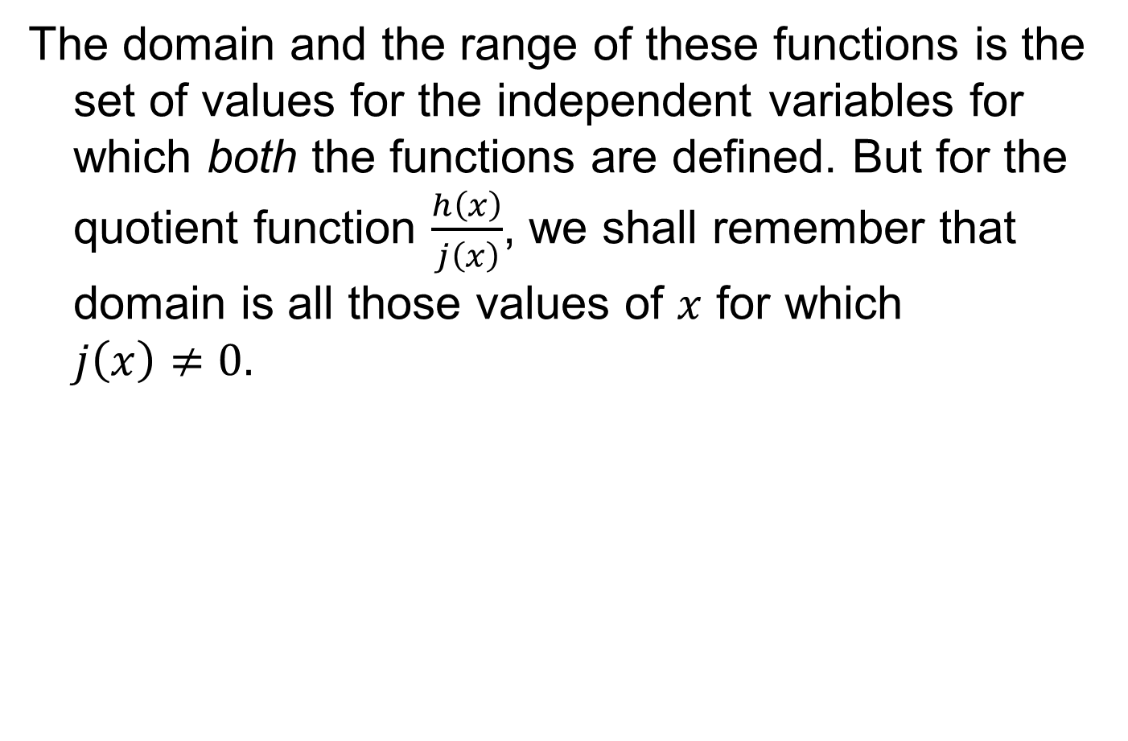
The domain and the range of these functions is the set of values for the independent variables for which both the functions are defined. But for the quotient function $\frac{h\left(x\right)}{j\left(x\right)}$, we shall remember that domain is all those values of $x$ for which $j\left(x\right)≠0.$

Slide 38
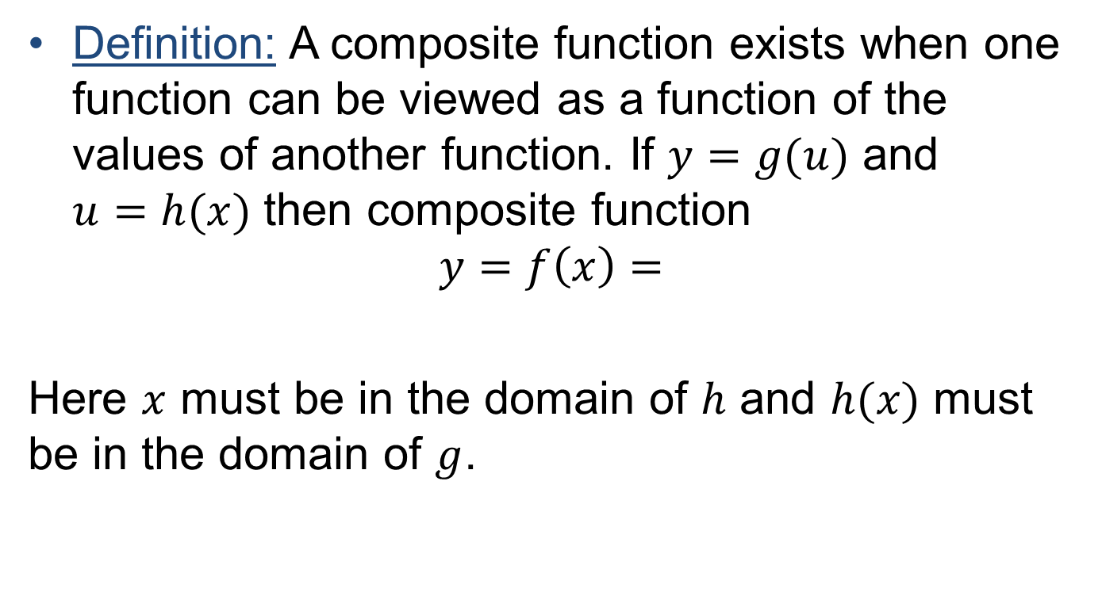
Composite functions
Definition: A composite function exists when one function can be viewed as a function of the values of another function. If $y=g(u)$ and $u=h(x)$ then composite function
$$y=f\left(x\right)=$$
Here $x$ must be in the domain of $h$ and $h(x)$ must be in the domain of $g$.

Slide 39
Example

Slide 40
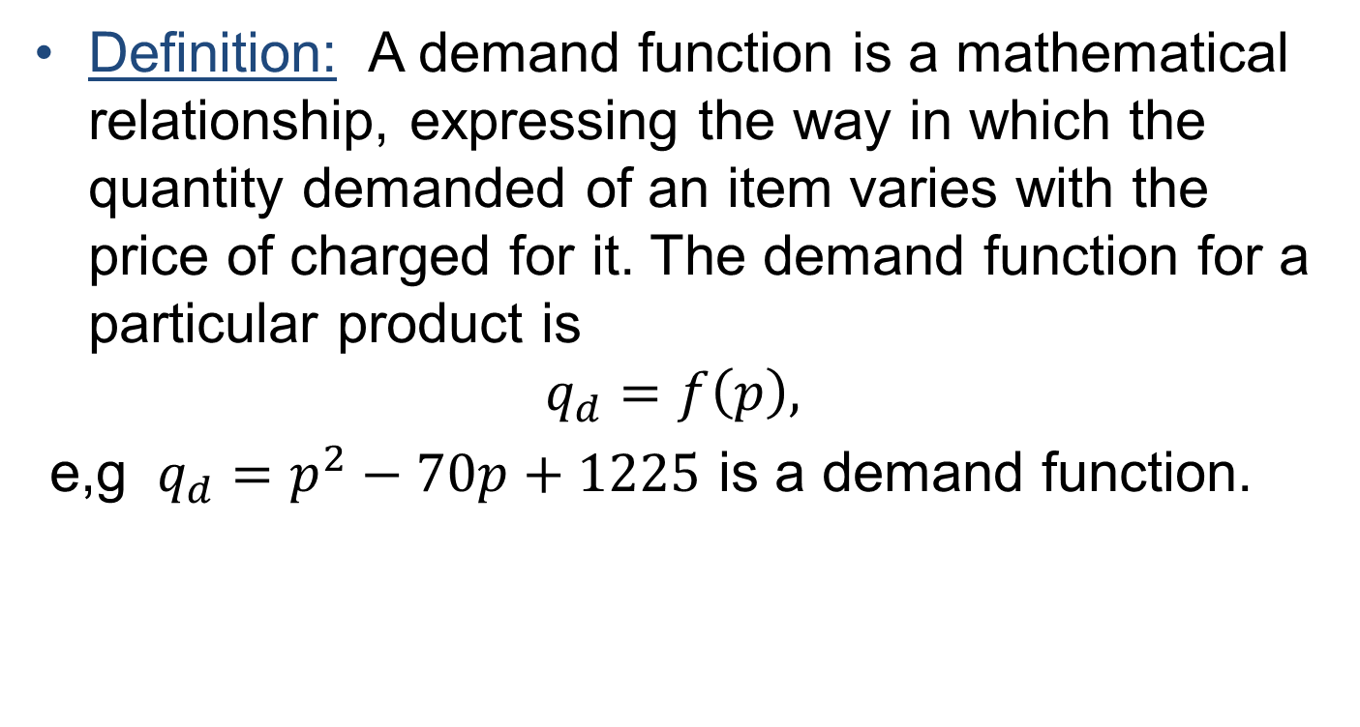
Demand functions
Definition: A demand function is a mathematical relationship, expressing the way in which the quantity demanded of an item varies with the price of charged for it. The demand function for a particular product is
$$q_{d}=f\left(p\right),$$
e,g $q_{d}=p^{2}−70p+1225$ is a demand function.

Slide 41
Review
Functions
Ways to define a function
Domain and range of a function
Multivariate functions
Types of functions

