Slide 1
Business Mathematics
MTH-367
Lecture 2

Slide 2
Chapter 3
Systems of Linear Equations

Slide 3
Objectives
Provide an understanding of the nature of systems of equations and their graphical representation
Provide an understanding of different solution set possibilities and their graphical interpretation
Present procedures for determining solution sets for system of equations
Some applications

Slide 4
Review
Characteristics of linear equations
Graphical characteristics
Slope-Intercept form
Determining the equation of a straight line
Linear equations involving more than two variables

Slide 5
Today’s topics
Two variable systems of equations
Solution sets
Graphical analysis
The elimination procedure
Systems of more than two equations with two variables only
Gaussian elimination method

Slide 6
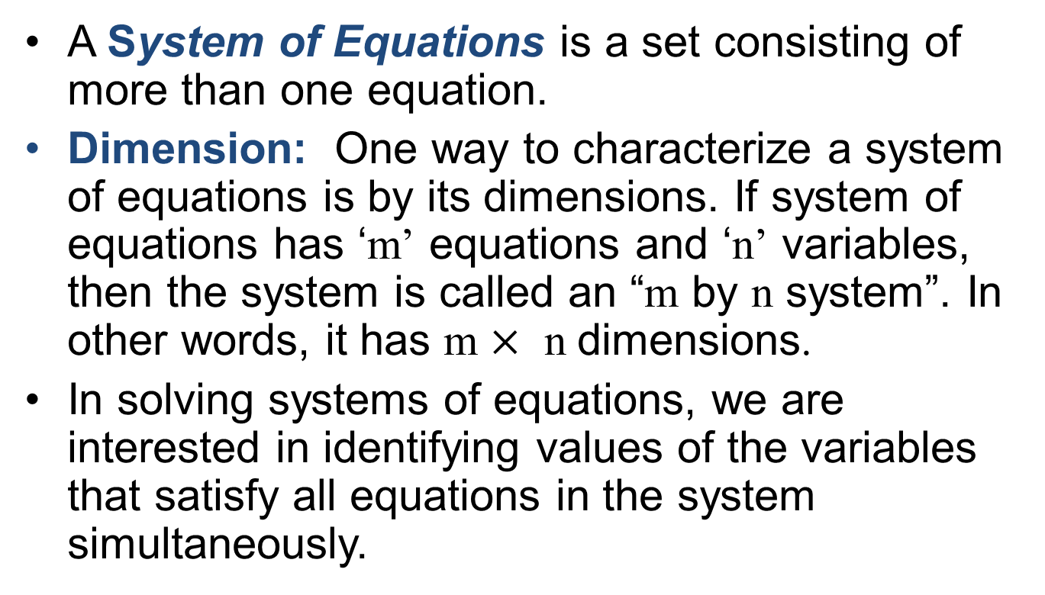
System of Equations
ASystem of Equationsis a set consisting of more than one equation.
Dimension: One way to characterize a system of equations is by its dimensions. If system of equations has ‘m’ equations and ‘n’ variables, then the system is called an “m by n system”. In other words, it has m $×$ n dimensions.
In solving systems of equations, we are interested in identifying values of the variables that satisfy all equations in the system simultaneously.

Slide 7
Solution set
The solution set for a system of linear equations may be a Null set, a finite set or an infinite set.
Methods to find the solution sets:
Graphical analysis method
Elimination method
Gaussian elimination method

Slide 8
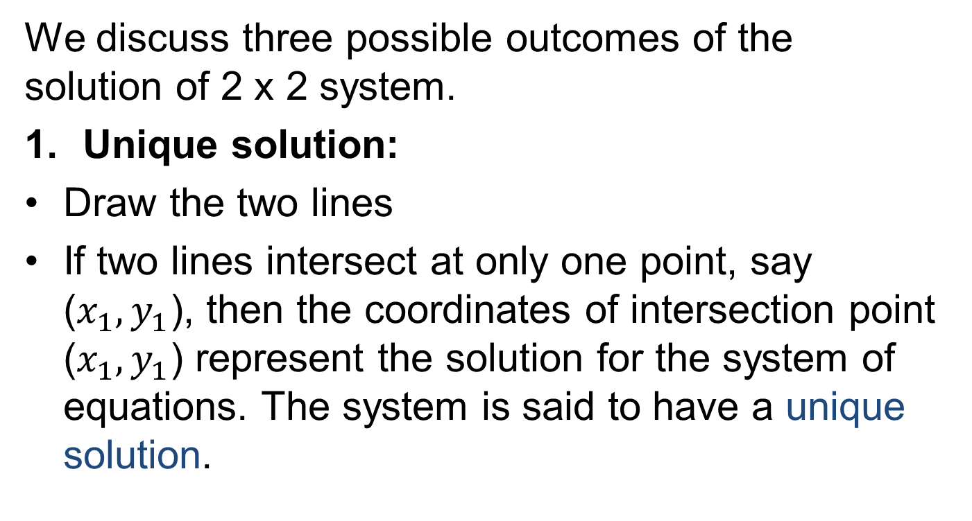
Graphical Analysis (2 x 2 system)
We discuss three possible outcomes of the solution of 2 x 2 system.
Unique solution:
Draw the two lines
If two lines intersect at only one point, say ($x_{1},y_{1}$), then the coordinates of intersection point ($x_{1},y_{1}$) represent the solution for the system of equations. The system is said to have a unique solution.

Slide 9
Graphical Analysis (2 x 2 system)

Slide 10
Graphical Analysis (2 x 2 system)
No solution:
If two lines are parallel (recall that parallel lines have same slope but different y-intercept) then such a system has no solution. The equations in such a system are called inconsistent.

Slide 11
Graphical Analysis (2 x 2 system)
Infinitely many solutions:
If both equations graph on the same line, an infinite number of points are common in two lines. Such a system is said to have infinitely many solutions.

Slide 12
Graphical analysis by slope-Intercept relationships
Given a (2 × 2) system of linear equations (in slope-intercept form),
where and represent the two slopes and and
denote the two y-intercepts then it has
Unique solution, if
No solution, if
Infinite solutions, if

Slide 13
Graphical solutions
Examples Solve graphically and check your answer algebraically.
i.

Slide 14
Graphical solutions
Limitations:
Good for two variable system of equations
Not good for non-integer values
Algebraic solution is preferred

Slide 15
The Elimination Procedure (2 x 2 system)
Given a (2 × 2) system of equations
Eliminate one of the variable by multiplying or adding the two equations
Solve the remaining equation in terms of remaining variable
Substitute back into one of the given equation to find the value of the eliminated variable

Slide 16
Examples
i.

Slide 17
Examples (contd.)
ii.

Slide 18
Examples (contd.)
iii.

Slide 19
(m × 2) systems, m >2
When there are more than two equations involving only two variables then
We solve two equations first to get a point (x, y)
Put the values in the rest of the equations.
If all equations are satisfied then system has unique solution (x, y) otherwise no solution.
If we get no solution at (1) then system has no solution.
If there are infinitely many solutions at step (1), then we select two different equations and repeat (1).

Slide 20
Example

Slide 21
Example (contd.)

Slide 22
Gaussian Elimination Method
This method can be used to solve systems of any size.
The method begins with the original system of equations.
Using row operations, it transforms the original system into an equivalent system from which the solution may be obtained easily
Recall that an equivalent system is one which has the same solution as the original system.
In contrast to the Elimination procedure, the transformed system maintain m×n dimension

Slide 23
Gaussian Elimination Method
The solution can be found directly from the system.

Slide 24
Basic Row Operations
Both sides of an equation may be multiplied by a nonzero constant.
Equations or non-zero multiples of equations may be added or subtracted to another equation.
The order of equations may be interchanged.

Slide 25
Example

Slide 26
Example Cont’d

Slide 27
Example Cont’d

Slide 28
Review
Two variable systems of equations
Solution sets
Graphical analysis
The elimination procedure
Systems of more than two equations with two variables only
Gaussian elimination method (2 x 2 Examples)

Slide 29
Next lecture
Solution by Gaussian elimination method of 3x3 system
Some applications

