Slide 1
Business Mathematics
MTH-367
Lecture 1

Slide 2
Instructor: Dr. Muhammad Imran Qureshi
Assistant Professor
Department of Mathematics
COMSATS Institute of Information Technology Park Road, Chak Shahzad, Islamabad
Ph.D. Mathematics
University of Oxford, UK

Slide 3
Books
Text Book:
Applied Mathematics for Business, Economics, and the Social Sciences (4th Edition);
by Frank S. Budnick
Additional Reading:
Introductory Mathematical Analysis for Business, Economics, and the Life and Social Sciences;
by Ernest F. Haeussler, Jr. Richard S. Paul, 8th Edition

Slide 4
Grading
Credit hours (3,0)
Total marks = 100
Sessional 1 = 10 points
Sessional 2 = 15 points
4 quizzes (MCQs only)
4 assignments
Final Exam = 50 points

Slide 5
Course Objectives
Students will be able to understand business world and its associated mathematical procedures.
To provide solid mathematical preparation and foundation for students continuing their studies and their careers in the areas of accounting, marketing, retailing, banking, office administration, management, finance, insurance, real estate, computer information systems, and general business administration.
To provide an ideal learning for small business management, entrepreneurship, and personal finance applications.

Slide 6
Course Objectives cont’d
To enable students to use linear programming tools such as Graphical method, simplex method, and Assignment and Transportation problem to cover a large area of mathematical optimization procedures.

Slide 7
Course Outline
Linear Equations
System of Linear Equations and its applications in Business.
Mathematical Functions and its types
Applications of linear, quadratic and Exponential functions in Finance and Business.
Mathematics of finance.

Slide 8
Course Outline Cont’d
Linear programming
Graphical Method
Simplex Method
Special Phenomenon
Dual Problem
Transportation and Assignment Models
Solutions to Transportation Models, Assignment Model and method of Solution

Slide 9
Course Outline Cont’d...
Limits, Average Rate of change, Differentiation
Additional Rules of Differentiation
Optimization, Identification of Maxima and Minima
Revenue, Cost, and Profit Applications
Integration and Techniques of integration
Differential Equations and its Applications
Definite integral, Applications of integral Calculus.
Functions of several variables, Partial Derivatives and its applications.

Slide 10
Chapter wise contents
Chapter 2,3: Linear Equations and System of Linear Equations, Applications.
Chapter 4,5,6,7: Mathematical Functions, Applications
Chapter 8: Mathematics of Finance

Slide 11
Chapter wise contents Cont’d
Chapter 10: Linear Programming
Chapter 11: The Simplex Method
Chapter 12: Transportation and Assignment Models

Slide 12
Course Outline Cont’d...
THE CALCULUS
Chapter 15: Differentiation
Chapter 16: Optimization; Methodology
Chapter 17: Optimization; Applications
Chapter 18: Integral Calculus; An Introduction
Chapter 19: Integral Calculus; Applications
Chapter 20: Functions of Several Variables

Slide 13
Chapter 2
Linear Equations

Slide 14
Objectives
Provide a thorough understanding of the algebraic and graphical characteristics of linear equations
Provide the tools which allow one to determine the equation which represents a linear relationship
Illustrate some applications

Slide 15
Today’s Topics
Linear Equations
Linear Equations in two Variables
Linear Equations with n Variables;
Graphical Characteristics of Two Variable Equation
Slope, Formulae to Find Slope
Determining the equation of straight line

Slide 16
Linear Equations
Definition: Linear equations are first degree equations. Each variable in the equation is raised to the first power.
Definition:
A linear equation involving two variables x and y has the standard form
ax + by= c (2.1)
where a, b and c are constants and a and b cannot both equal zero.

Slide 17
Note: The presence of terms having power other than 1 or product of variables, e.g. (xy) would exclude an equation from being linear. Name of the variables may be different from x and y .

Slide 18
Examples of linear and non-linear equations
Equations | Variables | a | b | c | Linear/non-linear

Slide 19
Solution set of an equation
Given a linear equation ax + by= c, the solution set for the equation (2.1) is the set of all ordered pairs (x, y) which satisfy the equation.
S={(x,y)|ax+by=c}
For any linear equation, S consists of an infinite number of elements.
Method:
Assume a value of one variable
Substitute this into the equation
Solve for the other variable

Slide 20
Examples
2x + 4y= 16
Determine the pair of values which satisfy the equation when x=-2
Determine the pair of values which satisfy the equation when y=0

Slide 22
Linear equation with n variables
Definition
A linear equation involving n variables x₁, x₂, . . . , x_{n} has the general form
a₁ x₁ + a₂ x₂+ . . . + a_{n} x_{n} = b
where

Slide 23
Definition:
The solution set of a linear equation with n variables as defined in (2.2) is the n-tuple
satisfying (2.2). The set S will be
As in the case of two variables, there are infinitely many values in the solution set.

Slide 24
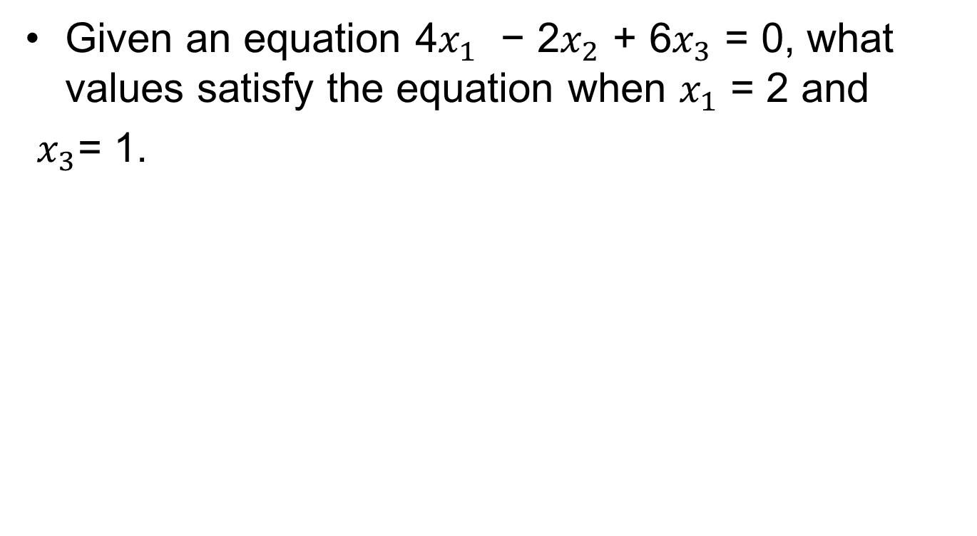
Example
Given an equation 4$x_{1}$ − 2$x_{2}$ + 6$x_{3}$ = 0, what values satisfy the equation when $x_{1}$ = 2 and
$x_{3}$= 1.

Slide 25
Graphing two variable equations
A linear equation involving two variables graphs as a straight line in two dimensions.
Method:
Set one variable equal to zero
Solve for the value of other variable
Set second variable equal to zero
Solve for the value of first variable
The ordered pairs (0, y) and (x, 0) lie on the line

Slide 26
Examples
Graph the linear equation 4x + 8y = 16

Slide 27
Examples cont’d
Graph the linear equation 4x - 7y = 0

Slide 29
Intercepts
x-intercept
The x-intercept of an equation is the point where the graph of the equation crosses the x-axis, i.e. y=0.
y-intercept
The y-intercept of an equation is the point where the graph of the equation crosses the y-axis, i.e. x=0
Equations of the form x=k has no y-intercept
Equations of the form y=k has no x-intercept

Slide 30
Slope
Any straight line with the exception of vertical lines can be characterized by its slope.
Slope represents the inclination of a line or equivalently it shows the rate at which the line
raises and fall or how steep the line is.

Slide 31
Graphical explanation of slope

Slide 32
Explanation
The slope of a line may be positive, negative, zero or undefined. The line with slope
Positive
rises from left to right
Negative
falls from left to right
Zero
horizontal line
Undefined
vertical line

Slide 33
Note: The sign of the slope represents whether the line falling or raising. It’s mag

Slide 34
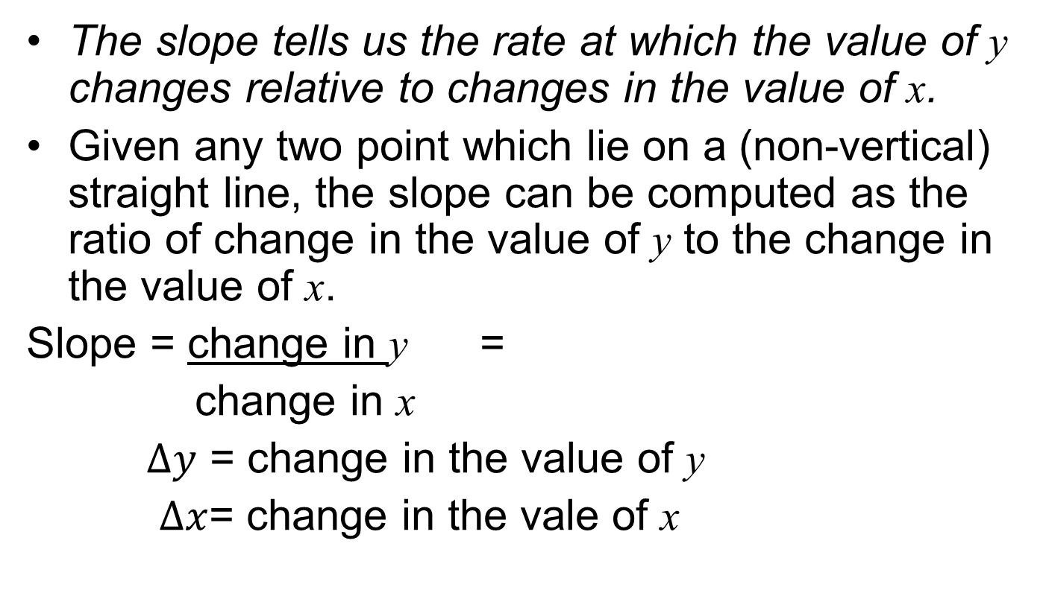
Two point formula (slope)
The slope tells us the rate at which the value of y changes relative to changes in the value of x.
Given any two point which lie on a (non-vertical) straight line, the slope can be computed as the ratio of change in the value of y to the change in the value of x.
Slope = change in y =
change in x
$Δy$ = change in the value of y
$Δx$= change in the vale of x

Slide 35
Two point formula (mathematically)
The slope m of a straight line connecting two points (x₁, y ₁) and (x ₂, y ₂) is given by the formula

Slide 36
Example
Compute the slope of the line segment connecting the two points (−2, 3) and (1, −9).

Slide 37
Note: Along any straight line the slope is constant.
The line connecting any two points will have the same slope.

Slide 38
Slope Intercept form
Consider the general form of two variable equation as
ax+by=c
We can write it as
The above equation is called the slope-intercept form.
Generally, it is written as:
y=mx+k
m= slope, k = y-intercept

Slide 39
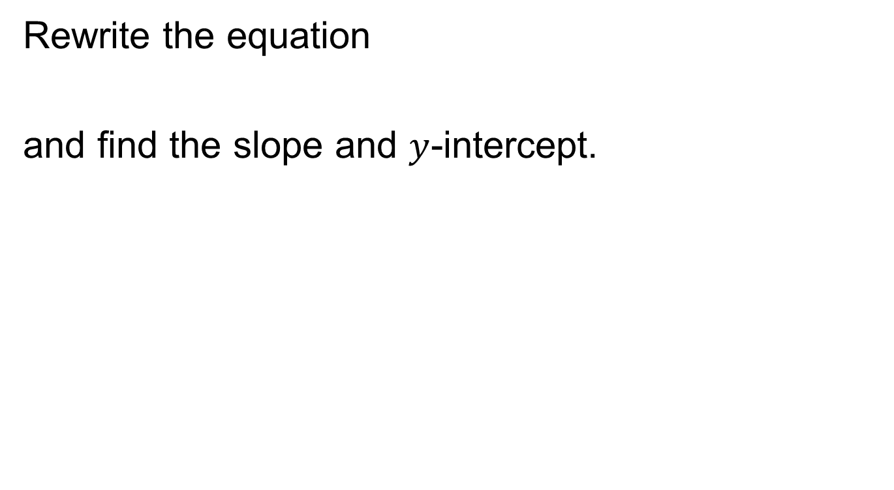
Example
Rewrite the equation
and find the slope and $y$-intercept.

Slide 40
Determining the equation of a straight line
Slope and Intercept: This is the easiest situation to find an equation of line, if slope of a line is -5 and y-intercept is (0, 15) then we have
m= -5, k = 15. We can write down

Slide 41
Determining the equation of a straight line
2) Slope and one point
If we are given the slope of a line and some point that lies on the line, we can substitute the known slope m and coordinates of the given point into y = mx + k and solve for k, e.g.

Slide 42
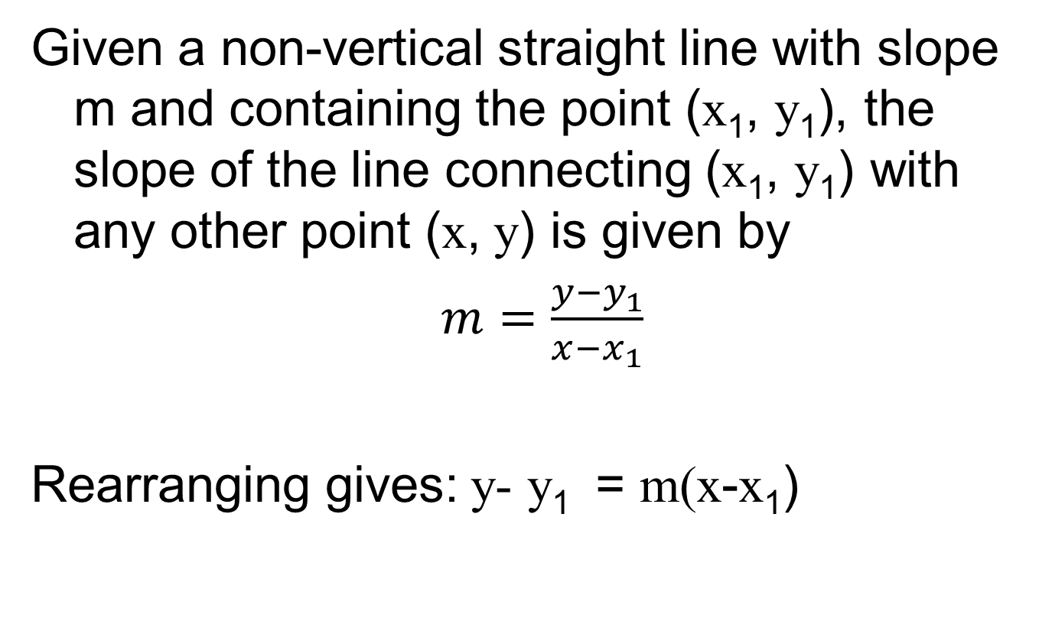
Determining the equation of a straight line
Given a non-vertical straight line with slope m and containing the point (x₁, y₁), the slope of the line connecting (x₁, y₁) with any other point (x, y) is given by
$m=\frac{y−y_{1}}{x−x_{1}}$
Rearranging gives: y-y₁ = m(x-x₁)

Slide 43
Example
Find the equation of line having slope m = −2 and passing through the point (2, 8).

Slide 44
Parallel and perpendicular lines
Two lines are parallel if they have the same slope, i.e.
Two lines are perpendicular if their slopes are equal to the negative reciprocal of each other, i.e.

Slide 45
Example
Find an equation of line through the point (2, −4)
and parallel to the line 8x − 4y = 20.

Slide 47
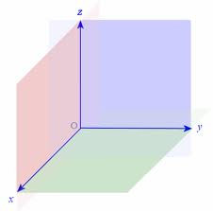
Linear equations involving more than two variables

Slide 48
Three dimensional
Three dimensional coordinate system
Three coordinate axes which are perpendicular to one another, intersecting at their respective zero points called the origin (0,0,0).
Linear equations involving three variables is of the form
Solution set of this equation are all ordered tuples
which satisfy the above equation

Slide 49
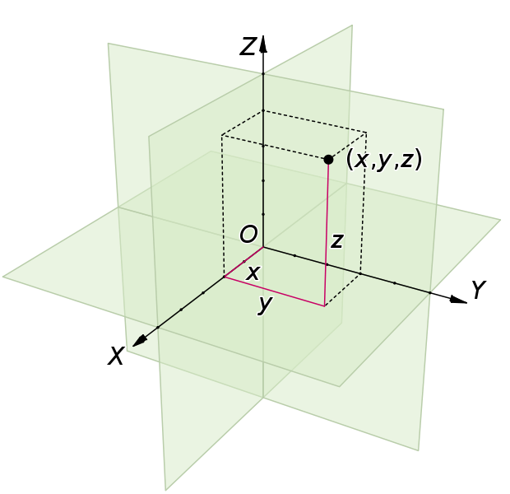
Representation of a point

Slide 50
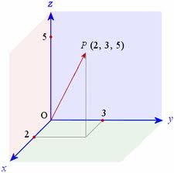
Example

Slide 51
Summary
Linear Equations
Linear Equations in two Variables
Linear Equations with n Variables;
Graphical Characteristics of Two Variable Equation
Slope, Formulae to Find Slope
Determining the equation of straight line

Slide 52
Next lecture
Two variable systems of equations
Solution sets
Graphical analysis
The elimination procedure
Systems of more than two equations with two variables only
Gaussian elimination method

