Slide 1
Lecture # 9
MTH352: Differential Geometry
For
Master of Mathematics
By
Dr. SOHAIL IQBAL
Assistant Professor
Department of Mathematics, CIIT Islamabad

Slide 2
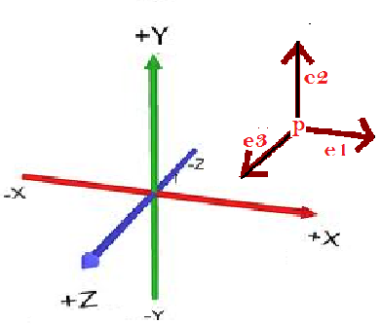
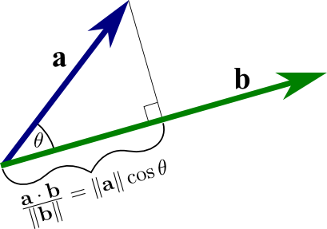
Last lecture
Contents:
The Dot Product
Frames

Slide 3
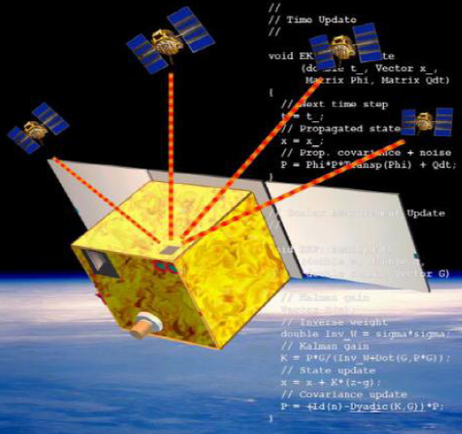
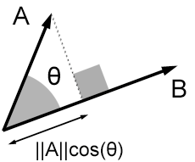
Today’s lecture
Contents:
Formulas For The Dot Product
The Attitude Matrix
Cross Product

Slide 4
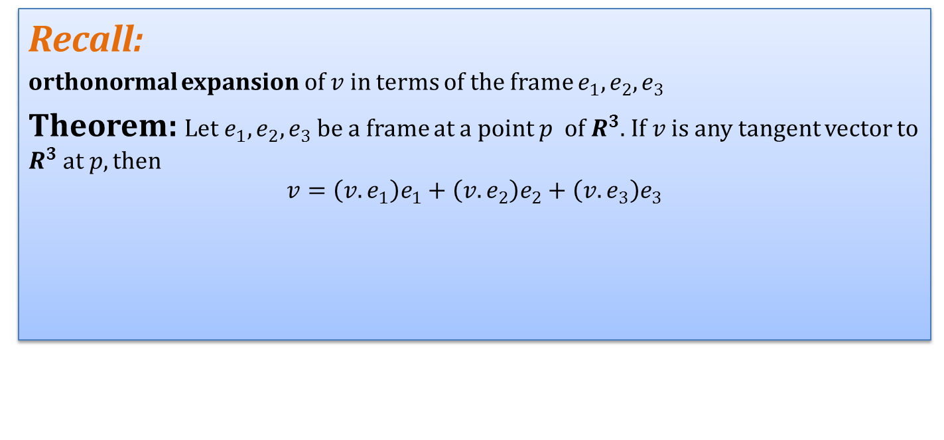
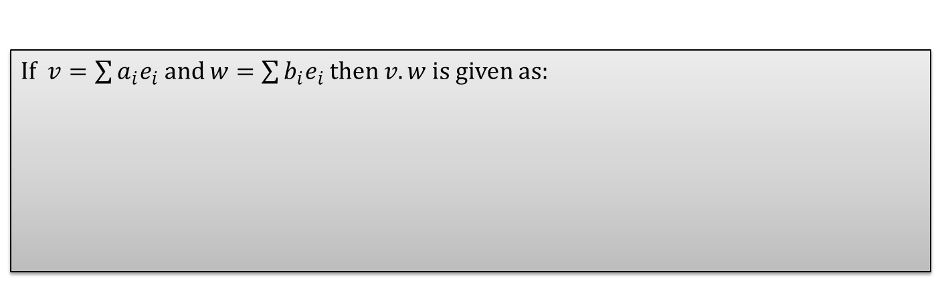
Formulas For The Dot Product
Recall:
orthonormal expansion of $v$ in terms of the frame $e_{1},e_{2},e_{3}$
Theorem: Let $e_{1},e_{2},e_{3}$be a frame at a point $p$ of $R^{3}$. If $v$ is any tangent vector to $R^{3}$ at $p, then$
$$v=\left(v.e_{1}\right)e_{1}+\left(v.e_{2}\right)e_{2}+\left(v.e_{3}\right)e_{3}$$
If $v=\sum{a_{i}e_{i}}$ and $w=\sum{b_{i}e_{i}}$ then $v.w$ is given as:

Slide 5
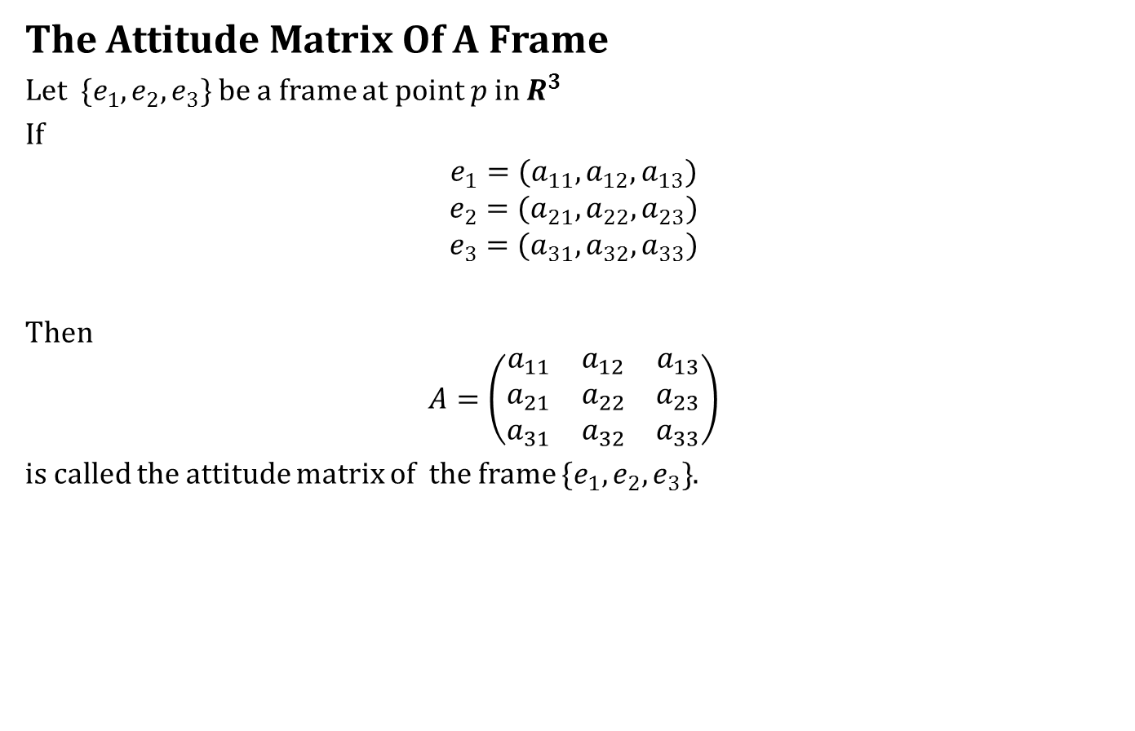
The Attitude Matrix
The Attitude Matrix Of A Frame
Let $\{e_{1},e_{2},e_{3}\}$ be a frame at point $p$ in $R^{3}$
If
$$e_{1}=(a_{11}, a_{12}, a_{13})$$
$$e_{2}=(a_{21},a_{22},a_{23})$$
$$e_{3}=(a_{31},a_{32},a_{33})$$
Then
$$A=\left(\begin{matrix}a_{11} & a_{12} & a_{13} \\ a_{21} & a_{22} & a_{23} \\ a_{31} & a_{32} & a_{33}\end{matrix}\right)$$
is called the attitude matrix of the frame $\{e_{1},e_{2},e_{3}\}$.

Slide 6
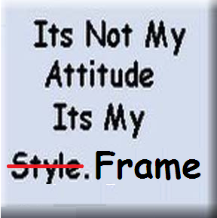
The Attitude Matrix
The Attitude Matrix Of A Frame
Let $\{e_{1},e_{2},e_{3}\}$ be a frame at point $p$ in $R^{3}$
If
$$e_{1}=(a_{11}, a_{12}, a_{13})$$
$$e_{2}=(a_{21},a_{22},a_{23})$$
$$e_{3}=(a_{31},a_{32},a_{33})$$
Then
$$A=\left(\begin{matrix}a_{11} & a_{12} & a_{13} \\ a_{21} & a_{22} & a_{23} \\ a_{31} & a_{32} & a_{33}\end{matrix}\right)$$
is called the attitude matrix of the frame $\{e_{1},e_{2},e_{3}\}$.

Slide 7
The Attitude Matrix
Example1:

Slide 8
The Attitude Matrix
Example2:

Slide 9
The Attitude Matrix
Definition:
If the rows of a square matrix are orthonormal, then the matrix is called orthogonal.
Hence the attitude matrix of any frame is an orthogonal matrix.

Slide 10
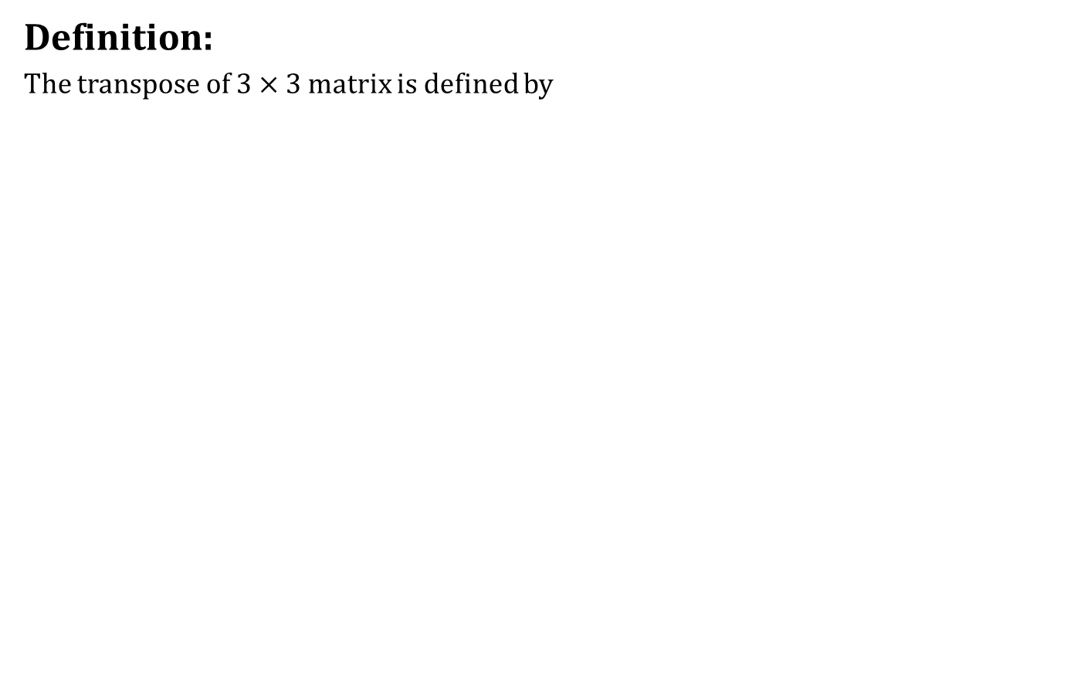
The Attitude Matrix
Definition:
The transpose of $3×3$ matrix is defined by

Slide 11
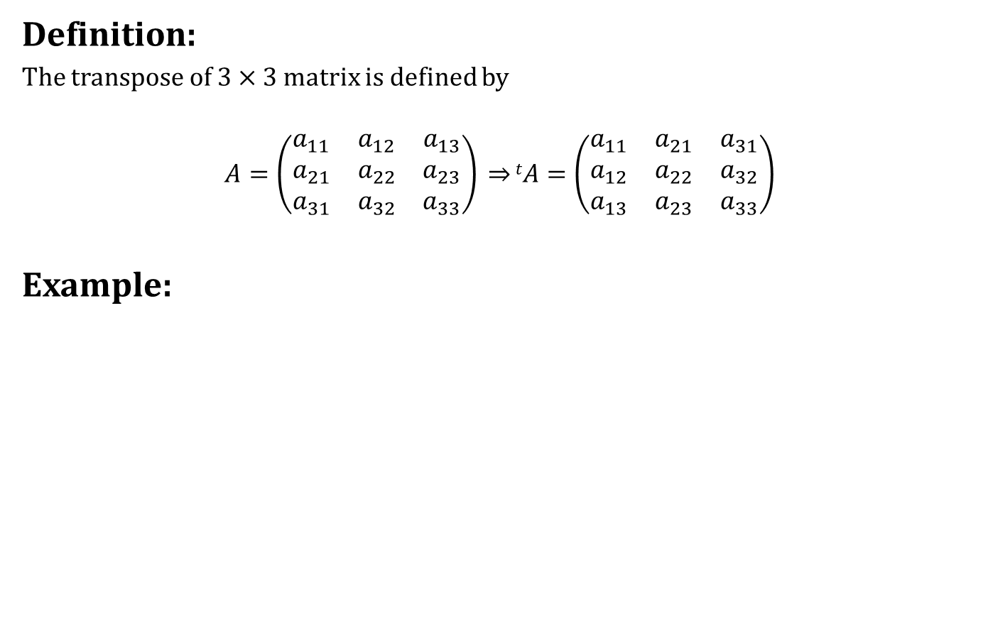
The Attitude Matrix
Definition:
The transpose of $3×3$ matrix is defined by
$$A=\left(\begin{matrix}a_{11} & a_{12} & a_{13} \\ a_{21} & a_{22} & a_{23} \\ a_{31} & a_{32} & a_{33}\end{matrix}\right) \overset{⇒}{}tA=\left(\begin{matrix}a_{11} & a_{21} & a_{31} \\ a_{12} & a_{22} & a_{32} \\ a_{13} & a_{23} & a_{33}\end{matrix}\right)$$
Example:

Slide 12
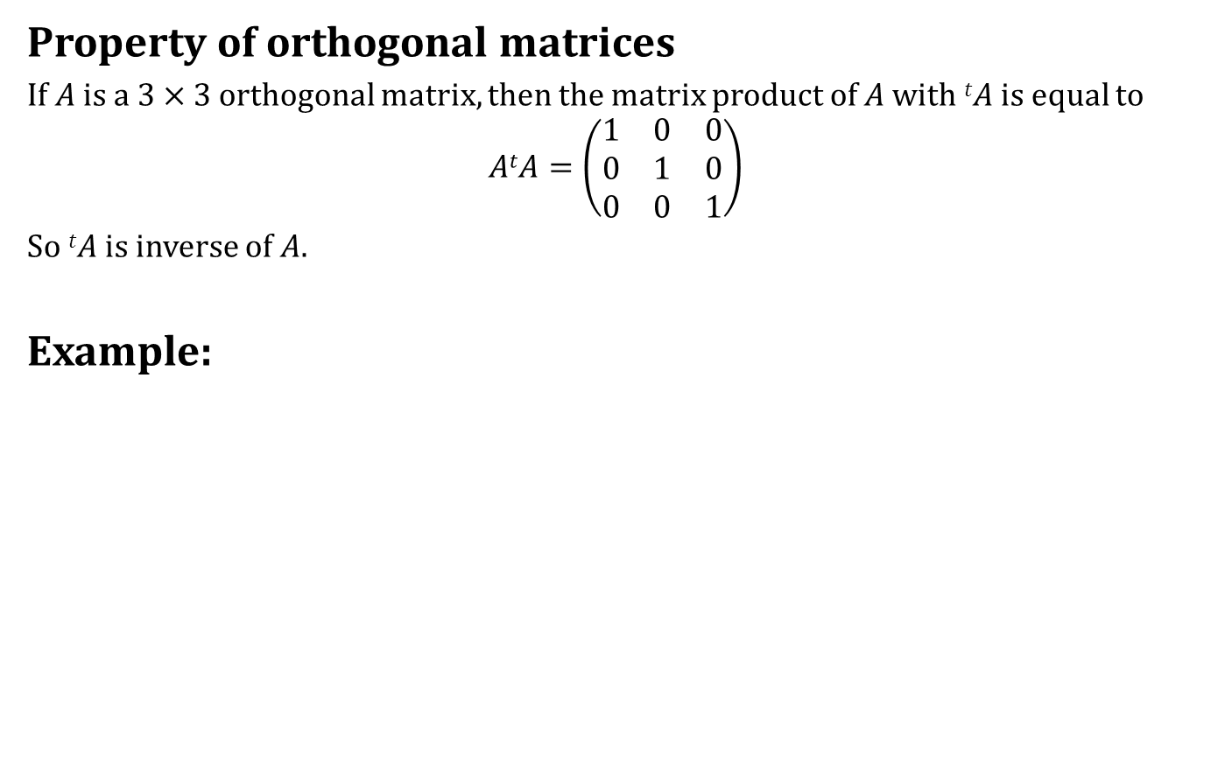
The Attitude Matrix
Property of orthogonal matrices
If $A$ is a $3×3$ orthogonal matrix, then the matrix product of $A$ with $tA$ is equal to
$$AtA=\left(\begin{matrix}1 & 0 & 0 \\ 0 & 1 & 0 \\ 0 & 0 & 1\end{matrix}\right)$$
So $tA$ is inverse of $A$.
Example:

Slide 13
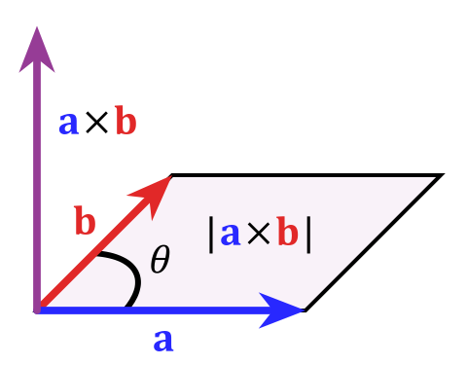
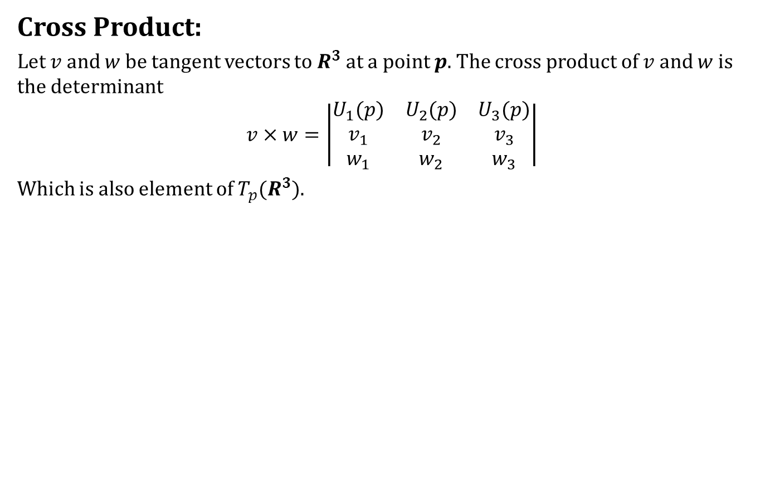
Cross Product
Cross Product:
Let $v$ and $w$ be tangent vectors to $R^{3}$at a point $p$. The cross product of $v$ and $w$ is the determinant
$$v×w=\left|\begin{matrix}U_{1}(p) & U_{2}(p) & U_{3}(p) \\ v_{1} & v_{2} & v_{3} \\ w_{1} & w_{2} & w_{3}\end{matrix}\right|$$
Which is also element of $T_{p}(R^{3})$.

Slide 14
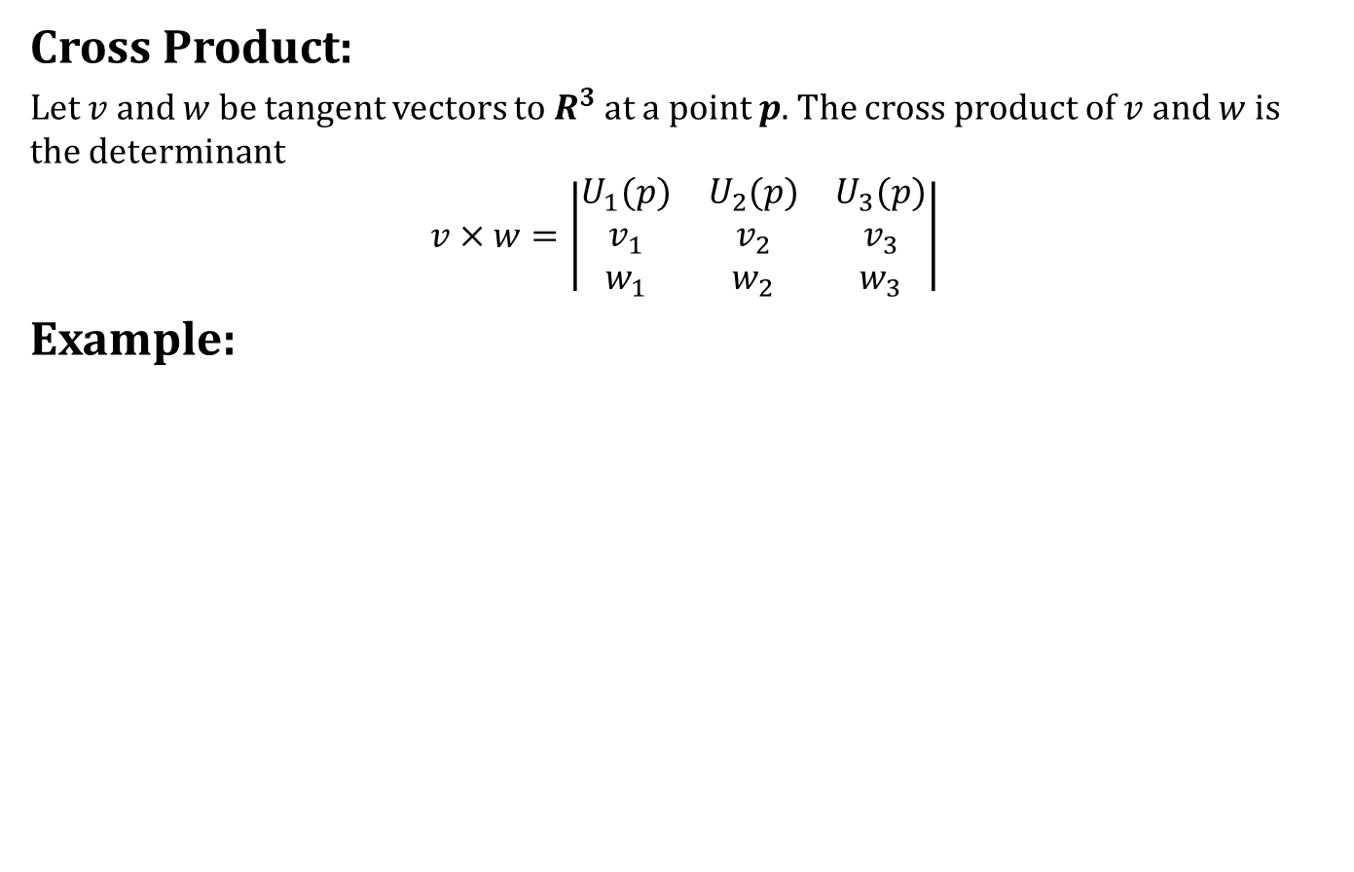
Cross Product
Cross Product:
Let $v$ and $w$ be tangent vectors to $R^{3}$at a point $p$. The cross product of $v$ and $w$ is the determinant
$$v×w=\left|\begin{matrix}U_{1}(p) & U_{2}(p) & U_{3}(p) \\ v_{1} & v_{2} & v_{3} \\ w_{1} & w_{2} & w_{3}\end{matrix}\right|$$
Example:

Slide 15
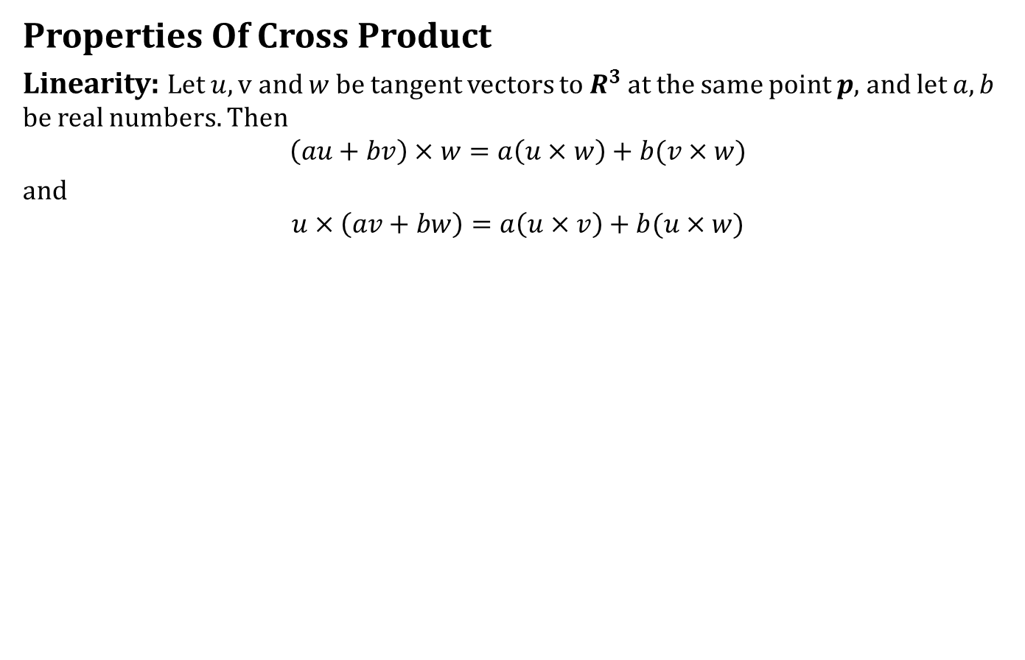
Cross Product
Properties Of Cross Product
Linearity: Let $u, v$ and $w$ be tangent vectors to $R^{3}$ at the same point $p$, and let $a,b$ be real numbers. Then
$$\left(au+bv\right)×w=a\left(u×w\right)+b(v×w)$$
and
$$u×\left(av+bw\right)=a\left(u×v\right)+b(u×w)$$

Slide 16
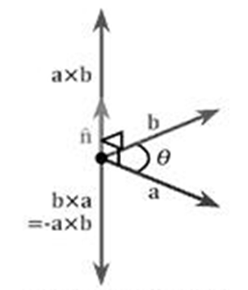
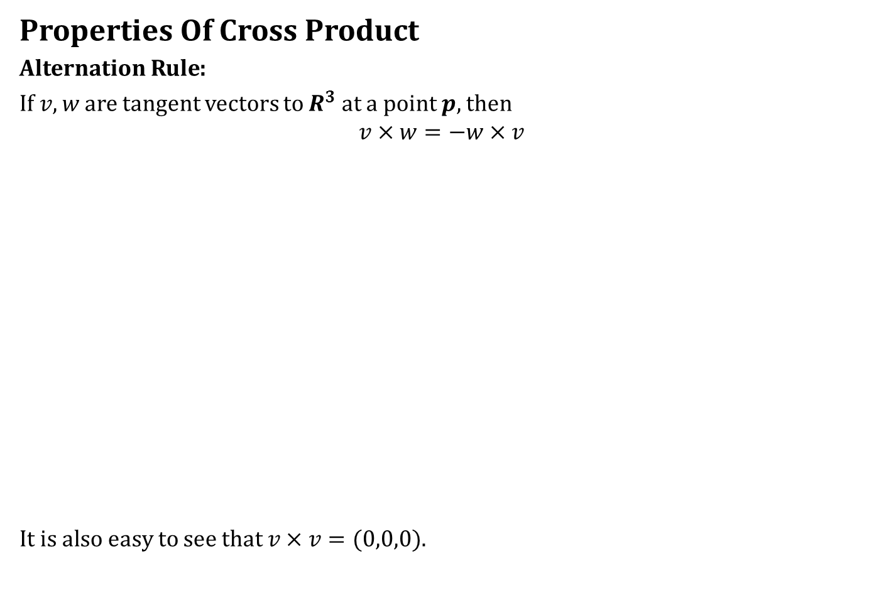
Cross Product
Properties Of Cross Product
Alternation Rule:
If $v,w$ are tangent vectors to $R^{3}$ at a point $p,$then
$$v×w=−w×v$$
It is also easy to see that $v×v=(0,0,0)$.

Slide 17
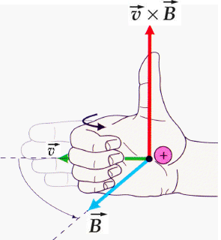
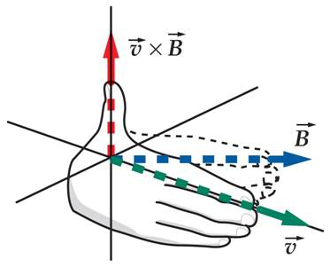
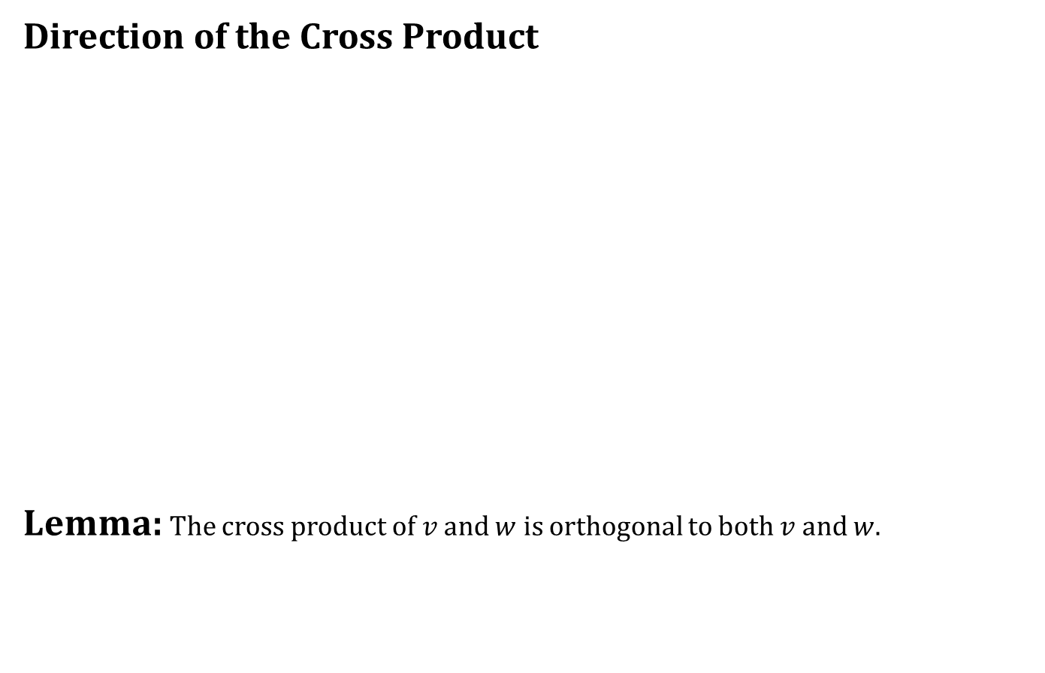
Cross Product
Direction of the Cross Product
Lemma: The cross product of $v$ and $w$ is orthogonal to both $v$ and $w$.

Slide 18
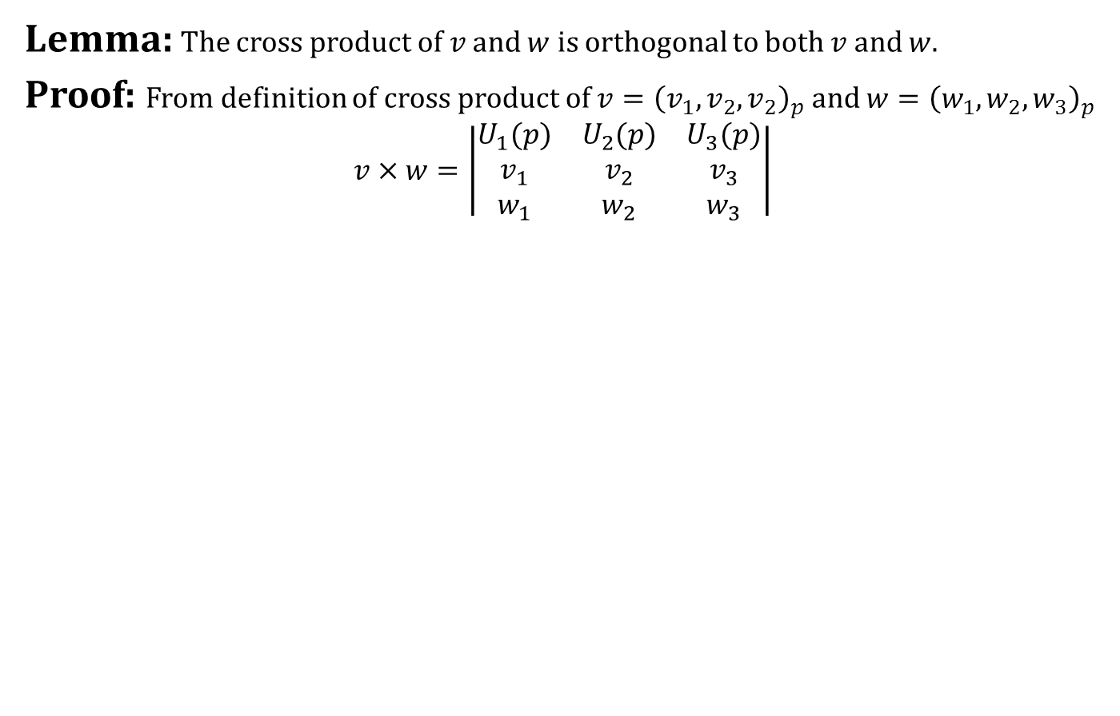
Cross Product
Lemma: The cross product of $v$ and $w$ is orthogonal to both $v$ and $w$.
Proof: From definition of cross product of $v={\left(v_{1},v_{2},v_{2}\right)}_{p}$ and $w={\left(w_{1},w_{2},w_{3}\right)}_{p}$
$$v×w=\left|\begin{matrix}U_{1}(p) & U_{2}(p) & U_{3}(p) \\ v_{1} & v_{2} & v_{3} \\ w_{1} & w_{2} & w_{3}\end{matrix}\right|$$

Slide 19
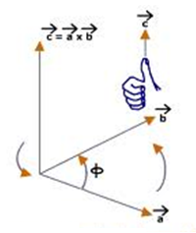
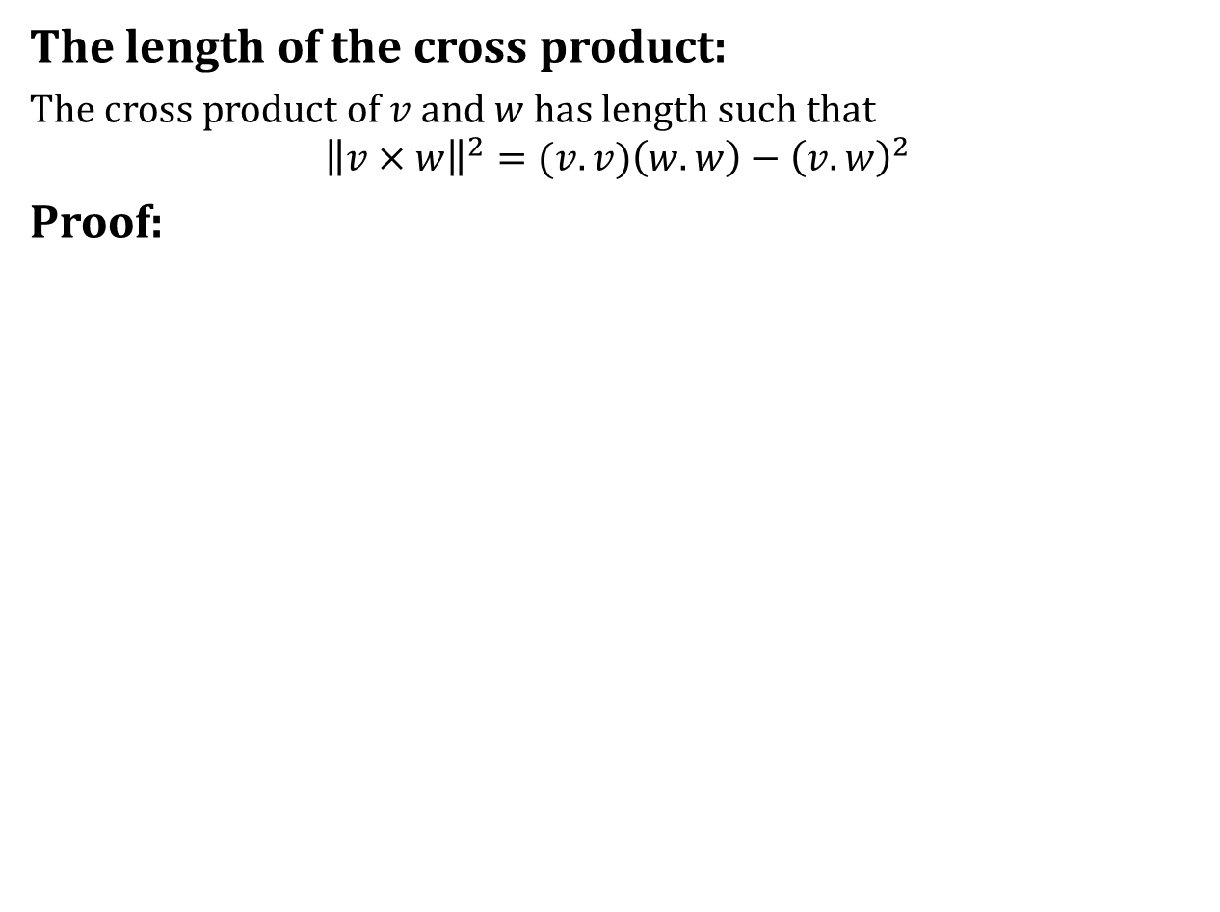
Cross Product
The length of the cross product:
The cross product of $v$ and $w$ has length such that
$${\left\|v×w\right\|}^{2}=(v.v)\left(w.w\right)−{\left(v.w\right)}^{2}$$
Proof:

Slide 20
Cross Product
The length of the cross product:
The cross product of $v$ and $w$ has length such that
$${\left\|v×w\right\|}^{2}=(v.v)\left(w.w\right)−{\left(v.w\right)}^{2}$$
Proof:

Slide 21
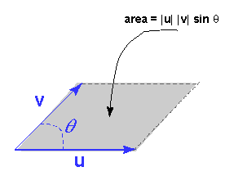
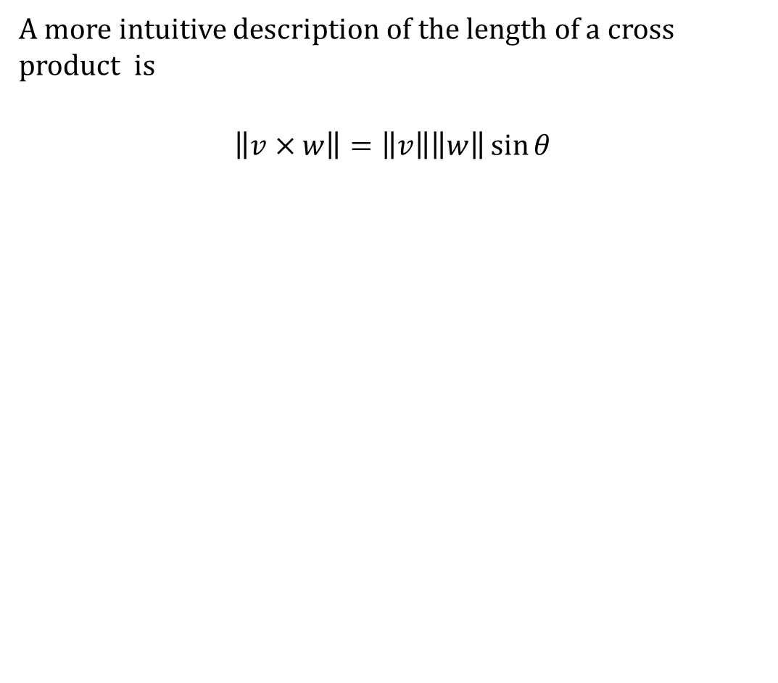
Cross Product
A more intuitive description of the length of a cross product is
$$\left\|v×w\right\|=\left\|v\right\|\left\|w\right\|\sin{θ}$$

Slide 22
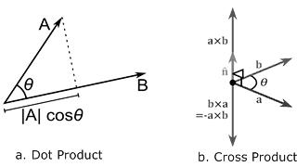
Cross Product
Reminder

Slide 23
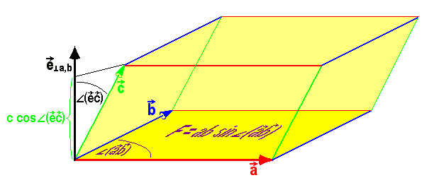
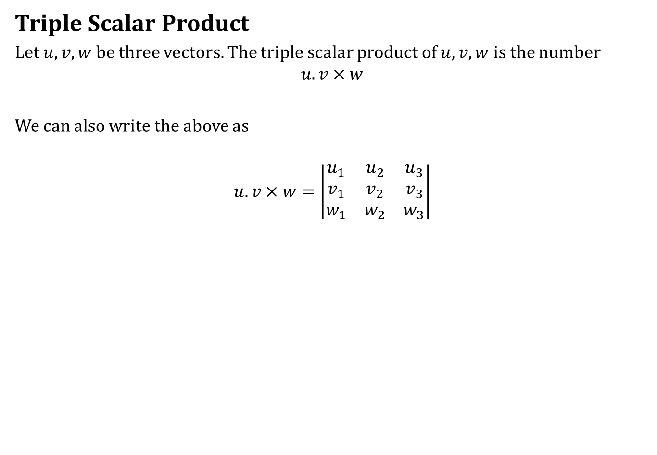
Cross Product
Triple Scalar Product
Let $u,v,w$ be three vectors. The triple scalar product of $u,v,w$ is the number
$$u.v×w$$
We can also write the above as
$$u.v×w=\left|\begin{matrix}u_{1} & u_{2} & u_{3} \\ v_{1} & v_{2} & v_{3} \\ w_{1} & w_{2} & w_{3}\end{matrix}\right|$$

Slide 24
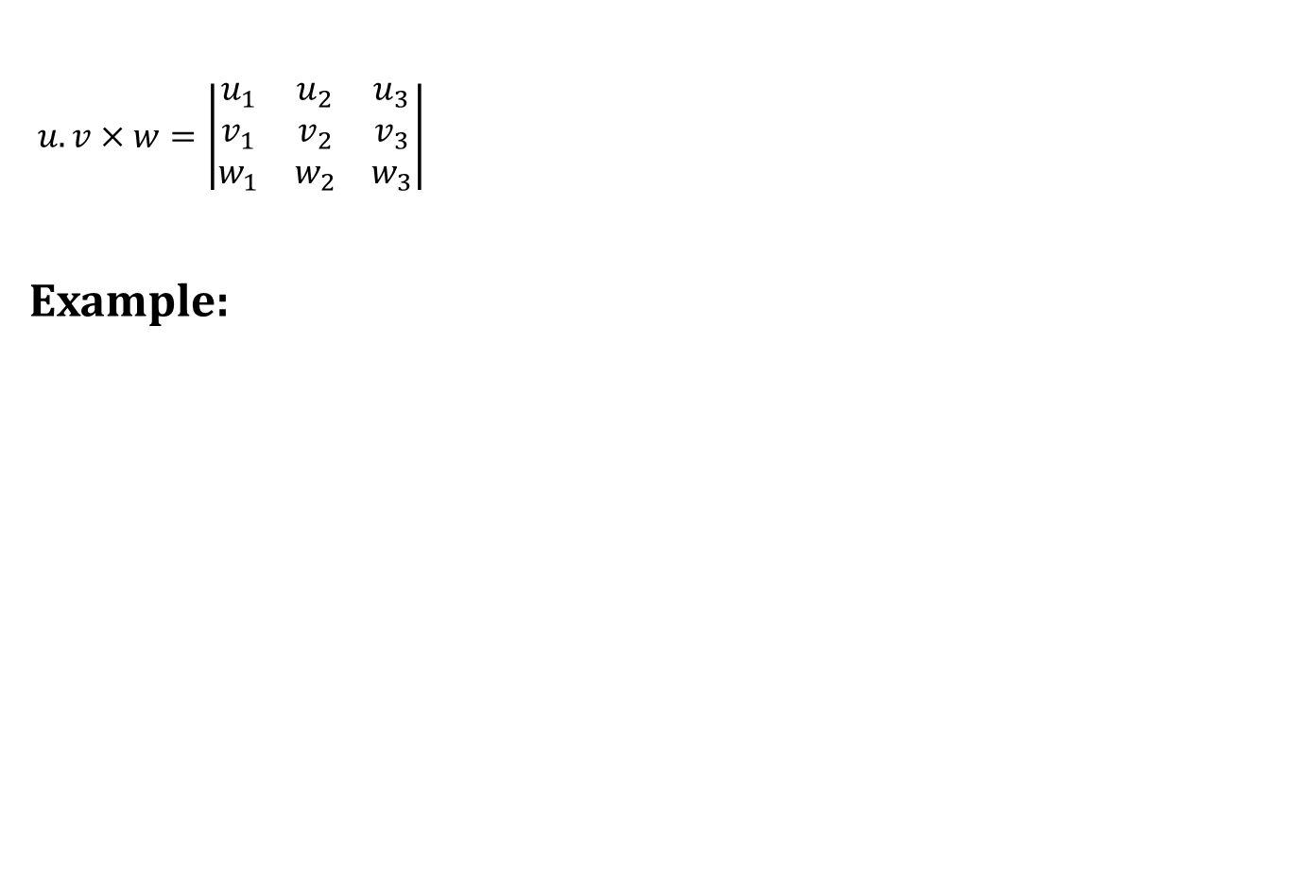
Cross Product
$u.v×w=\left|\begin{matrix}u_{1} & u_{2} & u_{3} \\ v_{1} & v_{2} & v_{3} \\ w_{1} & w_{2} & w_{3}\end{matrix}\right|$
Example:

Slide 25
Today we learnt
Contents:
Formulas For The Dot Product
The Attitude Matrix
Cross Product

Slide 26
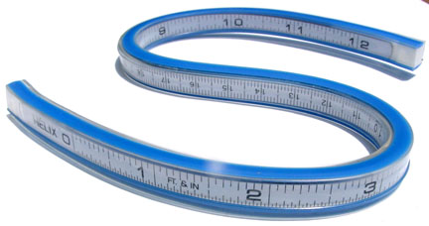
Next time
Curves

Slide 27

End of the lecture

