Slide 1
Lecture # 8
MTH352: Differential Geometry
For
Master of Mathematics
By
Dr. SOHAIL IQBAL
Assistant Professor
Department of Mathematics, CIIT Islamabad

Slide 2

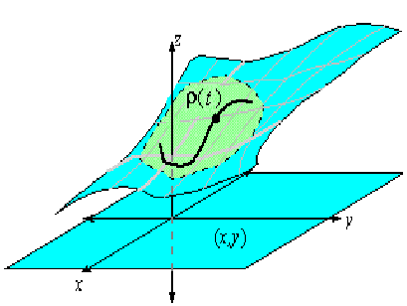
Last lecture
Contents:
Introduction to Mappings
Tangent Maps

Slide 3
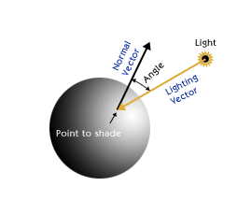
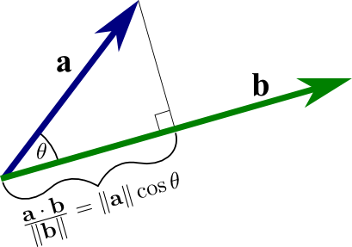
Today’s lecture
Contents:
The Dot Product
Frames

Slide 4
The Dot Product
We study distances and angles in geometry. We will see that geometry of Euclidean spaces can be derived from dot product.

Slide 5
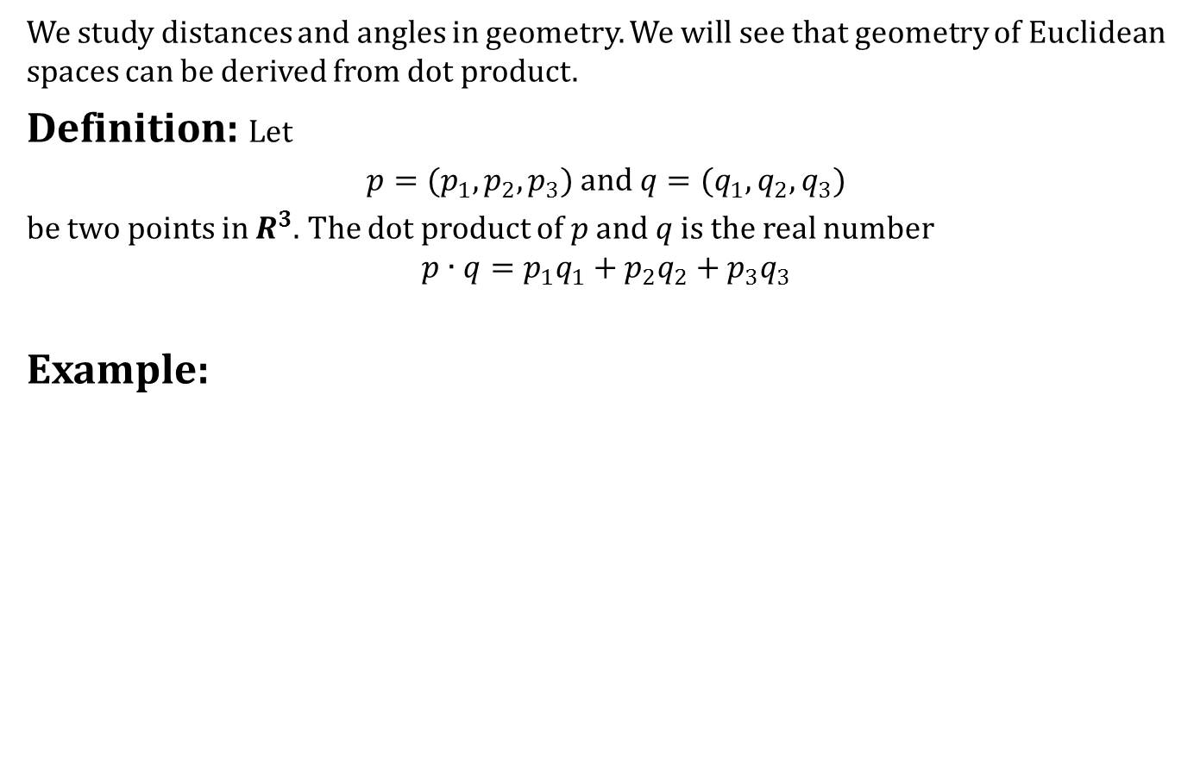
The Dot Product
We study distances and angles in geometry. We will see that geometry of Euclidean spaces can be derived from dot product.
Definition: Let
$p=(p_{1},p_{2}, p_{3})$ and $q=(q_{1},q_{2}, q_{3})$
be two points in $R^{3}$. The dot product of $p$ and $q$ is the real number
$$p∙q=p_{1}q_{1}+p_{2}q_{2}+p_{3}q_{3}$$
Example:

Slide 6
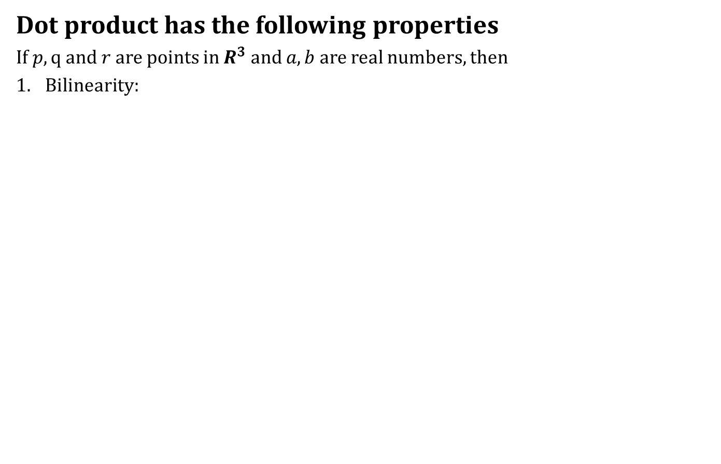
The Dot Product
Dot product has the following properties
If $p, q$ and $r$ are points in $R^{3}$ and $a,b$ are real numbers, then
Bilinearity:

Slide 7
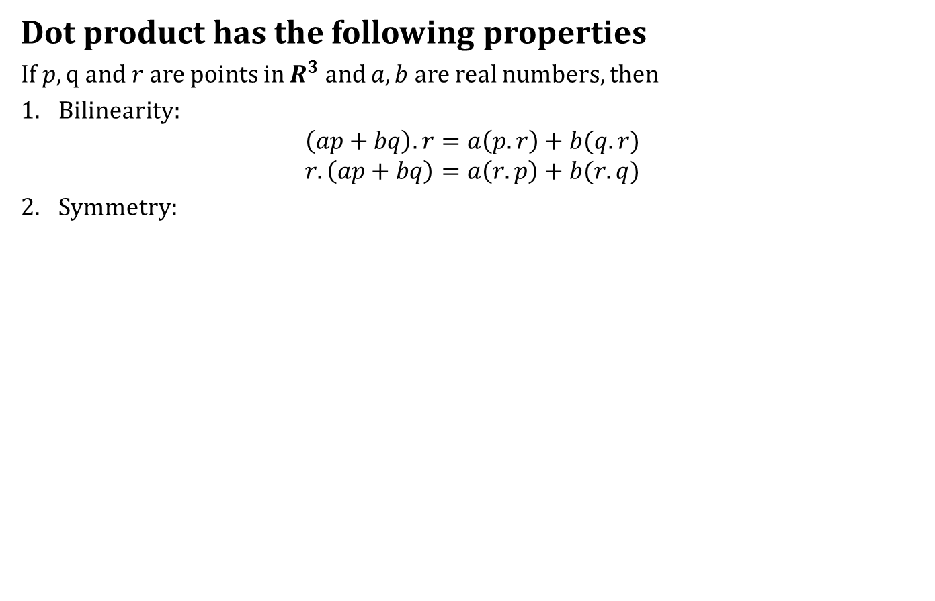
The Dot Product
Dot product has the following properties
If $p, q$ and $r$ are points in $R^{3}$ and $a,b$ are real numbers, then
Bilinearity:
$$\left(ap+bq\right).r=a\left(p.r\right)+b(q.r)$$
$$r.\left(ap+bq\right)=a\left(r.p\right)+b(r.q)$$
Symmetry:

Slide 8
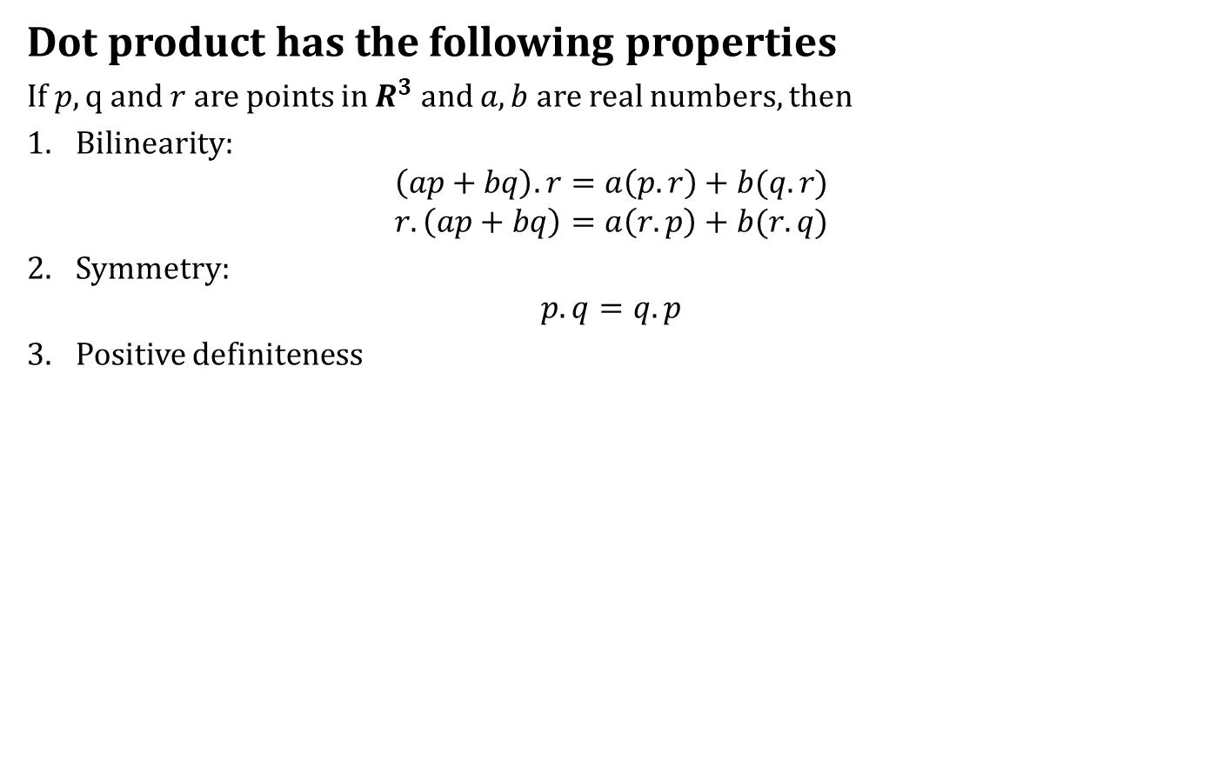
The Dot Product
Dot product has the following properties
If $p, q$ and $r$ are points in $R^{3}$ and $a,b$ are real numbers, then
Bilinearity:
$$\left(ap+bq\right).r=a\left(p.r\right)+b(q.r)$$
$$r.\left(ap+bq\right)=a\left(r.p\right)+b(r.q)$$
Symmetry:
$$p.q=q.p$$
Positive definiteness

Slide 9
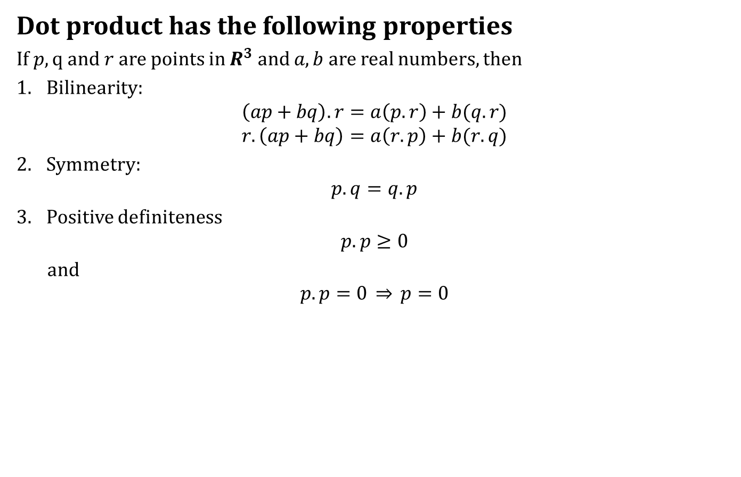
The Dot Product
Dot product has the following properties
If $p, q$ and $r$ are points in $R^{3}$ and $a,b$ are real numbers, then
Bilinearity:
$$\left(ap+bq\right).r=a\left(p.r\right)+b(q.r)$$
$$r.\left(ap+bq\right)=a\left(r.p\right)+b(r.q)$$
Symmetry:
$$p.q=q.p$$
Positive definiteness
$$p.p≥0$$
and
$$p.p=0 \overset{⇒}{} p=0$$

Slide 10
The Dot Product
The norm of a point

Slide 11
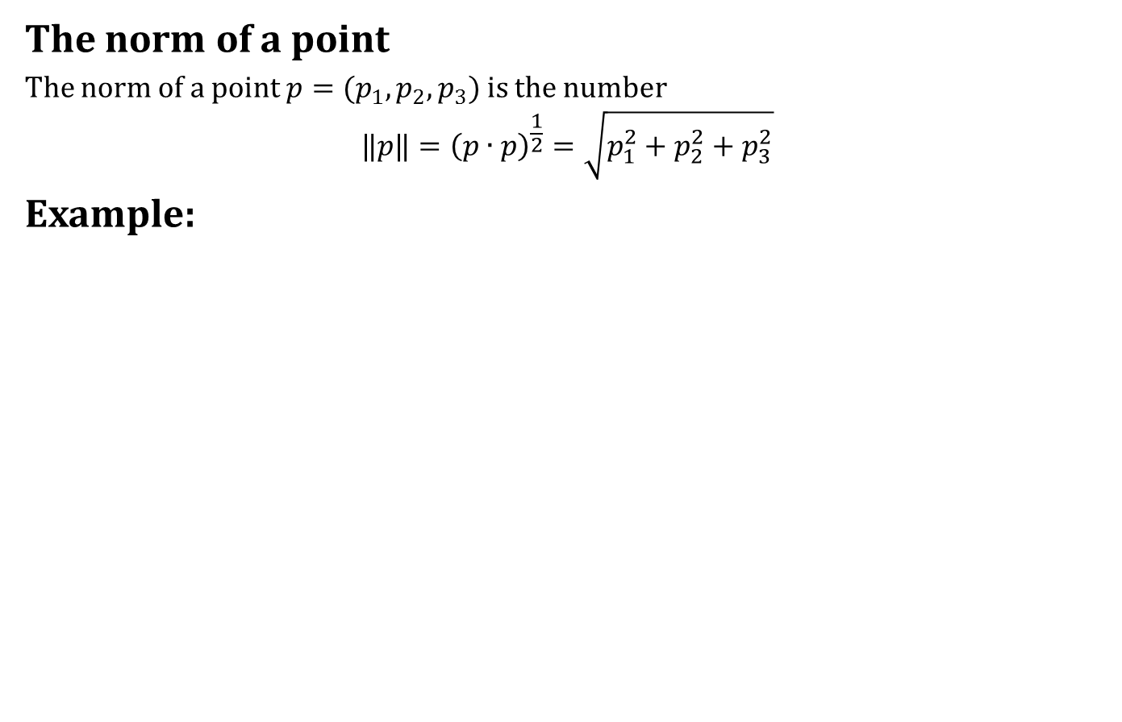
The Dot Product
The norm of a point
The norm of a point $p=(p_{1},p_{2},p_{3})$ is the number
$${‖p‖=\left(p∙p\right)}^{\frac{1}{2}}=\sqrt{p_{1}^{2}+p_{2}^{2}+p_{3}^{2}}$$
Example:

Slide 12
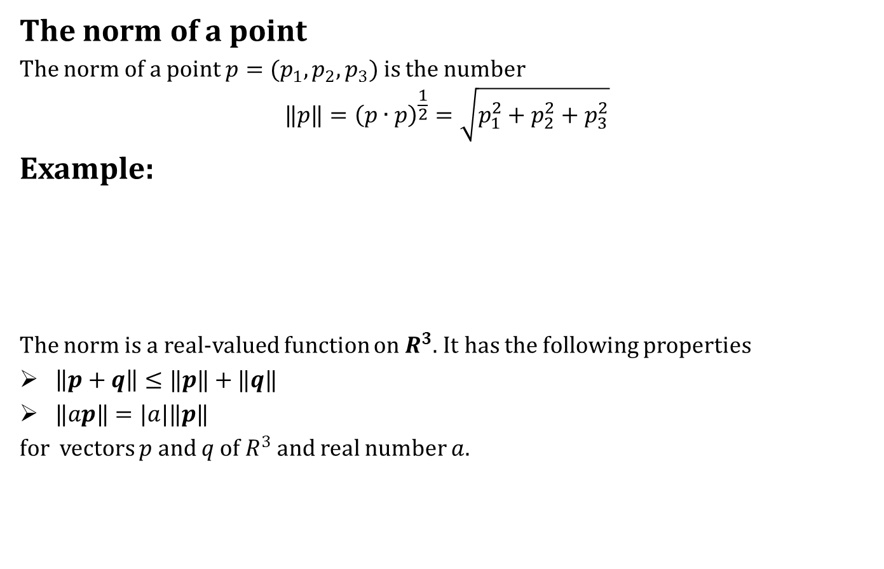
The Dot Product
The norm of a point
The norm of a point $p=(p_{1},p_{2},p_{3})$ is the number
$${‖p‖=\left(p∙p\right)}^{\frac{1}{2}}=\sqrt{p_{1}^{2}+p_{2}^{2}+p_{3}^{2}}$$
Example:
The norm is a real-valued function on $R^{3}$. It has the following properties
$\left\|p+q\right\|≤‖p‖+‖q‖$
$‖ap‖=|a|‖p‖$
for vectors $p$ and $q$ of $R^{3}$ and real number $a$.

Slide 13

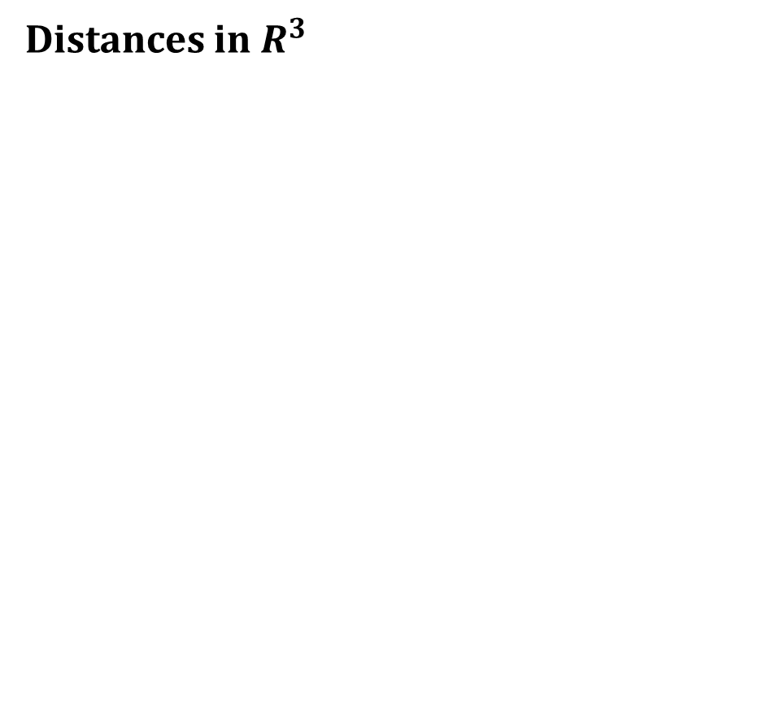
The Dot Product
Distances in $R^{3}$

Slide 14
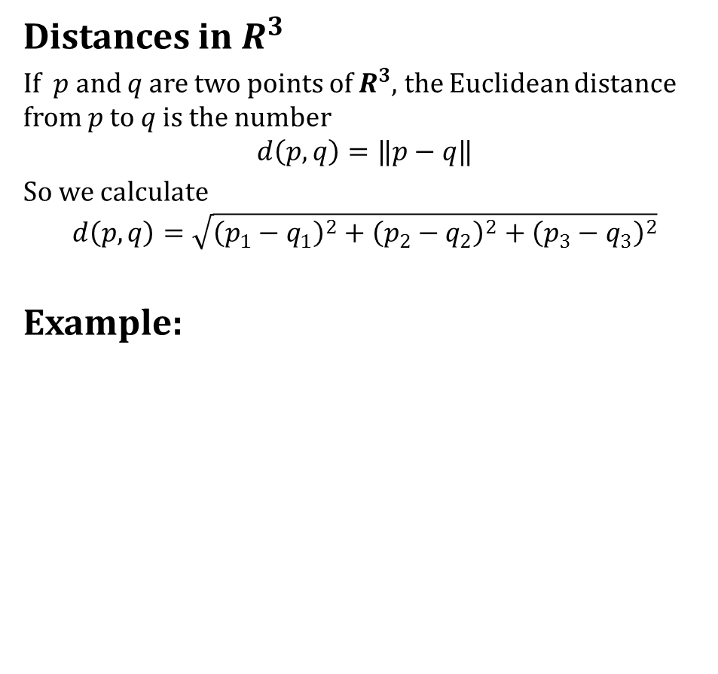
The Dot Product
Distances in $R^{3}$
If $p$ and $q$ are two points of $R^{3}$, the Euclidean distance from $p$ to $q$ is the number
$$d\left(p,q\right)=‖p−q‖$$
So we calculate
$$d\left(p,q\right)=\sqrt{{\left(p_{1}−q_{1}\right)}^{2}+{\left(p_{2}−q_{2}\right)}^{2}+{\left(p_{3}−q_{3}\right)}^{2}}$$
Example:

Slide 15
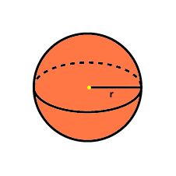
The Dot Product
Open sets
The distance formula can be used to give a precise definition of open sets.

Slide 16
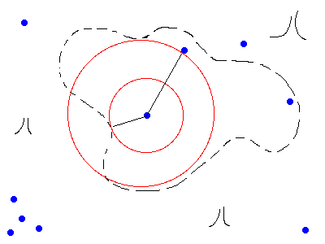
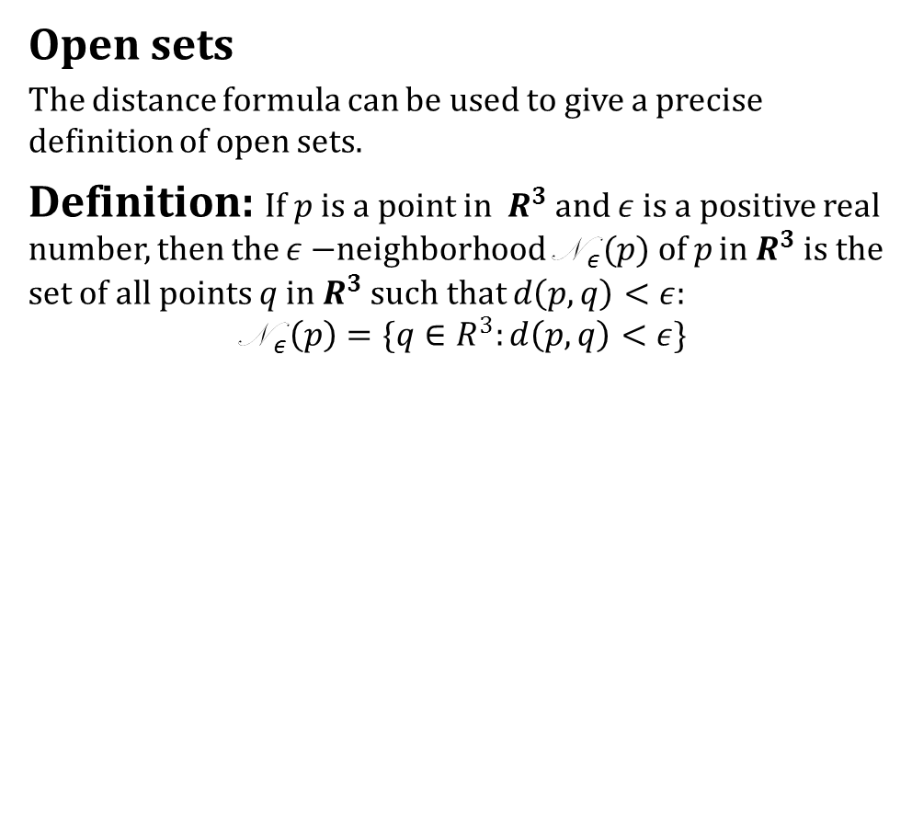
The Dot Product
Open sets
The distance formula can be used to give a precise definition of open sets.
Definition: If $p$ is a point in $R^{3}$and $ε$ is a positive real number, then the $ε−$neighborhood N$_{ε}(p)$of $p$ in $R^{3}$ is the set of all points $q$ in $R^{3}$ such that $d\left(p,q\right)<ε$:
$$\text{N} _{ε}\left(p\right)=\{q∈R^{3}:d\left(p,q\right)<ε\}$$

Slide 17
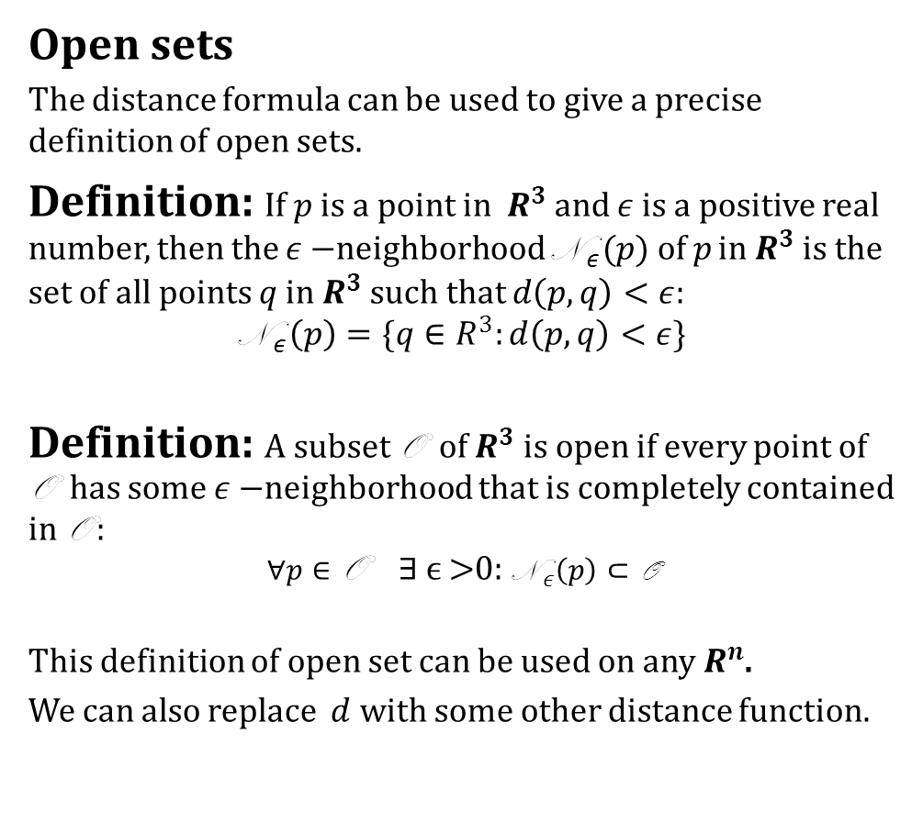
The Dot Product
Open sets
The distance formula can be used to give a precise definition of open sets.
Definition: If $p$ is a point in $R^{3}$and $ε$ is a positive real number, then the $ε−$neighborhood N$_{ε}(p)$of $p$ in $R^{3}$ is the set of all points $q$ in $R^{3}$ such that $d\left(p,q\right)<ε$:
$$\text{N} _{ε}\left(p\right)=\{q∈R^{3}:d\left(p,q\right)<ε\}$$
Definition: A subset O of $R^{3}$ is open if every point of O has some $ε−$neighborhood that is completely contained in O :
$$∀p∈\text{O} \text{∃} ϵ\text{ >0: }\text{N} _{ε}\left(p\right)⊂\text{O}$$
This definition of open set can be used on any $R^{n}$.
We can also replace $d$ with some other distance function.

Slide 18
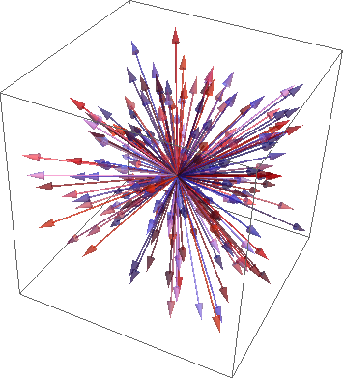
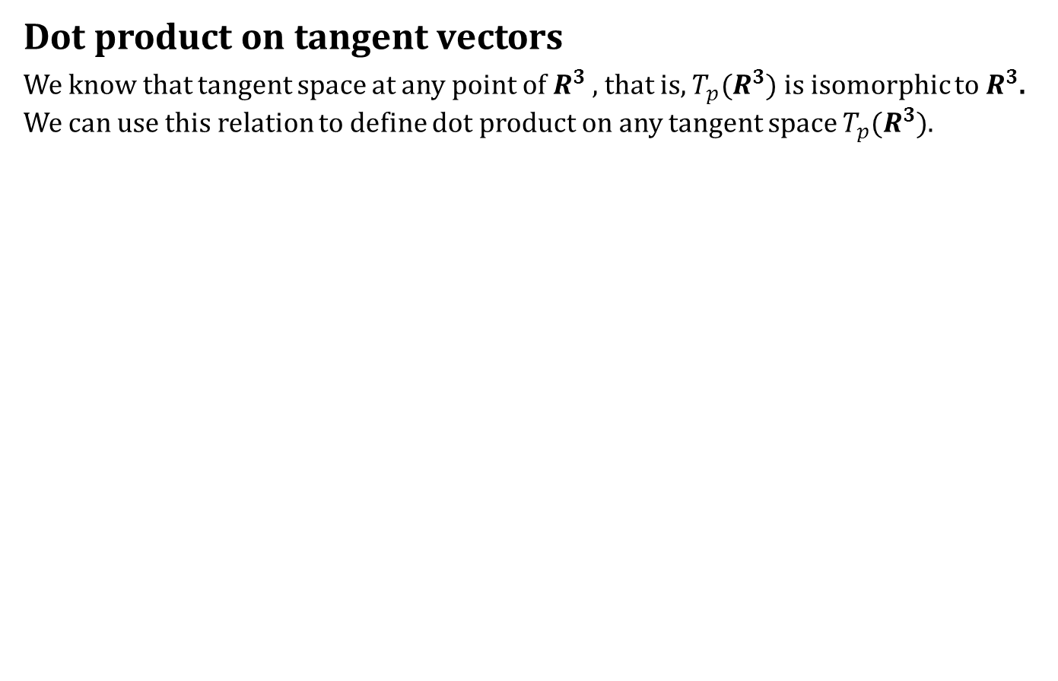
The Dot Product
Dot product on tangent vectors
We know that tangent space at any point of $R^{3}$ , that is, $T_{p}(R^{3})$ is isomorphic to $R^{3}$. We can use this relation to define dot product on any tangent space $T_{p}(R^{3})$.

Slide 19
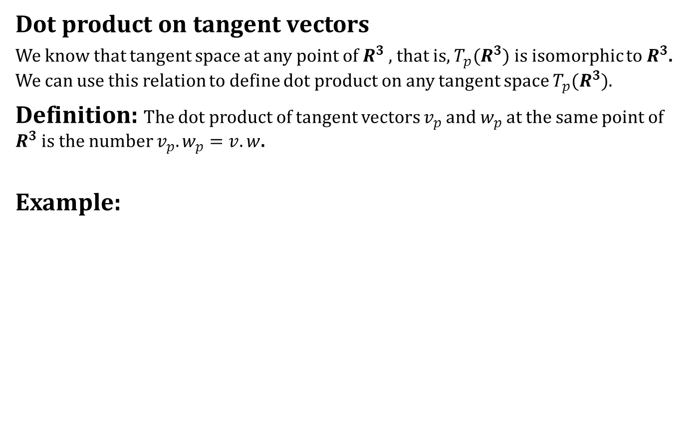
The Dot Product
Dot product on tangent vectors
We know that tangent space at any point of $R^{3}$ , that is, $T_{p}(R^{3})$ is isomorphic to $R^{3}$. We can use this relation to define dot product on any tangent space $T_{p}(R^{3})$.
Definition: The dot product of tangent vectors $v_{p}$ and $w_{p}$ at the same point of $R^{3}$ is the number $v_{p}.w_{p}=v. w$.
Example:

Slide 20
The Dot Product
Similarly we can define norm of any tangent vector in the following way.

Slide 21
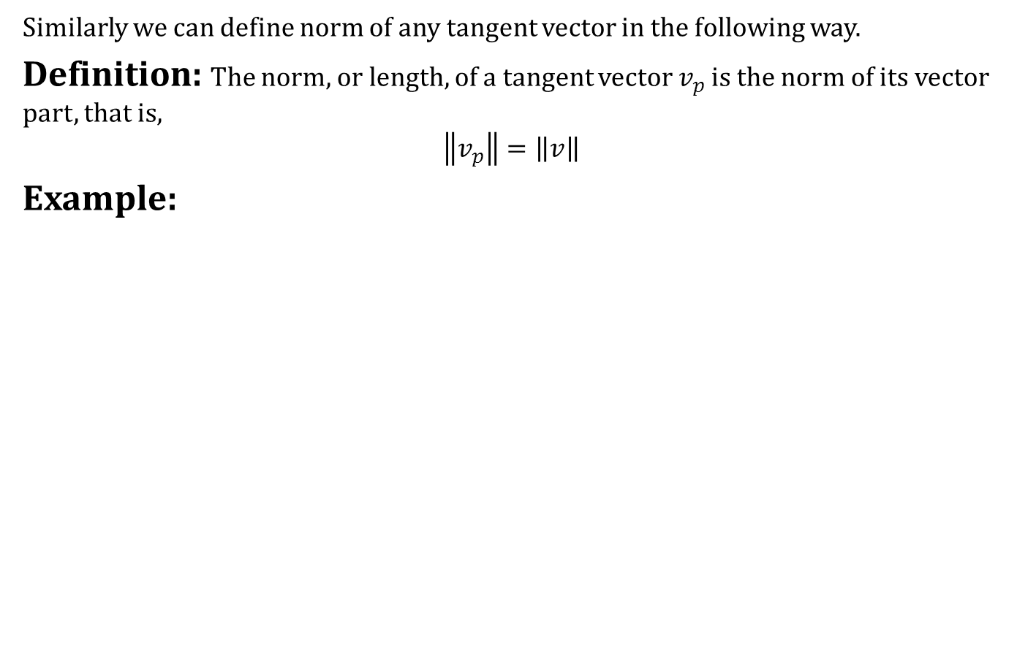
The Dot Product
Similarly we can define norm of any tangent vector in the following way.
Definition: The norm, or length, of a tangent vector $v_{p}$ is the norm of its vector part, that is,
$$\left\|v_{p}\right\|=\left\|v\right\|$$
Example:

Slide 22
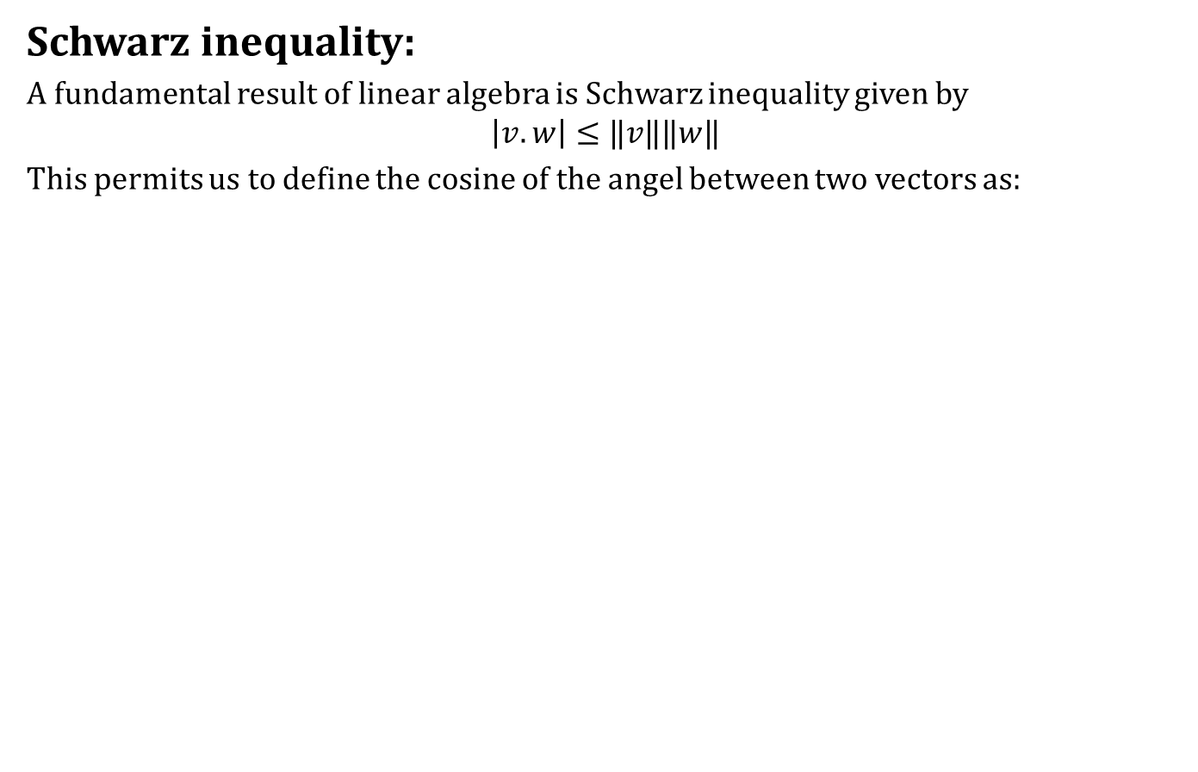
The Dot Product
Schwarz inequality:
A fundamental result of linear algebra is Schwarz inequality given by
$$\left|v.w\right|≤‖v‖‖w‖$$
This permits us to define the cosine of the angel between two vectors as:

Slide 23
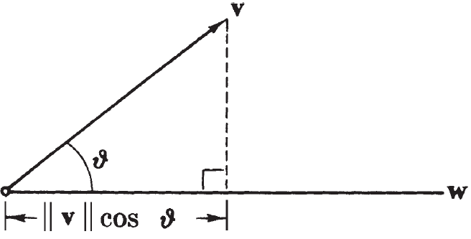
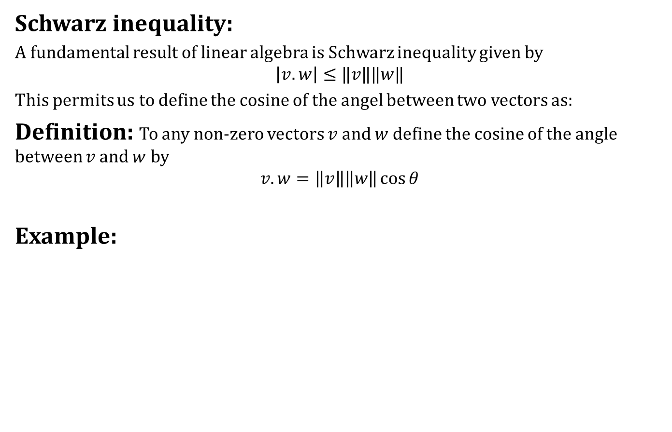
The Dot Product
Schwarz inequality:
A fundamental result of linear algebra is Schwarz inequality given by
$$\left|v.w\right|≤‖v‖‖w‖$$
This permits us to define the cosine of the angel between two vectors as:
Definition: To any non-zero vectors $v$ and $w$ define the cosine of the angle between $v$ and $w$ by
$$v.w=\left\|v\right\|\left\|w\right\|\cos{θ}$$
Example:

Slide 24
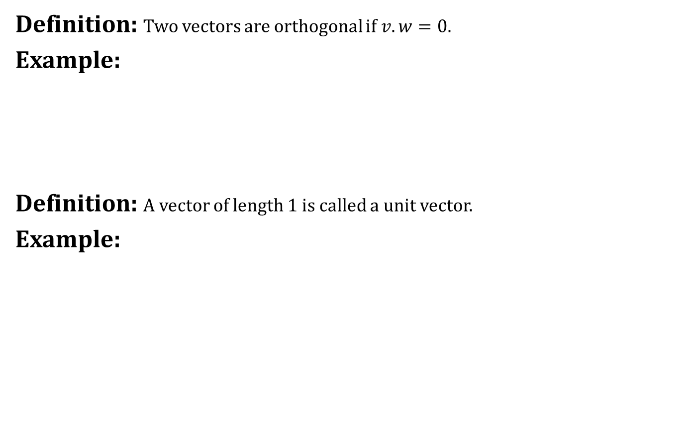
The Dot Product
Definition: Two vectors are orthogonal if $v.w=0$.
Example:
Definition: A vector of length 1 is called a unit vector.
Example:

Slide 25
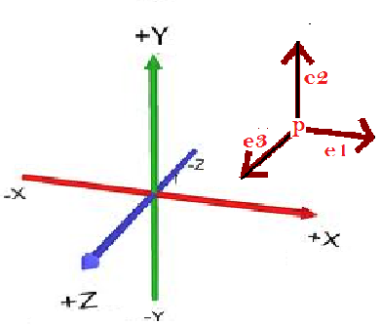
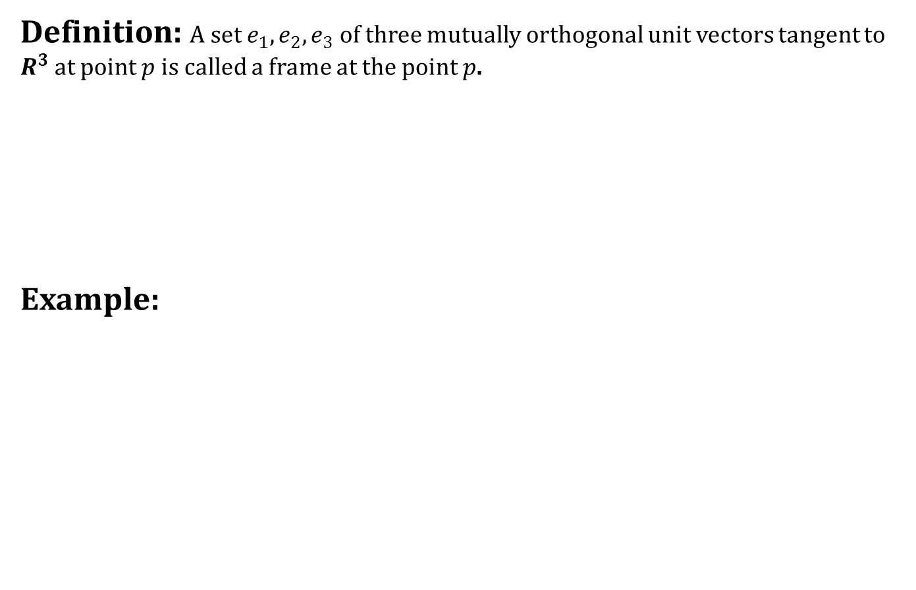
Frames
Definition: A set $e_{1},e_{2},e_{3}$ of three mutually orthogonal unit vectors tangent to $R^{3}$at point $p$ is called a frame at the point $p$.
Example:

Slide 26
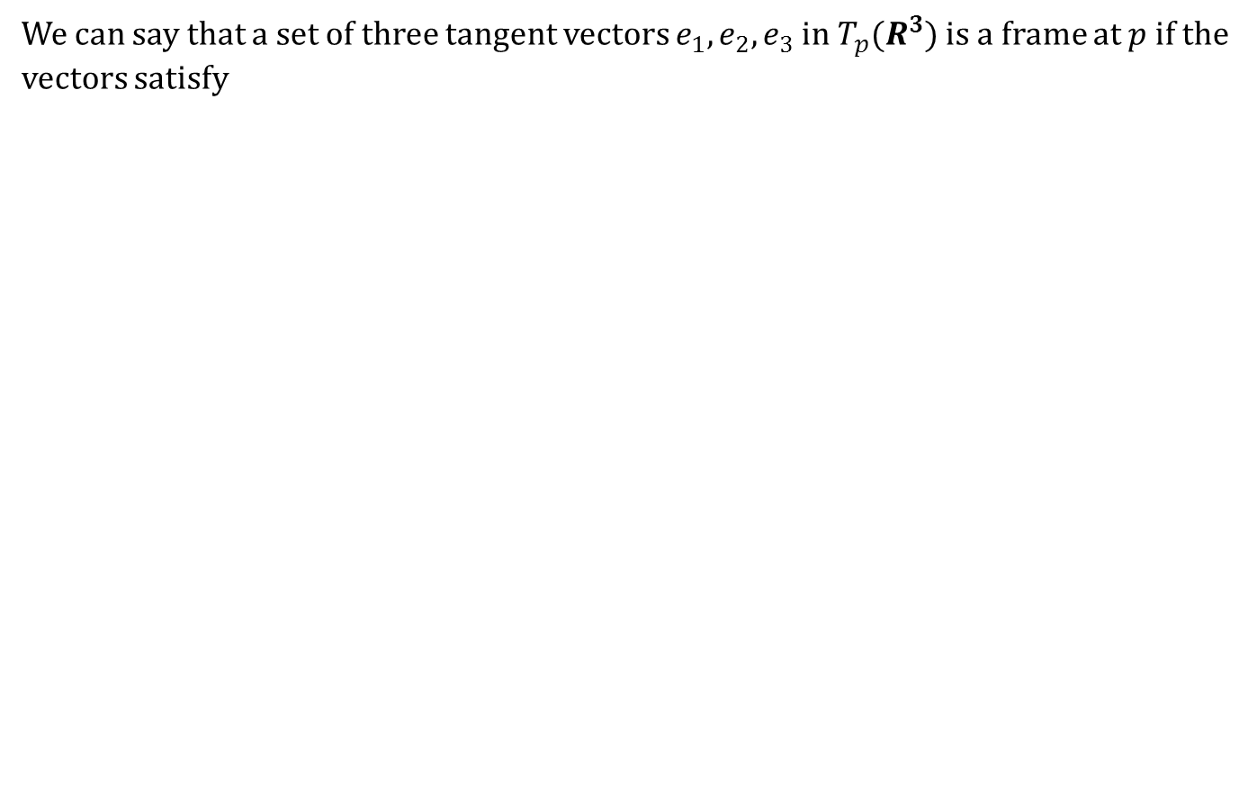
Frames
We can say that a set of three tangent vectors $e_{1},e_{2},e_{3}$ in $T_{p}(R^{3})$ is a frame at $p$ if the vectors satisfy

Slide 27
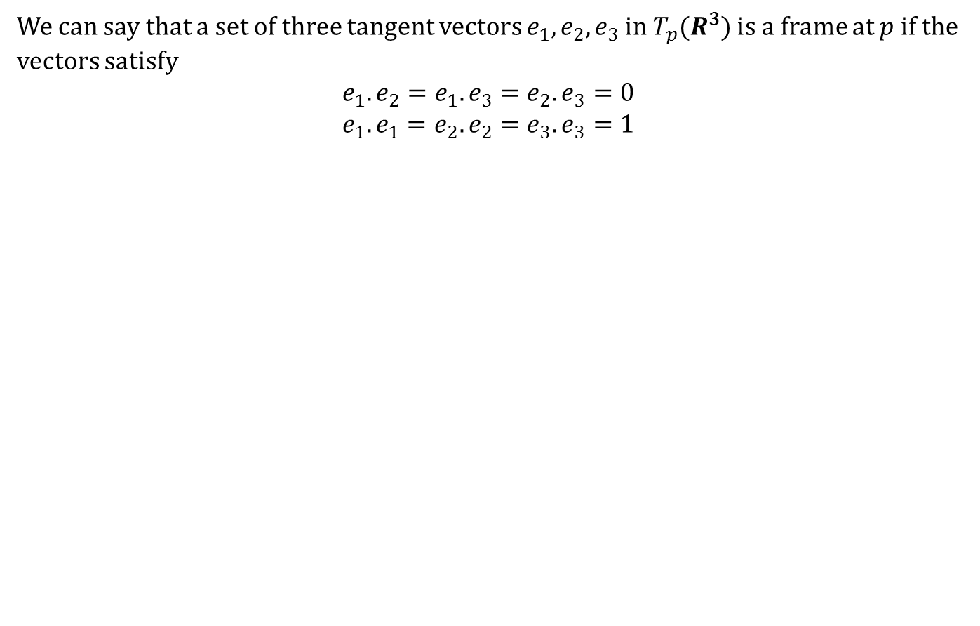
Frames
We can say that a set of three tangent vectors $e_{1},e_{2},e_{3}$ in $T_{p}(R^{3})$ is a frame at $p$ if the vectors satisfy
$$e_{1}.e_{2}=e_{1}.e_{3}=e_{2}.e_{3}=0$$
$$e_{1}.e_{1}=e_{2}.e_{2}=e_{3}.e_{3}=1$$

Slide 28
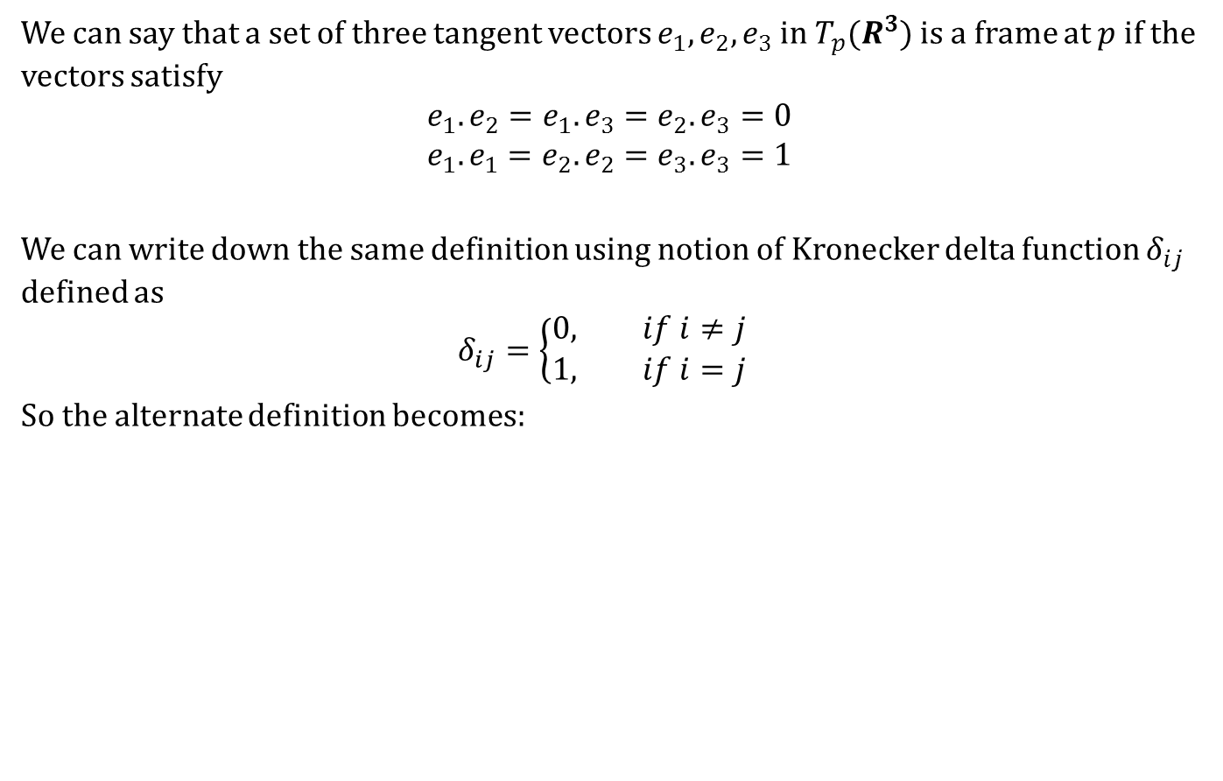
Frames
We can say that a set of three tangent vectors $e_{1},e_{2},e_{3}$ in $T_{p}(R^{3})$ is a frame at $p$ if the vectors satisfy
$$e_{1}.e_{2}=e_{1}.e_{3}=e_{2}.e_{3}=0$$
$$e_{1}.e_{1}=e_{2}.e_{2}=e_{3}.e_{3}=1$$
We can write down the same definition using notion of Kronecker delta function $δ_{ij}$ defined as
$$δ_{ij}=\left\{\begin{aligned}0, if i≠j \\ 1, if i=j\end{aligned}\right.$$
So the alternate definition becomes:

Slide 29
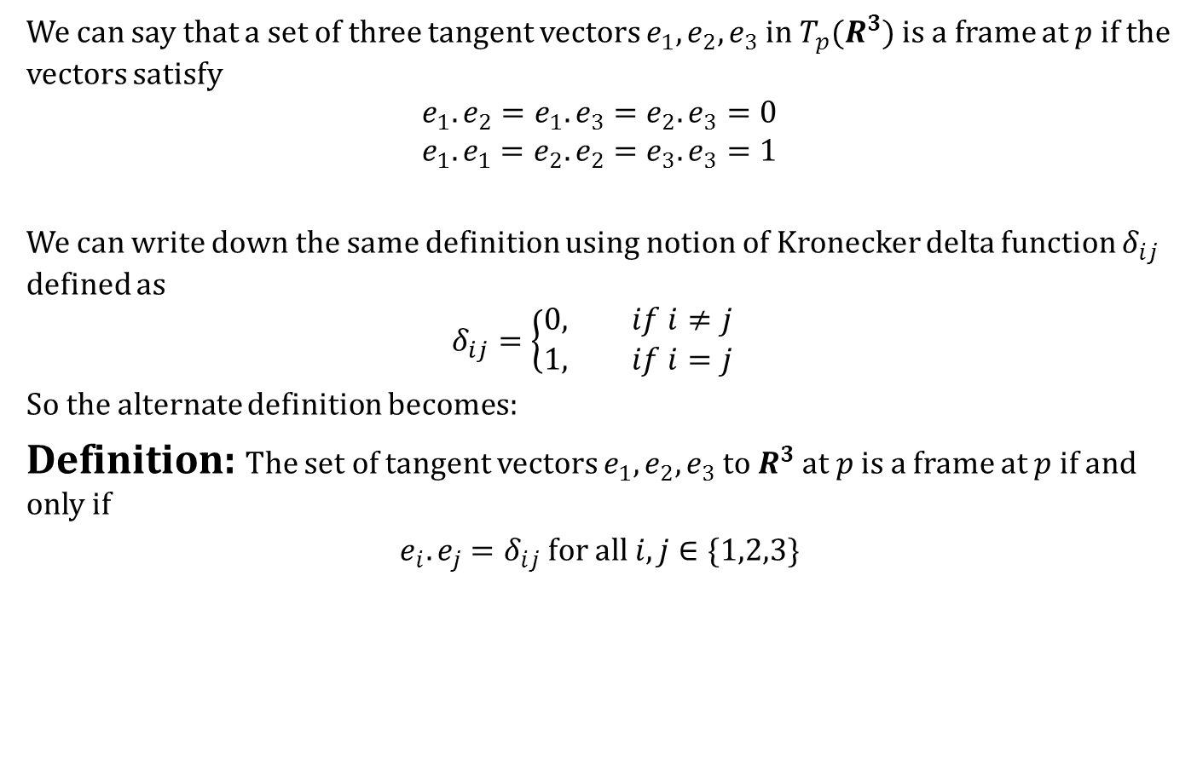
Frames
We can say that a set of three tangent vectors $e_{1},e_{2},e_{3}$ in $T_{p}(R^{3})$ is a frame at $p$ if the vectors satisfy
$$e_{1}.e_{2}=e_{1}.e_{3}=e_{2}.e_{3}=0$$
$$e_{1}.e_{1}=e_{2}.e_{2}=e_{3}.e_{3}=1$$
We can write down the same definition using notion of Kronecker delta function $δ_{ij}$ defined as
$$δ_{ij}=\left\{\begin{aligned}0, if i≠j \\ 1, if i=j\end{aligned}\right.$$
So the alternate definition becomes:
Definition: The set of tangent vectors $e_{1},e_{2},e_{3}$ to $R^{3}$ at $p$ is a frame at $p$ if and only if
$e_{i}.e_{j}=δ_{ij}$ for all $i,j∈\{1,2,3\}$

Slide 30
Frames
Example:

Slide 31
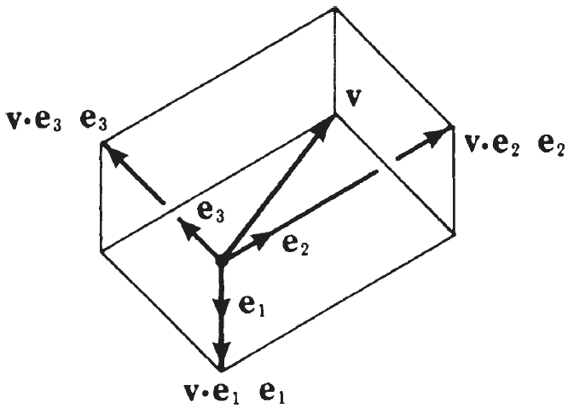
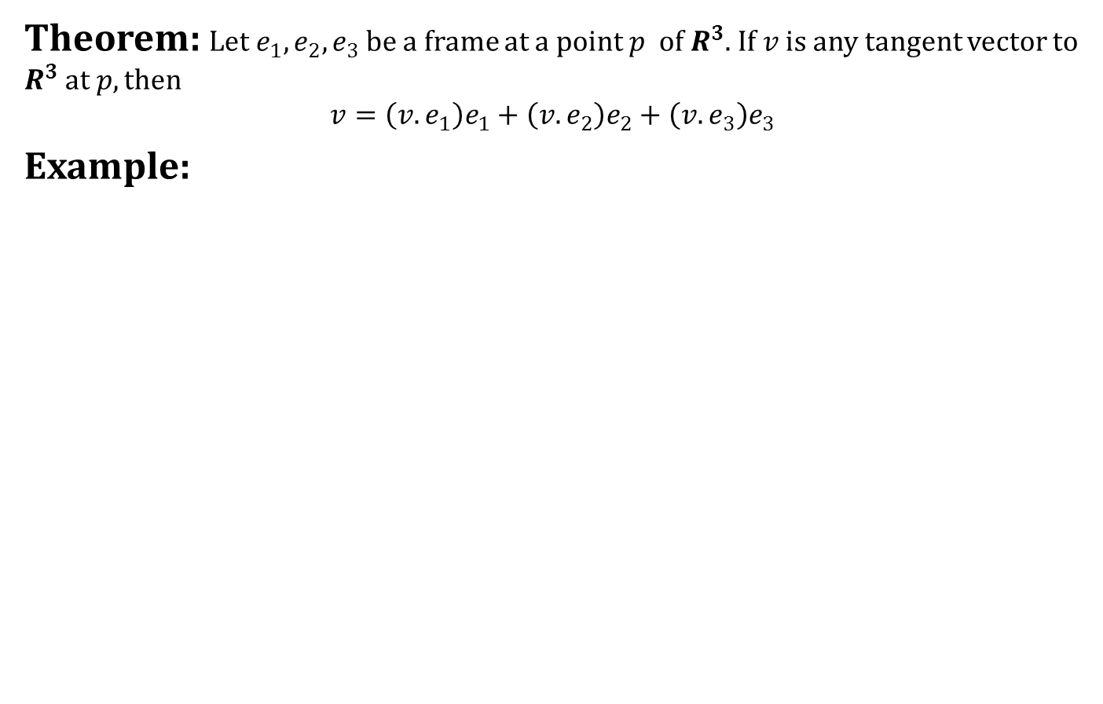
Frames
Theorem: Let $e_{1},e_{2},e_{3}$be a frame at a point $p$ of $R^{3}$. If $v$ is any tangent vector to $R^{3}$ at $p, then$
$$v=\left(v.e_{1}\right)e_{1}+\left(v.e_{2}\right)e_{2}+\left(v.e_{3}\right)e_{3}$$
Example:

Slide 32
Frames

Slide 33
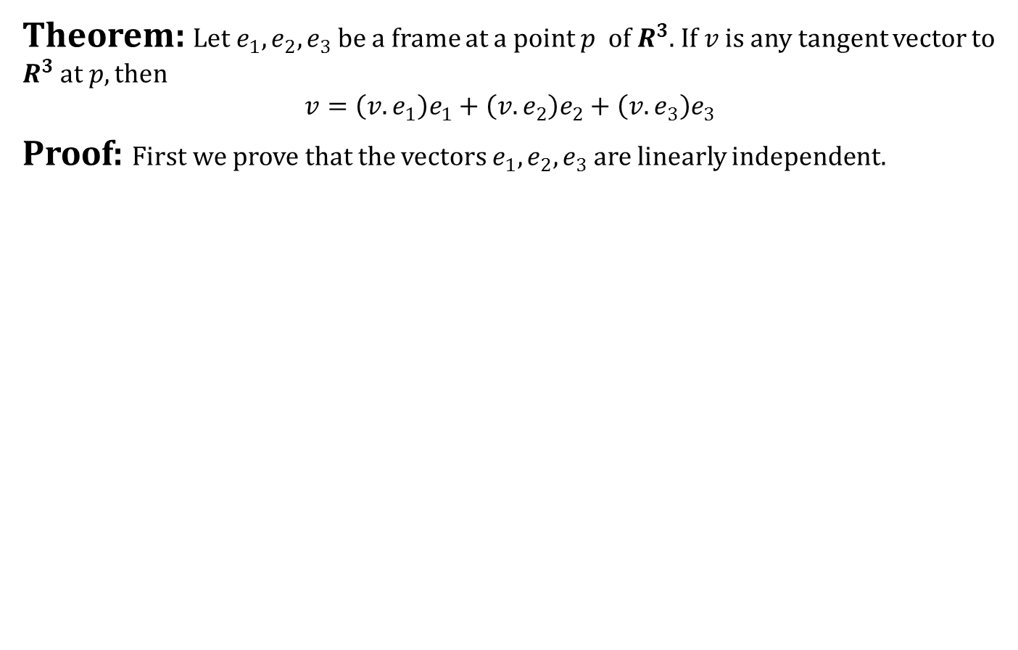
Frames
Theorem: Let $e_{1},e_{2},e_{3}$be a frame at a point $p$ of $R^{3}$. If $v$ is any tangent vector to $R^{3}$ at $p, then$
$$v=\left(v.e_{1}\right)e_{1}+\left(v.e_{2}\right)e_{2}+\left(v.e_{3}\right)e_{3}$$
Proof: First we prove that the vectors $e_{1},e_{2},e_{3}$ are linearly independent.

Slide 34
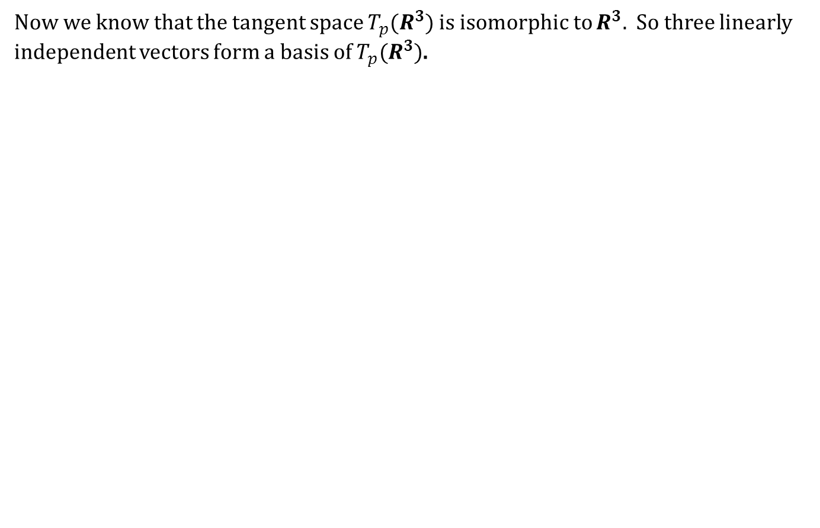
Frames
Now we know that the tangent space $T_{p}(R^{3})$ is isomorphic to $R^{3}.$ So three linearly independent vectors form a basis of $T_{p}(R^{3})$.

Slide 35
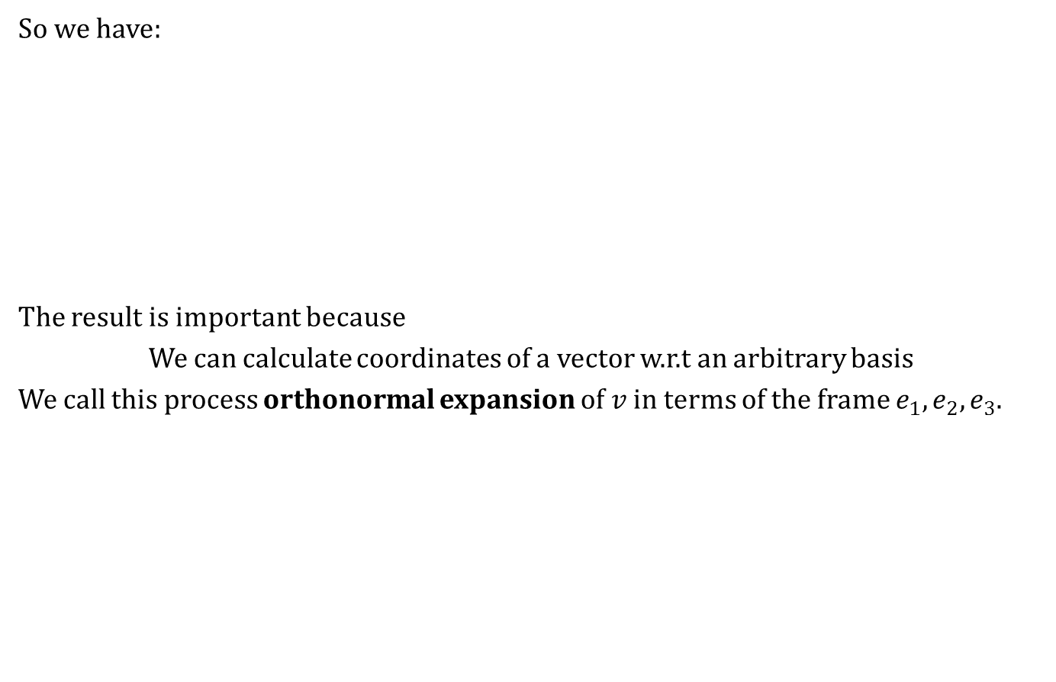

Frames
So we have:
The result is important because
We can calculate coordinates of a vector w.r.t an arbitrary basis
We call this process orthonormal expansion of $v$ in terms of the frame $e_{1},e_{2},e_{3}$.
Theorem: Let $e_{1},e_{2},e_{3}$be a frame at a point $p$ of $R^{3}$. If $v$ is any tangent vector to $R^{3}$ at $p, then$
$$v=\left(v.e_{1}\right)e_{1}+\left(v.e_{2}\right)e_{2}+\left(v.e_{3}\right)e_{3}$$

Slide 36
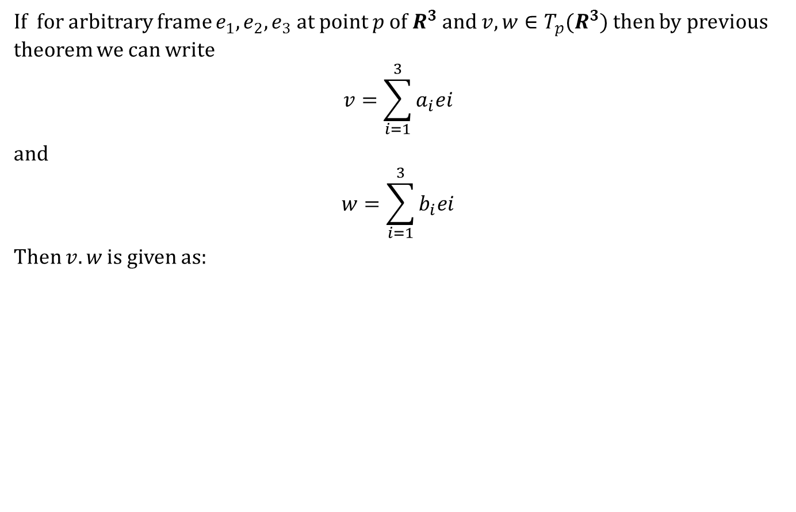
Frames
If for arbitrary frame $e_{1},e_{2},e_{3}$ at point $p$ of $R^{3}$ and $v,w∈T_{p}(R^{3})$ then by previous theorem we can write
$$v=\sum_{i=1}^{3}{a_{i}ei }$$
and
$$w=\sum_{i=1}^{3}{b_{i}ei }$$
Then $v.w$ is given as:

Slide 37
Today we learnt
Contents:
The Dot Product
Frames

Slide 38
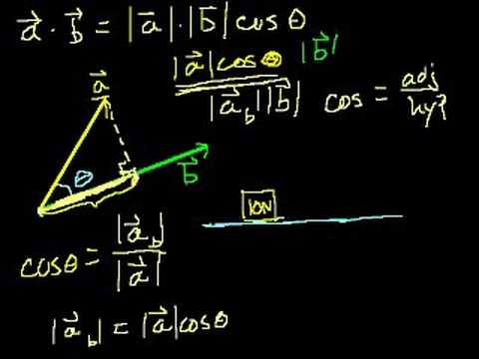
Next time
Dot Product Continued

Slide 39

End of the lecture

