Slide 1
Lecture # 7
MTH352: Differential Geometry
For
Master of Mathematics
By
Dr. SOHAIL IQBAL
Assistant Professor
Department of Mathematics, CIIT Islamabad

Slide 2
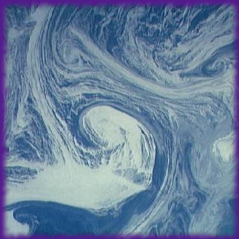
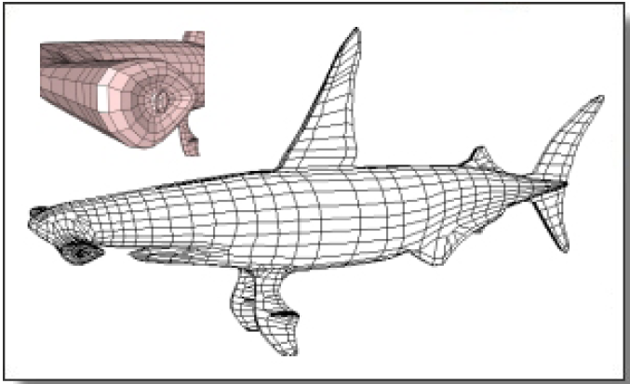
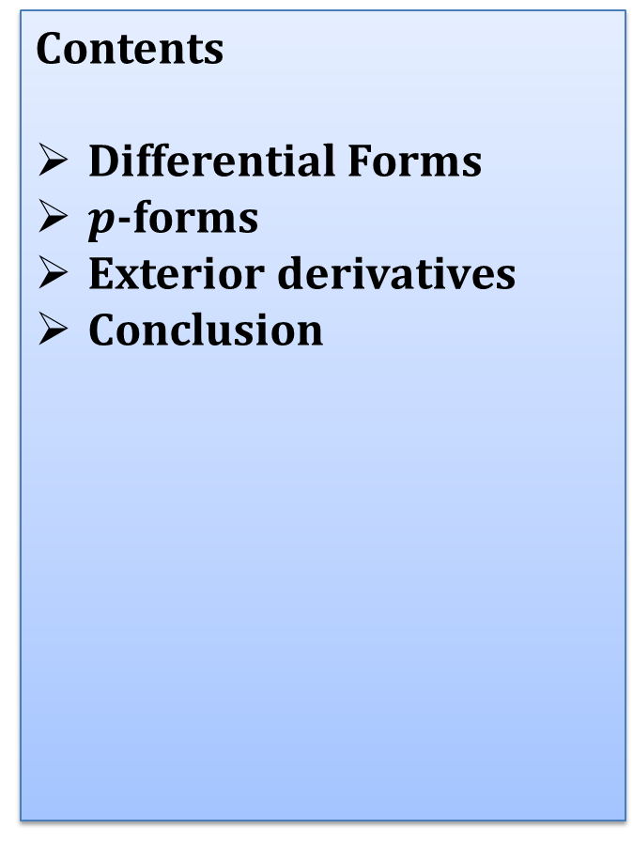
Last lecture
Contents
Differential Forms
$p$-forms
Exterior derivatives
Conclusion

Slide 3

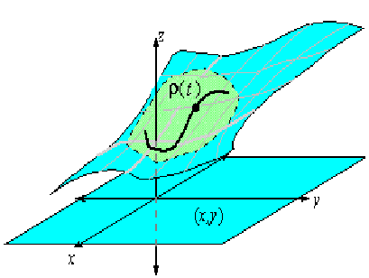
Today’s lecture
Contents:
Introduction to Mappings
Tangent Maps

Slide 4
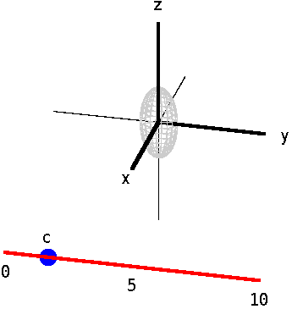
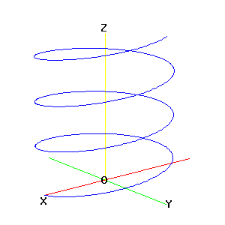
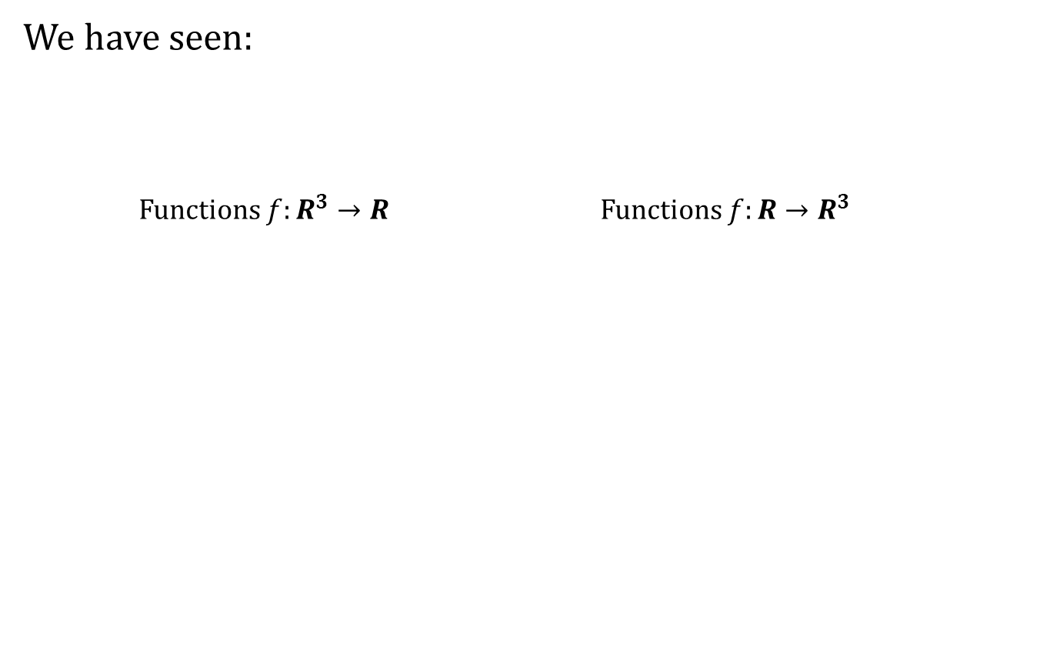
Introduction to Mappings
We have seen:
Functions $f:R^{3}→R$ Functions $f:R→R^{3}$

Slide 5
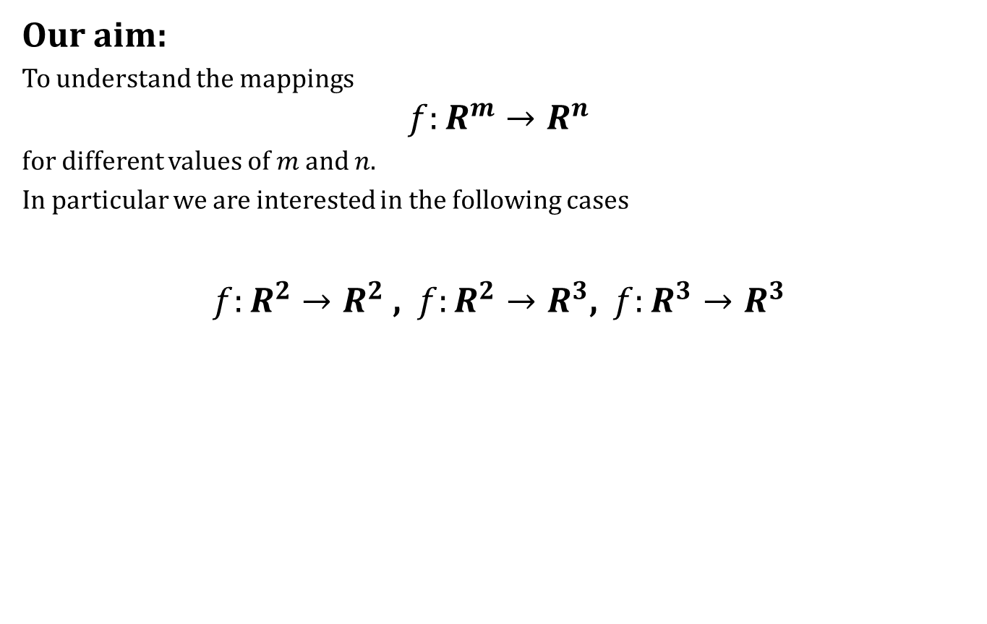
Introduction to Mappings
Our aim:
To understand the mappings
$$f:R^{m}→R^{n}$$
for different values of $m$ and $n$.
In particular we are interested in the following cases
$f:R^{2}→R^{2}$ , $f:R^{2}→R^{3}$, $f:R^{3}→R^{3}$

Slide 6
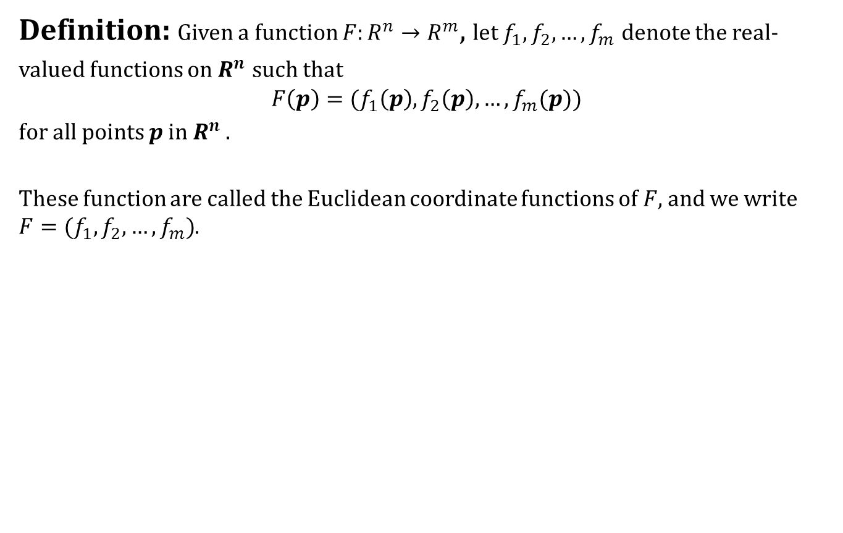
Introduction to Mappings
Definition: Given a function $F:R^{n}→R^{m}$, let $f_{1},f_{2},…,f_{m}$ denote the real-valued functions on $R^{n}$ such that
$$F\left(p\right)=(f_{1}\left(p\right),f_{2}\left(p\right),…,f_{m}(p))$$
for all points $p$ in $R^{n}$ .
These function are called the Euclidean coordinate functions of $F$, and we write $F=(f_{1},f_{2},…,f_{m})$.

Slide 7
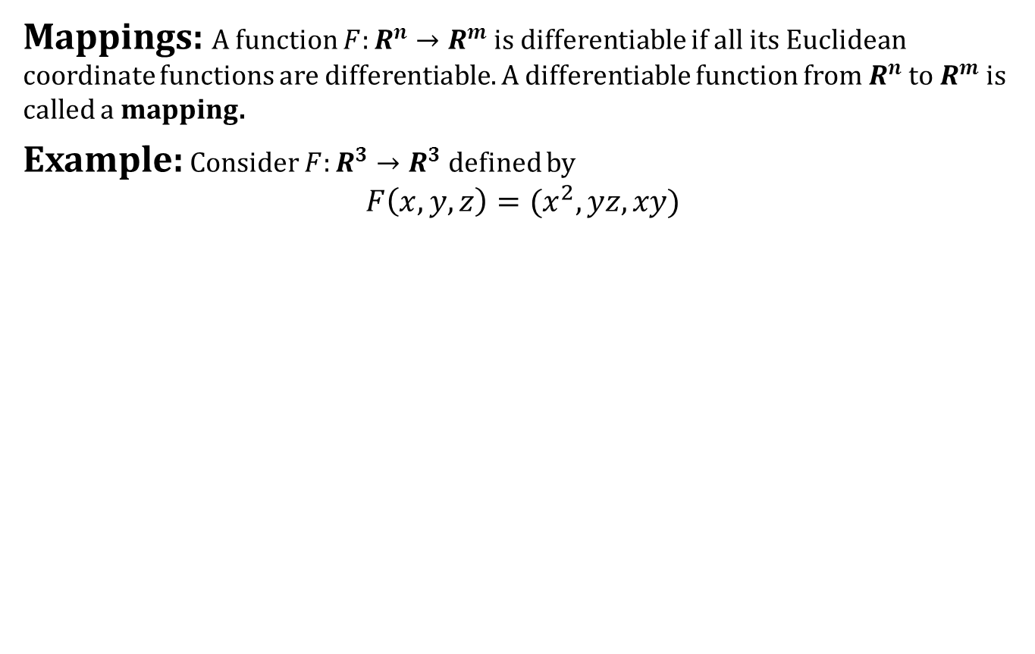
Introduction to Mappings
Mappings: A function $F:R^{n}→R^{m}$ is differentiable if all its Euclidean coordinate functions are differentiable. A differentiable function from $R^{n}$ to $R^{m}$is called a mapping.
Example: Consider $F:R^{3}→R^{3}$ defined by
$$F\left(x,y,z\right)=(x^{2},yz,xy)$$

Slide 8
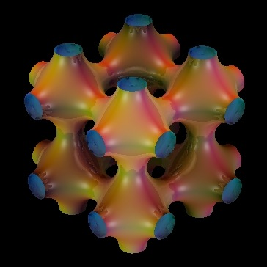
Introduction to Mappings
Strategy:
A simple kind of mappings are curves.
We will use curves to understand more complicated kind of mappings.

Slide 9
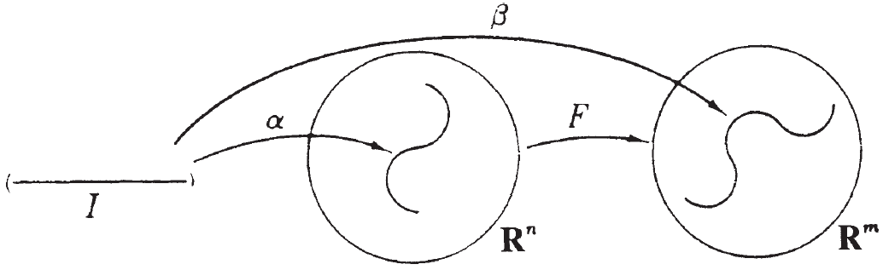
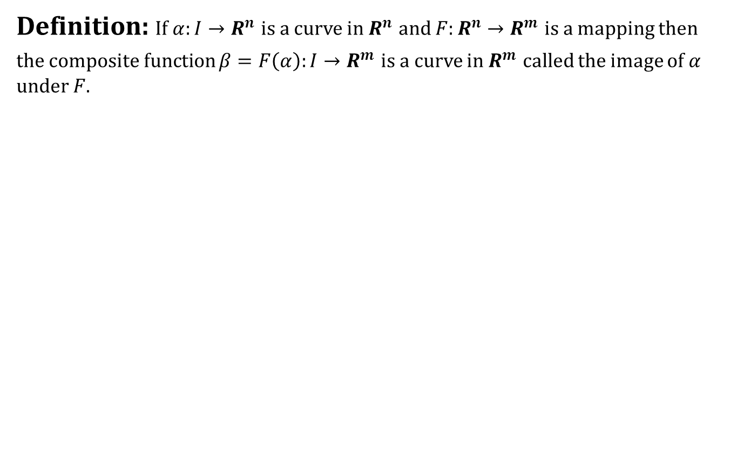
Introduction to Mappings
Definition: If $α:I→R^{n}$ is a curve in $R^{n}$ and $F:R^{n}→R^{m}$ is a mapping then the composite function $β=F\left(α\right):I→R^{m}$ is a curve in $R^{m}$ called the image of $α$ under $F$.

Slide 10
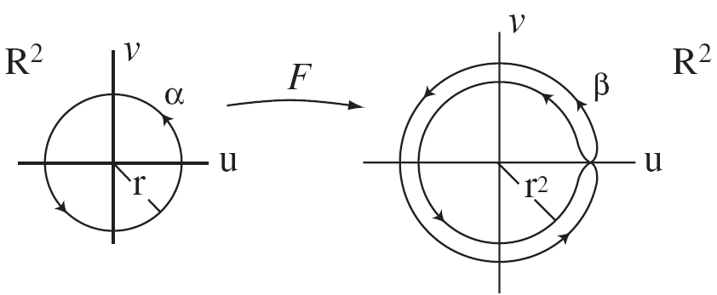
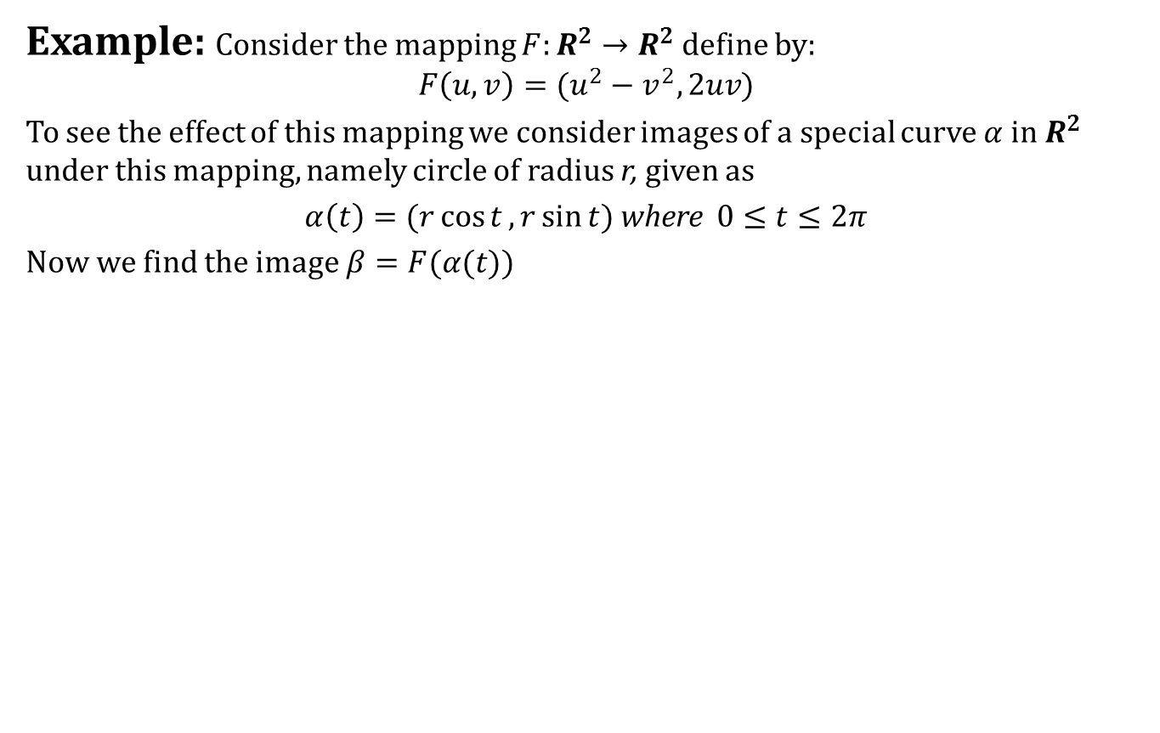
Introduction to Mappings
Example: Consider the mapping $F:R^{2}→R^{2}$ define by:
$$F\left(u,v\right)=(u^{2}−v^{2},2uv)$$
To see the effect of this mapping we consider images of a special curve $α$ in $R^{2}$ under this mapping, namely circle of radius r, given as
$α\left(t\right)=(r\cos{t},r\sin{t})$ where $0≤t≤2π$
Now we find the image $β=F(α(t))$

Slide 11
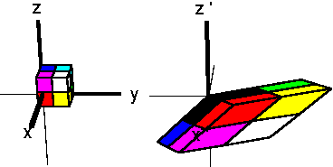
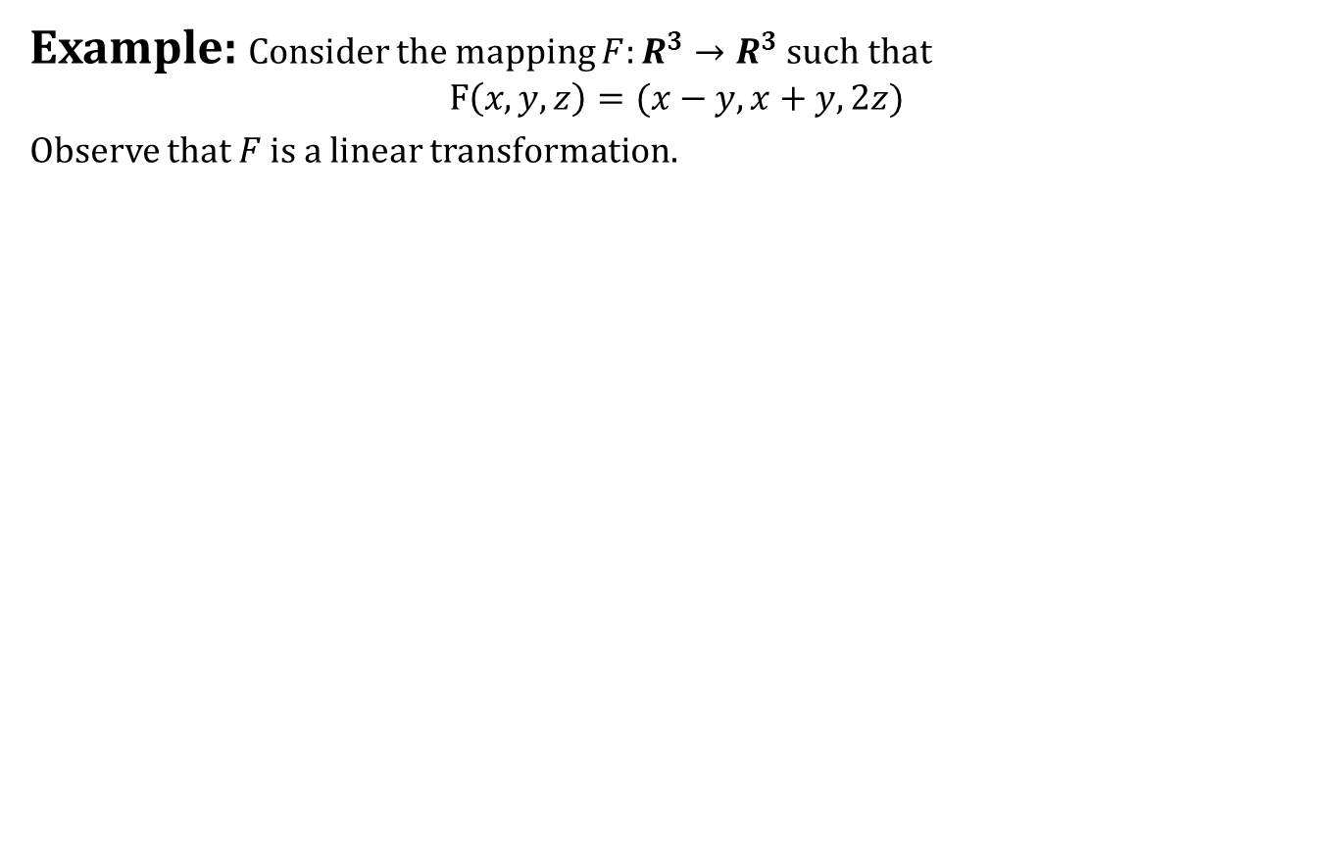
Introduction to Mappings
Example: Consider the mapping $F:R^{3}→R^{3}$ such that
$$F\left(x,y,z\right)=(x−y,x+y,2z)$$
Observe that $F$ is a linear transformation.

Slide 12
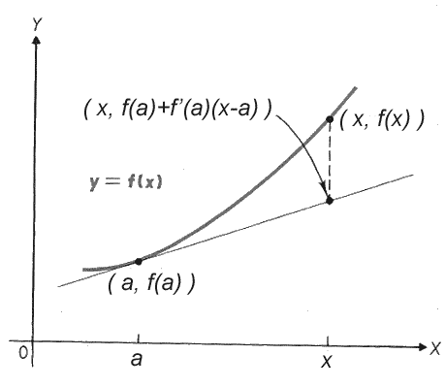
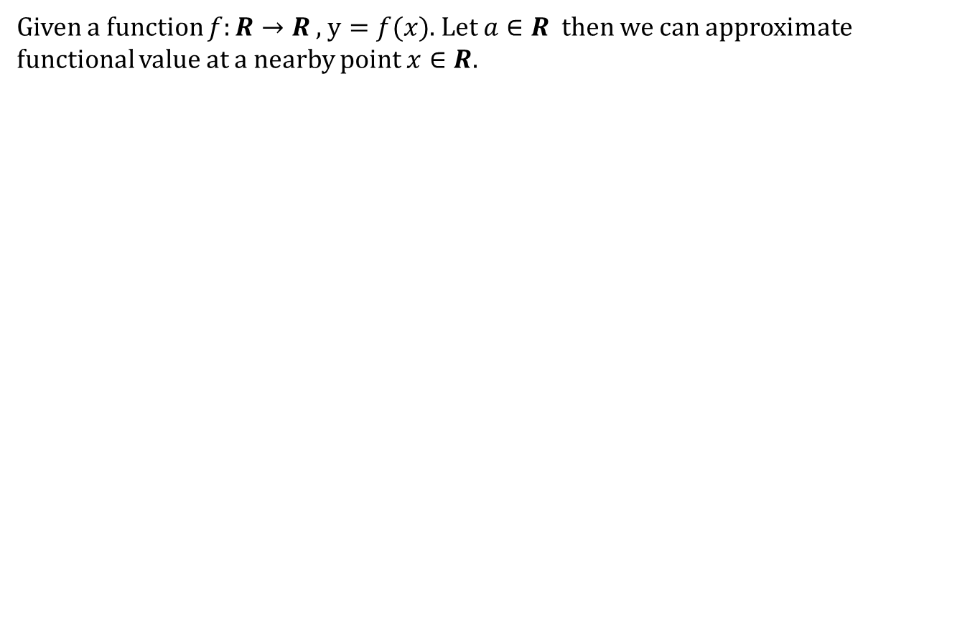
Tangent Maps
Given a function $f:R→R$ , $y=f(x)$. Let $a∈R$ then we can approximate functional value at a nearby point $x∈R$.

Slide 13
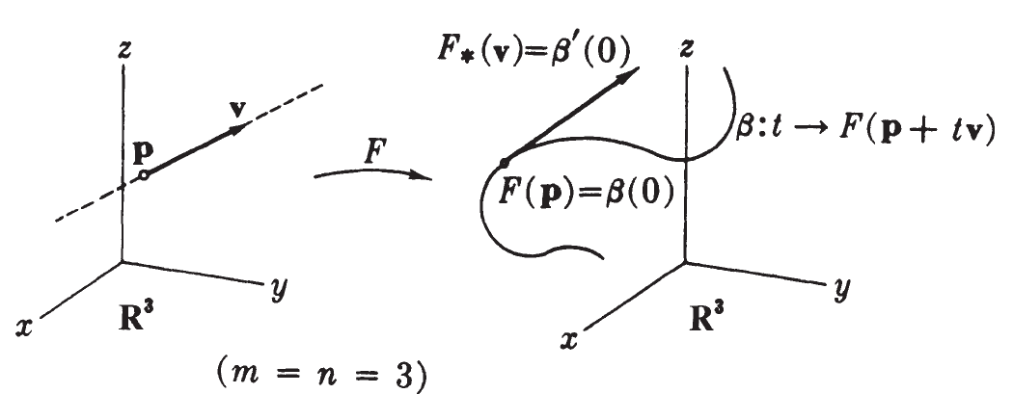
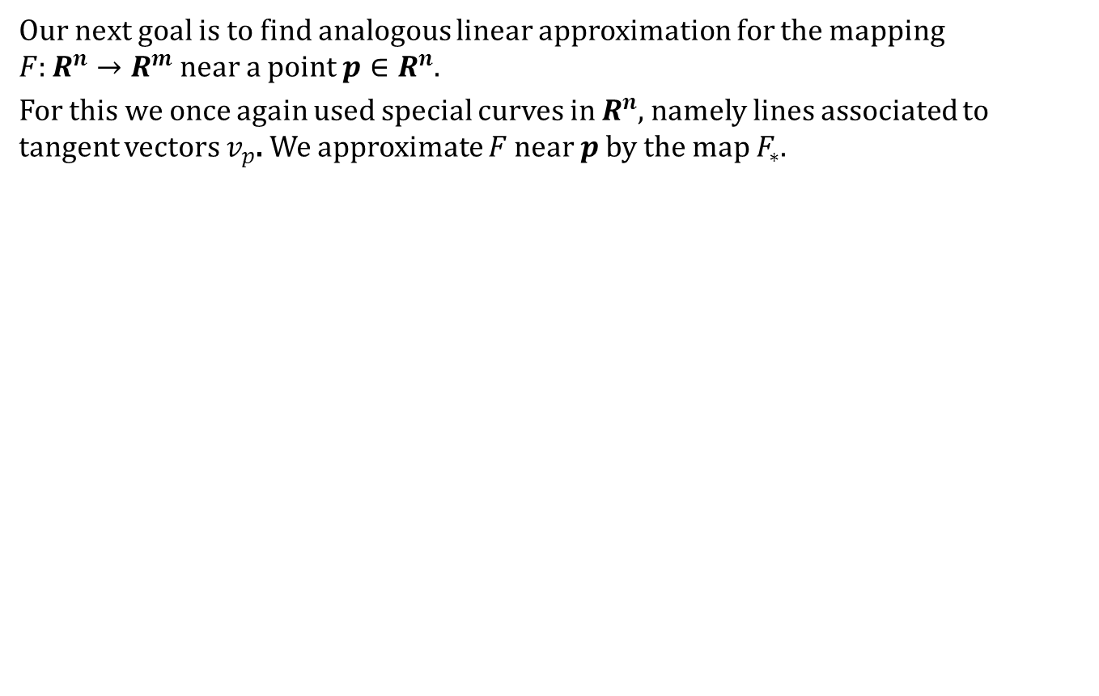
Tangent Maps
Our next goal is to find analogous linear approximation for the mapping $F:R^{n}→R^{m}$ near a point $p∈R^{n}$.
For this we once again used special curves in $R^{n}$, namely lines associated to tangent vectors $v_{p}$. We approximate $F$ near $p$ by the map $F_{∗}$.

Slide 14
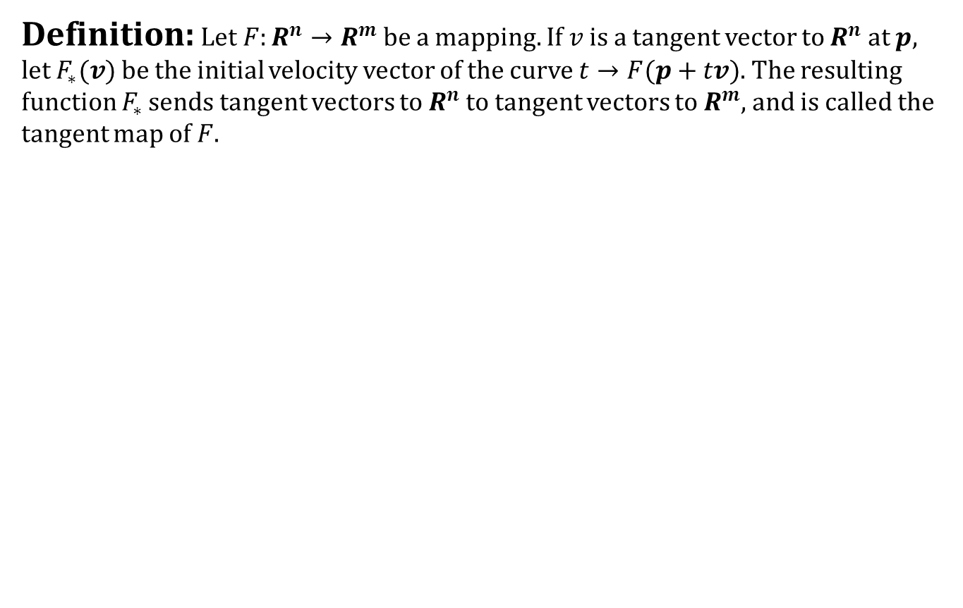
Tangent Maps
Definition: Let $F:R^{n}→R^{m}$be a mapping. If $v$ is a tangent vector to $R^{n}$ at $p,$ let $F_{∗}(v)$ be the initial velocity vector of the curve $t→F(p+tv)$. The resulting function $F_{∗}$ sends tangent vectors to $R^{n}$ to tangent vectors to $R^{m}$, and is called the tangent map of $F$.

Slide 15
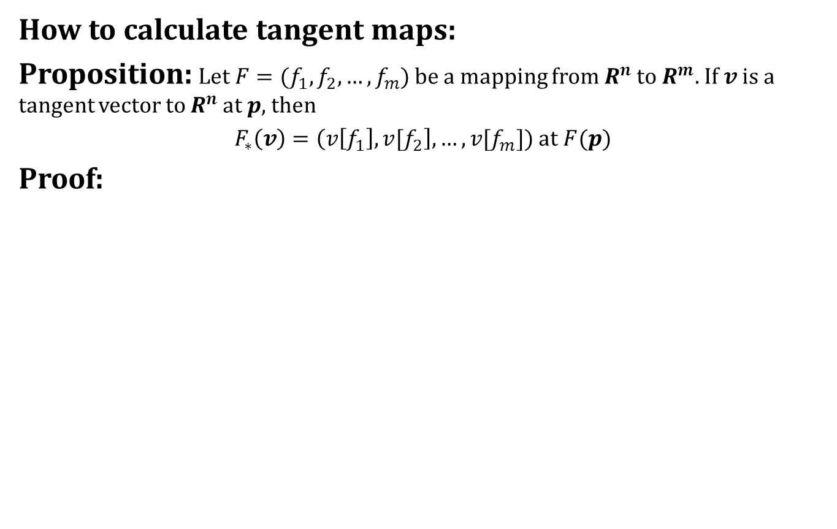
Tangent Maps
How to calculate tangent maps:
Proposition: Let $F=(f_{1},f_{2},…,f_{m})$ be a mapping from $R^{n}$ to $R^{m}.$ If $v$ is a tangent vector to $R^{n}$ at $p$, then
$F_{∗}\left(v\right)=\left(v\left[f_{1}\right],v[f_{2}\right],…,{v[f}_{m}])$ at $F(p)$
Proof:

Slide 16
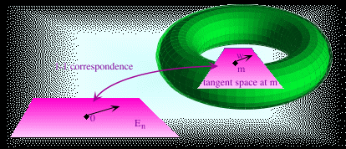
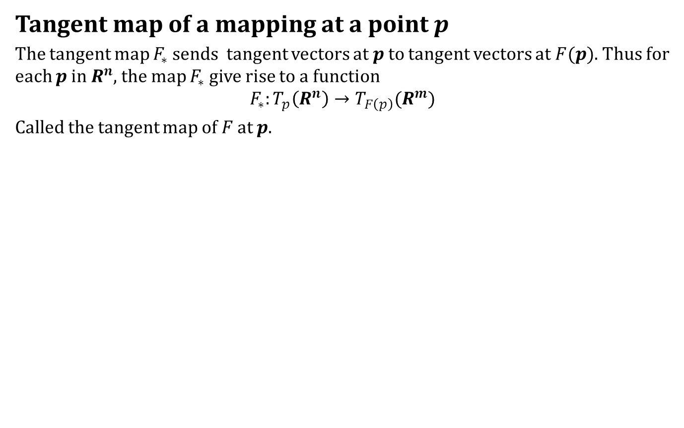
Tangent Maps
Tangent map of a mapping at a point $p$
The tangent map $F_{∗}$ sends tangent vectors at $p$ to tangent vectors at $F(p)$. Thus for each $p$ in $R^{n}$, the map $F_{∗}$ give rise to a function
$$F_{∗}:T_{p}\left(R^{n}\right)→T_{F\left(p\right)}(R^{m})$$
Called the tangent map of $F$ at $p$.

Slide 17
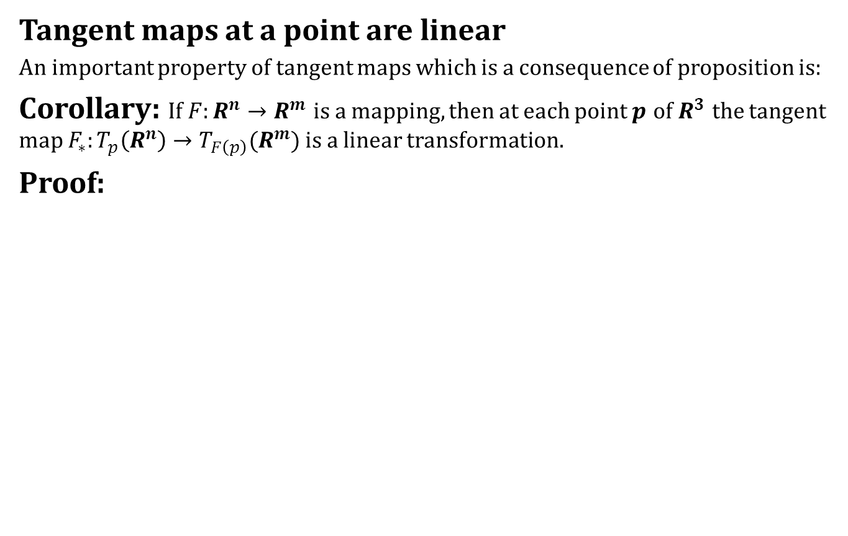
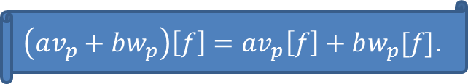
Tangent Maps
Tangent maps at a point are linear
An important property of tangent maps which is a consequence of proposition is:
Corollary: If $F:R^{n}→R^{m}$ is a mapping, then at each point $p$ of $R^{3}$ the tangent map $F_{∗}:T_{p}\left(R^{n}\right)→T_{F\left(p\right)}(R^{m})$ is a linear transformation.
Proof:
$\left(av_{p}+bw_{p}\right)\left[f\right]=av_{p}\left[f\right]+bw_{p}[f]$.

Slide 18

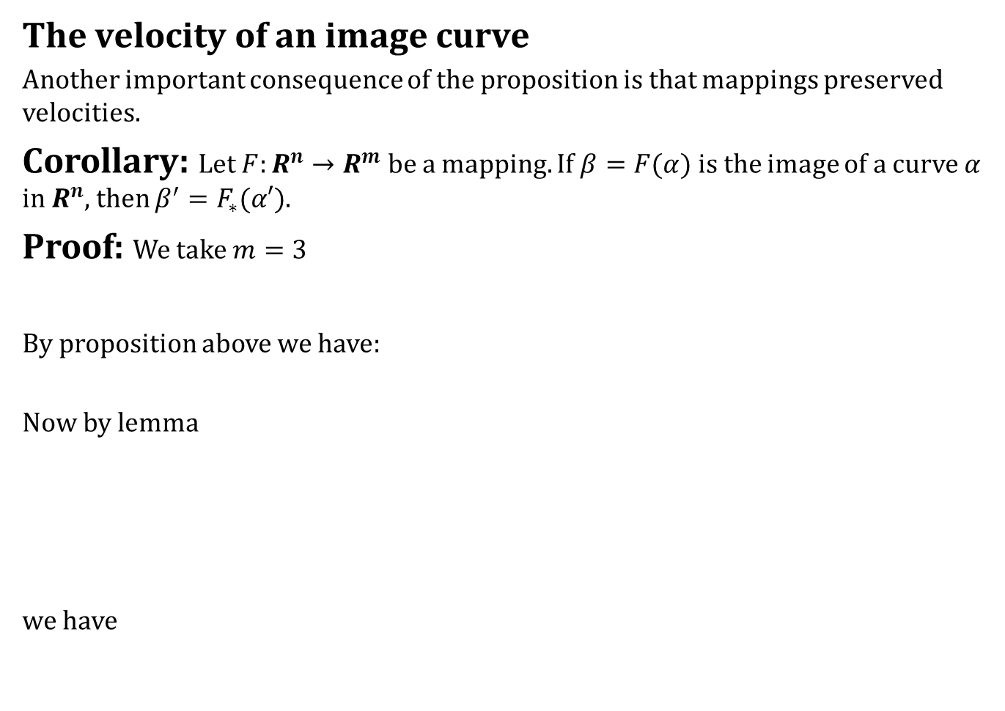
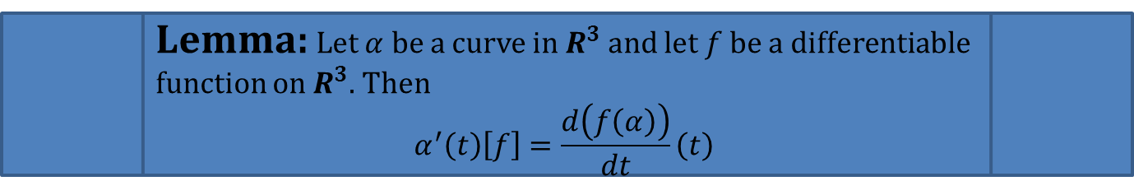
Tangent Maps
The velocity of an image curve
Another important consequence of the proposition is that mappings preserved velocities.
Corollary: Let $F:R^{n}→R^{m}$ be a mapping. If $β=F(α)$ is the image of a curve $α$ in $R^{n}$, then $β^{′}=F_{∗}(α′)$.
Proof: We take $m=3$
By proposition above we have:
Now by lemma
we have
Lemma: Let $α$ be a curve in $R^{3}$ and let $f$ be a differentiable function on $R^{3}$. Then
$$α^{′}\left(t\right)\left[f\right]=\frac{d\left(f\left(α\right)\right)}{dt}\left(t\right)$$

Slide 19

Tangent Maps
Hence

Slide 20
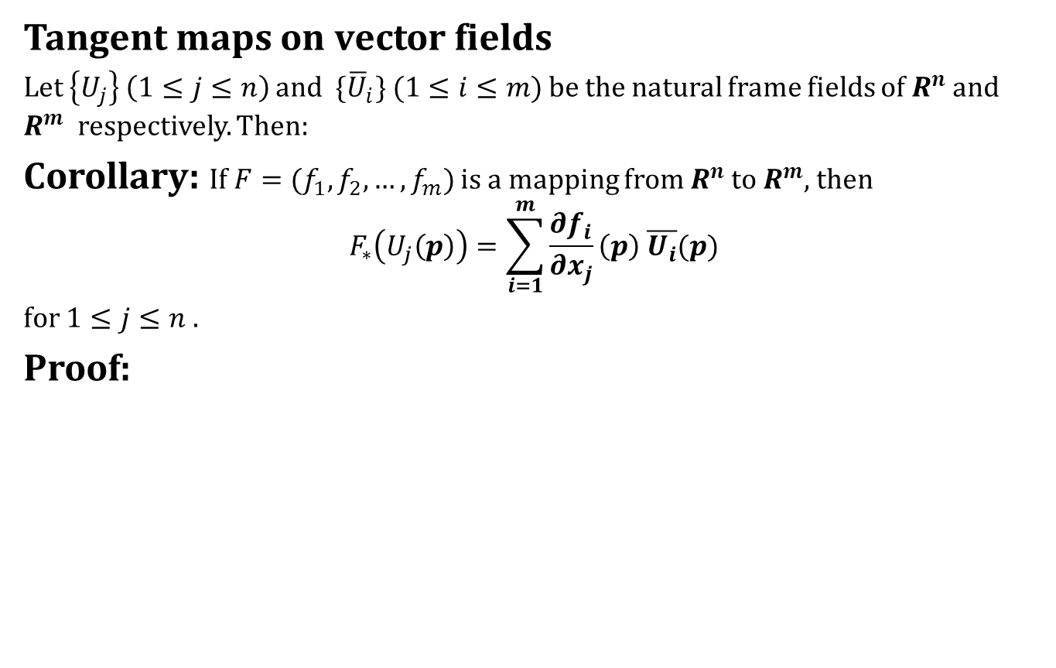
Tangent Maps
Tangent maps on vector fields
Let $\left\{U_{j}\right\}$ $\left(1≤j≤n\right)$ and ${\{\overline{U}}_{i}\} (1≤i≤m)$ be the natural frame fields of $R^{n}$ and $R^{m}$ respectively. Then:
Corollary: If $F=(f_{1},f_{2},…,f_{m})$ is a mapping from $R^{n}$ to $R^{m}$, then
$$F_{∗}\left(U_{j}\left(p\right)\right)=\sum_{i=1}^{m}{\frac{∂f_{i}}{∂x_{j}}\left(p\right) \overline{U_{i}}(p)}$$
for $1≤j≤n$.
Proof:

Slide 22
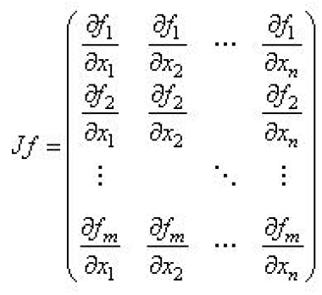
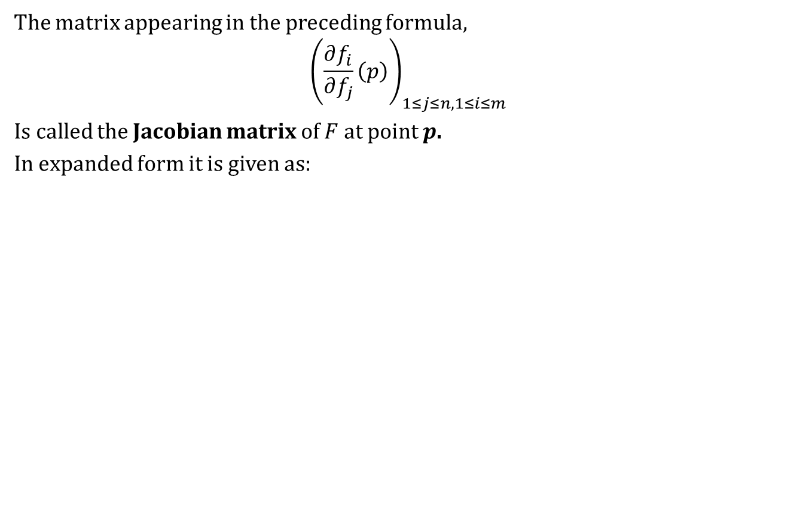
Tangent Maps
The matrix appearing in the preceding formula,
$${\left(\frac{∂f_{i}}{∂f_{j}}\left(p\right)\right)}_{1≤j≤n,1≤i≤m}$$
Is called the Jacobian matrix of $F$ at point $p$.
In expanded form it is given as:

Slide 23
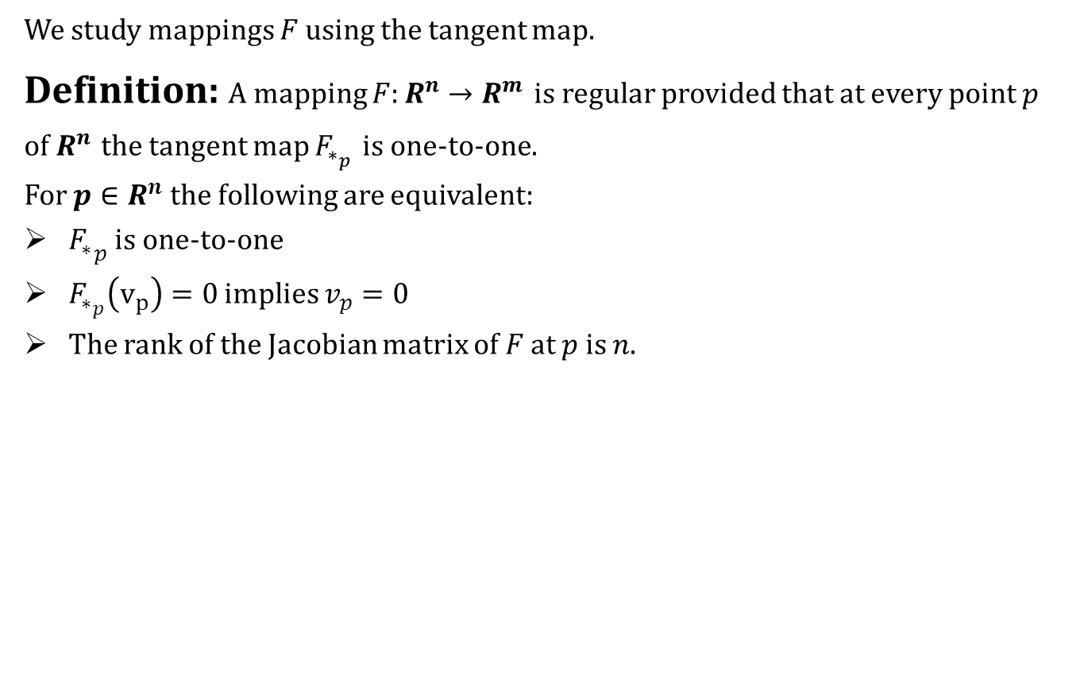
Tangent Maps
We study mappings $F$ using the tangent map.
Definition: A mapping $F:R^{n}→R^{m}$ is regular provided that at every point $p$ of $R^{n}$ the tangent map $F_{∗_{p}}$ is one-to-one.
For $p∈R^{n}$ the following are equivalent:
${F_{∗}}_{p}$ is one-to-one
$F_{∗_{p}}\left(v_{p}\right)=0$ implies $v_{p}=0$
The rank of the Jacobian matrix of $F$ at $p$ is $n$.

Slide 24
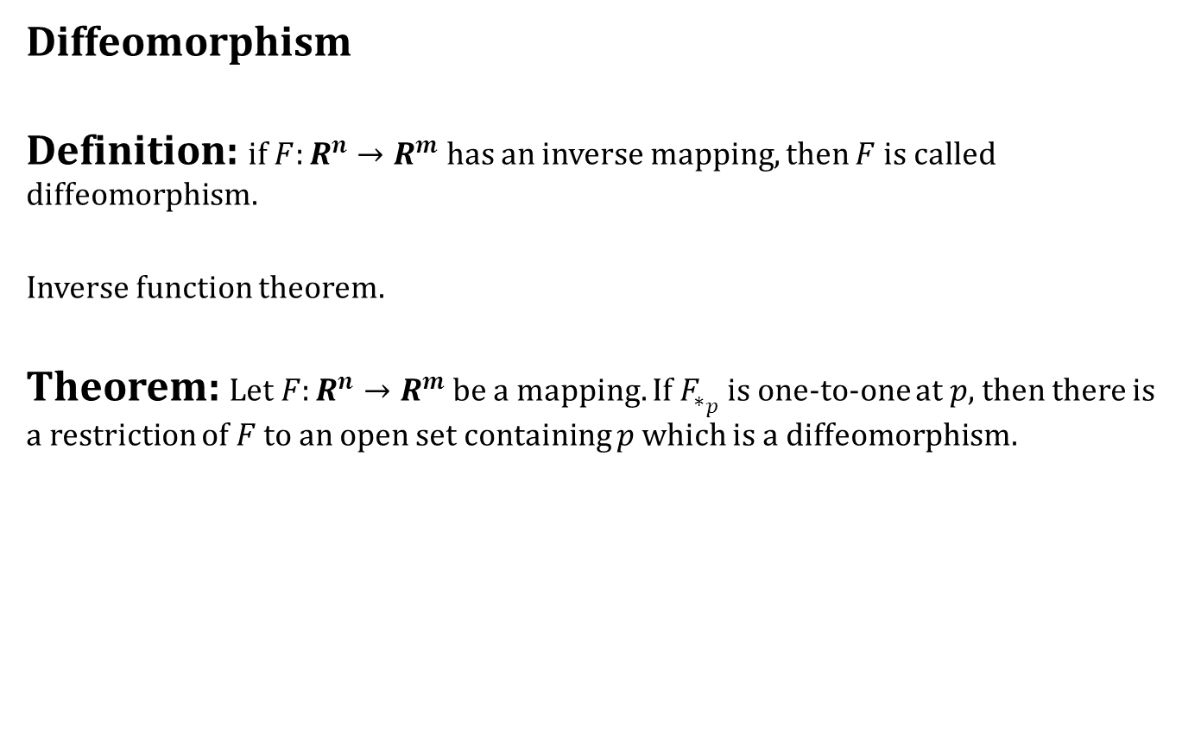
Tangent Maps
Diffeomorphism
Definition: if $F:R^{n}→R^{m}$ has an inverse mapping, then $F$ is called diffeomorphism.
Inverse function theorem.
Theorem: Let $F:R^{n}→R^{m}$ be a mapping. If $F_{∗_{p}}$ is one-to-one at $p$, then there is a restriction of $F$ to an open set containing $p$ which is a diffeomorphism.

Slide 25
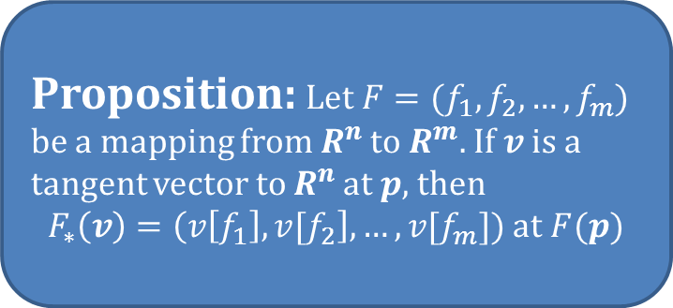
What did we learnt today
Contents:
Introduction to Mappings
Tangent Maps
Proposition: Let $F=(f_{1},f_{2},…,f_{m})$ be a mapping from $R^{n}$ to $R^{m}.$ If $v$ is a tangent vector to $R^{n}$ at $p$, then
$F_{∗}\left(v\right)=\left(v\left[f_{1}\right],v[f_{2}\right],…,{v[f}_{m}])$ at $F(p)$

Slide 26
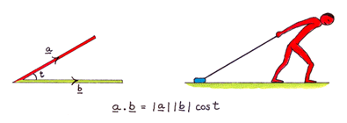
Next time
Dot Product

Slide 27

End of the lecture

