Slide 1
Lecture # 6
MTH352: Differential Geometry
For
Master of Mathematics
By
Dr. SOHAIL IQBAL
Assistant Professor
Department of Mathematics, CIIT Islamabad

Slide 2
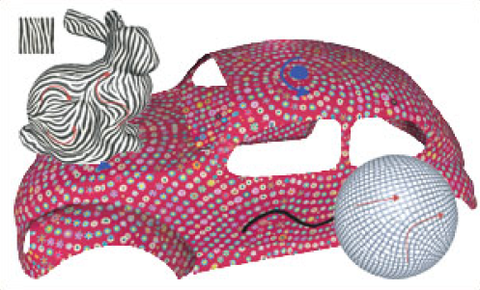
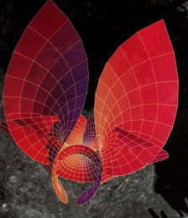
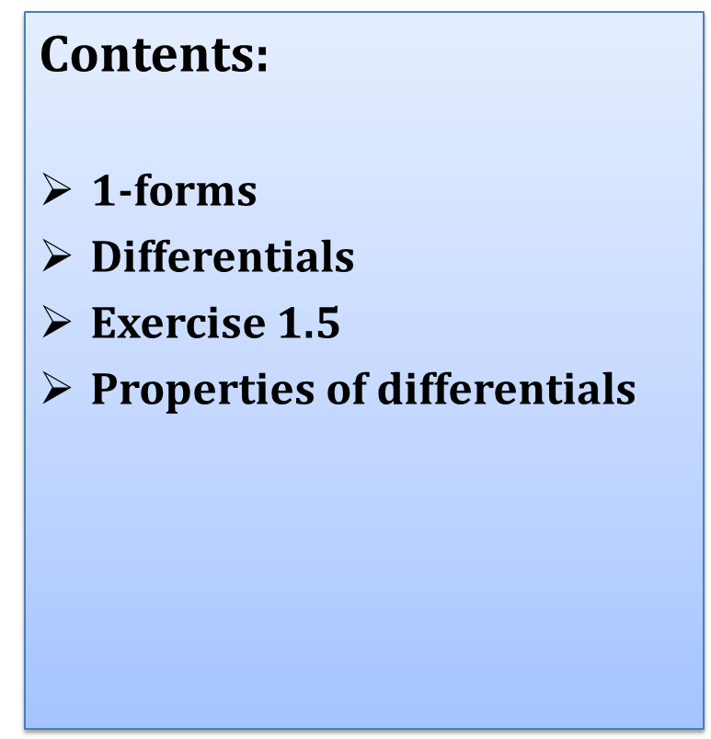
Last Lecture
Contents:
$1$-forms
Differentials
Exercise 1.5
Properties of differentials

Slide 3
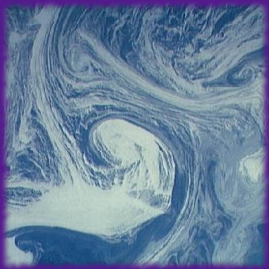
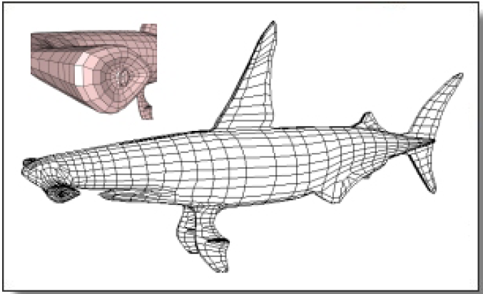
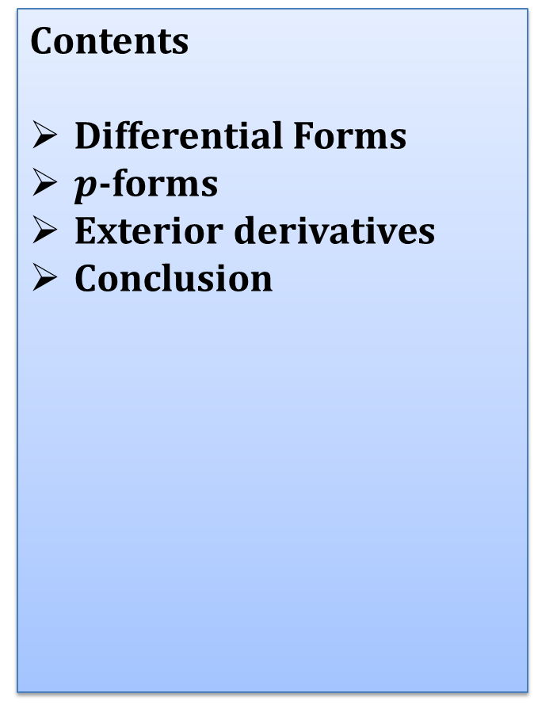
Today’s Lecture
Contents
Differential Forms
$p$-forms
Exterior derivatives
Conclusion

Slide 4
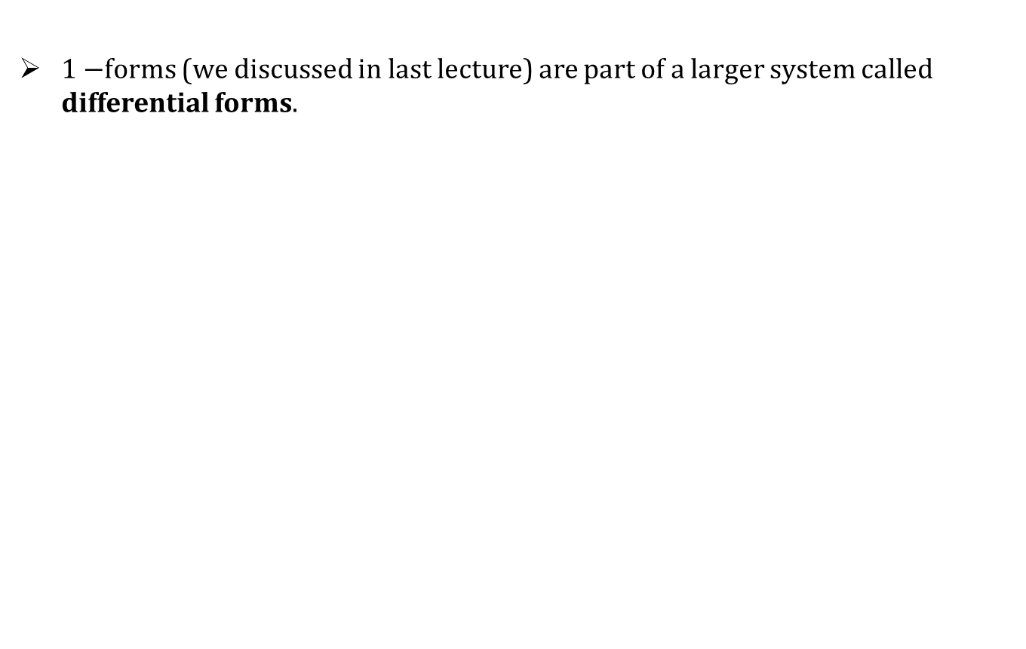
Differential Forms
$1−$forms (we discussed in last lecture) are part of a larger system called differential forms.

Slide 5
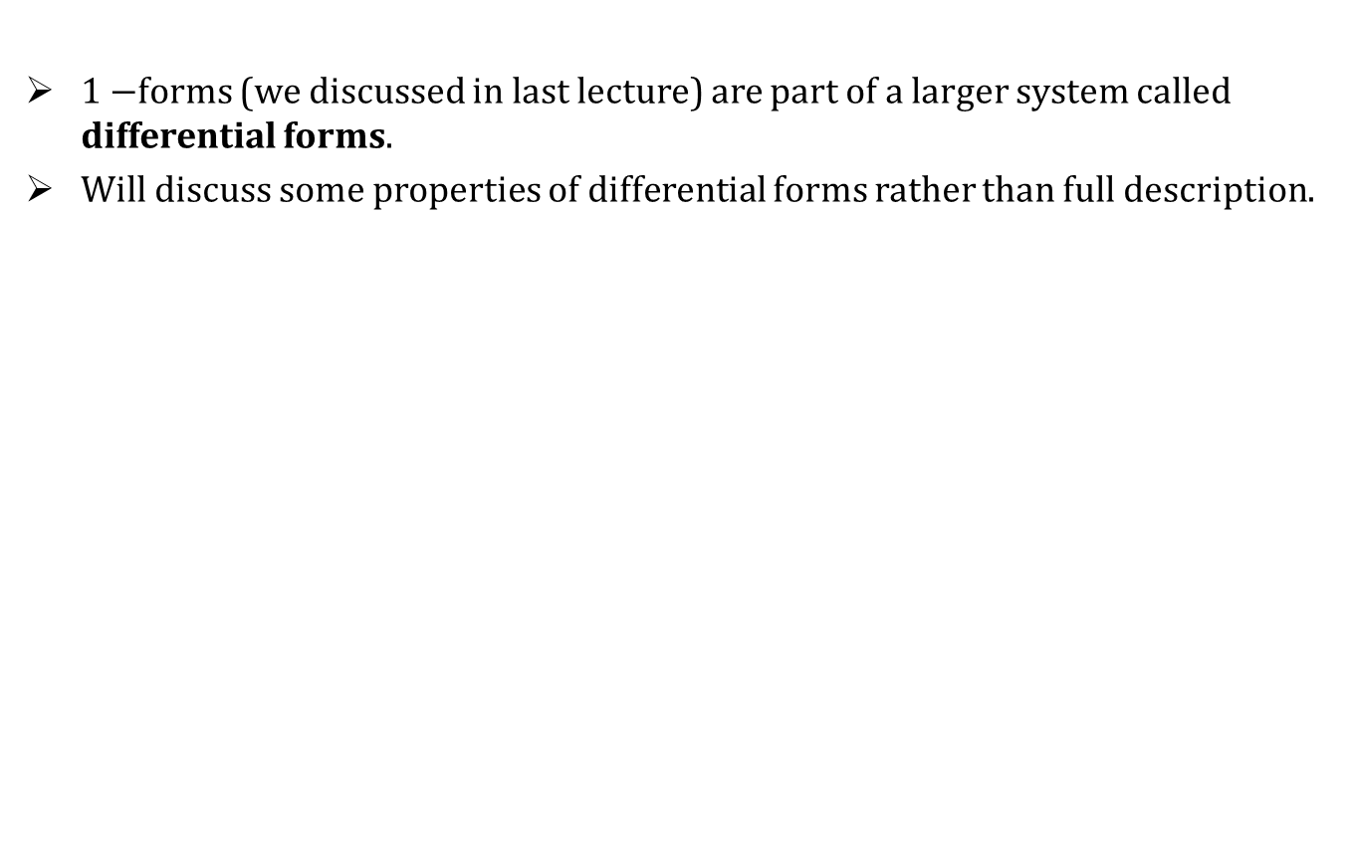
Differential Forms
$1−$forms (we discussed in last lecture) are part of a larger system called differential forms.
Will discuss some properties of differential forms rather than full description.

Slide 6
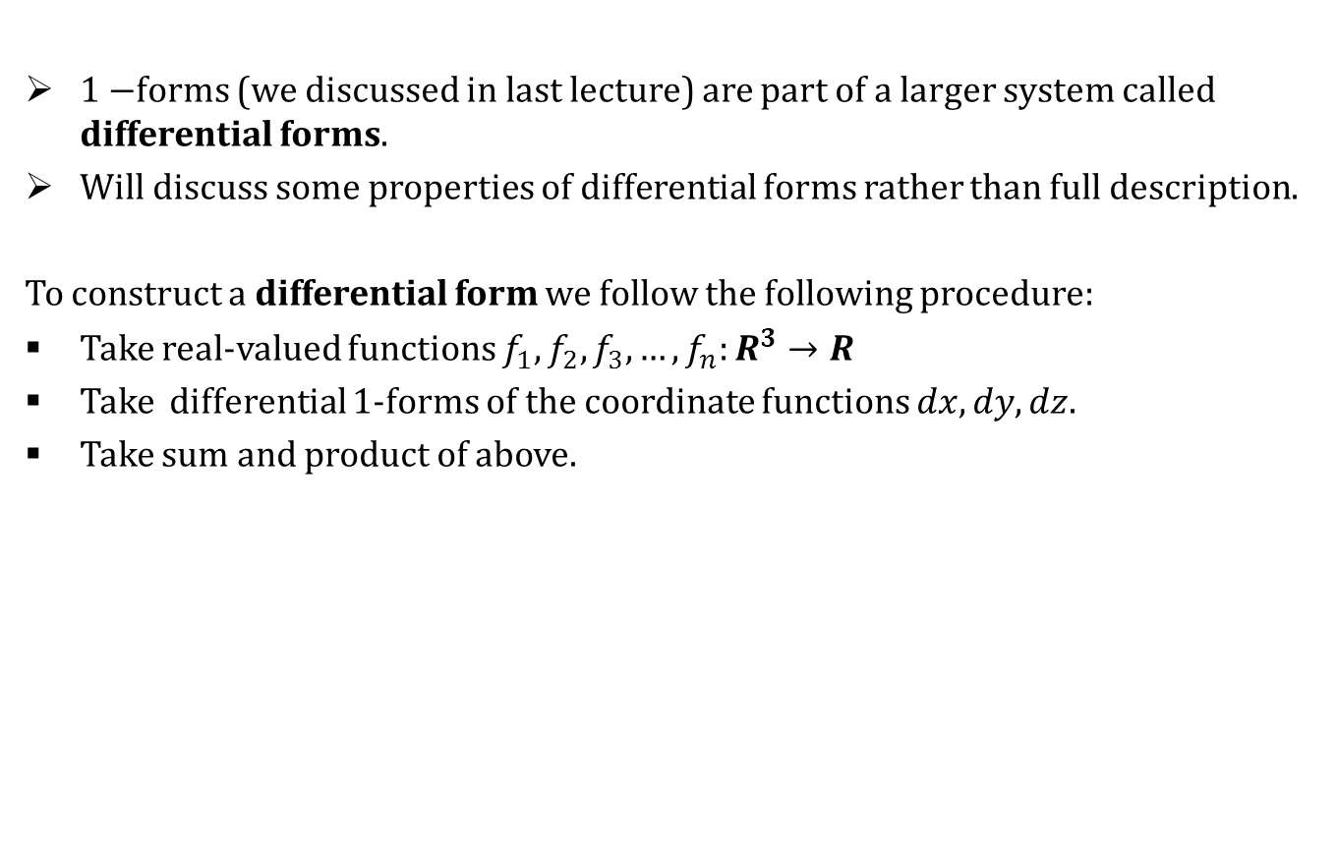
Differential Forms
$1−$forms (we discussed in last lecture) are part of a larger system called differential forms.
Will discuss some properties of differential forms rather than full description.
To construct a differential form we follow the following procedure:
Take real-valued functions $f_{1},f_{2},f_{3},…,f_{n}:R^{3}→R$
Take differential $1$-forms of the coordinate functions $dx, dy, dz$.
Take sum and product of above.

Slide 7
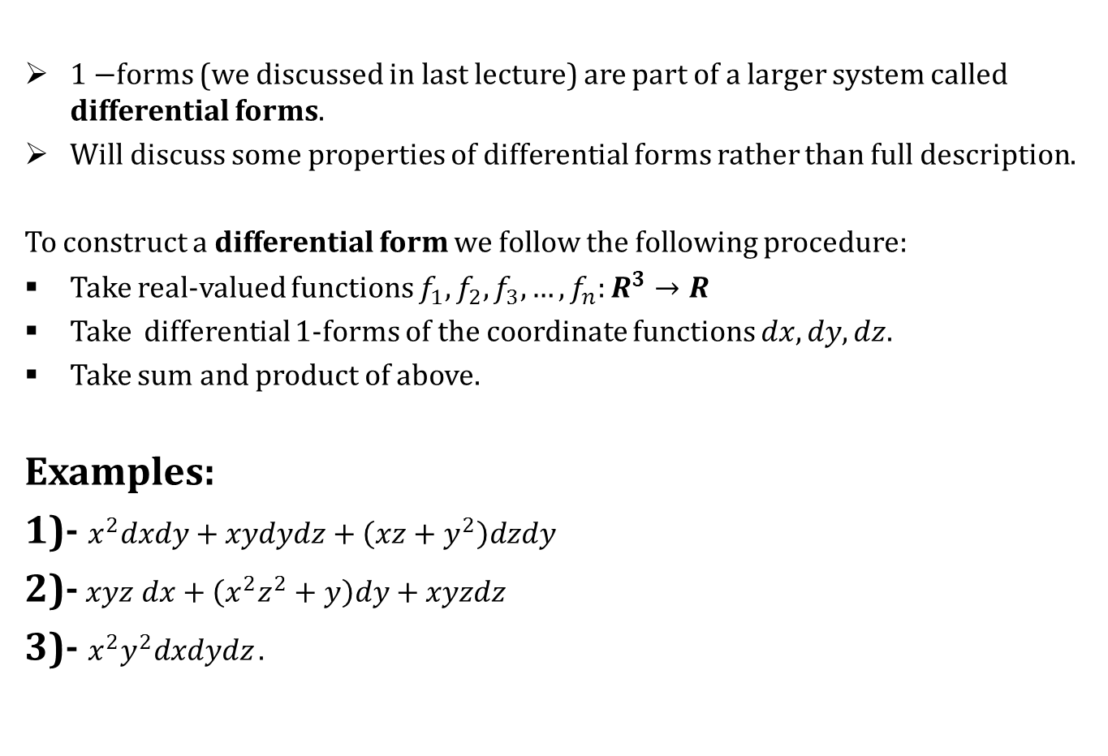
Differential Forms
$1−$forms (we discussed in last lecture) are part of a larger system called differential forms.
Will discuss some properties of differential forms rather than full description.
To construct a differential form we follow the following procedure:
Take real-valued functions $f_{1},f_{2},f_{3},…,f_{n}:R^{3}→R$
Take differential $1$-forms of the coordinate functions $dx, dy, dz$.
Take sum and product of above.
Examples:
1)- $x^{2}dxdy+xydydz+\left(xz+y^{2}\right)dzdy$
2)- $xyz dx+\left(x^{2}z^{2}+y\right)dy+xyzdz$
3)- $x^{2}y^{2}dxdydz$ .

Slide 8
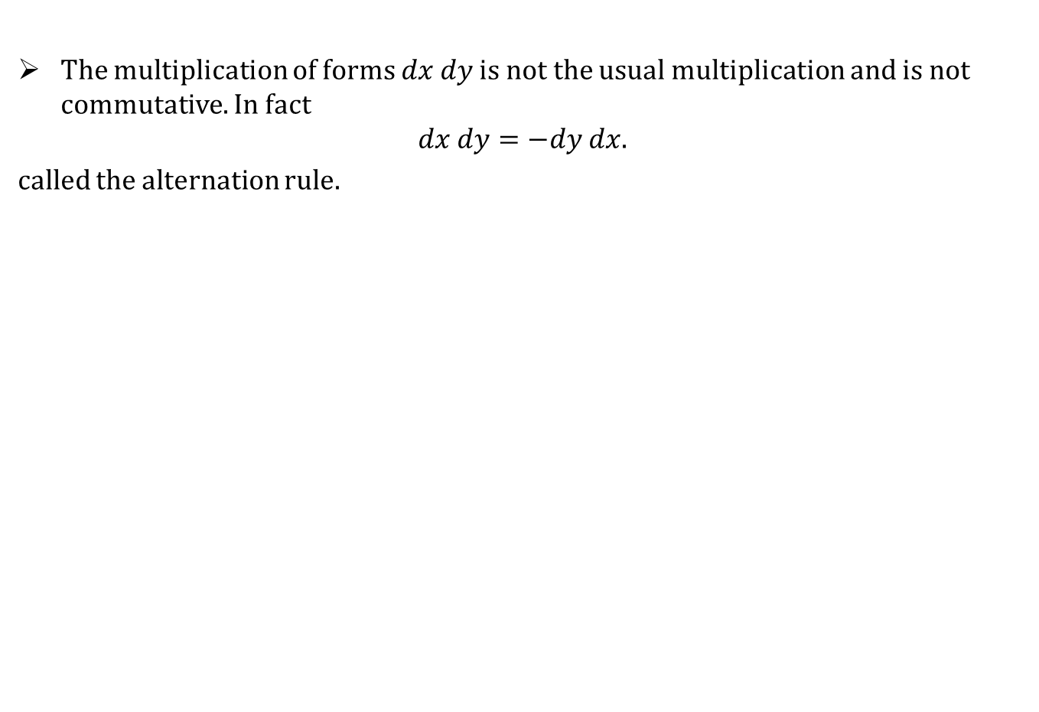
Differential Forms
The multiplication of forms $dx dy$ is not the usual multiplication and is not commutative. In fact
$$dx dy=−dy dx.$$
called the alternation rule.

Slide 9
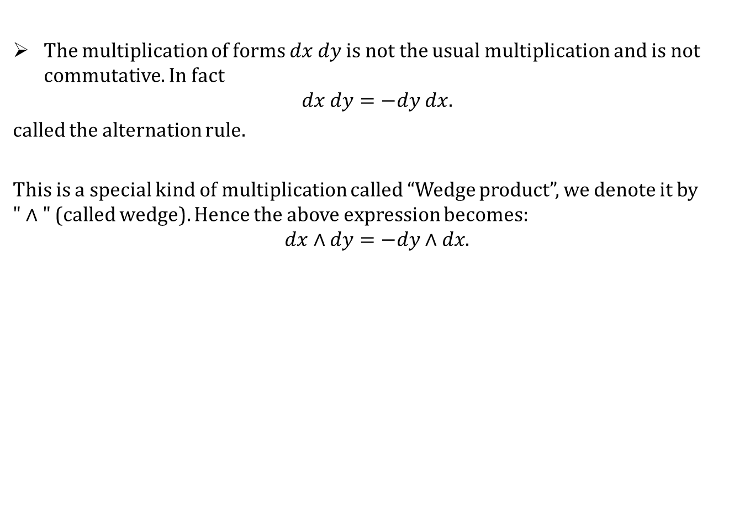
Differential Forms
The multiplication of forms $dx dy$ is not the usual multiplication and is not commutative. In fact
$$dx dy=−dy dx.$$
called the alternation rule.
This is a special kind of multiplication called “Wedge product”, we denote it by $"∧"$ (called wedge). Hence the above expression becomes:
$$dx∧dy=−dy∧dx.$$

Slide 10
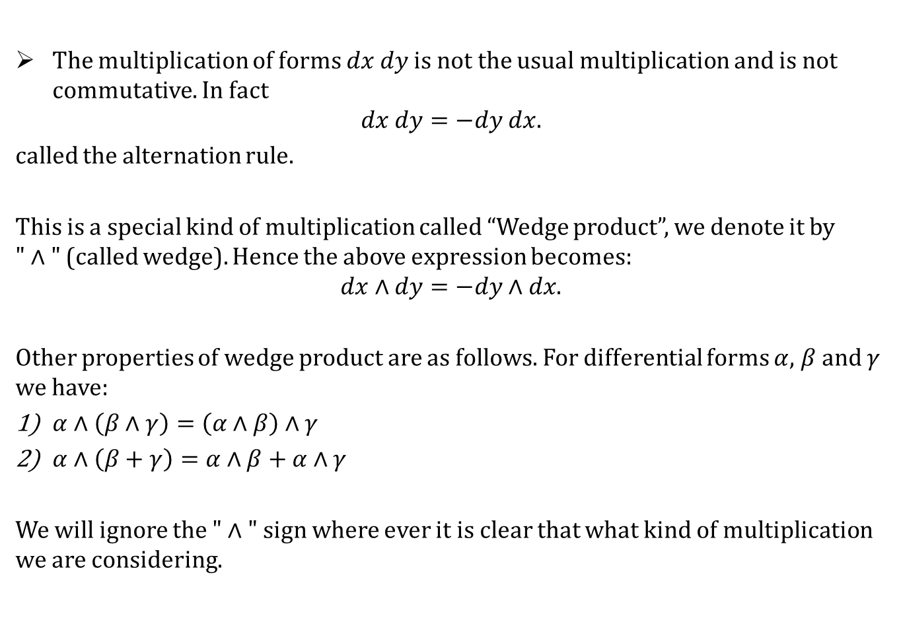
Differential Forms
The multiplication of forms $dx dy$ is not the usual multiplication and is not commutative. In fact
$$dx dy=−dy dx.$$
called the alternation rule.
This is a special kind of multiplication called “Wedge product”, we denote it by $"∧"$ (called wedge). Hence the above expression becomes:
$$dx∧dy=−dy∧dx.$$
Other properties of wedge product are as follows. For differential forms $α$, $β$ and $γ$ we have:
$α∧\left(β∧γ\right)=\left(α∧β\right)∧γ$
$α∧\left(β+γ\right)=α∧β+α∧γ$
We will ignore the $"∧"$ sign where ever it is clear that what kind of multiplication we are considering.

Slide 11
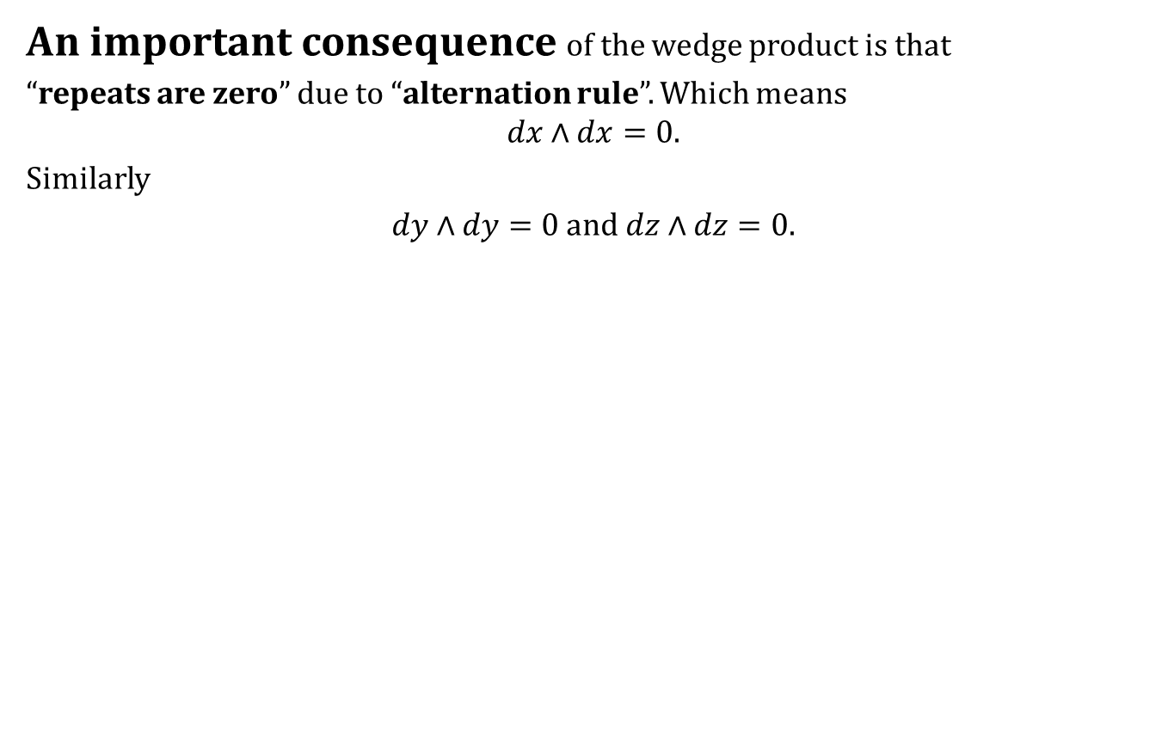
Differential Forms
An important consequence of the wedge product is that
“repeats are zero” due to “alternation rule”. Which means
$$dx∧dx=0.$$
Similarly
$dy∧dy=0$ and $dz∧dz=0$.

Slide 12
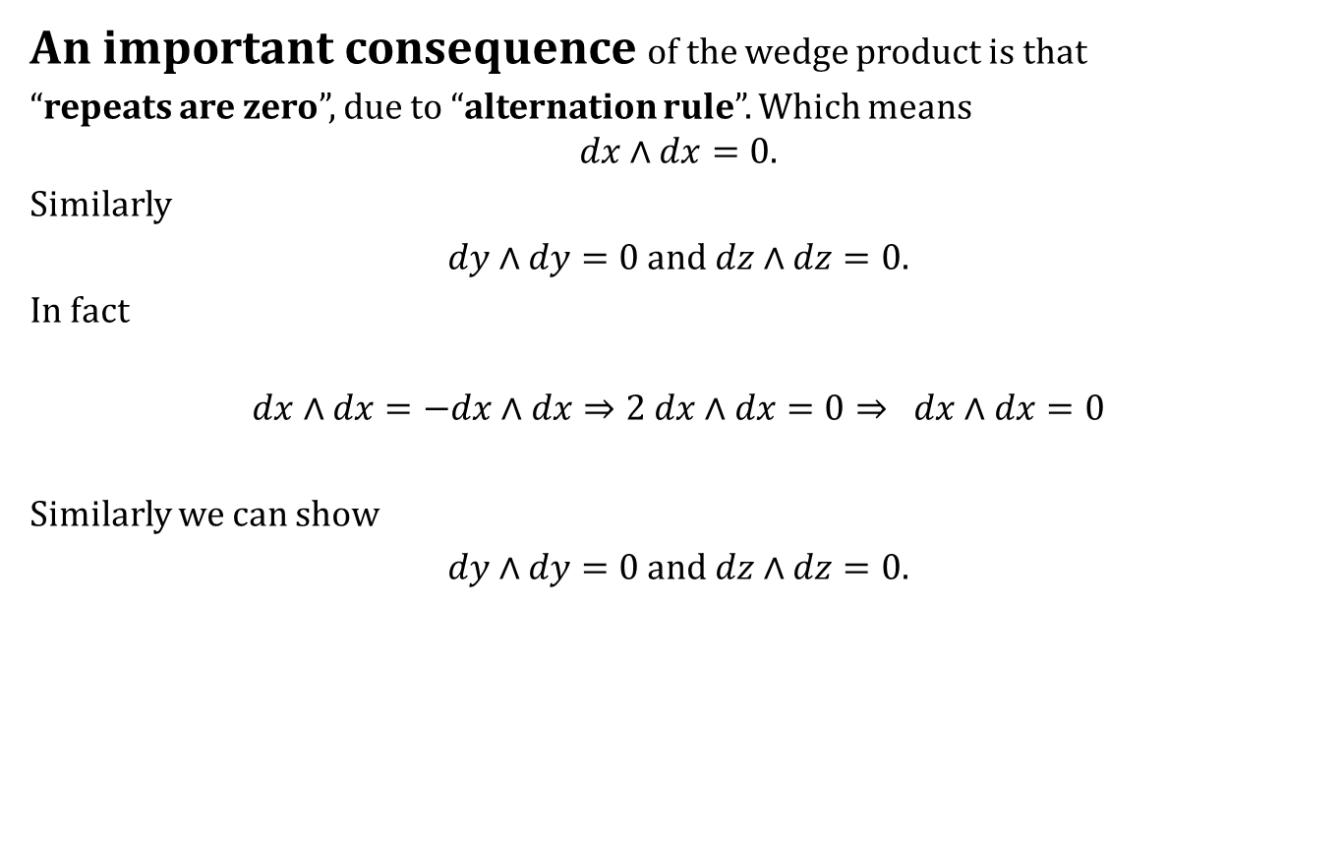
Differential Forms
An important consequence of the wedge product is that
“repeats are zero”, due to “alternation rule”. Which means
$$dx∧dx=0.$$
Similarly
$dy∧dy=0$ and $dz∧dz=0$.
In fact
$$dx∧dx=−dx∧dx⇒2 dx∧dx=0⇒ dx∧dx=0$$
Similarly we can show
$dy∧dy=0$ and $dz∧dz=0$.

Slide 13
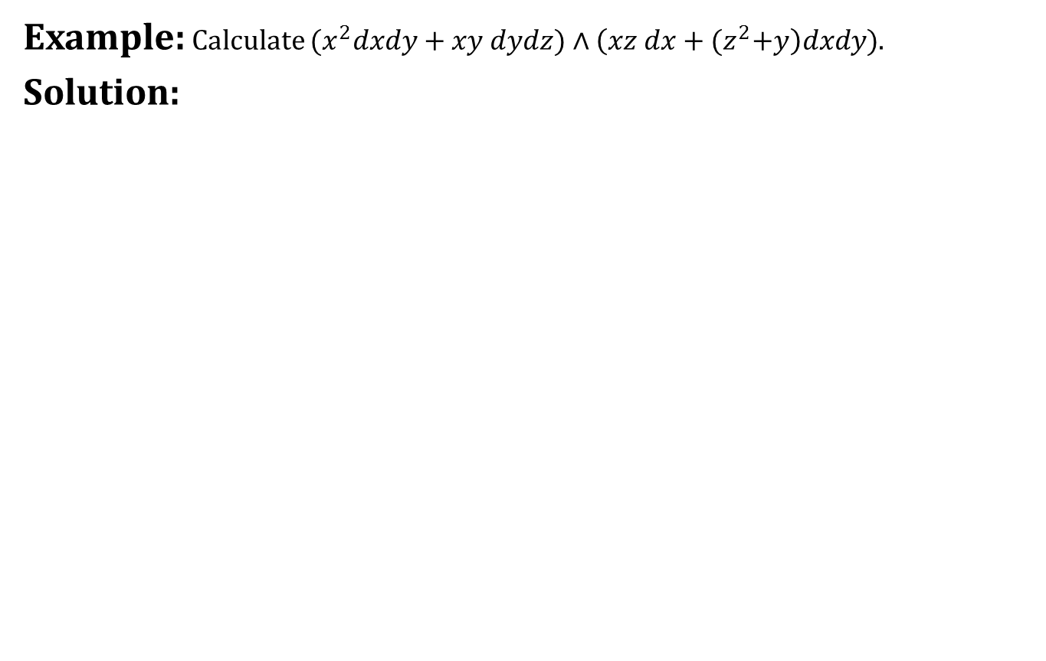
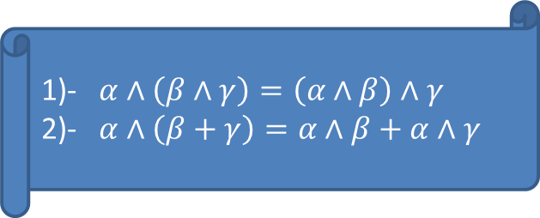
Differential Forms
Example: Calculate ${(x}^{2}dxdy+xy dydz)∧\left(xz dx+{(z}^{2}+y\right)dxdy)$.
Solution:
- $α∧\left(β∧γ\right)=\left(α∧β\right)∧γ$
- $α∧\left(β+γ\right)=α∧β+α∧γ$

Slide 14
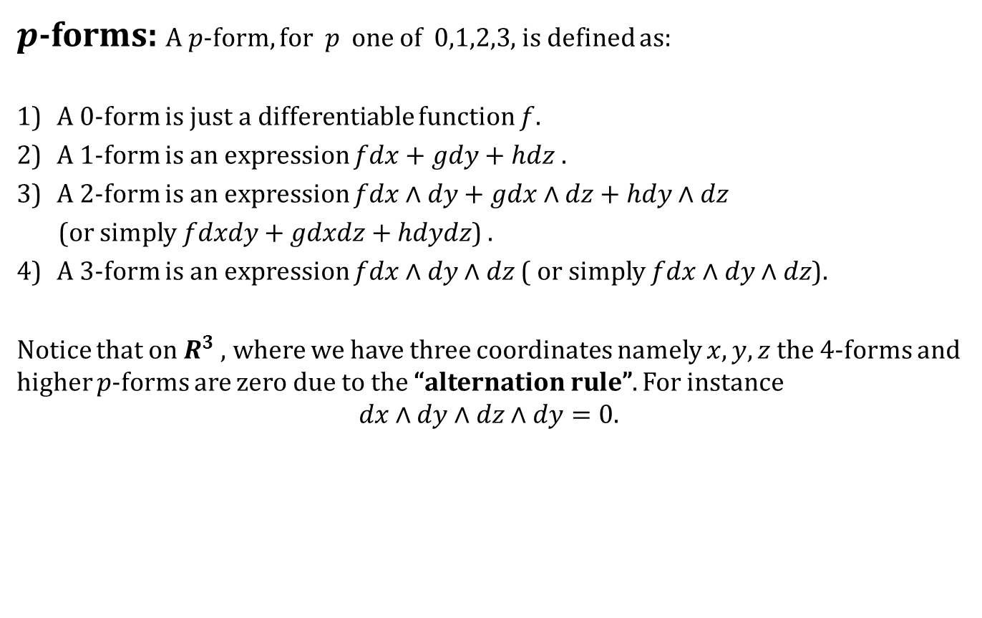
p-forms
$p$-forms: A $p$-form, for $p$ one of $0,1,2,3$, is defined as:
A $0$-form is just a differentiable function $f$.
A $1$-form is an expression $fdx+gdy+hdz$ .
A $2$-form is an expression $fdx∧dy+gdx∧dz+hdy∧dz$
(or simply $fdxdy+gdxdz+hdydz$) .
A $3$-form is an expression $fdx∧dy∧dz$( or simply $fdx∧dy∧dz$).
Notice that on $R^{3}$ , where we have three coordinates namely $x,y,z$ the $4$-forms and higher $p$-forms are zero due to the “alternation rule”. For instance
$$dx∧dy∧dz∧dy=0.$$

Slide 15

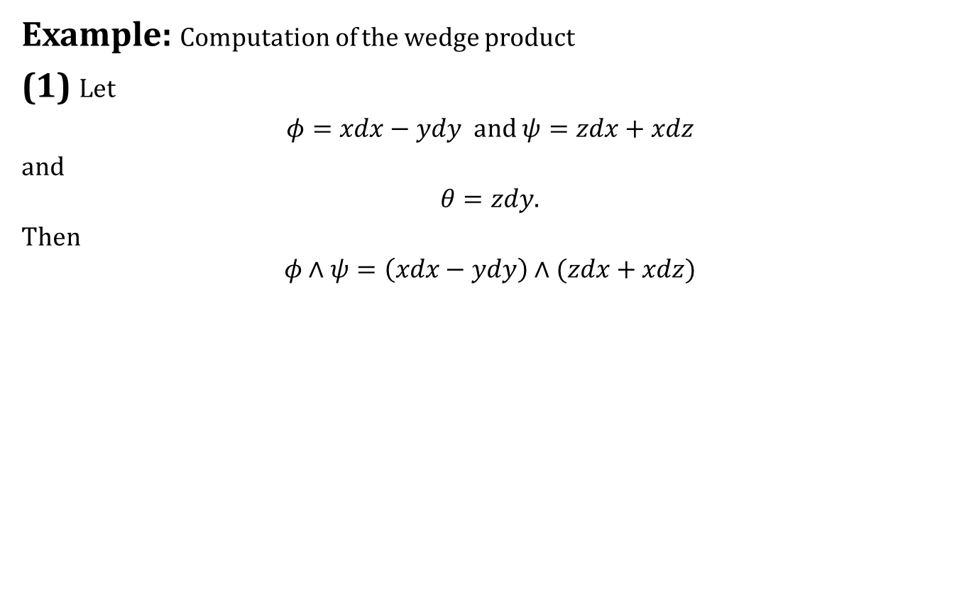
Product of $p$-forms
Example: Computation of the wedge product
(1) Let
$φ=xdx−ydy$ and $ψ=zdx+xdz$
and
$$θ=zdy.$$
Then
$$φ∧ψ=\left(xdx−ydy\right)∧(zdx+xdz)$$

Slide 16
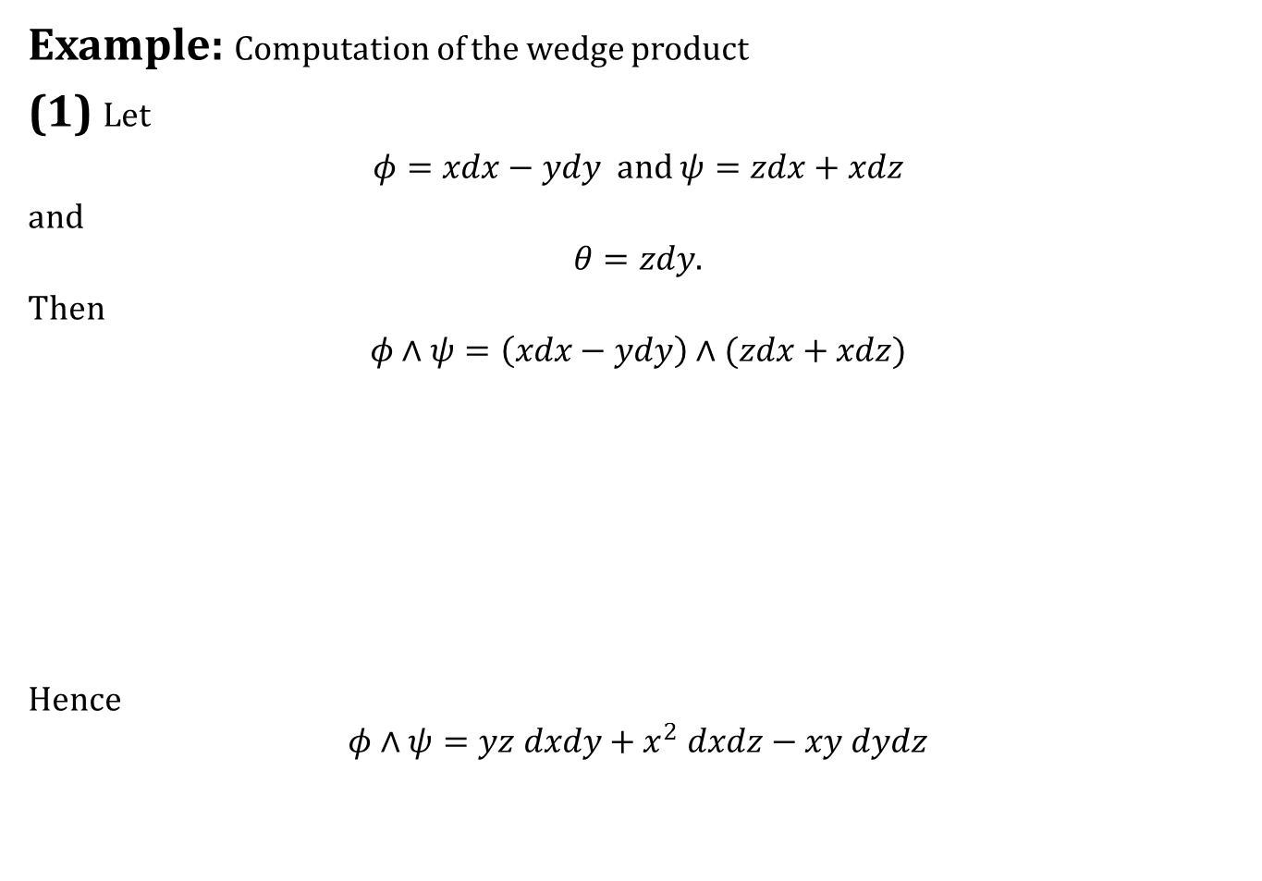
Product of $p$-forms
Example: Computation of the wedge product
(1) Let
$φ=xdx−ydy$ and $ψ=zdx+xdz$
and
$$θ=zdy.$$
Then
$$φ∧ψ=\left(xdx−ydy\right)∧(zdx+xdz)$$
Hence
$$φ∧ψ=yz dxdy+x^{2} dxdz−xy dydz$$

Slide 17
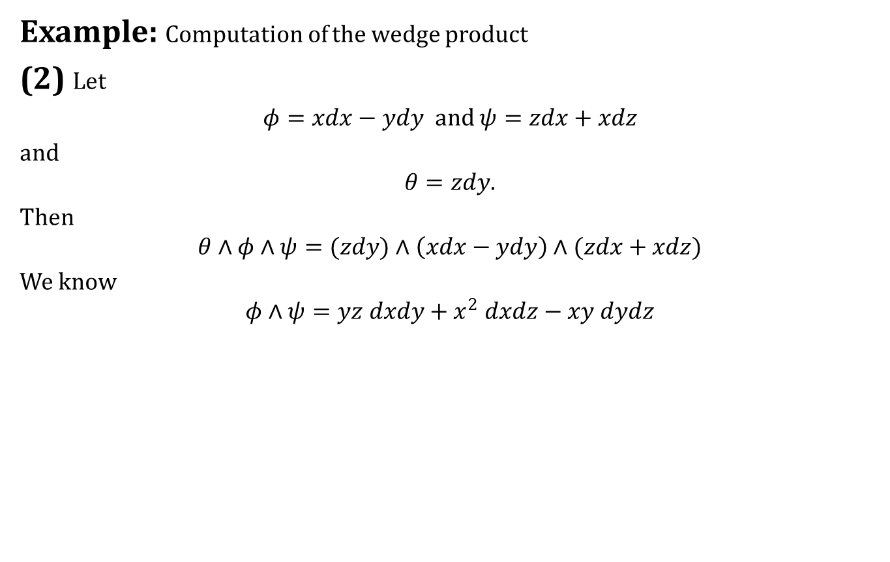
Product of $p$-forms
Example: Computation of the wedge product
(2) Let
$φ=xdx−ydy$ and $ψ=zdx+xdz$
and
$$θ=zdy.$$
Then
$$θ∧φ∧ψ=(zdy)∧\left(xdx−ydy\right)∧(zdx+xdz)$$
We know
$$φ∧ψ=yz dxdy+x^{2} dxdz−xy dydz$$

Slide 18

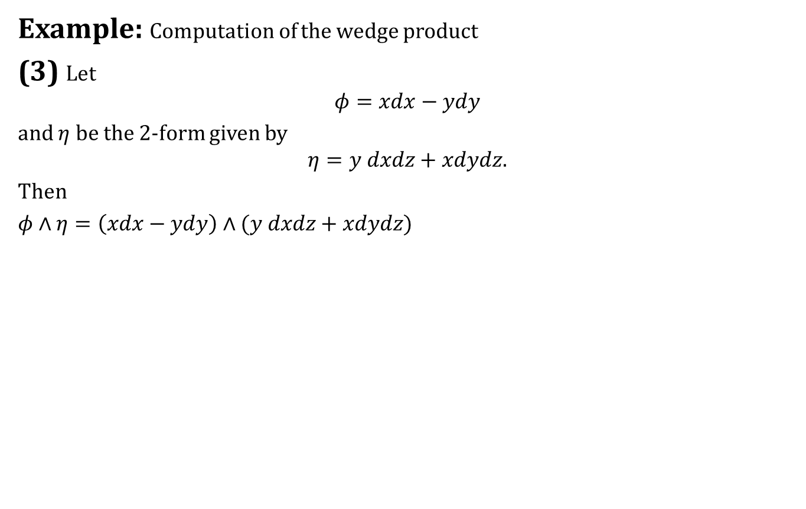
Product of $p$-forms
Example: Computation of the wedge product
(3) Let
$$φ=xdx−ydy$$
and $η$ be the 2-form given by
$$η=y dxdz+xdydz.$$
Then
$φ∧η=\left(xdx−ydy\right)∧(y dxdz+xdydz)$

Slide 19
Product of $p$-forms
From these examples we see that

Slide 20
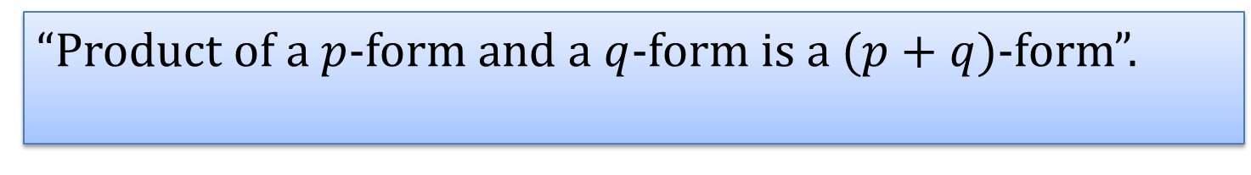
Product of $p$-forms
From these examples we see that
“Product of a $p$-form and a $q$-form is a $(p+q)$-form”.

Slide 21
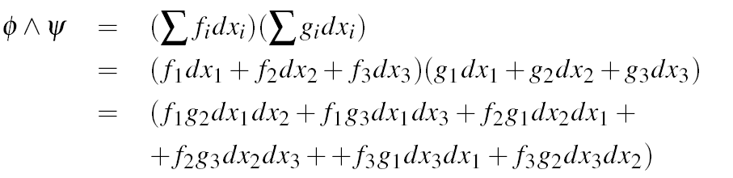
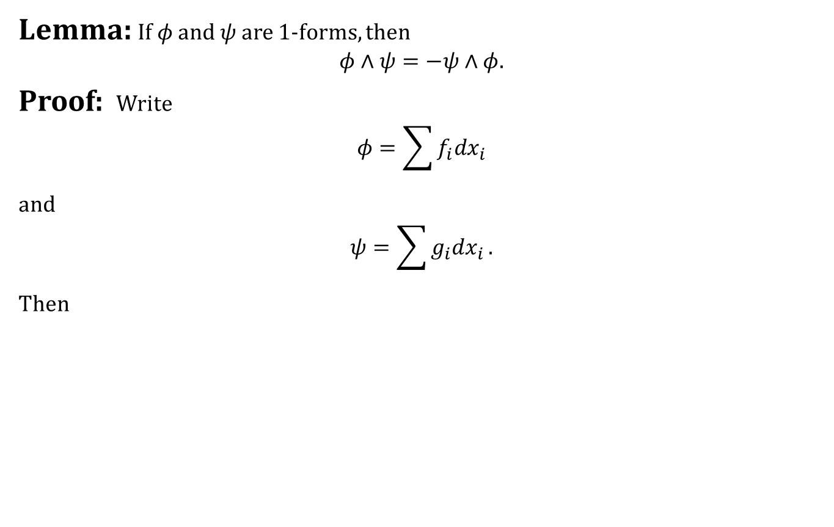
Product of $p$-forms
Lemma: If $φ$ and $ψ$ are 1-forms, then
$$φ∧ψ=−ψ∧φ.$$
Proof: Write
$$φ=\sum{f_{i}dx_{i}}$$
and
$$ψ=\sum{g_{i}dx_{i}}.$$
Then

Slide 22
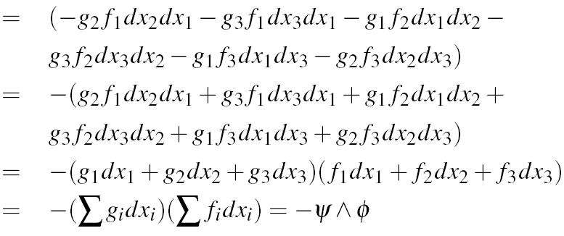
Product of $p$-forms

Slide 23
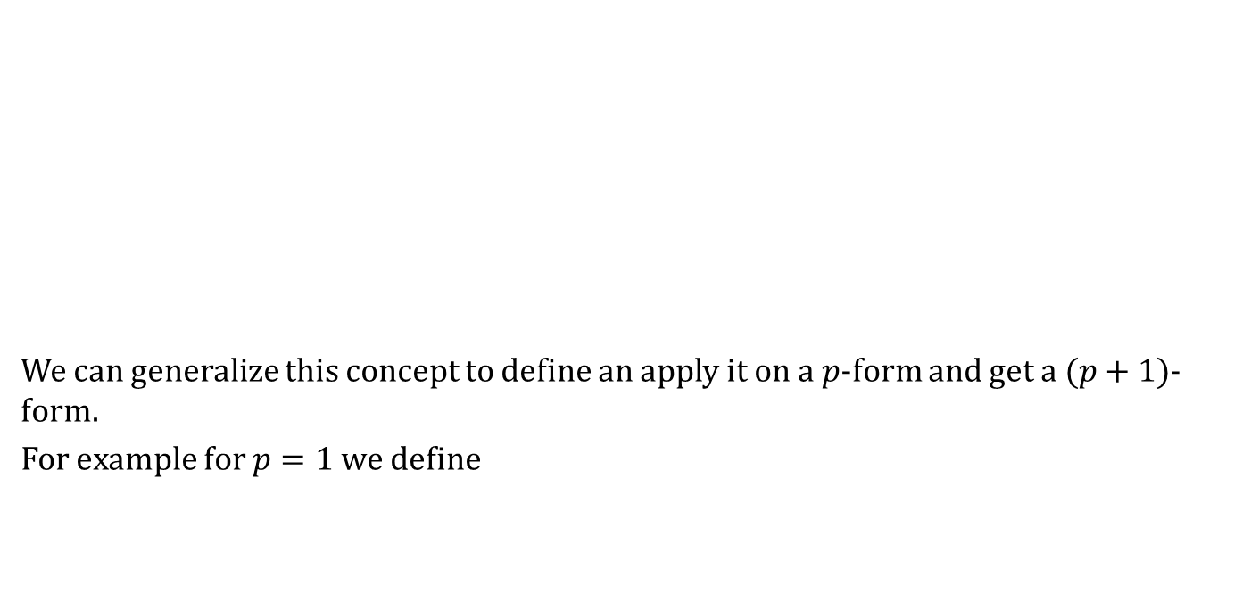
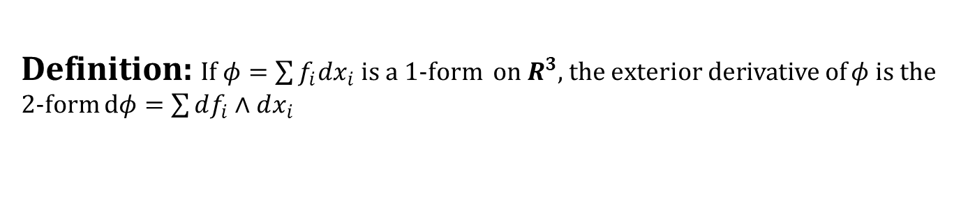
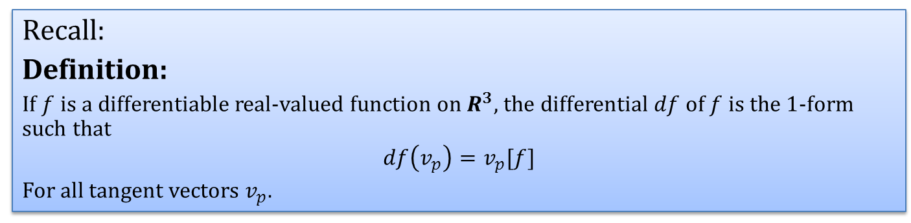
Exterior derivative
We can generalize this concept to define an apply it on a $p$-form and get a $(p+1)$-form.
For example for $p=1$ we define
Recall:
Definition:
If $f$ is a differentiable real-valued function on $R^{3}$, the differential $df$of $f$ is the $1$-form such that
$$df\left(v_{p}\right)=v_{p}[f]$$
For all tangent vectors $v_{p}$.
Definition: If $φ=\sum{f_{i}dx_{i}}$is a 1-form on $R^{3}$, the exterior derivative of $φ$ is the 2-form $dφ=\sum{df_{i}∧dx_{i}}$

Slide 24
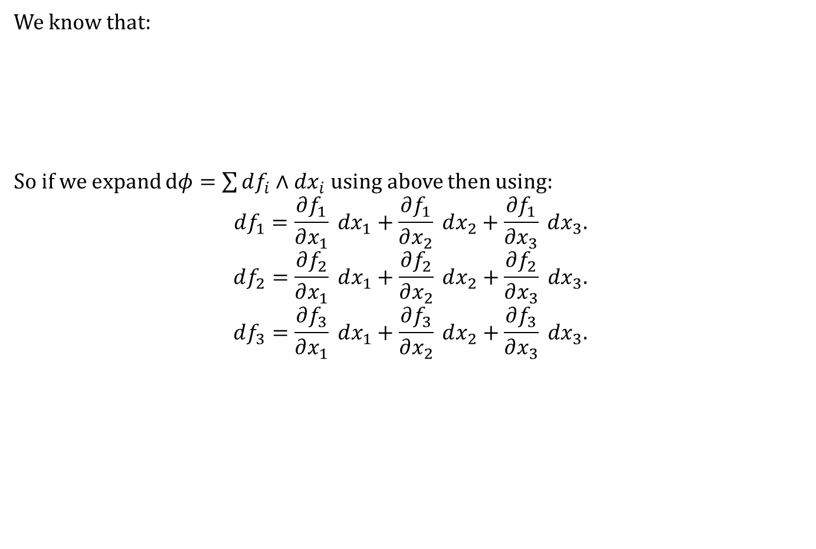

Exterior derivative
We know that:
So if we expand $dφ=\sum{df_{i}∧dx_{i}}$ using above then using:
$$df_{1}=\frac{∂f_{1}}{∂x_{1}} dx_{1}+\frac{∂f_{1}}{∂x_{2}} dx_{2}+\frac{∂f_{1}}{∂x_{3}} dx_{3}.$$
$$df_{2}=\frac{∂f_{2}}{∂x_{1}} dx_{1}+\frac{∂f_{2}}{∂x_{2}} dx_{2}+\frac{∂f_{2}}{∂x_{3}} dx_{3}.$$
$$df_{3}=\frac{∂f_{3}}{∂x_{1}} dx_{1}+\frac{∂f_{3}}{∂x_{2}} dx_{2}+\frac{∂f_{3}}{∂x_{3}} dx_{3}.$$
Corollary: Let $f:R^{3}→R$ be a differentiable function. Then
$$df=\frac{∂f}{∂x} dx+\frac{∂f}{∂y} dy+\frac{∂f}{∂z} dz.$$

Slide 25
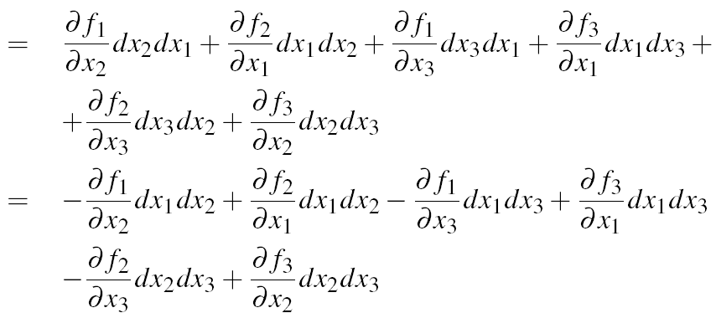

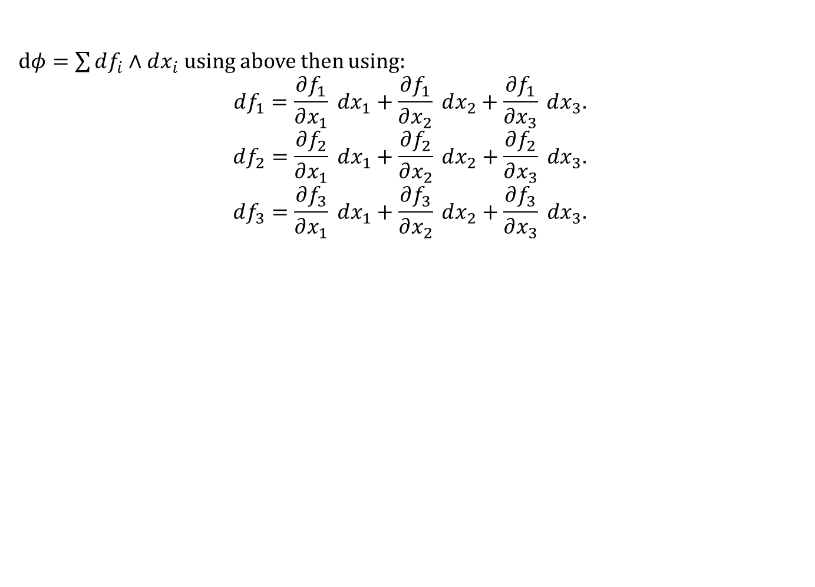
Exterior derivative
$dφ=\sum{df_{i}∧dx_{i}}$ using above then using:
$$df_{1}=\frac{∂f_{1}}{∂x_{1}} dx_{1}+\frac{∂f_{1}}{∂x_{2}} dx_{2}+\frac{∂f_{1}}{∂x_{3}} dx_{3}.$$
$$df_{2}=\frac{∂f_{2}}{∂x_{1}} dx_{1}+\frac{∂f_{2}}{∂x_{2}} dx_{2}+\frac{∂f_{2}}{∂x_{3}} dx_{3}.$$
$$df_{3}=\frac{∂f_{3}}{∂x_{1}} dx_{1}+\frac{∂f_{3}}{∂x_{2}} dx_{2}+\frac{∂f_{3}}{∂x_{3}} dx_{3}.$$

Slide 26
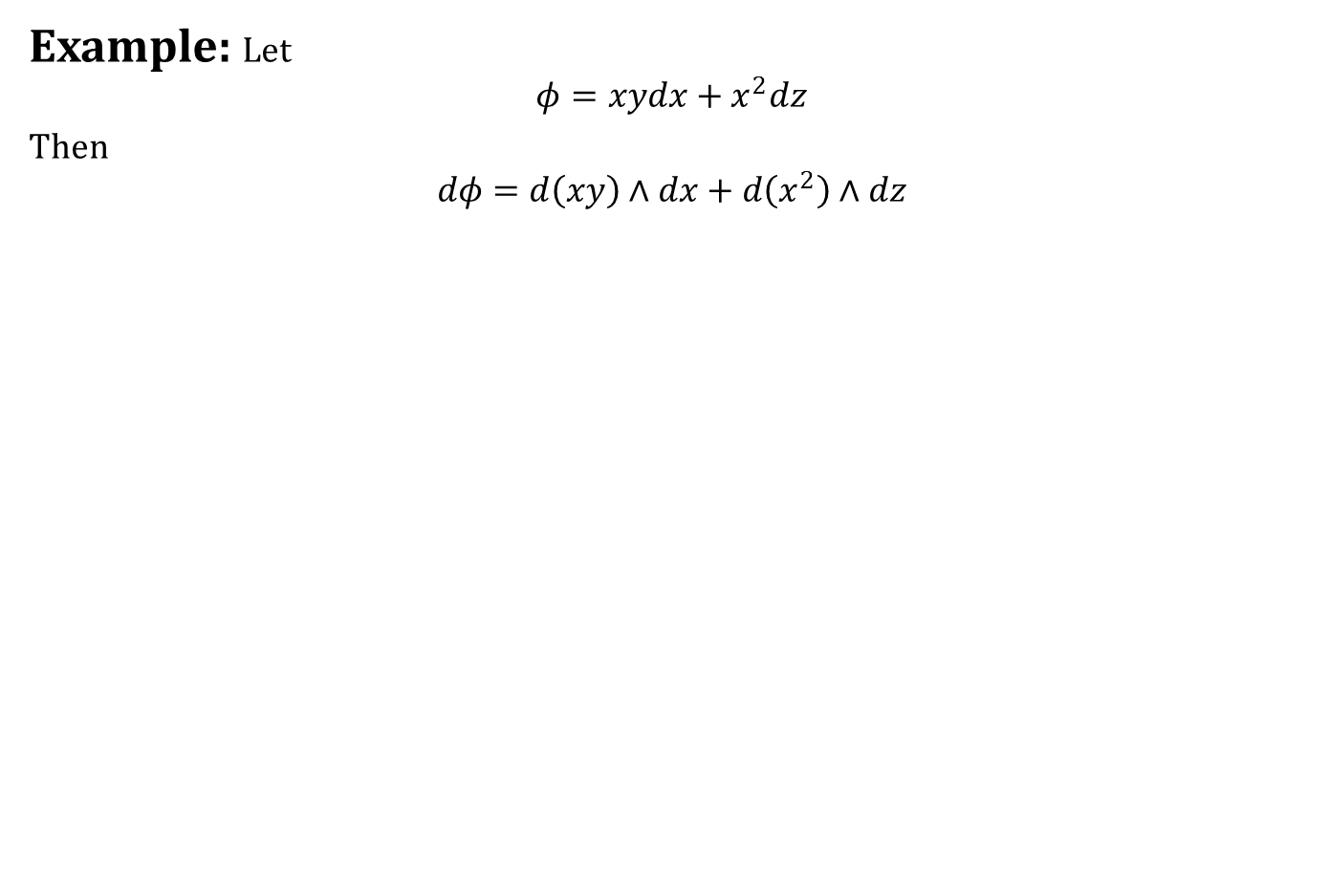
Exterior derivative
Example: Let
$$φ=xydx+x^{2}dz$$
Then
$$dφ=d\left(xy\right)∧dx+d\left(x^{2}\right)∧dz$$

Slide 27
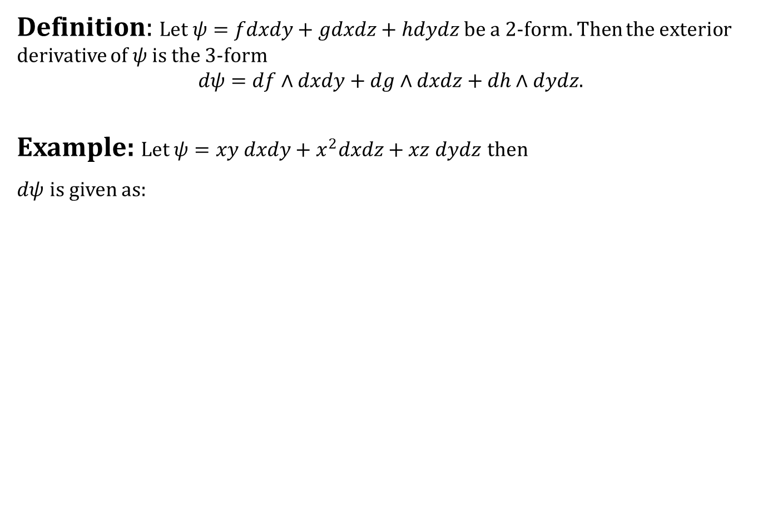
Exterior derivative
Definition: Let $ψ=fdxdy+gdxdz+hdydz$ be a 2-form. Then the exterior derivative of $ψ$ is the 3-form
$$dψ=df∧dxdy+dg∧dxdz+dh∧dydz.$$
Example: Let $ψ=xy dxdy+x^{2}dxdz+xz dydz$ then
$dψ$ is given as:

Slide 28
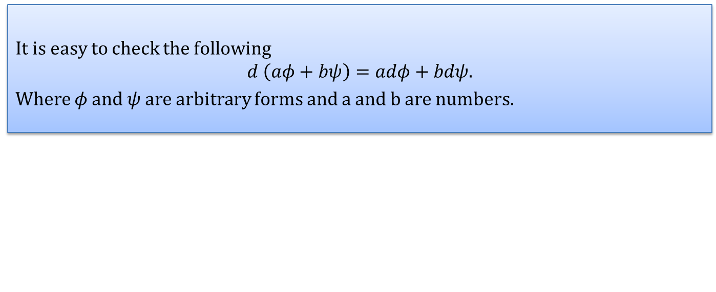
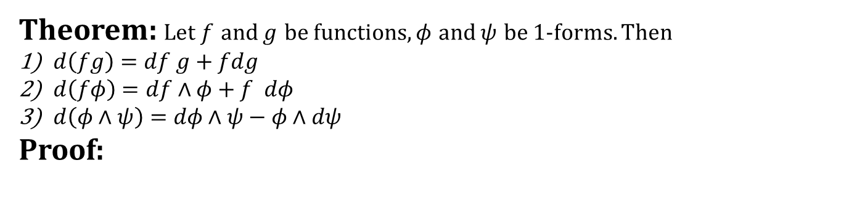
Exterior derivative
It is easy to check the following
$$d \left(aφ+bψ\right)=adφ+bdψ.$$
Where $φ$ and $ψ$ are arbitrary forms and a and b are numbers.
Theorem: Let $f$ and $g$ be functions, $φ$ and $ψ$ be 1-forms. Then
$d\left(fg\right)=df g+fdg$
$d\left(fφ\right)=df∧φ+f dφ$
$d\left(φ∧ψ\right)=dφ∧ψ−φ∧dψ$
Proof:

Slide 29
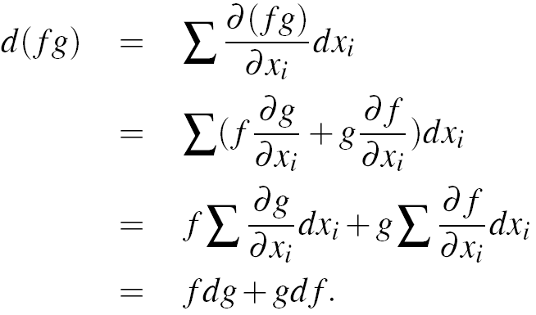
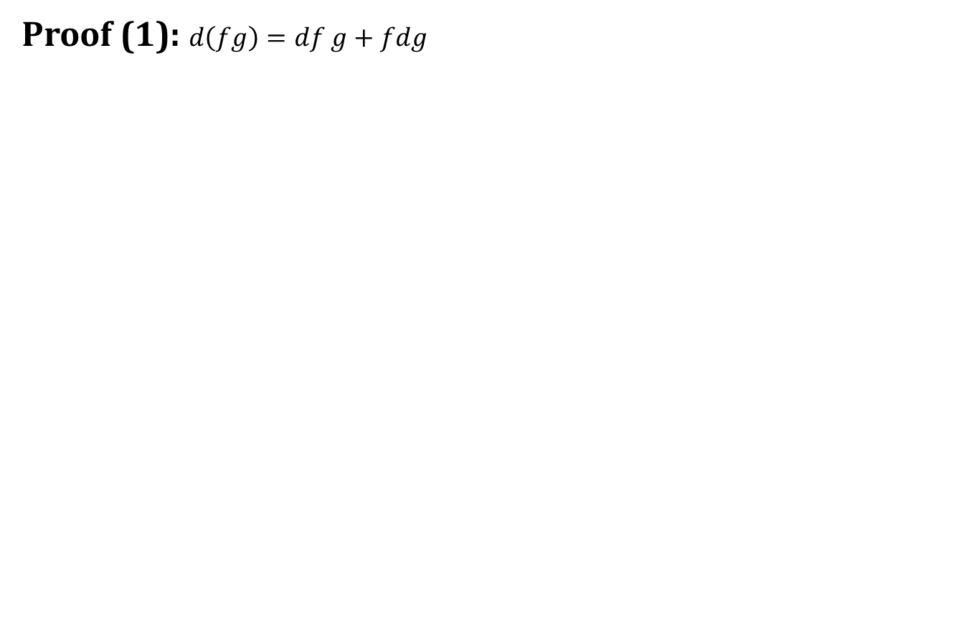
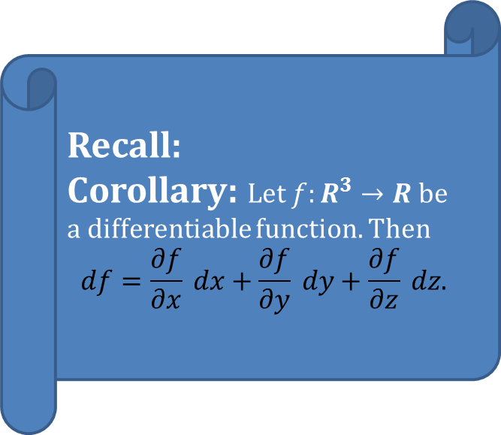
Exterior derivative
Proof (1): $d\left(fg\right)=df g+fdg$
Recall:
Corollary: Let $f:R^{3}→R$ be a differentiable function. Then
$$df=\frac{∂f}{∂x} dx+\frac{∂f}{∂y} dy+\frac{∂f}{∂z} dz.$$

Slide 30
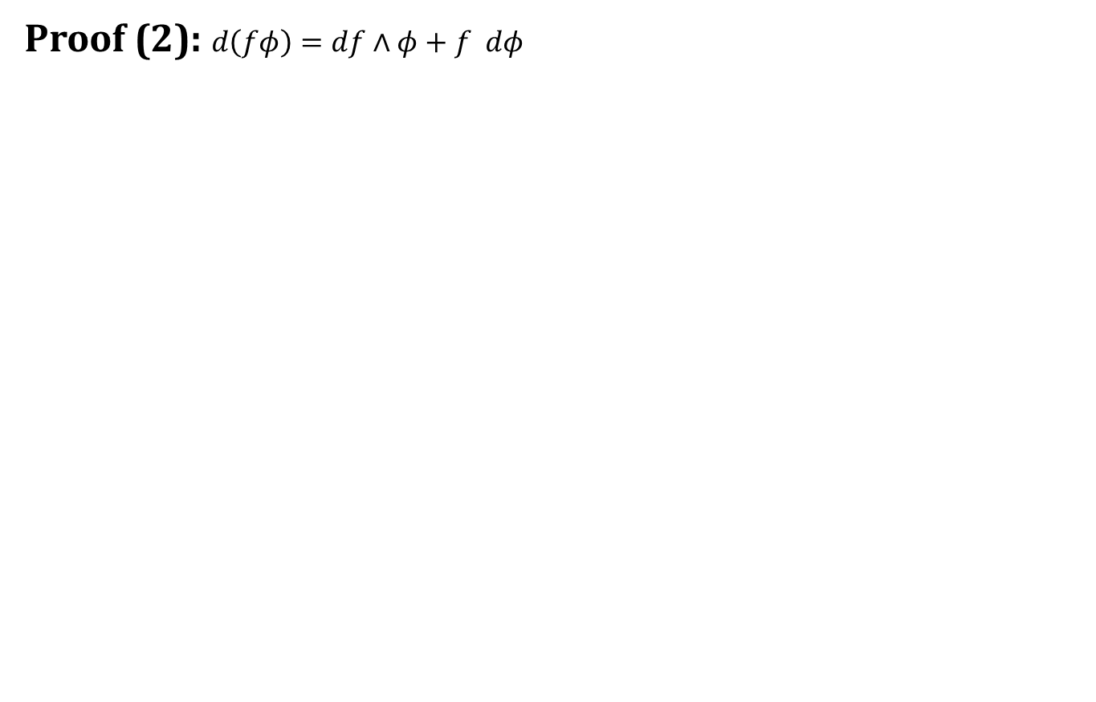
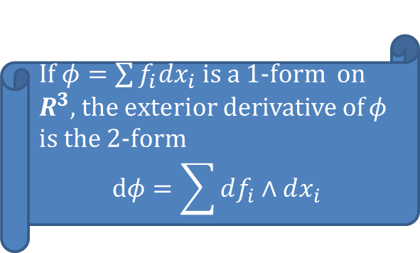
Exterior derivative
Proof (2): $d\left(fφ\right)=df∧φ+f dφ$
If $φ=\sum{f_{i}dx_{i}}$is a 1-form on $R^{3}$, the exterior derivative of $φ$ is the 2-form
$$dφ=\sum{df_{i}∧dx_{i}}$$

Slide 31
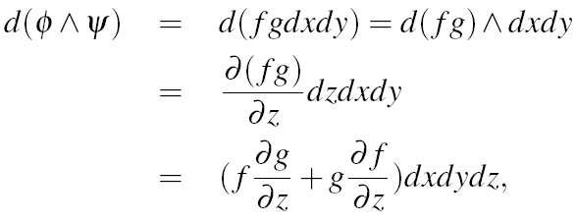
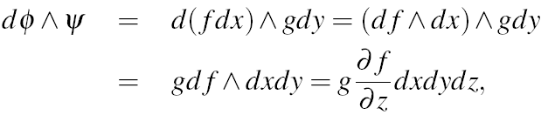
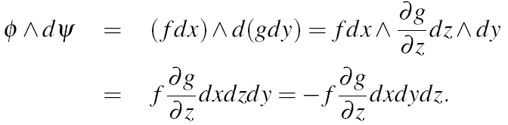
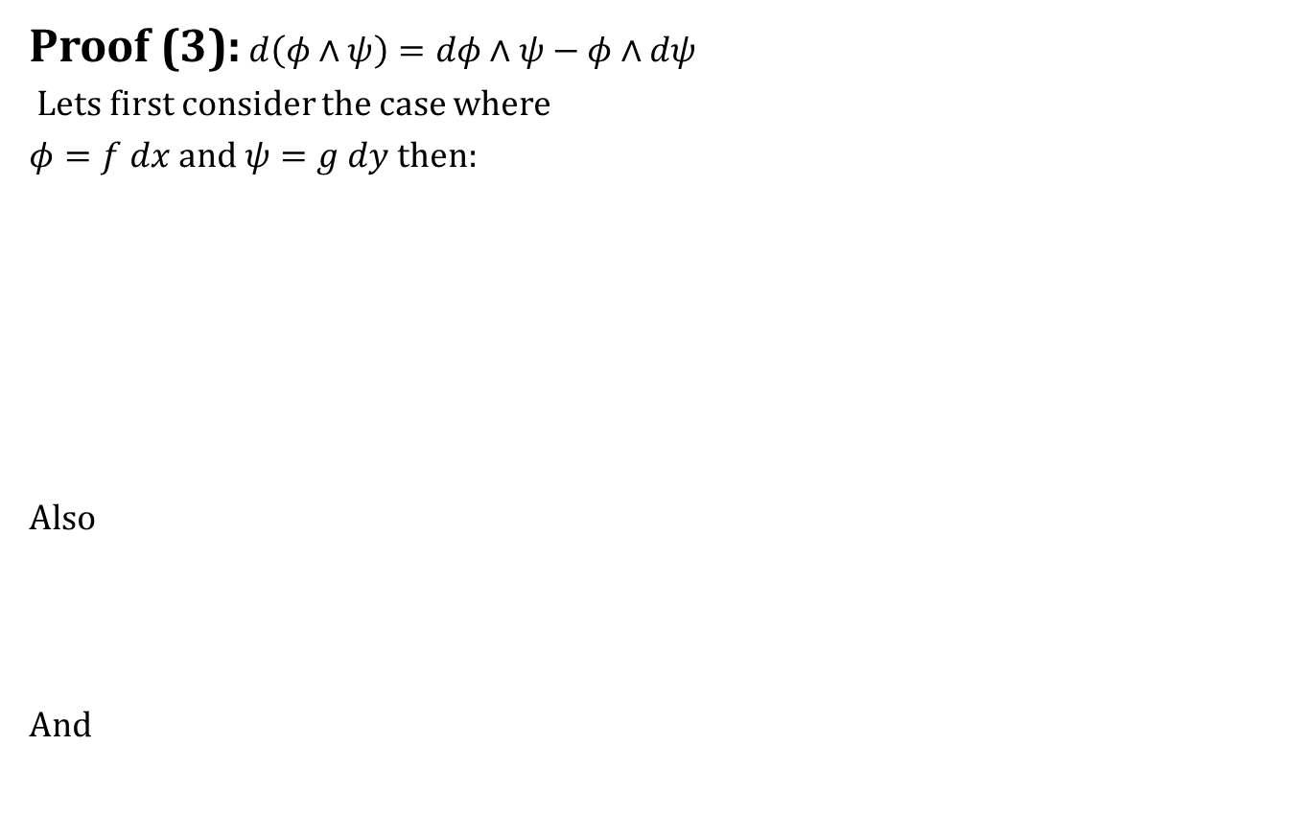
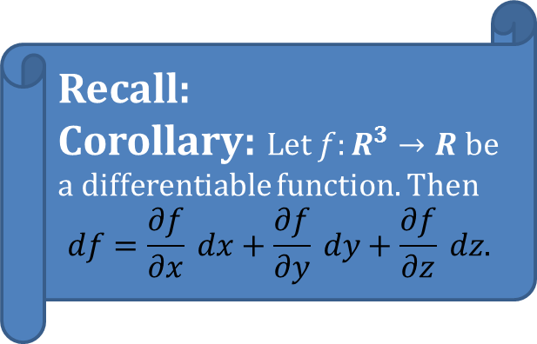
Exterior derivative
Recall:
Corollary: Let $f:R^{3}→R$ be a differentiable function. Then
$$df=\frac{∂f}{∂x} dx+\frac{∂f}{∂y} dy+\frac{∂f}{∂z} dz.$$
Proof (3):$d\left(φ∧ψ\right)=dφ∧ψ−φ∧dψ$
Lets first consider the case where
$φ=f dx$ and $ψ=g dy$then:
Also
And

Slide 32
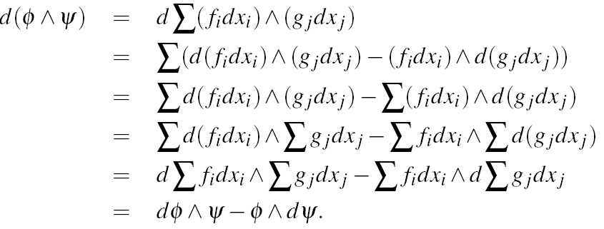
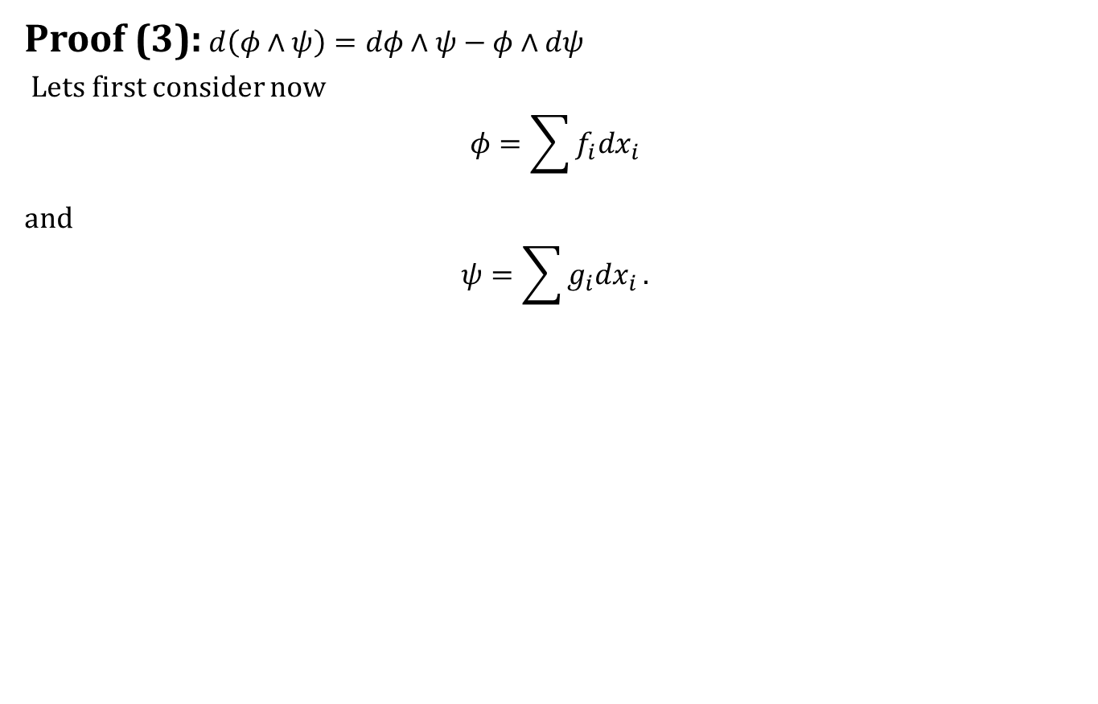
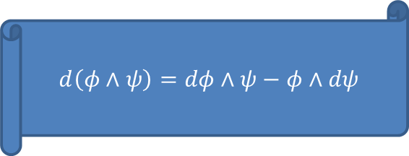
Exterior derivative
Proof (3):$d\left(φ∧ψ\right)=dφ∧ψ−φ∧dψ$
Lets first consider now
$$φ=\sum{f_{i}dx_{i}}$$
and
$$ψ=\sum{g_{i}dx_{i}}.$$
$$d\left(φ∧ψ\right)=dφ∧ψ−φ∧dψ$$

Slide 33
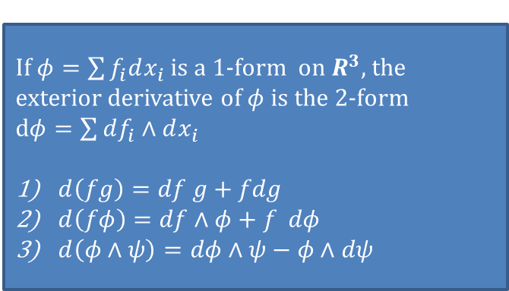

Today we learnt
A $0$-form is just a differentiable function $f$.
A $1$-form is an expression $fdx+gdy+hdz$ .
A $2$-form is an expression $fdx∧dy+gdx∧dz+hdy∧dz$
(or simply $fdxdy+gdxdz+hdydz$) .
A $3$-form is an expression $fdx∧dy∧dz$( or simply $fdx∧dy∧dz$).
Contents
Differential Forms
$p$-forms
Exterior derivatives
Conclusion
If $φ=\sum{f_{i}dx_{i}}$is a 1-form on $R^{3}$, the exterior derivative of $φ$ is the 2-form $dφ=\sum{df_{i}∧dx_{i}}$
$d\left(fg\right)=df g+fdg$
$d\left(fφ\right)=df∧φ+f dφ$
$d\left(φ∧ψ\right)=dφ∧ψ−φ∧dψ$

Slide 34

Next time
Mappings

Slide 35

End of the lecture

