Slide 1
Lecture # 5
MTH352: Differential Geometry
For
Master of Mathematics
By
Dr. SOHAIL IQBAL
Assistant Professor
Department of Mathematics, CIIT Islamabad

Slide 2
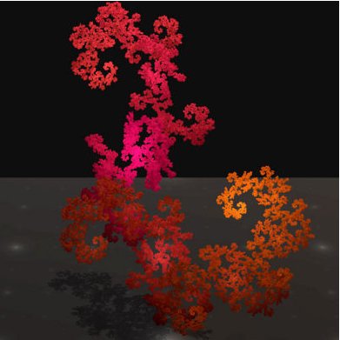
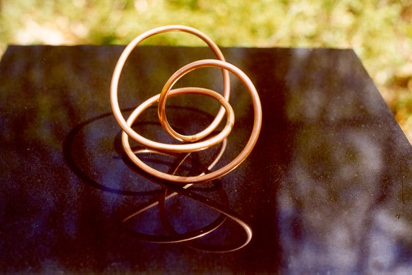
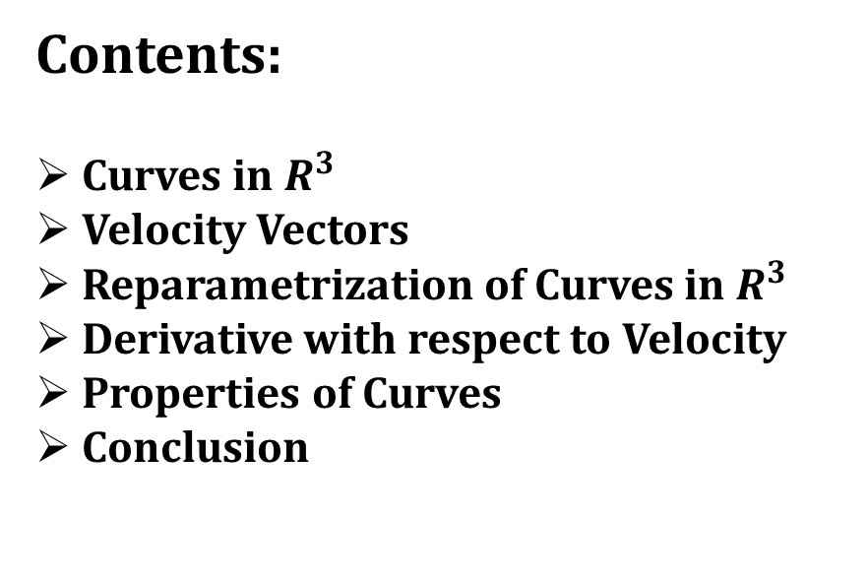
Last Lecture
Contents:
Curves in $R^{3}$
Velocity Vectors
Reparametrization of Curves in $R^{3}$
Derivative with respect to Velocity
Properties of Curves
Conclusion

Slide 3
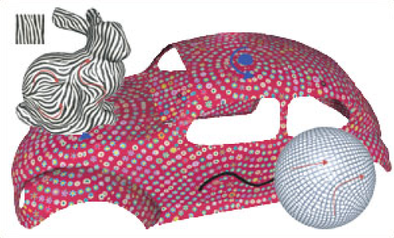
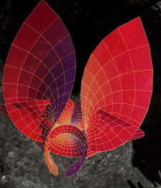
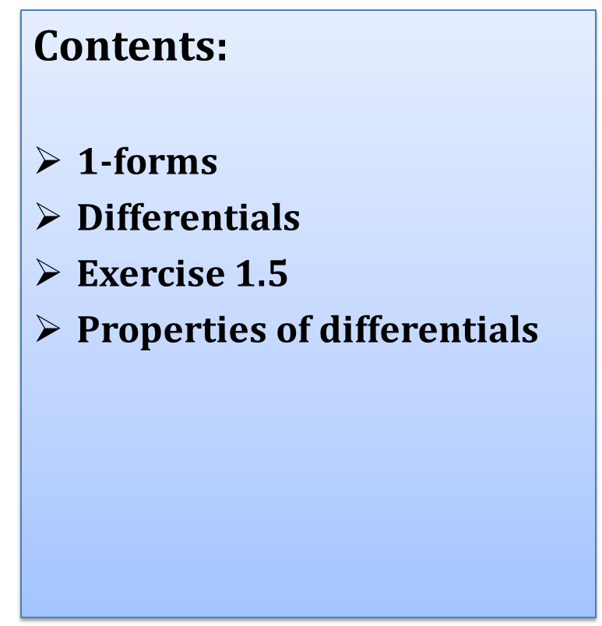
Today’s Lecture
Contents:
$1$-forms
Differentials
Exercise 1.5
Properties of differentials

Slide 4

1-forms
Why $1−$forms?

Slide 5
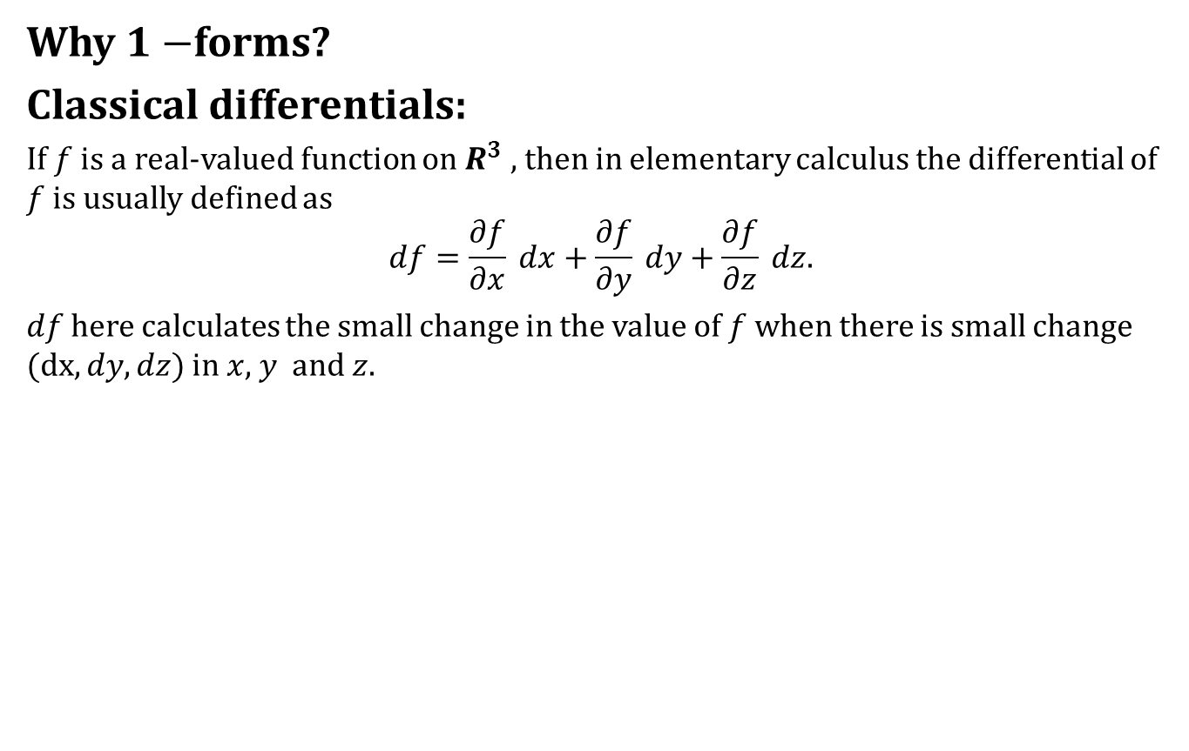
1-forms
Why $1−$forms?
Classical differentials:
If $f$ is a real-valued function on $R^{3}$ , then in elementary calculus the differential of $f$ is usually defined as
$$df=\frac{∂f}{∂x} dx+\frac{∂f}{∂y} dy+\frac{∂f}{∂z} dz.$$
$df$ here calculates the small change in the value of $f$ when there is small change $(dx,dy,dz)$ in $x$, $y$ and $z$.

Slide 6
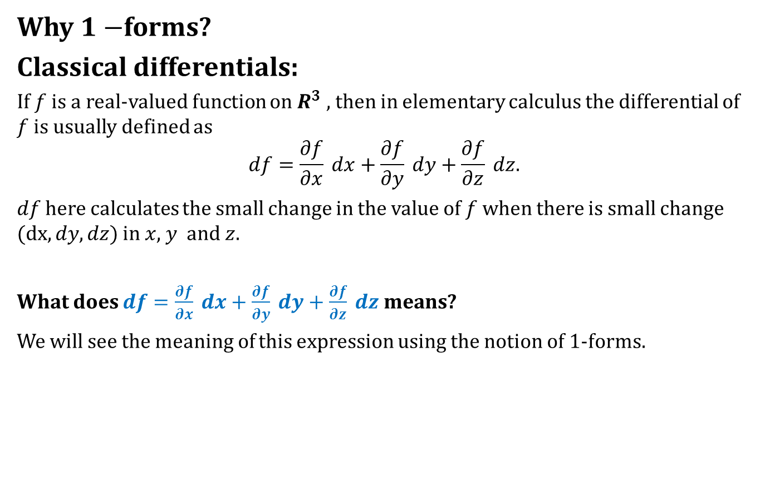
1-forms
Why $1−$forms?
Classical differentials:
If $f$ is a real-valued function on $R^{3}$ , then in elementary calculus the differential of $f$ is usually defined as
$$df=\frac{∂f}{∂x} dx+\frac{∂f}{∂y} dy+\frac{∂f}{∂z} dz.$$
$df$ here calculates the small change in the value of $f$ when there is small change $(dx,dy,dz)$ in $x$, $y$ and $z$.
What does $df=\frac{∂f}{∂x} dx+\frac{∂f}{∂y} dy+\frac{∂f}{∂z} dz$ means?
We will see the meaning of this expression using the notion of $1$-forms.

Slide 7
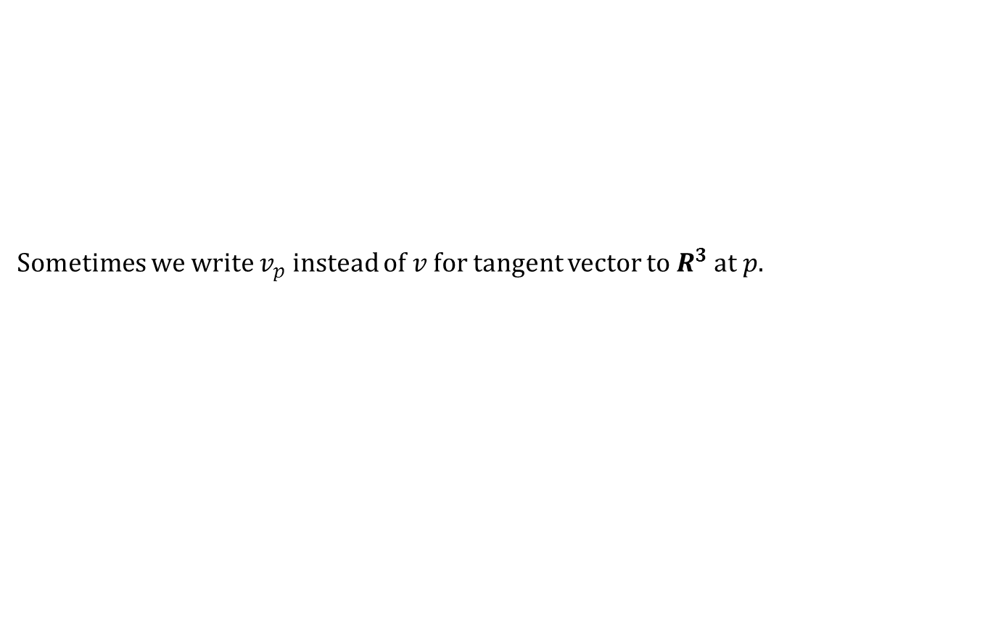
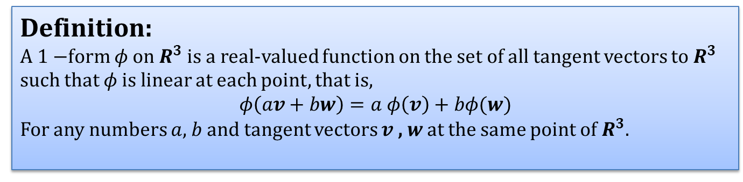
1-forms
Sometimes we write $v_{p}$ instead of $v$ for tangent vector to $R^{3}$ at $p$.
Definition:
A $1−$form $φ$ on $R^{3}$ is a real-valued function on the set of all tangent vectors to $R^{3}$ such that $φ$ is linear at each point, that is,
$$φ\left(av+bw\right)=a φ\left(v\right)+bφ(w)$$
For any numbers $a$, $b$ and tangent vectors $v$ , $w$ at the same point of $R^{3}$.

Slide 8
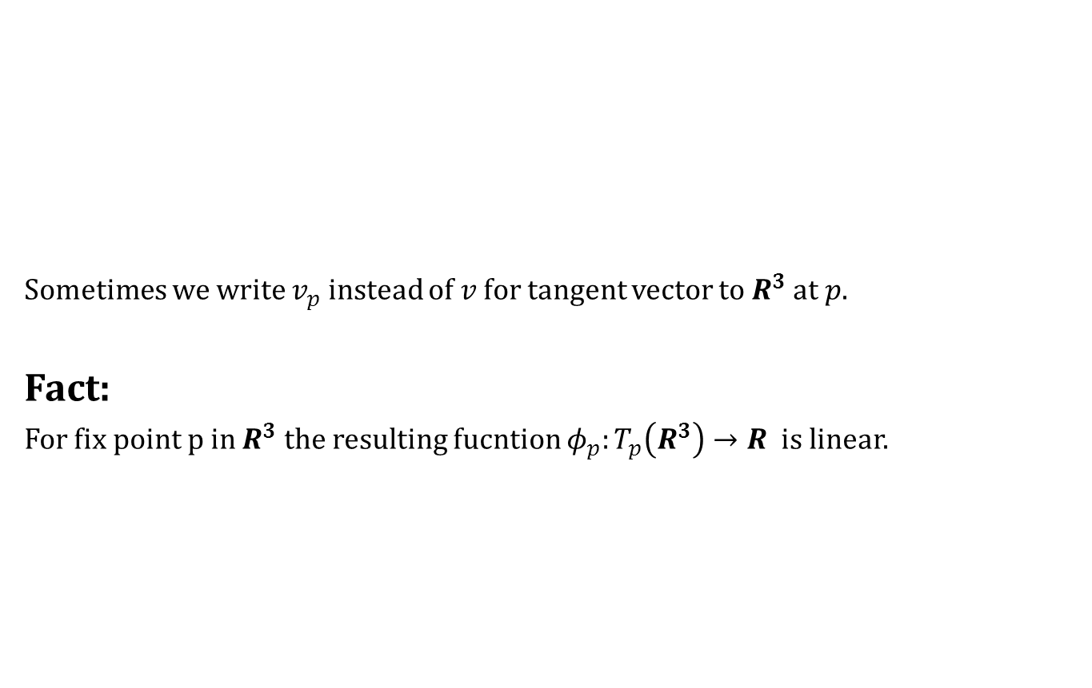
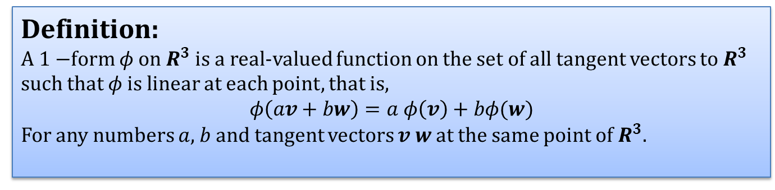
1-forms
Sometimes we write $v_{p}$ instead of $v$ for tangent vector to $R^{3}$ at $p$.
Fact:
For fix point p in $R^{3}$ the resulting fucntion $φ_{p}:T_{p}\left(R^{3}\right)→R$ is linear.
Definition:
A $1−$form $φ$ on $R^{3}$ is a real-valued function on the set of all tangent vectors to $R^{3}$ such that $φ$ is linear at each point, that is,
$$φ\left(av+bw\right)=a φ\left(v\right)+bφ(w)$$
For any numbers $a$, $b$ and tangent vectors $v$ $w$ at the same point of $R^{3}$.

Slide 9
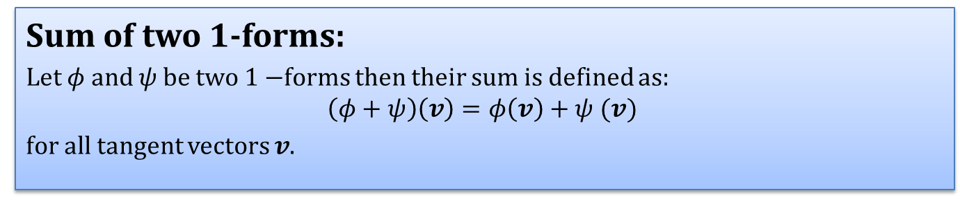
1-forms
Sum of two $1$-forms:
Let $φ$ and $ψ$ be two $1−$forms then their sum is defined as:
$$\left(φ+ψ\right)\left(v\right)=φ\left(v\right)+ψ (v)$$
for all tangent vectors $v$.

Slide 10
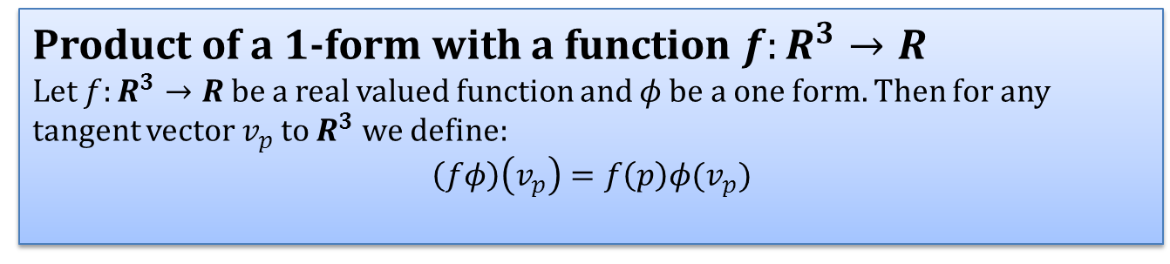
1-forms
Product of a $1$-form with a function $f:R^{3}→R$
Let $f:R^{3}→R$ be a real valued function and $φ$ be a one form. Then for any tangent vector $v_{p}$ to $R^{3}$ we define:
$$\left(fφ\right)\left(v_{p}\right)=f\left(p\right)φ(v_{p})$$

Slide 11
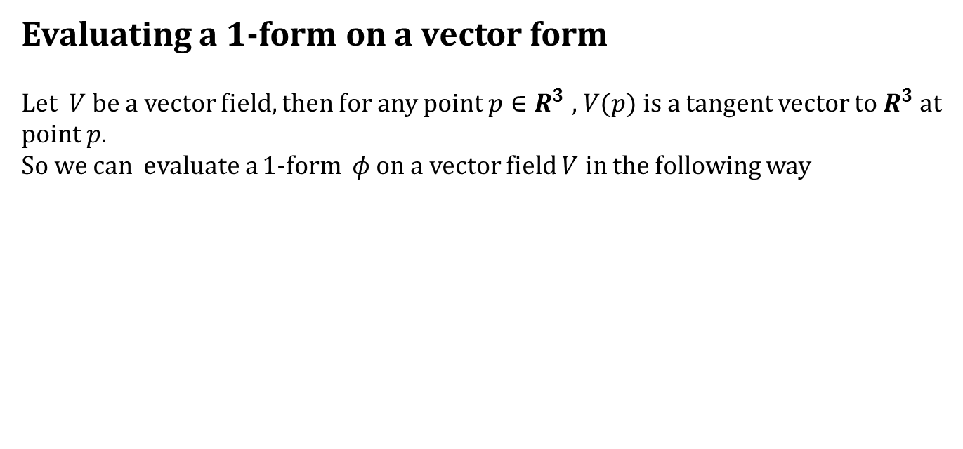
1-forms
Evaluating a $1$-form on a vector form
Let $V$ be a vector field, then for any point $p∈R^{3}$ , $V(p)$ is a tangent vector to $R^{3}$ at point $p$.
So we can evaluate a $1$-form $φ$ on a vector field $V$ in the following way
At each point $p∈R^{3}$ the value of $φ(V)$ is the number $φ(V(p))$.

Slide 12
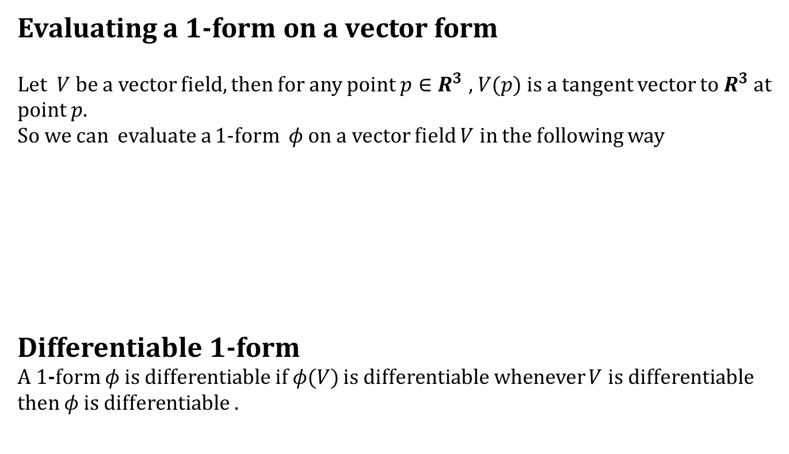
1-forms
Evaluating a $1$-form on a vector form
Let $V$ be a vector field, then for any point $p∈R^{3}$ , $V(p)$ is a tangent vector to $R^{3}$ at point $p$.
So we can evaluate a $1$-form $φ$ on a vector field $V$ in the following way
Differentiable $1$-form
A $1$-form $φ$ is differentiable if $φ(V)$ is differentiable whenever $V$ is differentiable then $φ$ is differentiable .
At each point $p∈R^{3}$ the value of $φ(V)$ is the number $φ(V(p))$.

Slide 13
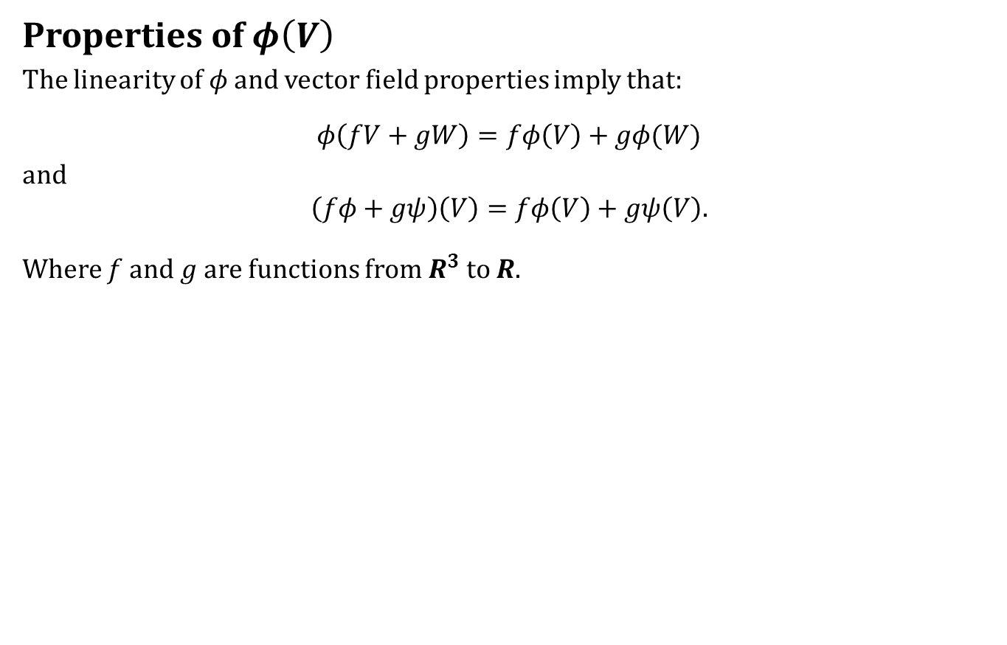
1-forms
Properties of $φ\left(V\right)$
The linearity of $φ$ and vector field properties imply that:
$$φ\left(fV+gW\right)=fφ\left(V\right)+gφ(W)$$
and
$$\left(fφ+gψ\right)\left(V\right)=fφ\left(V\right)+gψ\left(V\right).$$
Where $f$ and $g$ are functions from $R^{3}$ to $R$.

Slide 14
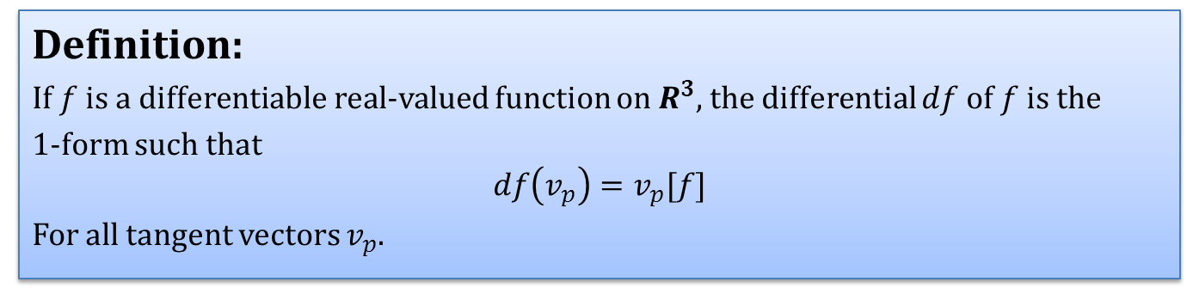
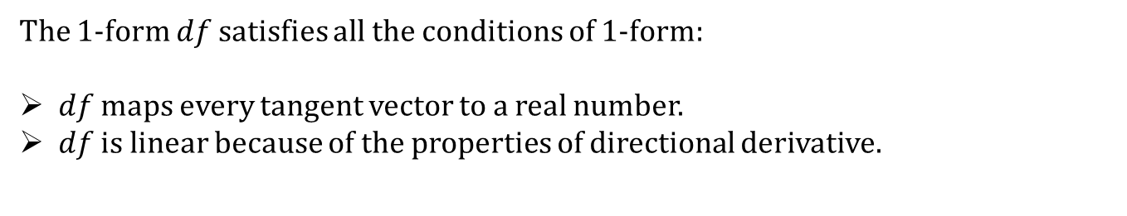
Differentials
Definition:
If $f$ is a differentiable real-valued function on $R^{3}$, the differential $df$of $f$ is the
$1$-form such that
$$df\left(v_{p}\right)=v_{p}[f]$$
For all tangent vectors $v_{p}$.
The $1$-form $df$ satisfies all the conditions of $1$-form:
$df$ maps every tangent vector to a real number.
$df$ is linear because of the properties of directional derivative.

Slide 15
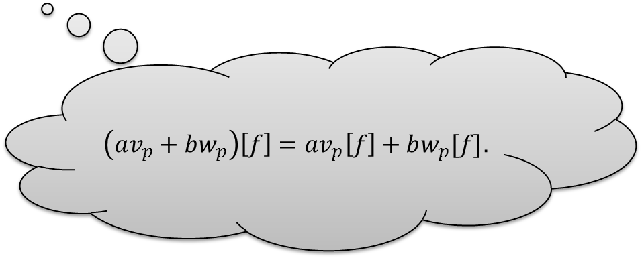
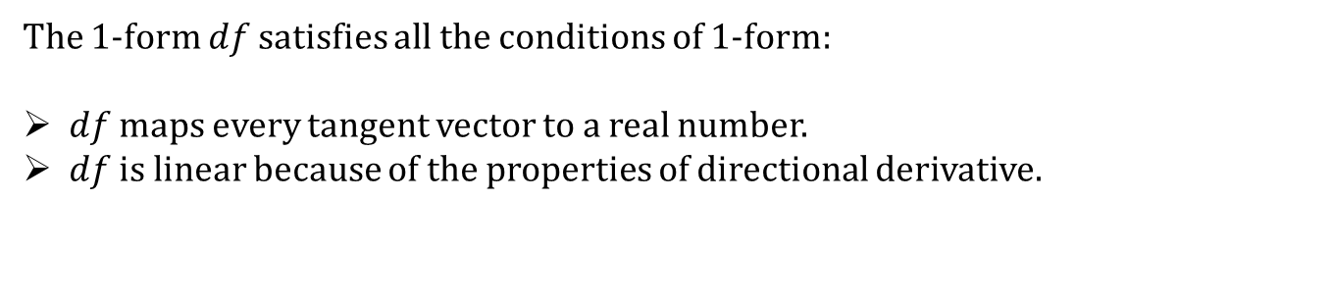
Differentials
Definition:
If $f$ is a differentiable real-valued function on $R^{3}$, the differential $df$of $f$ is the
$1$-form such that
$$df\left(v_{p}\right)=v_{p}[f]$$
For all tangent vectors $v_{p}$.
The $1$-form $df$ satisfies all the conditions of $1$-form:
$df$ maps every tangent vector to a real number.
$df$ is linear because of the properties of directional derivative.
$\left(av_{p}+bw_{p}\right)\left[f\right]=av_{p}\left[f\right]+bw_{p}[f]$.

Slide 16
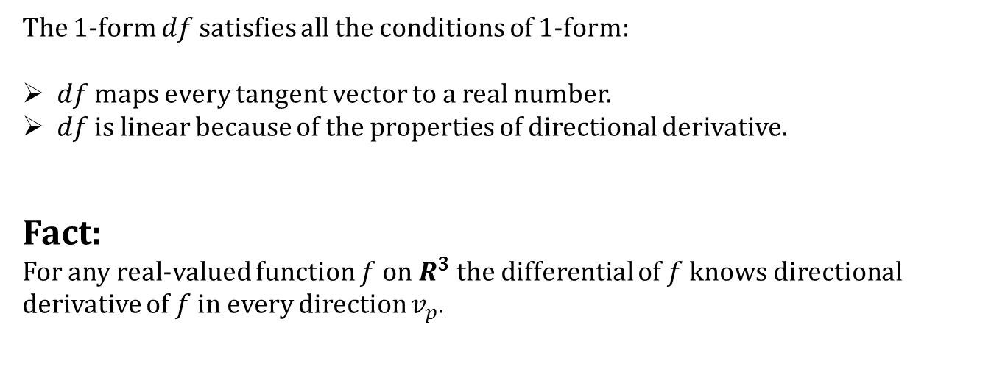
Differentials
Definition:
If $f$ is a differentiable real-valued function on $R^{3}$, the differential $df$of $f$ is the
$1$-form such that
$$df\left(v_{p}\right)=v_{p}[f]$$
For all tangent vectors $v_{p}$.
The $1$-form $df$ satisfies all the conditions of $1$-form:
$df$ maps every tangent vector to a real number.
$df$ is linear because of the properties of directional derivative.
Fact:
For any real-valued function $f$ on $R^{3}$ the differential of $f$ knows directional derivative of $f$ in every direction $v_{p}$.

Slide 17
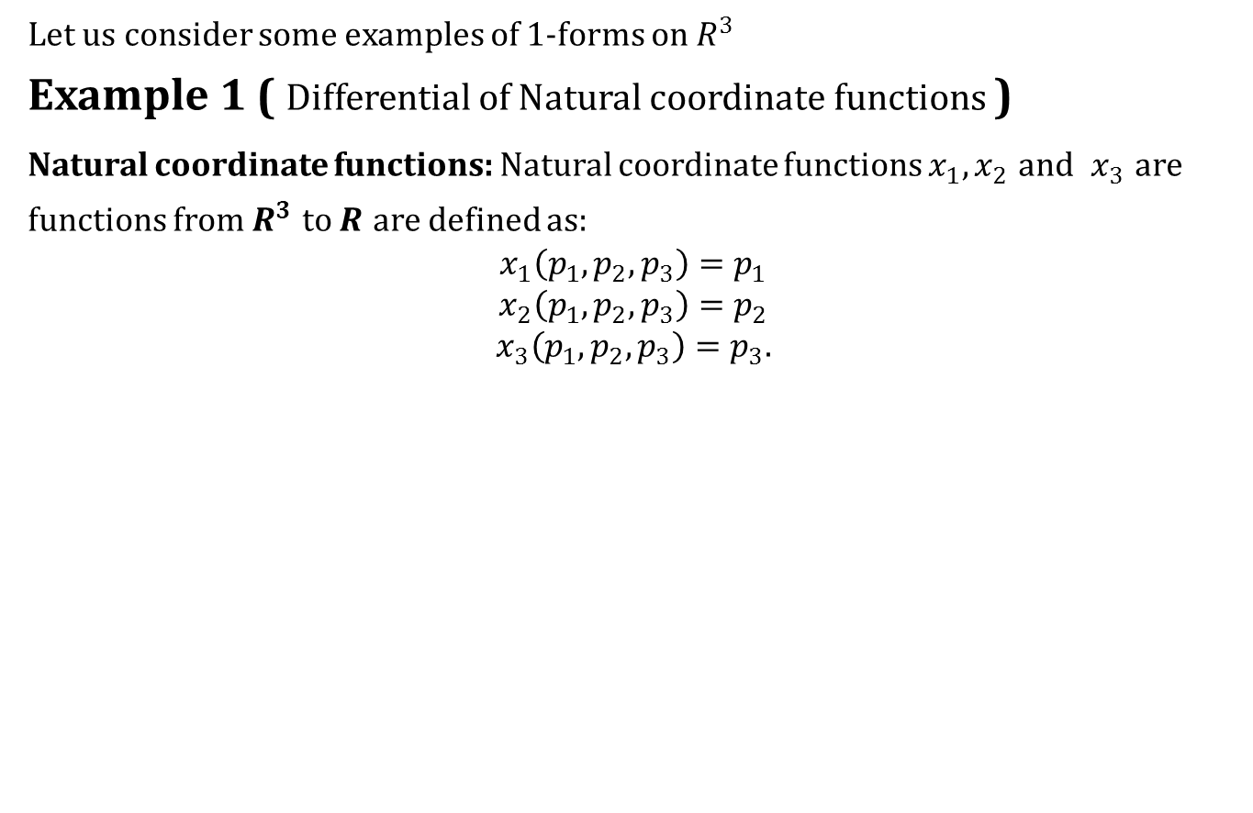
Differentials
Let us consider some examples of $1$-forms on $R^{3}$
Example 1 ( Differential of Natural coordinate functions )
Natural coordinate functions: Natural coordinate functions $x_{1}, x_{2}$ and $x_{3}$ are functions from $R^{3}$ to $R$ are defined as:
$$x_{1}\left(p_{1},p_{2},p_{3}\right)=p_{1}$$
$$x_{2}\left(p_{1},p_{2},p_{3}\right)=p_{2}$$
$$x_{3}\left(p_{1},p_{2},p_{3}\right)=p_{3}.$$

Slide 18
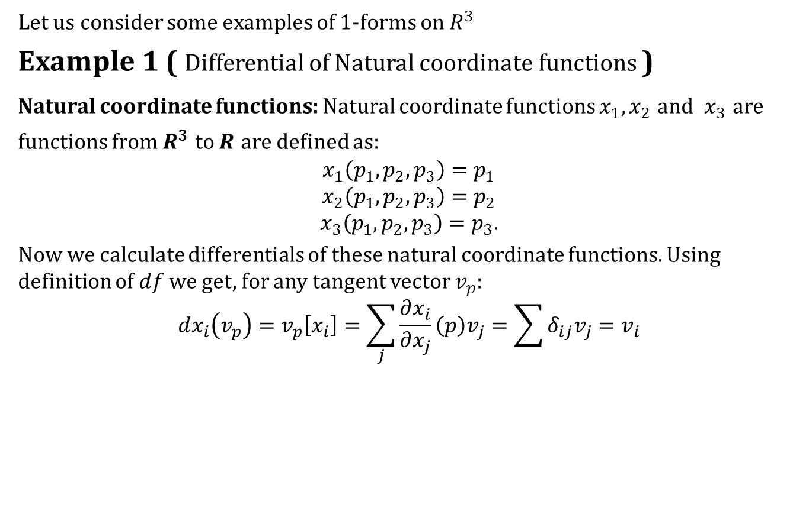
Differentials
Let us consider some examples of $1$-forms on $R^{3}$
Example 1 ( Differential of Natural coordinate functions )
Natural coordinate functions: Natural coordinate functions $x_{1}, x_{2}$ and $x_{3}$ are functions from $R^{3}$ to $R$ are defined as:
$$x_{1}\left(p_{1},p_{2},p_{3}\right)=p_{1}$$
$$x_{2}\left(p_{1},p_{2},p_{3}\right)=p_{2}$$
$$x_{3}\left(p_{1},p_{2},p_{3}\right)=p_{3}.$$
Now we calculate differentials of these natural coordinate functions. Using definition of $df$ we get, for any tangent vector $v_{p}$:
$$dx_{i}\left(v_{p}\right)=v_{p}\left[x_{i}\right]=\sum_{j}{\frac{∂x_{i}}{∂x_{j}}\left(p\right)v_{j}}=\sum{δ_{ij}v_{j}}=v_{i}$$

Slide 19
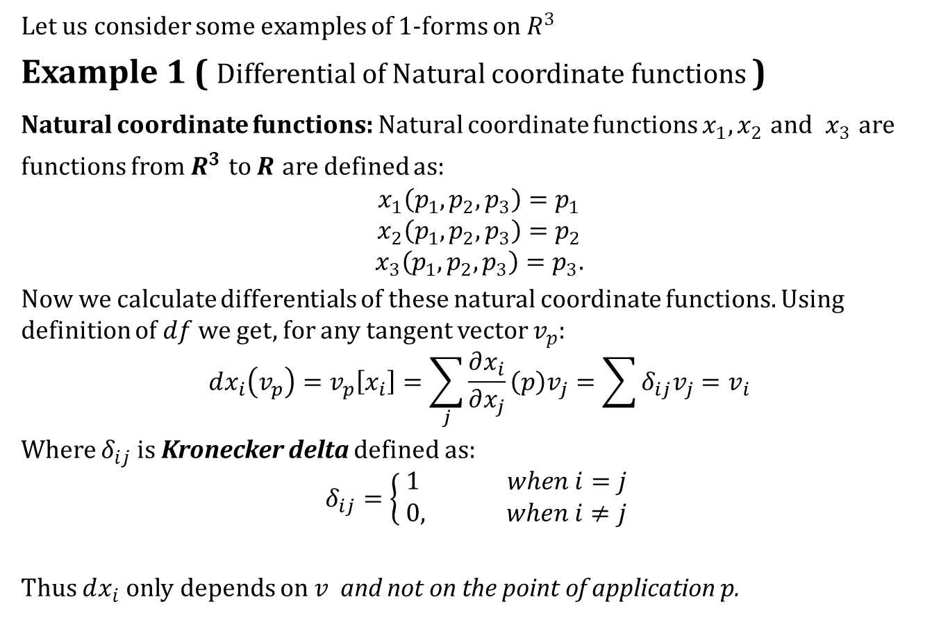
Differentials
Let us consider some examples of $1$-forms on $R^{3}$
Example 1 ( Differential of Natural coordinate functions )
Natural coordinate functions: Natural coordinate functions $x_{1}, x_{2}$ and $x_{3}$ are functions from $R^{3}$ to $R$ are defined as:
$$x_{1}\left(p_{1},p_{2},p_{3}\right)=p_{1}$$
$$x_{2}\left(p_{1},p_{2},p_{3}\right)=p_{2}$$
$$x_{3}\left(p_{1},p_{2},p_{3}\right)=p_{3}.$$
Now we calculate differentials of these natural coordinate functions. Using definition of $df$ we get, for any tangent vector $v_{p}$:
$$dx_{i}\left(v_{p}\right)=v_{p}\left[x_{i}\right]=\sum_{j}{\frac{∂x_{i}}{∂x_{j}}\left(p\right)v_{j}}=\sum{δ_{ij}v_{j}}=v_{i}$$
Where $δ_{ij}$ is Kronecker delta defined as:
$$δ_{ij}=\left\{\begin{aligned}1 when i=j \\ 0, when i≠j \end{aligned}\right.$$
Thus $dx_{i}$ only depends on $v$ and not on the point of application $p$.

Slide 20
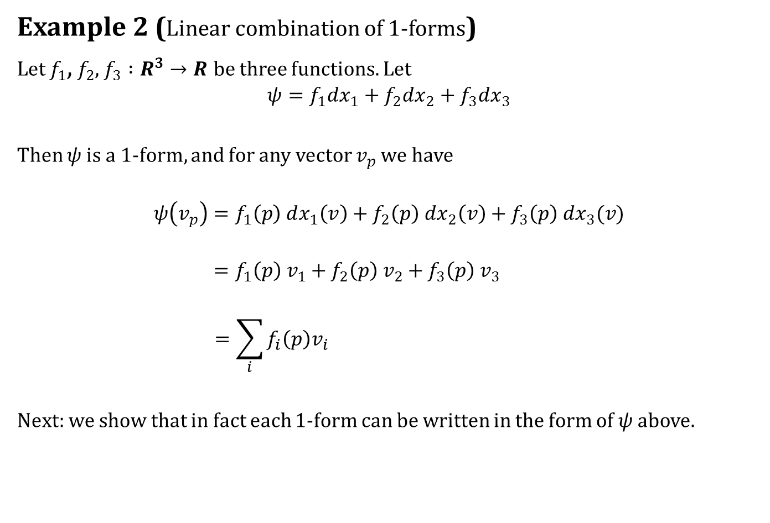
Differentials
Example 2 (Linear combination of $1$-forms)
Let $f_{1}$, $f_{2}$, $f_{3} :R^{3}→R$ be three functions. Let
$$ψ=f_{1}dx_{1}+f_{2}dx_{2}+f_{3}dx_{3}$$
Then $ψ$ is a $1$-form, and for any vector $v_{p}$ we have
$$ψ\left(v_{p}\right)=f_{1}\left(p\right) dx_{1}\left(v\right)+f_{2}\left(p\right) dx_{2}\left(v\right)+f_{3}\left(p\right) dx_{3}(v)$$
$$=f_{1}\left(p\right) v_{1}+f_{2}\left(p\right) v_{2}+f_{3}\left(p\right) v_{3}$$
$$=\sum_{i}{f_{i}\left(p\right)v_{i} }$$
Next: we show that in fact each $1$-form can be written in the form of $ψ$ above.

Slide 21
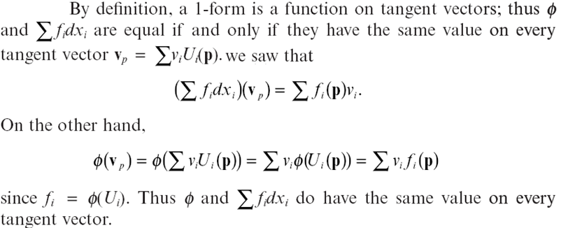
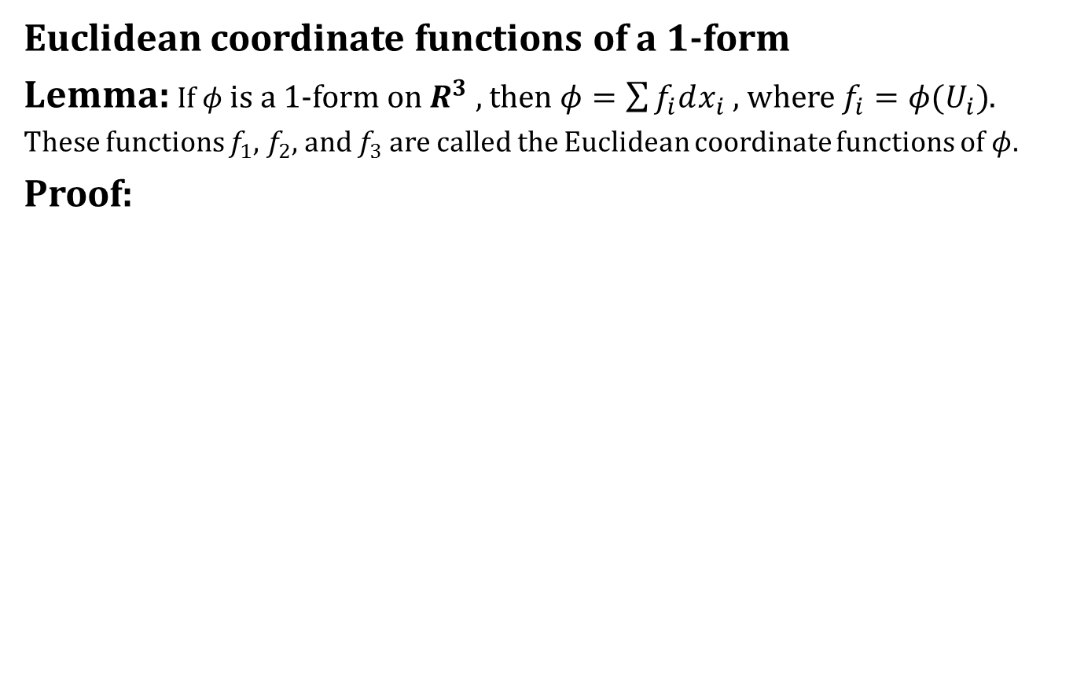

Differentials
Euclidean coordinate functions of a $1$-form
Lemma: If $φ$ is a $1$-form on $R^{3}$ , then $φ=\sum{f_{i}dx_{i} }$, where $f_{i}=φ(U_{i})$.
These functions $f_{1}$, $f_{2}$, and $f_{3}$ are called the Euclidean coordinate functions of $φ.$
Proof:
$$φ\left(fV+gW\right)=fφ\left(V\right)+gφ(W)$$

Slide 22
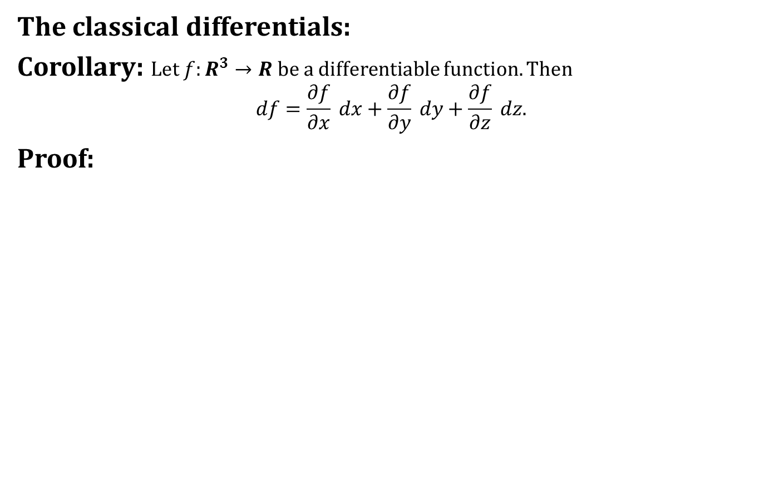
Differentials
The classical differentials:
Corollary: Let $f:R^{3}→R$ be a differentiable function. Then
$$df=\frac{∂f}{∂x} dx+\frac{∂f}{∂y} dy+\frac{∂f}{∂z} dz.$$
Proof:

Slide 23
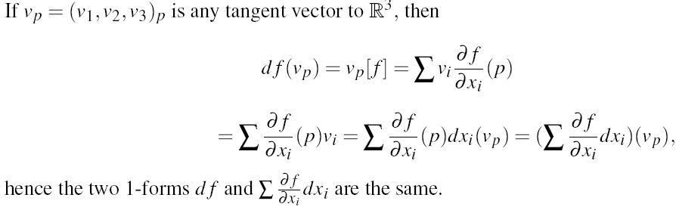
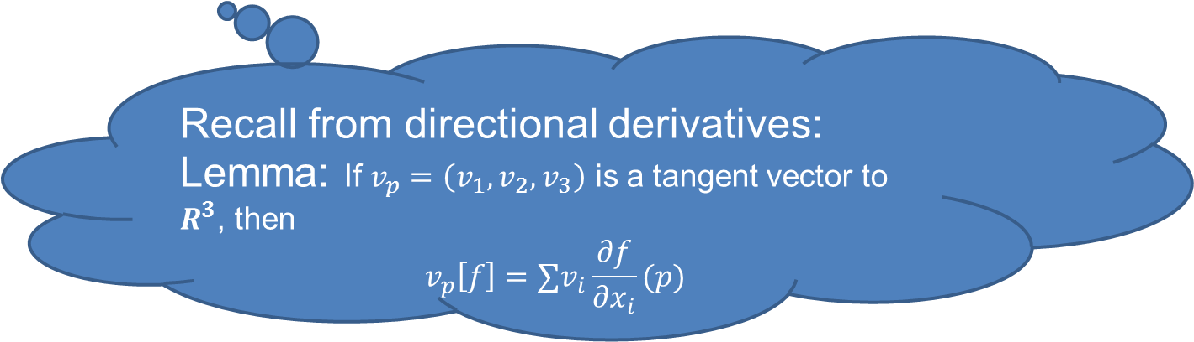
Differentials
The classical differentials:
Corollary: Let $f:R^{3}→R$ be a differentiable function. Then
$$df=\frac{∂f}{∂x} dx+\frac{∂f}{∂y} dy+\frac{∂f}{∂z} dz.$$
Proof:
Recall from directional derivatives:
Lemma: If $v_{p}=\left(v_{1},v_{2},v_{3}\right)$ is a tangent vector to $R^{3}$, then
$$v_{p}\left[f\right]={∑v}_{i}\frac{∂f}{∂x_{i}}(p)$$

Slide 24
Differentials
The classical differentials:
Corollary: Let $f:R^{3}→R$ be a differentiable function. Then
$$df=\frac{∂f}{∂x} dx+\frac{∂f}{∂y} dy+\frac{∂f}{∂z} dz.$$
Proof:

Slide 25

Exercise 1.5

Slide 26
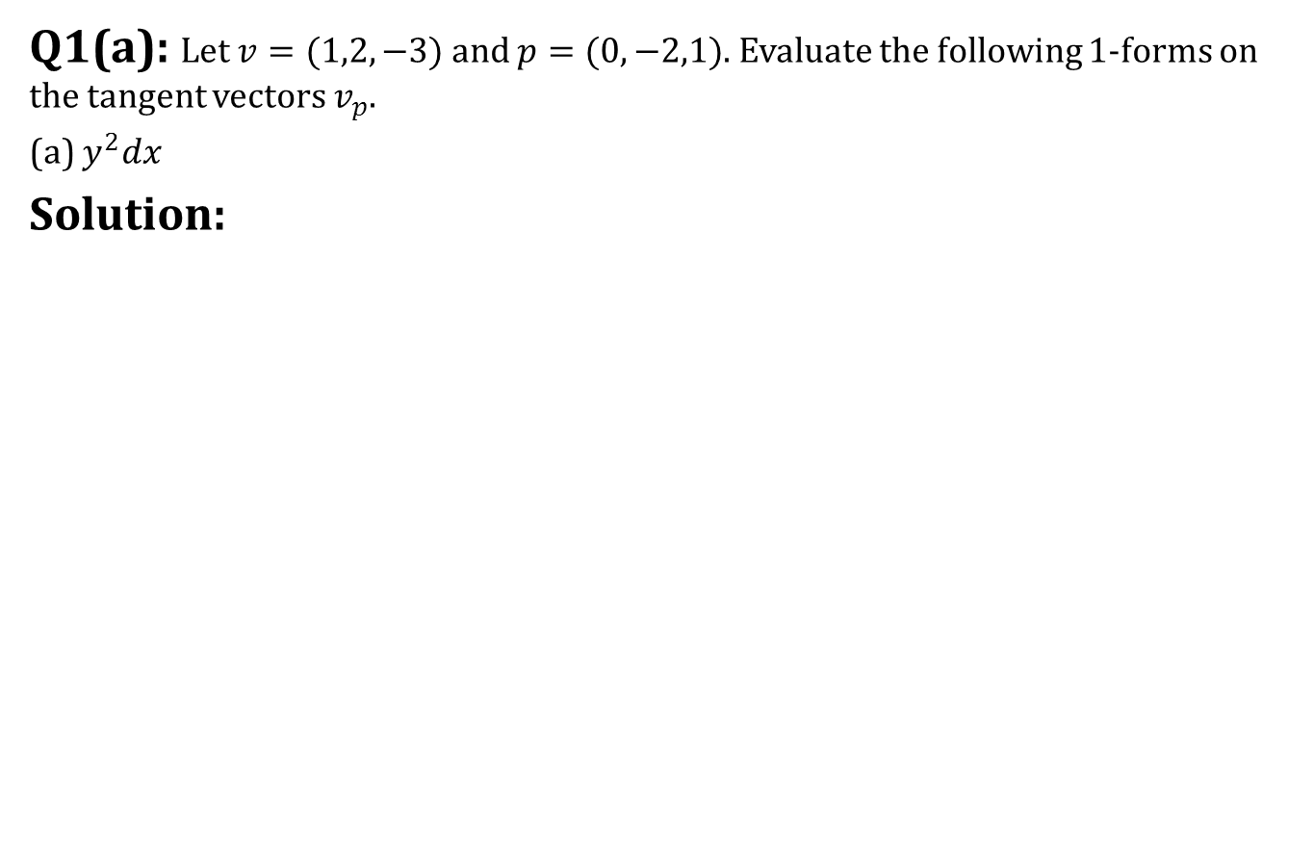
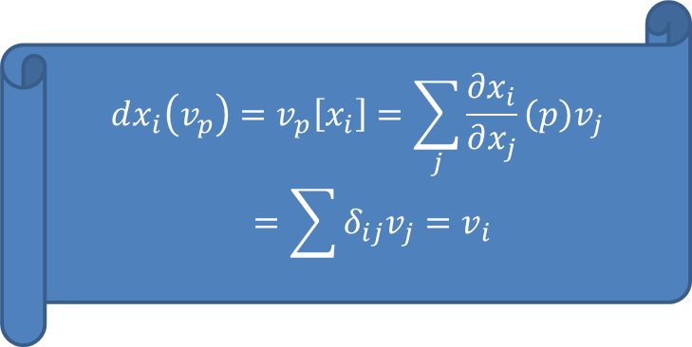
Exercise 1.5
Q1(a): Let $v=(1,2,−3)$ and $p=(0,−2,1)$. Evaluate the following $1$-forms on the tangent vectors $v_{p}$.
(a) $y^{2}dx$
Solution:
$$dx_{i}\left(v_{p}\right)=v_{p}\left[x_{i}\right]=\sum_{j}{\frac{∂x_{i}}{∂x_{j}}\left(p\right)v_{j}}=\sum{δ_{ij}v_{j}}=v_{i}$$

Slide 27
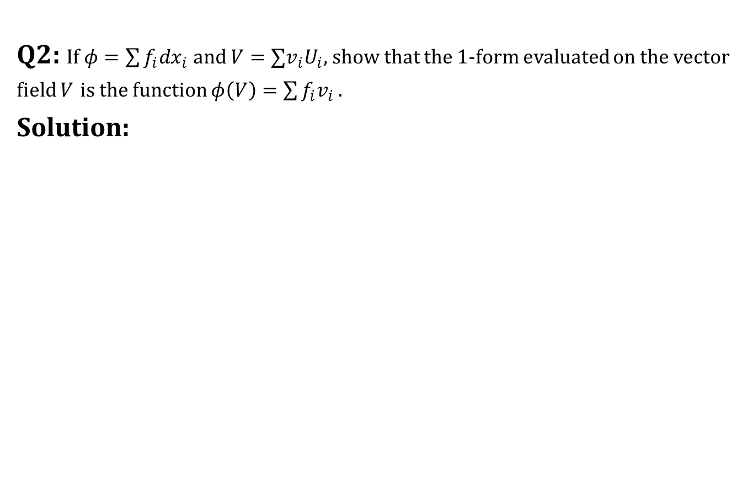
Exercise 1.5
Q2: If $φ=\sum{f_{i}dx_{i} }$and $V=∑v_{i}U_{i}$, show that the $1$-form evaluated on the vector field $V$ is the function $φ\left(V\right)=\sum{f_{i}v_{i} }$.
Solution:

Slide 28
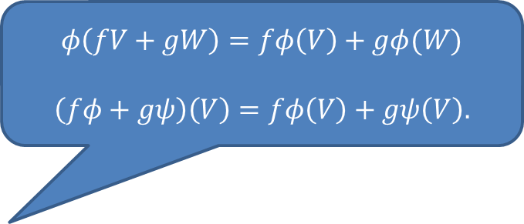
Exercise 1.5
Q2: If $φ=\sum{f_{i}dx_{i} }$and $V=∑v_{i}U_{i}$, show that the $1$-form evaluated on the vector field $V$ is the function $φ\left(V\right)=\sum{f_{i}v_{i} }$.
Solution:
$$φ\left(fV+gW\right)=fφ\left(V\right)+gφ(W)$$
$$\left(fφ+gψ\right)\left(V\right)=fφ\left(V\right)+gψ\left(V\right).$$

Slide 29
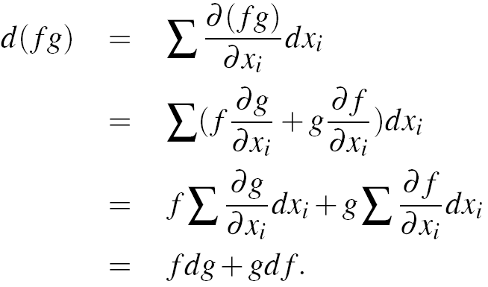
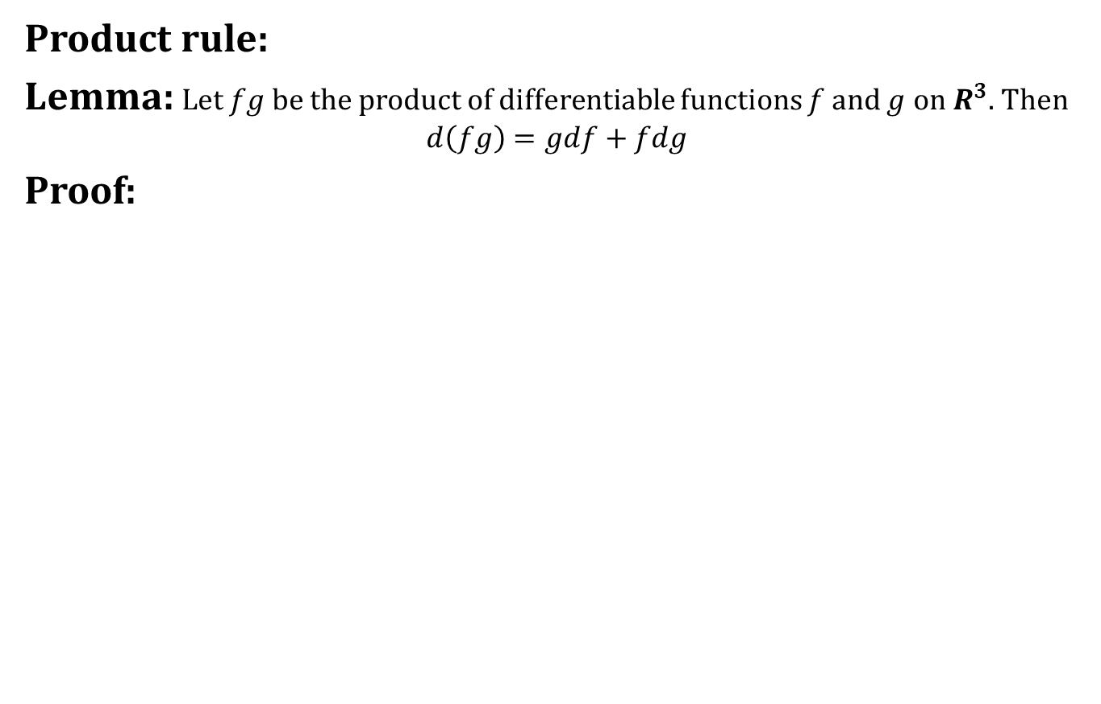
Properties of differentials
Product rule:
Lemma: Let $fg$ be the product of differentiable functions $f$ and $g$ on $R^{3}$. Then
$$d\left(fg\right)=gdf+fdg$$
Proof:

Slide 30
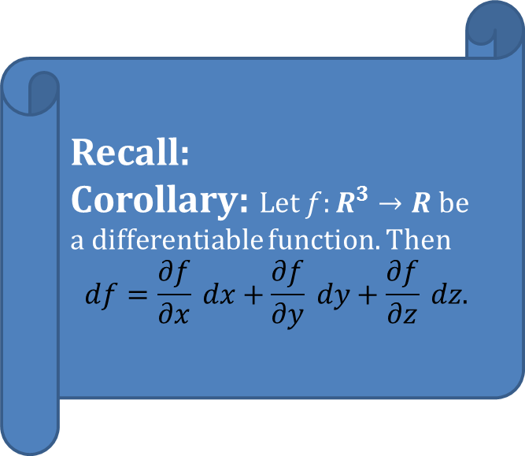
Properties of differentials
Product rule:
Lemma: Let $fg$ be the product of differentiable functions $f$ and $g$ on $R^{3}$. Then
$$d\left(fg\right)=gdf+fdg$$
Proof:
Recall:
Corollary: Let $f:R^{3}→R$ be a differentiable function. Then
$$df=\frac{∂f}{∂x} dx+\frac{∂f}{∂y} dy+\frac{∂f}{∂z} dz.$$

Slide 31

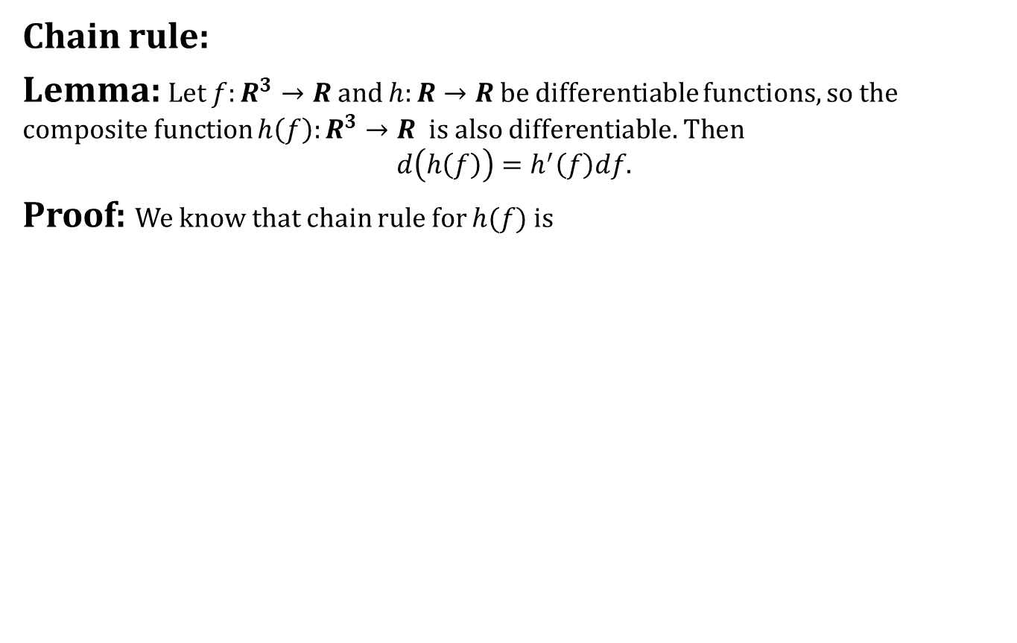
Properties of differentials
Chain rule:
Lemma: Let $f:R^{3}→R$ and $h:R→R$ be differentiable functions, so the composite function $h\left(f\right):R^{3}→R$ is also differentiable. Then
$$d\left(h\left(f\right)\right)=h^{′}\left(f\right)df.$$
Proof: We know that chain rule for $h(f)$ is

Slide 32
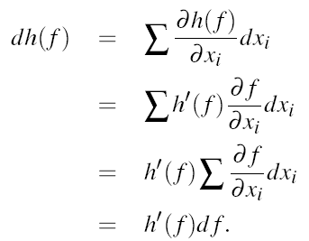
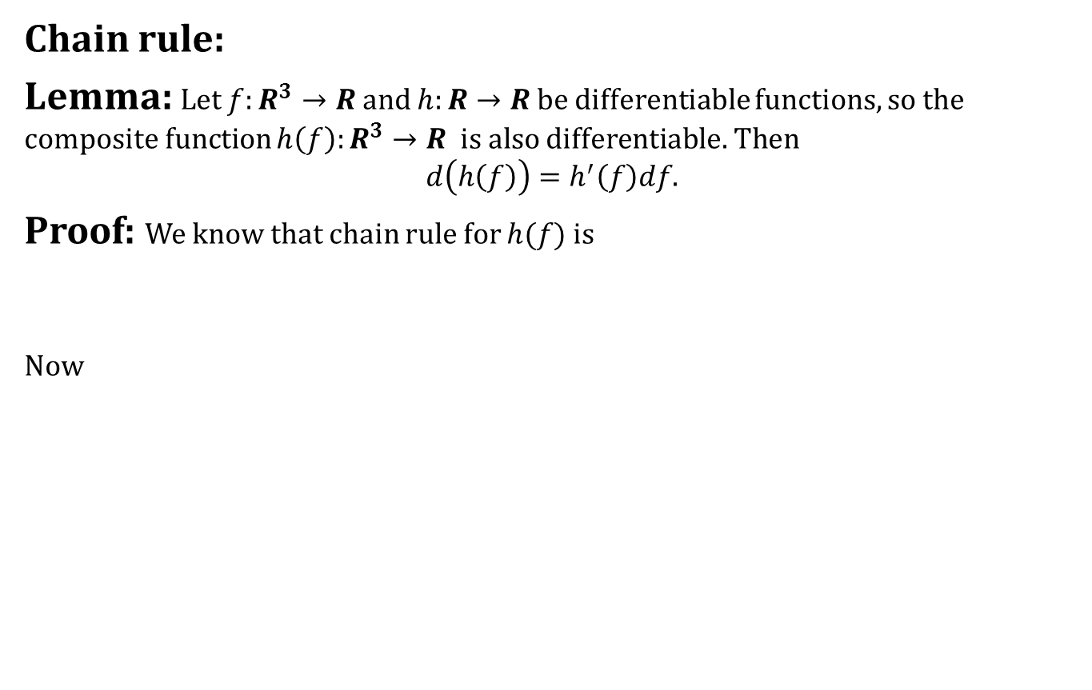
Properties of differentials
Chain rule:
Lemma: Let $f:R^{3}→R$ and $h:R→R$ be differentiable functions, so the composite function $h\left(f\right):R^{3}→R$ is also differentiable. Then
$$d\left(h\left(f\right)\right)=h^{′}\left(f\right)df.$$
Proof: We know that chain rule for $h(f)$ is
Now

Slide 33
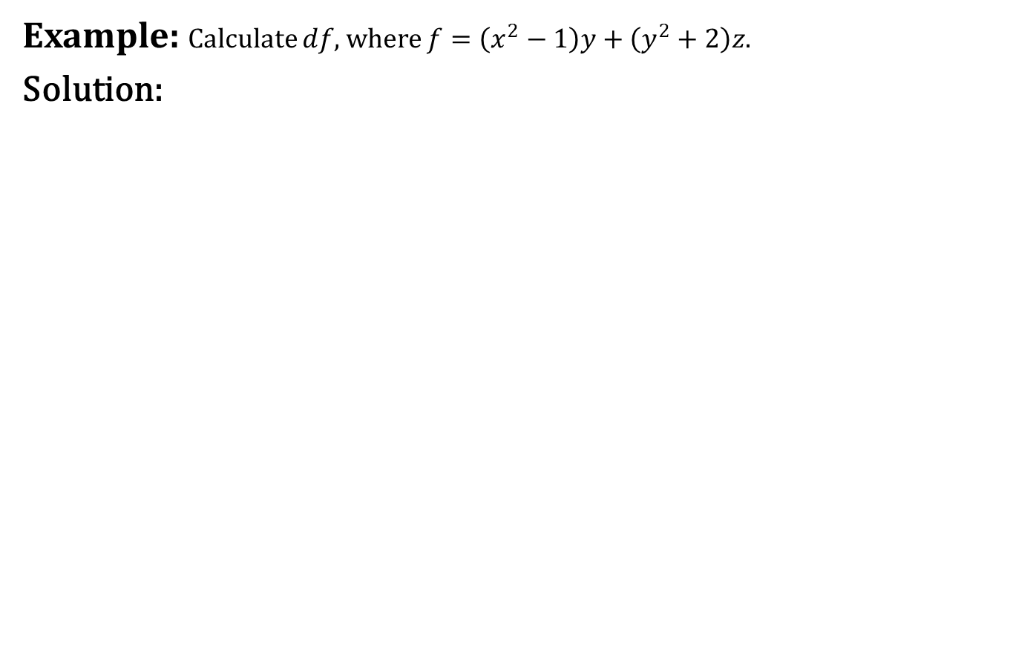
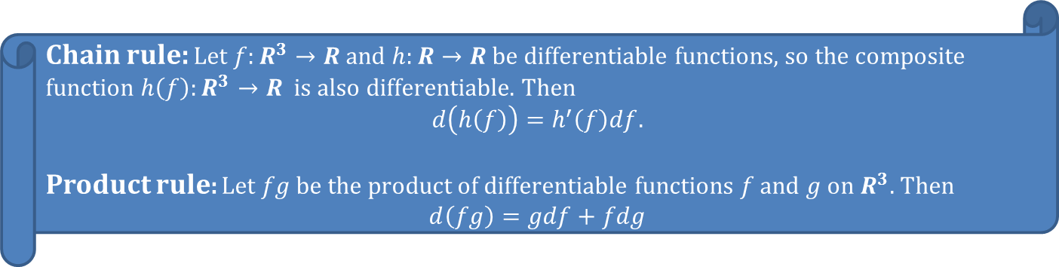
Properties of differentials
Example: Calculate $df$, where $f=\left(x^{2}−1\right)y+\left(y^{2}+2\right)z$.
Solution:
Chain rule: Let $f:R^{3}→R$ and $h:R→R$ be differentiable functions, so the composite function $h\left(f\right):R^{3}→R$ is also differentiable. Then
$$d\left(h\left(f\right)\right)=h^{′}\left(f\right)df.$$
Product rule: Let $fg$ be the product of differentiable functions $f$ and $g$ on $R^{3}$. Then
$$d\left(fg\right)=gdf+fdg$$

Slide 34
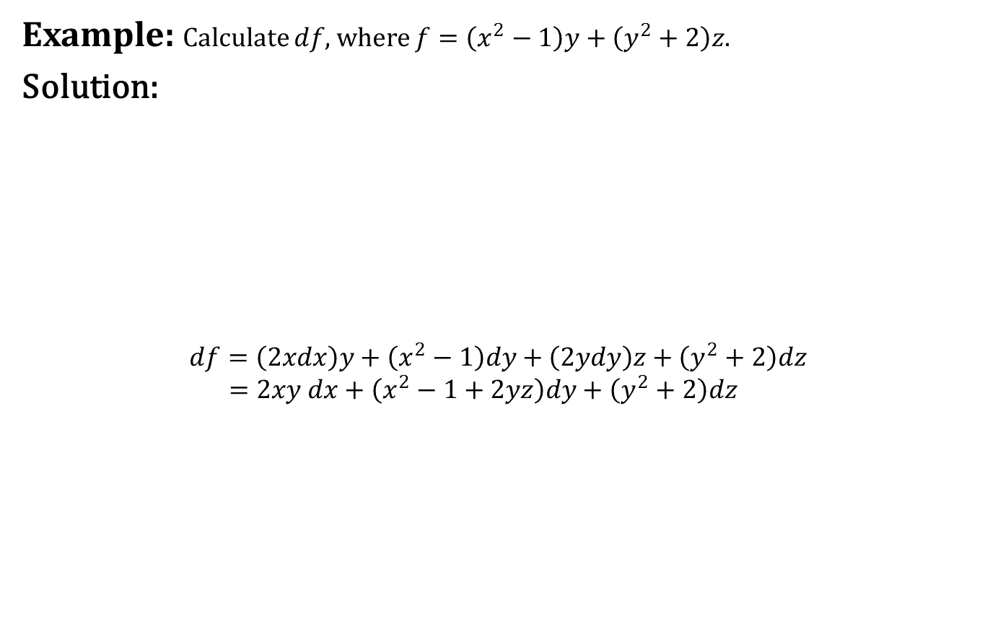
Properties of differentials
Example: Calculate $df$, where $f=\left(x^{2}−1\right)y+\left(y^{2}+2\right)z$.
Solution:
$$df=\left(2xdx\right)y+\left(x^{2}−1\right)dy+\left(2ydy\right)z+\left(y^{2}+2\right)dz$$
$$=2xy dx+\left(x^{2}−1+2yz\right)dy+\left(y^{2}+2\right)dz$$
Chain rule: Let $f:R^{3}→R$ and $h:R→R$ be differentiable functions, so the composite function $h\left(f\right):R^{3}→R$ is also differentiable. Then
$$d\left(h\left(f\right)\right)=h^{′}\left(f\right)df.$$
Product rule: Let $fg$ be the product of differentiable functions $f$ and $g$ on $R^{3}$. Then
$$d\left(fg\right)=gdf+fdg$$

Slide 35
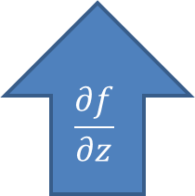
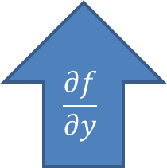
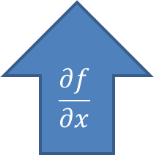
Properties of differentials
Example: Calculate $df$, where $f=\left(x^{2}−1\right)y+\left(y^{2}+2\right)z$.
Solution:
$$df=\left(2xdx\right)y+\left(x^{2}−1\right)dy+\left(2ydy\right)z+\left(y^{2}+2\right)dz$$
$$=2xy dx+\left(x^{2}−1+2yz\right)dy+\left(y^{2}+2\right)dz$$
Chain rule: Let $f:R^{3}→R$ and $h:R→R$ be differentiable functions, so the composite function $h\left(f\right):R^{3}→R$ is also differentiable. Then
$$d\left(h\left(f\right)\right)=h^{′}\left(f\right)df.$$
Product rule: Let $fg$ be the product of differentiable functions $f$ and $g$ on $R^{3}$. Then
$$d\left(fg\right)=gdf+fdg$$
$$\frac{∂f}{∂x}$$
$$\frac{∂f}{∂y}$$
$$\frac{∂f}{∂z}$$

Slide 36
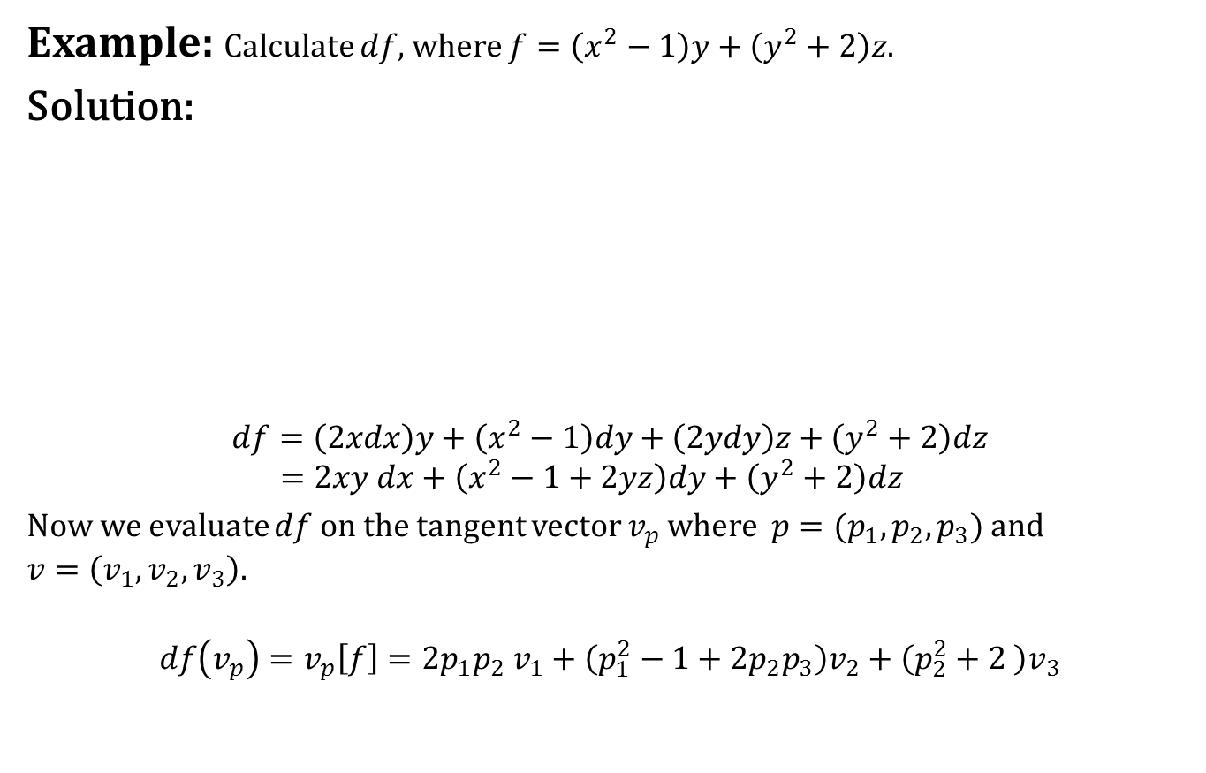
Properties of differentials
Example: Calculate $df$, where $f=\left(x^{2}−1\right)y+\left(y^{2}+2\right)z$.
Solution:
$$df=\left(2xdx\right)y+\left(x^{2}−1\right)dy+\left(2ydy\right)z+\left(y^{2}+2\right)dz$$
$$=2xy dx+\left(x^{2}−1+2yz\right)dy+\left(y^{2}+2\right)dz$$
Now we evaluate $df$ on the tangent vector $v_{p}$ where $p=(p_{1},p_{2},p_{3})$ and $v=\left(v_{1},v_{2},v_{3}\right).$
$$df\left(v_{p}\right)=v_{p}\left[f\right]=2p_{1}p_{2} v_{1}+\left(p_{1}^{2}−1+2p_{2}p_{3}\right)v_{2}+\left(p_{2}^{2}+2 \right)v_{3}$$
Chain rule: Let $f:R^{3}→R$ and $h:R→R$ be differentiable functions, so the composite function $h\left(f\right):R^{3}→R$ is also differentiable. Then
$$d\left(h\left(f\right)\right)=h^{′}\left(f\right)df.$$
Product rule: Let $fg$ be the product of differentiable functions $f$ and $g$ on $R^{3}$. Then
$$d\left(fg\right)=gdf+fdg$$

Slide 37
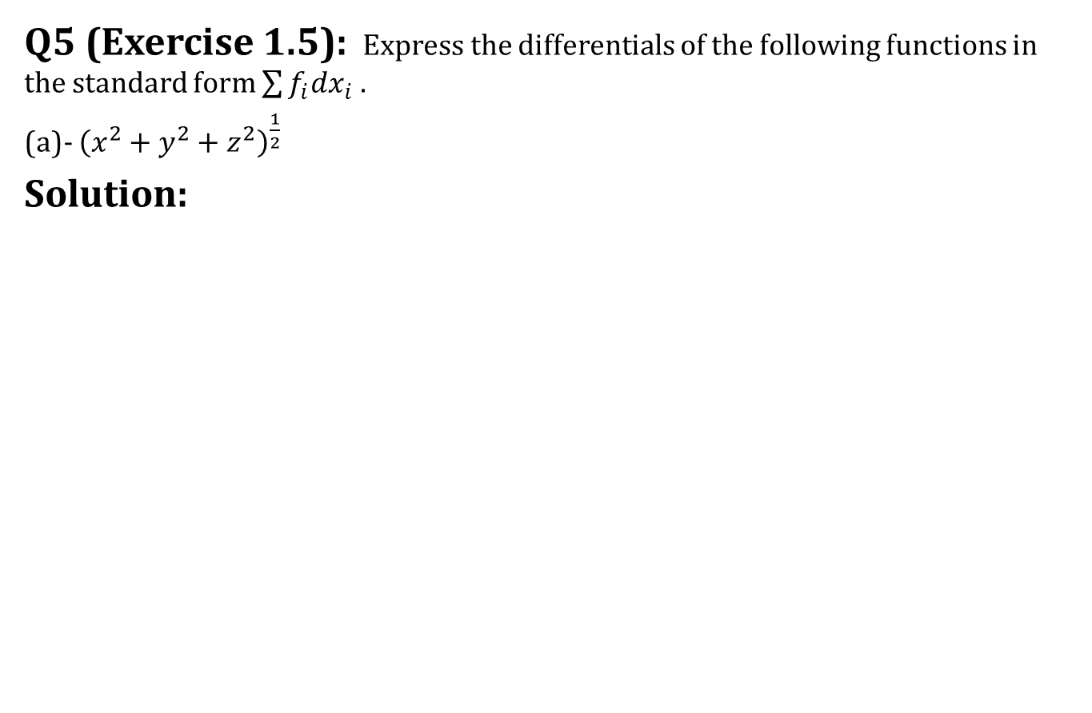
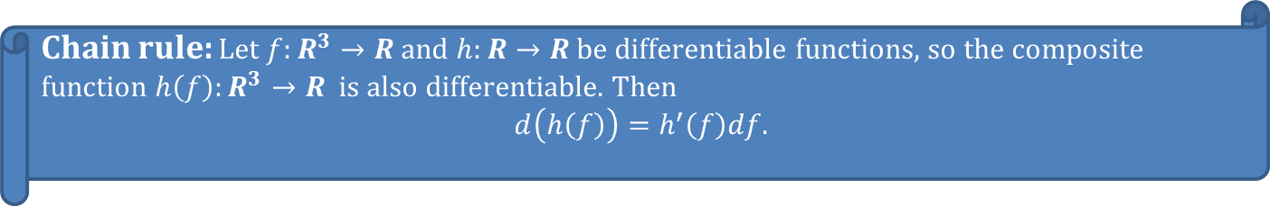
Some more questions
Q5 (Exercise 1.5): Express the differentials of the following functions in the standard form $\sum{f_{i}dx_{i}}$.
(a)- ${\left(x^{2}+y^{2}+z^{2}\right)}^{\frac{1}{2}}$
Solution:
Chain rule: Let $f:R^{3}→R$ and $h:R→R$ be differentiable functions, so the composite function $h\left(f\right):R^{3}→R$ is also differentiable. Then
$$d\left(h\left(f\right)\right)=h^{′}\left(f\right)df.$$

Slide 38

Some more questions
Q7 (Exercise 1.5): Which of the following are $1$-forms? In each case $φ$ is the function on tangent vectors such that the value of $φ$ on $(v_{1},v_{2},v_{3})$ is given :
$v_{1}−v_{3}$
$p_{1}−p_{3}$

Slide 39
Exercise 1.5
Please try the rest of exercise 1.5

Slide 40


Today we learnt
$1$-forms
Differentials
Exercise 1.5
Properties of differentials

Slide 41

Next time
Differential Forms

Slide 42

End of the lecture

