Slide 1
Lecture # 4
MTH352: Differential Geometry
For
Master of Mathematics
By
Dr. SOHAIL IQBAL
Assistant Professor
Department of Mathematics, CIIT Islamabad

Slide 2
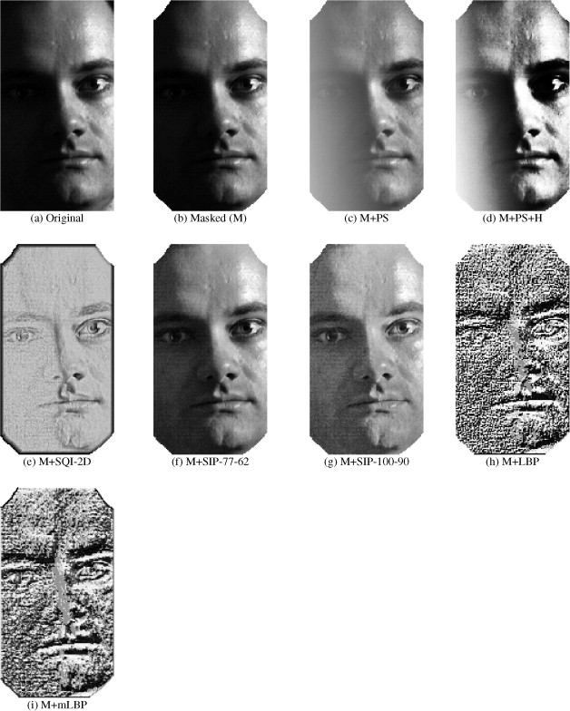
Last lecture:
Directional derivatives
  Definition
  How to differentiate composite functions
  (Chain rule)
  How to compute directional derivatives
  more efficiently
  The main properties of directional derivatives
Operation of a vector field
  Basic properties of operations of vector fields

Slide 3
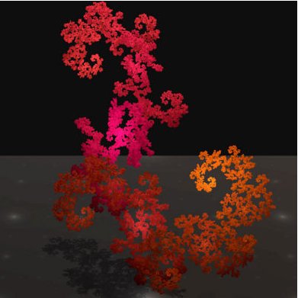
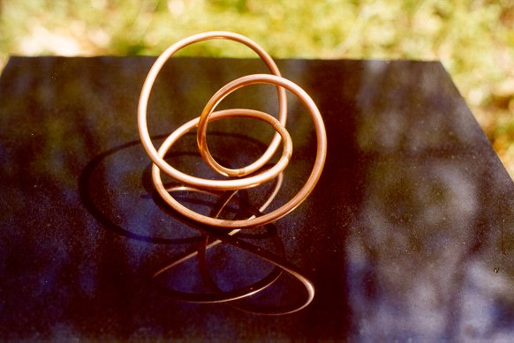
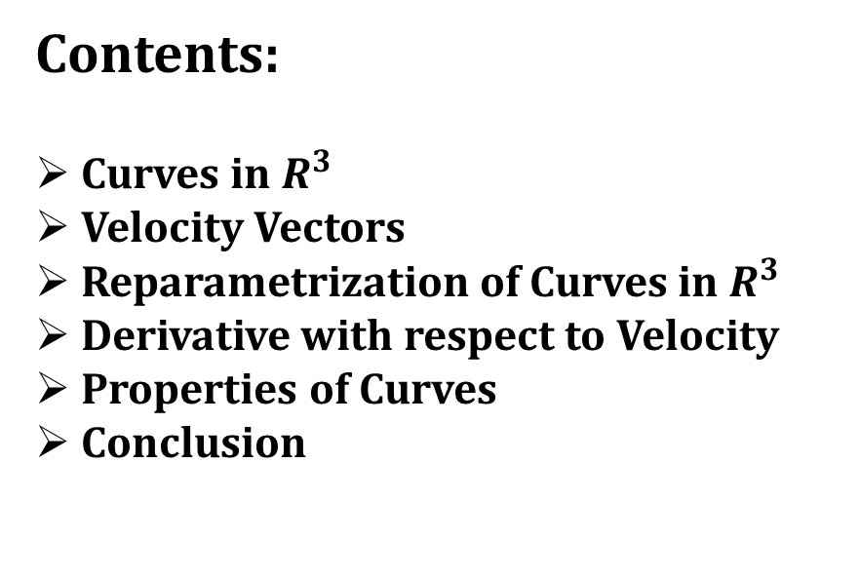
Today’s lecture
Contents:
Curves in $R^{3}$
Velocity Vectors
Reparametrization of Curves in $R^{3}$
Derivative with respect to Velocity
Properties of Curves
Conclusion

Slide 4
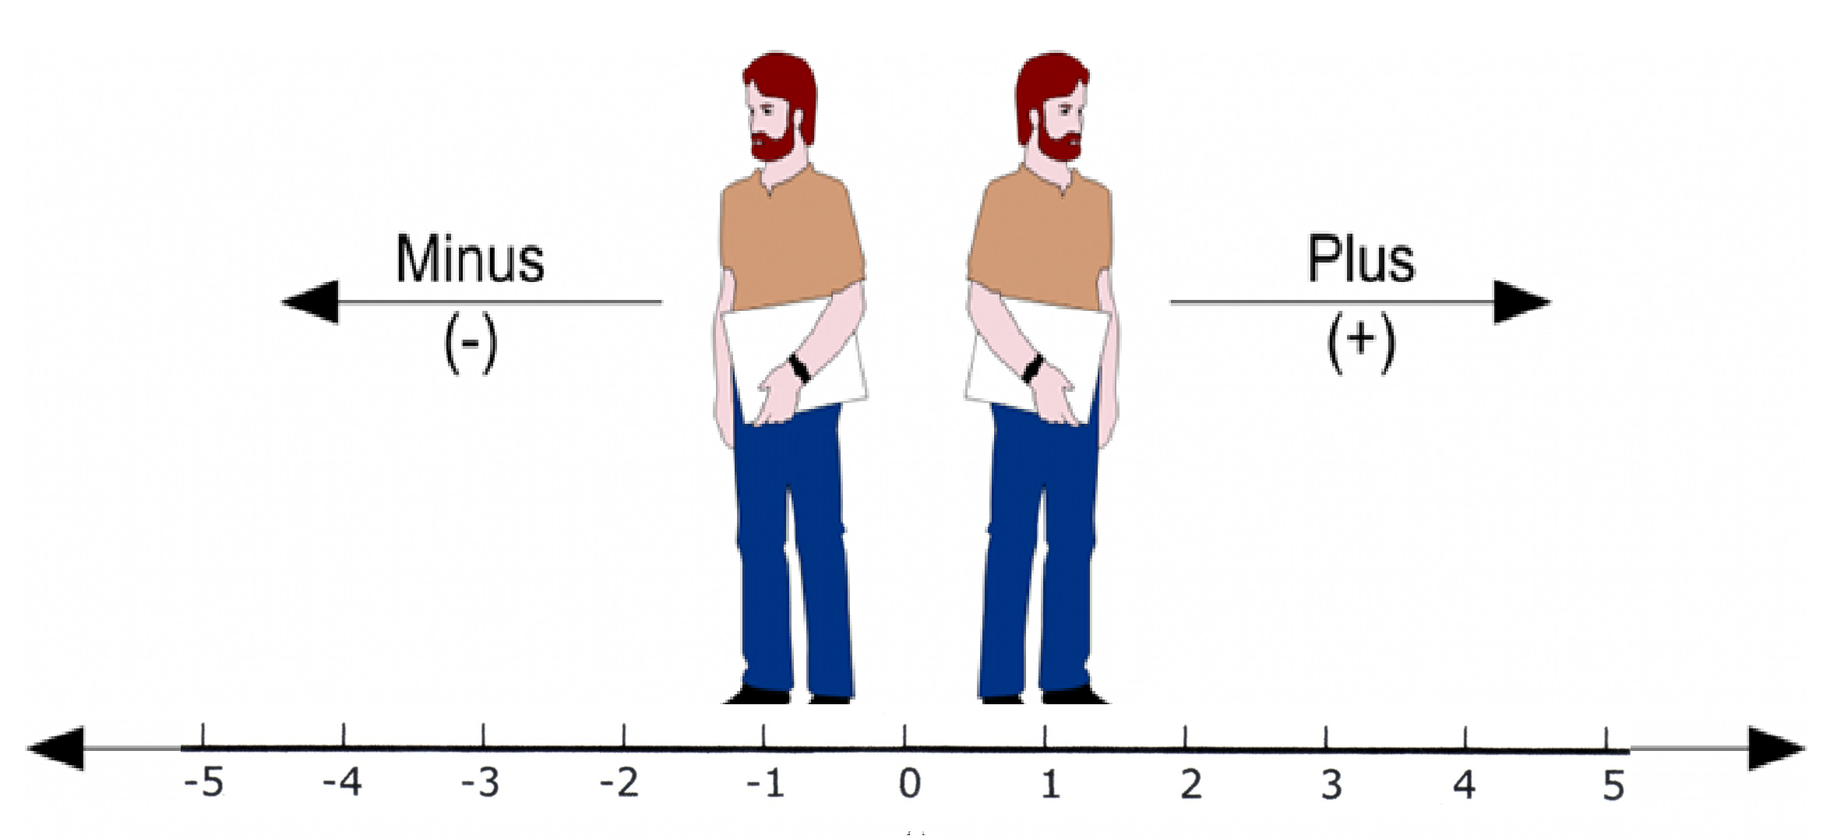

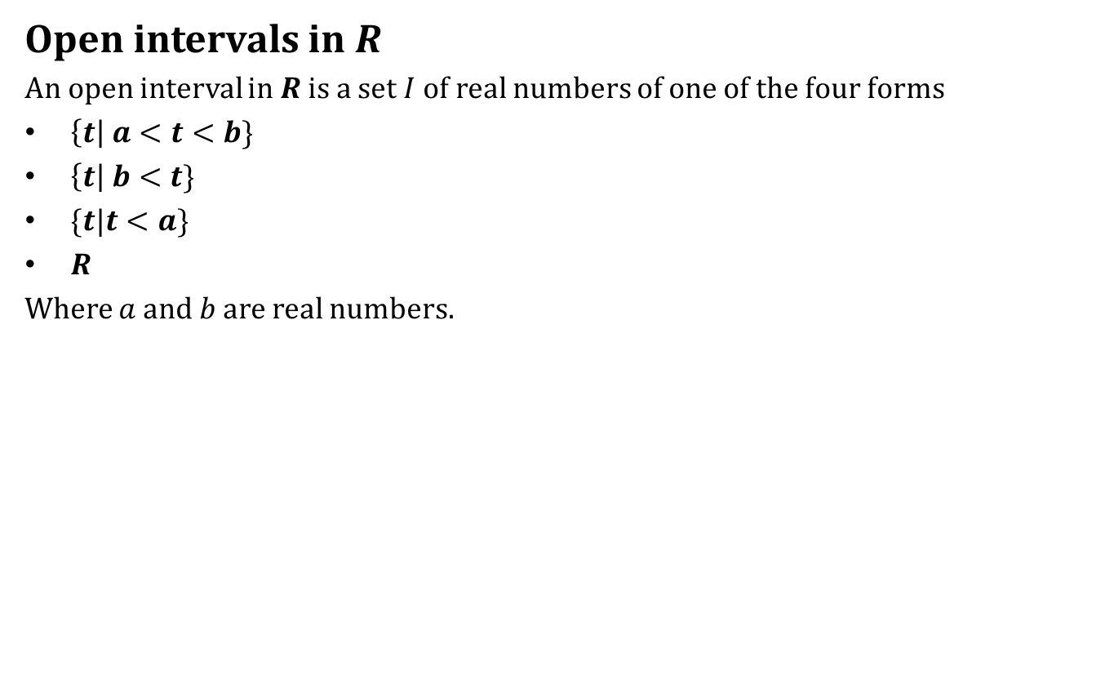
Curves in $R^{3}$
Open intervals in $R$
An open interval in $R$ is a set $I$ of real numbers of one of the four forms
$\left\{t\right| a<t<b\}$
$\left\{t\right| b<t\}$
$\{t|t<a\}$
$R$
Where $a$ and $b$ are real numbers.

Slide 5
Curves in $R^{3}$
Open intervals in $R$
An open interval in $R$ is a set $I$ of real numbers of one of the four forms
$\left\{t\right| a<t<b\}$
$\left\{t\right| b<t\}$
$\{t|t<a\}$
$R$
Where $a$ and $b$ are real numbers.

Slide 6
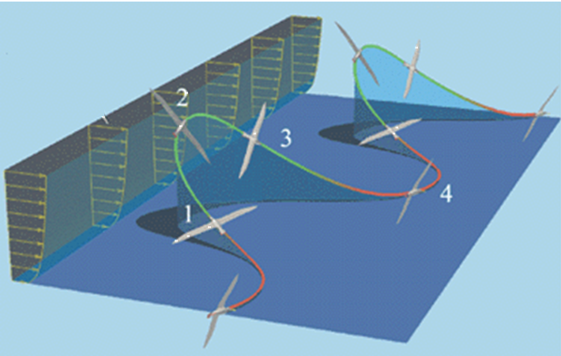
Curves in $R^{3}$
What is a curve in space intuitively?

Slide 7
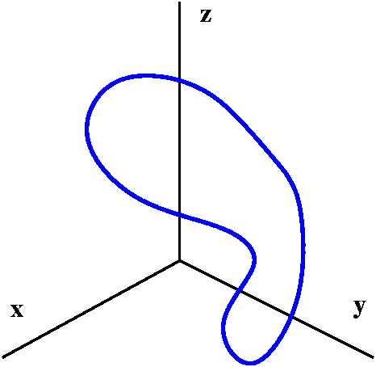
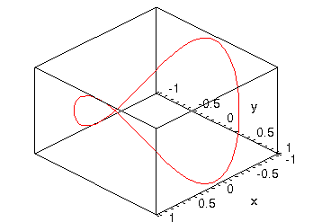
Curves in $R^{3}$
What is a curve in space intuitively?

Slide 8
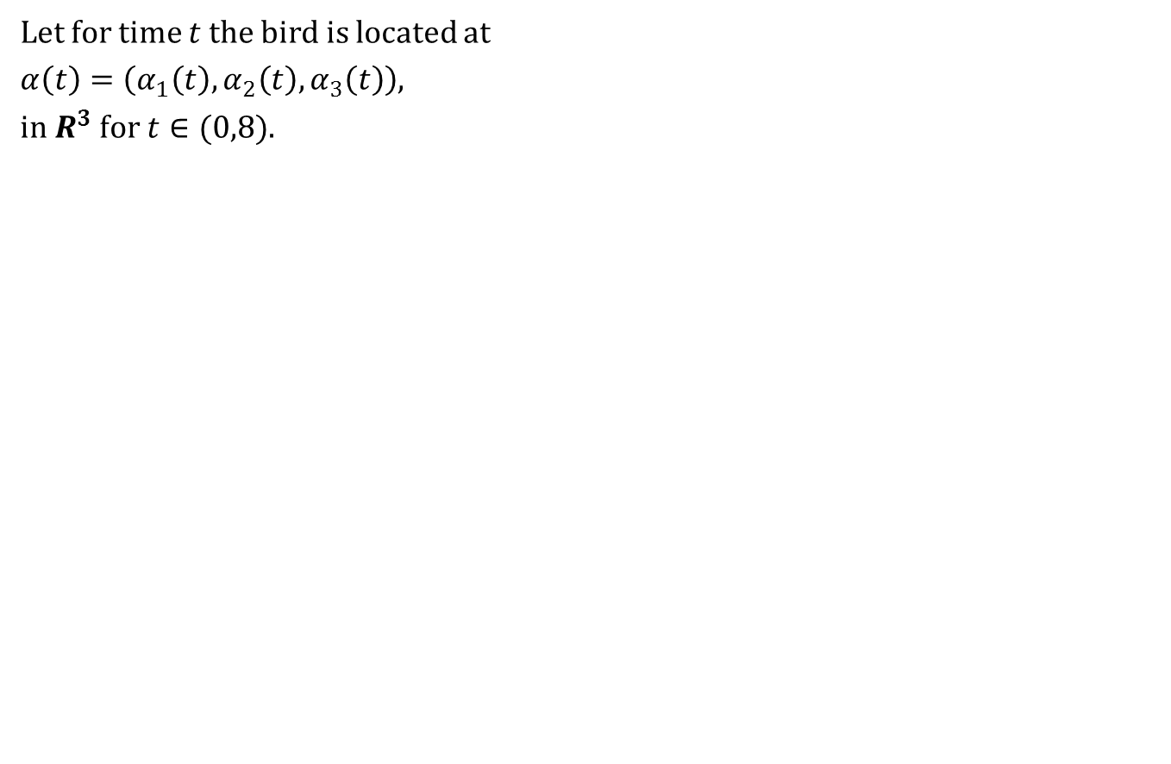
Curves in $R^{3}$
Let for time $t$ the bird is located at
$α\left(t\right)=\left(α_{1}\left(t\right),α_{2}\left(t\right),α_{3}\left(t\right)\right)$,
in $R^{3}$ for $t∈(0,8)$.

Slide 9
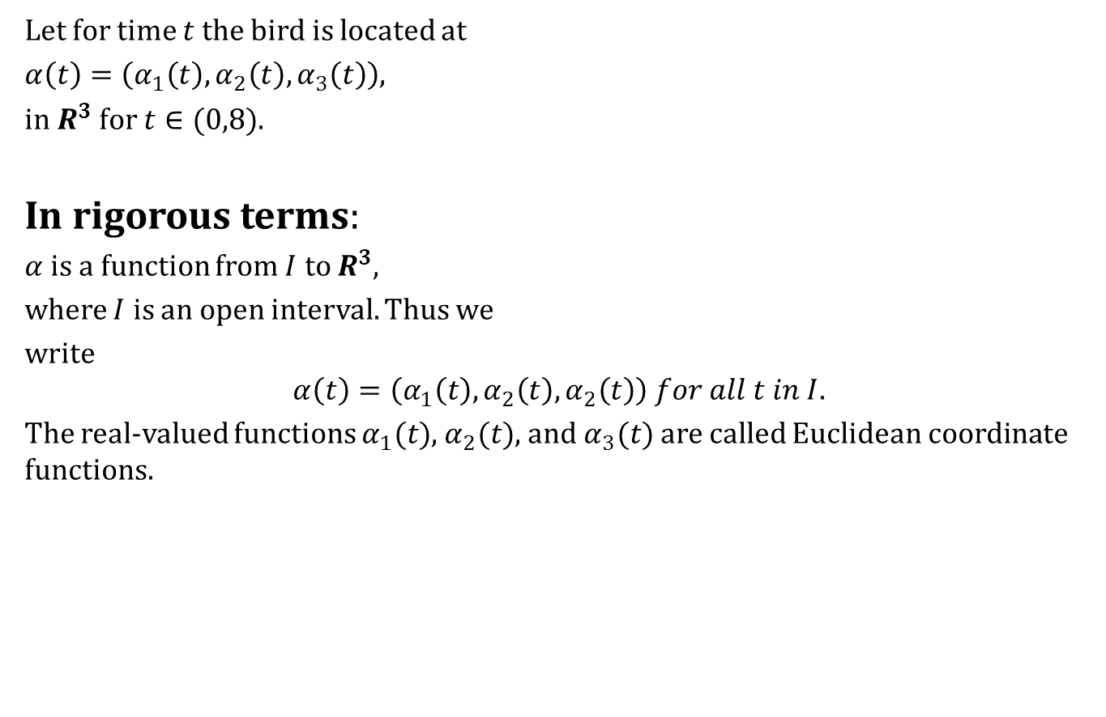
Curves in $R^{3}$
Let for time $t$ the bird is located at
$α\left(t\right)=\left(α_{1}\left(t\right),α_{2}\left(t\right),α_{3}\left(t\right)\right)$,
in $R^{3}$ for $t∈(0,8)$.
In rigorous terms:
$α$ is a function from $I$ to $R^{3}$,
where $I$ is an open interval. Thus we
write
$$α\left(t\right)=\left(α_{1}\left(t\right),α_{2}\left(t\right),α_{2}\left(t\right)\right) for all t in I.$$
The real-valued functions $α_{1}(t)$, $α_{2}(t)$, and $α_{3}(t)$ are called Euclidean coordinate functions.

Slide 10
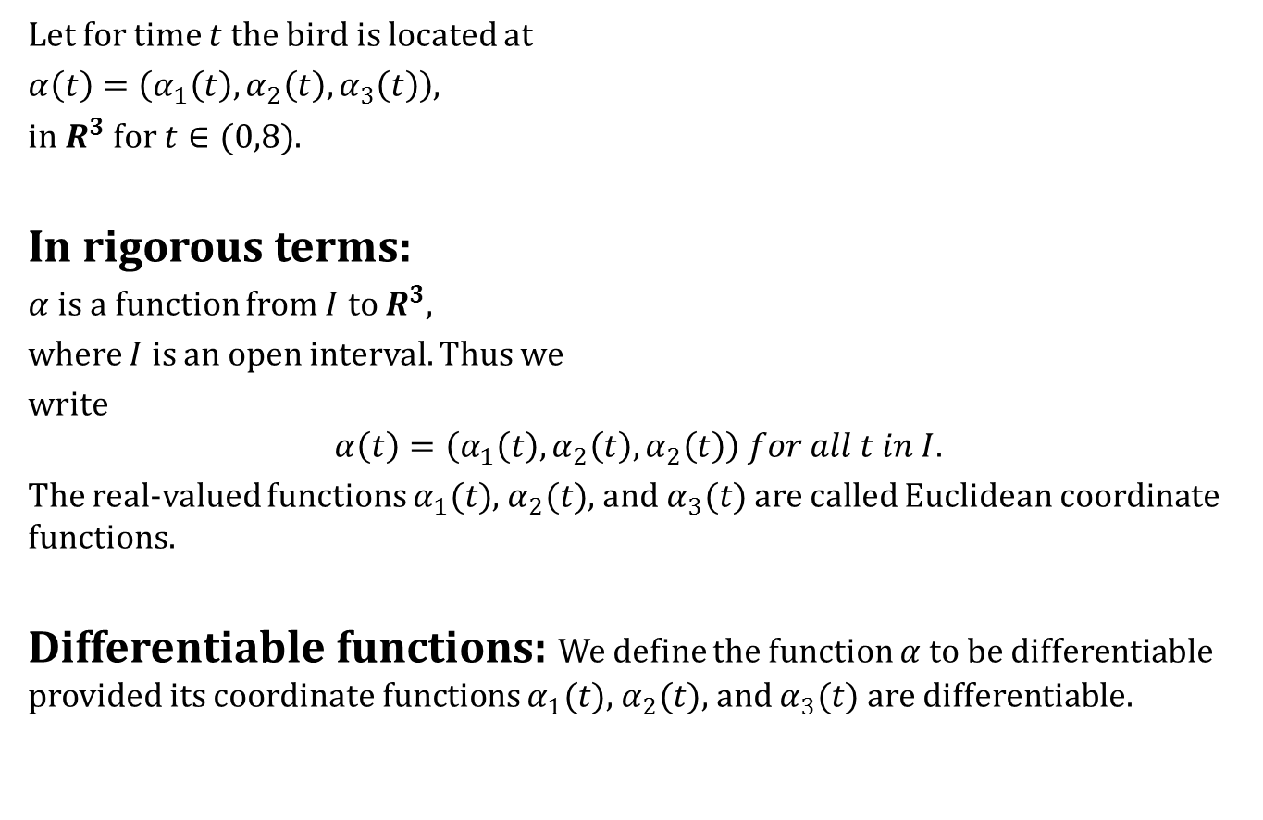
Curves in $R^{3}$
Let for time $t$ the bird is located at
$α\left(t\right)=\left(α_{1}\left(t\right),α_{2}\left(t\right),α_{3}\left(t\right)\right)$,
in $R^{3}$ for $t∈(0,8)$.
In rigorous terms:
$α$ is a function from $I$ to $R^{3}$,
where $I$ is an open interval. Thus we
write
$$α\left(t\right)=\left(α_{1}\left(t\right),α_{2}\left(t\right),α_{2}\left(t\right)\right) for all t in I.$$
The real-valued functions $α_{1}(t)$, $α_{2}(t)$, and $α_{3}(t)$ are called Euclidean coordinate functions.
Differentiable functions: We define the function $α$ to be differentiable provided its coordinate functions $α_{1}(t)$, $α_{2}(t)$, and $α_{3}(t)$ are differentiable.

Slide 11
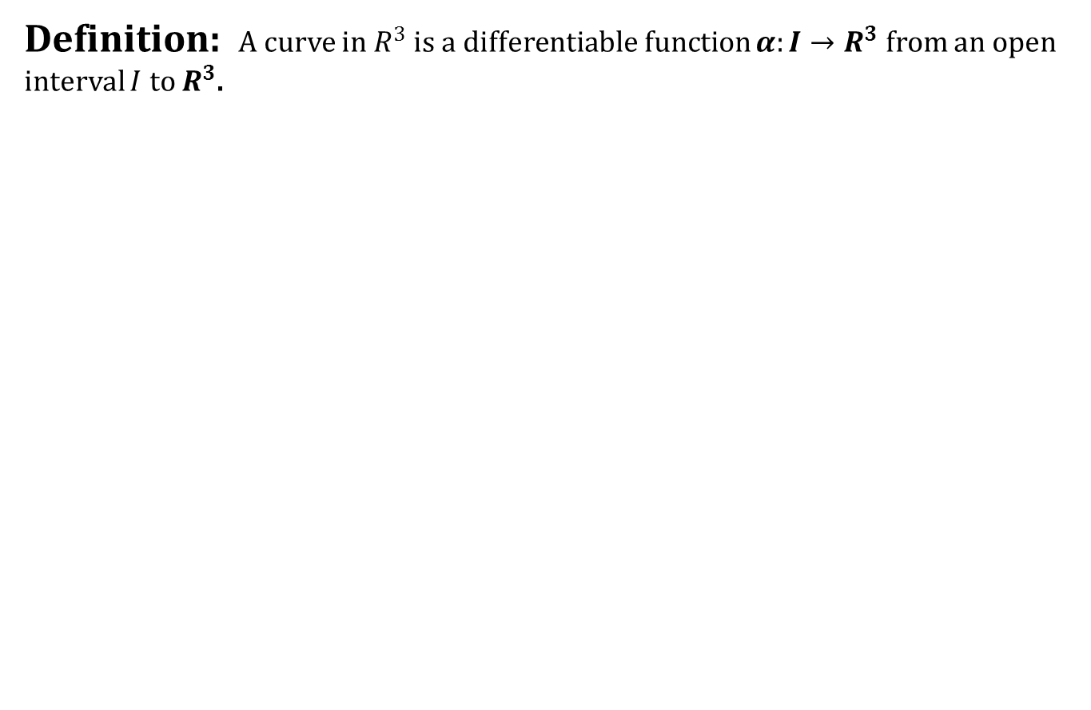
Curves in $R^{3}$
Definition: A curve in $R^{3}$ is a differentiable function $α:I→R^{3}$ from an open interval $I$ to $R^{3}$.

Slide 12
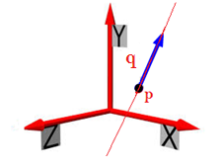
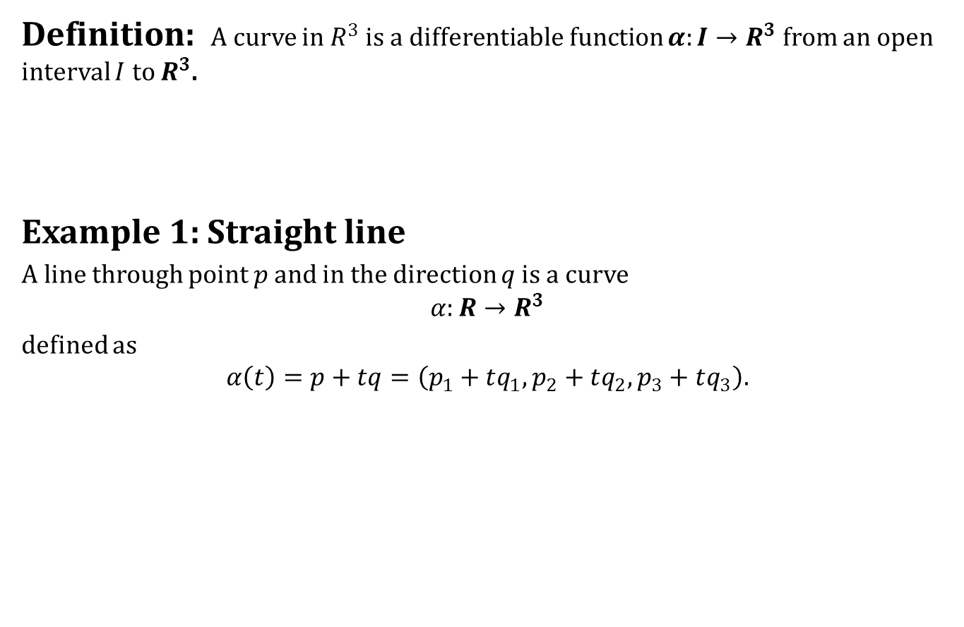
Curves in $R^{3}$
Definition: A curve in $R^{3}$ is a differentiable function $α:I→R^{3}$ from an open interval $I$ to $R^{3}$.
Example 1: Straight line
A line through point $p$ and in the direction $q$ is a curve
$$α:R→R^{3}$$
defined as
$$α\left(t\right)=p+tq=\left(p_{1}+tq_{1},p_{2}+tq_{2},p_{3}+tq_{3}\right).$$

Slide 13
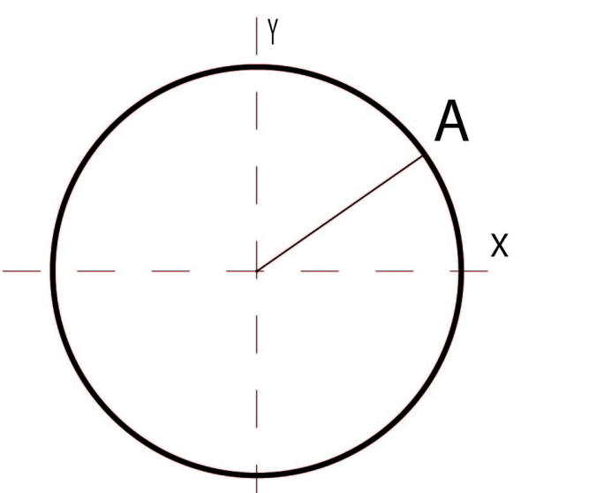
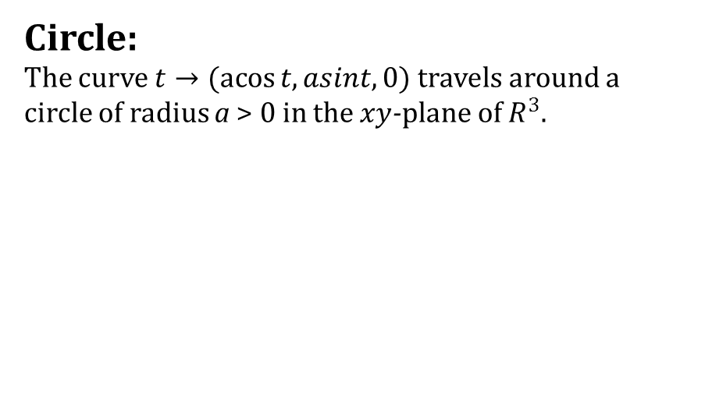
Curves in $R^{3}$
Circle:
The curve $t→(\operatorname{acos}{t, asint, 0})$ travels around a circle of radius a > 0 in the $xy$-plane of $R^{3}$.

Slide 14
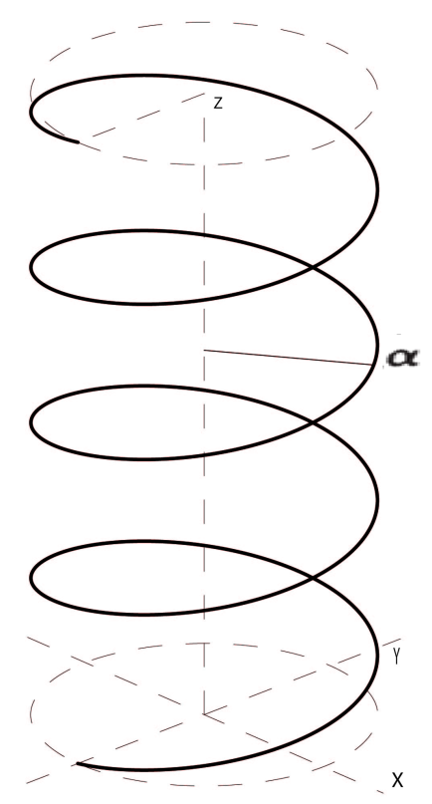
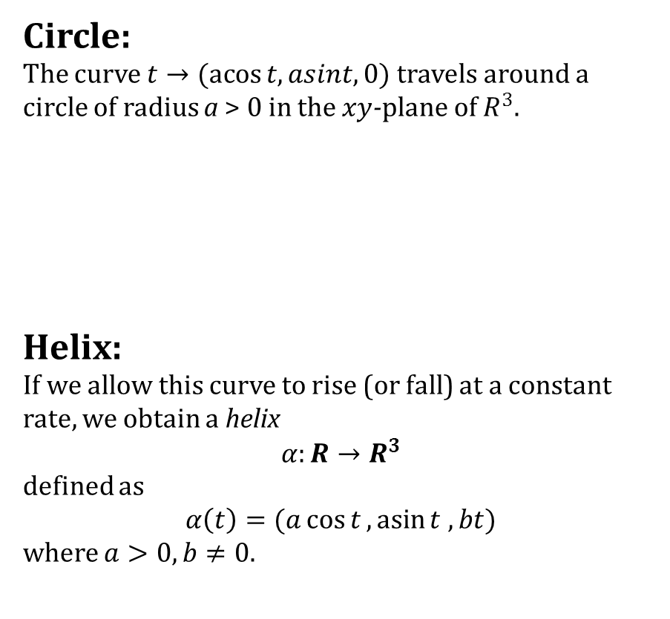
Curves in $R^{3}$
Circle:
The curve $t→(\operatorname{acos}{t, asint, 0})$ travels around a circle of radius a > 0 in the $xy$-plane of $R^{3}$.
Helix:
If we allow this curve to rise (or fall) at a constant rate, we obtain a helix
$$α:R→R^{3}$$
defined as
$$α\left(t\right)=(a\cos{t},\operatorname{asin}{t , bt})$$
where $a>0, b≠0$.

Slide 15
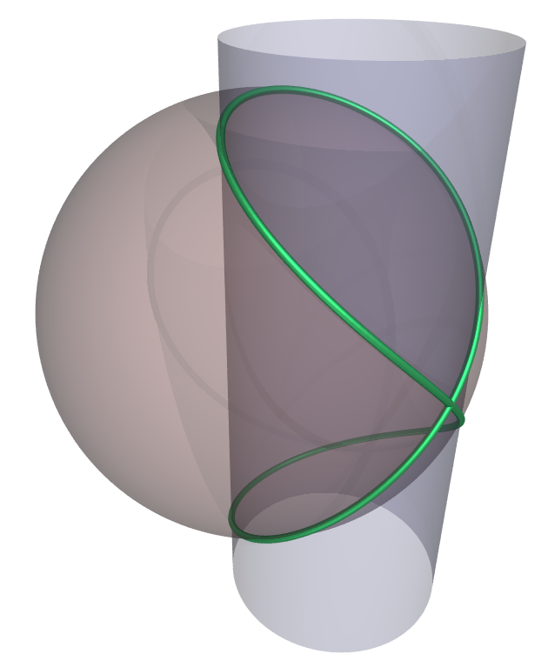
Curves in $R^{3}$

Slide 16
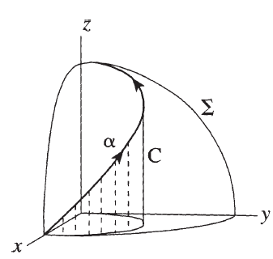
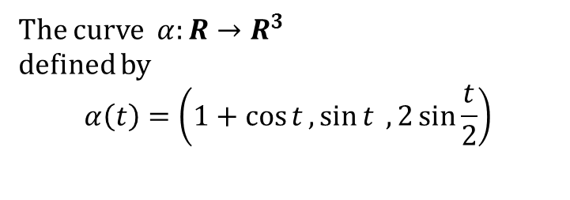
Curves in $R^{3}$
The curve $α:R→R^{3}$
defined by
$$α\left(t\right)=\left(1+\cos{t},\sin{t} ,2\sin{\frac{t}{2}}\right)$$

Slide 17
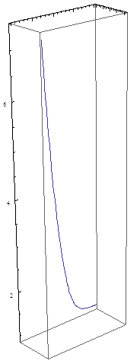

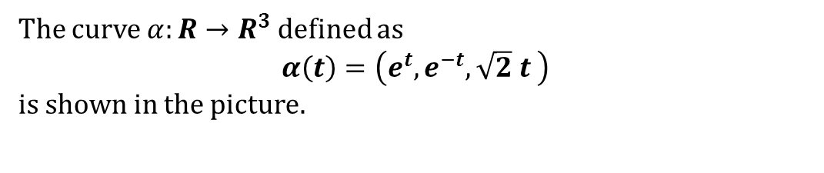
Curves in $R^{3}$
The curve $α:R→R^{3}$ defined as
$$α\left(t\right)=\left(e^{t},e^{−t},\sqrt{2} t \right)$$
is shown in the picture.

Slide 18
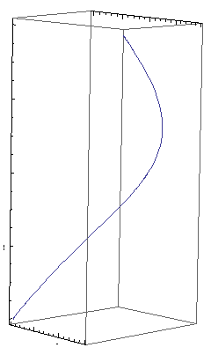
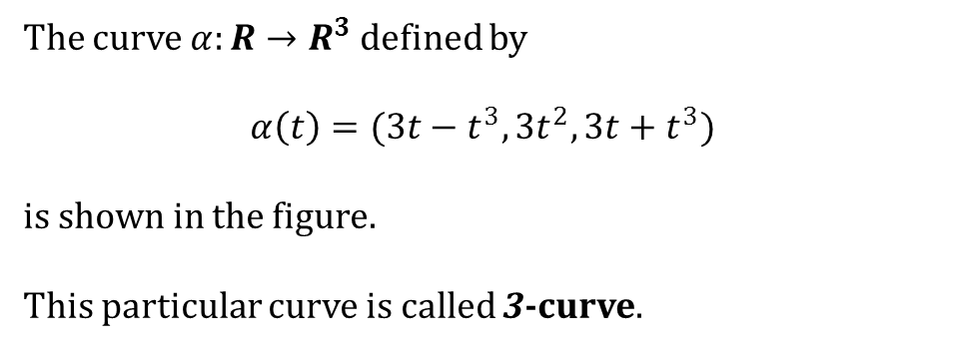
Curves in $R^{3}$
The curve $α:R→R^{3}$ defined by
$$α\left(t\right)=(3t−t^{3},3t^{2},3t+t^{3})$$
is shown in the figure.
This particular curve is called 3-curve.

Slide 19
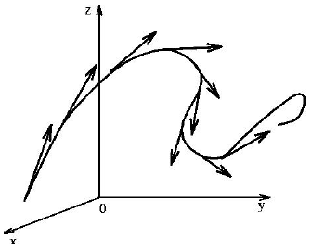
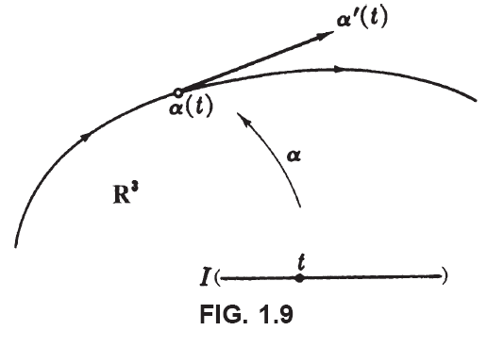
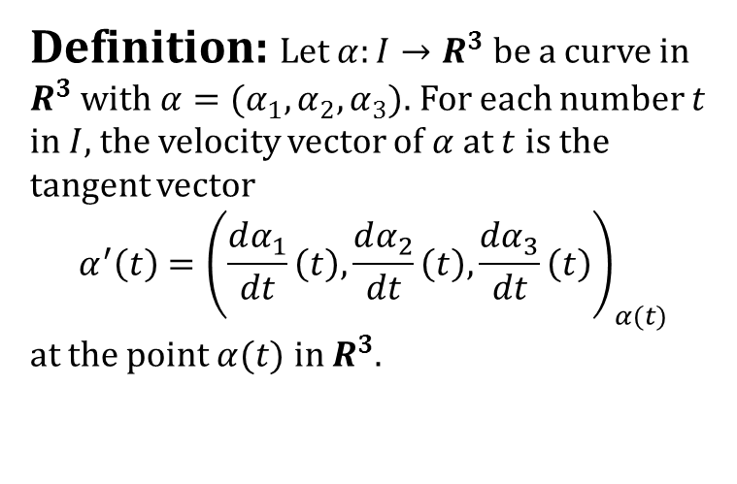
Velocity vector
Definition: Let $α:I→R^{3}$ be a curve in $R^{3}$ with $α=(α_{1},α_{2},α_{3})$. For each number $t$ in $I$, the velocity vector of $α$ at $t$ is the tangent vector
$$α^{′}\left(t\right)={\left(\frac{dα_{1}}{dt}\left(t\right),\frac{dα_{2}}{dt}\left(t\right),\frac{dα_{3}}{dt}\left(t\right)\right)}_{α(t)}$$
at the point $α(t)$ in $R^{3}$.

Slide 20
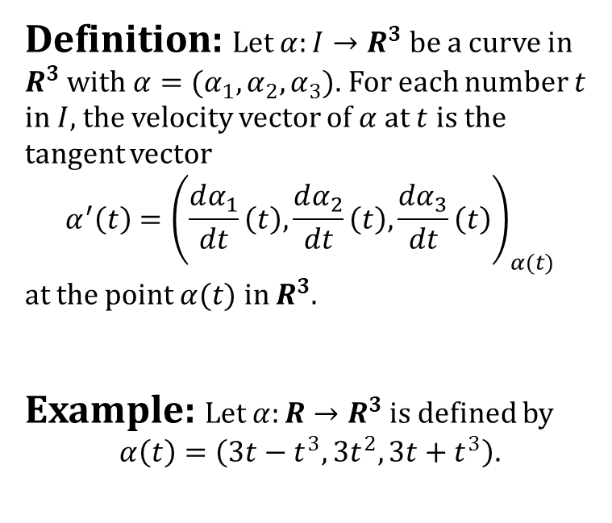
Velocity vector
Definition: Let $α:I→R^{3}$ be a curve in $R^{3}$ with $α=(α_{1},α_{2},α_{3})$. For each number $t$ in $I$, the velocity vector of $α$ at $t$ is the tangent vector
$$α^{′}\left(t\right)={\left(\frac{dα_{1}}{dt}\left(t\right),\frac{dα_{2}}{dt}\left(t\right),\frac{dα_{3}}{dt}\left(t\right)\right)}_{α(t)}$$
at the point $α(t)$ in $R^{3}$.
Example: Let $α:R→R^{3}$ is defined by
$$α\left(t\right)=\left(3t−t^{3},3t^{2},3t+t^{3}\right).$$

Slide 21
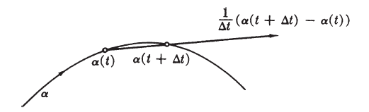
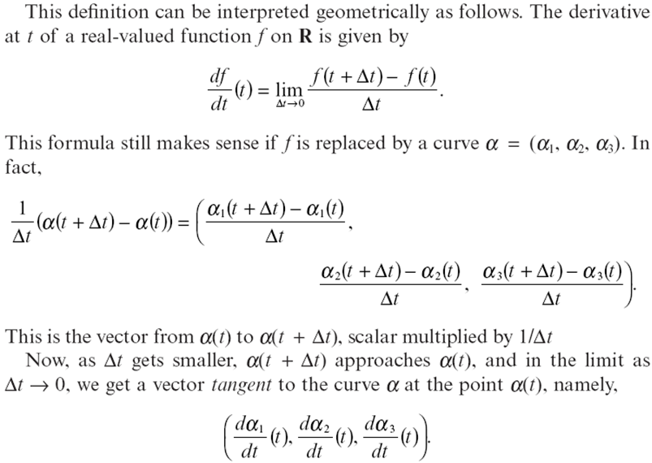
Velocity vector
Geometric interpretation:

Slide 22
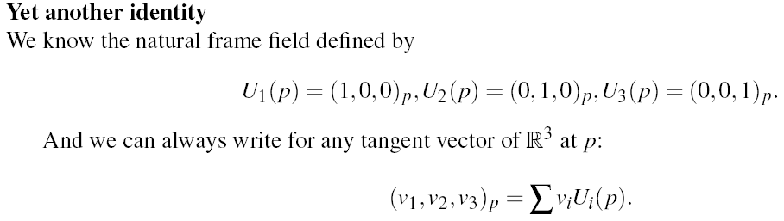
Velocity vector

Slide 23
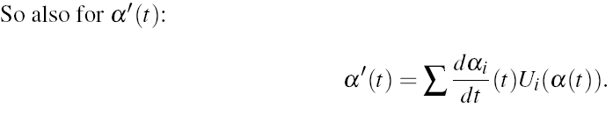
Velocity vector

Slide 24
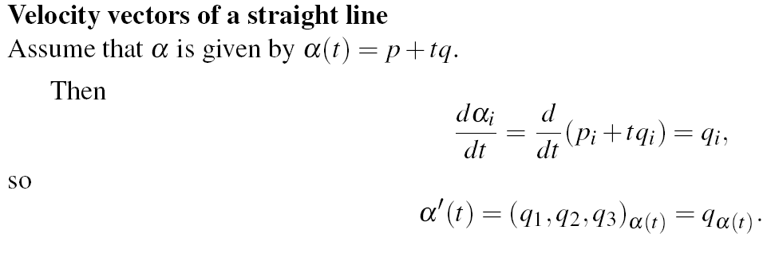
Velocity vector

Slide 25
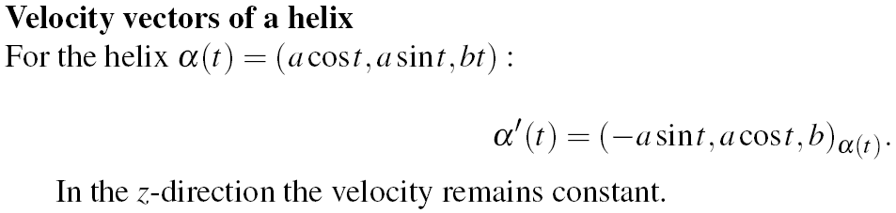
Velocity vector

Slide 26
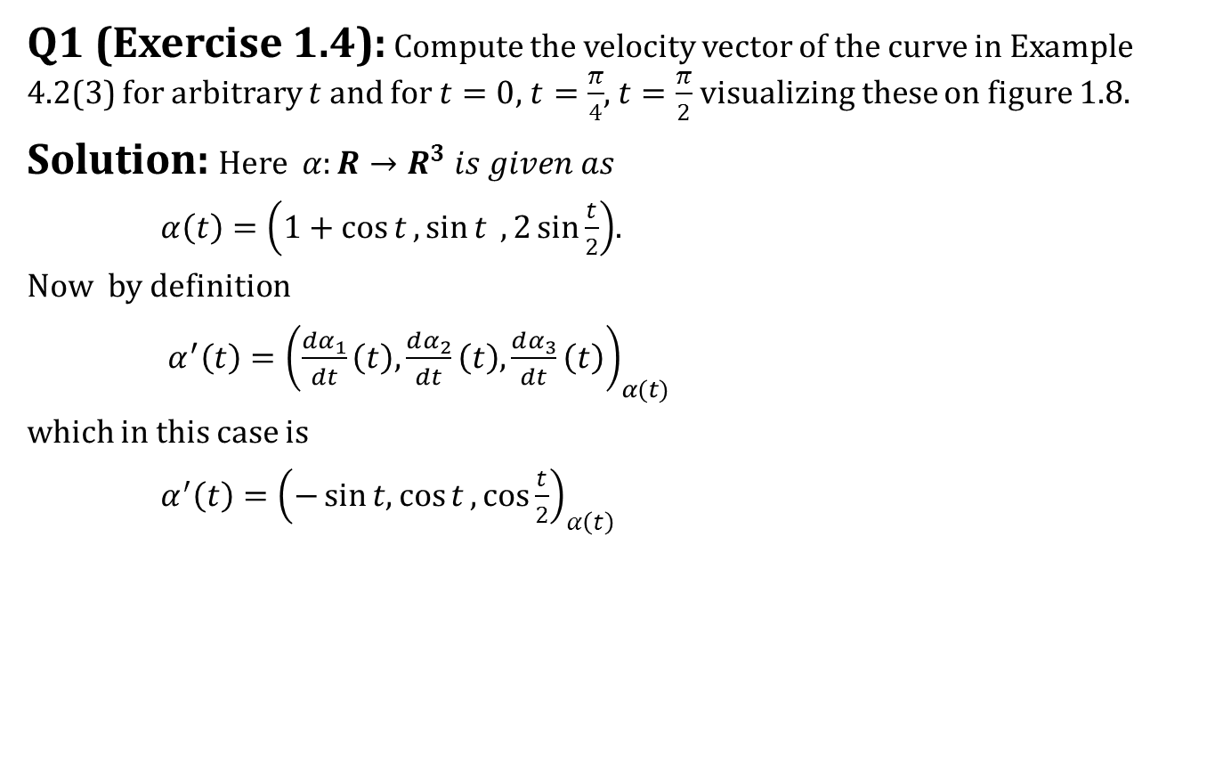
Velocity vector
Q1 (Exercise 1.4): Compute the velocity vector of the curve in Example 4.2(3) for arbitrary $t$ and for $t=0$, $t=\frac{π}{4}$, $t=\frac{π}{2}$ visualizing these on figure 1.8.
Solution: Here $α:R→R^{3} is given as$
$α\left(t\right)=\left(1+\cos{t},\sin{t} ,2\sin{\frac{t}{2}}\right)$.
Now by definition
$α^{′}\left(t\right)={\left(\frac{dα_{1}}{dt}\left(t\right),\frac{dα_{2}}{dt}\left(t\right),\frac{dα_{3}}{dt}\left(t\right)\right)}_{α(t)}$
which in this case is
$α^{′}\left(t\right)={\left(−\sin{t,\cos{t}},\cos{\frac{t}{2}}\right)}_{α\left(t\right)}$

Slide 27
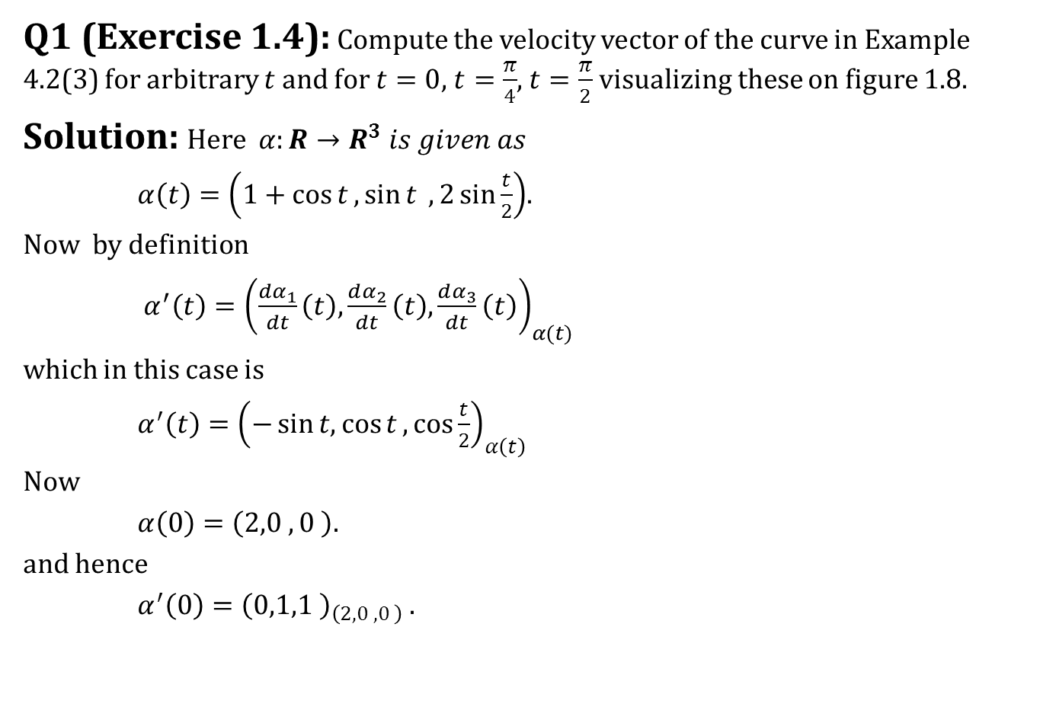
Velocity vector
Q1 (Exercise 1.4): Compute the velocity vector of the curve in Example 4.2(3) for arbitrary $t$ and for $t=0$, $t=\frac{π}{4}$, $t=\frac{π}{2}$ visualizing these on figure 1.8.
Solution: Here $α:R→R^{3} is given as$
$α\left(t\right)=\left(1+\cos{t},\sin{t} ,2\sin{\frac{t}{2}}\right)$.
Now by definition
$α^{′}\left(t\right)={\left(\frac{dα_{1}}{dt}\left(t\right),\frac{dα_{2}}{dt}\left(t\right),\frac{dα_{3}}{dt}\left(t\right)\right)}_{α(t)}$
which in this case is
$α^{′}\left(t\right)={\left(−\sin{t,\cos{t}},\cos{\frac{t}{2}}\right)}_{α\left(t\right)}$
Now
$α\left(0\right)=\left(2,0 ,0 \right)$.
and hence
$α^{′}\left(0\right)={\left(0,1,1 \right)}_{\left(2,0 ,0 \right)}$ .

Slide 28
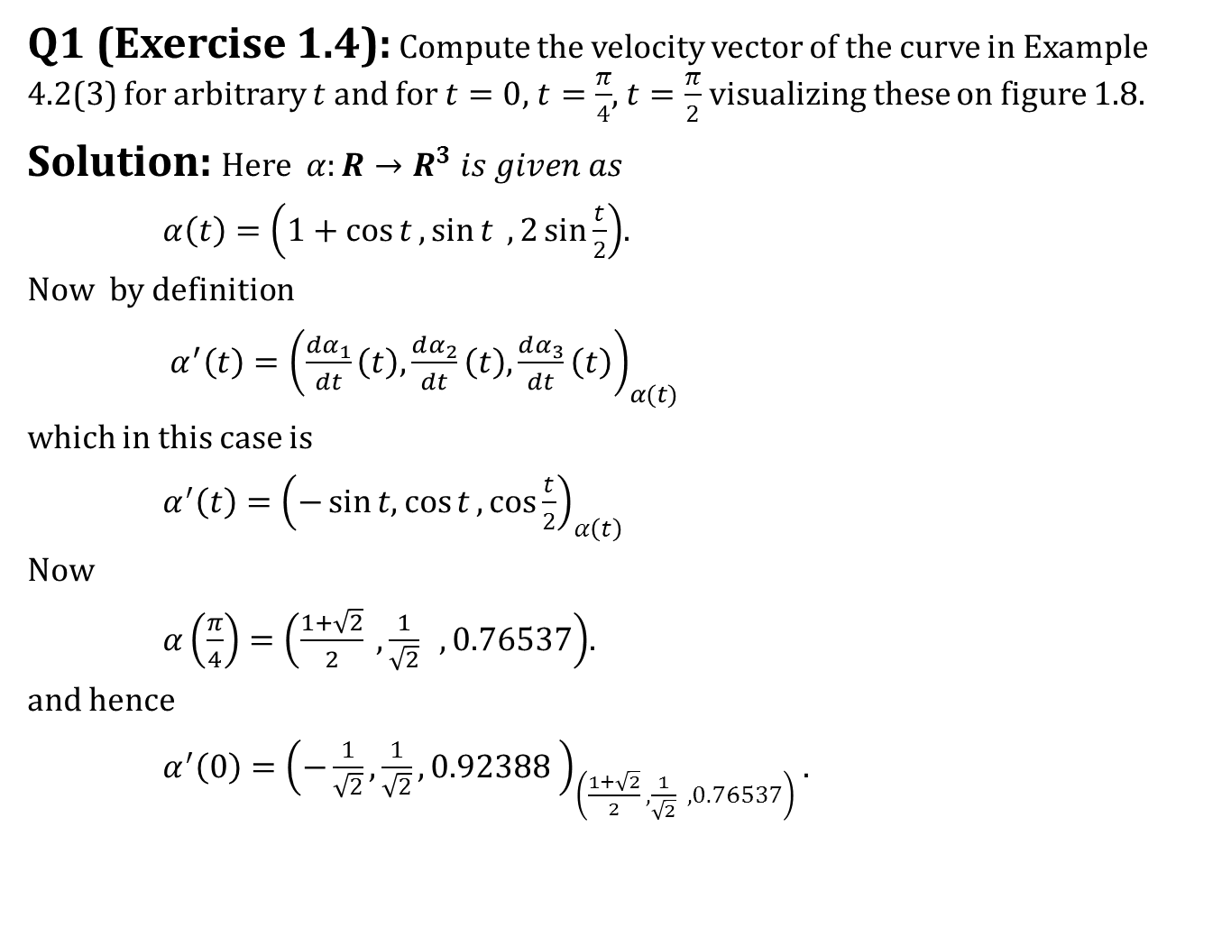
Velocity vector
Q1 (Exercise 1.4): Compute the velocity vector of the curve in Example 4.2(3) for arbitrary $t$ and for $t=0$, $t=\frac{π}{4}$, $t=\frac{π}{2}$ visualizing these on figure 1.8.
Solution: Here $α:R→R^{3} is given as$
$α\left(t\right)=\left(1+\cos{t},\sin{t} ,2\sin{\frac{t}{2}}\right)$.
Now by definition
$α^{′}\left(t\right)={\left(\frac{dα_{1}}{dt}\left(t\right),\frac{dα_{2}}{dt}\left(t\right),\frac{dα_{3}}{dt}\left(t\right)\right)}_{α(t)}$
which in this case is
$α^{′}\left(t\right)={\left(−\sin{t,\cos{t}},\cos{\frac{t}{2}}\right)}_{α\left(t\right)}$
Now
$α\left(\frac{π}{4}\right)=\left(\frac{1+\sqrt{2}}{2} ,\frac{1}{\sqrt{2}} ,0.76537\right)$.
and hence
$α^{′}\left(0\right)={\left(−\frac{1}{\sqrt{2}},\frac{1}{\sqrt{2}},0.92388 \right)}_{\left(\frac{1+\sqrt{2}}{2} ,\frac{1}{\sqrt{2}} ,0.76537\right)}$ .

Slide 29
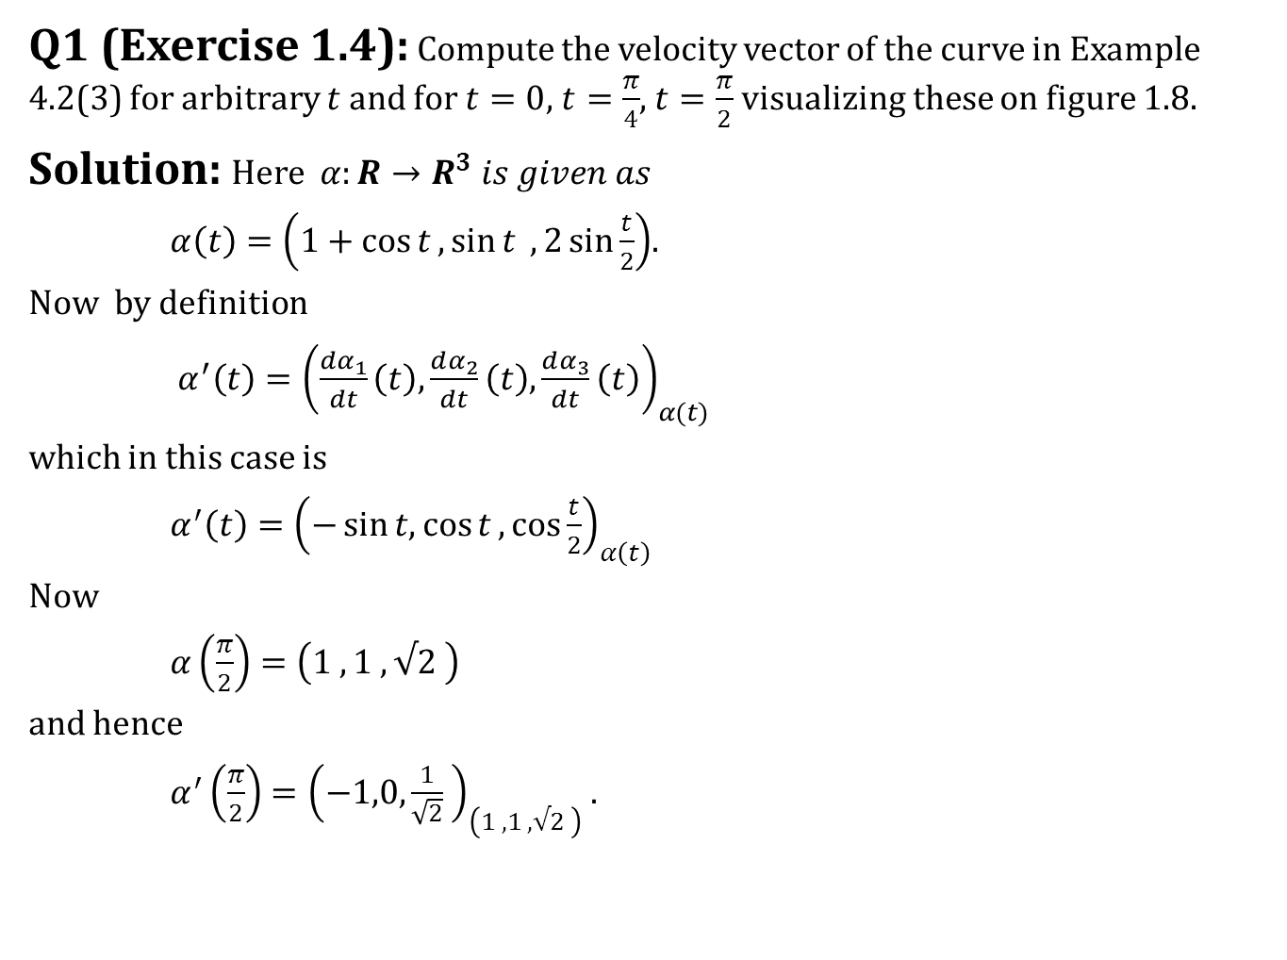
Velocity vector
Q1 (Exercise 1.4): Compute the velocity vector of the curve in Example 4.2(3) for arbitrary $t$ and for $t=0$, $t=\frac{π}{4}$, $t=\frac{π}{2}$ visualizing these on figure 1.8.
Solution: Here $α:R→R^{3} is given as$
$α\left(t\right)=\left(1+\cos{t},\sin{t} ,2\sin{\frac{t}{2}}\right)$.
Now by definition
$α^{′}\left(t\right)={\left(\frac{dα_{1}}{dt}\left(t\right),\frac{dα_{2}}{dt}\left(t\right),\frac{dα_{3}}{dt}\left(t\right)\right)}_{α(t)}$
which in this case is
$α^{′}\left(t\right)={\left(−\sin{t,\cos{t}},\cos{\frac{t}{2}}\right)}_{α\left(t\right)}$
Now
$α\left(\frac{π}{2}\right)=\left(1 ,1 ,√2 \right)$
and hence
$α^{′}\left(\frac{π}{2}\right)={\left(−1,0,\frac{1}{\sqrt{2}} \right)}_{\left(1 ,1 ,√2 \right)}$ .

Slide 30
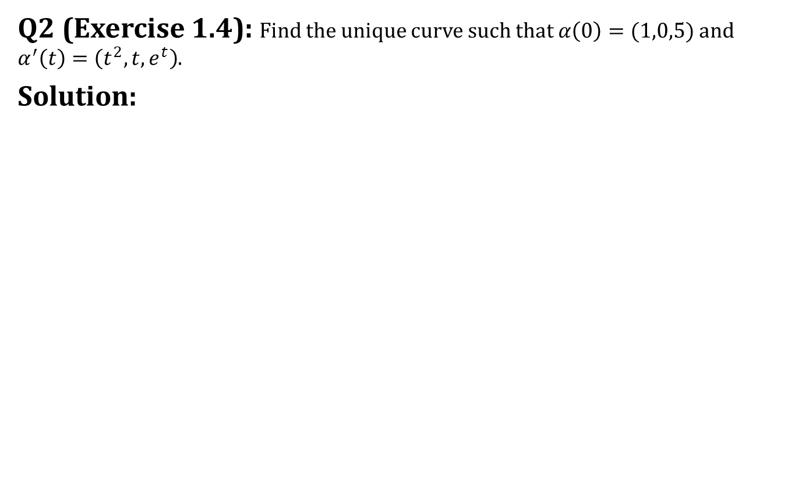
Velocity vector
Q2 (Exercise 1.4): Find the unique curve such that $α\left(0\right)=(1,0,5)$ and $α^{′}\left(t\right)=\left(t^{2},t,e^{t}\right)$.
Solution:

Slide 31
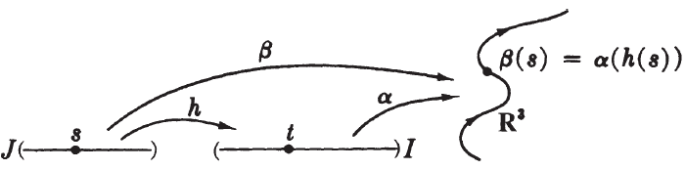
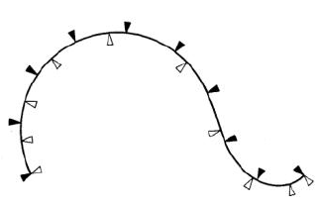

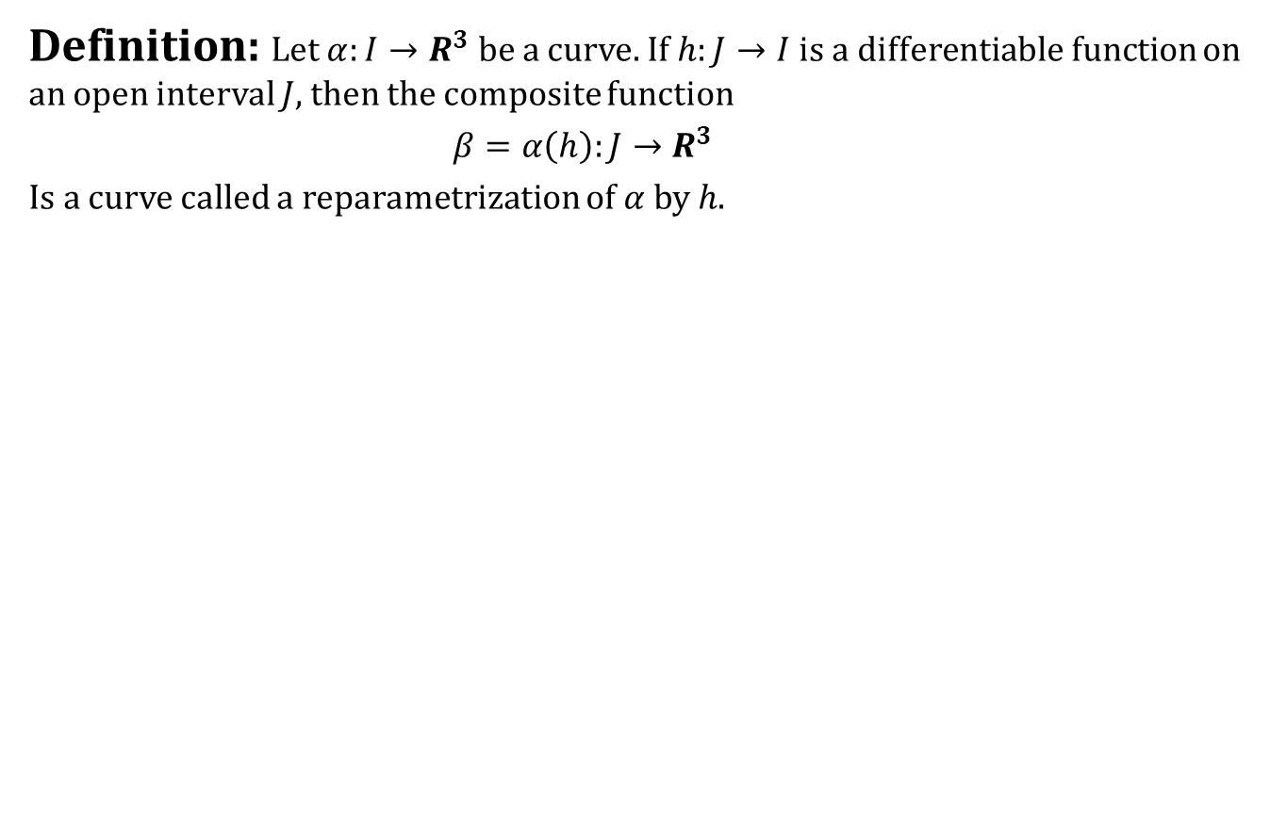
Reparametrization of Curves in $R^{3}$
Definition: Let $α:I→R^{3}$ be a curve. If $h:J→I$ is a differentiable function on an open interval $J$, then the composite function
$β=α\left(h\right):J→R^{3}$
Is a curve called a reparametrization of $α$ by $h$.

Slide 32
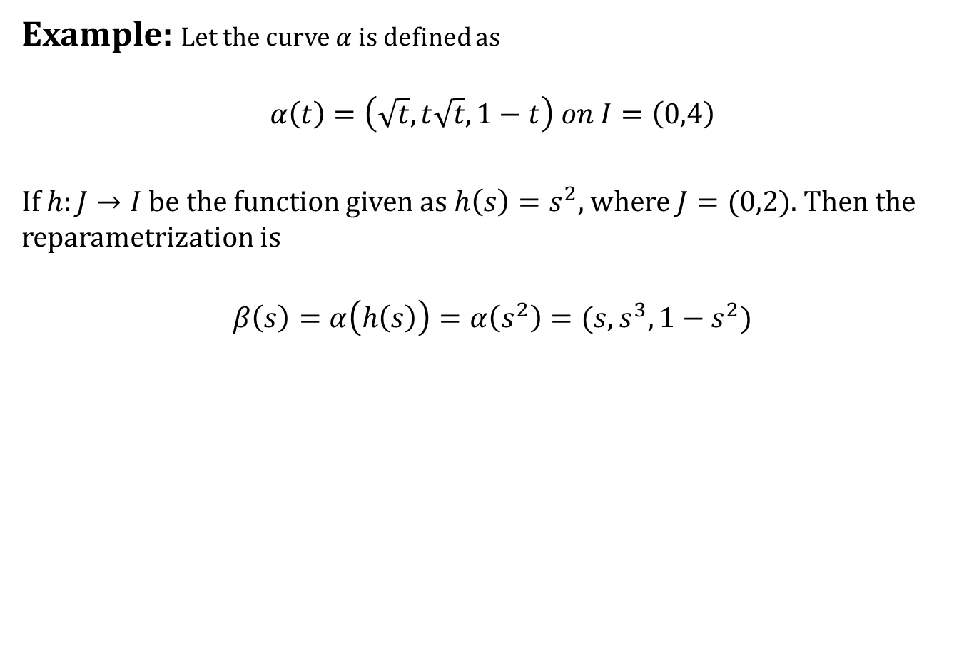
Reparametrization of Curves in $R^{3}$
Example: Let the curve $α$ is defined as
$$α\left(t\right)=\left(\sqrt{t},t\sqrt{t},1−t\right) on I=\left(0,4\right)$$
If $h:J→I$ be the function given as $h\left(s\right)=s^{2}$, where $J=(0,2)$. Then the reparametrization is
$$β\left(s\right)=α\left(h\left(s\right)\right)=α\left(s^{2}\right)=(s,s^{3},1−s^{2})$$

Slide 33
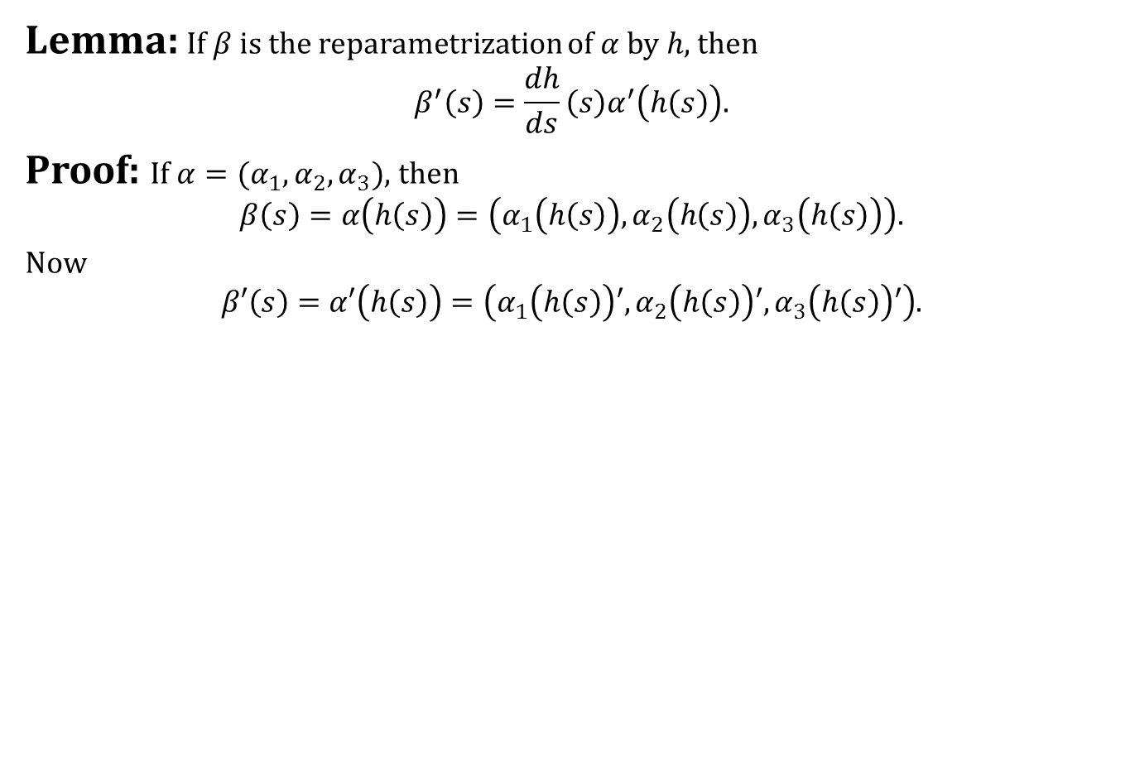
Reparametrization of Curves in $R^{3}$
Lemma: If $β$ is the reparametrization of $α$ by $h$, then
$$β^{′}\left(s\right)=\frac{dh}{ds}\left(s\right)α^{′}\left(h\left(s\right)\right).$$
Proof: If $α=(α_{1},α_{2},α_{3})$, then
$$β\left(s\right)=α\left(h\left(s\right)\right)=\left(α_{1}\left(h\left(s\right)\right),α_{2}\left(h\left(s\right)\right),α_{3}\left(h\left(s\right)\right)\right).$$
Now
$$β′\left(s\right)=α′\left(h\left(s\right)\right)=\left(α_{1}\left(h\left(s\right)\right)′,α_{2}\left(h\left(s\right)\right)′,α_{3}\left(h\left(s\right)\right)′\right).$$

Slide 34
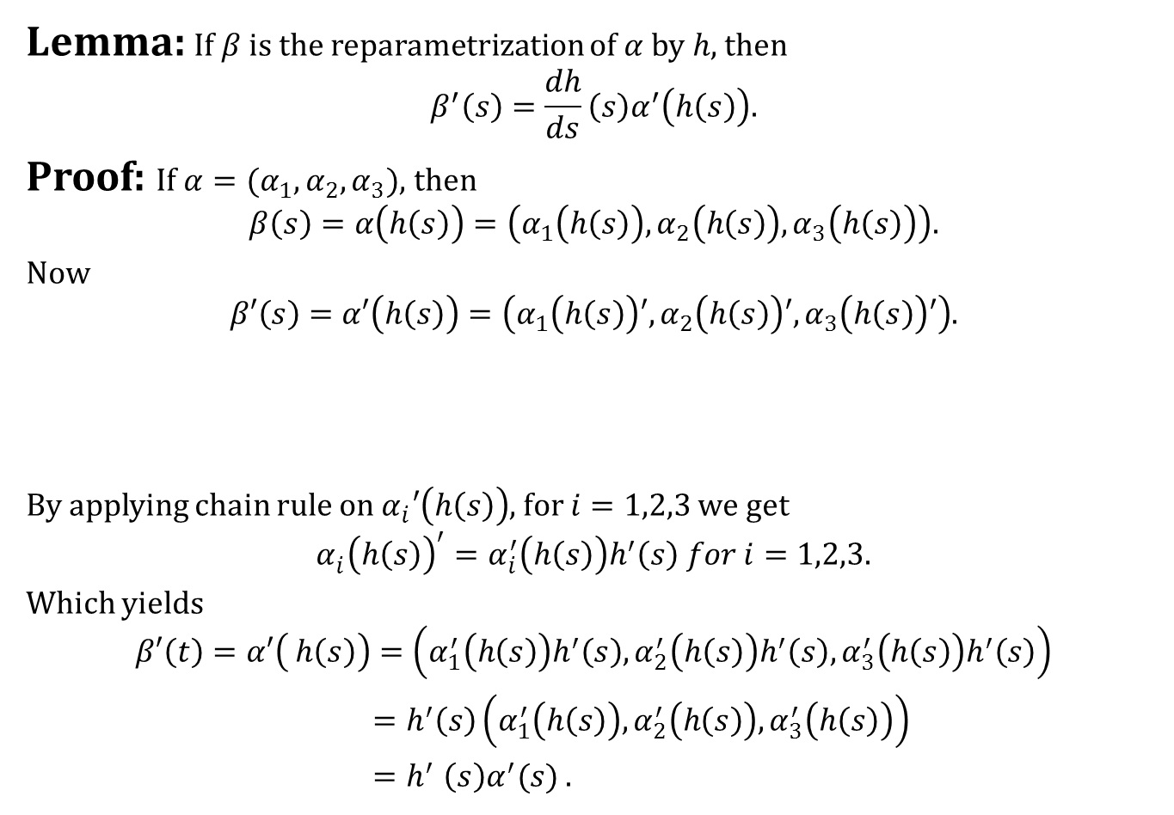
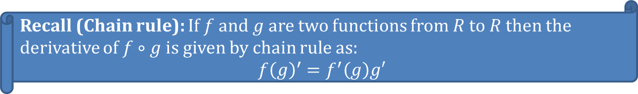
Reparametrization of Curves in $R^{3}$
Lemma: If $β$ is the reparametrization of $α$ by $h$, then
$$β^{′}\left(s\right)=\frac{dh}{ds}\left(s\right)α^{′}\left(h\left(s\right)\right).$$
Proof: If $α=(α_{1},α_{2},α_{3})$, then
$$β\left(s\right)=α\left(h\left(s\right)\right)=\left(α_{1}\left(h\left(s\right)\right),α_{2}\left(h\left(s\right)\right),α_{3}\left(h\left(s\right)\right)\right).$$
Now
$$β′\left(s\right)=α′\left(h\left(s\right)\right)=\left(α_{1}\left(h\left(s\right)\right)′,α_{2}\left(h\left(s\right)\right)′,α_{3}\left(h\left(s\right)\right)′\right).$$
By applying chain rule on $α_{i}′\left(h\left(s\right)\right)$, for $i=1,2,3$ we get
$$α_{i}^{}{\left(h\left(s\right)\right)}^{′}=α_{i}^{′}\left(h\left(s\right)\right)h^{′}\left(s\right) for i=1,2,3.$$
Which yields
$$β′\left(t\right)=α′\left( h\left(s\right)\right)=\left(α_{1}^{′}\left(h\left(s\right)\right)h^{′}\left(s\right),α_{2}^{′}\left(h\left(s\right)\right)h^{′}\left(s\right),α_{3}^{′}\left(h\left(s\right)\right)h^{′}\left(s\right)\right)$$
$=h^{′}\left(s\right)\left(α_{1}^{′}\left(h\left(s\right)\right),α_{2}^{′}\left(h\left(s\right)\right), α_{3}^{′}\left(h\left(s\right)\right)\right)$
${=h}^{′}\left(s\right)α^{′}(s)$ .
Recall (Chain rule): If $f$ and $g$ are two functions from $R$ to $R$ then the derivative of $f∘g$ is given by chain rule as:
$$f{\left(g\right)}^{′}=f^{′}\left(g\right)g′$$

Slide 35
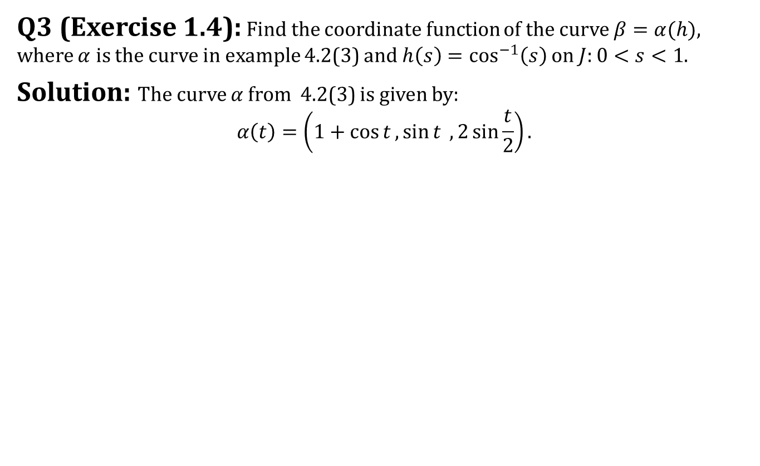
Reparametrization of Curves in $R^{3}$
Q3 (Exercise 1.4): Find the coordinate function of the curve $β=α(h)$, where $α$ is the curve in example 4.2(3) and $h\left(s\right)=\cos^{−1}\left(s\right)$ on $J:0<s<1$.
Solution: The curve $α$ from 4.2(3) is given by:
$$α\left(t\right)=\left(1+\cos{t},\sin{t} ,2\sin{\frac{t}{2}}\right).$$

Slide 36
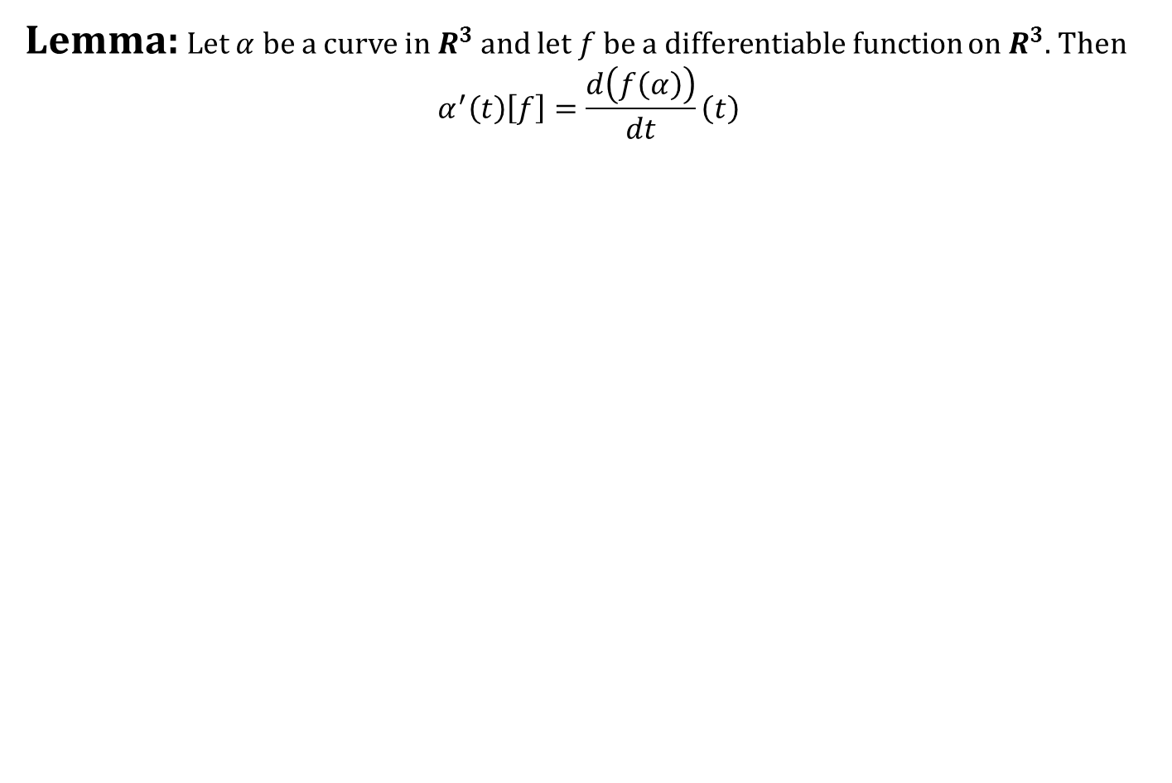
Derivative with respect to Velocity
Lemma: Let $α$ be a curve in $R^{3}$ and let $f$ be a differentiable function on $R^{3}$. Then
$$α^{′}\left(t\right)\left[f\right]=\frac{d\left(f\left(α\right)\right)}{dt}\left(t\right)$$

Slide 37


Derivative with respect to Velocity
Lemma: Let $α$ be a curve in $R^{3}$ and let $f$ be a differentiable function on $R^{3}$. Then
$$α^{′}\left(t\right)\left[f\right]=\frac{d\left(f\left(α\right)\right)}{dt}\left(t\right)$$
Proof:
In this case
$$α^{′}=\left(\frac{dα_{1}}{dt},\frac{dα_{2}}{dt},\frac{dα_{3}}{dt}\right)$$
So
$$α^{′}\left(t\right)\left[f\right]=\sum{\frac{∂f}{∂x_{i}}}\left(α\left(t\right)\right)\frac{dα_{i}}{dt}(t)$$
But by chain rule.
Recall: If $v_{p}=\left(v_{1},v_{2},v_{3}\right)$ is a tangent vector to $R^{3}$, then
$$v_{p}\left[f\right]={∑v}_{i}\frac{∂f}{∂x_{i}}\left(p\right).$$

Slide 38

Derivative with respect to Velocity

Slide 39

Derivative with respect to Velocity
Lemma: Let $α$ be a curve in $R^{3}$ and let $f$ be a differentiable function on $R^{3}$. Then
$$α^{′}\left(t\right)\left[f\right]=\frac{d\left(f\left(α\right)\right)}{dt}\left(t\right)$$
Proof:
In this case
$$α^{′}=\left(\frac{dα_{1}}{dt},\frac{dα_{2}}{dt},\frac{dα_{3}}{dt}\right)$$
So
$$α^{′}\left(t\right)\left[f\right]=\sum{\frac{∂f}{∂x_{i}}}\left(α\left(t\right)\right)\frac{dα_{i}}{dt}(t)$$
But by chain rule:
$$α^{′}\left(t\right)\left[f\right]=\frac{d\left(f\left(α\right)\right)}{dt}\left(t\right).$$
Recall: If $v_{p}=\left(v_{1},v_{2},v_{3}\right)$ is a tangent vector to $R^{3}$, then
$$v_{p}\left[f\right]={∑v}_{i}\frac{∂f}{∂x_{i}}\left(p\right).$$

Slide 40



Properties of Curves
One-to-one curves: The function $α:I→R^{3}$ is one-to one if
$$α\left(t_{1}\right)≠α\left(t_{2}\right)for t_{1}≠t_{2}$$
If $α$ is one-to-one then the curve does not intersect itself, or stay in the same point without moving on, or repeat itself over after some time.
Periodic curves:
A curve $α:R→R^{3}$ is called periodic if there is a positive number $p$ such that
$$α\left(t+p\right)=α\left(t\right) for all t∈R$$
The smallest such number $p$ is the period of $α$.

Slide 41


Properties of Curves
Regular curves: A curve $α:I→R^{3}$ is called regular if
$$α^{′}\left(t\right)≠{\left(0,0,0\right)}_{α\left(t\right)} for all t∈I$$
Example: The curve $α:R→R^{3}$ given as $α\left(t\right)=(t^{2},t^{3},0)$ is not regular.

Slide 42
What did we learn today
Contents:
Curves in $R^{3}$
Velocity Vectors
Reparametrization of Curves in $R^{3}$
Derivative with respect to Velocity
Properties of Curves
Conclusion

Slide 43


Next time
$1$-Forms

Slide 44

End of the lecture

