Slide 1
Lecture # 3
MTH352: Differential Geometry
For
Master of Mathematics
By
Dr. SOHAIL IQBAL
Assistant Professor
Department of Mathematics, CIIT Islamabad

Slide 2
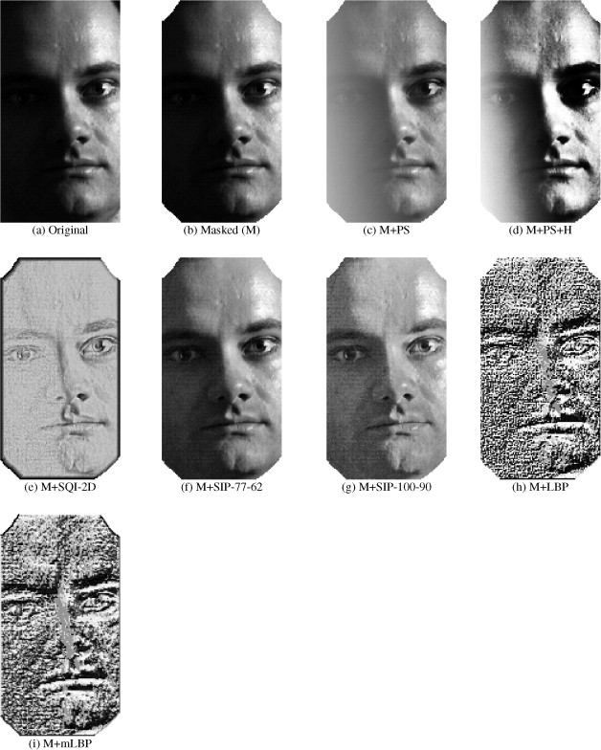
Today’s lecture
Contents:
Directional derivatives
  Definition
  How to differentiate composite functions
  (Chain rule)
  How to compute directional derivatives
  more efficiently
  The main properties of directional derivatives
Operation of a vector field
  Basic properties of operations of vector fields

Slide 3
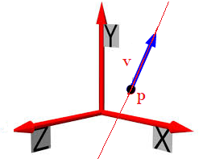
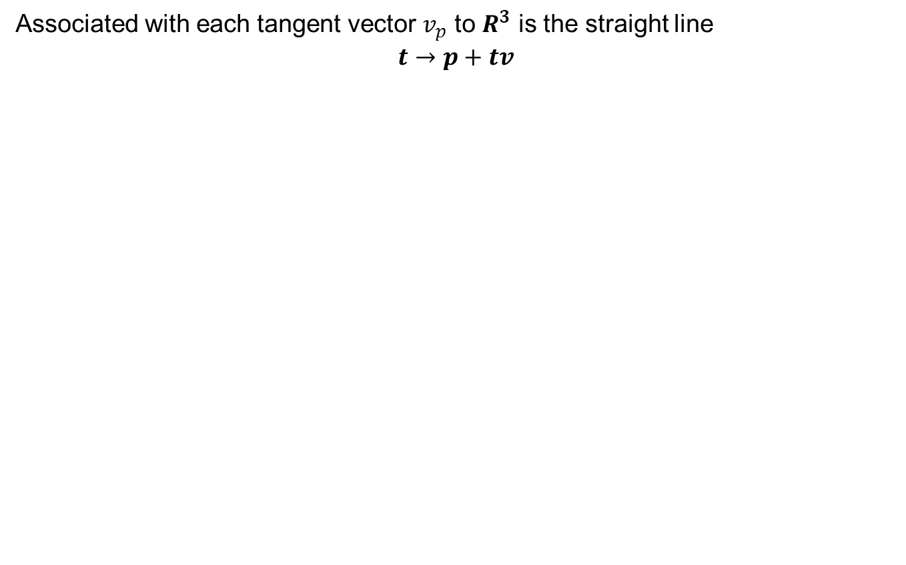
Directional derivatives
Associated with each tangent vector $v_{p}$ to $R^{3}$ is the straight line
$$t→p+tv$$

Slide 4
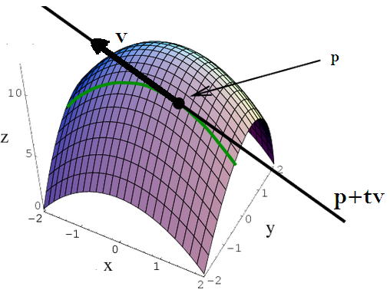
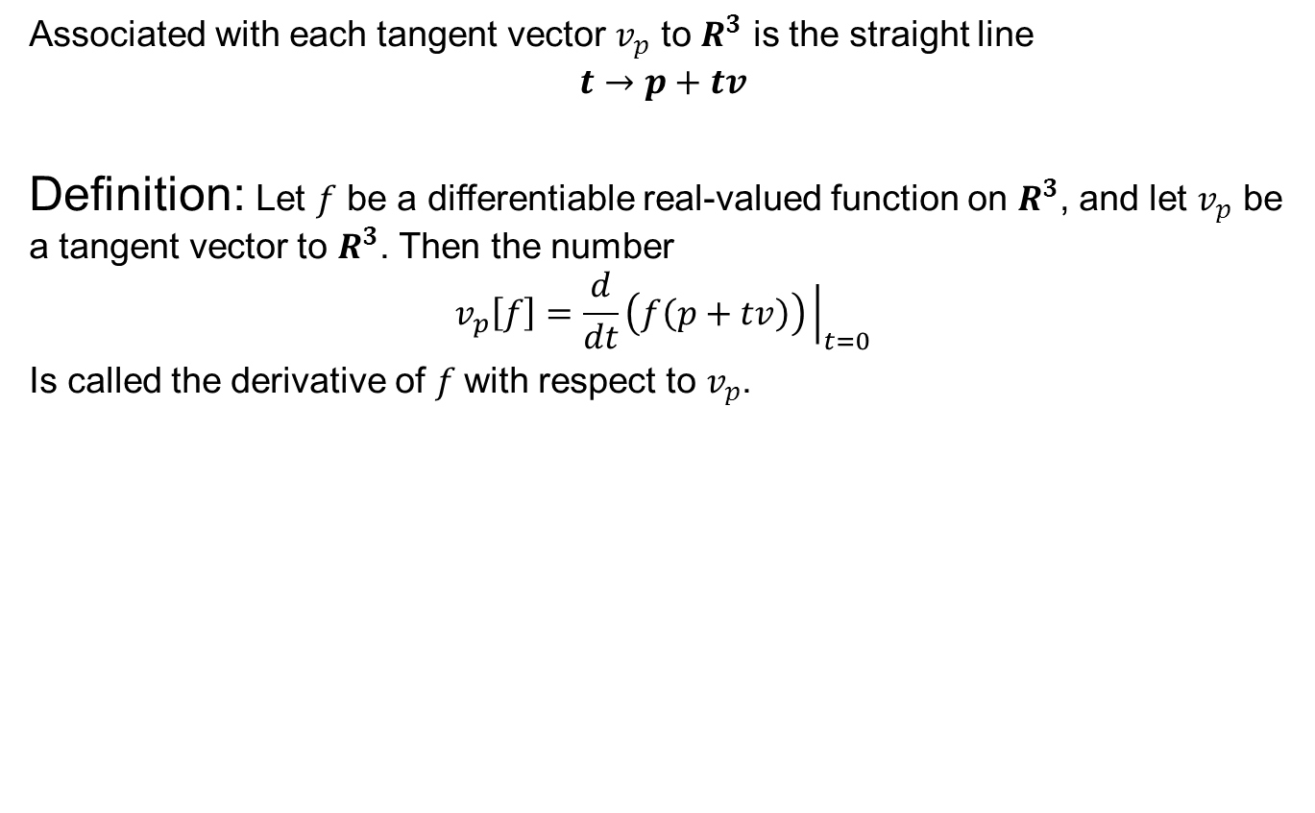
Directional derivatives
Associated with each tangent vector $v_{p}$ to $R^{3}$ is the straight line
$$t→p+tv$$
Definition: Let $f$ be a differentiable real-valued function on $R^{3}$, and let $v_{p}$ be a tangent vector to $R^{3}$. Then the number
$$v_{p}\left[f\right]=\frac{d}{dt}\left(f\left(p+tv\right)\right){\left.​\right|}_{t=0}$$
Is called the derivative of $f$with respect to $v_{p}$.

Slide 5
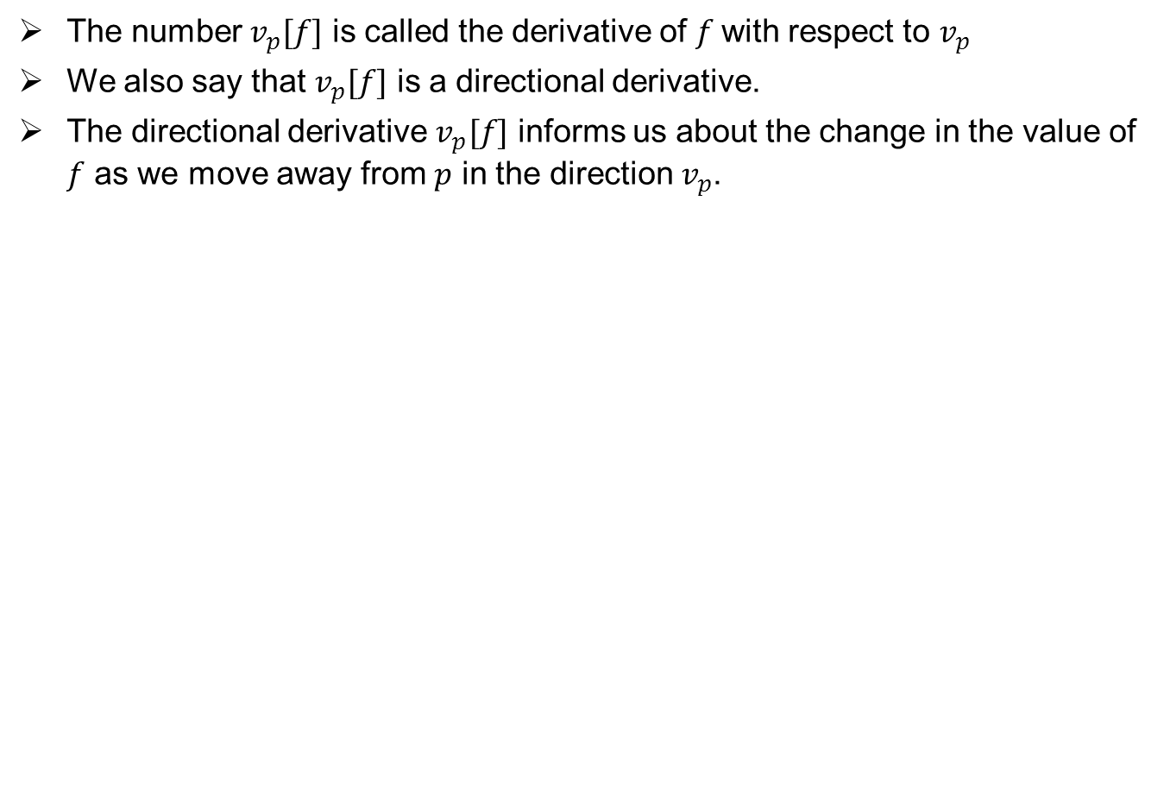
Directional derivatives
The number $v_{p}[f]$ is called the derivative of $f$with respect to $v_{p}$
We also say that $v_{p}[f]$ is a directional derivative.
The directional derivative $v_{p}[f]$ informs us about the change in the value of $f$ as we move away from $p$ in the direction $v_{p}$.

Slide 6
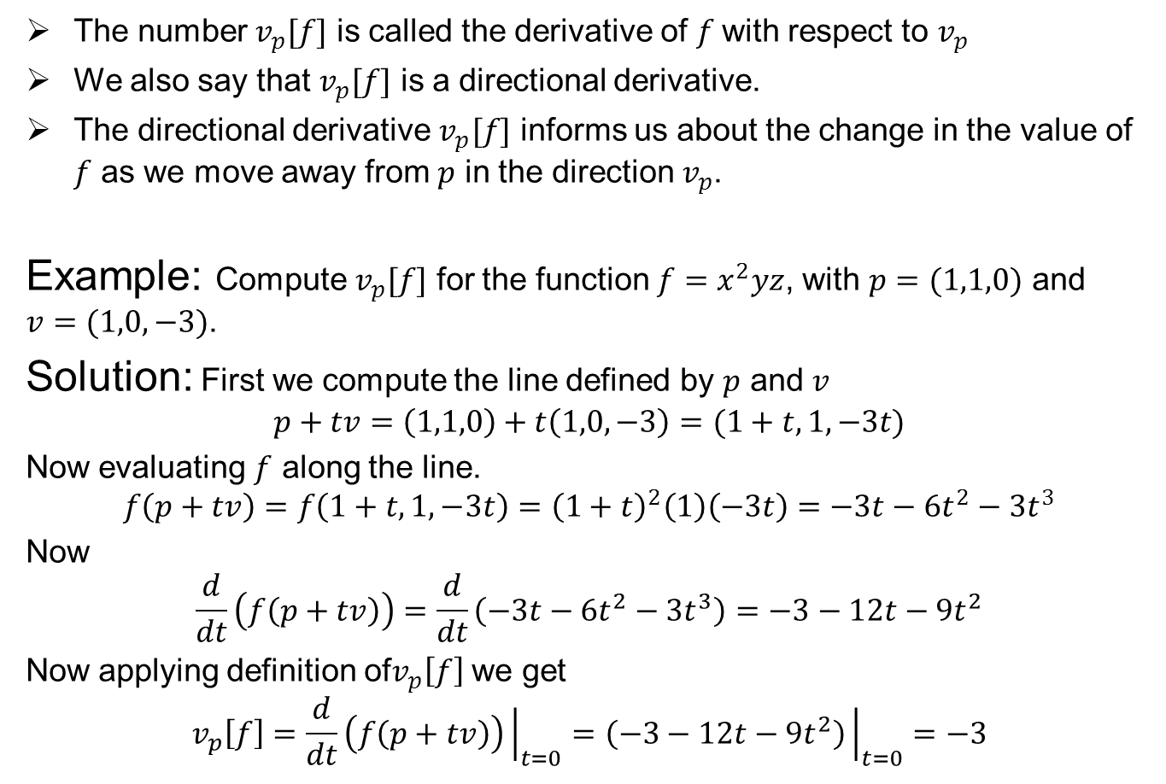
Directional derivatives
The number $v_{p}[f]$ is called the derivative of $f$with respect to $v_{p}$
We also say that $v_{p}[f]$ is a directional derivative.
The directional derivative $v_{p}[f]$ informs us about the change in the value of $f$ as we move away from $p$ in the direction $v_{p}$.
Example: Compute $v_{p}[f]$ for the function $f=x^{2}yz$, with $p=(1,1,0)$ and $v=(1,0,−3)$.
Solution: First we compute the line defined by $p$ and $v$
$$p+tv=\left(1,1,0\right)+t\left(1,0,−3\right)=(1+t,1,−3t)$$
Now evaluating $f$ along the line.
$$f\left(p+tv\right)=f\left(1+t,1,−3t\right)={\left(1+t\right)}^{2}\left(1\right)\left(−3t\right)=−3t−6t^{2}−3t^{3}$$
Now
$$\frac{d}{dt}\left(f\left(p+tv\right)\right)=\frac{d}{dt}\left(−3t−6t^{2}−3t^{3}\right)=−3−12t−9t^{2}$$
Now applying definition of$v_{p}\left[f\right]$ we get
$$v_{p}\left[f\right]=\frac{d}{dt}\left(f\left(p+tv\right)\right){\left.​\right|}_{t=0}=\left(−3−12t−9t^{2}\right){\left.​\right|}_{t=0}=−3$$

Slide 7
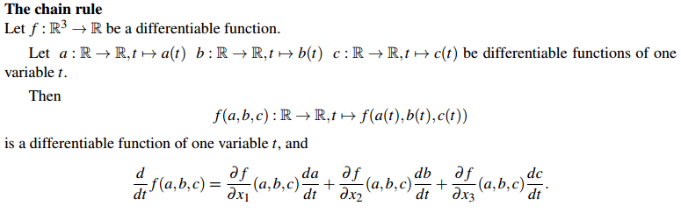
Directional derivatives
Recall:

Slide 9
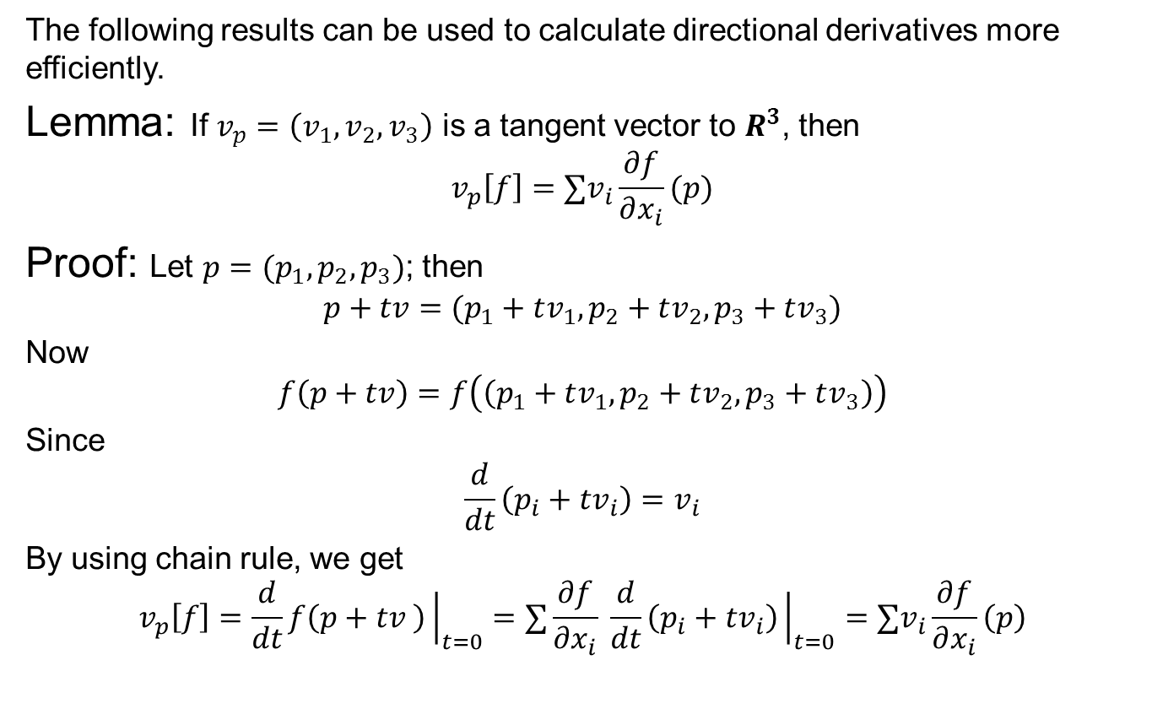
Directional derivatives
The following results can be used to calculate directional derivatives more efficiently.
Lemma: If $v_{p}=\left(v_{1},v_{2},v_{3}\right)$ is a tangent vector to $R^{3}$, then
$$v_{p}\left[f\right]={∑v}_{i}\frac{∂f}{∂x_{i}}(p)$$
Proof: Let $p=(p_{1},p_{2},p_{3})$; then
$$p+tv=(p_{1}+tv_{1},p_{2}+tv_{2},p_{3}+tv_{3})$$
Now
$$f\left(p+tv\right)=f\left(\left(p_{1}+tv_{1},p_{2}+tv_{2},p_{3}+tv_{3}\right)\right)$$
Since
$$\frac{d}{dt}\left(p_{i}+tv_{i}\right)=v_{i}$$
By using chain rule, we get
$$v_{p}\left[f\right]=\frac{d}{dt}f\left(p+tv \right){\left.​\right|}_{t=0}=∑\frac{∂f}{∂x_{i}} \frac{d}{dt}\left(p_{i}+tv_{i}\right){\left.​\right|}_{t=0}={∑v}_{i}\frac{∂f}{∂x_{i}}\left(p\right)$$

Slide 10
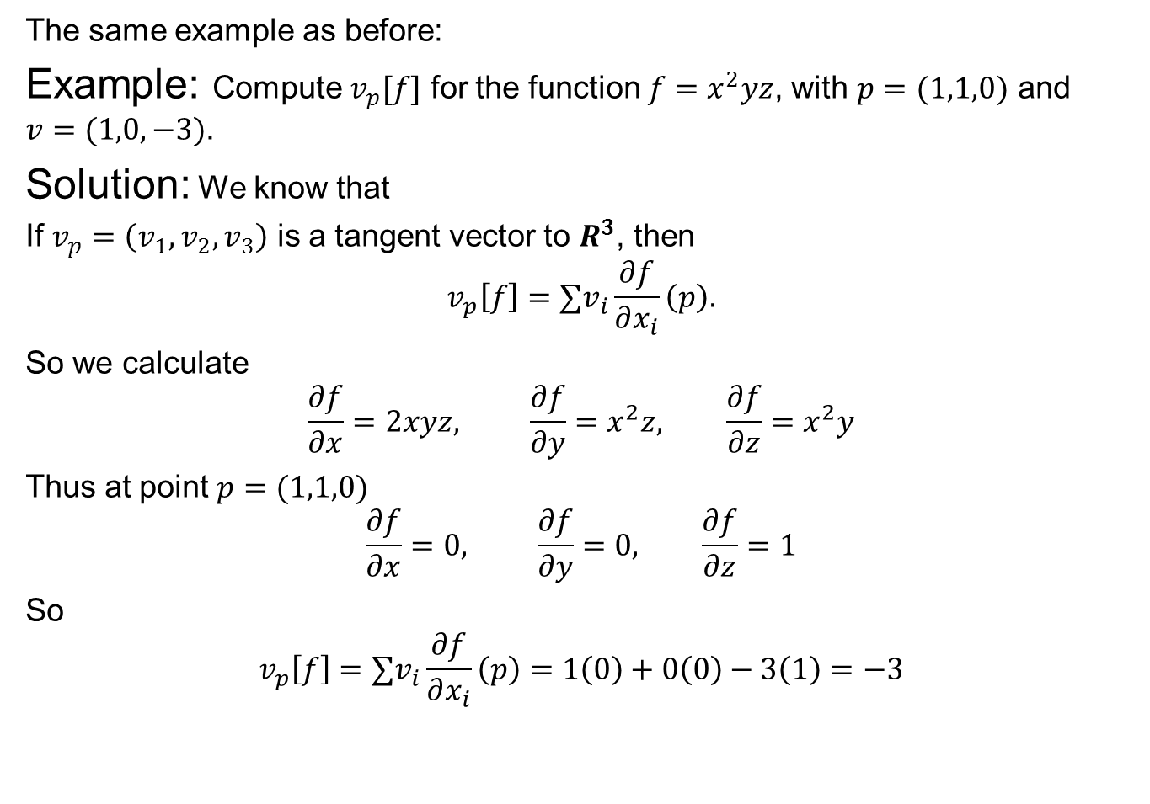
Directional derivatives
The same example as before:
Example: Compute $v_{p}[f]$ for the function $f=x^{2}yz$, with $p=(1,1,0)$ and $v=(1,0,−3)$.
Solution: We know that
If $v_{p}=\left(v_{1},v_{2},v_{3}\right)$ is a tangent vector to $R^{3}$, then
$$v_{p}\left[f\right]={∑v}_{i}\frac{∂f}{∂x_{i}}\left(p\right).$$
So we calculate
$$\frac{∂f}{∂x}=2xyz, \frac{∂f}{∂y}=x^{2}z, \frac{∂f}{∂z}=x^{2}y$$
Thus at point $p=(1,1,0)$
$$\frac{∂f}{∂x}=0, \frac{∂f}{∂y}=0, \frac{∂f}{∂z}=1$$
So
$$v_{p}\left[f\right]={∑v}_{i}\frac{∂f}{∂x_{i}}\left(p\right)=1\left(0\right)+0\left(0\right)−3\left(1\right)=−3$$

Slide 11
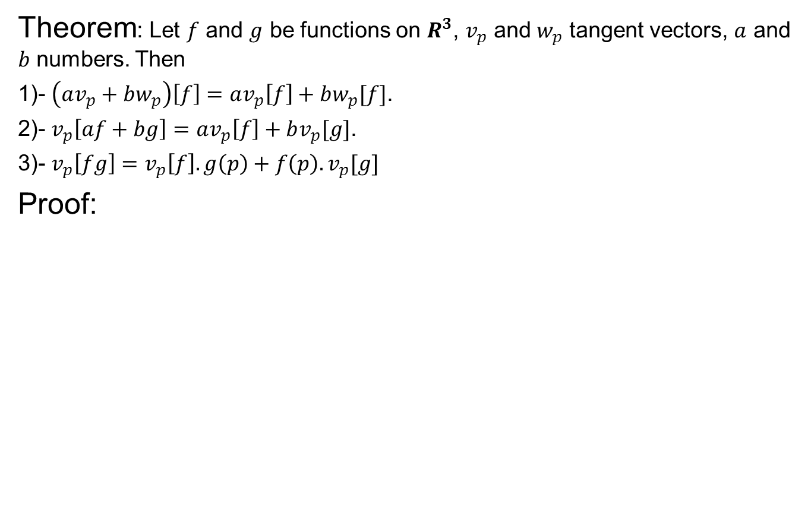
Directional derivatives
Theorem: Let $f$ and $g$ be functions on $R^{3}$, $v_{p}$ and $w_{p}$ tangent vectors, $a$ and $b$ numbers. Then
1)- $\left(av_{p}+bw_{p}\right)\left[f\right]=av_{p}\left[f\right]+bw_{p}[f]$.
2)- $v_{p}\left[af+bg\right]=av_{p}\left[f\right]+bv_{p}[g]\text{.}$
3)- $v_{p}\left[fg\right]=v_{p}\left[f\right].g\left(p\right)+f\left(p\right).v_{p}[g]$
Proof:

Slide 12
Directional derivatives
Theorem: Let $f$ and $g$ be functions on $R^{3}$, $v_{p}$ and $w_{p}$ tangent vectors, $a$ and $b$ numbers. Then
1)- $\left(av_{p}+bw_{p}\right)\left[f\right]=av_{p}\left[f\right]+bw_{p}[f]$.
2)- $v_{p}\left[af+bg\right]=av_{p}\left[f\right]+bv_{p}[g]\text{.}$
3)- $v_{p}\left[fg\right]=v_{p}\left[f\right].g\left(p\right)+f\left(p\right).v_{p}[g]$
Proof:

Slide 13
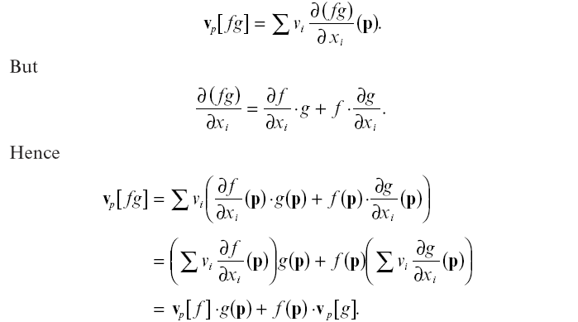
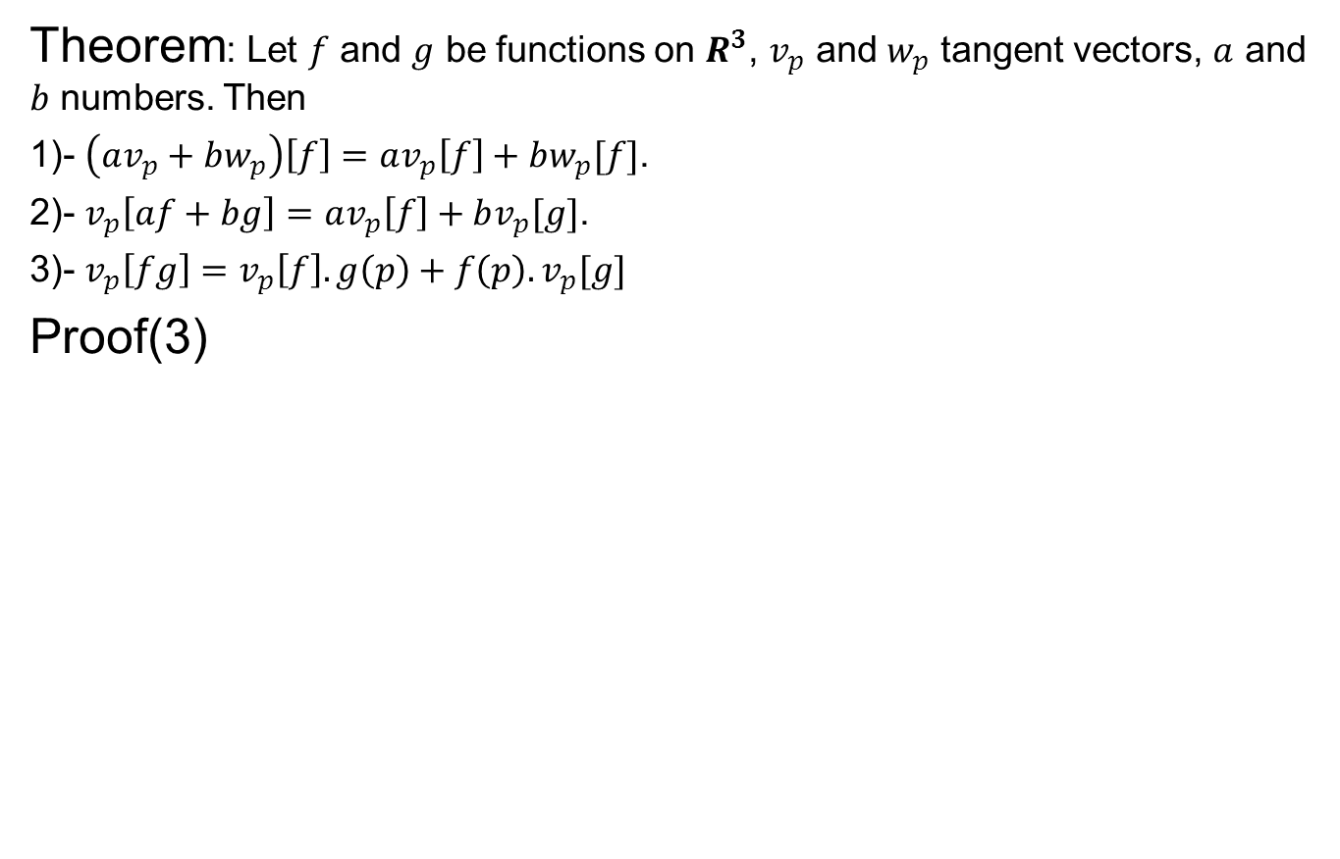
Directional derivatives
Theorem: Let $f$ and $g$ be functions on $R^{3}$, $v_{p}$ and $w_{p}$ tangent vectors, $a$ and $b$ numbers. Then
1)- $\left(av_{p}+bw_{p}\right)\left[f\right]=av_{p}\left[f\right]+bw_{p}[f]$.
2)- $v_{p}\left[af+bg\right]=av_{p}\left[f\right]+bv_{p}[g]\text{.}$
3)- $v_{p}\left[fg\right]=v_{p}\left[f\right].g\left(p\right)+f\left(p\right).v_{p}[g]$
Proof(3)

Slide 14
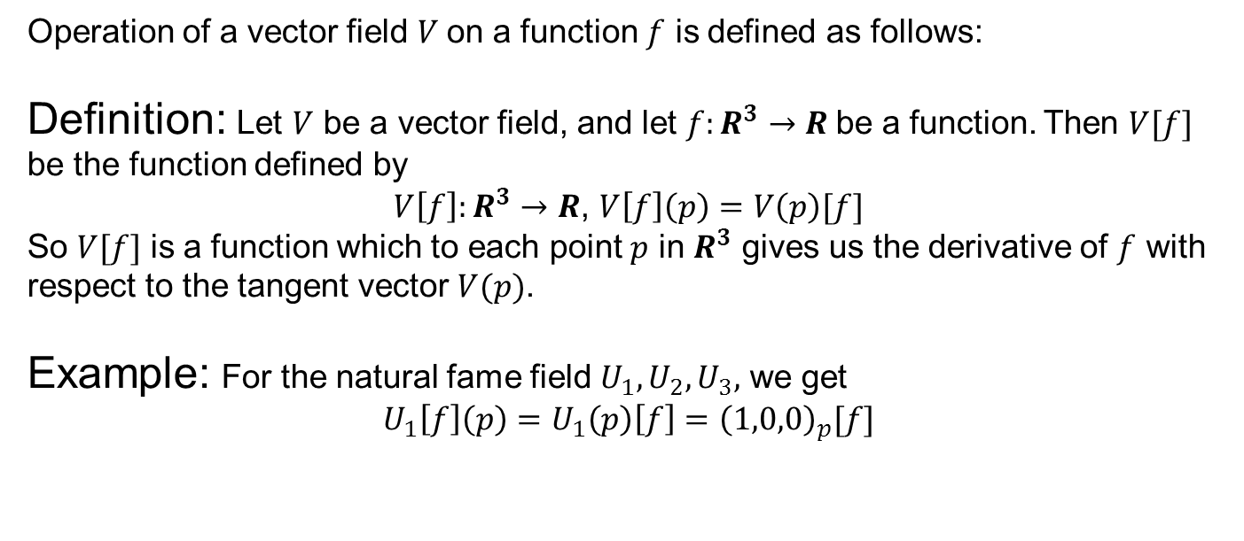
Operation of a vector field
Operation of a vector field $V$on a function $f$ is defined as follows:
Definition: Let $V$ be a vector field, and let $f:R^{3}→R$be a function. Then $V[f]$ be the function defined by
$V\left[f\right]:R^{3}→R$, $V\left[f\right]\left(p\right)=V\left(p\right)[f]$
So $V[f]$ is a function which to each point $p$ in $R^{3}$ gives us the derivative of $f$ with respect to the tangent vector $V(p)$.
Example: For the natural fame field $U_{1},U_{2},U_{3},$ we get
$$U_{1}\left[f\right]\left(p\right)=U_{1}\left(p\right)\left[f\right]={\left(1,0,0\right)}_{p}[f]$$

Slide 15
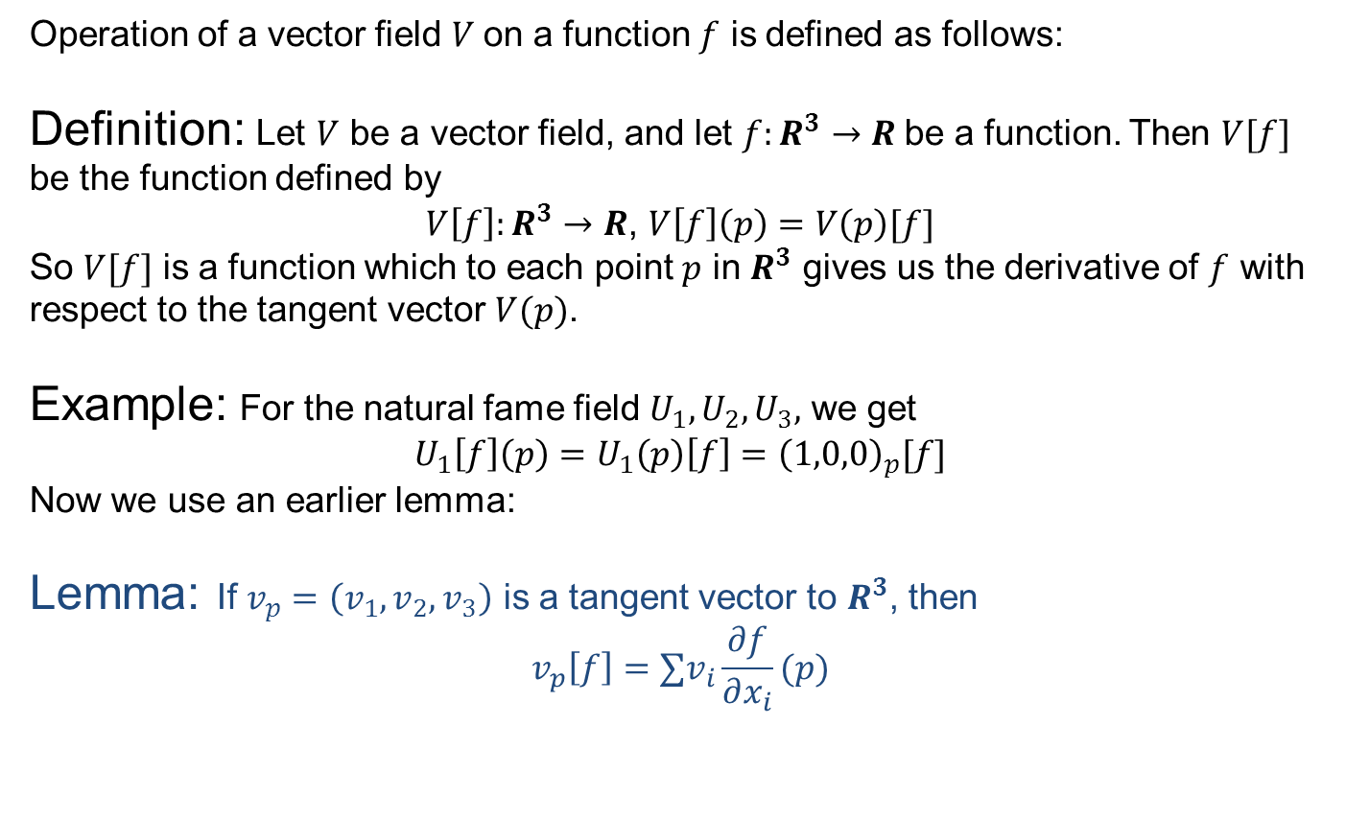
Operation of a vector field
Operation of a vector field $V$on a function $f$ is defined as follows:
Definition: Let $V$ be a vector field, and let $f:R^{3}→R$be a function. Then $V[f]$ be the function defined by
$V\left[f\right]:R^{3}→R$, $V\left[f\right]\left(p\right)=V\left(p\right)[f]$
So $V[f]$ is a function which to each point $p$ in $R^{3}$ gives us the derivative of $f$ with respect to the tangent vector $V(p)$.
Example: For the natural fame field $U_{1},U_{2},U_{3},$ we get
$$U_{1}\left[f\right]\left(p\right)=U_{1}\left(p\right)\left[f\right]={\left(1,0,0\right)}_{p}[f]$$
Now we use an earlier lemma:
Lemma: If $v_{p}=\left(v_{1},v_{2},v_{3}\right)$ is a tangent vector to $R^{3}$, then
$$v_{p}\left[f\right]={∑v}_{i}\frac{∂f}{∂x_{i}}(p)$$

Slide 16
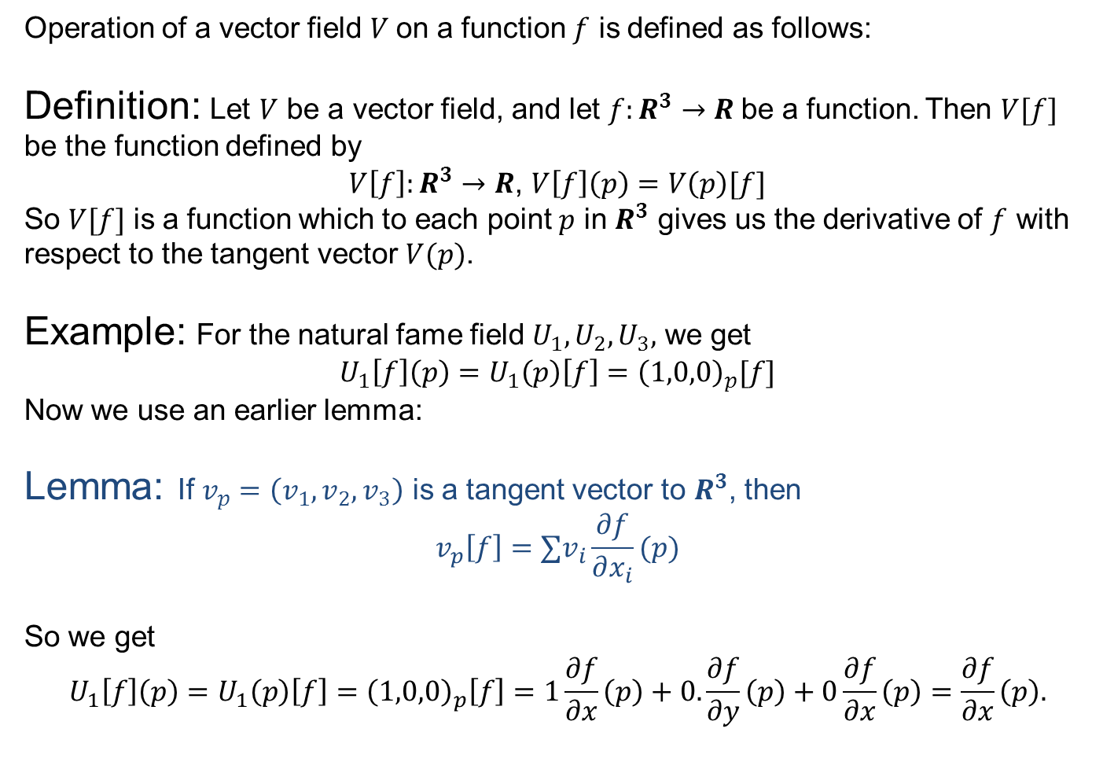
Operation of a vector field
Operation of a vector field $V$on a function $f$ is defined as follows:
Definition: Let $V$ be a vector field, and let $f:R^{3}→R$be a function. Then $V[f]$ be the function defined by
$V\left[f\right]:R^{3}→R$, $V\left[f\right]\left(p\right)=V\left(p\right)[f]$
So $V[f]$ is a function which to each point $p$ in $R^{3}$ gives us the derivative of $f$ with respect to the tangent vector $V(p)$.
Example: For the natural fame field $U_{1},U_{2},U_{3},$ we get
$$U_{1}\left[f\right]\left(p\right)=U_{1}\left(p\right)\left[f\right]={\left(1,0,0\right)}_{p}[f]$$
Now we use an earlier lemma:
Lemma: If $v_{p}=\left(v_{1},v_{2},v_{3}\right)$ is a tangent vector to $R^{3}$, then
$$v_{p}\left[f\right]={∑v}_{i}\frac{∂f}{∂x_{i}}(p)$$
So we get
$$U_{1}\left[f\right]\left(p\right)=U_{1}\left(p\right)\left[f\right]={\left(1,0,0\right)}_{p}\left[f\right]=1\frac{∂f}{∂x}\left(p\right)+0.\frac{∂f}{∂y}\left(p\right)+0\frac{∂f}{∂x}\left(p\right)=\frac{∂f}{∂x}\left(p\right).$$

Slide 18
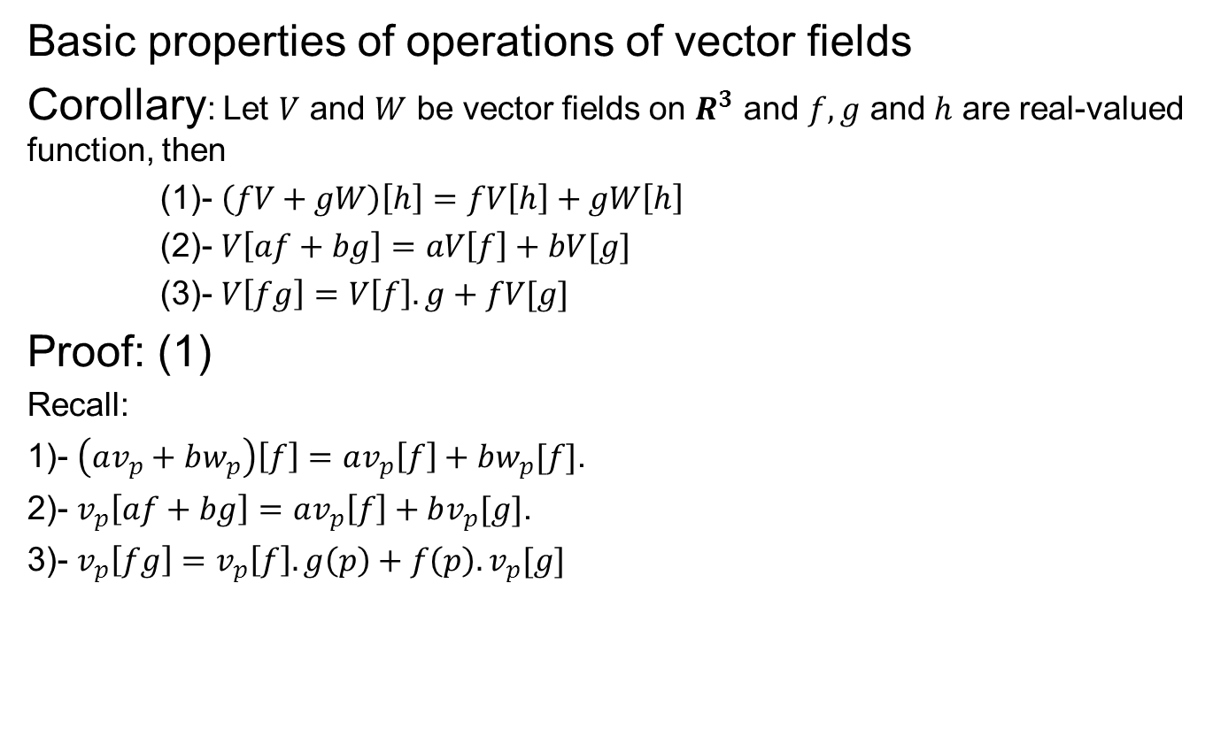
Operation of a vector field
Basic properties of operations of vector fields
Corollary: Let $V$ and $W$ be vector fields on $R^{3}$ and $f,g$ and $h$ are real-valued function, then
(1)- $\left(fV+gW\right)\left[h\right]=fV\left[h\right]+gW\left[h\right]$
(2)- $V\left[af+bg\right]=aV\left[f\right]+bV[g]$
(3)- $V\left[fg\right]=V\left[f\right].g+fV[g]$
Proof: (1)
Recall:
1)- $\left(av_{p}+bw_{p}\right)\left[f\right]=av_{p}\left[f\right]+bw_{p}[f]$.
2)- $v_{p}\left[af+bg\right]=av_{p}\left[f\right]+bv_{p}[g]\text{.}$
3)- $v_{p}\left[fg\right]=v_{p}\left[f\right].g\left(p\right)+f\left(p\right).v_{p}[g]$

Slide 19
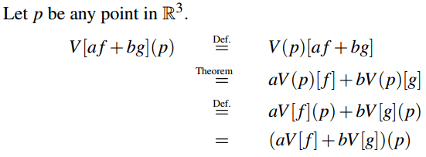

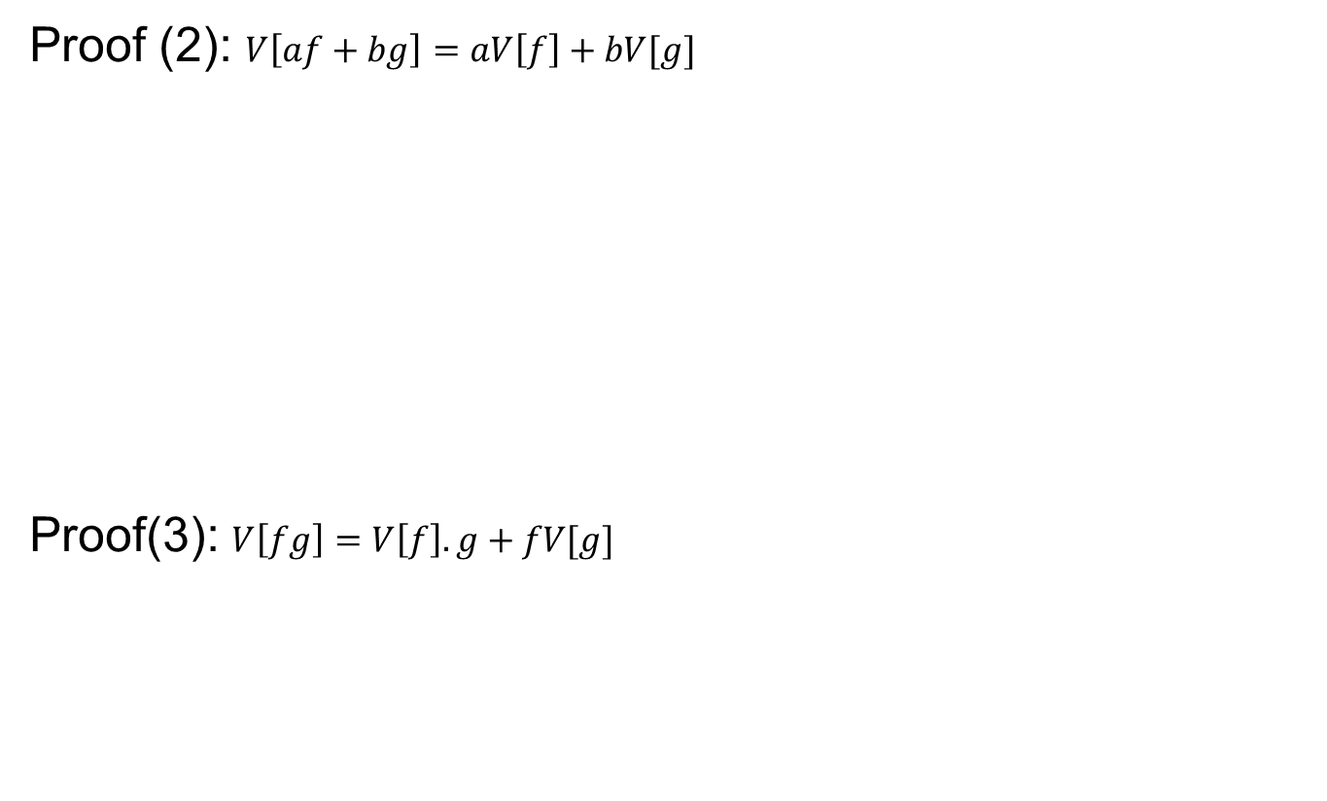
Operation of a vector field
Proof (2): $V\left[af+bg\right]=aV\left[f\right]+bV[g]$
Proof(3): $V\left[fg\right]=V\left[f\right].g+fV[g]$

Slide 20
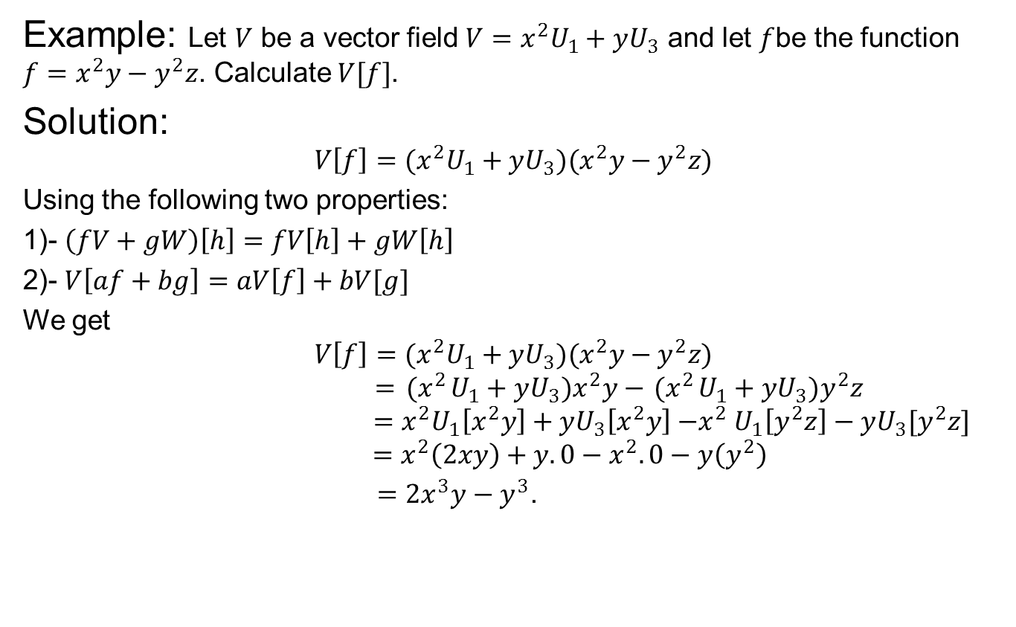
Operation of a vector field
Example: Let $V$ be a vector field $V=x^{2}U_{1}+yU_{3}$ and let $f$be the function $f=x^{2}y−y^{2}z$. Calculate $V[f]$.
Solution:
$$V\left[f\right]=(x^{2}U_{1}+yU_{3}){(x}^{2}y−y^{2}z)$$
Using the following two properties:
1)- $\left(fV+gW\right)\left[h\right]=fV\left[h\right]+gW\left[h\right]$
2)- $V\left[af+bg\right]=aV\left[f\right]+bV[g]$
We get
$${V\left[f\right]=(x}^{2}U_{1}+yU_{3}){(x}^{2}y−y^{2}z)$$
$$={ (x}^{2}U_{1}+yU_{3})x^{2}y−{ (x}^{2}U_{1}+yU_{3})y^{2}z$$
$${ =x}^{2}U_{1}\left[x^{2}y\right]+yU_{3}\left[x^{2}y\right]{−x}^{2}U_{1}\left[y^{2}z\right]−yU_{3}[y^{2}z]$$
$$=x^{2}\left(2xy\right)+y.0−x^{2}.0−y\left(y^{2}\right)$$
$=2x^{3}y−y^{3}$.

Slide 21
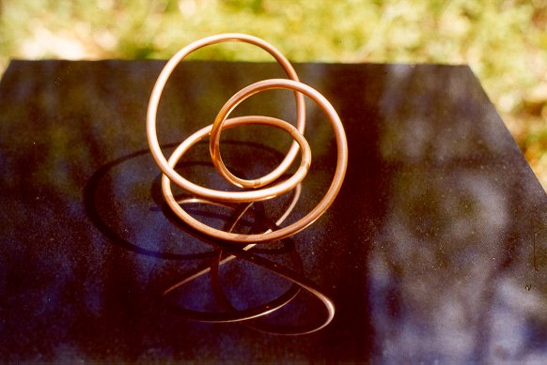

Next time
Curves in $R^{3}$

Slide 22

End of the lecture

