Slide 1
Lecture # 2
MTH352: Differential Geometry
For
Master of Mathematics
By
Dr. SOHAIL IQBAL
Assistant Professor
Department of Mathematics, CIIT Islamabad

Slide 2

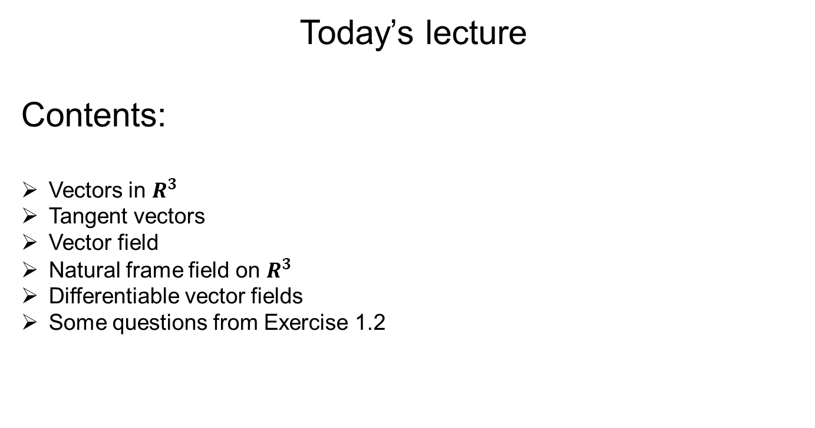
Today’s lecture
Contents:
Vectors in $R^{3}$
Tangent vectors
Vector field
Natural frame field on $R^{3}$
Differentiable vector fields
Some questions from Exercise 1.2

Slide 3
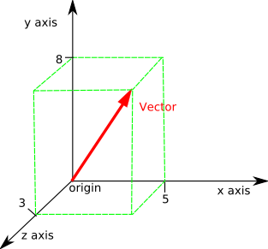
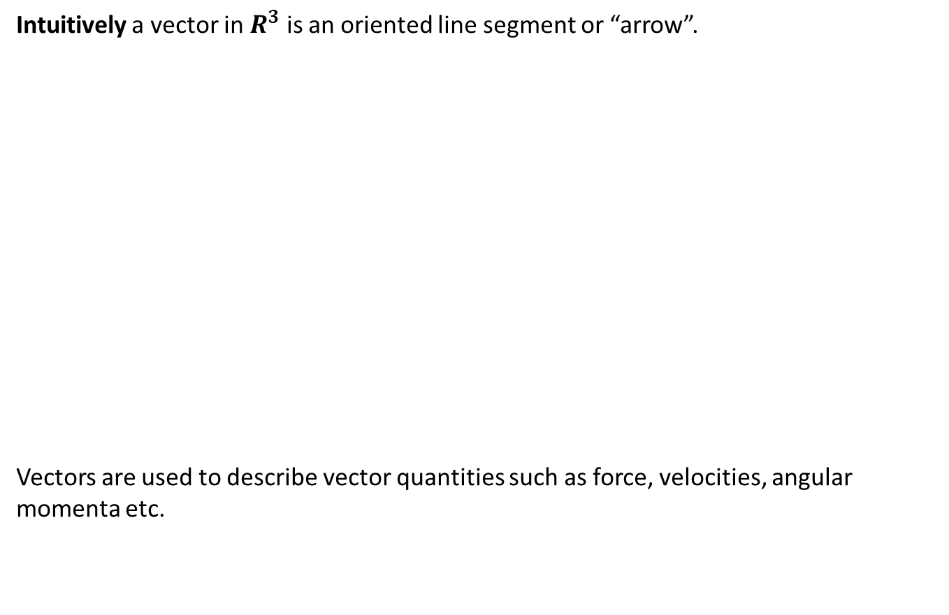

Vectors in $R^{3}$
Intuitively a vector in $R^{3}$ is an oriented line segment or “arrow”.
Vectors are used to describe vector quantities such as force, velocities, angular momenta etc.

Slide 4
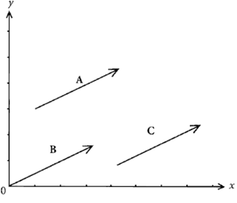
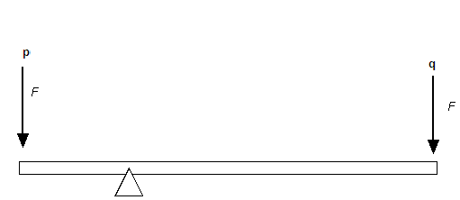

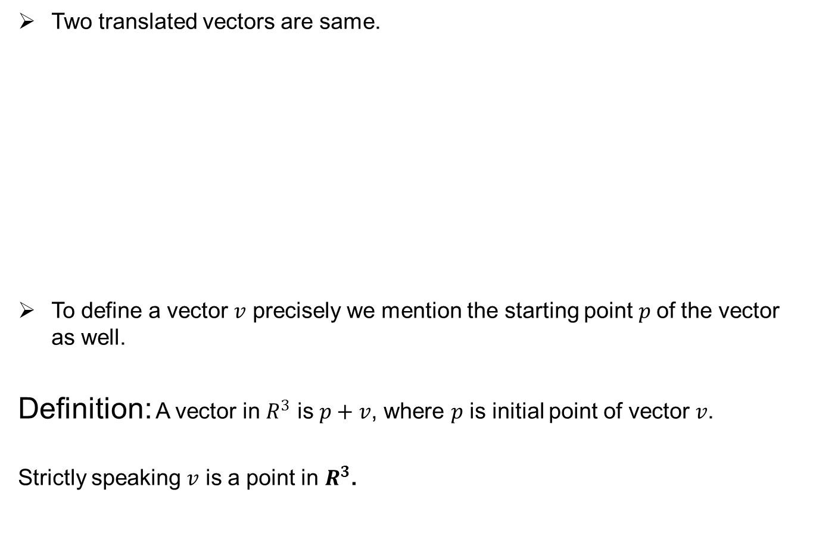
Vectors in $R^{3}$
Two translated vectors are same.
To define a vector $v$ precisely we mention the starting point $p$of the vector as well.
Definition: A vector in $R^{3}$ is $p+v$, where $p$ is initial point of vector $v$.
Strictly speaking $v$ is a point in $R^{3}$.

Slide 5
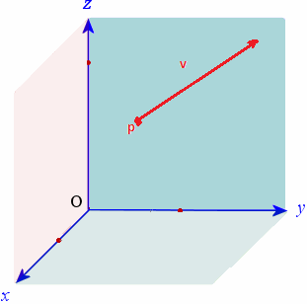
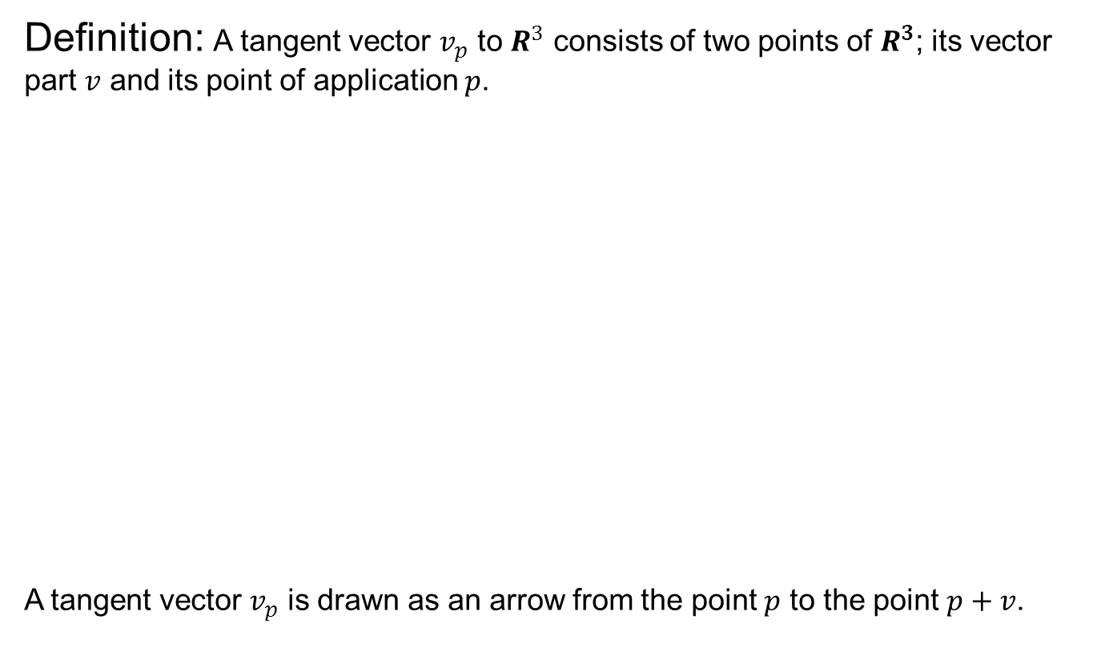
Tangent vectors
Definition: A tangent vector $v_{p}$ to $R^{3}$ consists of two points of $R^{3}$; its vector part $v$ and its point of application $p$.
A tangent vector $v_{p}$ is drawn as an arrow from the point $p$ to the point $p+v$.

Slide 6
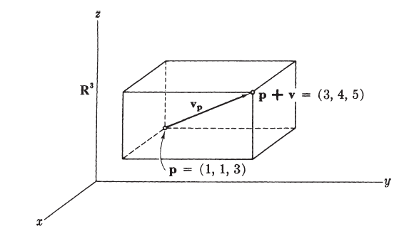
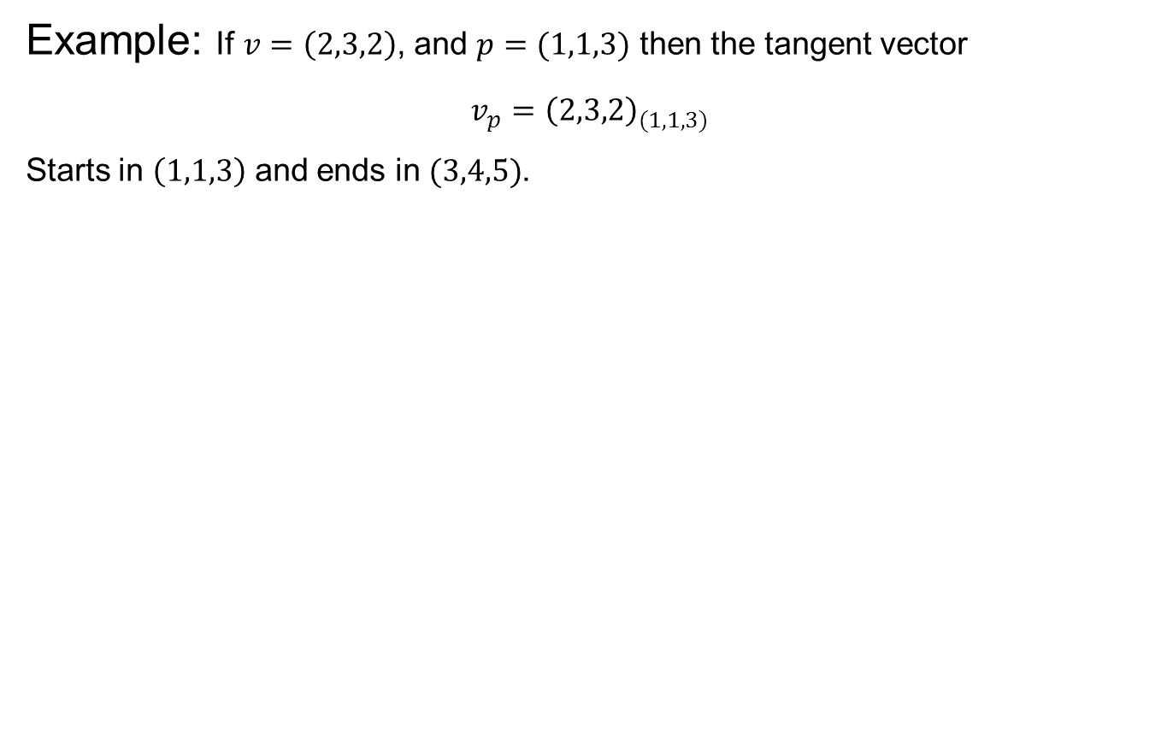
Tangent vectors
Example: If $v=\left(2,3,2\right)$, and $p=(1,1,3)$ then the tangent vector
$$v_{p}={\left(2,3,2\right)}_{(1,1,3)}$$
Starts in $\left(1,1,3\right)$ and ends in $(3,4,5)$.

Slide 7
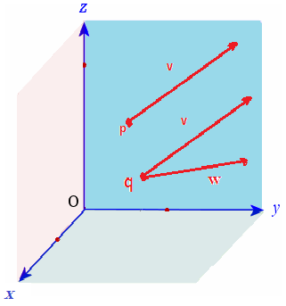
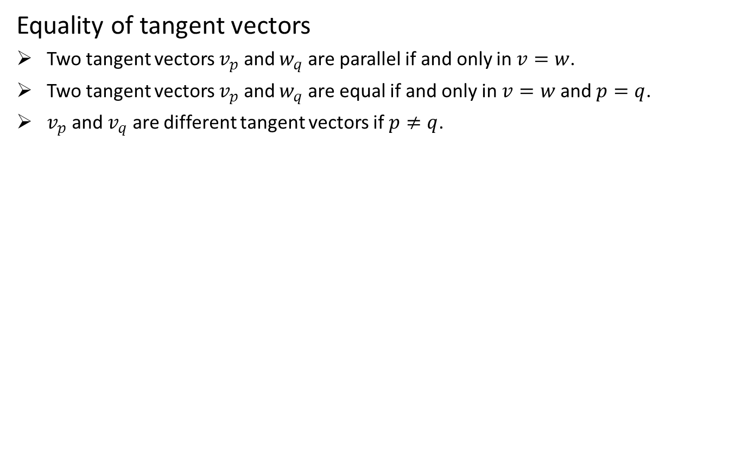
Tangent vectors
Equality of tangent vectors
Two tangent vectors $v_{p}$ and $w_{q}$ are parallel if and only in $v=w$.
Two tangent vectors $v_{p}$ and $w_{q}$ are equal if and only in $v=w$ and $p=q$.
$v_{p}$ and $v_{q}$ are different tangent vectors if $p≠q$.

Slide 8
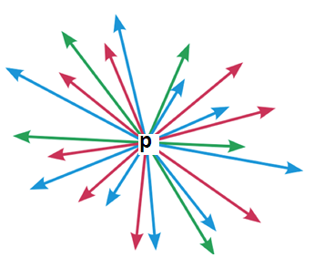
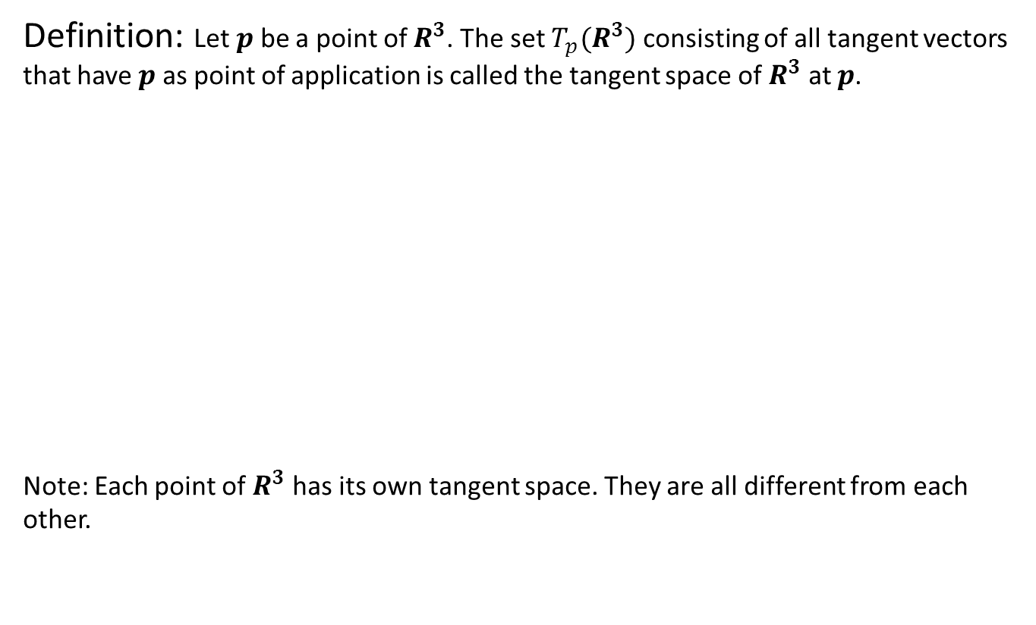
Tangent Space
Definition: Let $p$ be a point of $R^{3}$. The set $T_{p}(R^{3})$ consisting of all tangent vectors that have $p$ as point of application is called the tangent space of $R^{3}$ at $p$.
Note: Each point of $R^{3}$ has its own tangent space. They are all different from each other.

Slide 9
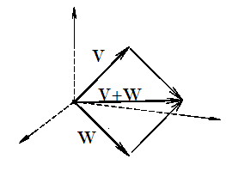
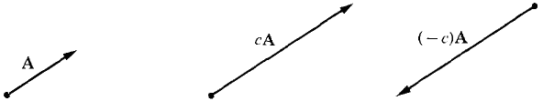
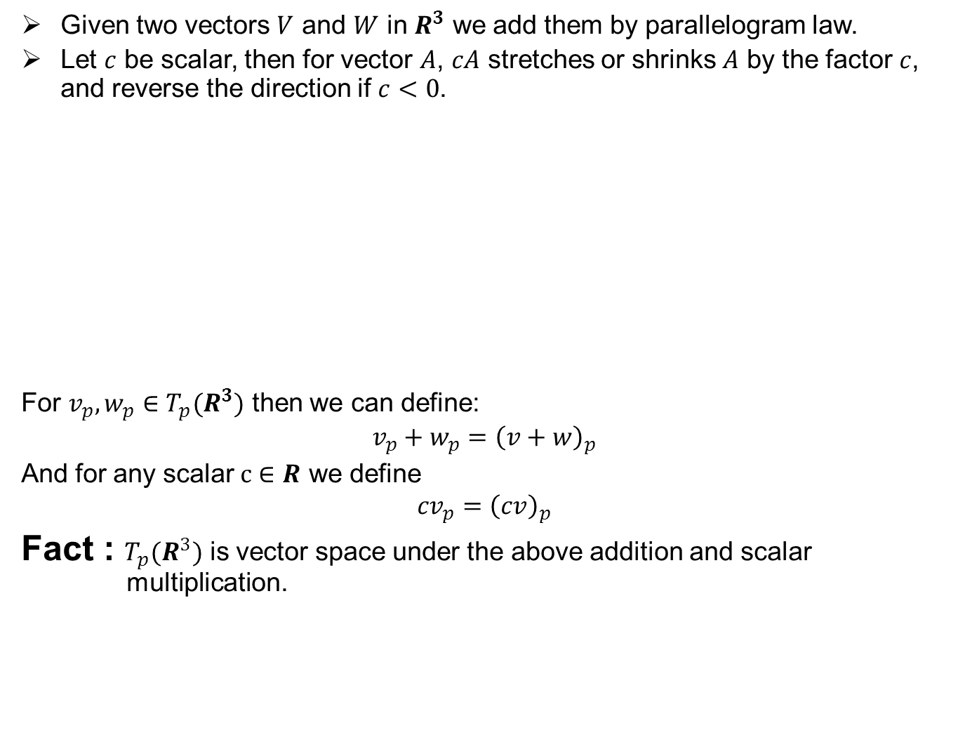
Tangent Space
Given two vectors $V$ and $W$ in $R^{3}$ we add them by parallelogram law.
Let $c$ be scalar, then for vector $A$, $cA$ stretches or shrinks $A$ by the factor $c$, and reverse the direction if $c<0$.
For $v_{p},w_{p}∈T_{p}(R^{3})$ then we can define:
$$v_{p}+w_{p}={\left(v+w\right)}_{p}$$
And for any scalar $c∈R$ we define
$${cv}_{p}={\left(cv\right)}_{p}$$
Fact : $T_{p}{(R}^{3})$ is vector space under the above addition and scalar multiplication.

Slide 10
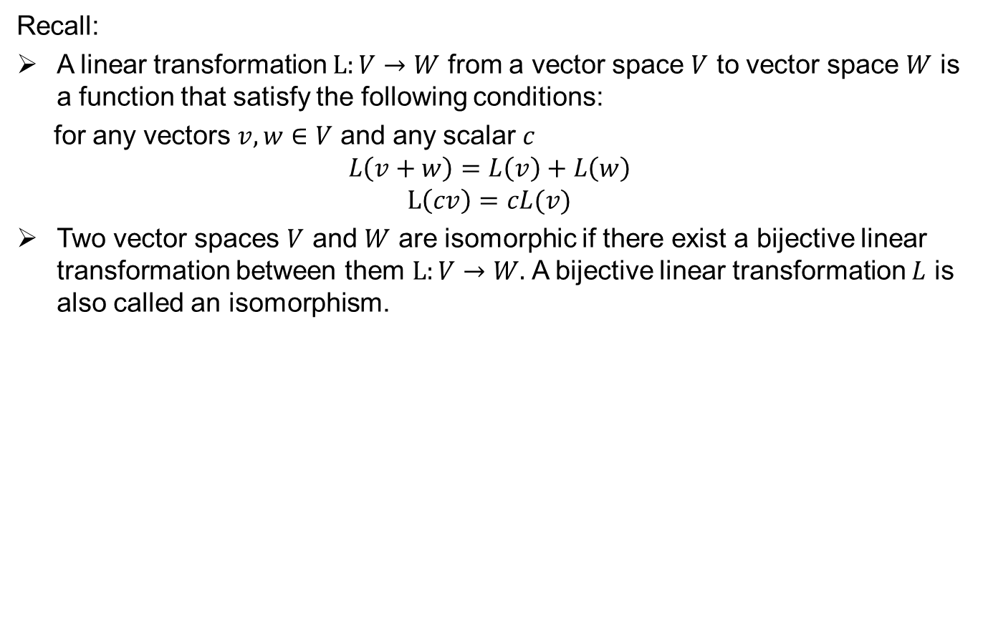
Tangent Space
Recall:
A linear transformation $L:V→W$ from a vector space $V$ to vector space $W$ is a function that satisfy the following conditions:
for any vectors $v,w∈V$ and any scalar $c$
$$L\left(v+w\right)=L\left(v\right)+L\left(w\right)$$
$$L\left(cv\right)=cL(v)$$
Two vector spaces $V$ and $W$ are isomorphic if there exist a bijective linear transformation between them $L:V→W.$ A bijective linear transformation $L$ is also called an isomorphism.

Slide 11
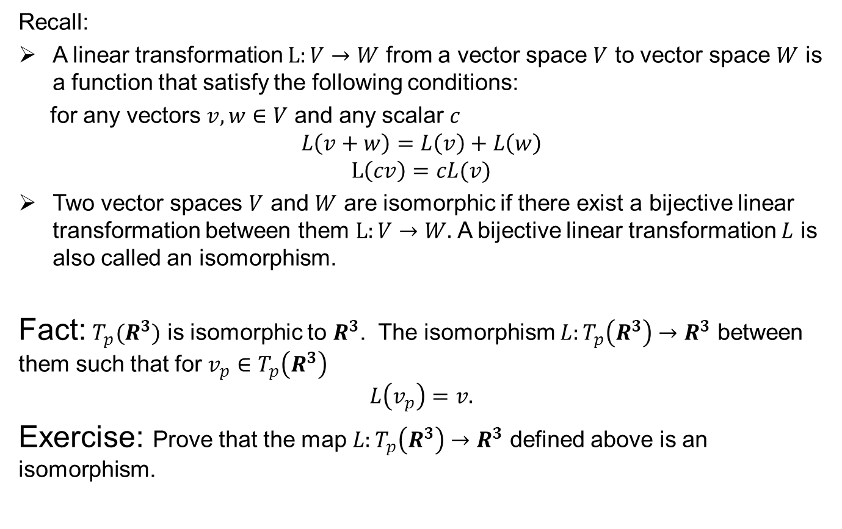
Tangent Space
Recall:
A linear transformation $L:V→W$ from a vector space $V$ to vector space $W$ is a function that satisfy the following conditions:
for any vectors $v,w∈V$ and any scalar $c$
$$L\left(v+w\right)=L\left(v\right)+L\left(w\right)$$
$$L\left(cv\right)=cL(v)$$
Two vector spaces $V$ and $W$ are isomorphic if there exist a bijective linear transformation between them $L:V→W.$ A bijective linear transformation $L$ is also called an isomorphism.
Fact: $T_{p}(R^{3})$ is isomorphic to $R^{3}$. The isomorphism $L:T_{p}\left(R^{3}\right)→R^{3}$ between them such that for $v_{p}∈T_{p}\left(R^{3}\right)$
$$L\left(v_{p}\right)=v.$$
Exercise: Prove that the map $L:T_{p}\left(R^{3}\right)→R^{3}$ defined above is an isomorphism.

Slide 12
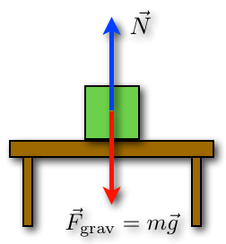
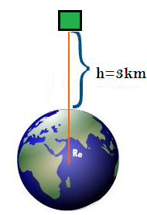
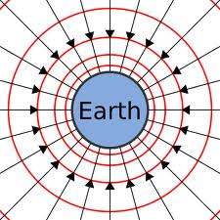
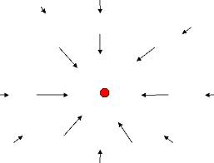
Vector field
Why vector fields?

Slide 13
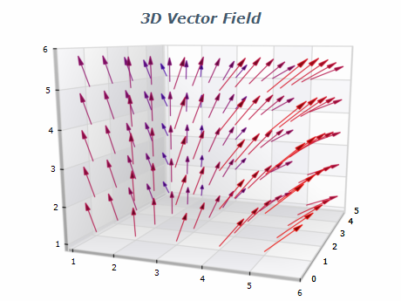
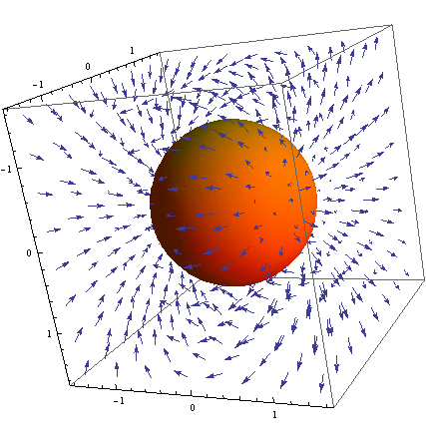
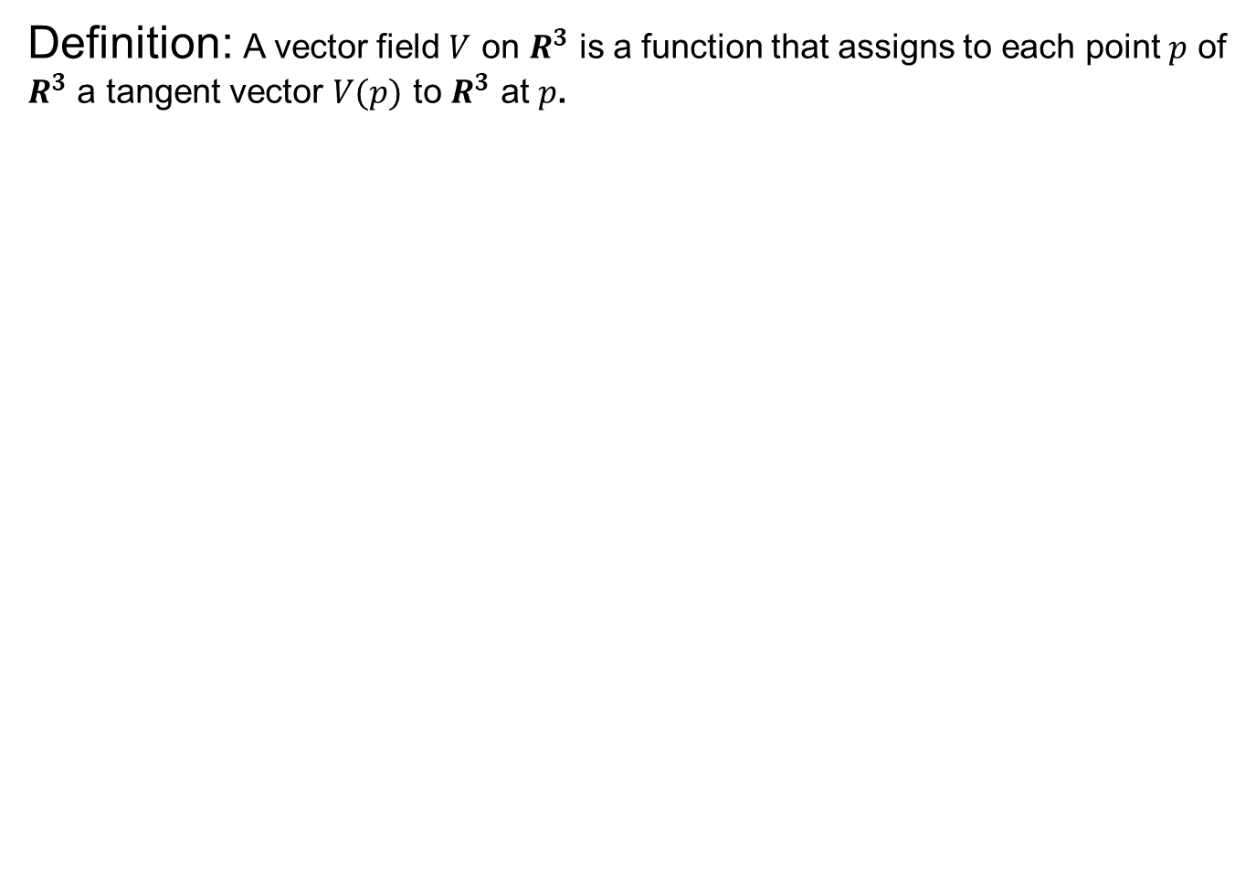
Vector field
Definition: A vector field $V$ on $R^{3}$ is a function that assigns to each point $p$ of $R^{3}$ a tangent vector $V(p)$ to $R^{3}$ at $p$.

Slide 14
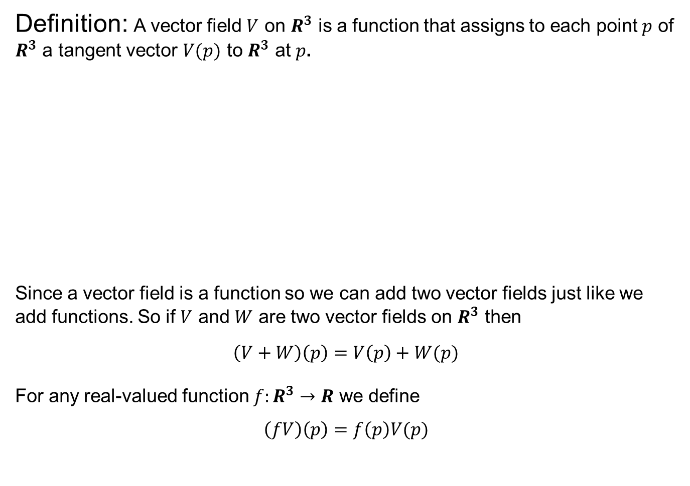
Vector field
Definition: A vector field $V$ on $R^{3}$ is a function that assigns to each point $p$ of $R^{3}$ a tangent vector $V(p)$ to $R^{3}$ at $p$.
Since a vector field is a function so we can add two vector fields just like we add functions. So if $V$ and $W$ are two vector fields on $R^{3}$ then
$\left(V+W\right)\left(p\right)=V\left(p\right)+W(p)$
For any real-valued function $f:R^{3}→R$ we define
$$\left(fV\right)\left(p\right)=f\left(p\right)V(p)$$

Slide 15
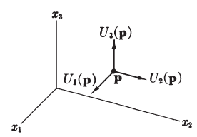
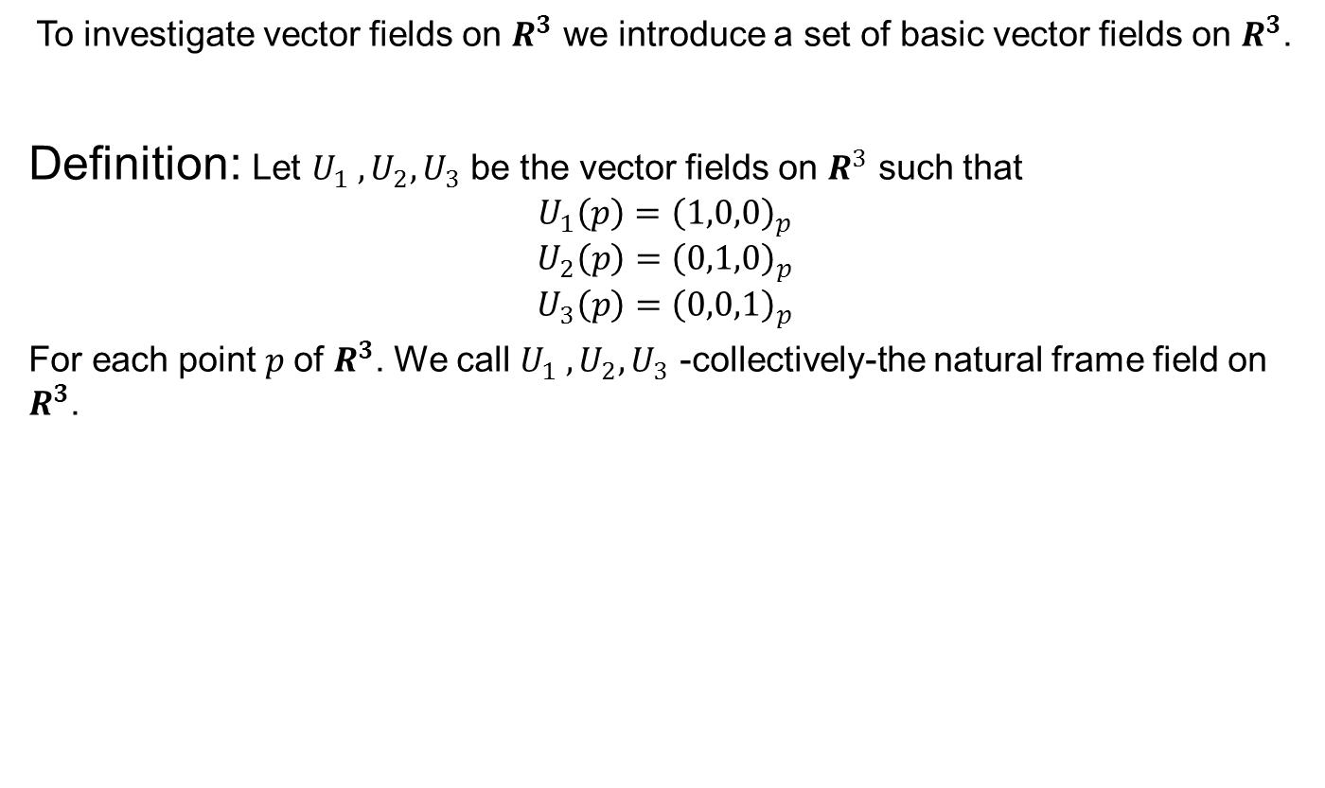
Natural frame field on $R^{3}$
To investigate vector fields on $R^{3}$ we introduce a set of basic vector fields on $R^{3}$.
Definition: Let $U_{1} , U_{2}, U_{3}$ be the vector fields on $R^{3}$ such that
$$U_{1}\left(p\right)={\left(1,0,0\right)}_{p}$$
$$U_{2}\left(p\right)={\left(0,1,0\right)}_{p}$$
$$U_{3}\left(p\right)={\left(0,0,1\right)}_{p}$$
For each point $p$of $R^{3}$. We call $U_{1} , U_{2}, U_{3}$ -collectively-the natural frame field on $R^{3}$.

Slide 16
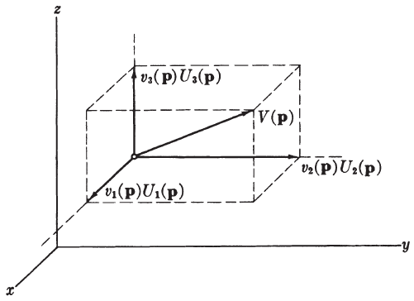
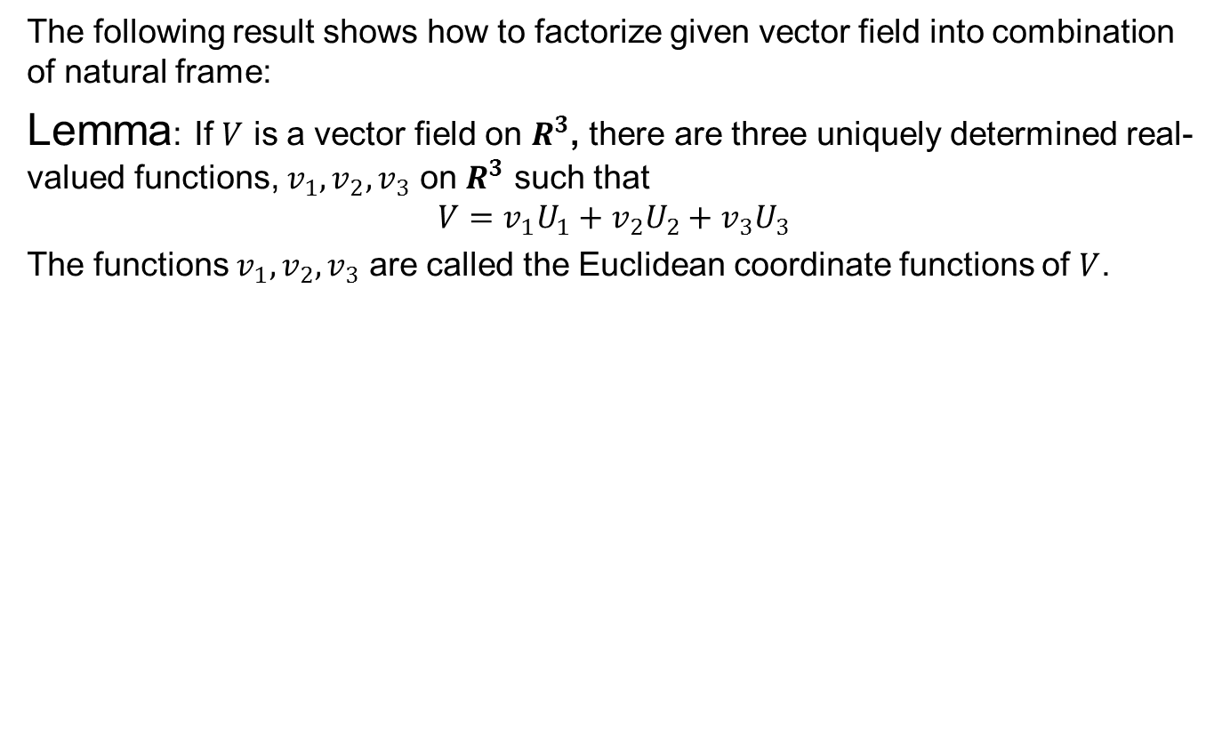
Natural frame field on $R^{3}$
The following result shows how to factorize given vector field into combination of natural frame:
Lemma: If $V$ is a vector field on $R^{3}$, there are three uniquely determined real-valued functions, $v_{1},v_{2},v_{3}$ on $R^{3}$ such that
$$V=v_{1}U_{1}+v_{2}U_{2}+v_{3}U_{3}$$
The functions $v_{1},v_{2},v_{3}$ are called the Euclidean coordinate functions of $V$.

Slide 17
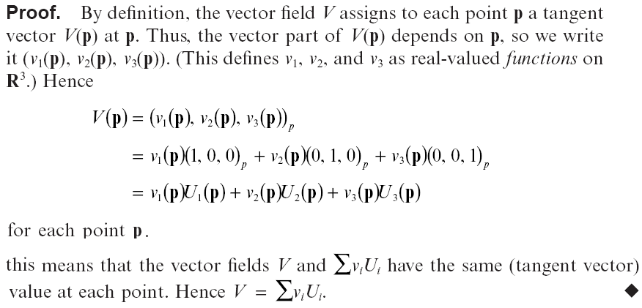
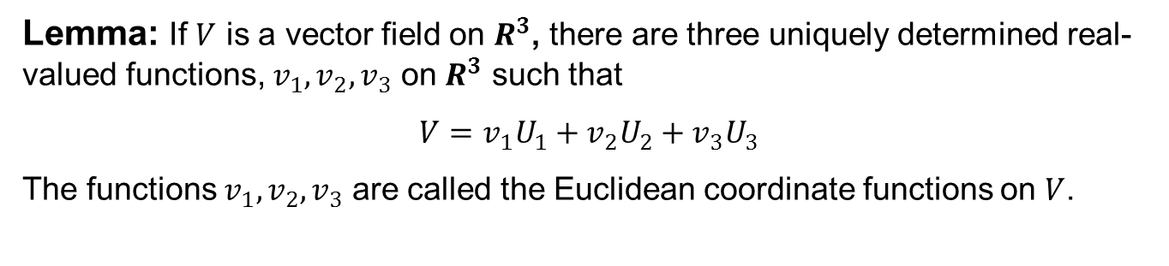
Natural frame field on $R^{3}$
Lemma: If $V$ is a vector field on $R^{3}$, there are three uniquely determined real-valued functions, $v_{1},v_{2},v_{3}$ on $R^{3}$ such that
$$V=v_{1}U_{1}+v_{2}U_{2}+v_{3}U_{3}$$
The functions $v_{1},v_{2},v_{3}$ are called the Euclidean coordinate functions on $V$.

Slide 18
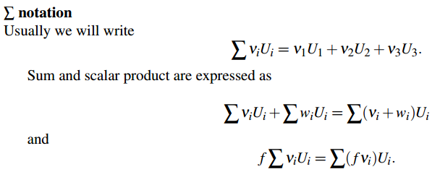
Natural frame field on $R^{3}$

Slide 19
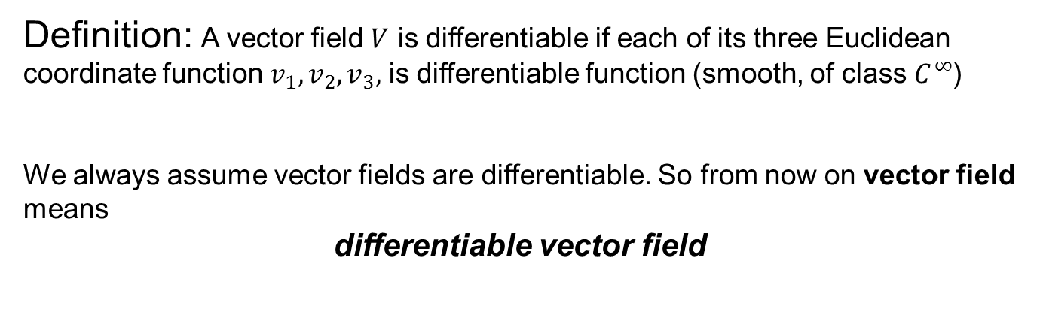
Differentiable vector field
Definition: A vector field $V$ is differentiable if each of its three Euclidean coordinate function $v_{1},v_{2},v_{3},$ is differentiable function (smooth, of class $C^{∞}$)
We always assume vector fields are differentiable. So from now on vector field means
differentiable vector field

Slide 20

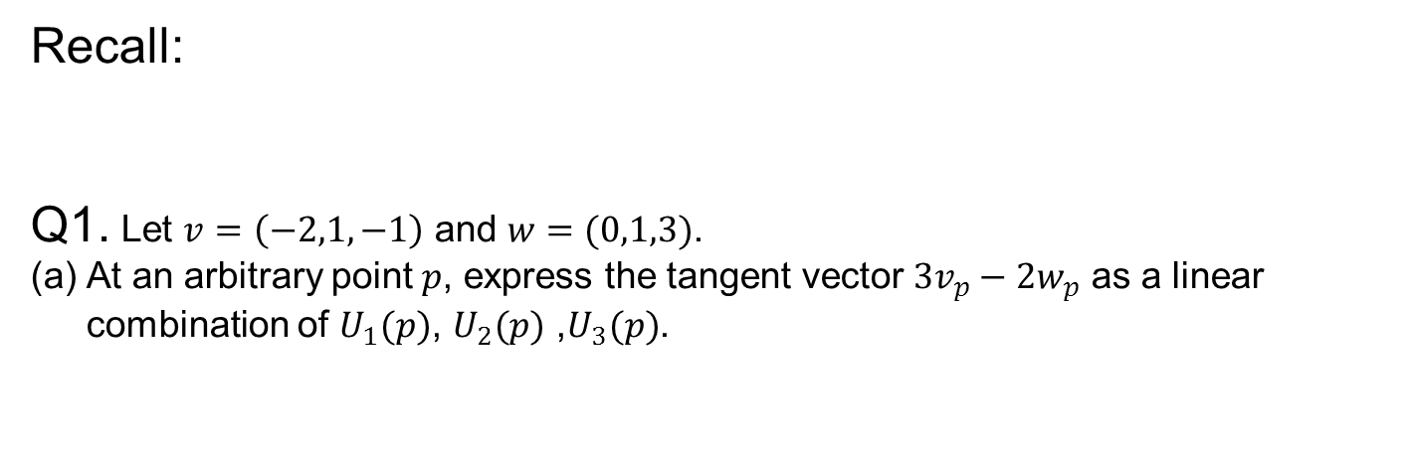
Exercise 1.2
Recall:
Q1. Let $v=\left(−2,1,−1\right)$ and $w=(0,1,3)$.
At an arbitrary point $p$, express the tangent vector $3v_{p}−2w_{p}$ as a linear combination of $U_{1}(p)$, $U_{2}(p)$ ,$U_{3}(p)$.

Slide 21
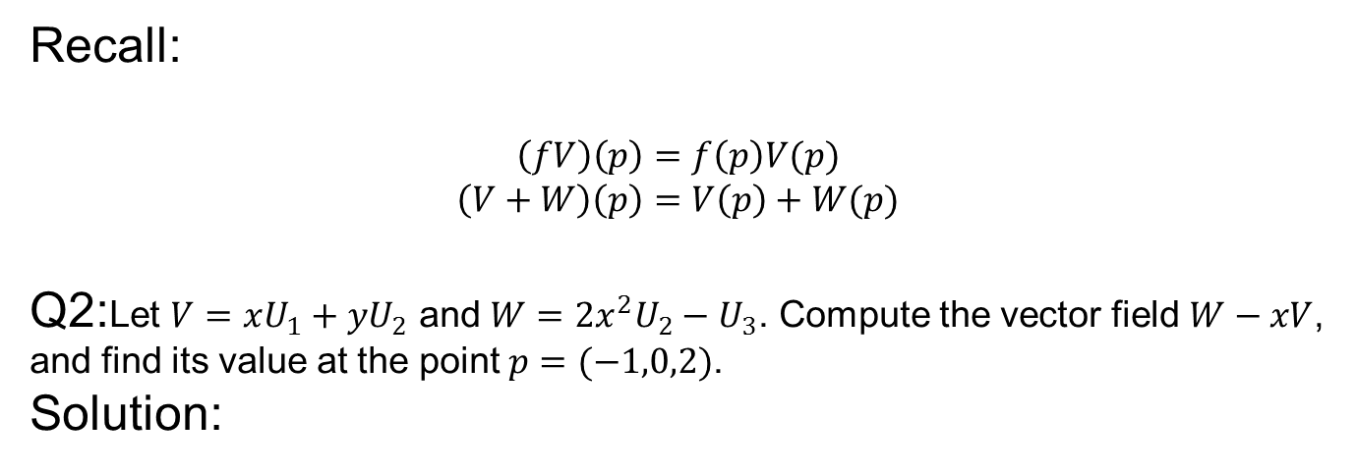
Exercise 1.2

Slide 23

Next time
Directional derivative

Slide 24

End of the lecture

