Slide 1
Lecture # 15
MTH352: Differential Geometry
For
Master of Mathematics
By
Dr. SOHAIL IQBAL
Assistant Professor
Department of Mathematics, CIIT Islamabad

Slide 2


Last lecture
Contents:
Frenet Apparatus For A Regular Curve
Computing Frenet Frame
The Spherical Image

Slide 3
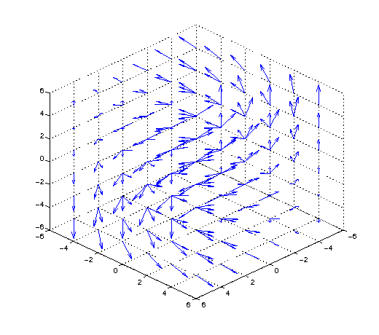
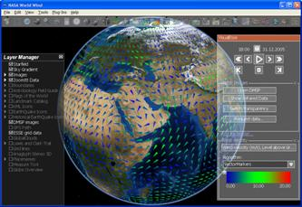
Today’s lecture
Contents:
Cylindrical Helix
Covariant Derivatives
Euclidean Coordinate Representation
Properties Of The Covariant Derivative
The Vector Field Of Covariant Derivatives

Slide 4
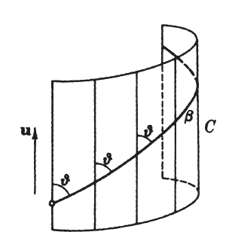
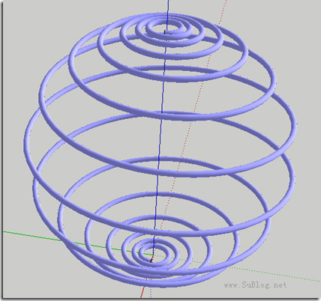
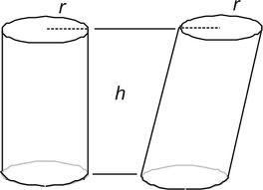
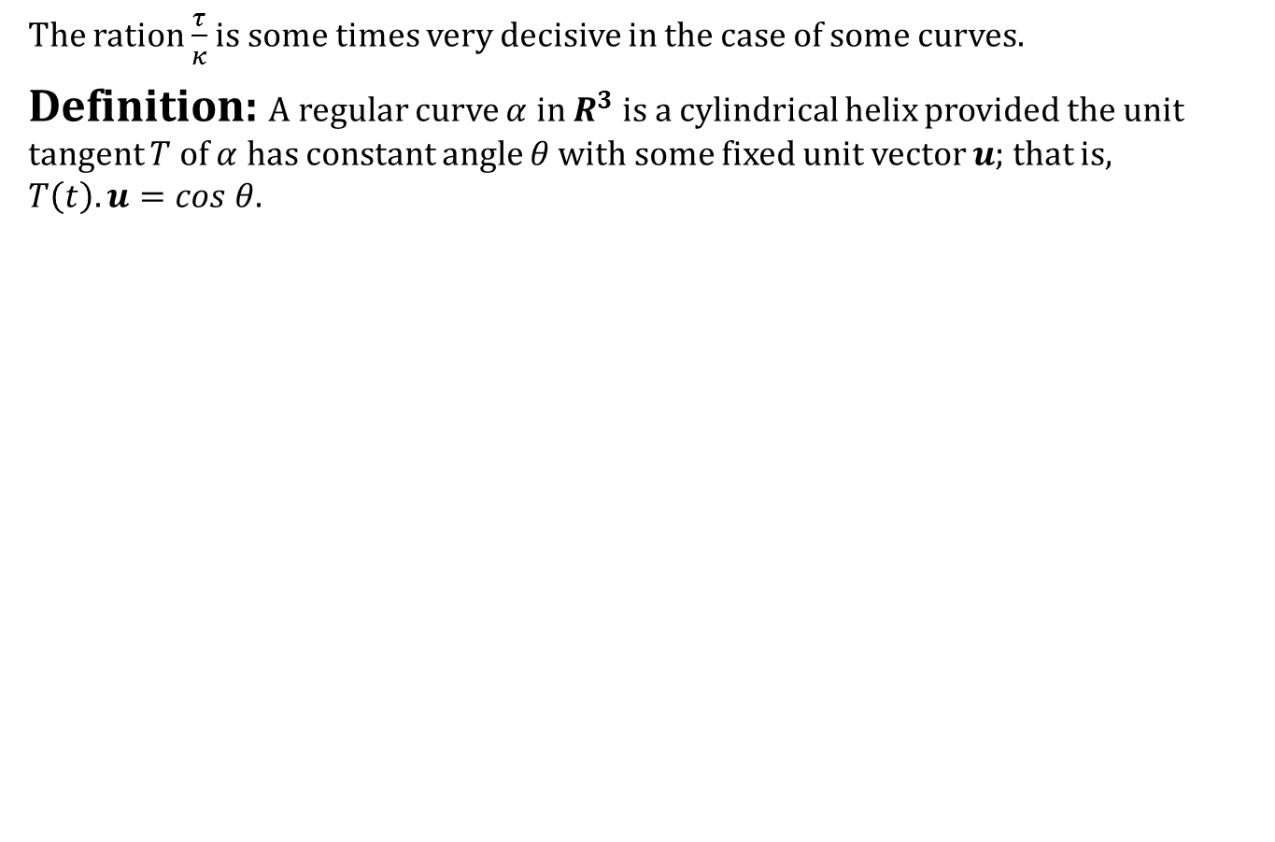
Cylindrical Helix
The ration $\frac{τ}{κ}$ is some times very decisive in the case of some curves.
Definition: A regular curve $α$ in $R^{3}$ is a cylindrical helix provided the unit tangent $T$ of $α$ has constant angle $θ$ with some fixed unit vector $u$; that is, $T\left(t\right).u=cos θ$.

Slide 5
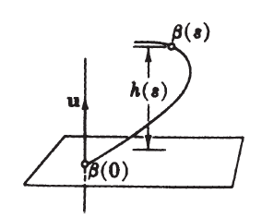
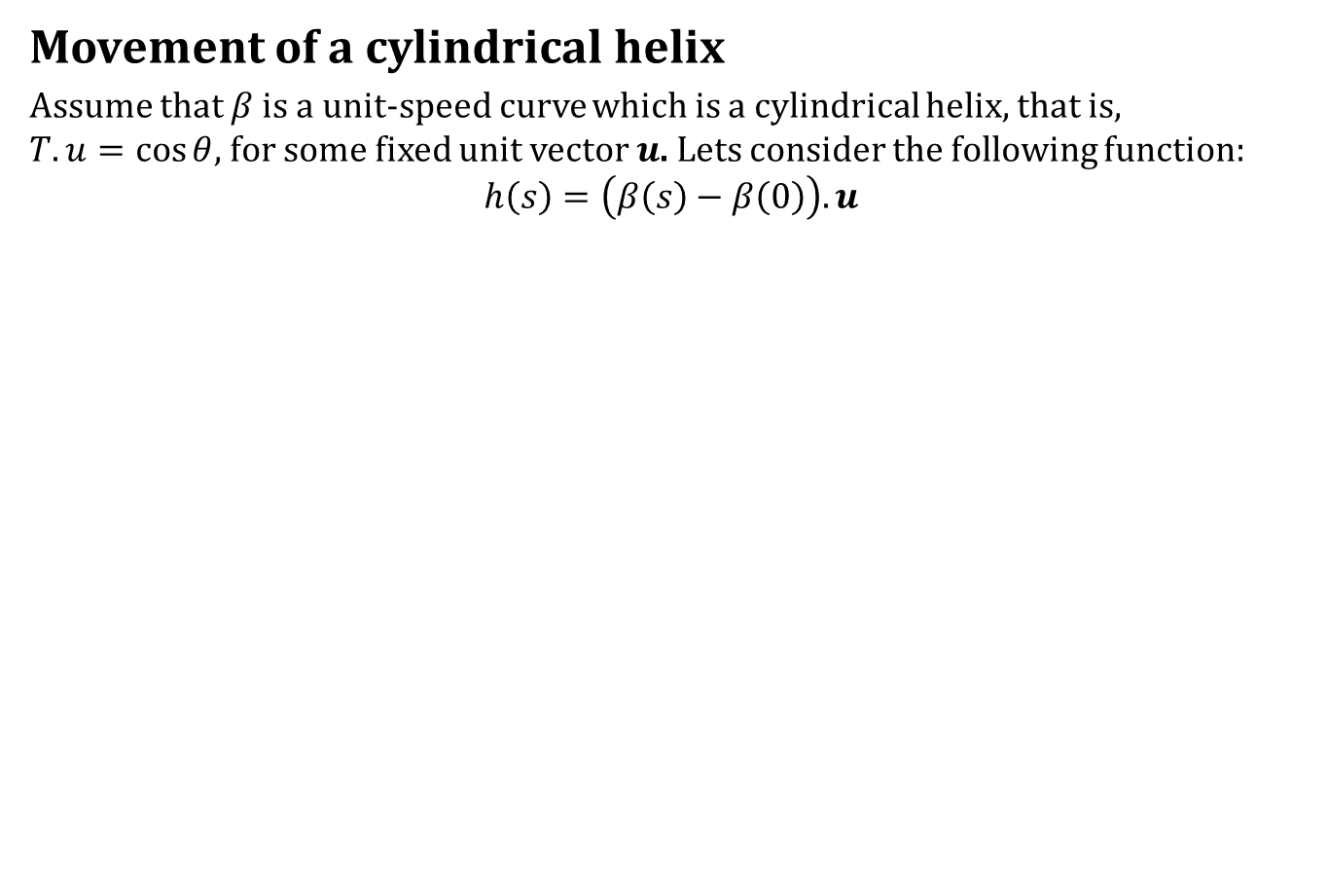
Cylindrical Helix
Movement of a cylindrical helix
Assume that $β$ is a unit-speed curve which is a cylindrical helix, that is, $T.u=\cos{θ}$, for some fixed unit vector $u$. Lets consider the following function:
$$h\left(s\right)=\left(β\left(s\right)−β\left(0\right)\right).u$$

Slide 6
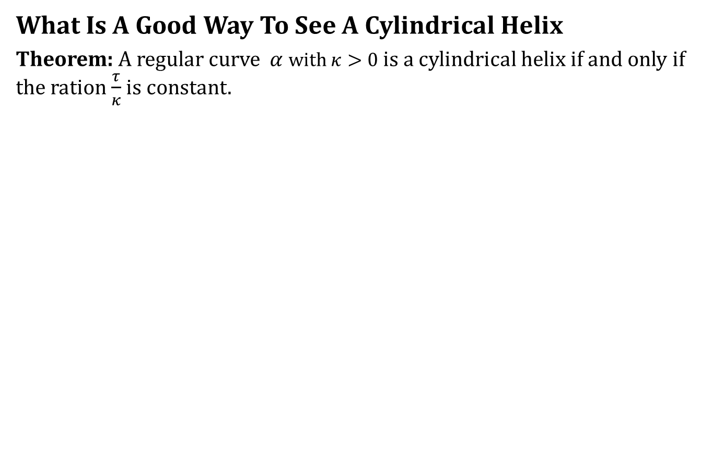
Cylindrical Helix
What Is A Good Way To See A Cylindrical Helix
Theorem: A regular curve $α$ with $κ>0$ is a cylindrical helix if and only if the ration $\frac{τ}{κ}$ is constant.

Slide 7
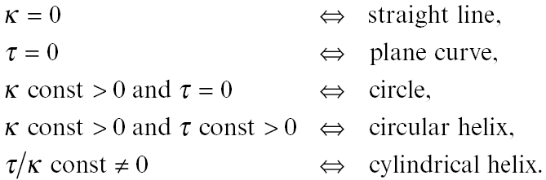
Conclusion

Slide 8
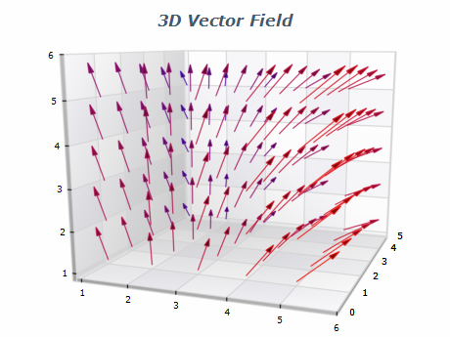
Covariant Derivative

Slide 9
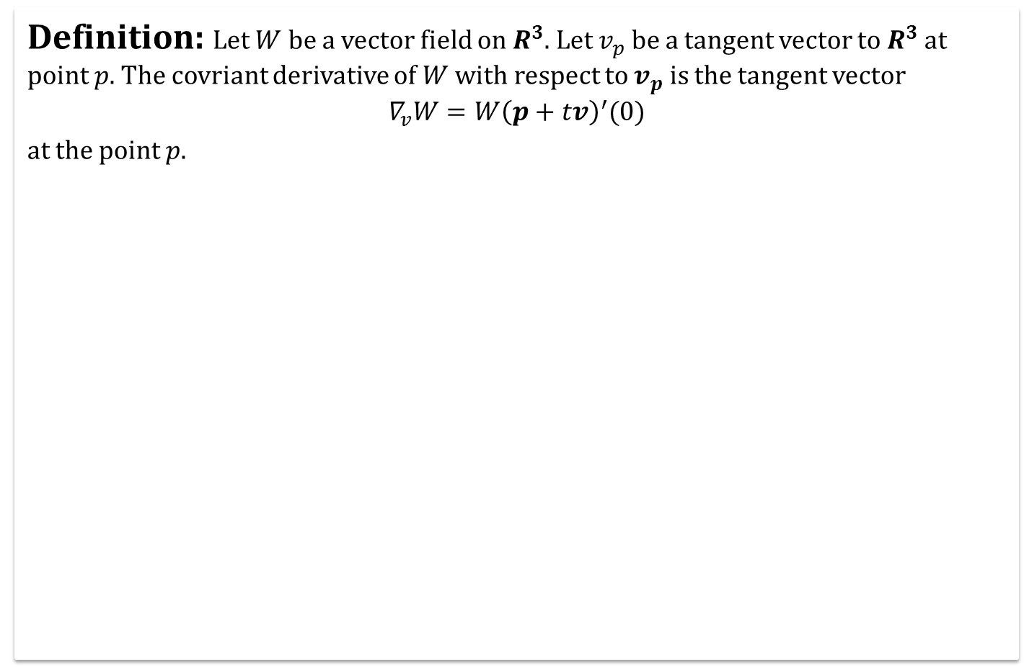
Covariant Derivatives
Definition: Let $W$ be a vector field on $R^{3}$. Let $v_{p}$ be a tangent vector to $R^{3}$at point $p.$ The covriant derivative of $W$ with respect to $v_{p}$ is the tangent vector
$$∇_{v}W=W{\left(p+tv\right)}^{′}(0)$$
at the point $p$.

Slide 10
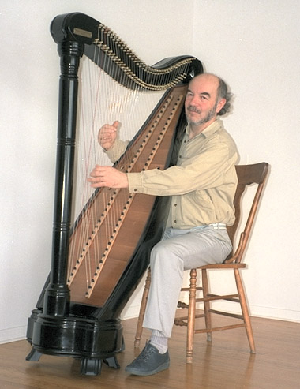
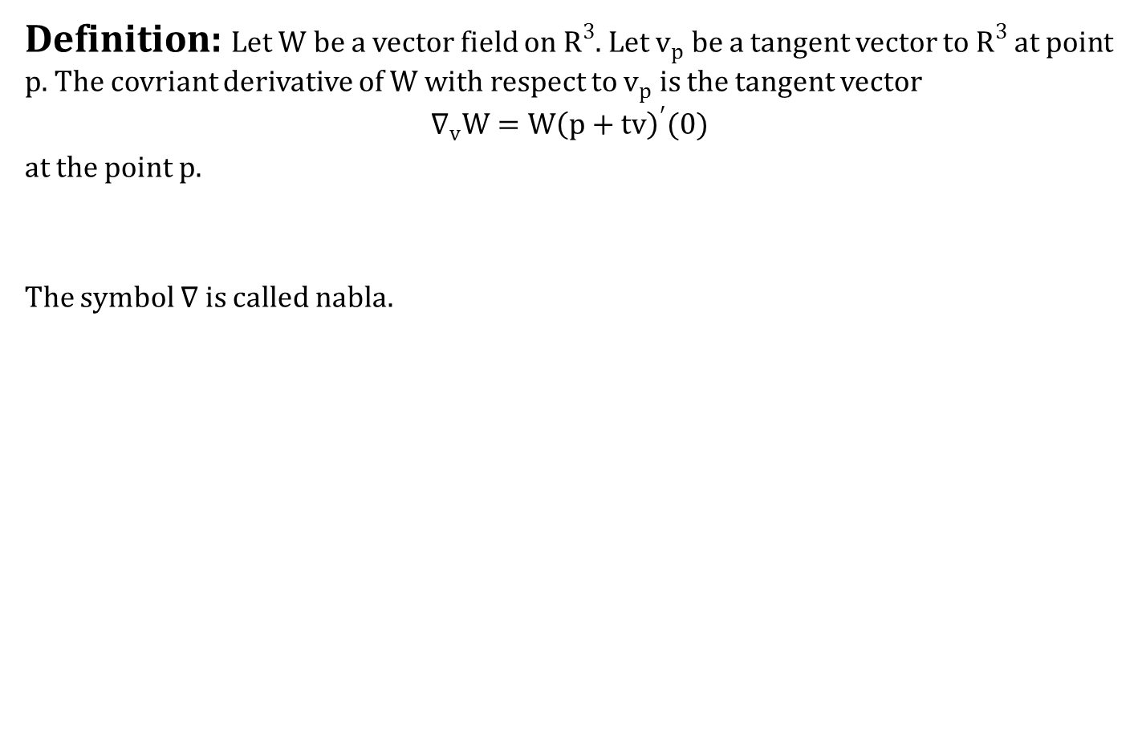
Covariant Derivatives
Definition: Let $W$ be a vector field on $R^{3}$. Let $v_{p}$ be a tangent vector to $R^{3}$at point $p.$ The covriant derivative of $W$ with respect to $v_{p}$ is the tangent vector
$$∇_{v}W=W{\left(p+tv\right)}^{′}(0)$$
at the point $p$.
The symbol $∇$ is called nabla.

Slide 11
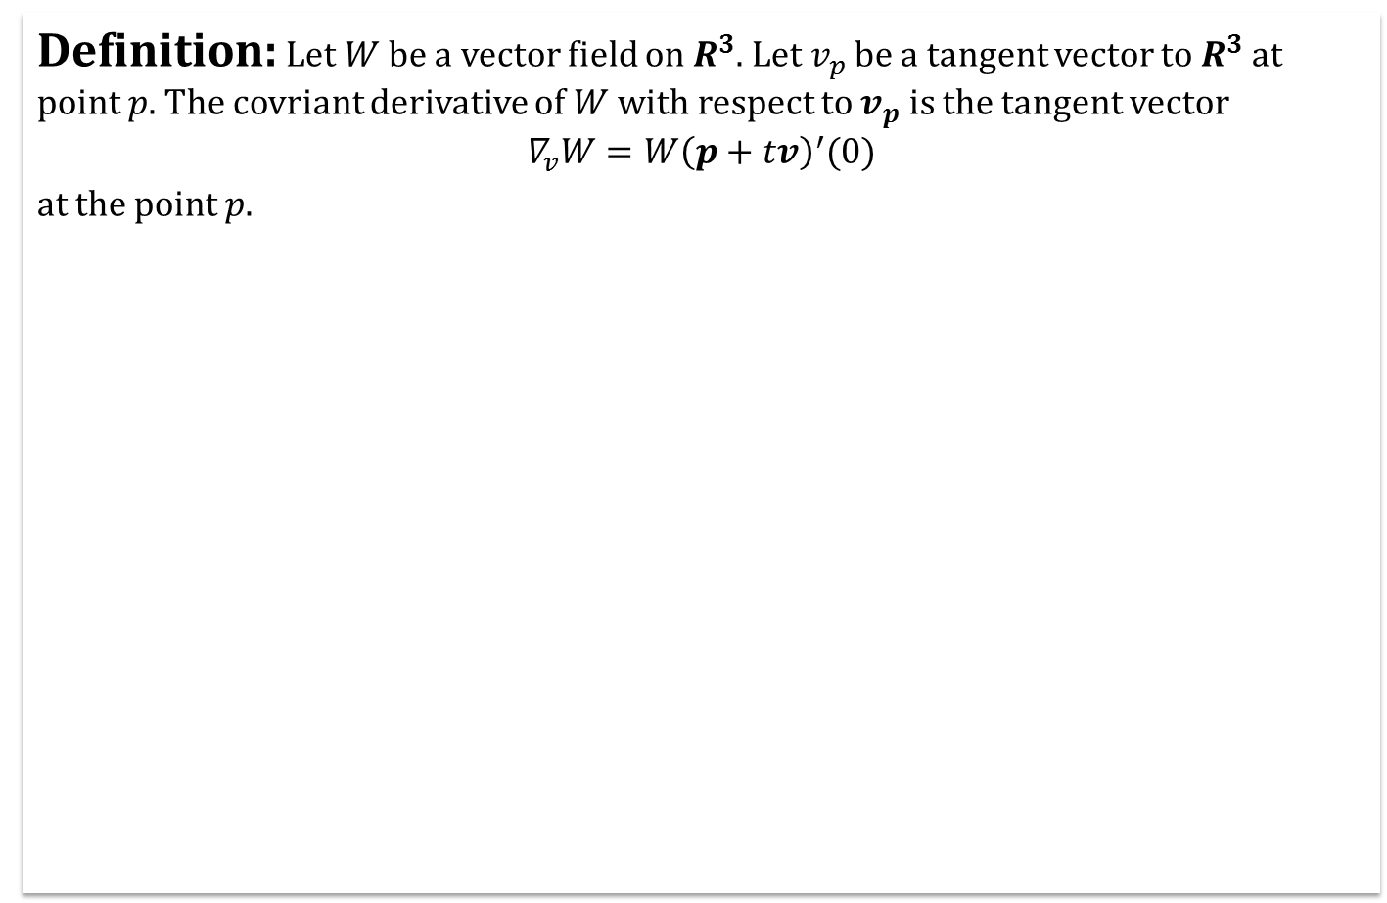
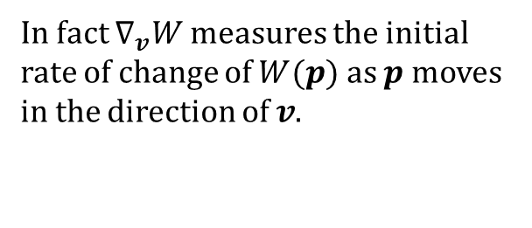
Covariant Derivatives
Definition: Let $W$ be a vector field on $R^{3}$. Let $v_{p}$ be a tangent vector to $R^{3}$at point $p.$ The covriant derivative of $W$ with respect to $v_{p}$ is the tangent vector
$$∇_{v}W=W{\left(p+tv\right)}^{′}(0)$$
at the point $p$.
In fact $∇_{v}W$ measures the initial rate of change of $W(p)$ as $p$ moves in the direction of $v$.

Slide 12
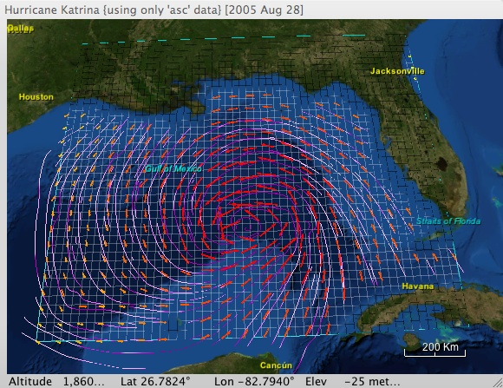
Covariant Derivatives
Example: Wind Vector field

Slide 13
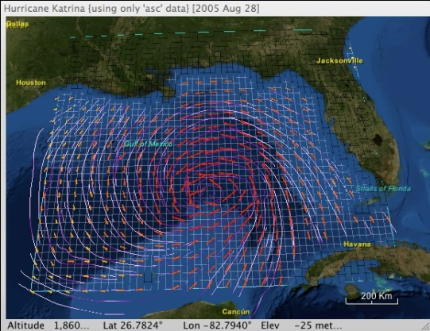
Covariant Derivatives
D

Slide 14
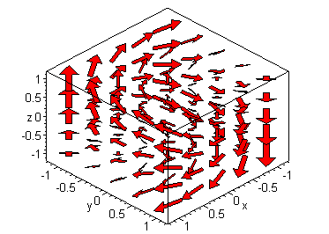
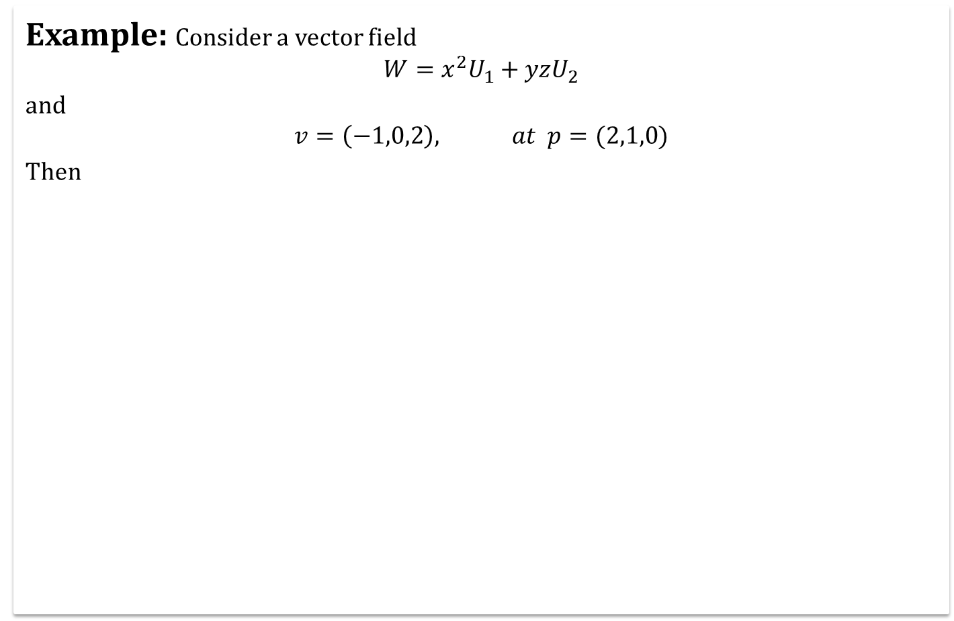
Covariant Derivatives
Example: Consider a vector field
$$W=x^{2}U_{1}+yzU_{2}$$
and
$$v=\left(−1,0,2\right), at p=(2,1,0)$$
Then

Slide 15
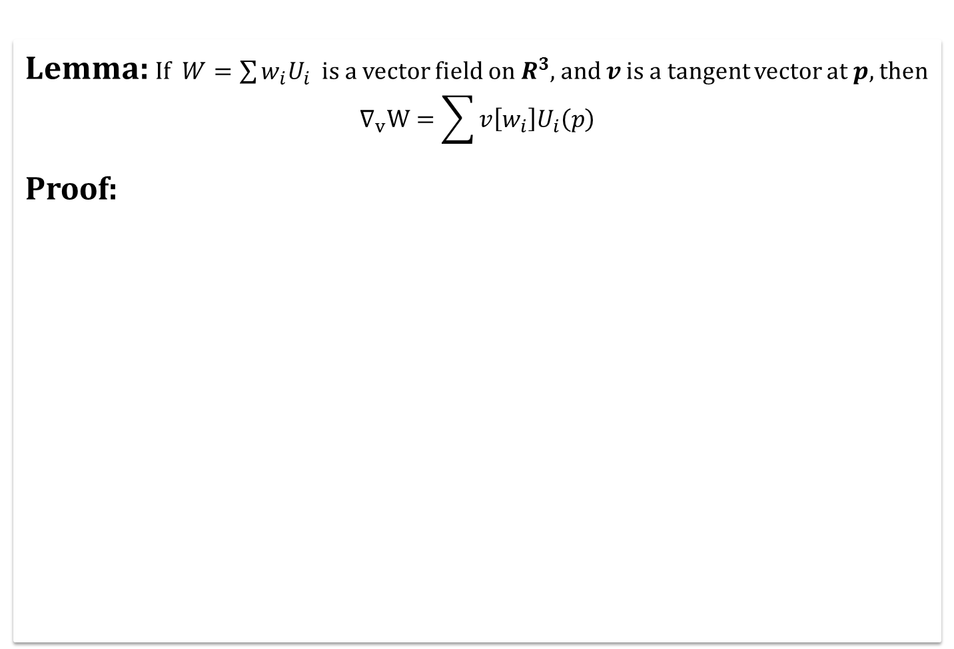
Euclidean Coordinate Representation
Lemma: If $W=\sum{w_{i}U_{i} }$ is a vector field on $R^{3}$, and $v$ is a tangent vector at $p,$ then
$$∇_{v}W=\sum{v\left[w_{i}\right]U_{i}\left(p\right)}$$
Proof:

Slide 16
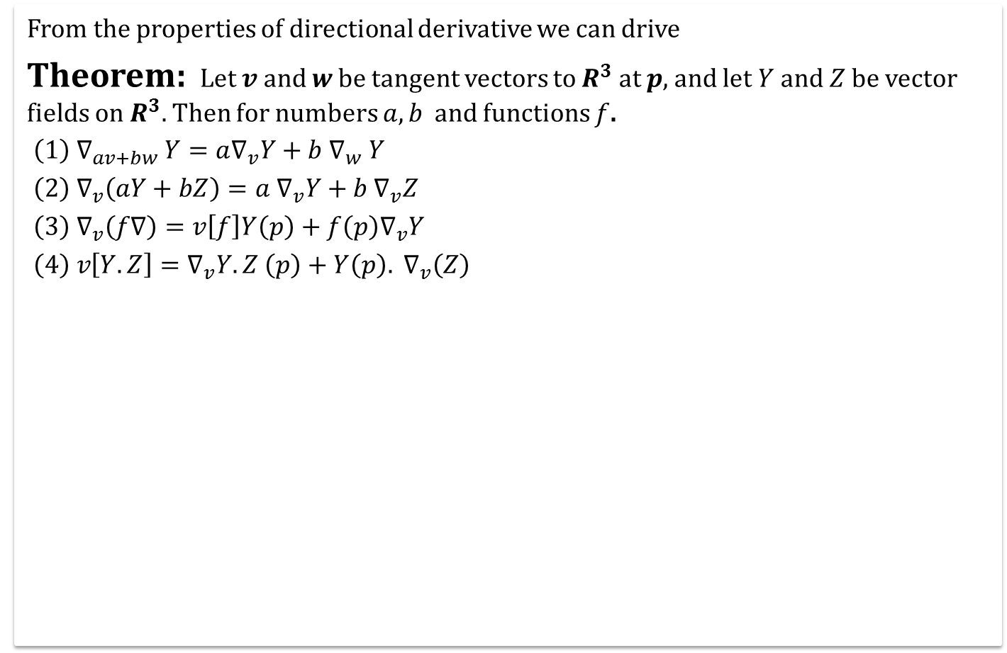
Properties Of The Covariant Derivative
From the properties of directional derivative we can drive
Theorem: Let $v$ and $w$ be tangent vectors to $R^{3}$ at $p$, and let $Y$ and $Z$ be vector fields on $R^{3}.$ Then for numbers $a, b$ and functions $f$.
$\left(1\right) ∇_{av+bw} Y=a∇_{v}Y+b ∇_{w} Y$
$\left(2\right) ∇_{v}\left(aY+bZ\right)=a ∇_{v}Y+b ∇_{v}Z$
${\left(3\right) ∇}_{v}\left(f∇\right)=v\left[f\right]Y\left(p\right)+f\left(p\right)∇_{v}Y$
$\left(4\right) v\left[Y.Z\right]=∇_{v}Y.Z \left(p\right)+Y\left(p\right). ∇_{v}\left(Z\right)$

Slide 17
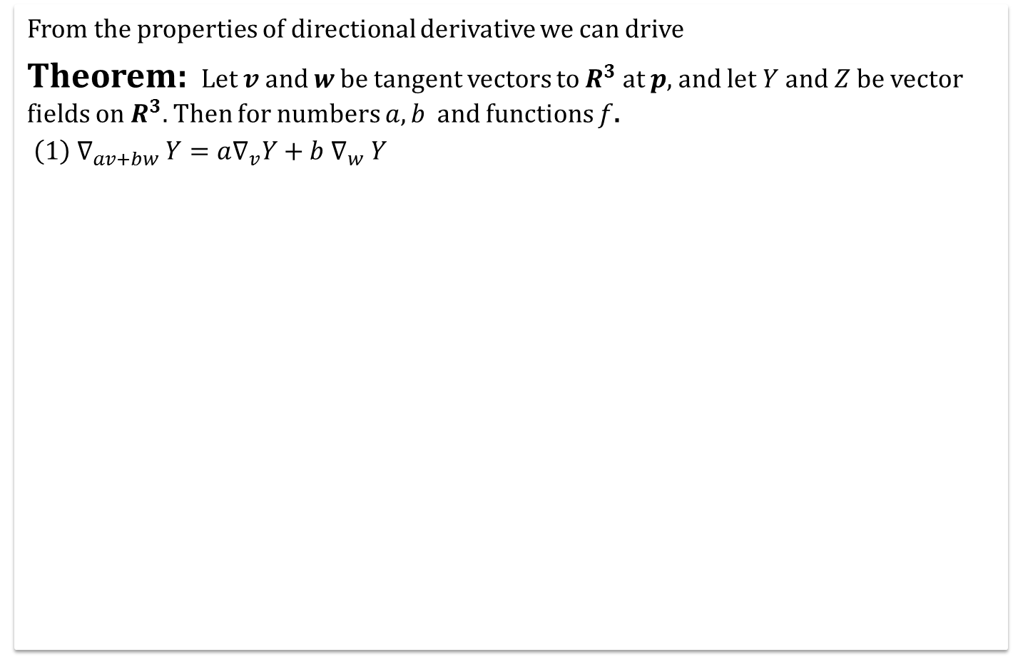
Properties Of The Covariant Derivative
From the properties of directional derivative we can drive
Theorem: Let $v$ and $w$ be tangent vectors to $R^{3}$ at $p$, and let $Y$ and $Z$ be vector fields on $R^{3}.$ Then for numbers $a, b$ and functions $f$.
$\left(1\right) ∇_{av+bw} Y=a∇_{v}Y+b ∇_{w} Y$

Slide 18
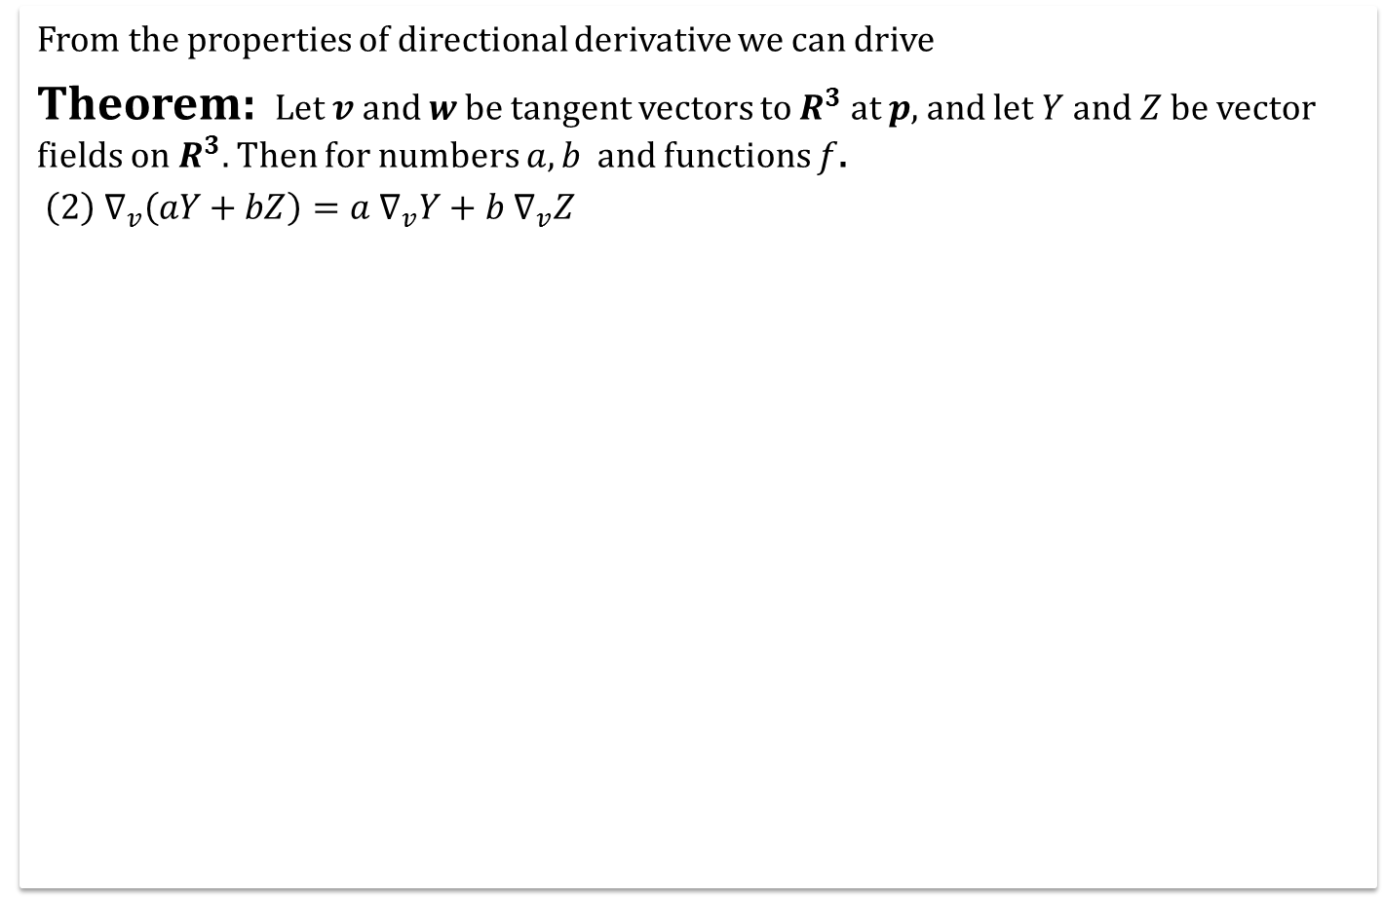
Properties Of The Covariant Derivative
From the properties of directional derivative we can drive
Theorem: Let $v$ and $w$ be tangent vectors to $R^{3}$ at $p$, and let $Y$ and $Z$ be vector fields on $R^{3}.$ Then for numbers $a, b$ and functions $f$.
$\left(2\right) ∇_{v}\left(aY+bZ\right)=a ∇_{v}Y+b ∇_{v}Z$

Slide 19
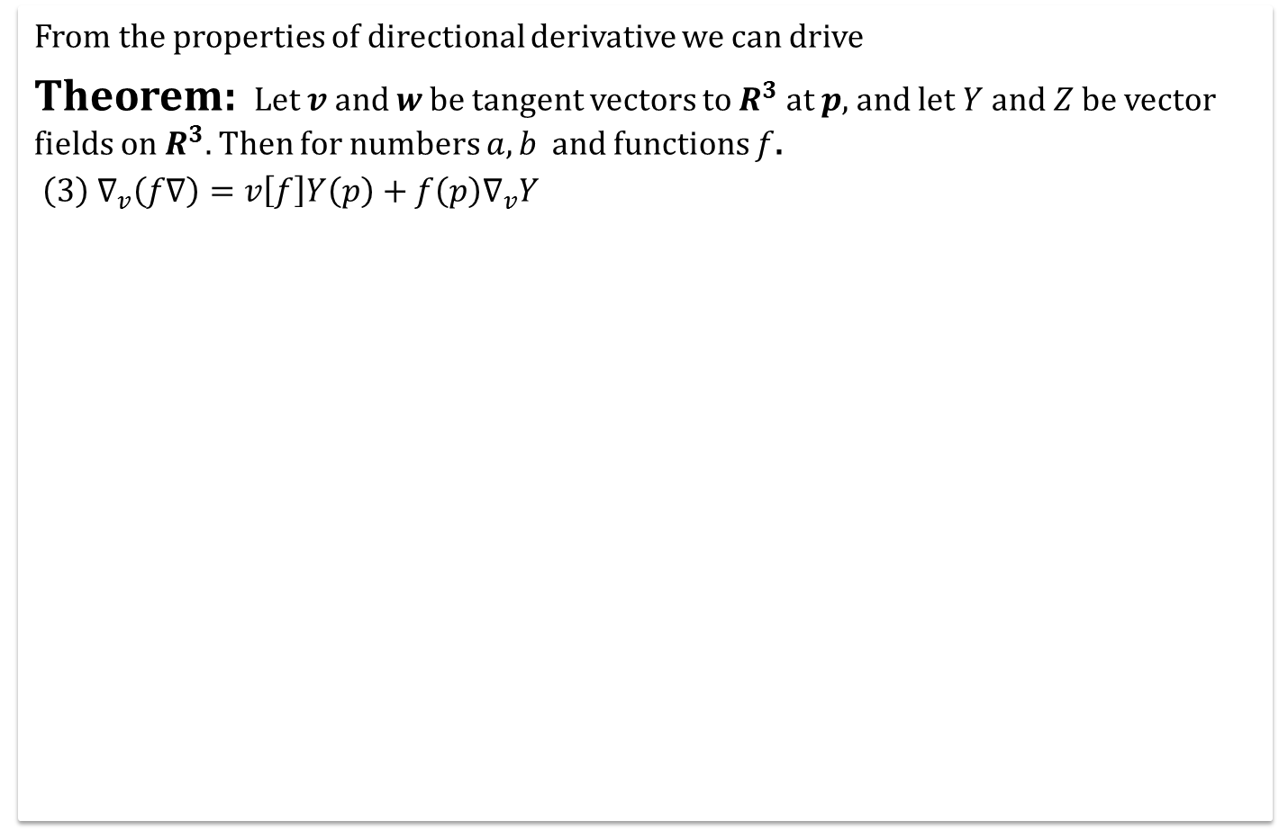
Properties Of The Covariant Derivative
From the properties of directional derivative we can drive
Theorem: Let $v$ and $w$ be tangent vectors to $R^{3}$ at $p$, and let $Y$ and $Z$ be vector fields on $R^{3}.$ Then for numbers $a, b$ and functions $f$.
${\left(3\right) ∇}_{v}\left(f∇\right)=v\left[f\right]Y\left(p\right)+f\left(p\right)∇_{v}Y$

Slide 20
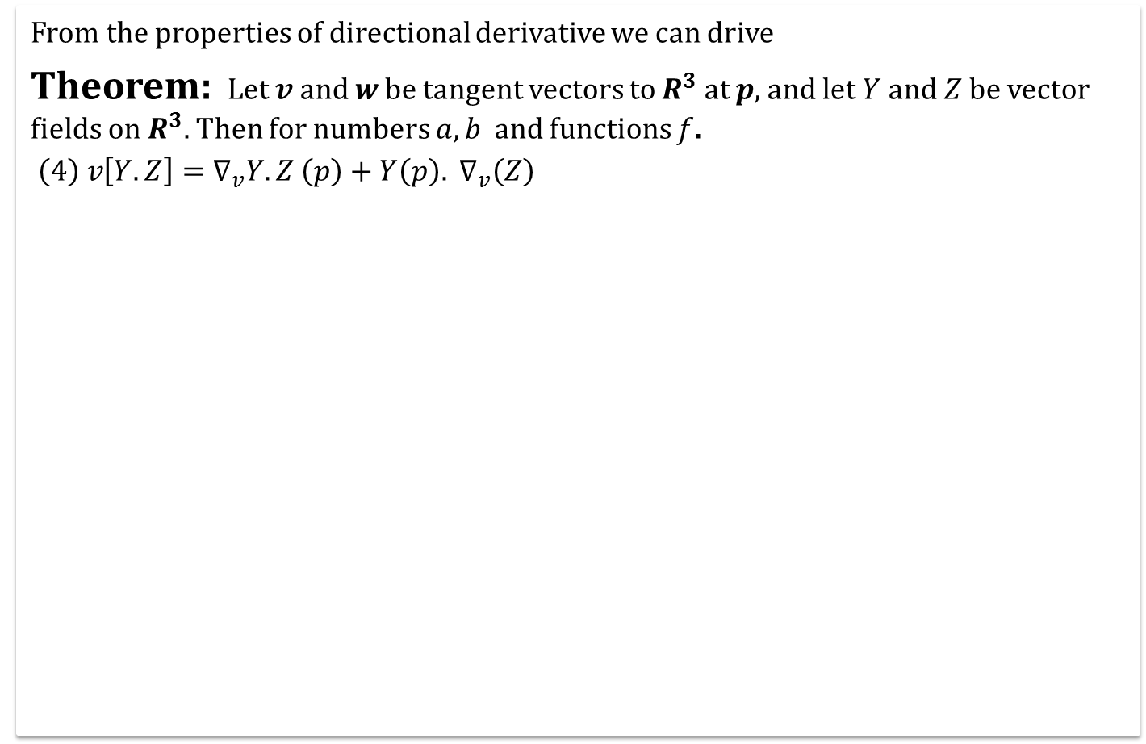
Properties Of The Covariant Derivative
From the properties of directional derivative we can drive
Theorem: Let $v$ and $w$ be tangent vectors to $R^{3}$ at $p$, and let $Y$ and $Z$ be vector fields on $R^{3}.$ Then for numbers $a, b$ and functions $f$.
$\left(4\right) v\left[Y.Z\right]=∇_{v}Y.Z \left(p\right)+Y\left(p\right). ∇_{v}\left(Z\right)$

Slide 21
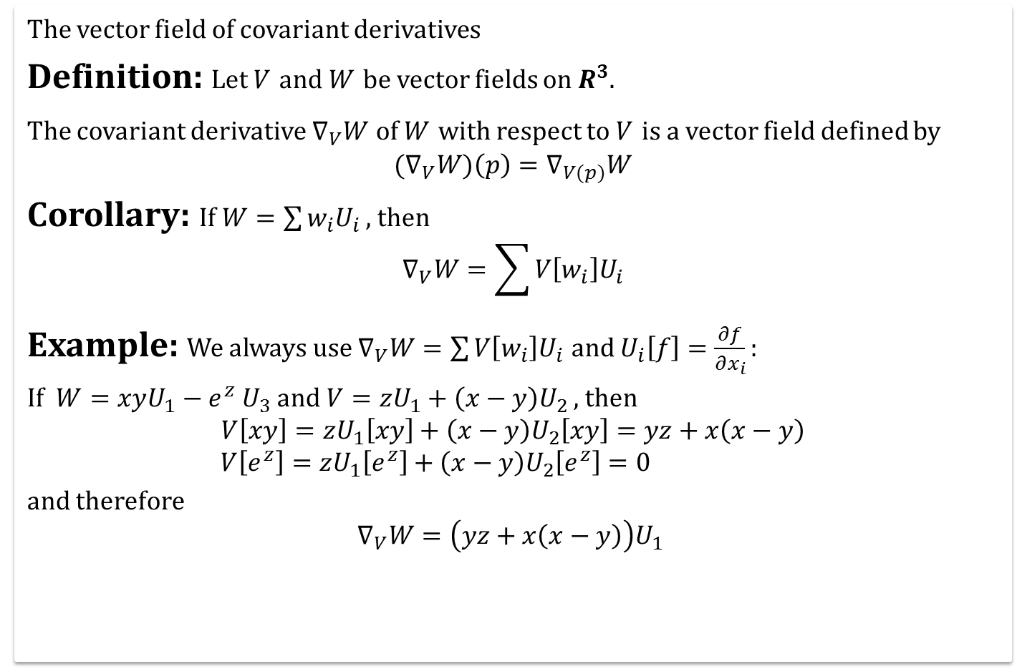
The Vector Field Of Covariant Derivatives
The vector field of covariant derivatives
Definition: Let $V$ and $W$ be vector fields on $R^{3}$.
The covariant derivative $∇_{V}W$ of $W$ with respect to $V$ is a vector field defined by
$${(∇}_{V}W)\left(p\right)=∇_{V(p)}W$$
Corollary: If $W=\sum{w_{i}U_{i}}$ , then
$$∇_{V}W=\sum{V\left[w_{i}\right]U_{i}}$$
Example: We always use $∇_{V}W=\sum{V\left[w_{i}\right]U_{i}}$ and $U_{i}\left[f\right]=\frac{∂f}{∂x_{i}}:$
If $W=xyU_{1}−e^{z} U_{3}$and $V=zU_{1}+\left(x−y\right)U_{2}$ , then
$$V\left[xy\right]=zU_{1}\left[xy\right]+\left(x−y\right)U_{2}\left[xy\right]=yz+x\left(x−y\right)$$
$$V\left[e^{z}\right]=zU_{1}\left[e^{z}\right]+\left(x−y\right)U_{2}\left[e^{z}\right]=0$$
and therefore
$$∇_{V}W=\left(yz+x\left(x−y\right)\right)U_{1}$$

Slide 22
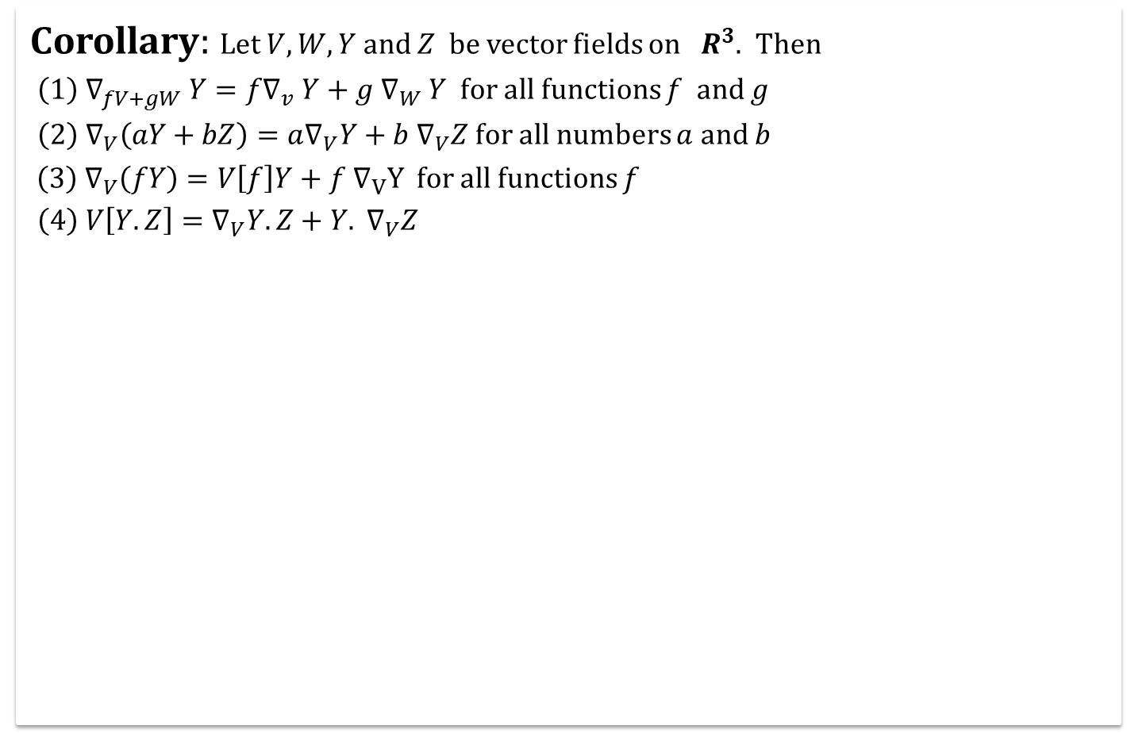
Covariant Derivatives
Corollary: Let $V, W, Y$ and $Z$ be vector fields on $R^{3}$. Then
$\left(1\right) ∇_{fV+gW} Y=f∇_{v} Y+g ∇_{W} Y$ for all functions $f$ and $g$
$\left(2\right) ∇_{V}\left(aY+bZ\right)=a∇_{V}Y+b ∇_{V}Z$ for all numbers $a$ and $b$
$\left(3\right) ∇_{V}\left(fY\right)=V\left[f\right]Y+f ∇_{V}Y$ for all functions $f$
$\left(4\right) V\left[Y.Z\right]=∇_{V}Y.Z+Y. ∇_{V}Z$

Slide 23
Today we learnt
Contents:
Cylindrical Helix
Covariant Derivatives
Euclidean Coordinate Representation
Properties Of The Covariant Derivative
The Vector Field Of Covariant Derivatives

Slide 24

Next time
Frame Fields

Slide 25

End of the lecture

