Slide 1
Lecture # 14
MTH352: Differential Geometry
For
Master of Mathematics
By
Dr. SOHAIL IQBAL
Assistant Professor
Department of Mathematics, CIIT Islamabad

Slide 2
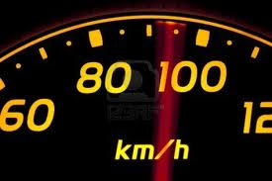
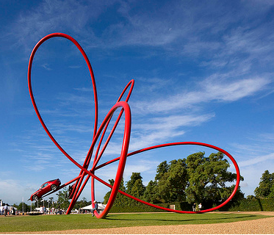
Last lecture
Contents:
Frenet Approximation
Conclusion
Frenet Frame For Arbitrary Speed Curves
Velocity And Acceleration

Slide 3
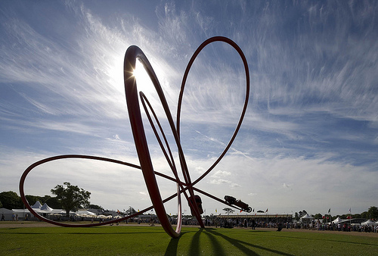
Today’s lecture
Contents:
Frenet Apparatus For A Regular Curve
Computing Frenet Frame
The Spherical Image
Cylindrical Helix
Conclusion

Slide 4
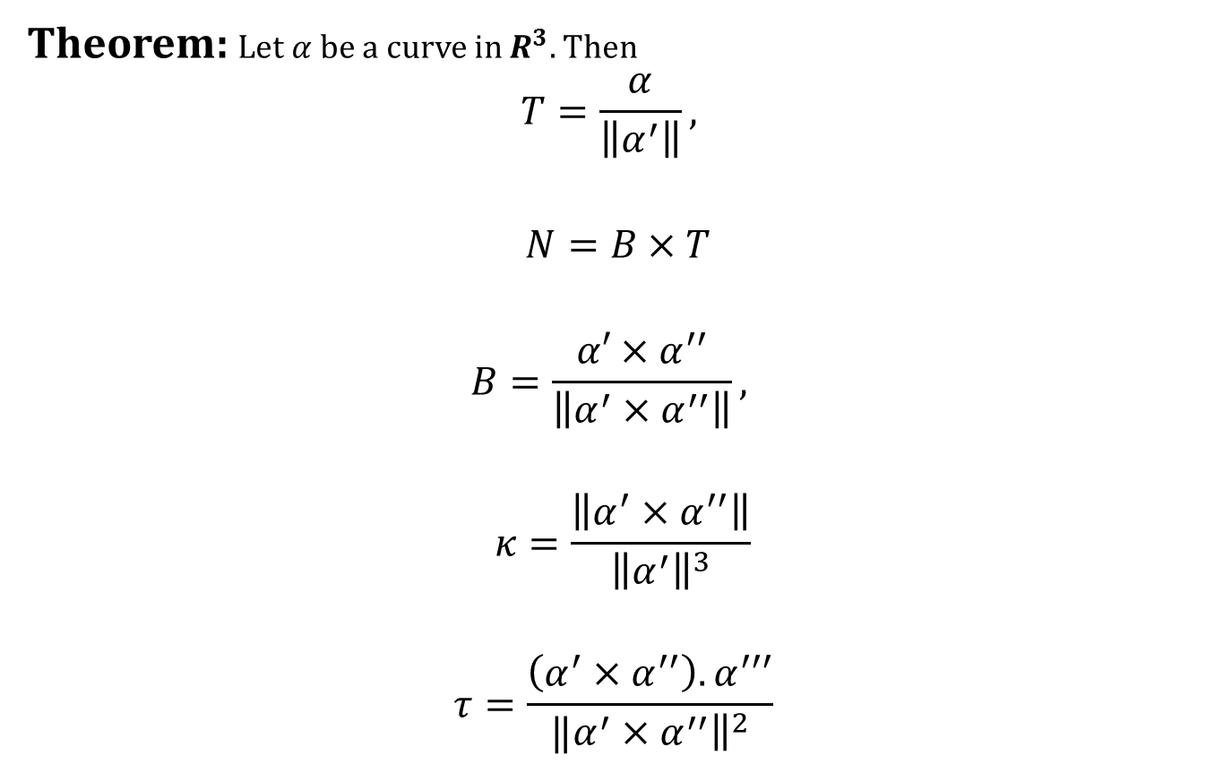
Frenet Apparatus For A Regular Curve
Theorem: Let $α$ be a curve in $R^{3}.$Then
$$T=\frac{α}{\left\|α^{′}\right\|},$$
$$N=B×T$$
$$B=\frac{{α′×α}^{′′}}{\left\|α^{′}×α^{′′}\right\|},$$
$$κ=\frac{\left\|α^{′}×α^{′′}\right\|}{{\left\|α^{′}\right\|}^{3}}$$
$$τ=\frac{\left(α^{′}×α^{′′}\right). α^{′′′}}{‖{\left.​α^{′}×α^{′′}\right\|}^{2}}$$

Slide 5

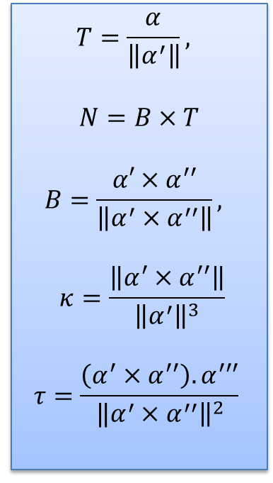
Frenet Apparatus For A Regular Curve
Proof$\left(T=\frac{α}{\left\|α^{′}\right\|}\right)$
$$T=\frac{α}{\left\|α^{′}\right\|},$$
$$N=B×T$$
$$B=\frac{{α′×α}^{′′}}{\left\|α^{′}×α^{′′}\right\|},$$
$$κ=\frac{\left\|α^{′}×α^{′′}\right\|}{{\left\|α^{′}\right\|}^{3}}$$
$$τ=\frac{\left(α^{′}×α^{′′}\right). α^{′′′}}{‖{\left.​α^{′}×α^{′′}\right\|}^{2}}$$

Slide 6
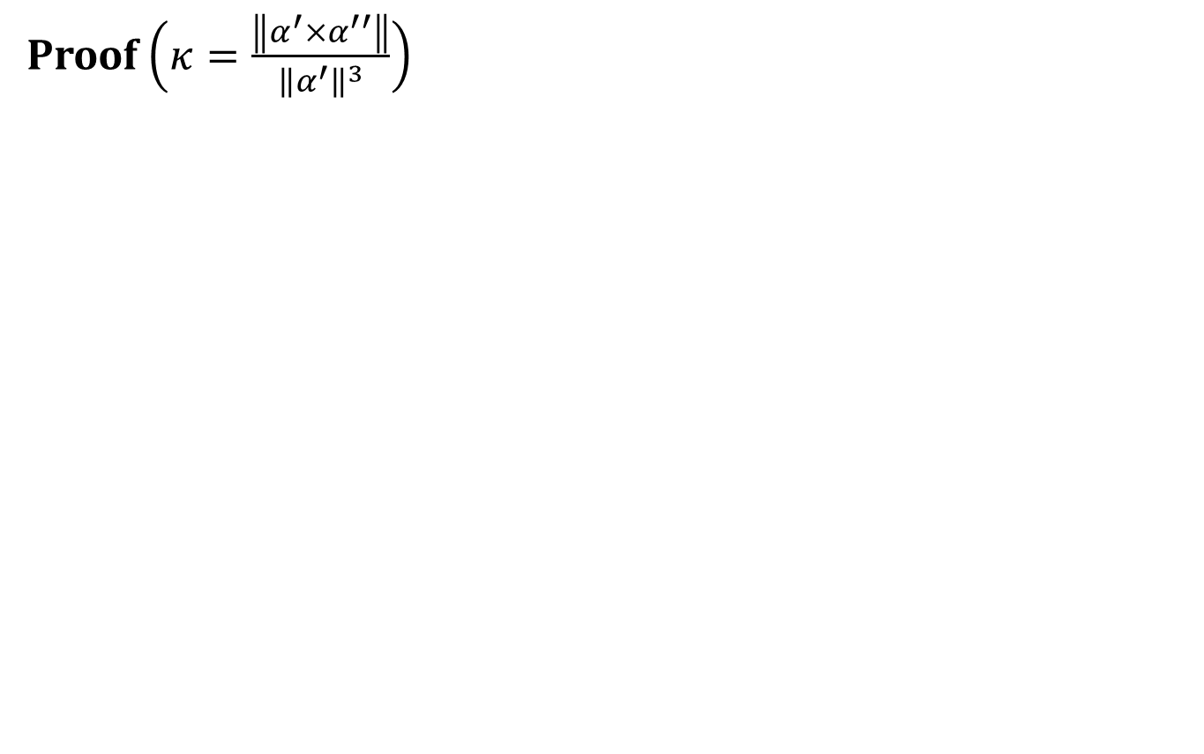
Frenet Apparatus For A Regular Curve
Proof$\left(κ=\frac{\left\|α^{′}×α^{′′}\right\|}{{\left\|α^{′}\right\|}^{3}}\right)$
$$T=\frac{α}{\left\|α^{′}\right\|},$$
$$N=B×T$$
$$B=\frac{{α′×α}^{′′}}{\left\|α^{′}×α^{′′}\right\|},$$
$$κ=\frac{\left\|α^{′}×α^{′′}\right\|}{{\left\|α^{′}\right\|}^{3}}$$
$$τ=\frac{\left(α^{′}×α^{′′}\right). α^{′′′}}{‖{\left.​α^{′}×α^{′′}\right\|}^{2}}$$

Slide 7
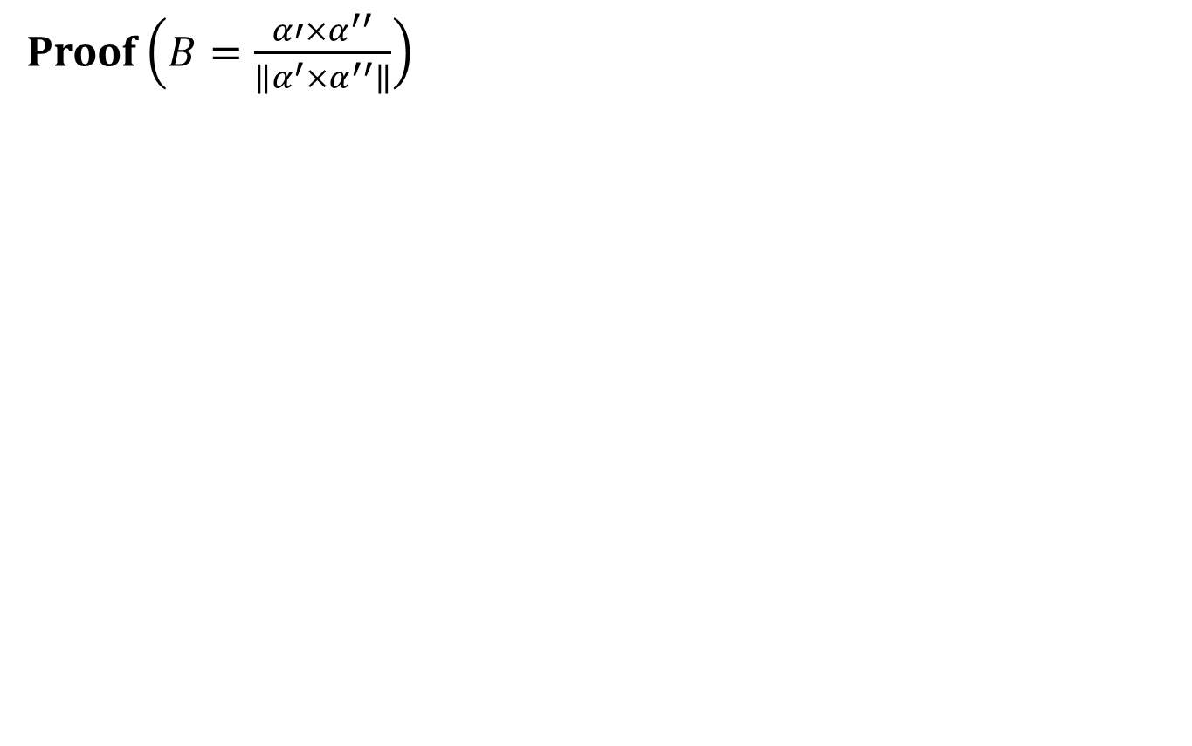
Frenet Apparatus For A Regular Curve
Proof$\left(B=\frac{{α′×α}^{′′}}{\left\|α^{′}×α^{′′}\right\|}\right)$
$$T=\frac{α}{\left\|α^{′}\right\|},$$
$$N=B×T$$
$$B=\frac{{α′×α}^{′′}}{\left\|α^{′}×α^{′′}\right\|},$$
$$κ=\frac{\left\|α^{′}×α^{′′}\right\|}{{\left\|α^{′}\right\|}^{3}}$$
$$τ=\frac{\left(α^{′}×α^{′′}\right). α^{′′′}}{‖{\left.​α^{′}×α^{′′}\right\|}^{2}}$$

Slide 8
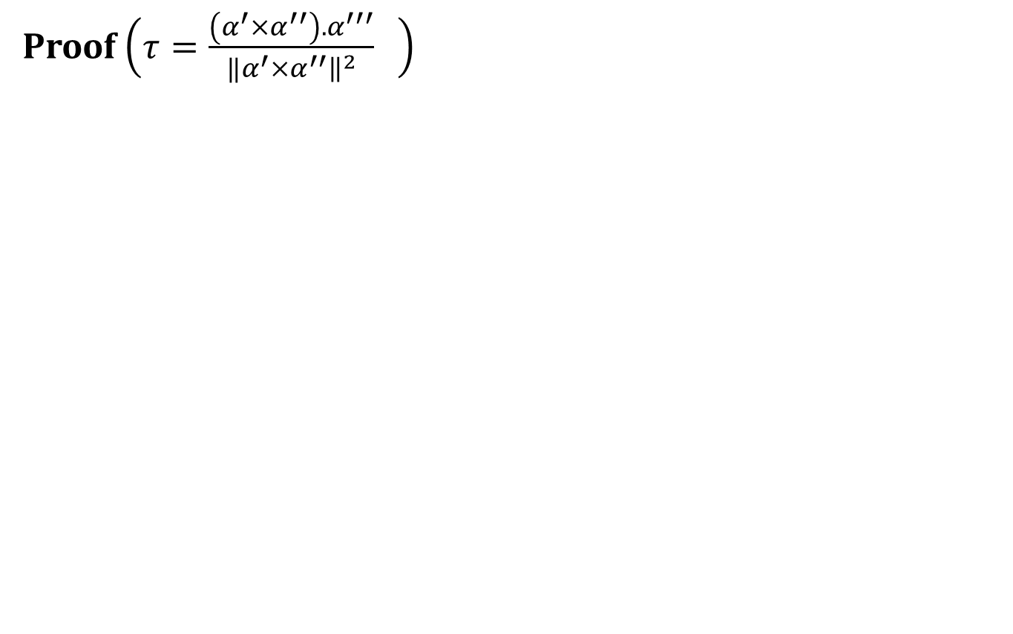
Frenet Apparatus For A Regular Curve
Proof$\left(τ=\frac{\left(α^{′}×α^{′′}\right). α^{′′′}}{‖{\left.​α^{′}×α^{′′}\right\|}^{2}} \right)$
$$T=\frac{α}{\left\|α^{′}\right\|},$$
$$N=B×T$$
$$B=\frac{{α′×α}^{′′}}{\left\|α^{′}×α^{′′}\right\|},$$
$$κ=\frac{\left\|α^{′}×α^{′′}\right\|}{{\left\|α^{′}\right\|}^{3}}$$
$$τ=\frac{\left(α^{′}×α^{′′}\right). α^{′′′}}{‖{\left.​α^{′}×α^{′′}\right\|}^{2}}$$

Slide 9
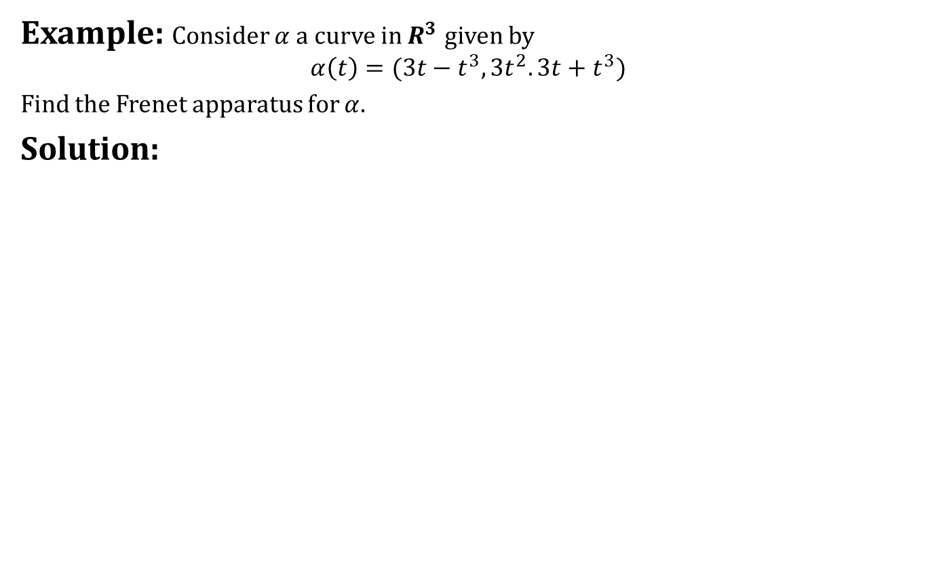
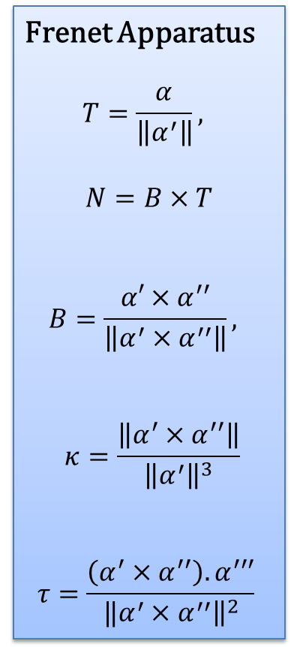
Frenet Apparatus For A Regular Curve
Example: Consider $α$ a curve in $R^{3}$given by
$$α\left(t\right)=(3t−t^{3},3t^{2}.3t+t^{3})$$
Find the Frenet apparatus for $α.$
Solution:
Frenet Apparatus
$$T=\frac{α}{\left\|α^{′}\right\|},$$
$$N=B×T$$
$$B=\frac{{α′×α}^{′′}}{\left\|α^{′}×α^{′′}\right\|},$$
$$κ=\frac{\left\|α^{′}×α^{′′}\right\|}{{\left\|α^{′}\right\|}^{3}}$$
$$τ=\frac{\left(α^{′}×α^{′′}\right). α^{′′′}}{‖{\left.​α^{′}×α^{′′}\right\|}^{2}}$$

Slide 10
Frenet Apparatus For A Regular Curve
Example: Consider $α$ a curve in $R^{3}$given by
$$α\left(t\right)=(3t−t^{3},3t^{2}.3t+t^{3})$$
Find the Frenet apparatus for $α.$
Solution:
Frenet Apparatus
$$T=\frac{α}{\left\|α^{′}\right\|},$$
$$N=B×T$$
$$B=\frac{{α′×α}^{′′}}{\left\|α^{′}×α^{′′}\right\|},$$
$$κ=\frac{\left\|α^{′}×α^{′′}\right\|}{{\left\|α^{′}\right\|}^{3}}$$
$$τ=\frac{\left(α^{′}×α^{′′}\right). α^{′′′}}{‖{\left.​α^{′}×α^{′′}\right\|}^{2}}$$

Slide 11
Frenet Apparatus For A Regular Curve
Example: Consider $α$ a curve in $R^{3}$given by
$$α\left(t\right)=(3t−t^{3},3t^{2}.3t+t^{3})$$
Find the Frenet apparatus for $α.$
Solution:
Frenet Apparatus
$$T=\frac{α}{\left\|α^{′}\right\|},$$
$$N=B×T$$
$$B=\frac{{α′×α}^{′′}}{\left\|α^{′}×α^{′′}\right\|},$$
$$κ=\frac{\left\|α^{′}×α^{′′}\right\|}{{\left\|α^{′}\right\|}^{3}}$$
$$τ=\frac{\left(α^{′}×α^{′′}\right). α^{′′′}}{‖{\left.​α^{′}×α^{′′}\right\|}^{2}}$$

Slide 12
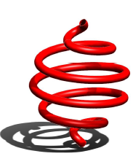
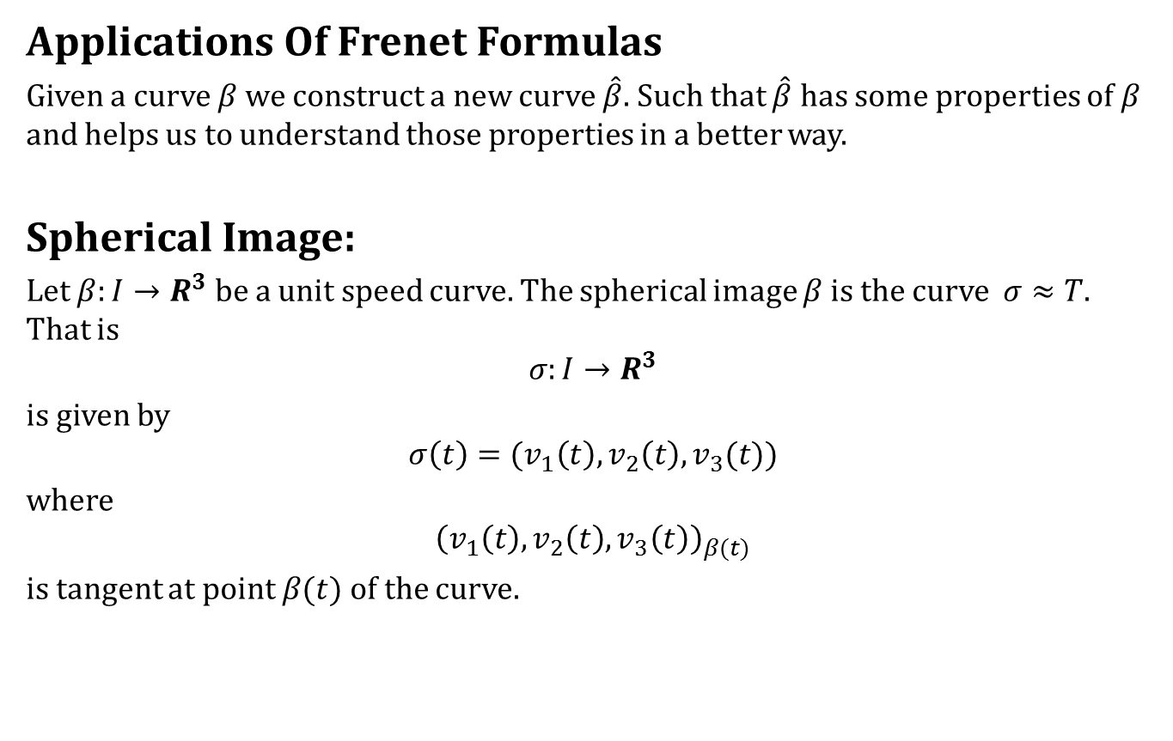
The Spherical Image
Applications Of Frenet Formulas
Given a curve $β$ we construct a new curve $\hat{β}$. Such that $\hat{β}$ has some properties of $β$ and helps us to understand those properties in a better way.
Spherical Image:
Let $β:I→R^{3}$be a unit speed curve. The spherical image $β$ is the curve $σ≈T.$ That is
$$σ:I→R^{3}$$
is given by
$$σ\left(t\right)=(v_{1}\left(t\right),v_{2}\left(t\right),v_{3}(t))$$
where
$${\left(v_{1}\left(t\right),v_{2}\left(t\right),v_{3}\left(t\right)\right)}_{β(t)}$$
is tangent at point $β(t)$ of the curve.

Slide 13
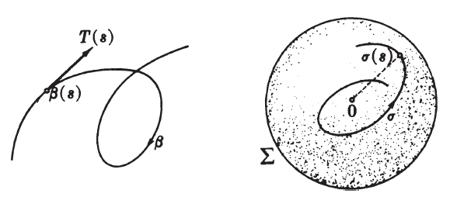
The Spherical Image
Spherical Image

Slide 14
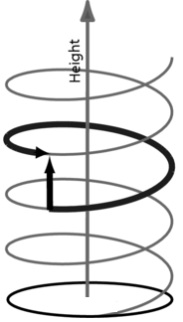
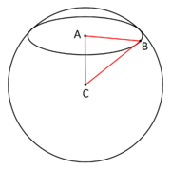
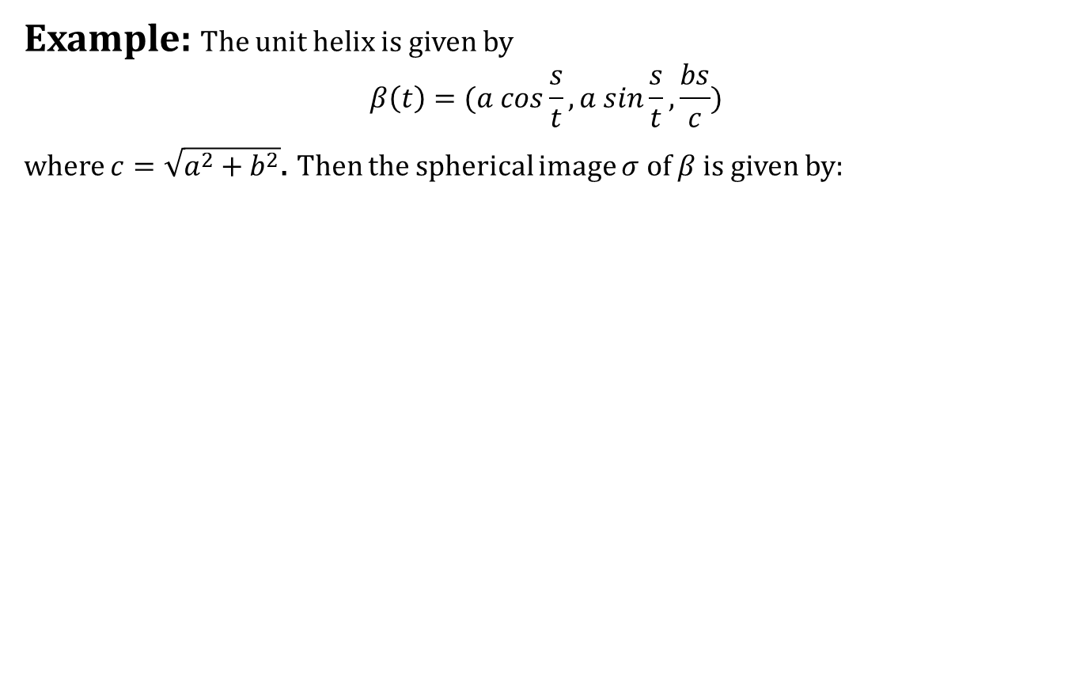
The Spherical Image
Example: The unit helix is given by
$$β\left(t\right)=(a cos\frac{s}{t}, a sin\frac{s}{t},\frac{bs}{c})$$
where $c=\sqrt{a^{2}+b^{2}}$. Then the spherical image $σ$ of $β$ is given by:

Slide 15
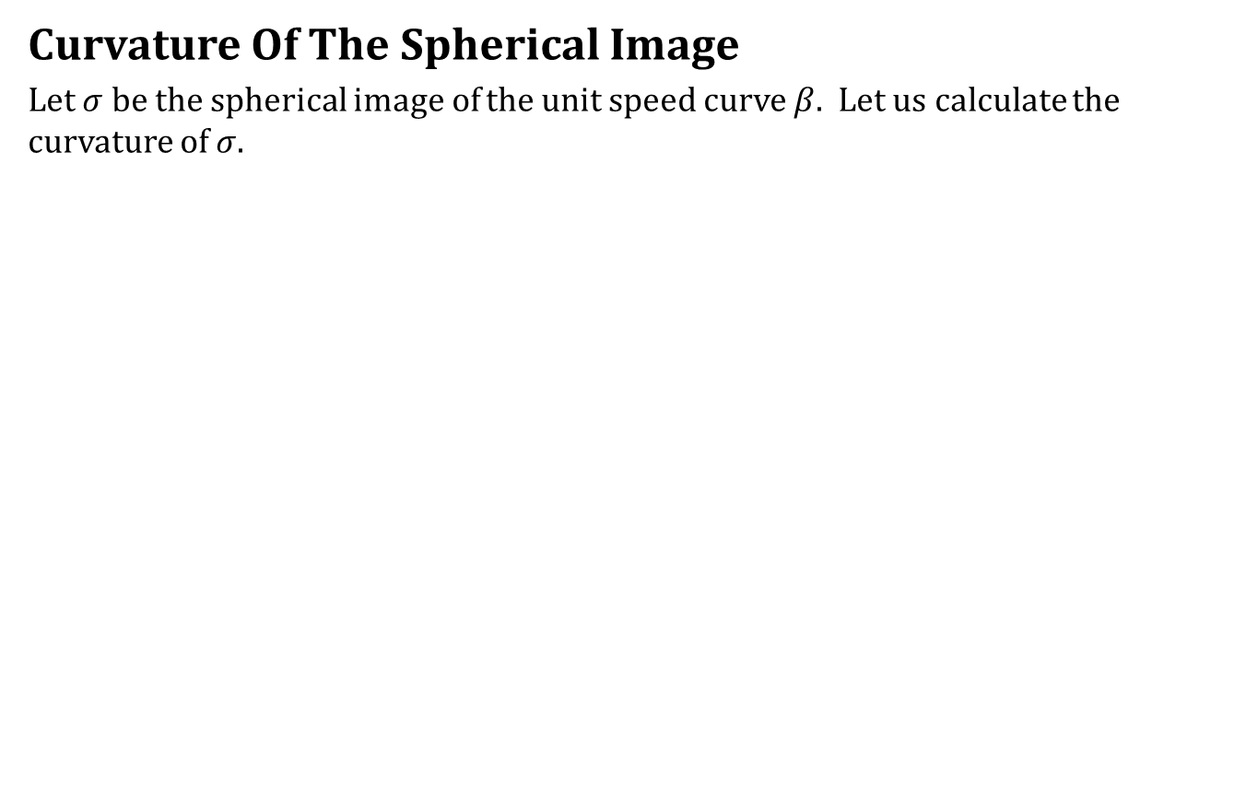
The Spherical Image
Curvature Of The Spherical Image
Let $σ$ be the spherical image of the unit speed curve $β$. Let us calculate the curvature of $σ$.

Slide 16
What we have learnt today
Contents:
Frenet Apparatus For A Regular Curve
Computing Frenet Frame
The Spherical Image

Slide 17
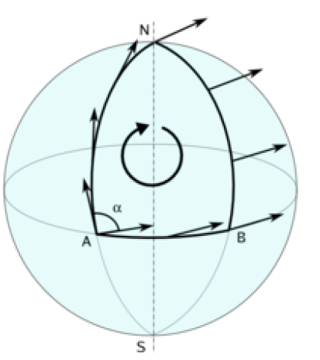
Next time
Cylindrical Helix,
Covariant Derivative

Slide 18

End of the lecture

