Slide 1
Lecture # 13
MTH352: Differential Geometry
For
Master of Mathematics
By
Dr. SOHAIL IQBAL
Assistant Professor
Department of Mathematics, CIIT Islamabad

Slide 2
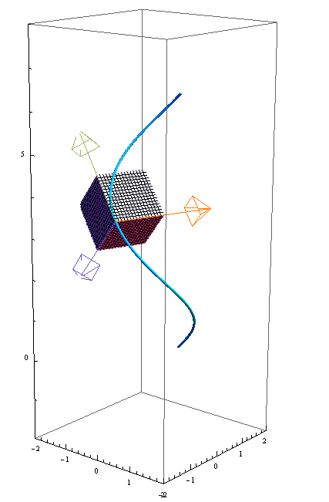
Last lecture
Contents:
Frenet Approximation
Plane Curves

Slide 3
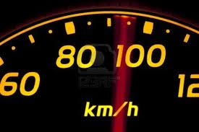
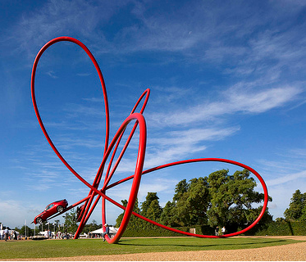
Today’s lecture
Contents:
Frenet Approximation
Conclusion
Frenet Frame For Arbitrary Speed Curves
Velocity And Acceleration

Slide 4
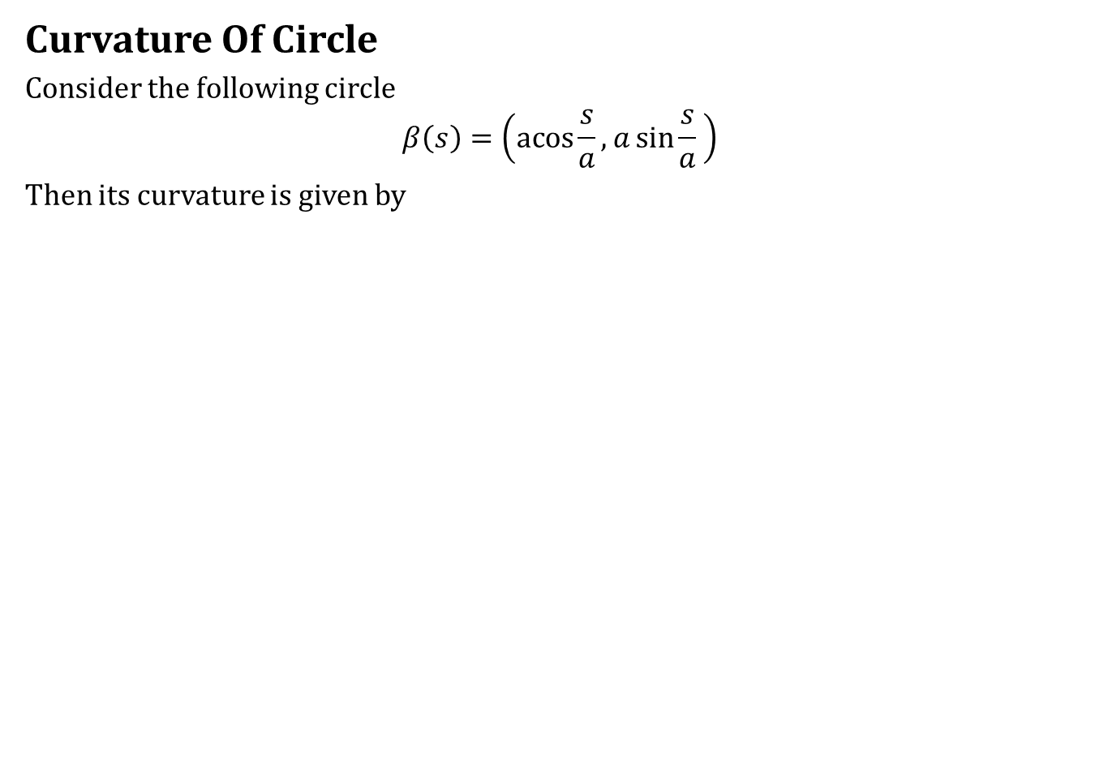
Frenet Approximation
Curvature Of Circle
Consider the following circle
$$β\left(s\right)=\left(\operatorname{acos}{\frac{s}{a}},a\sin{\frac{s}{a}} \right)$$
Then its curvature is given by

Slide 5
Frenet Approximation
Curvature Of Circle
Consider the following circle
$$β\left(s\right)=\left(\operatorname{acos}{\frac{s}{a}},a\sin{\frac{s}{a}} \right)$$
Then its curvature is given by
Question: Every curve with torsion zero (contained in plane) and constant curvature is a circle?

Slide 6
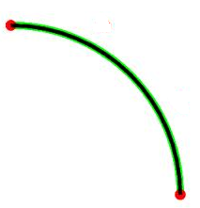
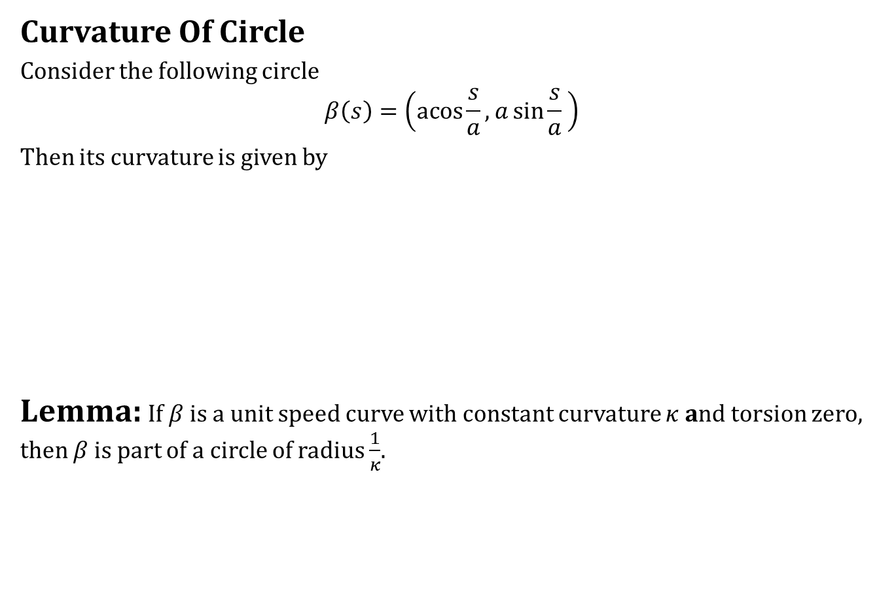
Frenet Approximation
Curvature Of Circle
Consider the following circle
$$β\left(s\right)=\left(\operatorname{acos}{\frac{s}{a}},a\sin{\frac{s}{a}} \right)$$
Then its curvature is given by
Lemma: If $β$ is a unit speed curve with constant curvature $κ$ and torsion zero, then $β$is part of a circle of radius $\frac{1}{κ}$.
Question: Every curve with torsion zero (contained in plane) and constant curvature is a circle?

Slide 7

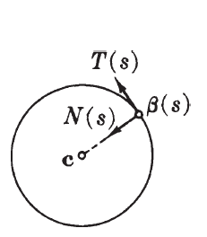
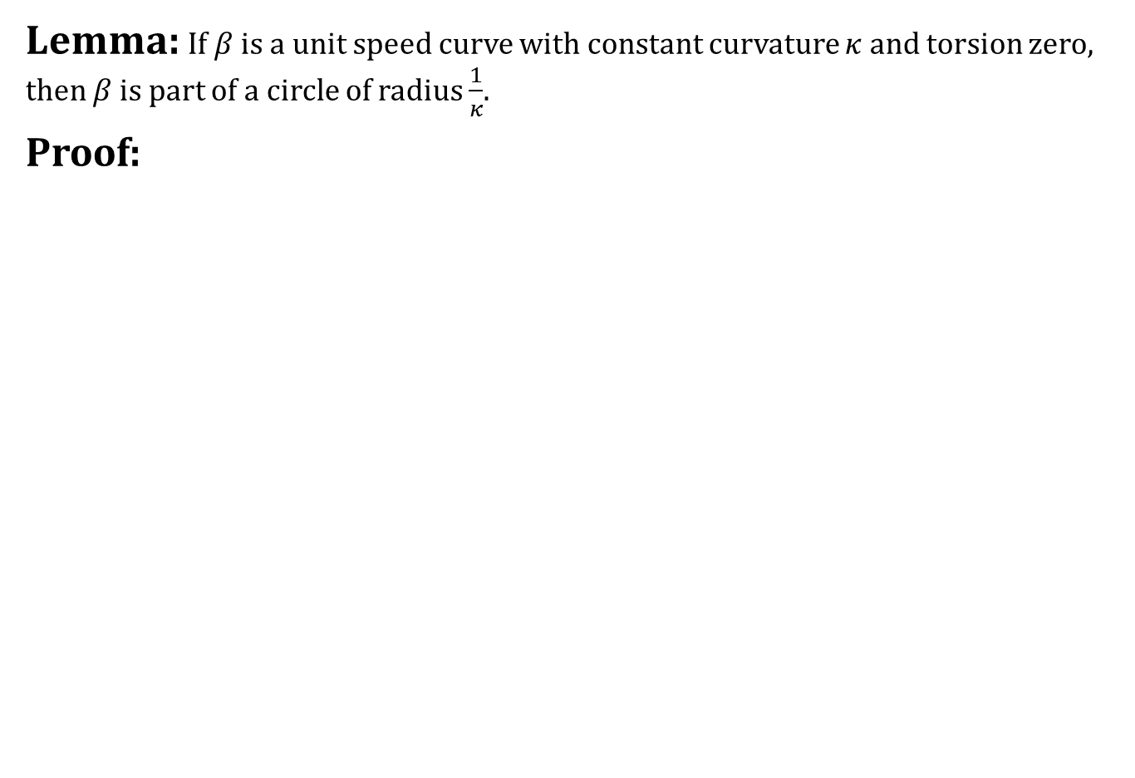
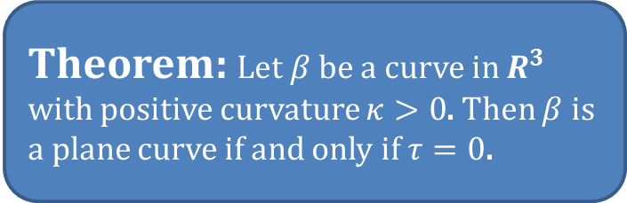
Frenet Approximation
Lemma: If $β$ is a unit speed curve with constant curvature $κ$ and torsion zero, then $β$is part of a circle of radius $\frac{1}{κ}$.
Proof:
Theorem: Let $β$ be a curve in $R^{3}$ with positive curvature $κ>0$. Then $β$ is a plane curve if and only if $τ=0$.

Slide 8
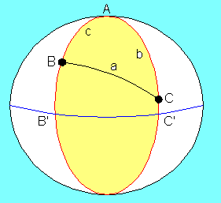
Frenet Approximation
Spherical Curves

Slide 9
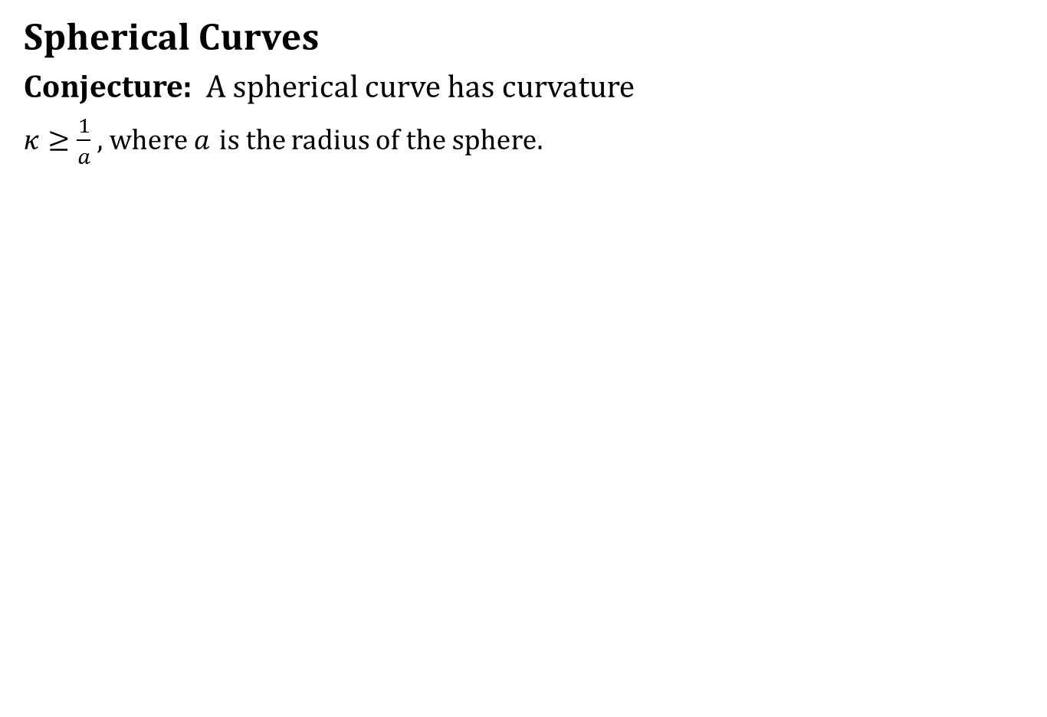
Frenet Approximation
Spherical Curves
Conjecture: A spherical curve has curvature
$κ≥\frac{1}{a}$ , where $a$ is the radius of the sphere.

Slide 10
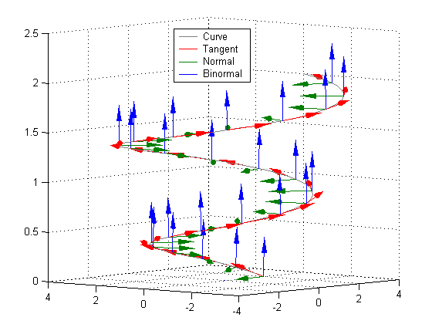
Conclusion

Slide 11
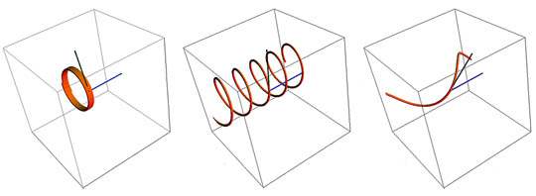
Conclusion

Slide 12
Conclusion

Slide 13
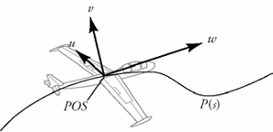
Conclusion

Slide 14
Arbitrary Speed Curves

Slide 15
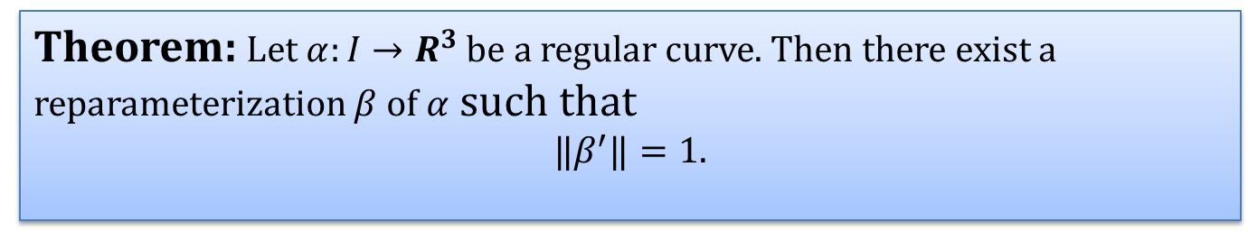
The Frenet Frame
Frenet Frame For Arbitrary Speed Curves
Idea is to use the following result
Theorem: Let $α:I→R^{3}$ be a regular curve. Then there exist a reparameterization $β$ of $α$ such that
$$‖β^{′}‖=1.$$

Slide 16
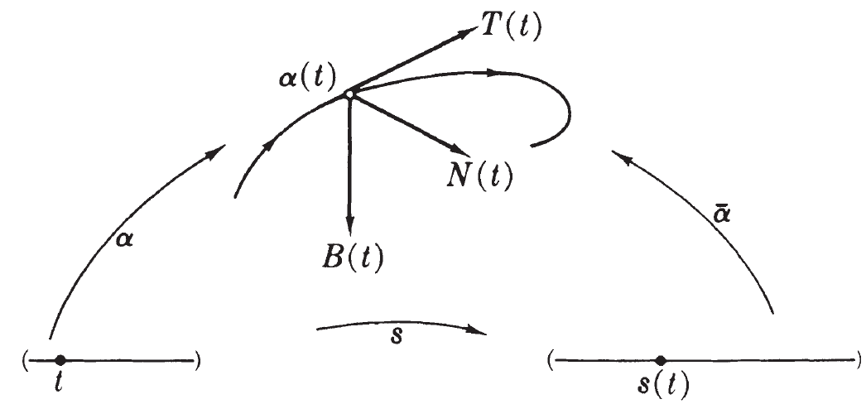
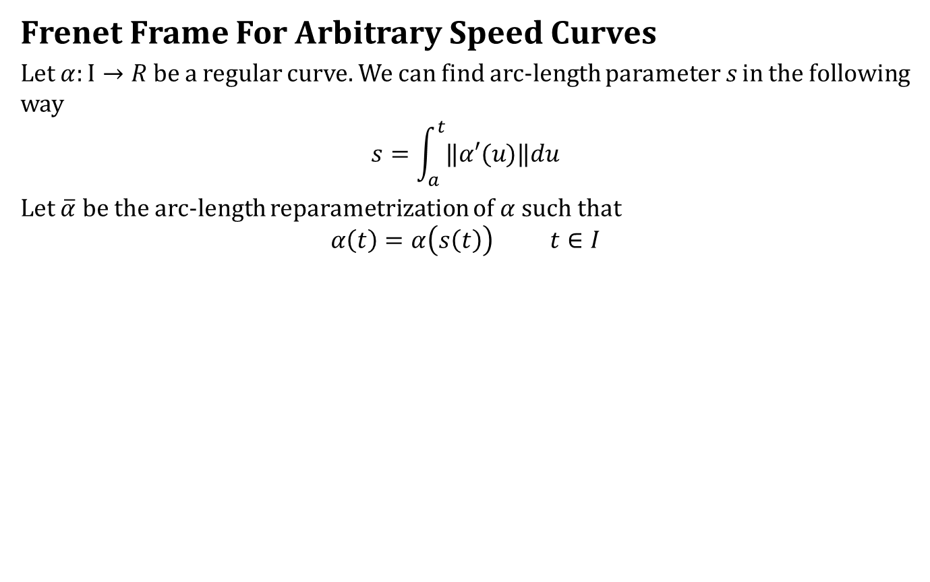
The Frenet Frame
Frenet Frame For Arbitrary Speed Curves
Let $α:I→R$ be a regular curve. We can find arc-length parameter $s$ in the following way
$$s=\int_{a}^{t}{‖α′(u)‖du}$$
Let $\overline{α}$ be the arc-length reparametrization of $α$ such that
$$α\left(t\right)=α\left(s\left(t\right)\right) t∈I$$

Slide 17
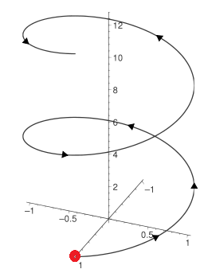
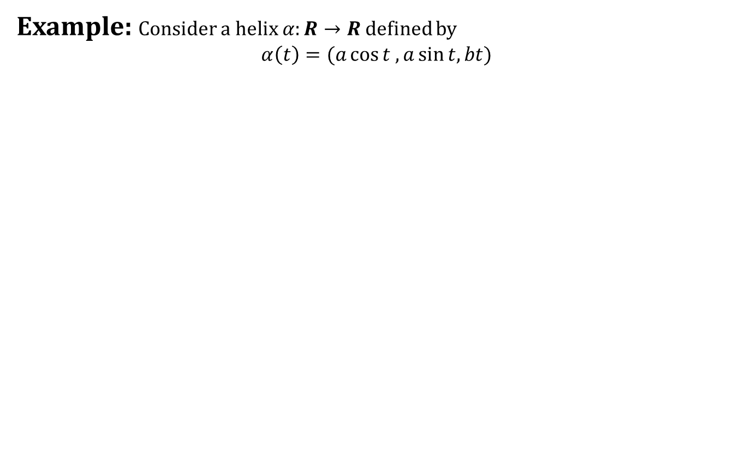
The Frenet Frame
Example: Consider a helix $α:R→R$ defined by
$$α\left(t\right)=(a\cos{t ,a\sin{t, bt}})$$

Slide 18
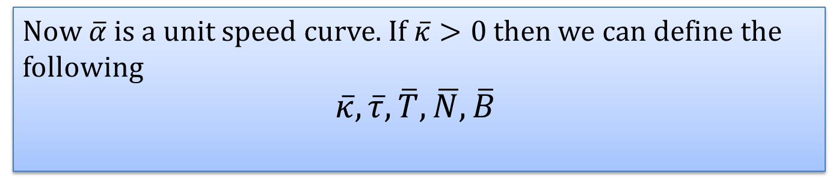
The Frenet Frame
From previous lectures:
Now $\overline{α}$ is a unit speed curve. If $\overline{κ}>0$then we can define the following
$$\overline{κ}, \overline{τ}, \overline{T},\overline{N}, \overline{B}$$

Slide 19
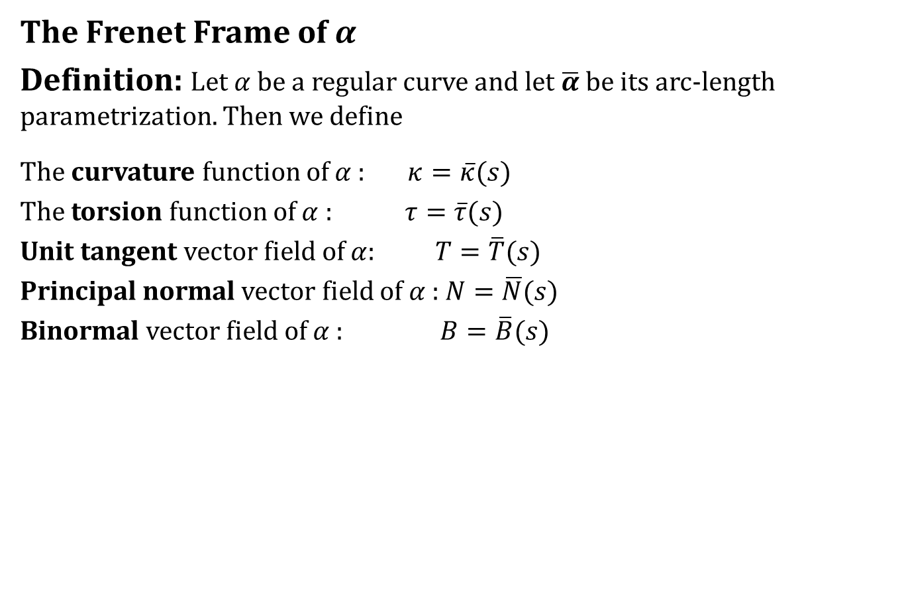
The Frenet Frame
The Frenet Frame of $α$
Definition: Let $α$ be a regular curve and let $\overline{α}$ be its arc-length parametrization. Then we define
The curvature function of $α$ : $κ=\overline{κ}(s)$
The torsion function of $α$ : $τ=\overline{τ}(s)$
Unit tangent vector field of $α$: $T=\overline{T}(s)$
Principal normal vector field of $α$ : $N=\overline{N}(s)$
Binormal vector field of $α$ : $B=\overline{B}(s)$

Slide 20
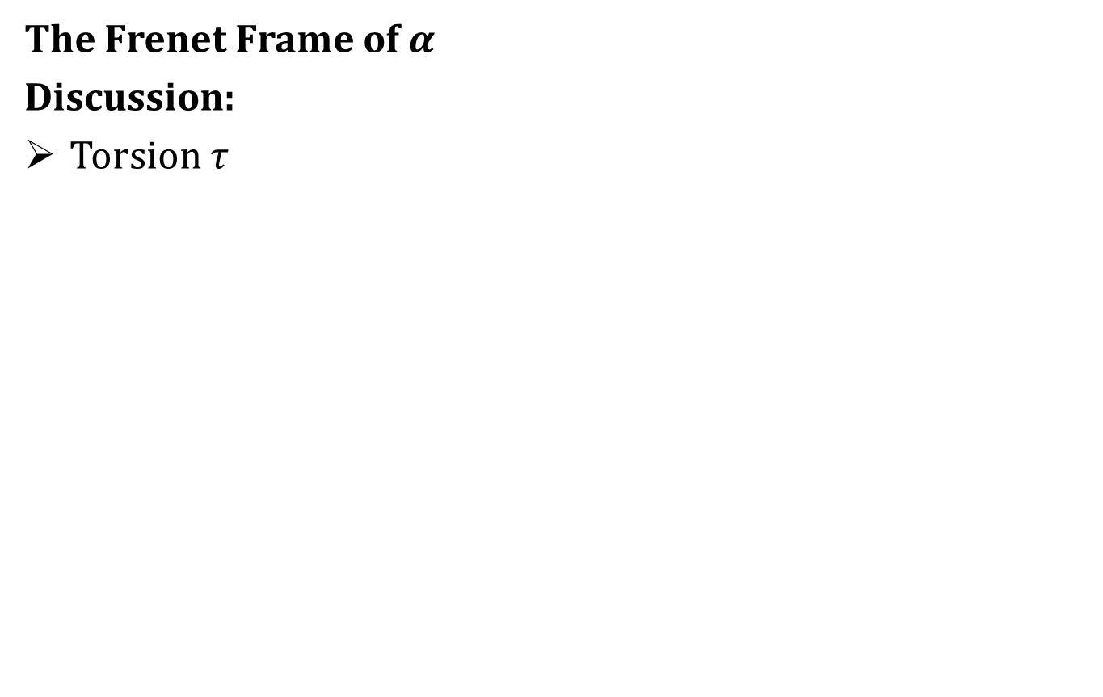
The Frenet Frame
The Frenet Frame of $α$
Discussion:
Torsion $τ$

Slide 21
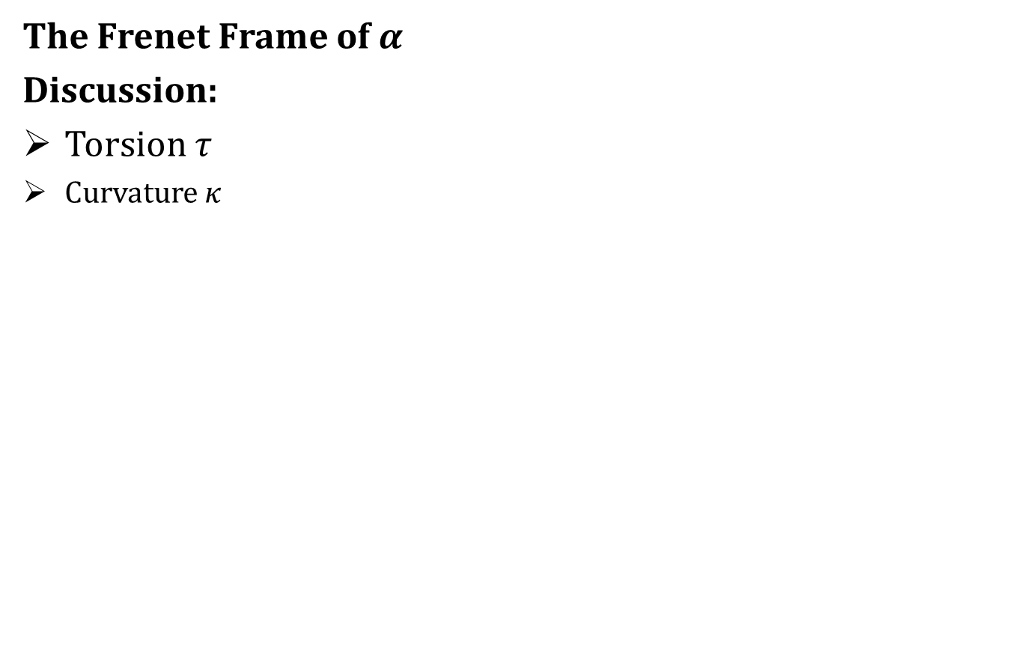
The Frenet Frame
The Frenet Frame of $α$
Discussion:
Torsion $τ$
Curvature $κ$

Slide 22
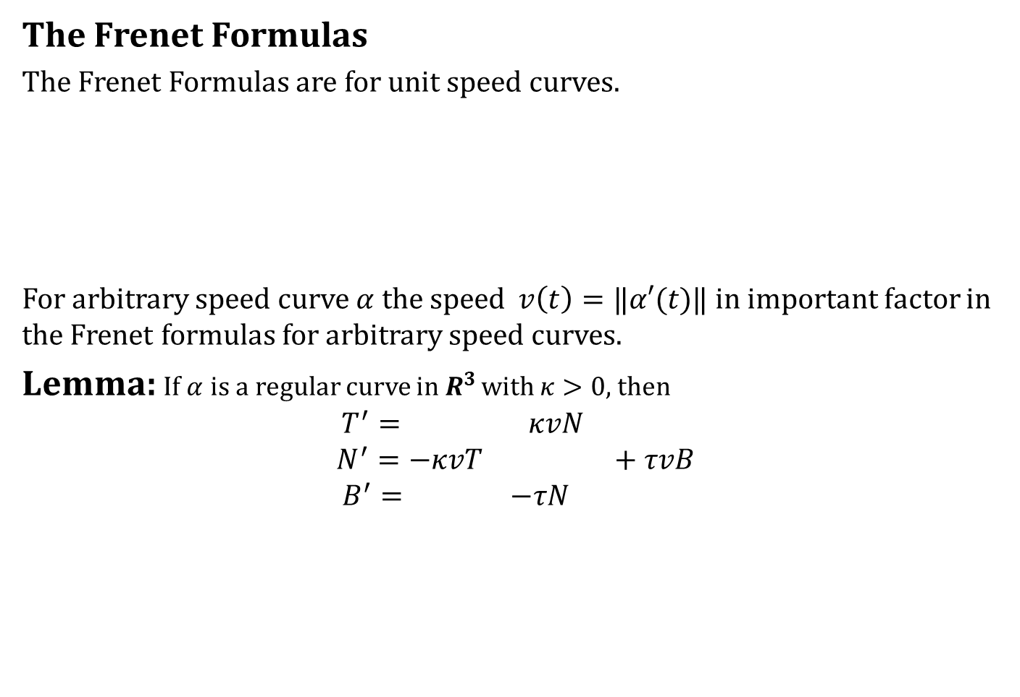
The Frenet Frame
The Frenet Formulas
The Frenet Formulas are for unit speed curves.
For arbitrary speed curve $α$ the speed$v\left(t\right)=‖α′(t)‖$ in important factor in the Frenet formulas for arbitrary speed curves.
Lemma: If $α$ is a regular curve in $R^{3 }$with $κ>0$, then
$$T^{′}= κvN$$
$$N^{′}=−κvT +τvB$$
$$B^{′}= −τN$$

Slide 23
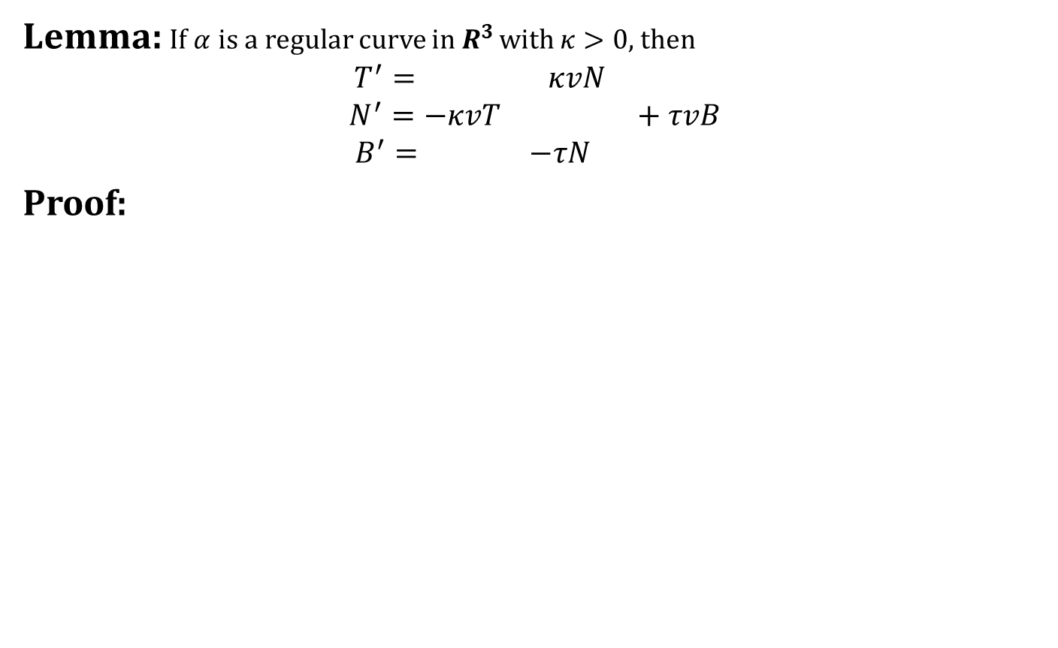
The Frenet Frame
Lemma: If $α$ is a regular curve in $R^{3 }$with $κ>0$, then
$$T^{′}= κvN$$
$$N^{′}=−κvT +τvB$$
$$B^{′}= −τN$$
Proof:

Slide 24
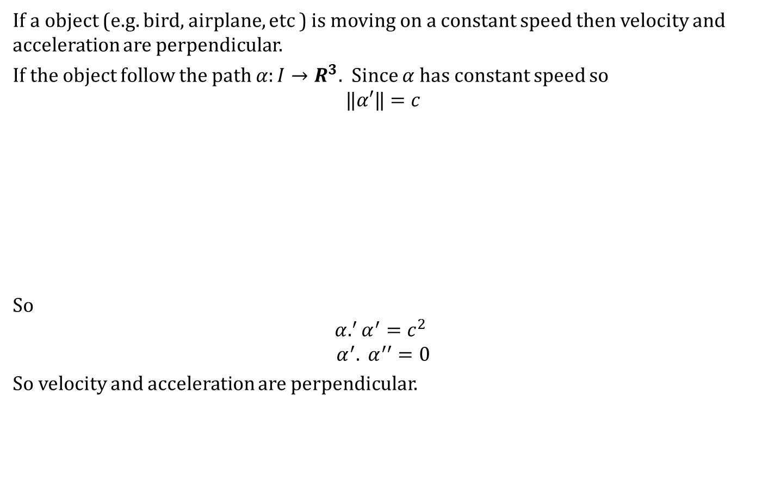
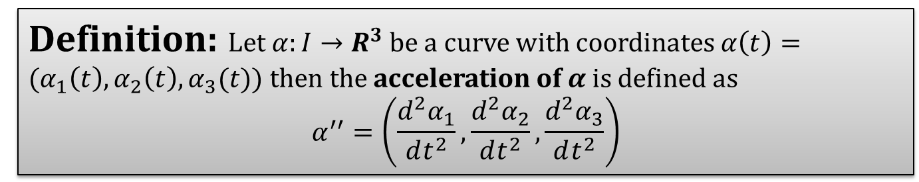
Velocity And Acceleration
If a object (e.g. bird, airplane, etc ) is moving on a constant speed then velocity and acceleration are perpendicular.
If the object follow the path $α:I→R^{3}$. Since $α$ has constant speed so
$$‖α′‖=c$$
So
$$α.^{′}α^{′}=c^{2}$$
$$α^{′}. α^{′′}=0$$
So velocity and acceleration are perpendicular.
Definition: Let $α:I→R^{3}$ be a curve with coordinates $α\left(t\right)=(α_{1}\left(t\right),α_{2}\left(t\right),α_{3}(t))$ then the acceleration of $α$ is defined as
$$α^{′′}=\left(\frac{d^{2}α_{1}}{dt^{2}},\frac{d^{2}α_{2}}{dt^{2}},\frac{d^{2}α_{3}}{dt^{2}}\right)$$

Slide 25
Velocity And Acceleration
If a object (e.g. bird, airplane, etc ) is moving on a constant speed then velocity and acceleration are perpendicular.
If the object follow the path $α:I→R^{3}$. Since $α$ has constant speed so
$$‖α′‖=c$$
So
$$α.^{′}α^{′}=c^{2}$$
$$α^{′}. α^{′′}=0$$
So velocity and acceleration are perpendicular.
Definition: Let $α:I→R^{3}$ be a curve with coordinates $α\left(t\right)=(α_{1}\left(t\right),α_{2}\left(t\right),α_{3}(t))$ then the acceleration of $α$ is defined as
$$α^{′′}=\left(\frac{d^{2}α_{1}}{dt^{2}},\frac{d^{2}α_{2}}{dt^{2}},\frac{d^{2}α_{3}}{dt^{2}}\right)$$
We can analyze the situation by expressing velocity and acceleration in terms of Frenet Frame field.

Slide 26
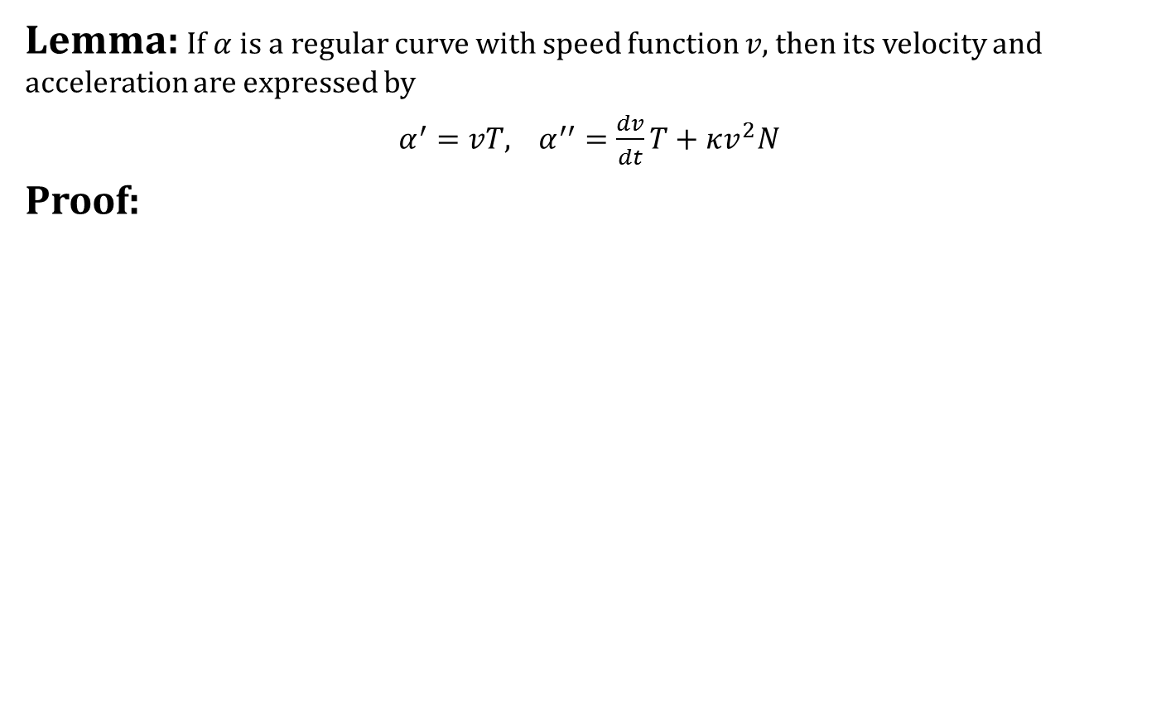
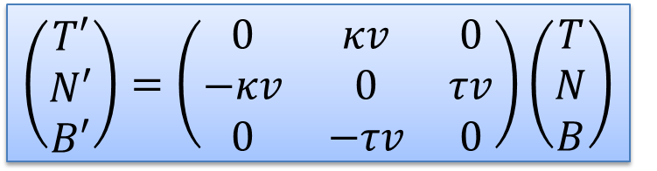
Velocity And Acceleration
Lemma: If $α$ is a regular curve with speed function $v,$ then its velocity and acceleration are expressed by
$α^{′}=vT$, $α^{′′}=\frac{dv}{dt}T+κv^{2}N$
Proof:
$$\left(\begin{matrix}T′ \\ N′ \\ B′\end{matrix}\right)=\left(\begin{matrix}0 & κv & 0 \\ −κv & 0 & τv \\ 0 & −τv & 0\end{matrix}\right)\left(\begin{matrix}T \\ N \\ B\end{matrix}\right)$$

Slide 27
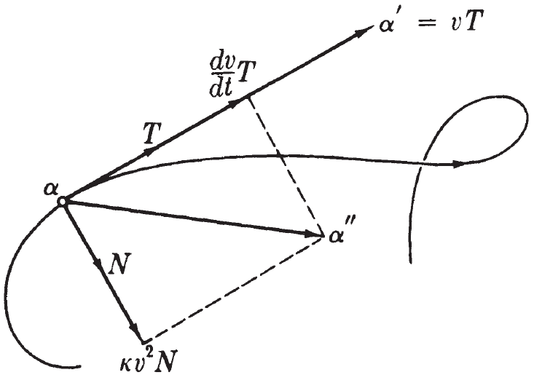
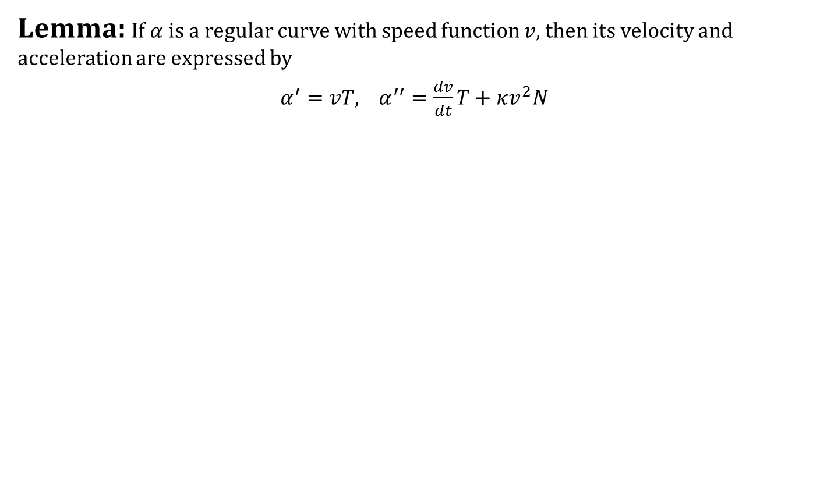
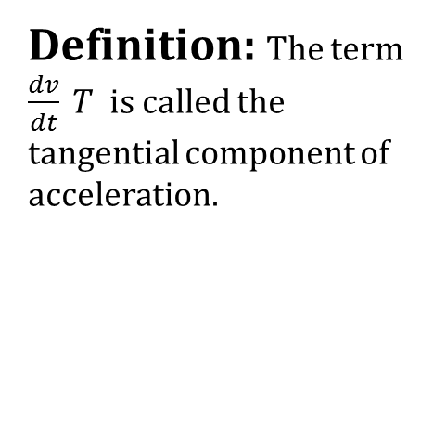
Velocity And Acceleration
Lemma: If $α$ is a regular curve with speed function $v,$ then its velocity and acceleration are expressed by
$α^{′}=vT$, $α^{′′}=\frac{dv}{dt}T+κv^{2}N$
Definition: The term $\frac{dv}{dt} T$ is called the tangential component of acceleration.

Slide 28
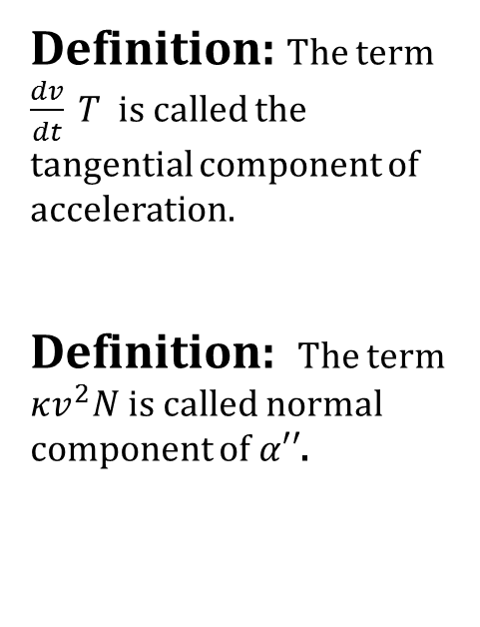
Velocity And Acceleration
Lemma: If $α$ is a regular curve with speed function $v,$ then its velocity and acceleration are expressed by
$α^{′}=vT$, $α^{′′}=\frac{dv}{dt}T+κv^{2}N$
Definition: The term $\frac{dv}{dt} T$ is called the tangential component of acceleration.
Definition: The term $κv^{2}N$ is called normal component of $α′′$.

Slide 29
What we learnt today
Contents:
Frenet Approximation
Conclusion
Frenet Frame For Arbitrary Speed Curves
Velocity And Acceleration

Slide 30
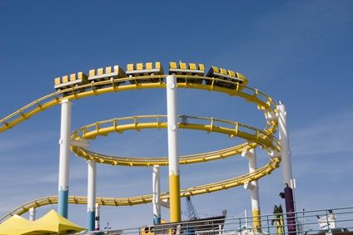
Next time
Arbitrary Speed Curves continued

Slide 31

End of the lecture

