Slide 1
Lecture # 12
MTH352: Differential Geometry
For
Master of Mathematics
By
Dr. SOHAIL IQBAL
Assistant Professor
Department of Mathematics, CIIT Islamabad

Slide 2
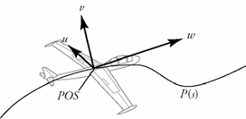
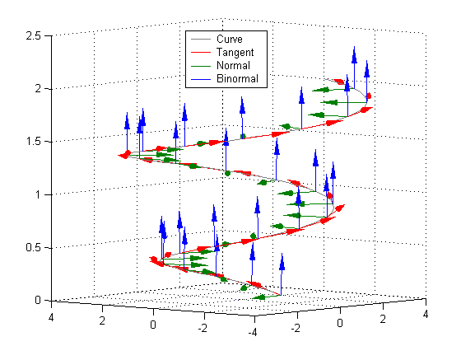
Last lecture
Contents:
Curvature
Frenet Frame Field
Frenet Formulas
Unit-Speed Helix

Slide 3
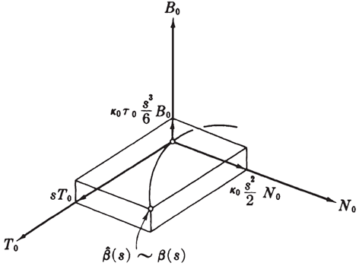
Today’s lecture
Contents:
Frenet Approximation
Plane Curves

Slide 4
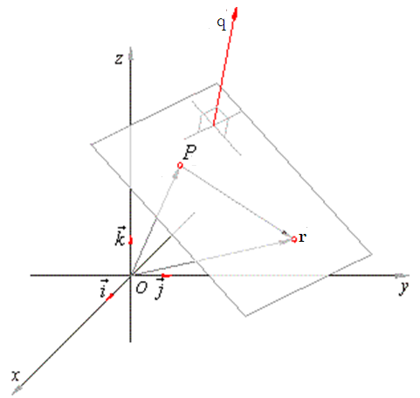
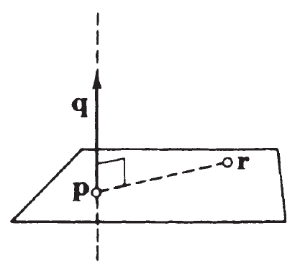
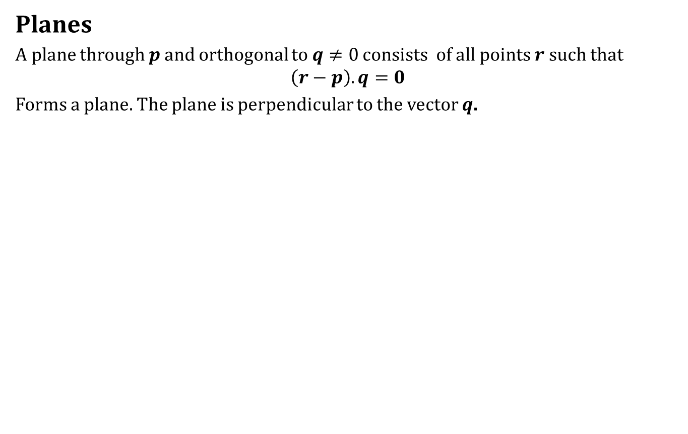
Frenet Approximation
Planes
A plane through $p$ and orthogonal to $q≠0$ consists of all points $r$ such that
$$\left(r−p\right).q=0$$
Forms a plane. The plane is perpendicular to the vector $q$.

Slide 5
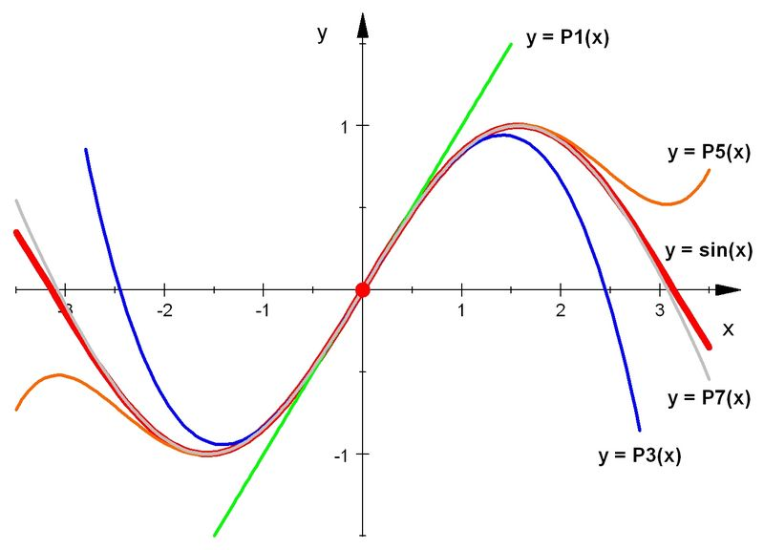
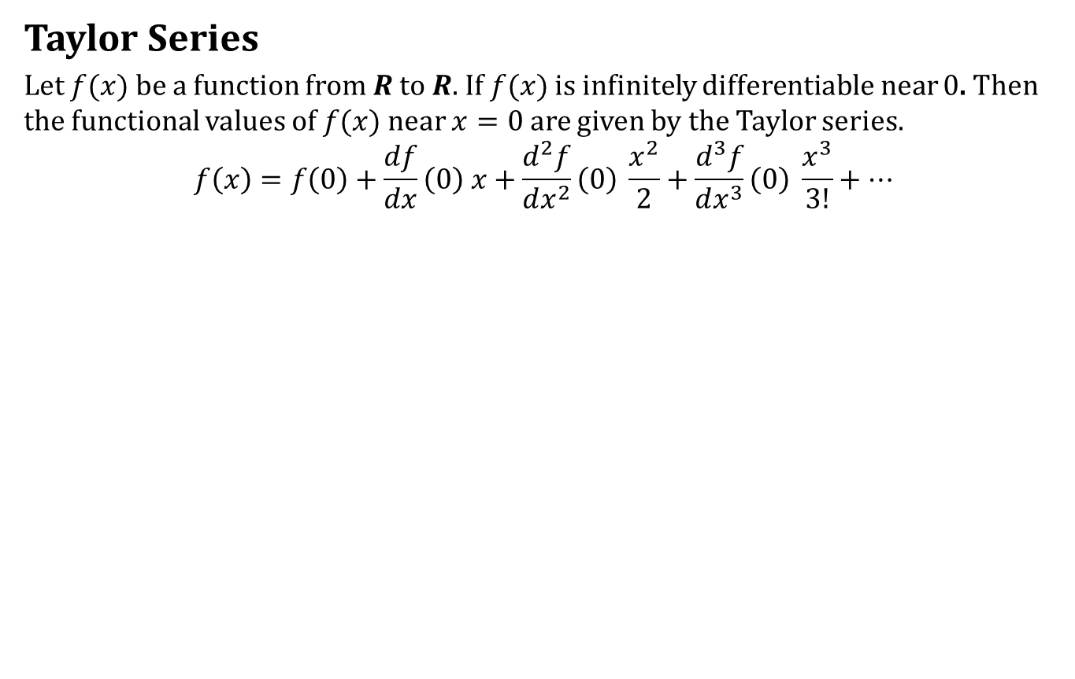
Frenet Approximation
Taylor Series
Let $f(x)$ be a function from $R$ to $R$. If $f(x)$ is infinitely differentiable near $0$. Then the functional values of $f(x)$ near $x=0$ are given by the Taylor series.
$$f\left(x\right)=f\left(0\right)+\frac{df}{dx}\left(0\right) x+\frac{d^{2}f}{dx^{2}}\left(0\right) \frac{x^{2}}{2}+\frac{d^{3}f}{dx^{3}}\left(0\right) \frac{x^{3}}{3!}+…$$

Slide 6
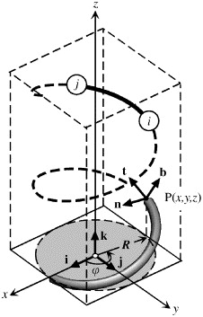
Frenet Approximation
Aim:
To approximate a curve near an arbitrary point on the curve.

Slide 7
Frenet Approximation
Aim:
To approximate a curve near an arbitrary point on the curve.
How to achieve this?
Use Taylor series
Use Frenet Frame at a point

Slide 8
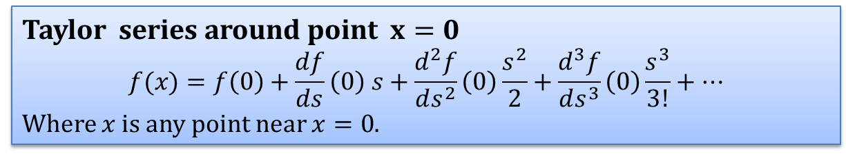
Frenet Approximation
Approximation of Euclidean Coordinate Functions
Taylor series around point $x=0$
$$f(x)=f\left(0\right)+\frac{df}{ds}\left(0\right) s+\frac{d^{2}f}{ds^{2}}\left(0\right)\frac{s^{2}}{2}+\frac{d^{3}f}{ds^{3}}\left(0\right)\frac{s^{3}}{3!}+…$$
Where $x$ is any point near $x=0$.

Slide 9
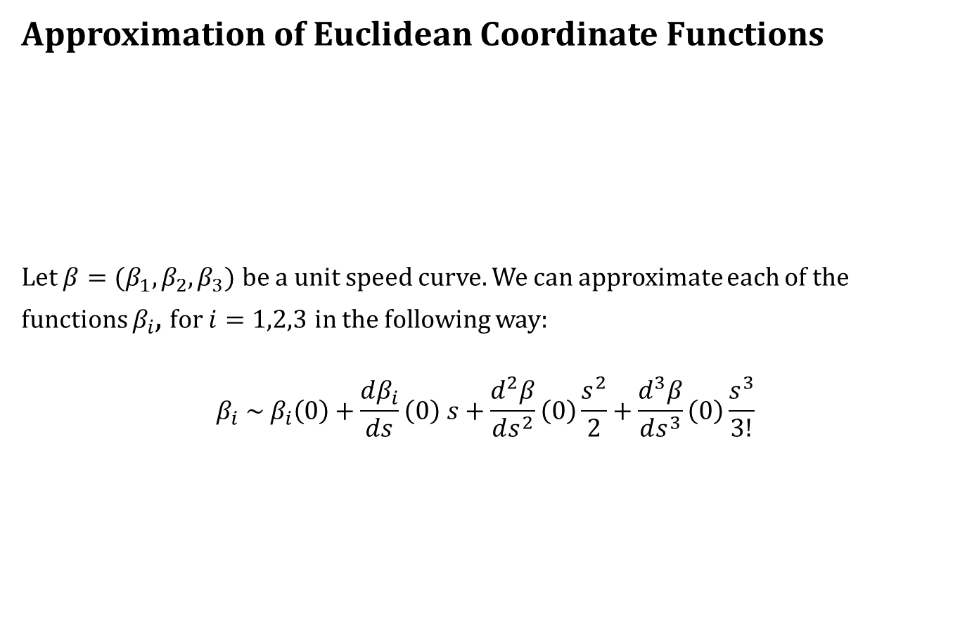
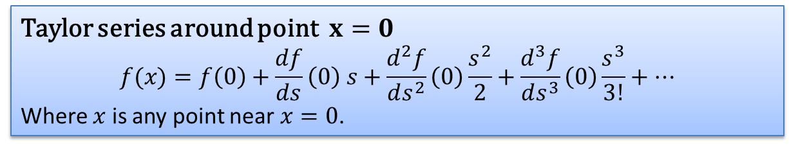
Frenet Approximation
Approximation of Euclidean Coordinate Functions
Let $β=(β_{1},β_{2},β_{3})$ be a unit speed curve. We can approximate each of the functions $β_{i}$, for $i=1,2,3$ in the following way:
$$β_{i} \sim β_{i}\left(0\right)+\frac{dβ_{i}}{ds}\left(0\right) s+\frac{d^{2}β}{ds^{2}}\left(0\right)\frac{s^{2}}{2}+\frac{d^{3}β}{ds^{3}}\left(0\right)\frac{s^{3}}{3!}$$
Taylor series around point $x=0$
$$f(x)=f\left(0\right)+\frac{df}{ds}\left(0\right) s+\frac{d^{2}f}{ds^{2}}\left(0\right)\frac{s^{2}}{2}+\frac{d^{3}f}{ds^{3}}\left(0\right)\frac{s^{3}}{3!}+…$$
Where $x$ is any point near $x=0$.

Slide 10
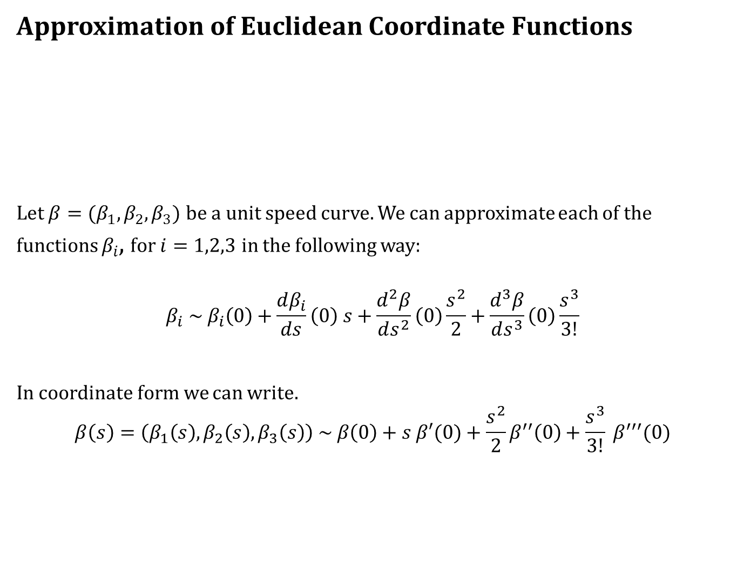
Frenet Approximation
Approximation of Euclidean Coordinate Functions
Let $β=(β_{1},β_{2},β_{3})$ be a unit speed curve. We can approximate each of the functions $β_{i}$, for $i=1,2,3$ in the following way:
$$β_{i} \sim β_{i}\left(0\right)+\frac{dβ_{i}}{ds}\left(0\right) s+\frac{d^{2}β}{ds^{2}}\left(0\right)\frac{s^{2}}{2}+\frac{d^{3}β}{ds^{3}}\left(0\right)\frac{s^{3}}{3!}$$
In coordinate form we can write.
$$β\left(s\right)=\left(β_{1}\left(s\right),β_{2}\left(s\right),β_{3}\left(s\right)\right) \sim β\left(0\right)+s β′(0)+\frac{s^{2}}{2}β^{′′}\left(0\right)+\frac{s^{3}}{3!} β^{′′′}(0)$$
Taylor series around point $x=0$
$$f(x)=f\left(0\right)+\frac{df}{ds}\left(0\right) s+\frac{d^{2}f}{ds^{2}}\left(0\right)\frac{s^{2}}{2}+\frac{d^{3}f}{ds^{3}}\left(0\right)\frac{s^{3}}{3!}+…$$
Where $x$ is any point near $x=0$.

Slide 11

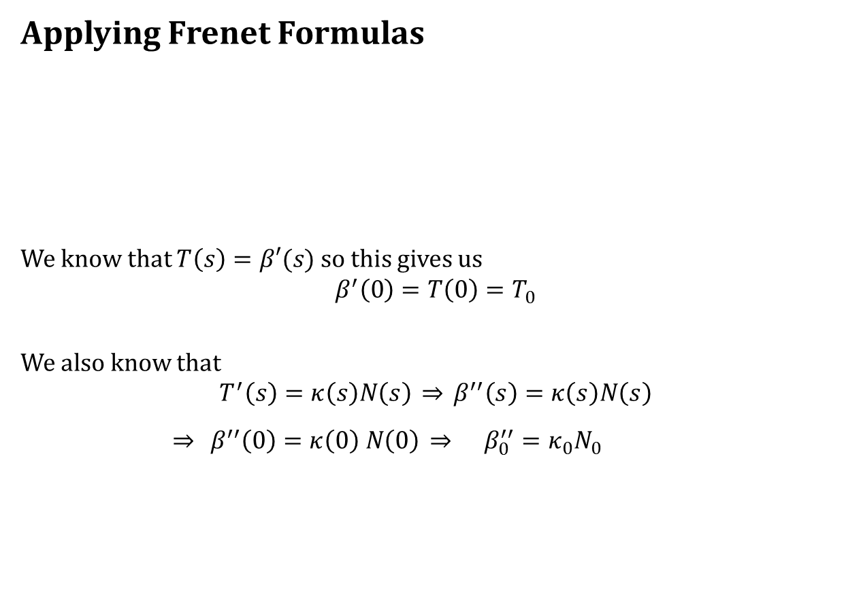
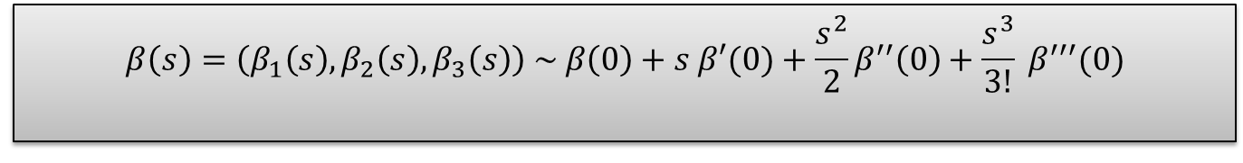
Frenet Approximation
Applying Frenet Formulas
We know that $T\left(s\right)=β′(s)$ so this gives us
$$β^{′}\left(0\right)=T\left(0\right)=T_{0}$$
We also know that
$$T^{′}\left(s\right)=κ\left(s\right)N\left(s\right) \overset{⇒}{} β^{′′}\left(s\right)=κ\left(s\right)N\left(s\right)$$
$\overset{⇒}{} β^{′′}\left(0\right)=κ\left(0\right) N\left(0\right) \overset{⇒}{} β_{0}^{′′}=κ_{0}N_{0}$
$$β\left(s\right)=\left(β_{1}\left(s\right),β_{2}\left(s\right),β_{3}\left(s\right)\right) \sim β\left(0\right)+s β′(0)+\frac{s^{2}}{2}β^{′′}\left(0\right)+\frac{s^{3}}{3!} β^{′′′}(0)$$

Slide 12

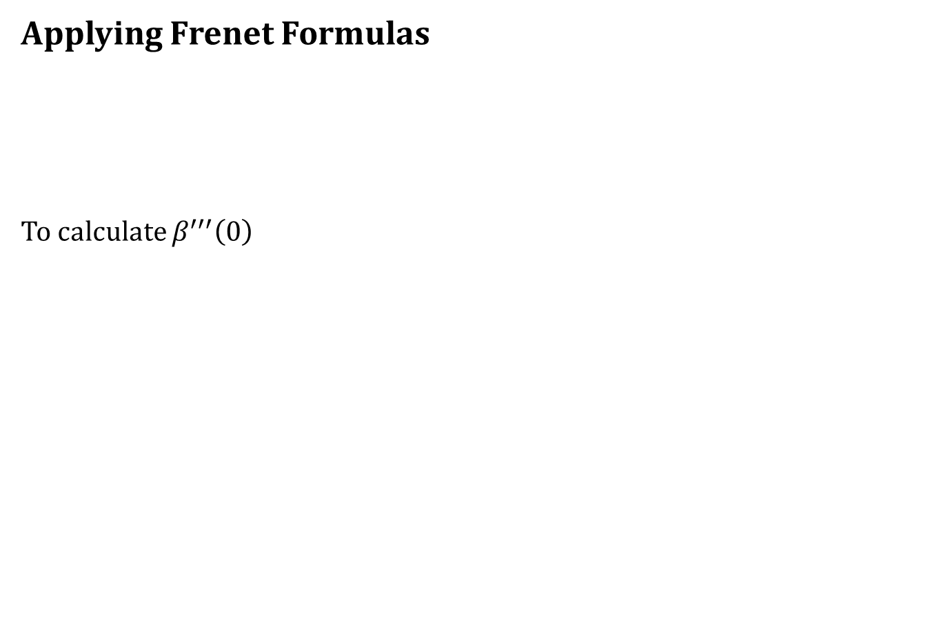
Frenet Approximation
Applying Frenet Formulas
To calculate $β^{′′′}\left(0\right)$
$$β\left(s\right)=\left(β_{1}\left(s\right),β_{2}\left(s\right),β_{3}\left(s\right)\right) \sim β\left(0\right)+s β′(0)+\frac{s^{2}}{2}β^{′′}\left(0\right)+\frac{s^{3}}{3!} β^{′′′}(0)$$

Slide 13
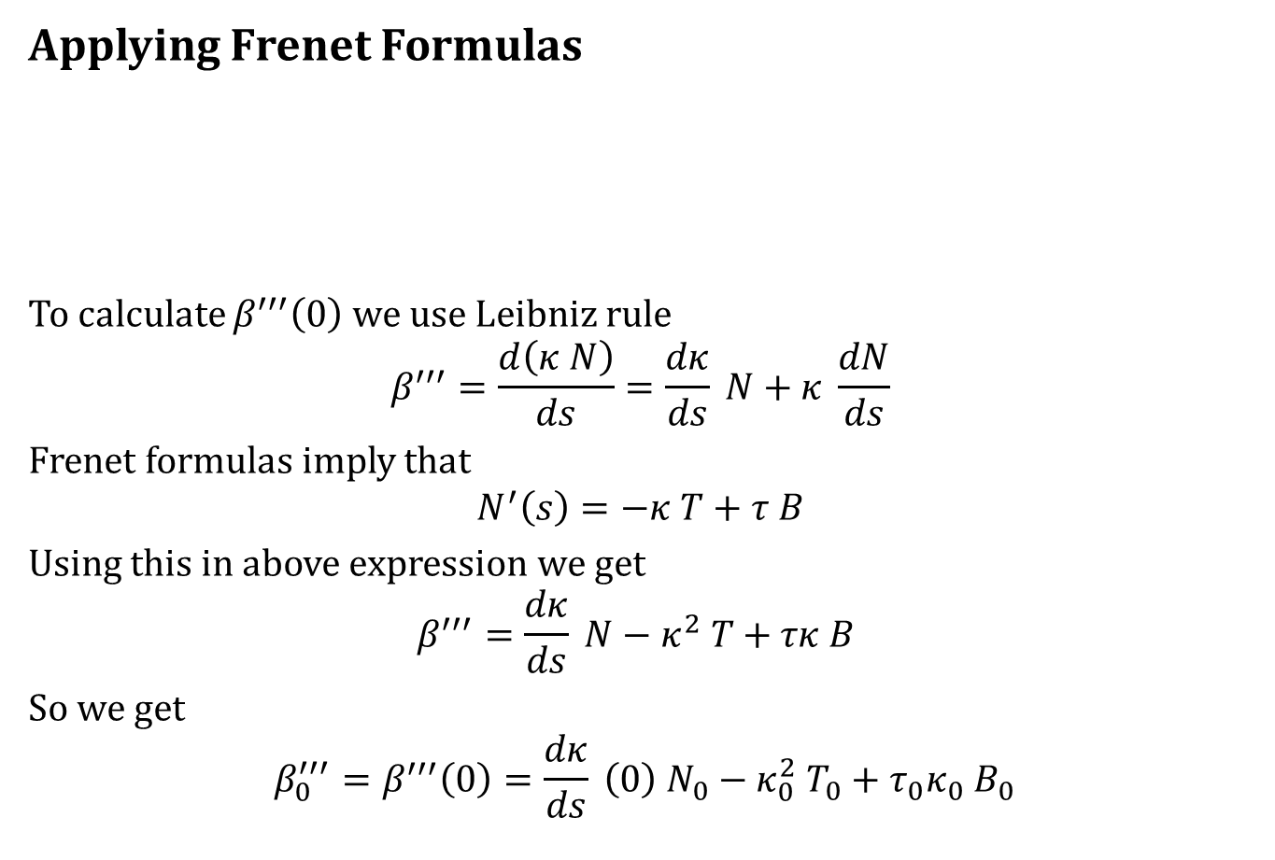
Frenet Approximation
Applying Frenet Formulas
To calculate $β^{′′′}\left(0\right)$ we use Leibniz rule
$$β^{′′′}=\frac{d\left(κ N\right)}{ds}=\frac{dκ}{ds} N+κ \frac{dN}{ds}$$
Frenet formulas imply that
$$N^{′}\left(s\right)=−κ T+τ B$$
Using this in above expression we get
$$β^{′′′}=\frac{dκ}{ds} N−κ^{2} T+τκ B$$
So we get
$${β_{0}^{′′′}=β}^{′′′}\left(0\right)=\frac{dκ}{ds} \left(0\right) N_{0}−κ_{0}^{2} T_{0}+τ_{0}κ_{0} B_{0}$$
$$β\left(s\right)=\left(β_{1}\left(s\right),β_{2}\left(s\right),β_{3}\left(s\right)\right) \sim β\left(0\right)+s β′(0)+\frac{s^{2}}{2}β^{′′}\left(0\right)+\frac{s^{3}}{3!} β^{′′′}(0)$$

Slide 14
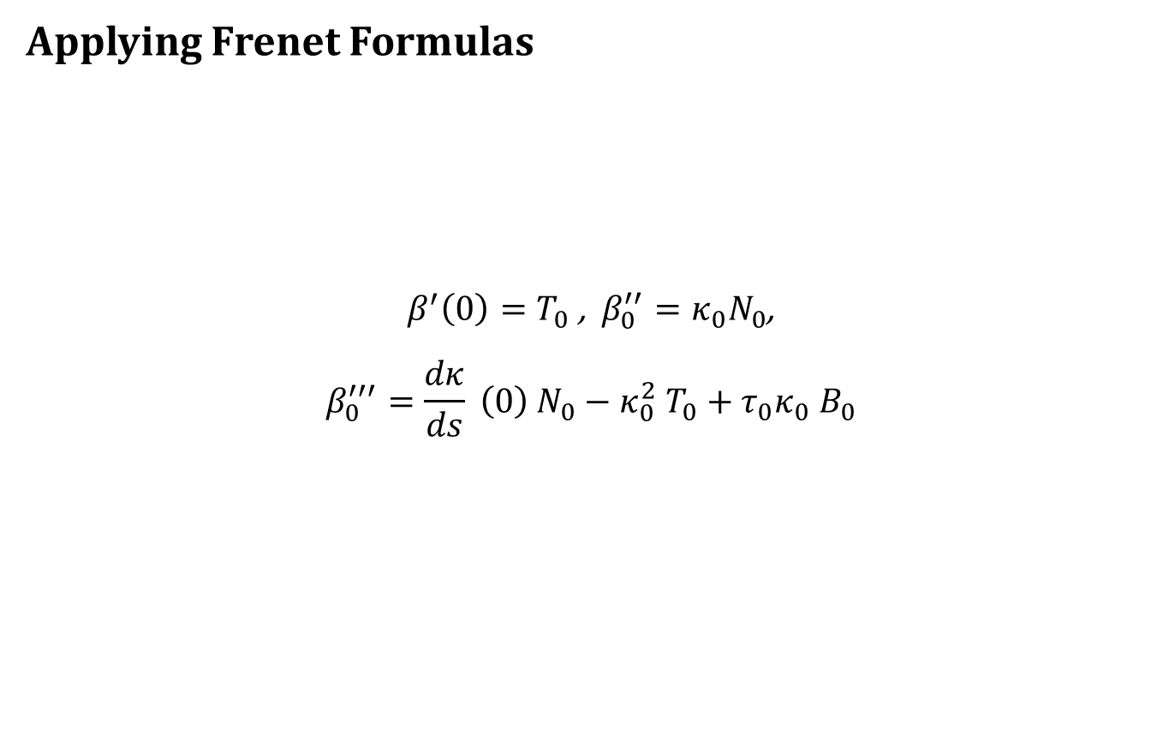

Frenet Approximation
Applying Frenet Formulas
$β^{′}\left(0\right)=T_{0}$ , $β_{0}^{′′}=κ_{0}N_{0}$,
$$β_{0}^{′′′}=\frac{dκ}{ds} \left(0\right) N_{0}−κ_{0}^{2} T_{0}+τ_{0}κ_{0} B_{0}$$
$$β\left(s\right)=\left(β_{1}\left(s\right),β_{2}\left(s\right),β_{3}\left(s\right)\right) \sim β\left(0\right)+s β′(0)+\frac{s^{2}}{2}β^{′′}\left(0\right)+\frac{s^{3}}{3!} β^{′′′}(0)$$

Slide 15
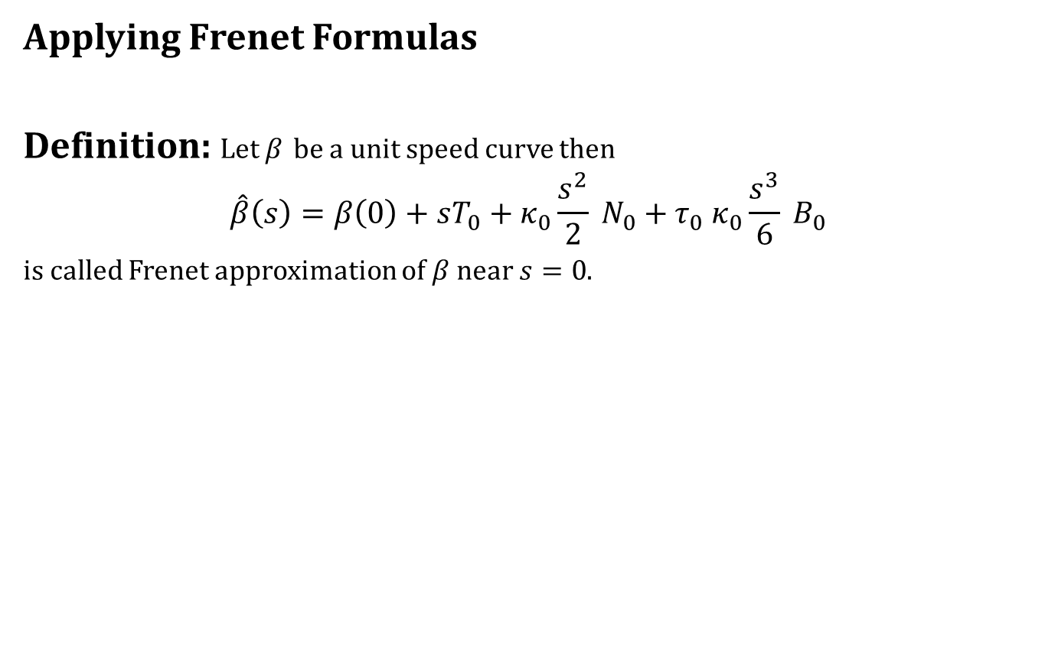
Frenet Approximation
Applying Frenet Formulas
Definition: Let $β$ be a unit speed curve then
$$\hat{β}\left(s\right)=β\left(0\right)+sT_{0}+κ_{0}\frac{s^{2}}{2} N_{0}+τ_{0} κ_{0}\frac{s^{3}}{6} B_{0}$$
is called Frenet approximation of $β$ near $s=0$.

Slide 16
Frenet Approximation
Applying Frenet Formulas
Definition: Let $β$ be a unit speed curve then
$$\hat{β}\left(s\right)=β\left(0\right)+sT_{0}+κ_{0}\frac{s^{2}}{2} N_{0}+τ_{0} κ_{0}\frac{s^{3}}{6} B_{0}$$
is called Frenet approximation of $β$ near $s=0$.
Next question: Can we do the same process for a point $s_{0}$ other than $s=0$.

Slide 17
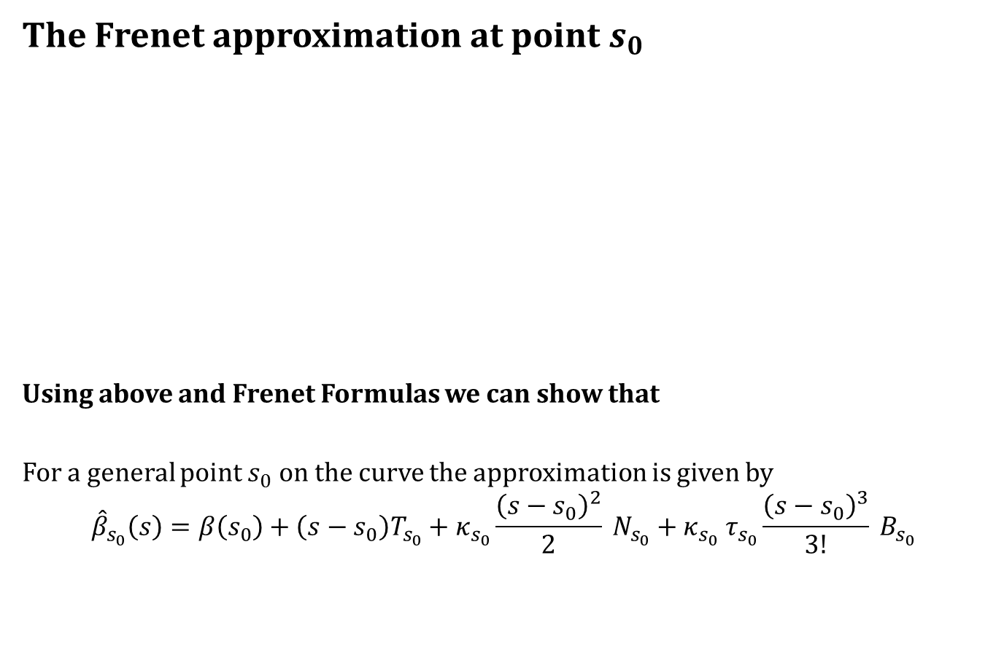
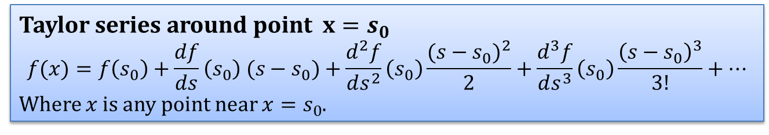
Frenet Approximation
The Frenet approximation at point $s_{0}$
Using above and Frenet Formulas we can show that
For a general point $s_{0}$ on the curve the approximation is given by
$${\hat{β}}_{s_{0}}\left(s\right)=β\left(s_{0}\right)+\left(s−s_{0}\right)T_{s_{0}}+κ_{s_{0}}\frac{{\left(s−s_{0}\right)}^{2}}{2} N_{s_{0}}+κ_{s_{0}} τ_{s_{0}}\frac{{\left(s−s_{0}\right)}^{3}}{3!} B_{s_{0}}$$
Taylor series around point $x=s_{0}$
$$f(x)=f\left(s_{0}\right)+\frac{df}{ds}\left(s_{0}\right) (s−s_{0})+\frac{d^{2}f}{ds^{2}}\left(s_{0}\right)\frac{{(s−s_{0})}^{2}}{2}+\frac{d^{3}f}{ds^{3}}\left(s_{0}\right)\frac{{\left(s−s_{0}\right)}^{3}}{3!}+…$$
Where $x$ is any point near $x=s_{0}$.

Slide 18
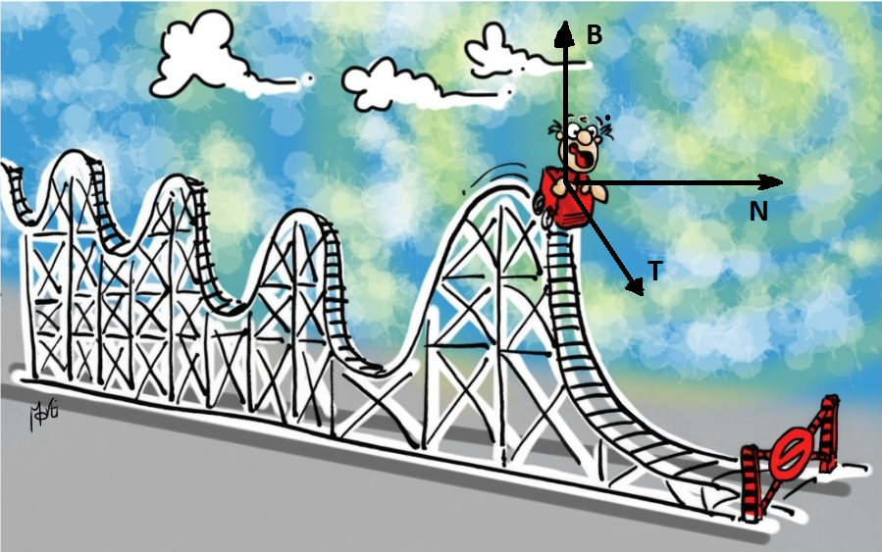
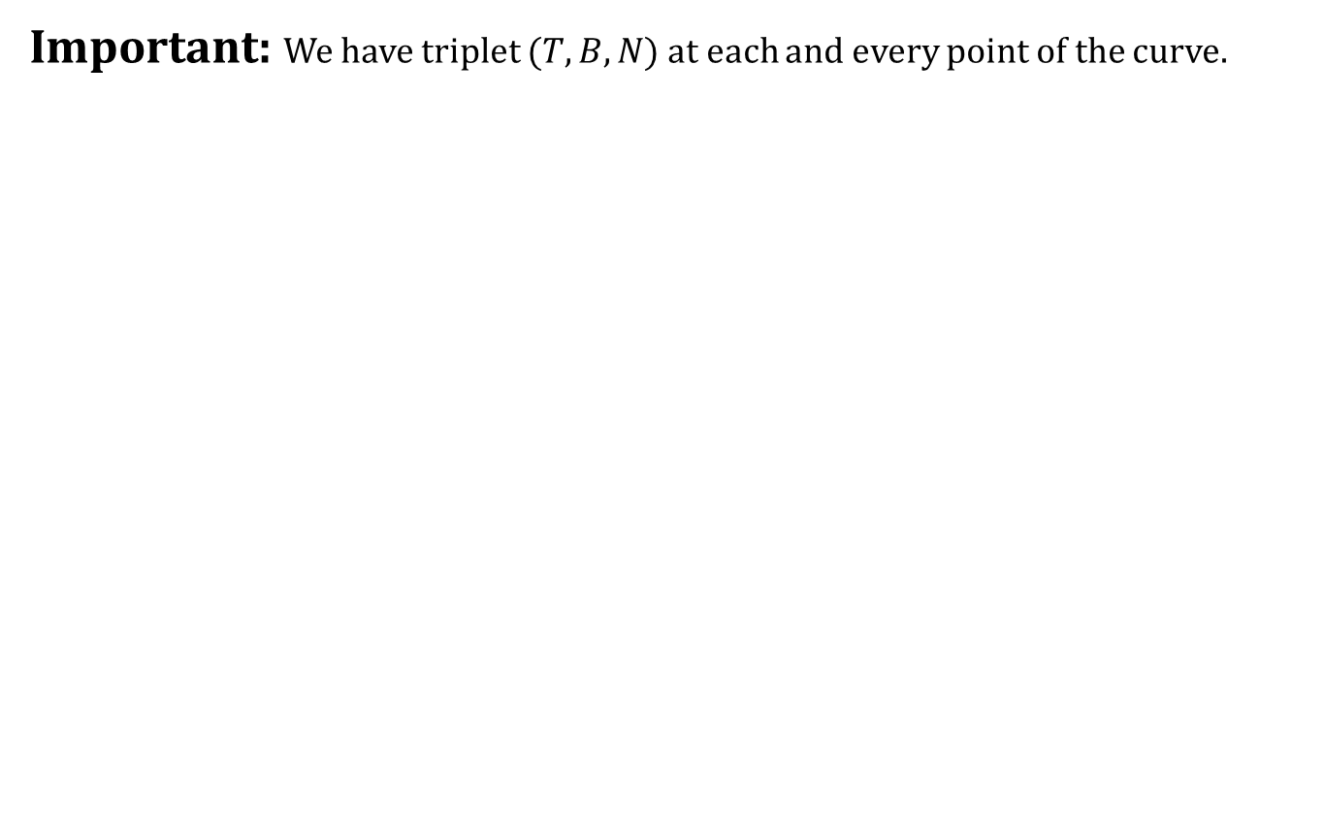
Frenet Approximation
Important: We have triplet $(T,B,N)$ at each and every point of the curve.

Slide 19
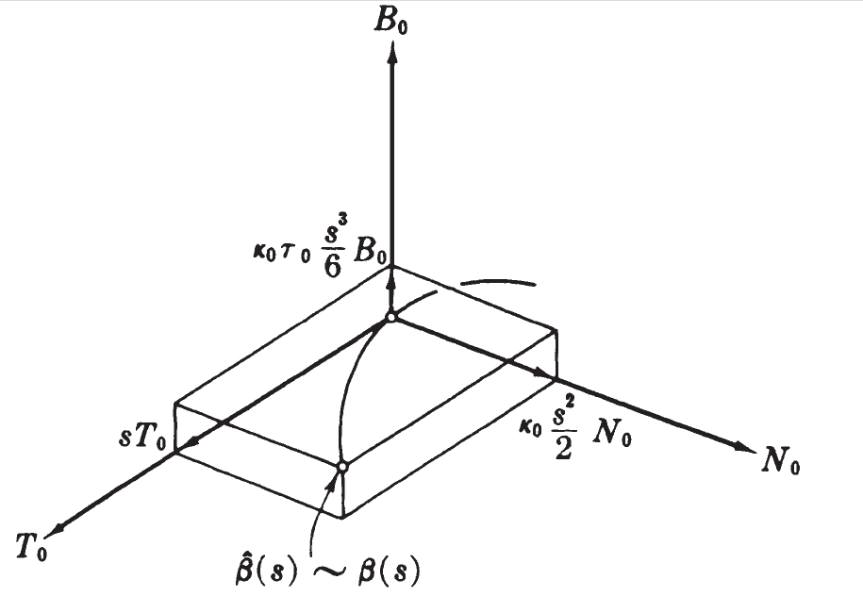
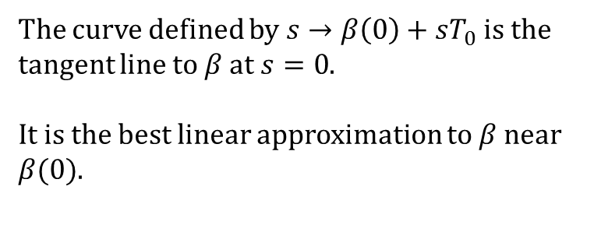
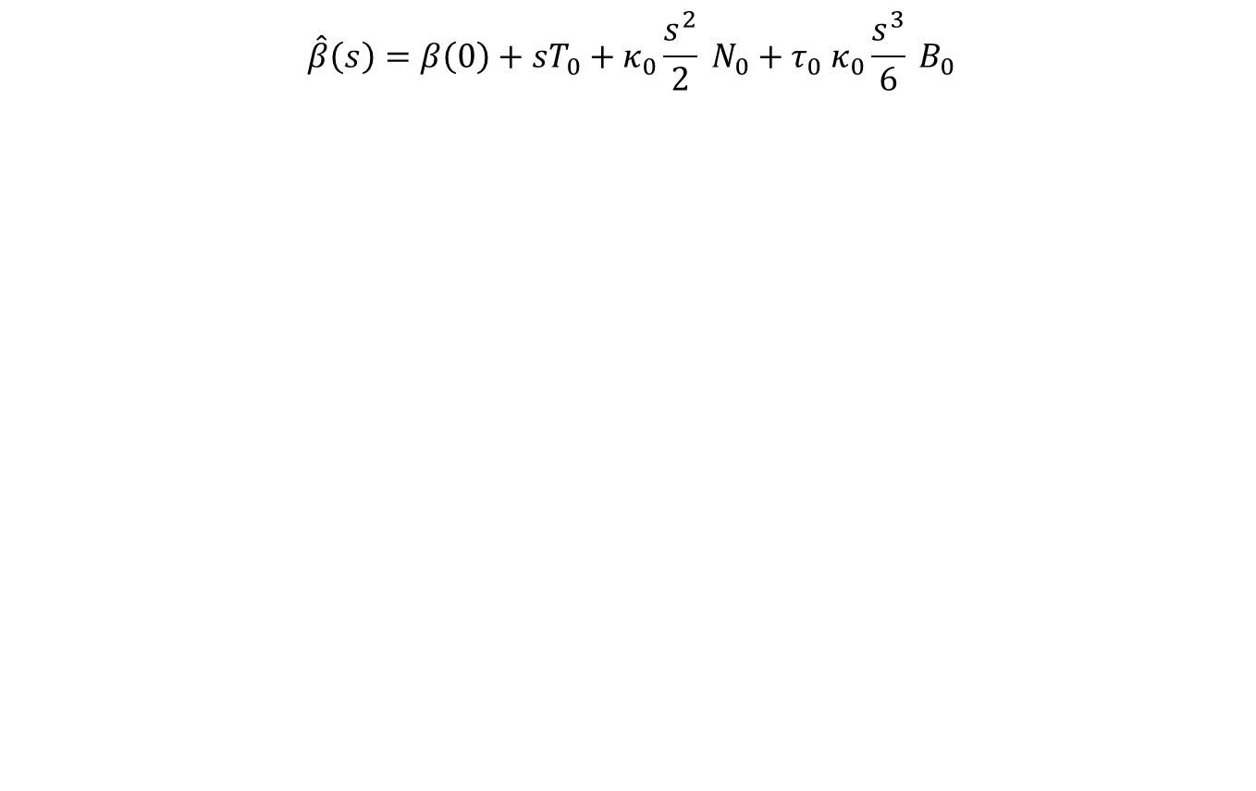
Frenet Approximation
$$\hat{β}\left(s\right)=β\left(0\right)+sT_{0}+κ_{0}\frac{s^{2}}{2} N_{0}+τ_{0} κ_{0}\frac{s^{3}}{6} B_{0}$$
The curve defined by $s→β\left(0\right)+sT_{0}$ is the tangent line to $β$ at $s=0$.
It is the best linear approximation to $β$ near $β(0)$.

Slide 20
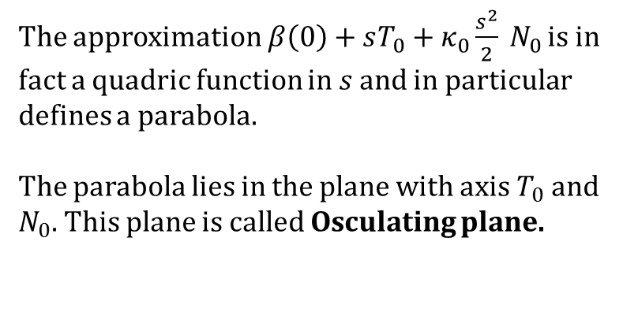
Frenet Approximation
$$\hat{β}\left(s\right)=β\left(0\right)+sT_{0}+κ_{0}\frac{s^{2}}{2} N_{0}+τ_{0} κ_{0}\frac{s^{3}}{6} B_{0}$$
The approximation $β\left(0\right)+sT_{0}+κ_{0}\frac{s^{2}}{2} N_{0}$ is in fact a quadric function in $s$ and in particular defines a parabola.
The parabola lies in the plane with axis $T_{0}$ and $N_{0}$. This plane is called Osculating plane.

Slide 21
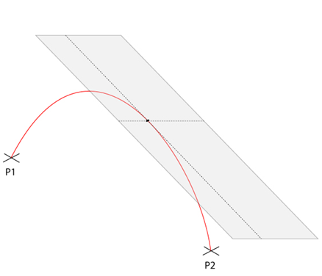
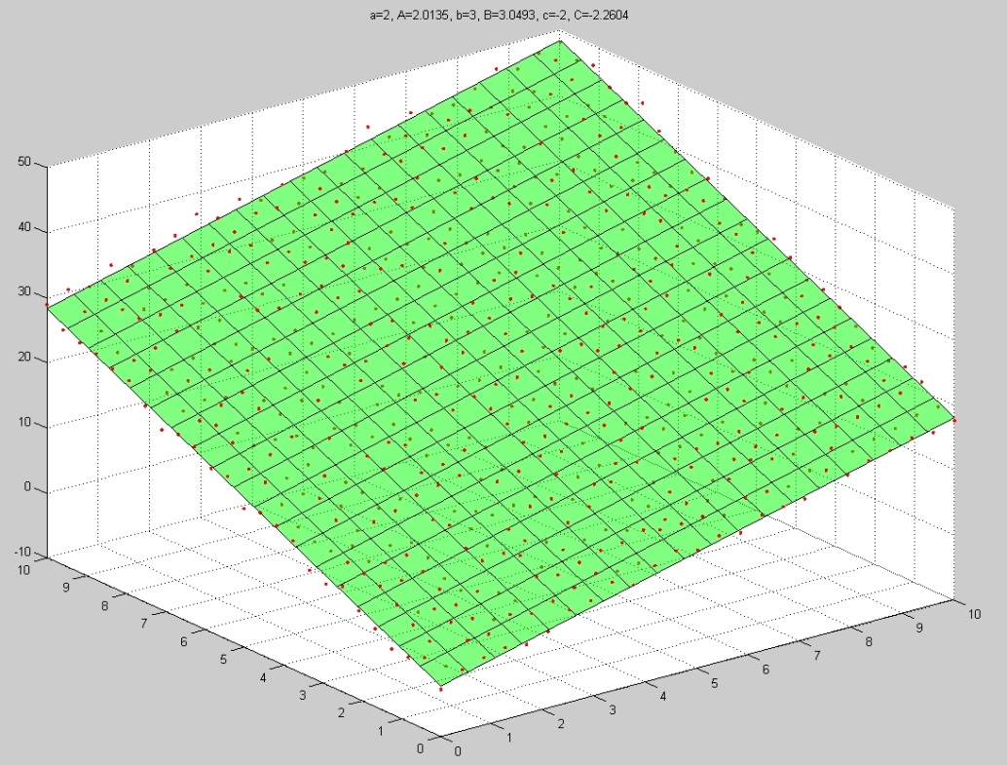
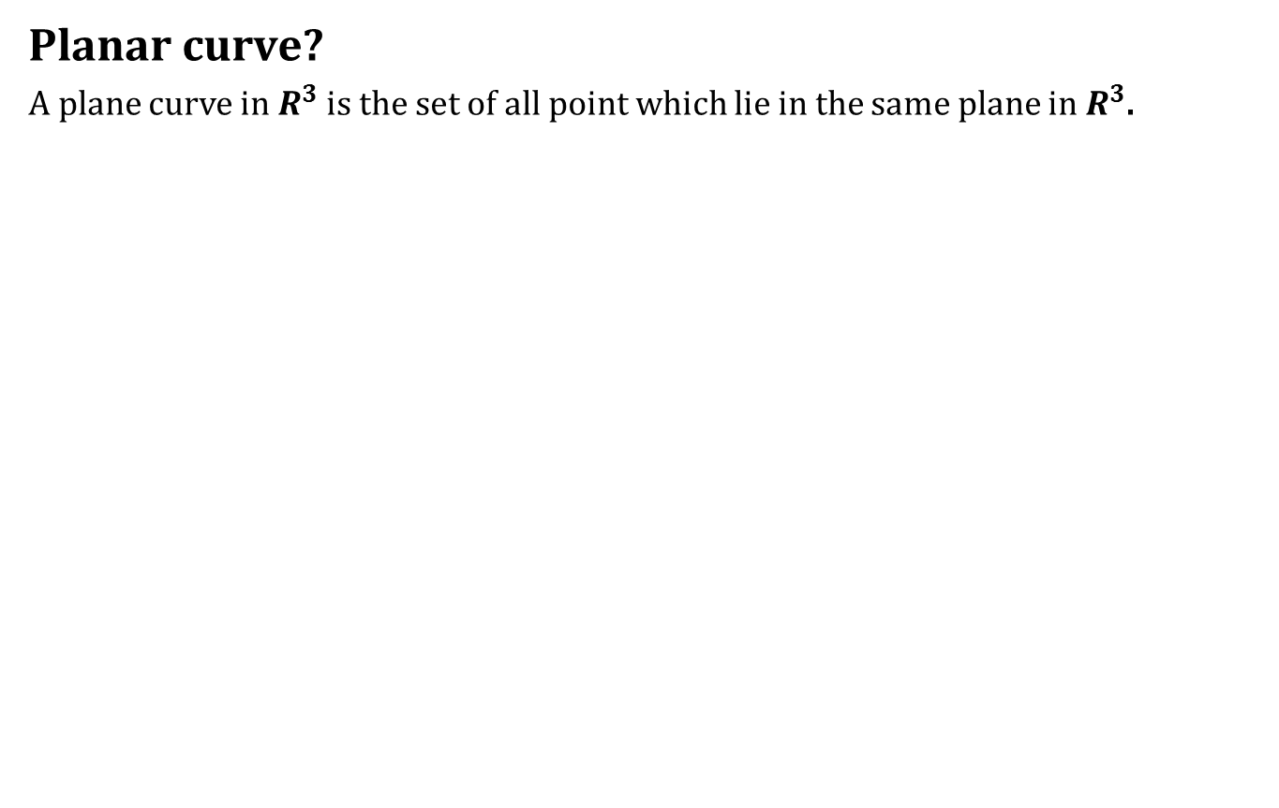
Frenet Approximation
Planar curve?
A plane curve in $R^{3}$ is the set of all point which lie in the same plane in $R^{3}$.

Slide 22
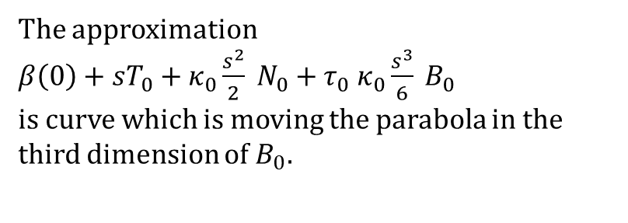
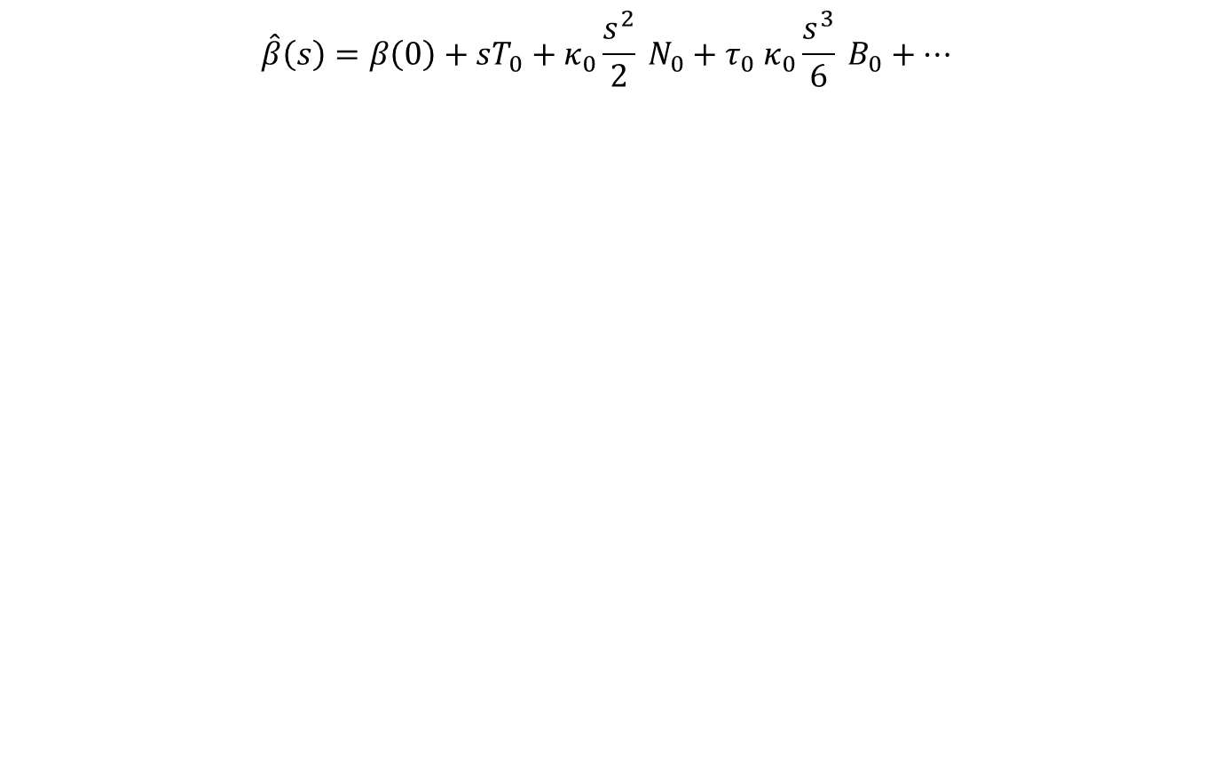
Frenet Approximation
$$\hat{β}\left(s\right)=β\left(0\right)+sT_{0}+κ_{0}\frac{s^{2}}{2} N_{0}+τ_{0} κ_{0}\frac{s^{3}}{6} B_{0}+…$$
The approximation
$β\left(0\right)+sT_{0}+κ_{0}\frac{s^{2}}{2} N_{0}+τ_{0} κ_{0}\frac{s^{3}}{6} B_{0}$
is curve which is moving the parabola in the third dimension of $B_{0}$.

Slide 23
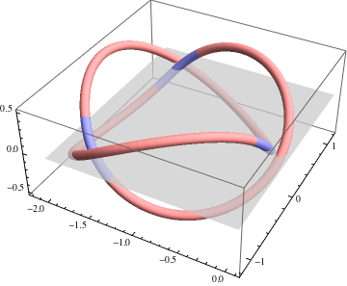
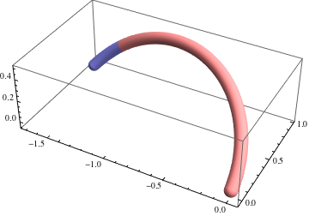
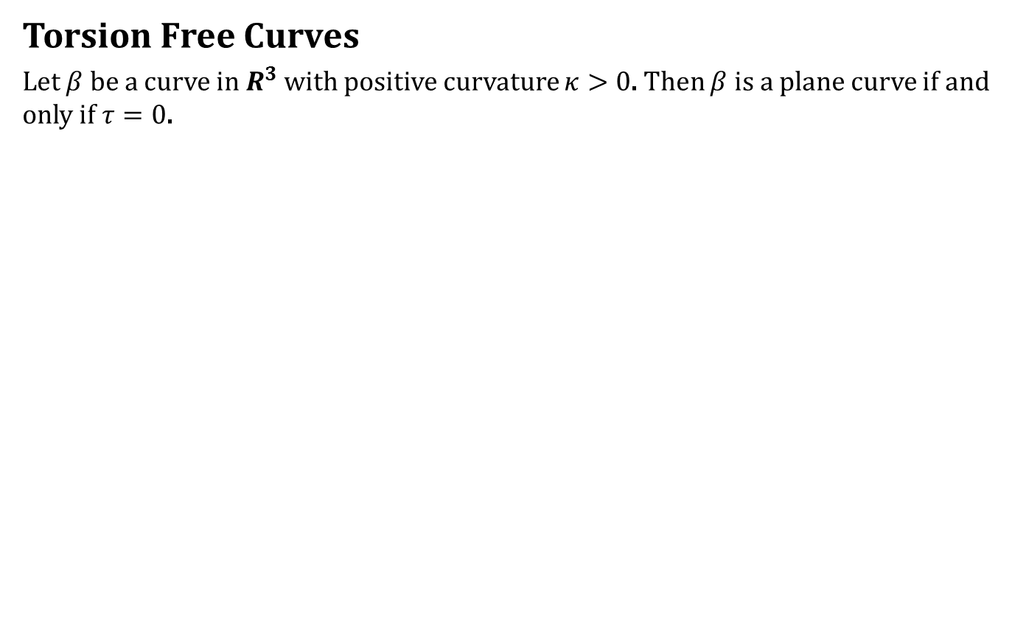
Plane Curves
Torsion Free Curves
Let $β$ be a curve in $R^{3}$ with positive curvature $κ>0$. Then $β$ is a plane curve if and only if $τ=0$.

Slide 24
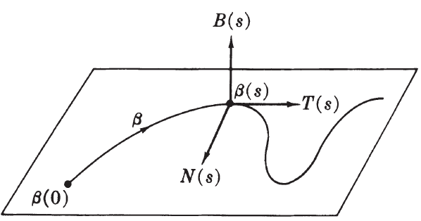
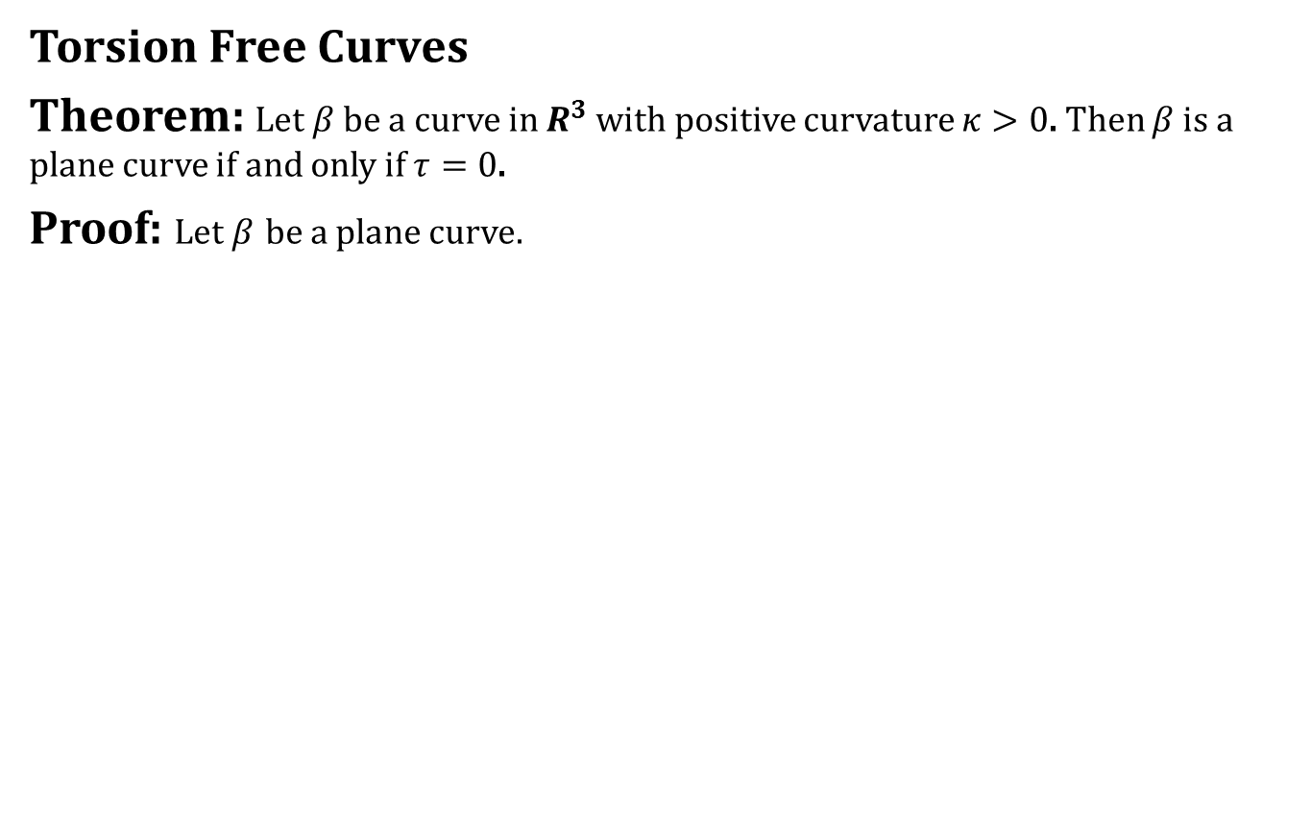
Plane Curves
Torsion Free Curves
Theorem: Let $β$ be a curve in $R^{3}$ with positive curvature $κ>0$. Then $β$ is a plane curve if and only if $τ=0$.
Proof: Let $β$ be a plane curve.

Slide 25
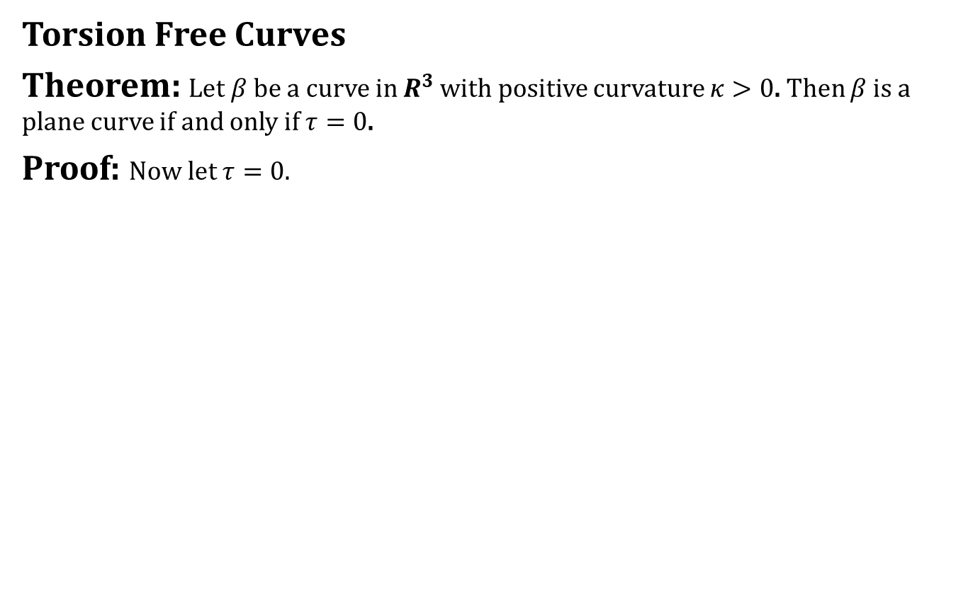
Plane Curves
Torsion Free Curves
Theorem: Let $β$ be a curve in $R^{3}$ with positive curvature $κ>0$. Then $β$ is a plane curve if and only if $τ=0$.
Proof: Now let $τ=0$.

Slide 26
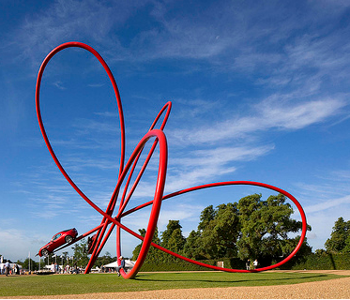
Next time
Frenet Approximation,
Arbitrary Speed Curves

Slide 27

End of the lecture

