Slide 1
Lecture # 11
MTH352: Differential Geometry
For
Master of Mathematics
By
Dr. SOHAIL IQBAL
Assistant Professor
Department of Mathematics, CIIT Islamabad

Slide 2
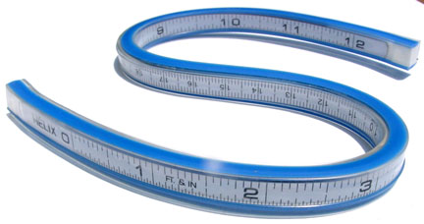
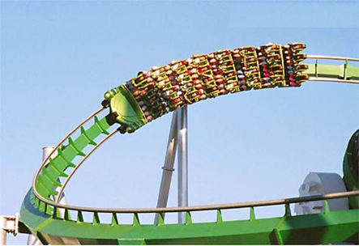
Last lecture
Contents:
Speed Of A Curve
Vector Fields On Curves
Differentiation of Vector Fields

Slide 3
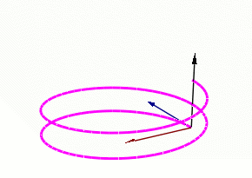

Today’s lecture
Contents:
Curvature
Frenet Frame Field
Frenet Formulas
Unit-Speed Helix

Slide 4
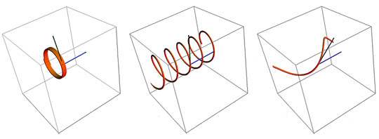
Today’s lecture
Aim:
To study mathematical measurements of turning and twisting

Slide 5
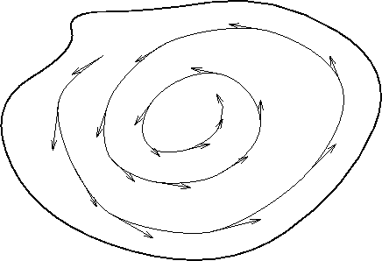
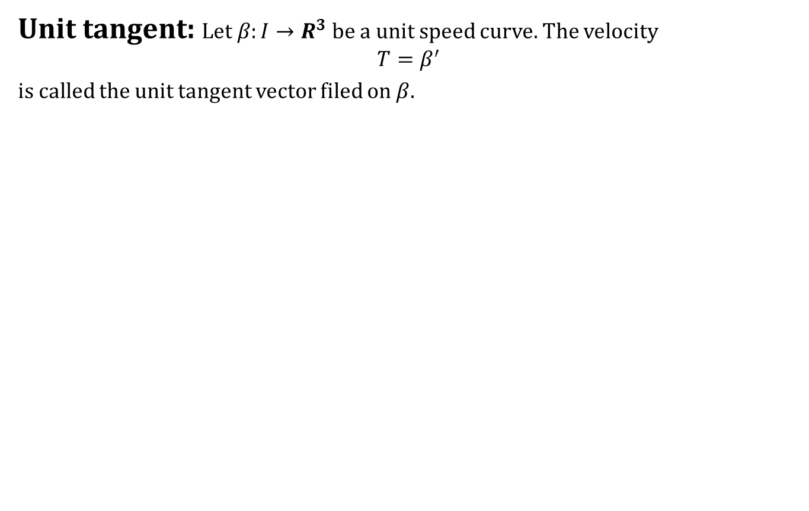
Curvature
Unit tangent: Let $β:I→R^{3}$ be a unit speed curve. The velocity
$$T=β^{′}$$
is called the unit tangent vector filed on $β$.

Slide 6
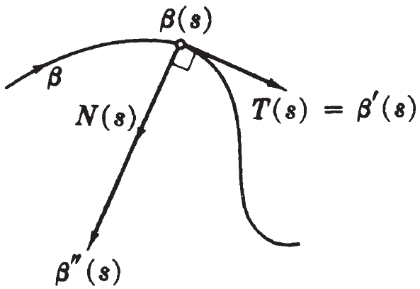
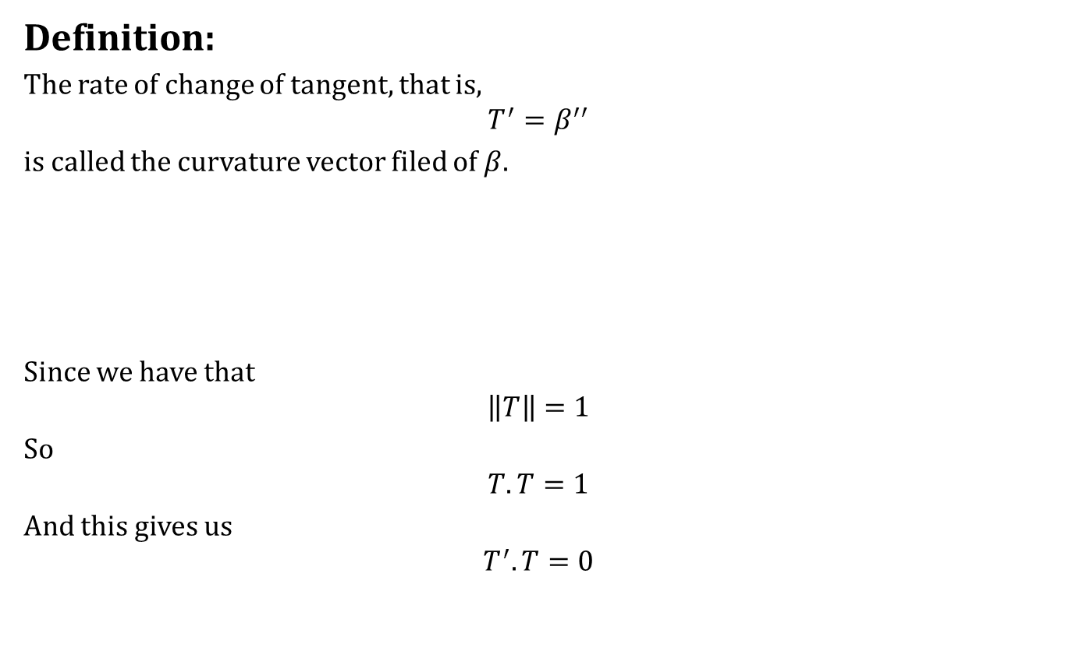
Curvature
Definition:
The rate of change of tangent, that is,
$$T^{′}=β^{′′}$$
is called the curvature vector filed of $β$.
Since we have that
$$\left\|T\right\|=1$$
So
$$T.T=1$$
And this gives us
$$T^{′}.T=0$$

Slide 7
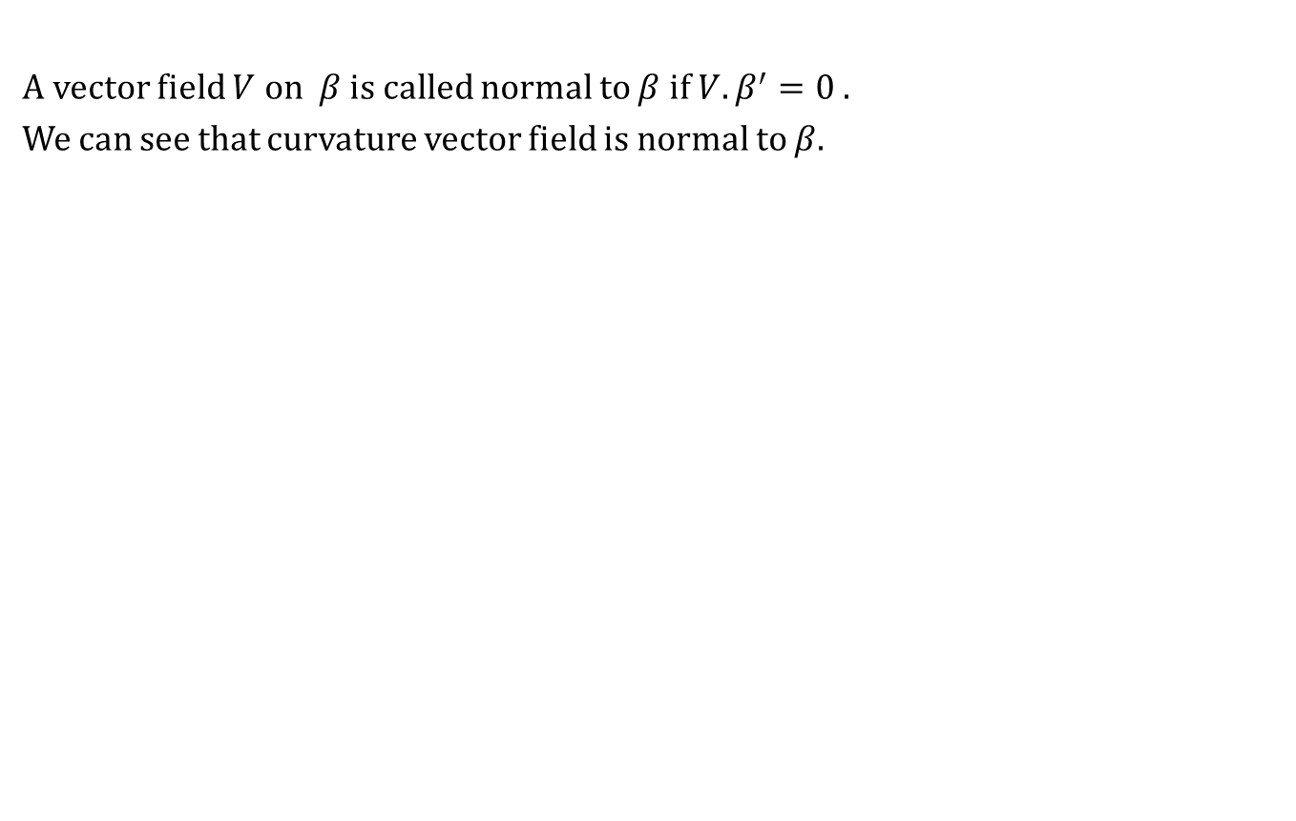
Curvature
A vector field $V$ on $β$ is called normal to $β$ if $V. β^{′}=0$.
We can see that curvature vector field is normal to $β$.

Slide 8
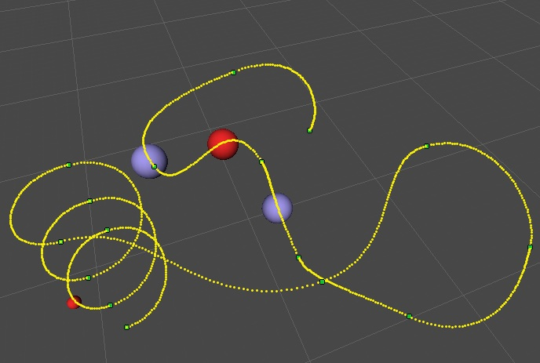
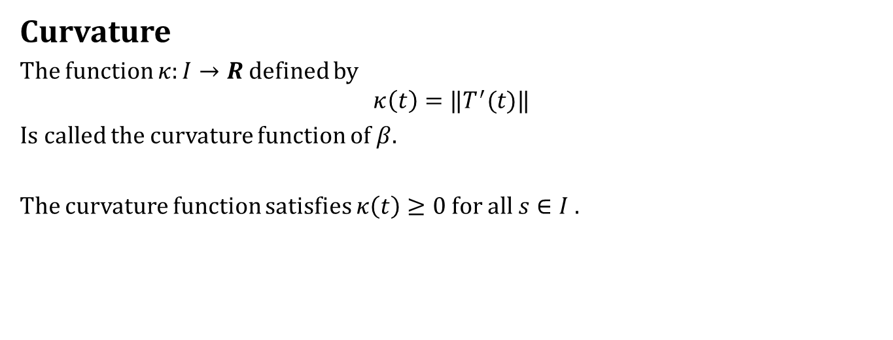
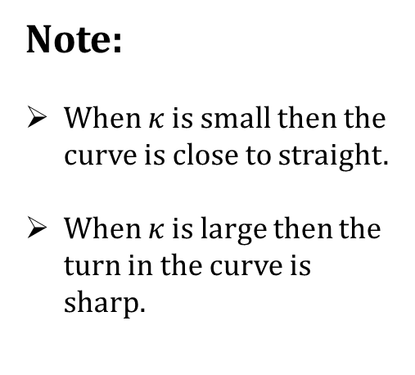
Curvature
Curvature
The function $κ:I→R$ defined by
$$κ\left(t\right)=‖T^{′}(t)‖$$
Is called the curvature function of $β$.
The curvature function satisfies $κ\left(t\right)≥0$ for all $s∈I$.
Note:
When $κ$ is small then the curve is close to straight.
When $κ$ is large then the turn in the curve is sharp.

Slide 9
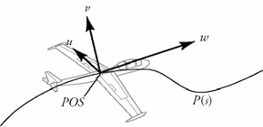
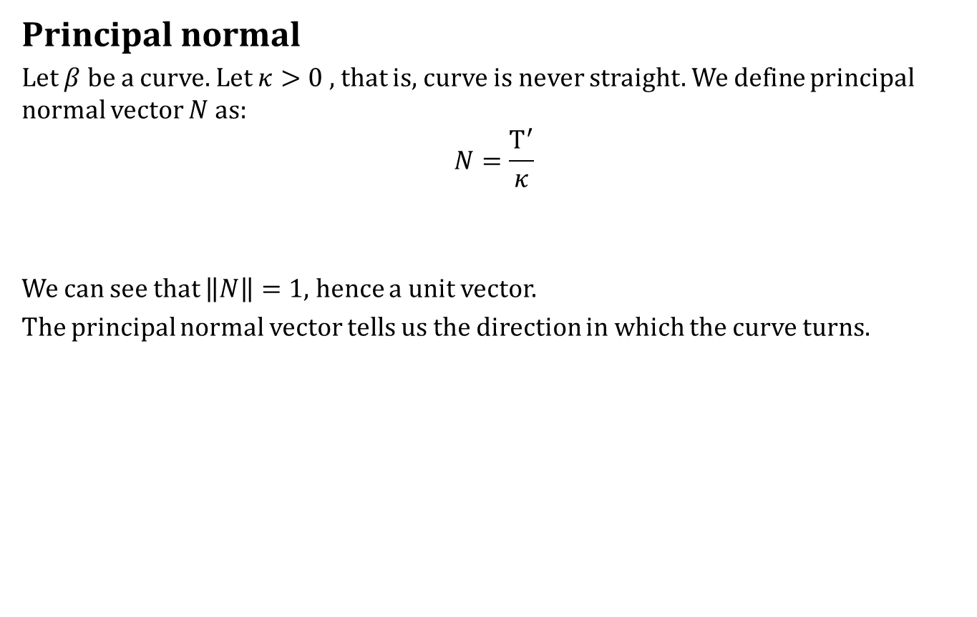
Curvature
Principal normal
Let $β$ be a curve. Let $κ>0$ , that is, curve is never straight. We define principal normal vector $N$ as:
$$N=\frac{T^{′}}{κ}$$
We can see that $\left\|N\right\|=1$, hence a unit vector.
The principal normal vector tells us the direction in which the curve turns.

Slide 10
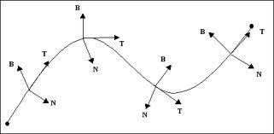
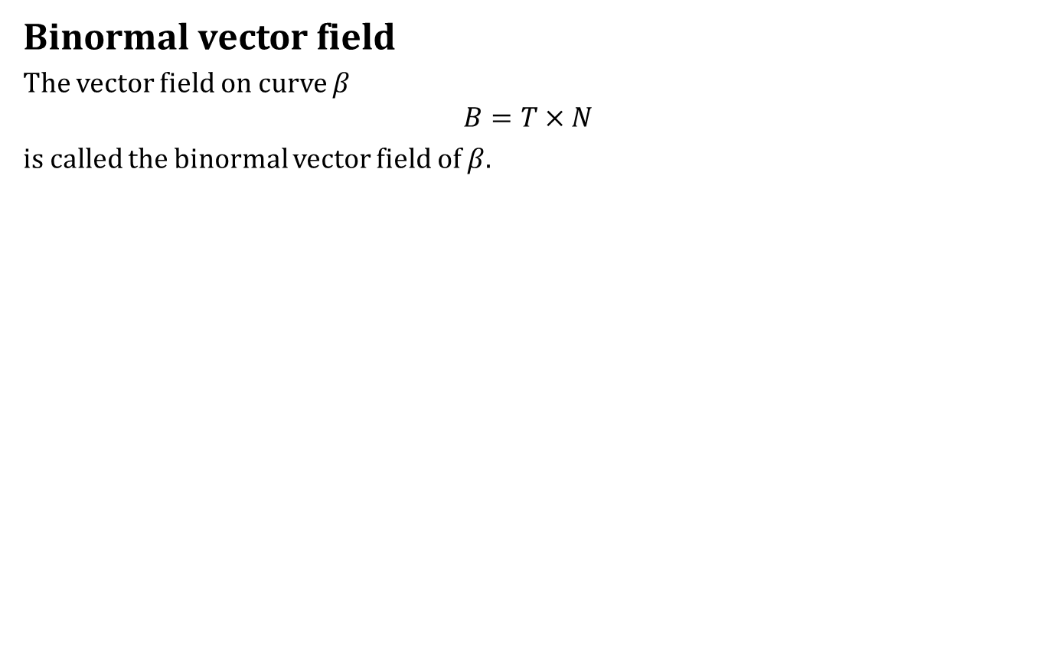
Curvature
Binormal vector field
The vector field on curve $β$
$$B=T×N$$
is called the binormal vector field of $β$.

Slide 11
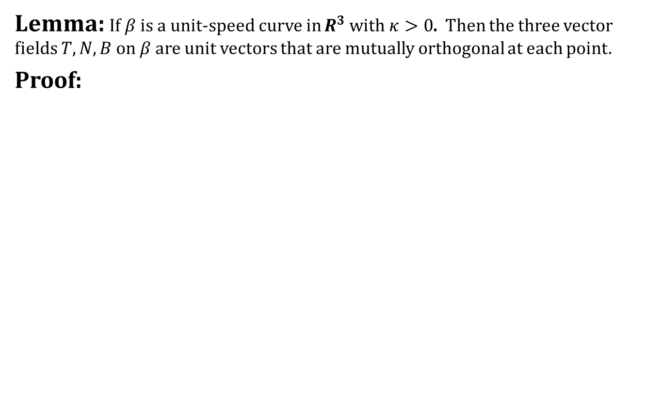
Frenet Frame Field
Lemma: If $β$ is a unit-speed curve in $R^{3}$ with $κ>0$. Then the three vector fields $T, N, B$ on $β$ are unit vectors that are mutually orthogonal at each point.
Proof:

Slide 12
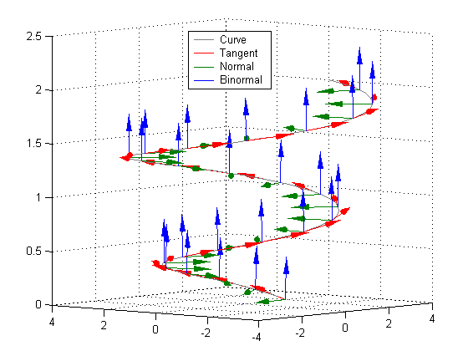
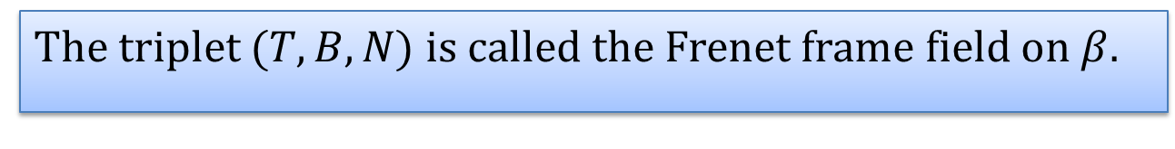
Frenet Frame Field
The triplet $(T,B,N)$ is called the Frenet frame field on $β$.

Slide 13
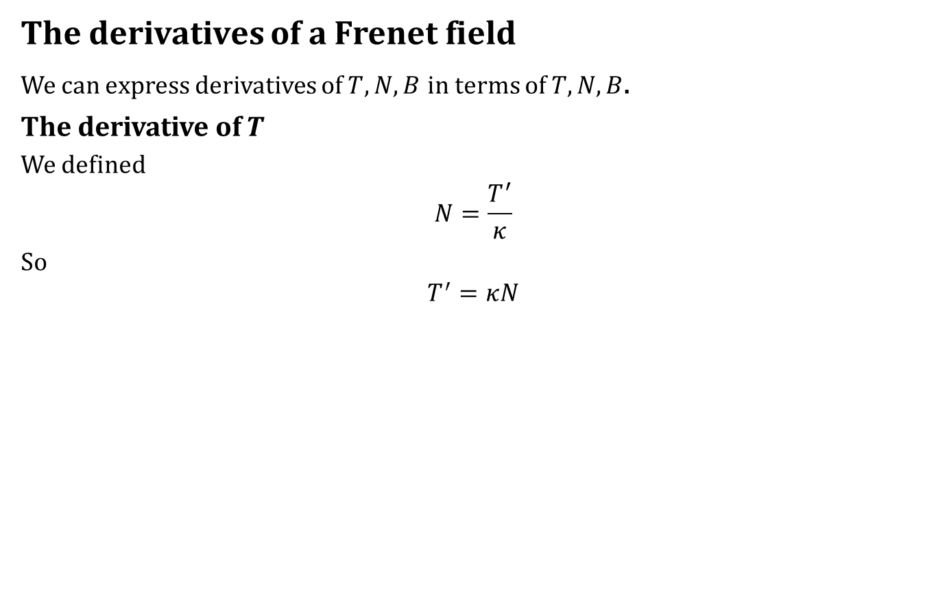
Frenet Frame Field
The derivatives of a Frenet field
We can express derivatives of $T, N, B$ in terms of $T,N, B$.
The derivative of $T$
We defined
$$N=\frac{T^{′}}{κ}$$
So
$$T^{′}=κN$$

Slide 14
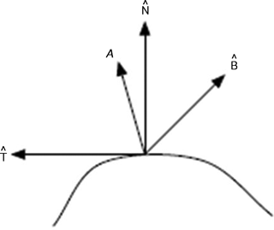
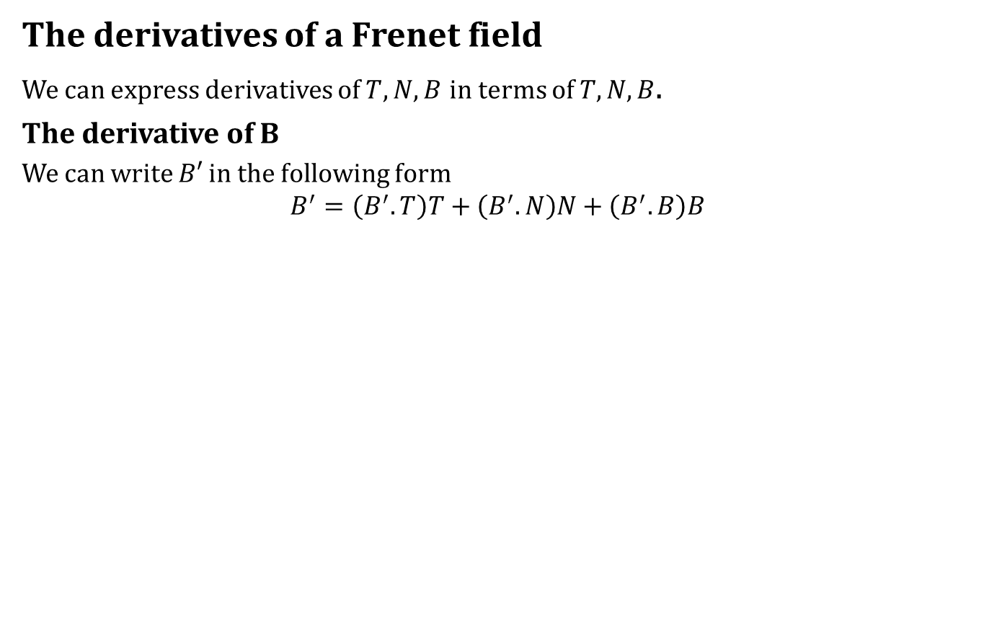
Frenet Frame Field
The derivatives of a Frenet field
We can express derivatives of $T, N, B$ in terms of $T,N, B$.
The derivative of B
We can write $B′$ in the following form
$$B^{′}=\left(B^{′}.T\right)T+\left(B^{′}.N\right)N+\left(B^{′}.B\right)B$$

Slide 15
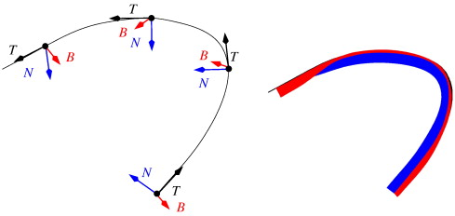
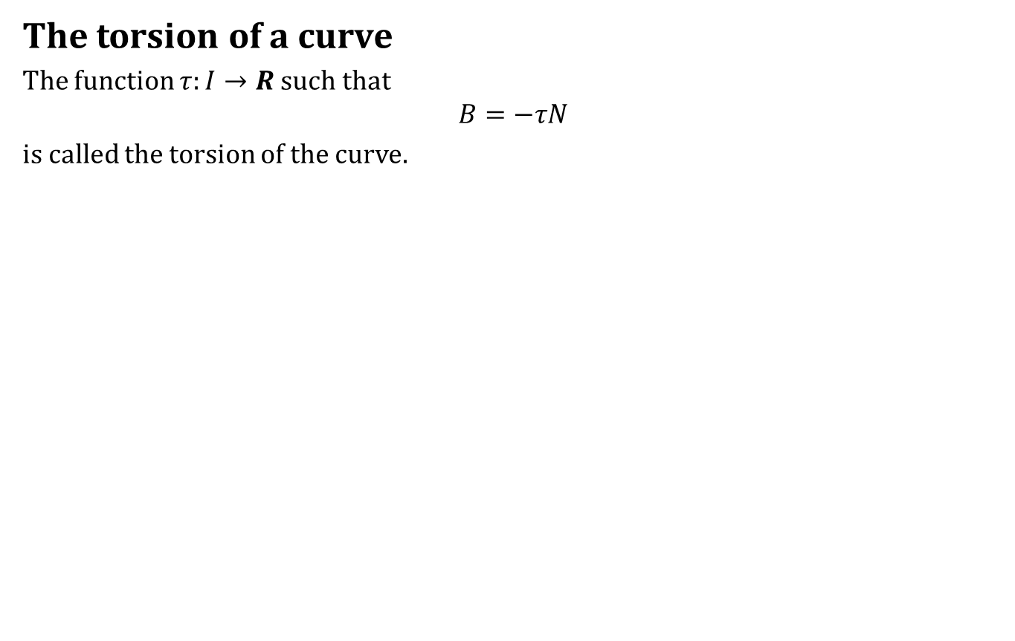
Frenet Frame Field
The torsion of a curve
The function $τ:I→R$ such that
$$B=−τN$$
is called the torsion of the curve.

Slide 16
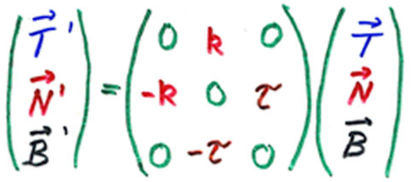
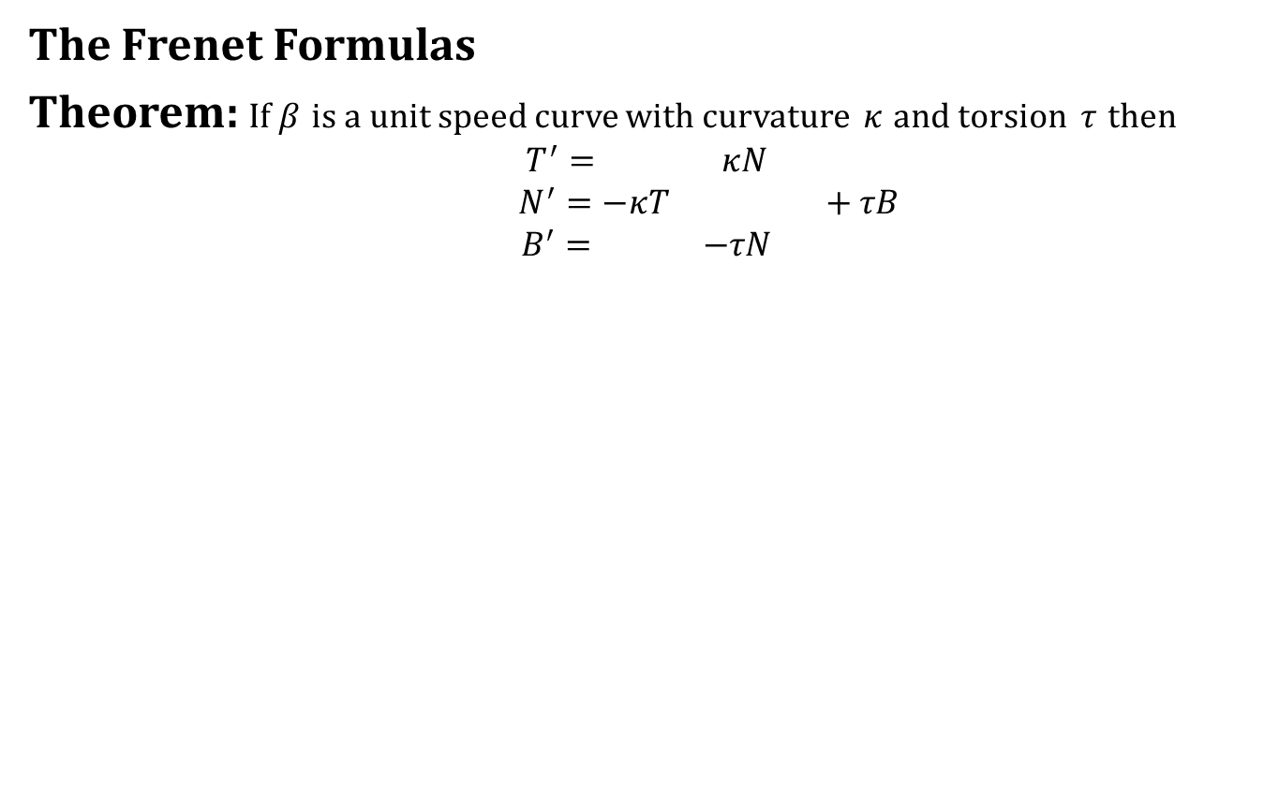
Frenet Formulas
The Frenet Formulas
Theorem: If $β$ is a unit speed curve with curvature $κ$ and torsion $τ$ then
$$T^{′}= κN$$
$$N^{′}=−κT +τB$$
$$B^{′}= −τN$$

Slide 17
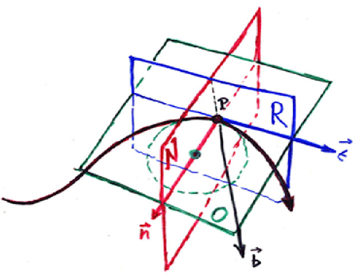
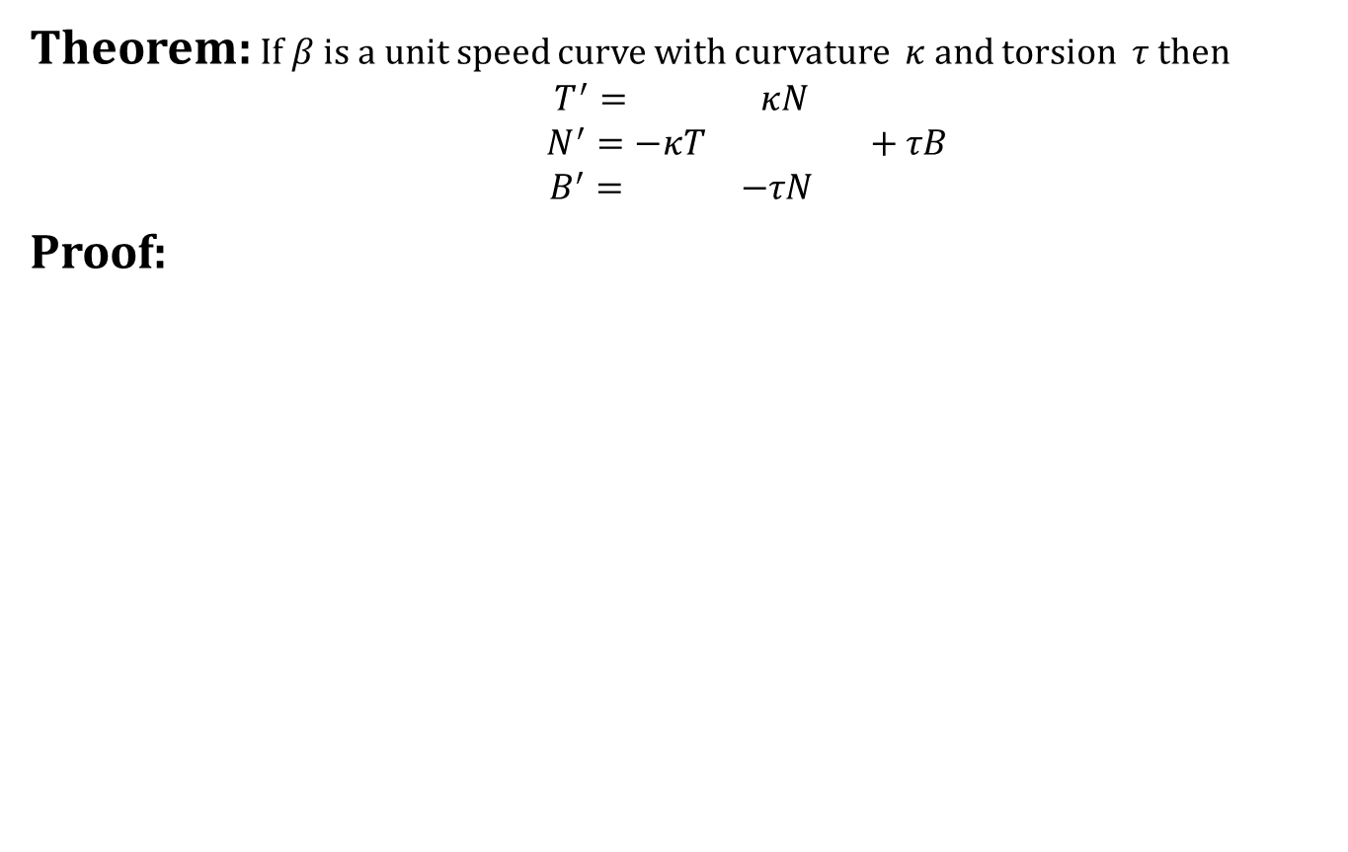
Frenet Formulas
Theorem: If $β$ is a unit speed curve with curvature $κ$ and torsion $τ$ then
$$T^{′}= κN$$
$$N^{′}=−κT +τB$$
$$B^{′}= −τN$$
Proof:

Slide 18
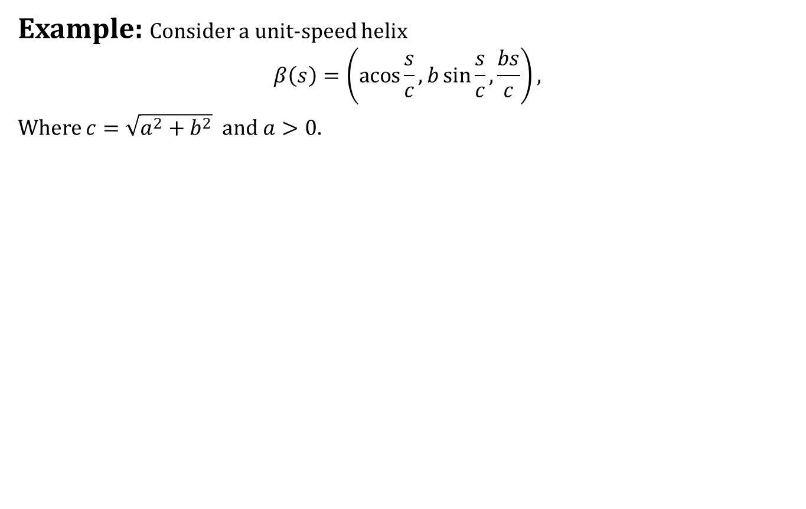
Unit-Speed Helix
Example: Consider a unit-speed helix
$$β\left(s\right)=\left(\operatorname{acos}{\frac{s}{c}},b\sin{\frac{s}{c}},\frac{bs}{c}\right),$$
Where $c=\sqrt{a^{2}+b^{2}}$ and $a>0$.

Slide 19
Unit-Speed Helix
Example: Consider a unit-speed helix
$$β\left(s\right)=\left(\operatorname{acos}{\frac{s}{c}},b\sin{\frac{s}{c}},\frac{bs}{c}\right),$$
Where $c=\sqrt{a^{2}+b^{2}}$ and $a>0$.

Slide 20
Today we learnt
Contents:
Curvature
Frenet Frame Field
Frenet Formulas
Unit-Speed Helix

Slide 21
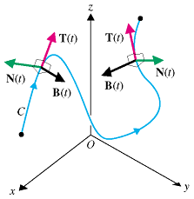
Next time
Frenet Formulas Continued

Slide 22

End of the lecture

