Slide 1
Lecture # 10
MTH352: Differential Geometry
For
Master of Mathematics
By
Dr. SOHAIL IQBAL
Assistant Professor
Department of Mathematics, CIIT Islamabad

Slide 2
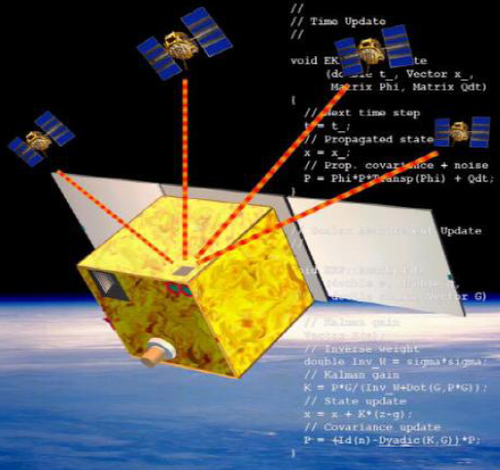
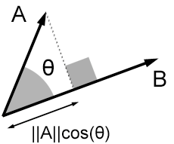
Last two lectures
Contents:
Dot Product
Frames
The Attitude Matrix
Cross Product

Slide 3
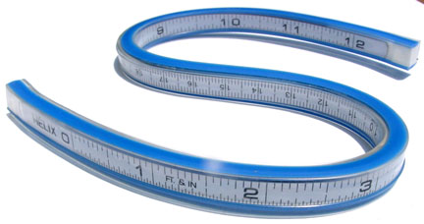
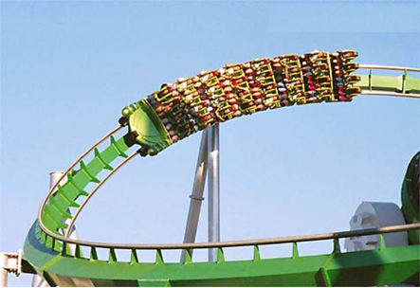
Today’s lecture
Contents:
Speed Of A Curve
Vector Fields On Curves
Differentiation of Vector Fields

Slide 4
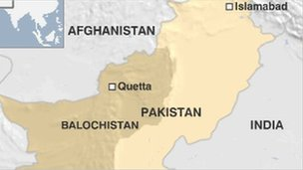
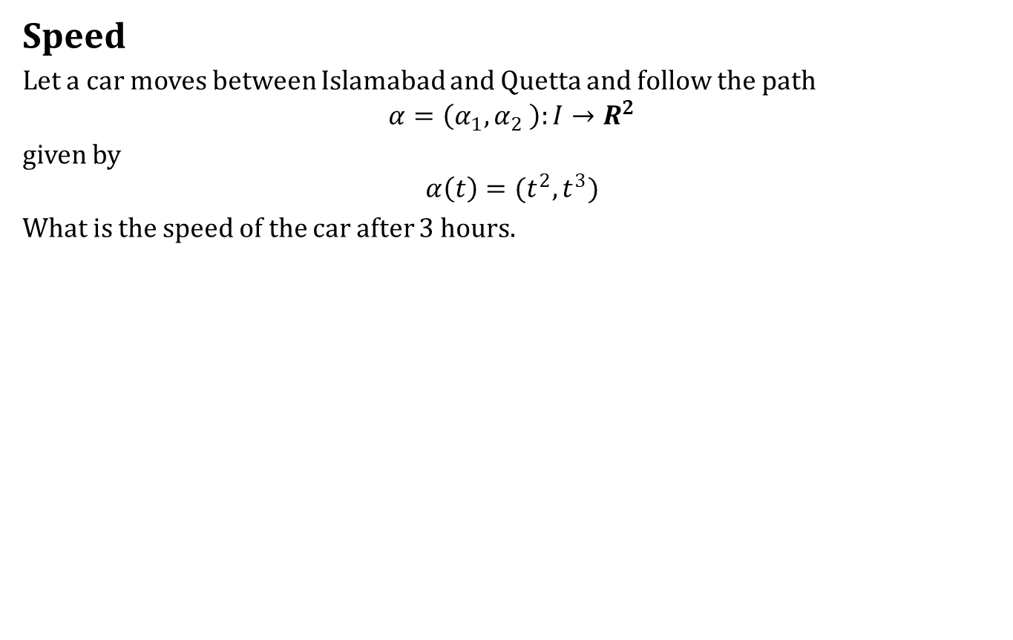
Speed Of A Curve
Speed
Let a car moves between Islamabad and Quetta and follow the path
$$α=\left(α_{1},α_{2} \right):I→R^{2}$$
given by
$$α\left(t\right)=(t^{2},t^{3})$$
What is the speed of the car after 3 hours.

Slide 5
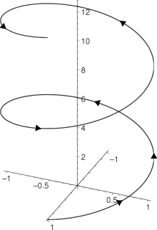
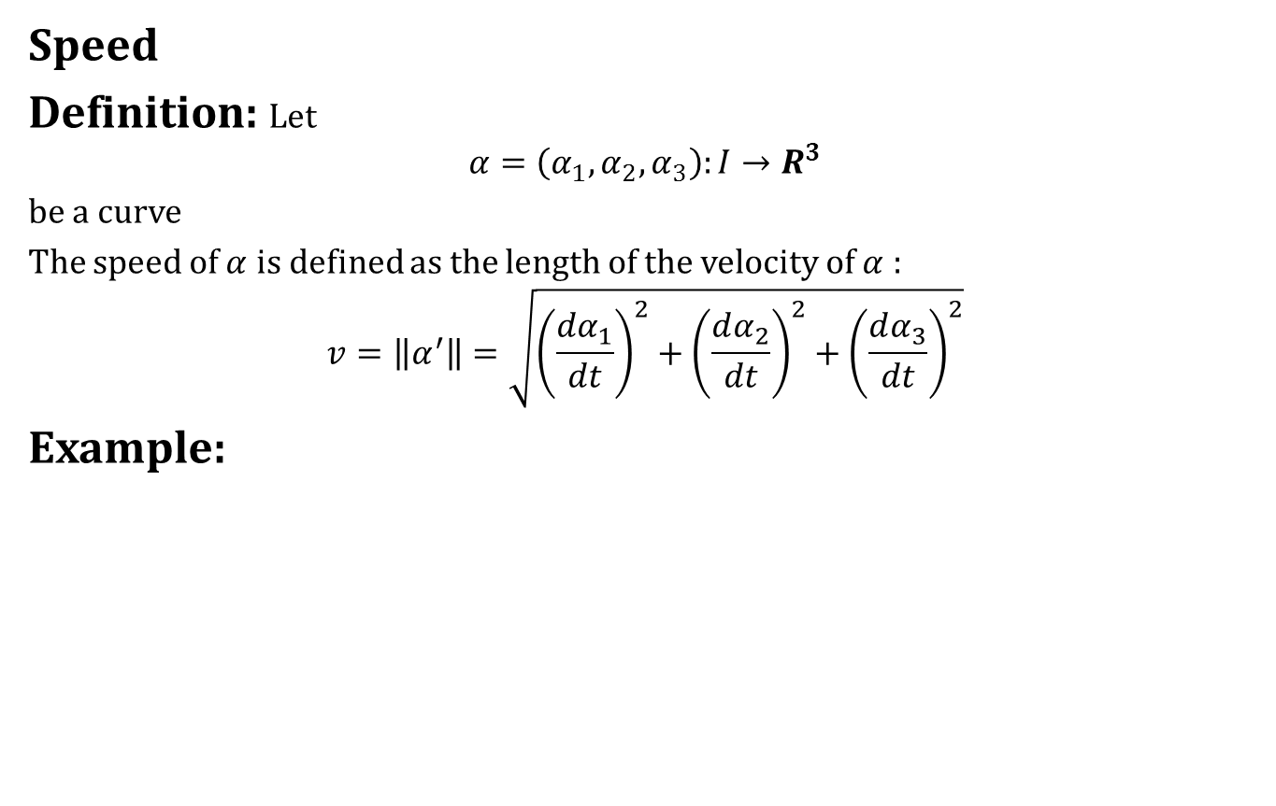
Speed Of A Curve
Speed
Definition: Let
$$α=\left(α_{1},α_{2},α_{3}\right):I→R^{3}$$
be a curve
The speed of $α$ is defined as the length of the velocity of $α$ :
$$v=\left\|α^{′}\right\|=\sqrt{{\left(\frac{dα_{1}}{dt}\right)}^{2}+{\left(\frac{dα_{2}}{dt}\right)}^{2}+{\left(\frac{dα_{3}}{dt}\right)}^{2}}$$
Example:

Slide 6
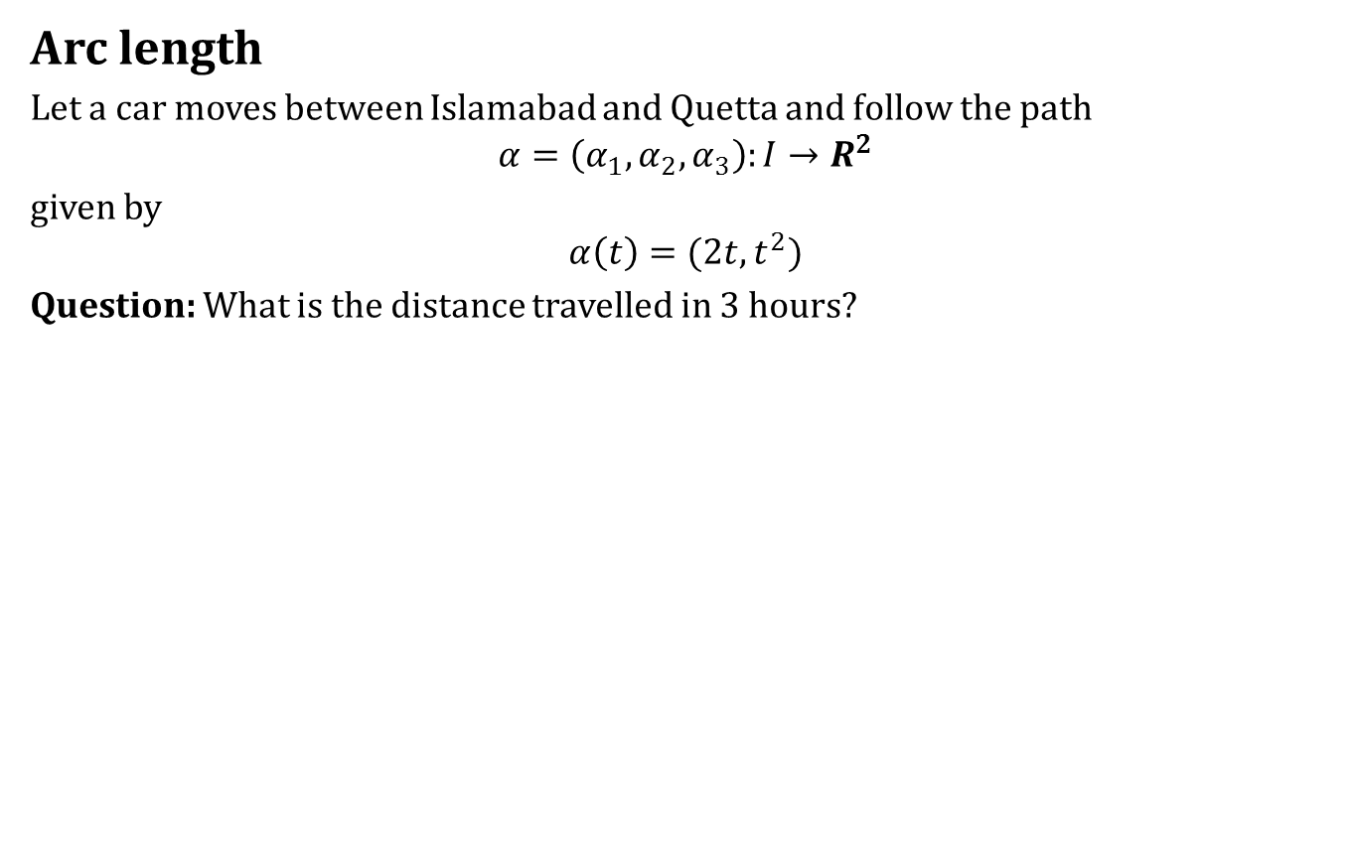
Speed Of A Curve
Arc length
Let a car moves between Islamabad and Quetta and follow the path
$$α=\left(α_{1},α_{2},α_{3}\right):I→R^{2}$$
given by
$$α\left(t\right)=(2t,t^{2})$$
Question: What is the distance travelled in 3 hours?

Slide 7
Speed Of A Curve
Arc length
Let a car moves between Islamabad and Quetta and follow the path
$$α=\left(α_{1},α_{2},α_{3}\right):I→R^{2}$$
given by
$$α\left(t\right)=(2t,t^{2})$$
Question: What is the distance travelled in 3 hours?
Not a simple question.

Slide 8
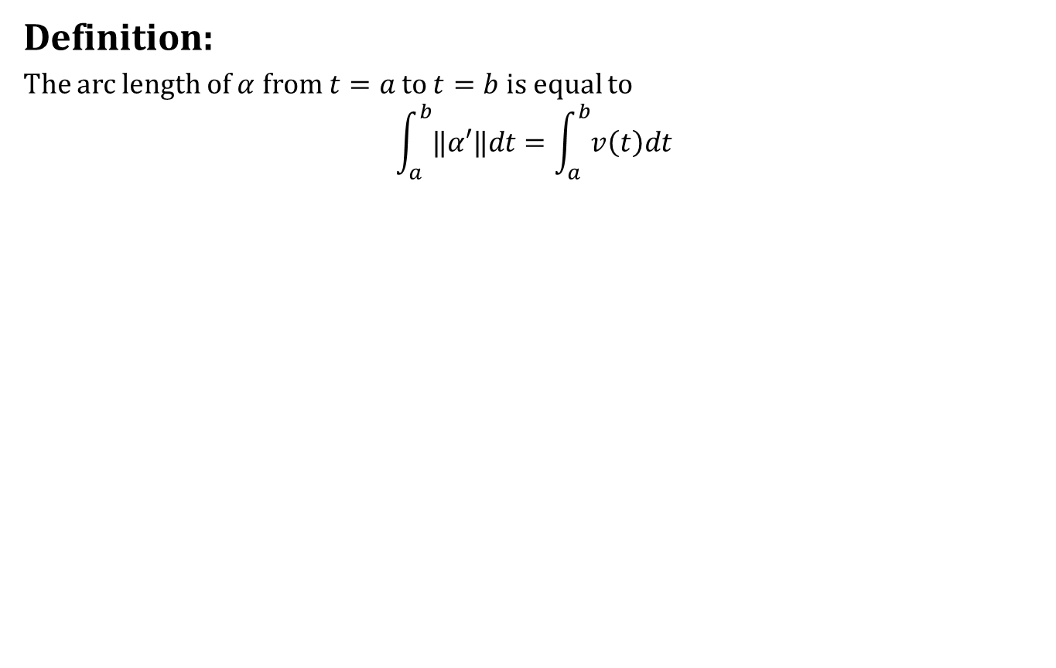
Speed Of A Curve
Definition:
The arc length of $α$ from $t=a$ to $t=b$ is equal to
$$\int_{a}^{b}{‖α′‖dt}=\int_{a}^{b}{v\left(t\right)dt}$$

Slide 9

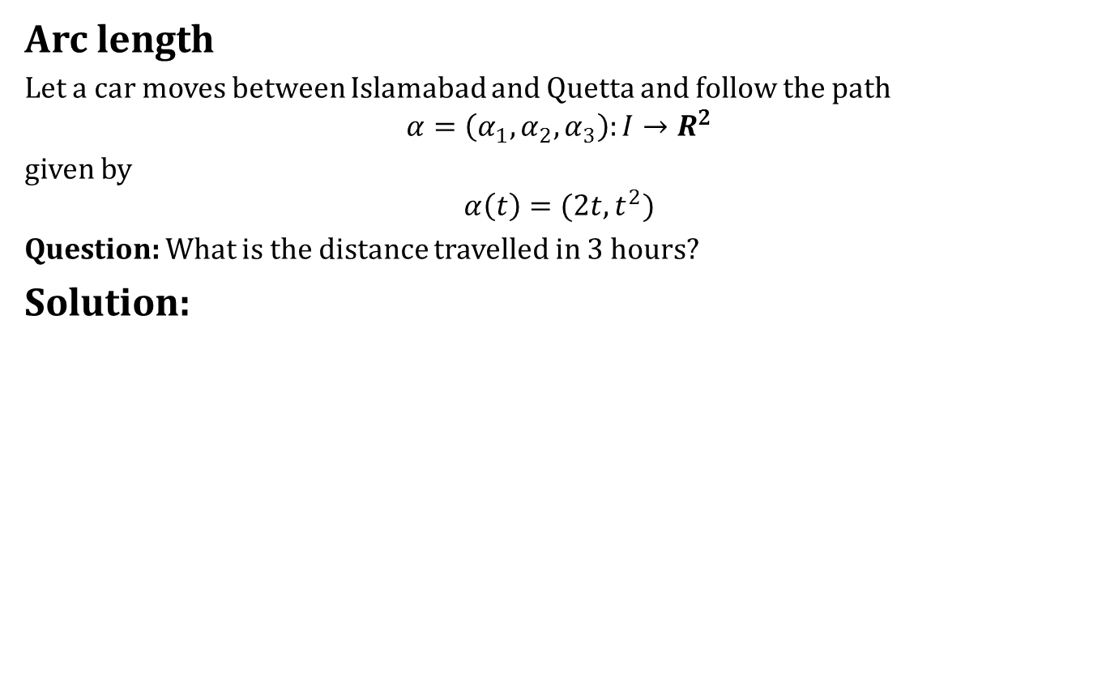
Speed Of A Curve
Arc length
Let a car moves between Islamabad and Quetta and follow the path
$$α=\left(α_{1},α_{2},α_{3}\right):I→R^{2}$$
given by
$$α\left(t\right)=(2t,t^{2})$$
Question: What is the distance travelled in 3 hours?
Solution:

Slide 10
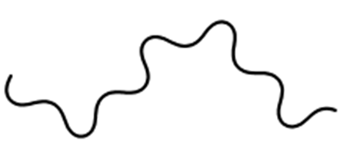
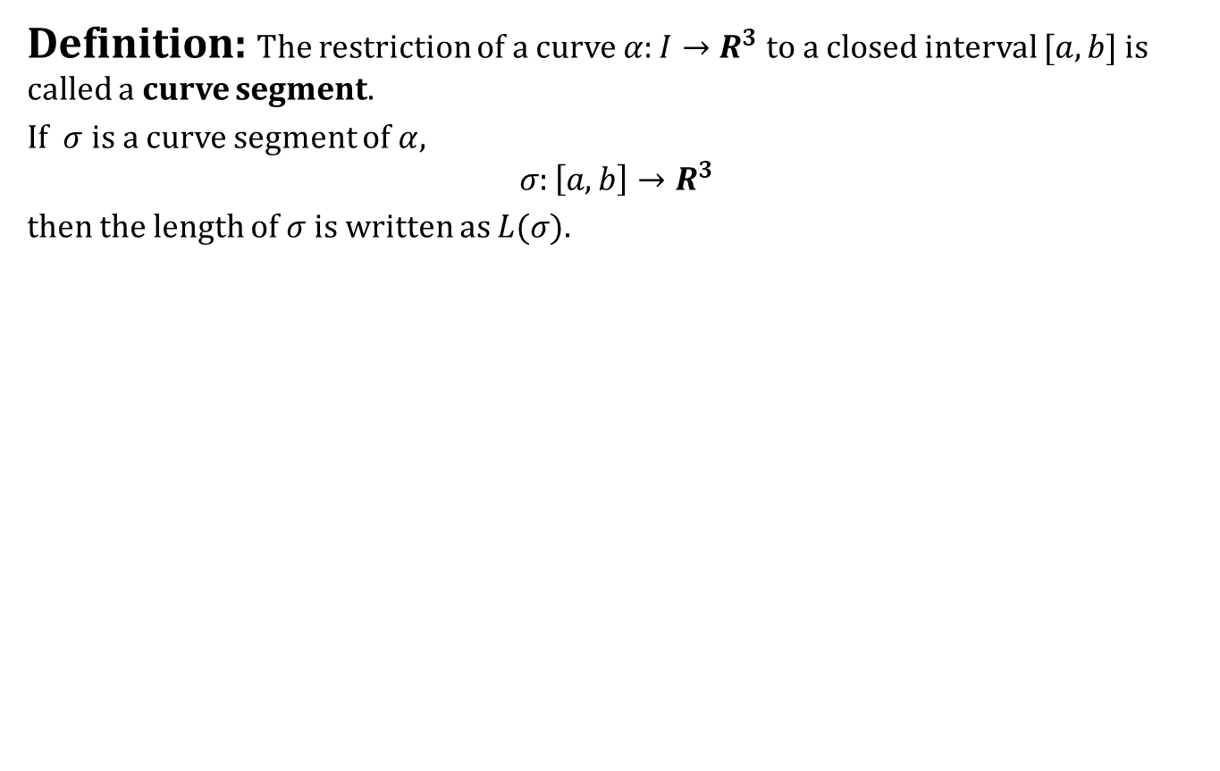
Speed Of A Curve
Definition: The restriction of a curve $α:I→R^{3}$ to a closed interval $[a,b]$ is called a curve segment.
If $σ$ is a curve segment of $α$,
$$σ:\left[a,b\right]→R^{3}$$
then the length of $σ$ is written as $L(σ)$.

Slide 11
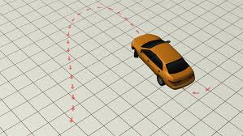
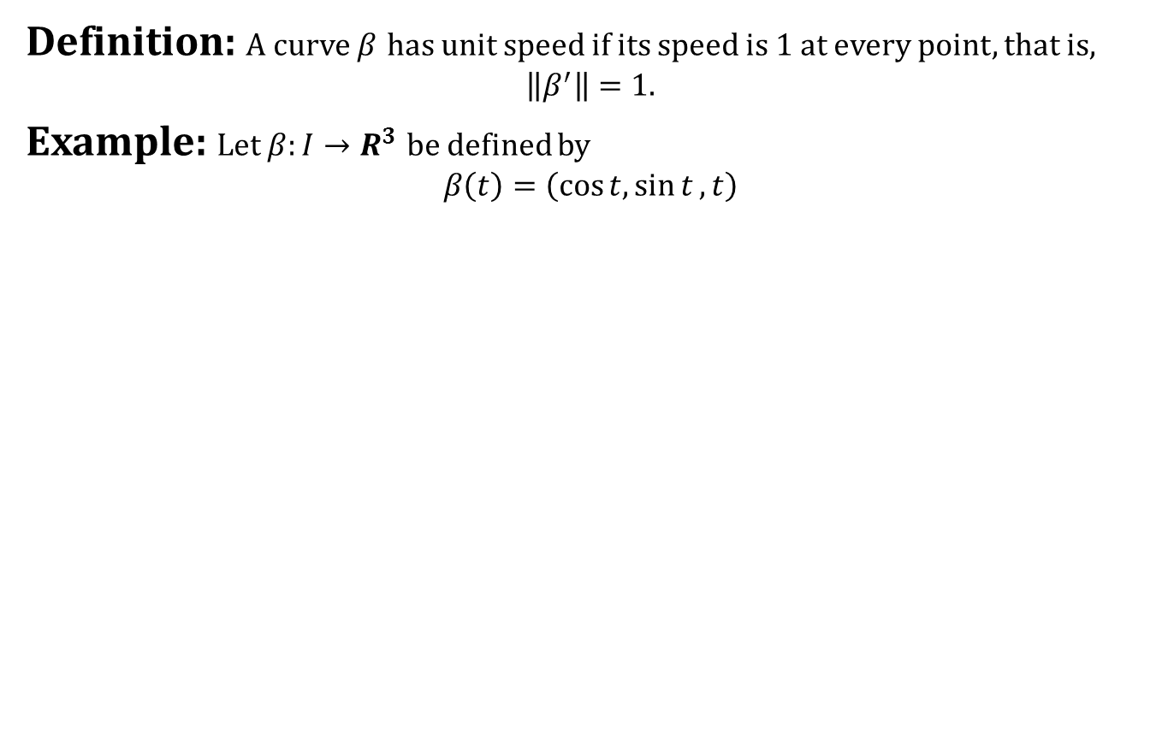
Speed Of A Curve
Definition: A curve $β$ has unit speed if its speed is 1 at every point, that is,
$$\left\|β^{′}\right\|=1.$$
Example: Let $β:I→R^{3}$ be defined by
$$β\left(t\right)=\left(\cos{t,\sin{t},}t\right)$$

Slide 12
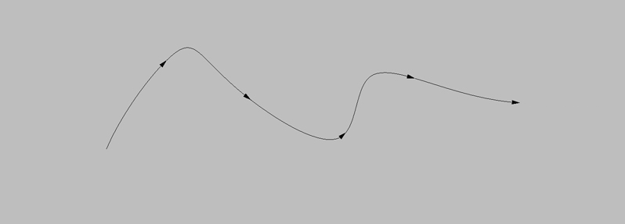
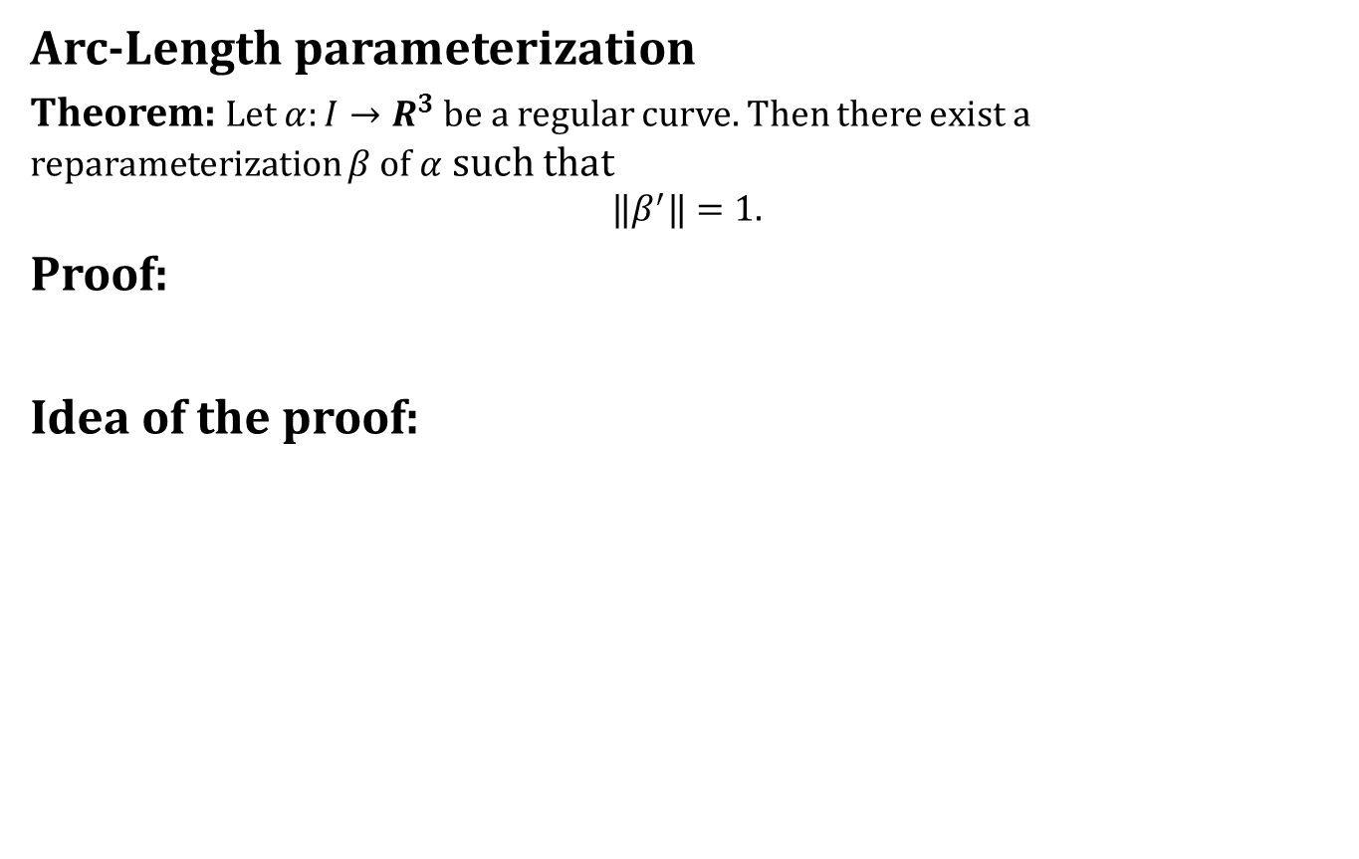
Speed Of A Curve
Arc-Length parameterization
Theorem: Let $α:I→R^{3}$ be a regular curve. Then there exist a reparameterization $β$ of $α$ such that
$$‖β^{′}‖=1.$$
Proof:
Idea of the proof:

Slide 13
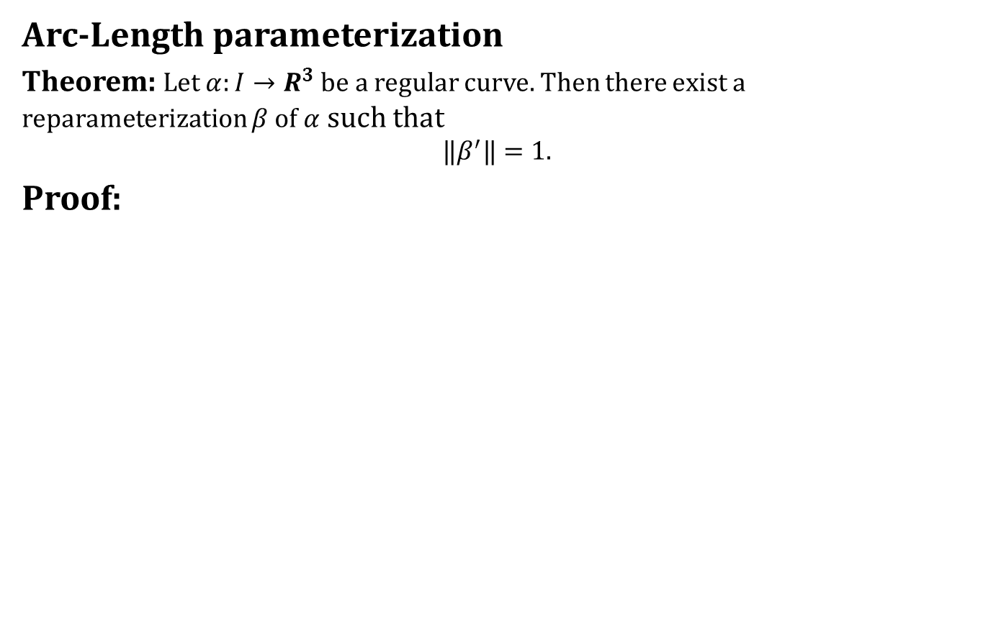
Speed Of A Curve
Arc-Length parameterization
Theorem: Let $α:I→R^{3}$ be a regular curve. Then there exist a reparameterization $β$ of $α$ such that
$$‖β^{′}‖=1.$$
Proof:

Slide 14
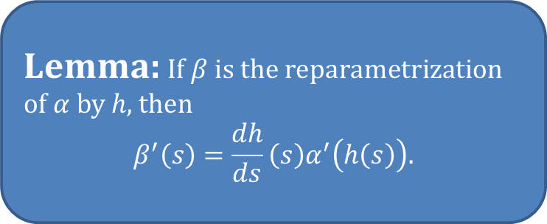
Speed Of A Curve
Arc-Length parameterization
Theorem: Let $α:I→R^{3}$ be a regular curve. Then there exist a reparameterization $β$ of $α$ such that
$$‖β^{′}‖=1.$$
Proof:
Lemma: If $β$ is the reparametrization of $α$ by $h$, then
$$β^{′}\left(s\right)=\frac{dh}{ds}\left(s\right)α^{′}\left(h\left(s\right)\right).$$

Slide 15
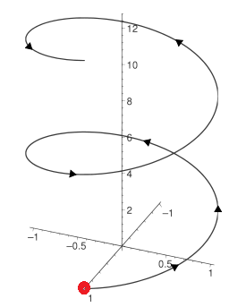
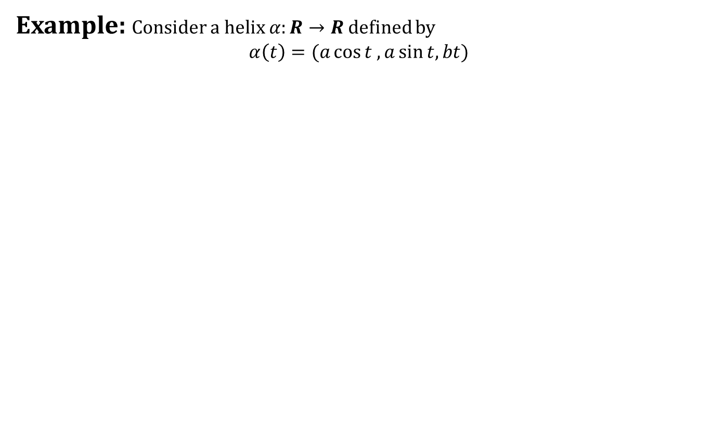
Speed Of A Curve
Example: Consider a helix $α:R→R$ defined by
$$α\left(t\right)=(a\cos{t ,a\sin{t, bt}})$$

Slide 16
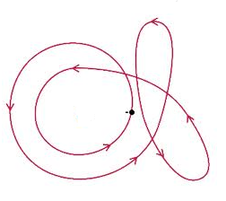
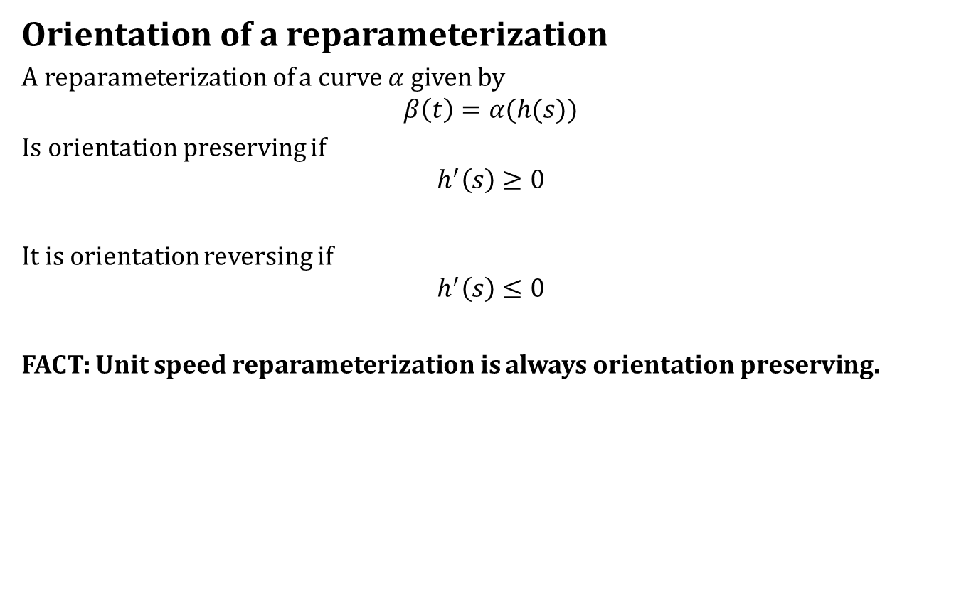
Speed Of A Curve
Orientation of a reparameterization
A reparameterization of a curve $α$ given by
$$β\left(t\right)=α(h(s))$$
Is orientation preserving if
$$h^{′}\left(s\right)≥0$$
It is orientation reversing if
$$h^{′}\left(s\right)≤0$$
FACT: Unit speed reparameterization is always orientation preserving.

Slide 17
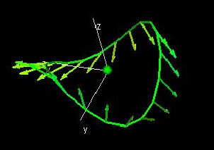
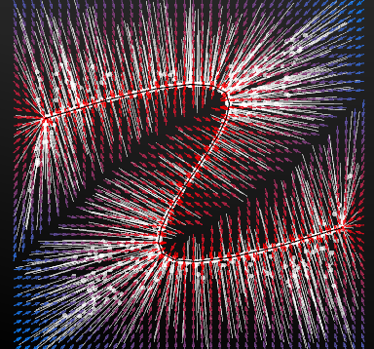
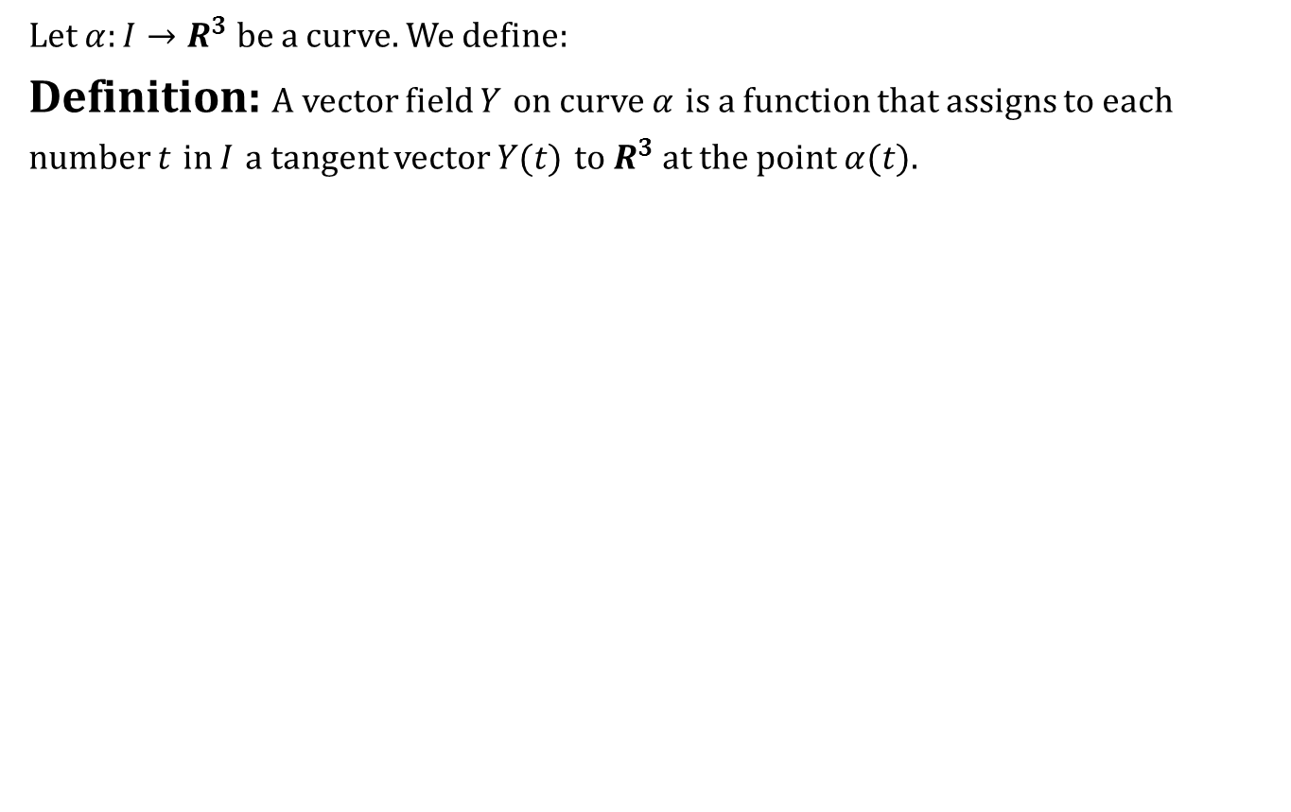
Vector Fields On Curves
Let $α:I→R^{3}$ be a curve. We define:
Definition: A vector field $Y$ on curve $α$ is a function that assigns to each number $t$ in $I$ a tangent vector $Y(t)$ to $R^{3}$ at the point $α(t)$.

Slide 18
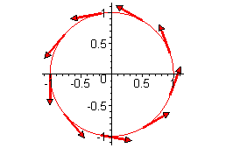
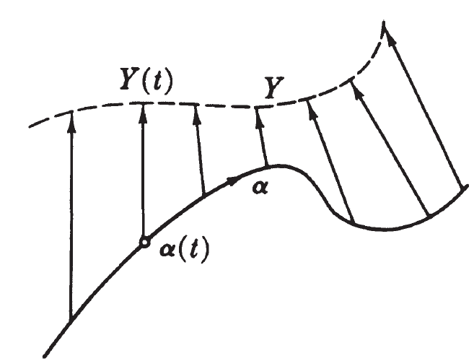
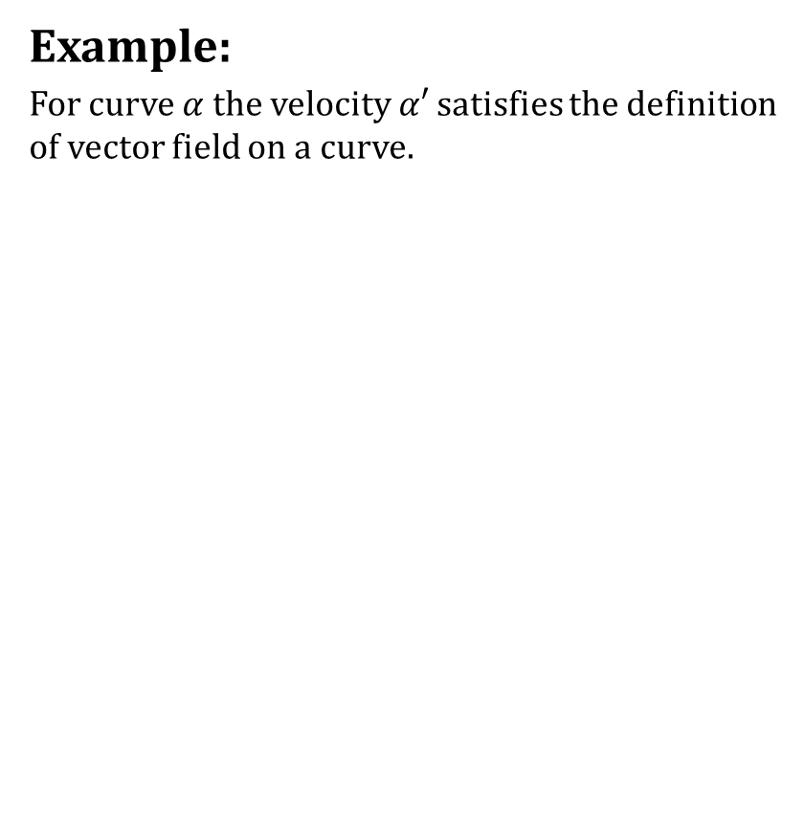
Vector Fields On Curves
Example:
For curve $α$ the velocity $α′$ satisfies the definition of vector field on a curve.

Slide 19
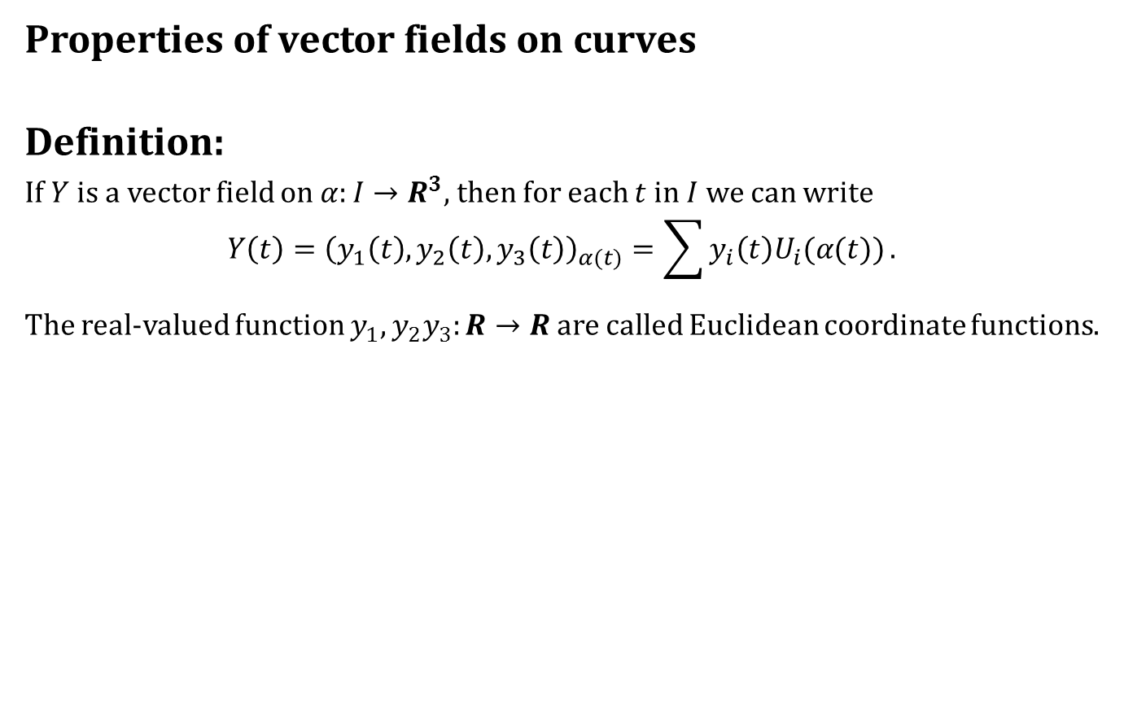
Vector Fields On Curves
Properties of vector fields on curves
Definition:
If $Y$ is a vector field on $α:I→R^{3}$, then for each $t$ in $I$ we can write
$$Y\left(t\right)={\left(y_{1}\left(t\right),y_{2}\left(t\right),y_{3}\left(t\right)\right)}_{α(t)}=\sum{y_{i}\left(t\right)U_{i}(α(t))}.$$
The real-valued function $y_{1},y_{2}y_{3}:R→R$ are called Euclidean coordinate functions.

Slide 20
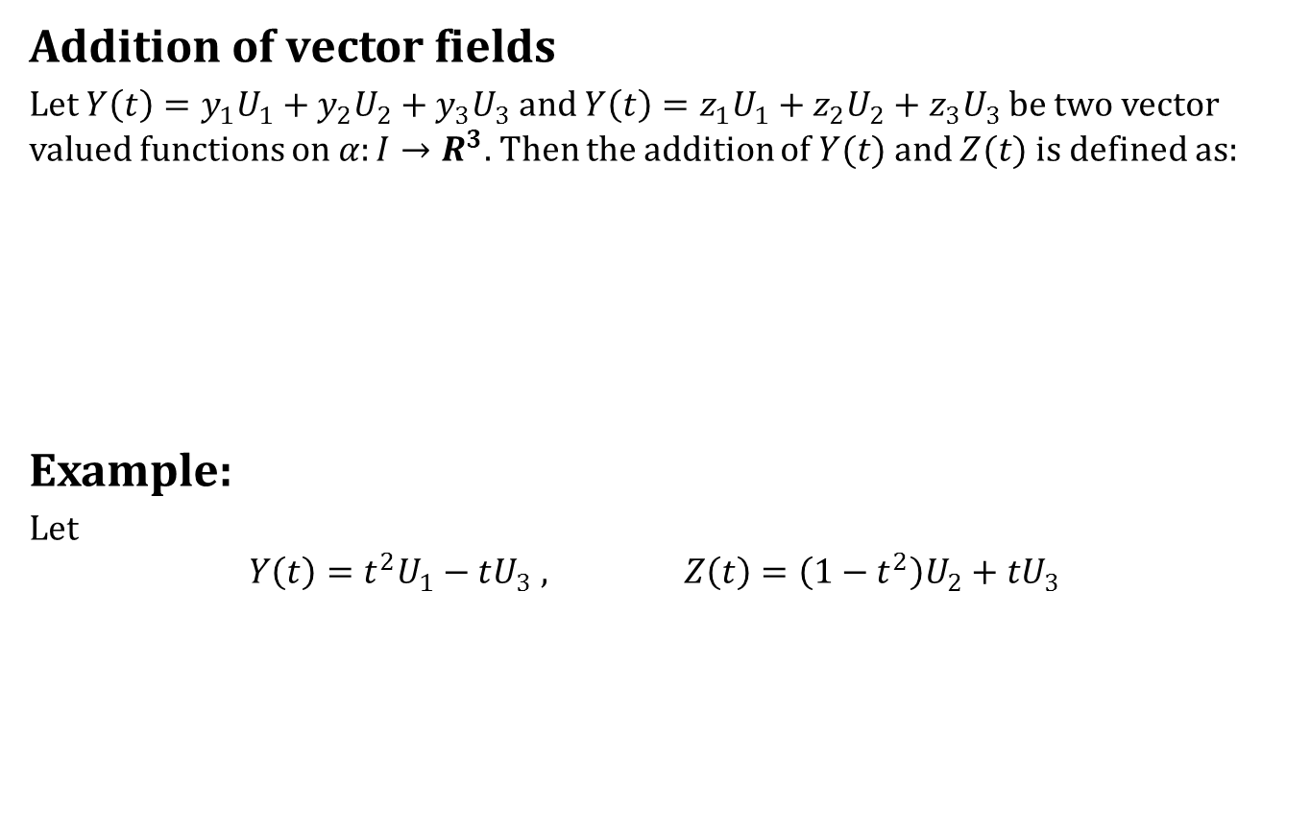
Vector Fields On Curves
Addition of vector fields
Let $Y\left(t\right)=y_{1}U_{1}+y_{2}U_{2}+y_{3}U_{3}$ and $Y\left(t\right)=z_{1}U_{1}+z_{2}U_{2}+z_{3}U_{3}$ be two vector valued functions on $α:I→R^{3}$. Then the addition of $Y(t)$ and $Z(t)$ is defined as:
Example:
Let
$$Y\left(t\right)=t^{2}U_{1}−tU_{3} , Z\left(t\right)=\left(1−t^{2}\right)U_{2}+tU_{3}$$

Slide 21
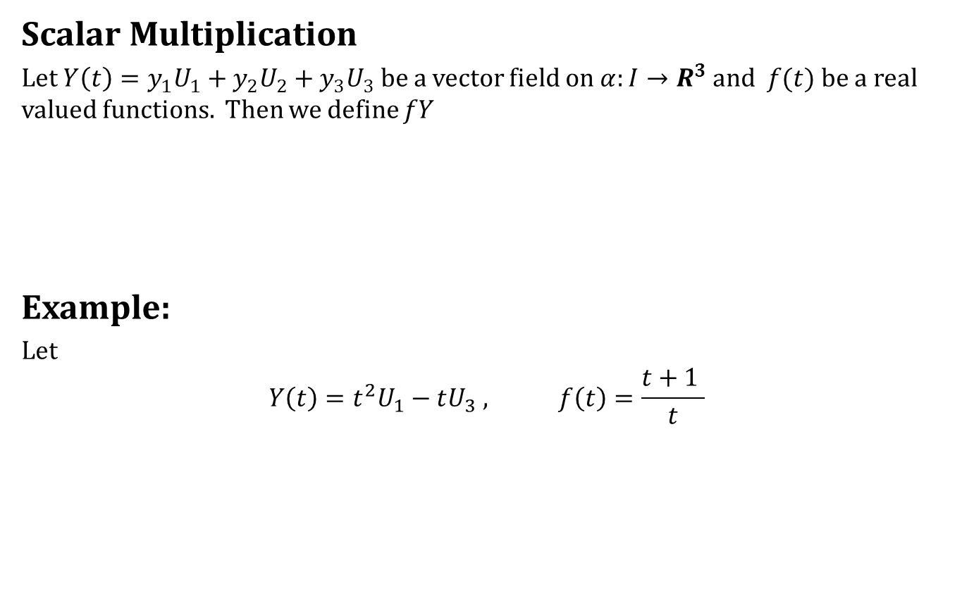
Vector Fields On Curves
Scalar Multiplication
Let $Y\left(t\right)=y_{1}U_{1}+y_{2}U_{2}+y_{3}U_{3}$ be a vector field on $α:I→R^{3}$ and $f(t)$ be a real valued functions. Then we define $fY$
Example:
Let
$$Y\left(t\right)=t^{2}U_{1}−tU_{3} , f\left(t\right)=\frac{t+1 }{t}$$

Slide 22
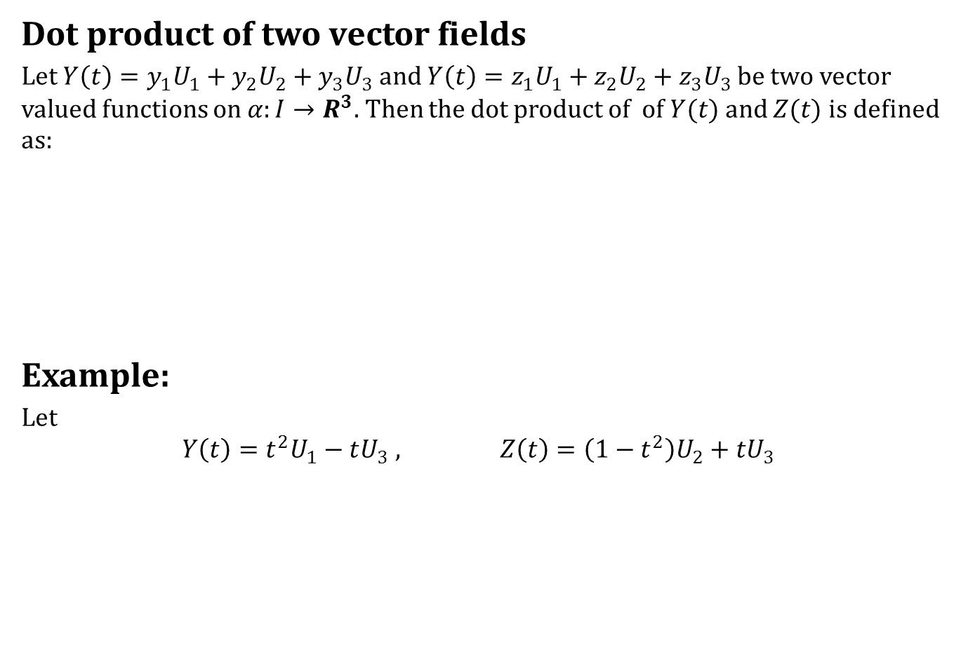
Vector Fields On Curves
Dot product of two vector fields
Let $Y\left(t\right)=y_{1}U_{1}+y_{2}U_{2}+y_{3}U_{3}$ and $Y\left(t\right)=z_{1}U_{1}+z_{2}U_{2}+z_{3}U_{3}$ be two vector valued functions on $α:I→R^{3}$. Then the dot product of of $Y(t)$ and $Z(t)$ is defined as:
Example:
Let
$$Y\left(t\right)=t^{2}U_{1}−tU_{3} , Z\left(t\right)=\left(1−t^{2}\right)U_{2}+tU_{3}$$

Slide 23
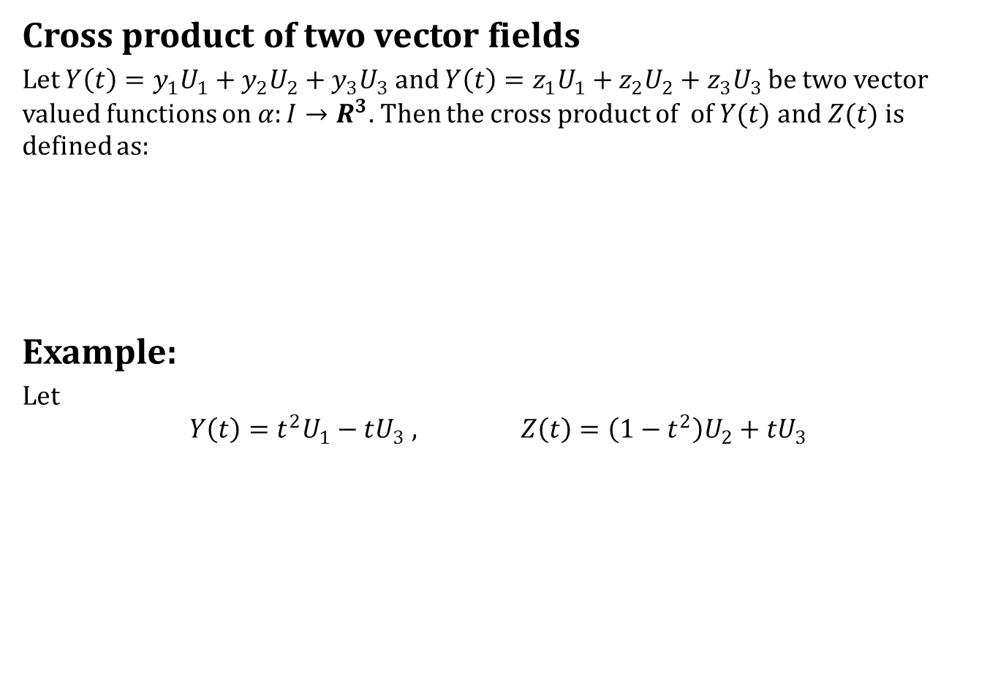
Vector Fields On Curves
Cross product of two vector fields
Let $Y\left(t\right)=y_{1}U_{1}+y_{2}U_{2}+y_{3}U_{3}$ and $Y\left(t\right)=z_{1}U_{1}+z_{2}U_{2}+z_{3}U_{3}$ be two vector valued functions on $α:I→R^{3}$. Then the cross product of of $Y(t)$ and $Z(t)$ is defined as:
Example:
Let
$$Y\left(t\right)=t^{2}U_{1}−tU_{3} , Z\left(t\right)=\left(1−t^{2}\right)U_{2}+tU_{3}$$

Slide 24
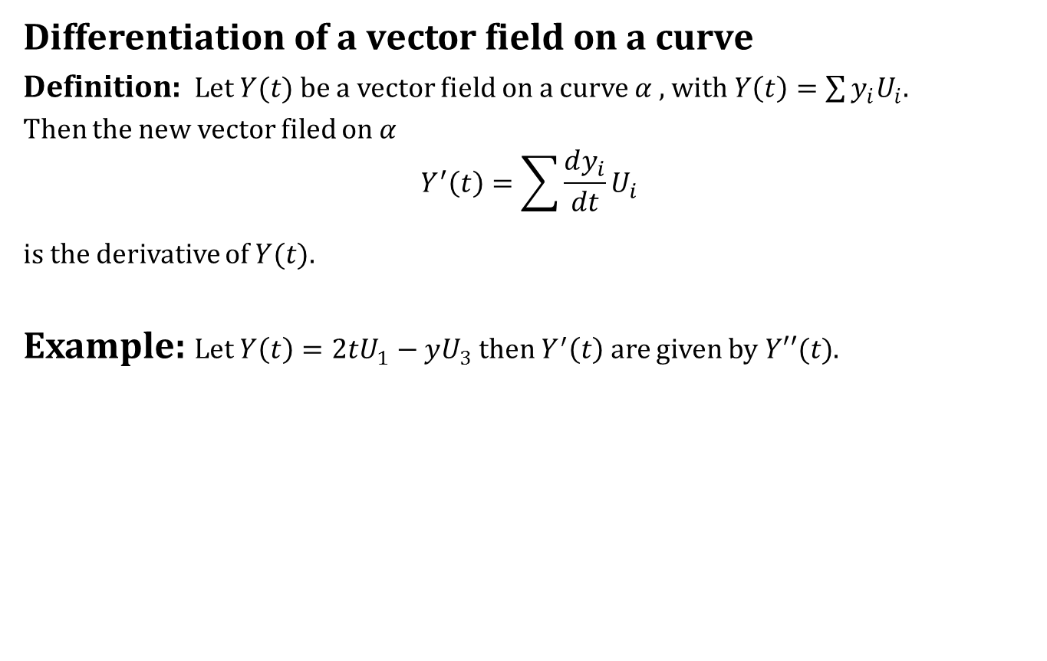
Differentiation of Vector Fields
Differentiation of a vector field on a curve
Definition: Let $Y(t)$ be a vector field on a curve $α$ , with $Y\left(t\right)=\sum{y_{i}U_{i}}$.
Then the new vector filed on $α$
$$Y^{′}\left(t\right)=\sum{\frac{dy_{i}}{dt}U_{i}}$$
is the derivative of $Y(t)$.
Example: Let $Y\left(t\right)=2tU_{1}−yU_{3}$ then $Y^{′}\left(t\right)$ are given by $Y′′(t)$.

Slide 25
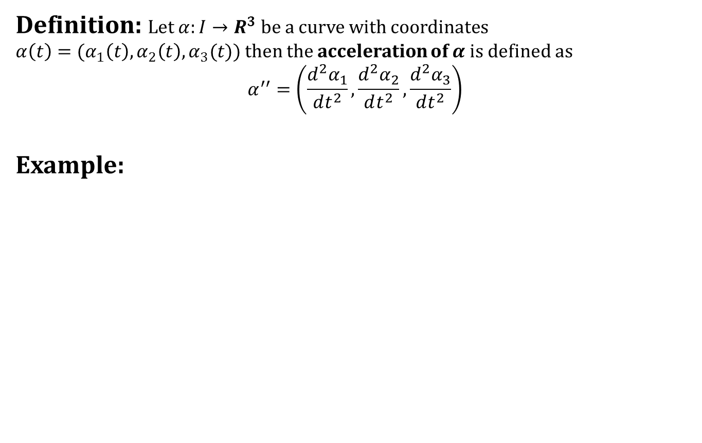
Differentiation of Vector Fields
Definition: Let $α:I→R^{3}$ be a curve with coordinates $α\left(t\right)=(α_{1}\left(t\right),α_{2}\left(t\right),α_{3}(t))$ then the acceleration of $α$ is defined as
$$α^{′′}=\left(\frac{d^{2}α_{1}}{dt^{2}},\frac{d^{2}α_{2}}{dt^{2}},\frac{d^{2}α_{3}}{dt^{2}}\right)$$
Example:

Slide 26
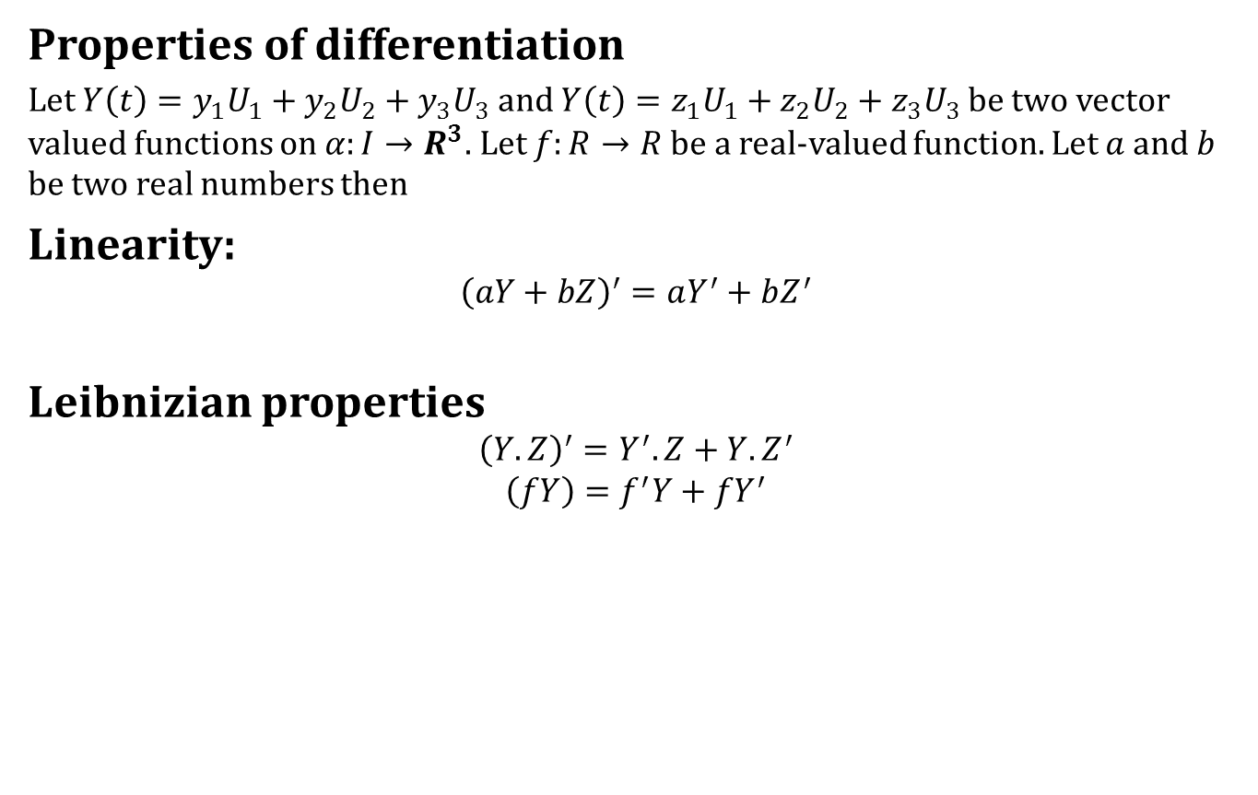
Differentiation of Vector Fields
Properties of differentiation
Let $Y\left(t\right)=y_{1}U_{1}+y_{2}U_{2}+y_{3}U_{3}$ and $Y\left(t\right)=z_{1}U_{1}+z_{2}U_{2}+z_{3}U_{3}$ be two vector valued functions on $α:I→R^{3}$. Let $f:R→R$ be a real-valued function. Let $a$ and $b$ be two real numbers then
Linearity:
$${\left(aY+bZ\right)}^{′}=aY^{′}+bZ^{′}$$
Leibnizian properties
$${\left(Y.Z\right)}^{′}=Y^{′}.Z+Y.Z^{′}$$
$$\left(fY\right)=f^{′}Y+fY^{′}$$

Slide 27
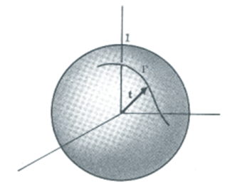
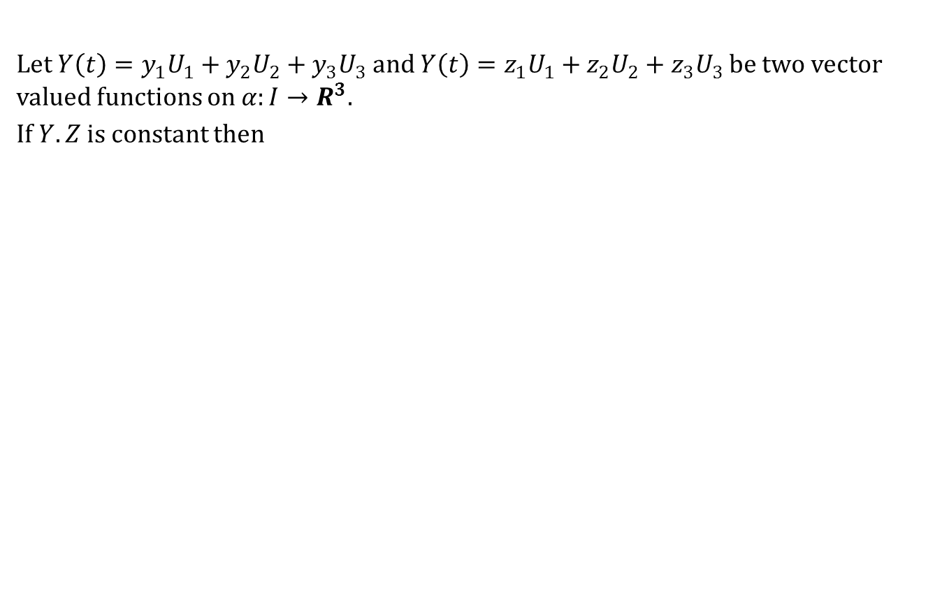
Differentiation of Vector Fields
Let $Y\left(t\right)=y_{1}U_{1}+y_{2}U_{2}+y_{3}U_{3}$ and $Y\left(t\right)=z_{1}U_{1}+z_{2}U_{2}+z_{3}U_{3}$ be two vector valued functions on $α:I→R^{3}$.
If $Y.Z$ is constant then

Slide 28
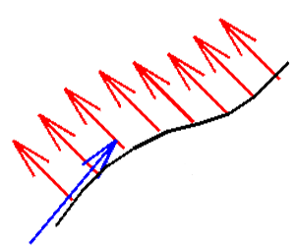
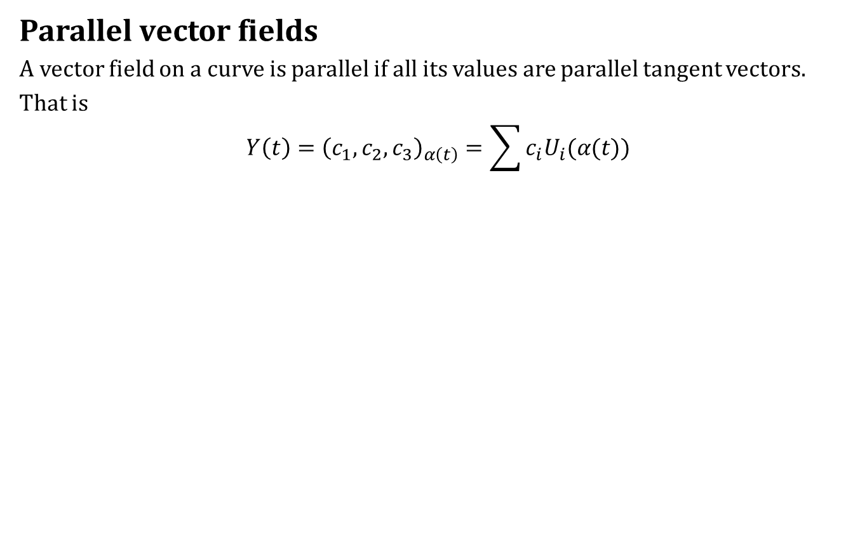
Differentiation of Vector Fields
Parallel vector fields
A vector field on a curve is parallel if all its values are parallel tangent vectors.
That is
$$Y\left(t\right)={\left(c_{1},c_{2},c_{3}\right)}_{α\left(t\right)}=\sum{c_{i}U_{i}(α(t))}$$

Slide 29
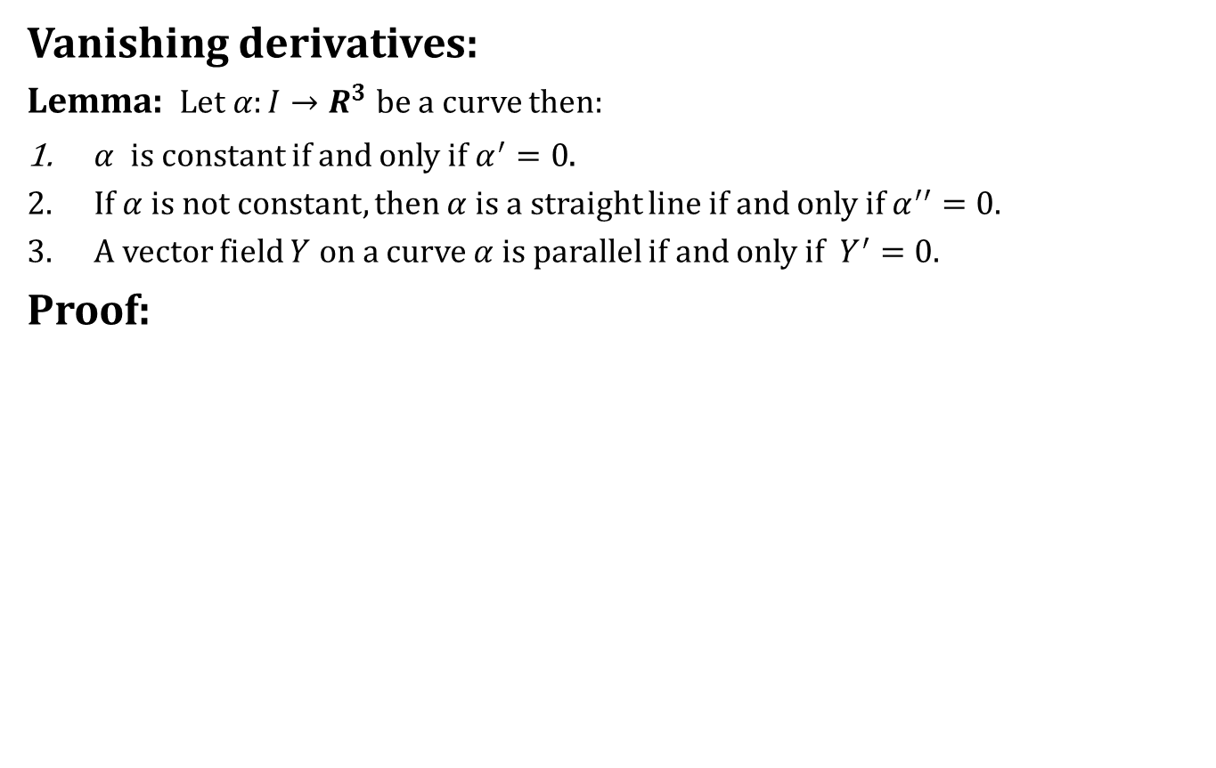
Differentiation of Vector Fields
Vanishing derivatives:
Lemma: Let $α:I→R^{3}$ be a curve then:
$α$ is constant if and only if $α^{′}=0$.
If $α$ is not constant, then $α$ is a straight line if and only if $α^{′′}=0$.
A vector field $Y$ on a curve $α$ is parallel if and only if $Y^{′}=0$.
Proof:

Slide 30
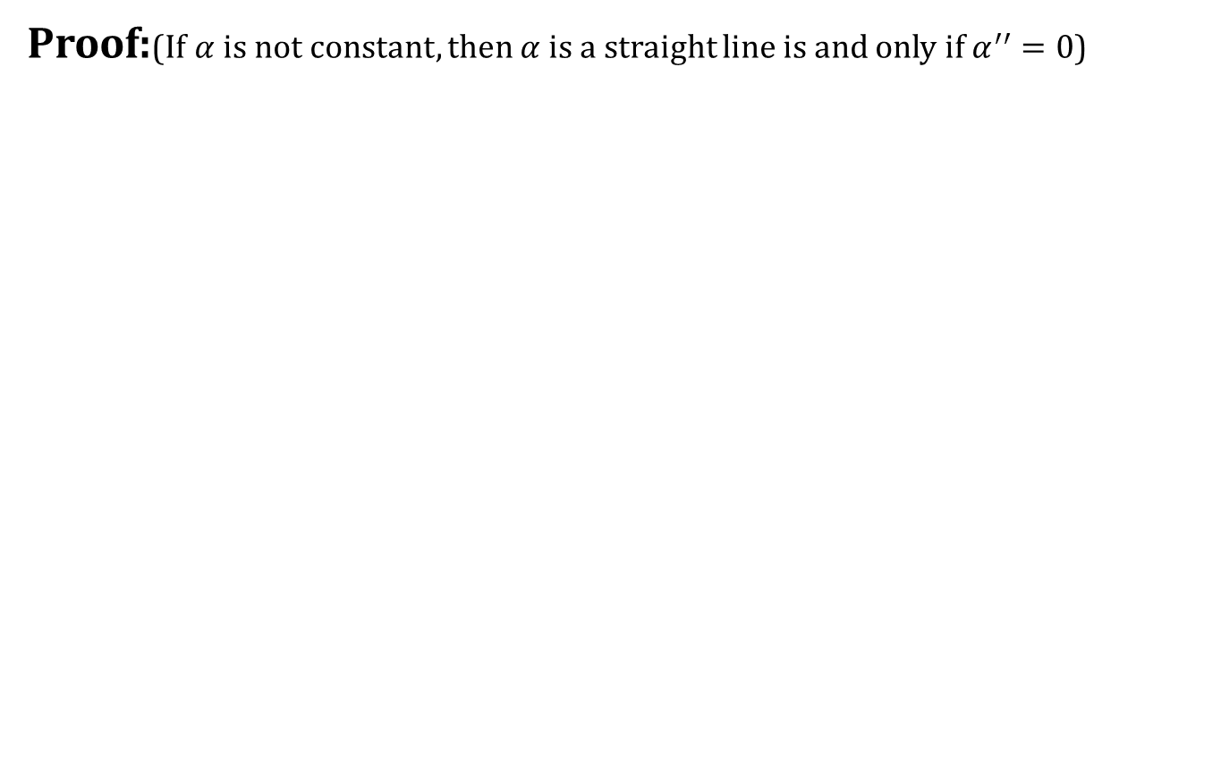
Differentiation of Vector Fields
Proof:(If $α$ is not constant, then $α$ is a straight line is and only if $α^{′′}=0$)

Slide 31
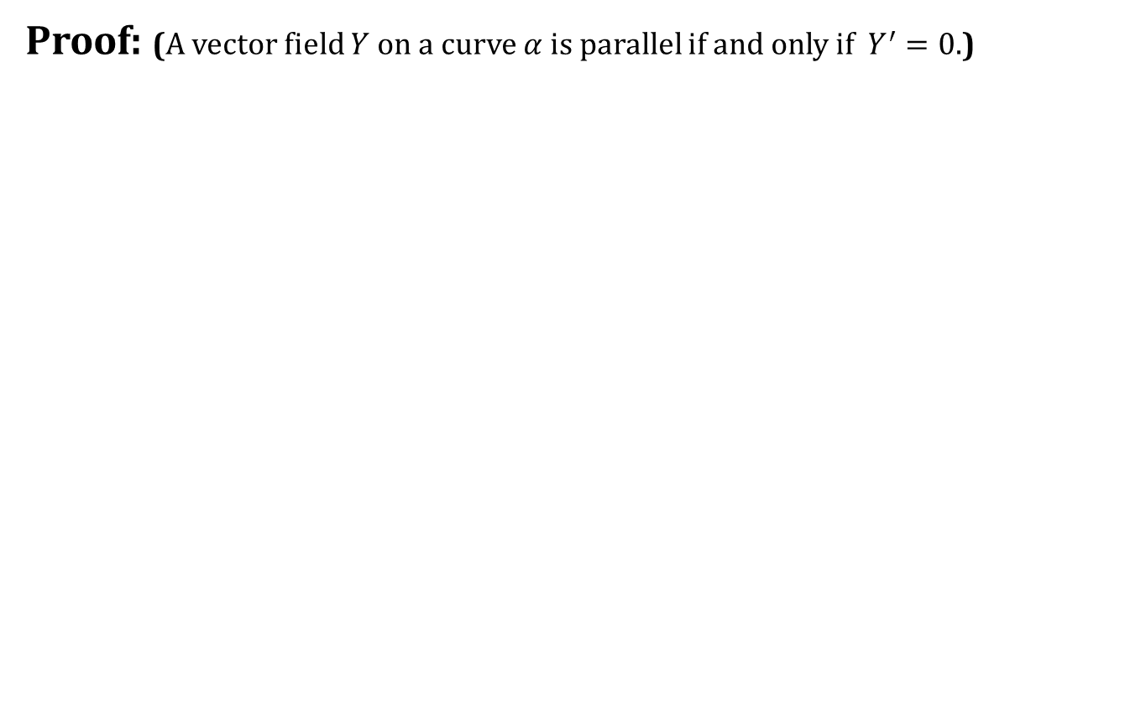
Differentiation of Vector Fields
Proof: (A vector field $Y$ on a curve $α$ is parallel if and only if $Y^{′}=0$.)

Slide 32
Today we learnt
Contents:
Speed Of A Curve
Vector Fields On Curves
Differentiation of Vector Fields

Slide 33
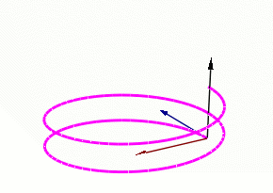

Next time
Frenet Formulas

Slide 34
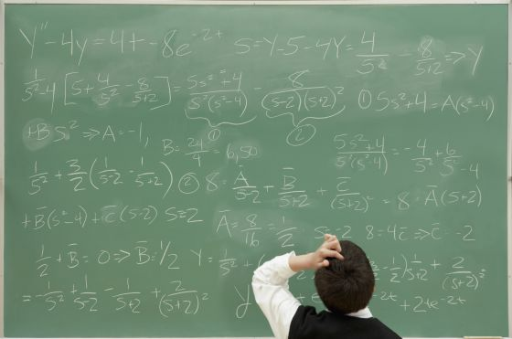
End of the lecture

