Slide 1
MTH352: Differential Geometry
For
Master of Mathematics
By
Dr. SOHAIL IQBAL
Assistant Professor
Department of Mathematics, CIIT Islamabad

Slide 2
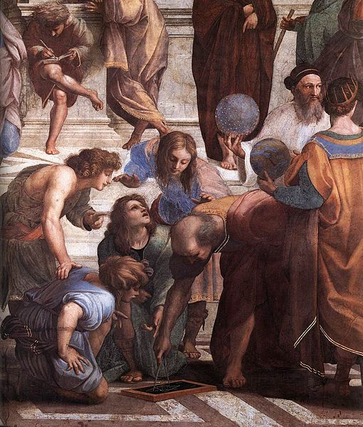
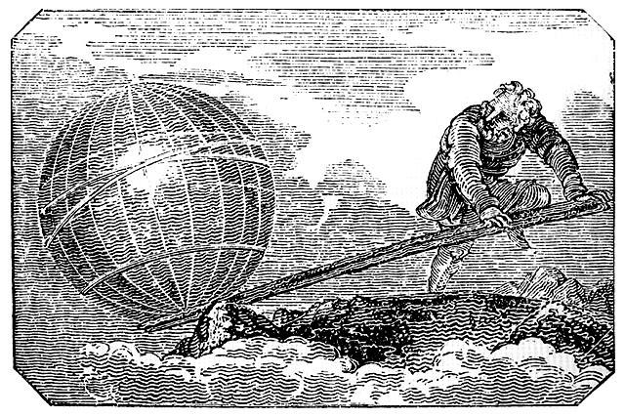
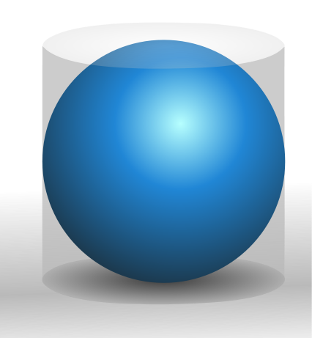
Euclid:
He is often referred to as the "Father of Geometry“.
Euclid's Elements.
His work is one of the most influential works in the history of mathematics. The “Elements” have been serving as the main textbook for teaching geometry from the 300 B.C. until the 20th century.
Archimedes
Give me a place to stand on, and I will move the Earth.
Calculated the area and volumes of different objects, the techniques were later formulated in calculus.

Slide 3
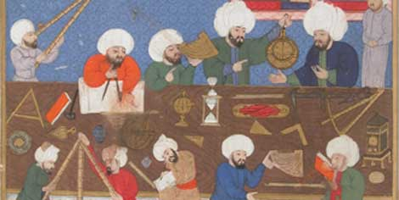
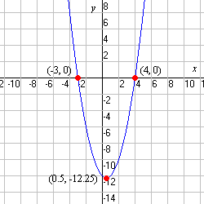
Muslim Era:
The need to predict the phases of the Moon for Ramadan and other religious festivals led to great steps forward in geometry of celestial objects (astronomy).
René Descartes/ Pierre de Fermat
Introduction “Cartesian coordinates” which marked a new stage for geometry, since geometric figures, could now be represented analytically, that is, with functions and equations.
Built a bridge between algebra and geometry.

Slide 4
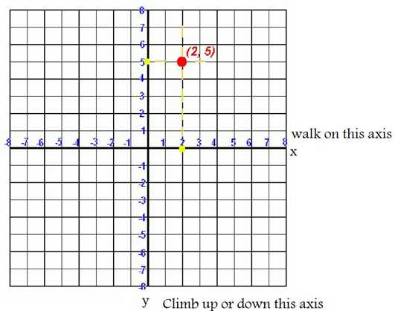
Cartesian coordinates On Euclidean plane
We can associate a point in plane with an ordered pair.
Using the coordinate plane we can associate a curve in plane with an equation.

Slide 5
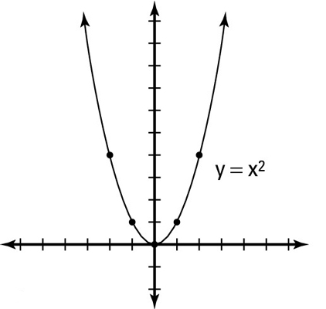
Graph of equations in Euclidean plane
Graph of equation
X | 0 | 1 | -1 | 2 | -2
Y | 0 | 1 | -1 | 4 | 4

Slide 6
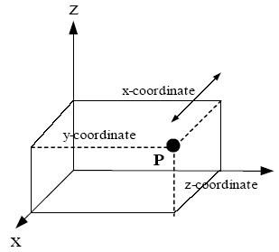
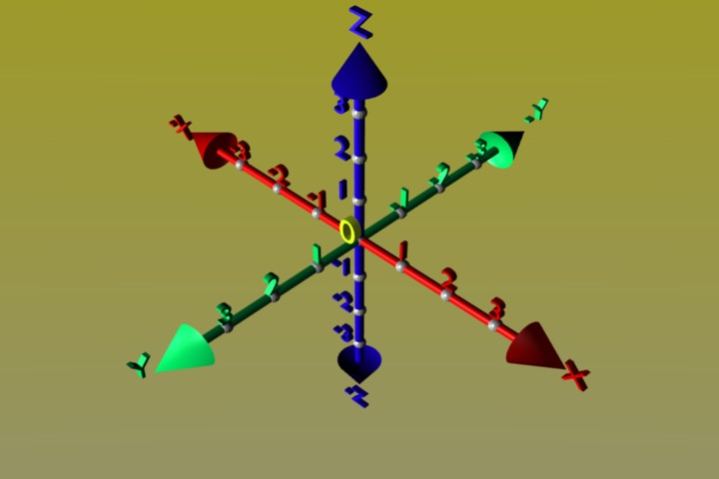
Cartesian coordinates in space
We can associate a point in space with an ordered triple.
Using these coordinates we can associate curves and surfaces in space with an equation.

Slide 7
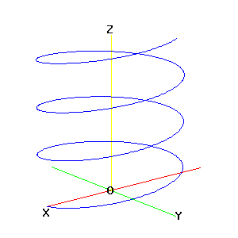
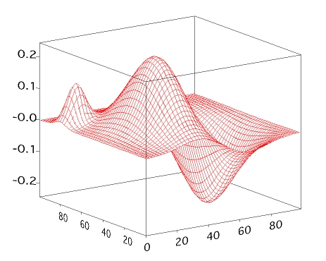
Graph of equations in space
Similar to the case of plane, we can use Cartesian coordinates to sketch graph of one equation or a set of equations.
A curve in Space
A surface in Space

Slide 8
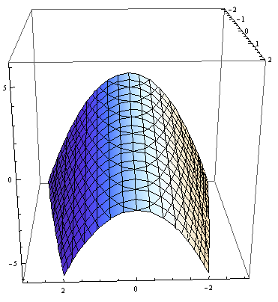
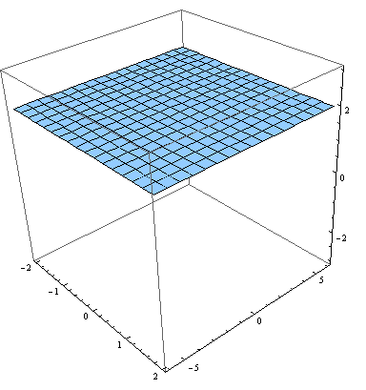
Aim of the course:
Main aim of the course is to:
Review of differential calculus.
Develop tools to study curves and surfaces in space.
Proper definition of surface. How to do calculus on surface.
A detailed study of geometry of surface.
A curved surface in space
A plane surface in space

Slide 9
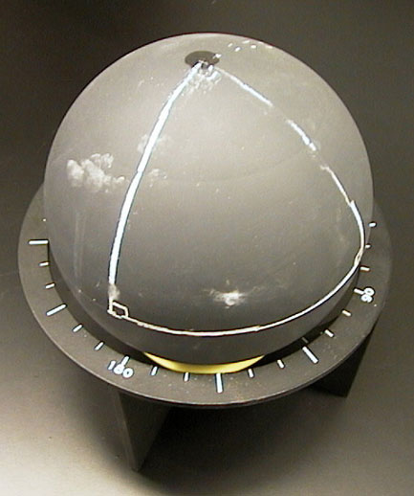
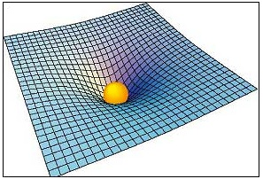
Why study surfaces
There are many examples of surfaces around us
Planet earth
Shape of space due to gravity

Slide 10
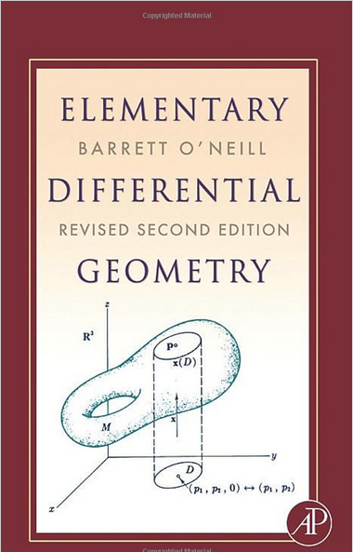
Textbook:
Author: Barrett O’Neill
Title: Elementary Differential Geometry
Marks scheme :
Quizzes – 10%
assignments – 10%
GDB – 5%
Sessionals(I & II) – 25%
Final – 50%

Slide 11
SOME DEFINITIONS:
Set : A set S is a collection of objects that are called the elements of S.
Example1: S = {1,2,3,4,…} is a set of natural numbers.
Example2: S = { x : x is an integer ^ x is divisible by 2} = Set of even integers.
Subset: A set A is a subset of S provided each element of A is also an element of S.
Example1: A = {1,2,3} is a subset of S = {1,2,3,4,…}.
Example2: A = { x : x is an integer ^ x is divisible by 2 } is a subset of integers.

Slide 12
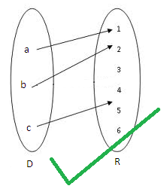
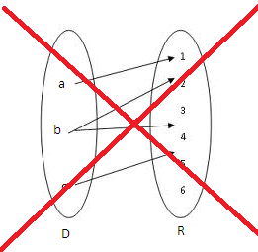
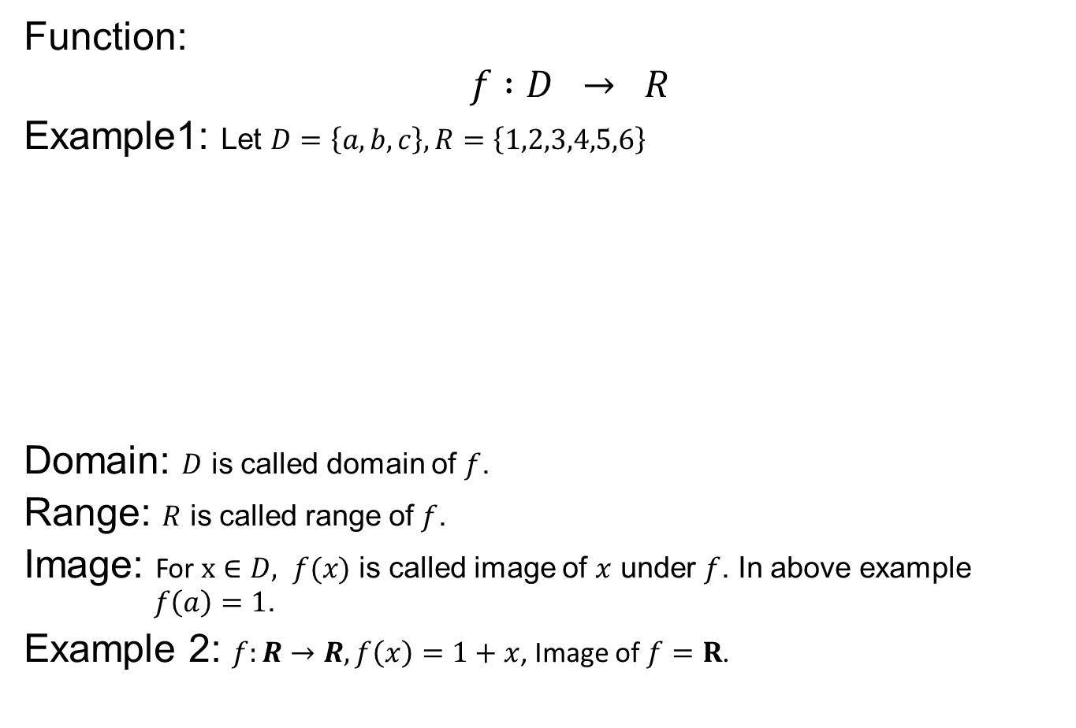
SOME DEFINITIONS:
Function:
$$f :D → R$$
Example1: Let $D=\left\{a,b,c\right\}, R=\left\{1,2,3,4,5,6\right\}$
Domain: $D$ is called domain of $f$.
Range: $R$ is called range of $f$.
Image: For $x∈D, f(x)$ is called image of $x$ under $f$. In above example $f\left(a\right)=1$.
Example 2: $f:R→R,f\left(x\right)=1+x$, Image of $f=R$.

Slide 13
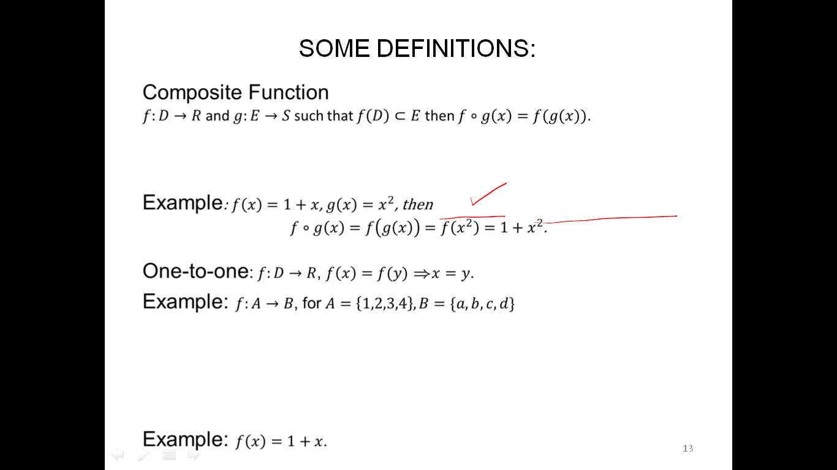
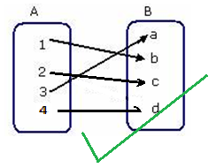
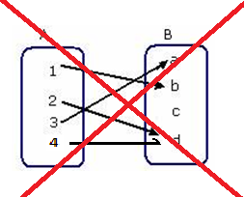
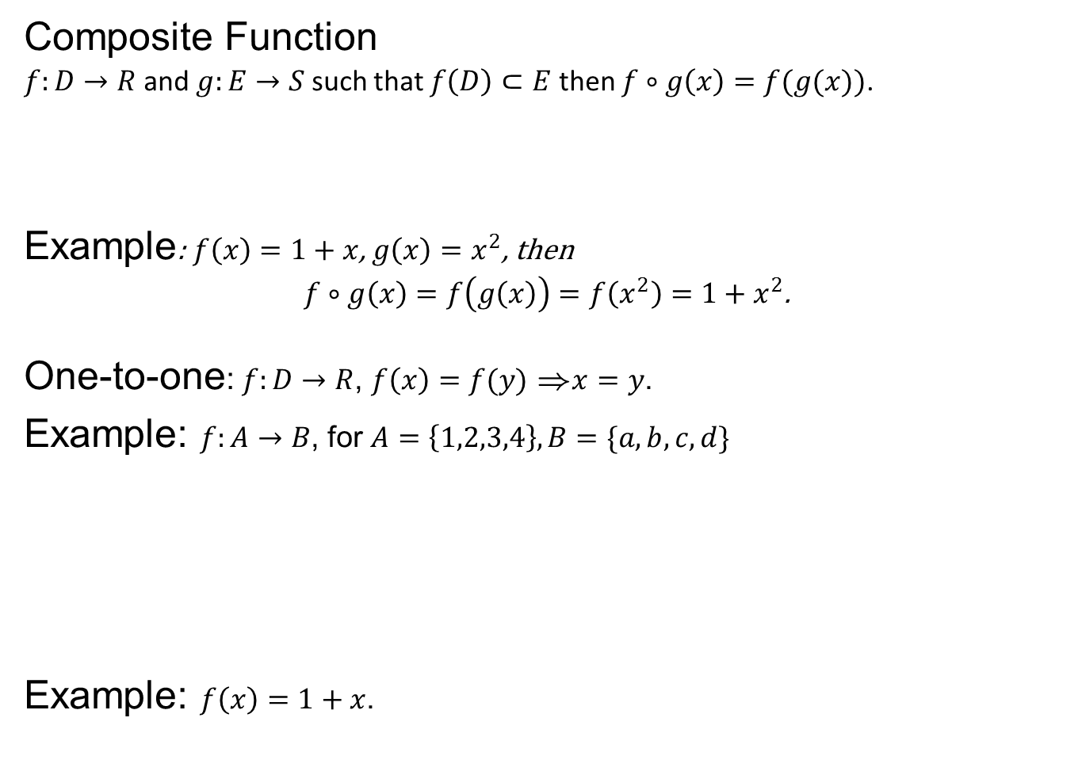
SOME DEFINITIONS:
Composite Function
$f:D→R$ and $g:E→S$ such that $f\left(D\right)⊂E$ then $f∘g\left(x\right)=f(g(x))$.
Example: $f\left(x\right)=1+x$, $g\left(x\right)=x^{2}$, then
$f∘g\left(x\right)=f\left(g\left(x\right)\right)=f\left(x^{2}\right)=1+x^{2}$.
One-to-one: $f:D→R$, $f\left(x\right)=f(y)$ )$x=y$.
Example: $f:A→B$, for $A=\left\{1,2,3,4\right\}, B=\{a,b,c,d\}$
Example: $f\left(x\right)=1+x$.
(E)
D

Slide 14
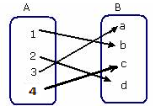
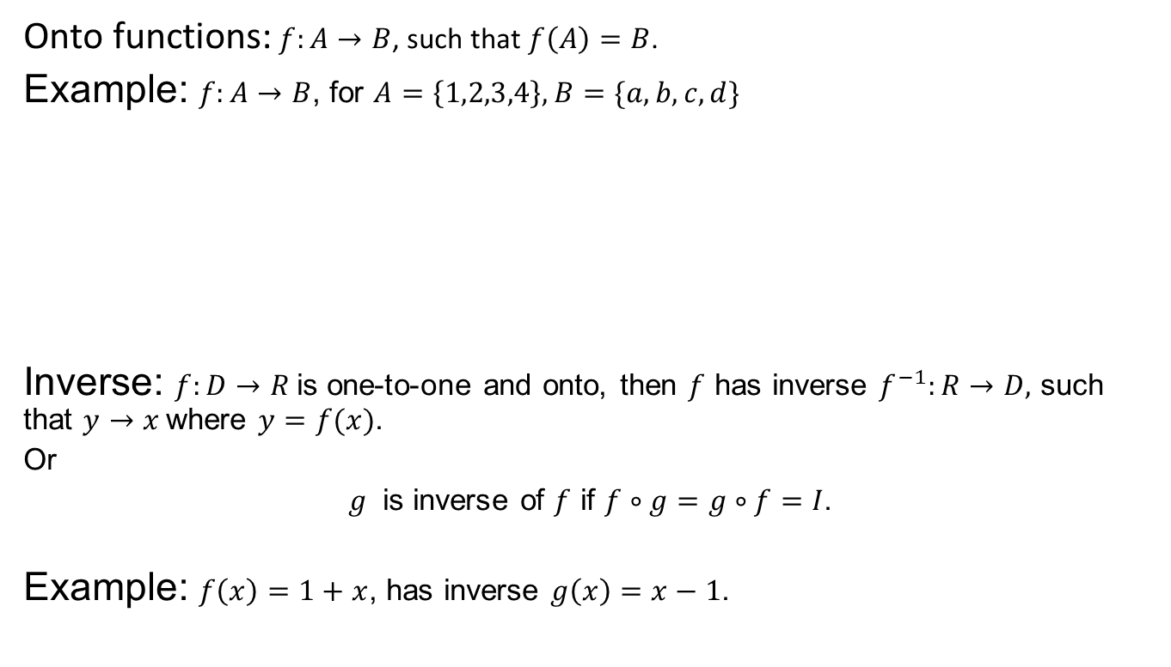
SOME DEFINITIONS
Onto functions: $f:A→B$, such that $f\left(A\right)=B$.
Example: $f:A→B$, for $A=\left\{1,2,3,4\right\}, B=\{a,b,c,d\}$
Inverse: $f:D→R$is one-to-one and onto, then $f$ has inverse $f^{−1}:R→D,$ such that $y→x$where $y=f(x)$.
Or
$g$ is inverse of $f$ if $f∘g=g∘f=I$.
Example: $f\left(x\right)=1+x$, has inverse $g\left(x\right)=x−1$.

Slide 15
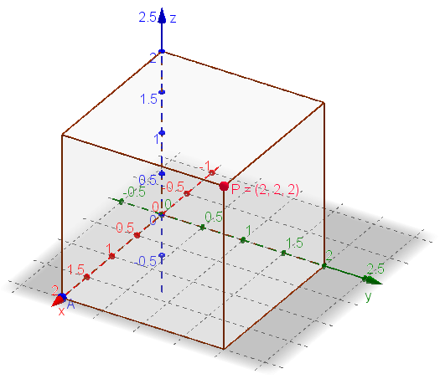
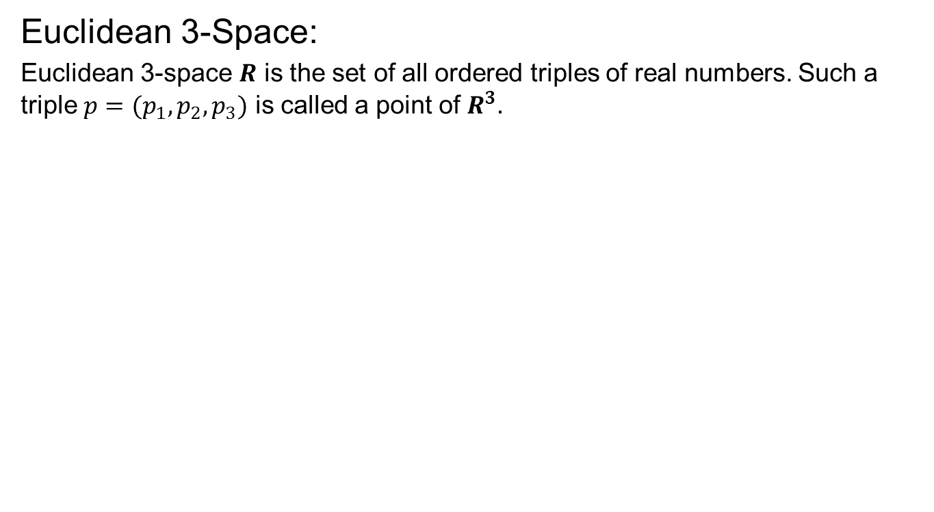
Euclidean Space
Euclidean 3-Space:
Euclidean 3-space $R$ is the set of all ordered triples of real numbers. Such a triple $p=(p_{1},p_{2},p_{3})$ is called a point of $R^{3}.$

Slide 16
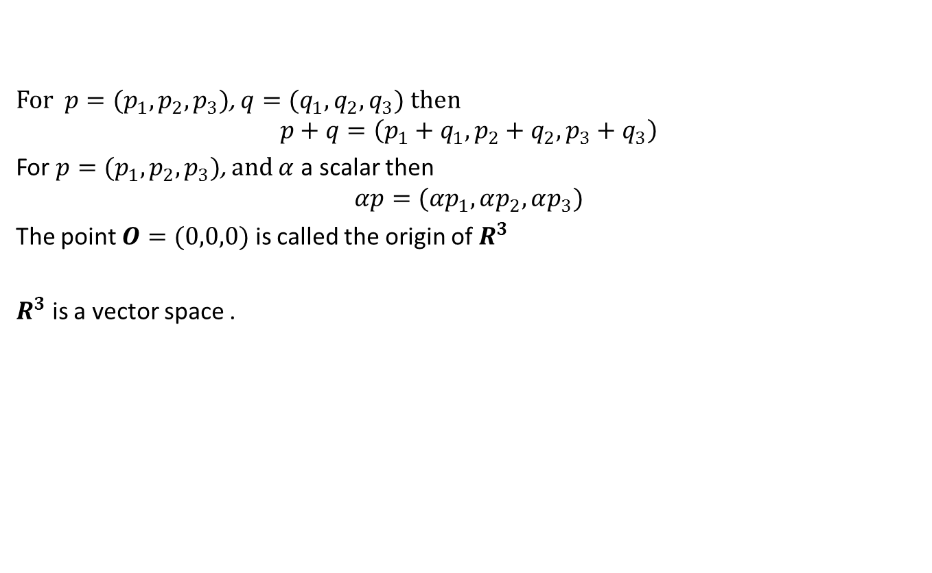
Euclidean Space
For $p=(p_{1},p_{2},p_{3})$, $q=(q_{1},q_{2},q_{3})$ then
$$p+q=\left(p_{1}+q_{1},p_{2}+q_{2}, p_{3}+q_{3}\right)$$
For $p=(p_{1},p_{2},p_{3})$, and $α$ a scalar then
$$αp=(αp_{1},αp_{2},αp_{3})$$
The point $O=(0,0,0)$ is called the origin of $R^{3}$
$R^{3}$ is a vector space .

Slide 17
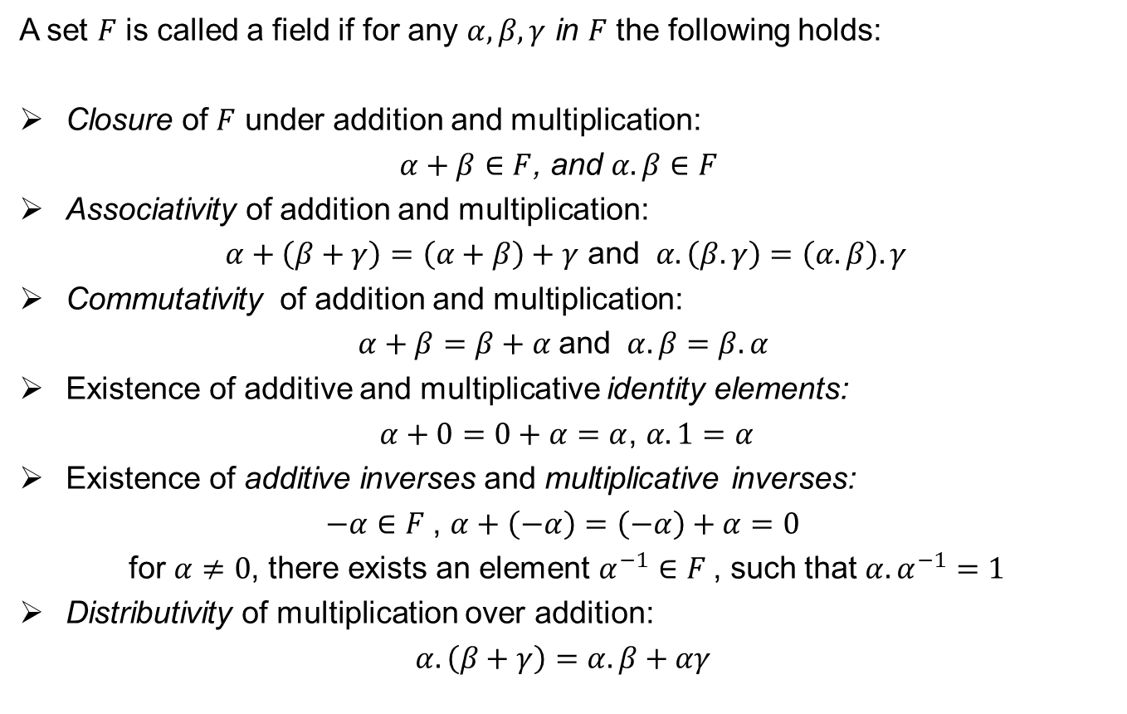
Field
A set $F$ is called a field if for any $α, β,γ$ in $F$ the following holds:
Closure of $F$ under addition and multiplication:
$α+β∈F$, and $α.β∈F$
Associativity of addition and multiplication:
$α+\left(β+γ\right)=\left(α+β\right)+γ$ and $α.\left(β.γ\right)=\left(α.β\right).γ$
Commutativity of addition and multiplication:
$α+β=β+α$and $α.β=β.α$
Existence of additive and multiplicative identity elements:
$α+0=0+α=α$, $α.1=α$
Existence of additive inverses and multiplicative inverses:
$−α∈F$, $α+\left(−α\right)=\left(−α\right)+α=0$
for $α≠0$, there exists an element $α^{−1}∈F$, such that $α.α^{−1}=1$
Distributivity of multiplication over addition:
$α.\left(β+γ\right)=α.β+αγ$

Slide 19
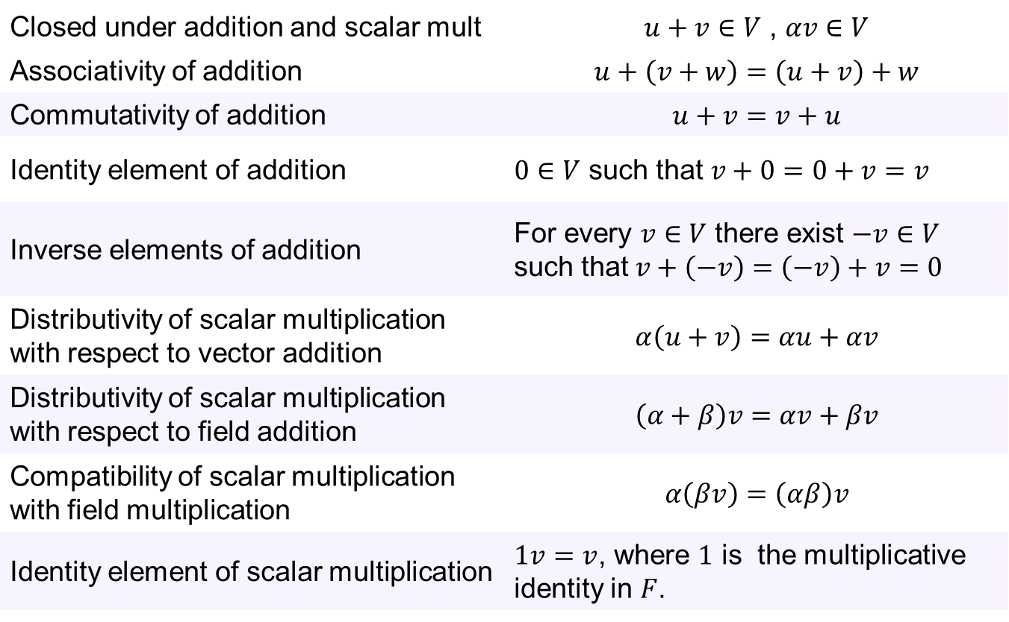
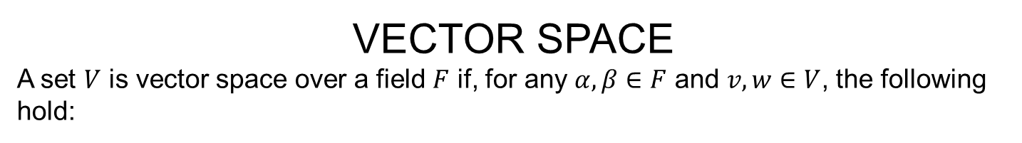
VECTOR SPACE
A set $V$ is vector space over a field $F$ if, for any $α, β∈F$ and $v, w∈V$, the following hold:
Closed under addition and scalar mult | $u+v∈V$ , $αv∈V$
Associativity of addition | $$u+\left(v+w\right)=\left(u+v\right)+w$$
Commutativity of addition | $$u+v=v+u$$
Identity element of addition | $0∈V$ such that $v+0=0+v=v$
Inverse elements of addition | For every $v∈V$ there exist $−v∈V$ such that $v+\left(−v\right)=\left(−v\right)+v=0$
Distributivity of scalar multiplication with respect to vector addition | $$α\left(u+v\right)=αu+αv$$
Distributivity of scalar multiplication with respect to field addition | $$\left(α+β\right)v=αv+βv$$
Compatibility of scalar multiplication with field multiplication | $$α\left(βv\right)=\left(αβ\right)v$$
Identity element of scalar multiplication | $1v=v$, where $1$ is the multiplicative identity in $F$.

Slide 21
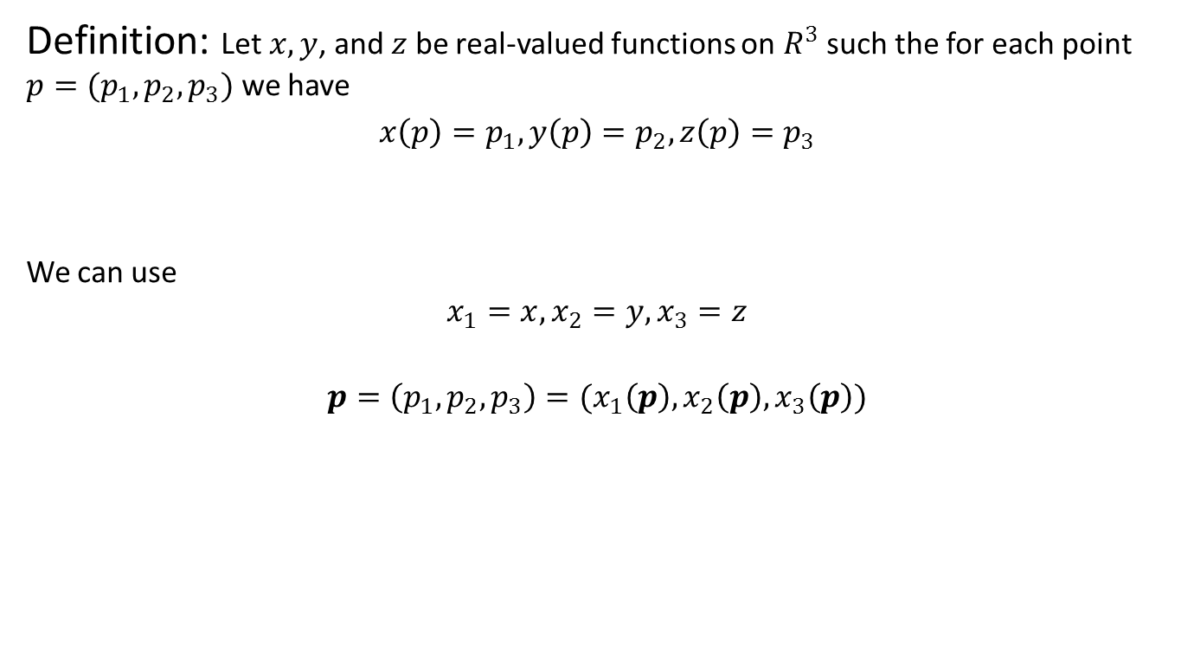
Euclidean Space
Definition: Let $x,y$, and $z$ be real-valued functions on $R^{3}$ such the for each point $p=(p_{1},p_{2},p_{3})$ we have
$x\left(p\right)=p_{1},y\left(p\right)=p_{2}, z\left(p\right)=p_{3}$
We can use
$$x_{1}=x, x_{2}=y, x_{3}=z$$
$$p=\left(p_{1},p_{2},p_{3}\right)=(x_{1}\left(p\right),x_{2}\left(p\right),x_{3}\left(p\right))$$

Slide 22

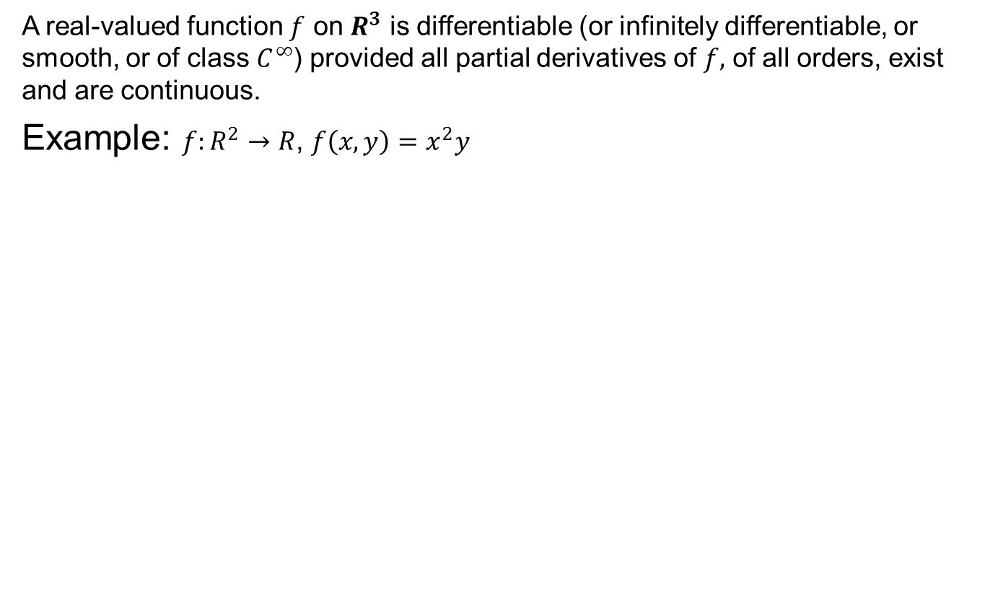
Differentiable OR $C^{∞}$ functions
A real-valued function $f$ on $R^{3}$ is differentiable (or infinitely differentiable, or smooth, or of class $C^{∞}$) provided all partial derivatives of $f,$ of all orders, exist and are continuous.
Example: $f:R^{2}→R$, $f\left(x,y\right)=x^{2}y$

Slide 23
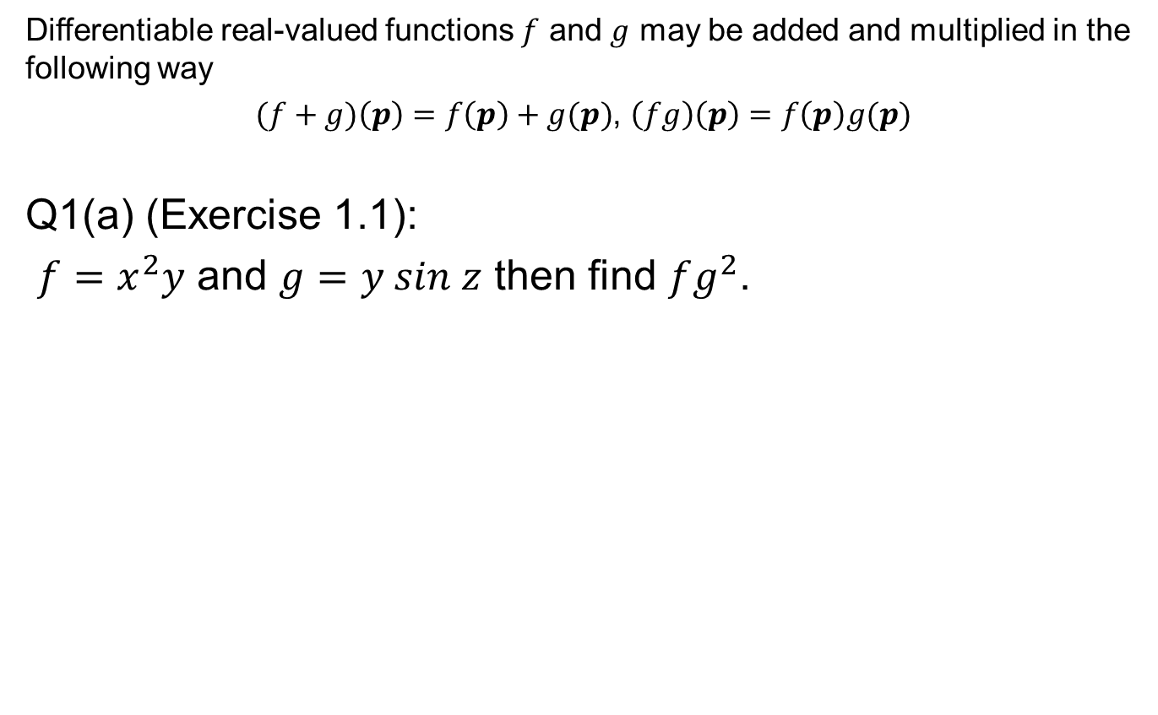
Arithmetic of differentiable functions
Differentiable real-valued functions $f$ and $g$ may be added and multiplied in the following way
$(f+g)\left(p\right)=f\left(p\right)+g(p)$, $\left(fg\right)\left(p\right)=f\left(p\right)g(p)$
Q1(a) (Exercise 1.1):
$f=x^{2}y$ and $g=y sin z$ then find $fg^{2}$.

Slide 24

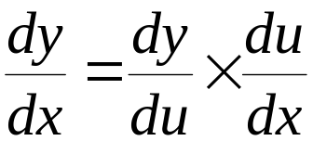
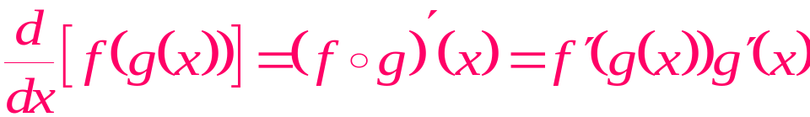
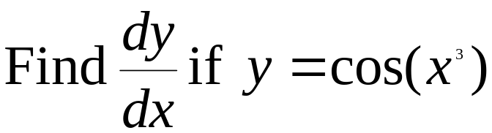
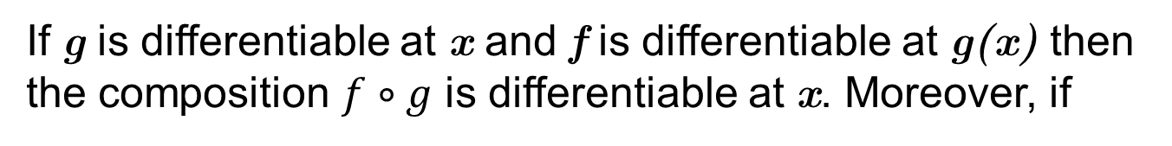
Chain rule
If g is differentiable at x and f is differentiable at g(x) then the composition $f∘g$ is differentiable at x. Moreover, if
Then y=f(u) and
Alternatively
Derivative of outside function
Derivative of inside function
Example

Slide 25


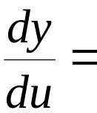

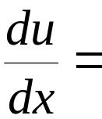



Let
And
Rates of change multiply

Slide 26
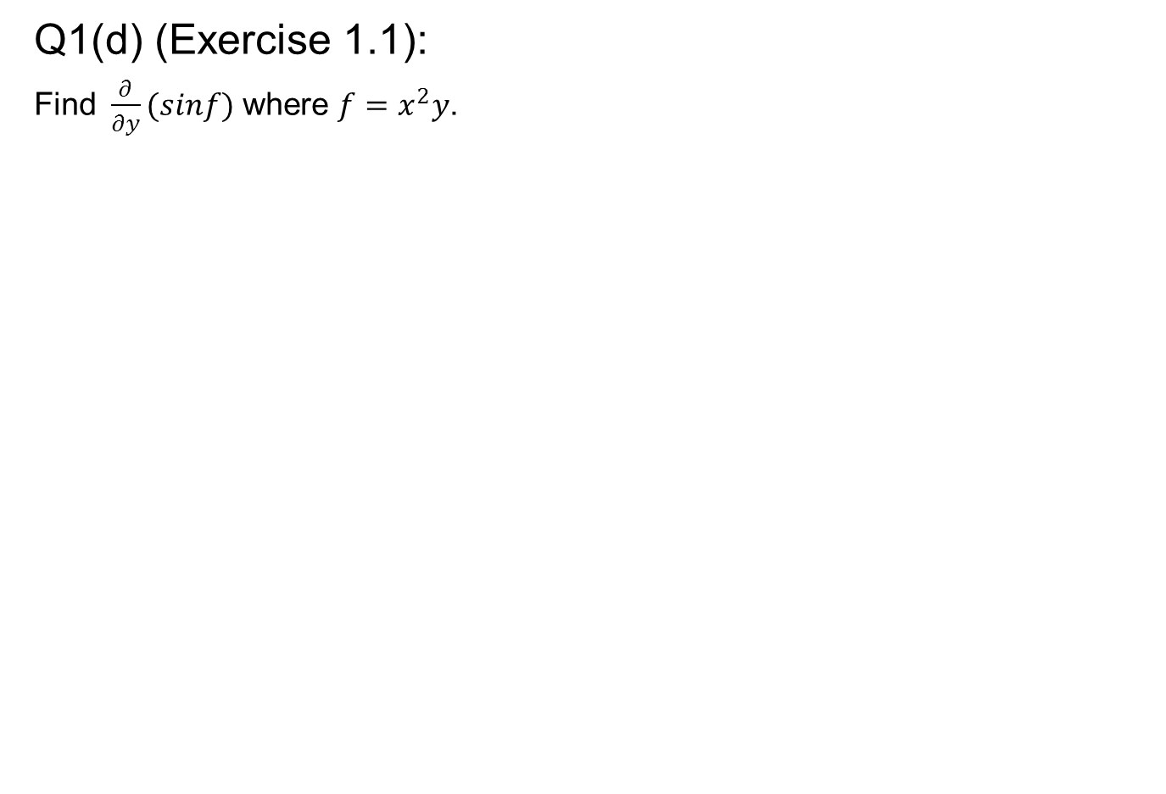
Q1(d) (Exercise 1.1):
Find $\frac{∂}{∂y}(sinf)$ where $f=x^{2}y$.

Slide 27
