Slide 1
By
Dr. Saqib Hussain
MTH 322
Real Analysis II

Slide 2
Series of functions
MTH 322
Lecture # 5

Slide 3
References:
1. Principles of Mathematical Analysis by Walter
Rudin
2. Introduction to real analysis by William F. Trench.

Slide 4
Recall

Slide 7
Lecture’s Outline
Series of functions
convergence of series of functions

Slide 8
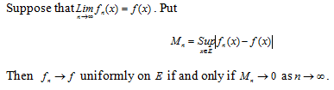
Mn-test for uniform convergence
Proof:

Slide 11
Example:
Solution:

Slide 16

Example:
Solution:

Slide 19
Series of functions

Slide 21
Example:
Solution:

Slide 26

Example:
Solution:

Slide 28

Example:
Solution:

