Slide 1
By
Dr. Saqib Hussain
MTH 322
Real Analysis II

Slide 2
Power Series and uniform convergence
MTH 322
Lecture # 15

Slide 5

Example:
Solution:

Slide 10

Example:
Solution:

Slide 13

Example:
Solution:

Slide 16

Theorem:
Proof:

Slide 19
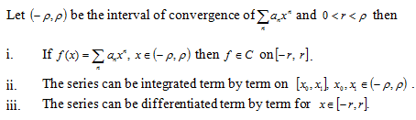
Remark:

Slide 23

Theorem:
Proof:

