Slide 1
Real Analysis I
Course Code MTH 321
By
Dr. Moiz ud Din khan
Professor of Mathematics

Slide 2
Lecture # 17

Slide 3
Lecture Outline
In this Lecture we will prove some theorems on the limit of a function:

Slide 4
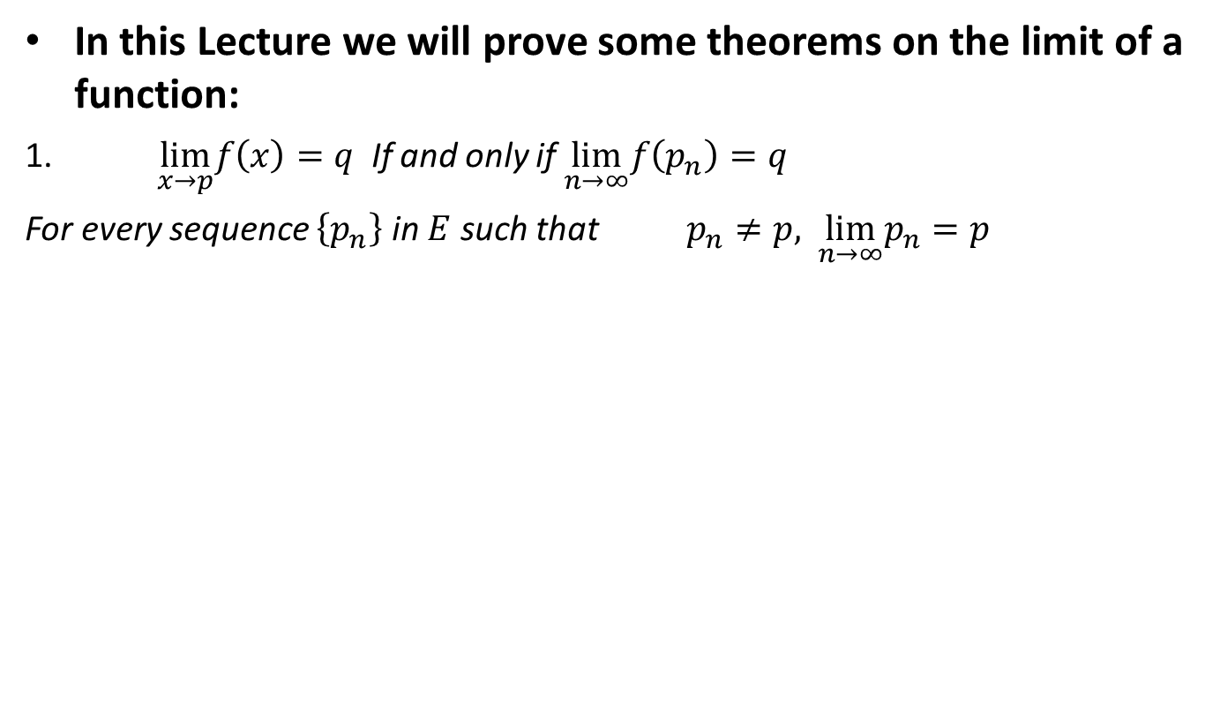
Lecture Outline
In this Lecture we will prove some theorems on the limit of a function:
$\lim_{x→p}f\left(x\right)=q$If and only if $\lim_{n→∞}f\left(p_{n}\right)=q$
For every sequence $\left\{p_{n}\right\}$ in $E$ such that $p_{n}≠p,$$\lim_{n→∞}p_{n}=p$

Slide 5
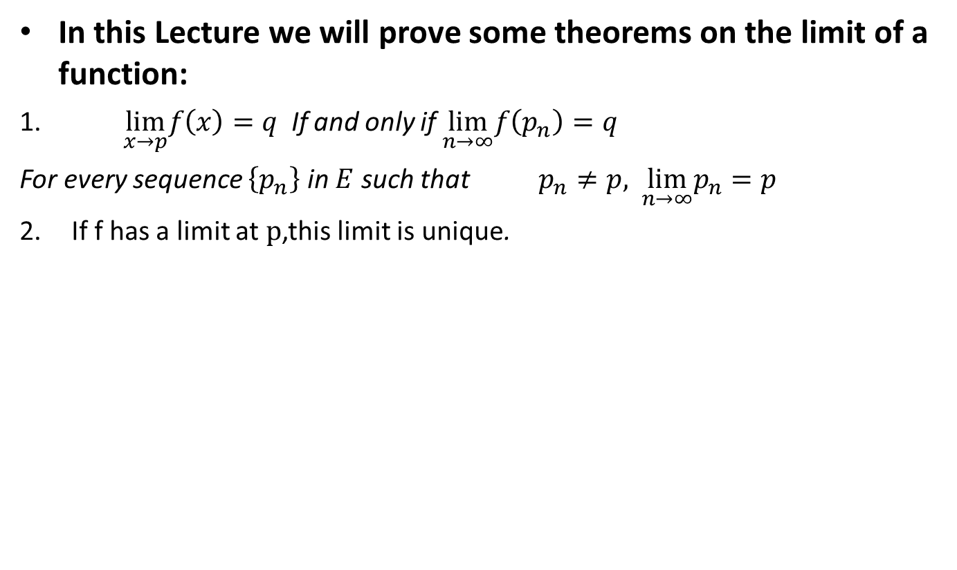
Lecture Outline
In this Lecture we will prove some theorems on the limit of a function:
$\lim_{x→p}f\left(x\right)=q$If and only if $\lim_{n→∞}f\left(p_{n}\right)=q$
For every sequence $\left\{p_{n}\right\}$ in $E$ such that $p_{n}≠p,$$\lim_{n→∞}p_{n}=p$
If f has a limit at $p$,this limit is unique.

Slide 6
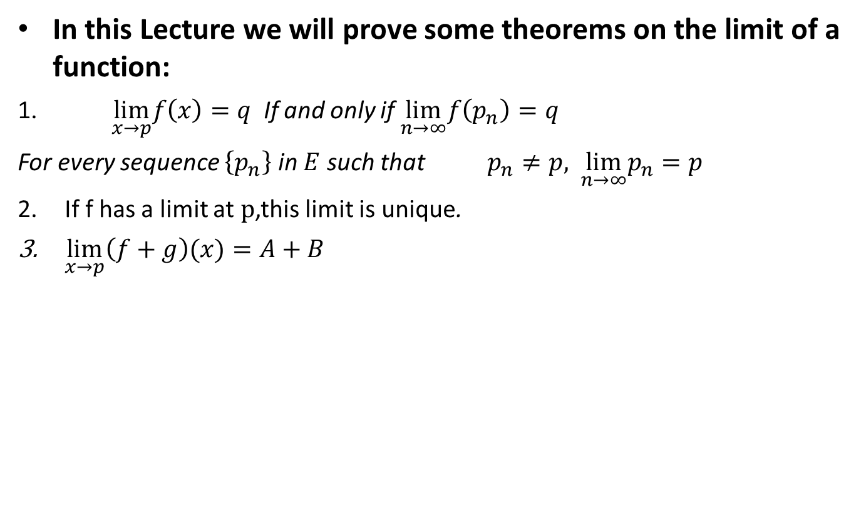
Lecture Outline
In this Lecture we will prove some theorems on the limit of a function:
$\lim_{x→p}f\left(x\right)=q$If and only if $\lim_{n→∞}f\left(p_{n}\right)=q$
For every sequence $\left\{p_{n}\right\}$ in $E$ such that $p_{n}≠p,$$\lim_{n→∞}p_{n}=p$
If f has a limit at $p$,this limit is unique.
$\lim_{x→p}\left(f+g\right)(x)=A+B$

Slide 7
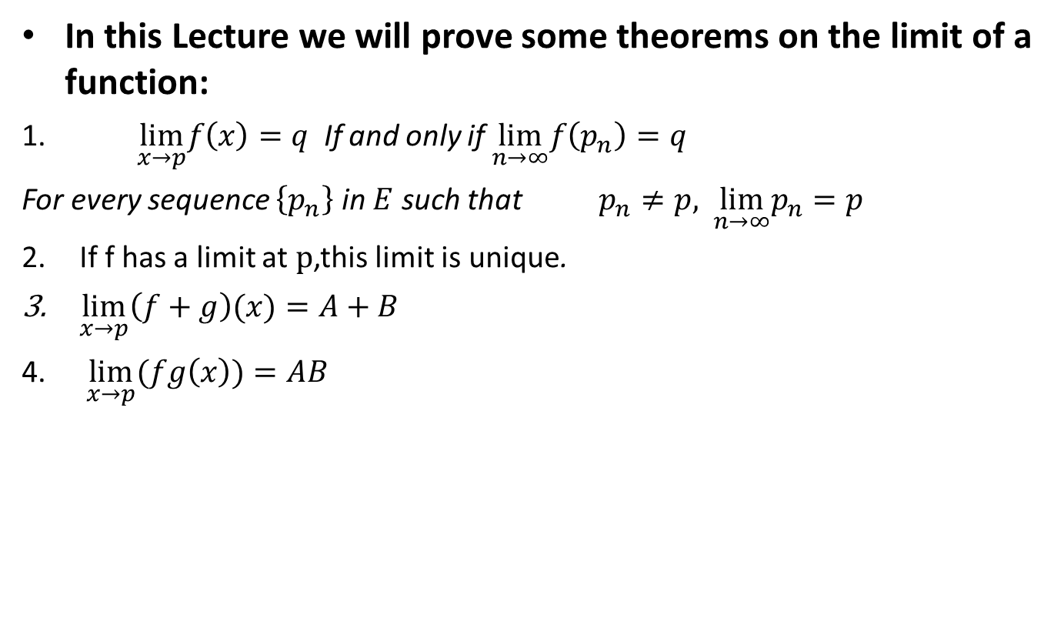
Lecture Outline
In this Lecture we will prove some theorems on the limit of a function:
$\lim_{x→p}f\left(x\right)=q$If and only if $\lim_{n→∞}f\left(p_{n}\right)=q$
For every sequence $\left\{p_{n}\right\}$ in $E$ such that $p_{n}≠p,$$\lim_{n→∞}p_{n}=p$
If f has a limit at $p$,this limit is unique.
$\lim_{x→p}\left(f+g\right)(x)=A+B$
$\lim_{x→p}(fg\left(x\right))=AB$

Slide 8
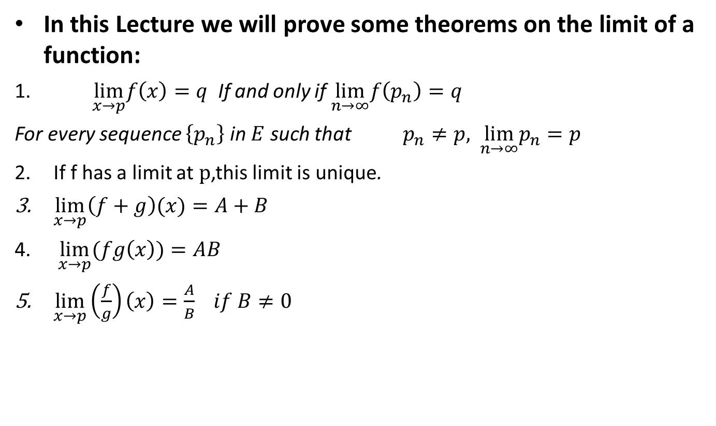
Lecture Outline
In this Lecture we will prove some theorems on the limit of a function:
$\lim_{x→p}f\left(x\right)=q$If and only if $\lim_{n→∞}f\left(p_{n}\right)=q$
For every sequence $\left\{p_{n}\right\}$ in $E$ such that $p_{n}≠p,$$\lim_{n→∞}p_{n}=p$
If f has a limit at $p$,this limit is unique.
$\lim_{x→p}\left(f+g\right)(x)=A+B$
$\lim_{x→p}(fg\left(x\right))=AB$
$\lim_{x→p}\left(\frac{f}{g}\right)\left(x\right)=\frac{A}{B}$$if B≠0$

Slide 9
Recall Limit of a function at a point:

Slide 10
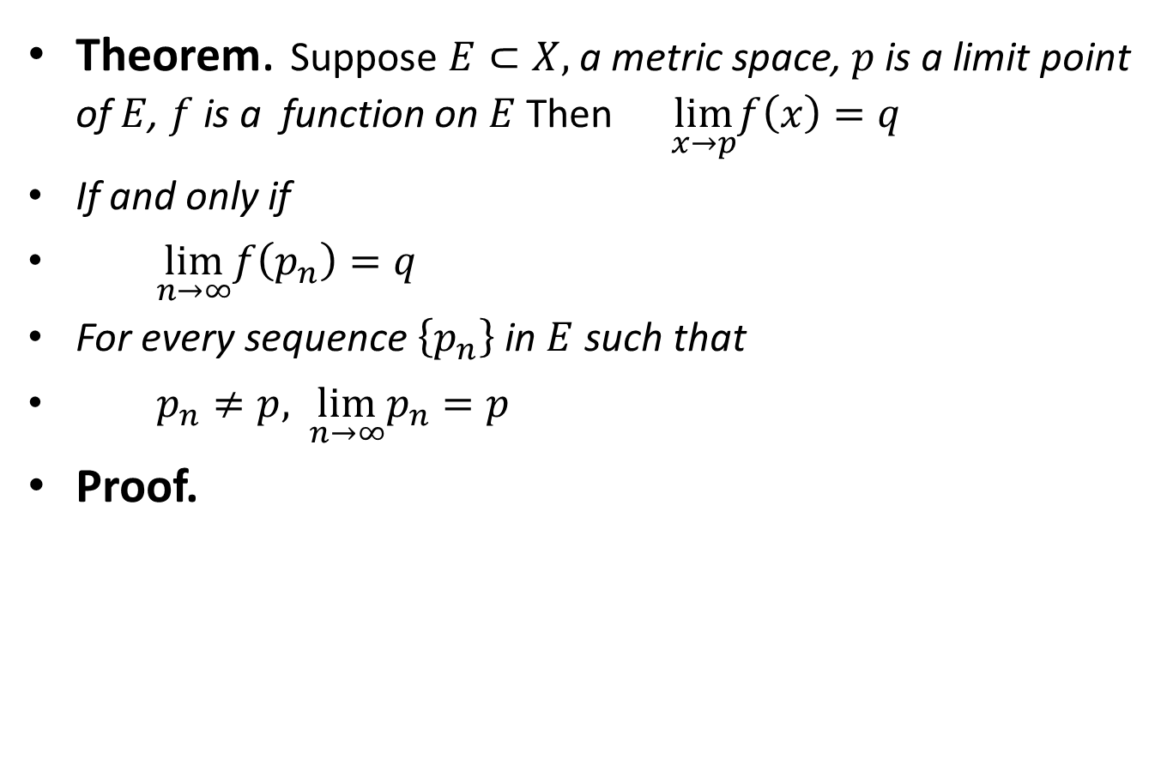
Theorem. Suppose $E⊂X,$a metric space, $p$ is a limit point of $E$, $f$is a function on $E$Then$\lim_{x→p}f\left(x\right)=q$
If and only if
$\lim_{n→∞}f\left(p_{n}\right)=q$
For every sequence $\left\{p_{n}\right\}$ in $E$ such that
$p_{n}≠p,$$\lim_{n→∞}p_{n}=p$
Proof.

Slide 16
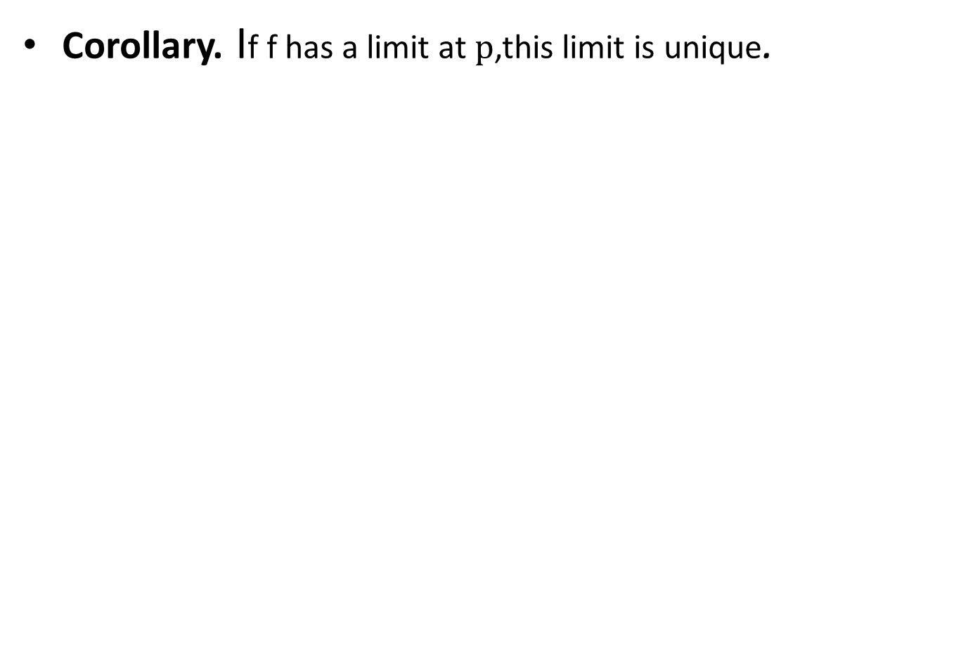
Corollary.If f has a limit at $p$,this limit is unique.

Slide 19
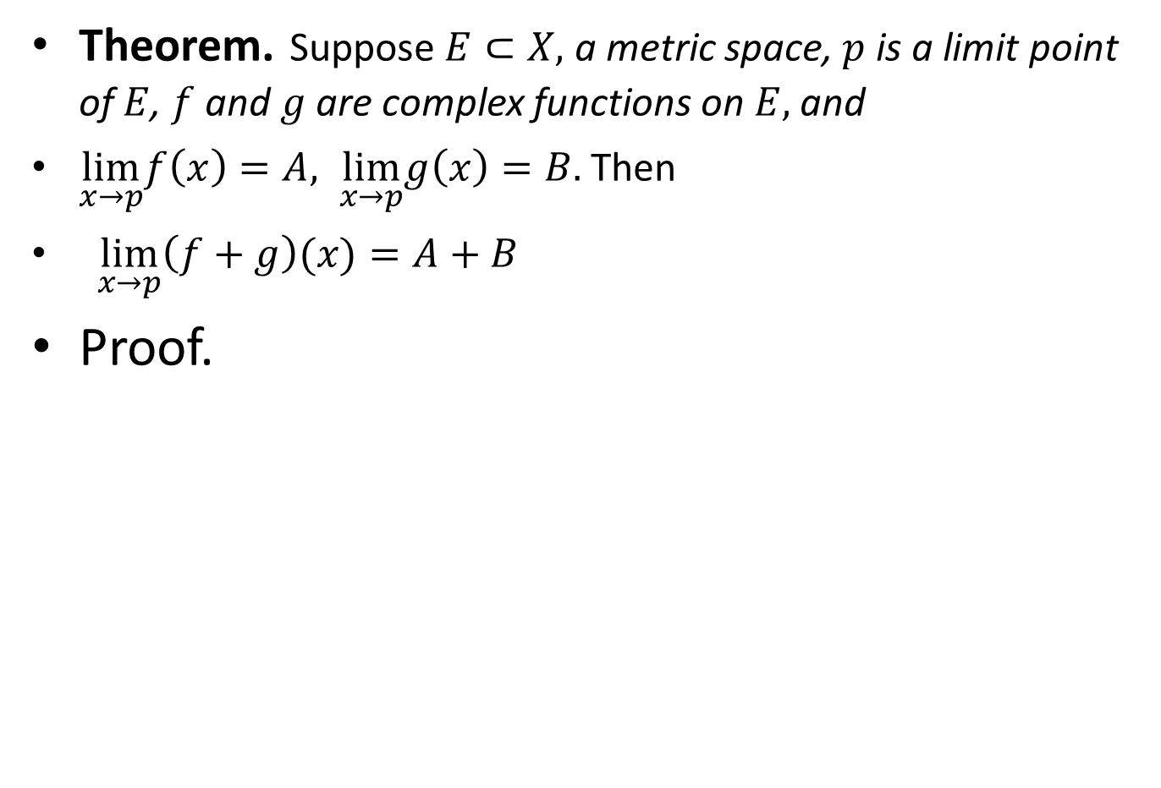
Theorem.Suppose $E⊂X,$a metric space, $p$ is a limit point of $E$, $f$ and $g$ are complex functions on $E,$ and
$\lim_{x→p}f\left(x\right)=A, \lim_{x→p}g\left(x\right)=B.$ Then
$\lim_{x→p}\left(f+g\right)(x)=A+B$
Proof.

Slide 24
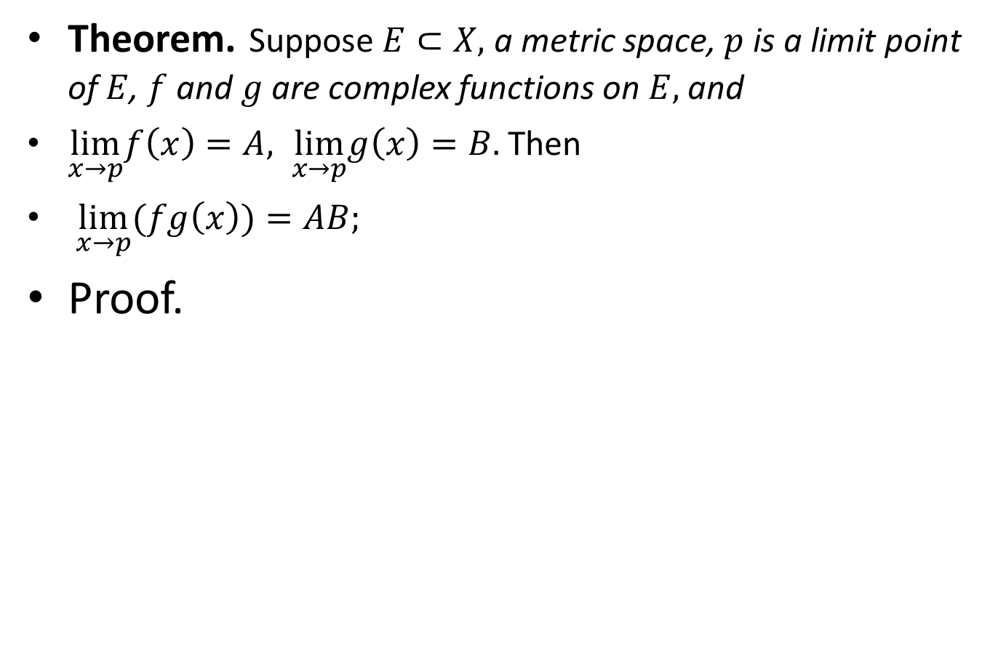
Theorem.Suppose $E⊂X,$a metric space, $p$ is a limit point of $E$, $f$ and $g$ are complex functions on $E,$ and
$\lim_{x→p}f\left(x\right)=A, \lim_{x→p}g\left(x\right)=B.$ Then
$\lim_{x→p}(fg\left(x\right))=AB;$
Proof.

Slide 29
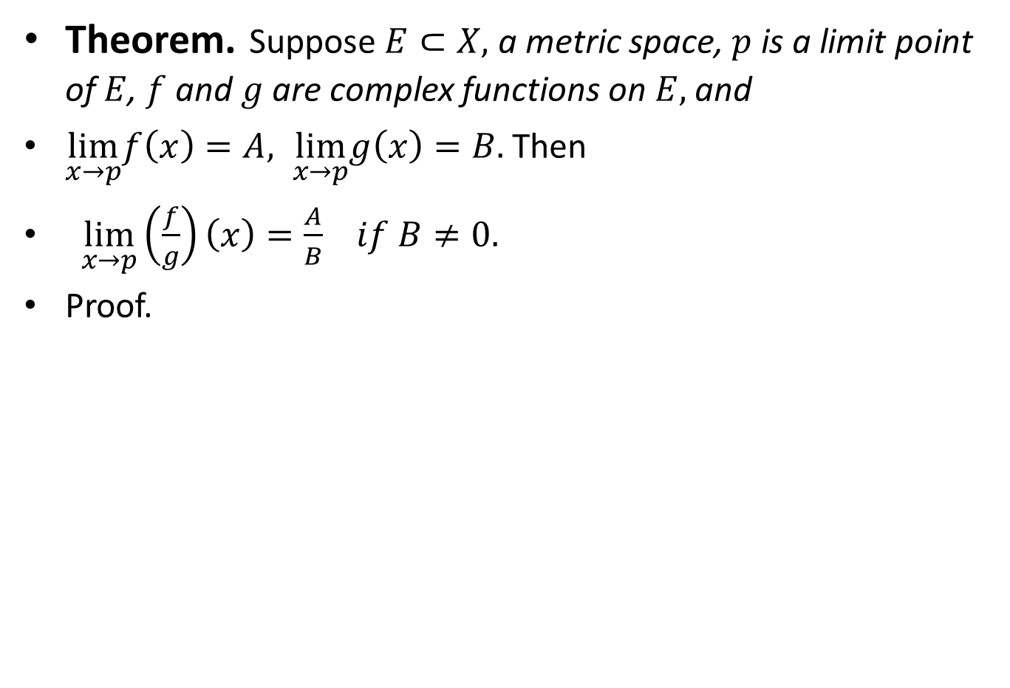
Theorem.Suppose $E⊂X,$a metric space, $p$ is a limit point of $E$, $f$ and $g$ are complex functions on $E,$ and
$\lim_{x→p}f\left(x\right)=A, \lim_{x→p}g\left(x\right)=B.$ Then
$\lim_{x→p}\left(\frac{f}{g}\right)\left(x\right)=\frac{A}{B}$$if B≠0.$
Proof.

Slide 34
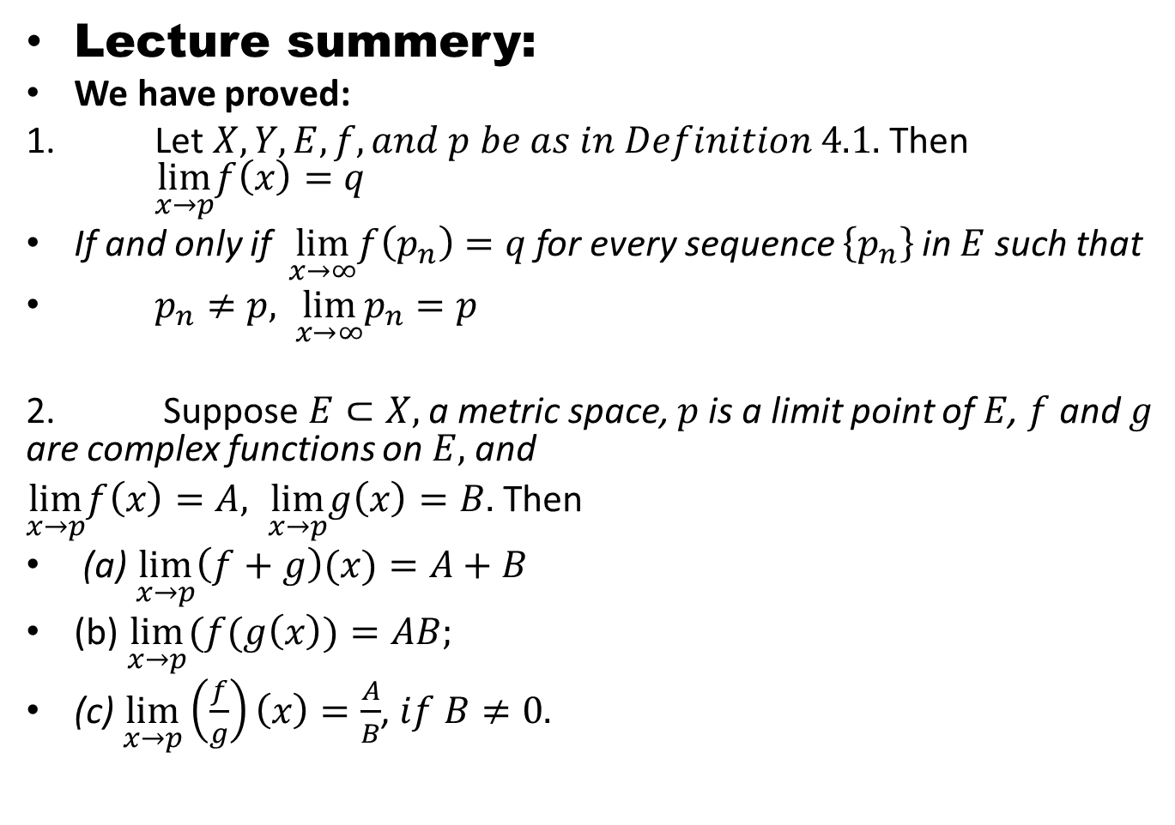
Lecture summery:
We have proved:
1. Let $X, Y, E,f, and p be as in Definition 4.1.$ Then $\lim_{x→p}f\left(x\right)=q$
If and only if $\lim_{x→∞}f\left(p_{n}\right)=q$ for every sequence $\left\{p_{n}\right\}$ in $E$ such that
$p_{n}≠p,$$\lim_{x→∞}p_{n}=p$
2. Suppose $E⊂X,$a metric space, $p$ is a limit point of $E$, $f$ and $g$ are complex functions on $E,$ and
$\lim_{x→p}f\left(x\right)=A, \lim_{x→p}g\left(x\right)=B.$ Then
(a) $\lim_{x→p}\left(f+g\right)(x)=A+B$
(b) $\lim_{x→p}(f(g\left(x\right))=AB;$
(c) $\lim_{x→p}\left(\frac{f}{g}\right)\left(x\right)=\frac{A}{B}$, $if B≠0.$

Slide 35
THANK YOU

