Slide 1
Real Analysis I
Course Code MTH 321
By
Dr. Moiz ud Din khan
Professor of Mathematics

Slide 2
Lecture # 15

Slide 3
Lecture Outline
In this Lecture we will discuss and prove the following theorems:

Slide 4
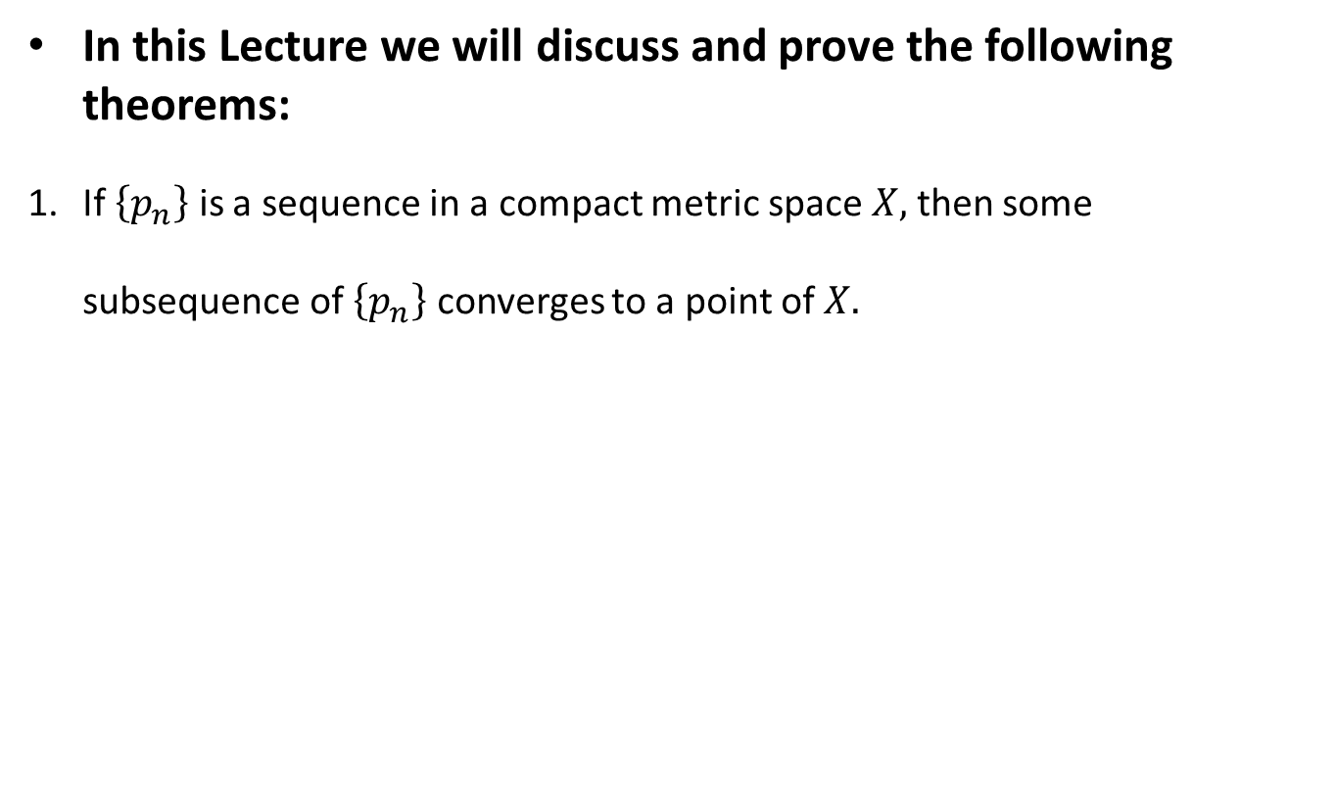
Lecture Outline
In this Lecture we will discuss and prove the following theorems:
If $\left\{p_{n}\right\}$ is a sequence in a compact metric space $X,$ then some subsequence of $\left\{p_{n}\right\}$ converges to a point of $X.$

Slide 5
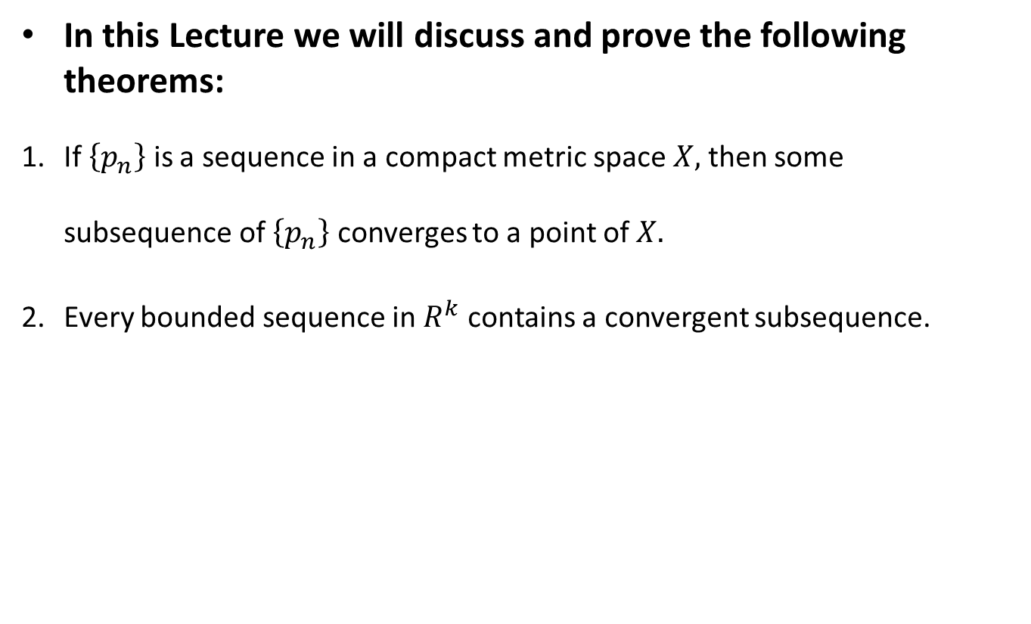
Lecture Outline
In this Lecture we will discuss and prove the following theorems:
If $\left\{p_{n}\right\}$ is a sequence in a compact metric space $X,$ then some subsequence of $\left\{p_{n}\right\}$ converges to a point of $X.$
Every bounded sequence in $R^{k}$ contains a convergent subsequence.

Slide 6
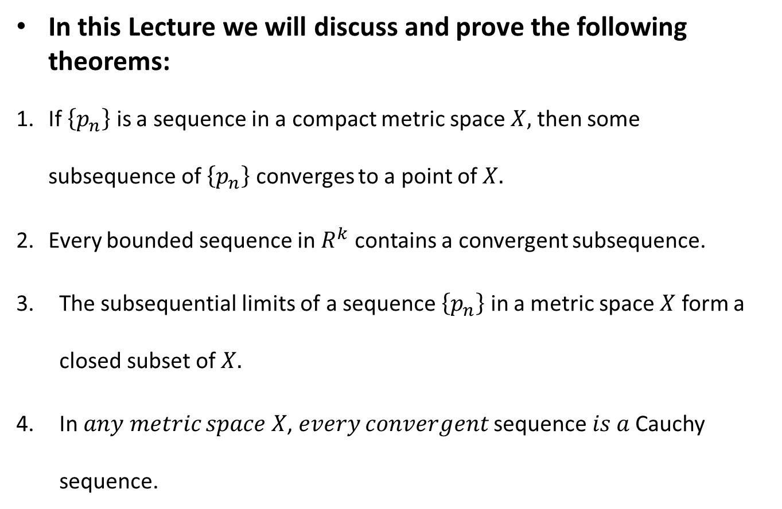
Lecture Outline
In this Lecture we will discuss and prove the following theorems:
If $\left\{p_{n}\right\}$ is a sequence in a compact metric space $X,$ then some subsequence of $\left\{p_{n}\right\}$ converges to a point of $X.$
Every bounded sequence in $R^{k}$ contains a convergent subsequence.
The subsequential limits of a sequence $\left\{p_{n}\right\}$ in a metric space $X$ form a closed subset of $X.$
In 𝑎𝑛𝑦 𝑚𝑒𝑡𝑟𝑖𝑐 𝑠𝑝𝑎𝑐𝑒 𝑋, 𝑒𝑣𝑒𝑟𝑦 𝑐𝑜𝑛𝑣𝑒𝑟𝑔𝑒𝑛𝑡 sequence 𝑖𝑠 𝑎 Cauchy sequence.

Slide 7
Definition. Subsequence.

Slide 8
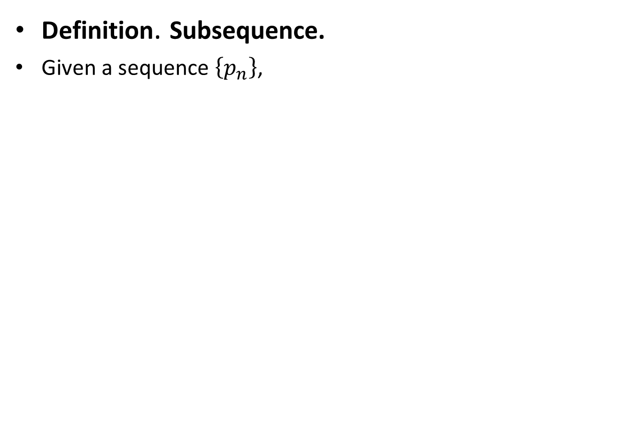
Definition. Subsequence.
Given a sequence $\left\{p_{n}\right\}$,

Slide 9
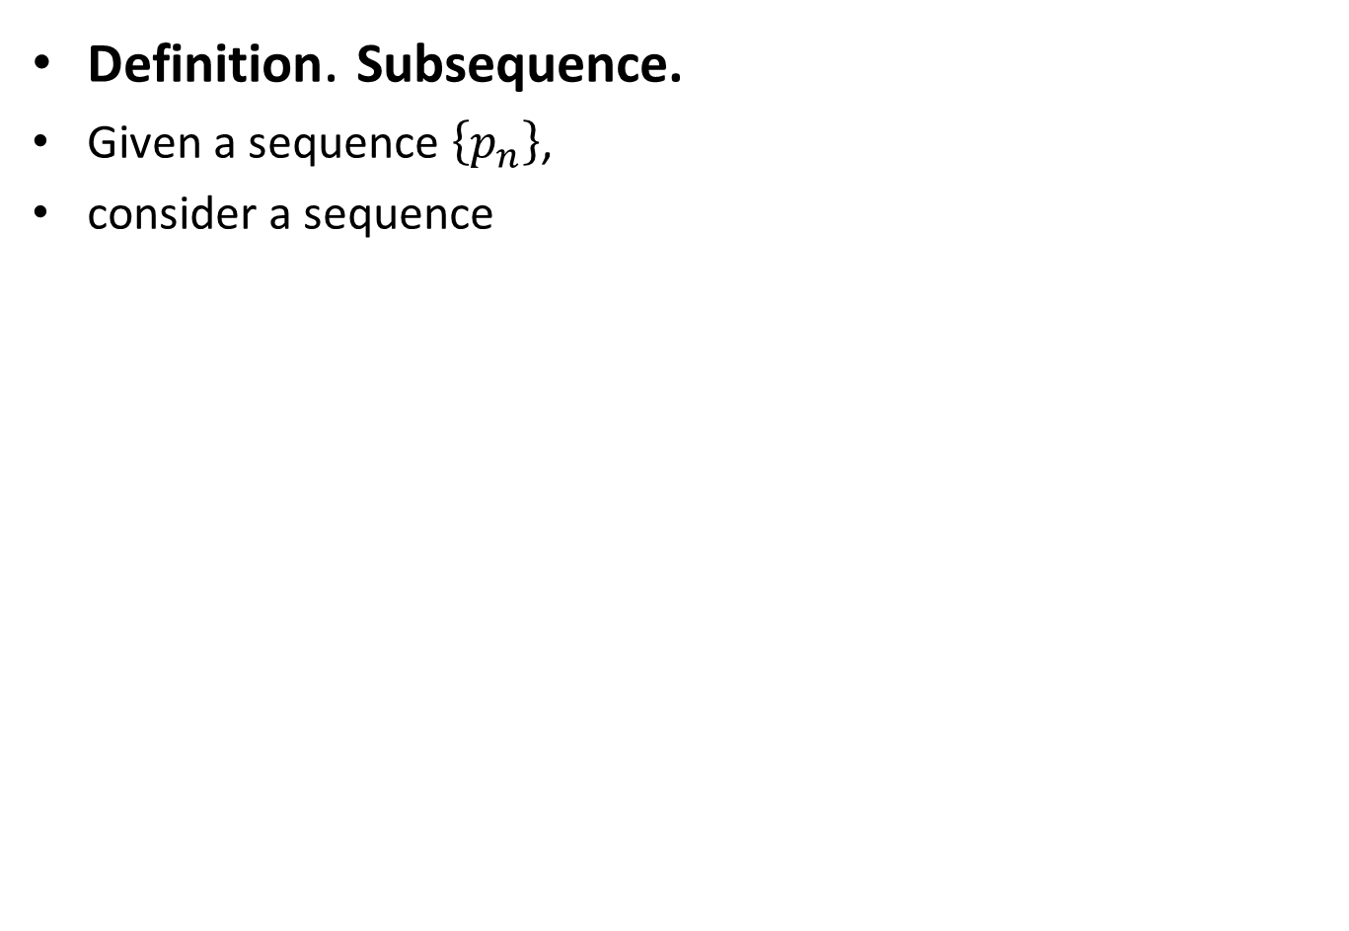
Definition. Subsequence.
Given a sequence $\left\{p_{n}\right\}$,
consider a sequence

Slide 10
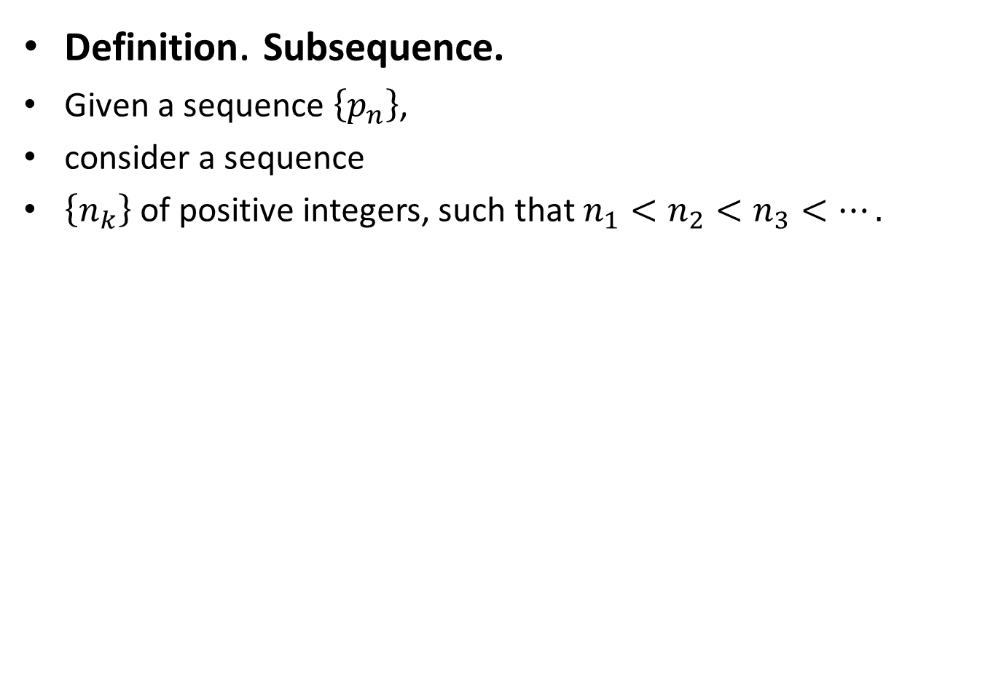
Definition. Subsequence.
Given a sequence $\left\{p_{n}\right\}$,
consider a sequence
$\left\{n_{k}\right\}$ of positive integers, such that $n_{1}<n_{2}<n_{3}<….$

Slide 11
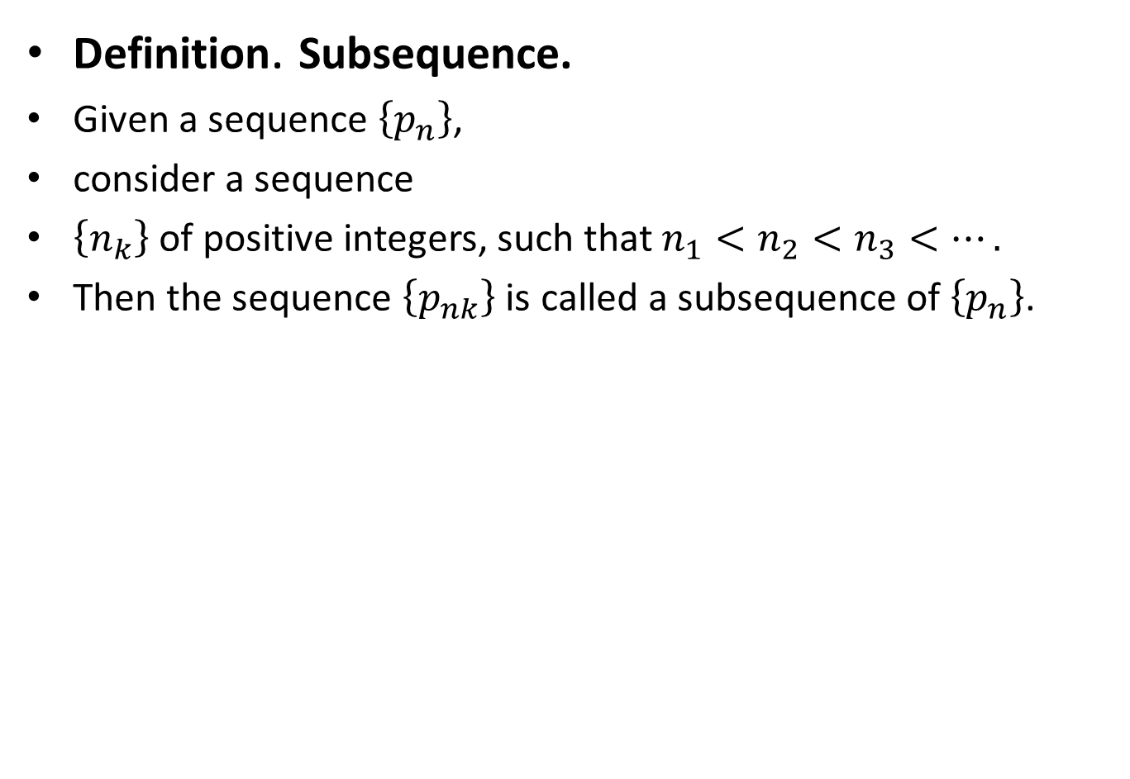
Definition. Subsequence.
Given a sequence $\left\{p_{n}\right\}$,
consider a sequence
$\left\{n_{k}\right\}$ of positive integers, such that $n_{1}<n_{2}<n_{3}<….$
Then the sequence $\left\{p_{nk}\right\}$ is called a subsequence of $\left\{p_{n}\right\}$.

Slide 12
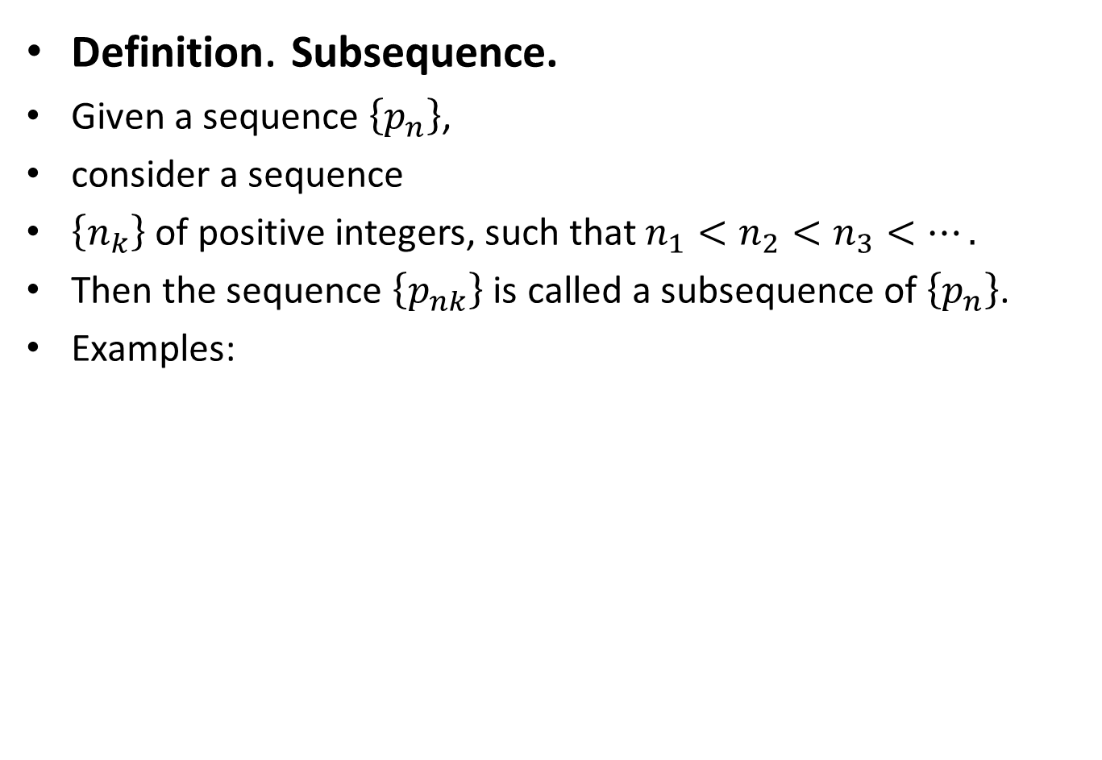
Definition. Subsequence.
Given a sequence $\left\{p_{n}\right\}$,
consider a sequence
$\left\{n_{k}\right\}$ of positive integers, such that $n_{1}<n_{2}<n_{3}<….$
Then the sequence $\left\{p_{nk}\right\}$ is called a subsequence of $\left\{p_{n}\right\}$.
Examples:

Slide 13
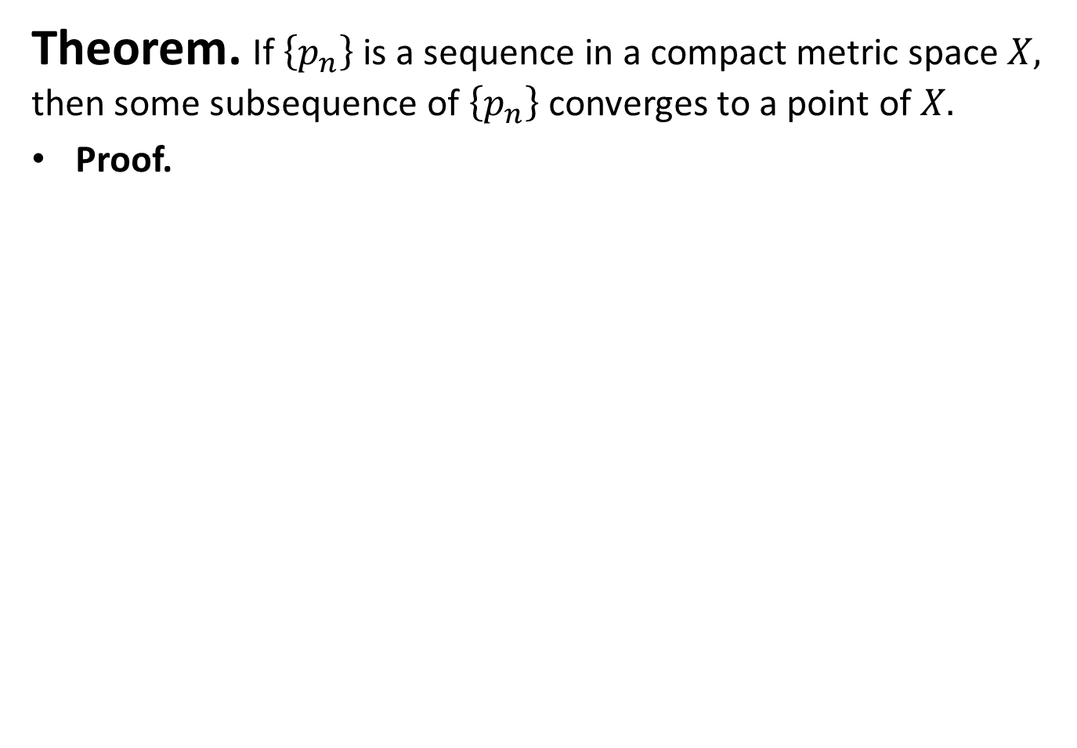
Theorem. If $\left\{p_{n}\right\}$ is a sequence in a compact metric space $X,$ then some subsequence of $\left\{p_{n}\right\}$ converges to a point of $X.$
Proof.

Slide 14
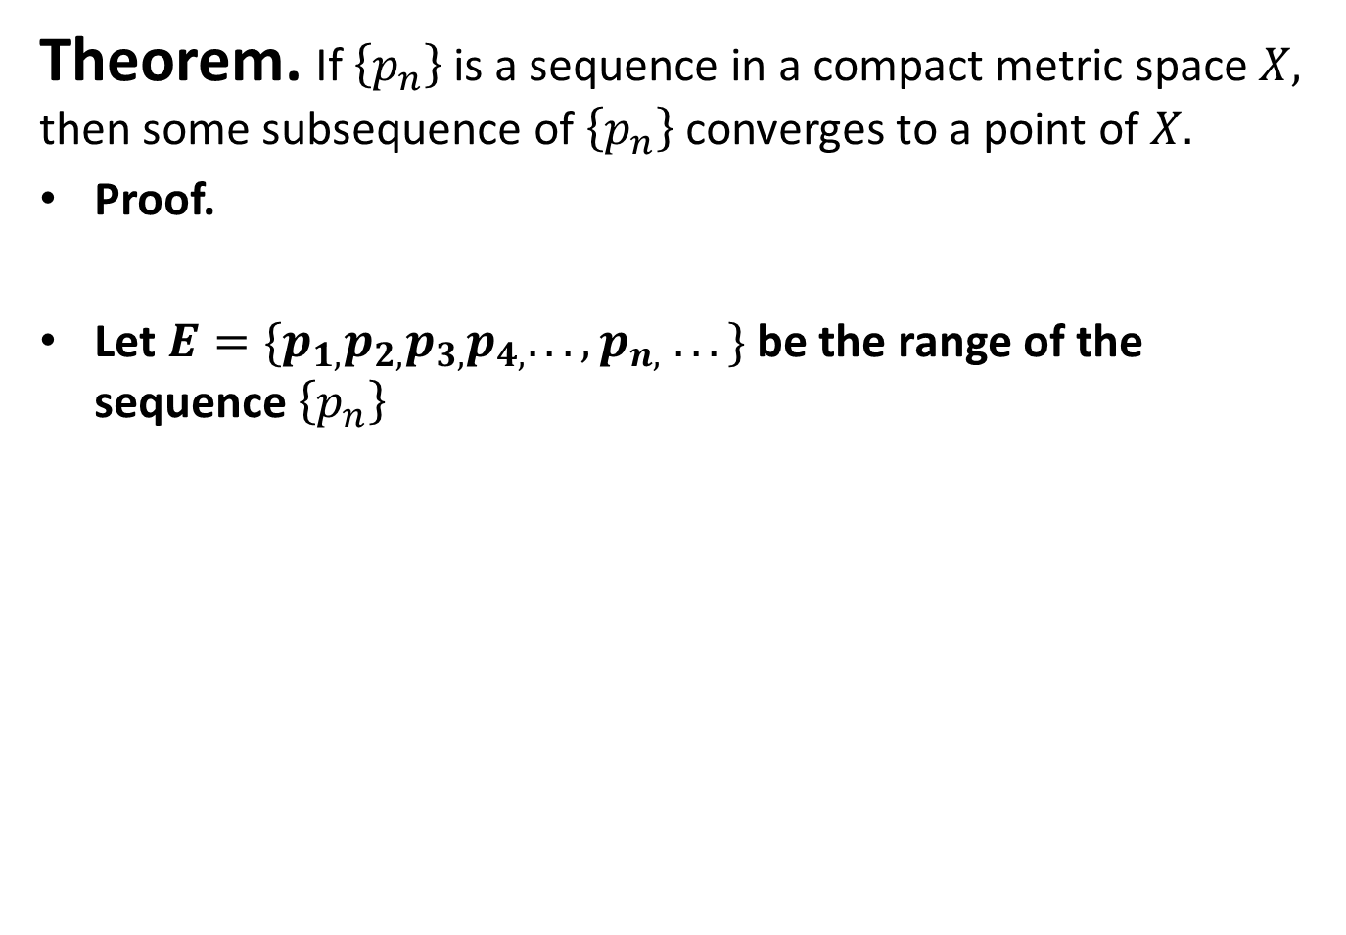
Theorem. If $\left\{p_{n}\right\}$ is a sequence in a compact metric space $X,$ then some subsequence of $\left\{p_{n}\right\}$ converges to a point of $X.$
Proof.
Let $E=\{p_{1,}p_{2,}p_{3,}p_{4,}. . . ,p_{n,} . . .\}$ be the range of the sequence $\left\{p_{n}\right\}$

Slide 15
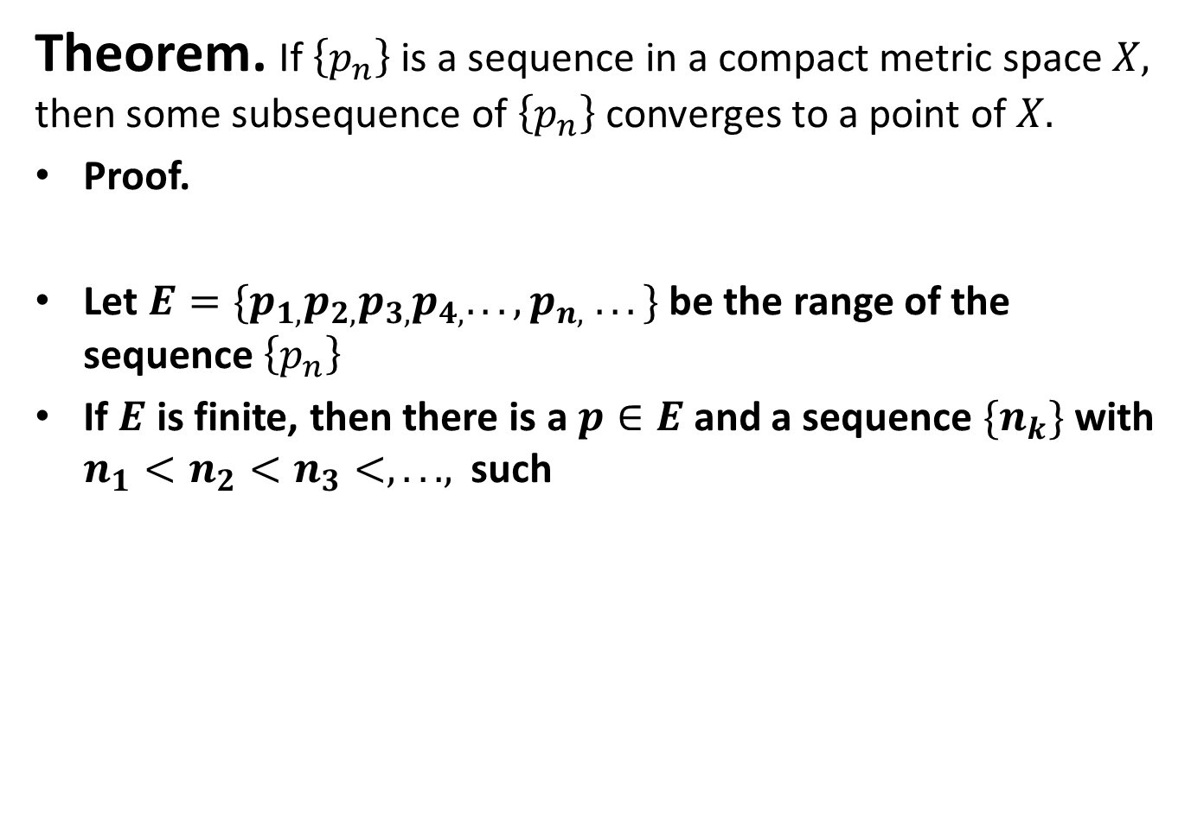
Theorem. If $\left\{p_{n}\right\}$ is a sequence in a compact metric space $X,$ then some subsequence of $\left\{p_{n}\right\}$ converges to a point of $X.$
Proof.
Let $E=\{p_{1,}p_{2,}p_{3,}p_{4,}. . . ,p_{n,} . . .\}$ be the range of the sequence $\left\{p_{n}\right\}$
If $E$ is finite, then there is a $p∈E$ and a sequence ${\{n}_{k}\}$ with $n_{1}<n_{2}<n_{3}<, . ..,$ such

Slide 16
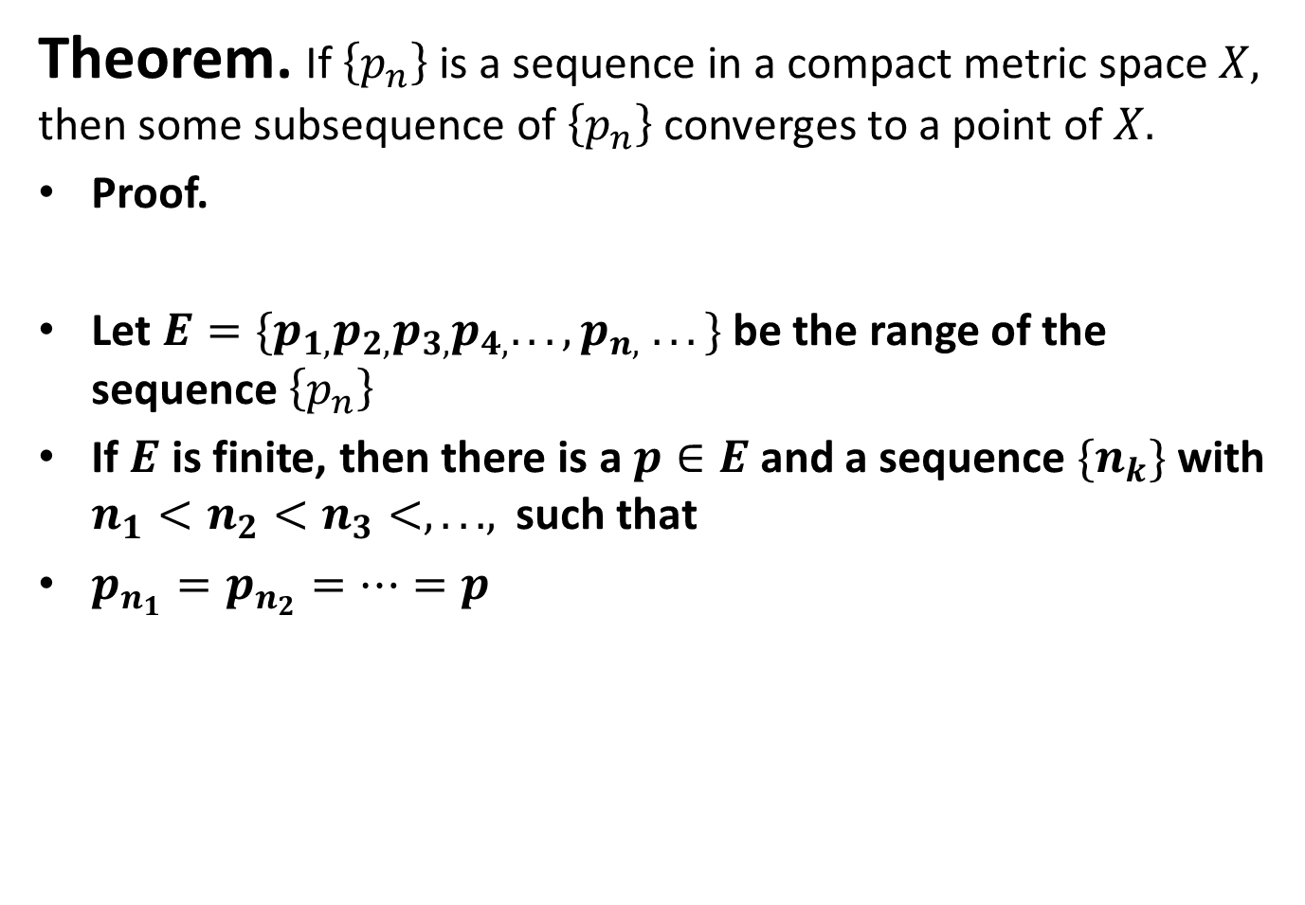
Theorem. If $\left\{p_{n}\right\}$ is a sequence in a compact metric space $X,$ then some subsequence of $\left\{p_{n}\right\}$ converges to a point of $X.$
Proof.
Let $E=\{p_{1,}p_{2,}p_{3,}p_{4,}. . . ,p_{n,} . . .\}$ be the range of the sequence $\left\{p_{n}\right\}$
If $E$ is finite, then there is a $p∈E$ and a sequence ${\{n}_{k}\}$ with $n_{1}<n_{2}<n_{3}<, . ..,$ such that
$p_{n_{1}}=p_{n_{2}}=…=p$

Slide 17
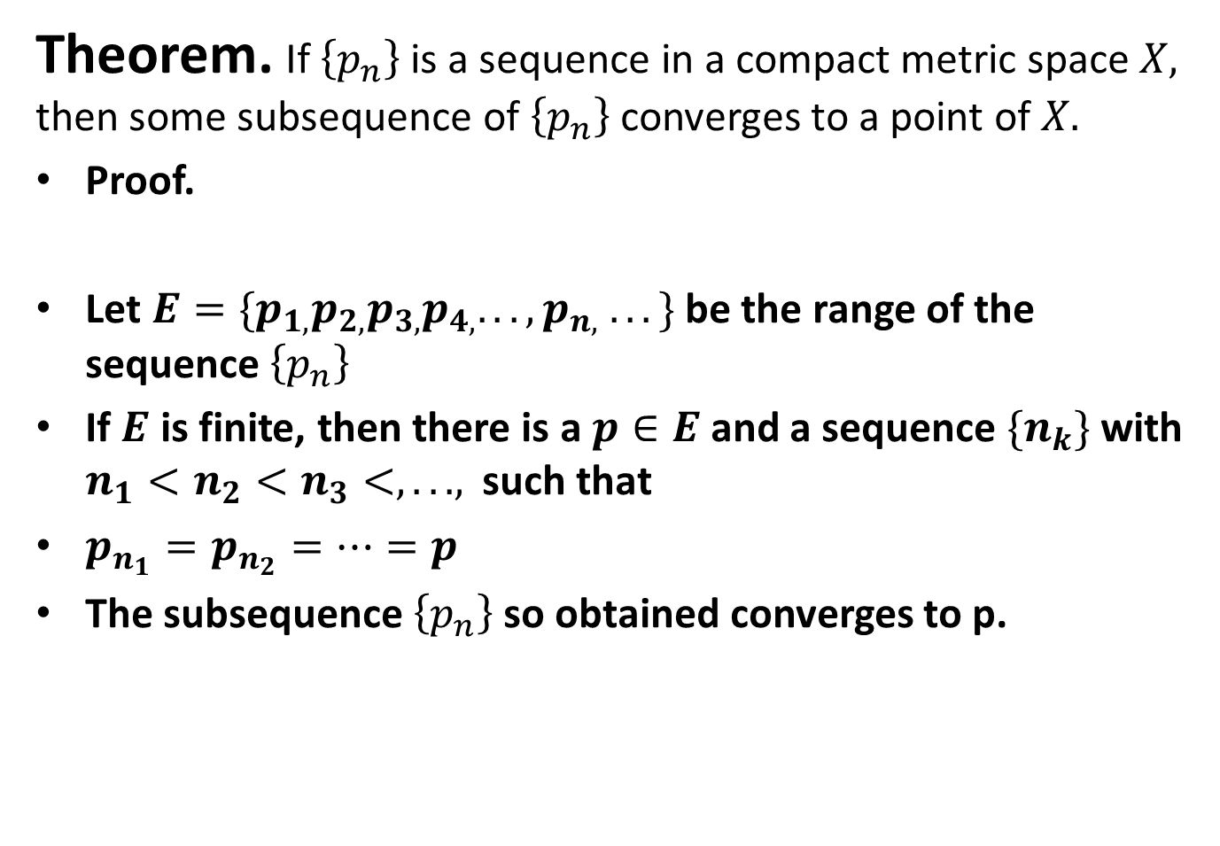
Theorem. If $\left\{p_{n}\right\}$ is a sequence in a compact metric space $X,$ then some subsequence of $\left\{p_{n}\right\}$ converges to a point of $X.$
Proof.
Let $E=\{p_{1,}p_{2,}p_{3,}p_{4,}. . . ,p_{n,} . . .\}$ be the range of the sequence $\left\{p_{n}\right\}$
If $E$ is finite, then there is a $p∈E$ and a sequence ${\{n}_{k}\}$ with $n_{1}<n_{2}<n_{3}<, . ..,$ such that
$p_{n_{1}}=p_{n_{2}}=…=p$
The subsequence $\left\{p_{n}\right\}$ so obtained converges to p.

Slide 18
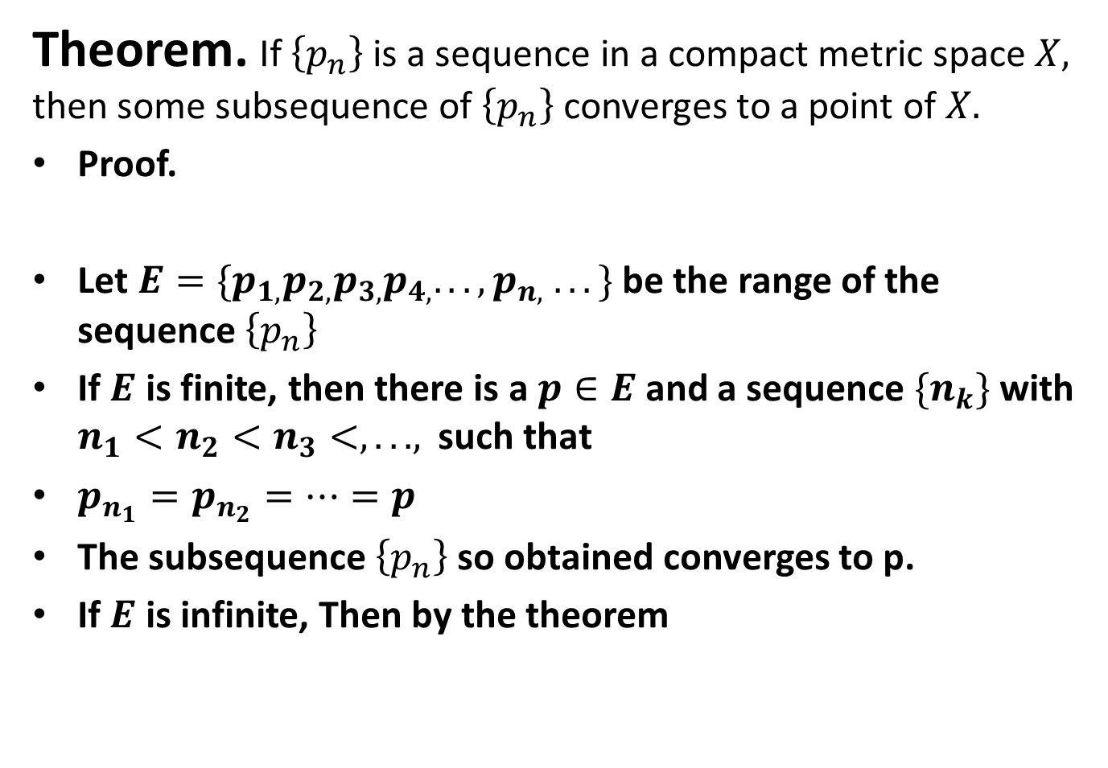
Theorem. If $\left\{p_{n}\right\}$ is a sequence in a compact metric space $X,$ then some subsequence of $\left\{p_{n}\right\}$ converges to a point of $X.$
Proof.
Let $E=\{p_{1,}p_{2,}p_{3,}p_{4,}. . . ,p_{n,} . . .\}$ be the range of the sequence $\left\{p_{n}\right\}$
If $E$ is finite, then there is a $p∈E$ and a sequence ${\{n}_{k}\}$ with $n_{1}<n_{2}<n_{3}<, . ..,$ such that
$p_{n_{1}}=p_{n_{2}}=…=p$
The subsequence $\left\{p_{n}\right\}$ so obtained converges to p.
If $E$ is infinite, Then by the theorem

Slide 19
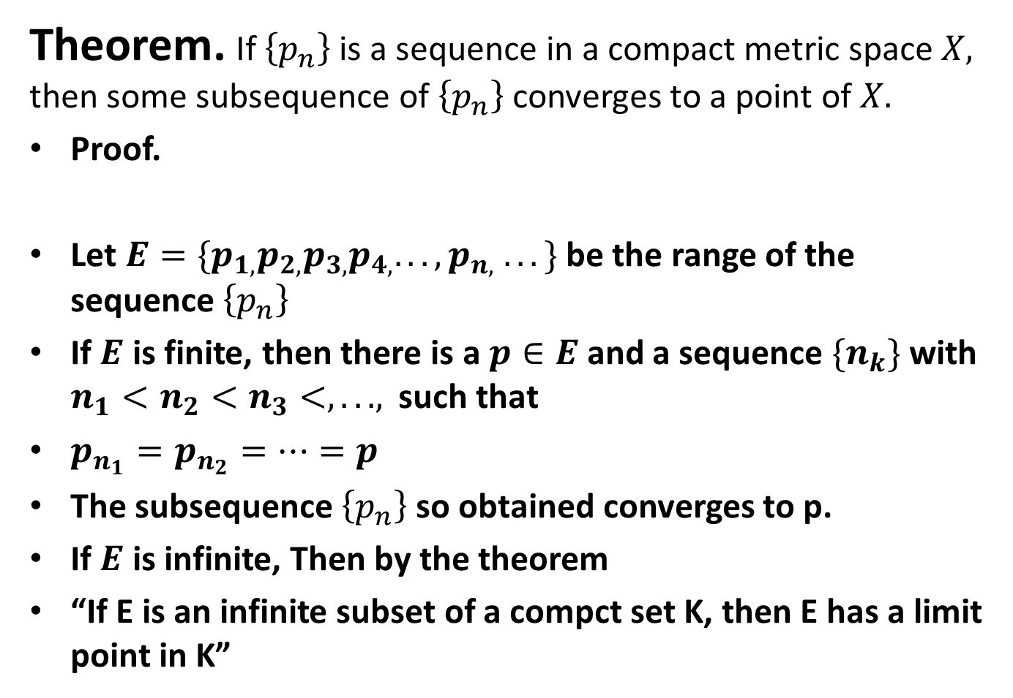
Theorem. If $\left\{p_{n}\right\}$ is a sequence in a compact metric space $X,$ then some subsequence of $\left\{p_{n}\right\}$ converges to a point of $X.$
Proof.
Let $E=\{p_{1,}p_{2,}p_{3,}p_{4,}. . . ,p_{n,} . . .\}$ be the range of the sequence $\left\{p_{n}\right\}$
If $E$ is finite, then there is a $p∈E$ and a sequence ${\{n}_{k}\}$ with $n_{1}<n_{2}<n_{3}<, . ..,$ such that
$p_{n_{1}}=p_{n_{2}}=…=p$
The subsequence $\left\{p_{n}\right\}$ so obtained converges to p.
If $E$ is infinite, Then by the theorem
“If E is an infinite subset of a compct set K, then E has a limit point in K”

Slide 20
We have,

Slide 21
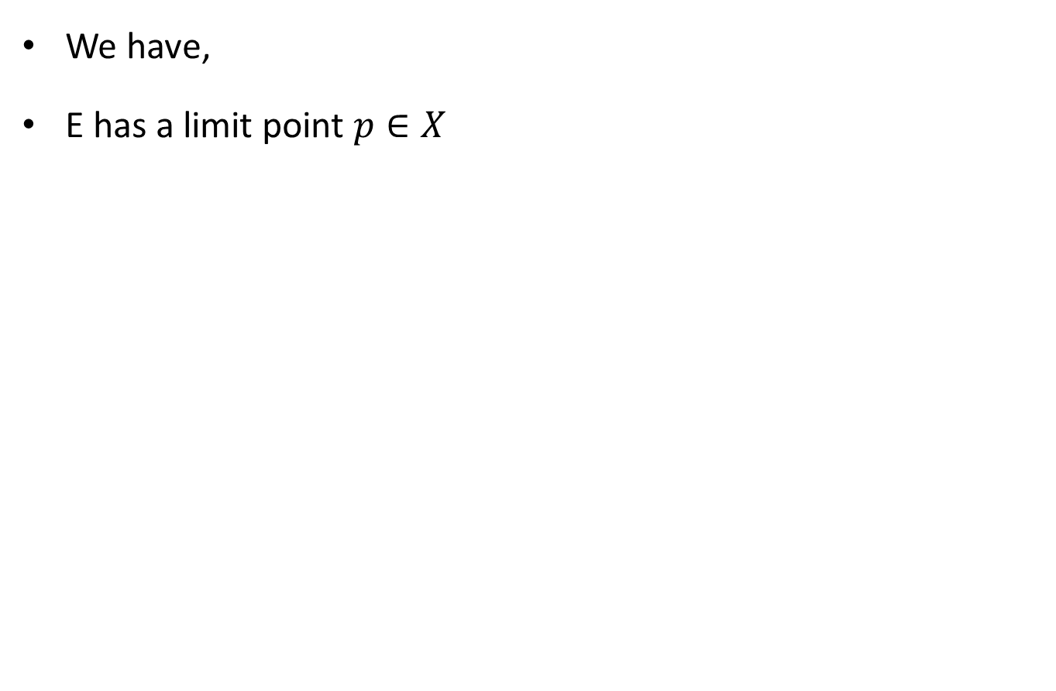
We have,
E has a limit point $p∈X$

Slide 22
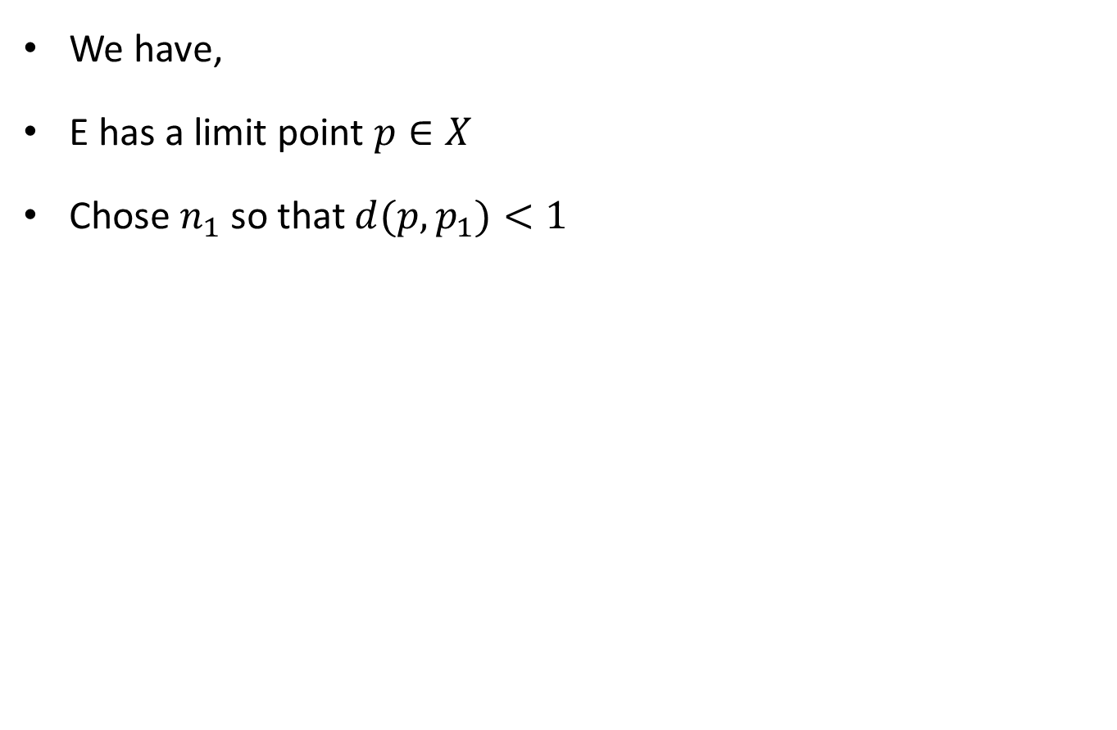
We have,
E has a limit point $p∈X$
Chose $n_{1}$ so that $d(p,p_{1})<1$

Slide 23
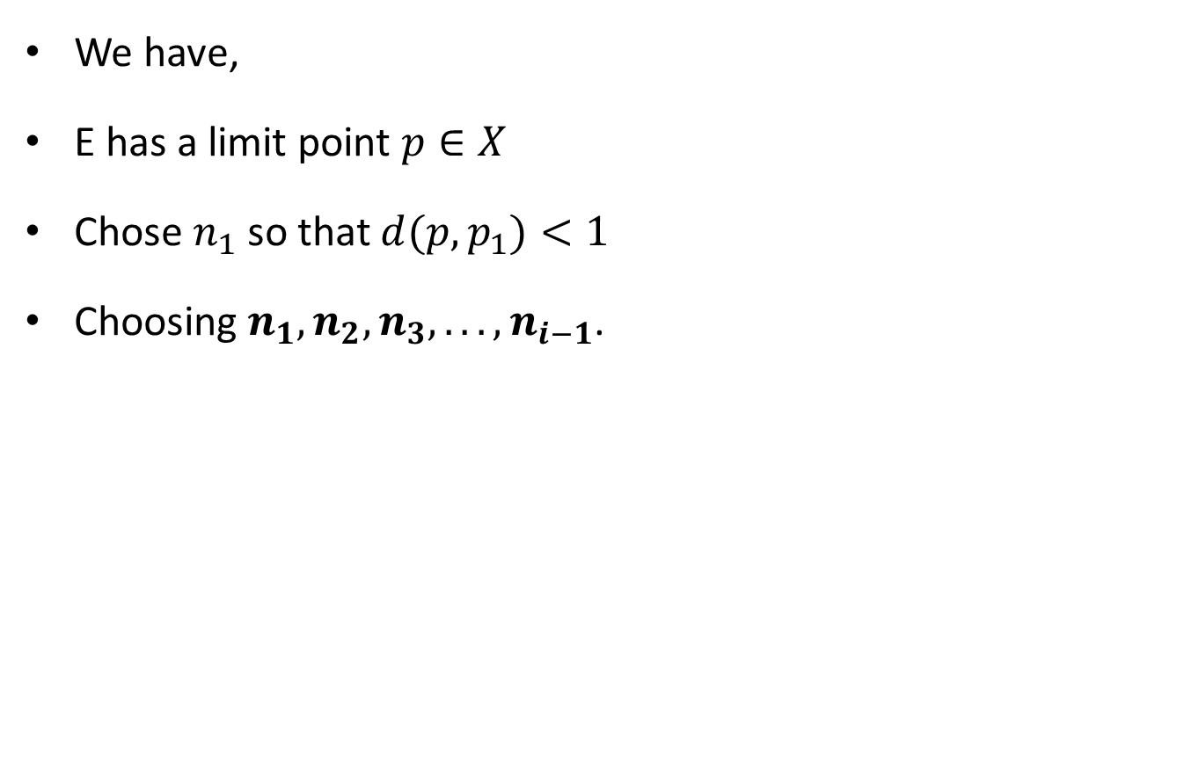
We have,
E has a limit point $p∈X$
Chose $n_{1}$ so that $d(p,p_{1})<1$
Choosing $n_{1},n_{2},n_{3}, . ..,n_{i−1}$.

Slide 24
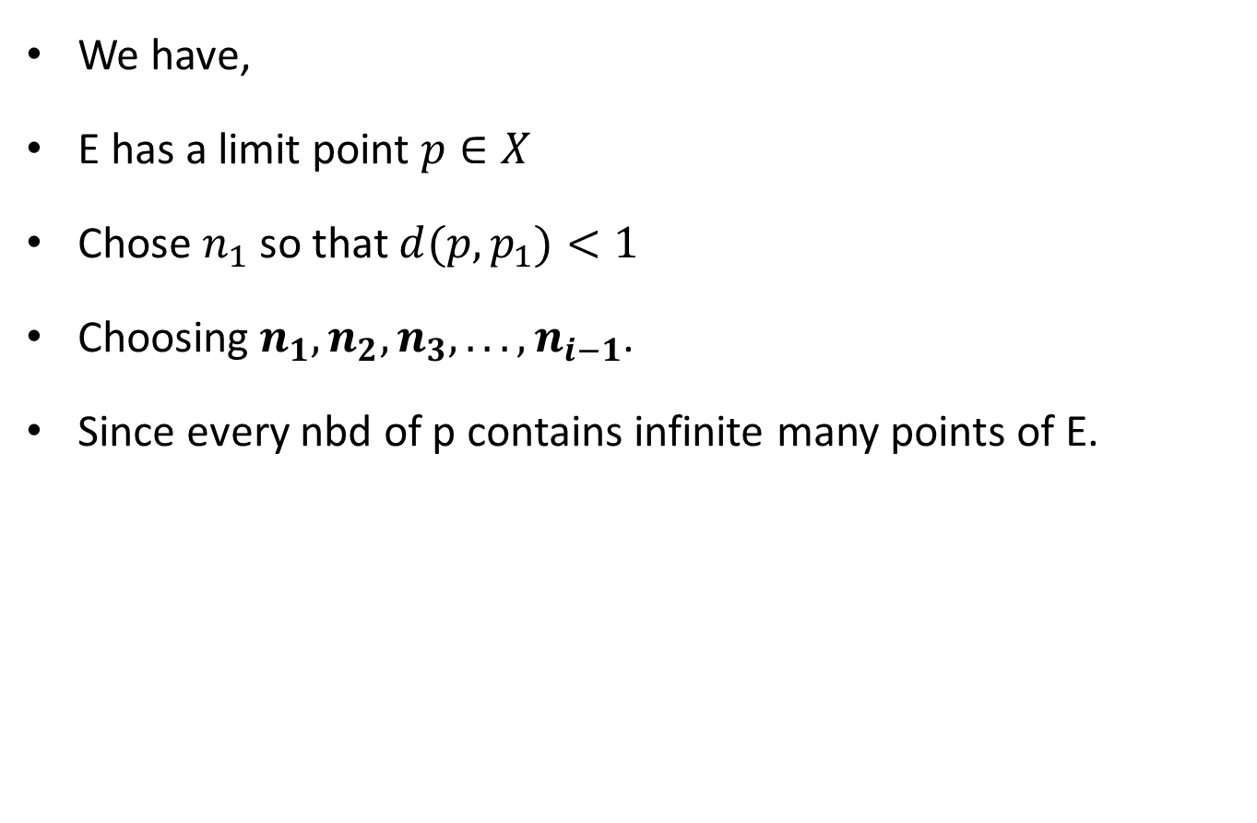
We have,
E has a limit point $p∈X$
Chose $n_{1}$ so that $d(p,p_{1})<1$
Choosing $n_{1},n_{2},n_{3}, . ..,n_{i−1}$.
Since every nbd of p contains infinite many points of E.

Slide 25
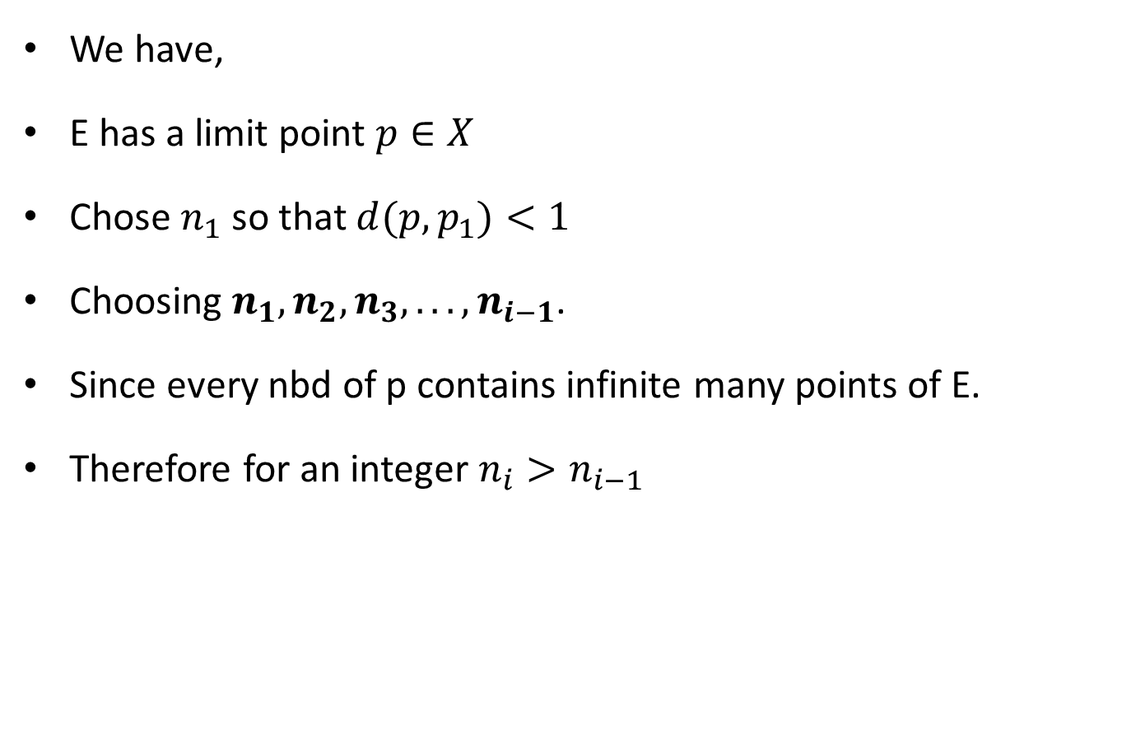
We have,
E has a limit point $p∈X$
Chose $n_{1}$ so that $d(p,p_{1})<1$
Choosing $n_{1},n_{2},n_{3}, . ..,n_{i−1}$.
Since every nbd of p contains infinite many points of E.
Therefore for an integer $n_{i}>n_{i−1}$

Slide 26
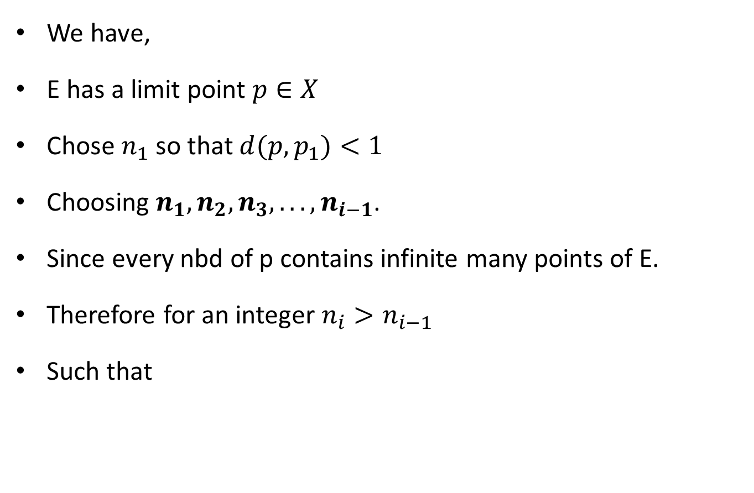
We have,
E has a limit point $p∈X$
Chose $n_{1}$ so that $d(p,p_{1})<1$
Choosing $n_{1},n_{2},n_{3}, . ..,n_{i−1}$.
Since every nbd of p contains infinite many points of E.
Therefore for an integer $n_{i}>n_{i−1}$
Such that

Slide 27
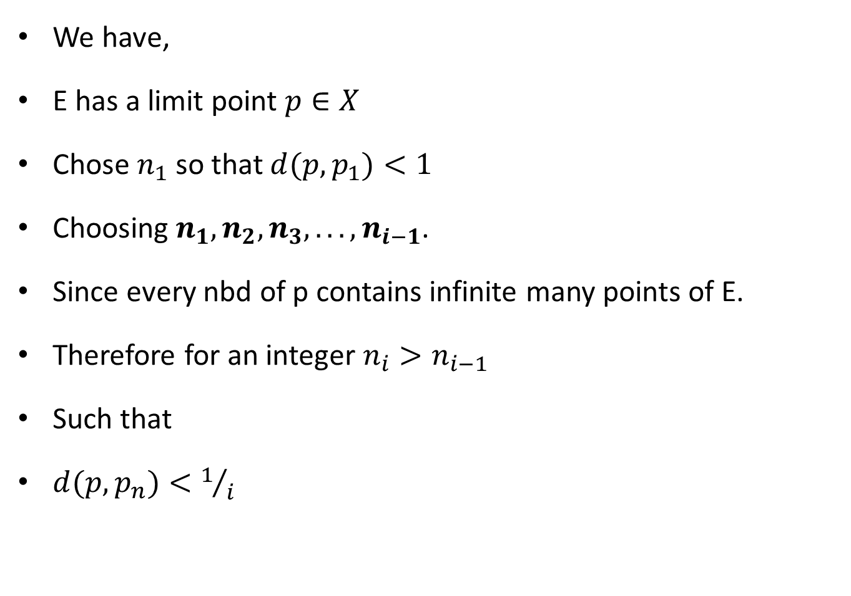
We have,
E has a limit point $p∈X$
Chose $n_{1}$ so that $d(p,p_{1})<1$
Choosing $n_{1},n_{2},n_{3}, . ..,n_{i−1}$.
Since every nbd of p contains infinite many points of E.
Therefore for an integer $n_{i}>n_{i−1}$
Such that
$d(p,p_{n})<1/i$

Slide 28
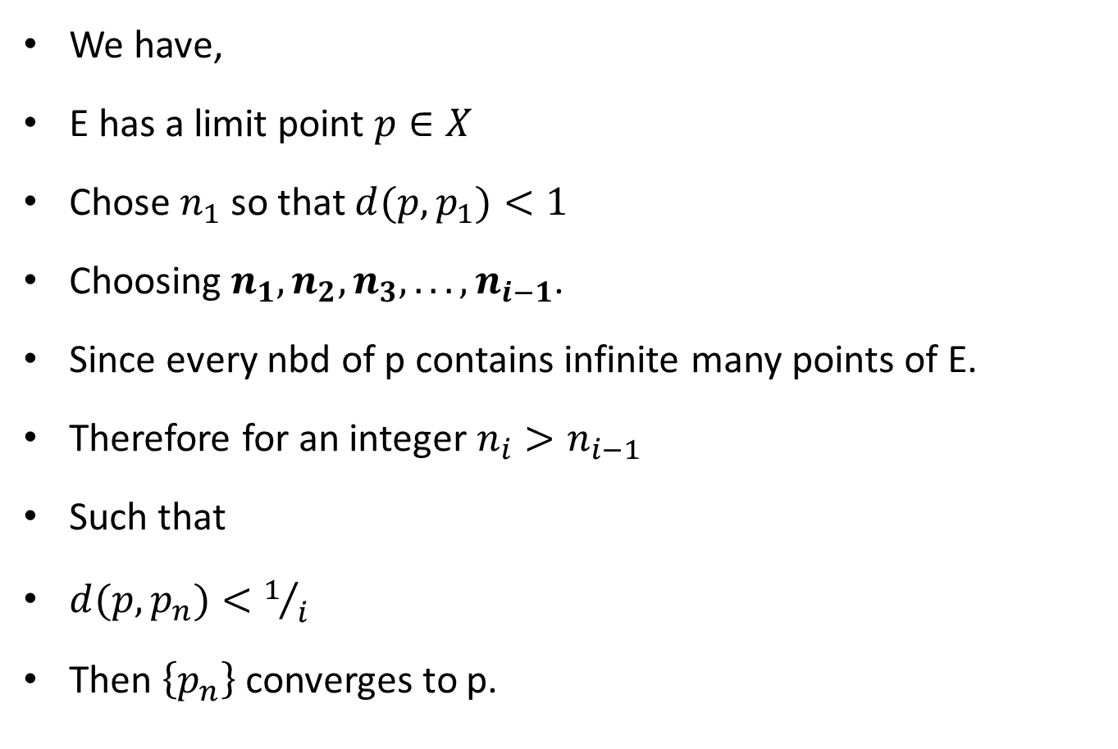
We have,
E has a limit point $p∈X$
Chose $n_{1}$ so that $d(p,p_{1})<1$
Choosing $n_{1},n_{2},n_{3}, . ..,n_{i−1}$.
Since every nbd of p contains infinite many points of E.
Therefore for an integer $n_{i}>n_{i−1}$
Such that
$d(p,p_{n})<1/i$
Then $\left\{p_{n}\right\}$ converges to p.

Slide 30
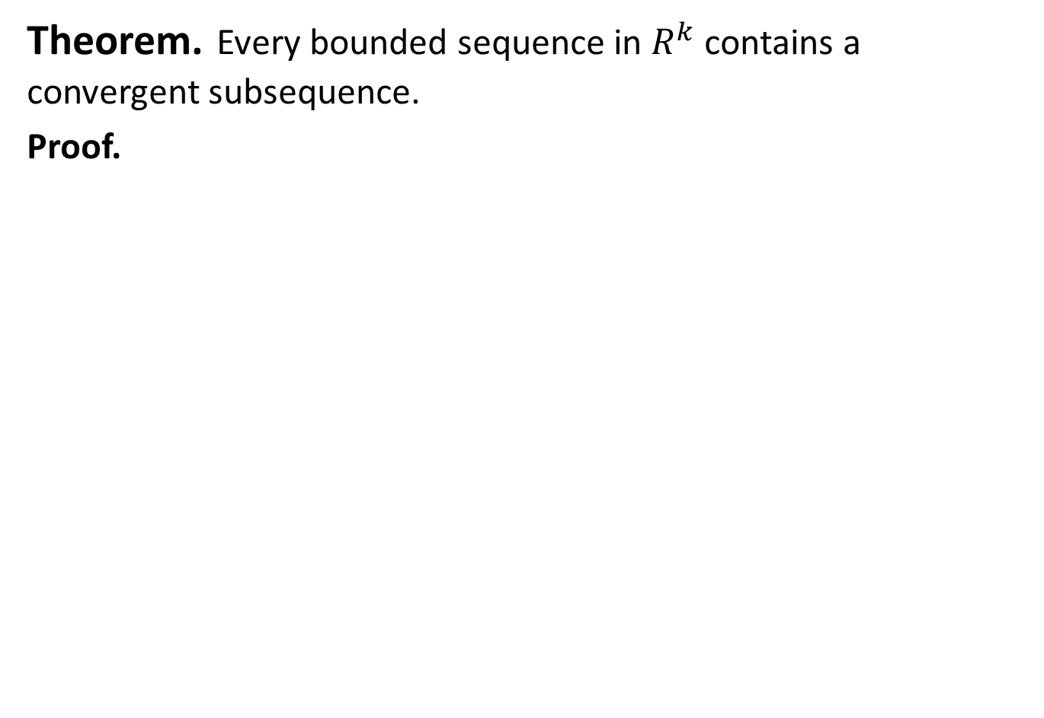
Theorem.Every bounded sequence in $R^{k}$ contains a convergent subsequence.
Proof.

Slide 31
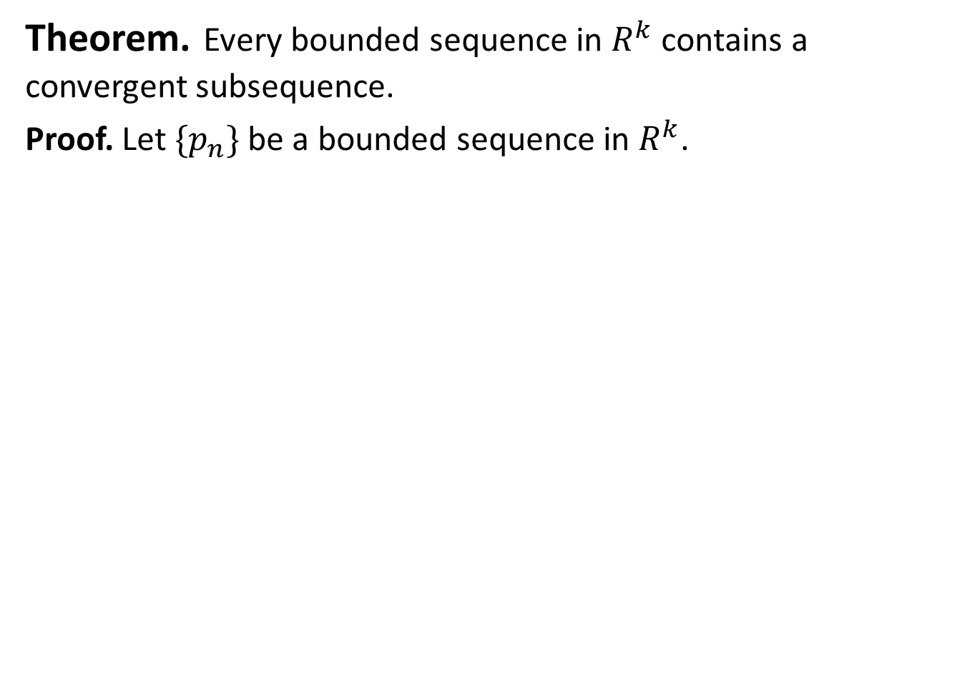
Theorem.Every bounded sequence in $R^{k}$ contains a convergent subsequence.
Proof. Let $\{p_{n}\}$ be a bounded sequence in $R^{k}$.

Slide 32
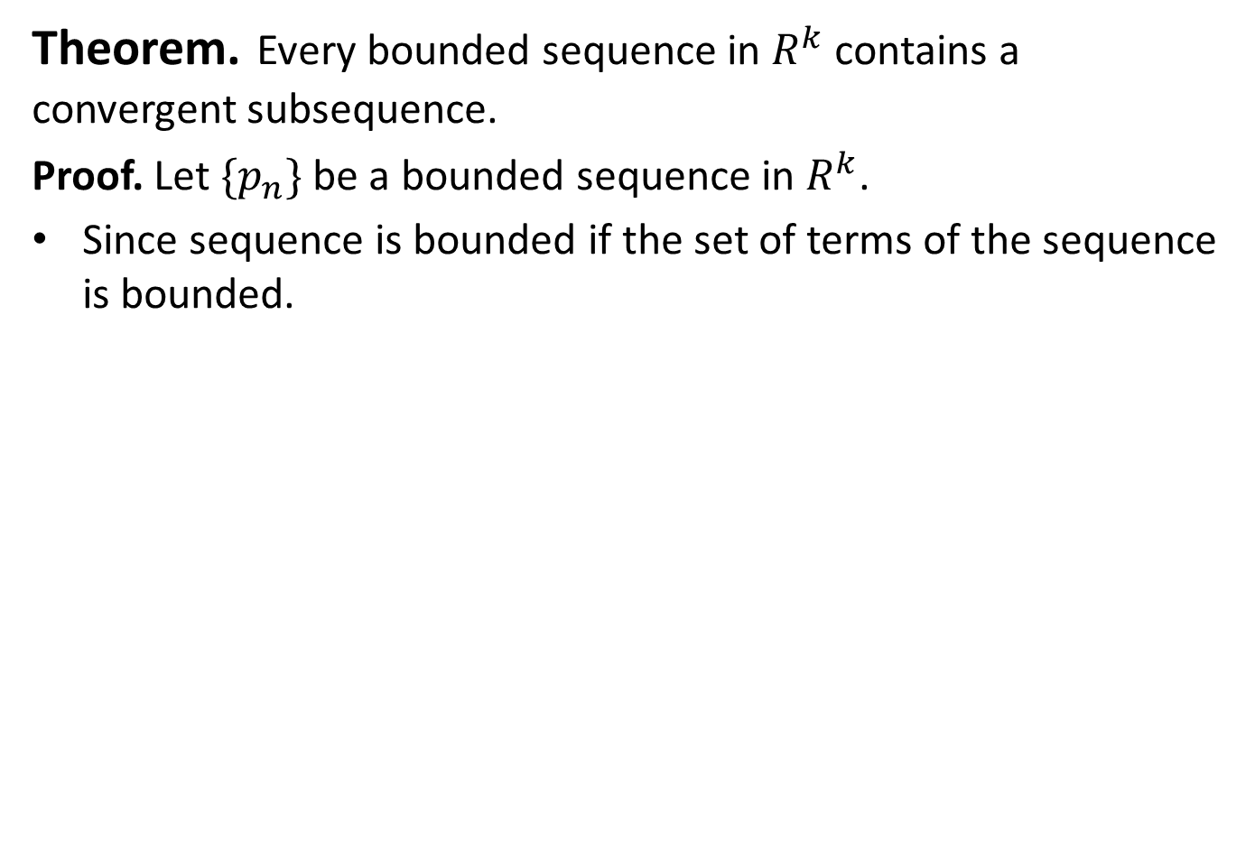
Theorem.Every bounded sequence in $R^{k}$ contains a convergent subsequence.
Proof. Let $\{p_{n}\}$ be a bounded sequence in $R^{k}$.
Since sequence is bounded if the set of terms of the sequence is bounded.

Slide 33
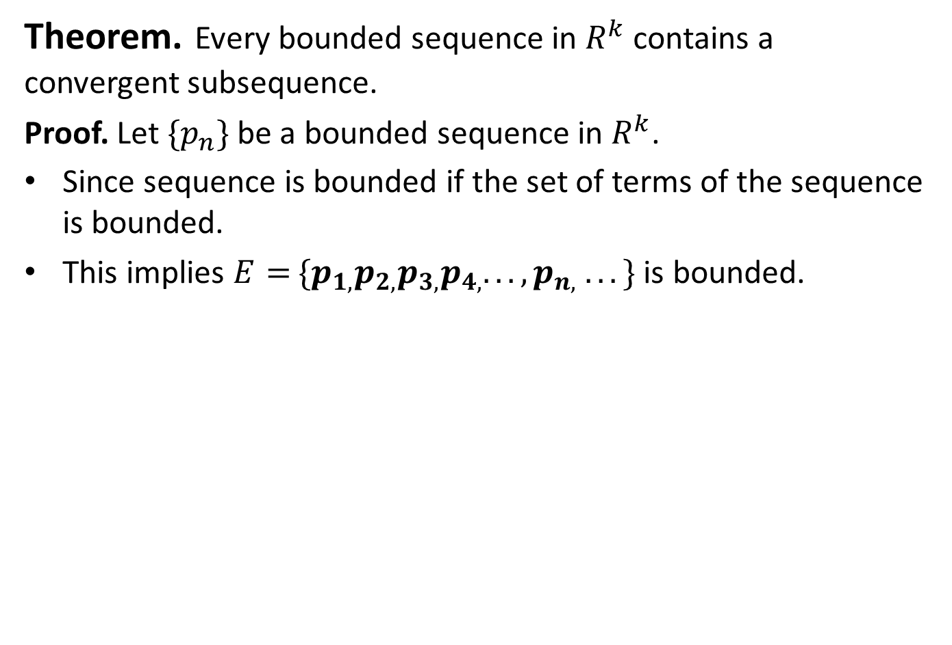
Theorem.Every bounded sequence in $R^{k}$ contains a convergent subsequence.
Proof. Let $\{p_{n}\}$ be a bounded sequence in $R^{k}$.
Since sequence is bounded if the set of terms of the sequence is bounded.
This implies $E=$$\{p_{1,}p_{2,}p_{3,}p_{4,}. . . ,p_{n,} . . .\}$is bounded.

Slide 34
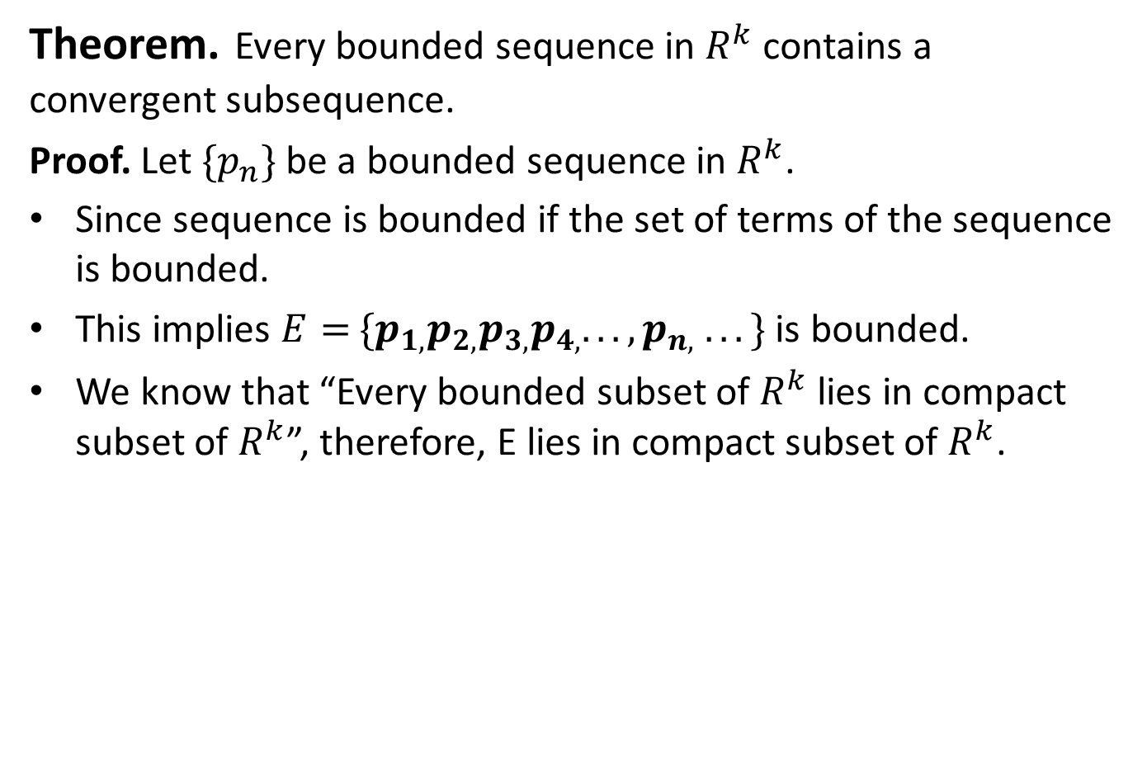
Theorem.Every bounded sequence in $R^{k}$ contains a convergent subsequence.
Proof. Let $\{p_{n}\}$ be a bounded sequence in $R^{k}$.
Since sequence is bounded if the set of terms of the sequence is bounded.
This implies $E=$$\{p_{1,}p_{2,}p_{3,}p_{4,}. . . ,p_{n,} . . .\}$is bounded.
We know that “Every bounded subset of $R^{k}$ lies in compact subset of $R^{k}$”, therefore, E lies in compact subset of $R^{k}$.

Slide 35
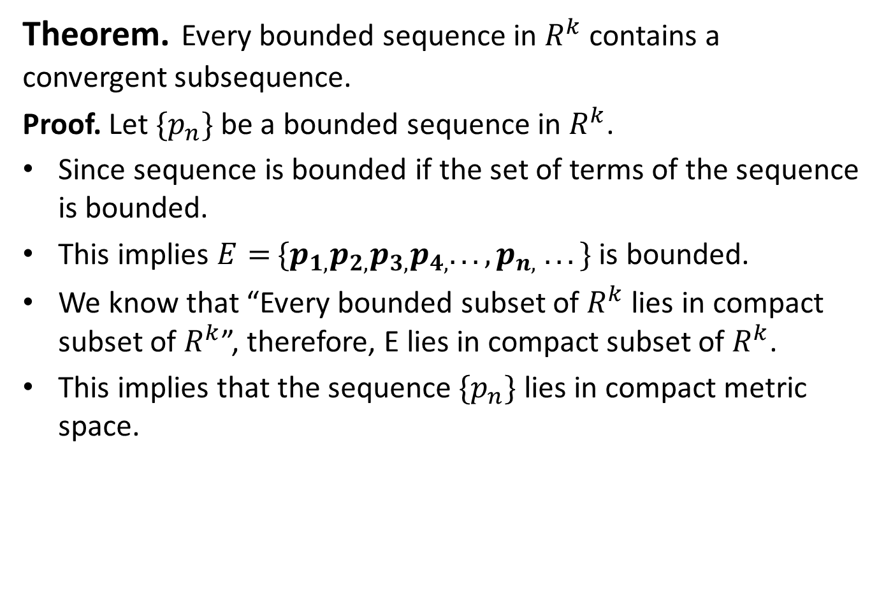
Theorem.Every bounded sequence in $R^{k}$ contains a convergent subsequence.
Proof. Let $\{p_{n}\}$ be a bounded sequence in $R^{k}$.
Since sequence is bounded if the set of terms of the sequence is bounded.
This implies $E=$$\{p_{1,}p_{2,}p_{3,}p_{4,}. . . ,p_{n,} . . .\}$is bounded.
We know that “Every bounded subset of $R^{k}$ lies in compact subset of $R^{k}$”, therefore, E lies in compact subset of $R^{k}$.
This implies that the sequence $\{p_{n}\}$lies in compact metric space.

Slide 36
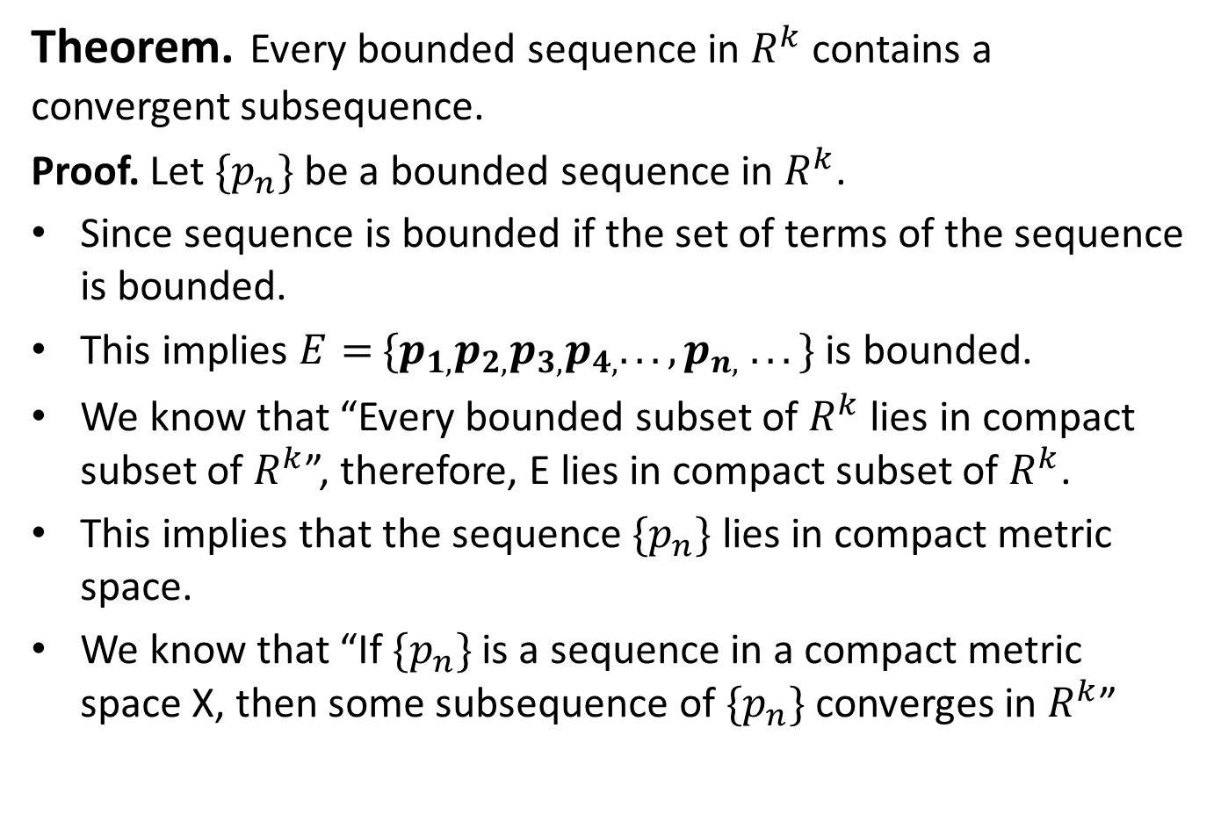
Theorem.Every bounded sequence in $R^{k}$ contains a convergent subsequence.
Proof. Let $\{p_{n}\}$ be a bounded sequence in $R^{k}$.
Since sequence is bounded if the set of terms of the sequence is bounded.
This implies $E=$$\{p_{1,}p_{2,}p_{3,}p_{4,}. . . ,p_{n,} . . .\}$is bounded.
We know that “Every bounded subset of $R^{k}$ lies in compact subset of $R^{k}$”, therefore, E lies in compact subset of $R^{k}$.
This implies that the sequence $\{p_{n}\}$lies in compact metric space.
We know that “If $\{p_{n}\}$ is a sequence in a compact metric space X, then some subsequence of $\{p_{n}\}$ converges in $R^{k}$”

Slide 37
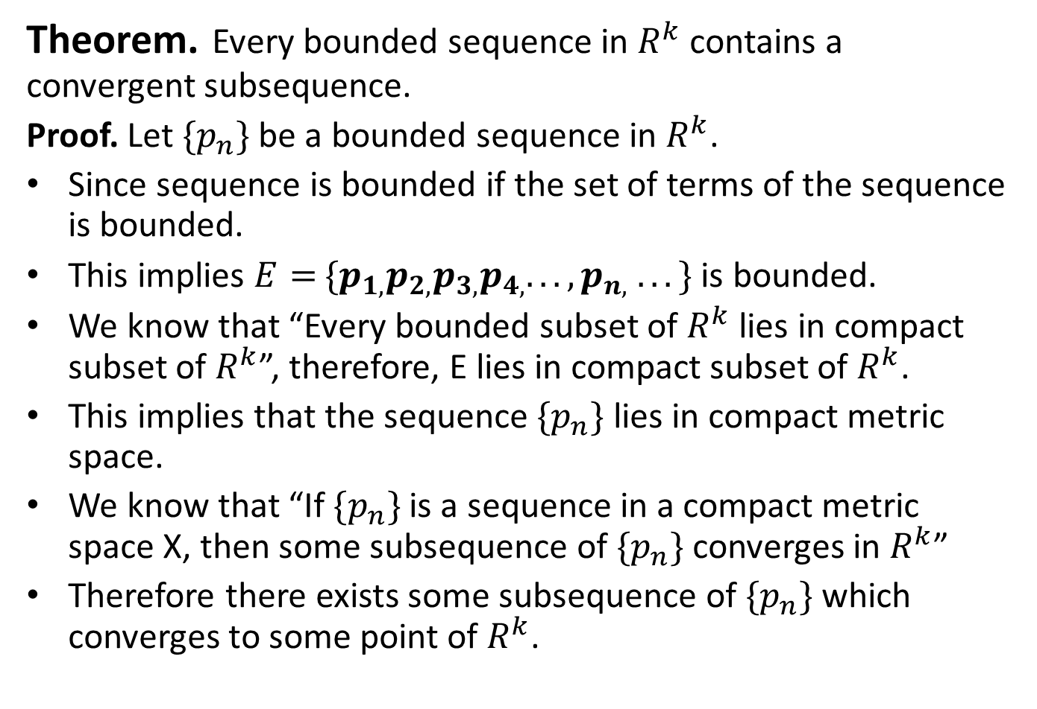
Theorem.Every bounded sequence in $R^{k}$ contains a convergent subsequence.
Proof. Let $\{p_{n}\}$ be a bounded sequence in $R^{k}$.
Since sequence is bounded if the set of terms of the sequence is bounded.
This implies $E=$$\{p_{1,}p_{2,}p_{3,}p_{4,}. . . ,p_{n,} . . .\}$is bounded.
We know that “Every bounded subset of $R^{k}$ lies in compact subset of $R^{k}$”, therefore, E lies in compact subset of $R^{k}$.
This implies that the sequence $\{p_{n}\}$lies in compact metric space.
We know that “If $\{p_{n}\}$ is a sequence in a compact metric space X, then some subsequence of $\{p_{n}\}$ converges in $R^{k}$”
Therefore there exists some subsequence of $\{p_{n}\}$which converges to some point of $R^{k}$.

Slide 39
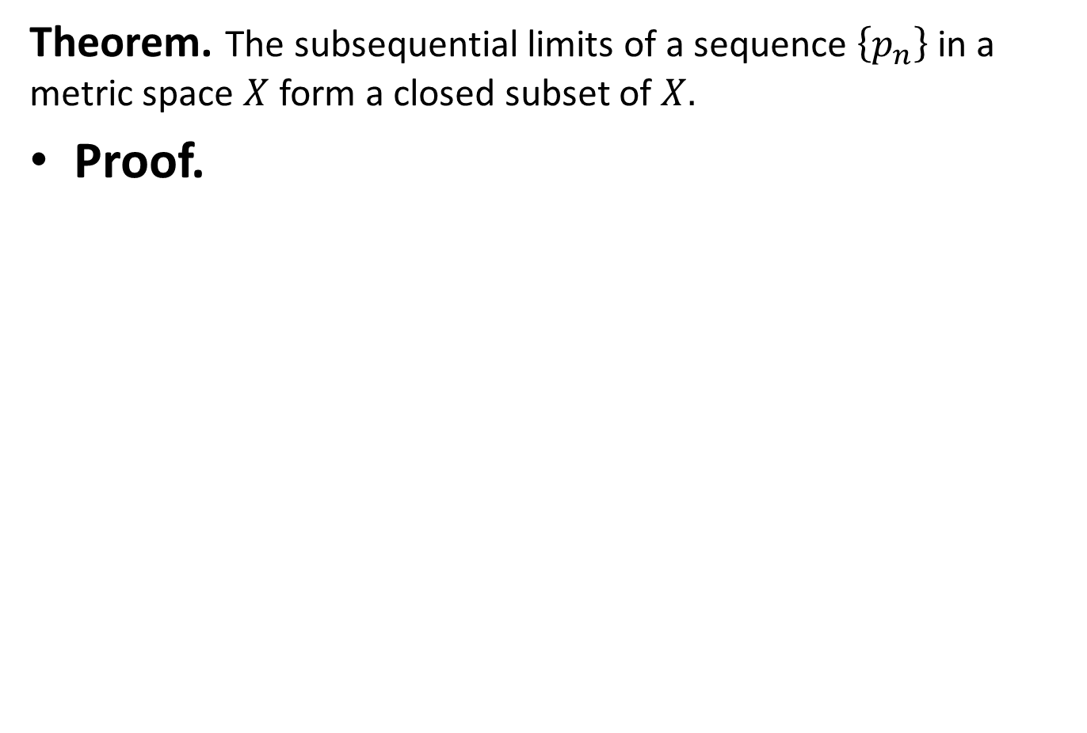
Theorem. The subsequential limits of a sequence $\left\{p_{n}\right\}$ in a metric space $X$ form a closed subset of $X.$
Proof.

Slide 40
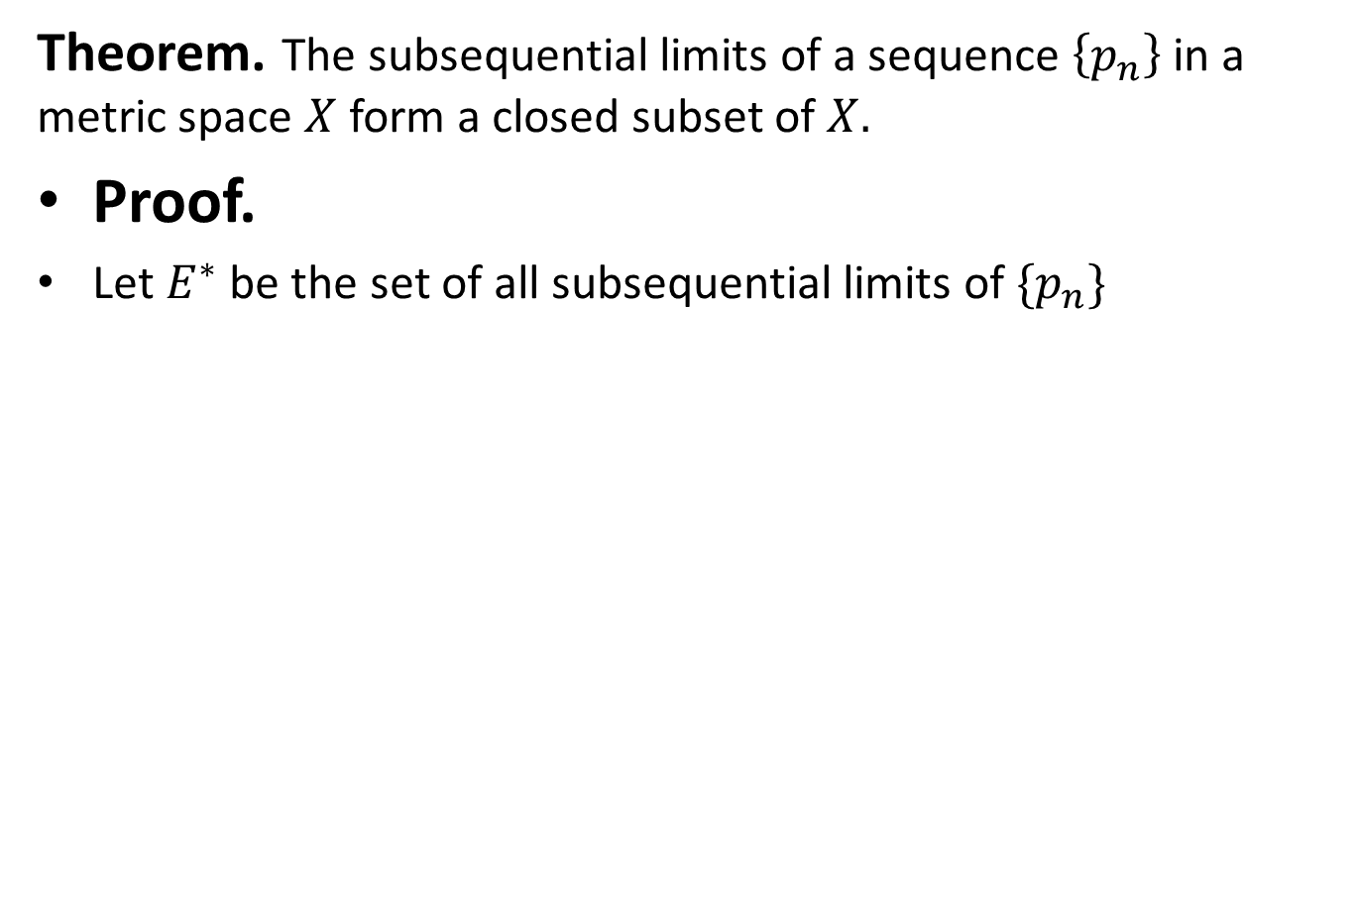
Theorem. The subsequential limits of a sequence $\left\{p_{n}\right\}$ in a metric space $X$ form a closed subset of $X.$
Proof.
Let $E^{∗}$ be the set of all subsequential limits of $\{p_{n}\}$

Slide 41
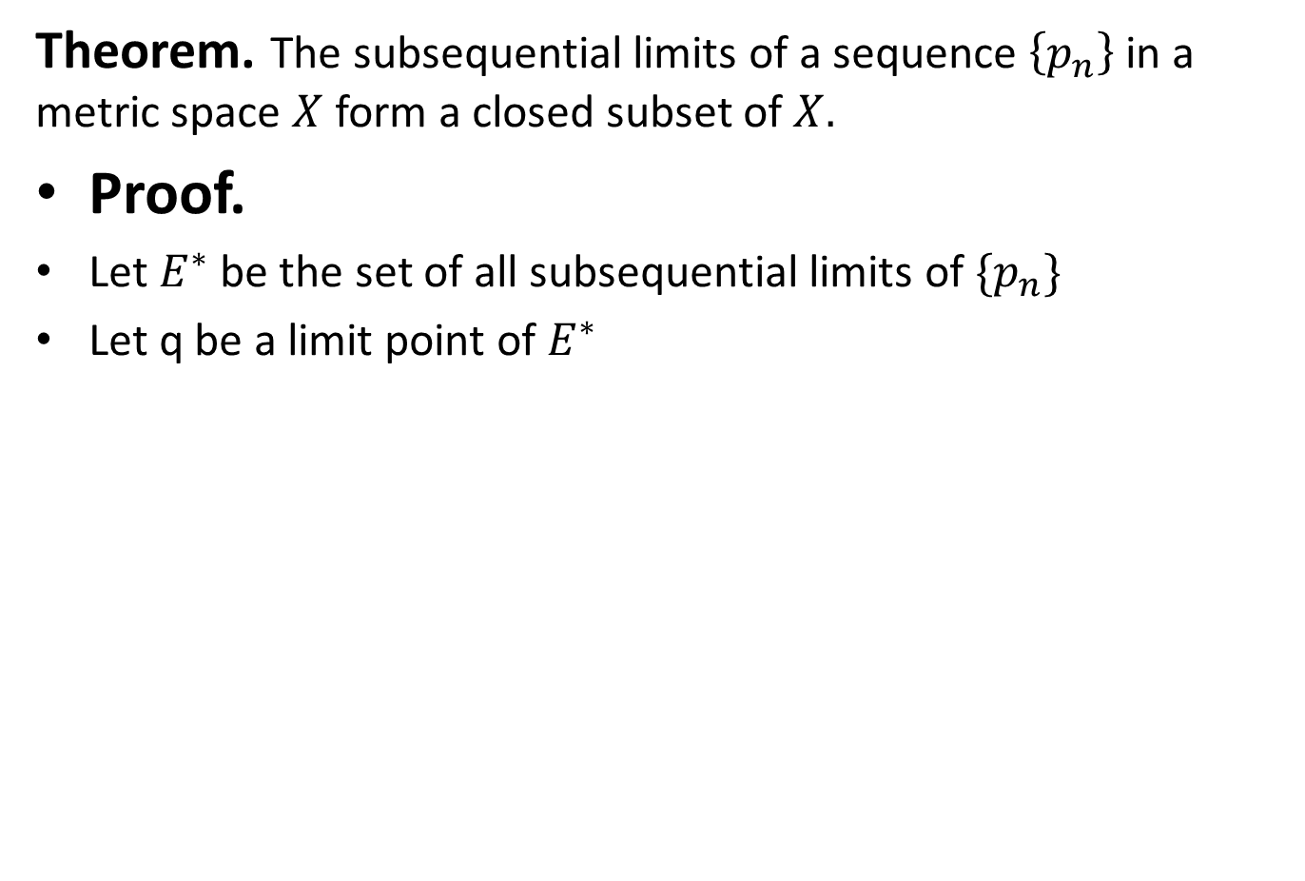
Theorem. The subsequential limits of a sequence $\left\{p_{n}\right\}$ in a metric space $X$ form a closed subset of $X.$
Proof.
Let $E^{∗}$ be the set of all subsequential limits of $\{p_{n}\}$
Let q be a limit point of $E^{∗}$

Slide 42
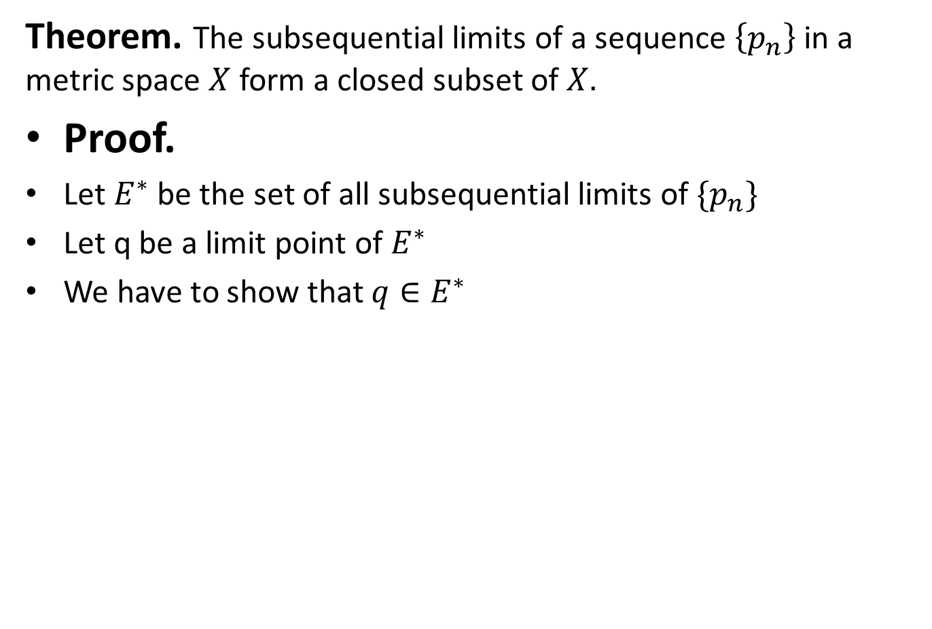
Theorem. The subsequential limits of a sequence $\left\{p_{n}\right\}$ in a metric space $X$ form a closed subset of $X.$
Proof.
Let $E^{∗}$ be the set of all subsequential limits of $\{p_{n}\}$
Let q be a limit point of $E^{∗}$
We have to show that ${q∈E}^{∗}$

Slide 43
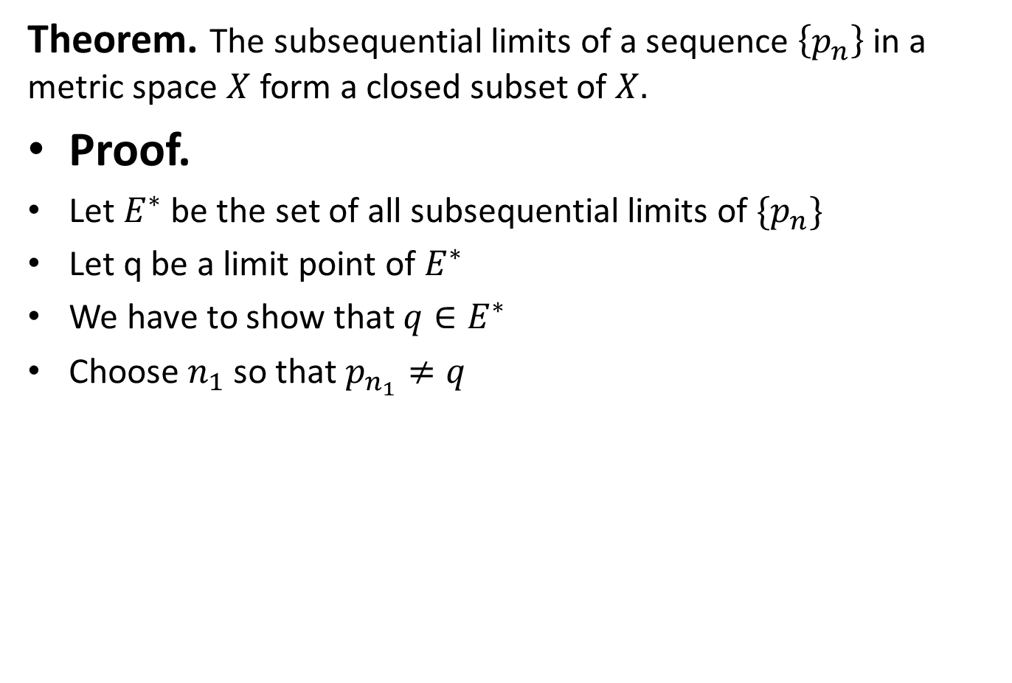
Theorem. The subsequential limits of a sequence $\left\{p_{n}\right\}$ in a metric space $X$ form a closed subset of $X.$
Proof.
Let $E^{∗}$ be the set of all subsequential limits of $\{p_{n}\}$
Let q be a limit point of $E^{∗}$
We have to show that ${q∈E}^{∗}$
Choose $n_{1}$ so that $p_{n_{1}}≠q$

Slide 44
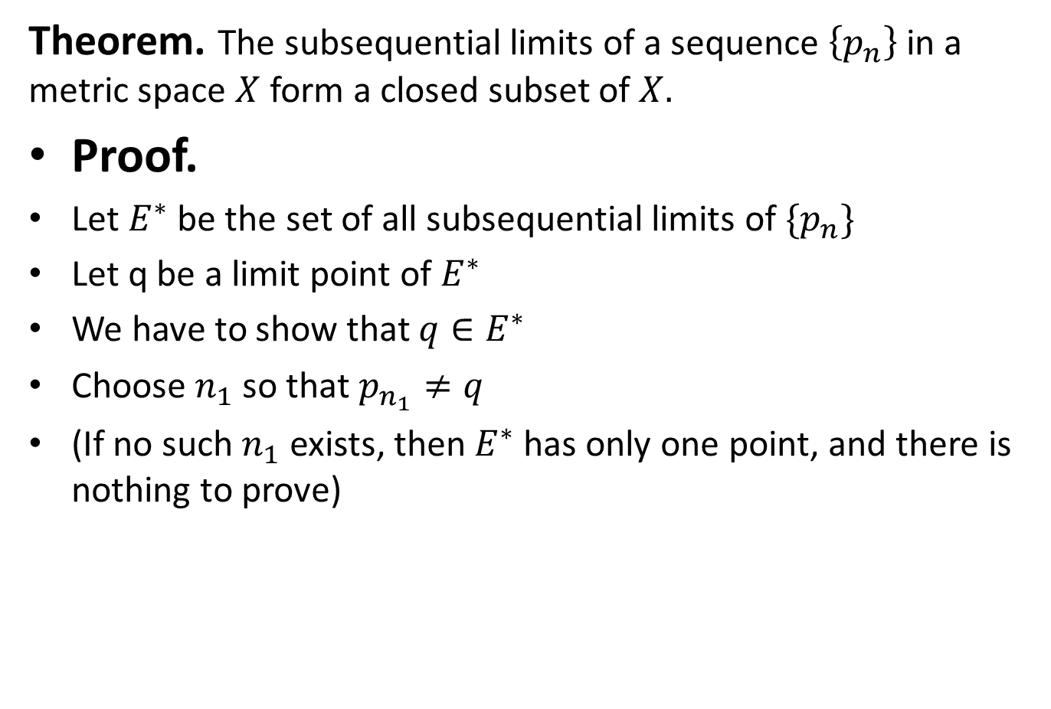
Theorem. The subsequential limits of a sequence $\left\{p_{n}\right\}$ in a metric space $X$ form a closed subset of $X.$
Proof.
Let $E^{∗}$ be the set of all subsequential limits of $\{p_{n}\}$
Let q be a limit point of $E^{∗}$
We have to show that ${q∈E}^{∗}$
Choose $n_{1}$ so that $p_{n_{1}}≠q$
(If no such $n_{1}$ exists, then $E^{∗}$ has only one point, and there is nothing to prove)

Slide 45
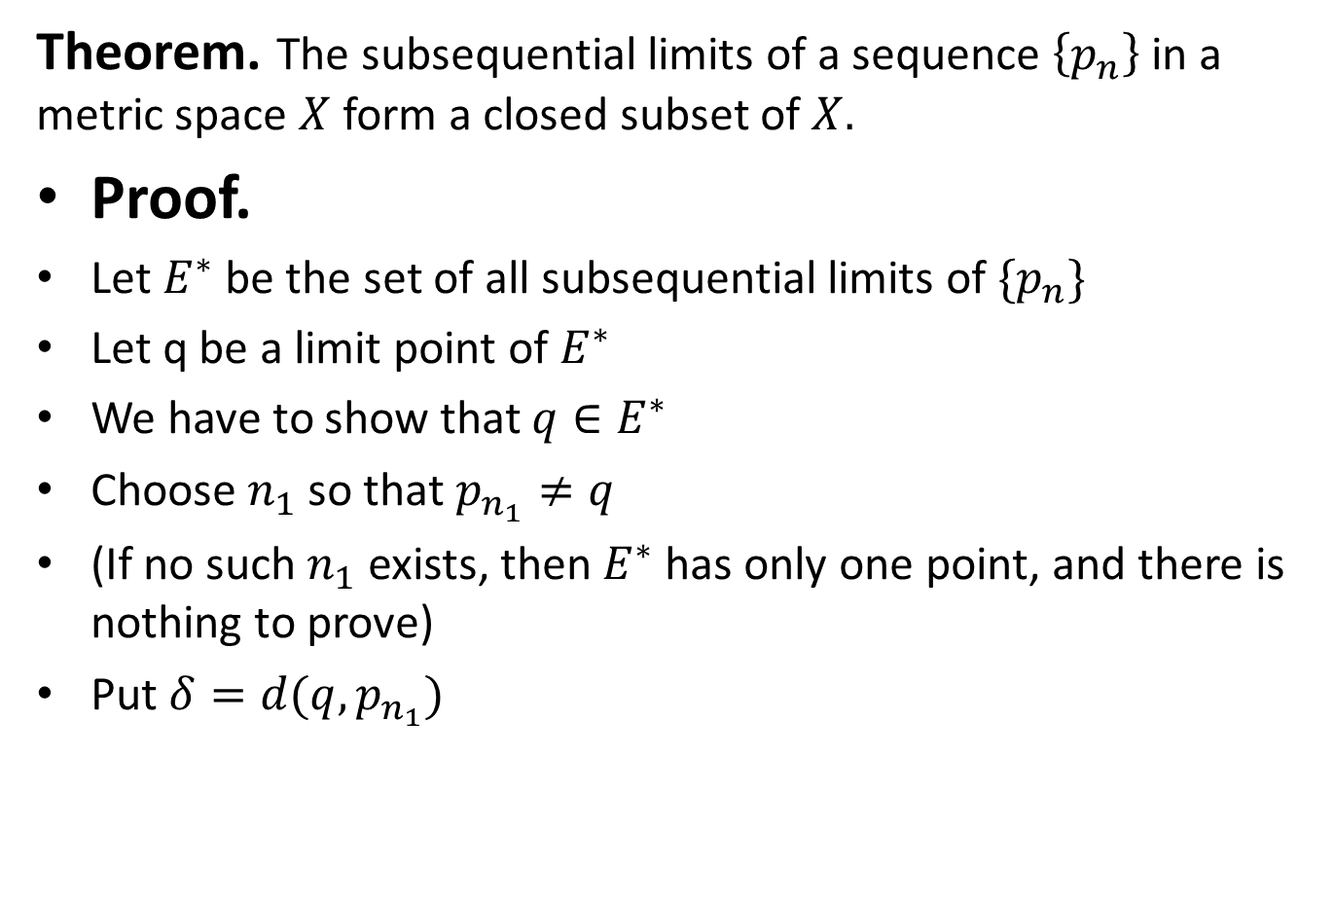
Theorem. The subsequential limits of a sequence $\left\{p_{n}\right\}$ in a metric space $X$ form a closed subset of $X.$
Proof.
Let $E^{∗}$ be the set of all subsequential limits of $\{p_{n}\}$
Let q be a limit point of $E^{∗}$
We have to show that ${q∈E}^{∗}$
Choose $n_{1}$ so that $p_{n_{1}}≠q$
(If no such $n_{1}$ exists, then $E^{∗}$ has only one point, and there is nothing to prove)
Put $δ=d(q,p_{n_{1}})$

Slide 46
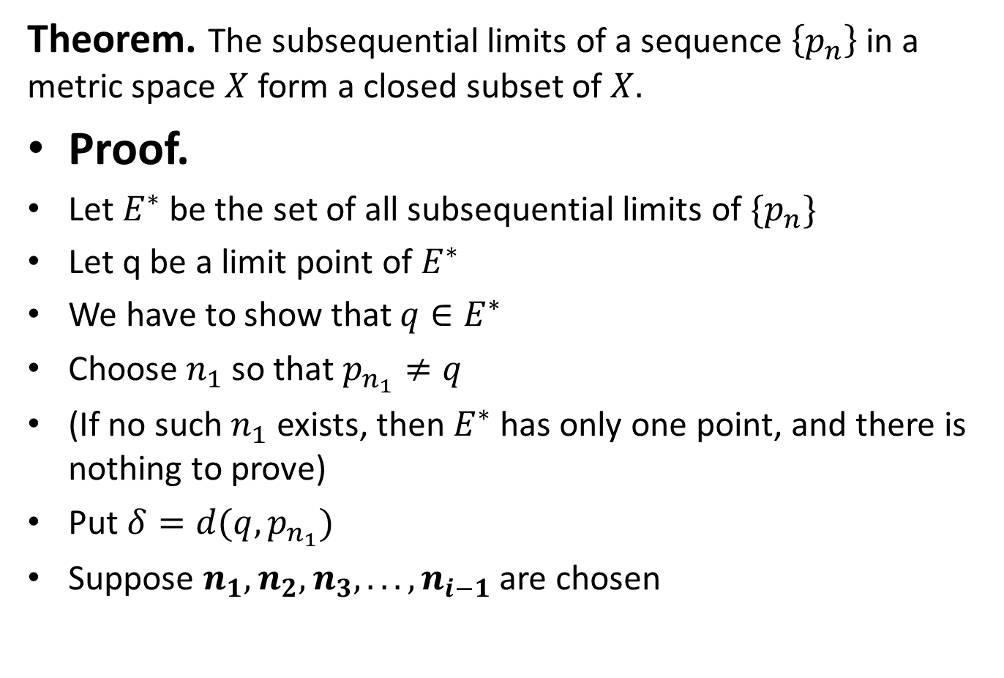
Theorem. The subsequential limits of a sequence $\left\{p_{n}\right\}$ in a metric space $X$ form a closed subset of $X.$
Proof.
Let $E^{∗}$ be the set of all subsequential limits of $\{p_{n}\}$
Let q be a limit point of $E^{∗}$
We have to show that ${q∈E}^{∗}$
Choose $n_{1}$ so that $p_{n_{1}}≠q$
(If no such $n_{1}$ exists, then $E^{∗}$ has only one point, and there is nothing to prove)
Put $δ=d(q,p_{n_{1}})$
Suppose $n_{1},n_{2},n_{3}, . ..,n_{i−1}$ are chosen

Slide 47
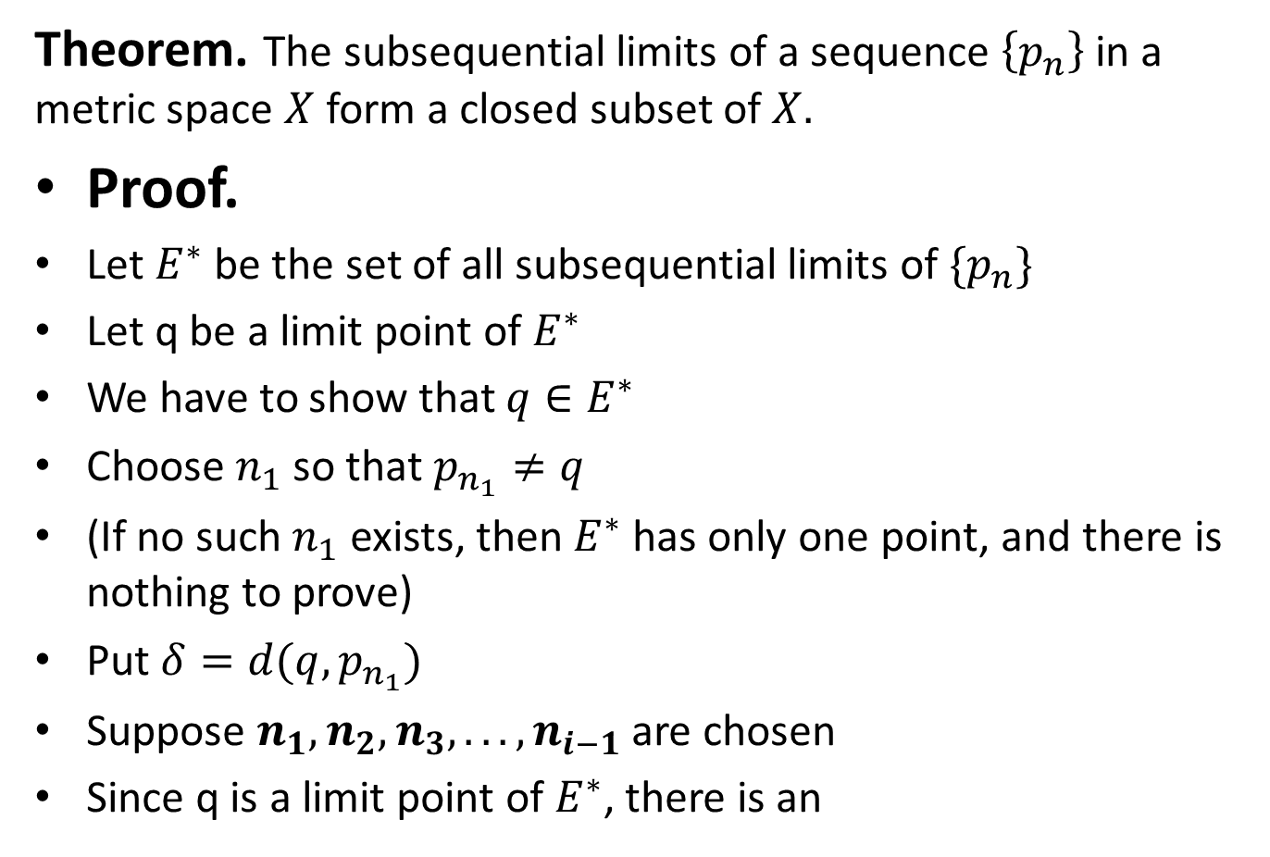
Theorem. The subsequential limits of a sequence $\left\{p_{n}\right\}$ in a metric space $X$ form a closed subset of $X.$
Proof.
Let $E^{∗}$ be the set of all subsequential limits of $\{p_{n}\}$
Let q be a limit point of $E^{∗}$
We have to show that ${q∈E}^{∗}$
Choose $n_{1}$ so that $p_{n_{1}}≠q$
(If no such $n_{1}$ exists, then $E^{∗}$ has only one point, and there is nothing to prove)
Put $δ=d(q,p_{n_{1}})$
Suppose $n_{1},n_{2},n_{3}, . ..,n_{i−1}$ are chosen
Since q is a limit point of $E^{∗}$, there is an

Slide 48
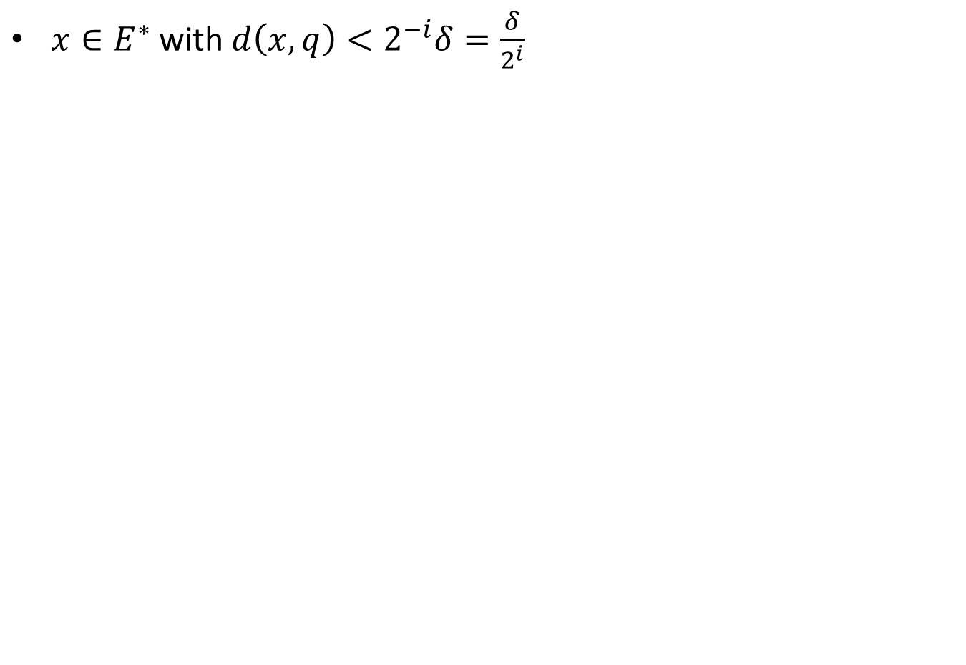
$x∈E^{∗}$ with $d\left(x,q\right)<2^{−i}δ=\frac{δ}{2^{i}}$

Slide 49
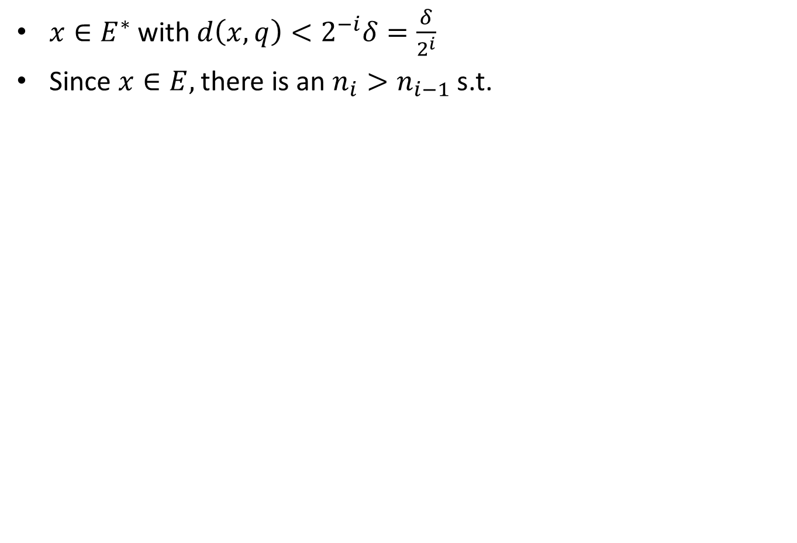
$x∈E^{∗}$ with $d\left(x,q\right)<2^{−i}δ=\frac{δ}{2^{i}}$
Since $x∈E,$there is an $n_{i}>n_{i−1}$s.t.

Slide 50
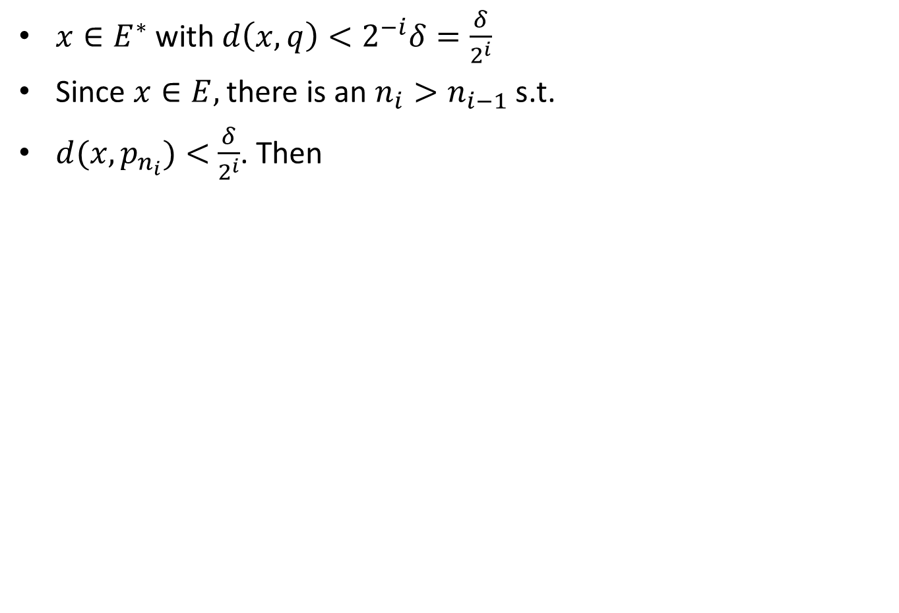
$x∈E^{∗}$ with $d\left(x,q\right)<2^{−i}δ=\frac{δ}{2^{i}}$
Since $x∈E,$there is an $n_{i}>n_{i−1}$s.t.
$d(x,p_{n_{i}})<$$\frac{δ}{2^{i}}$. Then

Slide 51
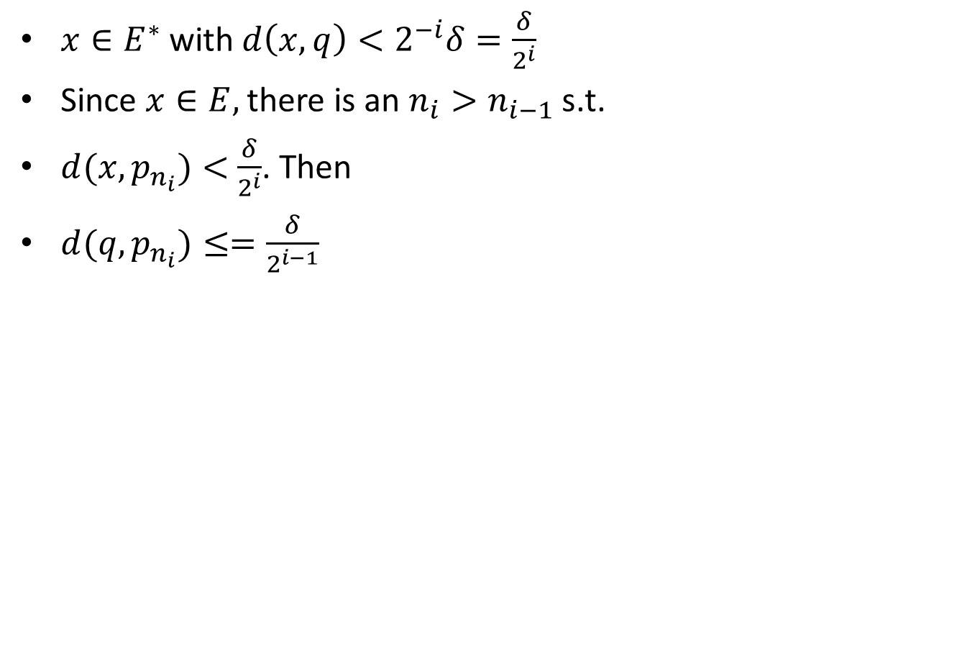
$x∈E^{∗}$ with $d\left(x,q\right)<2^{−i}δ=\frac{δ}{2^{i}}$
Since $x∈E,$there is an $n_{i}>n_{i−1}$s.t.
$d(x,p_{n_{i}})<$$\frac{δ}{2^{i}}$. Then
$d(q,p_{n_{i}})≤=\frac{δ}{2^{i−1}}$

Slide 52
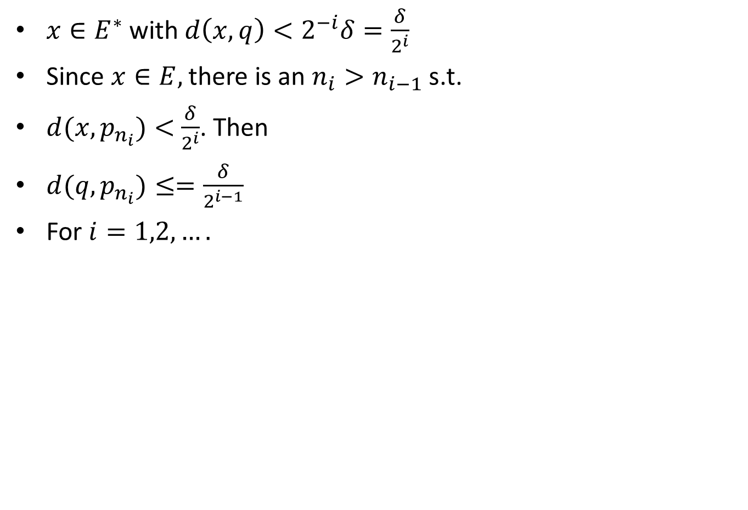
$x∈E^{∗}$ with $d\left(x,q\right)<2^{−i}δ=\frac{δ}{2^{i}}$
Since $x∈E,$there is an $n_{i}>n_{i−1}$s.t.
$d(x,p_{n_{i}})<$$\frac{δ}{2^{i}}$. Then
$d(q,p_{n_{i}})≤=\frac{δ}{2^{i−1}}$
For $i=1,2,….$

Slide 53
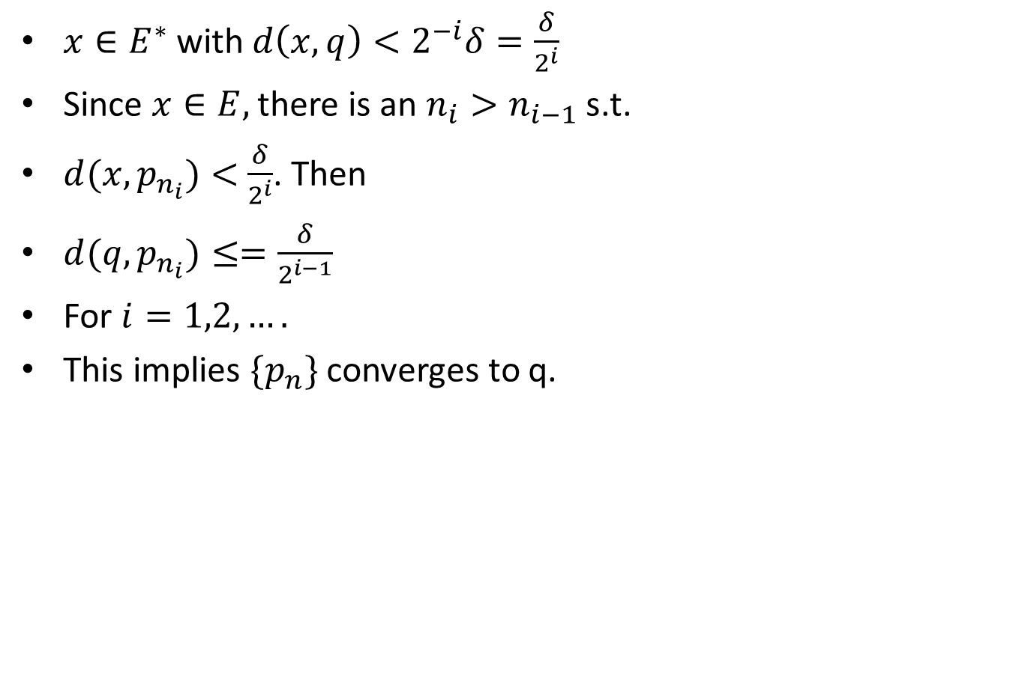
$x∈E^{∗}$ with $d\left(x,q\right)<2^{−i}δ=\frac{δ}{2^{i}}$
Since $x∈E,$there is an $n_{i}>n_{i−1}$s.t.
$d(x,p_{n_{i}})<$$\frac{δ}{2^{i}}$. Then
$d(q,p_{n_{i}})≤=\frac{δ}{2^{i−1}}$
For $i=1,2,….$
This implies $\{p_{n}\}$ converges to q.

Slide 54
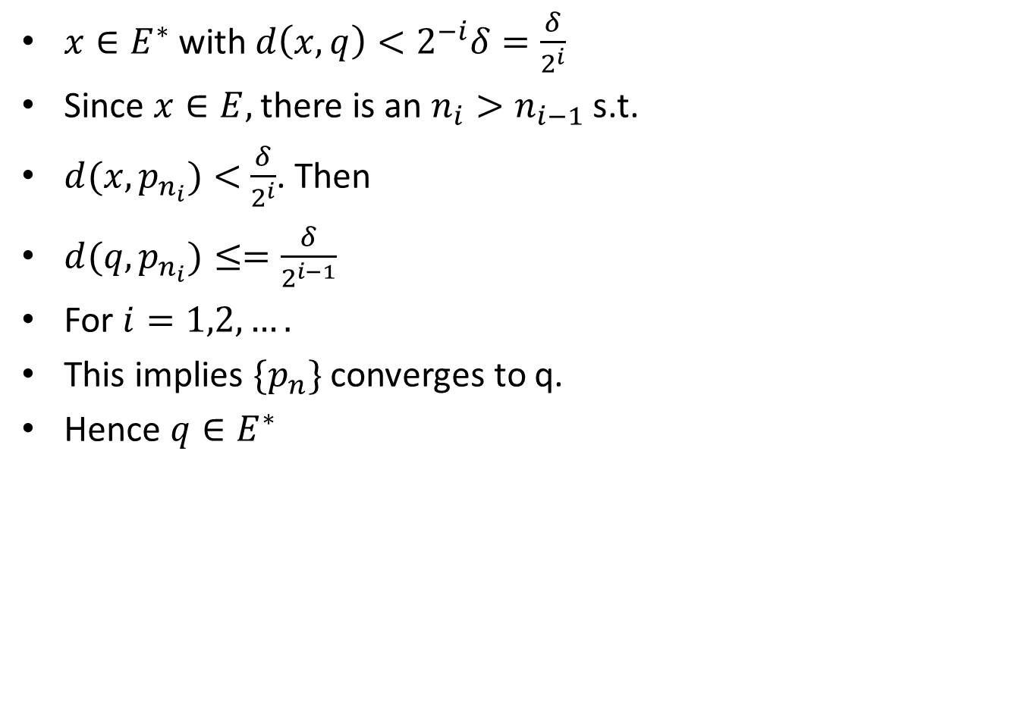
$x∈E^{∗}$ with $d\left(x,q\right)<2^{−i}δ=\frac{δ}{2^{i}}$
Since $x∈E,$there is an $n_{i}>n_{i−1}$s.t.
$d(x,p_{n_{i}})<$$\frac{δ}{2^{i}}$. Then
$d(q,p_{n_{i}})≤=\frac{δ}{2^{i−1}}$
For $i=1,2,….$
This implies $\{p_{n}\}$ converges to q.
Hence $q∈E^{∗}$

Slide 55
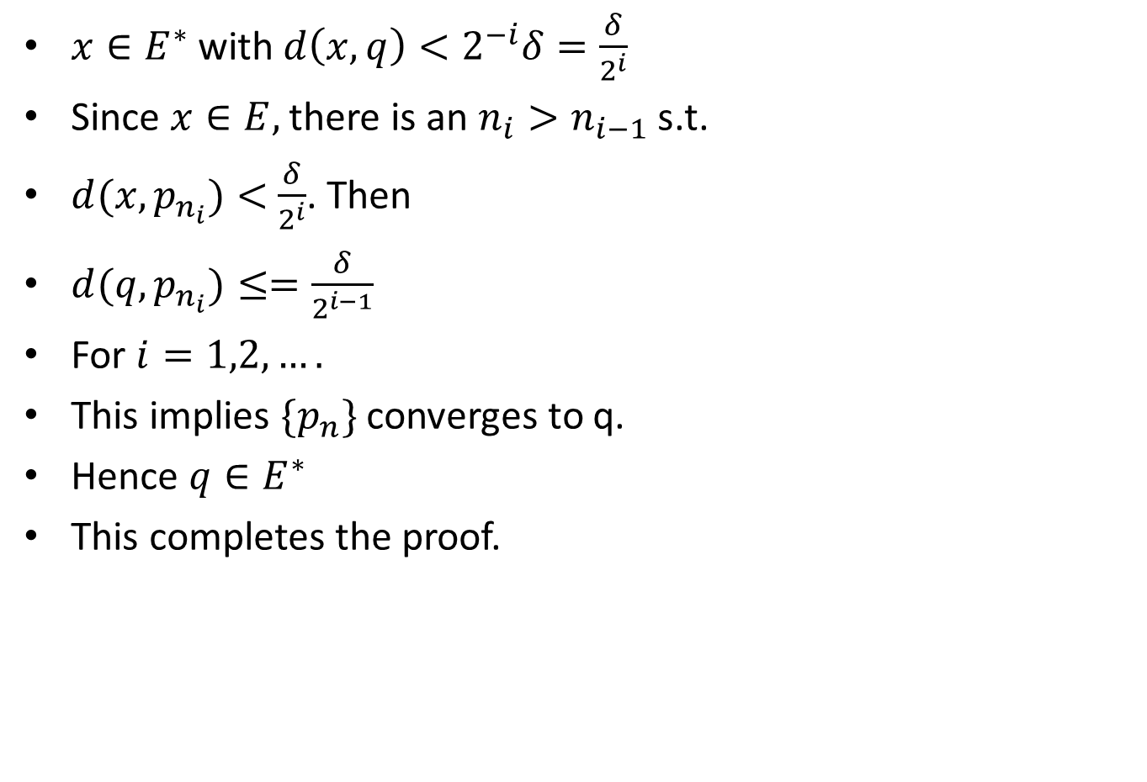
$x∈E^{∗}$ with $d\left(x,q\right)<2^{−i}δ=\frac{δ}{2^{i}}$
Since $x∈E,$there is an $n_{i}>n_{i−1}$s.t.
$d(x,p_{n_{i}})<$$\frac{δ}{2^{i}}$. Then
$d(q,p_{n_{i}})≤=\frac{δ}{2^{i−1}}$
For $i=1,2,….$
This implies $\{p_{n}\}$ converges to q.
Hence $q∈E^{∗}$
This completes the proof.

Slide 57
Cauchy Sequence.

Slide 59
Theorem. In 𝑎𝑛𝑦 𝑚𝑒𝑡𝑟𝑖𝑐 𝑠𝑝𝑎𝑐𝑒 𝑋, 𝑒𝑣𝑒𝑟𝑦 𝑐𝑜𝑛𝑣𝑒𝑟𝑔𝑒𝑛𝑡 sequence 𝑖𝑠 𝑎 Cauchy sequence.
Proof.

Slide 63
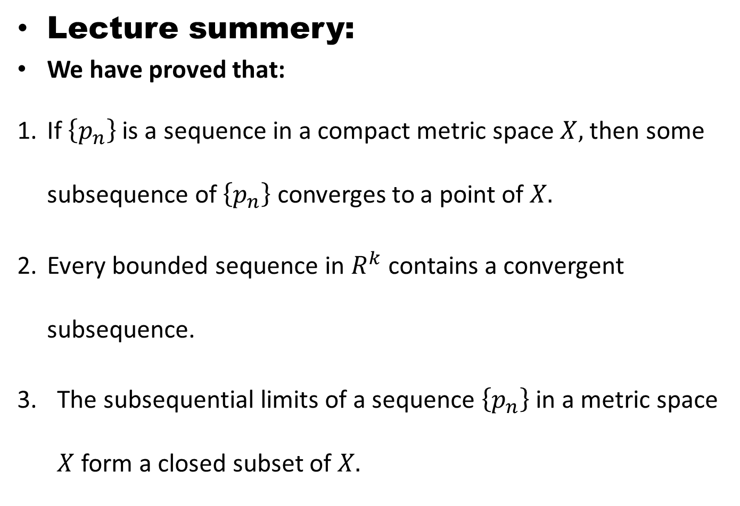
Lecture summery:
We have proved that:
If $\left\{p_{n}\right\}$ is a sequence in a compact metric space $X,$ then some subsequence of $\left\{p_{n}\right\}$ converges to a point of $X.$
Every bounded sequence in $R^{k}$ contains a convergent subsequence.
The subsequential limits of a sequence $\left\{p_{n}\right\}$ in a metric space $X$ form a closed subset of $X.$

Slide 64
THANK YOU

