Slide 1
Real Analysis I
Course Code MTH 321
By
Dr. Moiz ud Din khan
Professor of Mathematics

Slide 2
Lecture # 09

Slide 3
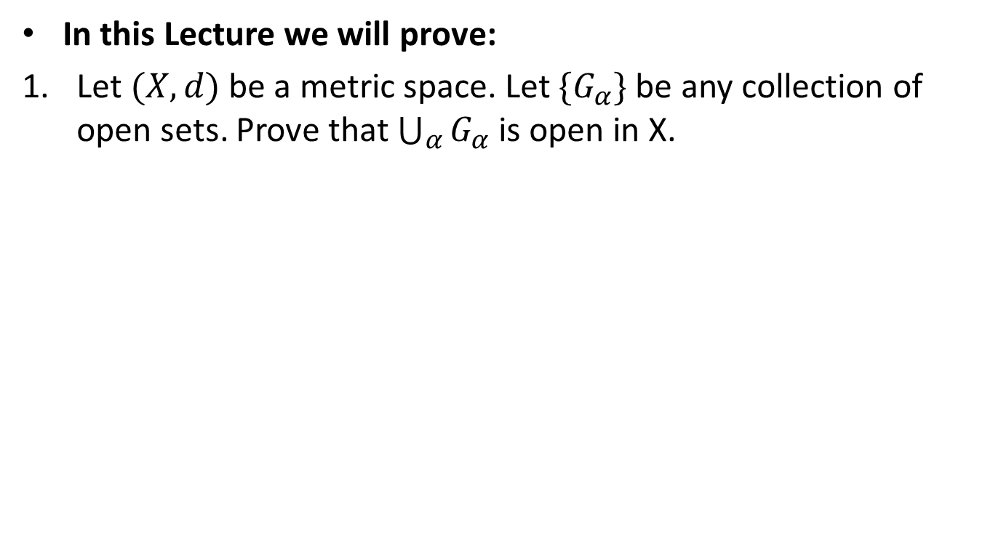
Lecture Outline
In this Lecture we will prove:
Let $(X,d)$ be a metric space. Let $\{G_{α}\}$ be any collection of open sets. Prove that $\bigcup_{α}{G_{α}}$ is open in X.

Slide 4
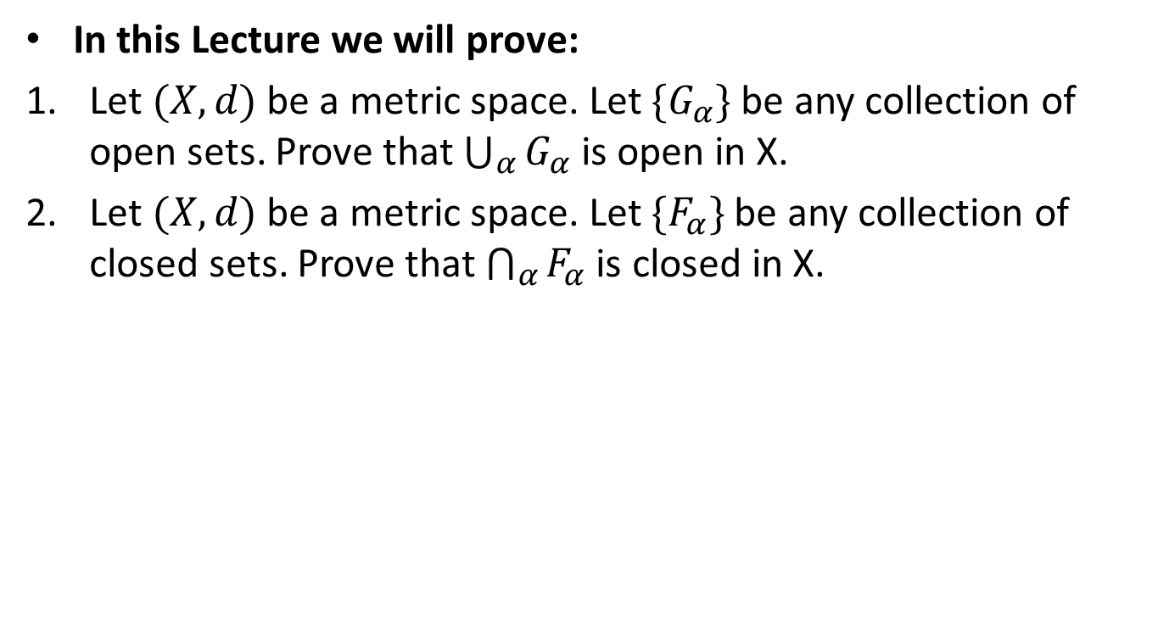
Lecture Outline
In this Lecture we will prove:
Let $(X,d)$ be a metric space. Let $\{G_{α}\}$ be any collection of open sets. Prove that $\bigcup_{α}{G_{α}}$ is open in X.
Let $(X,d)$ be a metric space. Let $\{F_{α}\}$ be any collection of closed sets. Prove that $\bigcap_{α}{F_{α}}$ is closed in X.

Slide 5
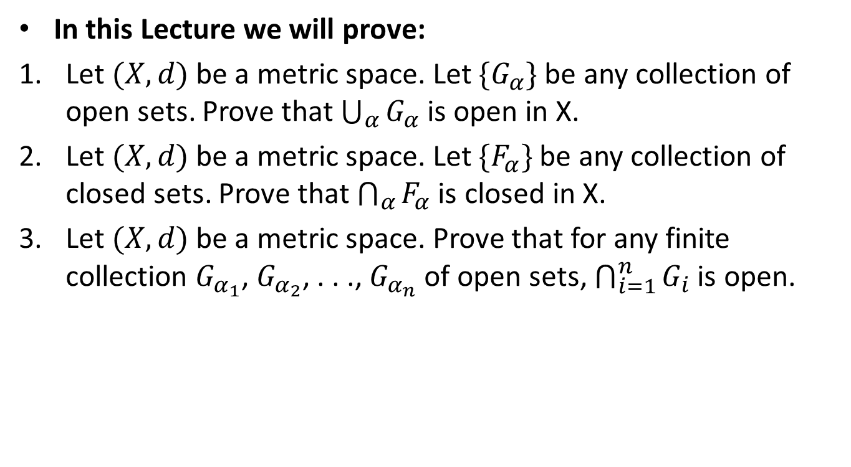
Lecture Outline
In this Lecture we will prove:
Let $(X,d)$ be a metric space. Let $\{G_{α}\}$ be any collection of open sets. Prove that $\bigcup_{α}{G_{α}}$ is open in X.
Let $(X,d)$ be a metric space. Let $\{F_{α}\}$ be any collection of closed sets. Prove that $\bigcap_{α}{F_{α}}$ is closed in X.
Let $(X,d)$ be a metric space. Prove that for any finite collection $G_{α_{1}}$, $G_{α_{2}}$, . . ., $G_{α_{n}}$ of open sets, $\bigcap_{i=1}^{n}{G_{i}}$ is open.

Slide 6
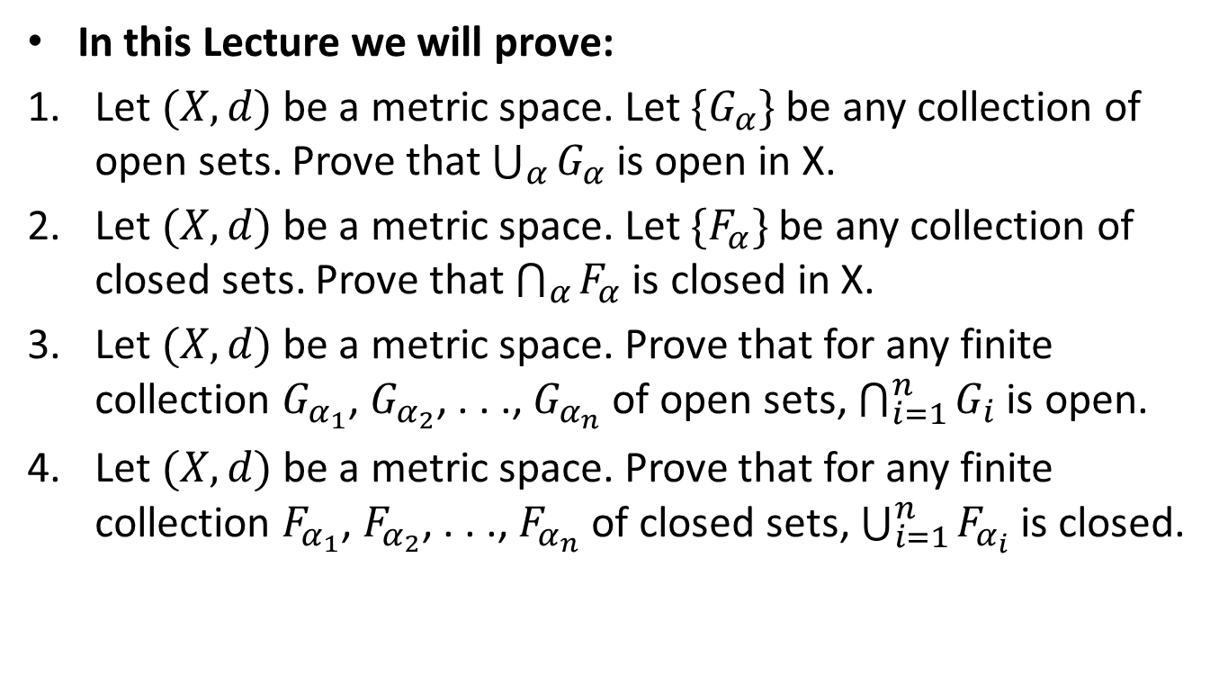
Lecture Outline
In this Lecture we will prove:
Let $(X,d)$ be a metric space. Let $\{G_{α}\}$ be any collection of open sets. Prove that $\bigcup_{α}{G_{α}}$ is open in X.
Let $(X,d)$ be a metric space. Let $\{F_{α}\}$ be any collection of closed sets. Prove that $\bigcap_{α}{F_{α}}$ is closed in X.
Let $(X,d)$ be a metric space. Prove that for any finite collection $G_{α_{1}}$, $G_{α_{2}}$, . . ., $G_{α_{n}}$ of open sets, $\bigcap_{i=1}^{n}{G_{i}}$ is open.
Let $(X,d)$ be a metric space. Prove that for any finite collection $F_{α_{1}}$, $F_{α_{2}}$, . . ., $F_{α_{n}}$ of closed sets, $\bigcup_{i=1}^{n}{F_{α_{i}}}$ is closed.

Slide 7
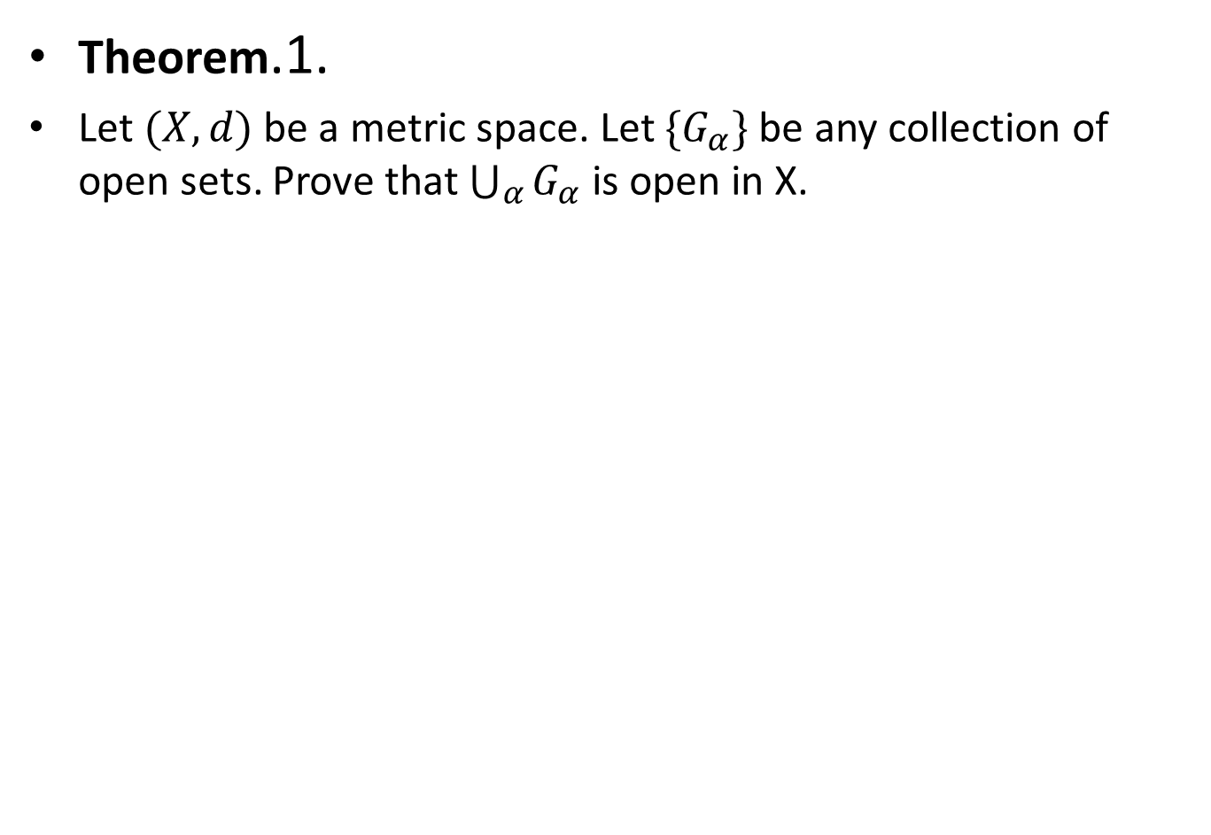
Theorem.1.
Let $(X,d)$ be a metric space. Let $\{G_{α}\}$ be any collection of open sets. Prove that $\bigcup_{α}{G_{α}}$ is open in X.

Slide 12
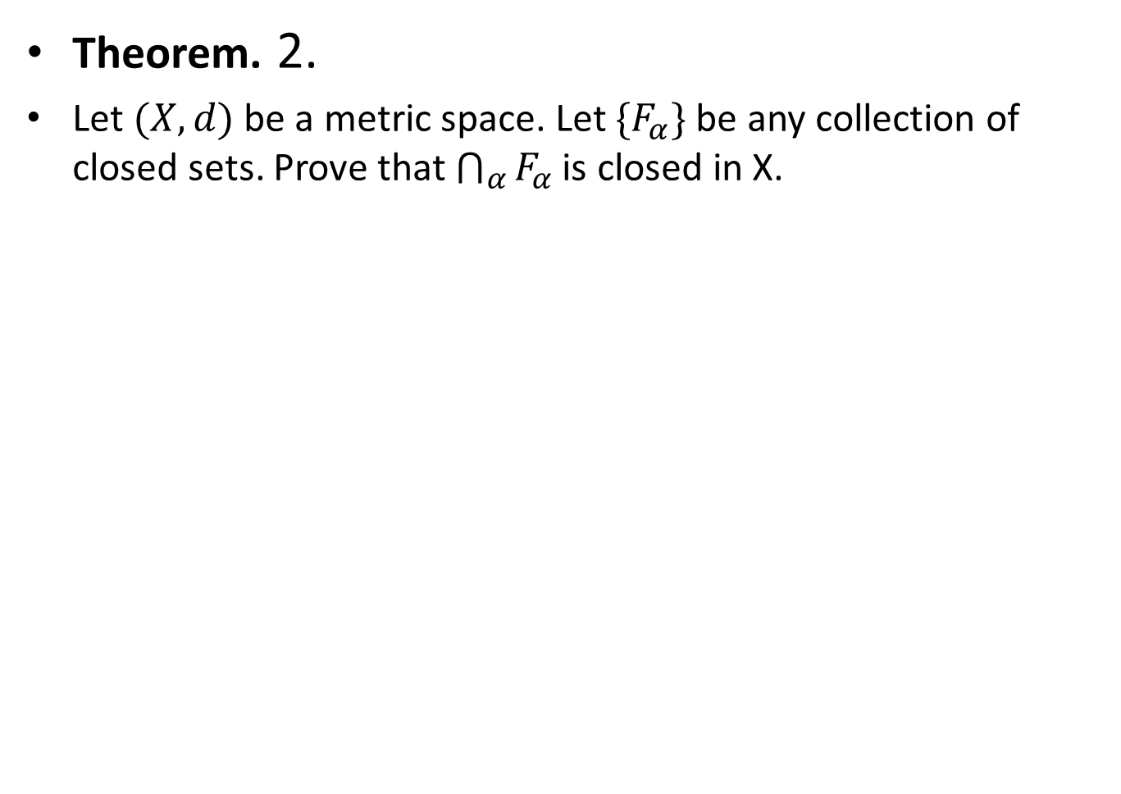
Theorem. 2.
Let $(X,d)$ be a metric space. Let $\{F_{α}\}$ be any collection of closed sets. Prove that $\bigcap_{α}{F_{α}}$ is closed in X.

Slide 17
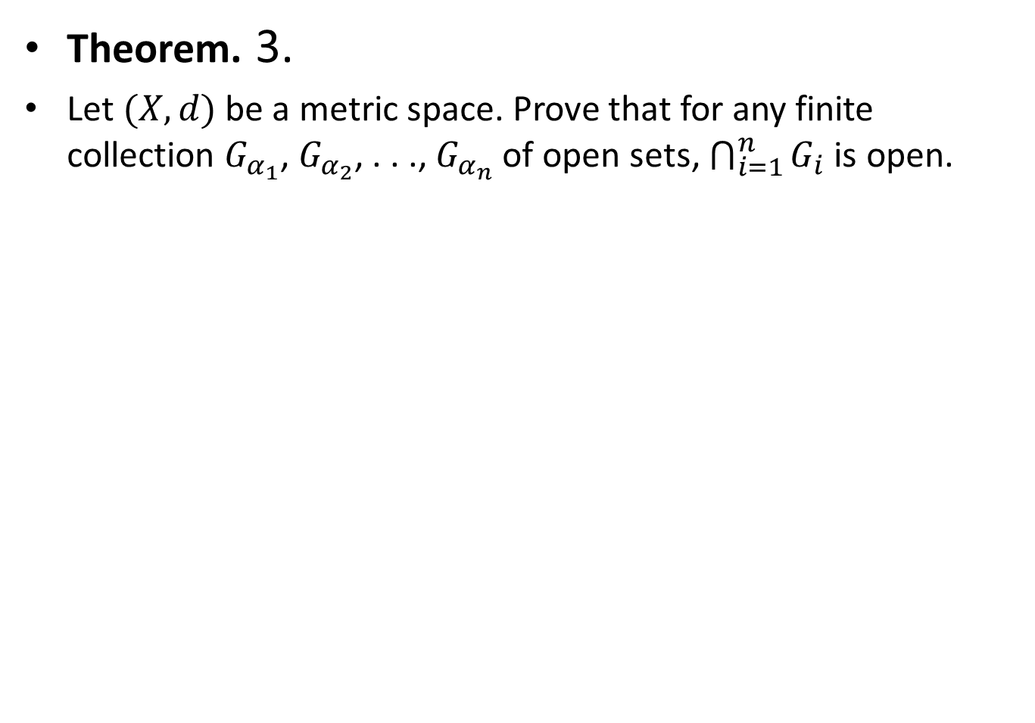
Theorem. 3.
Let $(X,d)$ be a metric space. Prove that for any finite collection $G_{α_{1}}$, $G_{α_{2}}$, . . ., $G_{α_{n}}$ of open sets, $\bigcap_{i=1}^{n}{G_{i}}$ is open.

Slide 21
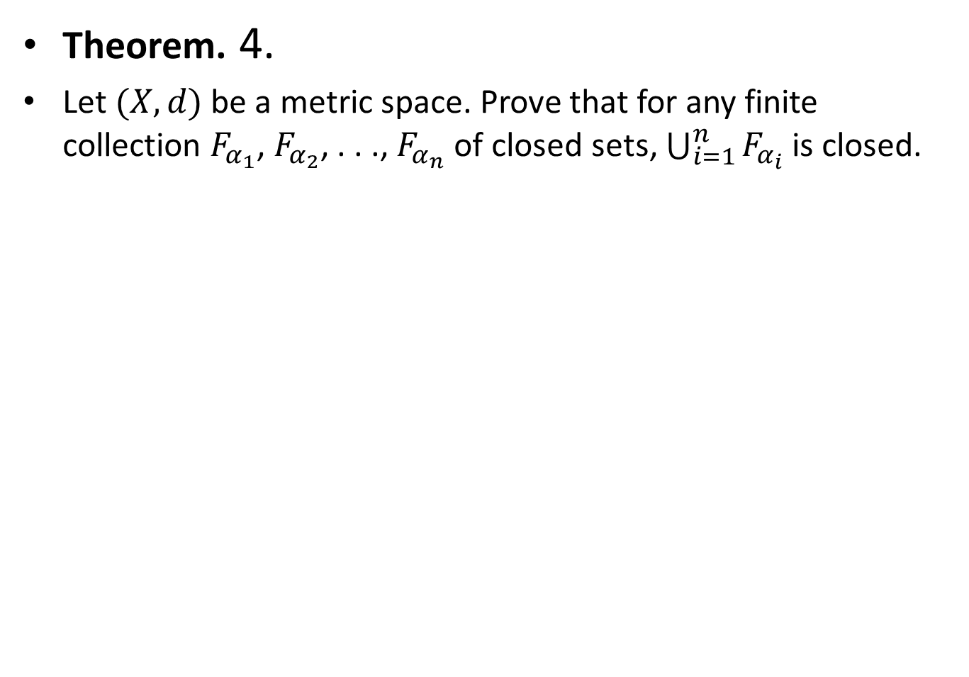
Theorem. 4.
Let $(X,d)$ be a metric space. Prove that for any finite collection $F_{α_{1}}$, $F_{α_{2}}$, . . ., $F_{α_{n}}$ of closed sets, $\bigcup_{i=1}^{n}{F_{α_{i}}}$ is closed.

Slide 26
Note: In theorem 3 and 4, finiteness of collection is essential.

Slide 29
Covering and Open Covering

Slide 30
Compact Set.
Note: Every finite set is compact.

Slide 32
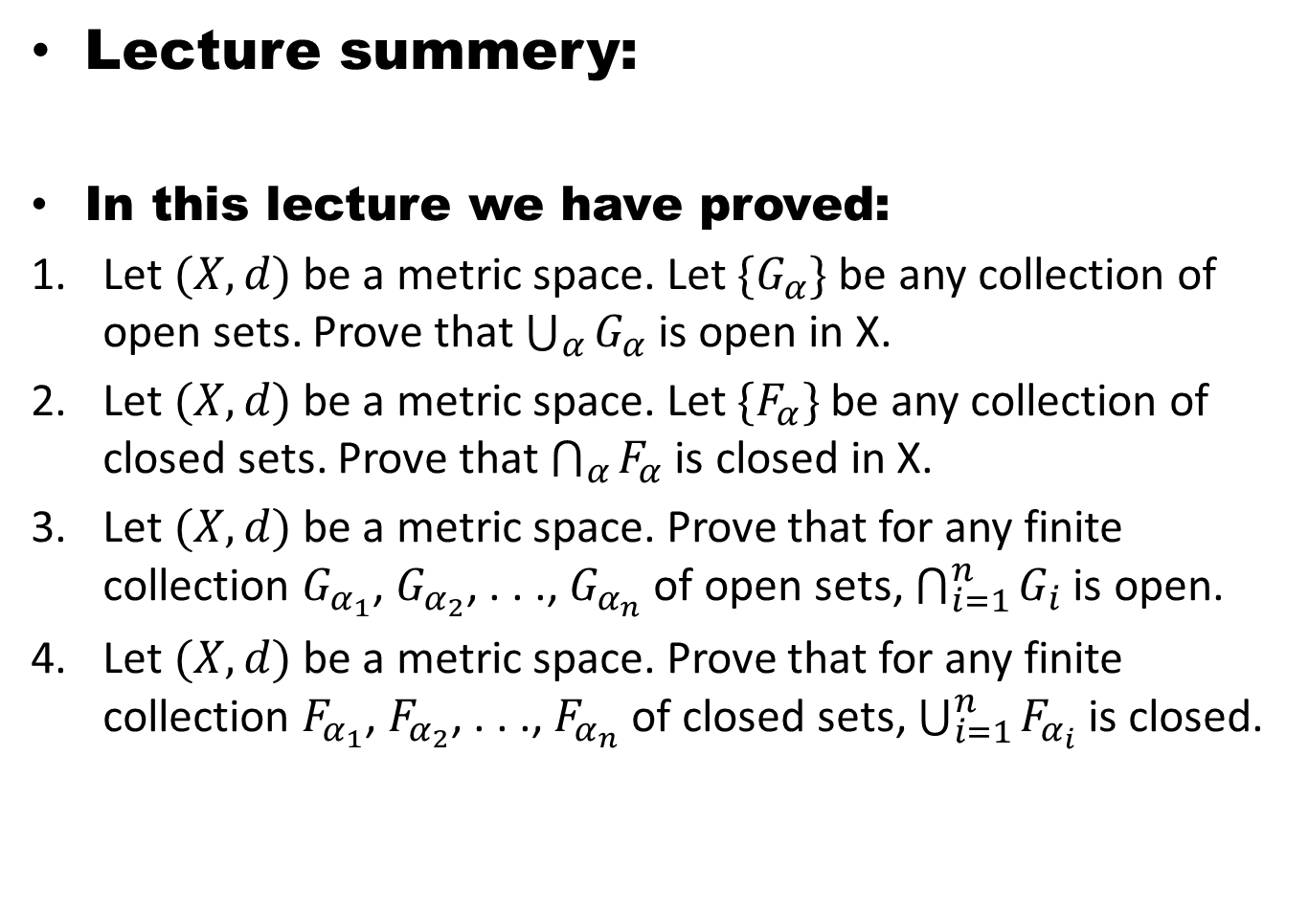
Lecture summery:
In this lecture we have proved:
Let $(X,d)$ be a metric space. Let $\{G_{α}\}$ be any collection of open sets. Prove that $\bigcup_{α}{G_{α}}$ is open in X.
Let $(X,d)$ be a metric space. Let $\{F_{α}\}$ be any collection of closed sets. Prove that $\bigcap_{α}{F_{α}}$ is closed in X.
Let $(X,d)$ be a metric space. Prove that for any finite collection $G_{α_{1}}$, $G_{α_{2}}$, . . ., $G_{α_{n}}$ of open sets, $\bigcap_{i=1}^{n}{G_{i}}$ is open.
Let $(X,d)$ be a metric space. Prove that for any finite collection $F_{α_{1}}$, $F_{α_{2}}$, . . ., $F_{α_{n}}$ of closed sets, $\bigcup_{i=1}^{n}{F_{α_{i}}}$ is closed.

Slide 33
THANK YOU

