Slide 1
Virtual COMSATS
Inferential Statistics
Lecture-9
Ossam Chohan
Assistant Professor
CIIT Abbottabad

Slide 2
Recap of previous lecture
Margin of error
Understanding normal curve and areas
Problem related to normal curve
Confidence intervals for different population mean and population proportion.
Different cases when variation is known or unknown.
Consideration of sample size while deciding test statistic
Confidence interval construction for different cases

Slide 3
Objective of this lecture
We will discuss more problems
Understanding normal curve and finding critical values.
Understanding t table.

Slide 4
Assessment problem-1
From a population known to have a standard deviation of 1.4, a sample of 60 individuals is taken. The mean for this sample is found to be 6.2
Find the standard error of the mean.
Establish an interval estimate around the sample mean, using one standard deviation from the mean.

Slide 5
Assessment problem-2
The COMSATS University Islamabad is conducting a study on the average weight of the many bricks that make up the university’s walkways. Workers are sent to dig up and weigh a sample of 421 bricks and the average brick weight of this sample was 14.2 lb. it is known that the standard deviation of bricks weight is 0.8 lb.
  Find the standard error of the mean.
  What is the interval around the sample mean that will include the population mean 95.5% of the time?

Slide 6
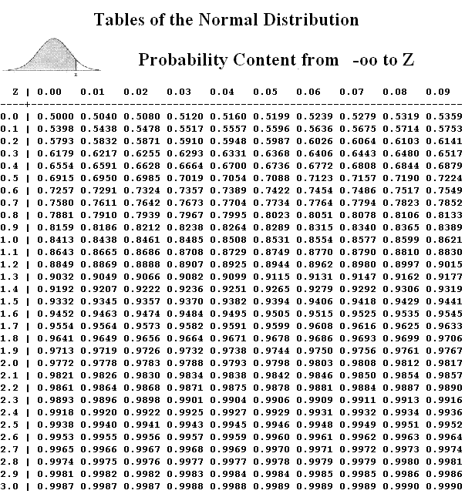
Assessment Problem-3
We know that the statement
P( -1.96δ <µ< +1.96δ )=0.95 is correct, while the statement P(140<µ<160)=0.95 is not correct. Explain why the latter is erroneous?
Some guidelines….

Slide 7
How to find z value
Suppose confidence is 95%,
Then it means that 1-α=0.95
α =0.05, α/2=0.025
To find Z_{α/2}=Z_{0.025}
You need to subtract 0.025 from 1 that is 1-0.025=0.975.
Now go to the table find 0.975 inside the table, you will find this value exactly on 1.96,
Therefore Z_{α/2}=Z_{0.025} = 1.96

Slide 9
Important!
What if we are interested to find the value of Zα?
What if the exact value is not given there in table?
What if the value is out of table range?
Will this scheme to looking or finding z values work in all normal tables?
Can we find normal values through any other source other than table?

Slide 11
Z values for various confidence levels
99.73% 3.00
99% 2.58
98% 2.33
96% 2.05
95.45% 2.00
95% 1.96
90% 1.645
80% 1.28
68.27% 1.00
50% 0.6745

Slide 12
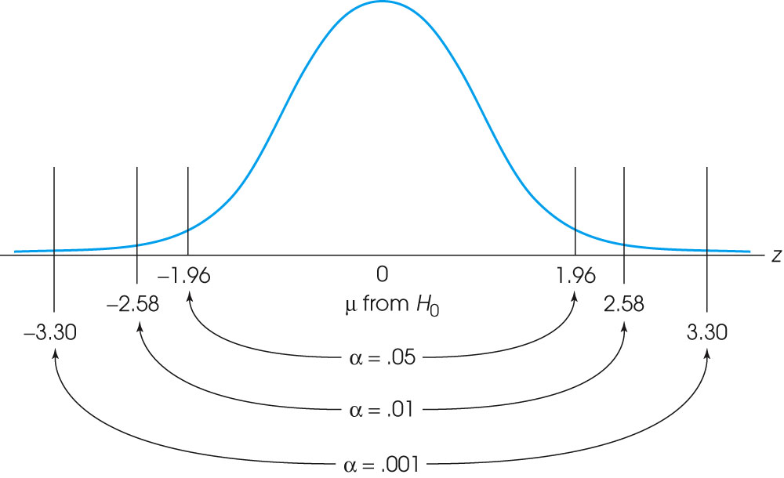
Notes:
The locations of the critical region boundaries for three different levels of significance: α = .05, α = .01, and α = .001.

Slide 13
Problem-6
From a population of 540, a sample of 60 individuals is taken. From this sample, the mean is found to be 6.2 and the standard deviation 1.368.
  Find the estimated standard error of the mean.
  Construct a 96% confidence interval for the mean.
  Note that n> 5% N

Slide 14
Problem-6 Solution

Slide 15
Problem-7
Measurement of the diameters of a random sample of 200 ball bearings made by a certain machine during 1 week showed a mean of 8.24 mm and a standard deviation of 0.42 mm. find the
  95% confidence interval for the mean diameter of all the ball bearings
  99% confidence interval for the mean diameter of all the ball bearing.
Try other confidence coefficients.

Slide 16
Problem-7 Solution

Slide 17
Problem-7 Solution

Slide 18
Problem-8
A sample poll of 100 voters chosen at random from all voters in a given district indicated that 55% of them were in favor of a particular candidate. Find the
  95% CI for the proportion of all the voters in favor of this candidate.
  99% CI for the proportion of all the voters in favor of this candidate.
  99.73% confidence limits for the proportion of all the voters in favor of this candidate.

Slide 19
Problem-8 Solution

Slide 20
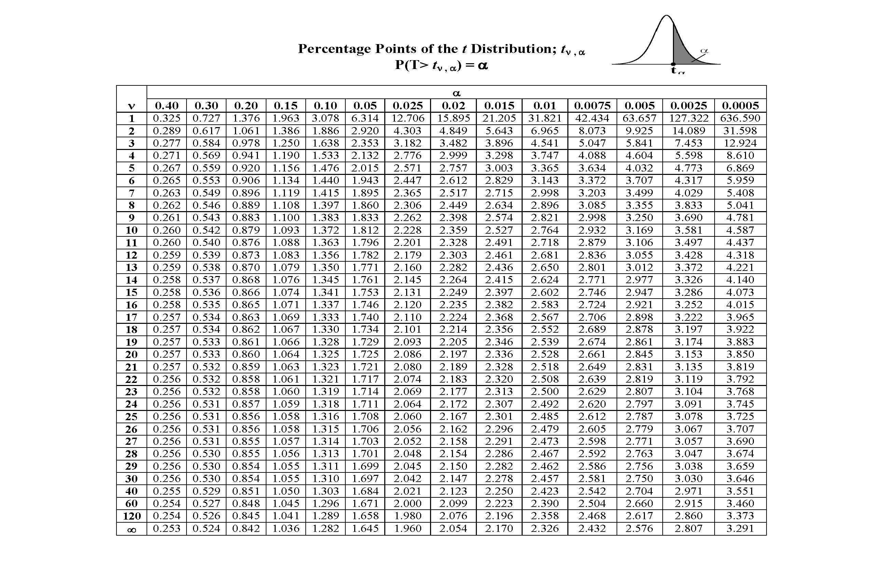
t-distribution table

Slide 21
Problem-9
For the following sample sizes and confidence levels, find the appropriate t values for constructing intervals:
  n=28; 95% t_{α/2}=?, t_{α}
  n=8; 98%
  n=13; 90%
  n=10; 95%
  n=25; 99%
  n=10; 99%

Slide 22
Problem-9 Solution

Slide 23
Problem-10
The masses, in grams, of thirteen ball bearings taken at random from a batch are
21.4, 23.1, 25.9, 24.7, 23.4, 24.5, 25.0, 22.5, 26.9, 26.4, 25.8, 23.2, 21.9
Calculate a 95% CI for the mean mass of the population, supposed normal, from which these masses were drawn:

Slide 24
Problem-10 Solution
Sample mean= 314.7/13= 24.21
s= √[Σ(xi- )²]/n-1
s= √ 3.12= 1.77
v=n-1, degree of freedom
1-α=0.95, α=0.05
t_{α/2(v)}= t_{0.025(12)}=2.179

Slide 25
Problem-10 Solution

Slide 26
Problem-11
The following sample of eight observations is from an infinite population with normal distribution:
75.3, 76.4, 83.2, 91.0, 80.1, 77.5, 84.8, 81
Find the sample mean.
Estimate the population standard deviation and standard error.
Construct a 98% CI for the population mean.

Slide 27
Problem-11 Solution
Sample mean=81.1625
Estimated standard deviation= 5.1517
Estimated standard error=1.8214
1-α=0.98

Slide 28
Problem-11 Solution

Slide 29
Problem-12
Twelve bank tellers were randomly sampled and it was determined they made an average of 3.6 errors per day with a sample of standard deviation of 0.42 error. Construct a 90% CI for population mean of errors per day.

Slide 30
Problme-12 Solution

Slide 31
Problem-13
In a certain large city, a random sample of 400 families contacted by a local TV station showed that 275 owned color TV sets. Find an approximate 90% confidence interval on that true proportion of all families living in the city who
  Own color TV sets
  Don’t have color TV sets

Slide 32
Problem-13 Solution

Slide 33
Problem-14
The average monthly electricity consumption for a sample of 100 families is 1250 units. Assuming the standard deviation of electric consumption of all families is 150 units, construct a 95% Confidence Interval estimate of the actual mean electric consumption.

Slide 34
Problem-14 Solution

Slide 35
Problem-15
A random sample of 50 sales invoices was taken from a large population of sales invoices. The average value was found to be Rs. 2000 with a standard deviation of Rs 540. Find a 90% confidence interval for the true mean of all the sales

Slide 36
Problem-15 Solution

Slide 37
Problem-16
Suppose we want to estimate the proportion of families in a town which have two or more children. A random sample 144 families shows that 48 families have two or more children. Setup a 95% confidence interval estimate of the population proportion of families having two or more children.

Slide 38
Problem-16 Solution

Slide 39
Problem-17
A show manufacturing company is producing 50,000 pairs of shoes daily. From a sample of 500 pairs, 2 % are found to be substandard quality. Estimate at 95% level of confidence the number of pairs of shoes that are reasonably expected to be spoiled in the daily production.

Slide 40
Problem-17 Solution

Slide 41
Estimating Sample Size
Estimation of sample size is important to infer about population parameter.
Standard errors are generally inversely proportional to sample size.
It means that n is also related to width of confidence interval.

Slide 42
Precision of confidence interval
The precision with which a confidence interval estimates the true population parameters is determined by the width of the confidence interval.
Narrow the CI, more precise the estimate and vice versa.
Width of CI depends upon
  Specified level of confidence
  Sample size
  Population standard deviation

Slide 43
More precision can be achieved by increasing sample size.
But cost of increasing sample size, sometimes not possible.
Therefore to achieve desired precision, lower the confidence.
Lets have a look on some problems.

Slide 44
Problem-18
Suppose the sample standard deviation of P/E rations for stocks listed on KSE is s=7.8. Assume that we are interested in estimating the population mean of P/E ration for all stocks listed on KSE with 95% confidence. How many stocks should be included in the sample if we desire a margin of error of 2.

Slide 45
Problem-18 Solution

Slide 46
Problem-19
A car manufacturing company received a shipment of petrol filters. These filter are to be sampled to estimate the proportion that is unusable. From past experience, the proportion of unusable filter is estimated to be 10%. How large a random sample should be taken to estimate the true proportion of unusable filter to within 0.07 with 99% confidence

Slide 47
Problem-19 Solution

Slide 48
Home Work
Variable | 1-α | Sample mean | n | S.D | Confident interval
Systolic BP | 0.95 | 122 | 61 | s= 11
Weight (kg) | 0.99 | 75 | 46 | δ= 8.4
Serum cholesterol | 0.95 | 177 | 51 | δ= 21
Age | 0.95 | 45 | 25 | s= 6.2
Age | 0.95 | 45 | 51 | s= 6.2
Income | 0.95 | 48 | 91 | δ= 12.8
Income | 0.99 | 48 | 91 | δ= 12.8

Slide 49
Understanding 1-α
1-α is confidence coefficient.
It means that α is risk or tolerance level.
You may want to change the confidence coefficient from a certain value to another confidence, that will effect critical values (z or t).

Slide 50
Confidence Intervals for the Difference between Two Population Means µ₁ - µ₂: Independent Samples
50

Slide 51
Confidence Intervals for the Difference between Two Population Means µ₁ - µ₂: Independent Samples
Two random samples are drawn from the two populations of interest.
Because we compare two population means, we use the statistic .
51

Slide 52
Estimating the Difference Between Two Population Means
The estimates of the population parameters are calculated from the sample data.
Properties of the Sampling Distribution of ,
the Difference Between Two Sample Means:
When independent random sample of n₁ and n ₂ have been selected from populations with means μ ₁ and μ ₂ and variances,
respectively, the sampling distribution of the differences has the following properties:
1. The mean and the standard error of are
and

Slide 53
2. If the sampled populations are normally distributed, then the
sampling distribution of is exactly normally
distributed, regardless of the sample size.
3. If the sampled populations are not normally distributed, then
the sampling distribution of is approximately
normally distributed when n₁ and n ₂ are large, due to the CLT.
Since μ ₁ − μ ₂ is the mean of the sampling distribution,
is an unbiased estimator of (μ ₁ − μ ₂ ) with an approximately normal distribution.
The statistic
has an approximately standard normal z distribution.
©1998 Brooks/Cole Publishing/ITP

Slide 54
Point Estimation of (μ ₁ − μ ₂ ) :
Point estimator:
Margin of error:
If are unknown, but both n₁ and n ₂ are 30 or
more, you can use the sample variances to estimate
A (1−α )100% Confidence Interval for (μ ₁ − μ ₂ ) :
©1998 Brooks/Cole Publishing/ITP

Slide 55
If are unknown, they can be approximated by the sample variances and the approximate confidence interval is
The calculation of confidence intervals.
©1998 Brooks/Cole Publishing/ITP

Slide 56
Population 1 Population 2
Parameters: µ₁ and σ₁² Parameters: µ₂ and σ₂²
(values are unknown) (values are unknown)
Sample size: n₁ Sample size: n₂
Statistics: x₁ and s₁² Statistics: x₂ and s₂²
Estimate µ₁− µ₂ with x₁− x₂
56

Slide 58
Confidence Interval for μ₁ – μ₂
What about the conditions?
What if unknown variances are equal???
58

Slide 59
Problem-20
A research team is interested in the difference between serum uric acid levels in patients with and without Down's syndrome. In a large hospital for the treatment of the mentally retarded, a sample of 12 individuals with Down's syndrome yielded a mean of = 4.5 mg/100 ml. In a general hospital a sample of 15 normal individuals of the same age and sex were found to have a mean value of = 3.4 mg/100 ml. If it is reasonable to assume that the two populations of values are normally distributed with variances equal to 1 and 1.5, find the 95 percent confidence interval for -

Slide 60
Problem-20 Solution

Slide 61
Population variances are unknown but can be assumed to be equal (t is used)
If it can be assumed that the population variances are equal then each sample variance is actually a point estimate of the same quantity. Therefore, we can combine the sample variances to form a pooled estimate.
Weighted averages
The pooled estimated of the common variance is made using weighted averages. This means that each sample variance is weighted by its degrees of freedom.

Slide 62


Pooled estimate of the variance
The pooled estimate of the variance comes from the formula:
Standard error of the estimate
The standard error of the estimate is

Slide 63
Confidence interval
The 100(1- ) confidence interval for µ₁-µ₂ is

Slide 64
Problem-21
Given
n₁ = 13, = 21.0, s₁= 4.9
n₂ = 17, = 12.1, s₂= 5.6
We have to find 95% confidence for difference between population means

Slide 67
Problem-22
Suppose that simple random samples of college freshman are selected from two universities - 15 students from school A and 20 students from school B. On a standardized test, the sample from school A has an average score of 1000 with a standard deviation of 100. The sample from school B has an average score of 950 with a standard deviation of 90.
What is the 90% confidence interval for the difference in test scores at the two schools, assuming that test scores came from normal distributions in both schools?

Slide 68
Problem-22 Solution

Slide 69
Problem-23
Suppose the Cartoon Network conducts a nation-wide survey to assess viewer attitudes toward Superman. Using a simple random sample, they select 400 boys and 300 girls to participate in the study. Forty percent of the boys say that Superman is their favorite character, compared to thirty percent of the girls. What is the 90% confidence interval for the true difference in attitudes toward Superman?

Slide 70
Problem-23 Discussion
The sampling method must be simple random sampling. This condition is satisfied; the problem statement says that we used simple random sampling.
Both samples should be independent. This condition is satisfied since neither sample was affected by responses of the other sample.
The sampling distribution should be approximately normally distributed. Because each sample size is large, we know from the central limit theorem that the sampling distribution of the difference between sample proportions will be normal or nearly normal; so this condition is satisfied.

Slide 71
Problem-23 Solution

Slide 72

Confidence Interval for difference between proportion

Slide 73
Problem-24
To study the effectiveness of a drug for arthritis, two samples of patients were randomly selected. One sample of 100 was injected with the drug, the other sample of 60 receiving a placebo injection. After a period of time the patients were asked if their arthritic condition had improved. Results were:

Slide 74
Problem-24
 | Drug | Placebo
Improved | 59 | 22
Not Improved | 41 | 38
total | 100 | 60

Slide 75
Problem-24 Solution

Slide 76
Practice Problem-1
In order to ensure efficient usage of a server, it is necessary to estimate the mean number of concurrent users. According to records, the sample mean and sample standard deviation of number of concurrent users at 100 randomly selected times is 37.7 and 9.2, respectively.
Construct a 90% confidence interval for the mean number of concurrent users.

Slide 77
Practice Problem-2
To assess the accuracy of a laboratory scale, a standard weight that is known to weigh 1 gram is repeatedly weighed 4 times. The resulting measurements (in grams) are: 0.95, 1.02, 1.01, 0.98. Assume that the weighing by the scale when the true weight is 1 gram are normally distributed with mean.
Use these data to compute a 95% confidence interval for µ.

Slide 78
Practice Problem-3
A sample of size n = 100 produced the sample mean of X = 16. Assuming the population standard deviation = 3, compute a 95% confidence interval for the population mean.

Slide 79
Practice Problem-4
Installation of a certain hardware takes a random amount of time with a standard deviation of 5 minutes. A computer technician installs this hardware on 64 different computers, with the average installation time of 42 minutes. Compute a 95% confidence interval for the mean installation time.

Slide 80
Practice Problem-25

Slide 81
Example: confidence interval for μ₁ – μ₂
Example
  Do people who eat high-fiber cereal for breakfast consume, on average, fewer calories for lunch than people who do not eat high-fiber cereal for breakfast?
  A sample of 150 people was randomly drawn. Each person was identified as a consumer or a non-consumer of high-fiber cereal.
  For each person the number of calories consumed at lunch was recorded.
81

Slide 82
Common Mistake !!!
A common mistake is to calculate a one-sample
confidence interval for μ₁, a one-sample confidence interval for μ₂, and to then conclude that μ₁ and μ₂ are equal if the confidence intervals overlap.
This is WRONG because the variability in the sampling distribution for from two independent samples is more complex and must take into account variability coming from both samples. Hence the more complex formula for the standard error.

Slide 83
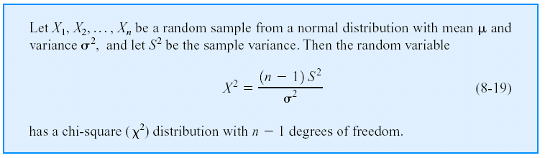
Confidence Interval on the Variance and Standard Deviation of a Normal Distribution
Definition
Test Statistics

Slide 84
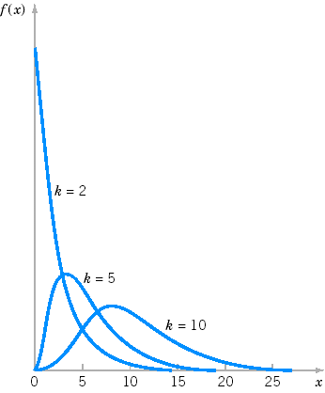
Probability density functions of several χ² distributions.

