Slide 1
Virtual COMSATS
Inferential Statistics
Lecture-7
Ossam Chohan
Assistant Professor
CIIT Abbottabad

Slide 2
Point Estimation
This technique is used in estimating population mean & proportions.
To choose the best estimator, it is required to observe the behavior of estimator in repeated trials. (How?)
Two characteristics of point estimate
  The sampling distribution of respective point estimate should center on the value of population parameter.
  The variation of sampling distribution should be minimum (How much?)

Slide 3
Mean Square Error
Mean Square Error (MSE) for sample mean can be defined as
MSE( )= E ( - µ)²
An estimator’s average squared distance from the true parameter is referred to as its mean square error.

Slide 4
MSE Relation with Estimator
Ideally a perfect estimator should have MSE= 0, but remember estimator is an estimator, we can never have perfect estimator equal to its parameter. Therefore never be equal to zero.
Reason: Statistical estimators always depends upon random data, so never have same characteristics as population might have.
So, major objective of estimation to find an estimator whose MSE is as smallest as possible.

Slide 5
Properties of point estimate
Why we need to apply properties:
  There could be many estimators for one population parameter.
  Selection is important?
  Criteria is averages and variation
  Need restriction to evaluate point estimate.

Slide 6
Properties: 1. Unbiasedness
First property is that an estimator should be an unbiased estimate of true population parameter.
An estimator is unbiased if expected value of estimator is equal to the parameter that is being estimated.
Common example is an unbiased estimator of the population mean µ. That is
E( ) = µ

Slide 7
Properties: 2. Consistency
An estimator is said to be consistent if the statistic to be used as estimator closer and closer to its respective population parameter as the sample size increases.
A consistent estimator may or may not be unbiased.
Sample mean is an unbiased and consistent estimator of population mean.

Slide 8
Properties: 3. Efficiency
An efficient estimator should be unbiased.
An estimator is said to be efficient if the variance of its sampling distribution is smaller than that of the sampling distribution of any other unbiased estimator(s) of the same parameter.
Let say Ѳ₁ and Ѳ₂ are two unbiased estimator for a parameter A. Which one is efficient?

Slide 9
Properties: 4. Sufficiency
If an estimator used all the information in sample then estimator is defined as sufficient one.
The sample mean is a sufficient estimator for µ whereas sample proportion is also a sufficient estimator of the population proportion P

Slide 10
Estimating a population mean or proportion
To estimate the population mean µ for a quantitative population, the point estimator (sample mean) is unbiased with standard error given as δ/√n.
The margin or error is ±Z_{α/2}[S.E].
To estimate the population proportion p for binomial population, the point estimate =X/n is unbiased with S.E=
The margin of error is ±Z_{α/2}[S.E]

Slide 11
Example-3
An investigator is interested in the possibility of merging the capabilities of television and the internet. A random sample of n=50 internet users who were polled about the time they spend watching television produced an of average of 11.5 hours per week with a standard deviation of 3.5 hours. Use this information to estimate the population mean time internet users spend watching television.

Slide 12
Example-3 Solution

Slide 13
Precision of the point estimate
Accuracy of estimator is serious concern while handling point estimate.
There is no degree of confidence associated with point estimates even if an estimator satisfied all four properties discussed above.
So……What's the Solution?

Slide 14
Interval Estimation
An interval estimator is the rule in which we calculate two numbers-say U and L which form the interval about which we are fairly certain that it contains the population parameter.
Fairly certain means that by using statistical tools we can associate some degree of confidence with interval-confidence interval.
The confidence coefficient would be 1-α.

Slide 16
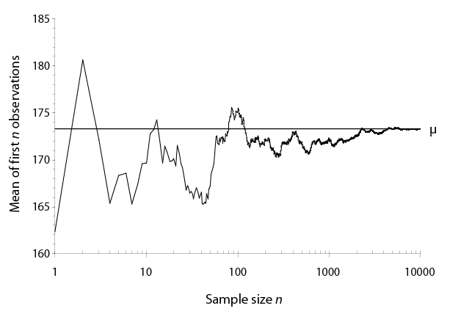
Law of Large Numbers
As a sample gets larger and larger, the x-bar approaches μ. Figure demonstrates results from an experiment done in a population with μ = 173.3
Mean body weight, men
Notes:
This slide illustrates a related concept: the Law of Large Numbers. The Law of Large Numbers says that as the sample gets larger and larger, the sample mean tends to get closer and closer to the value of the population mean. This is a reflection of the unbiased nature of the mean as an estimate of μ.

Slide 17
Recall Central Limit Theorem
CLT clearly stated that if sample size is fairly large (n>30), the sample mean has an approximate normal distribution with mean µ and variance S²/n .
As distribution approximates normal so we can use sample standard deviation instead of population standard deviation but ‘S’ clearly shows that population standard deviation is not known and approximation is used.

Slide 18
Selection of Test Statistics
Selection of test statistics is another important concept to understand before establishing confidence interval.
For single population parameter (µ, P…), there are three situations
  If population variation (or SD) is known.
  If population variation is not known but n≥30
  If population variation is not known and n<30

Slide 19
Case-1
If population variation (δ² or δ) is known then we will use test statistic:
S.E = δ/√n
= Σx_{i} /n

Slide 20
Case-2
If population variation (δ² or δ) is not known but sample size is ≥ 30, then we will use test statistic:
S.E = S/√n S=Sample standard deviation
= Σx_{i} /n
Why δ is replaced with S?

