Slide 1
Virtual COMSATS
Inferential Statistics
Lecture-4
Ossam Chohan
Assistant Professor
CIIT Abbottabad

Slide 2
SAMPLING DISTRIBUTION OF THE PROPORTION
The sampling distribution of the proportion is the probability distribution of sample proportions, with all samples having the same sample size n.
When sampling is without replacement
µ_{p}=p, Var(p)=[pq/n]* [(N-n)/(N-1)]
When sampling is with replacement
Var(p) = pq/n
What does proportion means????
No of boys in class of 50 (consisting on 40 boys and 10 girls)??

Slide 3
Example-4
Sampling with proportions
A population consists of N=6 values 1,3,6,8,9 and 12. Draw all possible samples of size 3 (WOR). Find the proportion of even numbers and construct sampling distribution of sample proportions and verify the results.

Slide 4
Example-4 Cont…..

Slide 5
Example-4 cont…

Slide 6
The next slide shows the sampling distributions of several statistics for our example as well as the sampling distribution of the proportion of odd numbers for our example.

Slide 7
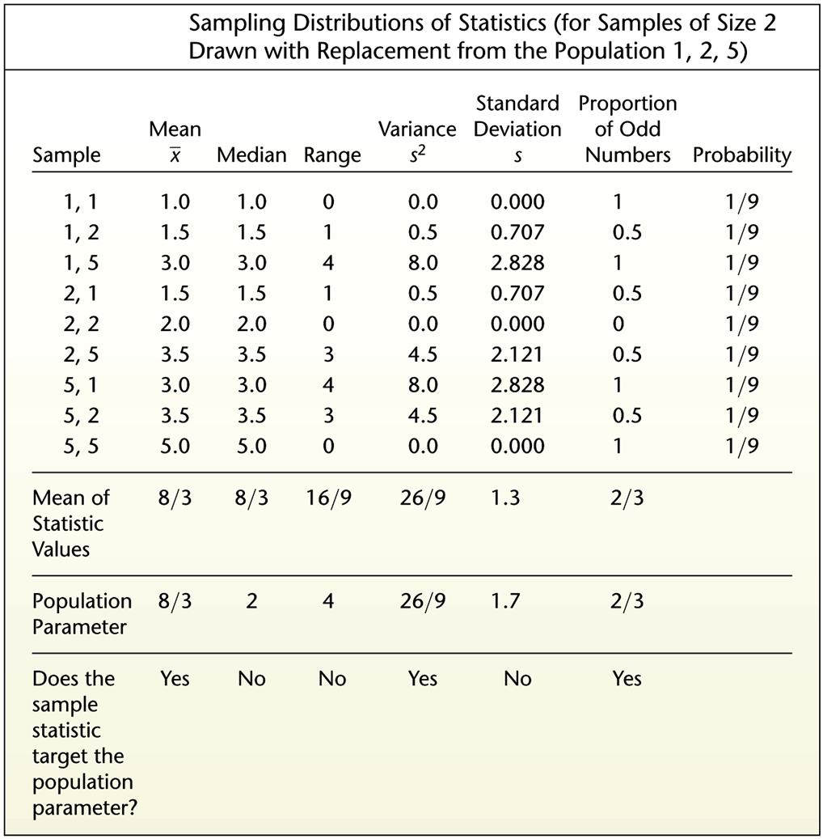

Slide 8
PROPERTIES OF THE DISTRIBUTION OF SAMPLE MEANS
The sample mean target the value of the population mean. (That is, the mean of the sample means is the population mean. The expected value of the sample means is equal to the population mean.)
The distribution of sample means tends to be a normal distribution. The distribution tends to become closer to a normal distribution as the sample size increase.

Slide 9
PROPERTIES OF THE DISTRIBUTION OF SAMPLE PROPORTIONS
The sample proportions tend to target the value of the population proportion. (That is, the mean of the sample proportions is the population proportion. The expected value of the sample proportion is equal to the population proportion.)
The distribution of sample proportions tends to be a normal distribution.

Slide 10
Example-5
(Difference between means)
Suppose N₁=4,6,8 and n₁=2
Suppose N₂=1,2,3 and n₂=2
Find all possible differences between the sample means of two populations.
Construct the sampling distribution of and computer mean and variances.
Verify the results

Slide 14
BIASED AND UNBIASED ESTIMATORS
You will notice from slide 16 that some sample statistics (the mean, variation, and proportion) “target” the population parameters. These sample statistics are called unbiased estimators.
Other sample statistics (the median, range, and standard deviation) either overestimate or underestimate the population parameter. These sample statistics are called biased estimators.

Slide 15
A COMMENT ON THE STANDARD DEVIATION
Even though the standard deviation is biased, the bias is relatively small in a large sample. As a result s is often used to estimate σ.This is an important property and we will discuss it in details in estimation section.

Slide 16
Practice Problems
Define and distinguish between
  Target and sampled populations
  Probability and non-probability sampling
  Sampling and non-sampling errors
Draw all possible distinct samples of size two from the following population: 2,4,6,8,10. Calculate the means of variances of the samples and of the population. Discuss the results

Slide 17
Practice Problems
Explain how you would select a random samples of 10 households from a list of 250 households by using a random number table.

Slide 18
Next Lecture
In next lecture we will come up with some more problems related to sampling distribution.
Having application of central limit theorem.
Calculating z-values.
Sampling distribution using probability distribution.
More Assessment problems ☹

