Slide 1
Virtual COMSATS
Inferential Statistics
Lecture-15
Ossam Chohan
Assistant Professor
CIIT Abbottabad

Slide 2
Recap of last lecture
So far we have discussed difference between means and difference between two population proportions and paired samples.
One sided confidence intervals.
Practice problems.

Slide 3
Objective of this lecture
More practice problems.
Important caution.
Confidence interval for population variance.
Some more problems☺

Slide 4
Practice Problem-3
A sample of size n = 100 produced the sample mean of = 16. Assuming the population standard deviation δ= 3, compute a 95% confidence interval for the population mean.

Slide 5
Practice Problem-3 Solution

Slide 6
Practice Problem-4
Installation of a certain hardware takes a random amount of time with a standard deviation of 5 minutes. A computer technician installs this hardware on 64 different computers, with the average installation time of 42 minutes. Compute a 95% confidence interval for the mean installation time.

Slide 7
Practice Problem-4 Solution

Slide 8
Practice Problem-5
A department store accepts only its own credit card. Among 35 randomly selected cardholders, it was found that the mean amount owed was $175.37, while the standard deviation was $84.77. Using information above, construct 95% confidence interval for true mean, that is average amount of money a cardholder might have.

Slide 9
Practice Problem-5 Solution

Slide 10
Practice Problem-6
A university in the Northeast claims in its brochures that it has an acceptance rate of 60%. A sample of 300 high school seniors who applied to this university shows that 148 of them were accepted. Construct 90% confidence interval.
Specify the test statistics first and then construct confidence limits.

Slide 11
Practice problem-6 Solution

Slide 12
Practice Problem-7
You interview a random sample of 50 adults. The results of the survey show that 48% of the adults said they were more likely to buy a product when there are free samples.
Need confidence limits for 95% confidence.

Slide 13
Practice Problem-7 Solution

Slide 14
Practice Problem-8
A public bus company official claims that the mean waiting time for bus number 14 during peak hours is less than 10 minutes. A college student took bus number 14 during peak hours on 18 different occasions. Her mean waiting time was 7.4 minutes with a standard deviation of 1.7 minutes. Construct 99% confidence limits.

Slide 15
Practice Problem-8 Solution

Slide 16
Practice Problem-9
The HRD department of the company developed an aptitude test for screening potential employees. The person who devised the test asserted that the mean mark attained would be 100. The following result are obtained with the random sample of applicants : =96, s=5.2 and n=40. Calculate the 95% confidence interval for the mean mark of all candidates and use it to see if the mean rank could be 100?

Slide 17
Practice Problem-9 Solution

Slide 18
Common Mistake !!!
A common mistake is to calculate a one-sample confidence interval for μ₁, a one-sample confidence interval for μ₂, and to then conclude that μ₁ and μ₂ are equal if the confidence intervals overlap.
This is WRONG because the variability in the sampling distribution for from two independent samples is more complex and must take into account variability coming from both samples. Hence the more complex formula for the standard error.

Slide 19
Reason for Contradictory Result

Slide 20
Assessment Problem-3
Objective Type
A finance major was asked to estimate the average total compensation of CEO's in the Computer industry. Data were randomly collected from 18 CEO's and the 97% confidence interval was calculated to be $2,181,260 to $5,836,180. Which of the following interpretations is correct?
  a. 97% of the sampled total compensation values fell between $2,181,260 and $5,836,180.
  b. We are 97% confident that the mean of the sampled CEO's falls in the interval $2,181,260 to $5,836,180.
  c. In the population of Service industry CEO's, 97% of them will have total compensations that fall in the interval $2,181,260 to $5,836,180.
  d. We are 97% confident that the average total compensation of all CEO's in the Service industry falls in the interval $2,181,260 to $5,836,180.

Slide 21
Assessment Problem-4
Objective type
A finance major was asked to estimate the average total compensation of CEO's in the Computer industry. Data were randomly collected from 18 CEO's and the 97% confidence interval was calculated to be $2,181,260 to $5,836,180. Based on the interval above, do you believe the average total compensation of CEO's in the Computer industry is more than $3,000,000?
  a. Yes, and I am 97% confident of it.
  b. Yes, and I am 78% confident of it.
  c. I am 97% confident that the average compensation is $3,000,000.
  d. I cannot conclude that the average exceeds $3,000,000 at the 97% confidence level.

Slide 22
Assessment Problem-5
Objective Type
To estimate the proportion of statistics students that are females a confidence interval estimation is used. A random sample of 72 statistics students generated the following 90% confidence interval estimates: (.438 to .642). Based on this interval, is the population proportion of females equal to 60%?
  a. No, and we are 90% sure of it.
  b. Yes, and we are 90% sure of it.
  c. No. The proportion is 54.17%
  d. Maybe. 60% is a believable value of the population proportion based on the information above.

Slide 23
Assessment Problem-6
Objective Type
Suppose a large labor union wishes to estimate the mean number of hours per month a union member is absent from work. The union decides to sample 320 of its members at random and monitor their working time for 1 month. At the end of the month, the total number of hours absent from work is recorded for each employee. If the mean and standard deviation of the sample are x = 9.6 hours and s = 6.4 hours, find a 90% confidence interval for the true mean number of hours absent per month per employee.
  a. 9.6 ± .458
  b. 9.6 ± .033
  c. 9.6 ± .211
  d. 9.6 ± .589

Slide 24
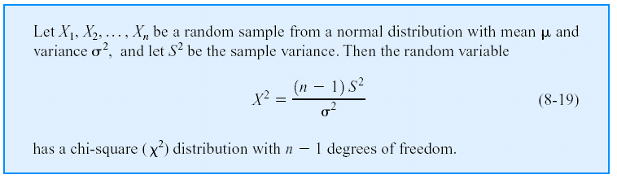
Confidence Interval on the Variance and Standard Deviation of a Normal Distribution
Definition
Test Statistics

Slide 25
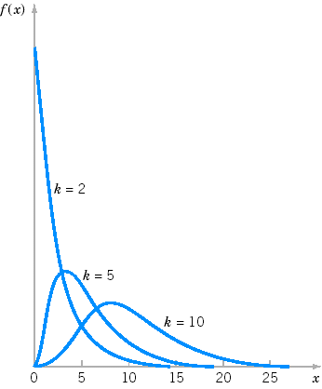
Probability density functions of several χ² distributions.

Slide 26

χ² distribution.
The chi-square ( ) distribution is obtained from the values of the ratio of the sample variance and population variance multiplied by the degrees of freedom. This occurs when the population is normally distributed with population variance δ².

Slide 27
Properties and Characteristics:
Chi-square density curves are right-skewed.
Each Chi-square random variable is associated with a degree of freedom (υ), . As υ increase, Chi-square curves become more symmetric.
Z², the square of a normal[0,1] random variable, follows a Chi square (with1 df)distribution.
Chi-square is non-negative and the ratio of two non-negative values, therefore must be non-negative itself.
Chi-square is non-symmetric
There are many different chi-square distributions, one for each degree of freedom.
The degrees of freedom when working with a single population variance is n-1.

Slide 28
Confidence Interval construction for population variance.

Slide 29
Can we find CI for population standard deviation??

Slide 30
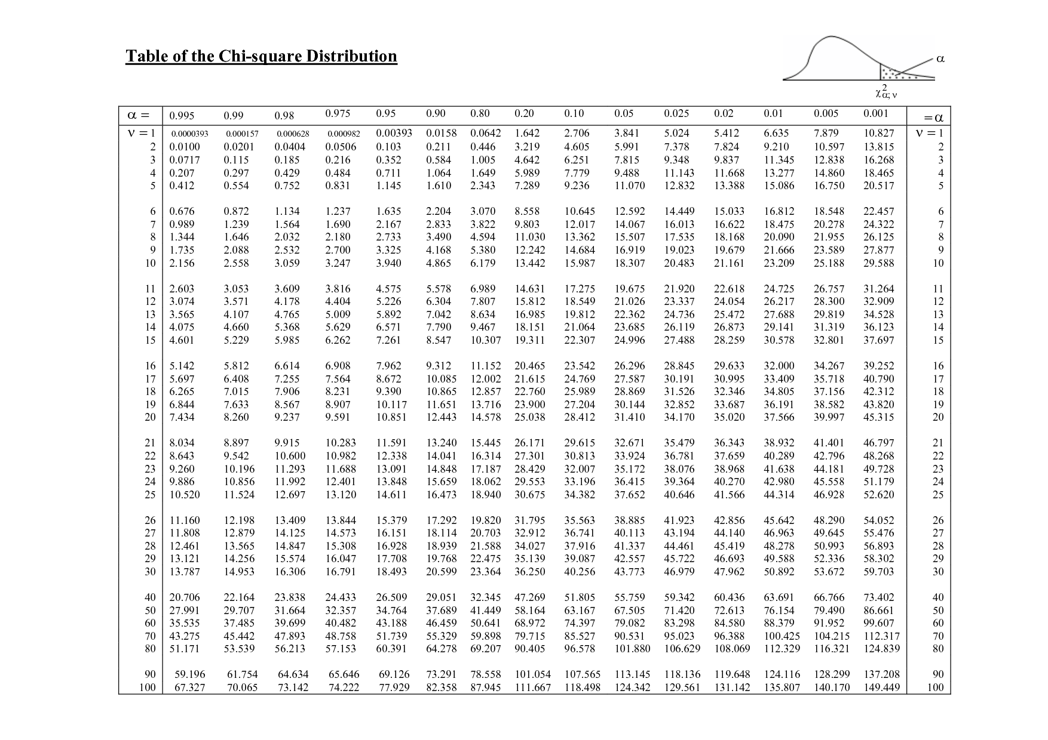

Slide 31
Problem-33
A cigarette manufacturer wants to test the claim that the variance of the nicotine content of its cigs. is 0.644 milligram. Assume that it is normally distributed. A sample of 20 cigs. has a std. dev. of 1.00 milligram. Calculate 95% confidence limits for population variance.

Slide 32
Problem-33 Solution

Slide 33
Assessment Problem-3
A machine dispenses a liquid drug into bottles in such a way that the standard deviation of the contents is 81 milliliters. A new machine is tested on a sample of 24 containers and the standard deviation for this sample group is found to be 26 milliliters. Calculate 95% confidence limits for population variance.

Slide 34
Assessment Problem Discussion

