Slide 1
Virtual COMSATS
Inferential Statistics
Lecture-13
Ossam Chohan
Assistant Professor
CIIT Abbottabad

Slide 2
Recap of previous lecture
In previous lecture we discussed
Two population concepts
Independence and Random
CI Construction for two cases

Slide 3
Objective of this lecture
After completing this lecture, you should be able to:
Interval Estimate for
  Two independent population means.
    Standard deviations known
    Standard deviations unknown, but sample sizes>30
    Standard deviations unknown but n_{i}<30
  Two means from paired samples.
  The difference between two population proportions.

Slide 4
Population variances are unknown but can be assumed to be equal (t is used)
If it can be assumed that the population variances are equal then each sample variance is actually a point estimate of the same quantity. Therefore, we can combine the sample variances to form a pooled estimate.
Weighted averages
The pooled estimated of the common variance is made using weighted averages. This means that each sample variance is weighted by its degrees of freedom.

Slide 5
Assumptions
Populations are normally distributed.
Populations have equal variances but still unknown.
Independence of samples must be ensured.
If population variances are equal then pooled value can be calculated.
Degree of freedom would be (n₁+n₂-2).
Appropriate test is ‘t’

Slide 6


Pooled estimate of the variance
The pooled estimate of the variance comes from the formula:
Standard error of the estimate
The standard error of the estimate is

Slide 7
Confidence interval
The 100(1-α )% confidence interval for µ₁-µ₂ is:

Slide 8
Problem-24
Given
n₁ = 13, = 21.0, s₁= 4.9
n₂ = 17, = 12.1, s₂= 5.6
We have to find 95% confidence for difference between population means. Assume population variances are equal.

Slide 9
Problem-24 Solution

Slide 10
Problem-25
From an area planted in one variety of a rubber producing plant, 54 plants were selected at random. Of these, 15 were off types and 12 were aberrant. Rubber percentages for these plants were:
Off types | 6.21, 5.70, 6.04, 4.47, 5.22, 4.45, 4.84, 5.88, 5.82, 6.09, 5.59, 6.06, 5.59, 6.74, 5.55
Aberrant | 4.28, 7.71, 6.48, 7.71, 7.37, 7.20, 7.06, 6.40, 8.93, 5.91, 5.51, 6.36

Slide 11
Problem-25 Cont…
Calculate a 95% confidence limits for difference between means of populations of rubber percentages. Assume the populations of rubber percentages are approximately normal and have equal variances.

Slide 12
Problem-25 Solution

Slide 13
Population variances are unknown and unequal (t is used)
Suppose that we are given two small random samples from two normally distributed populations with means µ₁ and µ₂ and standard deviation δ₁ n δ₂ respectively. If δ₁ not equal to δ₂ and unknown , we use their sample estimates s₁ and s₂ to compute the standard error of the difference between means and get

Slide 14
Confidence Interval and degrees of freedom
Test statistic to be used will be same as t.
Degree of freedom
An estimate of the degrees of freedom is
min(n₁ − 1, n₂ − 1).

Slide 15
Problem-26
Given two random samples of size n1=7 and n2=6 from two independent normal populations, with =10.91, =4.60, s₁=6.34 and s₂= 3.09, calculate 95% confidence interval for difference between means. Assume that the population variances are unequal.

Slide 16
Problem-26 Solution

Slide 17
Confidence Interval for difference between Proportions
This is for large samples.
Suppose there are two binomial populations with unknown proportions of successes p₁ and p₂ respectively. Let p₁ be the proportions of successes based on a random sample of size n₁ drawn from first population and p₂ be the proportions of successes based on a random sample of size n₂ drawn from second population. Then the sampling distribution of the difference P₁ – P₁ will be approximately normal with mean of p₁ – p₂ and the standard deviation of

Slide 18
For sufficiently large samples, the random variable
Is approximately N(0,1)
Note: What is p-bar???

Slide 19
Confidence Interval for
Two Population Proportions

Slide 20
Problem-27
Suppose the Cartoon Network conducts a nation-wide survey to assess viewer attitudes toward Ben10. Using a simple random sample, they select 400 boys and 300 girls to participate in the study. Forty percent of the boys say that Ben10 is their favorite character, compared to thirty percent of the girls. What is the 90% confidence interval for the true difference in attitudes toward Ben10?

Slide 21
Problem-27 Discussion
The sampling method must be simple random sampling. This condition is satisfied; the problem statement says that we used simple random sampling.
Both samples should be independent. This condition is satisfied since neither sample was affected by responses of the other sample.
The sampling distribution should be approximately normally distributed. Because each sample size is large, we know from the central limit theorem that the sampling distribution of the difference between sample proportions will be normal or nearly normal; so this condition is satisfied.

Slide 22
Problem-27 Solution

Slide 23
Problem-28
To study the effectiveness of a drug for some disease, two samples of patients were randomly selected. One sample of 100 was injected with the drug, the other sample of 60 receiving a placebo injection. After a period of time the patients were asked if their disease condition had improved. Results were:

Slide 24
Problem-28
 | Drug | Placebo | Total
Improved | 59 | 22 | 81
Not Improved | 41 | 38 | 79
total | 100 | 60 | 160
Calculate the 95% confidence interval for difference between proportions reflecting the proportions of improved and not improved respectively.

Slide 25
Problem-28 Solution

Slide 26
Problem-29
The Physicians Health Study Research Group at Harvard Medical School conducted a five-year randomized study about the relationship between aspirin and heart disease. The study subjects were 22,071 male physicians. Every other day, study participants took either an aspirin tablet or a placebo tablet. The physicians were randomly assigned to the aspirin or to the placebo group. The study was double-blind. The following table shows the results:
Group | Heart Attack | No H Attack | Total
Placebo | 189 | 10,845 | 11034
Aspirin | 104 | 10,933 | 11037

Slide 27
Problem-29 Cont…
What is the sample proportion suffering a heart attack?
What is the estimated difference?
What is the standard error of this estimate?
95% , 90%, 80% confidence interval is required.

Slide 28
Problem-29 Solution

Slide 29
Home work
You are required to consider this home work on top priority.
  You are required to observe the behavior of interval when confidence coefficient increase, that is first find 80% CI, then 85%, 90% , 95%, 99%.
  You need to report how confidence coefficient effect the interval.
  For same confidence coefficient, try different sample sizes, and observe behavior of interval.

Slide 30
Home Work Cont…
Keep confidence coefficient as 80% and try different n in increasing order.
n | Confidence Coefficient=80%
 | Lower value | Upper Value | Width of interval
25
50
100
200
300
400

Slide 31
Home Work Cont…
For single value of n, try different confidence coefficient and observe the behavior of interval.
Confidence Coefficients | n=25
 | Lower value | Upper value | Width
80%
85%
90%
95%
99%

Slide 32
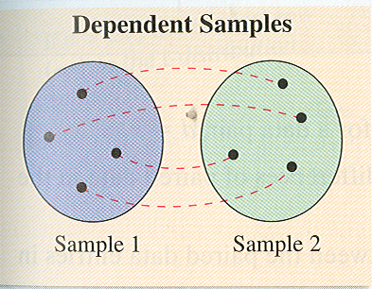
Dependent and independent samples
In previous section, we have discussed two-sample interval estimation in which the samples were independent.
But we have not discussed what does it mean when samples are dependent.
In this section, we are going to discuss how to observe dependence between two samples and what is the impact on analysis.

Slide 33
Dependent samples???
Two samples are independent if the sample selected from one population having no relation or impact on the selection (observation) with other sample.
The two samples are dependent if each member of one sample corresponds to a member of the other sample.
Dependent samples are also called paired samples or matched samples.

Slide 34
Independent and Dependent Samples
Classify each pair of samples as independent or dependent:
Sample 1: Resting heart rates of 35 individuals before drinking coffee.
Sample 2: Resting heart rates of the same individuals after drinking two cups of coffee.

Slide 35
These samples are dependent. Because each reading or observation is based on previous result that is before coffee and after coffee.
These samples are related.
The samples can be paired with respect to each individual.

Slide 36
Independent and Dependent Samples
Classify each pair of samples as independent or dependent:
Sample 1: Test scores for 35 statistics students
Sample 2: Test scores for 42 biology students who do not study statistics
What do u think now about independence or dependence???

Slide 37
Important Tip ☺
We can observe that in dependent samples experimental units or subjects are same.
That is for each experimental unit, two observations are recorded.
It means that observation after some experiment will depend upon the previous history.

Slide 38
The t-Test for the Difference Between Means but paired one.
We were using the test statistic, (the difference in the means of two samples). To perform a two-sample analysis in interval estimation when samples are dependent, we will use a different approach. You will first find the difference for each data pair,
. The test statistic is the mean of these differences,

Slide 39
To conduct the test with paired observations, the following conditions are required:
The samples must be dependent (paired) and randomly selected.
Both populations must be normally distributed.
If these two requirement are met, then the sampling distribution for , the mean of the differences of the paired data entries in the dependent samples, has a t-distribution with n – 1 degrees of freedom, where n is the number of data pairs

Slide 40
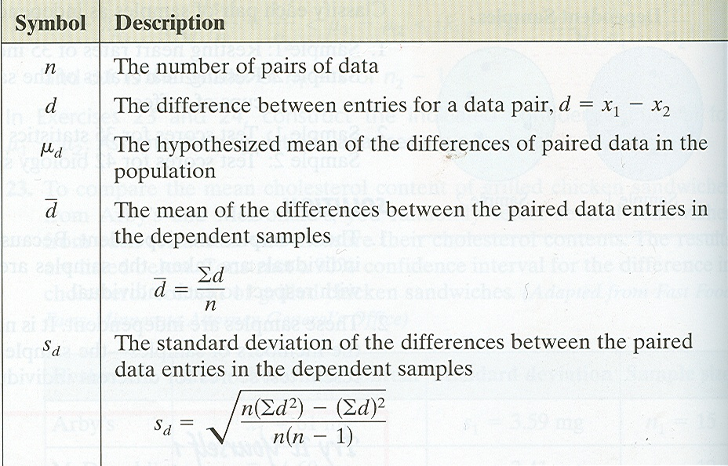
The following symbols are used for the t-test for μ_{d}.
It is highly recommended that you better use calculator to find the required values to avoid any mistake while manual calculations.

Slide 41
Problem-30
When comparing the difference between driving speed of an individual in the morning as opposed to the evening a random sample was conducted to choose 100 individuals. Each individual was then observed and a morning driving speed and an evening driving speed were calculated. The differences of each individuals driving speed was then analyzed.
Comment on above case.

Slide 42
Problem-31
Ten young recruits were put through a tough physical training program by the Army. Their weights were recorded before and after the training with the following results.
Recruit | 1 | 2 | 3 | 4 | 5 | 6 | 7 | 8 | 9 | 10
Before | 125 | 195 | 160 | 171 | 140 | 201 | 170 | 176 | 195 | 139
After | 136 | 201 | 158 | 184 | 145 | 195 | 175 | 190 | 190 | 145

Slide 43
Problem-31 Cont…
Analyze the problem and check either it is dependent case or independent?
Construct 95% confidence interval for efficiency of program with respect to weight.

Slide 44
Problem-31 Solution

Slide 45
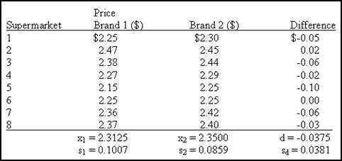
Problem-32
We are interested in comparing the avg. supermarket prices of two leading colas in the Tampa area. Our sample was taken by randomly going to each of eight supermarkets and recording the price of s-pack of cola of each brand. The data are shown in the following table:
Find a 98% confidence interval for the difference in mean price of brand 1 and brand 2.

Slide 46
Problem-32 Solution

Slide 47
One sided confidence interval
So far we have studied two sided 100(1-α)% confidence interval.
Because interval specified both lower and upper limits of any particular parameter.
We may wish to have only one tail (limit).
Therefore α area will be located at one side of the sampling distribution.

Slide 48
Problem-32
For estimating the average weight of college students in Lahore city, a sample of 100 college students is randomly selected and a sample mean of 120 pounds is obtained. Assume that the variance of the population is 1600. determine the lower limit of the 95% confidence interval where upper limit is 280 pounds.

Slide 49
Problem-32 Solution

Slide 50
Practice Problems
In this section, we will go through various problems without having any title and will try to understand the suitable approach to solve problems.
This will include different problems like single mean, proportions, difference between means, proportions, z, t statistics, paired case.

Slide 51
Practice Problem-1
In order to ensure efficient usage of a server, it is necessary to estimate the mean number of concurrent users. According to records, the sample mean and sample standard deviation of number of concurrent users at 100 randomly selected times is 37.7 and 9.2, respectively.
Construct a 90% confidence interval for the mean number of concurrent users.

Slide 52
Practice Problem-1 Solution

Slide 53
Practice Problem-2
To assess the accuracy of a laboratory scale, a standard weight that is known to weigh 1 gram is repeatedly weighed 4 times. The resulting measurements (in grams) are: 0.95, 1.02, 1.01, 0.98. Assume that the weighing by the scale when the true weight is 1 gram are normally distributed with mean.
Use these data to compute a 95% confidence interval for µ.

Slide 54
Practice Problem-2 Solution

Slide 55
Practice Problem-3
A sample of size n = 100 produced the sample mean of = 16. Assuming the population standard deviation δ= 3, compute a 95% confidence interval for the population mean.

Slide 56
Practice Problem-3 Solution

Slide 57
Practice Problem-4
Installation of a certain hardware takes a random amount of time with a standard deviation of 5 minutes. A computer technician installs this hardware on 64 different computers, with the average installation time of 42 minutes. Compute a 95% confidence interval for the mean installation time.

Slide 58
Practice Problem-4 Solution

Slide 59
Practice Problem-5
A department store accepts only its own credit card. Among 35 randomly selected cardholders, it was found that the mean amount owed was $175.37, while the standard deviation was $84.77. Using information above, construct 95% confidence interval for true mean, that is average amount of money a cardholder might have.

Slide 60
Practice Problem-5 Solution

Slide 61
Practice Problem-6
A university in the Northeast claims in its brochures that it has an acceptance rate of 60%. A sample of 300 high school seniors who applied to this university shows that 148 of them were accepted. Construct 90% confidence interval.
Specify the test statistics first and then construct confidence limits.

Slide 62
Practice problem-6 Solution

Slide 63
Practice Problem-7
You interview a random sample of 50 adults. The results of the survey show that 48% of the adults said they were more likely to buy a product when there are free samples.
Need confidence limits for 95% confidence.

Slide 64
Practice Problem-7 Solution

Slide 65
Practice Problem-8
A public bus company official claims that the mean waiting time for bus number 14 during peak hours is less than 10 minutes. A college student took bus number 14 during peak hours on 18 different occasions. Her mean waiting time was 7.4 minutes with a standard deviation of 1.7 minutes. Construct 99% confidence limits.

Slide 66
Practice Problem-8 Solution

Slide 67
Practice Problem-9
The HRD department of the company developed an aptitude test for screening potential employees. The person who devised the test asserted that the mean mark attained would be 100. The following result are obtained with the random sample of applicants : =96, s=5.2 and n=40. Calculate the 95% confidence interval for the mean mark of all candidates and use it to see if the mean rank could be 100?

Slide 68
Practice Problem-9 Solution

Slide 69
Common Mistake !!!
A common mistake is to calculate a one-sample confidence interval for μ₁, a one-sample confidence interval for μ₂, and to then conclude that μ₁ and μ₂ are equal if the confidence intervals overlap.
This is WRONG because the variability in the sampling distribution for from two independent samples is more complex and must take into account variability coming from both samples. Hence the more complex formula for the standard error.

Slide 70
Reason for Contradictory Result

Slide 71
Assessment Problem-3
Objective Type
A finance major was asked to estimate the average total compensation of CEO's in the Computer industry. Data were randomly collected from 18 CEO's and the 97% confidence interval was calculated to be $2,181,260 to $5,836,180. Which of the following interpretations is correct?
  a. 97% of the sampled total compensation values fell between $2,181,260 and $5,836,180.
  b. We are 97% confident that the mean of the sampled CEO's falls in the interval $2,181,260 to $5,836,180.
  c. In the population of Service industry CEO's, 97% of them will have total compensations that fall in the interval $2,181,260 to $5,836,180.
  d. We are 97% confident that the average total compensation of all CEO's in the Service industry falls in the interval $2,181,260 to $5,836,180.

Slide 72
Assessment Problem-4
Objective type
A finance major was asked to estimate the average total compensation of CEO's in the Computer industry. Data were randomly collected from 18 CEO's and the 97% confidence interval was calculated to be $2,181,260 to $5,836,180. Based on the interval above, do you believe the average total compensation of CEO's in the Computer industry is more than $3,000,000?
  a. Yes, and I am 97% confident of it.
  b. Yes, and I am 78% confident of it.
  c. I am 97% confident that the average compensation is $3,000,000.
  d. I cannot conclude that the average exceeds $3,000,000 at the 97% confidence level.

Slide 73
Assessment Problem-5
Objective Type
To estimate the proportion of statistics students that are females a confidence interval estimation is used. A random sample of 72 statistics students generated the following 90% confidence interval estimates: (.438 to .642). Based on this interval, is the population proportion of females equal to 60%?
  a. No, and we are 90% sure of it.
  b. Yes, and we are 90% sure of it.
  c. No. The proportion is 54.17%
  d. Maybe. 60% is a believable value of the population proportion based on the information above.

Slide 74
Assessment Problem-6
Objective Type
Suppose a large labor union wishes to estimate the mean number of hours per month a union member is absent from work. The union decides to sample 320 of its members at random and monitor their working time for 1 month. At the end of the month, the total number of hours absent from work is recorded for each employee. If the mean and standard deviation of the sample are x = 9.6 hours and s = 6.4 hours, find a 90% confidence interval for the true mean number of hours absent per month per employee.
  a. 9.6 ± .458
  b. 9.6 ± .033
  c. 9.6 ± .211
  d. 9.6 ± .589

Slide 75
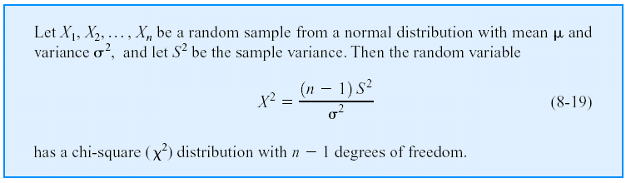
Confidence Interval on the Variance and Standard Deviation of a Normal Distribution
Definition
Test Statistics

Slide 76
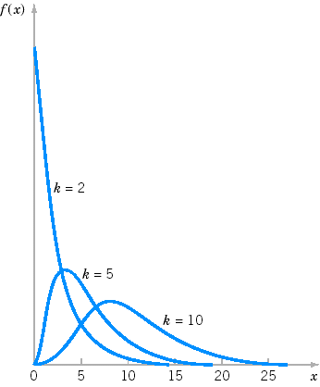
Probability density functions of several χ² distributions.

Slide 77

χ² distribution.
The chi-square ( ) distribution is obtained from the values of the ratio of the sample variance and population variance multiplied by the degrees of freedom. This occurs when the population is normally distributed with population variance δ².

Slide 78
Properties and Characteristics:
Chi-square density curves are right-skewed.
Each Chi-square random variable is associated with a degree of freedom (υ), . As υ increase, Chi-square curves become more symmetric.
Z², the square of a normal[0,1] random variable, follows a Chi square (with1 df)distribution.
Chi-square is non-negative and the ratio of two non-negative values, therefore must be non-negative itself.
Chi-square is non-symmetric
There are many different chi-square distributions, one for each degree of freedom.
The degrees of freedom when working with a single population variance is n-1.

Slide 79
Confidence Interval construction for population variance.

Slide 80
Can we find CI for population standard deviation??

Slide 81
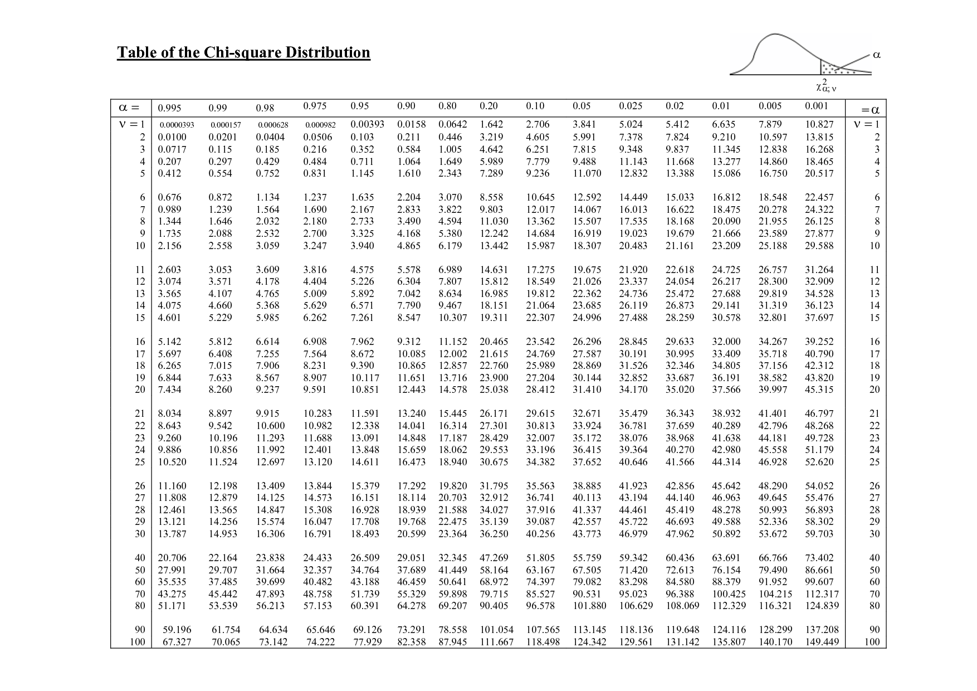

Slide 82
Problem-33
A cigarette manufacturer wants to test the claim that the variance of the nicotine content of its cigs. is 0.644 milligram. Assume that it is normally distributed. A sample of 20 cigs. has a std. dev. of 1.00 milligram. Calculate 95% confidence limits for population variance.

Slide 83
Problem-33 Solution

Slide 84
Assessment Problem-3
A machine dispenses a liquid drug into bottles in such a way that the standard deviation of the contents is 81 milliliters. A new machine is tested on a sample of 24 containers and the standard deviation for this sample group is found to be 26 milliliters. Calculate 95% confidence limits for population variance.

Slide 85
Assessment Problem Discussion

Slide 86
Introduction to Hypothesis Testing

Slide 87
Objective of lecture
Introduction of Statistical Inferences.
Introduction to Hypothesis testing.
  Null and alternative hypothesis
  One tail and two tail hypothesis.
  Directional hypothesis.
  Level of significance.
  Type-I and type-II error.
  Test Statistic(s)
  Critical Region
  Conclusion

Slide 88
Introduction
“Hypothesis testing can be defined as an inferential procedure that uses sample data to evaluate the credibility of a hypothesis about a population”
Hypothesis:
  “A tentative statement about a population parameter that might be true or wrong”
  Why Hypothesis?

Slide 89
A hypothesis is an assumption about the population parameter.
  A parameter is a Population mean or proportion or any other characteristics of population
  The parameter must be identified before analysis.
A hypothesis is a specific, testable prediction about what you expect to happen in your study.

Slide 90
Examples of Hypotheses
    An operation manager wants to determine if the mean demand during lead time is greater than 350.
    Assume that population mean age is 50.
    More students get sick during the final week of testing that at other times.
    Amount of sun exposure will increase the growth of a tomato plant.
    There is a positive correlation between the availability of hours for work and the productivity of employees.
    Worker satisfaction increases worker productivity.

Slide 91
Basics About Hypotheses
The two types of hypotheses are scientific and working.
A scientific hypothesis is based on experiments and observations from the past that cannot be explained with current theories.
A working hypothesis is one that is widely accepted and becomes the basis of further experimentation.

Slide 92
Good Hypothesis
In order to be a good hypothesis that can be tested or studied, a hypothesis:
  Needs to be logical
  Must use precise language
  Should be testable with research or experimentation

Slide 93
Hypothesis, Law and Theory
Hypothesis:
  A hypothesis will give a plausible explanation that will be tested. It can also explain future phenomenon that will need to be tested.
Law:
  Once a hypothesis has been widely accepted, it is called a law. This means that it is assumed to be true and will predict the outcome of certain conditions or experiments.
Theory:
  A scientific theory is broader in scope and explains more events that a law. After hypotheses and laws have been tested many times, with accurate results, they become theories.

Slide 94
Finally what is hypothesis?
A statistical hypothesis is a claim (assertion, statement, belief or assumption) about an unknown population parameter value.
For example an investment company claims that the average return across all its investments is 20 percent and so on. To test such claims sample data are collected and analyzed.
On the basis of sample findings hypothesized value of population parameter is accepted or rejected.

Slide 95
Types of Hypothesis
Null hypothesis:
  The null hypothesis is a statement that you want to test. For example, if you measure the size of the feet of male and female chickens, the null hypothesis could be that the average foot size in male chickens is the same as the average foot size in female chickens
Research/ Alternative hypothesis:
  The alternative hypothesis is that things are different from each other, or different from a theoretical expectation.

Slide 96
Cont….
For example, one alternative hypothesis would be that male chickens have a different average foot size than female chickens.
Example: If you predict girls are more intelligent than boys; the experimental hypothesis would be that girls will be significantly more intelligent than boys. Where as the Null hypothesis would be there is no significant difference in intelligence between boys and girls.

Slide 97
The Null Hypothesis, H₀
States the Assumption (numerical) to be tested
e.g. The average # TV sets in US homes is at least 3 (H₀: μ ≥ 3)
Begin with the assumption that the null hypothesis is TRUE. Real life example is Similar to the notion of innocent until proven guilty
Always contains the ‘ = ‘ sign
The Null Hypothesis may or may not be rejected.

Slide 98
The Alternative Hypothesis,
H₁ or H_{A}
Is the opposite of the null hypothesis e.g. The average # TV sets in US homes is less than 3 (H₁: μ < 3)
Challenges the Status Quo
Never contains the ‘=‘ sign
The Alternative Hypothesis may or may not be accepted

Slide 99
Types of Errors
Two types of errors may occur when deciding whether to reject H₀ based on the statistic value.
  Type I error: Reject H₀ while the truth is, it is true.
  Type II error: Do not reject H₀ while the truth is, it is false.
Example continued
  Type I error: Reject H₀ (μ ≥ 30) in favor of H₁ (μ < 30) while the truth is, the real value of μ ≥ 30.
  Type II error: Do not reject H₀ (μ ≥ 30) while the truth is, the real value of μ is less than 30.

Slide 100
Types of Errors-discussion

Slide 101
Errors in Hypothesis Testing
 |  | Actual State of Affairs
Belief | Conclusion | H₀ is True | H₀ is False
H₀ is False | Reject H₀ | Type I Error False Positive α | Correct Rejection 1 - β Power
H₀ is True | Fail to Reject H₀ | Correct Failure to Reject 1 - α | Type II Error False Negative β

Slide 102
Example of errors: Jury’s Decision
 | Did Not Commit Crime | Committed Crime
Guilty | Type I Error Convict Innocent Person | Correct Verdict Convict Guilty Person No Error
Not Guilty | Correct Acquittal Fail to Convict Innocent Person No Error | Type II Error Fail to Convict Guilty Person

Slide 103
Practical Problem for understanding
We will use following example throughout the understanding phase of introduction. And we will add some more problems to make it more clear.

Slide 104
Define hypothesis
  Example:
  Does an average box of cereal contain more than 368 grams of cereal? A random sample of 25 boxes showed = 372.5. The company has specified σ to be 15 grams. Test at the α=0.05 level.
  The two hypotheses about a population mean:
    H₀: The null hypothesis μ ≤ 368
    H₁: The alternative hypothesis μ > 368

Slide 105
Important Tips
How to represent hypothesis?
Role of equality in hypothesis?

Slide 106
Discussion

Slide 107
Discussion continued

Slide 108
One tail/Two tail hypothesis
Is that example one tail or two tail? Justify

Slide 109
Directional Hypothesis

Slide 110
Level of Significance
Alpha: probability of committing a Type I error
    Reject H₀ although it is true
    Symbolized by α
What about probability of type-II error?
What is the role of type-II error in HT?
Probability that the test will correctly reject a false null hypothesis-Power of the Test

Slide 111
The significance level of a statistical hypothesis test is a fixed probability of wrongly rejecting the null hypothesis H₀, if it is in fact true. It is the probability of a type-I error and is set by the investigator in relation to the consequences of such an error. That is, we want to make the significance level as small as possible in order to protect the null hypothesis and to prevent, as far as possible, the investigator from inadvertently making false claims.
The significance level is usually denoted by significance level = P (type I error) = α
Usually, the significance level is chosen to be 0.05 (or equivalently, 5%).

Slide 112
Identifying δ and observe n
The role of population variation and sample size is highly significant in drawing inferences-statistical, as we discussed in estimation section.
All the rules are same as we discussed in estimation.
Selection of test statistics depends upon population variability and sample size. (obviously CLT plays role here)

Slide 113
Test Statistic
A test statistic is a quantity calculated from our sample of data. Its value is used to decide whether or not the null hypothesis should be rejected in our hypothesis test.
There are different test statistics for different situations, same rules followed as we selected test statistics in estimation.

Slide 114
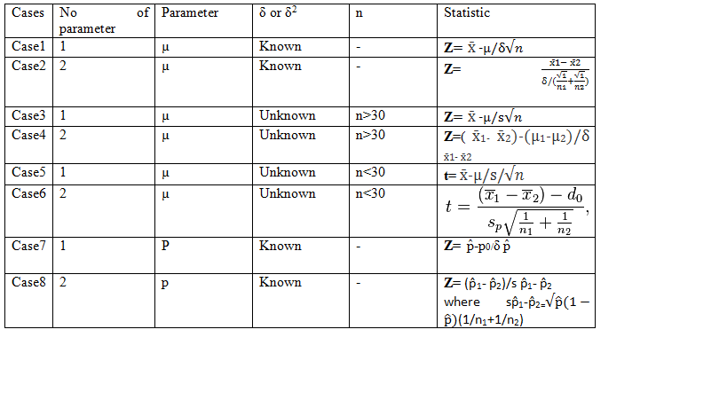
Some Test Statistics

Slide 115
Calculation of Test Statistics
Calculate the standard error of the sample statistic. Use the standard error to convert the observed value of the sample statistic to a standardize value.
Test Statistic will provide you consolidated sample evidence, and this value will be after considering variation in data.

Slide 116
Critical region and Conclusions
The critical region CR, or rejection region RR, is a set of values of the test statistic for which the null hypothesis is rejected in a hypothesis test.
The sample space for the test statistic is partitioned into two regions;
The critical region will lead us to reject the null hypothesis H₀, the other will not.
If the observed value of the test statistic is a member of the critical region, we conclude "Reject H₀"; if it is not a member of the critical region then we conclude "Do not reject H₀".

Slide 117
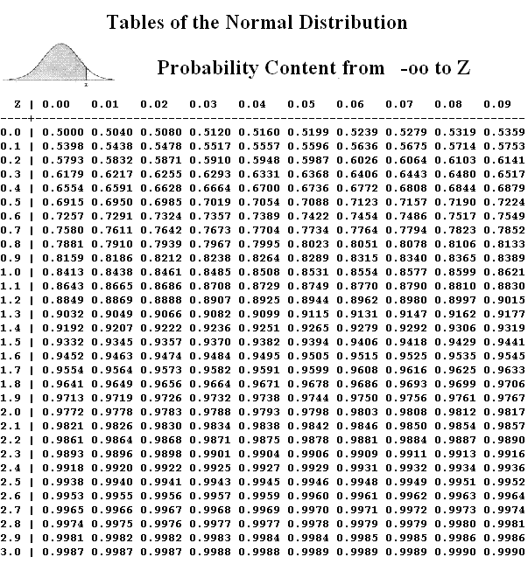
Assessment Problem-3
We know that the statement
P( -1.96δ <µ< +1.96δ )=0.95 is correct, while the statement P(140<µ<160)=0.95 is not correct. Explain why the latter is erroneous?
Some guidelines….

Slide 118
Z values for various confidence levels
99.73% 3.00
99% 2.58
98% 2.33
96% 2.05
95.45% 2.00
95% 1.96
90% 1.645
80% 1.28
68.27% 1.00
50% 0.6745

Slide 119
Problem-1
The mean lifetime of electric light bulbs produced by a company has in the past been 1120 hours with standard deviation of 125 hours. A sample of 100 electric bulbs recently chosen from a supply of newly produced bulbs showed a mean lifetime of 1070 hours. Test the hypothesis that the mean lifetime of bulbs has not changed, using 5% levels of significance.

Slide 120
Problem-1 Solution

Slide 121
Problem-2
The mean weight of a tablet of a certain drug is claimed to be 50 mg. A sample of 100 tablets showed a mean weight of 50.15 mg with a standard deviation of 0.4 mg. Using a 1% level of significance, can we conclude that the desired weight is not properly maintained?

Slide 122
Problem-2 Solution

Slide 123
Assessment problem-1
A manufacturer supplies the rear axles for U.S Postal Service mail trucks. These axles must be able to withstand 80,000 pounds per square inch in stress tests, but an excessively strong axle raises production costs significantly. Long experience indicates that the standard deviation of the strength of its axles is 4,000 pounds per square inch. The manufacturer selects a sample of 100 axles from production, tests them, and finds that the mean stress capacity of the sample is 79,600 pounds per square inch.

Slide 124
Assessment Problem-2
It has been found from experience at the mean breaking strength of a particular brand of threads is 9.63N with a standard deviation of 1.40N. Recently a sample of 36 pieces of threads showed a mean breaking strength of 8.93N. Can we conclude at 5% and 1% levels of significance that the threads have become inferior?

Slide 125
Problem-3
A company claims that the average lifetime of his product is 2000 hours. A random sample of 64 products is put on test and their lifetime in hours is recorded. The following sums are obtained from the lifetimes: Σx = 127808 and Σ(x- )² = 9694.6. Test the hypothesis that the manufacturer is overestimating the lifetimes of the products. Take α = 0.01.

Slide 126
Problem-3 Solution

Slide 127
Problem-4
Individual filing of income tax returns prior to 30th June had an average refund of Rs. 1200. Consider the population of last minutes filers who file their returns during the last week of June. For a random sample of 400individuals who filed a return between 25 and 30 June, the sample mean refund was Rs.1054 and the sample standard deviation was Rs. 1600. Using 5% level of significance, test the belief that the individuals who wait until the last week of June to file their returns to get a higher refund than early the filers.

Slide 128
Problem-4 Solution

Slide 129
Assessment Problem-3
A package device is set to fill detergent powder packets with a mean weight of 5 kg, with standard deviation of 0.21kg. The weight of packets can be assumed to be normally distributed. The weight of packets is known to drift upwards over a period of time due to machine fault, which is not tolerable. A random sample of 100 packets is taken and weighted. This sample has a mean weight of 5.03kg. Can we conclude that the mean weight produced by the machine has increased? Use a 5% level of significance.

Slide 130
Assessment Problem-4
The mean life span of a sample fluorescent LEDs produced by a company is found to be 1600 days with a standard deviation of 150 days. Test the hypothesis that the mean life span of fluorescent LEDs produced in general is higher than the mean life of 1570 days at α = 0.01 level of significance.

Slide 131
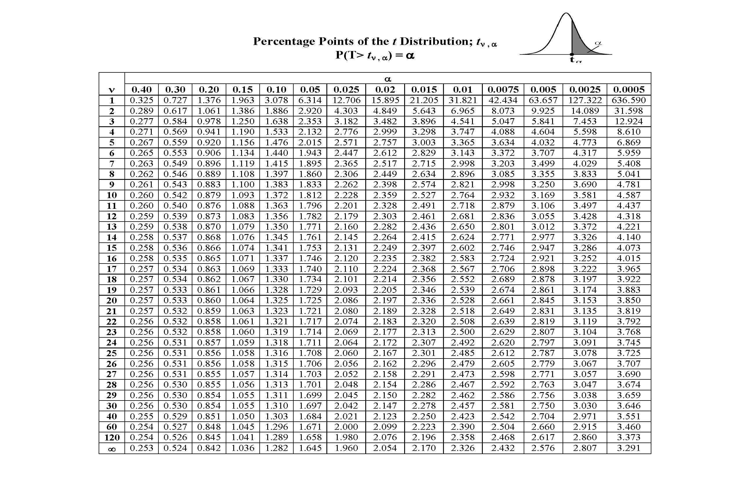
t-distribution table

Slide 132
Problem-5
Researchers are interested in whether the mean level of enzyme B in a certain population is different from 120. They measure levels of enzyme B in a sample of 15 individuals and find that the mean, = 96 and the sample standard deviation, s = 35.

Slide 133
Problem-5 Solution

Slide 134
Problem-6
The Average breaking strength of steel rods is specified to be 18.5 thousand kg. For this a sample of 14 rods was tested. The mean and standard deviation obtained were 17.85 and 1.955, respectively. Test the significance of the deviation.

Slide 135
Problem-6 Solution

Slide 136
Assessment Problem-5
An automobile tyre manufacturer claims that the average life of a particular grade of tyre is more than 20,000 km when used under normal conditions. A random sample of 16 tyres was tested and a mean and standard deviation of 22,000 km and 5,000 km, respectively were computed. Assuming the life of the tyres in km to be approximately normally distributed, decide whether the manufacturer’s claim is valid.

Slide 137
Assessment Problem-6
A random sample of 22 fifth grade pupils have a grade point average of 5.0 in maths with a standard deviation of 0.452, whereas marks range from 1 (worst) to 6 (excellent). The grade point average (GPA) of all fifth grade pupils of the last five years is 4.7. Is the GPA of the 22 pupils different from the populations’ GPA?

Slide 138
Conti…
Pupil | Grade Point | Pupil | Grade Point
1 | 5 | 13 | 5.5
2 | 5.5 | 14 | 5.5
3 | 5.5 | 15 | 4
4 | 5 | 16 | 5
5 | 5 | 17 | 5
6 | 6 | 18 | 5.5
7 | 5 | 19 | 4.5
8 | 5 | 20 | 5.5
9 | 4.5 | 21 | 5
10 | 5 | 22 | 5.5
11 | 5 | Mean | 5.0
12 | 4.5 | Variance | 0.2045

Slide 139
Problem-7
Suppose that you interview 1000 exiting voters about who they voted for governor. Of the 1000 voters, 550 reported that they voted for the democratic candidate. Is there sufficient evidence to suggest that the democratic candidate will win the election at the .01 level?

Slide 140
Problem-7 Solution

Slide 141
Problem-8
The CEO of a large electric utility claims that 80 percent of his 1,000,000 customers are very satisfied with the service they receive. To test this claim, the local newspaper surveyed 100 customers, using simple random sampling. Among the sampled customers, 73 percent say they are very satisfied. Based on these findings, can we reject the CEO's hypothesis that 80% of the customers are very satisfied? Use a 0.05 level of significance.

Slide 142
Problem-8 Solution

Slide 143
Assessment Problem-7
1500 randomly selected pine trees were tested for traces of the Bark Beetle infestation. It was found that 153 of the trees showed such traces. Test the hypothesis that more than 10% of the Tahoe trees have been infested. (Use a 5% level of significance)

Slide 144
Assessment Problem-8
Suppose the CEO claims that at least 80 percent of the company's 1,000,000 customers are very satisfied. Again, 100 customers are surveyed using simple random sampling. The result: 73 percent are very satisfied. Based on these results, should we accept or reject the CEO's hypothesis? Assume a significance level of 0.05.

Slide 145
What if we have two populations??
So far we have discussed hypothesis testing for single parameter.
We assume that students are capable to understand the problem and decide which statistic is applicable under different conditions.
Students are also capable of designing critical region.
Final conclusion should be in the form of detailed analysis.

Slide 146
Suppose we want to compare two population of students.
Two antibiotics are required to compare for response time.
Analysis of Performance of two machines.
Analysis of two detergents’ efficiency like whitening.
And many situations like….

Slide 147
Problem-9
A firm believes that the tyres produced by process A on an average last longer than tyres produced by process B. To test this belief, random samples of tyres produced by the two processes were tested and the results are:
Is there evidence at a 5% level of significance that the firm is correct in its belief?
Process | Sample Size | Average lifetime in Km | Standard deviation (Km)
A | 50 | 22400 | 1000
B | 50 | 21800 | 1000

Slide 148
Problem-9 Solution

Slide 149
Problem-10
A random sample of size 6 from a normal population with variance 24 gave mean= 15. A sample of size 8 from a normal population with variance 80 gave mean = 13. Test the H_{o}= μ₁-μ₂=0 against not equal to 0.

Slide 150
Problem-10 Solution

Slide 151
Assessment Problem-
On an examination in a statistics course, the average marks of 50 boys was 72 with a population standard deviation of 8, while the average marks of 45 girls was 75. Test the hypothesis at (a) 5% and (b) 1% level of significance that the boys’ performance is inferior to that of the girls.

Slide 152
Problem-11
An experiment was conducted to compare the mean time in days required to recover from the common cold for a person given daily dose of 4mg of vitamin C versus those who were not given a vitamin supplement. Suppose that 35 adults were randomly selected for each treatment category and that the mean recovery times and standard devotions for the two groups were as fellows:

Slide 153
Cont…
 | Vitamin C | No Vitamin C Supplement
Sample size | 35 | 35
Sample Mean | 5.8 | 6.9
Sample Standard Deviation | 1.2 | 2.9
Test the hypothesis that the use of vitamin C reduces the
mean time required to recover from a common cold and
its complications, at the level of significance α =0.05.

Slide 154
Problem-11 Solution

Slide 155
Problem-12
The education testing Service conducted a study to investigate differences between the scores of female and male students on the Mathematics Aptitude Test. The study identified a random sample of 562 female and 852 male students who had achieved the same high score on the mathematics portion of the test. That is, the female and male students viewed as having similar high ability in mathematics. The verbal scores for the two samples are given below:

Slide 156
Cont…
Do the data support the conclusion that given populations of female and male students with similar high ability in mathematics, the female students will have a significantly high verbal ability? Test at α =0.05 significance level. What is your conclusion?
 | Female | Male
Sample Mean | 547 | 525
Sample Standard Deviation | 83 | 78

Slide 157
Problem-12 Solution

Slide 158
Assessment Problem-
The mean height of 50 males students of group I is 68.2 inches with a standard deviation of 2.5 inches, while 0 males students of group II as a mean height of 67.5 inches with a standard deviation of 2.8 inches. Test the hypothesis that male students of group of I are taller than male students of group II at the 0.05 level of significance.

Slide 159
Assessment Problem-
A farmer claims that the average yield of corn of variety-----variety B by at least 12 bushels per acre.----- with a standard deviation of 6.28 bushels per acre, while variety B yielded on average 77.8 bushels per acre with a standard deviation of 5.64 bushels per acre. Test the farmer’s claim using a 0.05 level of significance.

Slide 160
Problem 13
Suppose the Acme Drug Company develops a new drug, designed to prevent colds. The company states that the drug is equally effective for men and women. To test this claim, they choose a a simple random sample of 100 women and 200 men from a population of 100,000 volunteers.
At the end of the study, 38% of the women caught a cold; and 51% of the men caught a cold. Based on these findings, can we reject the company's claim that the drug is equally effective for men and women? Use a 0.05 level of significance.

Slide 161
Problem-13 Solution

Slide 162
Problem-14
Suppose the Acme Drug Company develops a new drug, designed to prevent colds. The company states that the drug is more effective for women than for men. To test this claim, they choose a simple random sample of 100 women and 200 men from a population of 100,000 volunteers.

Slide 163
Problem-14 Solution

Slide 164
Assessment Problem-
Researchers want to test the effectiveness of a new anti-anxiety medication. In clinical testing, 64 out of 200 people taking the medication report symptoms of anxiety. The people receiving a placebo, 92 out of 200 report symptoms of anxiety. Is the medication working any differently than the placebo? Test this claim using alpha = 0.05.

Slide 165
Problem-15
A researcher interested in employee satisfaction and productivity measured the number of units produced by employees at a plant before and after a company-wide pay raise occurred. The researcher hypothesized that production would be higher after the raise compared to before the raise. Assume that the difference scores are normally distributed and let a = 0.05.

Slide 166
Cont…
Participant | Before | After
1 | 7 | 7
2 | 4 | 5
3 | 8 | 9
4 | 8 | 9
5 | 6 | 6
6 | 6 | 6
7 | 5 | 5
8 | 5 | 4
9 | 7 | 7

Slide 167
Problem 15 Solution

Slide 168
Problem-16
A sociologist is interested in the decay of long-term memory compared to the number of errors in memory that an individual made after 1 week and after 1 year for a specific crime event. Participants viewed a videotape of a bank robbery and were asked a number of specific questions about the video 1 week after viewing it. They were asked the same questions 1 year after seeing the video. The number of memory errors was recorded for each participant at each time period. The researchers asked whether or not there was a significant difference in the number of errors in the two time periods. Assume that the difference scores are normally distributed and let a = 0.05.

Slide 169
Cont…
Subject | One Week | One Year
1 | 5 | 7
2 | 4 | 5
3 | 6 | 9
4 | 8 | 9
5 | 6 | 6
6 | 5 | 6
7 | 4 | 5
8 | 5 | 4
9 | 7 | 7

Slide 170
Problem-16 Solution

Slide 171
Assessment Problem-
Suppose you are interested in developing a counseling technique to reduce stress within marriages. You randomly select two samples of married individuals out of ten churches in the association. You provide Group 1 with group counseling and study materials. You provide Group 2 with individual counseling and study materials.
At the conclusion of the treatment period, you measure the level of marital stress in the group members. Here are the scores:

Slide 172
Cont…
Group-1 | Group-2
25 17 29 29 26 24 27 33 23 14 21 26 20 27 26 32 20 32 17 23 20 30 26 12 | 21 26 28 31 14 27 29 23 18 25 32 23 16 21 17 20 26 23 7 18 29 32 24 19

