Slide 1
Set Topology
MTH 251
Lecture # 32

Slide 2
Lecture Plan
Components of Connected Spaces
Totally Disconnected subsets
Locally Connected Spaces
Path Connected Spaces

Slide 3
Definition (component)
A component E of a topological space X is a maximal connected subset of X;

Slide 4
Definition (component)
A component E of a topological space X is a maximal connected subset of X;
that is, E is connected and E is not a proper subset of any connected subset of X.

Slide 5
Example
If X is connected, then X has only one component: X itself

Slide 6
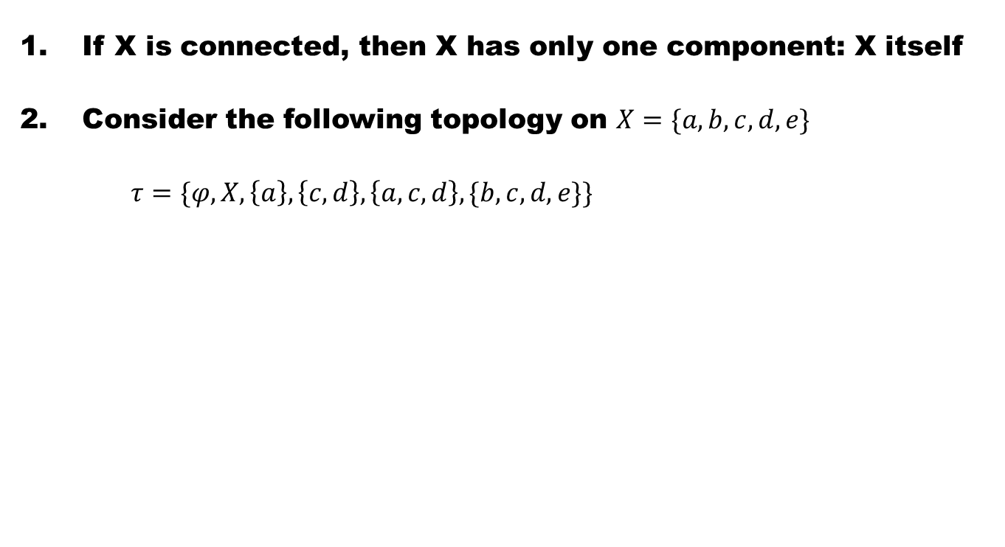
Example
If X is connected, then X has only one component: X itself
Consider the following topology on $X=\{a,b,c,d,e\}$
$τ=\{φ,X,\left\{a\right\},\left\{c,d\right\},\left\{a,c,d\right\},\{b,c,d,e\}\}$

Slide 7
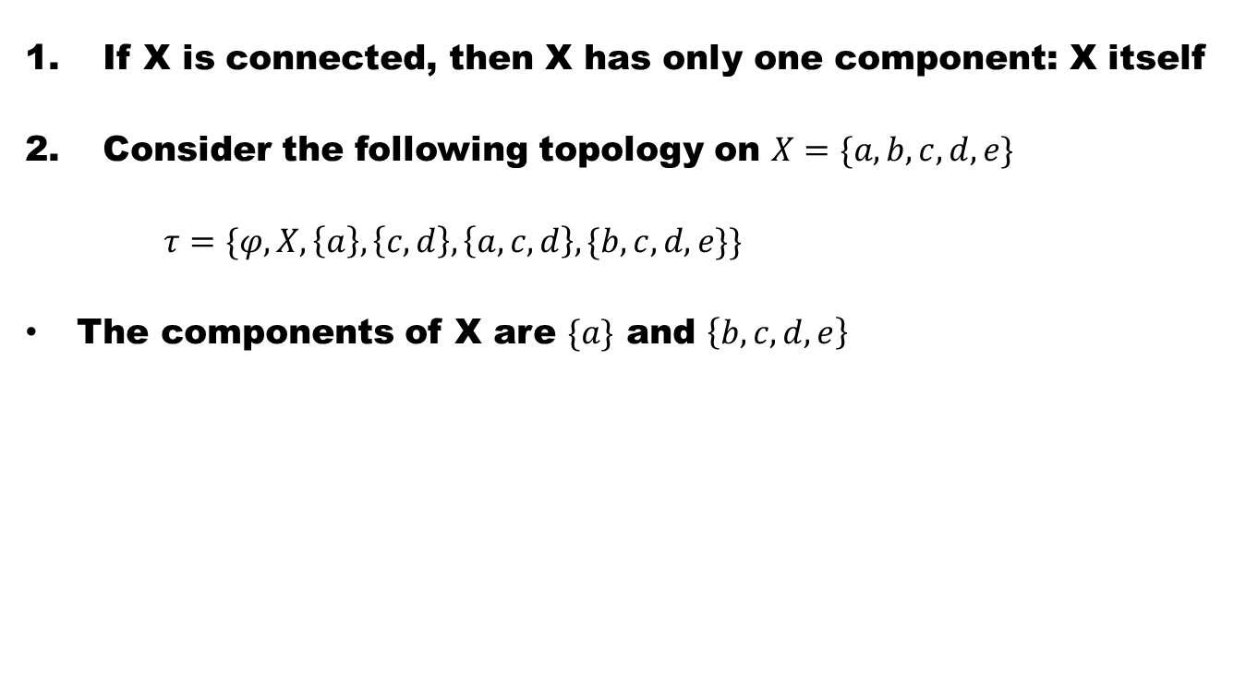
Example
If X is connected, then X has only one component: X itself
Consider the following topology on $X=\{a,b,c,d,e\}$
$τ=\{φ,X,\left\{a\right\},\left\{c,d\right\},\left\{a,c,d\right\},\{b,c,d,e\}\}$
The components of X are $\{a\}$ and $\left\{b,c,d,e\right\}$

Slide 8
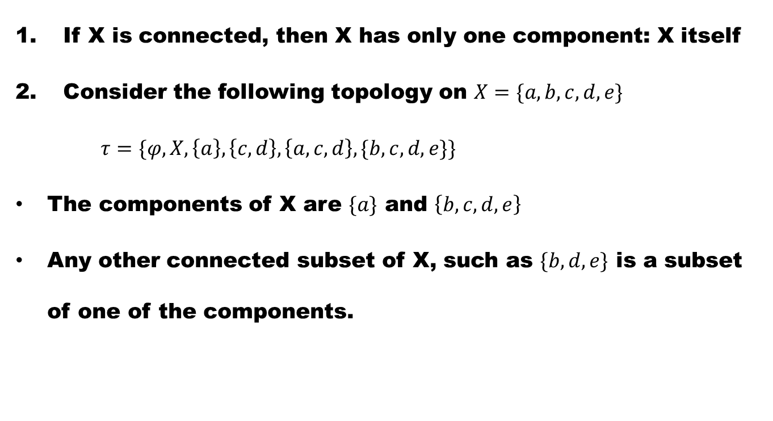
Example
If X is connected, then X has only one component: X itself
Consider the following topology on $X=\{a,b,c,d,e\}$
$τ=\{φ,X,\left\{a\right\},\left\{c,d\right\},\left\{a,c,d\right\},\{b,c,d,e\}\}$
The components of X are $\{a\}$ and $\left\{b,c,d,e\right\}$
Any other connected subset of X, such as $\{b,d,e\}$ is a subset of one of the components.

Slide 9
Example
If X is connected, then X is itself a component.

Slide 10
Example
If X is connected, then X is itself a component.
Let X be a discrete space. Then each singleton is a component

Slide 11
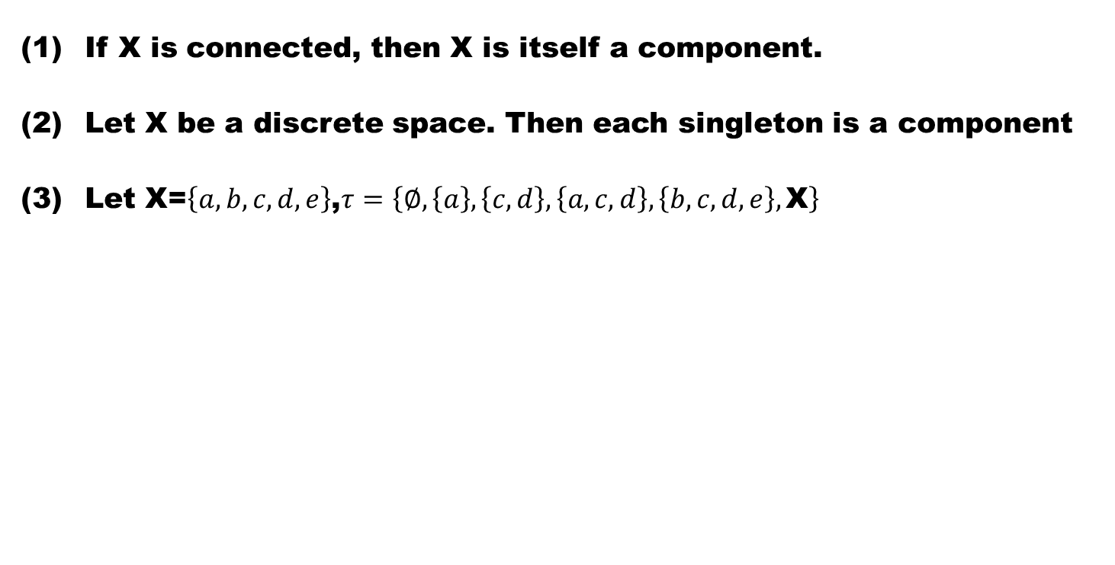
Example
If X is connected, then X is itself a component.
Let X be a discrete space. Then each singleton is a component
Let X=$\left\{a,b,c,d,e\right\}$,$τ=\left\{∅,\left\{a\right\},\left\{c,d\right\},\left\{a,c,d\right\},\left\{b,c,d,e\right\},\text{X}\right\}$

Slide 12
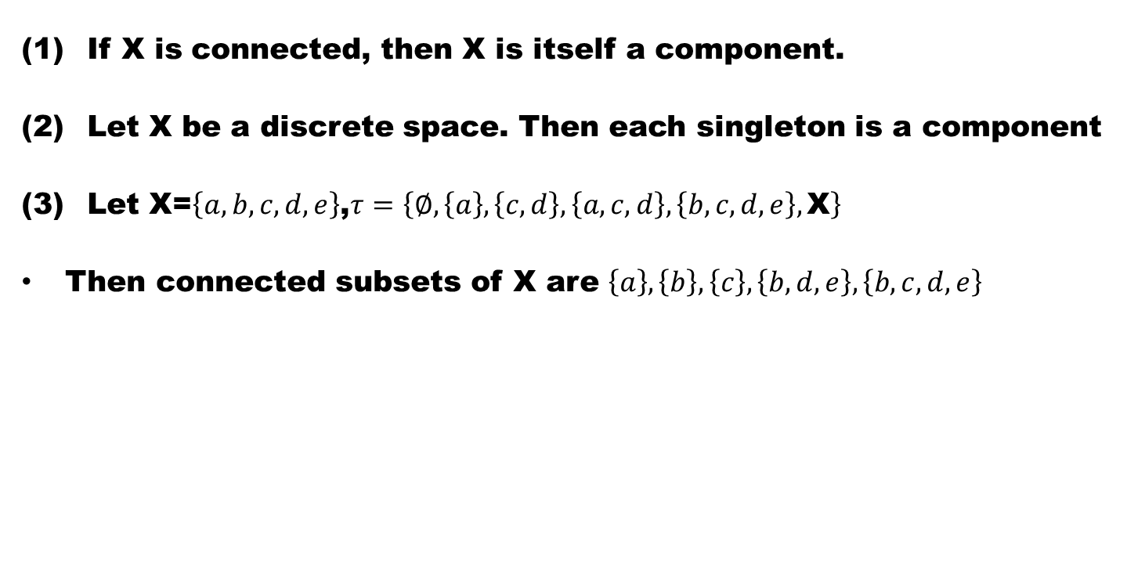
Example
If X is connected, then X is itself a component.
Let X be a discrete space. Then each singleton is a component
Let X=$\left\{a,b,c,d,e\right\}$,$τ=\left\{∅,\left\{a\right\},\left\{c,d\right\},\left\{a,c,d\right\},\left\{b,c,d,e\right\},\text{X}\right\}$
Then connected subsets of X are $\left\{a\right\},\left\{b\right\},\left\{c\right\},\left\{b,d,e\right\},\left\{b,c,d,e\right\}$

Slide 13
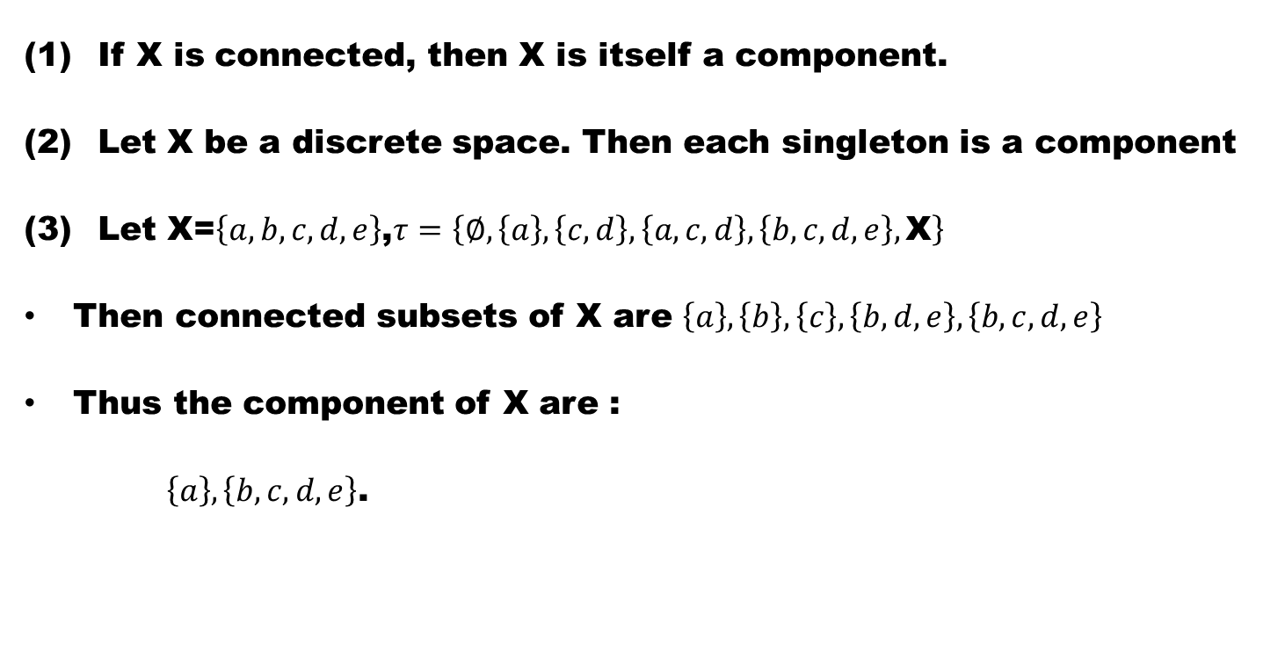
Example
If X is connected, then X is itself a component.
Let X be a discrete space. Then each singleton is a component
Let X=$\left\{a,b,c,d,e\right\}$,$τ=\left\{∅,\left\{a\right\},\left\{c,d\right\},\left\{a,c,d\right\},\left\{b,c,d,e\right\},\text{X}\right\}$
Then connected subsets of X are $\left\{a\right\},\left\{b\right\},\left\{c\right\},\left\{b,d,e\right\},\left\{b,c,d,e\right\}$
Thus the component of X are :
$\left\{a\right\},\left\{b,c,d,e\right\}$.

Slide 14
Definition (Totally Disconnected)
A space X is totally disconnected,

Slide 15
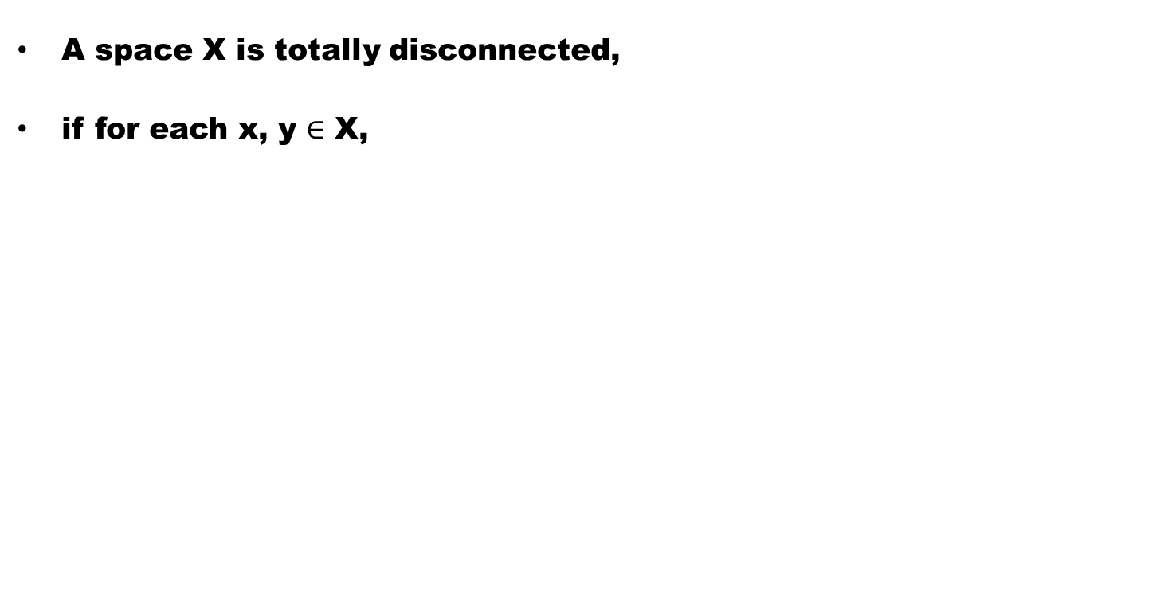
Definition (Totally Disconnected)
A space X is totally disconnected,
if for each x, y $∈$ X,

Slide 16
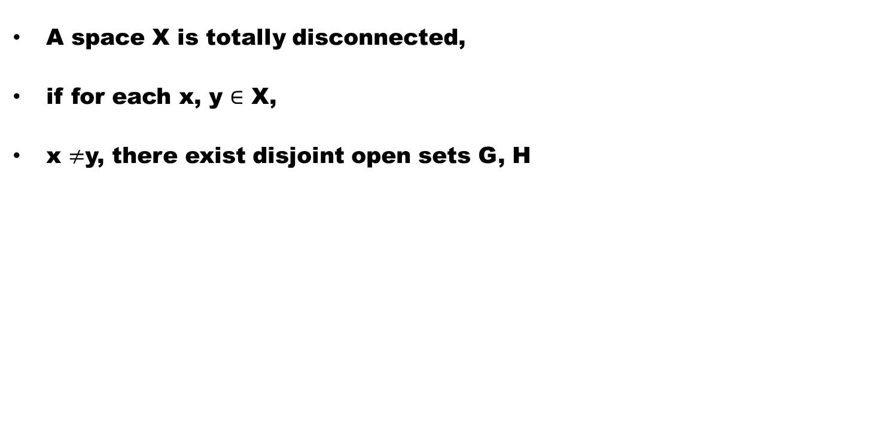
Definition (Totally Disconnected)
A space X is totally disconnected,
if for each x, y $∈$ X,
x $≠$y, there exist disjoint open sets G, H

Slide 17
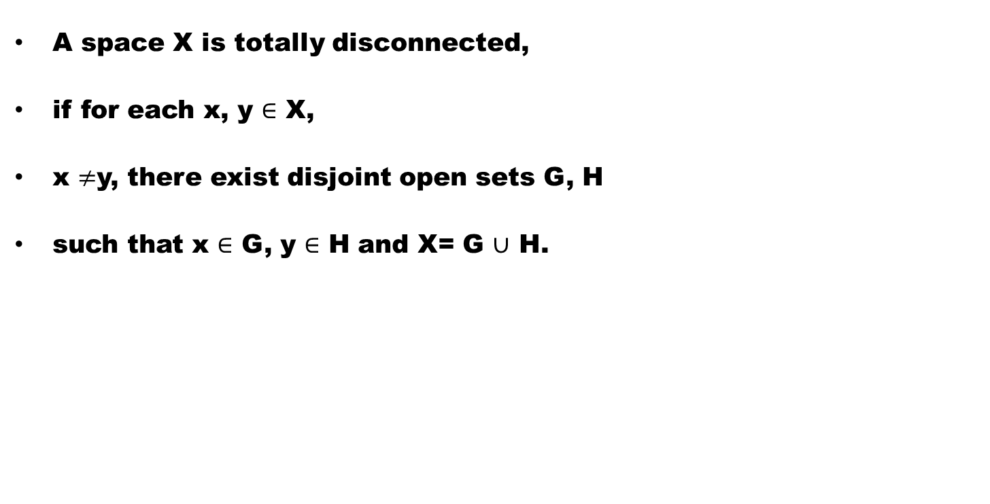
Definition (Totally Disconnected)
A space X is totally disconnected,
if for each x, y $∈$ X,
x $≠$y, there exist disjoint open sets G, H
such that x $∈$ G, y $∈$ H and X= G $∪$ H.

Slide 18
Example
  One point space is totally disconnected

Slide 19
Example
  One point space is totally disconnected
  Discrete space is totally disconnected

Slide 20
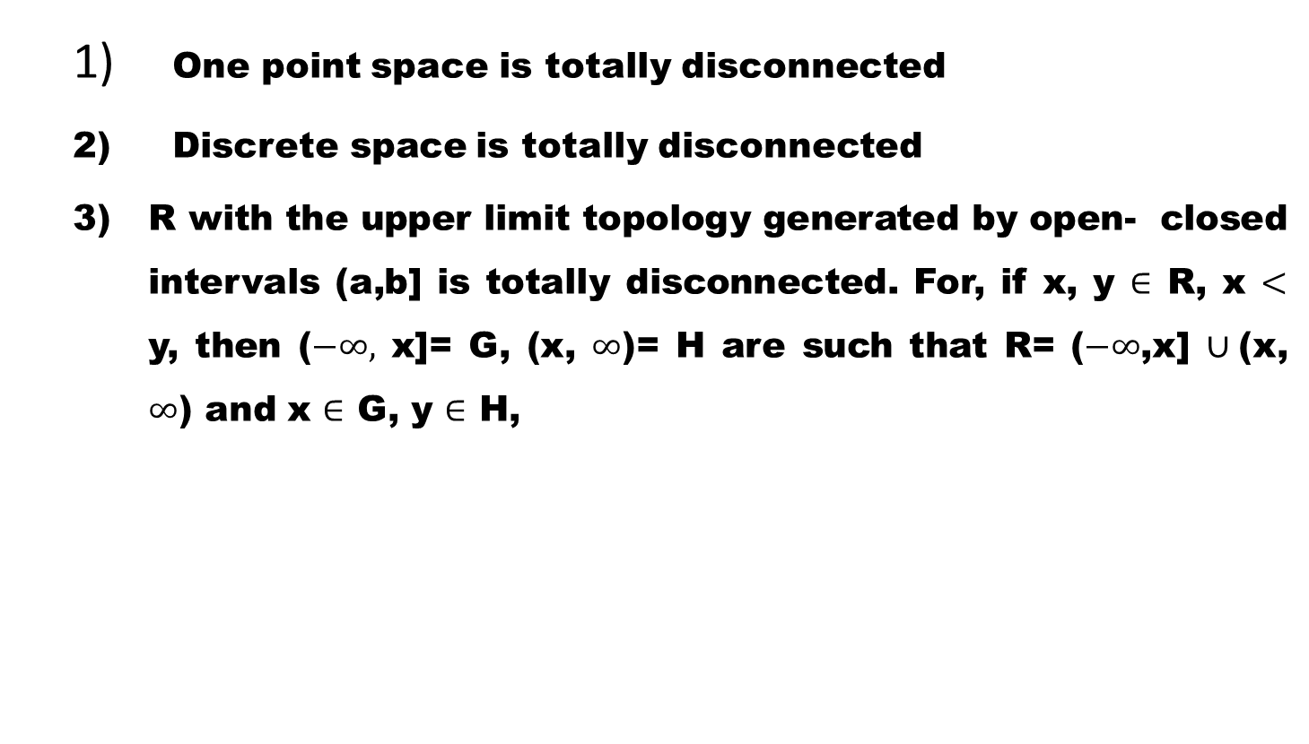
Example
  One point space is totally disconnected
  Discrete space is totally disconnected
  R with the upper limit topology generated by open- closed intervals (a,b] is totally disconnected. For, if x, y $∈$ R, x $<$ y, then ($−∞,$ x]= G, (x, $∞$)= H are such that R= ($−∞$,x] $∪$(x, $∞$) and x $∈$ G, y $∈$ H,

Slide 21
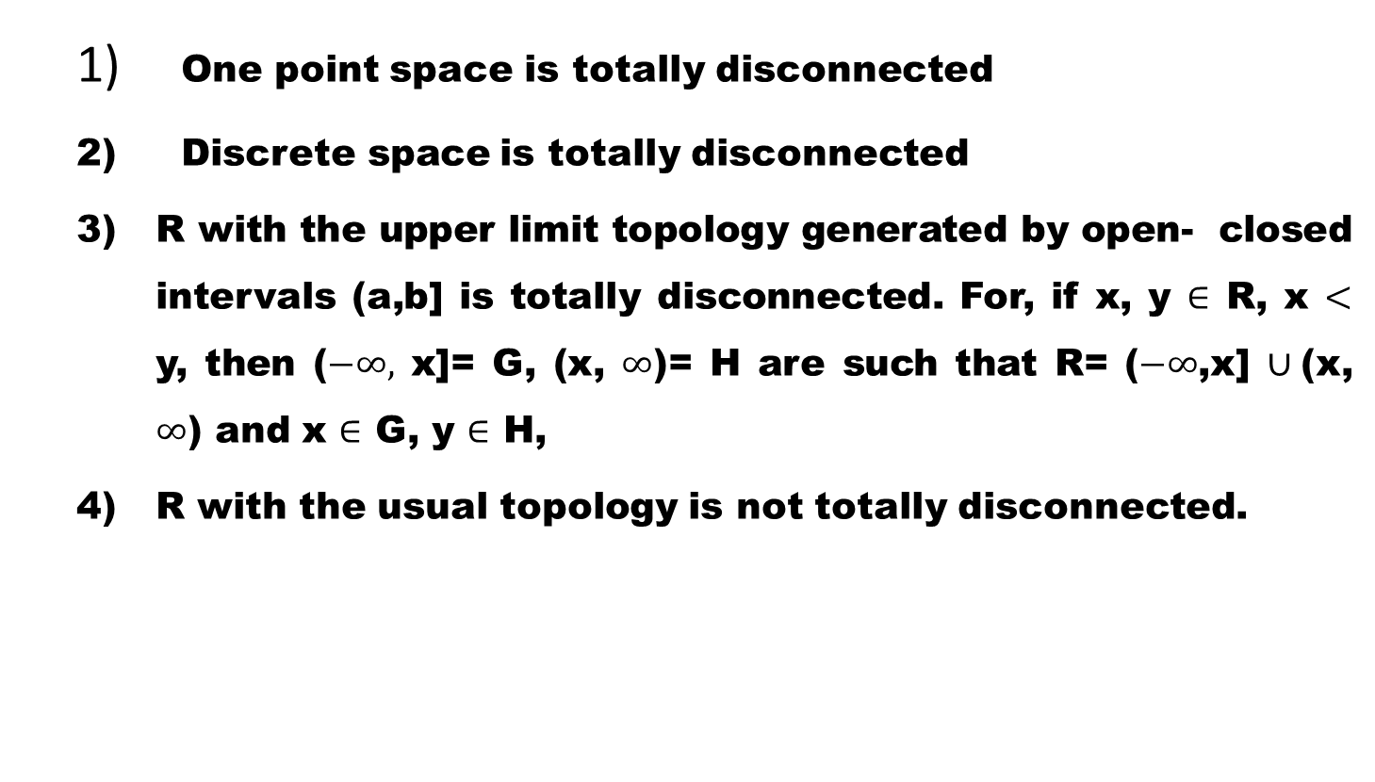
Example
  One point space is totally disconnected
  Discrete space is totally disconnected
  R with the upper limit topology generated by open- closed intervals (a,b] is totally disconnected. For, if x, y $∈$ R, x $<$ y, then ($−∞,$ x]= G, (x, $∞$)= H are such that R= ($−∞$,x] $∪$(x, $∞$) and x $∈$ G, y $∈$ H,
  R with the usual topology is not totally disconnected.

Slide 22
Theorem. The component of a totally disconnected space are singletons.
Proof. suppose a component C of X is not singleton.

Slide 23
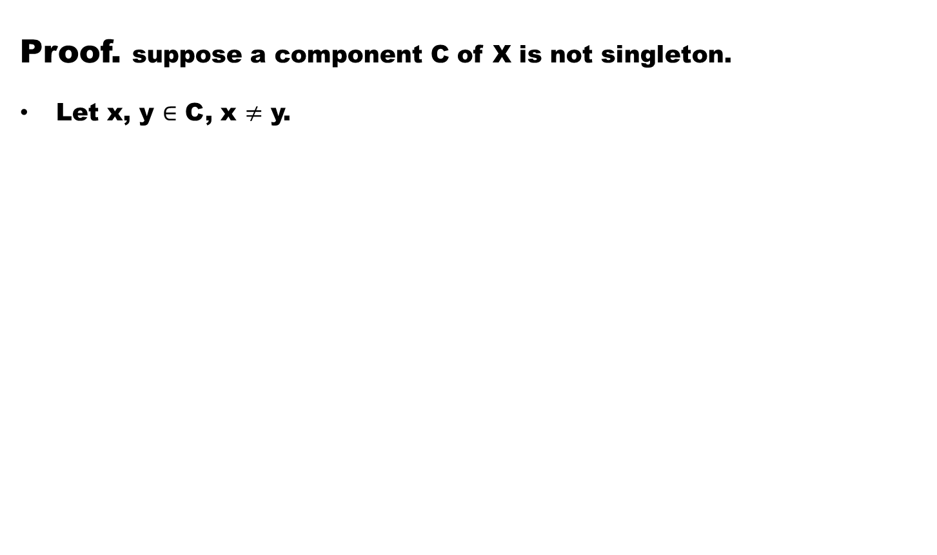
Theorem. The component of a totally disconnected space are singletons.
Proof. suppose a component C of X is not singleton.
Let x, y $∈$ C, x $≠$ y.

Slide 24
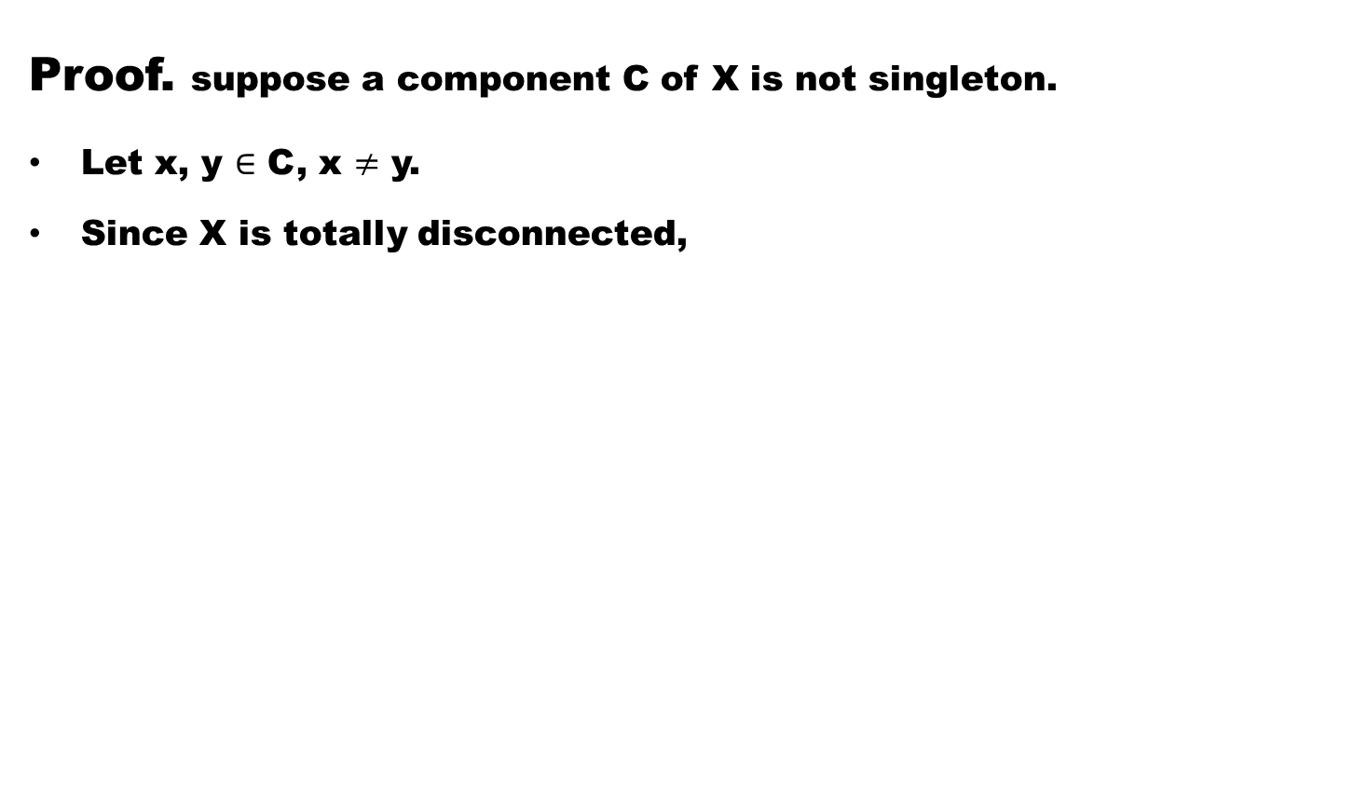
Theorem. The component of a totally disconnected space are singletons.
Proof. suppose a component C of X is not singleton.
Let x, y $∈$ C, x $≠$ y.
Since X is totally disconnected,

Slide 25
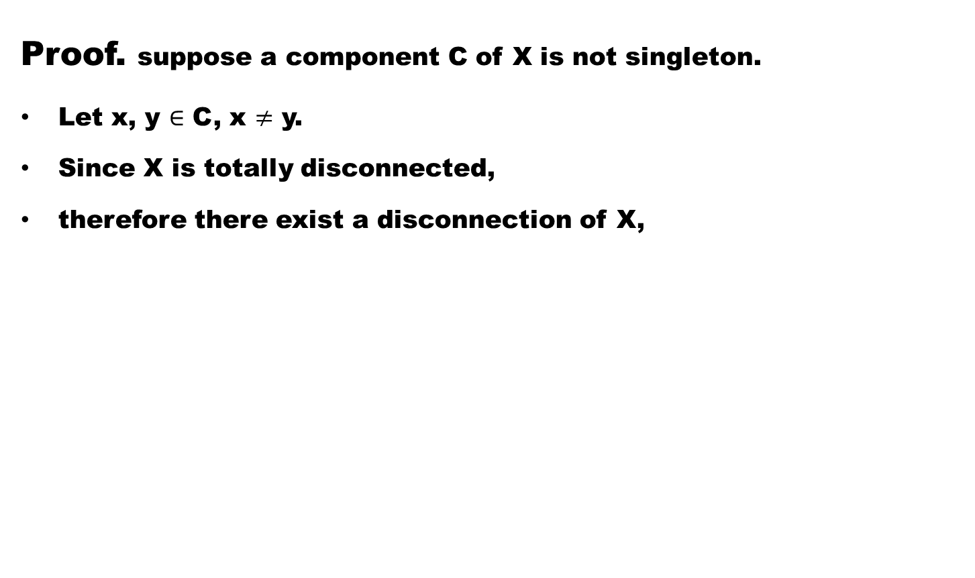
Theorem. The component of a totally disconnected space are singletons.
Proof. suppose a component C of X is not singleton.
Let x, y $∈$ C, x $≠$ y.
Since X is totally disconnected,
therefore there exist a disconnection of X,

Slide 26
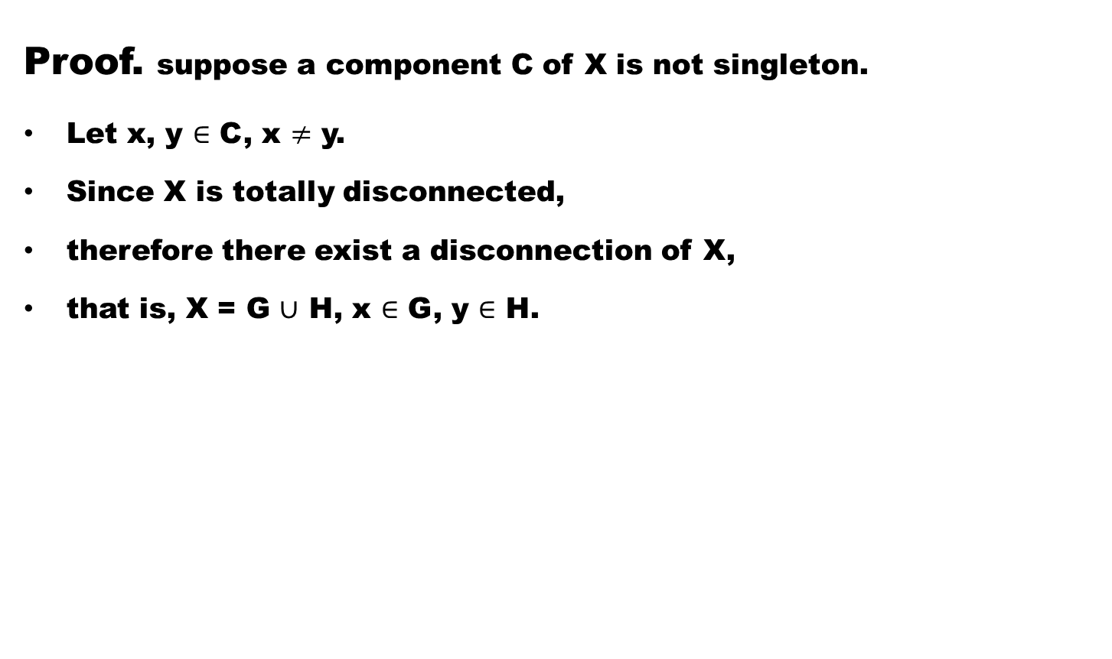
Theorem. The component of a totally disconnected space are singletons.
Proof. suppose a component C of X is not singleton.
Let x, y $∈$ C, x $≠$ y.
Since X is totally disconnected,
therefore there exist a disconnection of X,
that is, X = G $∪$ H, x $∈$ G, y $∈$ H.

Slide 27
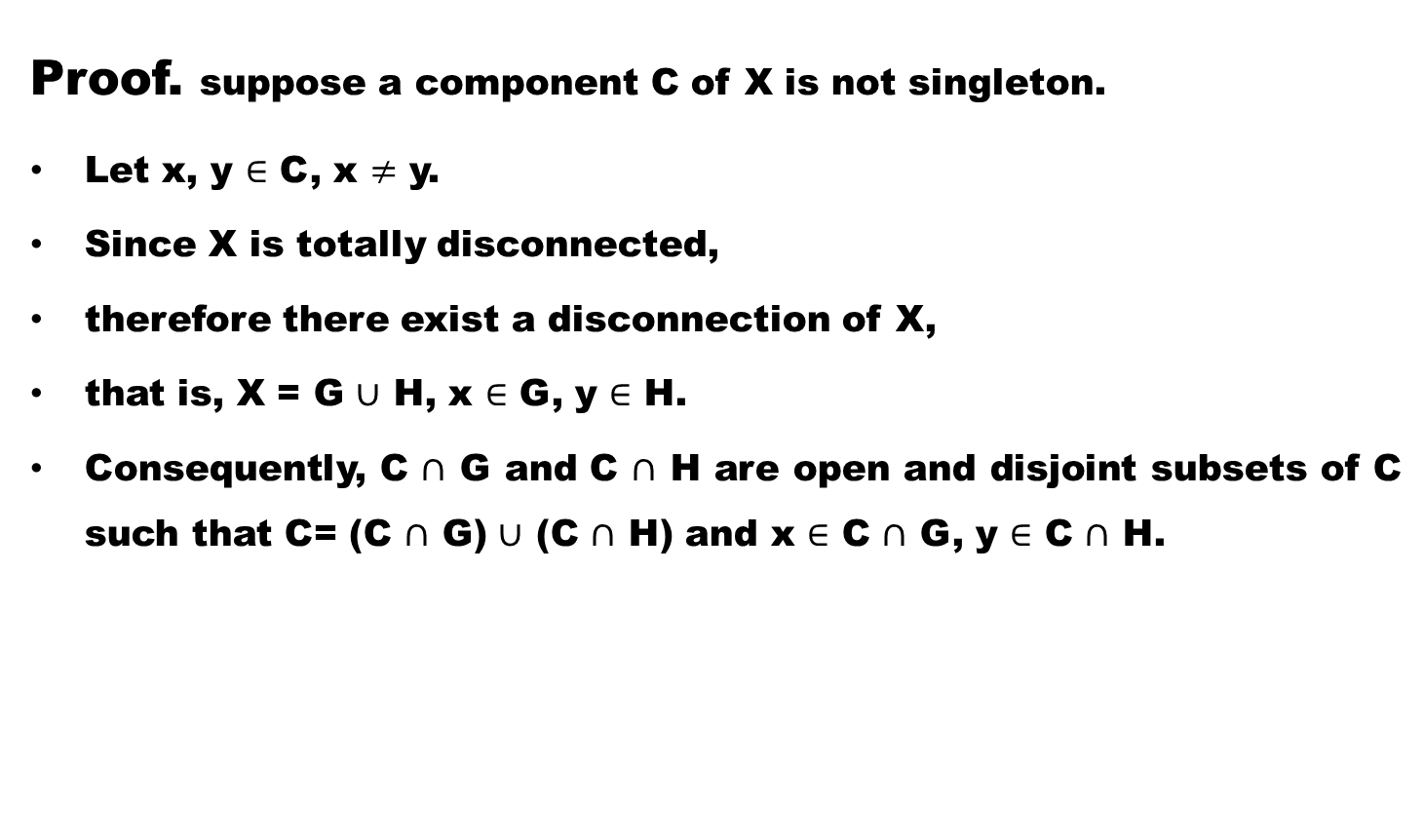
Theorem. The component of a totally disconnected space are singletons.
Proof. suppose a component C of X is not singleton.
Let x, y $∈$ C, x $≠$ y.
Since X is totally disconnected,
therefore there exist a disconnection of X,
that is, X = G $∪$ H, x $∈$ G, y $∈$ H.
Consequently, C $∩$ G and C $∩$ H are open and disjoint subsets of C such that C= (C $∩$ G) $∪$ (C $∩$ H) and x $∈$ C $∩$ G, y $∈$ C $∩$ H.

Slide 28
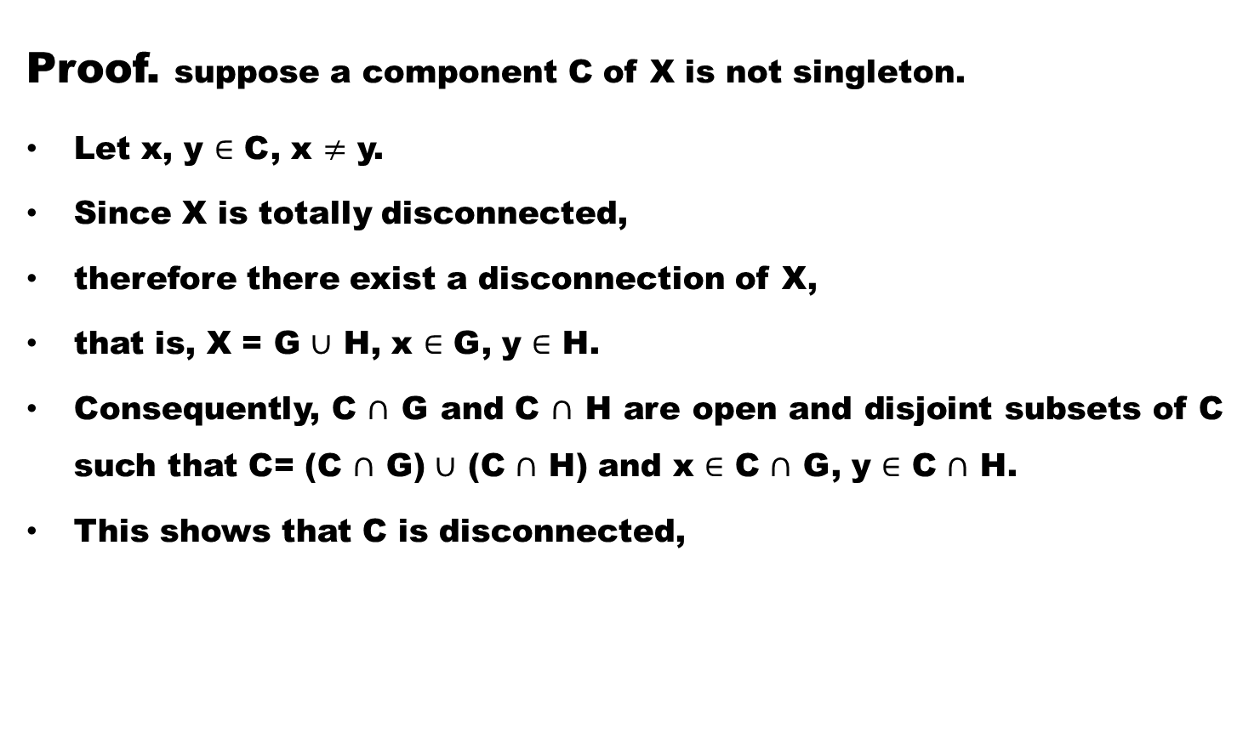
Theorem. The component of a totally disconnected space are singletons.
Proof. suppose a component C of X is not singleton.
Let x, y $∈$ C, x $≠$ y.
Since X is totally disconnected,
therefore there exist a disconnection of X,
that is, X = G $∪$ H, x $∈$ G, y $∈$ H.
Consequently, C $∩$ G and C $∩$ H are open and disjoint subsets of C such that C= (C $∩$ G) $∪$ (C $∩$ H) and x $∈$ C $∩$ G, y $∈$ C $∩$ H.
This shows that C is disconnected,

Slide 29
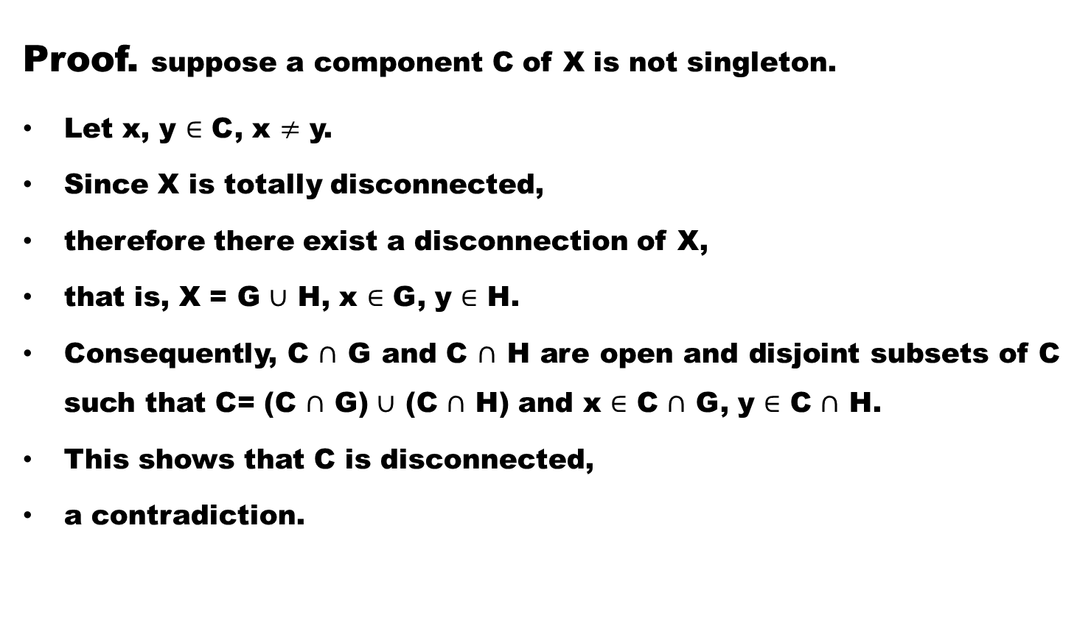
Theorem. The component of a totally disconnected space are singletons.
Proof. suppose a component C of X is not singleton.
Let x, y $∈$ C, x $≠$ y.
Since X is totally disconnected,
therefore there exist a disconnection of X,
that is, X = G $∪$ H, x $∈$ G, y $∈$ H.
Consequently, C $∩$ G and C $∩$ H are open and disjoint subsets of C such that C= (C $∩$ G) $∪$ (C $∩$ H) and x $∈$ C $∩$ G, y $∈$ C $∩$ H.
This shows that C is disconnected,
a contradiction.

Slide 30
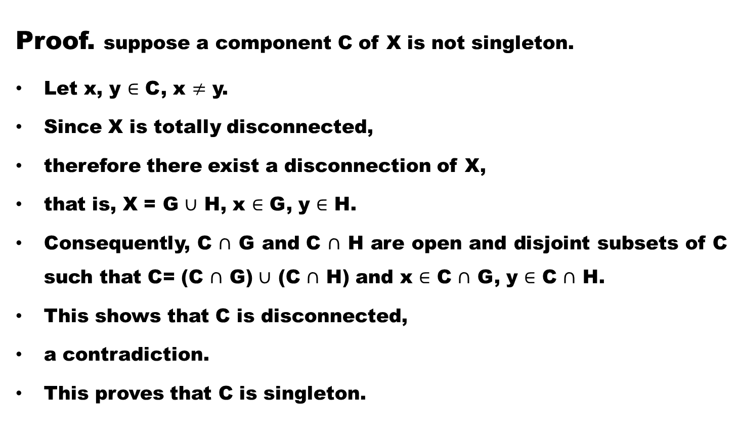
Theorem. The component of a totally disconnected space are singletons.
Proof. suppose a component C of X is not singleton.
Let x, y $∈$ C, x $≠$ y.
Since X is totally disconnected,
therefore there exist a disconnection of X,
that is, X = G $∪$ H, x $∈$ G, y $∈$ H.
Consequently, C $∩$ G and C $∩$ H are open and disjoint subsets of C such that C= (C $∩$ G) $∪$ (C $∩$ H) and x $∈$ C $∩$ G, y $∈$ C $∩$ H.
This shows that C is disconnected,
a contradiction.
This proves that C is singleton.

Slide 31
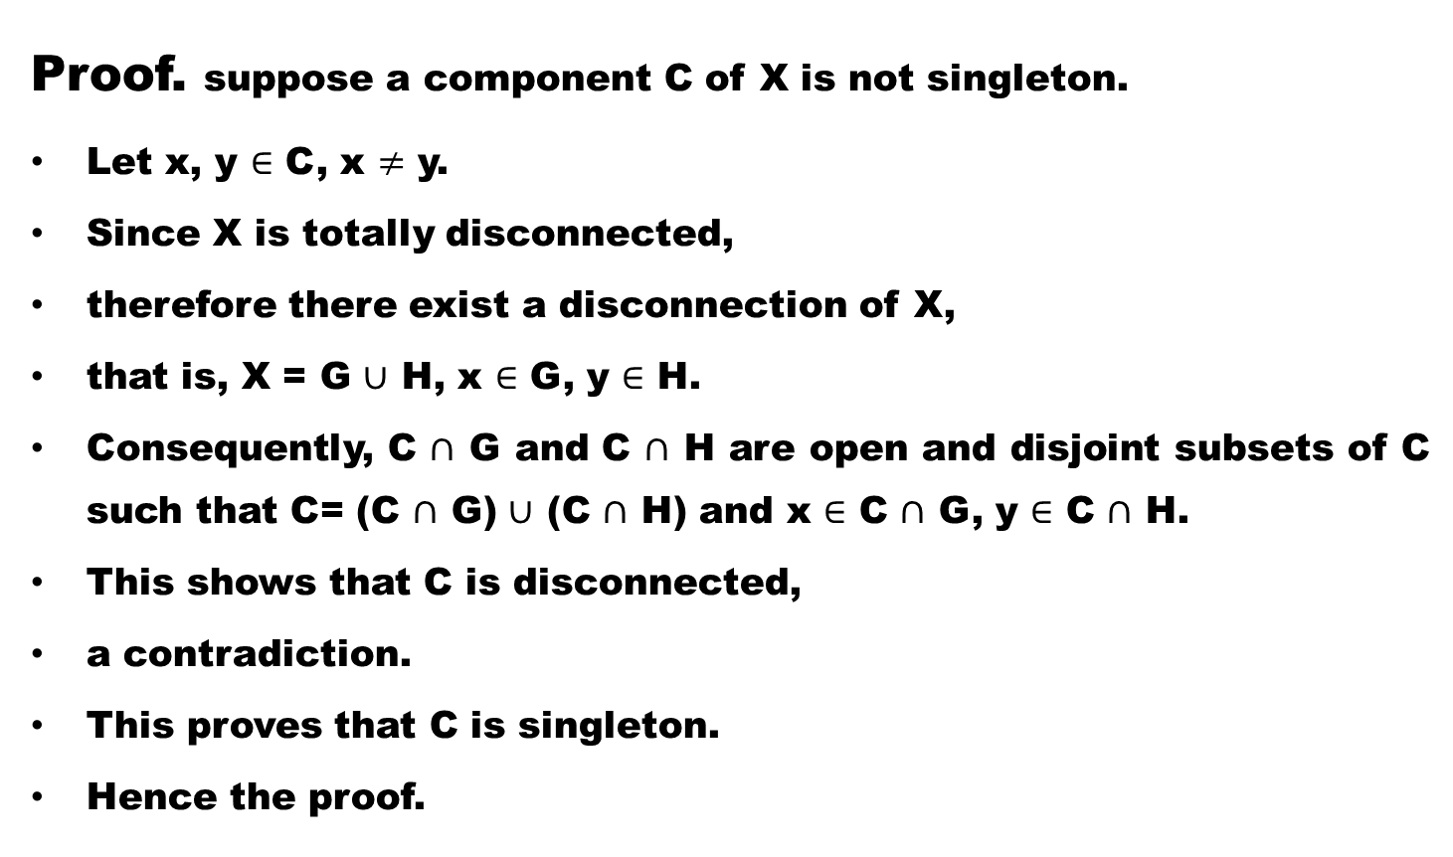
Theorem. The component of a totally disconnected space are singletons.
Proof. suppose a component C of X is not singleton.
Let x, y $∈$ C, x $≠$ y.
Since X is totally disconnected,
therefore there exist a disconnection of X,
that is, X = G $∪$ H, x $∈$ G, y $∈$ H.
Consequently, C $∩$ G and C $∩$ H are open and disjoint subsets of C such that C= (C $∩$ G) $∪$ (C $∩$ H) and x $∈$ C $∩$ G, y $∈$ C $∩$ H.
This shows that C is disconnected,
a contradiction.
This proves that C is singleton.
Hence the proof.

Slide 32
We know that
every totally disconnected space is Hausdorff,
but the converse is not true in general .

Slide 33
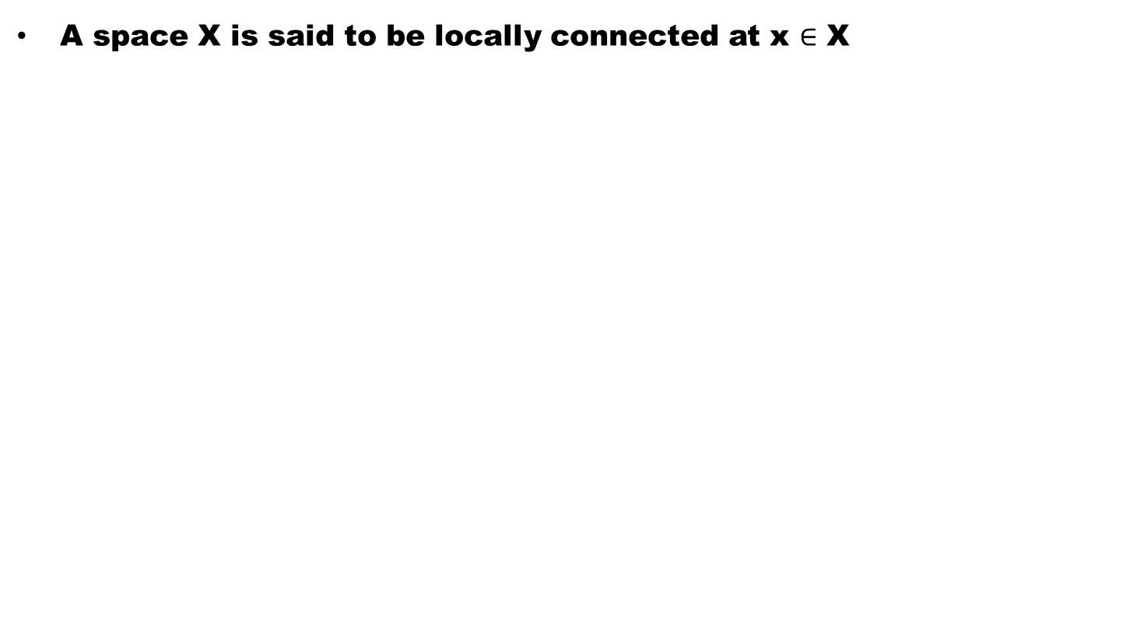
Definition (Locally Connected Space)
A space X is said to be locally connected at x $∈$ X

Slide 34
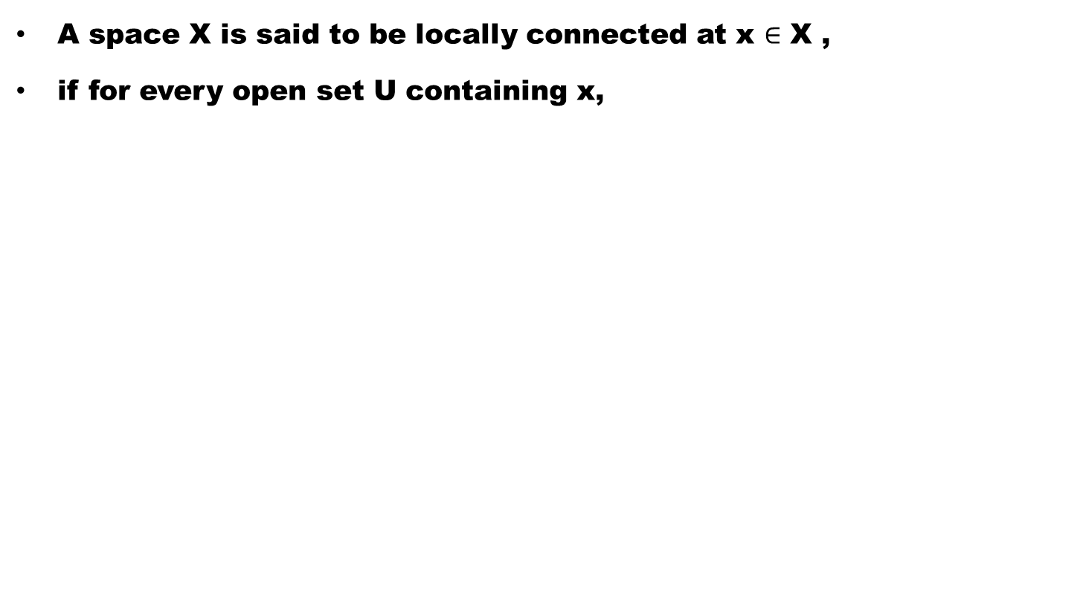
Definition (Locally Connected Space)
A space X is said to be locally connected at x $∈$ X ,
if for every open set U containing x,

Slide 35
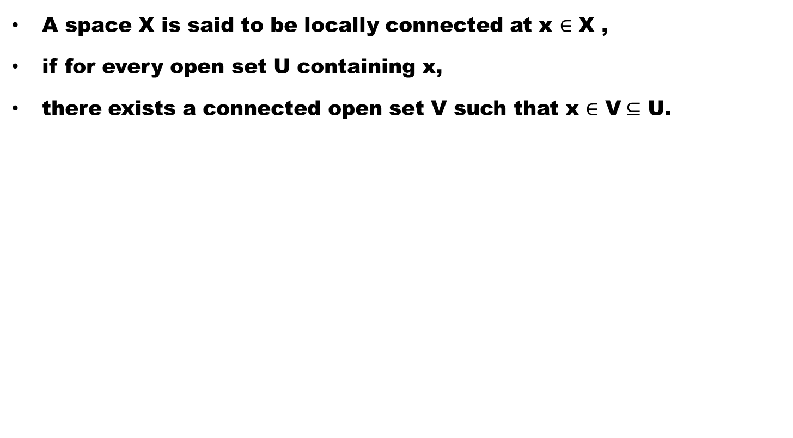
Definition (Locally Connected Space)
A space X is said to be locally connected at x $∈$ X ,
if for every open set U containing x,
there exists a connected open set V such that x $∈$ V$⊆$ U.

Slide 36
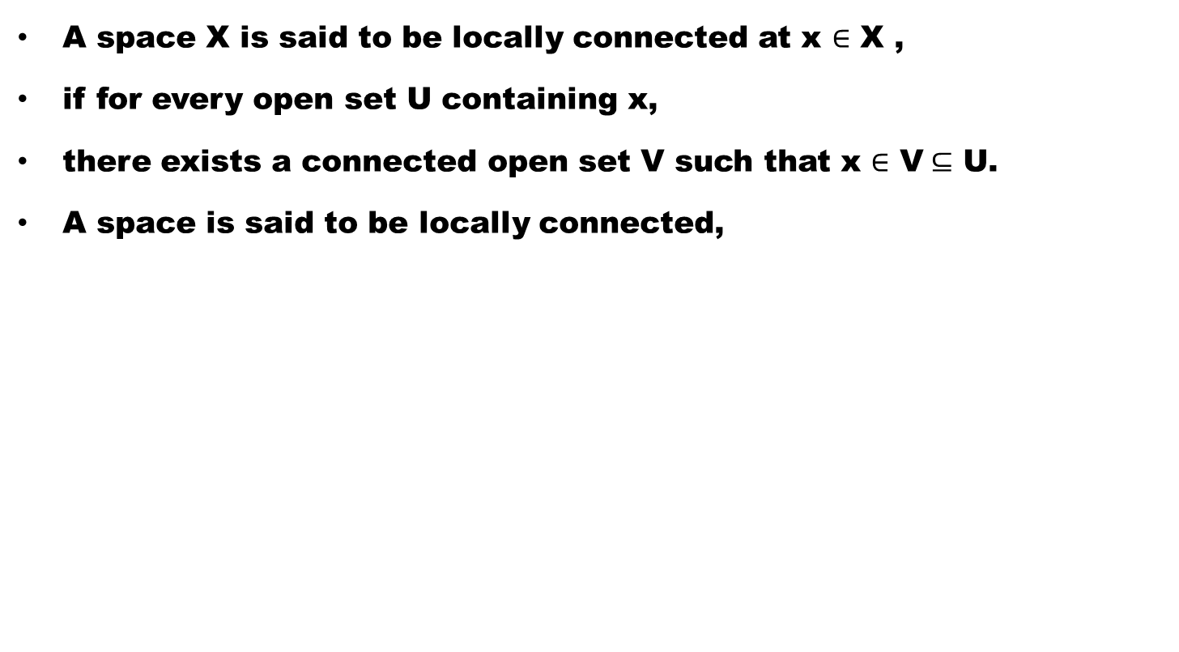
Definition (Locally Connected Space)
A space X is said to be locally connected at x $∈$ X ,
if for every open set U containing x,
there exists a connected open set V such that x $∈$ V$⊆$ U.
A space is said to be locally connected,

Slide 37
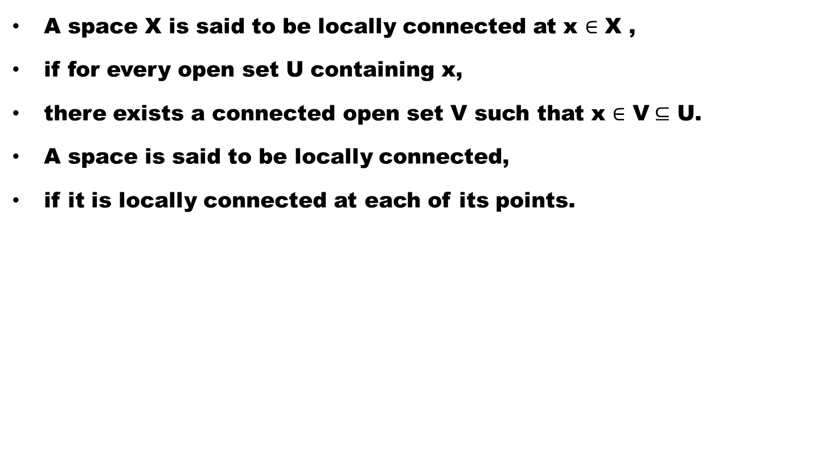
Definition (Locally Connected Space)
A space X is said to be locally connected at x $∈$ X ,
if for every open set U containing x,
there exists a connected open set V such that x $∈$ V$⊆$ U.
A space is said to be locally connected,
if it is locally connected at each of its points.

Slide 38
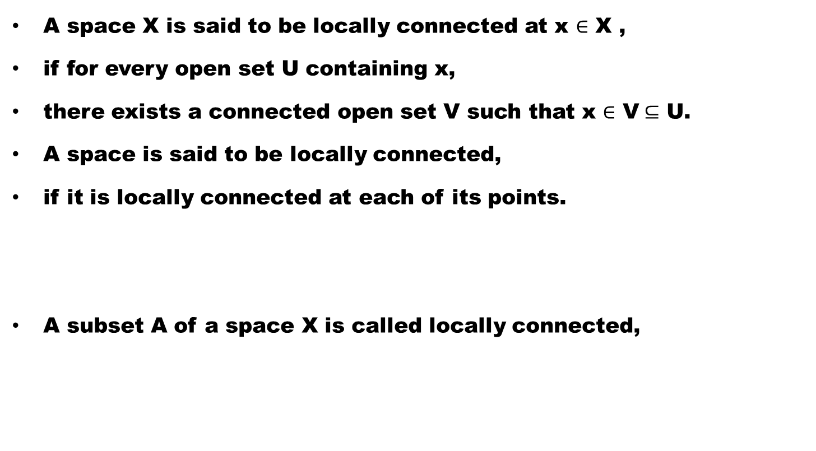
Definition (Locally Connected Space)
A space X is said to be locally connected at x $∈$ X ,
if for every open set U containing x,
there exists a connected open set V such that x $∈$ V$⊆$ U.
A space is said to be locally connected,
if it is locally connected at each of its points.
A subset A of a space X is called locally connected,

Slide 39
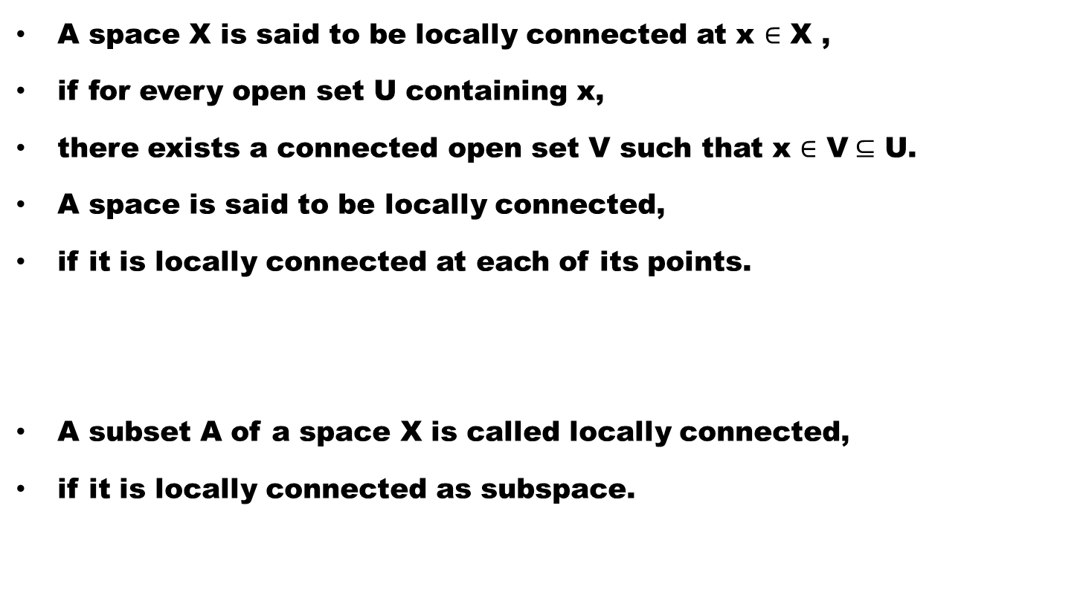
Definition (Locally Connected Space)
A space X is said to be locally connected at x $∈$ X ,
if for every open set U containing x,
there exists a connected open set V such that x $∈$ V$⊆$ U.
A space is said to be locally connected,
if it is locally connected at each of its points.
A subset A of a space X is called locally connected,
if it is locally connected as subspace.

Slide 40
Example. Every discrete space X is locally connected.

Slide 41
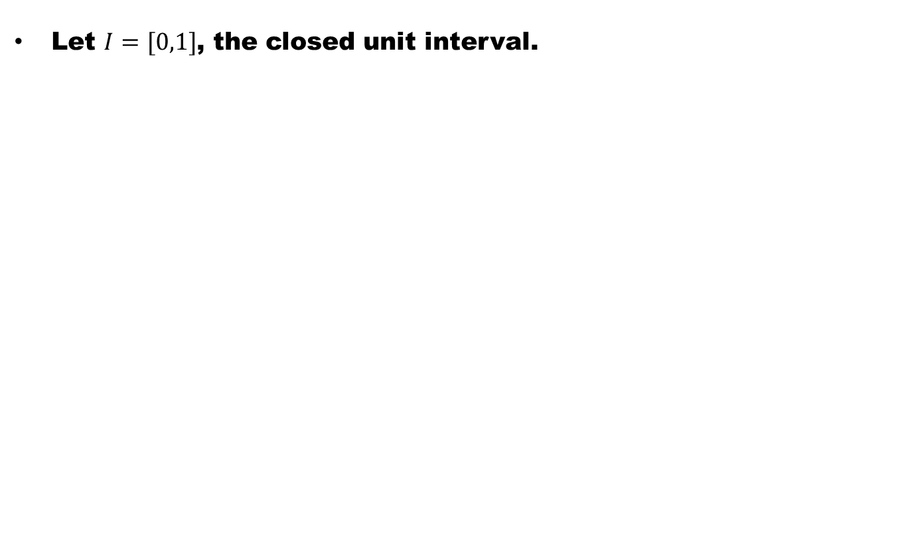
Paths
Let $I=[0,1]$, the closed unit interval.

Slide 42
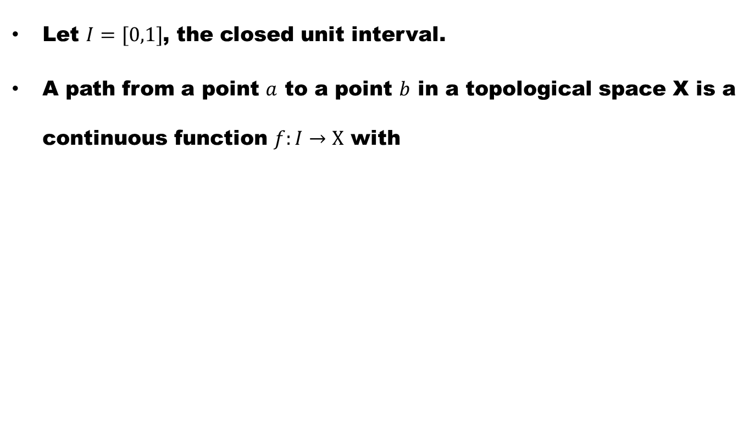
Paths
Let $I=[0,1]$, the closed unit interval.
A path from a point $a$ to a point $b$ in a topological space X is a continuous function $f:I→X$ with

Slide 43
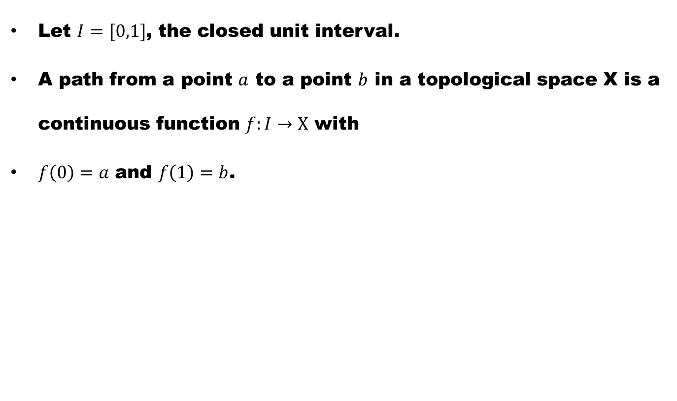
Paths
Let $I=[0,1]$, the closed unit interval.
A path from a point $a$ to a point $b$ in a topological space X is a continuous function $f:I→X$ with
$f\left(0\right)=a$ and $f\left(1\right)=b$.

Slide 44
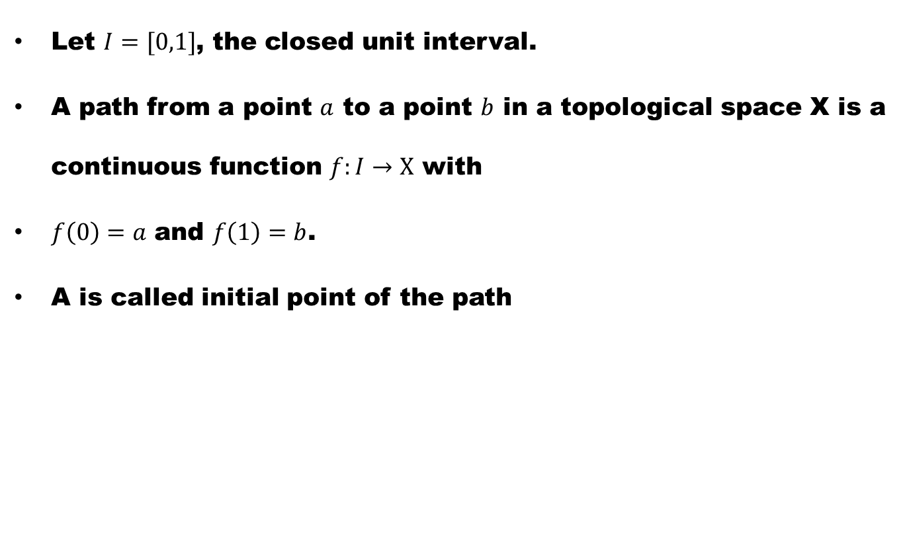
Paths
Let $I=[0,1]$, the closed unit interval.
A path from a point $a$ to a point $b$ in a topological space X is a continuous function $f:I→X$ with
$f\left(0\right)=a$ and $f\left(1\right)=b$.
A is called initial point of the path

Slide 45
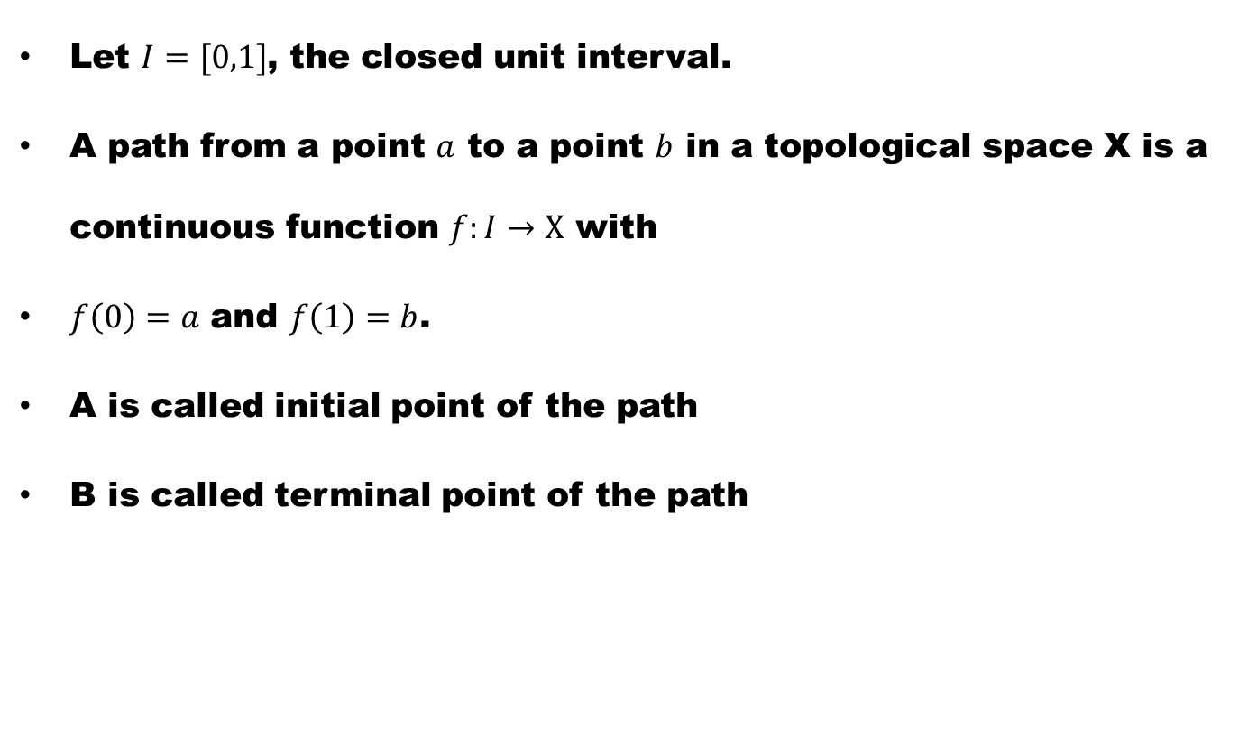
Paths
Let $I=[0,1]$, the closed unit interval.
A path from a point $a$ to a point $b$ in a topological space X is a continuous function $f:I→X$ with
$f\left(0\right)=a$ and $f\left(1\right)=b$.
A is called initial point of the path
B is called terminal point of the path

Slide 46
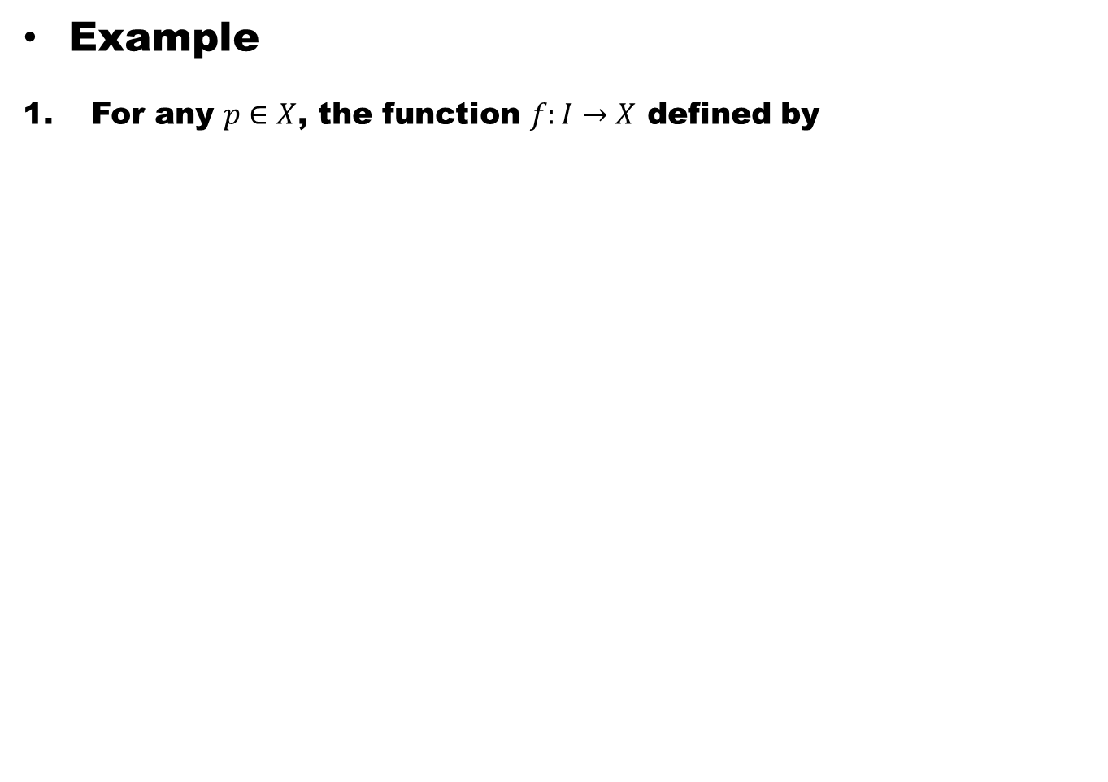
Example
For any $p∈X$, the function $f:I→X$ defined by

Slide 47
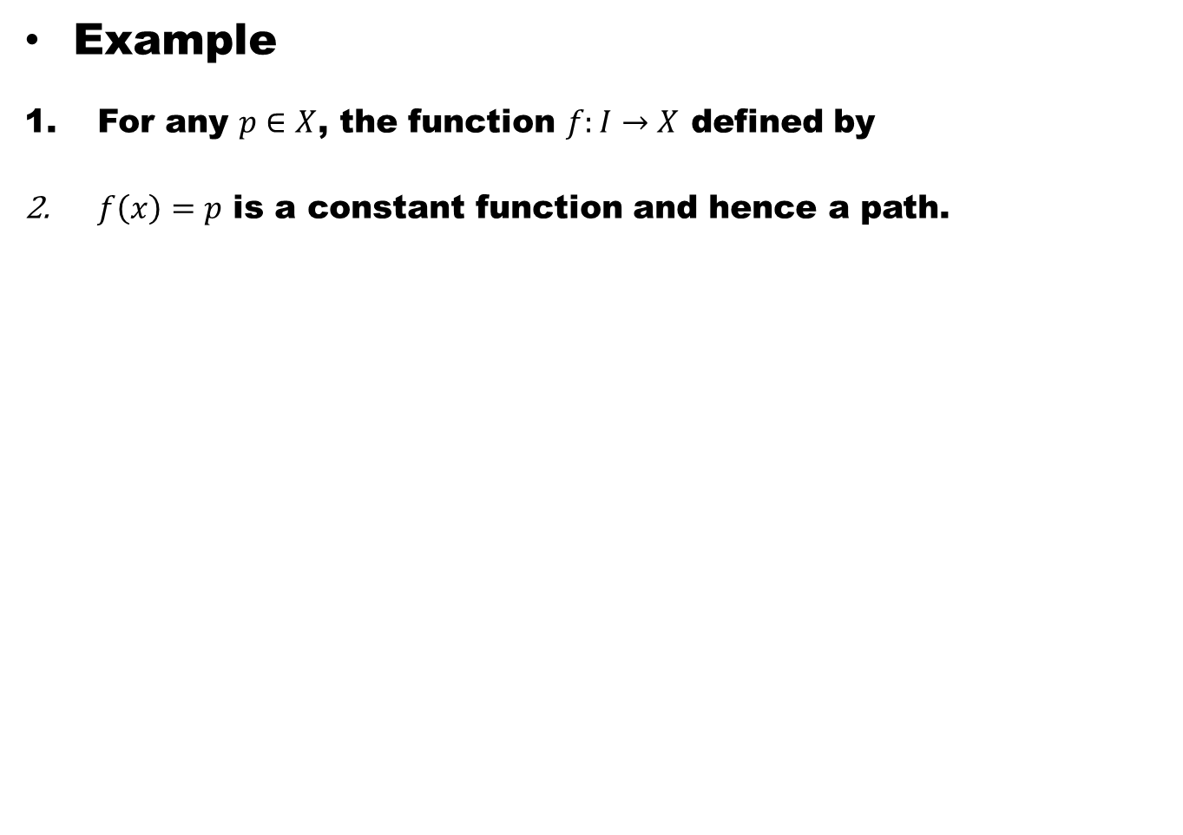
Example
For any $p∈X$, the function $f:I→X$ defined by
$f\left(x\right)=p$ is a constant function and hence a path.

Slide 48
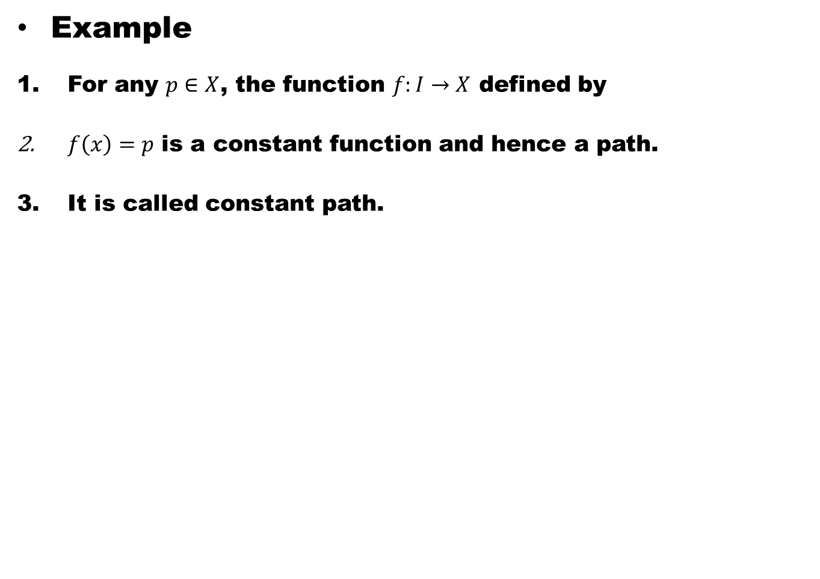
Example
For any $p∈X$, the function $f:I→X$ defined by
$f\left(x\right)=p$ is a constant function and hence a path.
It is called constant path.

Slide 49
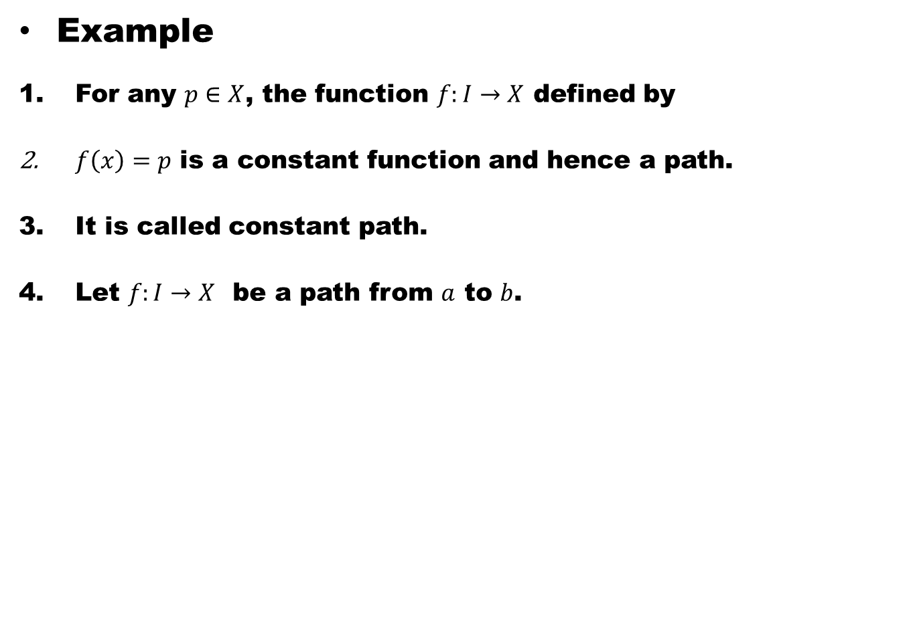
Example
For any $p∈X$, the function $f:I→X$ defined by
$f\left(x\right)=p$ is a constant function and hence a path.
It is called constant path.
Let $f:I→X$ be a path from $a$ to $b$.

Slide 50
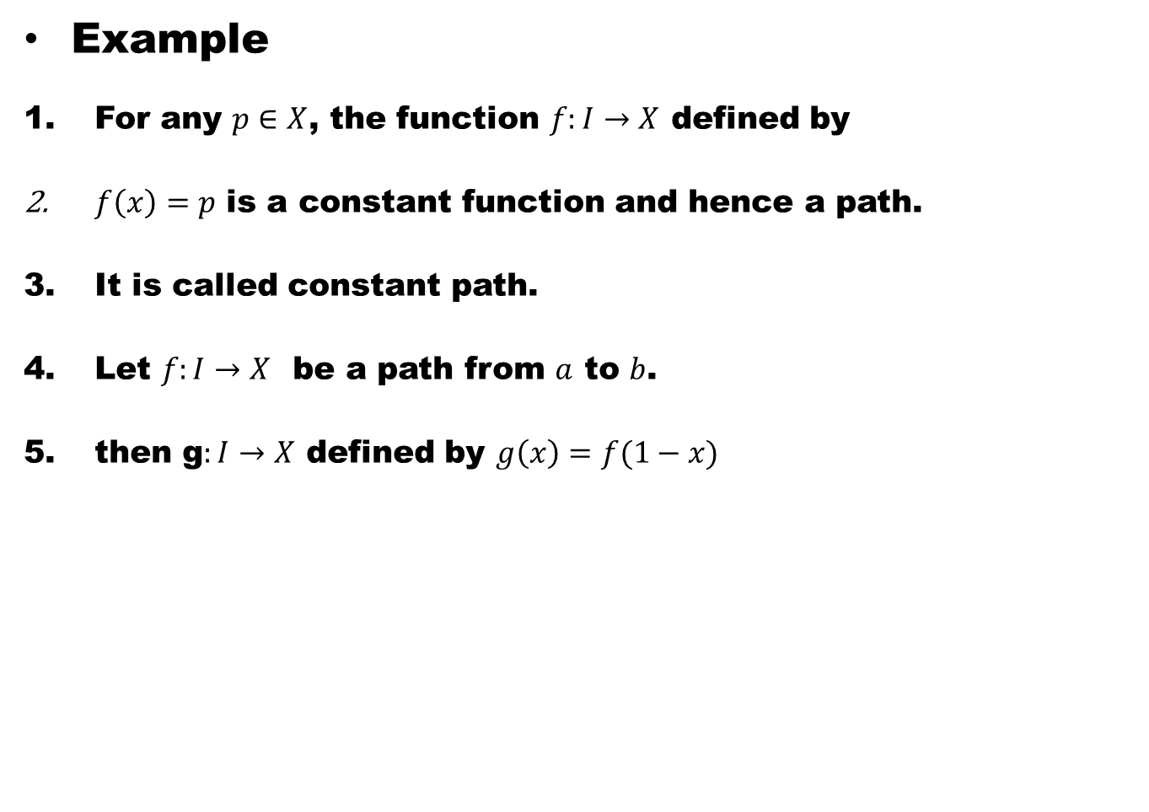
Example
For any $p∈X$, the function $f:I→X$ defined by
$f\left(x\right)=p$ is a constant function and hence a path.
It is called constant path.
Let $f:I→X$ be a path from $a$ to $b$.
then g$:I→X$ defined by $g\left(x\right)=f(1−x)$

Slide 51
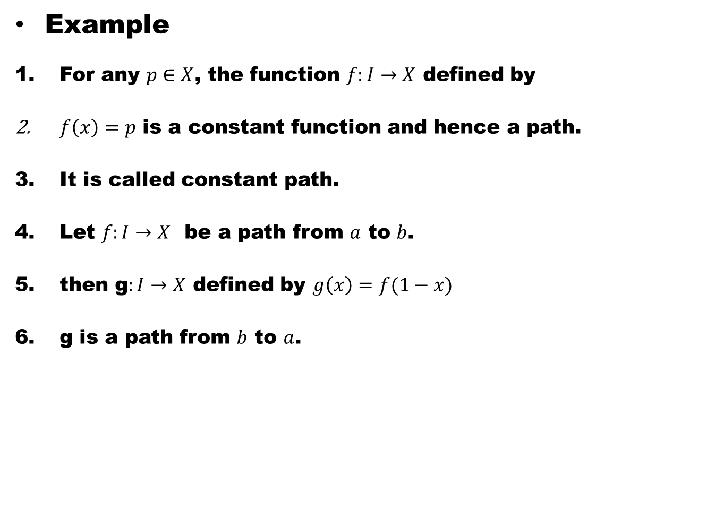
Example
For any $p∈X$, the function $f:I→X$ defined by
$f\left(x\right)=p$ is a constant function and hence a path.
It is called constant path.
Let $f:I→X$ be a path from $a$ to $b$.
then g$:I→X$ defined by $g\left(x\right)=f(1−x)$
g is a path from $b$ to $a$.

Slide 52
Definition. Path Connected Space
A space X is path connected,
if each pair of points can be joined by a path in X.

Slide 53
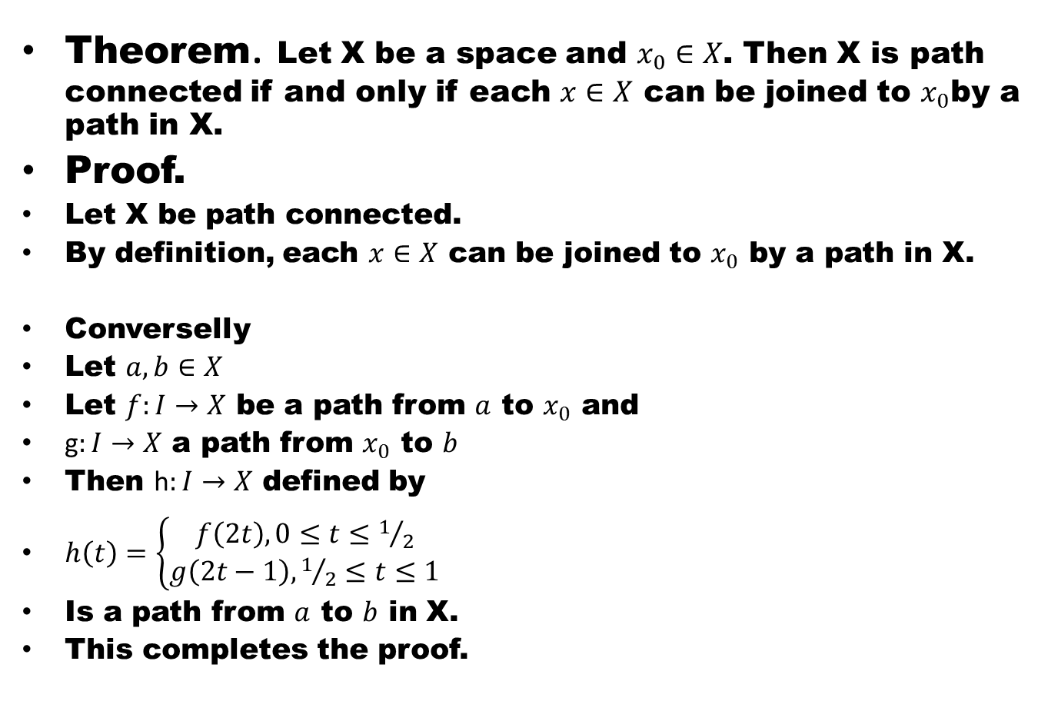
Theorem. Let X be a space and $x_{0}∈X$. Then X is path connected if and only if each $x∈X$ can be joined to $x_{0}$by a path in X.
Proof.
Let X be path connected.
By definition, each $x∈X$ can be joined to $x_{0}$ by a path in X.
Converselly
Let $a,b∈X$
Let $f:I→X$ be a path from $a$ to $x_{0}$ and
g$:I→X$ a path from $x_{0}$ to $b$
Then h$:I→X$ defined by
$h\left(t\right)=\left\{\begin{aligned}f\left(2t\right), 0≤t≤1/2 \\ g\left(2t−1\right), 1/2≤t≤1\end{aligned} \right.$
Is a path from $a$ to $b$ in X.
This completes the proof.

Slide 54
Theorem. Every path connected space is connected
Proof.
Suppose a path connected space X.

Slide 55
Theorem. Every path connected space is connected
Proof.
Suppose a path connected space X.
We shall prove that X is connected.

Slide 56
Theorem. Every path connected space is connected
Proof.
Suppose a path connected space X.
We shall prove that X is connected.
Assume contrary

Slide 57
Theorem. Every path connected space is connected
Proof.
Suppose a path connected space X.
We shall prove that X is connected.
Assume contrary
Suppose X is disconnected.

Slide 58
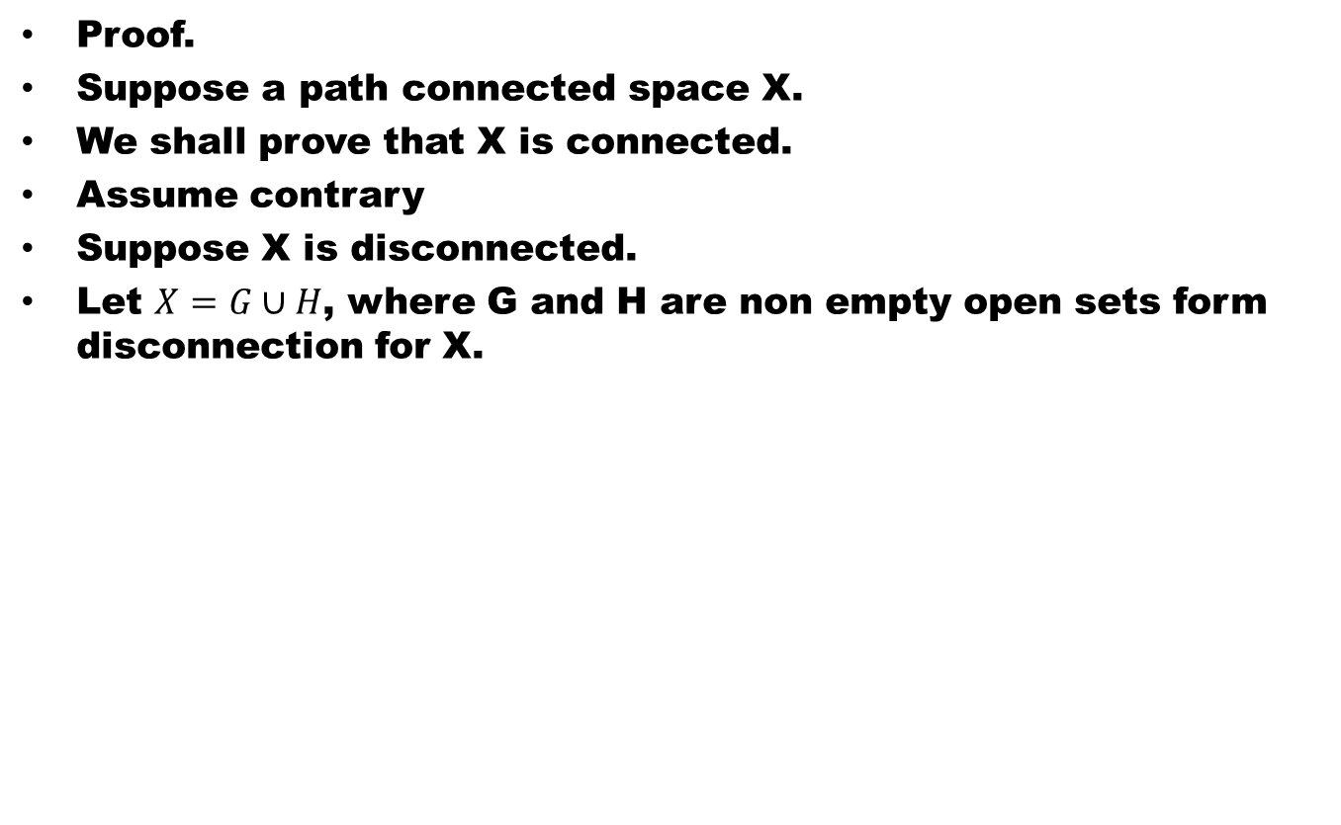
Theorem. Every path connected space is connected
Proof.
Suppose a path connected space X.
We shall prove that X is connected.
Assume contrary
Suppose X is disconnected.
Let $X=G∪H$, where G and H are non empty open sets form disconnection for X.

Slide 59
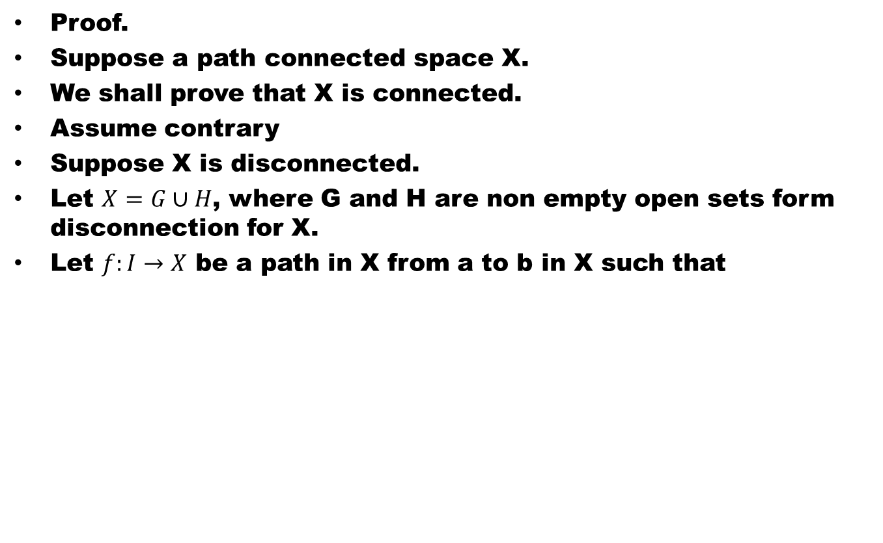
Theorem. Every path connected space is connected
Proof.
Suppose a path connected space X.
We shall prove that X is connected.
Assume contrary
Suppose X is disconnected.
Let $X=G∪H$, where G and H are non empty open sets form disconnection for X.
Let $f:I→X$ be a path in X from a to b in X such that

Slide 60
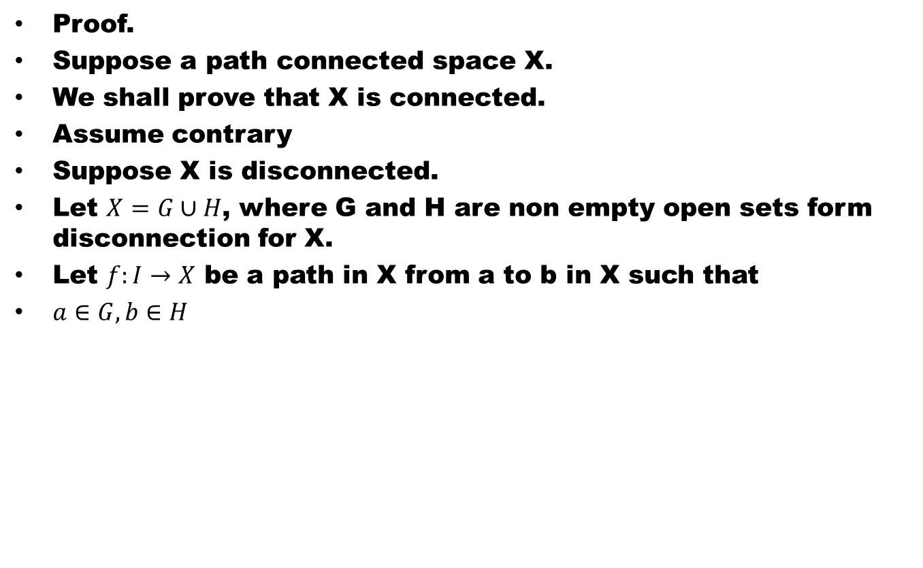
Theorem. Every path connected space is connected
Proof.
Suppose a path connected space X.
We shall prove that X is connected.
Assume contrary
Suppose X is disconnected.
Let $X=G∪H$, where G and H are non empty open sets form disconnection for X.
Let $f:I→X$ be a path in X from a to b in X such that
$a∈G, b∈H$

Slide 61
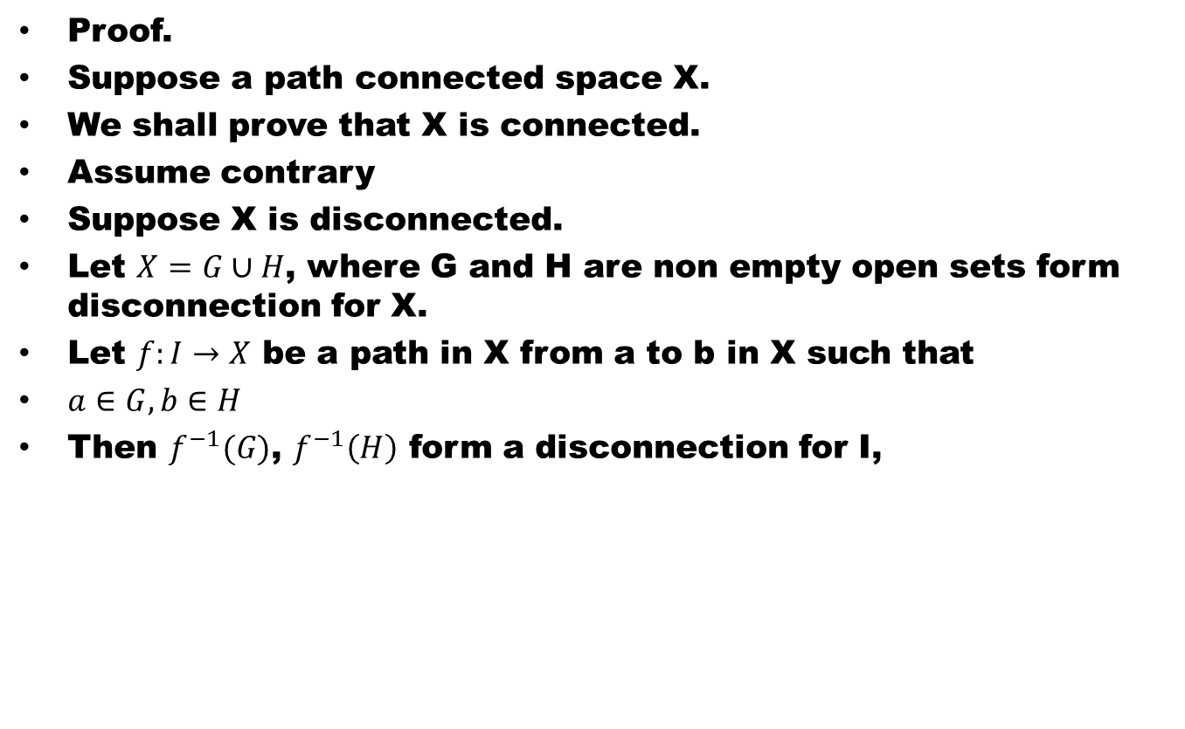
Theorem. Every path connected space is connected
Proof.
Suppose a path connected space X.
We shall prove that X is connected.
Assume contrary
Suppose X is disconnected.
Let $X=G∪H$, where G and H are non empty open sets form disconnection for X.
Let $f:I→X$ be a path in X from a to b in X such that
$a∈G, b∈H$
Then $f^{−1}(G)$, $f^{−1}\left(H\right)$ form a disconnection for I,

Slide 62
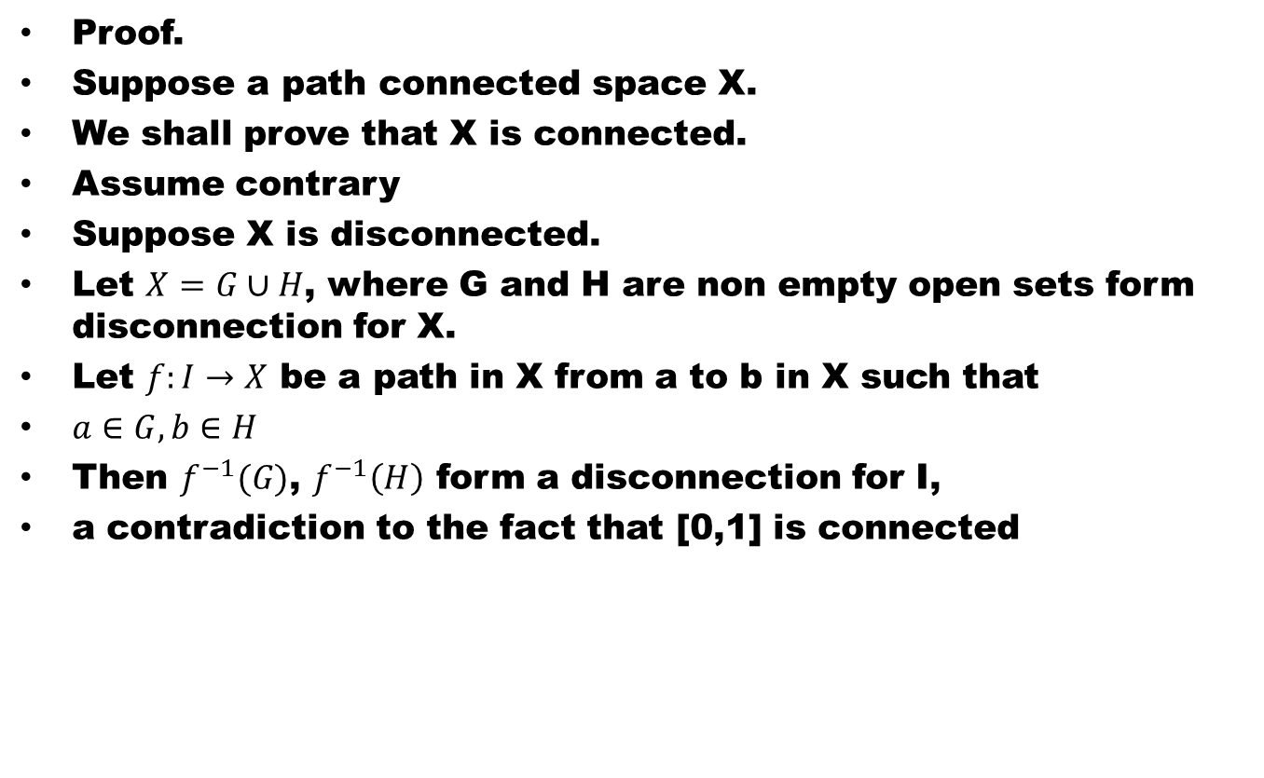
Theorem. Every path connected space is connected
Proof.
Suppose a path connected space X.
We shall prove that X is connected.
Assume contrary
Suppose X is disconnected.
Let $X=G∪H$, where G and H are non empty open sets form disconnection for X.
Let $f:I→X$ be a path in X from a to b in X such that
$a∈G, b∈H$
Then $f^{−1}(G)$, $f^{−1}\left(H\right)$ form a disconnection for I,
a contradiction to the fact that [0,1] is connected

Slide 63
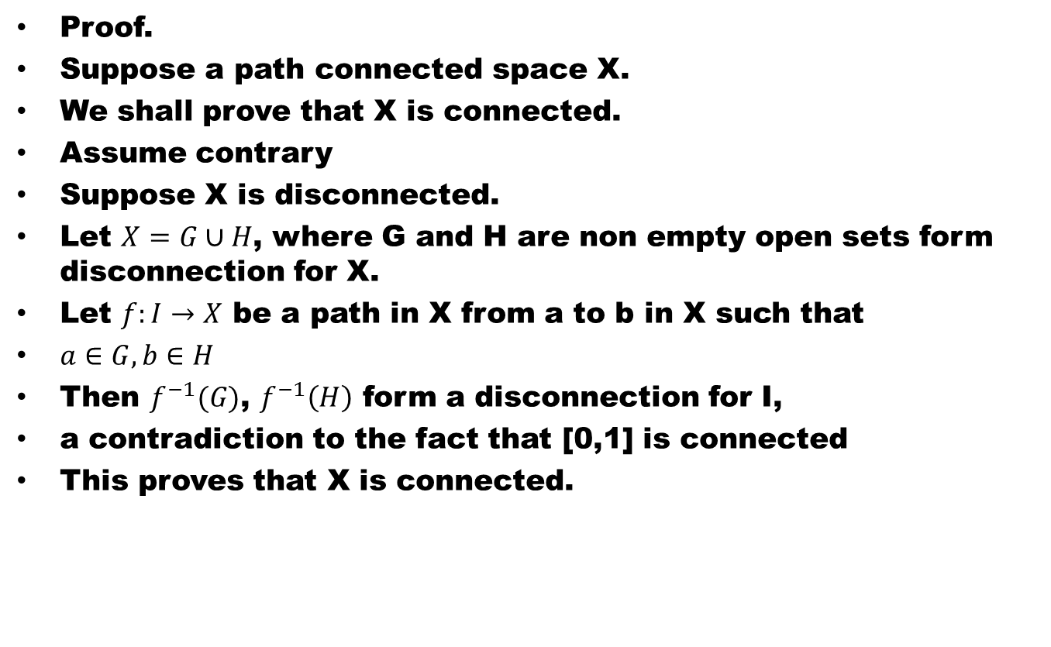
Theorem. Every path connected space is connected
Proof.
Suppose a path connected space X.
We shall prove that X is connected.
Assume contrary
Suppose X is disconnected.
Let $X=G∪H$, where G and H are non empty open sets form disconnection for X.
Let $f:I→X$ be a path in X from a to b in X such that
$a∈G, b∈H$
Then $f^{−1}(G)$, $f^{−1}\left(H\right)$ form a disconnection for I,
a contradiction to the fact that [0,1] is connected
This proves that X is connected.

Slide 64
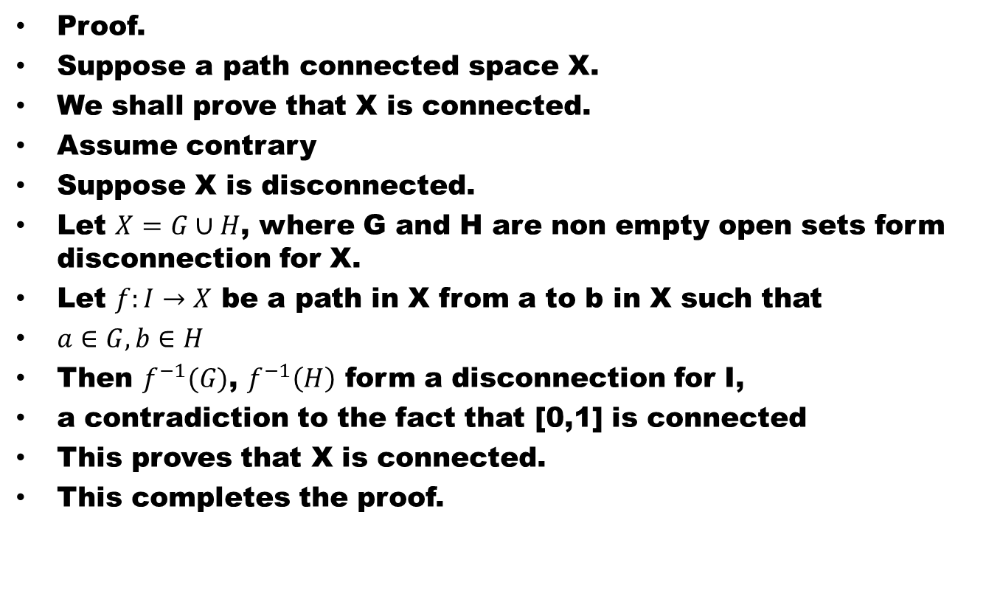
Theorem. Every path connected space is connected
Proof.
Suppose a path connected space X.
We shall prove that X is connected.
Assume contrary
Suppose X is disconnected.
Let $X=G∪H$, where G and H are non empty open sets form disconnection for X.
Let $f:I→X$ be a path in X from a to b in X such that
$a∈G, b∈H$
Then $f^{−1}(G)$, $f^{−1}\left(H\right)$ form a disconnection for I,
a contradiction to the fact that [0,1] is connected
This proves that X is connected.
This completes the proof.

Slide 65
Good Luck

